Slide 1
Nonmetric Techniques
Decision Tree Learning
  Introduction
  Types of Trees
  Constructing Trees
  Splitting Functions
  Overfitting
  Pruning
  Post-Pruning
  Discretization of Numeric Values
String Matching

Slide 2
Introduction
Suppose a classification problem has nominal data.
Example: color : {green, yellow, red}.
size : {big, medium, small}
In this case we have to move away from the idea of continuous probability distributions.
We need to address problems that are rule based or syntactic in nature.

Slide 3
Definition
A decision-tree learning algorithm approximates a target function using a tree representation, where each internal node corresponds to an attribute, and every terminal node corresponds to a class.
There are two types of nodes:
  Internal node.- Splits into different branches according to the different values the corresponding attribute can take.
  Terminal Node.- Decides the class assigned to the example.
Notes:
What is machine learning?

Slide 4
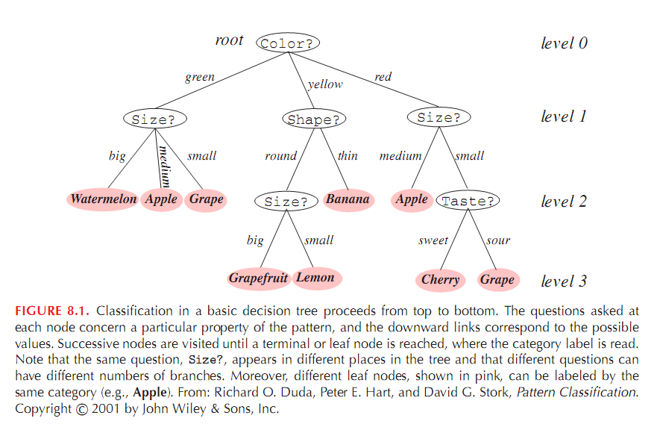
Figure 8.1
Notes:
What is machine learning?

Slide 5
Classifying Examples
To classify an example X we start at the root of the tree, and check the
value of that attribute on X. We follow the branch corresponding to that
value and jump to the next node. We continue until we reach a terminal
node and take that class as our best prediction.
Color
green
x = (green,medium,round,sweet)
Size
medium
Apple
Class = Apple
Notes:
What is machine learning?

Slide 6
Types of Decision Trees
Monothetic Decision Trees.
Decision boundaries are perpendicular to the
feature axes.
B. Polythetic Decision Trees.
Each node contains a test on two or
more attributes.
Notes:
What is machine learning?

Slide 7
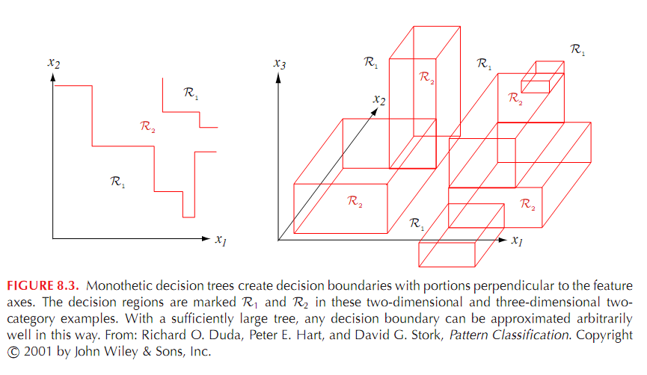
Figure 8.3
Notes:
What is machine learning?

Slide 8
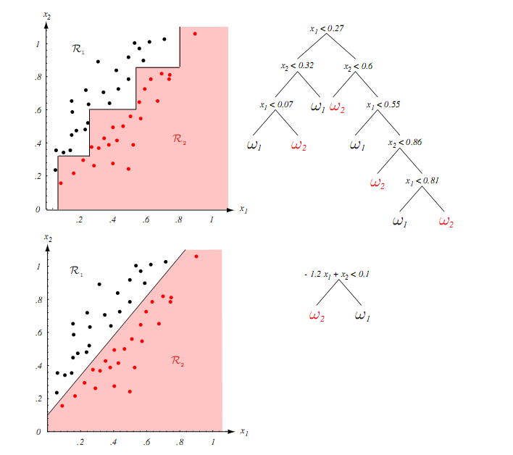
Figure 8.5
Notes:
What is machine learning?

Slide 9
Mechanism to Construct Decision Trees
There are different ways to construct trees from data.
We will concentrate on the top-down, greedy search approach:
Basic idea:
1. Choose the best attribute a* to place at the root of the tree.
2. Separate training set D into subsets {D1, D2, .., Dk} where
each subset Di contains examples having the same value for a*
3. Recursively apply the algorithm on each new subset until
examples have the same class or there are few of them.
Notes:
What is machine learning?

Slide 10
Illustration
Class +
color
Class -
low high
size
Notes:
What is machine learning?

Slide 11
Illustration
Suppose we choose size as the best attribute:
color
size
low
high
?
+
Class +
Class -
Notes:
What is machine learning?

Slide 12
Illustration
red green yellow
color
size
low
high
color
+
Class +
red
yellow
green
Class -
-
+
-
Notes:
What is machine learning?

Slide 13
Formal Mechanism
CART (Classification and Regression Trees)
Create a root for the tree
If all examples are of the same class or the number of examples is below a threshold return that class
If no attributes available return majority class
Let a* be the best attribute
For each possible value v of a*
  Add a branch below a* labeled “a = v”
  Let S_{v} be the subsets of example where attribute a*=v
  Recursively apply the algorithm to S_{v}
Notes:
What is machine learning?

Slide 14
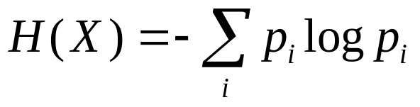
Splitting Functions
What attribute is the best to split the data?
Let us remember some definitions from information theory.
Remember a measure of uncertainty or entropy that is associated
to a random variable X is defined as
where the logarithm is in base 2.
This is the “average amount of information or entropy of a finite
complete probability scheme”.
Notes:
What is machine learning?

Slide 15
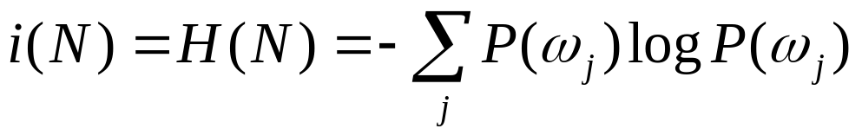
Purity and Impurity
We seek a property test T at each node N that makes the data reaching the immediate descendent nodes as "pure" as possible.
In formalizing this notion, it turns out to be more convenient to define the impurity:
where P(ω_{j}) is the fraction of patterns at node N that are in category ω_{j}.
Notes:
What is machine learning?

Slide 16
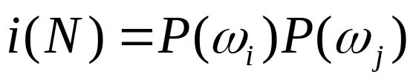
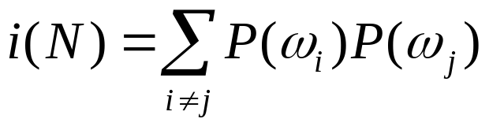
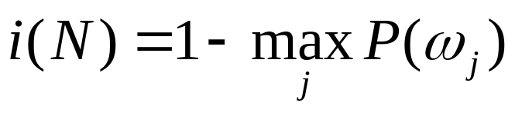
Other Impurity
variance impurity:
Gini impurity:
misclassification impurity:
Notes:
variance impurity

Slide 17
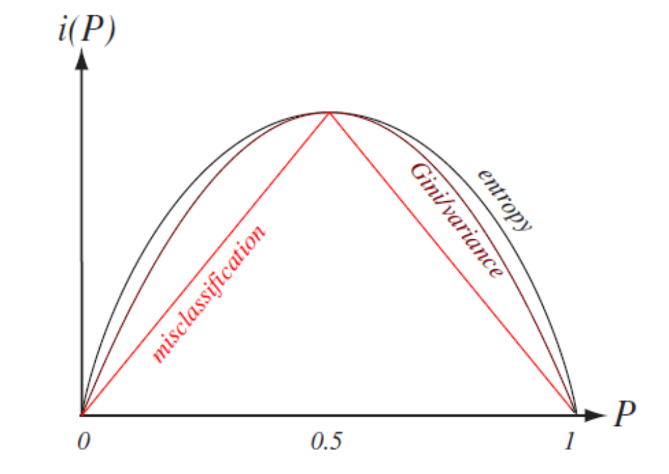
Other Impurity

Slide 18
Splitting based on Entropy
Let’s go back to our previous sample:
Size divides the sample in two.
S1 = { 6+, 0-}
S2 = { 3+, 5-}
color
H(S1) = 0
H(S2) = -(3/8)log₂(3/8)
-(5/8)log₂(5/8)
size
S1
S2
Notes:
What is machine learning?

Slide 19
Splitting based on Entropy
Let’s go back to our previous sample:
S1
Color divides the sample in three.
S1 = { 2+, 2-}
S2 = { 5+, 0-}
S3 = { 2+, 3-}
S2
red green yellow
color
H(S1) = 1
H(S2) = 0
H(S3) = -(2/5)log₂(2/5)
-(3/5)log₂(3/5)
S3
size
Notes:
What is machine learning?

Slide 20
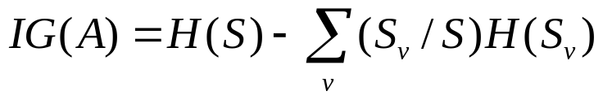
Information Gain
color
size
Information gain IG over attribute A: IG (A)
Notes:
What is machine learning?

Slide 21

Information Gain
H(S) is the entropy of all examples
H(S_{v}) is the entropy of one subsample after partitioning S
based on all possible values of attribute A.
Then the "best" test value is the choice that maximizes IG(A)
Notes:
What is machine learning?

Slide 22
Components of IG(A)
H(S1) = 0
H(S2) = -(3/8)log₂(3/8)
-(5/8)log₂(5/8)
H(S) = -(9/14)log₂(9/14)
-(5/14)log₂(5/14)
color
size
S1
S2
Notes:
What is machine learning?

Slide 23
Issues in Decision Tree Learning
Practical issues while building a decision tree can be enumerated as follows:
How deep should the tree be?
How do we handle continuous attributes?
What is a good splitting function?
How do we improve the computational efficiency?
Notes:
What is machine learning?

Slide 24
How deep should the tree be?
Overfitting the Data
A tree overfits the data if we let it grow deep enough so that it
begins to capture “aberrations” in the data that harm the predictive
power on unseen examples:
color
Possibly just noise, but
the tree is grown deeper
to capture these examples
size
Notes:
What is machine learning?

Slide 25
Data Overtting
We say a tree t in overfits a dataset D if there is another tree t’
where t has better classification accuracy than t’ on D but worse
classification accuracy than t’ on D’.
training data
overfitting
0.5 0.6 0.7 0.8 0.9 1.0
testing data
Size of the tree
Notes:
What is machine learning?

Slide 26
Causes for Overtting the Data
What causes a hypothesis to overfit the data?
Random errors or noise
  Examples have incorrect class label or
  incorrect attribute values.
Coincidental patterns
By chance examples seem to deviate from a pattern due to
the small size of the sample.
Overfitting is a serious problem that can cause serious performance
degradation.
Notes:
What is machine learning?

Slide 27
Solutions for Overtting the Data
There are two main classes of solutions:
Stop the tree early before it begins to overfit the data.
In practice this solution is hard to implement because it
is not clear what is a good stopping point.
2) Grow the tree until the algorithm stops even if the overfitting
problem shows up. Then prune the tree as a post-processing
step.
This method has found great popularity.
Notes:
What is machine learning?

Slide 28
Decision Tree Pruning
1.) Grow the tree to learn the
training data
2.) Prune tree to avoid overfitting
the data
Notes:
What is machine learning?

Slide 29
Methods to Validate the New Tree
Training and Validation Set Approach
  Divide dataset D into a training set TR and a Validating set VL
  Build a decision tree on TR
  Test pruned trees on VL to decide the best final tree.
Dataset D
Training TR
Validating VL
Notes:
What is machine learning?

Slide 30
Methods to Validate the New Tree
2. Use a statistical test
  Use all dataset D for training
  Use a statistical test to decide if you should expand
  the node or not (e.g., chi squared statistic χ²).
Should I expand or not?
estimate the distribution of all the reduction of impurity ∆i, then determine whether it is statistically significance
Notes:
估计全部已有节点的不纯度的概率分布，对每一候选分支节点，检验它与上诉分布是否有统计差异，如果分支分布不纯度下降统计不显著，则停止分支

Slide 31
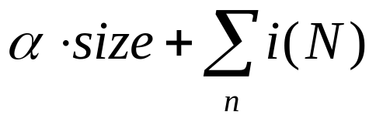
Methods to Validate the New Tree
Use an encoding scheme to capture the size of the tree and the
errors made by the tree.
  Use all dataset D for training
  Use the encoding scheme to know when to stop growing the tree.
  Method is know as minimum description length principle.
  (see 9.2.3-9.2.4 in textbook)
Notes:
What is machine learning?

Slide 32
Training and Validation
Dataset D
Training TR (normally 2/3 of D)
Validating VL(normally 1/3 of D)
There are two approaches:
Reduced Error Pruning
Rule Post-Pruning
Notes:
What is machine learning?

Slide 33
Reduced Error Pruning
Main Idea:
1) Consider all internal nodes in the tree.
2) For each node check if removing it (along with the subtree below it) and assigning the most common class to it does not harm accuracy on the validation set.
3) Pick the node n* that yields the best performance and prune its subtree
4) Go back to (2) until no more improvements are possible.
Notes:
What is machine learning?

Slide 34
Example
Possible trees after pruning:
Original Tree
Notes:
What is machine learning?

Slide 35
Example
Possible trees after 2nd pruning:
Pruned Tree
Notes:
What is machine learning?

Slide 36
Example
Process continues until no improvement is observed
on the validation set:
Stop pruning the tree
0.5 0.6 0.7 0.8 0.9 1.0
validation data
Size of the tree
Notes:
What is machine learning?

Slide 37
Reduced Error Pruning
Disadvantages:
If the original data set is small, separating examples away for
validation may leave you with few examples for training.
Dataset D
Training TR
Training set is too small
and so is the validation
set
Validating VL
Small dataset
Notes:
What is machine learning?

Slide 38
Rule Post-Pruning
Main Idea:
1) Convert the tree into a rule-based system.
2) Prune every single rules first by removing redundant conditions.
3) Sort rules by accuracy.
Notes:
3)搜索所有规则，如果删除它引起分类误差的增加量最小

Slide 39
Discretizing Continuous Attributes
Example: attribute temperature.
1) order all values in the training set
2) Consider only those cut points where there is a change of class
3) Choose the cut point that maximizes information gain
97 97.5 97.6 97.8 98.5 99.0 99.2 100 102.2 102.6 103.2
temperature
Notes:
What is machine learning?

Slide 40
String Matching
Whether a candidate x is a factor of text

Slide 41
Definitions
Length[x] = |x|
|text| >> |x|
Alphabet A
  Binary, A ={0,1}
  Decimal, A ={0,1,2..,9}
  English Letters, A ={a,b,c..,z}
  DNA bases, A ={A,G,C,T}

Slide 42
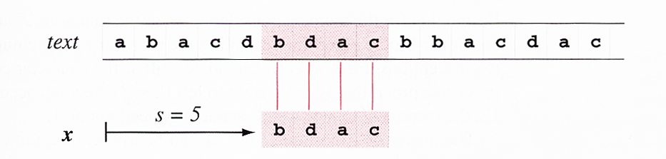
Naive String Matching
Naive String Matching

Slide 43
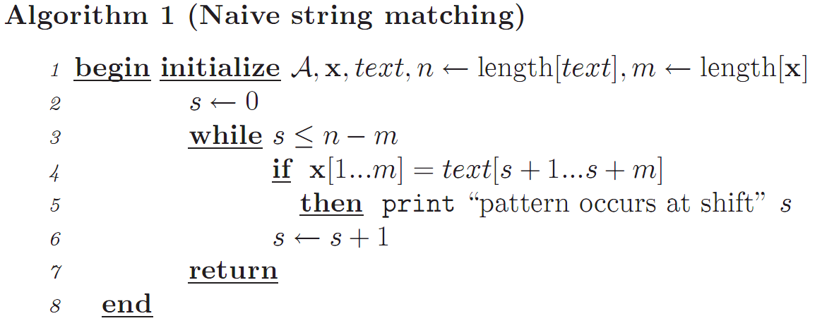
Naive String Matching

Slide 44
Naïve String Matching
O((n-m+1)m) in the worst case: matches at very end
Random x and test means algorithm is efficient
Information from one candidate shift is not exploited in subsequent candidate shift

Slide 45
Boyer Moore Algorithm
Resembles Naive String Matching
Except matching is done right-to-left
Shifts are done in larger increments
Good suffix heuristic
Bad character heuristic

Slide 46
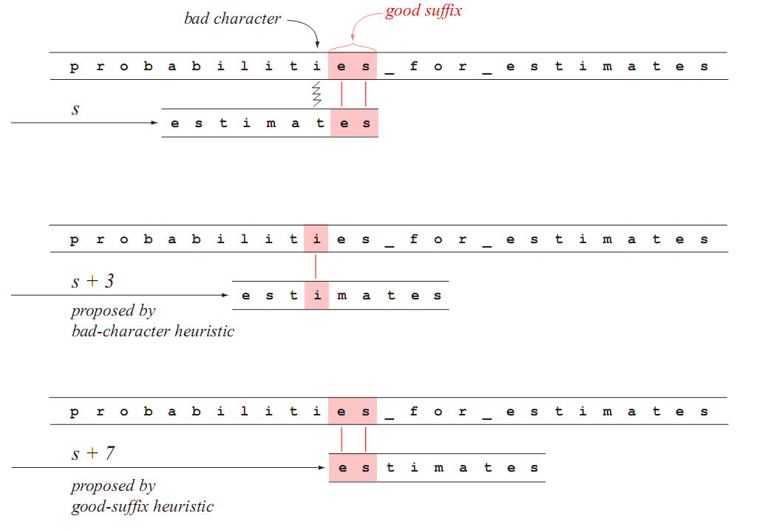
Boyer-Moore
Bad Character
Good Suffix

Slide 47
Boyer-Moore principle
Good Suffix heuristic and Bad Character heuristic operate independently and in parallel
After mismatch is detected, each proposes an amount by which s can be safely increased without missing a valid shift
Larger of these shifts is selected

Slide 48
Boyer-Moore Implementation
Good Suffix Function G(x)
  A table that for each suffix gives the second rightmost occurrence in x (count from left)
  For “estimates” s has value 2, es has value 1
Last occurrence Function F(x)
  A Table containing every letter of alphabet and position of its rightmost occurrence in x. (count from left)
  For “estimates”, a=6, b=c=d=0, e=8, i=4,etc.

Slide 49
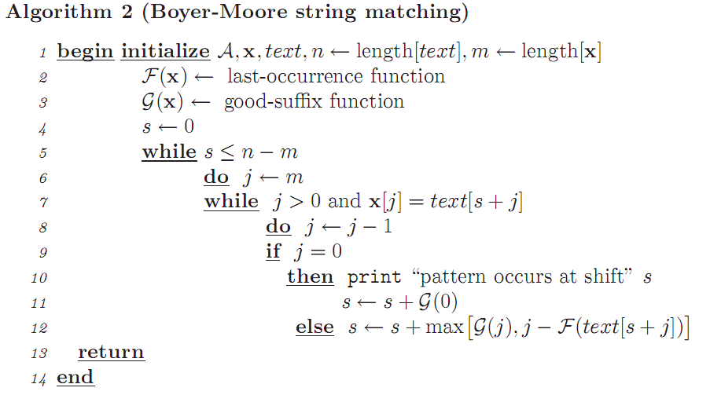
Seek mismatch
Notes:
Line7 and line8 are in “while circulation”

Slide 50
Edit Distance
Not clear whether “abbccc” is closer to “aabbcc” or to “abbcccb”
Edit distance is the number of fundamental operations required to transform one string to the other

Slide 51
Edit Distance
Distance cost C(i,j) between string s_{i} and s_{j}
s_{i} = s_{i-1}c_{i}, s_{j}=s_{j-1}c_{j}
if s_{j}=“” then C(i,j) = |s_{i}| else
Insertion: s_{i} = s_{i-1}, s_{j}=s_{j-1}c_{j} C1(i,j) = C(i-1, j)+1
Deletion: s_{i} = s_{i-1}c_{i}, s_{j}=s_{j-1} C2(i,j) = C(i, j-1)+1
Change: s_{i} = s_{i-1}c_{i}, s_{j}=s_{j-1}c_{j} C3(i,j) = C(i-1, j-1) + (c_{i}==c_{j})? 0 : 1
C(i,j) = min{C1, C2, C3}

Slide 52
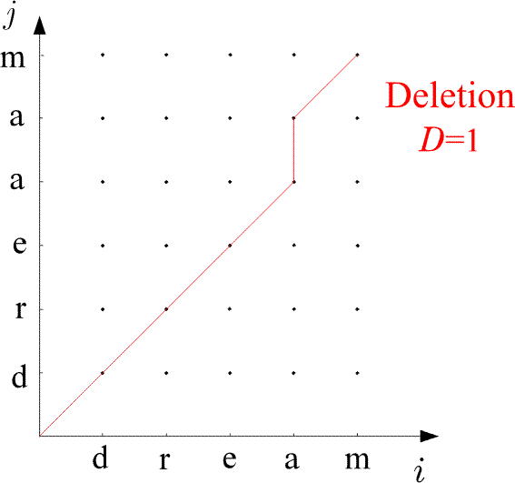
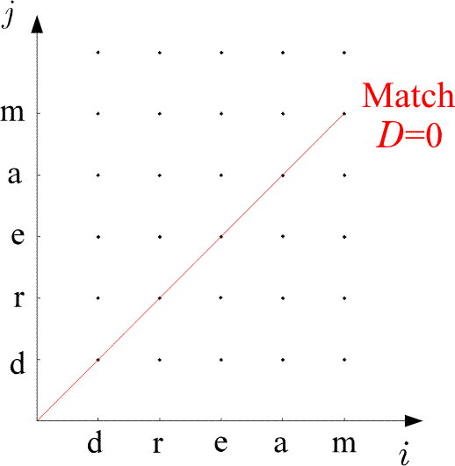

Slide 53
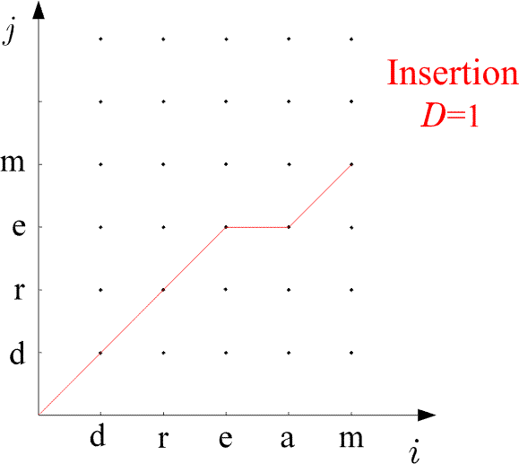
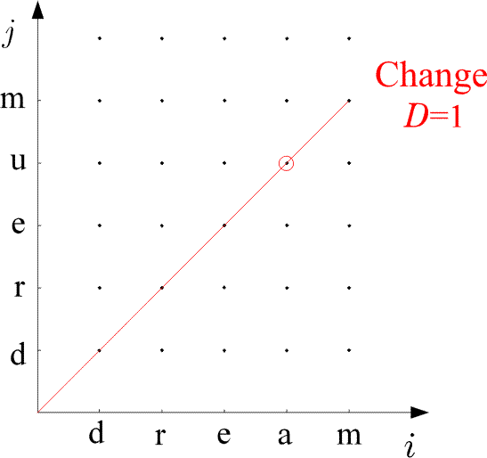

Slide 54
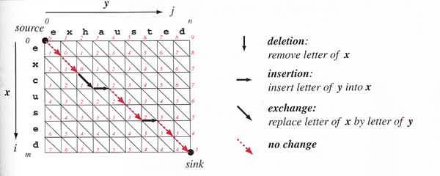
Edit Distance
Cost Matrix
C[i, j] = cost of transforming x to y
Edit Distance (excused, exhausted) = C[i = 7, j = 9] = 3

Slide 55
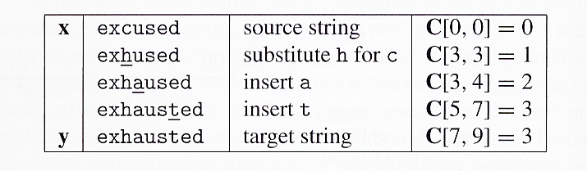
Edit Distance

Slide 56
