Slide 1
Unsupervised Learning and Clustering
Mixture Densities
k-means clustering
Sum-of-Squared Errors
EM-GMM

Slide 2
Introduction
Previously, all our training samples were labeled: these samples were said “supervised”
We now investigate a number of “unsupervised” procedures which use unlabeled samples

Slide 3
Introduction
Why unsupervised procedures?
Collecting and Labeling a large set of sample patterns can be costly.
We can train with large amounts of (less expensive) unlabeled data, and only then use supervision to label the groupings found, this is appropriate for large “data mining” applications where the contents of a large database are not known beforehand
Notes:
1、语音识别，标注困难，小样本集训练聚类算法，应用到大样本集上
2、反向应用，用大量样本集训练一个分类器，然后人工标记分组的结果，数据挖掘

Slide 4
Introduction
This is also appropriate in many applications when the characteristics of the patterns can change slowly with time. Improved performance can be achieved if classifiers running in a unsupervised mode are used
We can use unsupervised methods to identify features that will then be useful for categorization
We gain some insight into the nature (or structure) of the data
Notes:
样本的属性随着时间变化，如果这种变化能够无监督的捕捉，将能够改进分类器性能
可以用无监督学习来辅助特征选择，提取一些基本特征
无监督学习能够揭示数据一些内部的结构和规律，更有效的设计分类器

Slide 5
Mixture Densities
  We make the following assumptions:
    The samples come from a known number c of classes
    The prior probabilities P(ω_{j}) for each class are known
    (j = 1, …,c)
    The forms for the class-conditional probability densities p(x | ω_{j}, θ_{j}) (j = 1, …,c) are known
    The values of the c parameter vectors θ1, θ2, …, θc are unknown
    The category labels are unknown

Slide 6
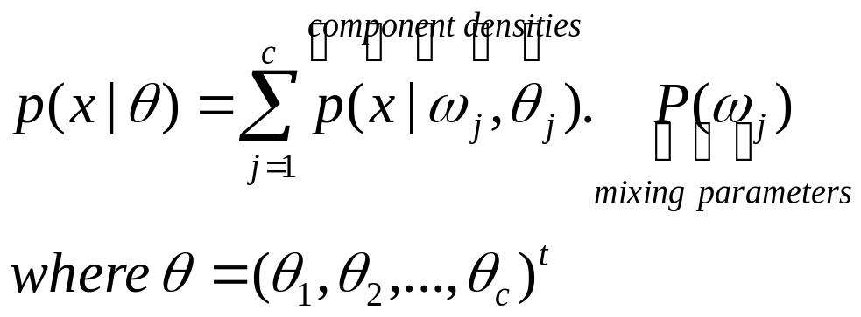
Mixture Densities
Samples are assumed to be obtained by selecting a state of nature ω_{j} with probability P(ω_{j}) and then selecting an x according to the probability law p(x | ω_{j}, θ_{j}).
Thus, the probability density function for the samples is given by
This density function is called a mixture density.
And how do we estimate the parameter vector θ?

Slide 7
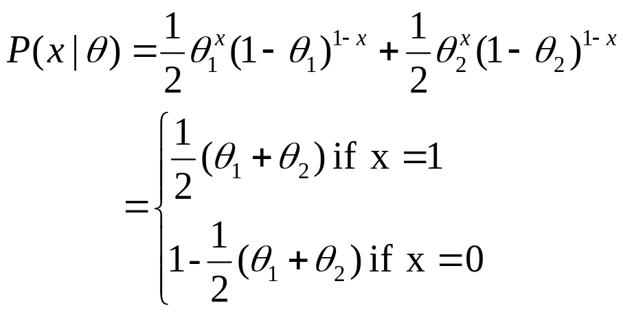
Identifiability
    A density p(x | θ) is said to be identifiable if
    θ ≠ θ’ implies that there exists an x such that:
    p(x | θ) ≠ p(x | θ’)
    As a simple example, consider the case where x is binary and
    P(x | θ) is the mixture:

Slide 8
Identifiability
the identiability of θ is a property of the model, irrespective of any procedure we might use to determine its value.
    Assume that:
    P(x = 1 | θ) = 0.6 ⇒ P(x = 0 | θ) = 0.4
    by replacing these probabilities values, we obtain:
    θ1 + θ2 = 1.2
    Thus, we have a case in which the mixture distribution is completely unidentifiable, and therefore unsupervised learning is impossible
  Identifiability can be a problem, we always assume that the densities we are dealing with are identifiable!

Slide 9
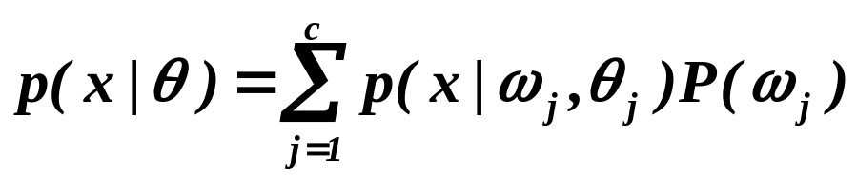
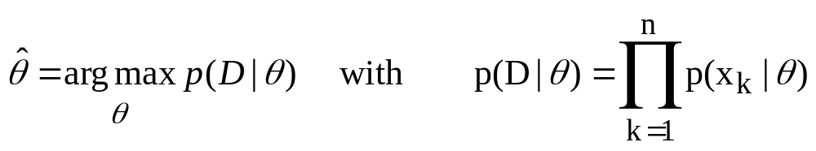
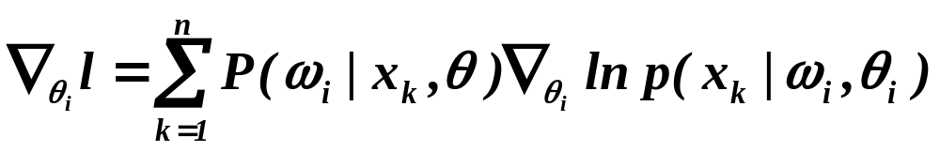
Maximum Likelihood
Suppose that we have a set D = {x₁, …, x_{n}} of n unlabeled samples drawn independently from the mixture density
(θ is fixed but unknown!)
The gradient of the log-likelihood is:

Slide 10
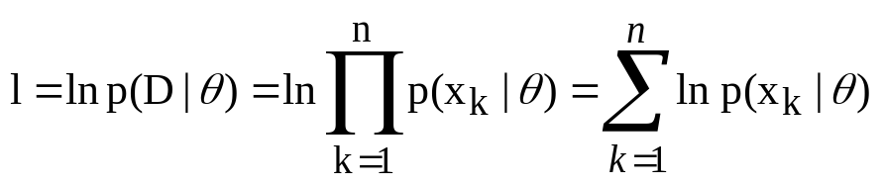
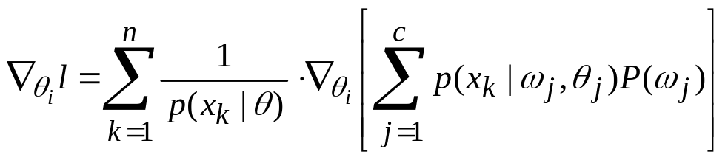
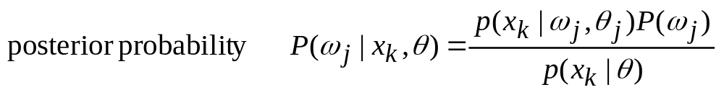
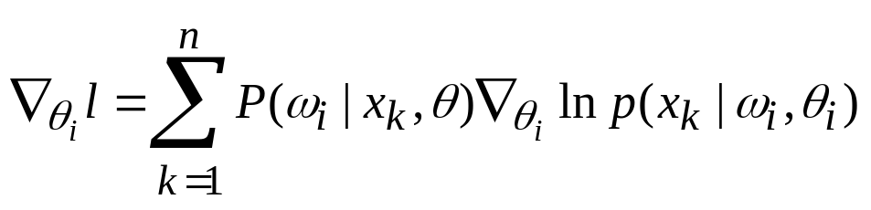
Maximum Likelihood

Slide 11
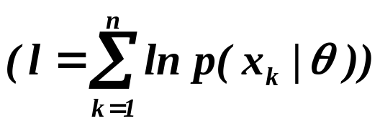

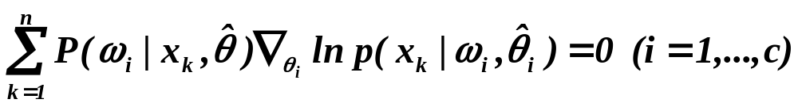
Maximum Likelihood
  Since the gradient must vanish at the value of θ_{i}
  that maximizes l , therefore,
  the ML estimate must satisfy the conditions

Slide 12
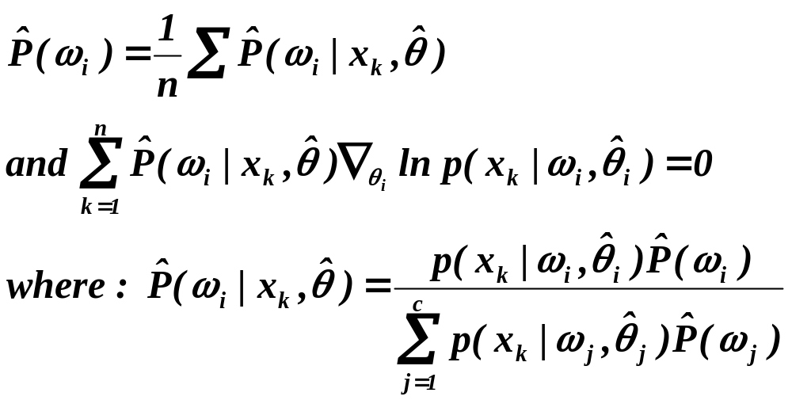
Maximum Likelihood
  By including the prior probabilities as unknown variables, we finally obtain:

Slide 13
Applications to Normal Mixtures
p(x | ω_{i}, θ_{i}) ~ N(μ_{i}, Σ_{i})
Case 1 = Simplest case
Case | μ_{i} | Σ_{i} | P(ω_{i}) | c
1 | ? | √ | √ | √
2 | ? | ? | ? | √
3 | ? | ? | ? | ?

Slide 14
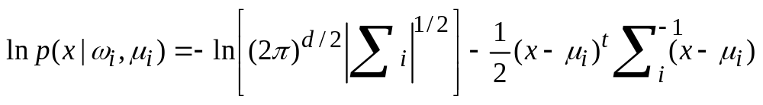
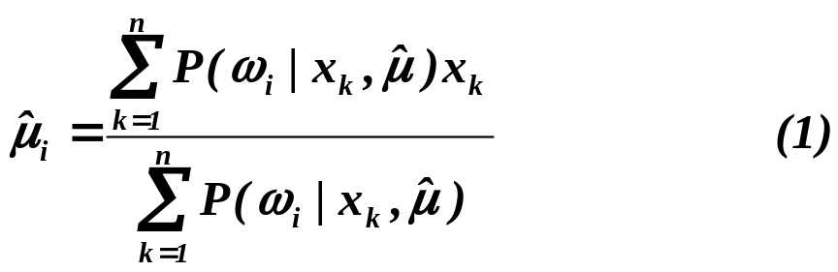
Case 1: Unknown mean vectors
    μ_{i} = θ_{i} ∀ i = 1, …, c
    ML estimate of μ = (μ_{i}) is:

Slide 15


Case 1: Unknown mean vectors
    is the fraction of those samples having value x_{k} that come from the ith class,
    and is the average of the samples coming from the ith class.
    Unfortunately, equation (1) does not give explicitly

Slide 16

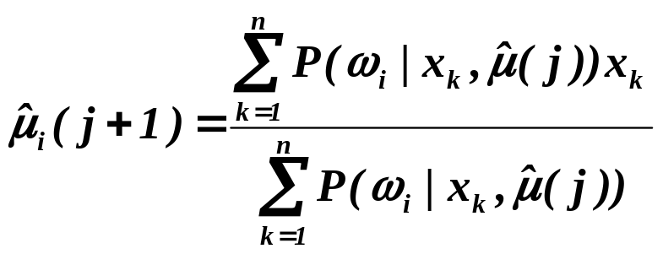
Case 1: Unknown mean vectors
    However, if we have some way of obtaining good initial estimates for the unknown means, therefore equation (1) can be seen as an iterative process for improving the estimates
this procedures carries no guarantee of yielding the global maximum.
Note too that if the model is mis-specified

Slide 17
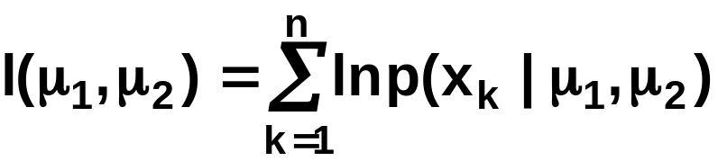
Example:
    Consider the simple two-component one-dimensional normal mixture
    (2 clusters!)
    Let’s set μ1 = -2, μ2 = 2 and draw 25 samples sequentially from this mixture. The log-likelihood function is:

Slide 18
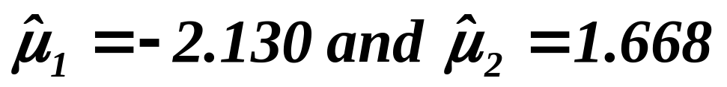

    The maximum value of l occurs at:
    (which are not far from the true values:
    μ₁ = -2 and μ₂ = +2 )
    There is another peak at which has almost the same height as can be seen from the following figure:
Notes:
第二个峰值的解释：交换u不影响我们的结果

Slide 19
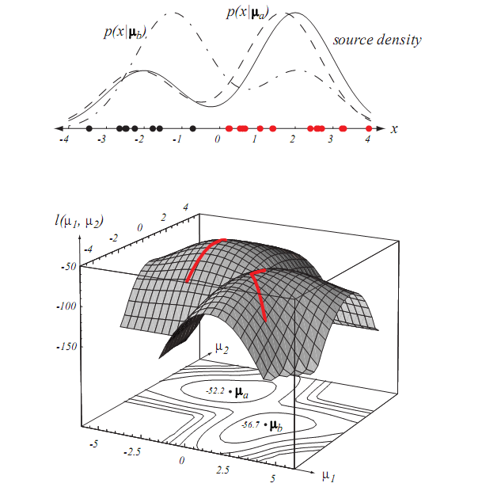

Slide 20
Case 2: All parameters unknown
    If no constraints are placed on the covariance matrix, maximum-likelihood solution becomes singular.
    Adding an assumption
    Consider the largest of the finite local maxima of the likelihood function and use the ML estimation.
    We obtain the following:

Slide 21
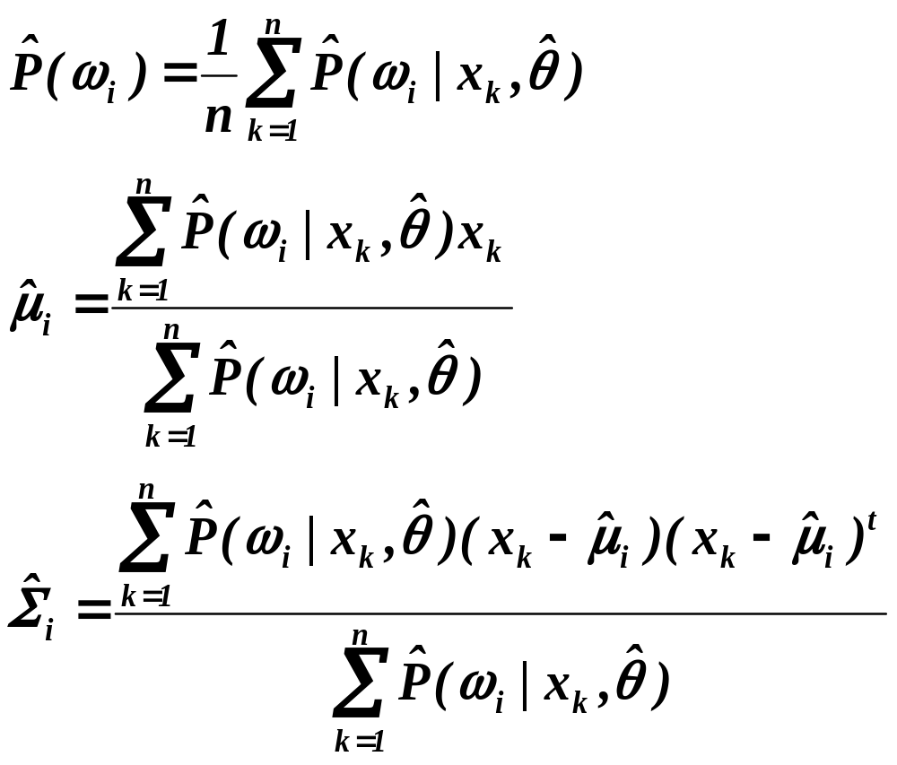
Case 2: All parameters unknown
Iterative
scheme

Slide 22
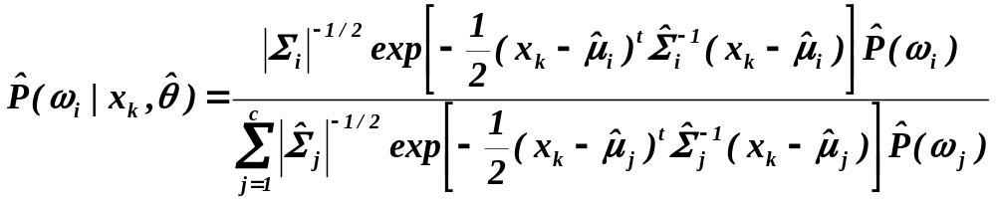
Case 2: All parameters unknown
where

Slide 23

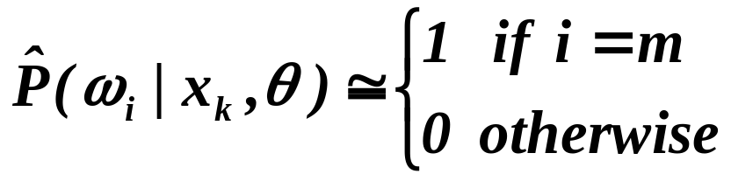
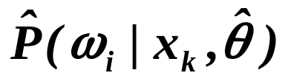
K-means clustering
This is an elementary but very popular method for clustering.
Our goal is to find the k mean vectors or “cluster centers”.
Find the mean nearest to x_{k} and approximate
as:

Slide 24
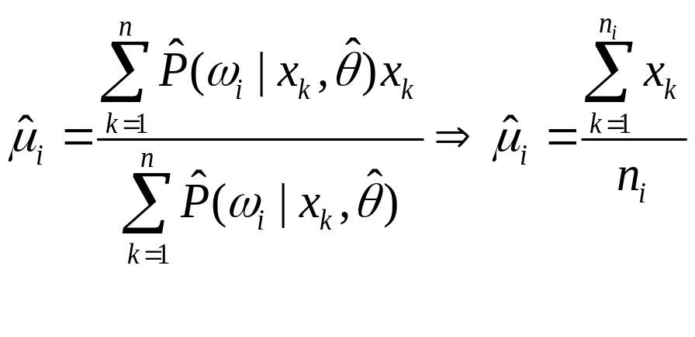
K-means clustering
n_{i} is the number of samples nearest to

Slide 25
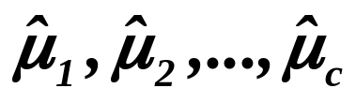
K-means clustering
    Use the iterative scheme to find
    Begin
      initialize n, c, μ₁, μ₂, …, μ_{c} (randomly selected)
      do classify n samples according to nearest μ_{i}
      recompute μ_{i}
      until no change in μ_{i}
      return μ₁, μ₂, …, μ_{c}
      End

Slide 26
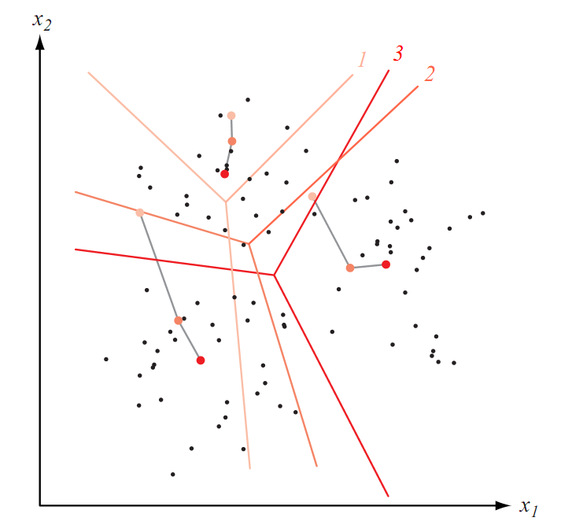
Figure 10.3

Slide 27
Complexity
The computational complexity of the algorithm is
defined as follows:
O( n d c T )
Where d is the number of features, n is the number of examples,
c is the number of classes, and T is the number of iterations.
The number of iterations is normally much less than the number
of examples.

Slide 28
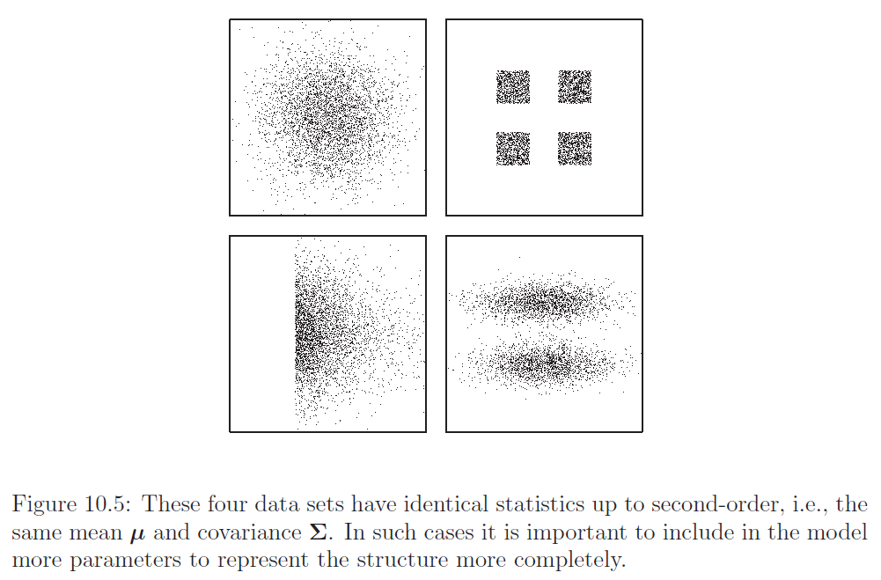
if the samples are not normally distributed
Notes:
如果样本不是正态分布，均值和方差描述数据很不恰当，不能完全描述数据的空间结构。
聚类算法是基于整个数据内部存在若干“分组”或“聚类”为出发点而产生的一种数据描述方法，每个子集具有高度的内在相似性。

Slide 29
Data Description and Clustering
Similarity Measures
How should one measure the similarity between samples?
How should one evaluate a partitioning of a set of samples into clusters?

Slide 30
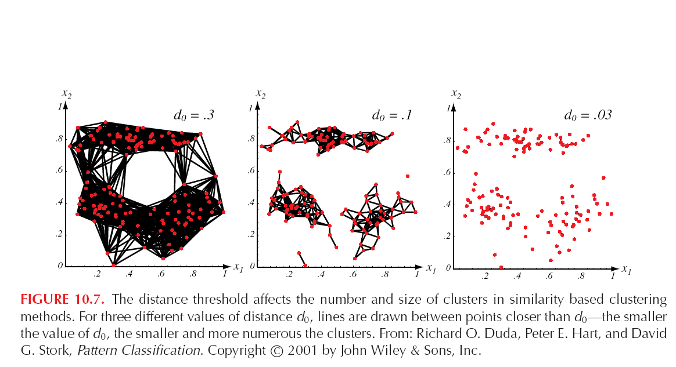
Similarity Measures

Slide 31
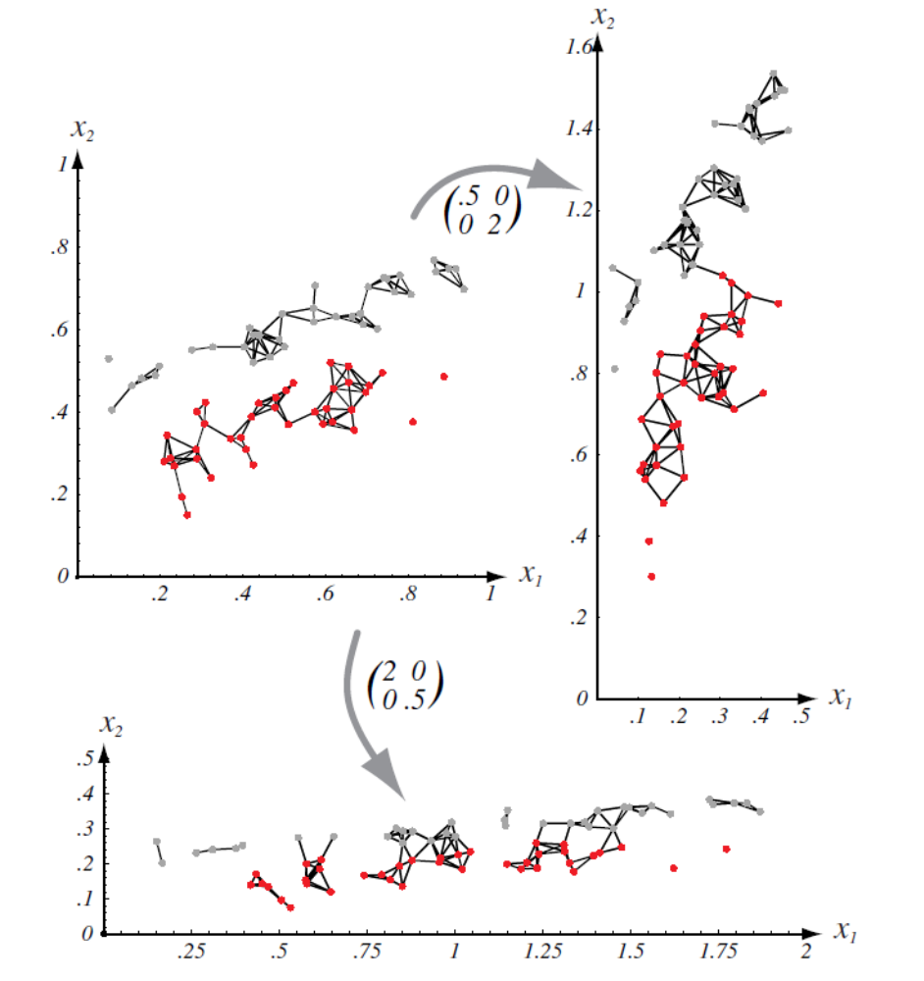
Scaling axes affects the clusters
Notes:
坐标缩放

Slide 32
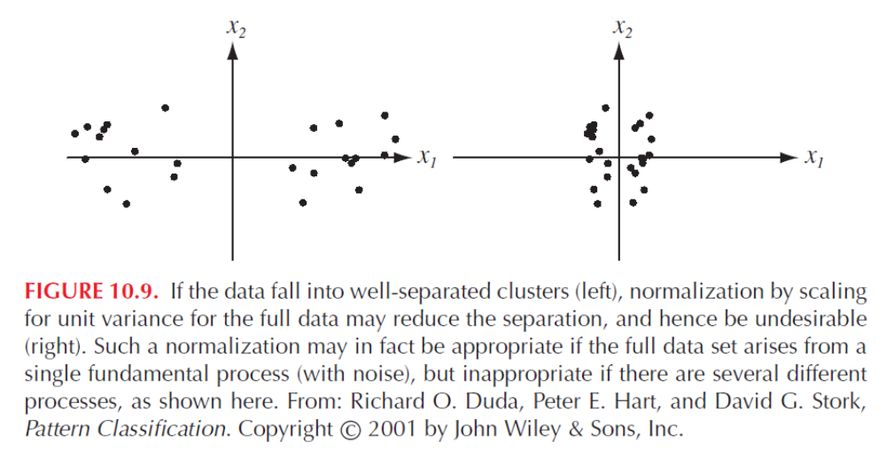
Normalization

Slide 33
Data Description and Clustering
We can now define the goal of clustering:
Goal: To divide a dataset of examples into c disjoint subsets
D1, D2, …, Dc, so that the distance between examples within
the same partition is small compared to the distance between
examples on different partitions.
To achieve this, we define the c means by looking to minimize
a metric.

Slide 34
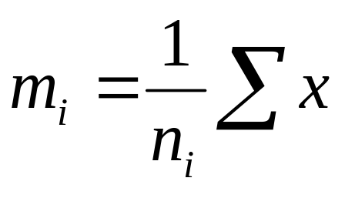
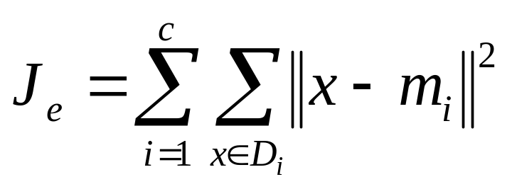
Criterion Functions for Clustering
Let m_{i} be the mean of examples on partition Di:
(for all x in Di)
Then the metric to minimize is the sum-of-squared errors:
For all x in Di where i goes along the clusters.

Slide 35
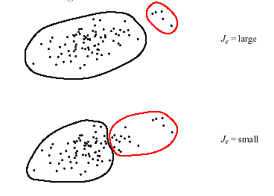
Figure 10.10

Slide 36
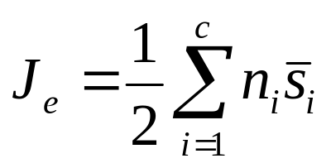
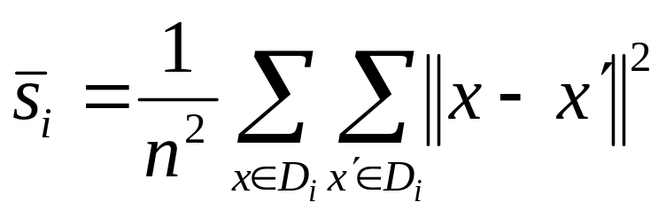
Others Metric
Related Minimum Variance Criteria
where
Notes:
相当于Je去掉均值向量

Slide 37
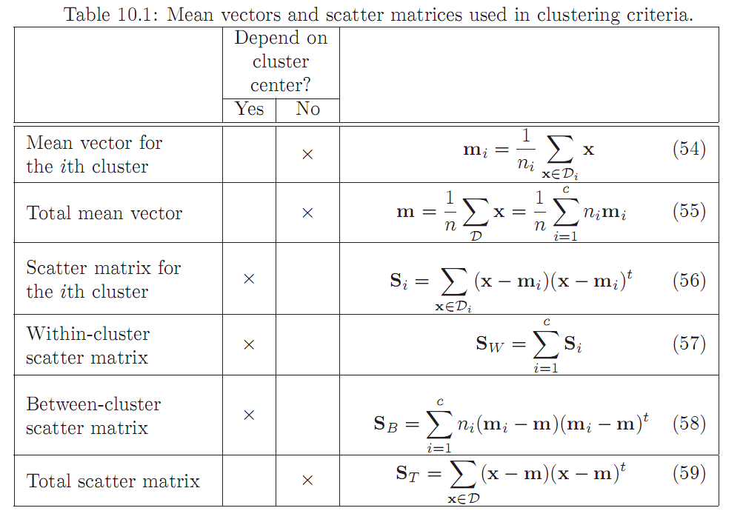
Others Metric

Slide 38
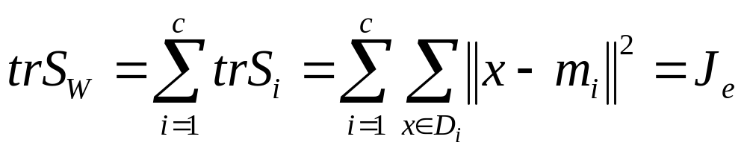
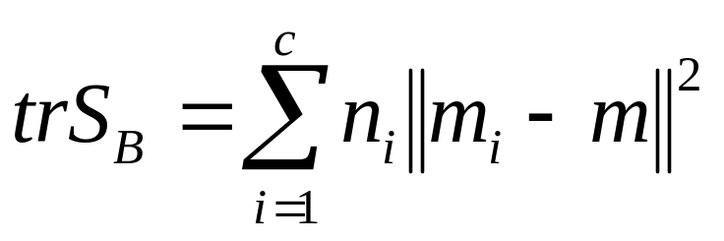
The Trace Criterion

Slide 39
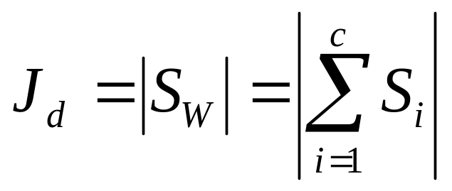
The Determinant Criterion
the determinant measures the square of the scattering volume, since it is proportional to the product of the variances in the directions of the principal axes

Slide 40

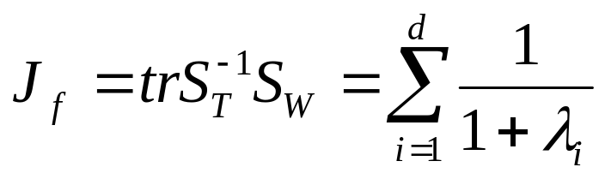
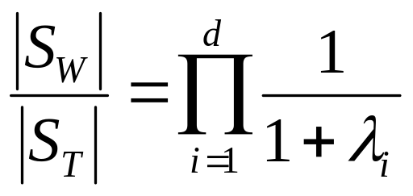
Invariant Criteria
It is not particularly hard to show that the eigenvalues λ_{i} of
are invariant under nonsingular linear transformations of the data
and
Notes:
Sb在c小于等于d时是奇异的，在n-c小于d时候也是奇异的

Slide 41
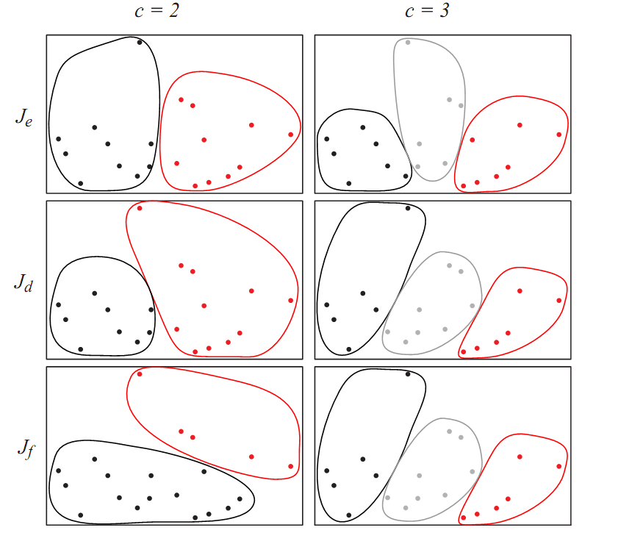
Notes:
不同聚类准则比较，c=2时，Je倾向于平均，而Jd倾向于一个类大一个类小，Jf倾向于水平分布

Slide 42
Others
Hierarchical clustering
Clusters have subclusters which also have
subclusters and so on.
Online clustering
As time goes on new information may call for restructuring
the clusters (plasticity). But we don’t want this to happen
very often (stability).
ISODATA

Slide 43
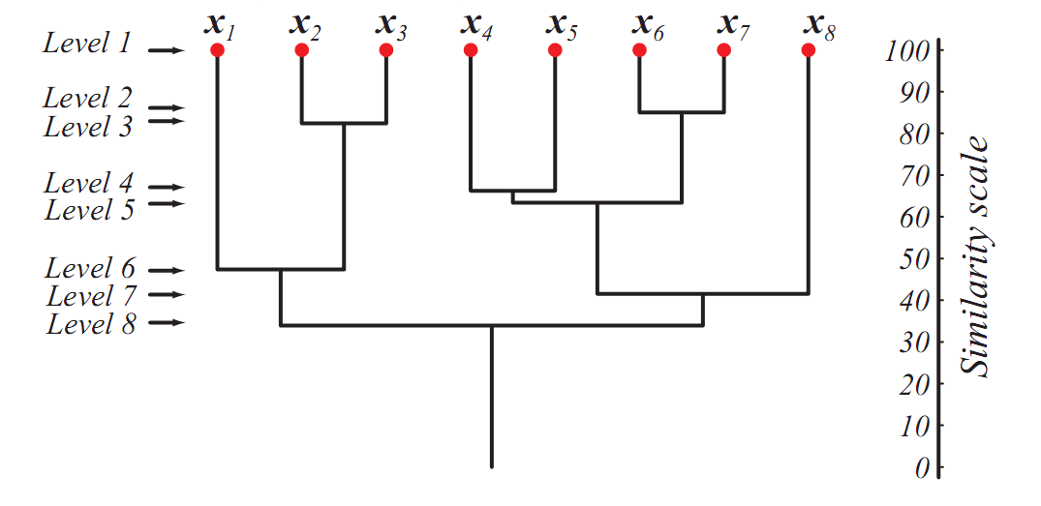
Figure 10.11

Slide 44
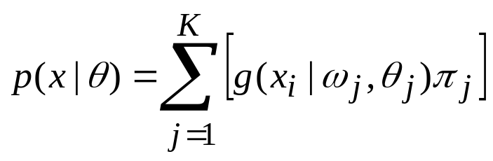
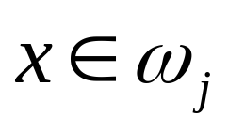
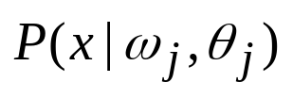
GMM+EM
If x is labeled we can compute the a posteriori probabilities : with all
But we don’t know which class x belongs.
We can consider that the label is a “missing feature”

Slide 45

Mixtures of Gaussians
-Each instance is generated using a two-step process:
  One of K Gaussians is selected at random, with probabilities
  A single random instance x_{i} is generated according to this selected distribution.
- This process is repeated to generate a set of data points D_{x}

Slide 46
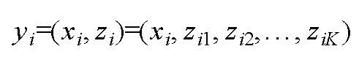
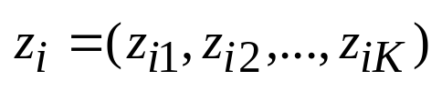
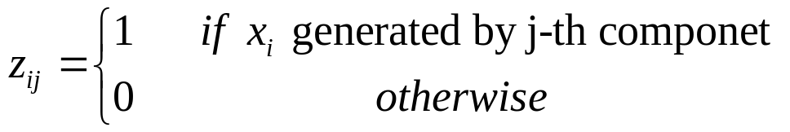
Estimating Mixture Parameters
Using EM (cont’d)
  We do not know which instance x_{i} was generated by which component(i.e., the missing data are the lables showing which class generated each datapoint)
  Introduce missed or unobserved variables z_{i}
  Where z_{i} is a class indicator vector
(x_{i} are observable and z_{i} non-observable)

Slide 47
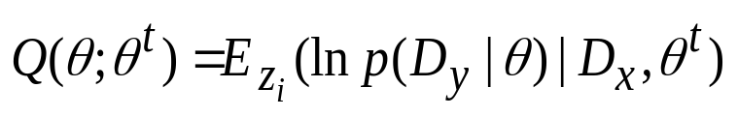

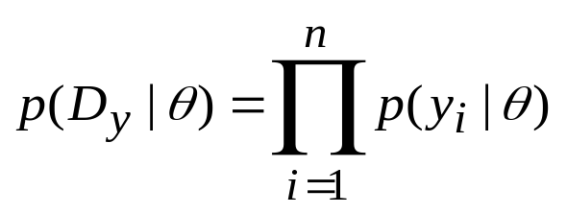


Estimating Mixture Parameters
Using EM (cont’d)
  Expectation Step
We must derive an expression for
We can write as fowlows:
We can write as fowlows:
(assuming z_{ij}=1 and z_{ik}=0 for k≠j)

Slide 48


Estimating Mixture Parameters
Using EM (cont’d)
We can rewrite the above expression as fowlows:
Thus, can be writeen as fowlows:

Slide 49


Estimating Mixture Parameters
Using EM: (cont’d)
  Expectation Step (cont’d)
Now we can compute

Slide 50


Estimating Mixture Parameters
Using EM (cont’d)
  Expectation Step (cont’d)
Take the expected value of
E(z_{ik}) is just the probablity that the x_{i} was generated by the k-th component

Slide 51


Estimating Mixture Parameters
Using EM (cont’d)
  Expectation Step (cont’d)

Slide 52

Estimating Mixture Parameters
Using EM Case (cont’d)
  Maximization Step
use Lagrange
optimization

Slide 53
Estimating Mixture Parameters
Using EM (cont’d)
  Maximization Step (cont’d)

Slide 54

Estimating Mixture Parameters
Using EM (cont’d)
  Summary
(1) Initialization step
(2) Expectation step

Slide 55

Estimating Mixture Parameters
Using EM (cont’d)
  Summary
(3)

