Slide 1
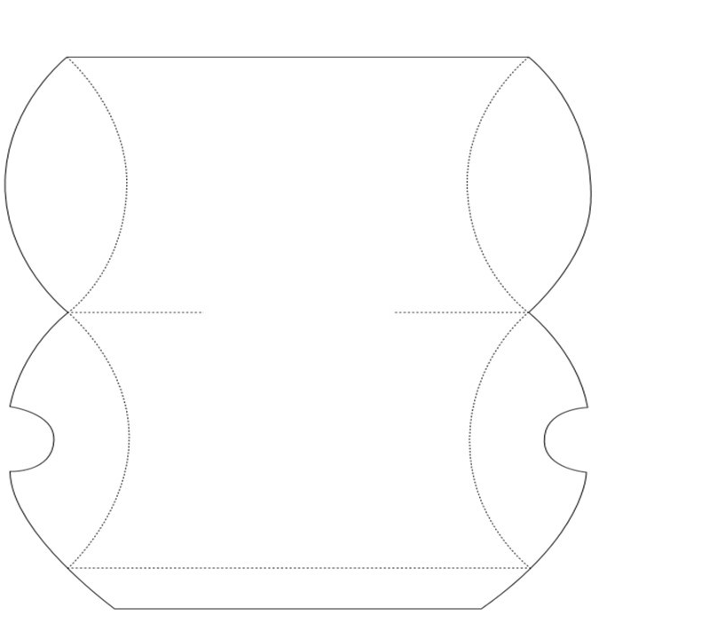
Customize the template. Make it your own!
Print
Cut along solid lines.
Score and fold along dashed lines.
Use glue or tape as necessary.
REUSABLE CLOTH FACE MASK

