Slide 1

IME 565 Project
Coronary Heart Disease Risk Prediction
David Harris, Hirsh Kedia
Link to app:

Slide 2
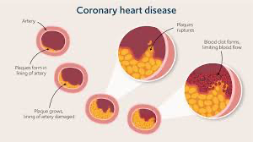
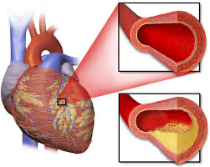
Project Background and Problem Statement
Background:
Coronary heart disease (CHD) is a condition where heart arteries narrow or become blocked by a buildup of plaque. This limits blood flow to the heart muscle, and it can lead to heart attacks and heart failures.
Problem:
Globally: 250,000,000+ people have a CHD
USA: 18,200,000 people (1 in 20 for adults 20 years or older)
Leading cause of death in USA
More people to need know if they are currently, or will be, at risk of CHD.
Solution:
We developed a Heart Disease Risk Estimator designed to help users assess their likelihood of developing CHD within the next 10 years
Users input personal health and lifestyle information, such as age, gender, smoking habits, medical history, and body measurements, and the application generates a personalized risk prediction
NOTE: This is not professional medical advice, just a tool that might be helpful

Slide 3
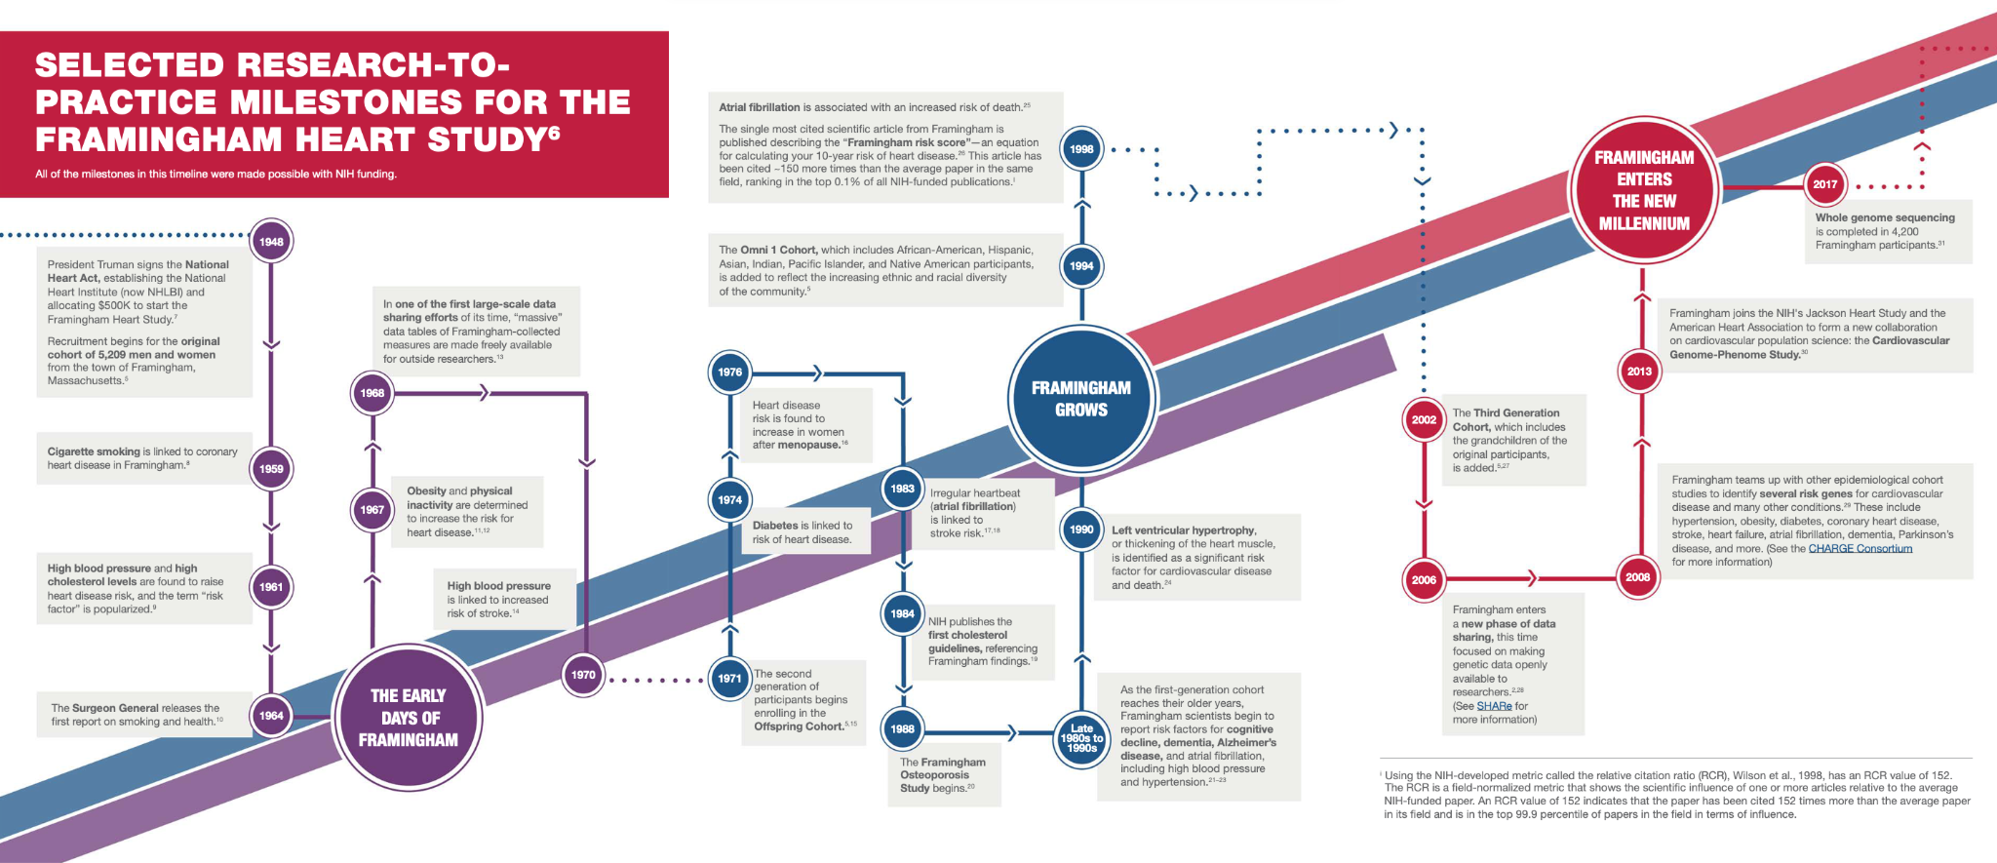
Data Collection, Description, Preprocessing, Visualization
Dataset is from the Framingham Heart Study:
Over 5,000 original patients
Founded and ongoing since 1948
Our specific subset of that data was from Kaggle
Necessary preprocessing was minimal
Working data set included ~3600 samples
15.2% were classified as at risk
84.8% were classified as not at risk
Milestone Timeline for Framingham Heart Study

Slide 4
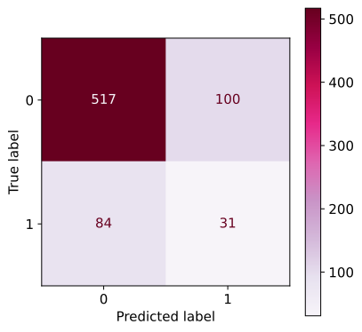
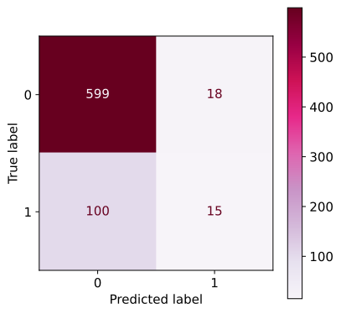
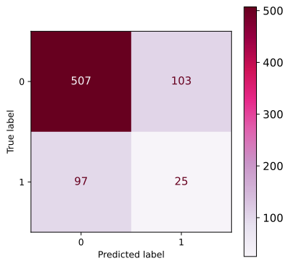
Prediction Modeling
Decision
Tree
Decision Tree
AdaBoost
SoftVoting Classifier
Random Forest
Decision Tree
AdaBoost
AdaBoost
SoftVoting
Classifier

Slide 5
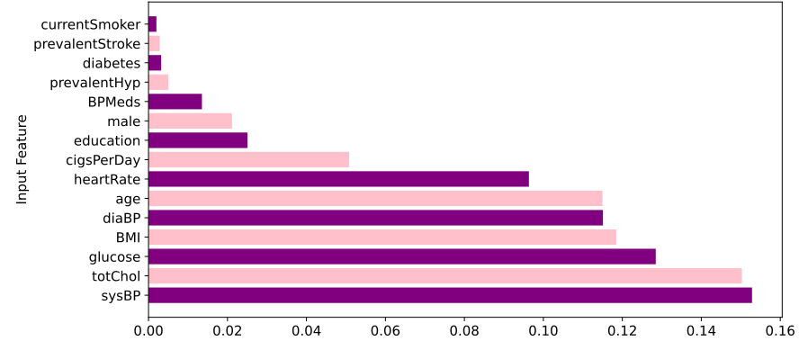
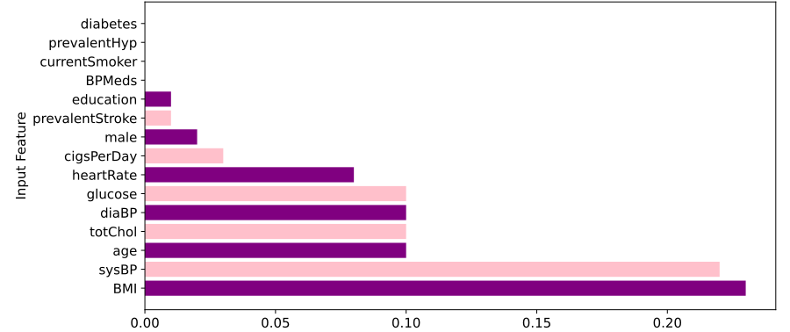
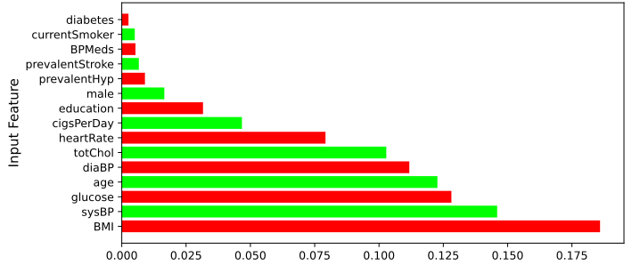
Results
Decision
Tree
Most important features:
Blood pressure
Cholesterol
BMI
Glucose
Age
AdaBoost
SoftVoting
Classifier

Slide 6
Ethical Considerations, Limitations, Future Extensions
Ethical:
Need to disclose that this is not a mature, medical model.
User inputs and results can not be secretly stored, sold, or used for ulterior motives.
Limitations:
Currently only trained on one data set.
Not advanced enough to be used reliably in the medical world.
Users may unintentionally input incorrect data; it cannot catch mistakes.
Future Extensions:
More detailed and accurate model that could grow into a professional, medical tool.
Tailor to other diseases, disorders, and medical concerns.
Expand to include more productive and actionable solutions dependant on user inputs.

Slide 7
Conclusions
Coronary Heart Disease is an incredibly important issue that some people neglect until it is too late. Although our model is not currently ready for professional use, we hope that it provides some insights regarding causes, actionable solutions, and monitoring your likelihood.
Please feel free to check it out! Stay safe, stay healthy, and make good decisions!
Link to app:

Slide 8
References
Dataset
App Image
Framingham Heart Study

Slide 9
Thank You!
Link to app:

