Slide 1
conMan
HL7 FHIR Connectathon Manager
http://conman.clinfhir.com/connectathon.html?event=con27

Slide 2
TL;DR
List connectathon tracks, implementation guides, servers, clients and participants in the connectathon to make it easier for people to understand the range of activities in the Connectathon event.
Allows testing results to be recorded for tracks (especially Implementation guides) to assist with determining IG maturity.
Provide links to other Connectathon artifacts such as Confluence pages, IG’s on the web and the FHIR Package registry
Note: Works with any modern browser, with the exception of the Brave Browser

Slide 3
Login & User creation
Login is just name. No password required (at the moment)
When starting the app in a browser
If this is the first time in the browser (or restarted), but the user has already been created:
Type name in dialog – auto complete
After selecting, user saved in browser and will be remembered
If this user has not been created:
Click ‘Register new Person’ in the dialog, then enter the user name
Must be a unique name
After selecting, user saved in browser and will be remembered
There is a logout option on the navbar
Really only useful if someone else wishes to use the same browser

Slide 4
Track Leads

Slide 5
Goal in setting up a track
Set up conMan tracks for participants to use
Specifically to enable
Easy way to find stuff
Enter tests / comments against an IG
One off task before event (though can edit at any time)

Slide 6
Architecture
Represent an IG
Description
Links to IG on web and FHIR Registry
0..*
Implementation Guide
Track
Description
Type
Track Lead
Links to confluence / chat
A specific scenario to be tested
Varying level of detail
Includes roles
0..*
Scenario
Must have scenarios if recording testing
Server
0..1
1..1
A FHIR server
Test
Result of testing a server interaction
Generally a client & server in roles
Can just be a note
Client
0..1
A FHIR client

Slide 7
Setting up a track
Process
If testing an IG, ensure that there is a definition for the IG
Should only be 1 per IG
IG’s can be referenced by any number of Tracks
Create the Track
Track Lead
Description
IGs
Links to confluence / FHIR registry
Add the scenarios
Basis of testing

Slide 8
Implementation Guide setup

Slide 9
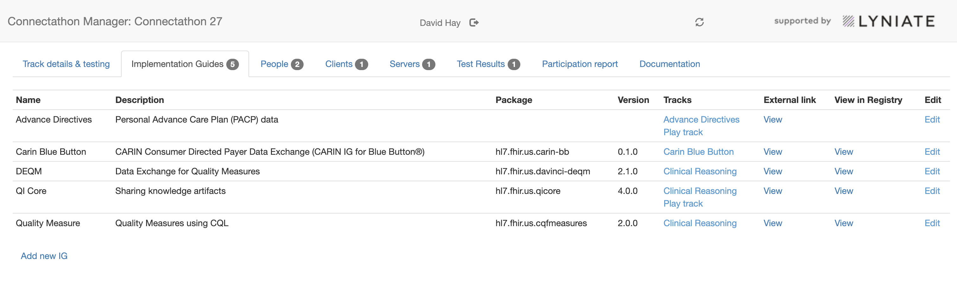
1a IG list and link to new/ edit
Main IG attributes
Tracks are those with a link to the IG
Set in track edit (next section) and read-only here
External link is IG on web (i.e. human readable version)
Package & version if IG is in FHIR registry
‘View in Registry’ link will display registry entry

Slide 10
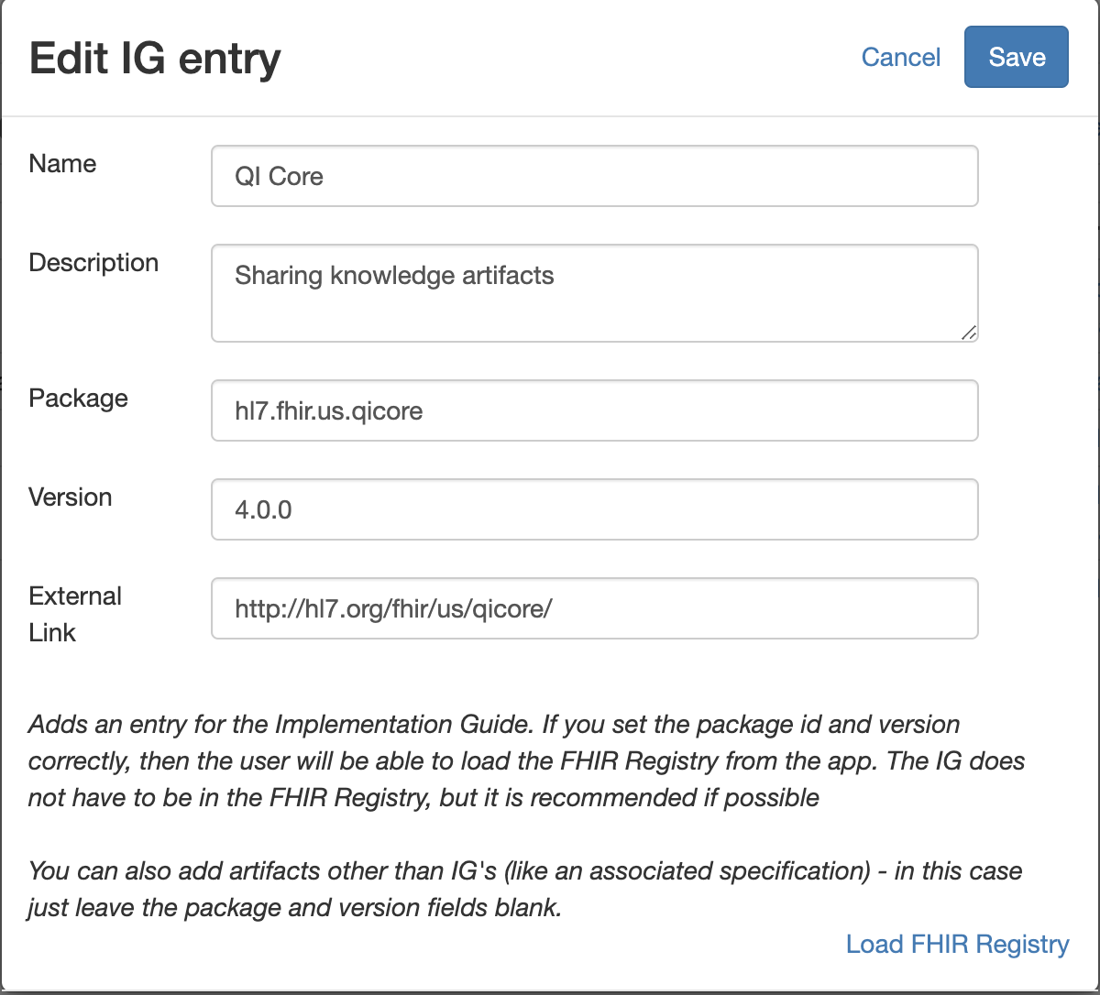
1b Create / Edit IG entry
Keep name & description short
Use ‘External Link’ for location of IG
Set package and version so can be found in registry
Link to registry bottom right for convenience

Slide 11
Track setup

Slide 12
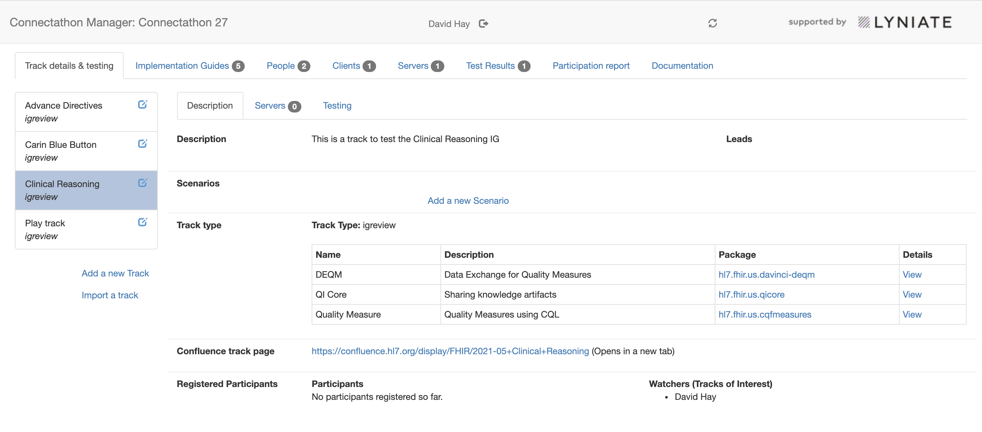
2a Track list tab
a

Slide 13
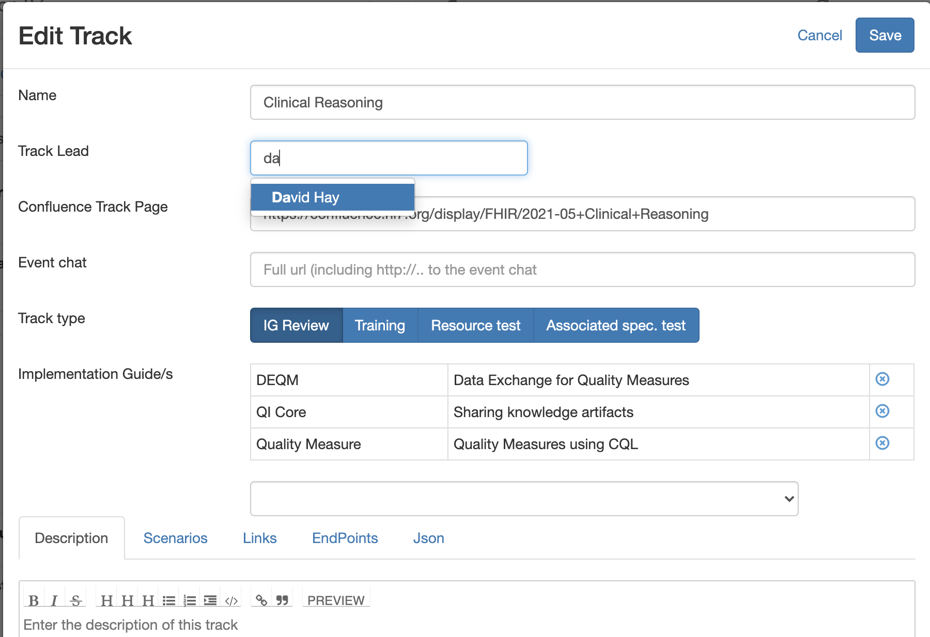
2b Track edit dialog
Track lead is only one who can edit
Logged in user
Track type so users know what to expect
If type = IG Review can select IG’s
Can have multiple
Will be displayed in IG list and track description
Description is useful, others in lower tab less so

Slide 14
Scenarios

Slide 15
3a Scenarios: General comments
Describes a specific usage of an IG (or other)
Optional, but needed if recording test results in conMan
Each scenario can have varying degrees of detail
User can always load the Confluence page via the link in the track
Each scenario has the roles needed within that scenario
E.g. for Clinical Reasoning there is a Producer (server) and a Consumer (client)
Roles are shared across all scenarios in a track
Define in one scenario, and include it in any others (within the track)
A single test is a client app and a server app in a particular role for a given scenario

Slide 16
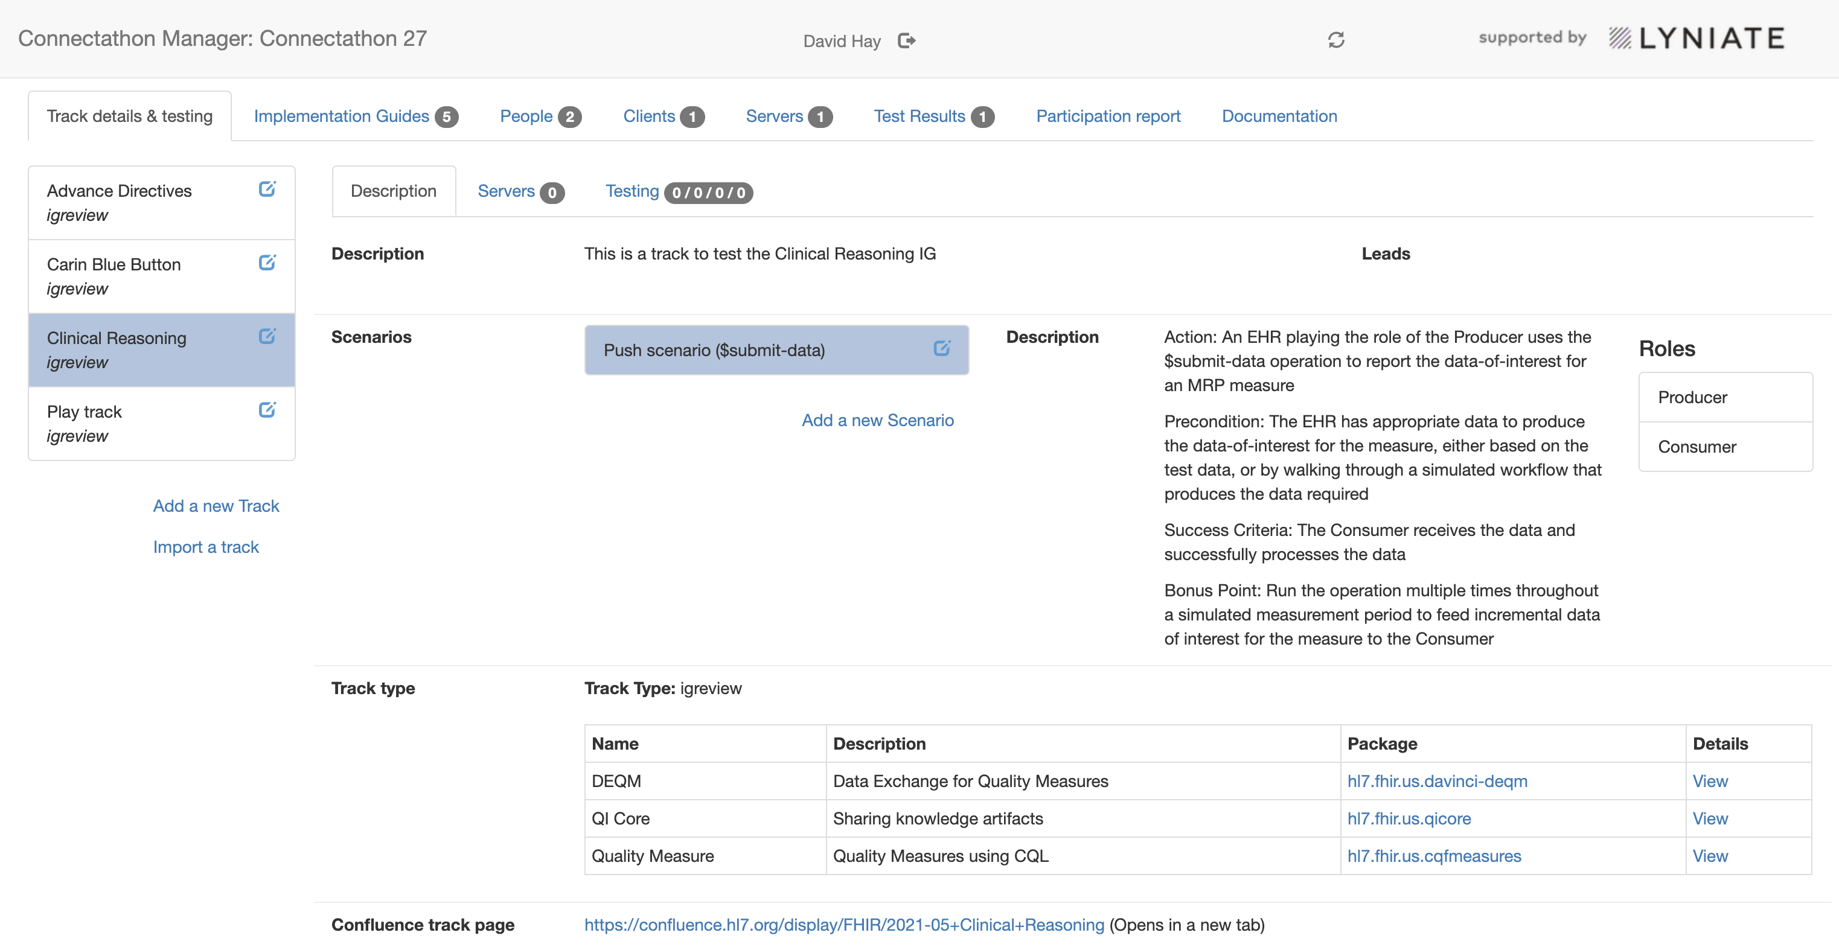
3b Scenarios: List and link to create / edit

Slide 17
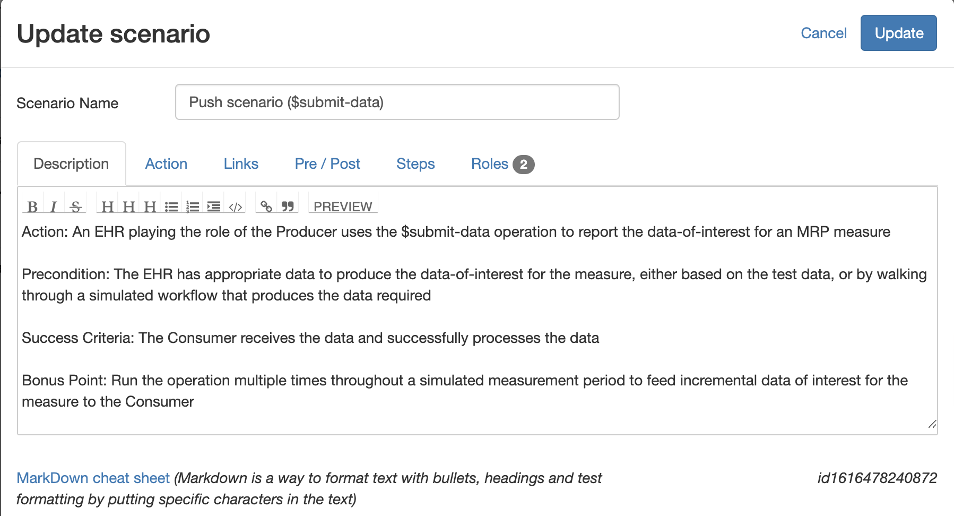
3c Scenarios: Create / Edit
At least have description and roles
Roles:
Want at least 1 client & 1 server
May have other roles
Each role is a client or aserver
Other tabs for specialized situations

Slide 18
All users

Slide 19
Main tasks
Person setup
Record servers the user has
Record clients the user has
Record outcomes of testing

Slide 20
Person setup

Slide 21
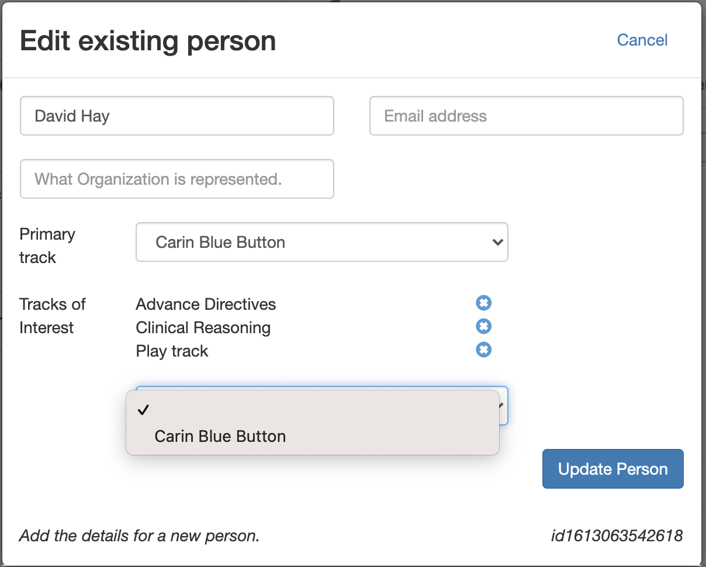
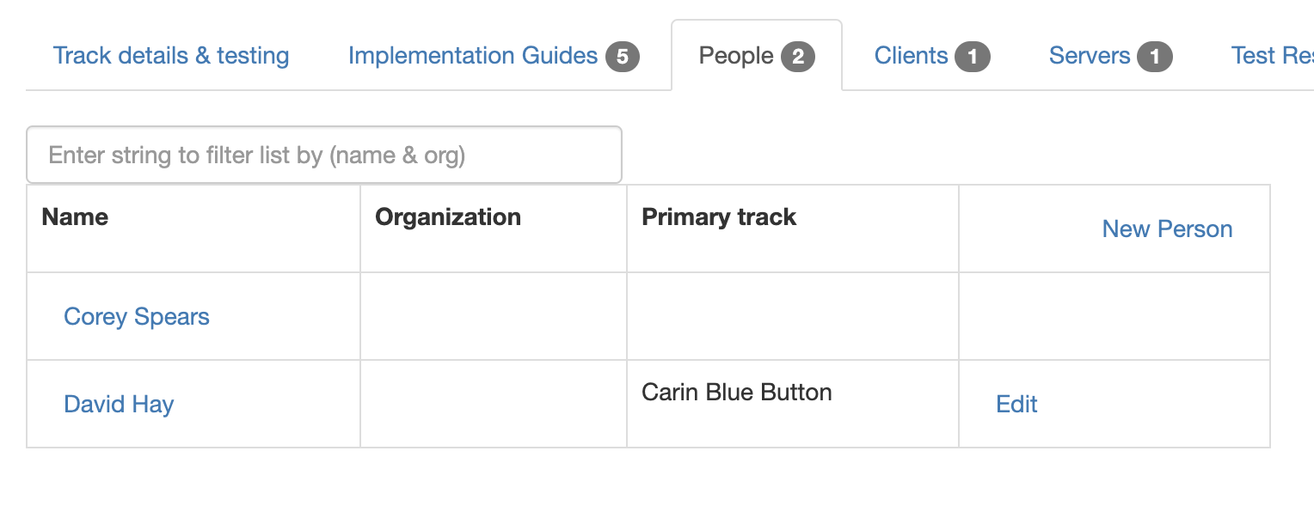
1a Person setup
‘Person’ is created by login
Can edit ‘profile’
Indicate tracks participating in
Primary Track
Main one. Only 1
Different to Track Lead
Tracks of Interest
Any number of others
Will populate participation report
And appear in track details

Slide 22
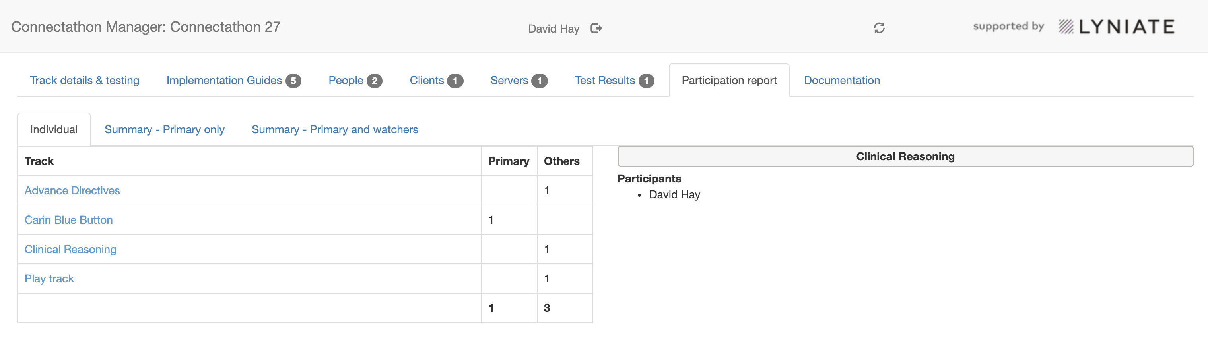
1b Participation report
Shows who participated in which track
Derived from user setup
Primary vs Tracks Of Interest / Others relatively immaterial

Slide 23
Server setup

Slide 24
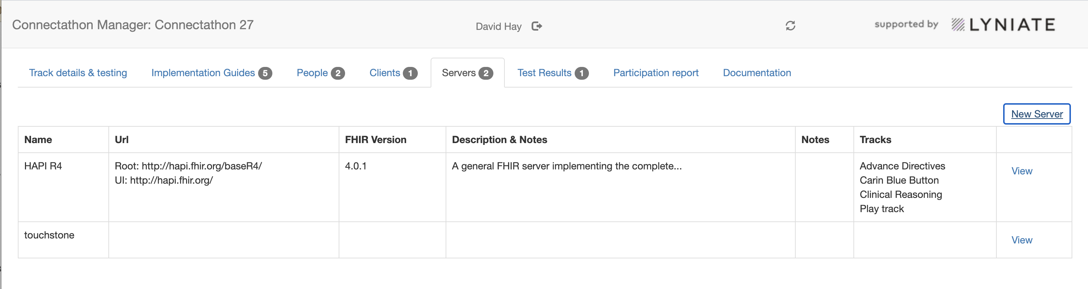
2a Servers
Allows participants to find servers for testing
Tracks set by server owner (in edit dialog).
Indicative only – ie any test can select any server
Will also show in the track description (under Track details and testing)

Slide 25
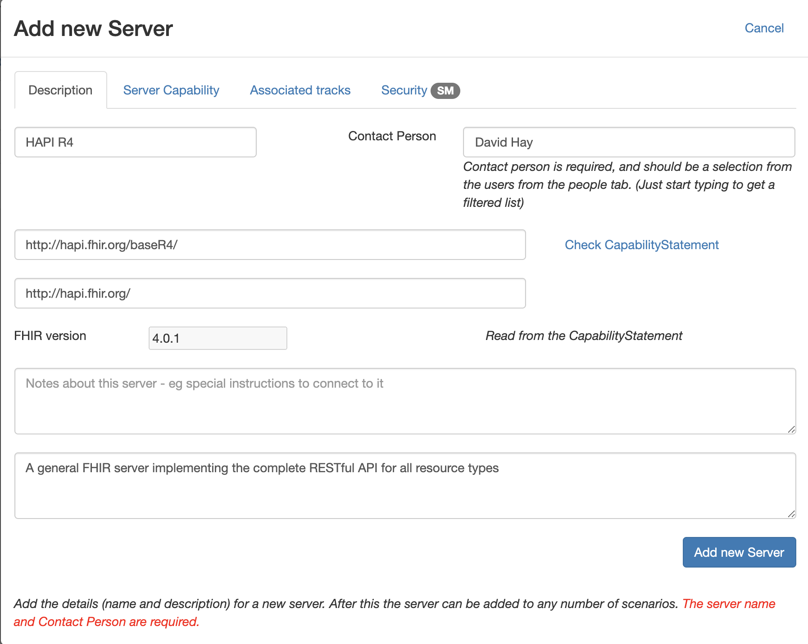
2b Server details
Has endpoint and UI (if any)
Check CapabilityStatement link to populate Capability tab
Populates FHIR version
Associated tracks tab
Tracks this server can be used for
(Indicative only)

Slide 26
Client setup

Slide 27
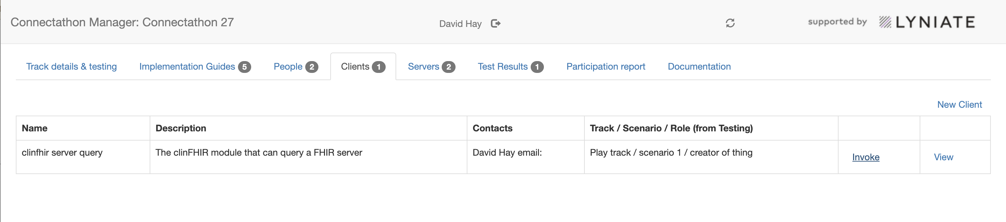
3a Clients
Potential clients for use against a server
The ‘invoke’ link will launch the client (if web based)
The Track / Scenario Role is populated from test results

Slide 28
Testing

Slide 29
4a Testing
Allows recording of testing a client/server interaction
Especially useful for IG
A test is a client accessing a server – each in some specific role
2 parts:
Recording a test result is from the ‘Track details & testing’ tab
All results in the ‘Test Results’ tab
Can also enter a general note against a scenario / IG

Slide 30
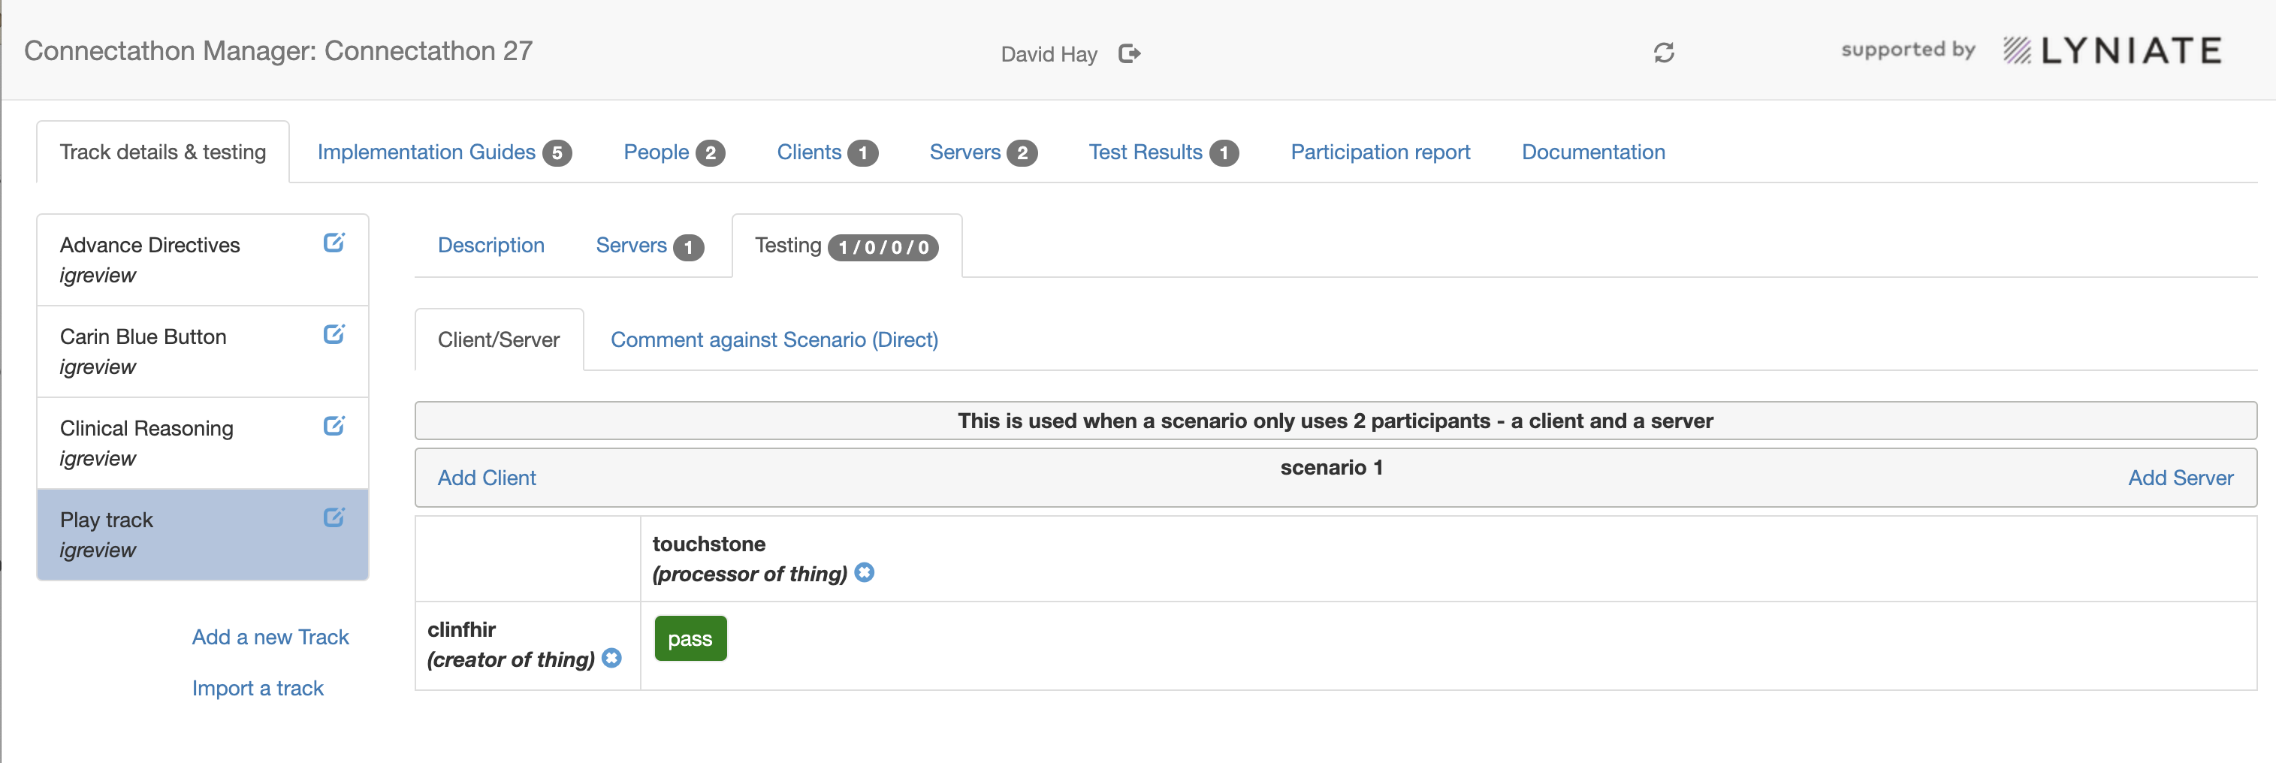
4b Recording a test
Existing results and new test under track tab

Slide 31
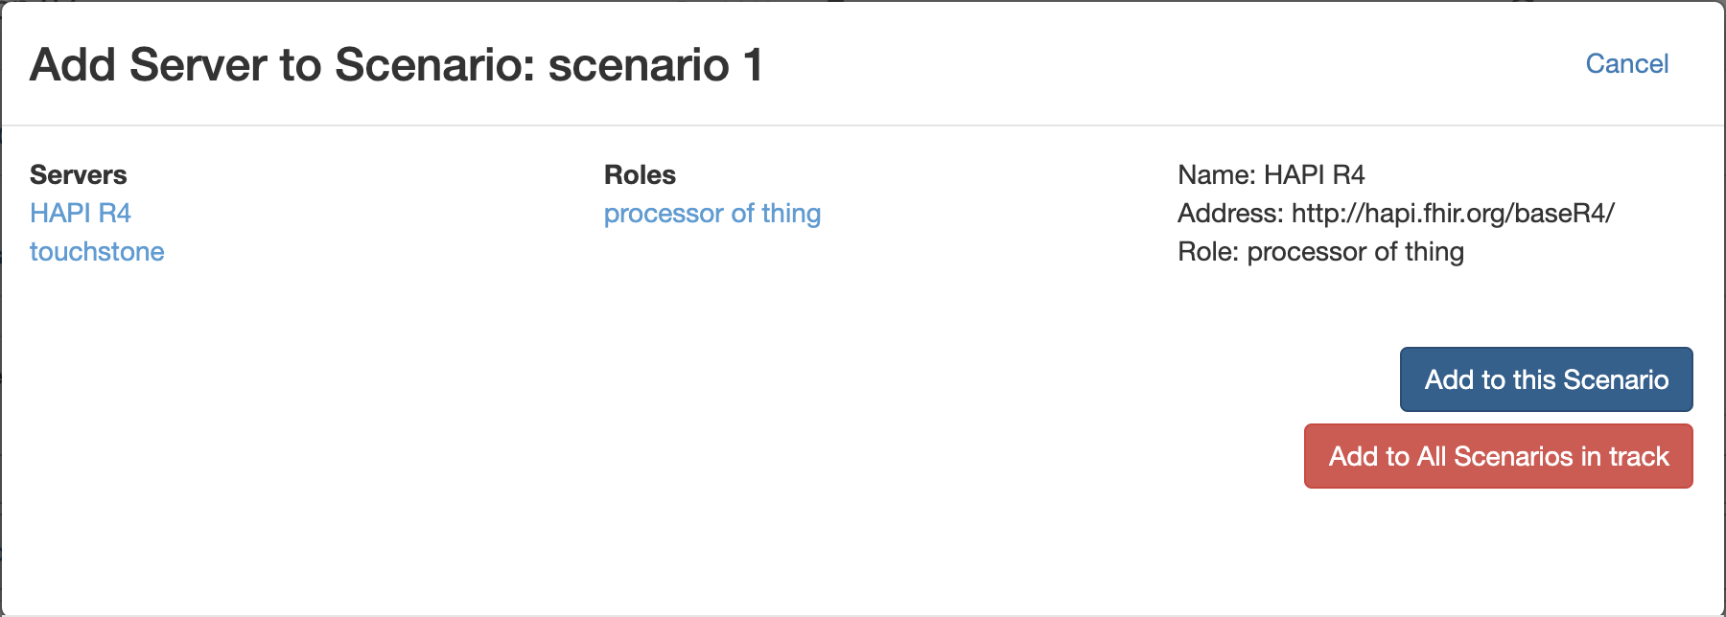
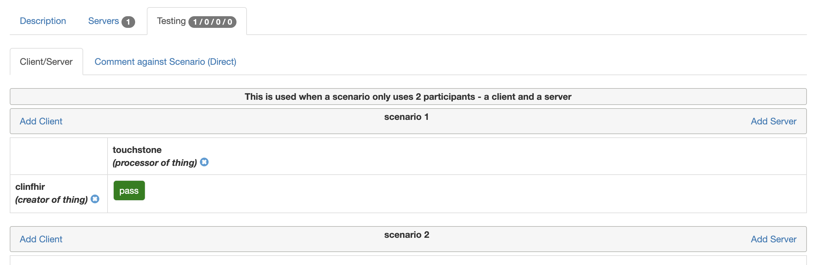
4c Add a client or server
All defined scenarios are listed in the tab.
Add a client (in a role) and a server (in a role) and the ‘intersection’ is where a test result can be added (one per combination)
Also have the option to make a general comment against a scenario without specifying client or server

Slide 32
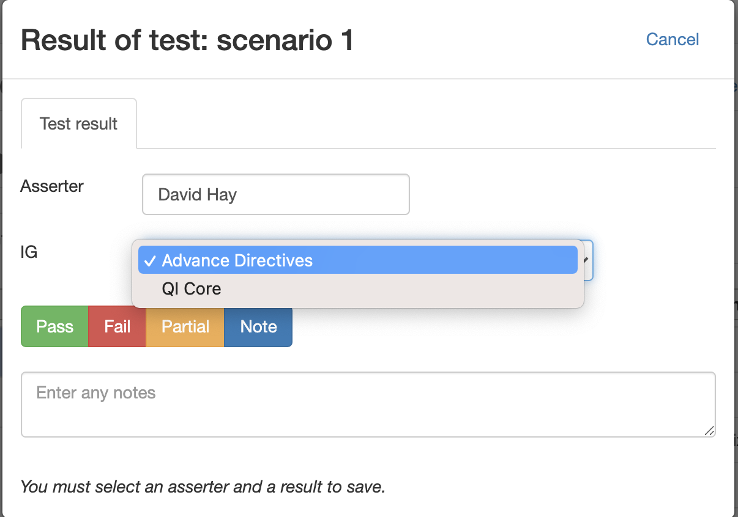
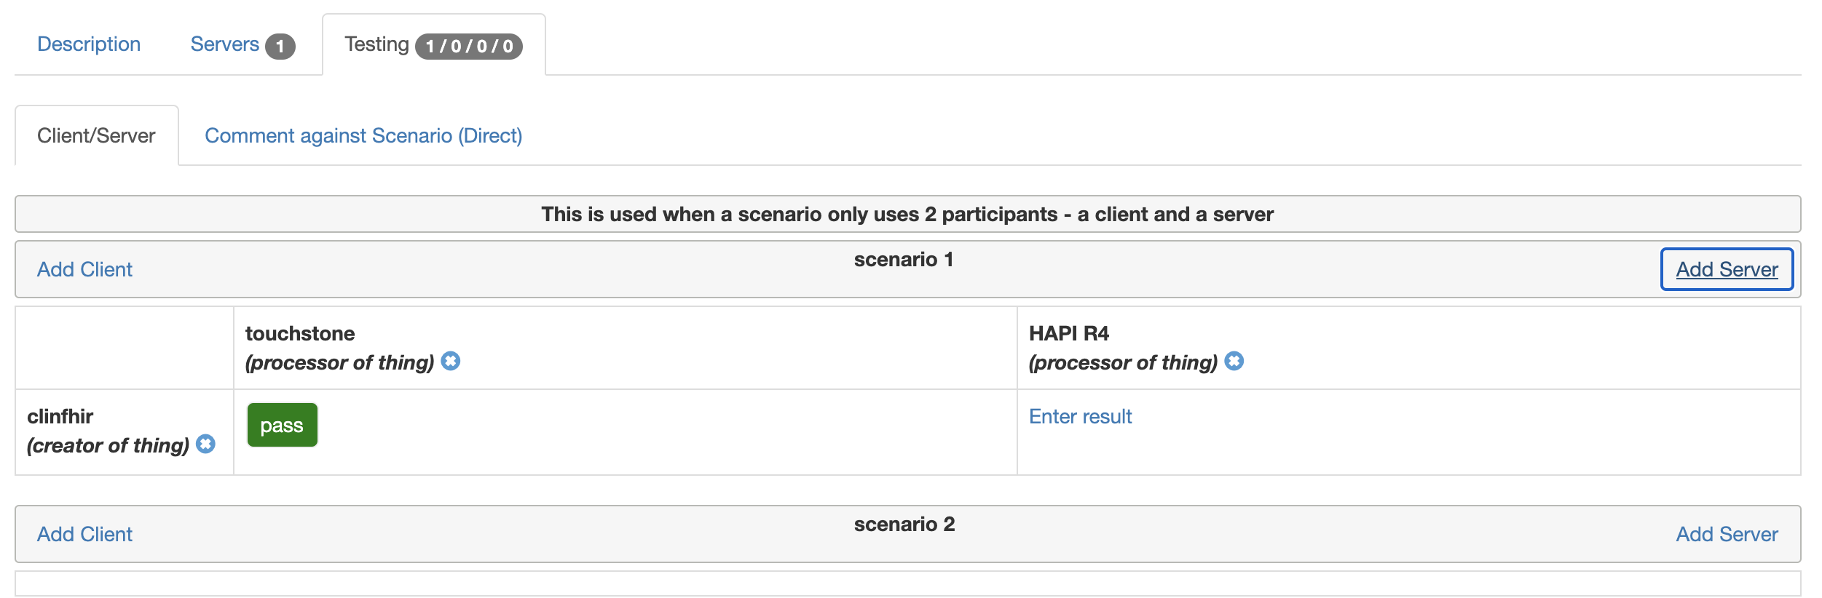
4d Enter the test result
Click the ‘Enter result’ link to set the result
Can indicate outcome: Pass / Fail / Partial or just a note
Can select the IG if more than 1
Can enter a note for any result
Can change the asserter
Can edit the result by clicking the result icon

Slide 33
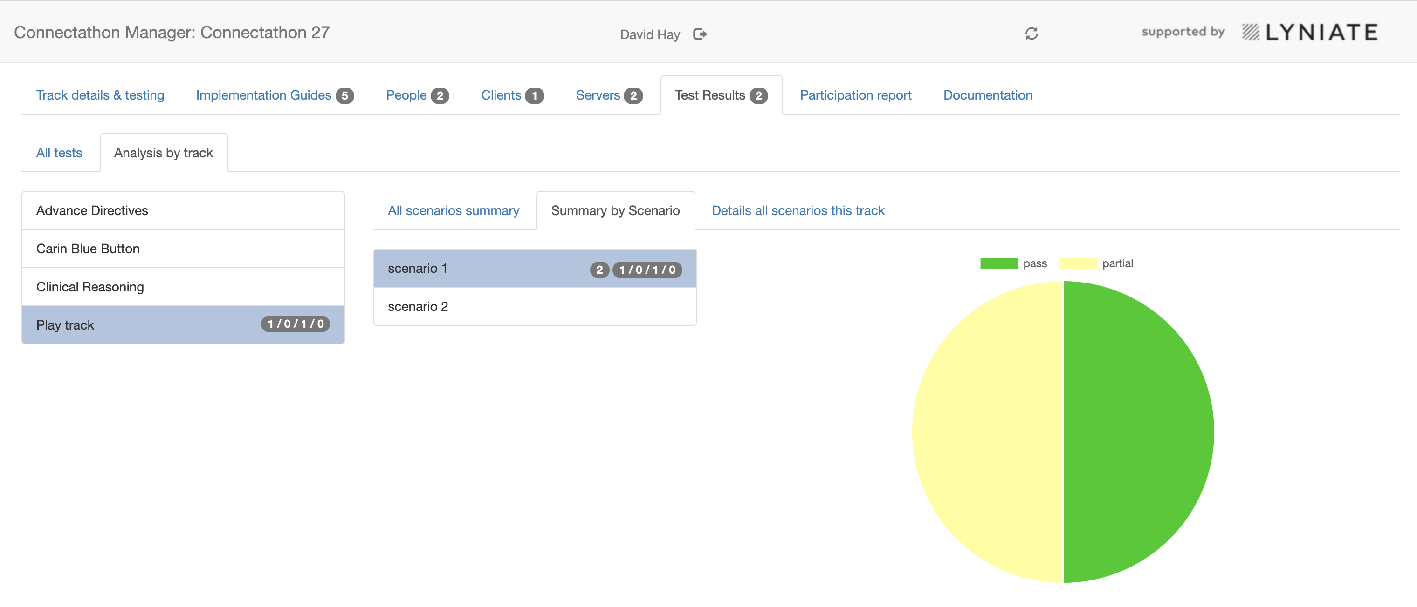
4e View results
Various report formats
Can also download all results (from the ‘details all scenarios this track)

Slide 34
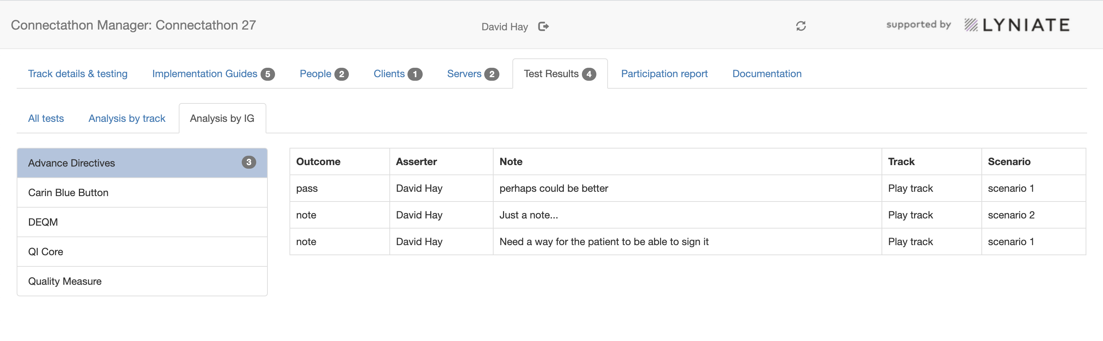
Report by IG
When a test is associated with an IG
IGs registered against track

