Slide 1
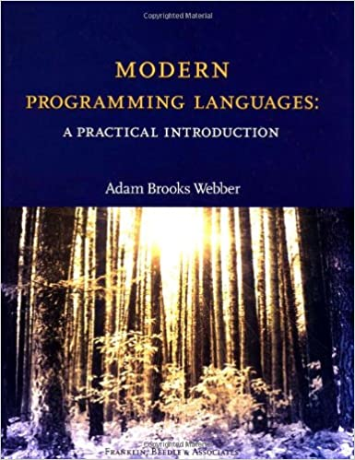
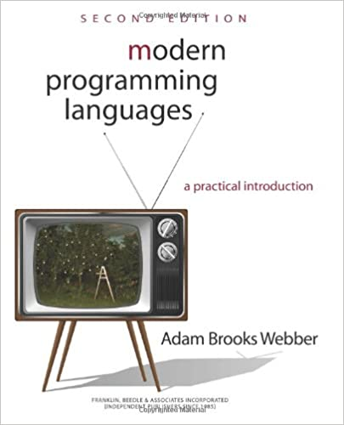

Welcome - CSC 301
CSC 301- Fundamentals of Programming Languages
Instructor: Mr. David H. Brown (MS in CS from URI)
Email: david_h_brown@uri.edu (underscores!)
Book: “Modern Programming Languages”, any edition
(for more details see BrightSpace)

Slide 2
Why Study Programming Languages?
Amazing variety
~2300 different programming languages discussed on online forums*.
“Strange” controversies
Should a programming language have a ‘goto’ statement?
Should an OO language support inheritance?
Terminology: argument vs. actual parameter.
Many connections
Programming languages touch upon virtually all areas of computer science: from the mathematical theory of formal languages and automata to the implementation of operating systems.
Intriguing evolution
Programming languages change!
New ideas and experiences trigger new languages.
New languages trigger new ideas, etc.
*Source: Webber, Modern Programming Languages: A Practical Introduction.

Slide 3
Reading
Chap 1 in “Modern Programming Languages” (MPL)

Slide 4
Programming Language Classes
There are many different programming language classes, but three classes or paradigms stand out:
Imperative Languages
Functional Languages
Logic/Rule Based Languages

Slide 5
What Happened to OOP?
Object-orientation is really a property of the type system of a language.
OO features have traditionally been added to imperative languages (C++, Java, Python)
Object-oriented features have also been added to:
Functional programming languages like Lisp (CLOS)
Logic languages like Prolog (Logtalk)
Here we look at object-based programming within the multi-paradigm language Asteroid

Slide 6
Meet Our Languages
Asteroid – An object-based, imperative, and functional programming language being developed right here at URI
https://asteroid-lang.org
Prolog – A logic programming language, most famously used in IBM Watson
The IBM Watson knowledge base was filled with 200 million pages of information, including the entire Wikipedia website. To parse the questions into a form that IBM Watson could understand, the IBM team used Prolog to parse natural-language questions into new facts that could be used in the IBM Watson pipeline. In 2011, the system competed in the game Jeopardy! and defeated former winners of the game.
https://www.swi-prolog.com
Source: developer.ibm.com/articles/cc-languages-artificial-intelligence/

Slide 7
Example Computation
Recursive definition of the factorial operator for all x > 0.

Slide 8
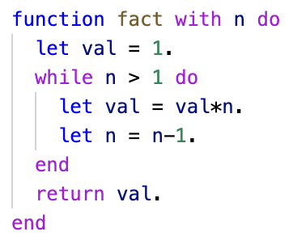
Imperative Languages
Hallmarks: assignment and iteration
Examples: C, FORTRAN, Imperative sublanguage of Asteroid
Example Program: factorial program in (imperative) Asteroid

Slide 9
Imperative Languages
Observations:
The program text determines the order of execution of the statements.
We have the notion of a ‘current value’ of a variable – accessible state of variable.
This is not always true in other languages.

Slide 10
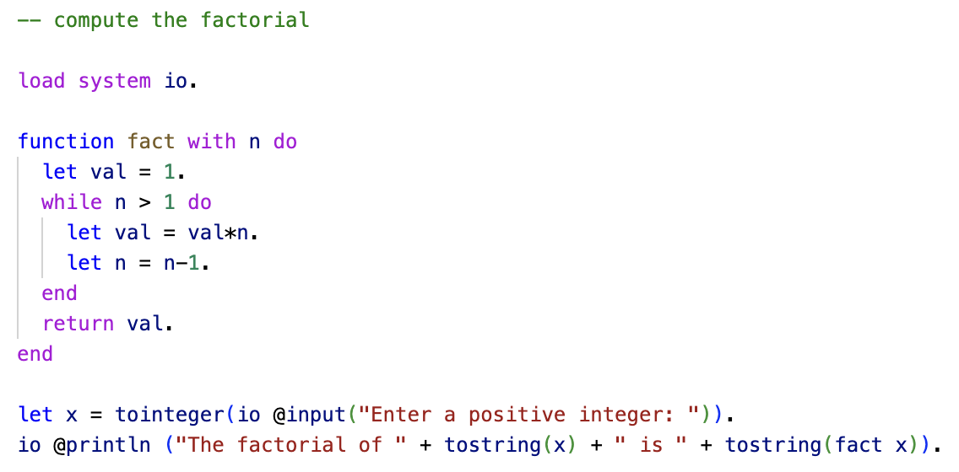
Imperative Asteroid
State variables
ln001/fact-iter.ast

Slide 11
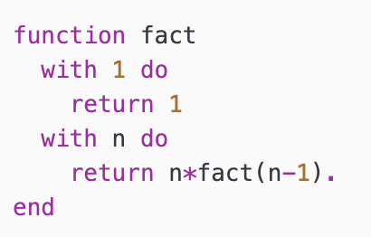
Functional Languages
Hallmarks: recursion, multi-dispatch, single valued variables.
Examples: ML, Lisp, Haskell, Functional sublanguage of Asteroid
Example Program: factorial program in (functional) Asteroid
multi-dispatch
n is single valued variable.
recursion

Slide 12
Functional Languages
Observations:
No explicit assignments necessary
we will allow them later for convenience sake but they will introduce only single valued variables
The name stems from the fact that programs consist of recursive definitions of functions.

Slide 13
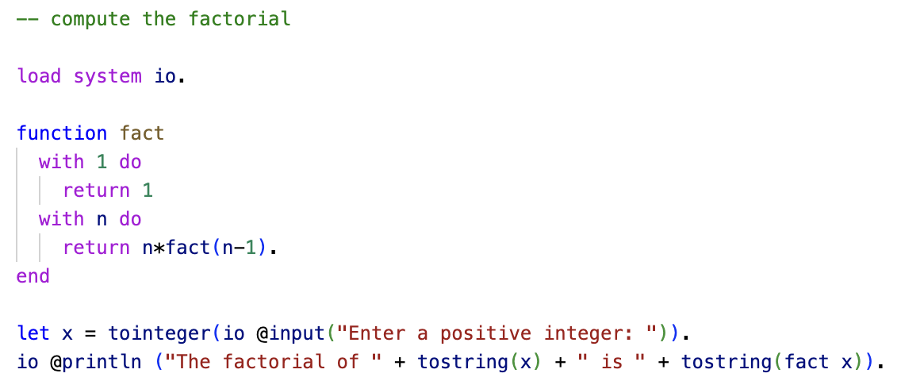
Functional Asteroid
ln001/fact-rec.ast

Slide 14
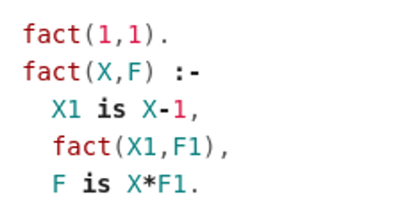
Logic Programming Languages
Hallmarks: programs consist of rules that specify the problem solution.
Examples: Prolog, Maude, Isabelle
Example Program: factorial program written in Prolog
fact(in,out)
‘and’
rules

Slide 15
Logic Programming Languages
Observations:
Rules do not appear in the order of execution in the program text.
No specific order of execution is given – rules ‘fire’ when necessary.

Slide 16
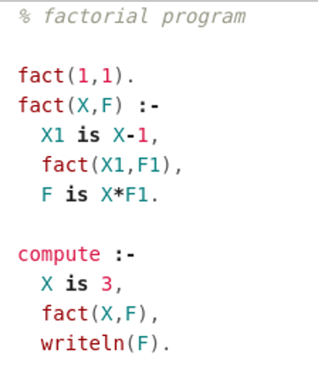
Prolog

Slide 17
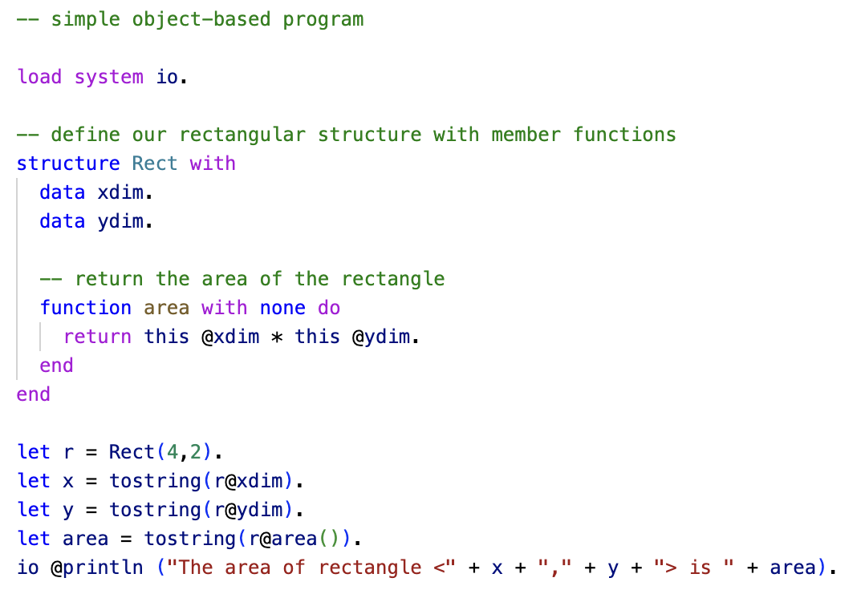
Object-Based Languages
Hallmarks: bundle data with the allowed operations  Objects
Asteroid takes an interesting approach here – structures with functions.
ln001/rect.ast

Slide 18
Programming Language Classes
General Observations:
Programming languages guide programmers towards a particular programming style:
Imperative → iteration/assignment
Functional → mathematical functions
OO → objects
Logic → rules
Programming itself guides the developer towards new language ideas:
Recursion was introduced by John McCarthy in the 1950’s with the programming language Lisp to solve problems in AI.
Classes and objects were developed by Nygaard and Dahl in the 1960’s and 70’s for the language Simula in order to solve problem in simulations.

Slide 19
Take Away
There exist many programming languages today (> 2000)
In order to understand the similarities and differences ⇒ sort into classes
Imperative
assignment and iteration
Functional
Recursion, single valued variables
Logic/rule based
programs consist of rules
Object-based
bundle data with the allowed operations

Slide 20
Reading & Assignments
Reading: Modern Programming Languages (MPL) Chap 1.
Install (and run!) Asteroid
https://asteroid-lang.readthedocs.io
Windows – if you get an error about pyreadline3, just pip install pyreadline3 and try again
Assignment #0: Syllabus Quiz!
Syllabus is online in our Brightspace (a little different from Professor Hamel’s)
You get three tries for the quiz; go for 10/10!

