Slide 1
Parallel Programming in Haskell
David Walker
Thanks to Kathleen Fisher and recursively to
Simon Peyton Jones for much of the content of these slides.
Optional Reading:
“Beautiful Concurrency”,
“The Transactional Memory / Garbage Collection Analogy”
“A Tutorial on Parallel and Concurrent Programming in Haskell”

Slide 2

Intel’s Nightmare
Produced by Arun Raman, Ph.D., Princeton 2011.

Slide 3
The Multi-Cores are Coming
Multi-cores are coming!
For 50 years, hardware designers delivered 40-50% increases per year in sequential program performance.
Around 2004, this pattern failed because power and cooling issues made it impossible to increase clock frequencies.
Now hardware designers are using the extra transistors that Moore’s law is still delivering to put more processors on a single chip.
If we want to improve performance, parallelism is no longer optional.
Notes:
NB: Not just our work: many have contributed both in Microsoft and outside.

Slide 4
Parallelism
Parallelism is essential to improve performance on a multi-core machine.
Unfortunately, parallel programming is seen as immensely more error-prone than traditional sequential programming, and it often is
If you have taken COS 318, you’ll know already that using locks and condition variables is unbelievably hard relative to using if statements and method calls
Notes:
NB: Not just our work: many have contributed both in Microsoft and outside.

Slide 5
What we want
Libraries build layered concurrency abstractions
Library
Library
Library
Library
Library
Library
Library
Concurrency primitives
Hardware

Slide 6
What we have using conventional techniques
Locks and condition variables (a) are hard to use and (b) do not compose
Library
Library
Library
Library
Library
Library
Library
Locks and condition variables
Hardware
“Building complex parallel programs is like building a sky scraper
out of bananas.” -- Simon Peyton Jones

Slide 7
Idea: Replace locks with atomic blocks
Atomic blocks are much easier to use, and do compose
Library
Library
Library
Library
Library
Library
Library
Atomic blocks
Hardware

Slide 8
A Quick Primer on Locks and Concurrency

Slide 9
A Quick Primer on Why Imperative Parallel Programming is Hard: 1 + 1 ain’t always 2!
global x
is initially 0
int x = 0;

Slide 10
A Quick Primer on Why Imperative Parallel Programming is Hard: 1 + 1 ain’t always 2!
global x
is initially 0
int x = 0;
two imperative assignments
execute “at the same time”:
x = x + 1;
x = x + 1;

Slide 11
A Quick Primer on Why Imperative Parallel Programming is Hard: 1 + 1 ain’t always 2!
global x
is initially 0
int x = 0;
two imperative assignments
execute “at the same time”:
x = x + 1;
x = x + 1;
possible answers: 1 or 2

Slide 12
A Quick Primer on Why Imperative Parallel Programming is Hard: 1 + 1 ain’t always 2!
int x = 0;
tempA = x;
tempB = x;
x = tempA + 1;
x = tempB + 1;

Slide 13
A Quick Primer on Why Imperative Parallel Programming is Hard: 1 + 1 ain’t always 2!
int x = 0;
tempA = x;
tempA: 0
x = tempA + 1;
x: 1
tempB = x;
tempB: 1
x = tempB + 1;
x: 2

Slide 14
A Quick Primer on Why Imperative Parallel Programming is Hard: 1 + 1 ain’t always 2!
int x = 0;
tempA = x;
tempA: 0
tempB = x;
tempB: 0
x = tempA + 1;
x: 1
x = tempB + 1;
x: 1

Slide 15
A Quick Primer on Why Imperative Parallel Programming is Hard: Locks and Critical Sections
critical
section
int x = 0;
acquire(L);
tempA = x;
x = tempA + 1;
release(L);
tempA: 0
x: 1
acquire(L);
tempB = x;
x = tempB + a;
release(L);
tempB: 1
x: 2

Slide 16
A Quick Primer on Why Imperative Parallel Programming is Hard: Synchronized Methods
acquires and releases the lock
associated with the object (1 lock per object)
Adder a = new Adder(0);
a.add()
x: 1
Java Synchronized Methods:
class Adder{
int x;
synchronized void add(){
x = x+1;
}
}
x: 2
a.add()

Slide 17
What’s wrong with locks?
Correct use of locks can solve concurrency problems, but locks are amazingly difficult to use correctly
Races: forgotten locks (or synchronization commands) lead to inconsistent views
Deadlock: locks acquired in “wrong” order
Lost wakeups: forget to notify condition variables
Diabolical error recovery: need to restore invariants and release locks in exception handlers. Yikes!
These are serious problems. But even worse...

Slide 18
Locks are Non-Compositional
Consider a (correct) Java bank Account class:
Now suppose we want to add the ability to transfer funds from one account to another.
class Account{
float balance;
synchronized void deposit(float amt) {
balance += amt;
}
synchronized void withdraw(float amt) {
if (balance < amt)
throw new OutOfMoneyError();
balance -= amt;
}
}

Slide 19
Locks are Non-Compositional
Simply calling withdraw and deposit to implement transfer causes a race condition:
class Account{
float balance;
…
void badTransfer(Acct other, float amt) {
other.withdraw(amt);
this.deposit(amt);}
}
class Bank {
Account[] accounts;
float global_balance;
checkBalances () {
return (sum(Accounts) == global_balance);
}
}
sees bad total
balance value
in between
withdraw and
deposit

Slide 20
Locks are Non-Compositional
Synchronizing transfer can cause deadlock:
class Account{
float balance;
synchronized void deposit(float amt) {
balance += amt;
}
synchronized void withdraw(float amt) {
if(balance < amt)
throw new OutOfMoneyError();
balance -= amt;
}
synchronized void badTrans(Acct other, float amt) {
// can deadlock with parallel reverse-transfer
this.deposit(amt);
other.withdraw(amt);
}
}

Slide 21
Locks are absurdly hard to get right
Scalable double-ended queue: one lock per cell
No interference if ends “far enough” apart
But watch out when the queue is 0, 1, or 2 elements long!

Slide 22
Locks are absurdly hard to get right
Coding style | Difficulty of queue implementation
Sequential code | Undergraduate (COS 226)

Slide 23
Locks are absurdly hard to get right
Coding style | Difficulty of concurrent queue
Sequential code | Undergraduate
Locks and condition variables | Publishable result at international conference
Coding style | Difficulty of queue implementation
Sequential code | Undergraduate (COS 226)
Efficient parallel code with locks and condition variables | Publishable result at international conference¹
¹ Simple, fast, and practical non-blocking and blocking concurrent queue algorithms.

Slide 24
What does Haskell do about this?
Caveat: Nobody has the general answer. It is a huge area of current research.
Haskell has an edge on Java and C because data structures are immutable by default and the problems appear when two parallel threads are actively mutating shared data or other resources
Haskell provides a tractor-trailer’s worth of options:
parallelism over immutable data via “sparks”
parallelism over immutable data via data-parallel operators like parallel map and parallel fold (aka reduce)
Google's map-reduce architecture borrows from older functional programming just like Haskell
software transactional memory
ordinary locks & threads (boo!)

Slide 25
What does Haskell do about this?
Caveat: Nobody has the general answer. It is a huge area of current research.
Haskell has an edge on Java and C because data structures are immutable by default and the problems appear when two parallel threads are actively mutating shared data or other resources
Haskell provides a tractor-trailer’s worth of options:
parallelism over immutable data via “sparks”
parallelism over immutable data via data-parallel operators like parallel map
Google's map-reduce architecture borrows from older functional programming just like Haskell
software transactional memory
ordinary locks & threads (boo!)
we will look at this
today

Slide 26
Software Transactional Memory (STM)

Slide 27
The Punchline for STM
Coding style | Difficulty of queue implementation
Sequential code | Undergraduate (COS 226)
Efficient parallel code with locks and condition variables | Publishable result at international conference¹
Parallel code with STM | Undergraduate
¹ Simple, fast, and practical non-blocking and blocking concurrent queue algorithms.

Slide 28
STM = Atomic Memory Transactions
Like database transactions
atomic {...sequential code...}
To a first approximation, just write the sequential code, and wrap atomic around it
All-or-nothing semantics: Atomic commit
Atomic block executes in Isolation
with automatic retry if another conflicting atomic block interferes
Cannot deadlock (there are no locks!)
guarantees about progress on retry
Atomicity makes error recovery easy (e.g. throw exception inside sequential code)
ACID

Slide 29
How does it work?
read y;
read z;
write 10 x;
write 42 z;
…
atomic {... <code> ...}
One possibility:
Execute <code> optimistically without taking any locks.
Log each read and write in <code> to a thread-local transaction log.
Writes go to the log only, not to memory.
At the end, the transaction validates the log.
Validation: Are the values I read the same now as when I read them?
If valid, atomically commits changes to memory.
If not valid, re-runs from the beginning, discarding changes.

Slide 30
Realizing STM in Haskell

Slide 31
Why STM in Haskell?
Logging memory effects is expensive.
Haskell already partitions the world into
immutable values (zillions and zillions)
mutable locations (some or none)
Only need to log the latter!
Type system: Controls where I/O effects happen.
Monad infrastructure: Ideal for constructing transactions & implicitly passing transaction log.
Already paid the bill: Simply reading or writing a mutable location is expensive (involving a procedure call) so transaction overhead is not as large as in an imperative language.
Haskell programmers brutally trained from birth to use memory effects sparingly.

Slide 32
Tracking Effects with Types
Consider a simple Haskell program:
Effects are explicit in the type system.
Main program is a computation with effects.
main = do { putStr (reverse “yes”); putStr “no” }
(reverse “yes”) :: String -- No effects
(putStr “no” ) :: IO () -- Yes effects
main :: IO ()

Slide 33
Mutable State
new :: a -> IO (Ref a) read :: Ref a -> IO a write :: Ref a -> a -> IO ()
Haskell uses new, read, and write* functions within the IO Monad to manage mutable state.
main = do {r <- new 0; -- int r := 0 inc r; -- r := r+1 s <- read r; -- s := r; print s } inc :: Ref Int -> IO () inc r = do { v <- read r; -- temp = r write r (v+1) } -- r = temp+1
Haskell's type system makes it impossible to use refs outside of the IO monad. Eg: Doesn't check:
(read r) + 3
* actually newRef, readRef, writeRef, …

Slide 34
Concurrent Threads in Haskell
The fork function spawns a thread.
It takes an action as its argument.
fork :: IO a -> IO ThreadId
main = do { fork (action1); action2 ... }
action 1 and
action 2 in
parallel

Slide 35
Atomic Blocks in Haskell
Idea: add a function atomic that guarantees atomic execution of its argument computation atomically.
main = do { r <- new 0; fork (atomic (action1)); atomic (action2); ... }

Slide 36
Atomic Details
Introduce a type for imperative transaction variables (TVar) and a new Monad (STM) to track transactions.
Ensure TVars can only be modified in transactions.
atomic :: STM a -> IO a newTVar :: a -> STM (TVar a) readTVar :: TVar a -> STM a writeTVar :: TVar a -> a -> STM ()
-- inc adds 1 to the mutable reference r
inc :: TVar Int -> STM () inc r = do { v <- readTVar r; writeTVar r (v+1) }
main = do { r <- atomic (newTVar 0); fork (atomic (inc r)) atomic (inc r); ... }

Slide 37
STM in Haskell
atomic :: STM a -> IO a newTVar :: a -> STM (TVar a) readTVar :: TVar a -> STM a writeTVar :: TVar a -> a -> STM()
The STM monad includes different ops than the IO monad:
Can’t use TVars outside atomic block
just like you can't use printStrLn outside of IO monad
Can’t do IO inside atomic block:
atomic is a function, not a syntactic construct
called atomically in the actual implementation
...and, best of all...
atomic (if x<y then launchMissiles)

Slide 38
STM Computations Compose (unlike locks)
incT :: TVar Int -> STM () incT r = do { v <- readTVar r; writeTVar r (v+1) }
incT2 :: TVar Int -> STM () incT2 r = do { incT r; incT r }
foo :: IO () foo = ...atomic (incT2 r)...
Composition is THE way to build big programs that work
The type guarantees that an STM computation is always executed atomically.
Glue STMs together arbitrarily as many times as you want
Then wrap with atomic to produce an IO action.

Slide 39
Exceptions
The STM monad supports exceptions:
In the call (atomic s), if s throws an exception, the transaction is aborted with no effect and the exception is propagated to the enclosing IO code.
No need to restore invariants, or release locks!
See “Composable Memory Transactions” for more information.
throw :: Exception -> STM a catch :: STM a -> (Exception -> STM a) -> STM a

Slide 40
Three more combinators: retry, orElse, always

Slide 41
Idea 1: Compositional Blocking
withdraw :: TVar Int -> Int -> STM () withdraw acc n =
do { bal <- readTVar acc; if bal < n then retry; writeTVar acc (bal-n) }
retry :: STM ()
retry means “abort the current transaction and re-execute it from the beginning”.
Implementation avoids early retry using reads in the transaction log (i.e. acc) to wait on all read variables.
ie: retry only happens when one of the variables read on the path to the retry changes

Slide 42
Compositional Blocking
withdraw :: TVar Int -> Int -> STM () withdraw acc n =
do { bal <- readTVar acc; if bal < n then retry; writeTVar acc (bal-n) }
No condition variables!
Retrying thread is woken up automatically when acc is written, so there is no danger of forgotten notifies.
No danger of forgetting to test conditions again when woken up because the transaction runs from the beginning. For example: atomic (do { withdraw a1 3; withdraw a2 7 })

Slide 43
What makes Retry Compositional?
retry can appear anywhere inside an atomic block, including nested deep within a call. For example,
waits for a1's balance >3 AND a2's balance >7, without any change to withdraw function.
atomic (do { withdraw a1 3; withdraw a2 7 })

Slide 44
Idea 2: Choice
Suppose we want to transfer 3 dollars from either account a1 or a2 into account b.
atomic (do { withdraw a1 3 `orelse` withdraw a2 3; deposit b 3 })
Try this
...and if it retries, try this
...and then do this
orElse :: STM a -> STM a -> STM a

Slide 45
Choice is composable, too!
transfer :: TVar Int -> TVar Int -> TVar Int -> STM ()
transfer a1 a2 b = do { withdraw a1 3 `orElse` withdraw a2 3; deposit b 3 }
atomic
(transfer a1 a2 b
`orElse`
transfer a3 a4 b)
The function transfer calls orElse, but calls to transfer can still be composed with orElse.

Slide 46
Composing Transactions
A transaction is a value of type STM a.
Transactions are first-class values.
Build a big transaction by composing little transactions: in sequence, using orElse and retry, inside procedures....
Finally seal up the transaction with atomic :: STM a -> IO a

Slide 47
Equational Reasoning
STM supports nice equations for reasoning:
orElse is associative (but not commutative)
retry `orElse` s = s
s `orElse` retry = s
These equations make STM an instance of the Haskell typeclass MonadPlus, a Monad with some extra operations and properties.

Slide 48
Idea 3: Invariants
The route to sanity is to establish invariants that are assumed on entry, and guaranteed on exit, by every atomic block.
We want to check these guarantees. But we don’t want to test every invariant after every atomic block.
Hmm.... Only test when something read by the invariant has changed.... rather like retry.

Slide 49
Invariants: One New Primitive
always :: STM Bool -> STM ()
newAccount :: STM (TVar Int)
newAccount = do { v <- newTVar 0; always (accountInv);
return v }
accountInv = do { cts <- readTVar v; return (cts >= 0)});
An arbitrary boolean valued STM computation
Any transaction that modifies the account will check the invariant (no forgotten checks). If the check fails, the transaction restarts.

Slide 50
What does it all mean?
Everything so far is intuitive and arm-wavey.
But what happens if it’s raining, and you are inside an orElse and you throw an exception that contains a value that mentions...?
We need a precise specification!

Slide 51
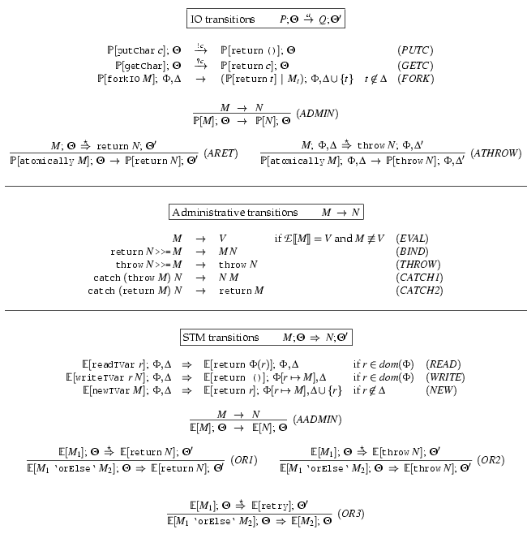
One exists
No way to wait for complex conditions
See “Composable Memory Transactions” for details.

Slide 52
STM in Mainstream Languages
There are similar proposals for adding STM to Java and other mainstream languages.
class Account {
float balance;
void deposit(float amt) {
atomic { balance += amt; }
}
void withdraw(float amt) {
atomic {
if(balance < amt) throw new OutOfMoneyError();
balance -= amt; }
}
void transfer(Acct other, float amt) {
atomic { // Can compose withdraw and deposit.
other.withdraw(amt);
this.deposit(amt); }
}
}

Slide 53
Weak vs Strong Atomicity
Unlike Haskell, type systems in mainstream languages don’t control where effects occur.
What happens if code outside a transaction conflicts with code inside a transaction?
Weak Atomicity: Non-transactional code can see inconsistent memory states. Programmer should avoid such situations by placing all accesses to shared state in transaction.
Strong Atomicity: Non-transactional code is guaranteed to see a consistent view of shared state. This guarantee may cause a performance hit.
For more information: “Enforcing Isolation and Ordering in STM”

Slide 54
Even in Haskell: Easier, But Not Easy.
The essence of shared-memory concurrency is deciding where critical sections should begin and end. This is still a hard problem.
Too small: application-specific data races (Eg, may see deposit but not withdraw if transfer is not atomic).
Too large: delay progress because deny other threads access to needed resources.
In Haskell, we can compose STM subprograms but at some point, we must decide to wrap an STM in "atomic"
When and where to do it can be a hard decision

Slide 55
Conclusions
Atomic blocks (atomic, retry, orElse) dramatically raise the level of abstraction for concurrent programming.
It is like using a high-level language instead of assembly code. Whole classes of low-level errors are eliminated.
Not a silver bullet:
you can still write buggy programs;
concurrent programs are still harder than sequential ones
aimed only at shared memory concurrency, not message passing
There is a performance hit, but it is usually acceptable in Haskell (and things can only get better as the research community focuses on the question.)
Notes:
55

Slide 56
Course Conclusions
The study of STMs brings together multiple threads of interest in this course:
functional programming
high-level abstractions
operational semantics
equational reasoning & proofs about programs
The development of STM is an example of modern programming language research
If you are interested, talk with Andrew Appel or I about independent work opportunities, including work involving other new parallel programming paradigms

Slide 57
End

Slide 58
What always does
always :: STM Bool -> STM ()
The function always adds a new invariant to a global pool of invariants.
Conceptually, every invariant is checked as every transaction commits.
But the implementation checks only invariants that read TVars that have been written by the transaction
...and garbage collects invariants that are checking dead Tvars.

Slide 59
Haskell Implementation
A complete, multiprocessor implementation of STM exists as of GHC 6.
Experience to date: even for the most mutation-intensive program, the Haskell STM implementation is as fast as the previous MVar implementation.
The MVar version paid heavy costs for (usually unused) exception handlers.
Need more experience using STM in practice, though!
You can play with it. See the course website.
Notes:
59

Slide 60
Performance
At first, atomic blocks look insanely expensive. A naive implementation (c.f. databases):
Every load and store instruction logs information into a thread-local log.
A store instruction writes the log only.
A load instruction consults the log first.
Validate the log at the end of the block.
If succeeds, atomically commit to shared memory.
If fails, restart the transaction.

Slide 61
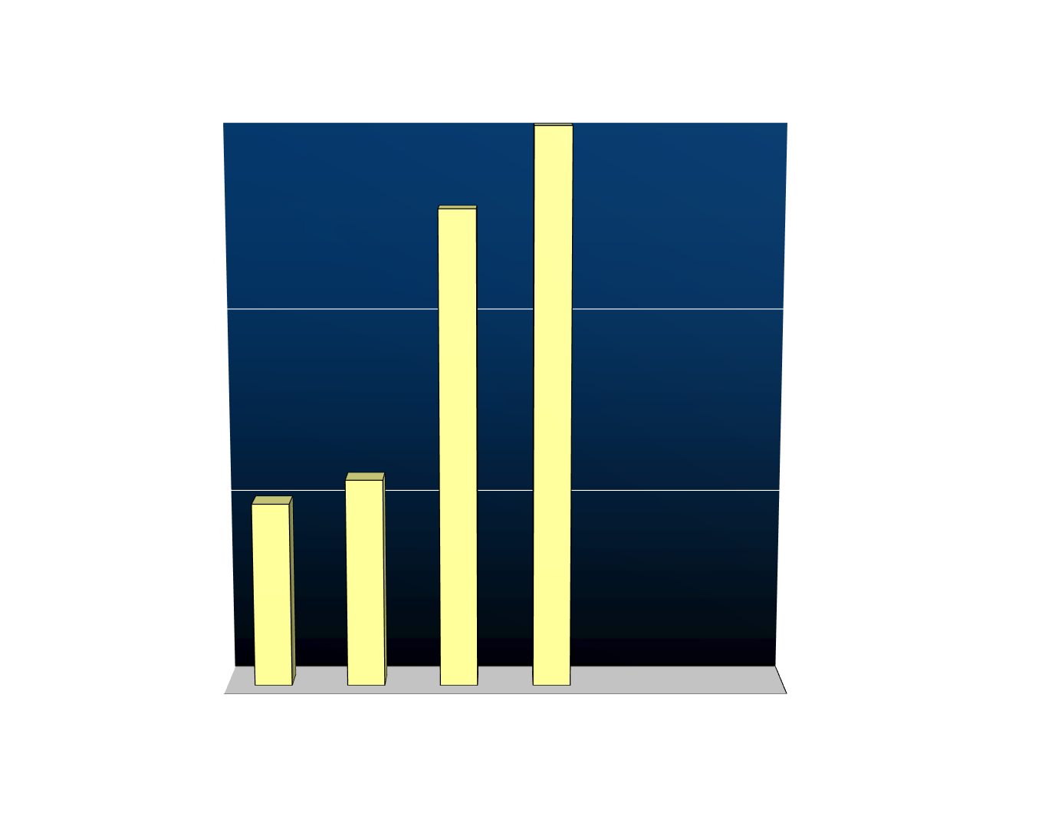
State of the Art Circa 2003
Fine-grained locking (2.57x)
Traditional STM (5.69x)
Coarse-grained locking (1.13x)
Normalised execution time
Sequential baseline (1.00x)
Workload: operations on a red-black tree, 1 thread, 6:1:1 lookup:insert:delete mix with keys 0..65535
See “Optimizing Memory Transactions” for more information.
Notes:
Scalable lock-per-node design
Visible arrows
Predede with “How much does it cost”
Cost of entry/exit
Cost oflogging etc
Compare -- unsafe / coarse-grained / fine-grained

Slide 62
New Implementation Techniques
Direct-update STM
Allows transactions to make updates in place in the heap
Avoids reads needing to search the log to see earlier writes that the transaction has made
Makes successful commit operations faster at the cost of extra work on contention or when a transaction aborts
Compiler integration
Decompose transactional memory operations into primitives
Expose these primitives to compiler optimization (e.g. to hoist concurrency control operations out of a loop)
Runtime system integration
Integrates transactions with the garbage collector to scale to atomic blocks containing 100M memory accesses

Slide 63
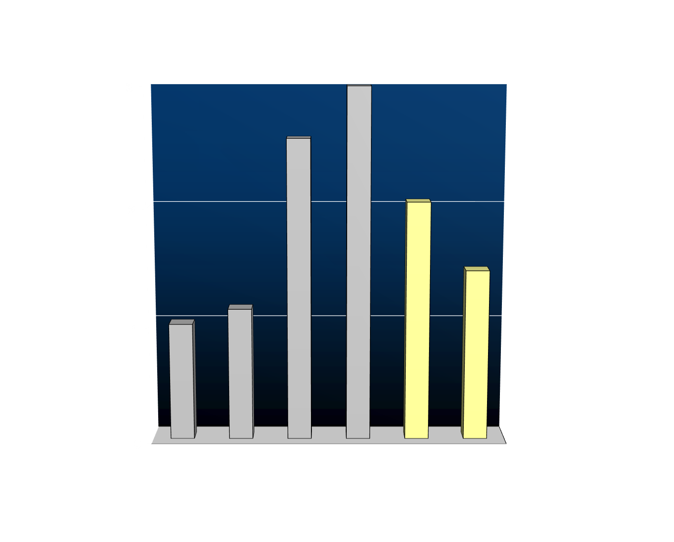
Results: Concurrency Control Overhead
Fine-grained locking (2.57x)
Traditional STM (5.69x)
Coarse-grained locking (1.13x)
Direct-update STM (2.04x)
Normalised execution time
Direct-update STM + compiler integration (1.46x)
Sequential baseline (1.00x)
Workload: operations on a red-black tree, 1 thread, 6:1:1 lookup:insert:delete mix with keys 0..65535
Scalable to multicore
Notes:
Scalable lock-per-node design
Visible arrows
Predede with “How much does it cost”
Cost of entry/exit
Cost oflogging etc
Compare -- unsafe / coarse-grained / fine-grained

Slide 64

Results: Scalability
Coarse-grained locking
Fine-grained locking
Traditional STM
Microseconds per operation
Direct-update STM + compiler integration
#threads
Notes:
Scalable lock-per-node design
Visible arrows
Predede with “How much does it cost”
Cost of entry/exit
Cost oflogging etc
Compare -- unsafe / coarse-grained / fine-grained

Slide 65
Performance, Summary
Naïve STM implementation is hopelessly inefficient.
There is a lot of research going on in the compiler and architecture communities to optimize STM.
This work typically assumes transactions are smallish and have low contention. If these assumptions are wrong, performance can degrade drastically.
We need more experience with “real” workloads and various optimizations before we will be able to say for sure that we can implement STM sufficiently efficiently to be useful.

Slide 66
Still Not Easy, Example
Consider the following program:
Successful completion requires A3 to run after A1 but before A2.
So adding a critical section (by uncommenting A0) changes the behavior of the program (from terminating to non-terminating).
Initially, x = y = 0
Thread 1
// atomic { //A0
atomic { x = 1; } //A1
atomic { if (y==0) abort; } //A2
//}
Thread 2
atomic { //A3
if (x==0) abort;
y = 1;
}

Slide 67
Starvation
Worry: Could the system “thrash” by continually colliding and re-executing?
No: A transaction can be forced to re-execute only if another succeeds in committing. That gives a strong progress guarantee.
But: A particular thread could starve:
Thread 1
Thread 2
Thread 3

Slide 68
A Monadic Skin
In languages like ML or Java, the fact that the language is in the IO monad is baked in to the language. There is no need to mark anything in the type system because IO is everywhere.
In Haskell, the programmer can choose when to live in the IO monad and when to live in the realm of pure functional programming.
Interesting perspective: It is not Haskell that lacks imperative features, but rather the other languages that lack the ability to have a statically distinguishable pure subset.
This separation facilitates concurrent programming.

Slide 69
The Central Challenge
Arbitrary effects
Useful
No effects
Useless
Dangerous
Safe

Slide 70
The Challenge of Effects
Plan A (everyone else)
Arbitrary effects
Nirvana
Useful
Plan B (Haskell)
No effects
Useless
Dangerous
Safe

Slide 71
Two Basic Approaches: Plan A
Arbitrary effects
Default = Any effect Plan = Add restrictions
Examples
Regions
Ownership types
Vault, Spec#, Cyclone

Slide 72
Two Basic Approaches: Plan B
Default = No effects Plan = Selectively permit effects
Types play a major role
Two main approaches:
Domain specific languages (SQL, Xquery, Google map/reduce)
Wide-spectrum functional languages + controlled effects (e.g. Haskell)
Value oriented programming

Slide 73
Lots of Cross Over
Plan A (everyone else)
Arbitrary effects
Nirvana
Useful
Envy
Plan B (Haskell)
No effects
Useless
Dangerous
Safe

Slide 74
Lots of Cross Over
Plan A (everyone else)
Arbitrary effects
Nirvana
Useful
Ideas; e.g. Software Transactional Memory (retry, orElse)
Plan B (Haskell)
No effects
Useless
Dangerous
Safe

Slide 75
An Assessment and a Prediction
One of Haskell’s most significant contributions is to take purity seriously, and relentlessly pursue Plan B.
Imperative languages will embody growing (and checkable) pure subsets.
-- Simon Peyton Jones

