Slide 1

A/B Testing Analysis
David Heller

Slide 2
Introduction
Context: An investment management company conducted an A/B experiment to enhance their user experience by implementing a new UI.
Objective:
Analyze the effectiveness of the new UI design vs. the existing one by uncovering actionable insights.
Use rigorous statistical analysis and testing.

Slide 3
A/B Experiment
An A/B test was set into motion from 3/15/2017 to 6/20/2017 by the company.
Control Group: Clients interacted with the company's traditional online process.
Test Group: Clients experienced the new, spruced-up digital interface.
Both groups navigated through an identical process sequence: an initial page, three subsequent steps, and finally, a confirmation page signaling process completion.

Slide 4
Data
Client Profiles (df_final_demo): Demographics like age, gender, and account details of the clients
Size and dimensionality: 70,609 rows × 9 columns
Digital Footprints (df_final_web_data): A detailed trace of client interactions online, divided into two parts: pt_1 and pt_2
Size and dimensionality of the combined df: 755,405 rows × 5 columns
Experiment Roster (df_final_experiment_clients): A list revealing which clients were part of the grand experiment
Size and dimensionality: 70,609 rows × 2 columns

Slide 5
Data Preprocessing and Cleaning
Renamed columns for better readability
Dropped clients with more than 5 null values (15 instances)
Filled age null values with the mean value
Assigned the 3 clients with gender ‘X’ to gender ‘U’
Merged client profiles and experiment roster datasets

Slide 6
Exploratory Data Analysis
On average, clients have been with the company for around 12 years and 150 months. The standard deviation is 7 years (wide range).
The average age of clients is approximately 47 years. The standard deviation is 15 years (moderate spread).
On average, clients have about 2 accounts.
The average balance across all clients is approximately USD 149,515. The standard deviation is USD 302,036.40 (wide range).
On average, clients made around 3 calls and logged in approximately 6 times in the last 6 months.

Slide 7
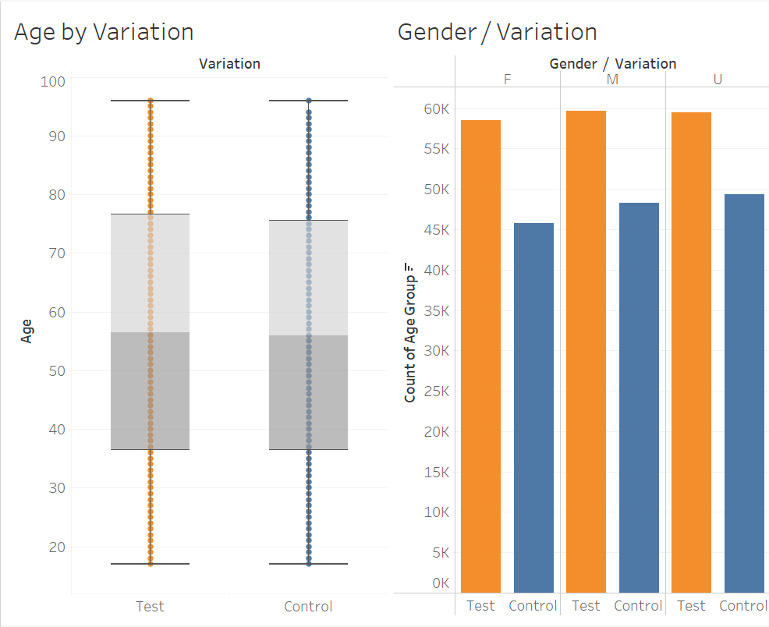
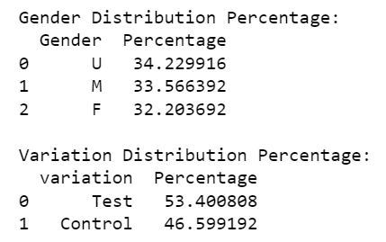
Exploratory Data Analysis

Slide 8
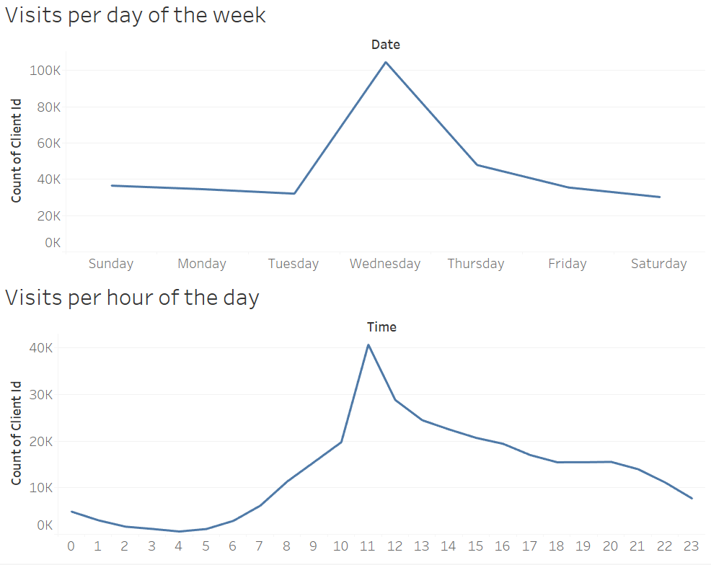
Exploratory Data Analysis

Slide 9
Performance Metrics
Completion Rate: The proportion of users who reach the final ‘confirm’ step.
Completion Rate by Age Group
Completion Rate by Gender
Time Spent on Each Step: The average duration users spend on each step.
Error Rates: If there’s a step where users go back to a previous step, it may indicate confusion or an error (clients moving from a later step to an earlier one).
Step Abandonment Rate: The proportion of users who abandon the process at each step. This will help identify specific steps where users are most likely to drop off.

Slide 10
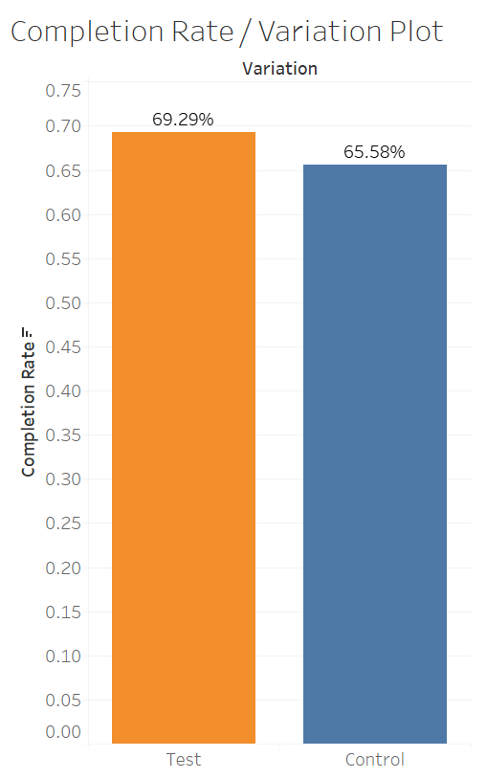
Completion Rate
The test group has a higher completion rate (69.29%) compared to the control group (65.58%). This indicates that the variation being tested is more effective in guiding users to complete the process and reach the final 'confirm' step.
Percentage increase in the completion rate from the control group to the test group: 3.71%

Slide 11
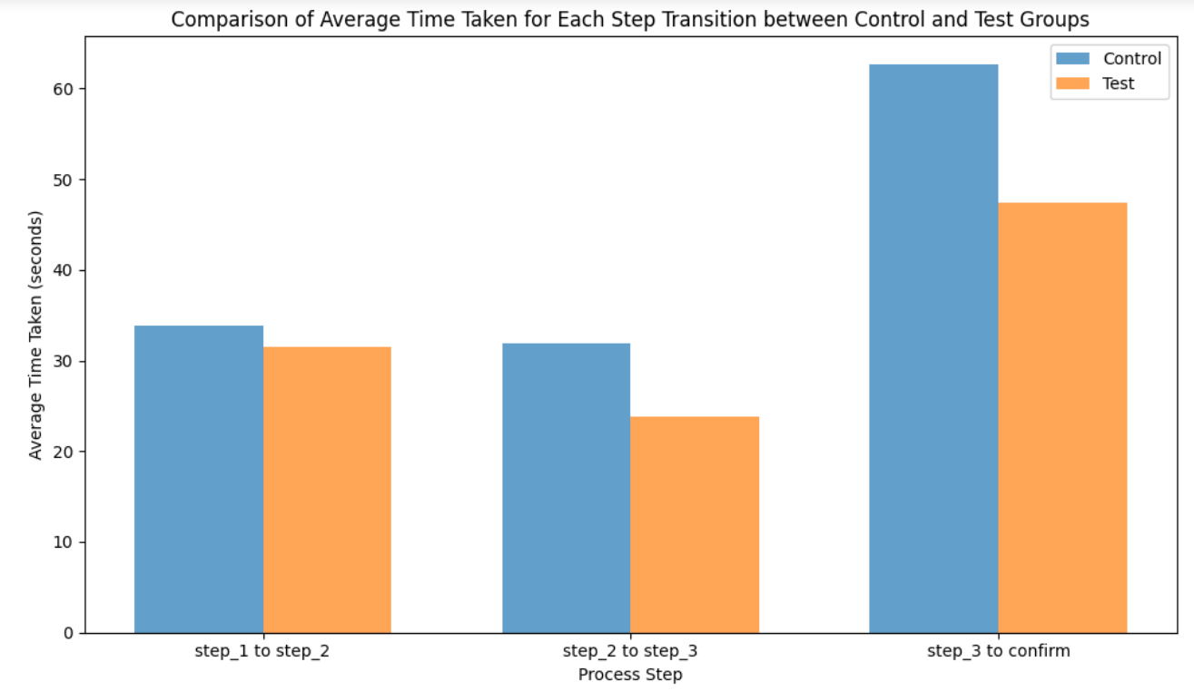
Time Spent on Each Step
The Test variation shows a decrease in the average total time taken compared to the Control variation (102.79 vs 128.36 seconds)

Slide 12
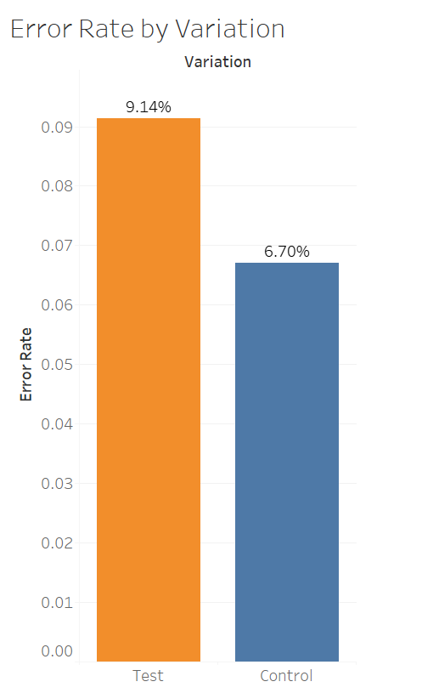
Error Rate
Higher Error Rate in Test Group:
The test group has a higher error rate (9.14%) compared to the control group (6.70%).
User Experience Insight:
The higher error rate in the test group is a signal that the new design, process, or feature being tested could need adjustments to improve user experience and reduce confusion.

Slide 13
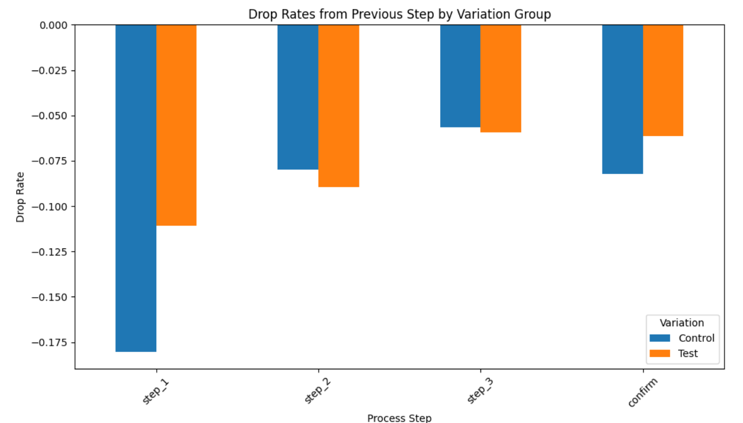
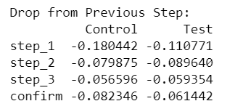
Step Abandonment Rate

Slide 14

Hypothesis Testing
Hypothesis I: Test and Control Group Completion Rate Equality Assessment
Null Hypothesis (H0):
The completion rates for the Test and Control groups are equal.
Alternative Hypothesis (H1):
The completion rates for the Test group are higher than those for the Control group.

Slide 15
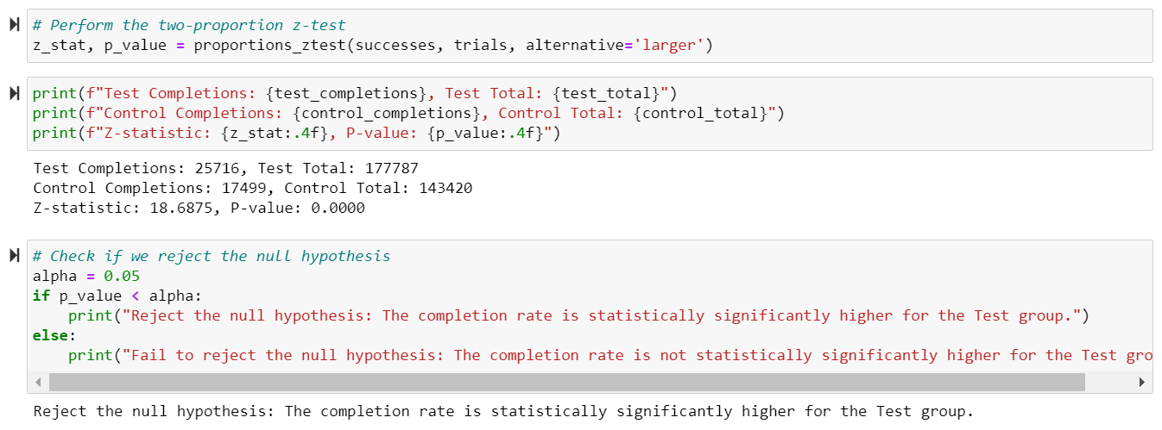
Hypothesis I

Slide 16
Cost of New UI
The introduction of a new UI design comes with its associated costs, To justify these costs, the company has determined that any new design should lead to a minimum increase in the completion rate at 5% to be deemed cost-effective.
If the new design doesn’t lead to at least this level of improvement, it may not be justifiable from a cost perspective, regardless of its statistical significance.

Slide 17

Hypothesis Testing
Hypothesis II: Evaluating Completion Rate Differential Between Test and Control Groups (5% threshold)
Null Hypothesis (H0):
The increase in completion rate for the Test group compared to the Control group is less than 5%.
Alternative Hypothesis (H1):
The increase in completion rate for the Test group compared to the Control group is at least 5%.

Slide 18
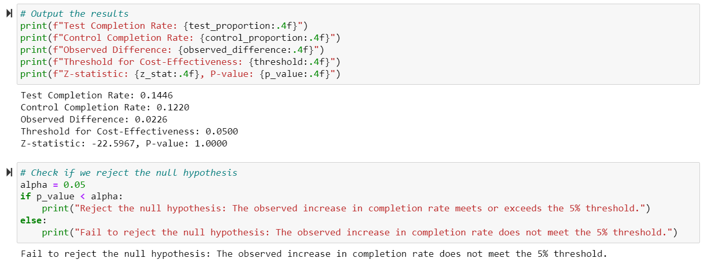
Hypothesis II

Slide 19
Hypothesis Testing
Hypothesis III: Assessing Systematic Differences in Group Distribution
Null Hypothesis (H0):
The distribution of clients between the Test and Control groups is equal, indicating that there is no systematic difference in the allocation of clients to the two groups.
Alternative Hypothesis (H1):
The distribution of clients between the Test and Control groups is not equal, suggesting that there is a systematic difference in the allocation of clients, possibly indicating non-random assignment or unequal group sizes.

Slide 20
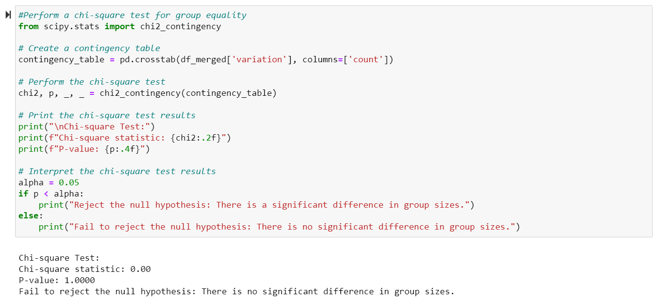
Hypothesis III

Slide 21
Summary
The test variation demonstrates higher completion rates, shorter average time spent, and higher step completion rates compared to the control group, suggesting the test design is more effective in guiding users through the process and reducing drop-offs. However, the higher error rate in the test group indicates a need for adjustments to improve user experience and reduce confusion.

Slide 22
Conclusion
The new design demonstrates a statistically significant higher completion rate, but it does not meet the required 5% increase threshold set by the organization. Despite the improvements in completion rates and user engagement, the new design may not be justifiable from a cost perspective, given that it does not meet the minimum increase threshold for cost-effectiveness. Further optimization and evaluation are necessary to ensure that the new design can achieve at least a 5% increase in completion rate to justify the associated costs.

Slide 23
Experiment Evaluation
Well-Structured Experiment: Clear objectives and defined metrics for success, with key performance indicators (KPIs) like completion rates selected for measurement in an A/B test setup.
Randomization and Equality: Random assignment ensured equal division between test and control groups, mitigating selection bias, and hypothesis testing showed no significant difference in group sizes.
Duration Assessment: Conducted over three months, from March 15 to June 20, 2017, the experiment's timeframe could potentially reveal temporal effects and seasonality, offering deeper insights into the long-term impact of design changes on user behavior.

