Slide 1

Presentation on
The Impact of Health Expenditure and GDP per capita on Child Mortality Rates

Slide 2
Overview:
Datasets Analysis and Filtering
Objectives
Dataset Merging and Cleaning
Top 10 Countries with Highest and Lowest Mortality Rate
Statistical Summary using Boxplot
Regression Analysis for each Income Group
Elbow Method for finding Optimal K
Clusters using K-Means
Policy Implications

Slide 3
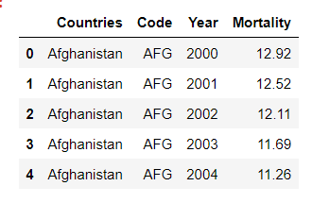
Datasets Analysis and Filtering
Consists data of infant mortality rate for each country by year.
Filtering:
Data from the years 2000 to 2019 (inclusive) has been included.
Columns have been renamed for improved readability.
Mortality column values have been converted into numerical format.
Dataset: child-mortality-by-income-level-of-country.csv

Slide 4
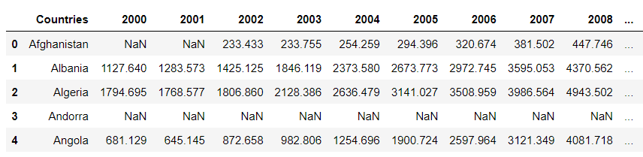
Datasets Analysis and Filtering
Dataset: imf_gdp_per_capita.csv
Consists data of GDP per capita for each country by year (2000-2019)
Filtering:
Columns have been renamed for improved readability.
Values in the all the year columns have been converted into numerical format.

Slide 5
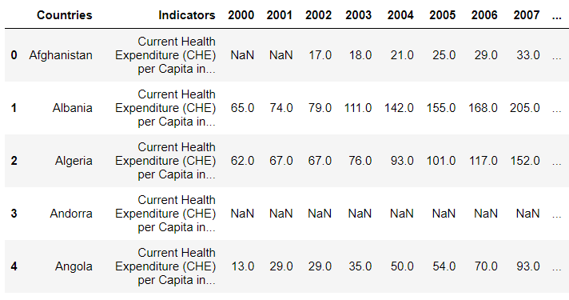
Datasets Analysis and Filtering
Consists data of health expenditure per capita for each country by year (2000-2019)
Filtering:
Empty rows and columns are filtered out.
Sorted in ascending order by country names.
Values in the all the year columns have been converted into numerical format.
Dataset: WHO_health_expenditure_per_capita.csv

Slide 6
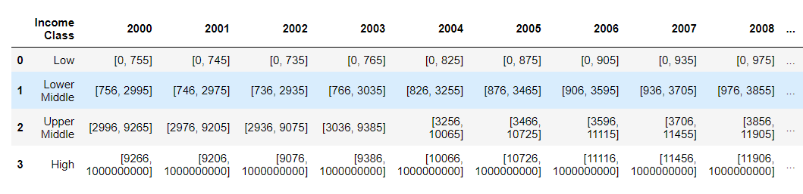
Datasets Analysis and Filtering
Dataset: income_classification.xlsx
Consists data of range of income class by GDP per capita.
Filtering:
String values representing income class ranges have been stripped and converted into numerical format.
Both lower and upper bounds are inserted as list.

Slide 7

Objectives
Investigating the impact of income groups on child mortality rates.
Examining whether the effect of health expenditure per capita on child mortality rates differs among different income groups.
Identifying clusters of countries exhibiting variations in child mortality rates.
Formulating policy implications based on the identified clusters.

Slide 8
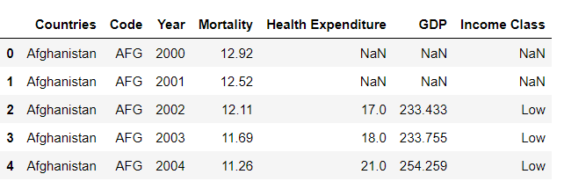
Dataset Merging and Cleaning
The four dataframes are merged together to facilitate the analysis process.
The Health Expenditure column has 1579 missing data.
Both the GDP column and Income Class column has 706 missing data.
The entries with missing data would be removed for proper analysis.

Slide 9
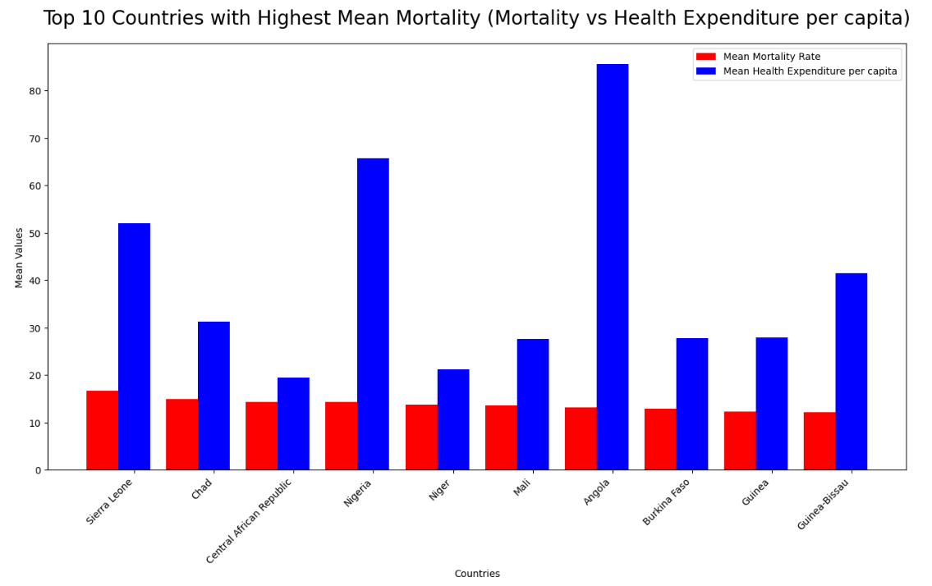
Top 10 Countries with Highest Mortality Rate
The average child mortality rate in these countries is approximately 14.235 per 1000.
These countries spend on average USD 38.205 per capita on healthcare.
These countries, which have the highest average mortality rates, spend too little on healthcare.

Slide 10
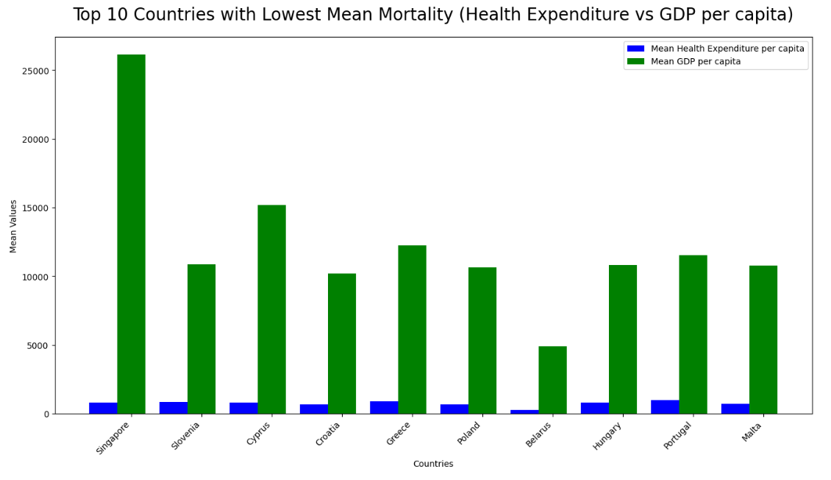
Top 10 Countries with Lowest Mortality Rate
The average child mortality rate in these countries is approximately 0.313 per 1000.
These countries spend around USD 4,252.10 per capita on healthcare.
These countries, with the lowest average mortality rates, spend a significant amount on healthcare.

Slide 11
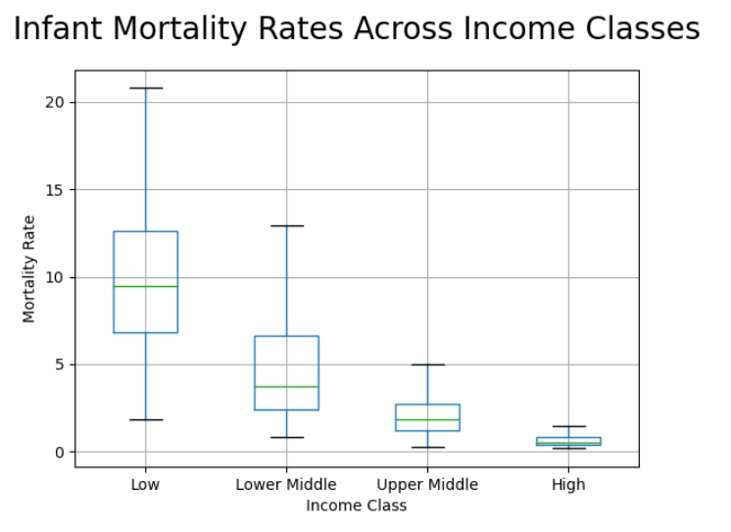
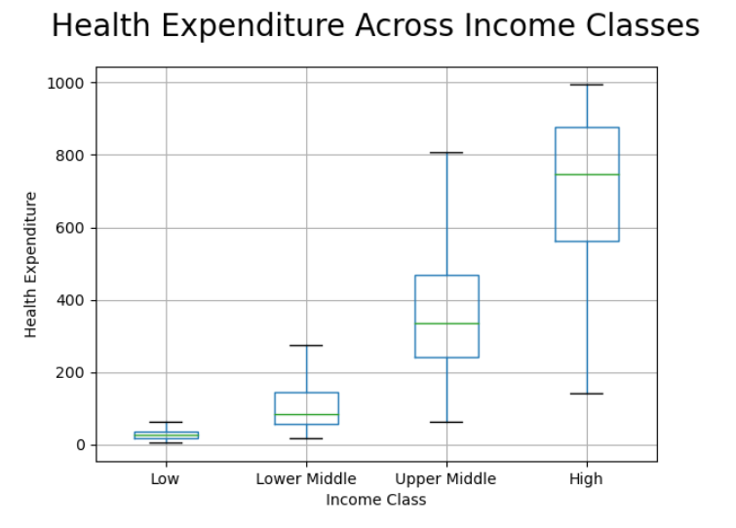
Statistical Summary using Boxplot
Lower income class countries have high infant mortality rate.
Higher income class countries have low infant mortality rate.
Lower income class countries spend less amount in health care.
Higher income class countries spend significant amount in health care.

Slide 12
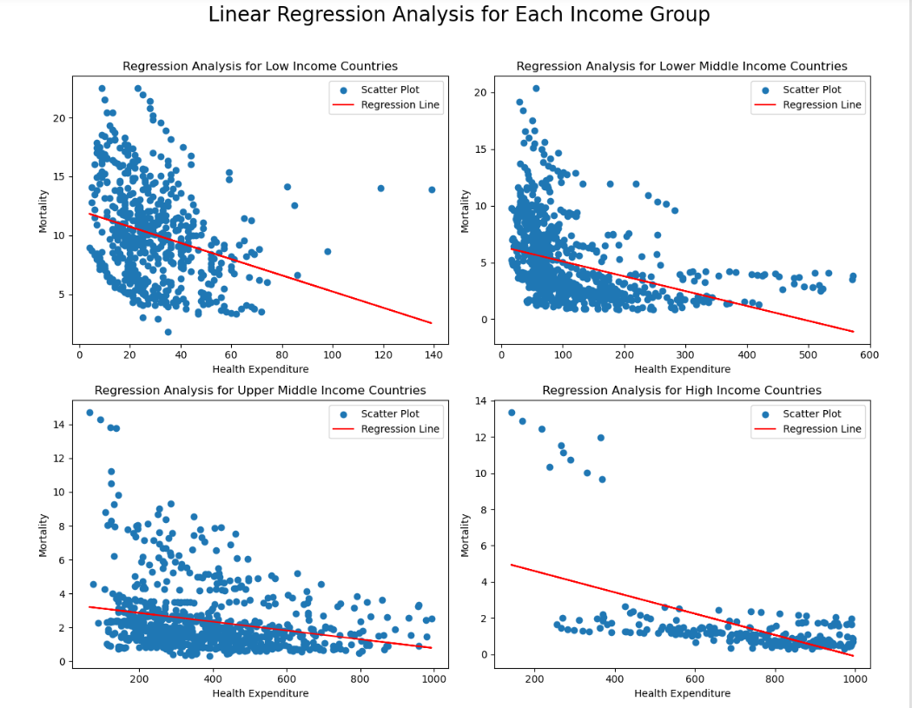
Regression Analysis for each Income Group
Health expenditure per capita may converge between lower- and higher-income countries.
Child mortality rates remain significantly higher in lower-income countries despite similar health expenditure levels.

Slide 13
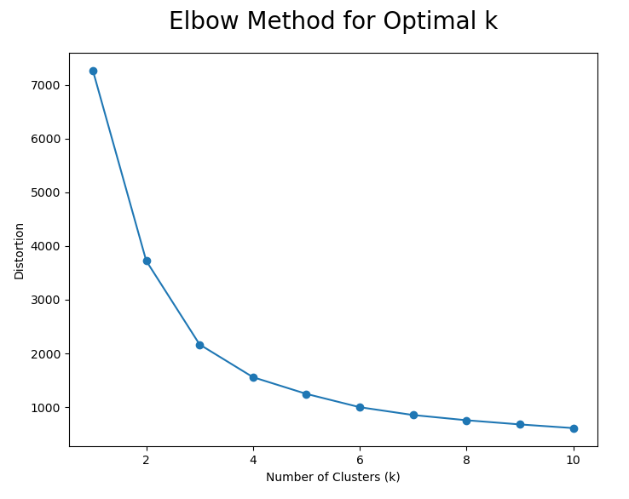
Elbow Method for finding Optimal K
The elbow method suggests that the optimal number of clusters (K) is 3.
At K=3, the distortion is significantly reduced, and it ensures efficient processing.

Slide 14
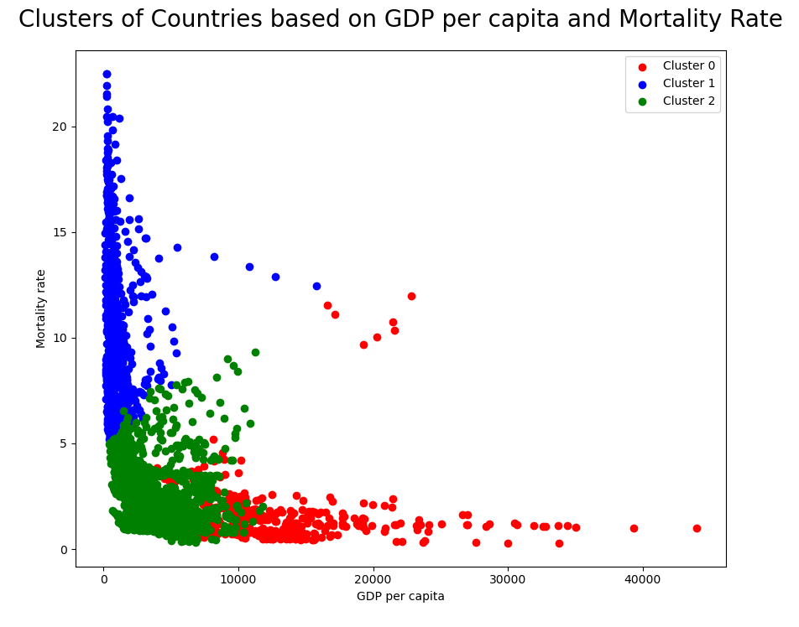
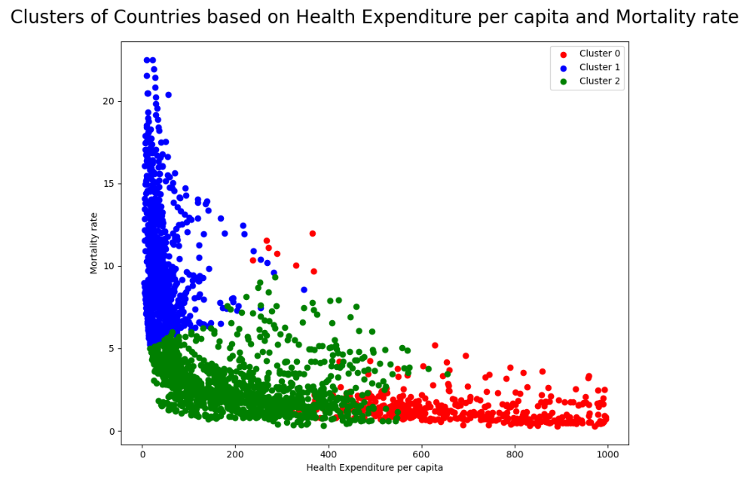
Clusters for K-Means
Blue cluster: This cluster has higher mortality rates and lower health expenditure.
Green cluster: This cluster has lower mortality rates than the Blue cluster and moderate health expenditure.
Red cluster: This cluster has lower mortality rates and higher health expenditure.

Slide 15
Policy Implications
Blue cluster:
Increase health expenditure
Enhance healthcare accessibility
Green cluster:
Address variability in mortality rates
Implement targeted healthcare programs
Red cluster:
Share successful policies and practices
Encourage knowledge transfer

