Slide 1

FLUTTERMON
Discover, collect, and build your Pokémon team

Slide 2

Architecture
lib/
models/ Data classes, JSON parsing
services/ API calls, asset loading, SharePreferences Access
providers/ ChangeNotifier state and app logic
screens/ Full app screens
widgets/ Reusable UI components
validators/ Input validation functions outside widgets
theme/ ThemeData, colors, theme extensions

Slide 3
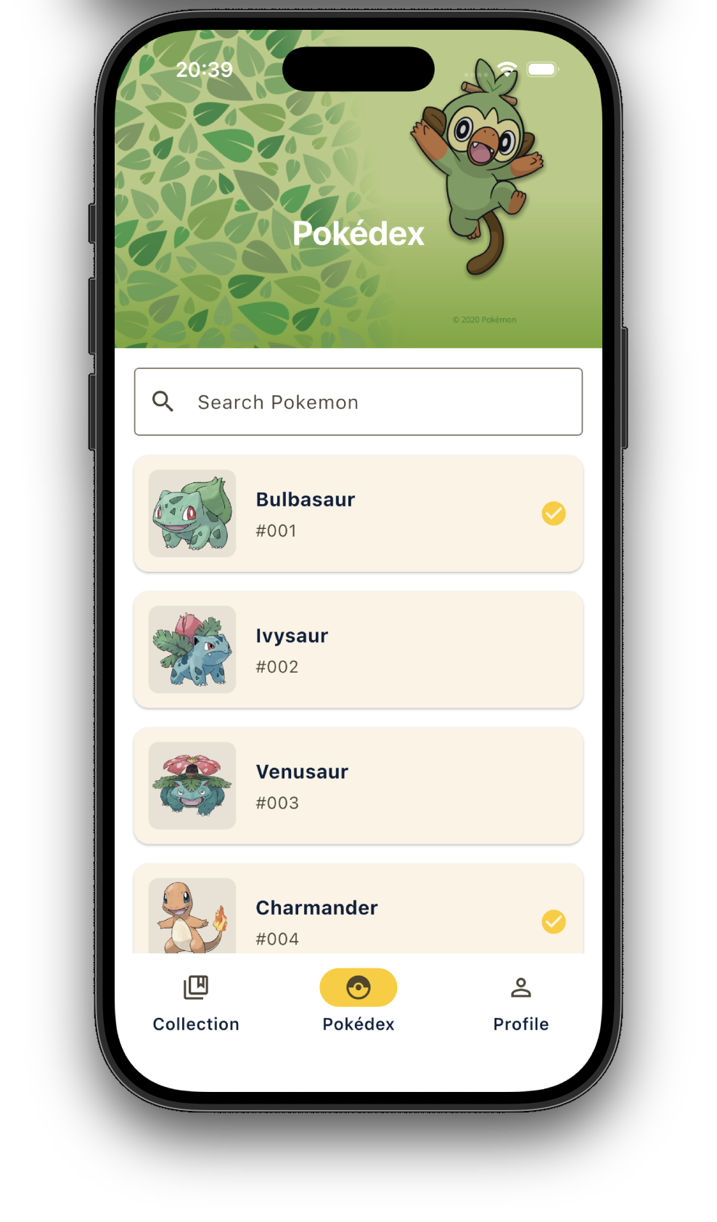
Main Screen
Full view of all pokemon (local .json)
Images fetched from github.com
CustomScrollView using Slivers with Infinite Scrolling*
Search Bar
Clickable Pokemon Cards
* ScrollController detects when user is near bottom: less than 480px -> call loadNextPage()

Slide 4
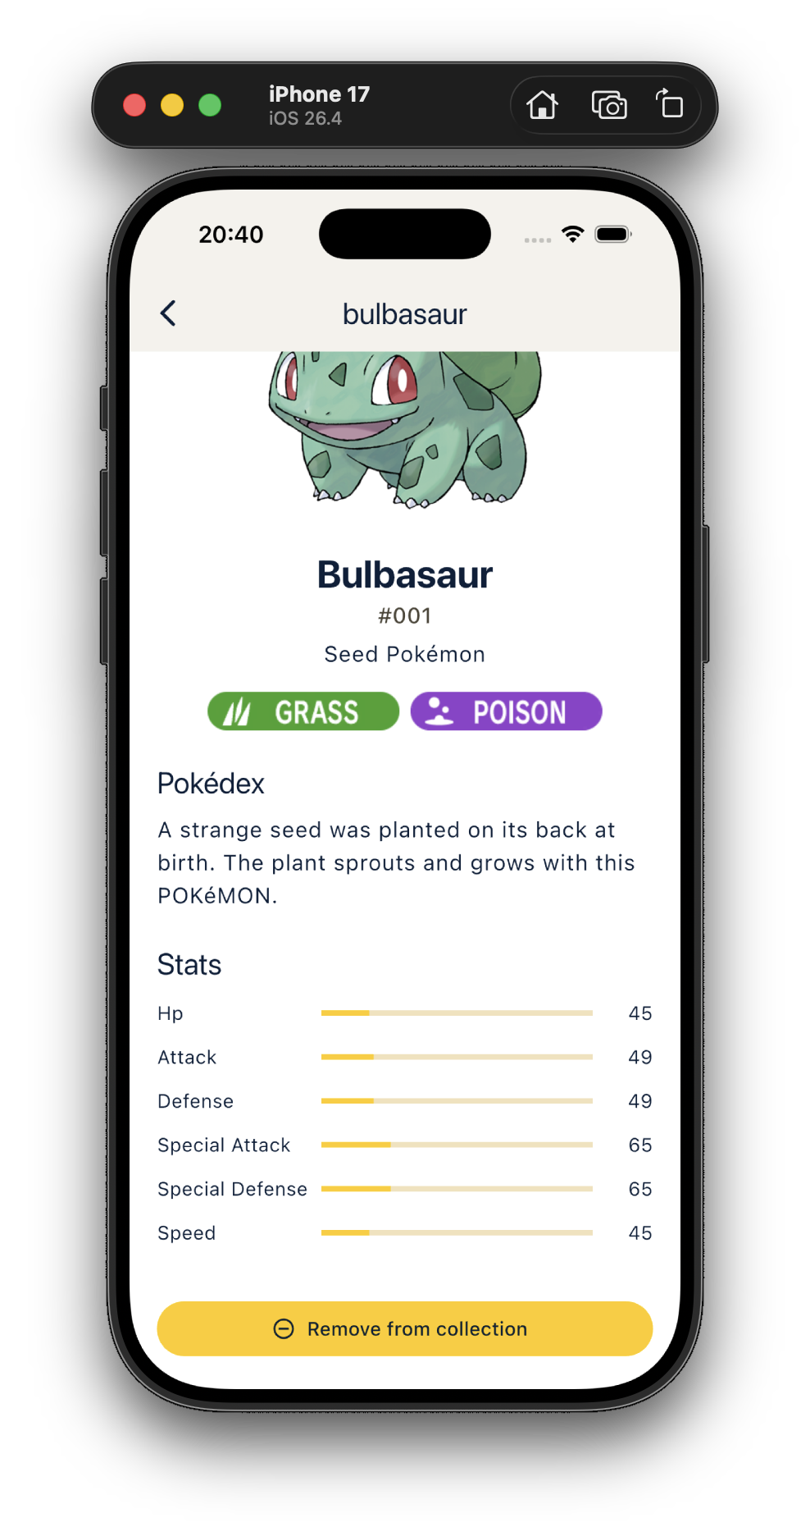
Detail Screen
Data fetched from pokeapi.co
Type Images from local assets
Add to collection button

Slide 5
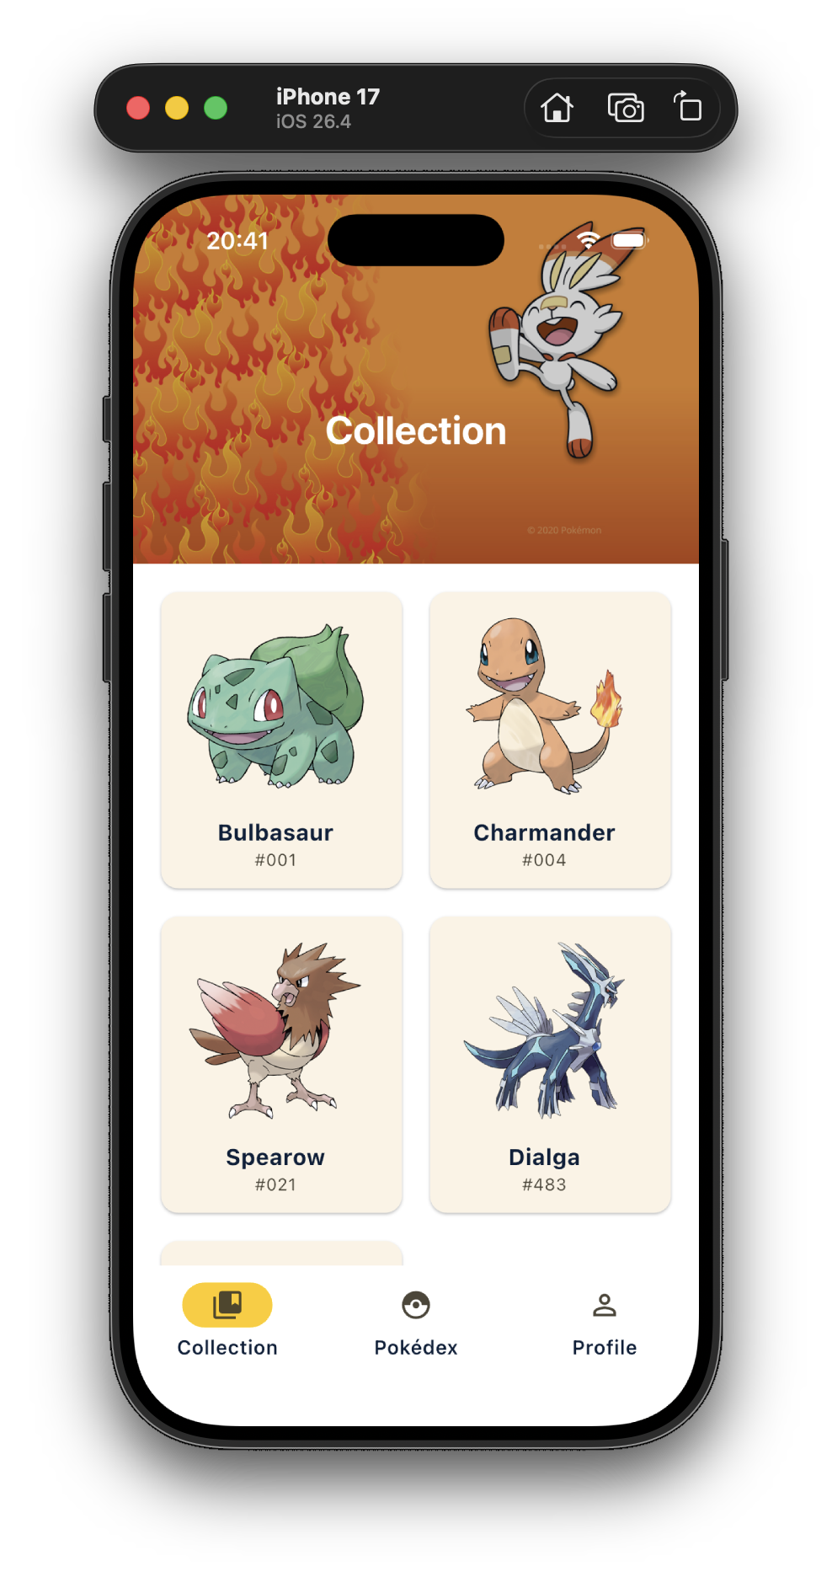
Collection Screen
All collected pokemon (SharedPrefs)
Quicklinks to detail
Remove from collection on detail page

Slide 6
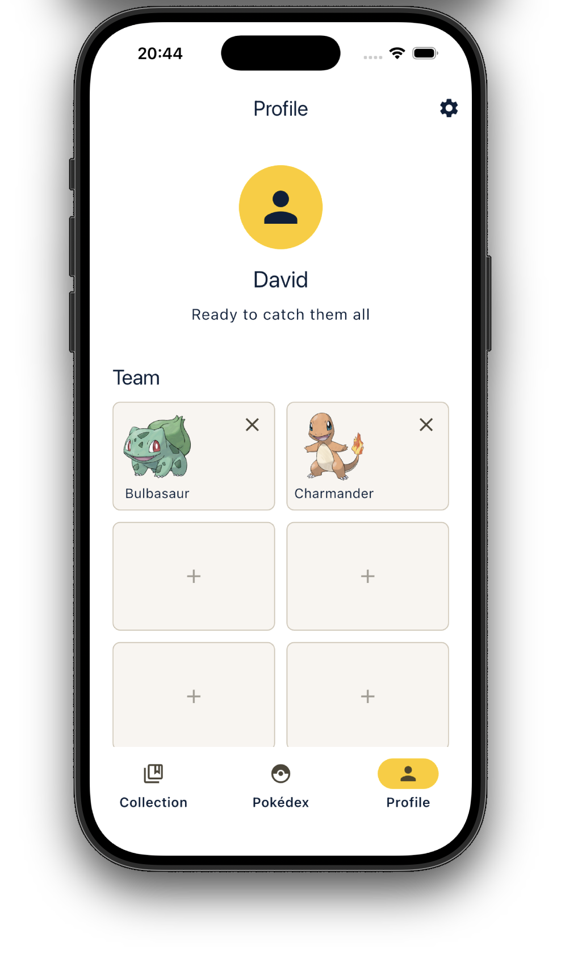
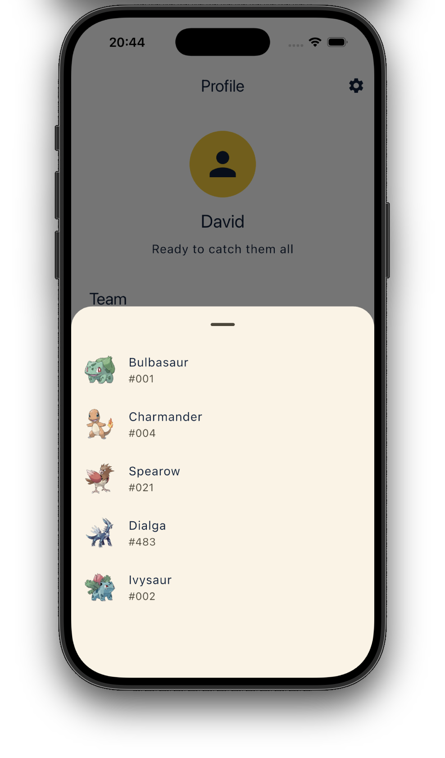
Profile Screen
Username
Team Selection
Only collected pokemon can be selected
All data persistent in SharedPrefs

Slide 7
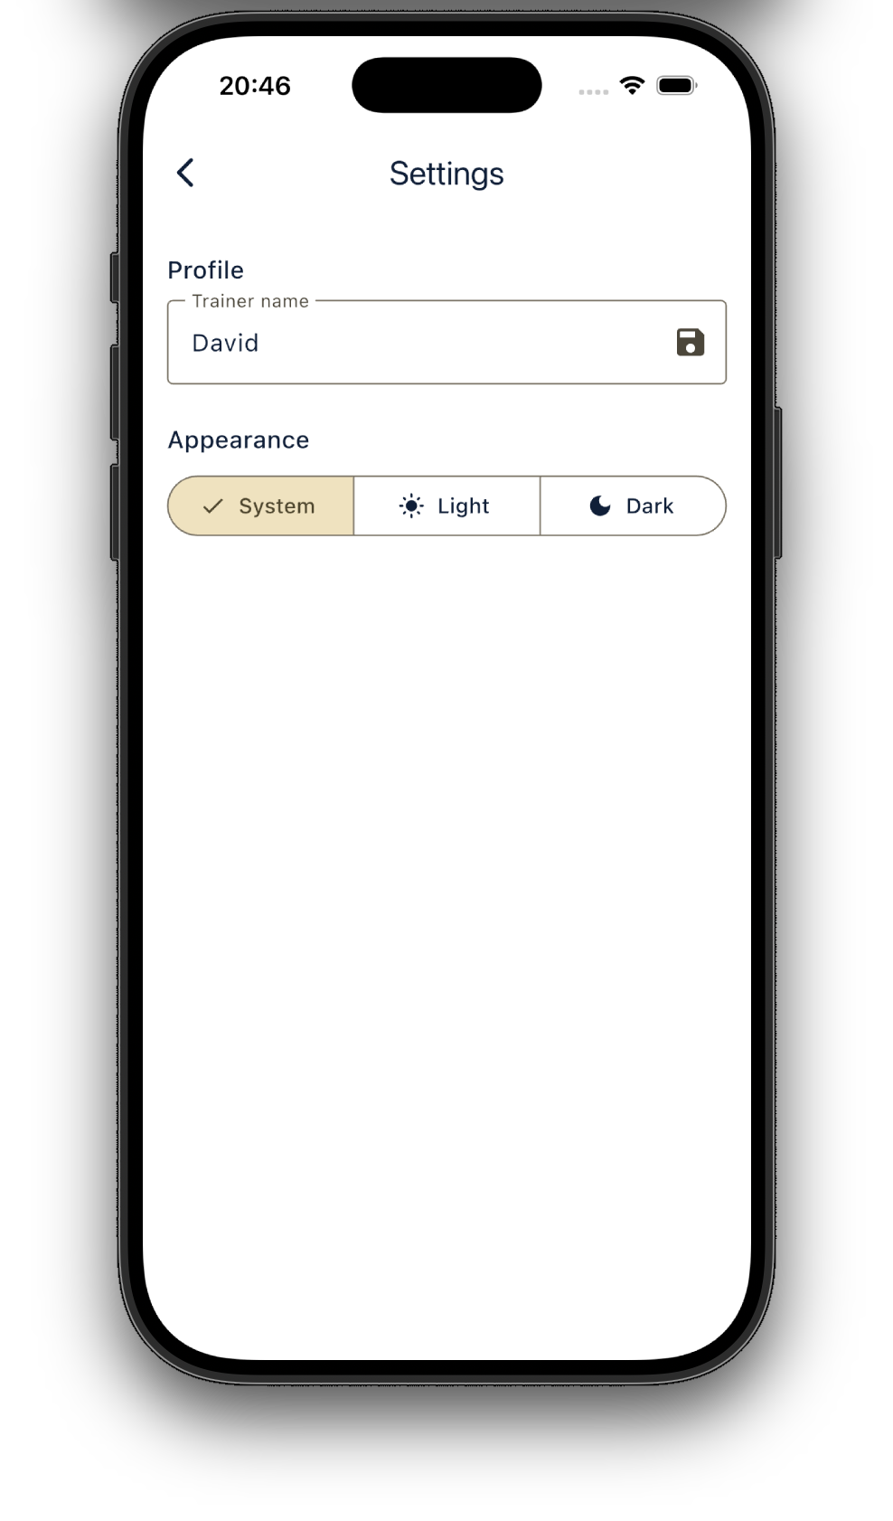
Settings Screen
Set Username
Theme Selection
All data persistent in SharedPrefs

Slide 8
Main user actions
Browse Pokémon
Search through the Pokédex
View live, updated, detail data
Save pokemon to collection (for example while playing)
Build a six-slot team
Change trainer name and theme

Slide 9
Data Strategy
Local pokemon_db.json for fast list loading and searching
PokeAPI for detailed Pokémon data
PokeAPI sprites repository for official artwork
Local type badge icon assets

Slide 10
State Management
provider with ChangeNotifier to manage shared app state
Each major feature has own provider
Provider | Use
PokemonProvider | Loads and filters Pokémon list
PokemonDetailProvider | Fetches detailed pokemon data
CollectionProvider | Manages saved Pokémon
TeamProvider | Manages six-slot team
ProfileProvider | Stores trainer profile data
SettingsProvider | Manages theme preferences
NavigationProvider | Tracks selected app section

Slide 11
Validators
Seperate validator functions that handle:
Empty search input
Minimum search length
Unsupported characters
Numeric Pokémon IDs
Makes the validators easier to test and keeps code cleaner

Slide 12

Testing
Unit tests cover basically all files / functions
Widget tests include full user flow using tester. that navigates and clicks through the app

Slide 13

LIVE DEMO

