Slide 1
Position Servo Control
Model-Reference Adaptive System (MRAS) Design and Implementation

Slide 2
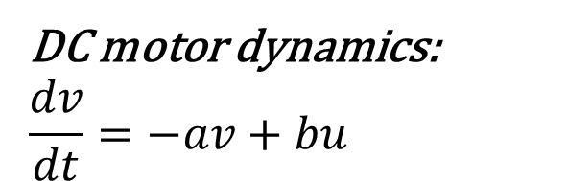
Setup:
DC motor dynamics:
$$\frac{dv}{dt}=−av+bu$$
Unknown motor constants
Input is terminal voltage
Output is angular position

Slide 3
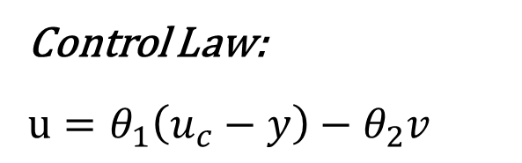

Setup:
DC motor dynamics:
$$\frac{dv}{dt}=−av+bu$$
Control Law:
$$u=θ_{1}\left(u_{c}−y\right)−θ_{2}v$$
Unknown motor constants
Input is terminal voltage
Output is angular position
$θ_{1}$/ $θ_{2}$ are the control parameters
$u_{c}$ is the reference input

Slide 4

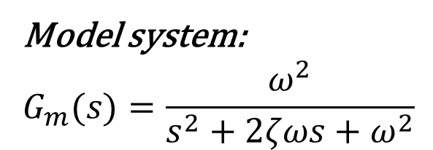
Setup:
DC motor dynamics:
$$\frac{dv}{dt}=−av+bu$$
Control Law:
$$u=θ_{1}\left(u_{c}−y\right)−θ_{2}v$$
Model system:
$$G_{m}(s)=\frac{ω^{2}}{s^{2}+2ζωs+ω^{2}}$$
Unknown motor constants
Input is terminal voltage
Output is angular position
$θ_{1}$/ $θ_{2}$ are the control parameters
$u_{c}$ is the reference input
Standard 2nd order model
$ζ$ and $ω$ define the intended system response

Slide 5
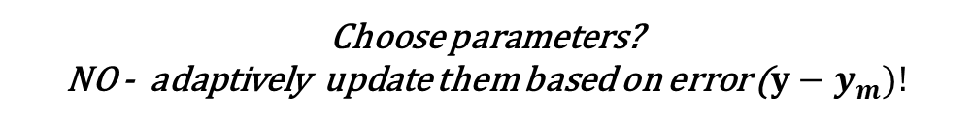
Setup:
DC motor dynamics:
$$\frac{dv}{dt}=−av+bu$$
Control Law:
$$u=θ_{1}\left(u_{c}−y\right)−θ_{2}v$$
Model system:
$$G_{m}(s)=\frac{ω^{2}}{s^{2}+2ζωs+ω^{2}}$$
Unknown motor constants
Input is terminal voltage
Output is angular position
$θ_{1}$/ $θ_{2}$ are the control parameters
$u_{c}$ is the reference input
Standard 2nd order model
$ζ$ and $ω$ define the intended system response
Choose parameters?
NO - adaptively update them based on error ($y−y_{m})!$

Slide 6
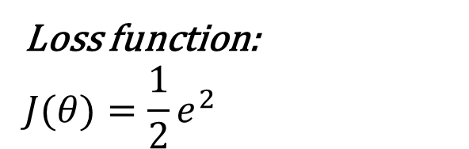
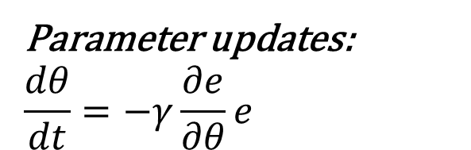
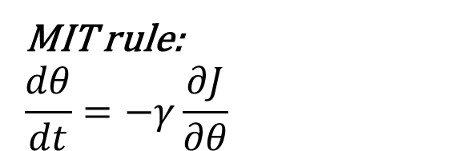
Setup:
DC motor dynamics:
$$\frac{dv}{dt}=−av+bu$$
Control Law:
$$u=θ_{1}\left(u_{c}−y\right)−θ_{2}v$$
Model system:
$$G_{m}(s)=\frac{ω^{2}}{s^{2}+2ζωs+ω^{2}}$$
Unknown motor constants
Input is terminal voltage
Output is angular position
$θ_{1}$/ $θ_{2}$ are the control parameters
$u_{c}$ is the reference input
Standard 2nd order model
$ζ$ and $ω$ define the intended system response
Choose parameters?
NO - adaptively update them based on error ($y−y_{m})!$
Loss function:
$$J(θ)=\frac{1}{2}e^{2}$$
MIT rule:
$$\frac{dθ}{dt}=−γ\frac{∂J}{∂θ}$$
Parameter updates:
$$\frac{dθ}{dt}=−γ\frac{∂e}{∂θ}e$$

Slide 7
Action:
Implement control law:

Slide 8
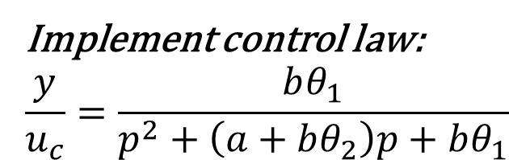
Action:
Implement control law:
$$\frac{y}{u_{c}}=\frac{bθ_{1}}{p^{2}+\left(a+bθ_{2}\right)p+bθ_{1}}$$
Equate coefficients:

Slide 9
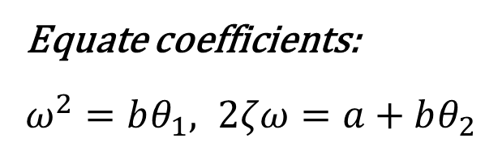
Action:
Implement control law:
$$\frac{y}{u_{c}}=\frac{bθ_{1}}{p^{2}+\left(a+bθ_{2}\right)p+bθ_{1}}$$
Equate coefficients:
$ω^{2}=bθ_{1}, 2ζω=a+bθ_{2}$

Slide 10
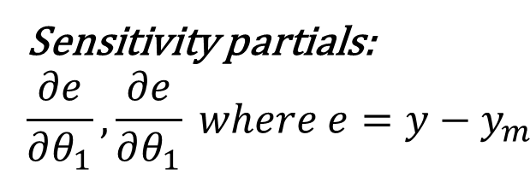
Action:
Implement control law:
$$\frac{y}{u_{c}}=\frac{bθ_{1}}{p^{2}+\left(a+bθ_{2}\right)p+bθ_{1}}$$
Equate coefficients:
$ω^{2}=bθ_{1}, 2ζω=a+bθ_{2}$
Sensitivity partials:
$$\frac{∂e}{∂θ_{1}}, \frac{∂e}{∂θ_{1}} where e=y−y_{m}$$

Slide 11
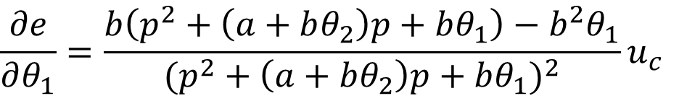
Action:
Implement control law:
$$\frac{y}{u_{c}}=\frac{bθ_{1}}{p^{2}+\left(a+bθ_{2}\right)p+bθ_{1}}$$
$$\frac{∂e}{∂θ_{1}}=\frac{b\left(p^{2}+\left(a+bθ_{2}\right)p+bθ_{1}\right)−b^{2}θ_{1}}{{(p^{2}+\left(a+bθ_{2}\right)p+bθ_{1})}^{2}}u_{c}$$
Equate coefficients:
$ω^{2}=bθ_{1}, 2ζω=a+bθ_{2}$
Sensitivity partials:
$$\frac{∂e}{∂θ_{1}}, \frac{∂e}{∂θ_{1}} where e=y−y_{m}$$

Slide 12
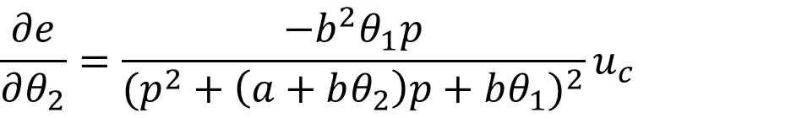
Action:
Implement control law:
$$\frac{y}{u_{c}}=\frac{bθ_{1}}{p^{2}+\left(a+bθ_{2}\right)p+bθ_{1}}$$
$$\frac{∂e}{∂θ_{1}}=\frac{b\left(p^{2}+\left(a+bθ_{2}\right)p+bθ_{1}\right)−b^{2}θ_{1}}{{(p^{2}+\left(a+bθ_{2}\right)p+bθ_{1})}^{2}}u_{c}$$
Equate coefficients:
$ω^{2}=bθ_{1}, 2ζω=a+bθ_{2}$
$$\frac{∂e}{∂θ_{2}}=\frac{−b^{2}θ_{1}p}{{(p^{2}+\left(a+bθ_{2}\right)p+bθ_{1})}^{2}}u_{c}$$
Sensitivity partials:
$$\frac{∂e}{∂θ_{1}}, \frac{∂e}{∂θ_{1}} where e=y−y_{m}$$

Slide 13
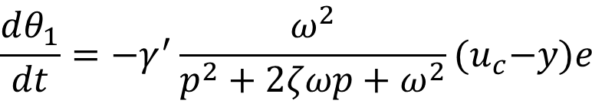
Action:
Implement control law:
$$\frac{y}{u_{c}}=\frac{bθ_{1}}{p^{2}+\left(a+bθ_{2}\right)p+bθ_{1}}$$
$$\frac{∂e}{∂θ_{1}}=\frac{b\left(p^{2}+\left(a+bθ_{2}\right)p+bθ_{1}\right)−b^{2}θ_{1}}{{(p^{2}+\left(a+bθ_{2}\right)p+bθ_{1})}^{2}}u_{c}$$
$$\frac{dθ_{1}}{dt}=−γ^{′}\frac{ω^{2}}{p^{2}+2ζωp+ω^{2}}{(u}_{c}−y)e$$
Equate coefficients:
$ω^{2}=bθ_{1}, 2ζω=a+bθ_{2}$
$$\frac{∂e}{∂θ_{2}}=\frac{−b^{2}θ_{1}p}{{(p^{2}+\left(a+bθ_{2}\right)p+bθ_{1})}^{2}}u_{c}$$
Sensitivity partials:
$$\frac{∂e}{∂θ_{1}}, \frac{∂e}{∂θ_{1}} where e=y−y_{m}$$

Slide 14
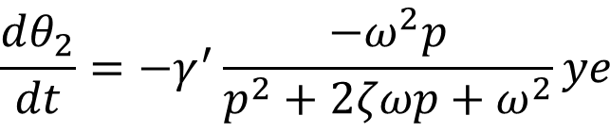
Action:
Implement control law:
$$\frac{y}{u_{c}}=\frac{bθ_{1}}{p^{2}+\left(a+bθ_{2}\right)p+bθ_{1}}$$
$$\frac{∂e}{∂θ_{1}}=\frac{b\left(p^{2}+\left(a+bθ_{2}\right)p+bθ_{1}\right)−b^{2}θ_{1}}{{(p^{2}+\left(a+bθ_{2}\right)p+bθ_{1})}^{2}}u_{c}$$
$$\frac{dθ_{1}}{dt}=−γ^{′}\frac{ω^{2}}{p^{2}+2ζωp+ω^{2}}{(u}_{c}−y)e$$
Equate coefficients:
$ω^{2}=bθ_{1}, 2ζω=a+bθ_{2}$
$$\frac{∂e}{∂θ_{2}}=\frac{−b^{2}θ_{1}p}{{(p^{2}+\left(a+bθ_{2}\right)p+bθ_{1})}^{2}}u_{c}$$
Sensitivity partials:
$$\frac{∂e}{∂θ_{1}}, \frac{∂e}{∂θ_{1}} where e=y−y_{m}$$
$$\frac{dθ_{2}}{dt}=−γ^{′}\frac{−ω^{2}p}{p^{2}+2ζωp+ω^{2}}ye$$

Slide 15
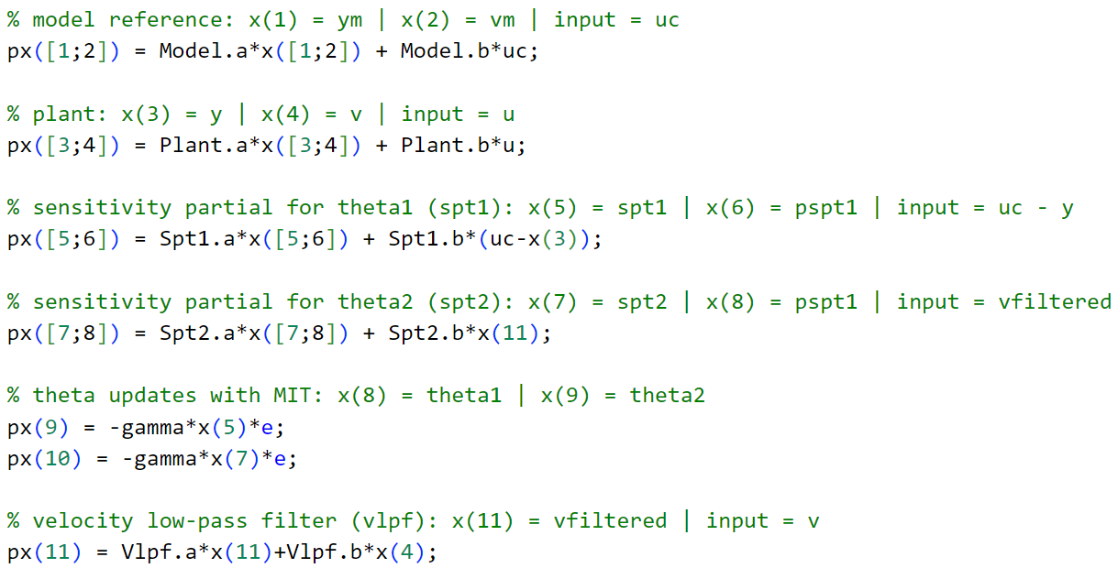
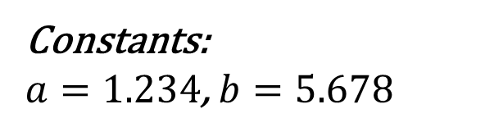
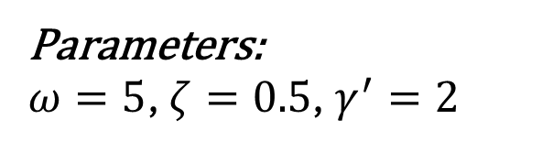
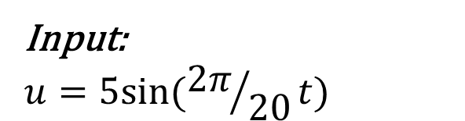
Software Implementation:
Parameters:
$ω=5$, $ζ=0.5$, $γ^{′}=2$
States:
Constants:
$a=1.234$, $b=5.678$
Input:
$$u=5sin⁡({2π}/{20}t)$$

Slide 16
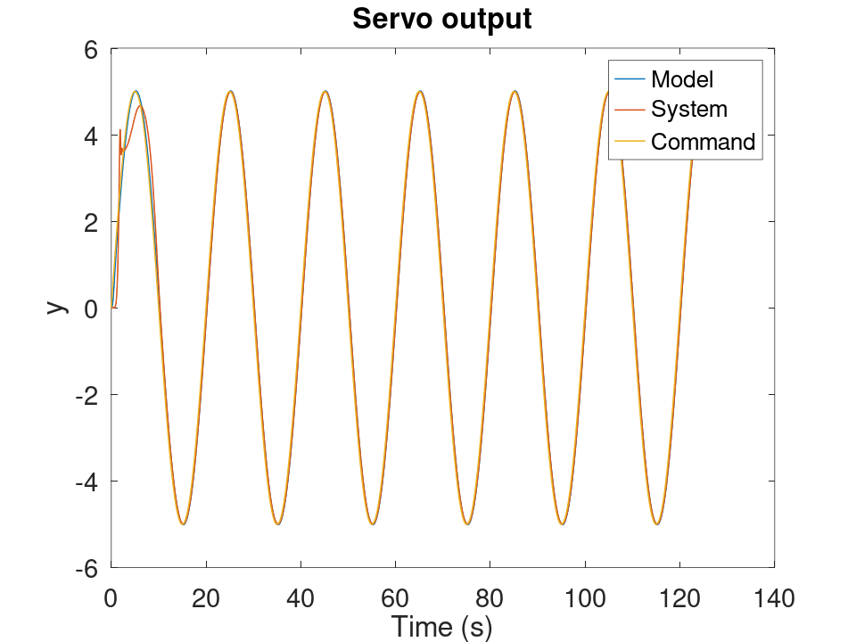
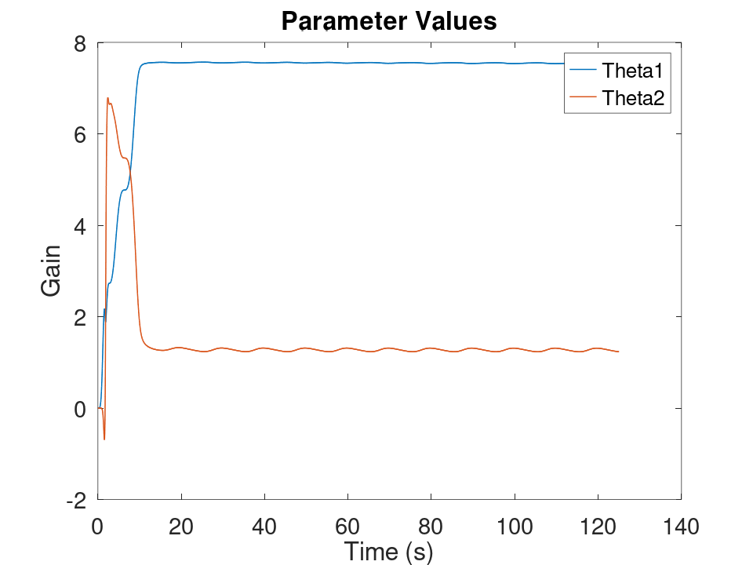
Simulation:

Slide 17
Hardware Implementation:
Setup:
HW:
MSP430FR2355
12V 150RPM geared motor
28 PPR quadrature encoder (pre-gearbox)
LM298N H-Bridge motor driver
POT for command

Slide 18
Hardware Implementation:
Setup:
HW:
MSP430FR2355
12V 150RPM geared motor
28 PPR quadrature encoder (pre-gearbox)
LM298N H-Bridge motor driver
POT for command
SW:
Hardware interrupts for encoder
Hardware PWM for motor driver
UART for data transmission
Zero-order hold discretization at 16 Hz
Low-pass filter on velocity
Floats used

Slide 19
Hardware Implementation:
Setup:
HW:
MSP430FR2355
12V 150RPM geared motor
28 PPR quadrature encoder (pre-gearbox)
LM298N H-Bridge motor driver
POT for command
SW:
Hardware interrupts for encoder
Hardware PWM for motor driver
UART for data transmission
Zero-order hold discretization at 16 Hz
Low-pass filter on velocity
Floats used
Tests:
Sinusoidal input:
0-270° at 100 mHz
Unstable at higher frequencies
Command following:
Turn POT to hearts content
Unstable for very quick adjustments

Slide 20
Hardware Implementation:
Setup:
HW:
MSP430FR2355
12V 150RPM geared motor
28 PPR quadrature encoder (pre-gearbox)
LM298N H-Bridge motor driver
POT for command
SW:
Hardware interrupts for encoder
Hardware PWM for motor driver
UART for data transmission
Zero-order hold discretization at 16 Hz
Low-pass filter on velocity
Floats used
Tests:
Sinusoidal input:
0-270° at 100 mHz
Unstable at higher frequencies
Command following:
Turn POT to hearts content
Unstable for very quick adjustments
Results:
Sinusoidal input:
Pretty cool!
Backlash/stall torque?
Command following:
Acceptable.
Again, backlash/stall torque?

Slide 21
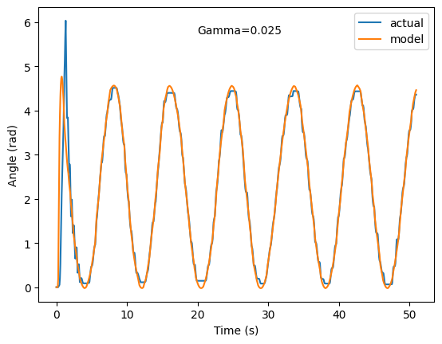
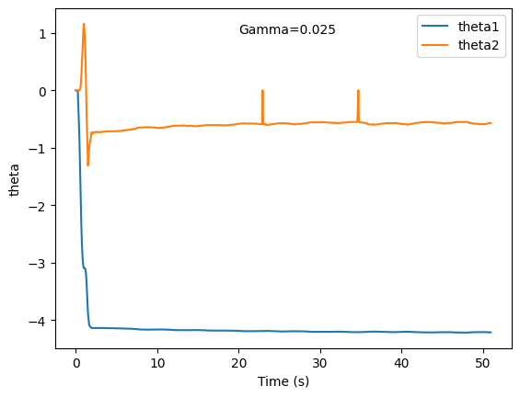
Sinusoidal Results:

Slide 22
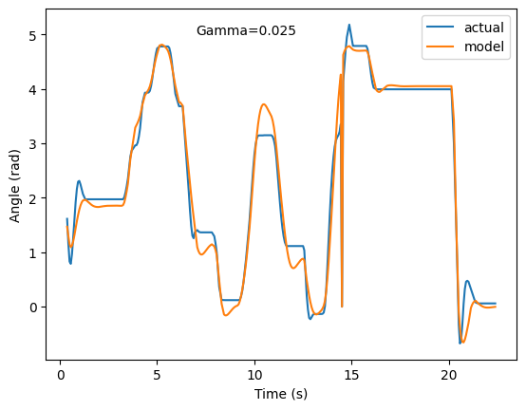
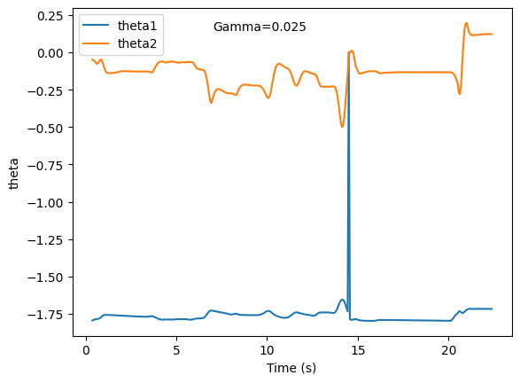
Command Following Results:

