Slide 1

Final Project Presentation to
December 5, 2013

Slide 2
Table of Contents
Assignment
Personas
Interview Insights
Proposed Solutions
Wireframes/Prototype
Measuring Results
Considerations

Slide 3
Assignment
Problem: YouTube content creators lack a dedicated platform to collaborate with other content creators, subscribers, and enterprises.
Objective: Identify opportunities to improve user interface and collaboration experience for content creators.
Method: Content creator interviews → Personas → Userflow → Wireframes

Slide 4
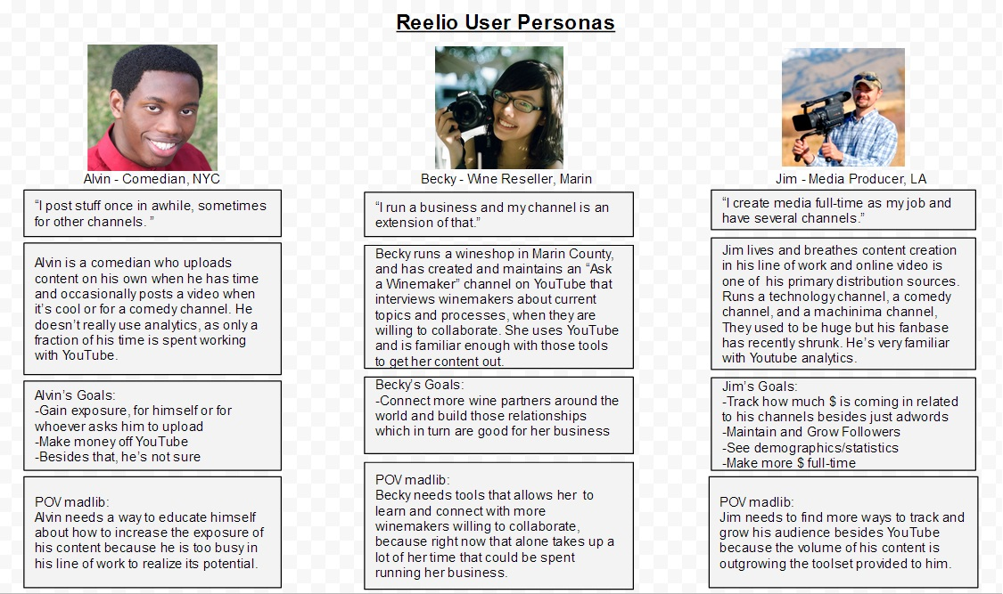
Personas

Slide 5
Interview Insights
Based on user interviews, some creators:
Simply don’t know how to make more money besides adWords
Find it challenging to find relevant collaborators, be it brands or other content creators
Need simple and digestible information derived from YouTube analytics
Current user interface feedback:
Confusion with terminology and search interface and results
Few help features/explanations

Slide 6
Proposed Solutions
Simply don’t know how to make more money besides adWords
Onboarding video intros Reelio and explains different ways to make money
Find it challenging to find relevant collaborators, be it brands or other content creators
Simple search function to find collaborators
Need simple and digestible information derived from YouTube analytics
Charts summarizing YouTube analytics data
Confusion with terminology and search interface and results
Propose new terminology: “profile”, “creators”, “collaborator”
Few help features/explanations
Onboarding video with explanation of features, as well as how-to’s and tips

Slide 7
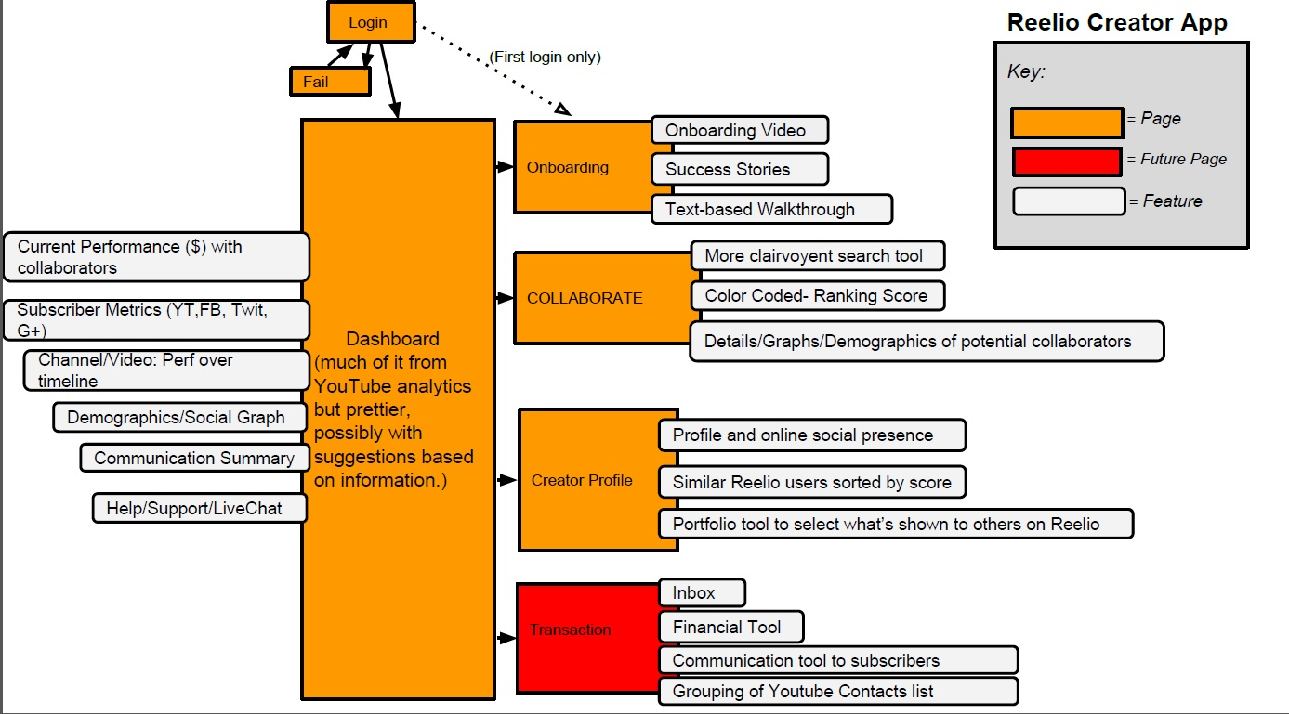
User flow
User Flow

Slide 8
Wireframes
Please see separate PDF for wireframes

Slide 9
Measuring Results: Data
Event name: Collaborator selection
Trigger: user taps collaborator option
Parameters: category of collaborator, Reelio rank
Description: zero or one value records if a content creator taps a selection
Event name: Collaborator search
Trigger: user taps “Search”
Parameters: key word, category of collaborator, social platform
Description: zero or one value records if a content creator taps “Search”
Event name: Onboard video
Trigger: user taps play
Parameters: play time range
Description: zero or one value records if content creator taps to view onboarding video
Notes:
Mobile analytics with Flurry:
Two-level structure: events and event parameters (for event distribution)
Tracks up to 300 events for each application
Each event can have dimension of time: duration, average length, by session and by user
Each event can have 10 parameters
Each parameter can have an infinite number of values

Slide 10
Measuring Results: Reporting
Funnel analytics: Big picture
Conversion % at each step, over time
User path chart: Identify bottlenecks
Number of users that navigate through the website/app
Path users taking, not taking, or dropping off (% with each route)
Events reporting: Drilling down
Distribution of the number of times event triggered per session (content consumption)
Number of unique visitors that triggered an event given a time period
Average number of times an event occurs per session
Event parameter reporting: Visibility to content creators
Source of subscriber traffic
Age range of subscribers
Geographic breakdown of subscribers

Slide 11
Considerations
Survey data for additional content creator insights
Design for other platforms (iPad)
Technical roadmap, requirements, and cost information from developers will need to be incorporated for prioritization of new/changed features (time, cost, quality balance)
Determine statistical significance of introducing or changing a feature with A/B testing or when introducing or changing more than one feature with multivariable regression
Notes:
JMP statistical tool very good for large data set analytics.

