Slide 1

OLAM AGRI · RUBBER DESK · BANGKOK
Thailand Update · Aug 25th 2026
THAILAND SITUATION — RAW MATERIAL
~71 THB
Supply overall okay — localized flood disruptions and rain-driven quality pressure; DRC weak on persistent rain
Cup lump: South ~71 THB/kg tracking SICOM, North ~70 — some factories paying premiums to secure material
Latex demand from glove makers steady, but they can't match RSS/USS pricing — sheet producers pay ~2 THB more, pulling material toward RSS/USS
Bottom line: the rally does not look driven by Thai raw-material shortage — more macro factors, other origins and nearby tightness; nearby still feels short as factories keep building stock
Cup lump, South (tracking SICOM)
~70 THB
Cup lump, North (DRC weak on rain)
+2 THB
RSS/USS premium over latex buyers
Compiled from the desk's market-intelligence emails · two-week market review inside (10–23 Aug)

Slide 2




Thailand Weather Update
Meteorological Department warnings, 25 August 2026
Thunderstorm warning — 23 provinces on Tuesday
Locally heavy rain expected; Bangkok and surrounding areas to see rain mainly from the afternoon through the evening.
Strong southwest monsoon over Thailand
A fairly strong southwest monsoon covers the country, with a monsoon trough stretching towards Tropical Storm Nangka over the Gulf of Tonkin.
Tropical Storm Nangka — not headed for Thailand
Nangka is forecast to make landfall in southern Guangxi, China on 25–26 August and is not expected to move into Thailand.
Rough seas on the upper Andaman
Waves of 2–3 metres, rising above 3 metres in thunderstorms. Small boats in the area are advised to remain ashore.
Desk read: continued rain keeps DRC weak and tapping patchy in flood-hit pockets — quality premiums persist, but no broad supply shortage.

Slide 3
Futures: a V-shaped fortnight
Week 1 washed out on demand fears — week 2 rallied on oil, a weaker dollar and the TOCOM squeeze
WEEK 1 · 10–14 AUG — WASHOUT
Settled 219.8 Friday after a 222.2 peak; Songkhla USS fell 3.2 to 79.2 THB
China Jul car sales –21.1% y/y (10th straight fall); Jul rubber imports –8.5%
Malaysia Jun output +31.5% m/m; RAOT warned of more downside
WEEK 2 · 17–21 AUG — FIVE-DAY RALLY
US–Iran MOU expired: Hormuz nearly shut (≈3 vessels/day vs ~130); Brent 93.25
Dollar index at 3-month lows; THB firmed 33.1 → 32.80
TSR20 +11.3¢ off the low; OSE Jan ¥420.5 → 438.4; SHFE Jan 17,790 → 18,350
OSE RSS3 Jan
SHFE RU Jan
Brent crude
USD/THB
¥438.4 +4.3% w/w
18,350 +3.1% w/w
$93.25 4-wk high
32.80 THB firming

Slide 4



Thai physical: raw materials firm off the lows
After the 6–14 Aug slide, every grade stabilised or rose through 17–21 Aug; latex led the recovery
Grade (THB/kg) | 10–14 Aug | 17–21 Aug | Change
USS auction (Songkhla) | 82.4 → 79.2 | 81.1 – 81.3 | stabilised
RSS3 (Songkhla) | 84.0 | 83.7 – 84.3 | steady
Cup lump (93 pts avg) | 65.2 | 65.45 → 66.30 | ▲ 5 sessions
Field latex (south) | 71 – 73 | 72 – 75 | ▲ ~1.0
Latex 60% conc. (intl) | 55.7 | 55.69 → 57.11 | ▲ 1.42
Factory USS buying | — | 73.0 – 75.8 | most 74–75
Monsoon disruption
Nationwide heavy-rain warnings 17–21 Aug; flood and mudslide alerts across the southern producing belt. Short-term supply support, but flood risk needs watching.
Supply re-engaging
Producers more active into the new trading season; central-market volumes rising. RSS export offers now 271 lowest, most at 275–280 US¢.
FX: THB firming
Central-market RSS volume hit a weekly high of 488 t on Fri 21 Aug — arrivals are catching up.
Baht strengthened 33.1 → 32.80/USD through the rally week — supports local prices but caps export margin upside.

Slide 5




Situation change: the TOCOM squeeze tightens
Exchange stocks near historic lows and record backwardation are reshaping Thai RSS flows
Stock down 45% — and still draining
3,002 t on 10 Aug vs 5,470 t June peak; deliverable RSS3 just 2,801 t. Outflow ~500 t/week vs only ~400 t heard heading in.
Record backwardation punishes shorts
OSE nearby spread hit ¥40.5 on 20 Aug — widest ever (previous ¥32.9, Feb 2020). Aug contract spiked to ¥478.9.
Thai RSS arbitrage to Japan opens
Thai RSS offers 271–280 US¢ vs TOCOM FOB ≈265–268 — spread narrowed sharply; traders eye RSS shipments to Japan.
STR producer economics still positive
Cup lump 65–68 THB in the field vs tire makers paying ~73 THB — about 1 THB/kg margin after 4–5 THB logistics.
Sources: Okachi Japan rubber stock reports (18 & 20 Aug) · desk weekly updates 17 & 23 Aug

Slide 6
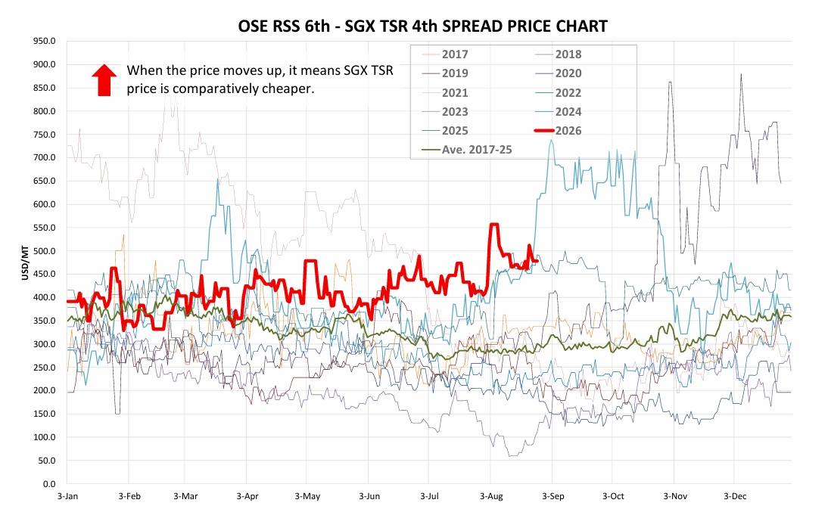
Intermarket spread: OSE RSS 6th – SGX TSR 4th
Rising spread = SGX TSR comparatively cheaper · 2026 in red vs 2017–25 seasonals
Source: Okachi & Co.

Slide 7
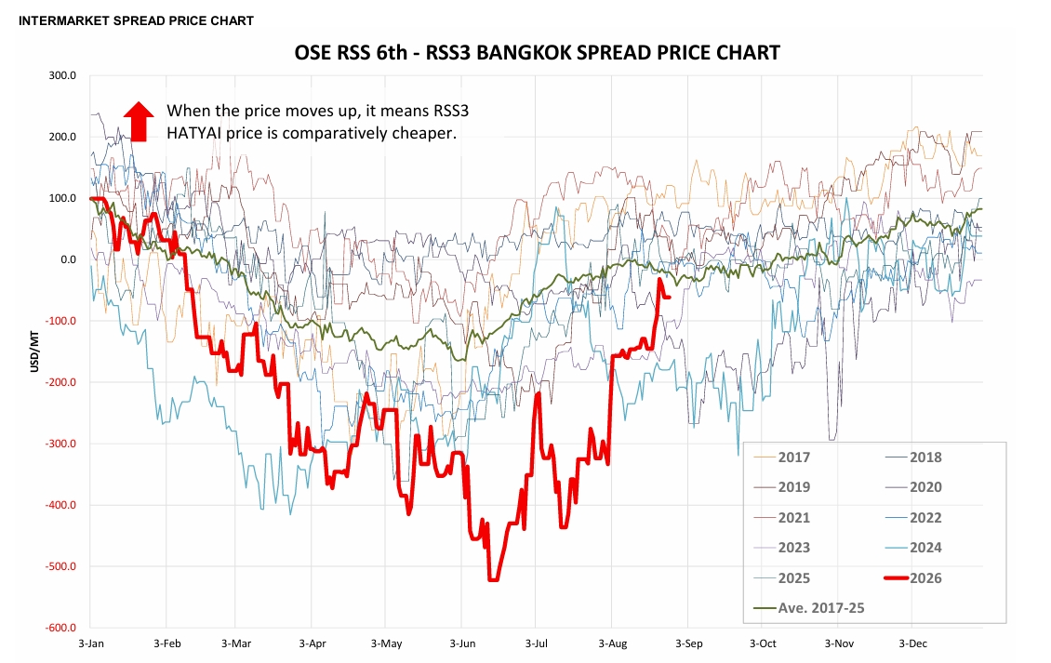
Intermarket spread: OSE RSS 6th – RSS3 Bangkok
Rising spread = RSS3 Hatyai comparatively cheaper · 2026 in red vs 2017–25 seasonals
Source: Okachi & Co.

