Slide 1
findNeighbour3 monitor
A front end for the findNeighbour3 server
V1.0 2019-07-07

Slide 2
Launching the monitor
Running a docker image is the easiest method
See github for details

Slide 3
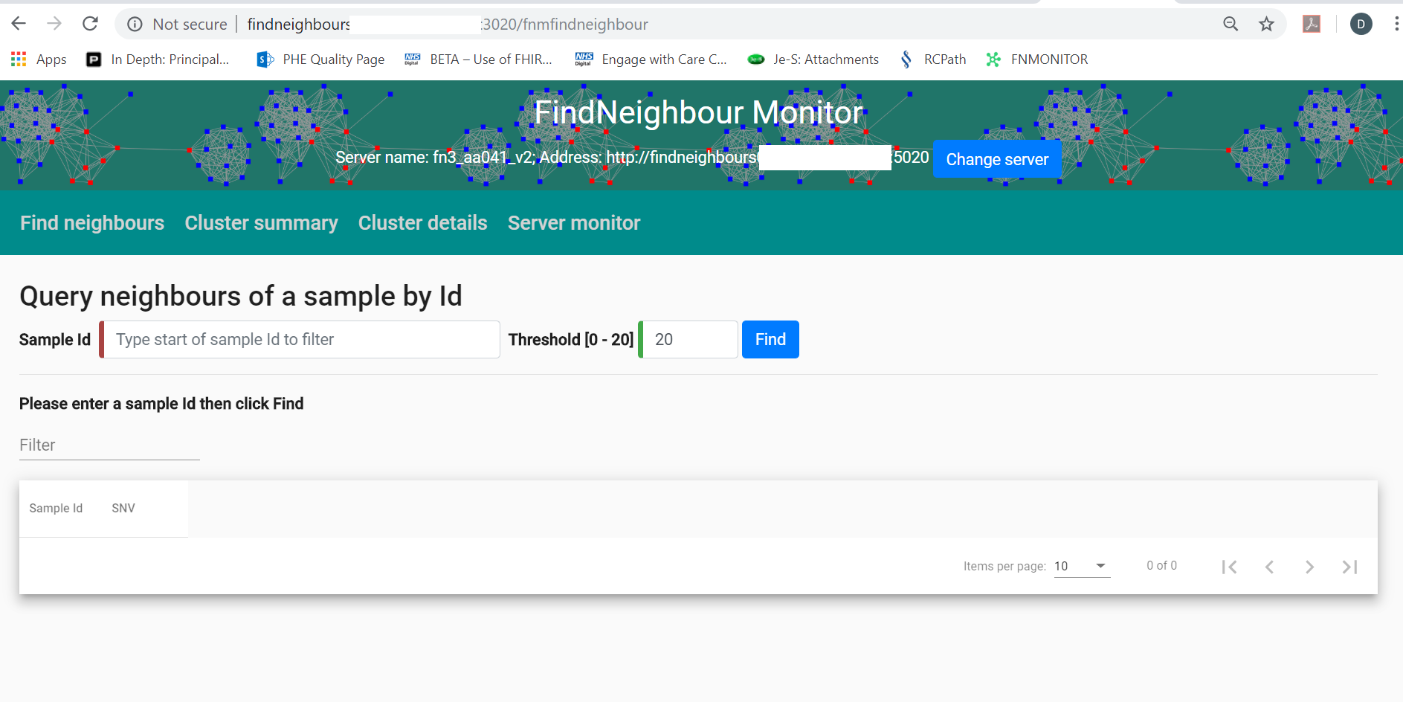
The monitor communicates with a findNeighbour3 server. You have to tell the monitor which findNeighbour server to talk to. One monitor can communicate with one findNeighbour server at at time.

Slide 4
You can change the findNeighbour3 server the monitor communicates with. On startup, you will be asked for a findNeighbour3 server url.
The URL of our server has been redacted and replaced with a white box.

Slide 5
There are four main sections to the UI

Slide 6
This tab allows you to search for samples and their neighbours

Slide 7
This tab allows you to search for samples and their neighbours

Slide 8
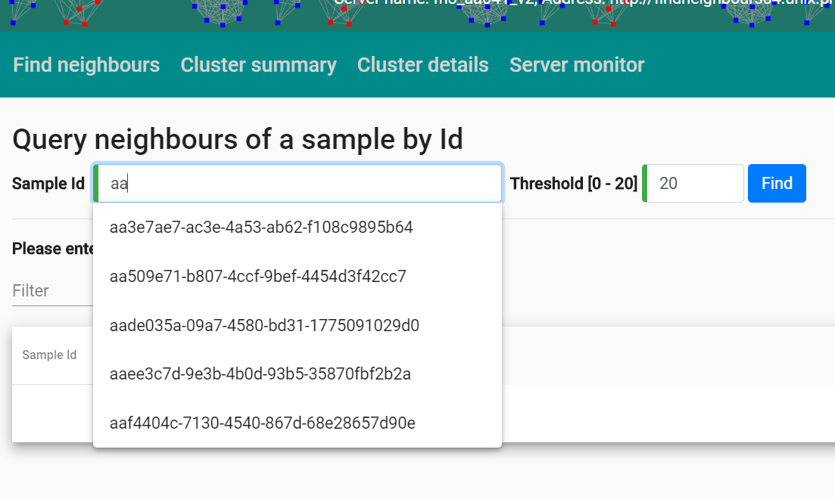
Enter the sample id and an autocomplete box appears
SNPCEILING
You can elect to find samples with less than a SNP distance from the sample.
The maximum distance allowed depends on the server configuration: the SNPCEILING entry in the config file tells the server the maximum SNP distance between samples to store.

Slide 9
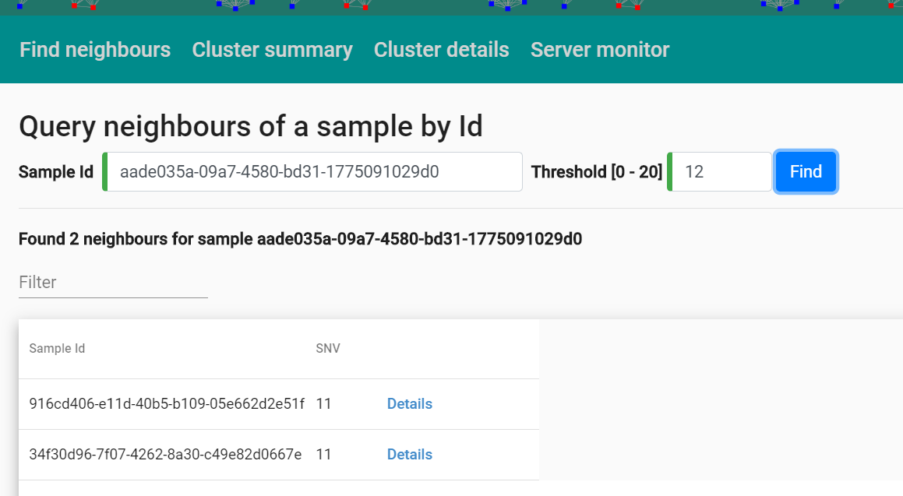
2 samples found within 12 SNP

Slide 10
More details are available on these samples

Slide 11
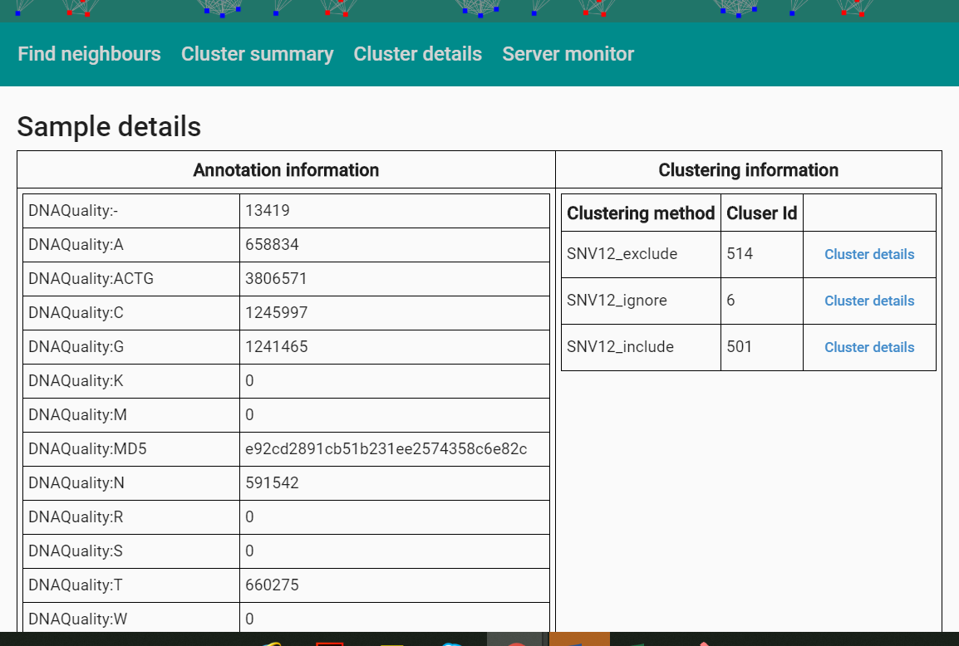
Number of positions with particular bases, and similar technical data
If the server is configured to build clusters of similar sequences, the clustering methods used (in this case, three different methods are in use) and cluster ids are shown.

Slide 12
This link will bring up a view of the cluster

Slide 13
Details of clusters can be searched for by number

Slide 14
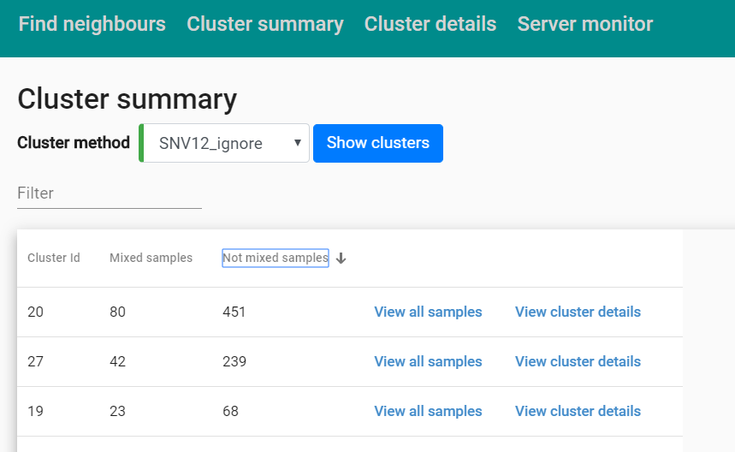
Details of clusters can be searched for by number
Or from the sample details page

Slide 15
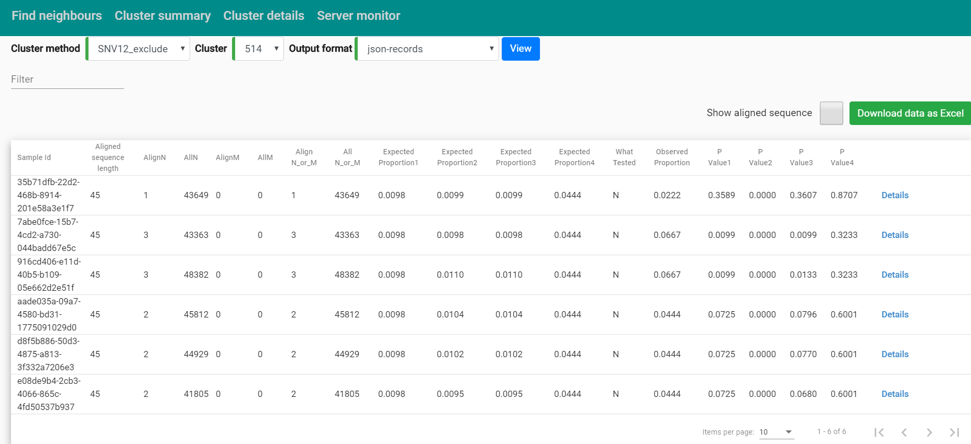
Four formats of the cluster view are available. This is a tabular format

Slide 16
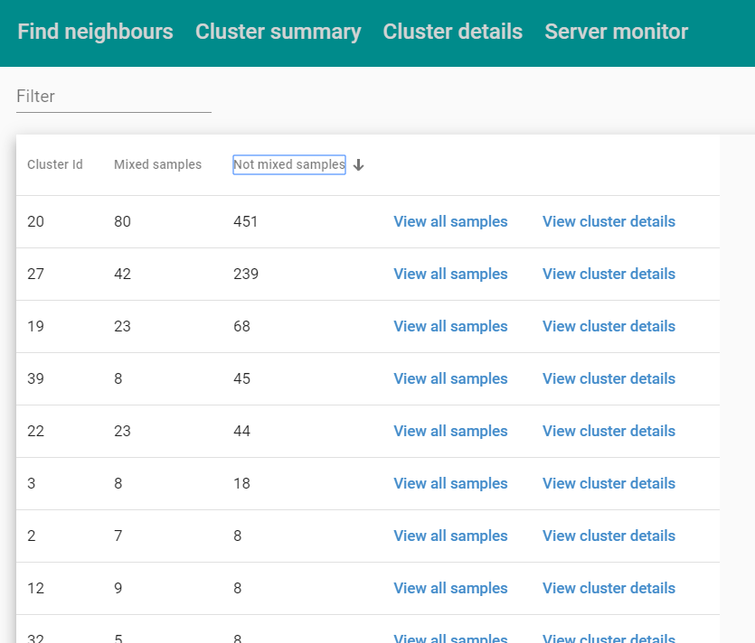
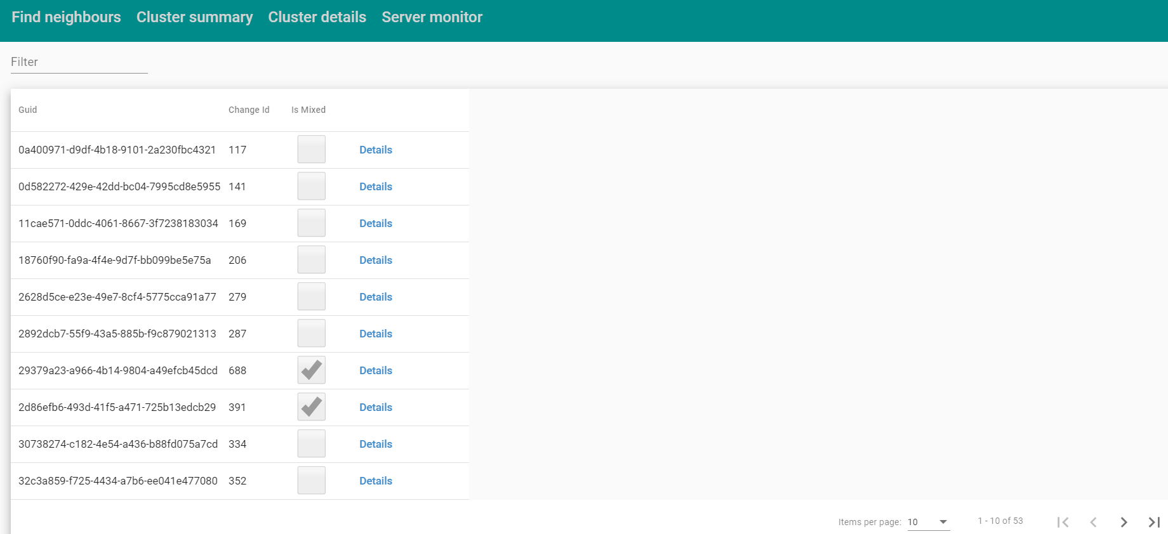
The grid (as with other grids) is sortable and searchable
Ticks indicate the server detects this sample as mixed
See next slide

Slide 17
The length of the alignment (sites which vary between the members of the cluster) is shown along with the number of N (unknown) and M (mixed) bases

Slide 18
The statistical approach to detection of mixed sequences involves comparing the number of Ns, Ms, or Ns/Ms with an expectation. The choice is determined in the server config file

Slide 19
Four statistics are provided, each testing the number of ‘what tested’ bases exceeds an expectation

Slide 20
The sequence can be shown

Slide 21
The content of the table displayed can be downloaded

Slide 22
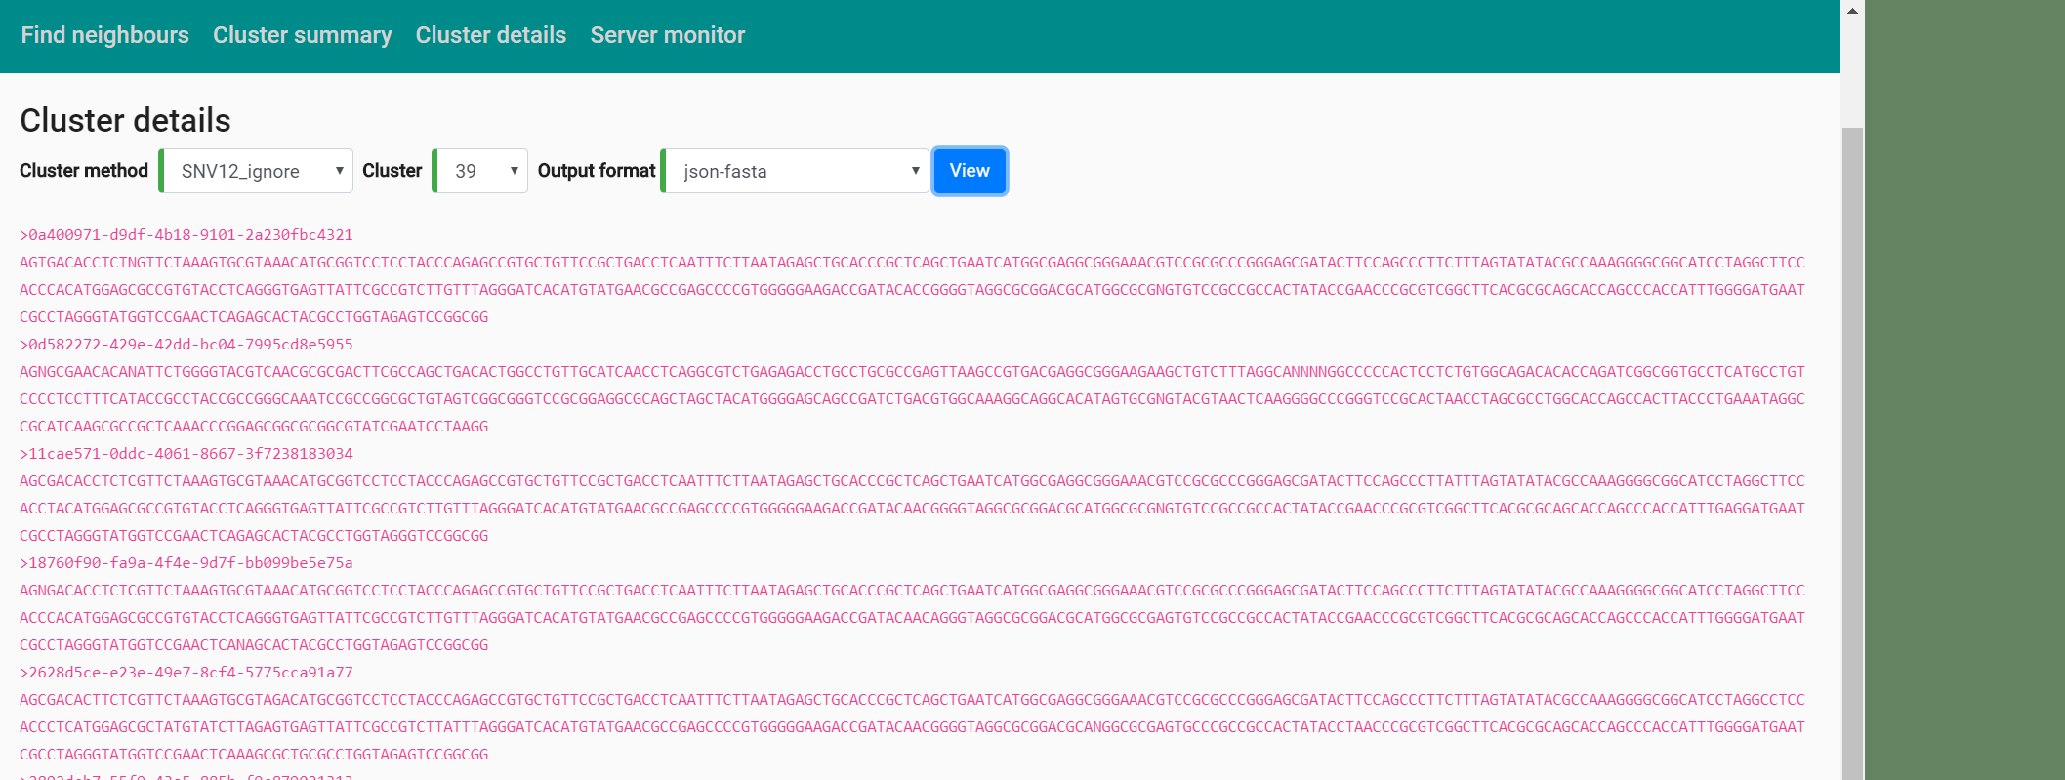
Shows multisequence alignment of positions varying between samples

Slide 23
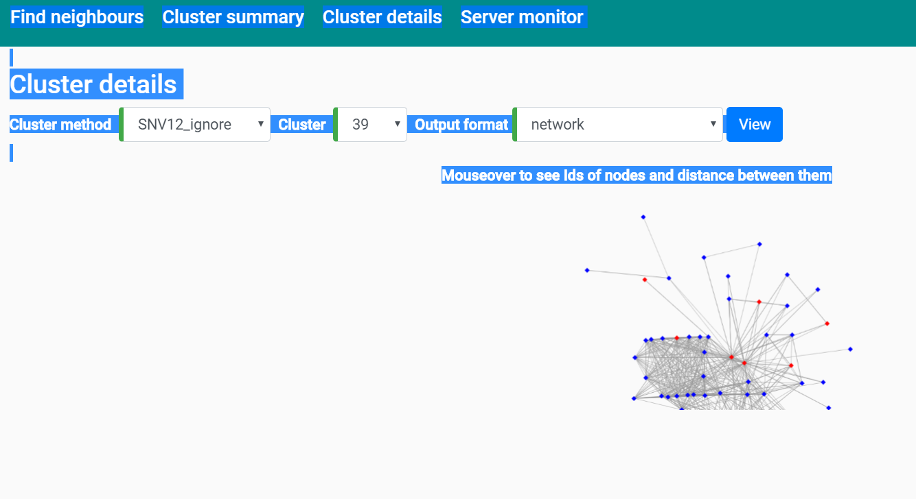
Shows all edges between samples less than the cutoff SNPCEILING set for the server. Mixed samples are coloured red

Slide 24
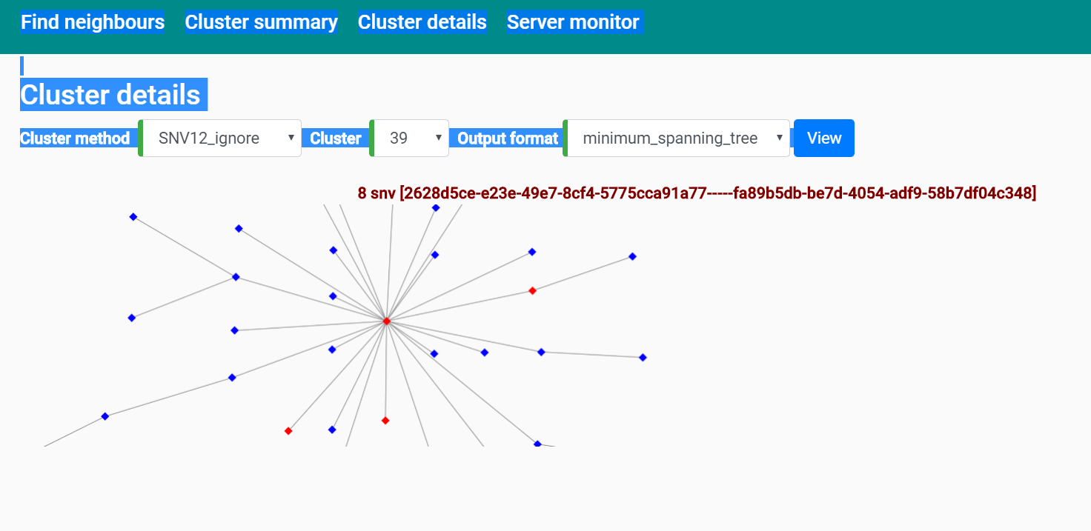
Shows a minimal spanning tree for an undirected graph with sequences as nodes and SNP distances as weighted edges. Mixed samples are coloured red

Slide 25
The server’s status, RAM etc can be viewed

Slide 26
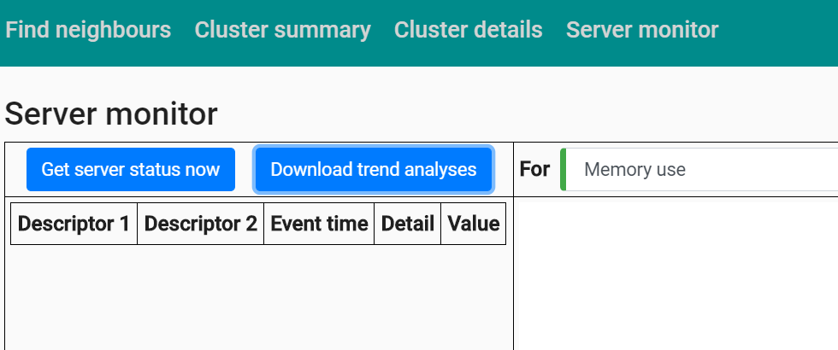
Server status

Slide 27
