Slide 1
Employing statistics to understand the COVID-19 pandemic
David H Yang
Dr. Paul Gordon & Dr. Quan Long
Dec 10th, 2021

Slide 2
Table of Content
Background information
Aim 1: Investigating the true prevalence of SARS-CoV-2
Aim 2: Eliminating sampling bias in SARS-CoV-2 analysis
Aim 3: Creating phylogenetic trees to understand our pandemic

Slide 3
Planning
Start with a clever introduction to why my topic is interesting (1 min) →
Move on into overview of my presentation and give background on the topic (4 min) →
Move onto the aims. For each aim provide the following: 1) Motivation 2) Methodology (specific focus on the math) 3) Results (be brief not a research presentation). (13 min) → Aim 1: surveying the pandemic and understanding, aim 2: Sampling the pandemic, Aim 3: Observing
Provide coherent conclusion and leave with a thought provoking question (2 min) →
Aside: Talk about various (i) statistics used, (iii) Bayesian inference, (iii) maximum likelihood, (iii) U-test, (ii) Weighted sampling strategy.
Note only 20 minute presentation…

Slide 4
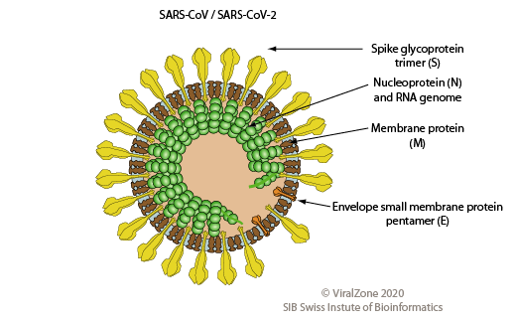
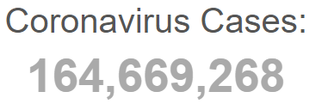
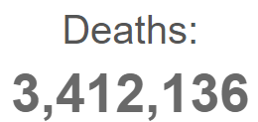
SARS-CoV-2
X 10.5
X 1.47

Slide 5
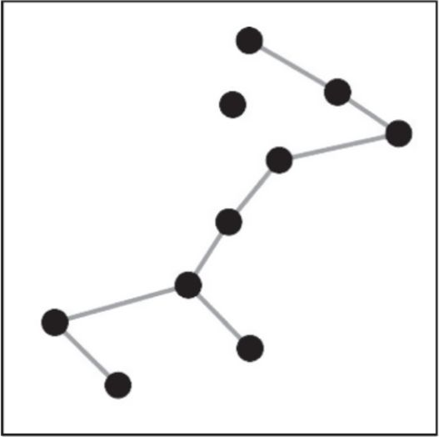
Phylogenetic Analysis
Node
Virus A
Clade
Virus B
Root
Virus C

Slide 6
Source of Sampling Bias
Table 1: The total number of cases, cases per 1 million population, tests per 1 million population and genome sequences from Canada, China, India, USA, and the United Kingdoms. All statistics were obtained from Worldometer and GISAID on October 7th, 2020
Country: | Cases | Cases/1 million population | Tests/1 million population | Genome sequences on GISAID
Canada | 196,321 | 5,188 | 226,302 | 2,714
China | 85,659 | 60 | 111,163 | 994
India | 7,492,727 | 5,414 | 67,381 | 3,092
USA | 8,334,763 | 25,137 | 376,047 | 34,577
United Kingdom | 705,428 | 10,375 | 426,333 | 61,441

Slide 7
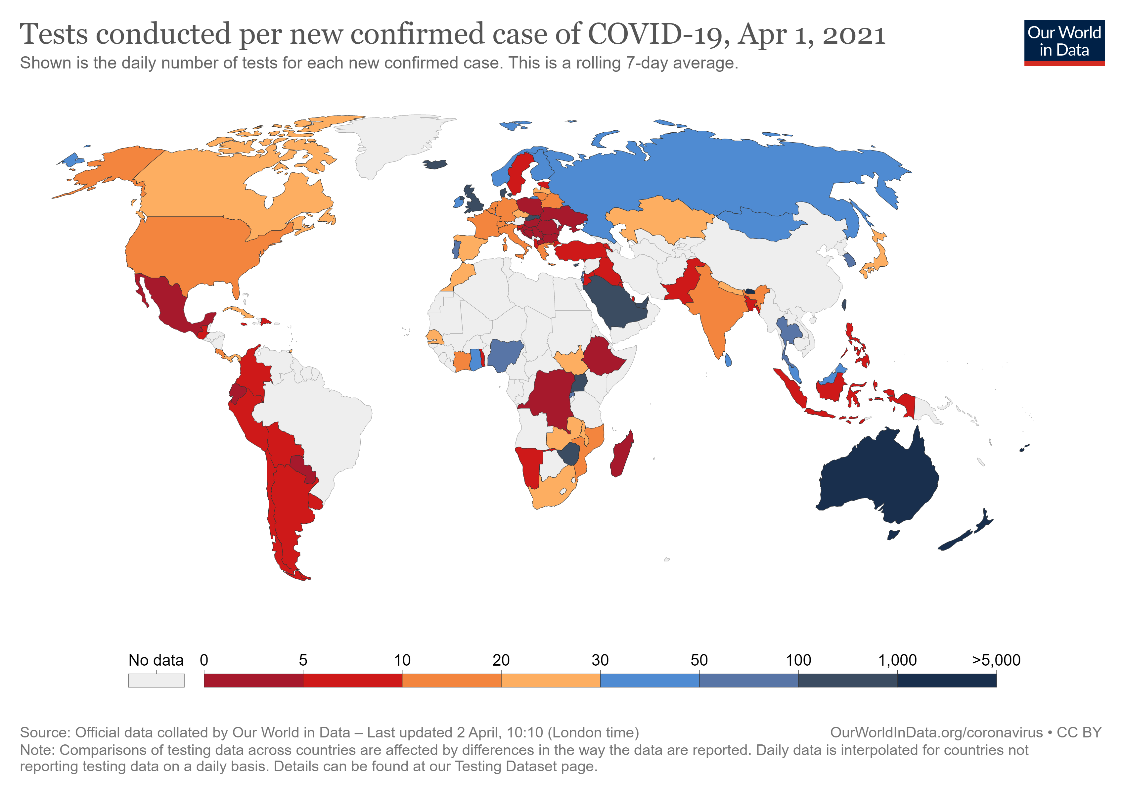
Difficulties Controlling Sampling Bias

Slide 8
SARS-CoV-2 Prevalence Metrics
$$Percent positive ratio (in \%)= \frac{\# of positive test results}{\# of RTPCR tests} x 100\%$$
$$Infection fatality ratio \left(in \%\right)=\frac{number of deaths from disease}{number of infected individuals} x 100\%$$
$$Case fatality ratio \left(in \%\right)=\frac{number of deaths from disease}{number of confirmed cases of disease} x 100\%$$
Serology test: Detection of previous infections via presence of anti-SARS-CoV-2 antibodies

Slide 9
Aims
Investigate the true prevalence of SARS-CoV-2 in each region around the world and the region’s corresponding sequencing contribution to public datasets
Devise a weighted sampling strategy to create sequence subsamples that are representative of SARS-CoV-2 prevalence in regions around the world and different months
Generate and compare the accuracy of phylogenetic trees produced through weighted sampling and random sampling

Slide 10
Aim 1
Investigate the true prevalence of SARS-CoV-2 in each region around the world and the region’s corresponding sequencing contribution to public datasets

Slide 11



Methodology
Data Collection
Obtain and calculate seroprevalence metrics
Data Manipulation
Group statistics by month and region
Data Analysis
Compare prevalence estimates from each metric

Slide 12
Prevalence
Figure 1: Number of cases and the Institute for Health Metrics and Evaluation’s mean estimate of cases in the world from February 1st, 2020 to October 31st, 2020.

Slide 13
Seroprevalence
Table 2: SARS-CoV-2 prevalence metrics obtained for the five countries and months with the highest seroprevalence findings.
Location | Month | Case count | Percent positivity | Serology tests | IHME estimate
Ecuador | May 2020 | 13896 | 36.54% | 44.74% (N = 992) | 573349.3915
Austria | April 2020 | 5746 | 2.82% | 40.71% (N = 3076) | 22240.91491
Italy | May 2020 | 29073 | 1.53% | 38.12% (N = 17123) | 244049.5844
Pakistan | June 2020 | 139841 | 19.00% | 35.75% (N = 2045) | 1693502.075
Iran | April 2020 | 52162 | 30.06% | 33% (N = 528) | 642326.7207

Slide 14
Sequencing contribution: march
a)
b)
c)
Figure 2: Doughnut charts for countries in March 2020. a) depicts the number of reported cases in each country, b) depicts the IHME estimate of the number of cases in each country, and c) depicts the number of sequences sequenced in each country.

Slide 15
Sequencing contribution: globally
Figure 2: Doughnut charts for countries between February 1st 2020 to October 31st, 2020. a) depicts the number of reported cases in each country, b) depicts the IHME estimate of the number of cases in each country, and c) depicts the number of sequences sequenced in each country.

Slide 16
Aim 2
Devise a weighted sampling strategy to create sequence subsamples that are representative of SARS-CoV-2 prevalence in regions around the world and different months

Slide 17
Methodology
Random sampling
Randomly select N sequences from all sequence data available
Weighted sampling
Select N sequences from each country in each month based on SARS-CoV-2 prevalence
Prevalence estimated with IHME mean estimates

Slide 18
Problems with using serology tests
Figure 3: A tally of the number of seroprevalence studies across the world collected on SeroTracker on December 9th, 2020. The last bar and third last bar from the right on the chart represents the total number of studies from the USA and China respectively

Slide 19
Weighted sampling strategy flowchart
Total sequences sampled
Month A sequences
Country A sequences
Country B sequences
Month B sequences
Country A sequences
Country B sequences
.8 x 12,500 = 10,000
2500
12,500
25,000
Notes:
DESCRIBE WEIGHTED SAMPLING STRATEGY

Slide 20
Weighted sampling versus random sampling
Figure 4: The number of sequences to be obtained from each country if 1576 sequences from March 2020 were to be obtained via weighted or random sampling.

Slide 21
Subsamples created
b)
Figure 5: Doughnut charts for the sequencing location of subsamples obtained via a) our weighted sampling strategy versus b) the random sampling strategy.

Slide 22
Aim 3
Generate and compare the accuracy of phylogenetic trees produced through weighted sampling and random sampling

Slide 23
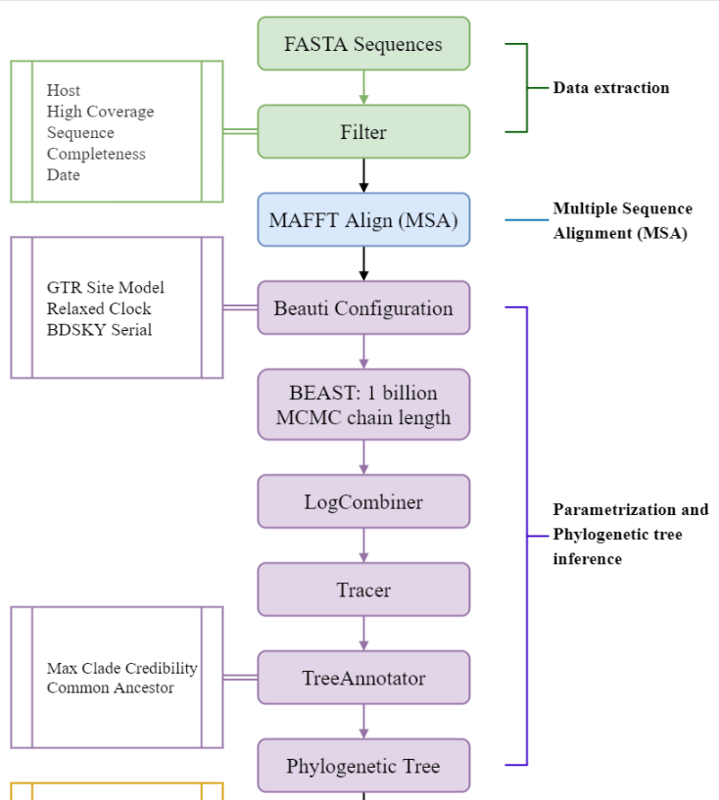
Methodology
Samples from weighted and random sampling
Strict clock
TransCOVID pipeline (Long Lab)
Compare to Nextstrain global analysis & dedicated builds

Slide 24
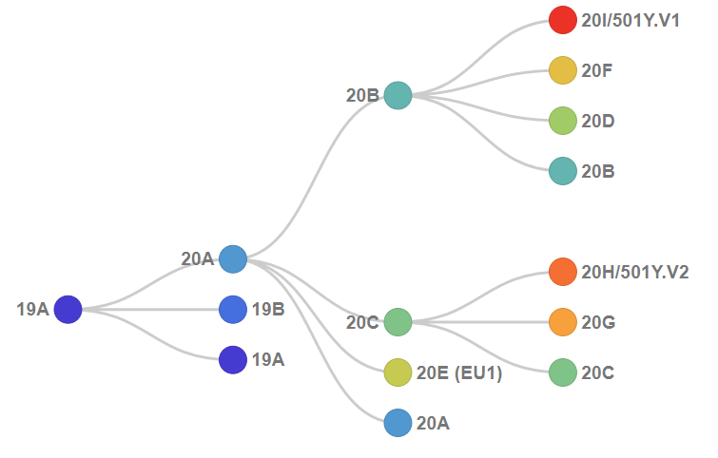
Nextstrain Clades
(Nextstrain)

Slide 25
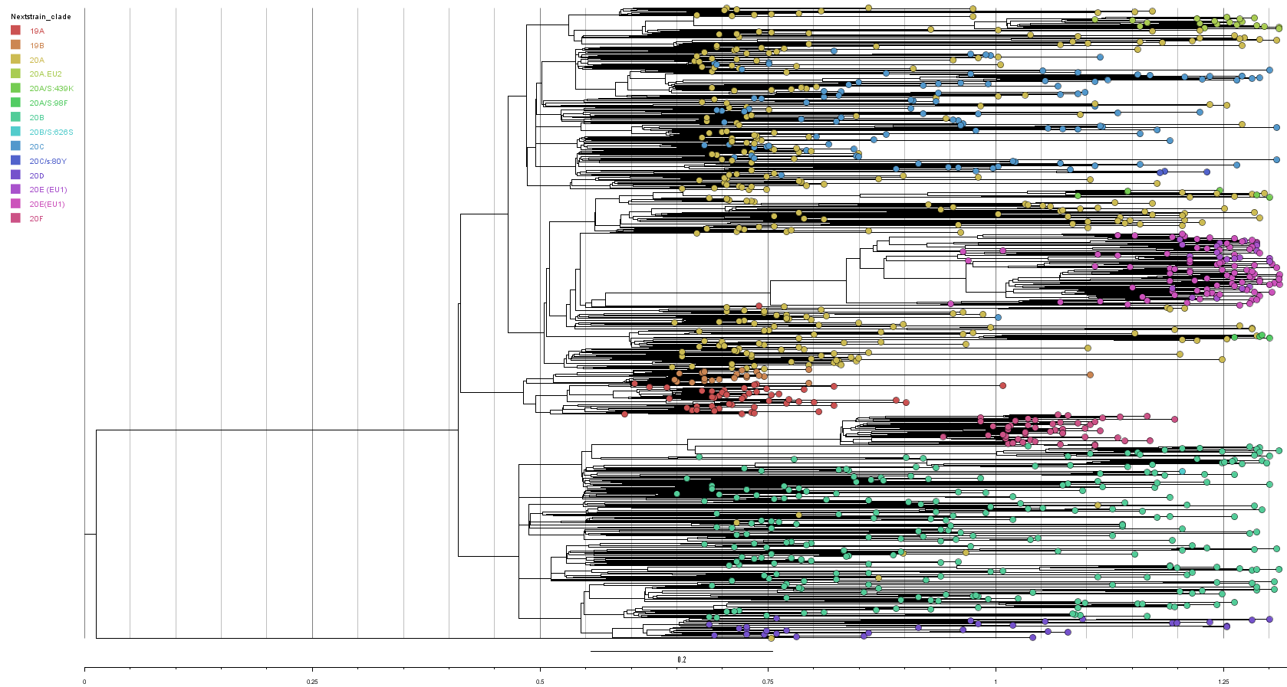
Random sampling
Figure 6: General clade (NextStrain) structure of phylogenetic tree produced from random sampling using BEAST2.

Slide 26
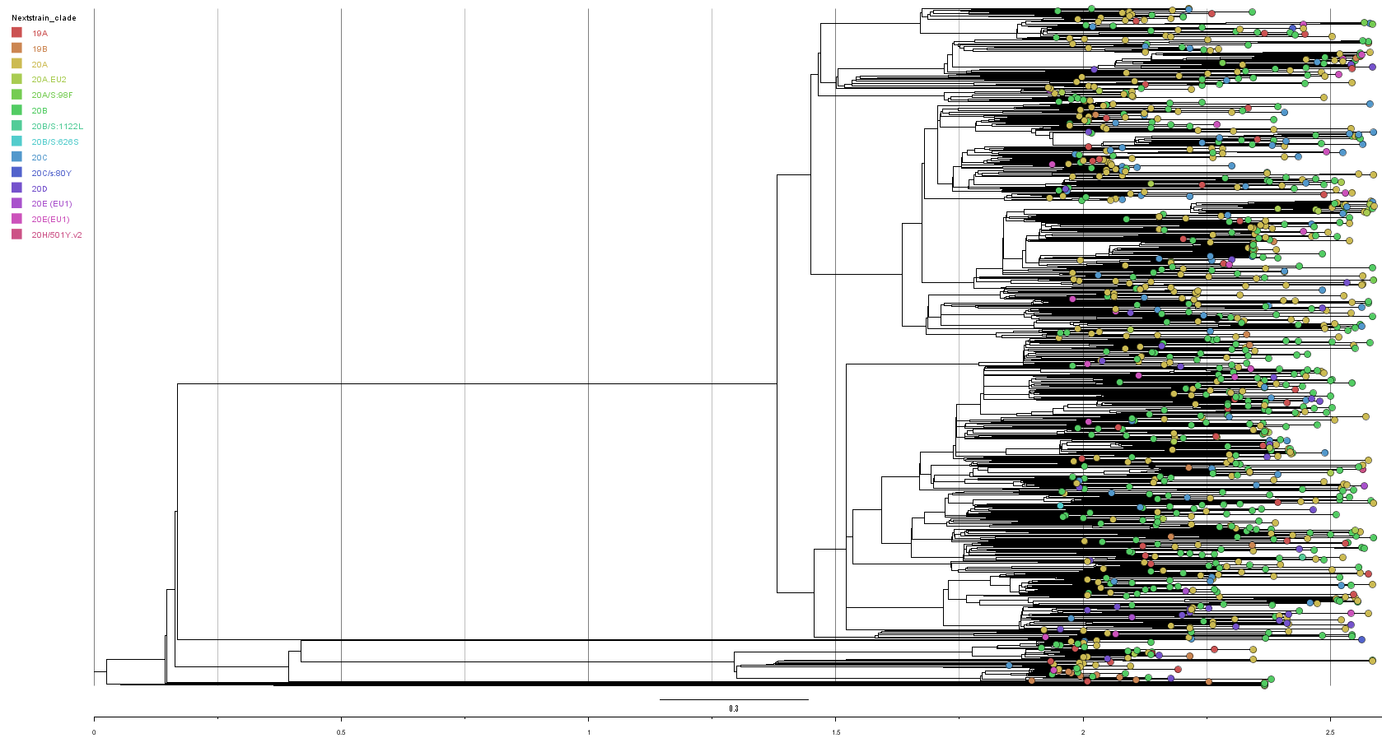
Weighted sampling
Figure 7: General clade (NextStrain) structure of phylogenetic tree produced from weighted sampling using BEAST2.

Slide 27
Comparison of Trees with Nextstrain
Table 3: Earliest dates sampled for various Nextstrain clades in each subsample. The global analysis and the dedicated builds were performed by Nextstrain.
Clade | Random | Weighted | Global Analysis | Dedicated Build
20A.EU2 | 2020-08-17 | 2020-08-20 | 2020-09-01 | 2020-06-10 (02-04 to 05-01)
20A/S:439K | 2020-08-10 | N/A | 2020-08-24 | 2020-04-03 (03-14 to 04-13)
20A/S:98F | 2020-10-12 | 2020-09-08 | 2020-08-28 | 2020-03-10 (01-23 to 02-19)
20B/S:1222L | N/A | 2020-10-07 | 2020-09-07 | 2020-07-06 (04-15 to 06-29)
20B/S:626S | 2020-09-21 | 2020-10-06 | 2020-12-22 | 2020-07-15 (05-31 to 07-10)
20C/S:80Y | 2020-09-12 | 2020-06-29 | 2020-09-21 | 2020-07-16 (04-09 to 04-20)
20E (EU1) | 2020-06-20 | 2020-07-10 | 2020-06-25 | 2020-04-30 (03-04 to 04-24)
20H/501Y.v2 | N/A | 2020-10-19 | 2020-11-17 | 2020-10-08 (07-02 to 09-20)

Slide 28
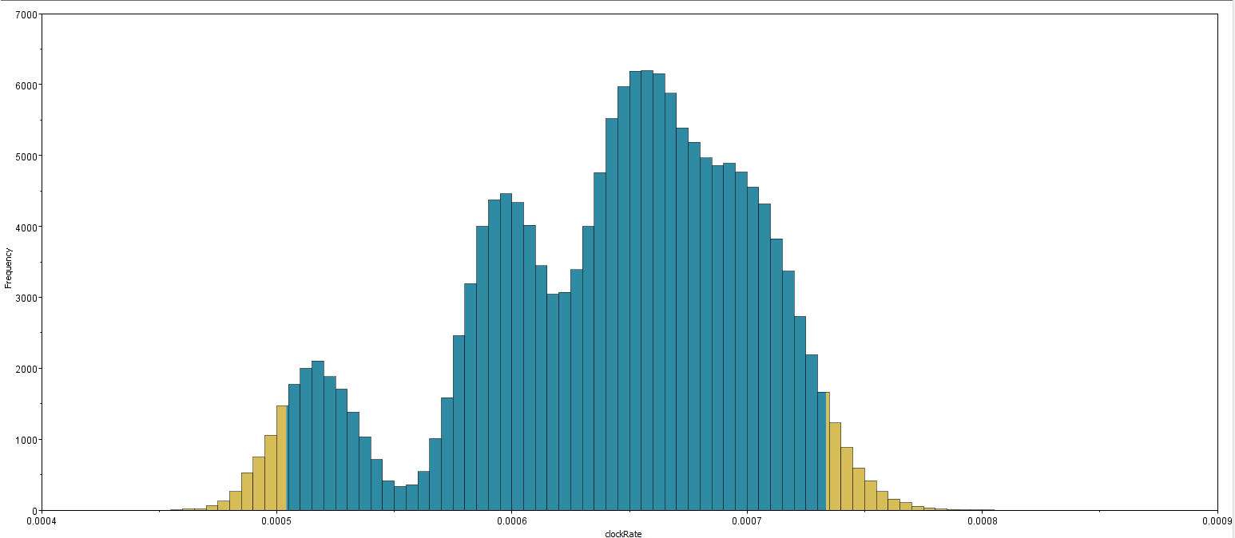
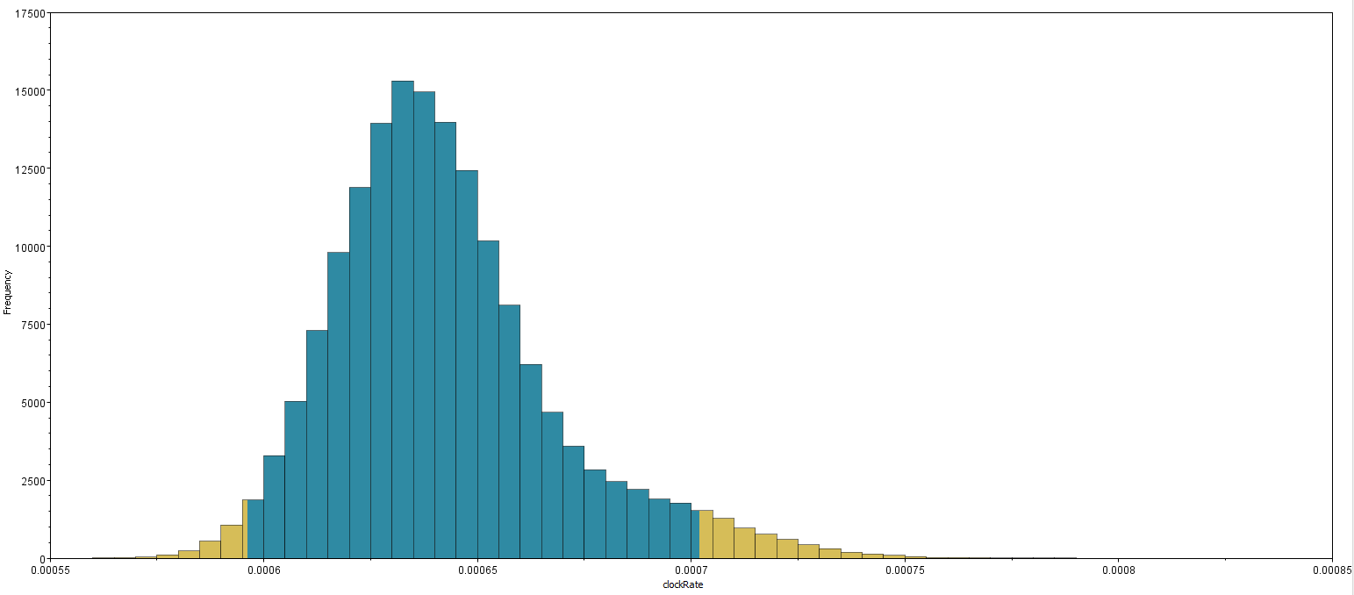
Phylogenetic Analysis: Clock rate
a)
b)
Figure 8: Clock rate trace files obtained from the analysis of the a) weighted sampled subsample and b) random sampled subsample.

Slide 29
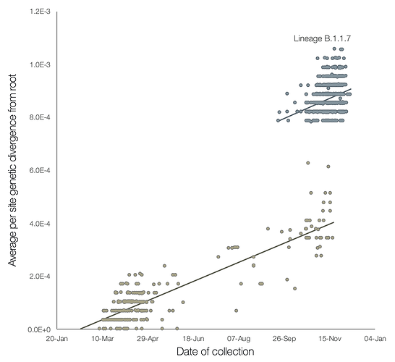
Differences in Clock Rate
(Rambaut et al., 2020)
Notes:
https://virological.org/t/preliminary-genomic-characterisation-of-an-emergent-sars-cov-2-lineage-in-the-uk-defined-by-a-novel-set-of-spike-mutations/563

Slide 30
Acknowledgements
Supervisors
Dr. Paul Gordon
Dr. Quan Long
Dr. Michael Hynes
Special thanks to
Deshan Perera
Long lab

Slide 31
Thank you for listening!

