Slide 1
Parallelization of MCMC based Phylogenetic analysis to greatly reduce run time
BioNet November Seminar
Presented by: David Yang
MSc. Student
University of Calgary
November 15th 2023

Slide 2
Introduction
Methods
Results
Conclusion
Table of Content

Slide 3
Introduction

Slide 4
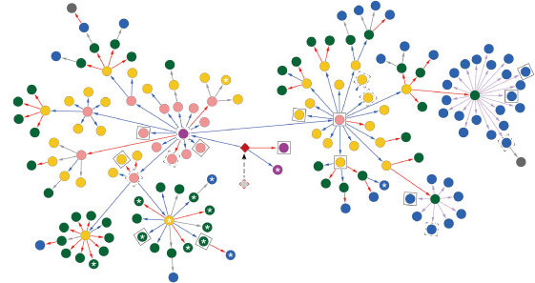
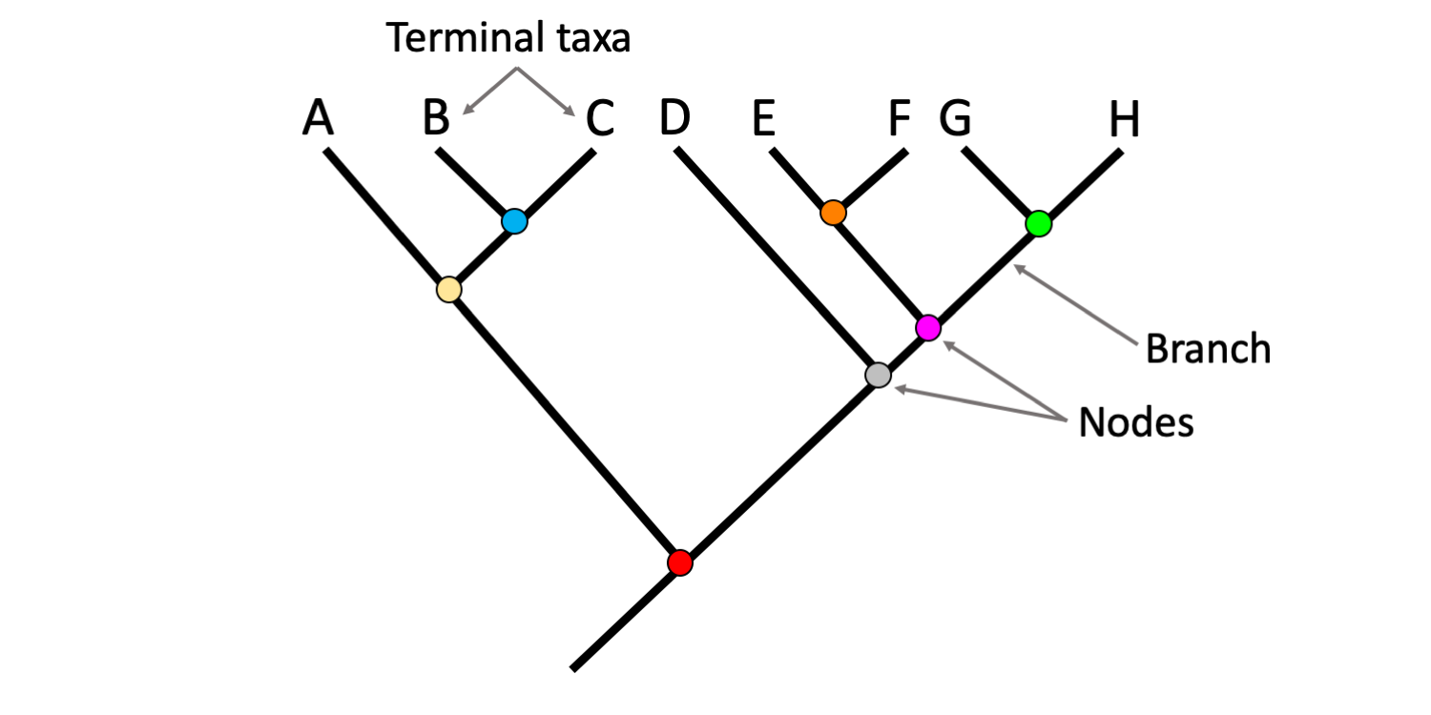
Phylogenetic analysis
Phylogenetics is the study of evolutionary history and relationships through the analysis of heritable traits such as genomic sequences
Time
Transmission network
Phylogenetic tree
Notes:
General: Phylogenetic analyses have been previously used to study evolutionary relationships between animals and viral outbreaks such as in SARS-CoV, MERS-CoV and HIV.
Trees:
- In phylogenetic analysis, phylogenetic trees (right) can be generated based off of genetic relatedness.
- In the figure on the right, I’ve included an example of a phylogenetic tree containing nodes, branches and taxa.
- We can use these phylogenetic trees to show the relationships between different species or even different strains of the same viruses.
- Typically, in phylogenetic trees, we are only provided the recent phylogenetic sequences and so earlier phylogenetic sequences are often inferred and not provided directly.
- We see that in phylogenetic trees, the length of the branches are associated with time or some cases can be associated with differences in genome.
Transmission networks:
- Another interesting application of phylogenetic analysis is creating transmission networks for disease outbreaks
- These networks help us better understand the spread of the virus and allows us to effectively formulate preventative measures to retard the spread of the diseases

Slide 5
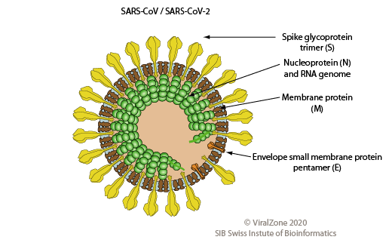
Relevance to COVID-19 Pandemic
Viral agent of COVID-19: SARS-CoV-2
Outcomes from phylogenetic analyses (genomic epidemiology):
Probable zoonotic origin was found
Elucidation of multiple episodes of the Founder effect during the early pandemic
Identification of Infection sources, “super-spreaders” and asymptomatic individuals
Notes:
General:
- In terms of COVID-19, numerous phylogenetic studies were performed to gain understanding about the pandemic.
- On this slide I included some results we obtained through phylogenetic analyses of SARS-CoV-2 which is the viral agent for COVID-19.
Outcomes:
- Talk about outcomes
- One thing that is important to note is that in the SARS-CoV-2 pandemic there are many nuances that we need to consider when performing phylogenetic analyses:
a lot of sequences available
There is ongoing sequencing of viruses and rebuilding phylogenetic trees as you keep getting data during the pandemic. Thus we were continually updating our beliefs about the pandemic as it went on.

Slide 6
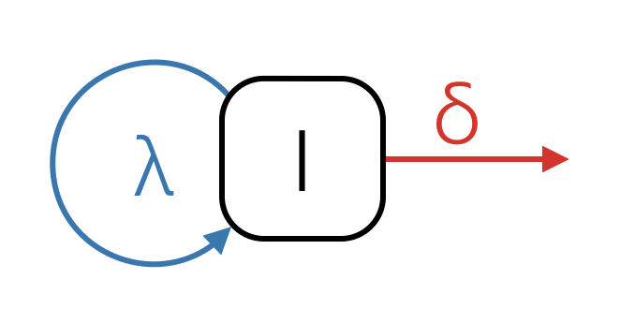
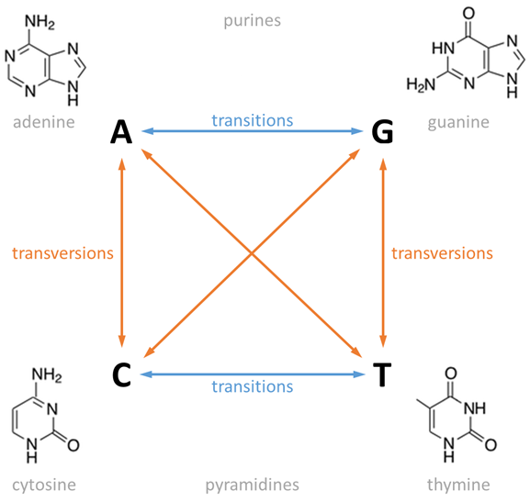
Bayesian Phylogenetics
Advantageous over conventional methods especially for viral outbreaks
Incorporates existing knowledge through various prior models:
Birth-death skyline model
Generalised time reversible model
Assumptions:
Independent transversions
Independent transitions
Unequal base frequencies
Assumption: sampled individual does not remain infectious
λ – transmission rate
δ – rate of becoming non-infectious
Notes:
General:
- Currently, the most commonly performed method of phylogenetic analyses because of these advantages
- Bayesian phylogenetic analyses can involve many different prior models combined including a prior model for: sequence evolution, tree evolution,
- Below we listed two commonly used prior models in the analysis of viral outbreaks
- There are other models that can be used in the analysis of viral outbreaks in place of the birth death skyline model, but here I describe the BDSKY model because we use it in our study
- On the other hand, the generalized time reversible model can be used with all those models
BDSKY:
- very flexible and allows any or all of these rates to change independently over time. The rates are then allowed to change between intervals.
- model assumptions are especially accurate for viral outbreaks

Slide 7


Limitations with Phylogenetic Analysis
Inference through phylogenetic analyses is a complex and exhaustive process:
# sequences (n) | # rooted trees | # unrooted trees
2 | 1 | 1
5 | 105 | 15
10 | 3.44e7 | 2.03e6
15 | 2.13e14 | 7.91e12
20 | 8.20e21 | 2.21e20
# rooted trees =$\frac{\left(2n−3\right)!}{2^{n−2}\left(n−2\right)!}$
# unrooted trees =$\frac{\left(2n−5\right)!}{2^{n−3}\left(n−3\right)!}$
The goal to obtain the maximum clade credibility (MCC) tree - most reasonable evolutionary relation given the estimated Bayesian parameters
Often accompanies long run-times and intensive computational demand
Notes:
- Inference involves the estimation of many different things including mutation rates, clock rates and phylogenetic trees.
- Number of different combinations of trees are governed by these equations
- In BEAST2, a simple analysis involving a couple hundred of sequences can take days to weeks to complete

Slide 8
Current methods
Many studies have proposed optimization methods:
RAxML provides features for parallelizing maximum likelihood calculations to speed up computations
matOptimize, which was inspired by the overwhelmingly number of SARS-CoV-2 sequences available, also optimizes maximum parsimony based phylogenetic analyses through parallelization and memory-efficient data structures
Lack of significant breakthroughs in terms reducing run-times for Bayesian phylogenetic analyses
Notes:
- There are three main types of methods which are underlined for building trees. These are some select work that have been done in the field to optimize the process in those respective methods.
- All existing parallelization methods for Bayesian analysis depend on the use of GPU to speed up the time to calculate one iteration
- We did not find any methods that parallelize many iterations at once
- The gpu method makes each iteration a little faster but not all the iterations and doesn’t make that much of a difference

Slide 9
In this paper, we propose a parallelization method for Bayesian phylogenetic analysis using BEAST2
Notes:
In our study, we demonstrate the validity of our method by performing phylogenetic analyses on two simulated HIV datasets and a SARS-CoV-2 dataset. To aid our understanding, we employed various distance metrics and statistical tests to assess output phylogenetic trees and MCMC predicted parameters.
These methods are based on random shuffle… MCMC based
Random sampling method where the outcome from one iteration is dependent only on the outcome from the previous gerneation, so in terms of trees the previous tree affects the next tree that is calculated. Like the GTR matrix

Slide 10
Methodology
Notes:
Metnion after datasets: software used

Slide 11
Datasets
Simulation data: Two HIV1 simulated sequence datasets each with 10 subsamples of 1000 sequences were generated with the simulation software FAVITES using established parameters for HIV from literature:
1st dataset – perfect sequence sampling
2nd dataset – 10% sequence sampling rate
SARS-CoV-2 data: Six total subsamples of 1000 sequences of SARS-CoV-2 were obtained from GISAID database using random (Augur) and weighted (Nybbler) sampling from February 1st, 2020 to October 31st, 2020.
Notes:
- 10% sampling rate was used because in the UK (best sequencing program) they were only capturing about 10% of sars cov 2 infections hence why the simulated dataset uses 10% sampling rate and we can compare to a perfectly sampled dataset

Slide 12
Software used
MAFFT: create multiple sequence alignments for nucleotide sequences
Beauti: Configuration for BEAST2 analysis
BEAST2: Bayesian analysis of molecular sequences
Logcombiner: Combining the output from multiple BEAST2 runs
Treeannotator: Finding maximum clade credibility tree
TreeCMP: Calculating similarity between phylogenetic trees
Notes:
Multiple sequence alignments identify regions of similarity that may reveal functional, structural or evolutionary relationships between the sequences.

Slide 13
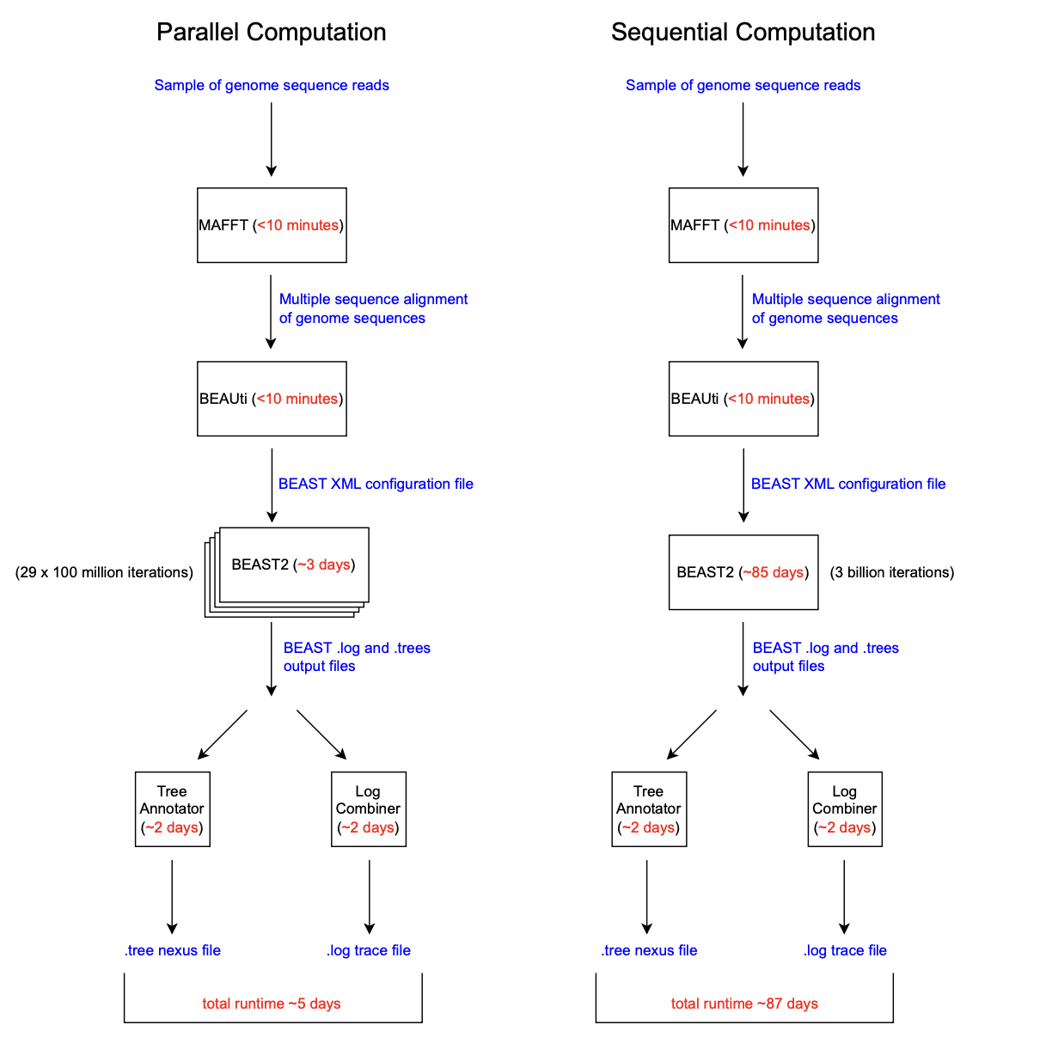
Figure 1: Overview of the Bayesian phylogenetic analyses performed in the study. Differences in methodology between MCMC ran in parallel and sequentially are shown along with the corresponding run-time for each step in the procedure.
Notes:
Time complexity of beast is linear with the number of iterations = O(n)
85 Days / 29 ~ 3 days
- the reason we chose to run 3 billion iterations is because there are metrics that commonly used to assess how well we looked at the parameter space
- we found that in the case of SARS-CoV-2 with 1000 sequences, 3 billion iterations gave us good coverage of the possible parameter space

Slide 14
Analysis of results (difference between parallel and sequential)
Two main components:
Comparison of parameter estimates (i.e., substitution rates & gamma rate parameter) from parallel computations with sequential computations and/or ground-truth
Comparison of phylogenetic trees (i.e., distance metrics) from parallel computations with sequential computations and/or ground-truth
Statistical tests such as U-test and T-test were performed to check significance
Notes:
Clarify: comparison of the parallel to the non-parallel results, and comparison of those results to the known simulation transmission tree that we specified in the FAVITES software prior to BEAST2 inference

Slide 15
Results
Notes:
- Overall, experiment times were reduced by more than 10 times in experiments involving sequential MCMC computation (~87 days) compared to experiments involving parallel MCMC computations (~5 days)
- This drastic reduction (>28 times) in run-time was observed because of the parallelization of BEAST2’s MCMC algorithm; computational times were reduced from 85 days to 3 days.

Slide 16
Simulation dataset #1 – perfect sampling

Slide 17
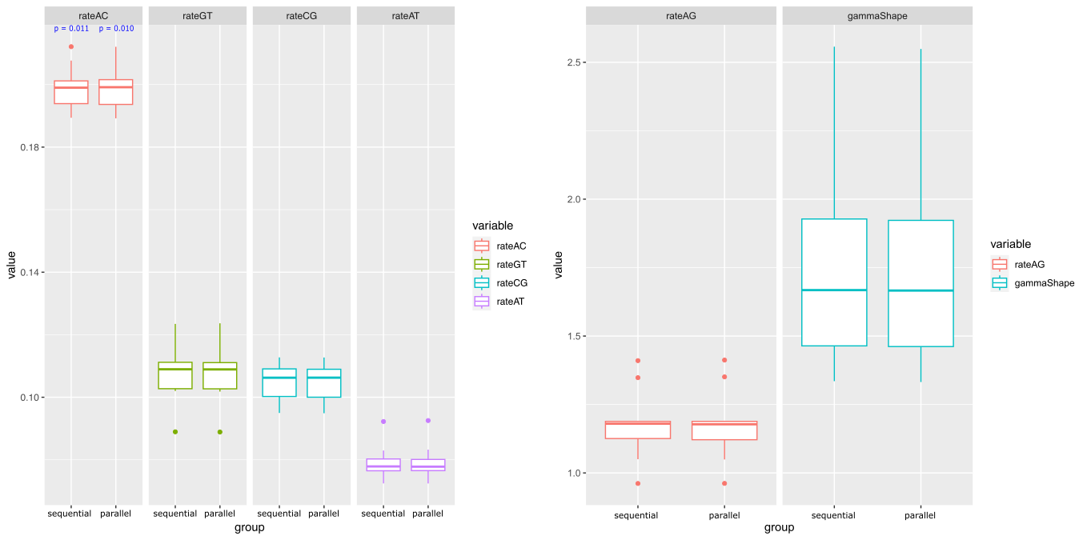
GTR estimates
Figure 2: Boxplots from ten parameter estimates from MCMC phylogenetic analyses ran in parallel and sequentially on simulated HIV data with perfect sampling rate. Significant p-values from the U-test (as a line) and t-test (directly above) are labelled. Figures with different vertical axis scaling were used due to differences in the ranges of values.
Notes:
rateAC:
- both the parallel and sequential inferred parameters differed significantly from the ground truth provided by the simulation.
- But then in all other aspects they did not differ from the ground truth.
- We don’t change the accuracy of the inference, we just improve the runtimes

Slide 18
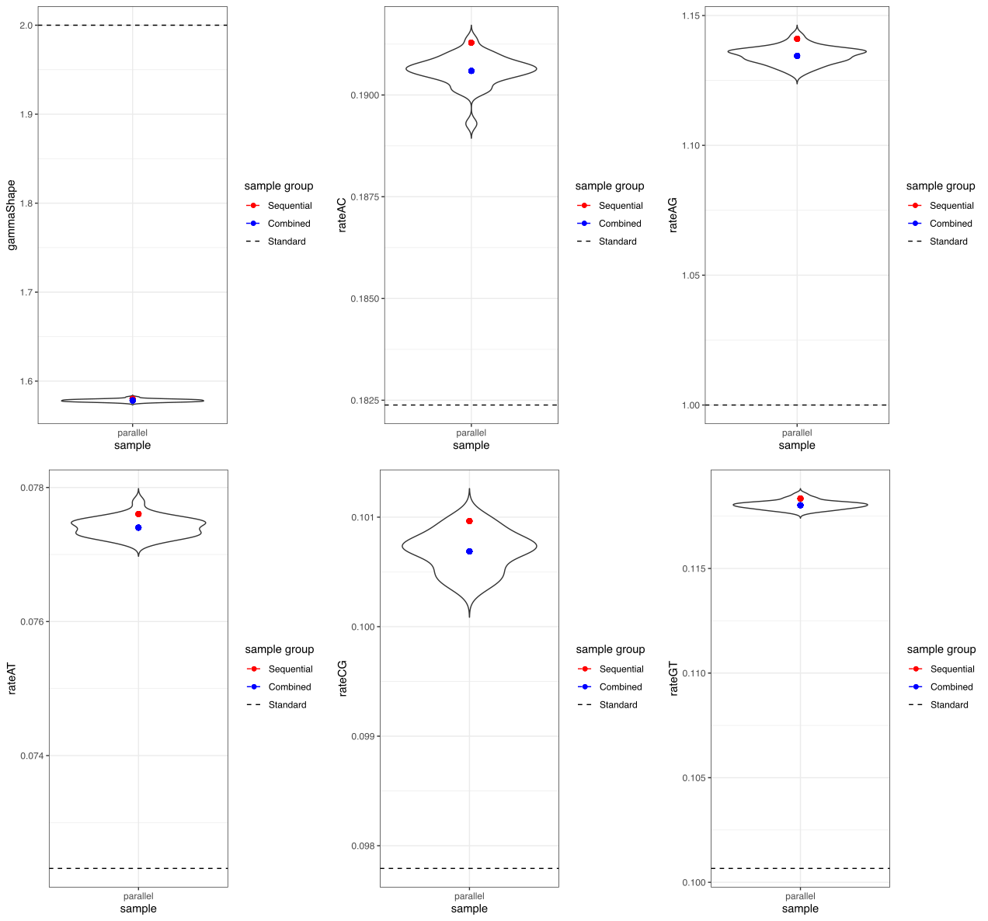
GTR estimates
Figure 3: Violin plots from parameter estimates from twenty-nine independent MCMC chains (100-million iterations) from the phylogenetic analysis performed on the first replicate of sequences in the HIV dataset perfect sampling rate. The parameter estimates for all 29 MCMC chains combined (“combined”) and parameter estimates from the MCMC run sequentially (“sequential”) on the same dataset are also shown. Horizontal dashed lines represent the true value (standard) for each parameter.
Notes:
- estimates from sequential and parallel runs fall within the same range as the individual iterations
- these estimates are far from the ground truth, but if we take the average of all samples, they are not much different.
- Worth mentioning the yaxis: although it looks really far away the values are actually deceptively close to each other.
- If we used a different scale starting from 0 you wouldn’t be able to tell the difference.

Slide 19
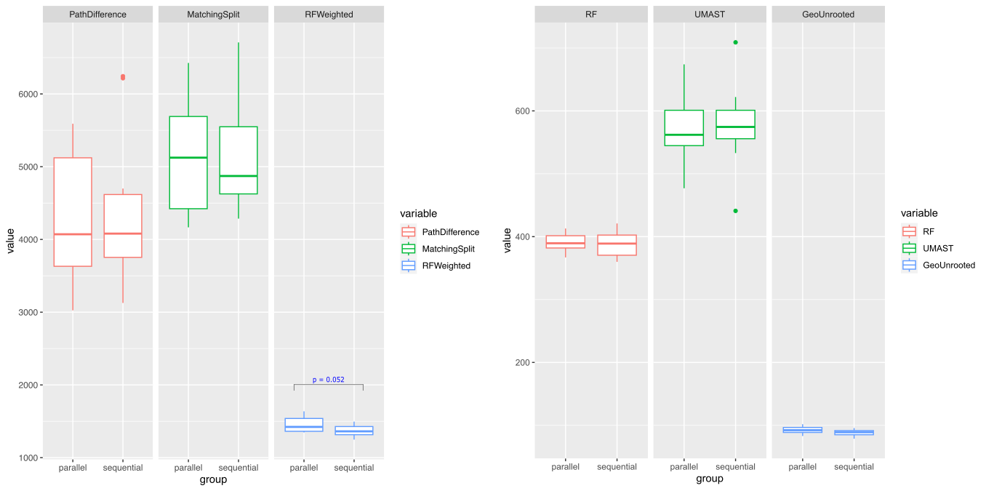
Tree similarity
Figure 4 : Boxplots from ten distance metrics calculated by comparing MCC phylogenetic trees obtained from MCMC with “true” trees defined in the simulated HIV data with perfect sampling rate. Significant p-values from the U-test comparing the distances from the sequential and parallel samples are labelled.
Notes:
Higher the number the more dissimilar the trees are.
We see that the simulated trees are different from the ground truth tree but the parallel ones are not anymore different than the sequential calculations

Slide 20
Simulation dataset #2 – 10% sampling

Slide 21
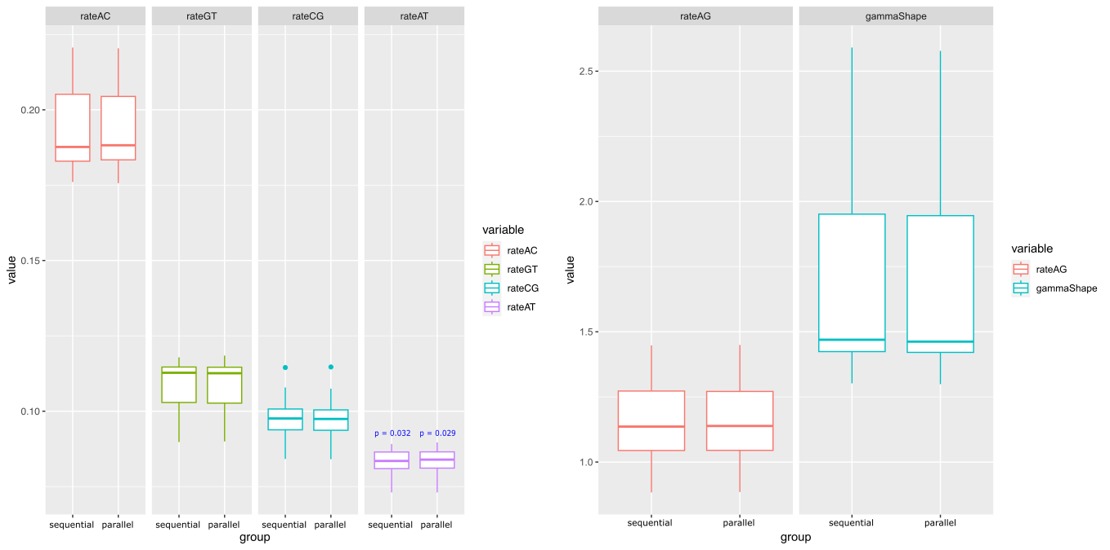
GTR estimates
Figure 5: Boxplots from parameter estimates from MCMC phylogenetic analyses ran in parallel and sequentially on simulated HIV data with 10% sampling rate. Significant p-values from the U-test (as a line) and t-test (directly above) are labelled. Figures with different vertical axis scaling were used due to differences in the ranges of values

Slide 22
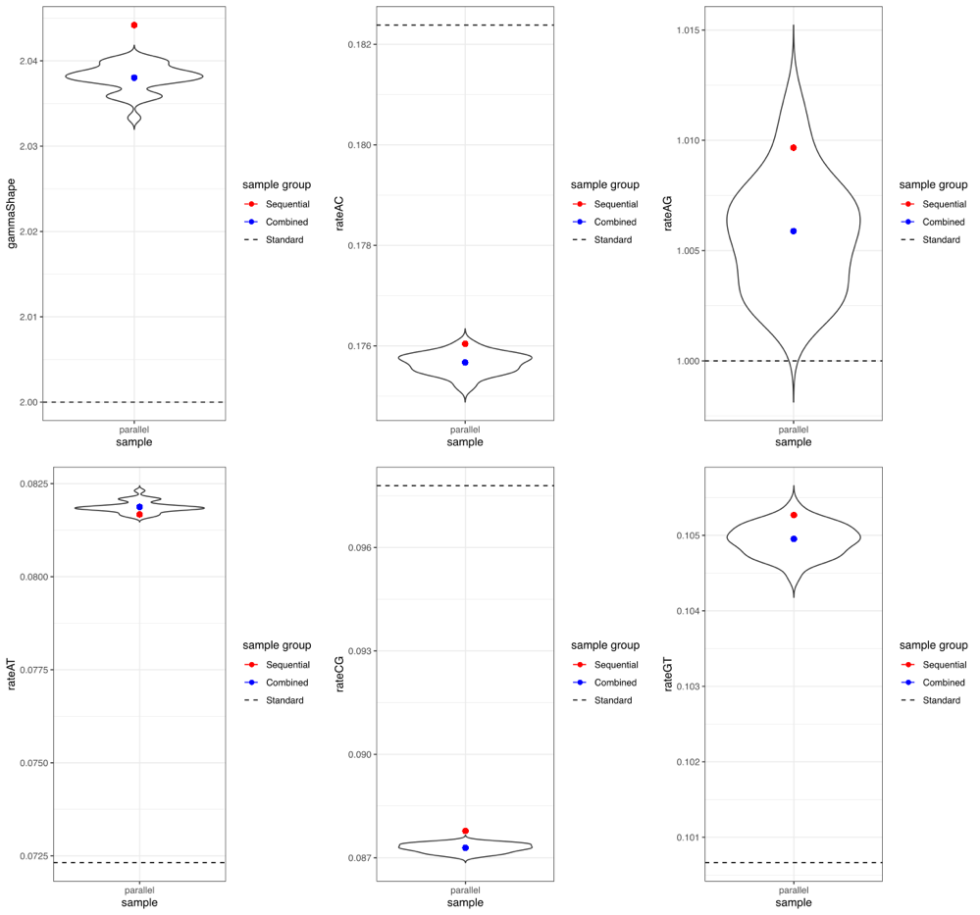
GTR estimates
Figure 6: Violin plots of parameter estimates from twenty-nine independent MCMC chains (100-million iterations) from the phylogenetic analysis performed the first replicate of sequences in the HIV dataset 10% sampling rate. The parameter estimates for all 29 MCMC chains combined (“combined”) and parameter estimate from the MCMC ran sequentially (“sequential”) on the same data are also shown. Horizontal dashed lines represent the true value (standard) for each parameter.

Slide 23
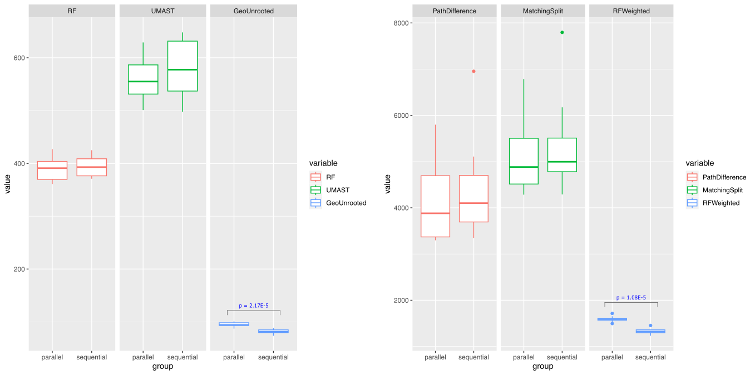
Tree similarity
Figure 7: Boxplots from ten distance metrics calculated by comparing MCC phylogenetic trees obtained from MCMC with “true” trees defined in the simulated HIV data with 10% sampling rate. Significant p-values from the U-test comparing the distances from the sequential and parallel samples are labelled.
Notes:
- Geounrooted and Rfweighted both take into account tree branch lengths
- RF does not take into account the tree branch lengths
- together this suggests differences in the scaling of the trees
MCC – maximum clade credibility tree: the tree that fits the idealized parameters the best (mention in the introduction somewhere) given the inferred Bayesian probailityies it is th most likely tree to have happened.

Slide 24
Real world dataset – SARS-CoV-2

Slide 25
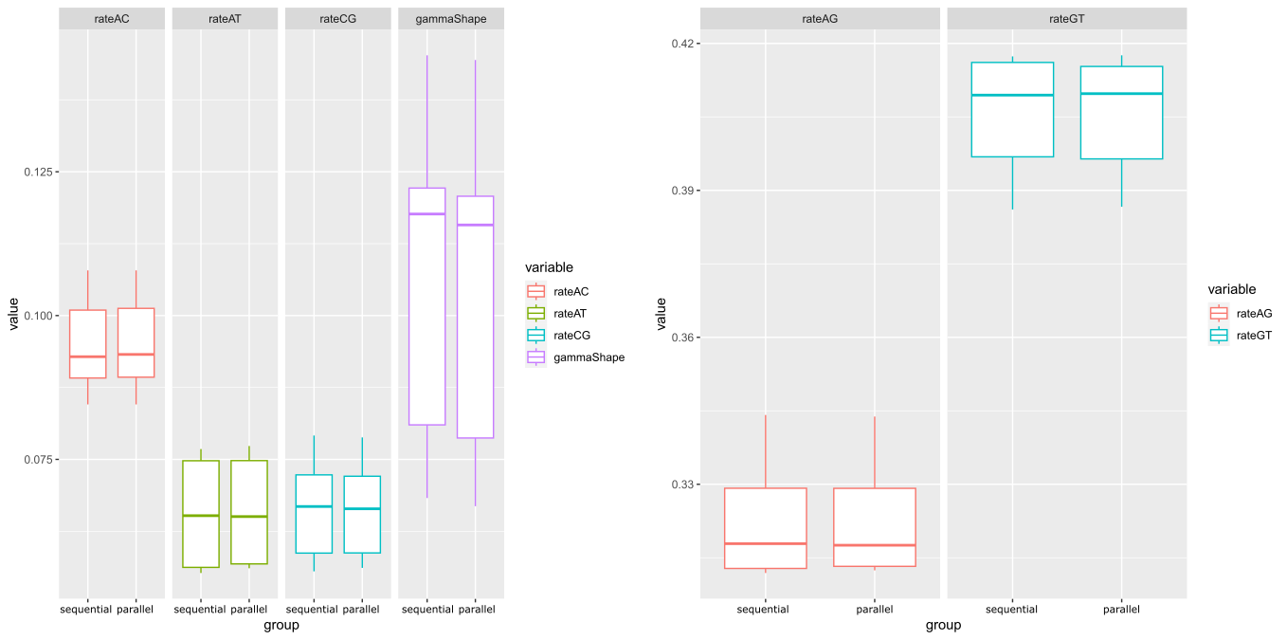
GTR estimates
Figure 8: Boxplots from six parameter estimates from MCMC phylogenetic analyses ran in parallel and sequentially on SARS-CoV-2 data. Significant p-values from the U-test (as a line) and t-test (directly above) are labelled.

Slide 26
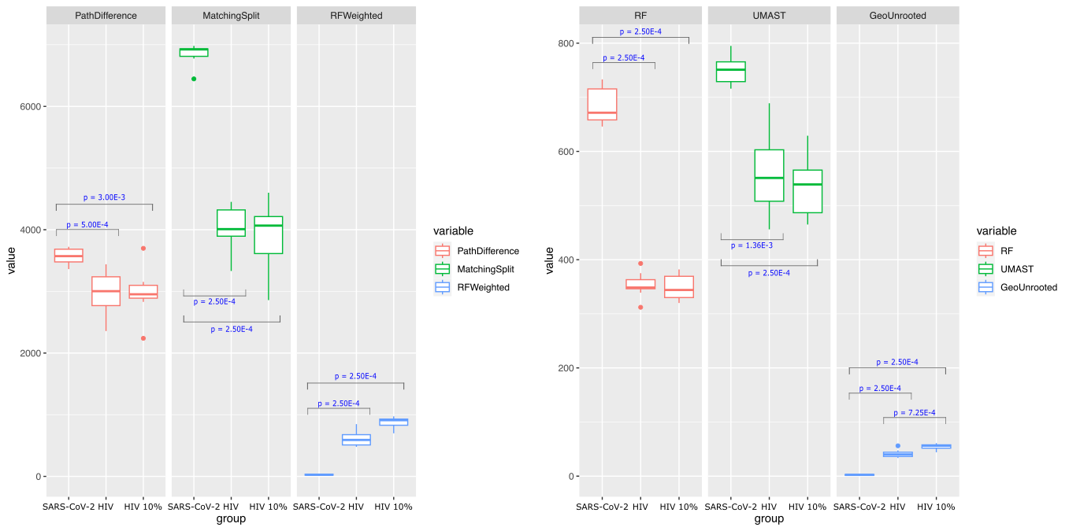
Tree similarity
Figure 9: Boxplots from distance metrics calculated by comparing MCC phylogenetic trees obtained from sequential and parallel MCMC runs on simulated HIV data with perfect sampling, simulated HIV data with 10% sampling rate, and SARS-CoV-2 data. Significant p-values from the U-test comparing the distances between the metrics from each dataset are labelled.
Notes:
No difference when 10% vs perfect sampling was used in the HIV dataset
We don’t know the groundtruth for the SARS-CoV-2 trees but we can say that the tree is no further from the ground truth. Comparison to the simulated ones show that neither are closer to the ground truth that the other.
Put arrow or highlight over RF and matchsplit (doube check )

Slide 27
Conclusion

Slide 28
Final remarks
Overall experimental run-times were reduced by almost 84 days owing to the parallelization
Parameter estimates:
The sequential MCMC runs provided no significant advantage predicting phylogenetic parameters over the parallel MCMC runs in our analyses involving simulated data
Even in the parameter estimates from SARS-CoV-2 data, no significant differences in parameter estimates were observed
Phylogenetic tree predictions:
Distance metrics calculated in the simulation study also suggested that MCC phylogenetic trees obtained from parallel and sequential MCMC were mostly similar except for branch lengths
In general, our parallelization methodology was less consistent for the real-world SARS-CoV-2 data
Most of the differences lay in the scaling of the phylogenetic trees and not in the topology of the phylogenetic trees for the simulation dataset whereas in the SARS-CoV-2 dataset, differences were found in the topology as well

Slide 29
Acknowledgements
Supervisor: Dr. Paul Gordon
Support from Dr. Qingrun Zhang & Dr. Quan Long and other lab members
Funding: Alberta Innovates

Slide 30
Thank you for attending!
Feel free to ask any questions!
David Yang
For any inquiries I may be reached at david.yang1@ucalgary.ca

Slide 31
Methodology
Random sampling
Randomly select N sequences from all sequence data available
Weighted sampling
Select N sequences from each country in each month based on SARS-CoV-2 prevalence
Prevalence estimated with IHME mean estimates

Slide 32
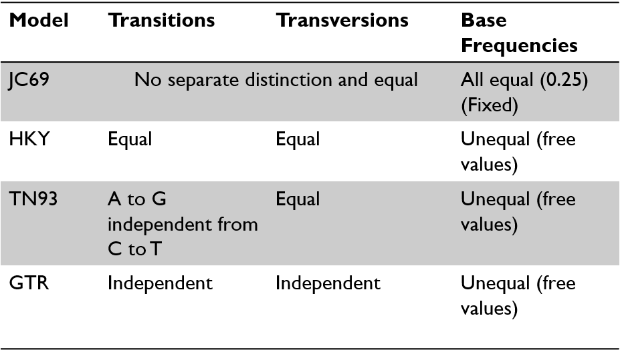
Site models

Slide 33
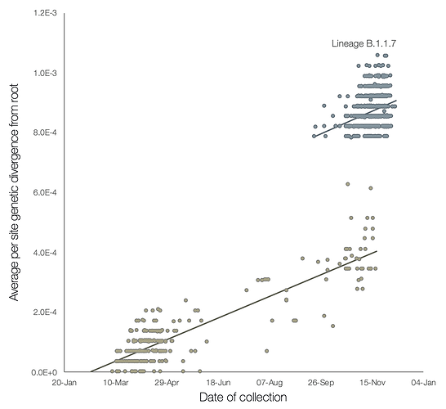
Differences in Clock Rate
(Rambaut et al., 2020)
Notes:
https://virological.org/t/preliminary-genomic-characterisation-of-an-emergent-sars-cov-2-lineage-in-the-uk-defined-by-a-novel-set-of-spike-mutations/563

