Slide 1
Investigating the effect of sampling bias on SARS-CoV-2 phylogenetic inference
David H Yang
Group Presentation
Dr. Paul Gordon & Dr. Quan Long
April 28th, 2022

Slide 2
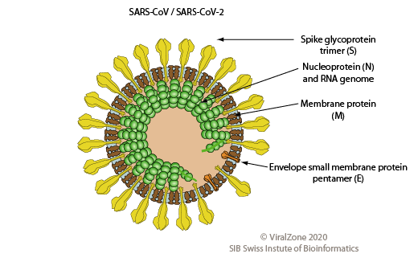
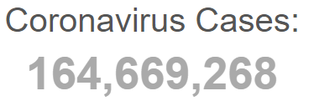
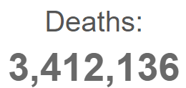
SARS-CoV-2
X 10.5
X 1.47

Slide 3
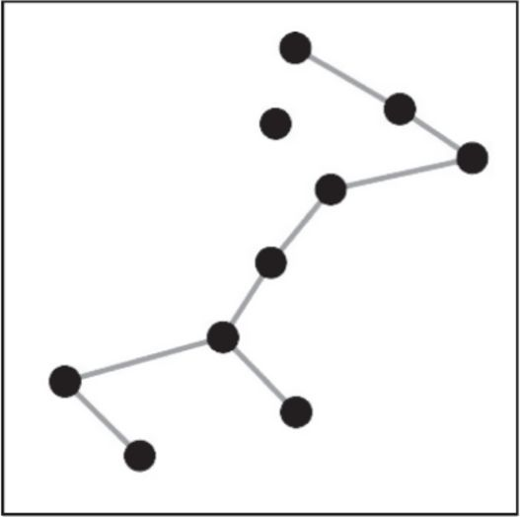
Phylogenetic Analysis
Node
Virus A
Clade
Virus B
Root
Virus C

Slide 4
Source of Sampling Bias
Table 1: The total number of cases, cases per 1 million population, tests per 1 million population and genome sequences from Canada, China, India, USA, and the United Kingdoms. All statistics were obtained from Worldometer and GISAID on October 7th, 2020
Country: | Cases | Cases/1 million population | Tests/1 million population | Genome sequences on GISAID
Canada | 196,321 | 5,188 | 226,302 | 2,714
China | 85,659 | 60 | 111,163 | 994
India | 7,492,727 | 5,414 | 67,381 | 3,092
USA | 8,334,763 | 25,137 | 376,047 | 34,577
United Kingdom | 705,428 | 10,375 | 426,333 | 61,441

Slide 5
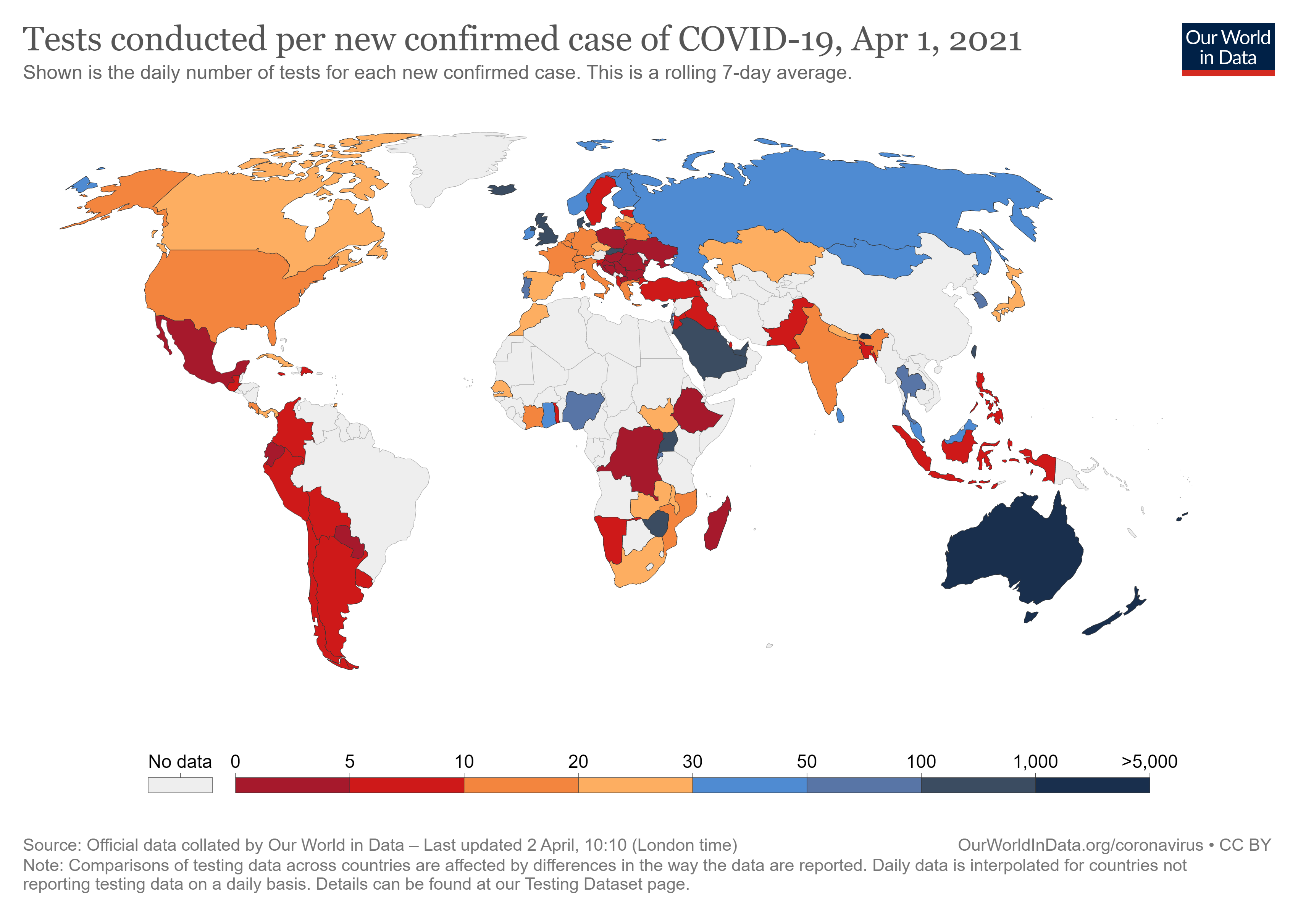
Difficulties Controlling Sampling Bias

Slide 6
SARS-CoV-2 Prevalence Metrics
$$Percent positive ratio (in \%)= \frac{\# of positive test results}{\# of RTPCR tests} x 100\%$$
$$Infection fatality ratio \left(in \%\right)=\frac{number of deaths from disease}{number of infected individuals} x 100\%$$
$$Case fatality ratio \left(in \%\right)=\frac{number of deaths from disease}{number of confirmed cases of disease} x 100\%$$
Serology test: Detection of previous infections via presence of anti-SARS-CoV-2 antibodies

Slide 7
Aims
Investigate the true prevalence of SARS-CoV-2 in each region around the world and the region’s corresponding sequencing contribution to public datasets
Devise a weighted sampling strategy to create sequence subsamples that are representative of SARS-CoV-2 prevalence in regions around the world and different months
Generate and compare the accuracy of phylogenetic trees produced through weighted sampling and random sampling

Slide 8
Aim 1
Investigate the true prevalence of SARS-CoV-2 in each region around the world and the region’s corresponding sequencing contribution to public datasets

Slide 9



Methodology
Data Collection
Obtain and calculate seroprevalence metrics
Data Manipulation
Group statistics by month and region
Data Analysis
Compare prevalence estimates from each metric

Slide 10
Prevalence
Figure 1: Number of cases and the Institute for Health Metrics and Evaluation’s mean estimate of cases in the world from February 1st, 2020 to October 31st, 2020.

Slide 11
Seroprevalence
Table 2: SARS-CoV-2 prevalence metrics obtained for the five countries and months with the highest seroprevalence findings.
Location | Month | Case count | Percent positivity | Serology tests | IHME estimate
Ecuador | May 2020 | 13896 | 36.54% | 44.74% (N = 992) | 573349.3915
Austria | April 2020 | 5746 | 2.82% | 40.71% (N = 3076) | 22240.91491
Italy | May 2020 | 29073 | 1.53% | 38.12% (N = 17123) | 244049.5844
Pakistan | June 2020 | 139841 | 19.00% | 35.75% (N = 2045) | 1693502.075
Iran | April 2020 | 52162 | 30.06% | 33% (N = 528) | 642326.7207

Slide 12
Sequencing contribution: march
a)
b)
c)
Figure 2: Doughnut charts for countries in March 2020. a) depicts the number of reported cases in each country, b) depicts the IHME estimate of the number of cases in each country, and c) depicts the number of sequences sequenced in each country.

Slide 13
Sequencing contribution: globally
Figure 2: Doughnut charts for countries between February 1st 2020 to October 31st, 2020. a) depicts the number of reported cases in each country, b) depicts the IHME estimate of the number of cases in each country, and c) depicts the number of sequences sequenced in each country.

Slide 14
Aim 2
Devise a weighted sampling strategy to create sequence subsamples that are representative of SARS-CoV-2 prevalence in regions around the world and different months

Slide 15
Methodology
Random sampling
Randomly select N sequences from all sequence data available
Weighted sampling
Select N sequences from each country in each month based on SARS-CoV-2 prevalence
Prevalence estimated with IHME mean estimates

Slide 16
Problems with using serology tests
Figure 3: A tally of the number of seroprevalence studies across the world collected on SeroTracker on December 9th, 2020. The last bar and third last bar from the right on the chart represents the total number of studies from the USA and China respectively

Slide 17
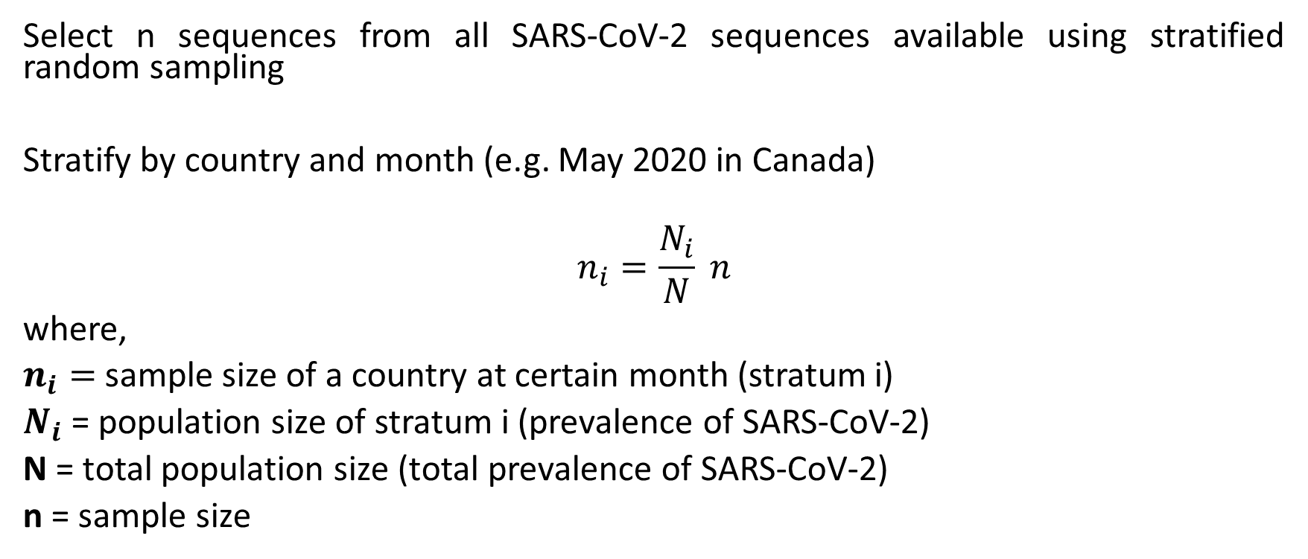
Sampling strategy (n = 1000)
Select n sequences from all SARS-CoV-2 sequences available using stratified random sampling
Stratify by country and month (e.g. May 2020 in Canada)
$$n_{i}=\frac{N_{i}}{N} n$$
where,
$n_{i}=$ sample size of a country at certain month (stratum i)
$N_{i}$ = population size of stratum i (prevalence of SARS-CoV-2)
N = total population size (total prevalence of SARS-CoV-2)
n = sample size

Slide 18
Weighted sampling strategy flowchart
Total sequences sampled
Month A sequences
Country A sequences
Country B sequences
Month B sequences
Country A sequences
Country B sequences
.8 x 12,500 = 10,000
2500
12,500
25,000
Notes:
DESCRIBE WEIGHTED SAMPLING STRATEGY

Slide 19
Weighted sampling versus random sampling
Figure 4: The number of sequences to be obtained from each country if 1576 sequences from March 2020 were to be obtained via weighted or random sampling.

Slide 20
Subsamples created
b)
Figure 5: Doughnut charts for the sequencing location of subsamples obtained via a) our weighted sampling strategy versus b) the random sampling strategy.

Slide 21
Aim 3
Generate and compare the accuracy of phylogenetic trees produced through weighted sampling and random sampling

Slide 22
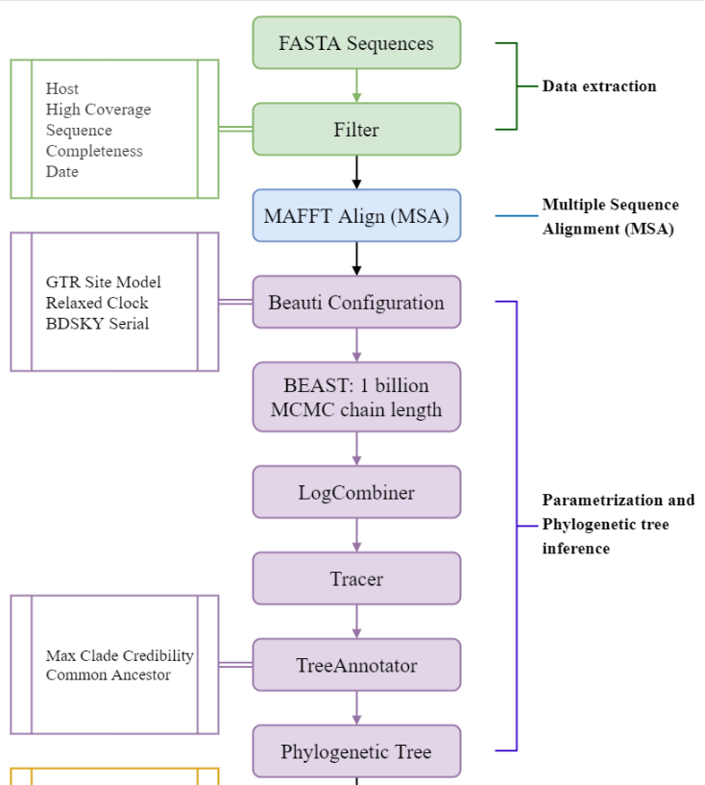
Methodology
Samples from weighted and random sampling
Strict clock
TransCOVID pipeline (Long Lab)
Compare to Nextstrain global analysis & dedicated builds

Slide 23
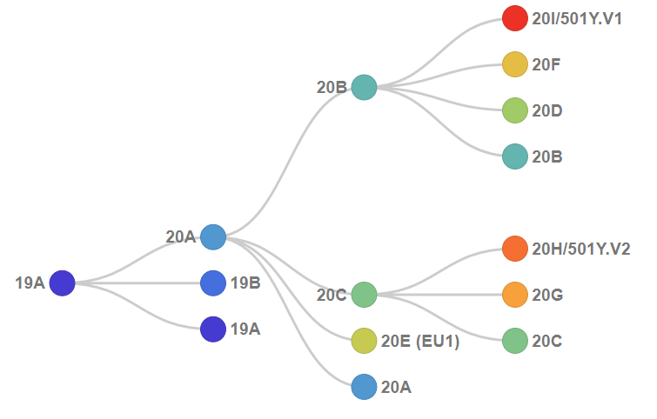
Nextstrain Clades
(Nextstrain)

Slide 24
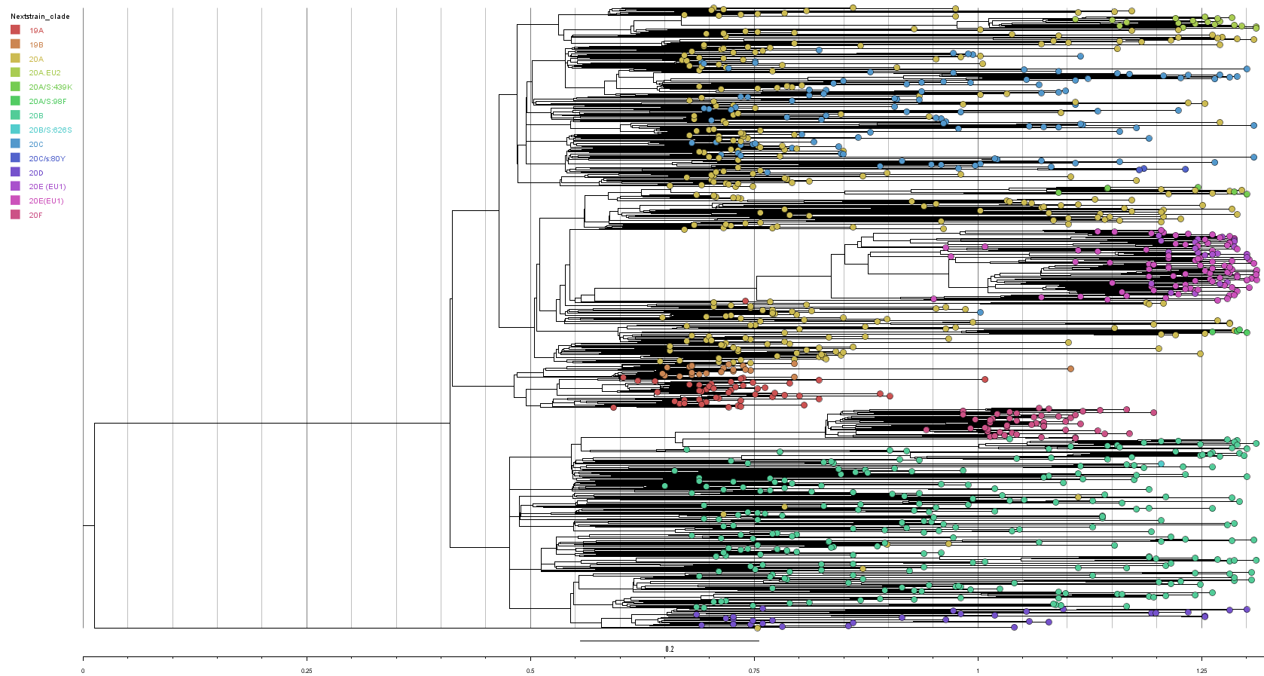
Random sampling
Figure 6: General clade (NextStrain) structure of phylogenetic tree produced from random sampling using BEAST2.

Slide 25
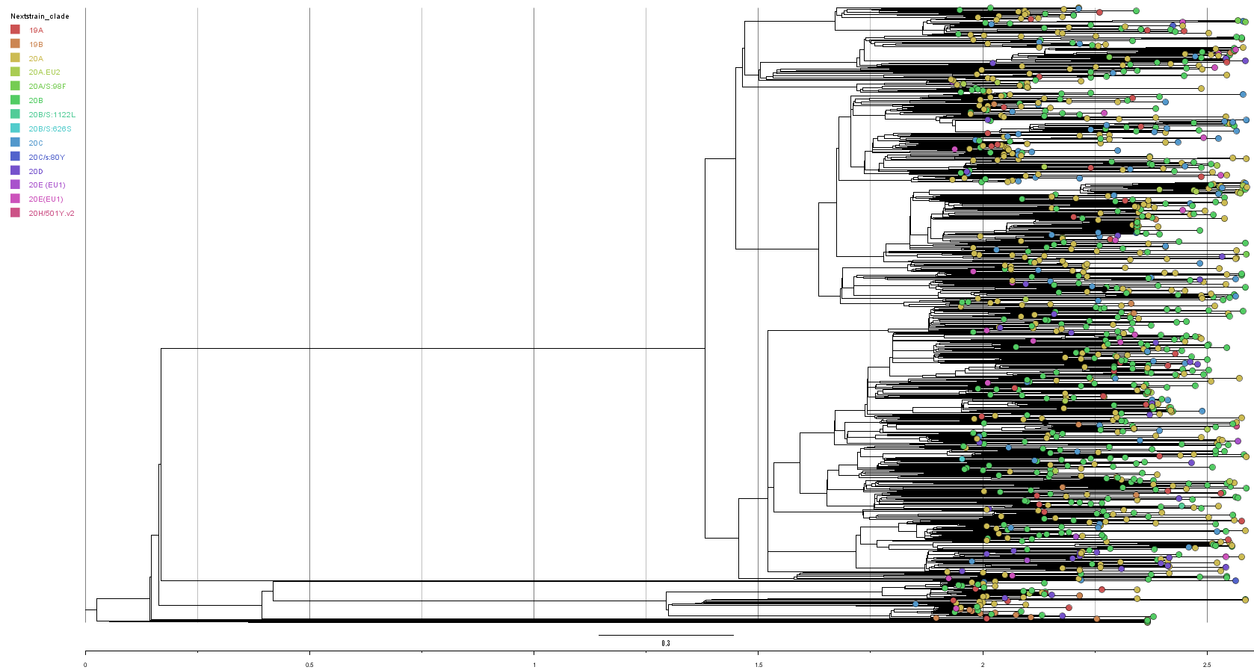
Weighted sampling
Figure 7: General clade (NextStrain) structure of phylogenetic tree produced from weighted sampling using BEAST2.

Slide 26
Comparison of Trees with Nextstrain
Table 3: Earliest dates sampled for various Nextstrain clades in each subsample. The global analysis and the dedicated builds were performed by Nextstrain.
Clade | Random | Weighted | Global Analysis | Dedicated Build
20A.EU2 | 2020-08-17 | 2020-08-20 | 2020-09-01 | 2020-06-10 (02-04 to 05-01)
20A/S:439K | 2020-08-10 | N/A | 2020-08-24 | 2020-04-03 (03-14 to 04-13)
20A/S:98F | 2020-10-12 | 2020-09-08 | 2020-08-28 | 2020-03-10 (01-23 to 02-19)
20B/S:1222L | N/A | 2020-10-07 | 2020-09-07 | 2020-07-06 (04-15 to 06-29)
20B/S:626S | 2020-09-21 | 2020-10-06 | 2020-12-22 | 2020-07-15 (05-31 to 07-10)
20C/S:80Y | 2020-09-12 | 2020-06-29 | 2020-09-21 | 2020-07-16 (04-09 to 04-20)
20E (EU1) | 2020-06-20 | 2020-07-10 | 2020-06-25 | 2020-04-30 (03-04 to 04-24)
20H/501Y.v2 | N/A | 2020-10-19 | 2020-11-17 | 2020-10-08 (07-02 to 09-20)

Slide 27
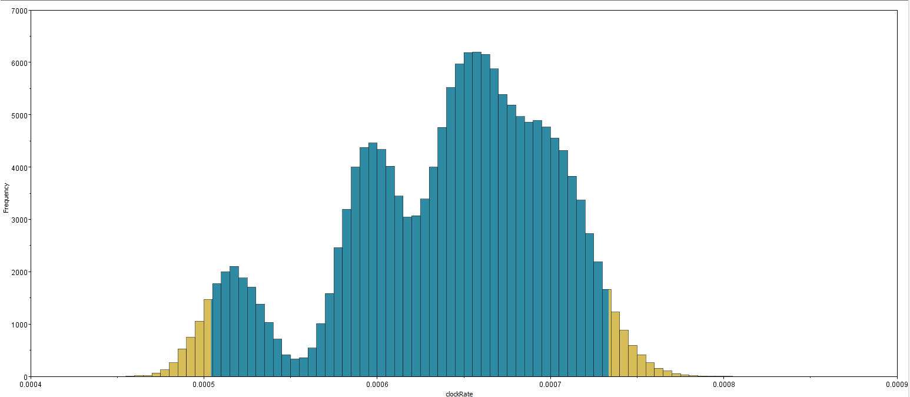
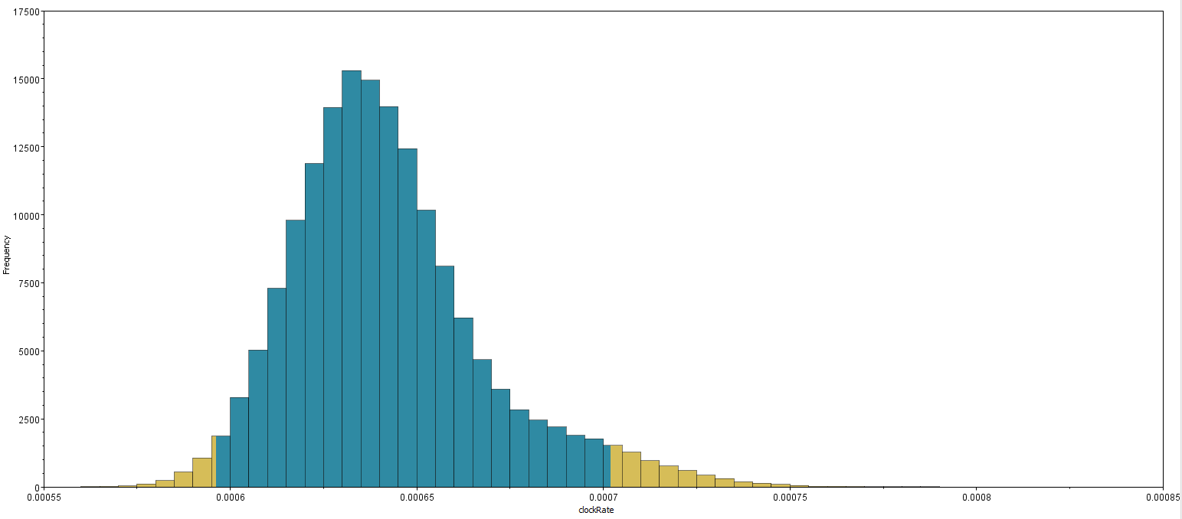
Phylogenetic Analysis: Clock rate
a)
b)
Figure 8: Clock rate trace files obtained from the analysis of the a) weighted sampled subsample and b) random sampled subsample.

Slide 28
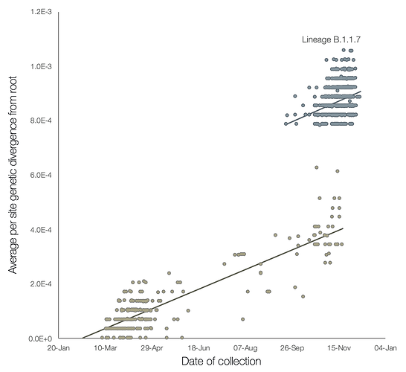
Differences in Clock Rate
(Rambaut et al., 2020)
Notes:
https://virological.org/t/preliminary-genomic-characterisation-of-an-emergent-sars-cov-2-lineage-in-the-uk-defined-by-a-novel-set-of-spike-mutations/563

Slide 29
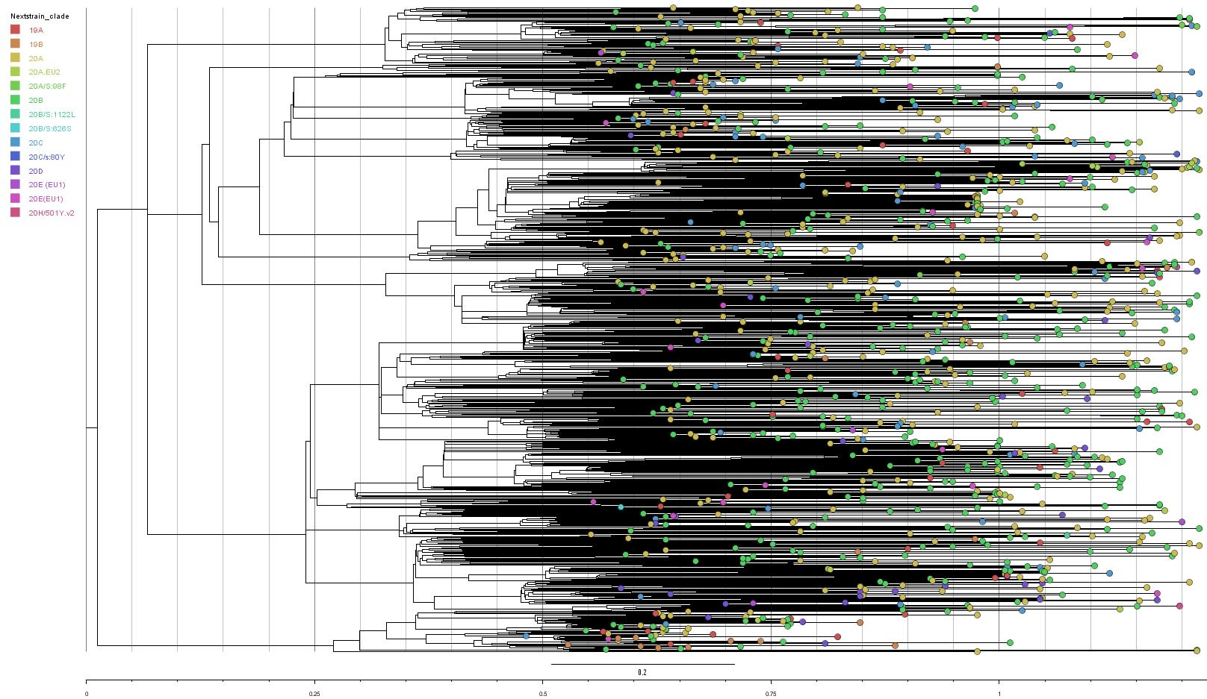
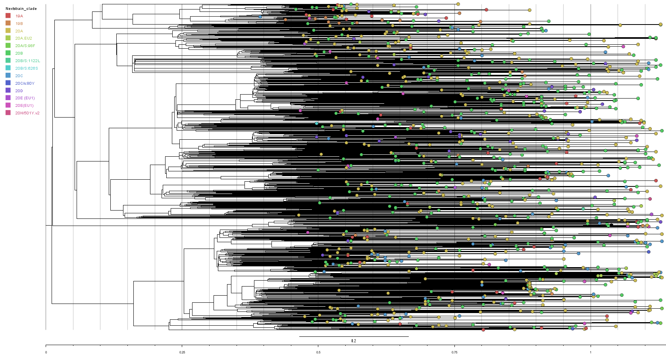
Phylogenetic tree results with relaxed clock
Figure 1: Tree produced from 1 billion MCMC iterations
Figure 2: Tree produced from 3 billion MCMC iterations

Slide 30
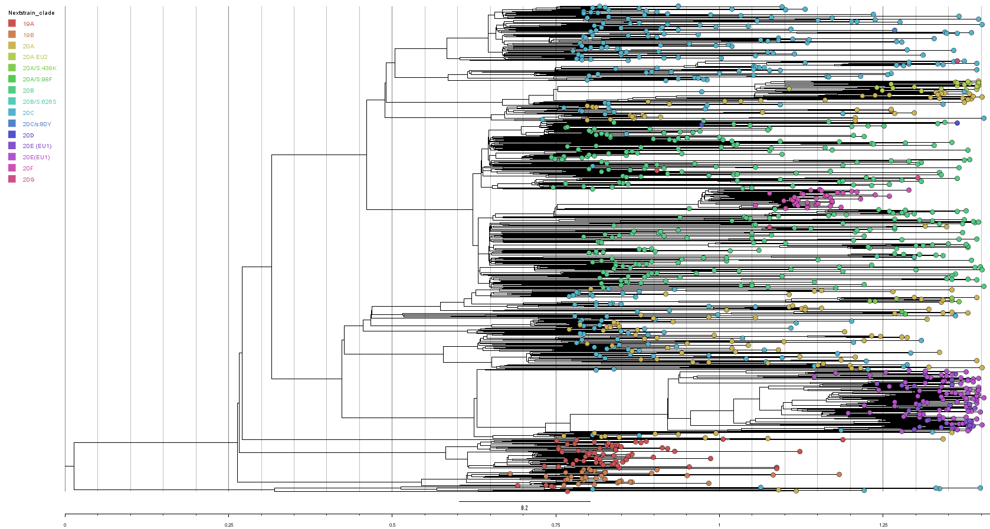
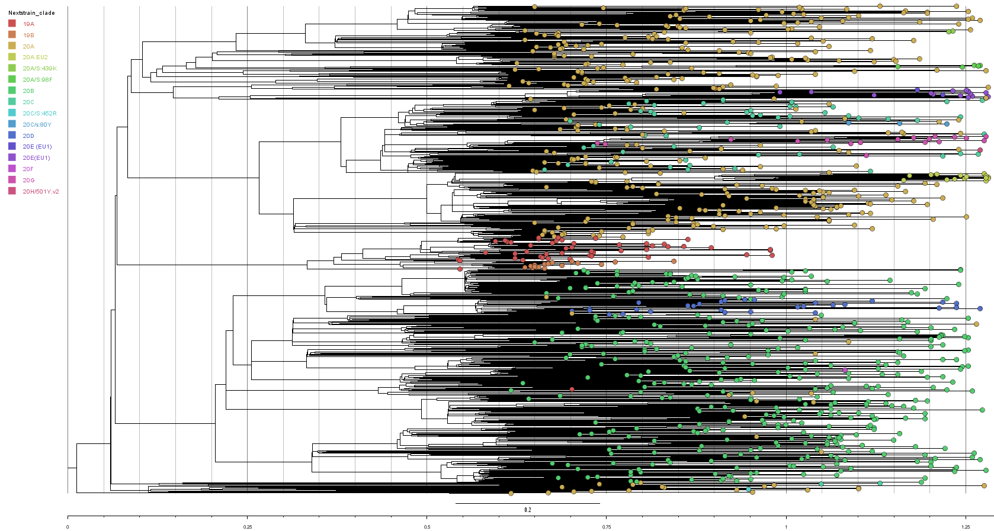
Phylogenetic tree results cont.
Figure 1: Tree produced from random sampling strategy
Figure 1: Tree produced from stratified sampling strategy

Slide 31
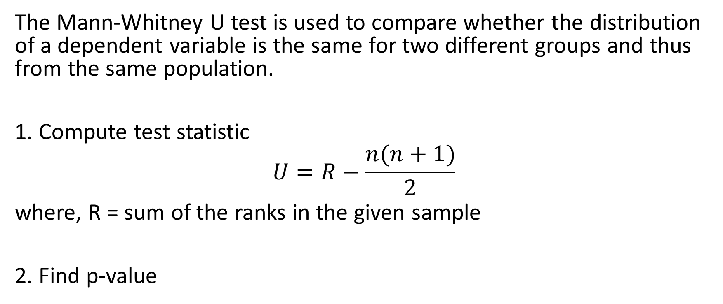
Mann-Whitney U test
The Mann-Whitney U test is used to compare whether the distribution of a dependent variable is the same for two different groups and thus from the same population.
1. Compute test statistic
$$U=R−\frac{n(n+1)}{2}$$
where, R = sum of the ranks in the given sample
2. Find p-value

Slide 32
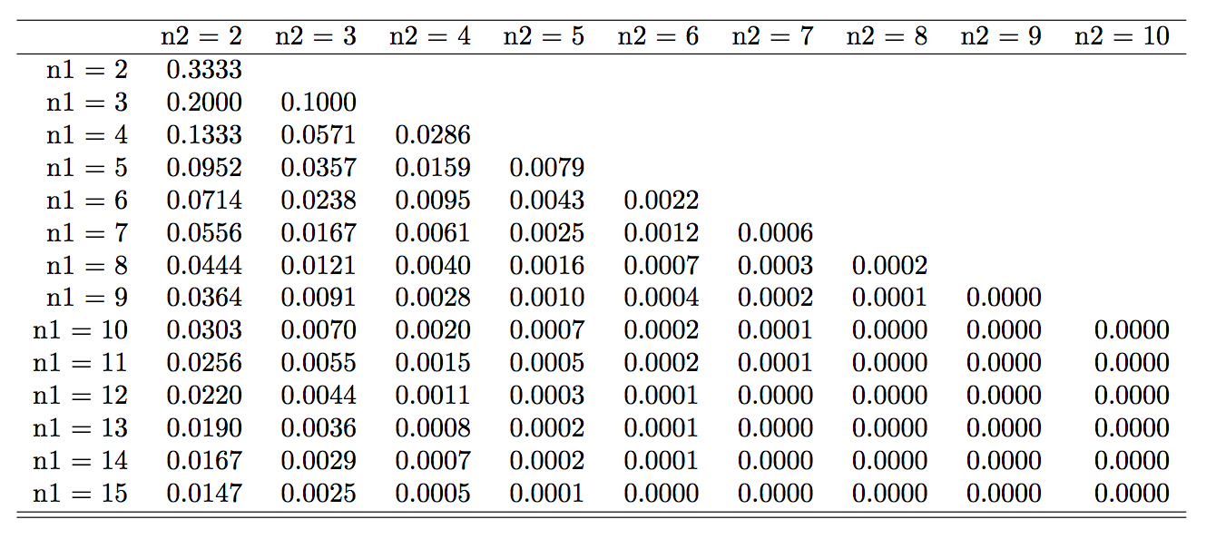
Mann-Whitney U test P value table

Slide 33
Comparison of parameters with U test
p value
parameters
Figure: p-value from U test between longer runs and shorter MCMC runs

Slide 34
Comparison of parameters with U test
p value
parameters
Figure: p-value from U test between trees obtained from random and stratified sampling

Slide 35
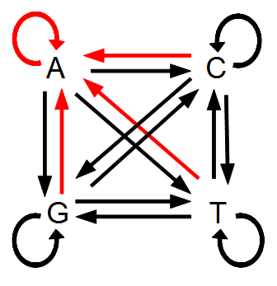
Gamma shape parameter
Gamma shape parameter governs the shape of the Gamma distribution of the rates across different sites.
Run | group | Gamma Shape
R1P | clustered | 0.1132
R1L | clustered | 0.115
R2P | clustered | 0.0668
R2L | clustered | 0.0696
R3P | clustered | 0.0665
R3L | clustered | 0.0684
W1P | unclustered | 0.1444
W1L | unclustered | 0.1452
W2P | clustered | 0.1185
W2L | clustered | 0.1204
W3P | unclustered | 0.1214
W3L | unclustered | 0.1227
W3Pg | gamma | 0.07
W1Pg | gamma | 0.07

Slide 36
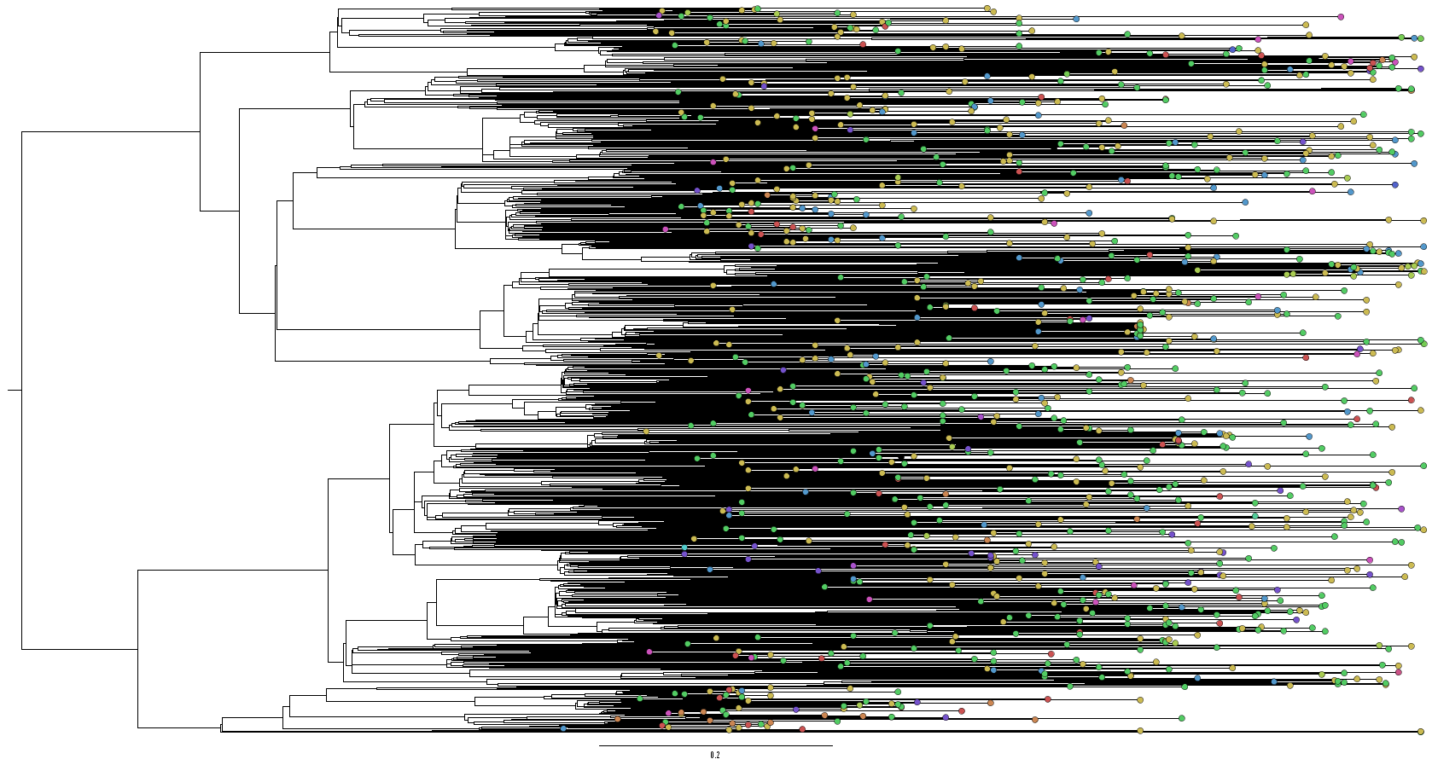
Phylogenetic trees with fixed gamma shape parameter
Figure: Tree produced from BEAST with fixed gamma parameter vs tree produced with no specification

Slide 37
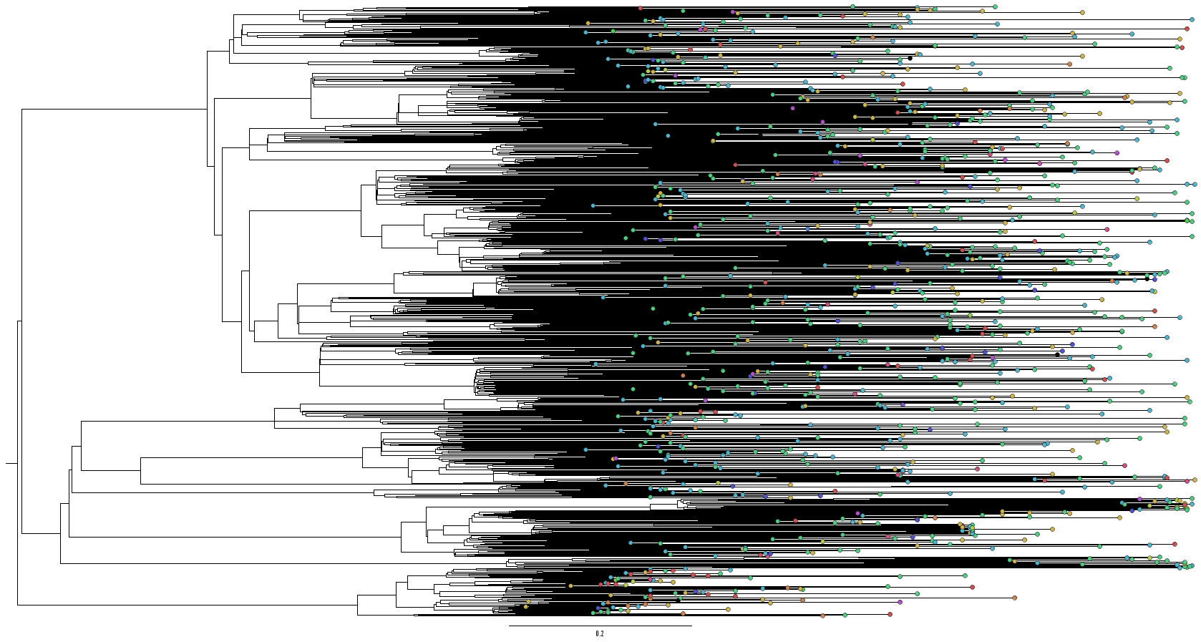
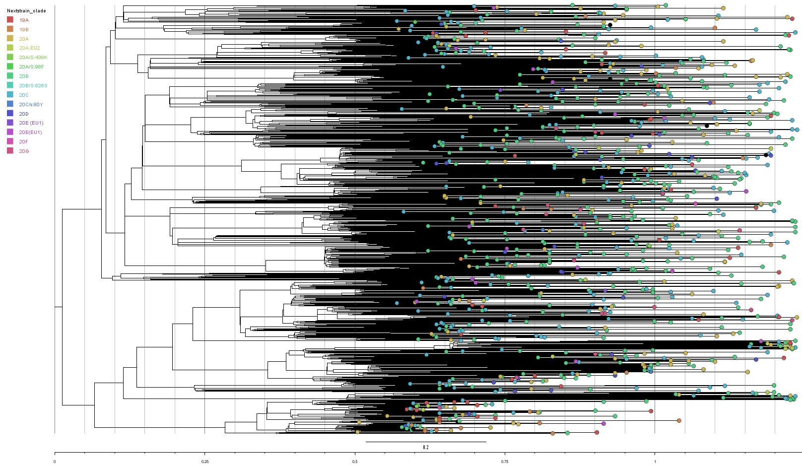
Phylogenetic trees with fixed gamma shape parameter
Figure: Tree produced from BEAST with fixed gamma parameter vs tree produced with no specification

Slide 39
Acknowledgements
Supervisors
Dr. Paul Gordon
Dr. Quan Long
Special thanks to
Deshan Perera
Long lab

Slide 40
Thank you for listening!

