Slide 1
On a Statistical Transmission Model in Analysis of the Early Phase of COVID-19 Outbreak
Yifan Zhu, Ying Qing Chen
Journal club presentation
By: David Yang
Notes:
This paper was released in 2021, so a lot of information that we know now was not known at the time of the study, which makes it quite interesting in my opinion as we can look at the situation almost omnisciently.
Disease onset – first time there has been noted a change in one’s usual health status with the identified signs and/or symptoms being able to be directly attributable to a specific disease process.
Hazard - usually denoted by h(t) or λ(t) and is the probability that an individual who is under observation at a time t has an event at that time. Put another way, it represents the instantaneous event rate for an individual who has already survived to time t. In summary, the hazard relates to the incident (current) event rate.
Intensity indicator - an estimate of the proportion of the population with acute respiratory disease
Augmented daily onset record – data generated from github where case reports are converted into incidence curves
Sensitivity analysis - a financial model that determines how target variables are affected based on changes in other variables known as input variables.

Slide 2
Table of Content
Introduction
Section 2:
Explanation of data structure
Assumption of COVID-19 natural disease history
Likelihood based Poisson model for evaluating transmissibility
Section 3:
Data source for analyses
Estimates of R₀
Impact of different model assumptions using sensitivity analyses
Section 4:
Applying model to updated onset data
Section 5
Summary of findings from transmission model
Discussion of advantages and drawbacks
Notes:
They separated paper into four sections, so intuitively my presentation will be structured similarly.

Slide 3
COVID-19
Disease caused by novel coronavirus (SARS-Cov2)
Outbreak first reported on December 2019 and lockdown measures were immediately imposed to contain the spread of the virus
Greatest transmission rate among all human coronaviruses (i.e. SARS-CoV & MERS-CoV)
In the early stages of the outbreak, it was important to understand the transmissibility of the outbreak

Slide 4
R₀
Many studies provide crucial information for establishing transmission models to estimate the basic reproduction number (R₀) of COVID-19 (measure of transmission for infectious diseases)
R₀: average number of secondary cases in an uninfected population that a diseased person would infect during their infectious window
Estimated R₀’s from initial models were generally greater than 2 with values as high as 3.8 for SARS-CoV2
In this paper, a Poisson transmission model was fitted and evaluated and R0 values were computed
Notes:
If the effective R0 is below 1, then the disease is contained and will eventually disappear

Slide 5
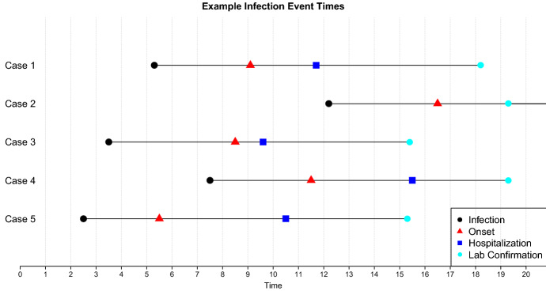
Explanation of data structure
Hypothetical example of case event time review and contact tracing process
Notes:
Black dot = time of infection
Red triangle = development of symptoms
Blue square = Hospitalization
Torquise circle = Lab confirmation of COVID-19
The goal of this figure is to illustrate that in the course of disease history of COVID-19:
there is first an incubation period in which an individual is asympotomatic
Followed by a delay once a person develops symptoms and is confirmed as a case of COVID-19 in the lab

Slide 6
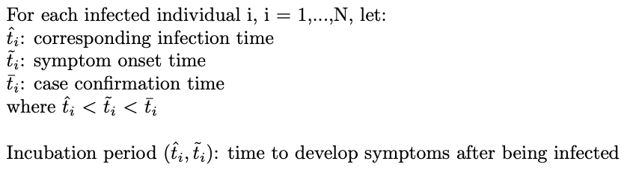
Explanation of Data Structure
Define some variables:
Notes:
These variables are defined here so that you can understand the variables in their probability models.

Slide 7
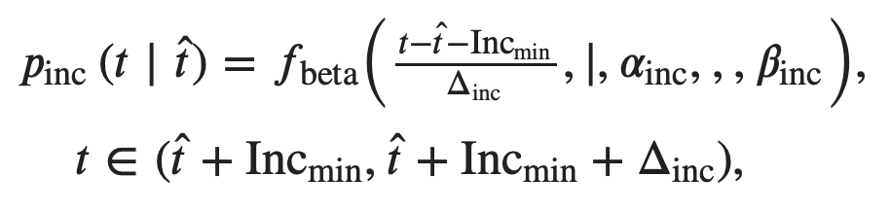
Assumption of Disease Natural History
Exact infection time is difficult to determine, hence we need a reasonable assumption of the incubation period distribution:
The probability of observing symptom onset at t given some infection time is,
Notes:
Inc min is the minimum length of incubation, inc min + delta is the maximum length of incubation. The mean incubation length is incmin + delta * alpha/(alpha+beta)
They used a beta-distribution is because it has finite support and so we don’t need to truncate the tails and that reflects the understanding of the incubation period.

Slide 8

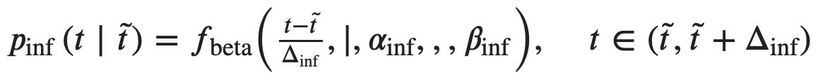
Assumption of Disease Natural History
We also assumed that the latent period (time length between infection and start of infectiousness) is the same as the incubation period
The relative infectivity during the infectious period is,
Notes:
In other words, they assumed that you were not infectious until you developed symptoms.
Relative infectivity is sort of like your ability to infect someone during different time points in your infectious window. So you’ll see your level of infectivity varies throughout different time points of your disease history.

Slide 9
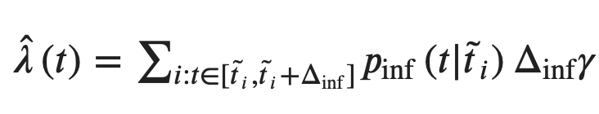
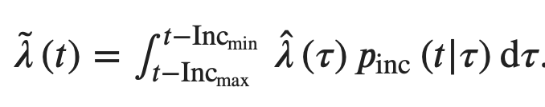
Poisson Transmission Model for Daily Disease Onset Record
Let. : the average hazard of secondary infection along the infectious period
The overall infection hazard from all infected cases in the community is
The intensity of disease onset at time t is
Notes:
The overall hazard can be thought of as the number of secondary infections at time t. As we see it is the average hazard multiplied by the interval of infectivity multiplied by the relative infectivity which would give the number of secondary infections per individual and the summation would give for the entire population.
The intensity of the disease can be thought of as the total number of cases up to time t. The bounds are used because it is assumed one is not infectious during incubation period. And we are multiplying by probability of symptom onset as it would tell us all the secondary infections that result in development of symptoms.

Slide 10



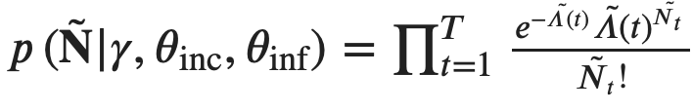

Poisson Transmission Model for Daily Disease Onset Record
Let : daily cumulative intensity rate of onset
Assume the number of observed symptom onsets for day t is Poisson distributed with intensity , the likelihood of observing onset record is
can be estimated using MLE
Notes:
Lambda can be thought of as the daily rate of increase in cases. With this lambda we can now construct our poisson model.
In our model the likelihood of observing certain records in each day is this poisson distribution.
We treat each day as iid and so look for the product of each day.
Finally R0 was estimated by using maximum likelihood estimation for the average hazard multiplied by the length of infectiousness

Slide 11

Probable Infectiousness Before Symptom Onset (Modified Model)
Previously assumption: latent period is the same as the incubation period
New assumption: infectiousness develops since time of infection, correspondingly,
Notes:
Relative infectivity
Overall hazard

Slide 12
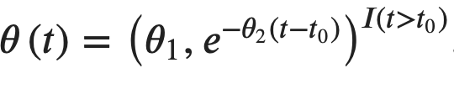
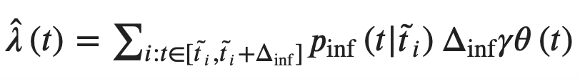
City Lock Down Intervention
Assumption:
The lock down intervention had an immediate effect to reduce the disease transmissibility
As well as a lasting effect that strengthens following the lockdown
Intervention effect:
Incorporation of intervention effect into transmission model:
Notes:
They attempted to model the effects of a city lockdown on their transmission model.
t0 is the start time
Theta1 is the immediate infectivity reduction
Theta2 is the lasting effect rate
Overall hazard

Slide 13
Data source
Transmission models were fitted with disease onset sizes recorded daily from December 1, 2019 to January 23, 2020
Data sources used:
Confirmed and suspected daily onset record from China CDC Epidemic update and risk assessment of 2019 Novel Coronavirus
Augmented daily onset record using confirmed cases reports from National Health Commission of the People’s Republic of China using delay distribution
Notes:
1. Daily reports were extracted from plots made public by CDC
2. Augmented daily records used a tool which predicted when infection first occurred from reported cases using a confirmation delay distribution.
We restricted case onset data until 23 January 2020 to be fitted, due to the following considerations:
(a) the onset record after the cutoff is likely inaccurate with the delayed confirmation process at the manuscript preparation time;
(b) insufficient evidence for transmission reduction effect with the strict lock down quarantine interventions in Greater Wuhan Region implemented since 23–24, January 2020.

Slide 14


Model Assumptions
Assumed for the beta distributed incubation periods, with range of 1 to 14 days and mean incubation of 5.67 days
Relativity infectivity varied over the infectious period (0-10 days after onset)
Sensitivity analyses were performed by varying the distribution of the incubation period and relative infectivity over time (next slide)
For the modified transmission model, after infection, and the relative infectivity was assumed to be highest at or after symptom onset.
Notes:
Relative infectivity varied over the infectious period which was decided to be 0-10 days since the patient may reduce their mobility and contact with others once they recognize alarming symptoms
For the modified transmission model the period of incubation was kept the same

Slide 15
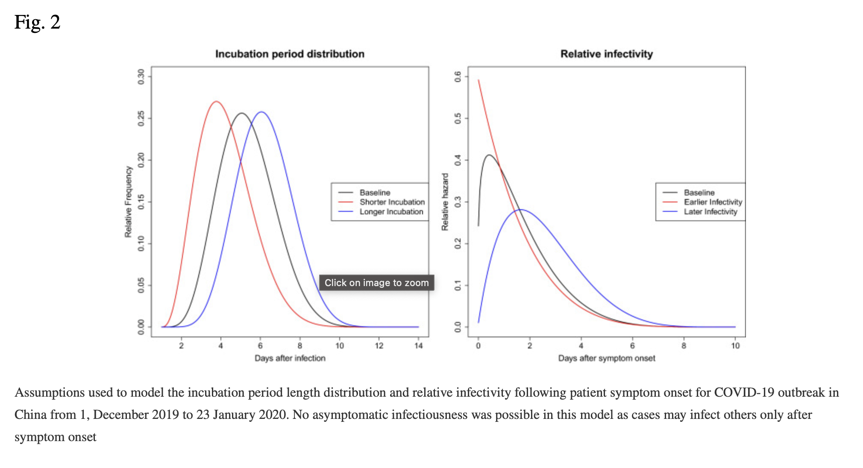
Sensitivity Analyses for Original Model
Notes:
Evaluation of model fit was performed by comparing observed and fitted values of onset records
Days after infection and days after symptom onset the x axis

Slide 16
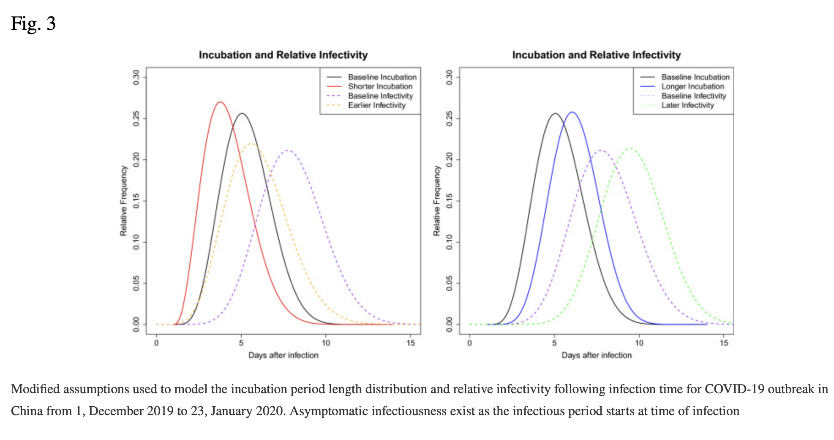
Sensitivity Analyses for Modified Model

Slide 17
R₀ Results
Poisson Transmission model (baseline assumptions), the estimated R₀ and it’s 95% CI,
Confirmed cases only: 2.47 (2.39, 2.55)
Both confirmed and suspected cases: 2.54 (2.49, 2.60)
Augmented onset record: 2.32 (2.25, 2.38)
Modified Poisson Transmission model (baseline assumptions), the estimated R₀ and it’s 95% CI,
Confirmed cases only: 2.88 (2.78, 2.95)
Both confirmed and suspected cases: 2.97 (2.90, 3.04)
Augmented onset record: 2.69 (2.61, 2.77)
Notes:
Interestingly they noticed similar goodness of fit performance from the modified model and that from the original model, but estimates for R0 is about 17% higher in the modified transmission model
For the modified Poisson model, varying incubation period distributions had very little impact on R0 estimates, while different positions of relative infectivity peak after infection affected R0 a lot.
In some scenarios, R0 was as high as 3.5-4.0

Slide 18
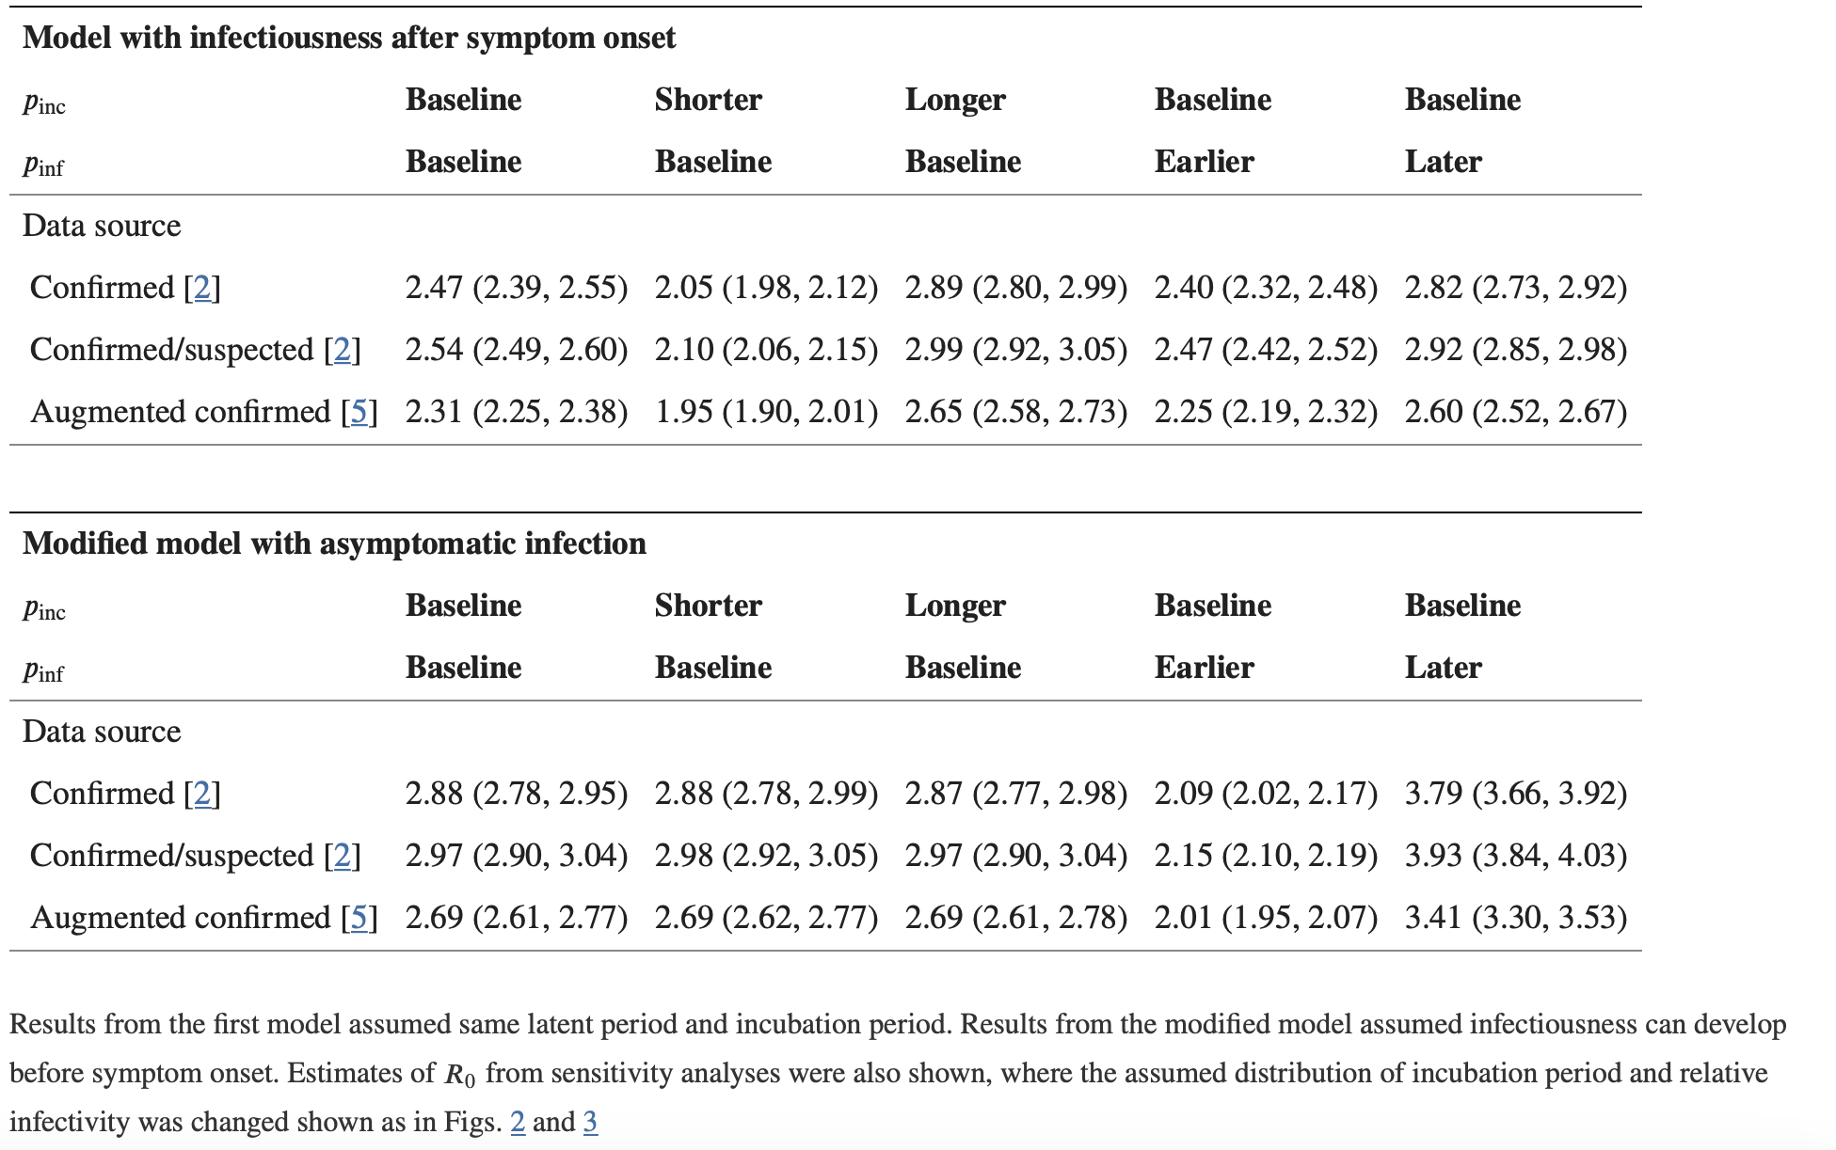

Slide 19
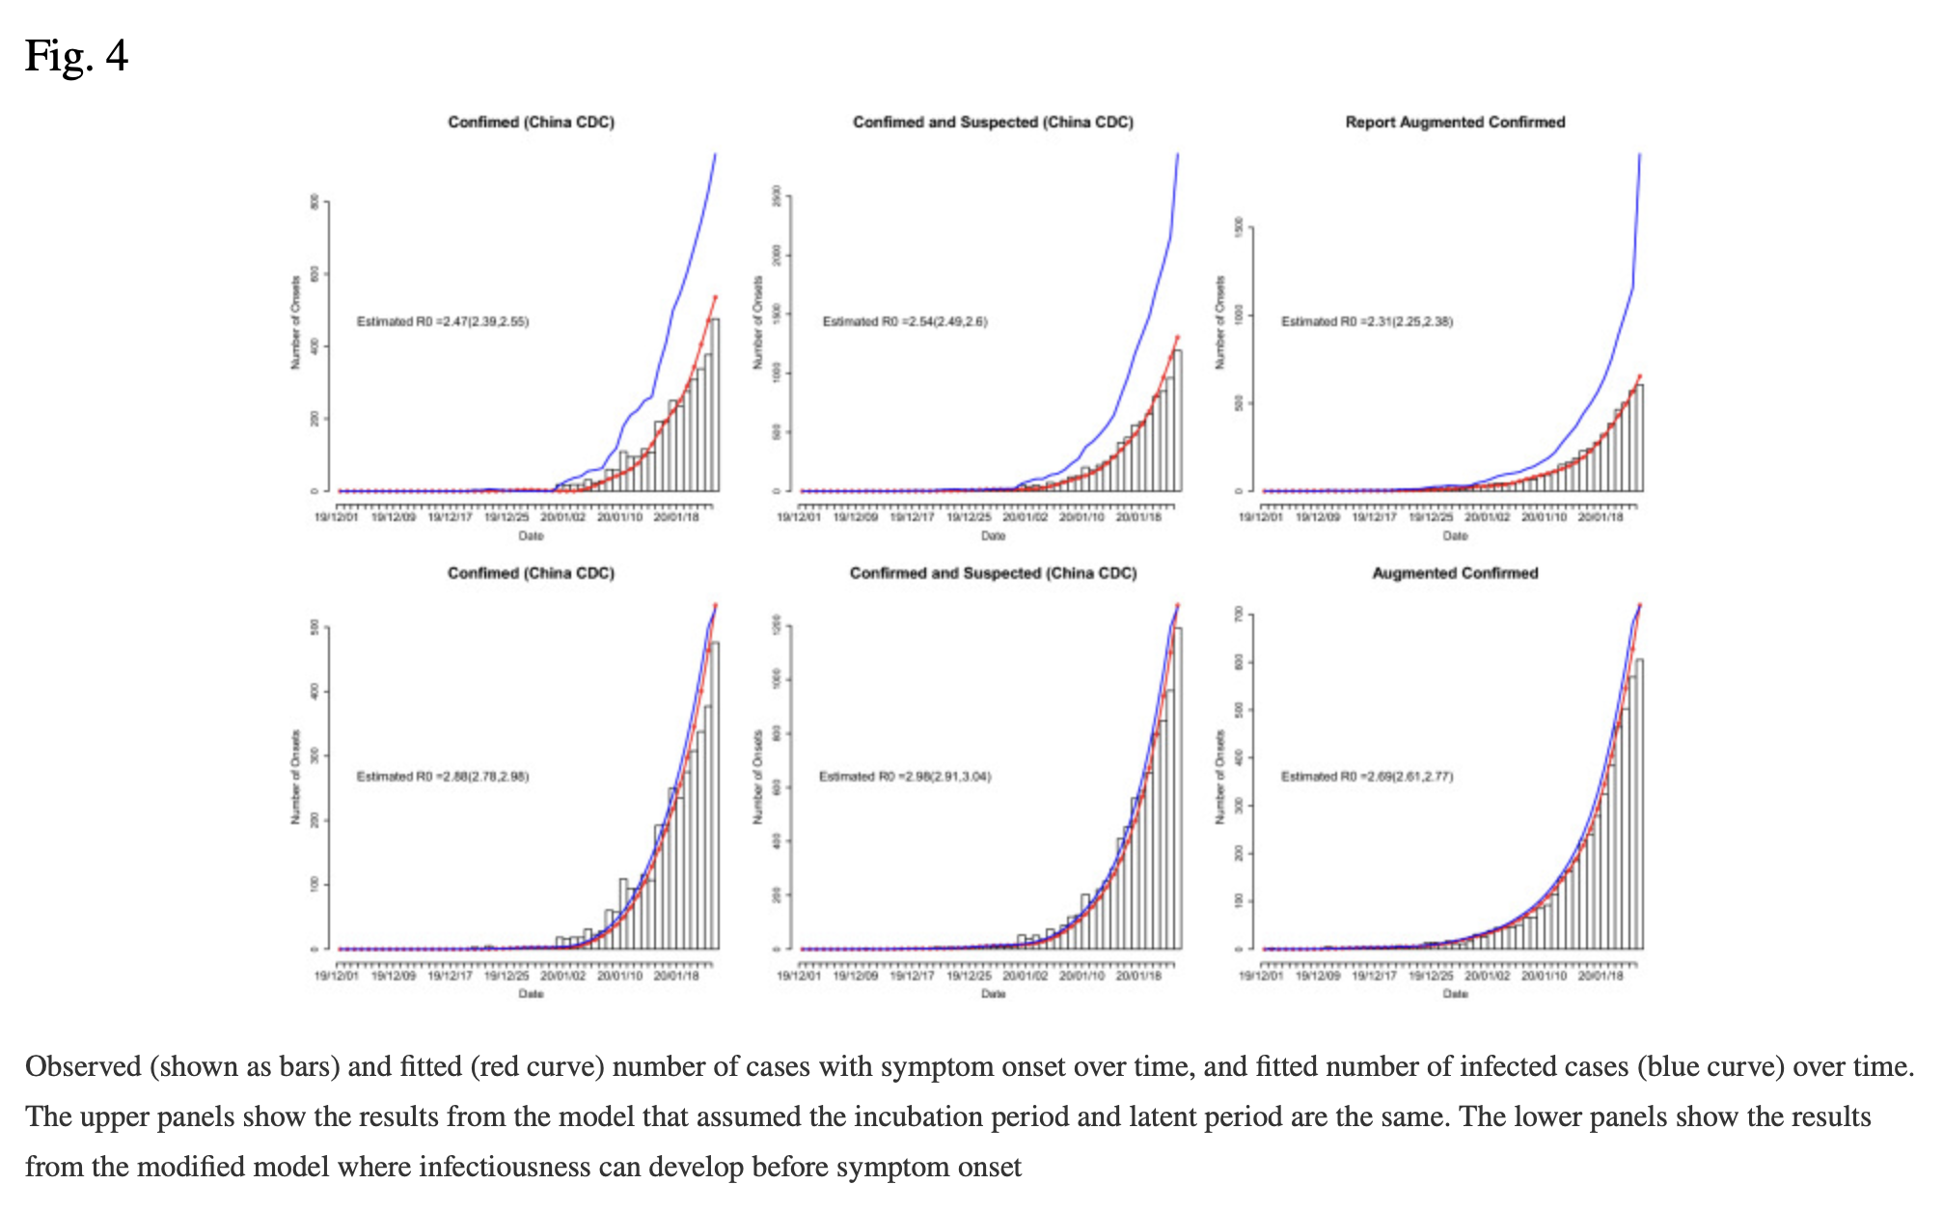
Notes:
Lower panel for the modified model and the top panel is the standard model.

Slide 20
Results with Updated Case Onsets
Updated data included more than 2 week’s onset records following the lock down of the Wuhan region
This allowed the estimation of the intervention effect parameters with the updated transmission model
Shorter incubation assumptions and either baseline or earlier infectivity assumptions were used in the transmission model
Notes:
Because literature stated that the incubation period was estimated to be about 4 days and that viral load was highest at or a few days following symptom onset.

Slide 21
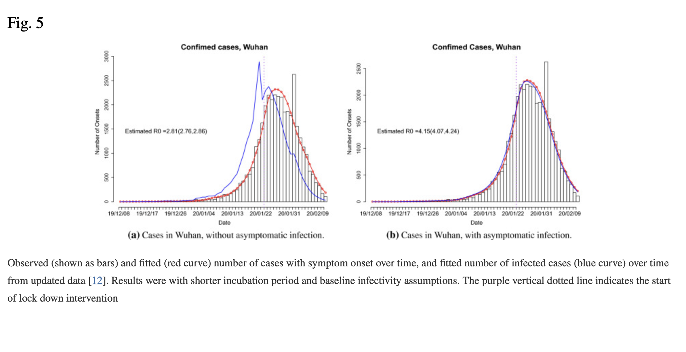

Slide 22
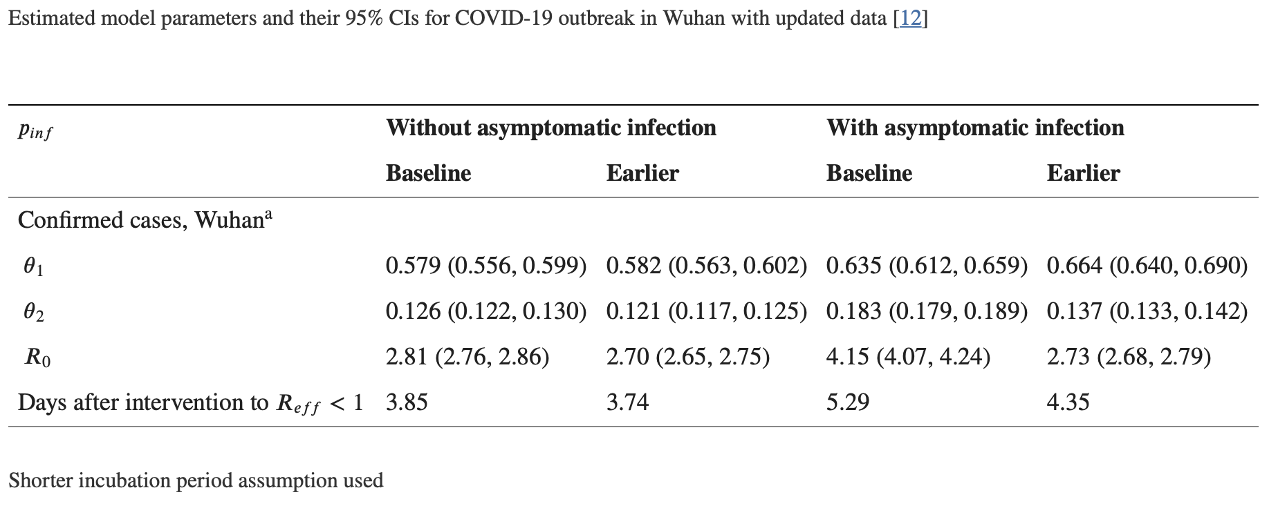

Slide 23

Results from Updated Case Onsets
R₀ with updated data tend to be higher than those from previous results (2.7 to 4.2)
Intervention effect of lockdown took place gradually. would fall below 1 after an average of 3.7-5.3 days
Notes:
The new results they believed were more accurate because it used more recent data with better assumptions due to better understanding of the virus.
If you notice in the figure, the case numbers start to decrease after 4 to 5 days.

Slide 24
Discussion
Inferred R₀ fall in the same range as results from other researchers who used different sources of data, and was consistent with multiple data sources
R₀ was sensitive to different assumptions of disease natural history
Limited resources such as case reporting may have caused a potential underestimation of cases and caused distortion in the distribution of report delay and relative infectivity
Notes:
Overall, I choose this paper since I found it quite interesting to read as it nicely ties in the use of biological understandings to make assumptions about statistical models for real life situations and in this case an outbreak that has effected all of our lives in some way.

Slide 25
Thank you for listening!

