Slide 1
Visualising associations between paired ‘omics’ data sets
By: Ignacio González, Kim-Anh Lê Cao, Melissa J Davis and Sébastien Déjean
October 28th Journal Club Presentation
David Yang

Slide 2
Problem
To obtain useful information from ‘omics’ data, it must be properly processed and analyzed
Hence, a major challenge with the integration of omics data involves the extraction of discernible biological meaning from the results
Statistical methods such as Canonical Correlation Analysis (CCA) and Partial Least Squares (PLS) regression have allowed investigation of the correlation structure between datasets
However, little attention has been given to the interpretation of the results and graphical outputs

Slide 3
Purpose
The paper revisits several graphical outputs dedicated to exploratory approaches to highlight associations
The relevance of these proposed graphical outputs were assessed on a simulation study
On two real data sets, interpretations from the graphical outputs are compared to known biological networks

Slide 4
Table of Content
Introduction of projection-based statistical methods
CCA
PLS
Introduction of graphical outputs
Correlation Circle plots
Relevance networks
Clustered Image maps
Simulation study
Biological studies
Nutrimouse data
Liver toxicity data

Slide 5
Projection-based statistical methods
Canonical Correlation Analysis (CCA) and Partial Least Squares (PLS) regression
Two-block data matrices to be integrated: X (n x p) and Y (n x q)
p and q are the total number of variables measured on the same n subjects
For example, X can contain gene expression and Y can contain metabolite concentrations

Slide 6
CCA
Searches for the largest correlation between a linear combination of X and a linear combination of Y
The first pair of canonical variates maximizes: ρ1 = cor(Xa¹, Yb¹) where var(Xa¹) = var(Yb¹) = 1.
Onwards, subsequent canonical variate pairs (Xa^{l}, Yb^{l}) are maximized for up to min{p, q} times subject to the constraint that they are to be uncorrelated with the first pair of canonical variables
Notes:
The goal of Canonical Correlation Analysis is to model relationships between two datasets. It is already a challenge to analyze the correlations between all the variables within one dataset, so the task is even more complex now that we have to make a distinction between the correlation between variables and correlation between the two datasets.
To simplify this task, the model is going to identify Canonical Variables. Canonical Variables are linear combinations of the variables of one of the data sets. Since Canonical Correlation Analysis focuses on correlations between two data sets, you will define pairs of Canonical Variables: one Canonical Variable coming from the X data set and a second Canonical Variable Coming from the Y data set. If you have a different number of variables in your two datasets, you can have as many pairs of Canonical Variables as there are variables in the smallest dataset.
The Canonical Variables will be defined by the model. They are chosen to be the two linear combinations of (original) variables (one in each dataset) that have the largest possible correlation.
Once the Canonical Variables are defined, you can continue with your analysis by looking at the correlations between the Canonical Variables.
How much is each Canonical Variable from data set 1 is correlated with its counterpart in data set 2?
Which original variables are represented by each of the Canonical Variables?

Slide 7
PLS
Searches for the largest covariance between linear combinations of x and the Y variables.
The first latent variable pair maximises cov(X a ¹,Y b ¹) subject to ||a ¹||=||b ¹||=1
Onwards, subsequent pairs (X a ^{l},Y b ^{l}) are maximized up to q times subject to the constraint that each pair is uncorrelated with the previous pair
PLS-regression models unidirectional relationship (Y = AX)
PLS-canonical models bidirectional relationships (AY = BX)
Notes:
The goal of Linear Regression is to model the dependence relationship between one dependent (target) variable and multiple independent (explanatory) variables. It allows you to reduce the dimensionality of correlated variables and model the underlying, shared, information of those variables.
The idea behind PLS and CCA is quite similar, in PLS, instead of maximizing the correlation between pairs, we maximize their covariance instead.

Slide 8
rCCA and PLS
In the context of high throughput biological data, the number of variables often exceeds the number of samples
This poses computational problems in CCA and PLS
Therefore, regularized CCA (rCCA) and sparse PLS (sPLS) are used
In short, rCCA adds a regularization term to the diagonal of covariance matrices while sPLS includes Lasso penalization on the loading vectors to shrink some coefficients to zero

Slide 9
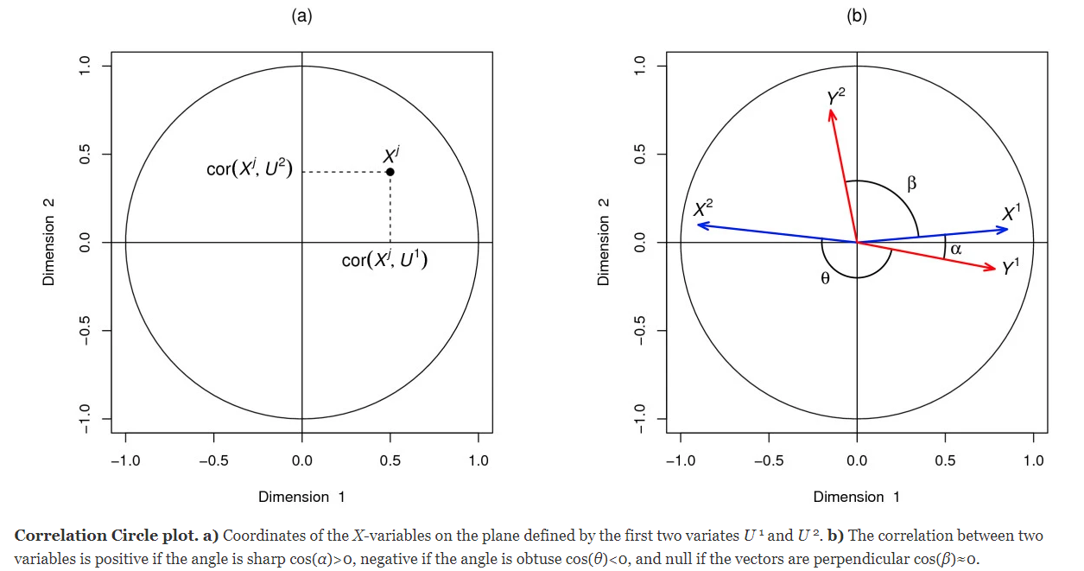
Correlation Circle plots
Notes:
Enables a graphical examination of the relationships between variables and variates
As variables are standardized and centered, the correlation obtained between each variable and component is simply the projection of the variable on the axis defined by the component

Slide 10
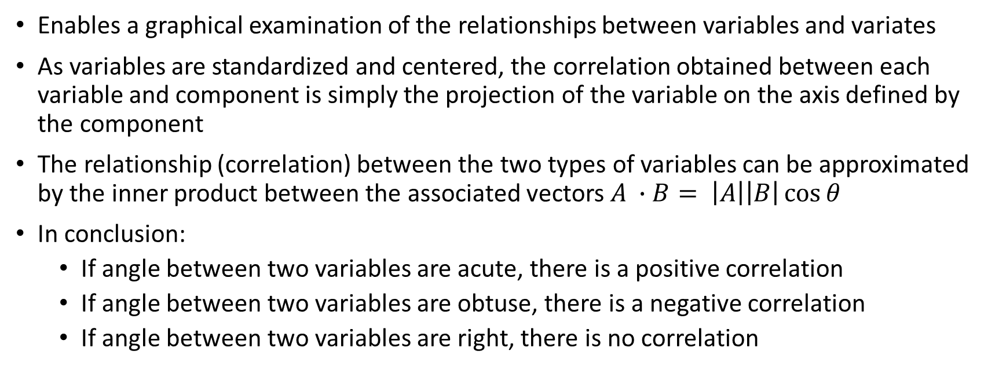
Correlation Circle plots
Enables a graphical examination of the relationships between variables and variates
As variables are standardized and centered, the correlation obtained between each variable and component is simply the projection of the variable on the axis defined by the component
The relationship (correlation) between the two types of variables can be approximated by the inner product between the associated vectors $A ∙B= \left|A\right|\left|B\right|\cos{θ}$
In conclusion:
If angle between two variables are acute, there is a positive correlation
If angle between two variables are obtuse, there is a negative correlation
If angle between two variables are right, there is no correlation

Slide 11
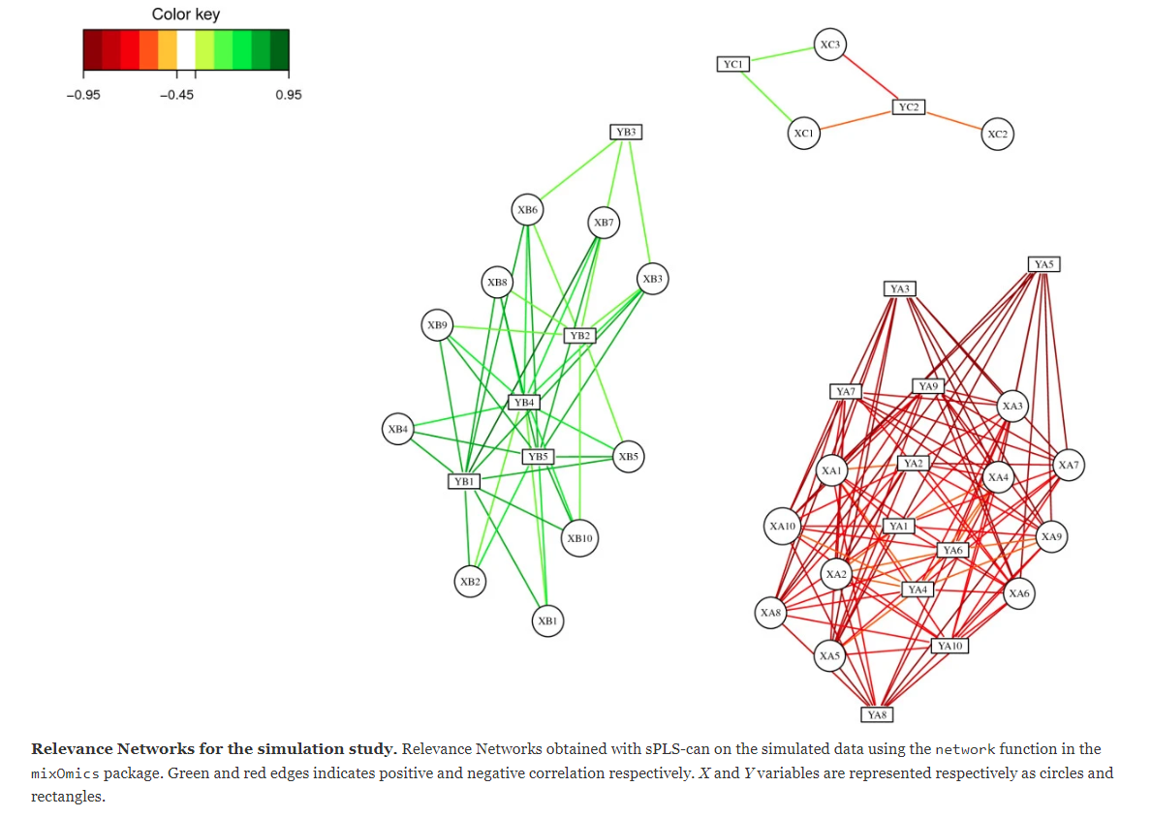
Relevance network
Notes:
The relevance network is built in a simple manner.
Correlation matrix is inferred from the data
For every estimated correlation coefficient exceeding (in absolute value) a pre-specified threshold between two variables (say 0.6), an edge is drawn between these two variables, otherwise, no edge is drawn and these two variables are considered not associated for this threshold
Variables/nodes with no link are no represented in the graph

Slide 12
Relevance networks
In the graphs, nodes represent variables and edges represent variable associations
In our case, we focus on the representation between variables of two different kinds, where nodes of X can only be connected to nodes of Y
These bipartite networks are inferred using a pair-wise similarity matrix obtained from the statistical methods
Notes:
Advantages:
a) The advantage of the relevance networks is their ability to simultaneously represent positive and negative correlations, which are missed by methods using Euclidian distances or mutual information.
b) The ability to represent genes in several pathways and most importantly, to represent correlations across disparate biological measures.
Main limitation: relevance networks requires extensive computing resources to compute the comprehensive pair-wise associations when underlying network is fully connected (i.e. when there is an edge between any pair of two types X and Y variables).

Slide 13
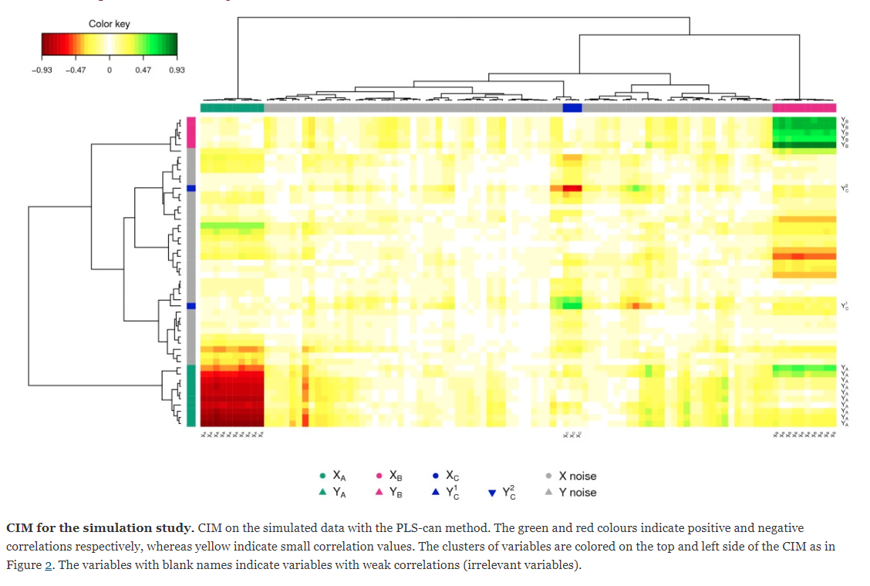
Clustered Image Maps

Slide 14
Clustered Image Maps
Also called ‘clustered correlation’ or ‘heat maps’
Each entry of the matrix is coloured based on its value in the pair-wise similarity matrix
Rows and columns are ordered according to the hierarchical clustering and arranged in dendrograms (tree diagrams) as clusters
Notes:
Dendrograms (tree diagrams) illustrating the arrangement of the clusters produced by the hierarchical clustering are added to the left (or right) side and to the top (or bottom) of the image. The color in the heat map indicates the nature of the correlation between subsets of variables, while the dendrogram indicate the proximity between correlated variables.
In practice, one looks for well defined large rectangles or squares of the same color corresponding to long branches of the dendrograms.
The similarity matrix represented by the CIM is the same as in the relevance networks described above.

Slide 15

Simulation study: Data sets
Two data sets X (30 x 100) and Y (30 x 50) with an equal number of 30 were generated
A subset of relevant variables in X were associated with a subset of relevant variables in Y according to the model described in the table
The remaining variables were simulated as noise $\sim Normal(0,1)$
Variable set 1: | Variable set 2: | Cross-correlation
X_{A} | Y_{A} | -0.93 to -0.51
X_{B} | Y_{B} | 0.5 to 0.85
X_{C} | Y_{C}¹ | 0.81 to 0.93
X_{C} | Y_{C}² | -0.81 to -0.93
Notes:
Goal of this simulation study is to assess if the proposed graphical representations allow differentiation of the associated groups of relevant variables from the noisy variables.
Relevant X and Y variables were generated according to a normal distribution with zero mean and covariance matrix sigma
X contains three independent sets of respectively 10, 10, and 3 cross-correlated variables: XA, XB, and XC
Y contains three independent sets of respectively 10, 5, and 2 cross-correlated variables: YA, YB, and YC
These groups of variables are associated with each other according to the cross correlation matrix sigma(x,y)
Irrelevant noisy variables were simulated with a normal distribution with zero mean and covariance identity matrices and were added to the sets such that final data set contained 100 variable for X and 50 variables for Y. Variables are independent within the sets X and Y and with each other.

Slide 16
Simulation study: Analysis process
i) PLS canonical mode was applied to these datasets
The first three dimensions were chosen for the graphical outputs
The correlation values between latent variables equal to 0.97, 0.94 and 0.95 respectively on each dimension, before decreasing for the following dimensions
ii) rCCA approach was also applied to the datasets
Regularization parameters for the first three dimensions were λ₁ = 0.889 and λ₂ = 0.889
The canonical values obtained were of 0.959, 0.925, and 0.881 on each dimension respectively, followed by much lower values.

Slide 17
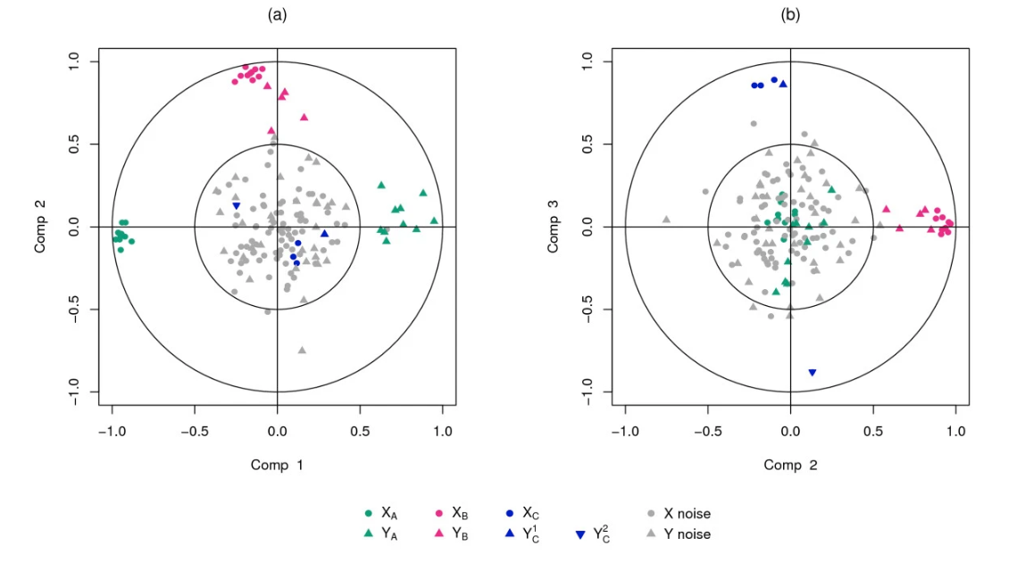
Simulation study: Graphical outputs
Notes:
Correlation circle plots:
Figure 2a shows strong negative correlation between clusters XA and YA on dimension 1 and the strong positive correlation between clusters XB and YB on dimension 2.
Figure 2b underlines a strong positive correlation between clusters XC and YC1 and a strong negative correlation between XC and YC2 on dimension 3.

Slide 18
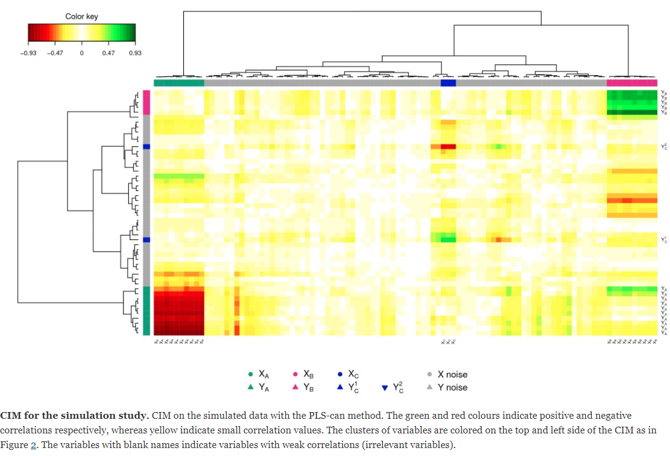
Simulation study: Graphical outputs
Notes:
Cluster Image Map: Pair-wise similarity matrix was computed for the first three PLS dimensions, and hierarchical clustering was performed with Euclidian distance and Ward method. In the figure, each coloured block represents an association between subsets of the X-variables and Y variables. Shows similar results to what is expected

Slide 19
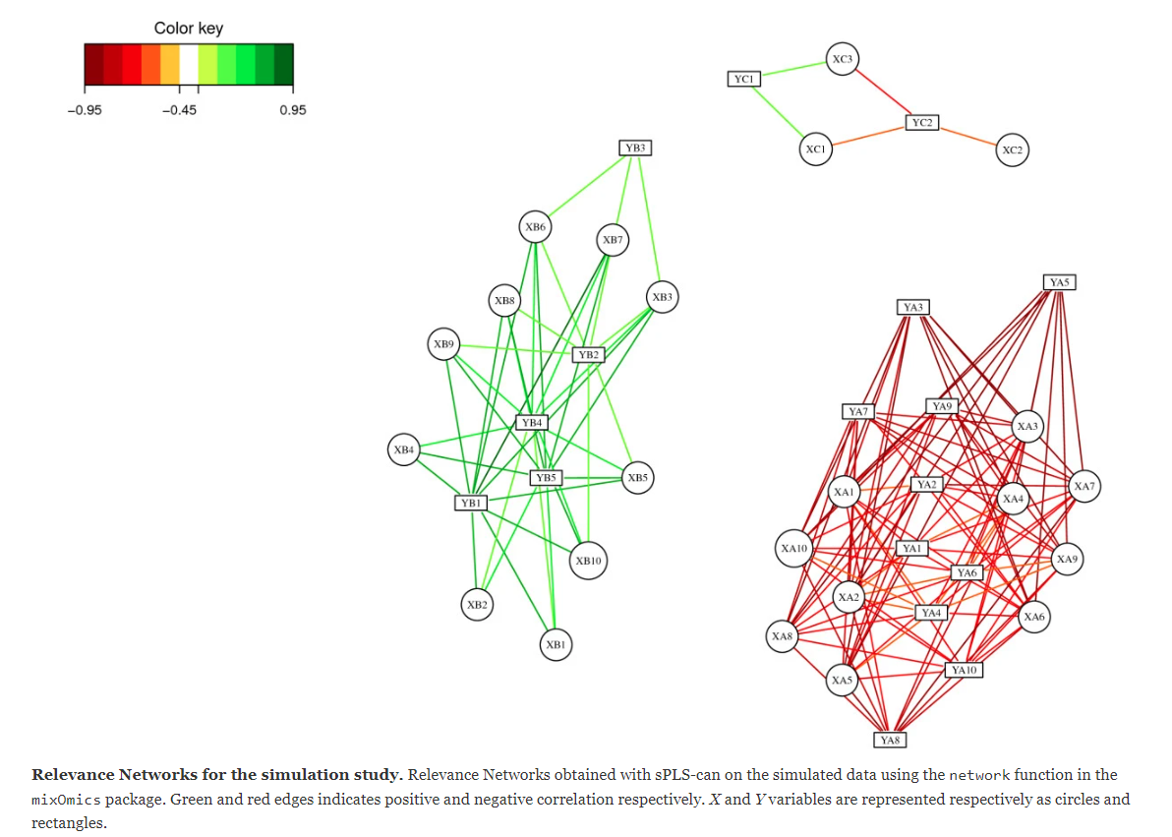
Simulation study: Graphical outputs
Notes:
Cluster Image Map: Pair-wise similarity matrix was computed for the first three PLS dimensions, and hierarchical clustering was performed with Euclidian distance and Ward method. In the figure, each coloured block represents an association between subsets of the X-variables and Y variables. Shows similar results to what is expected

Slide 20
Biological study: data sets
Nutrimouse data:
40 mice from two genotypes (WT and PPARα deficient) were fed with five diets
Expression of 120 gene in liver cells and concentrations of 21 hepatic fatty acids were quantified
Liver Toxicity data:
64 male rats of the inbred strain Fisher F344/N were exposed to 50 mg/kg, 150 mg/kg, 1500 mg/kg or 2000 mg/kg doses of acetaminophen
Liver cell gene expression matrix (64 x 3116) and clinical measurements matrix (64 x 10)
Treatment: | Composition of Diet:
reference diet | corn and colza oils
saturated fatty acid diet | hydrogenated coconut oil
Omega6 fatty acid ice diet | sunflower oil
Omega3 rich diet | linseed oil
FISH diet | corn/colza/enriched fish oil
Notes:
The nutrimouse data comes from a nutrigenomics study in which 40 mice from two genotypes (WT and PPARalpha deficient) were fed with five diets with contrasted fatty acid compositions. Expression of 120 genes in liver cells were acquired through microarray experiment and concentrating of 21 hepatic fatty acids were measured by gas chromatography. The study therefore includes two data metrics of size (40 x 120) for the gene expression and (40 x 21) for the fatty acids measurements.
Liver toxicity data: The data come from a liver toxicity study in which 64 male rats of the inbred strain Fisher F344/N were exposed to low (50 mg/kg or 150 mg/kg) or to high (1500 mg/kg or 2000 mg/kg) doses of acetaminophen in a controlled experiment. Necropsies were performed at 6, 18, 24 and 48 hours after exposure and the mRNA from the liver was extracted. Ten clinical chemistry measurements of variables containing markers for liver injury are available for each subject and the serum enzymes levels are numerically measured. The study therefore includes two data matrices of size (64 x 3116) for gene expression and (64 x 10) for the clinical measurements.

Slide 21
Biological study: Analysis process
In the Nutrimouse data, the methodology sPLS-can was applied
The aim was to highlight highly correlated subsets of genes and hepatic fatty acids in the two data sets
In the Liver Toxicity data, the methodology sPLS-reg was applied
The aim was to highlight a subset of correlated genes which expression can predict the clinical chemistry measurements
In addition,
Obtained networks were used as an input to Cytoscape for visualization and
Gene Ontology enrichment was used to assess the biological relevancy of the inferred associations between different types of variables
Notes:
Biological questions we ask:
Which subset of variables from both types are strongly positively or negatively correlated with each other?
Do these selected features bring any relevant insight in relation to system under study?
In both datasets three dimensions were chosen and 50 transcripts/genes were selected in each dimension

Slide 22
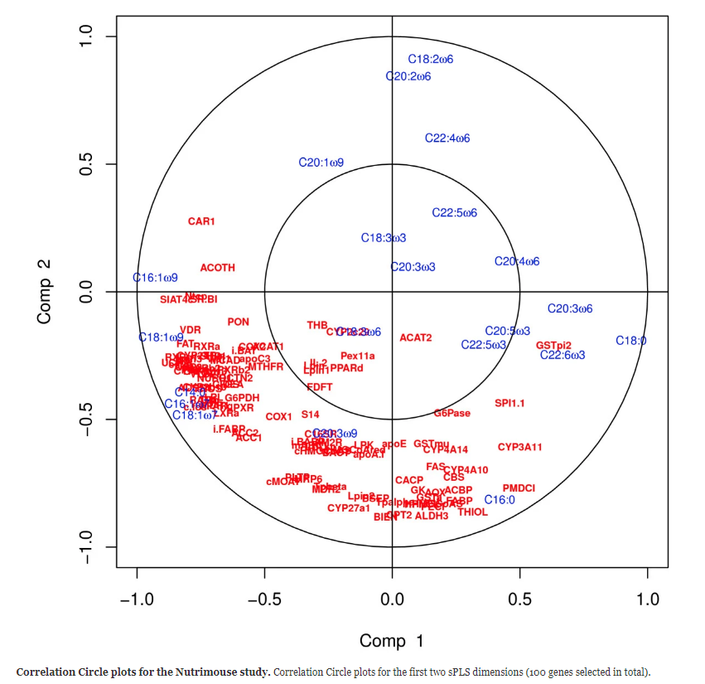
Nutrimouse data: results and graphical outputs
Notes:
The Correlation Circle plot (100 variables) highlights subsets of variables that are important to define each component. 50 variables were selected for each component
For example C18:2w6m C20:2w6 and C16:0 are the fatty acids which variation mainly participate to the definition of the sPLS component 2 (top and bottom of the y-axis).
Similarly, genes such as CAR1, ACOTH, SIAT4C, SR.BI, Ntop are positively correlated to each other, and to the fatty acid C16:1w9 and their variation contribute mainly to sPLS component 1.

Slide 23
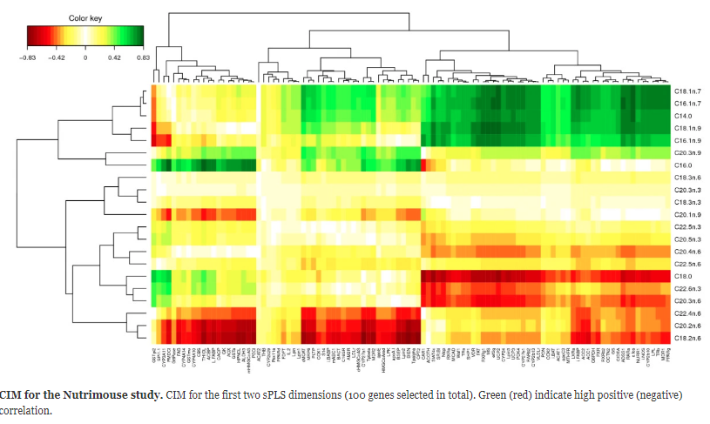
Nutrimouse data: results and graphical outputs
Notes:
CIM better highlights different clusters of variables and their degree of correlation than the Correlation Circle plots, but the visualization of the correlation within variable sets is more difficult to observe. For example correlations between Fatty acids themselves which was highlighted in the Correlation Circle plot is less obvious in this CIM

Slide 24
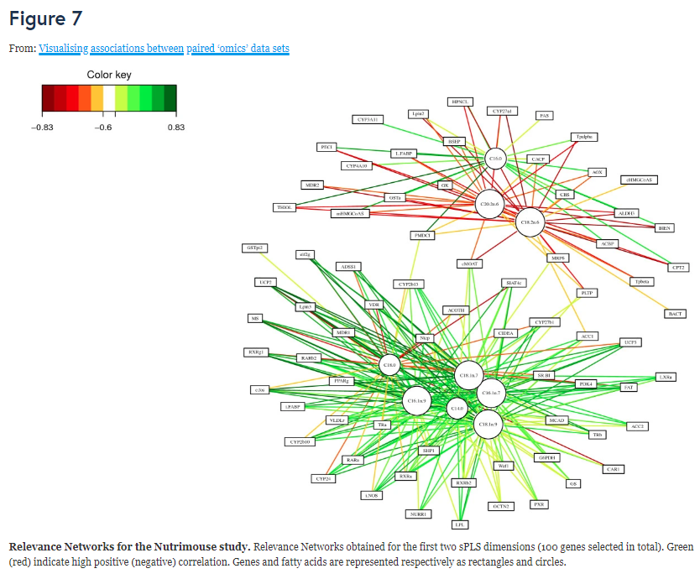
Nutrimouse data: results and graphical outputs
Notes:
The relevance network representation highlights two main subsets of genes and fatty acids. This information is slightly suggested on the dendrograms of the CIM by its dendrograms but barely observable in the Correlation Circle plot. This comparison demonstrates the usefulness of complementarity of graphical outputs to unravel the complex relationship structure between these different biological features

Slide 25
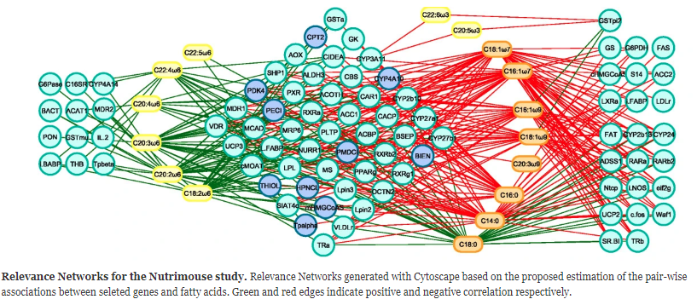
Nutrimouse data: results and graphical outputs
Notes:
After inputting the Relevance network generated for the Nutrimouse data int cytoscape we find two subsets of fatty acids and three subsets of genes.
GeneGO analysis: First group of fatty acids contained all the w6 fatty acids, second group of fatty acids consisted of those in the w9, w7, and saturated fatty acid groups, along with the two w3 fatty acids included in the data set. This makes sense. One biosynthetic pathway leads to the production of the w6 lipids, while alternative lipid biosynthetic pathways lead to the production of the w9, w7 and saturated lipids. w3 is an exception in the analysis (generated by a pathway related to the w6 pathway)
Three gene sets defined by network topology were
a set of genes that were negatively correlated with only the w6 lipid group;
a set of genes that were negatively correlated with the w6 group, but largely positively correlated with the other lipid group;
a gene set that was only associated with the second lipid group, with positive correlations to the w3, w7, w9 and saturated fatty acids C14:0 and C16:0, but negatively correlated with the C18:0.
w6 group showed only negative correlations with genes selected by sPLS-can. This is consistent with the observations made that feeding mice a diet rich in w6 fatty acids lead to the down regulation of several genes on the arrya
Second groups of genes contained many targets of PPARalpha, a nuclear receptor transcription factor associated with the high level regulation lipid metabolism. PPARalpha targets are expected to be associated with long-chain polyunsaturated fatty acids from the w3 family
Final subset of genes involved in lipid biosynthesis is expected to be closely associated with the saturated and monounsaturated fatty acids of the w7 and w9 families. Both of these associations were apparent in the network.

Slide 26
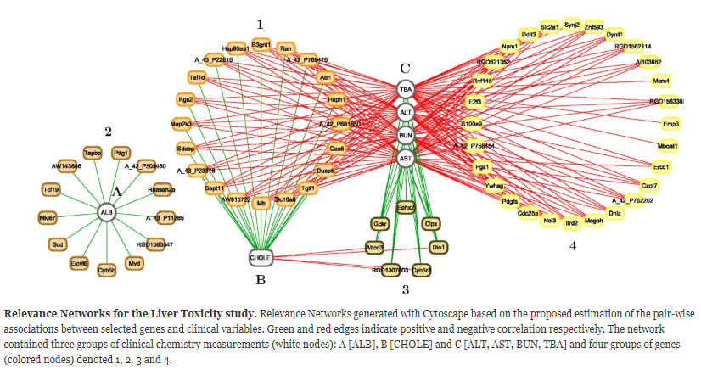
Liver Toxicity data: results and graphical outputs
Notes:
Relevance Networks for the Liver Toxicity data were generated from the results obtained with the sPLS-reg method. The selected variables with a pair-wise association score greater than 0.6 in absolute value were used as an input to Cytoscape. Green edge color represent a positive correlation. This network contained three groups of clinical chemistry measurement (white nodes) denoted A, B, and C, and four groups of genes denoted 1, 2, 3 and 4.
Groups A and B only consisted of albumin and cholesterol levels respectively.
Group C contained indicators of liver injury (Alanine Aminotransferase and Aspartate aminotransferase), indication of renal injury (urea nitrogen) and assessment of cholestasis - bile flow interruption (total bile acids)
group 1 genes were positively correlated with cholesterol B but negatively correlated with C
Group 2 were negatively correlated with ALB only
Group 3 positively correlated with group C and negatively correlated with group B
Group 4 only positive correlations with group C

Slide 27
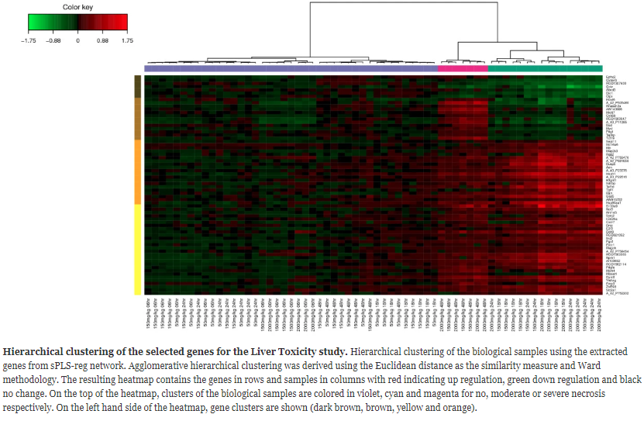
Liver Toxicity data: results and graphical outputs
Notes:
Figure 10: Hierarchical clustering of the biological samples on the extracted genes. This clustering highlights the groups of rats which were treated with different doses of acetaminophen. Clustered labelled on the top: violet (no), cyan (moderate), magenta (severe) necrosis of the centrilobular region of the rat liver were obtained by using the expression values of the genes extracted from the network.
This heat map is different than CIM and represents the relationship between the samples (the rats) and the variables (gene expression) and colour inside indicates the expression values of the genes.

Slide 28
Liver toxicity data: GO enrichment
Top five networks enriched using GeneGO:
i) regulation of programmed cell death in response to stress
ii) Cell cycle and regulation of metabolism
iii) cholesterol and sterol metabolism
iv) regulation of programmed cell death in response to organic substances
v) response to stress and presentation of endogenous antigens
Notes:
GO enrichment analysis: GO terms significantly enriched include biological processes related to nitric oxide metabolism, cellular stress responses, including reponses to unfolded proteins. The top GO molecular functions enriched in the gene set relate to protein binding, nucleotide binding, and enzyme activity. Cellular component GO terms enriched in the set mostly relate to general locations, but both an endopeptidase complex and the peroxisome are present in the list, reinforcing the association of the selected gene products with proteolysis and the response to stress and unfolded proteins.
Cluster 4 Go enrichment: enrichment for processes such as xenophobic transport, regulation of mesenchymal cell proliferation (occur in other tissues in response to epithelial damage signalling to the underlying mesenchyme to initiate proliferation and tissue remodelling), negative regulation of CREB transcription factor activity (associated with cytotoxic stress).

Slide 29
Conclusion
This article described in detail several useful visualization techniques
The value of these visualization methods were demonstrated on a simulation study and two biological studies
Such graphical outputs are undeniably important to understanding biological questions via ‘omics’ data

