Slide 1
Zero-inflated Poisson Model
STAT 600B
David Yang

Slide 2
Table of content
Poisson distribution
Problems with Poisson distribution
Zero-inflated Poisson model (ZIP)
Comparison of Poisson and ZIP

Slide 3
Poisson distribution
The Poisson distribution is a discrete probability distribution used to model the number of times a given event occurs in a fixed time interval.
This is denoted 𝑌∼𝑃𝑜𝑖𝑠𝑠𝑜𝑛(𝜃), where 𝜃 is the average number times the event occurs in the given time interval
A real-life example of something that might follow the Poisson distribution is:
How many times does the average person visit the doctor each year in the United States?

Slide 4
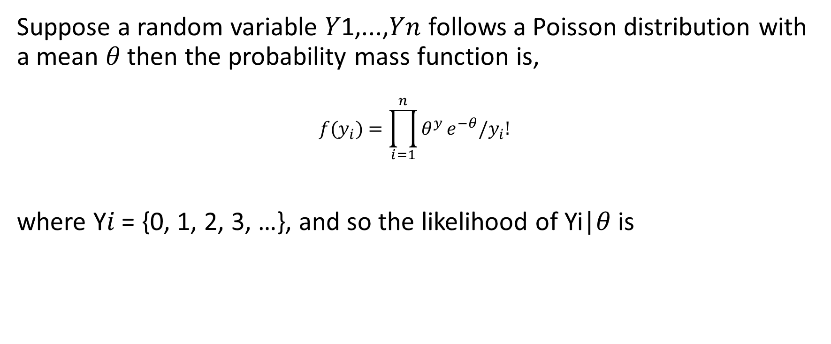
Poisson distribution: Probability Mass Function
Suppose a random variable 𝑌1,...,𝑌𝑛 follows a Poisson distribution with a mean 𝜃 then the probability mass function is,
$$f(y_{i})=\prod_{i=1}^{n}{θ^{y}}e^{−θ}/y_{i}!$$
where Y𝑖 = {0, 1, 2, 3, …}, and so the likelihood of Yi|𝜃 is
$$P\left(y_{i} | θ\right)∝θ^{\sum_{i=1}^{n}{y_{i}}}e^{−nθ}$$

Slide 5
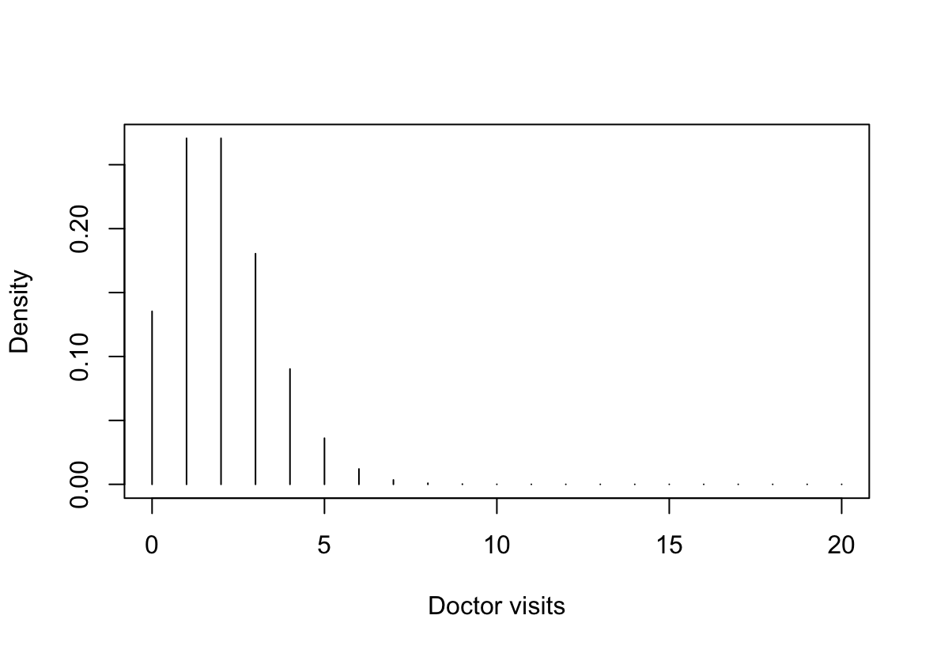
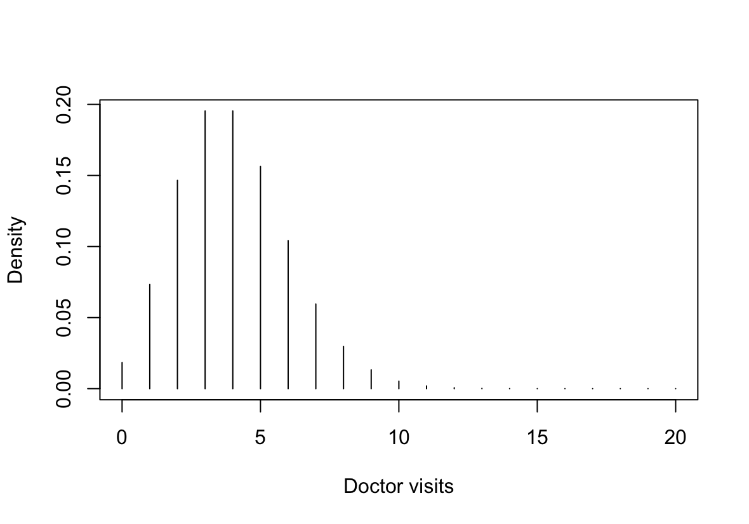
Poisson model
𝜃 = 2
𝜃 = 4

Slide 6
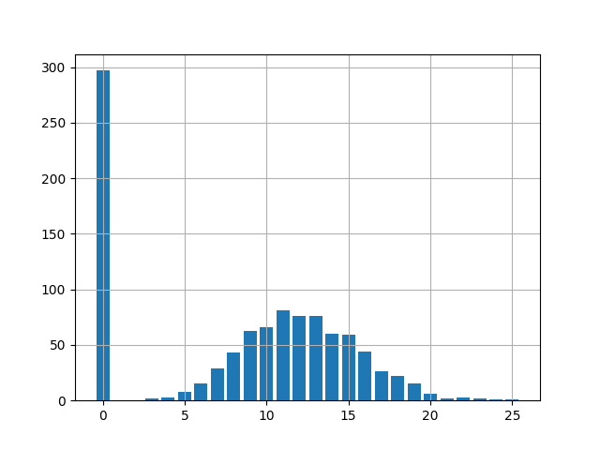
Problem: Excess number of zeros
Notes:
Image source: https://github.com/tensorflow/probability/issues/1134

Slide 7
Why does this happen?
Examples:
Average number of doctor visits per year a person makes in the United States
Average number of hours of television a person watches in a single day
Sampling zeros: Actual zeros that occur by chance in the probability distribution
Structural zeros: zero responses by subjects whose response will always be zero.

Slide 8
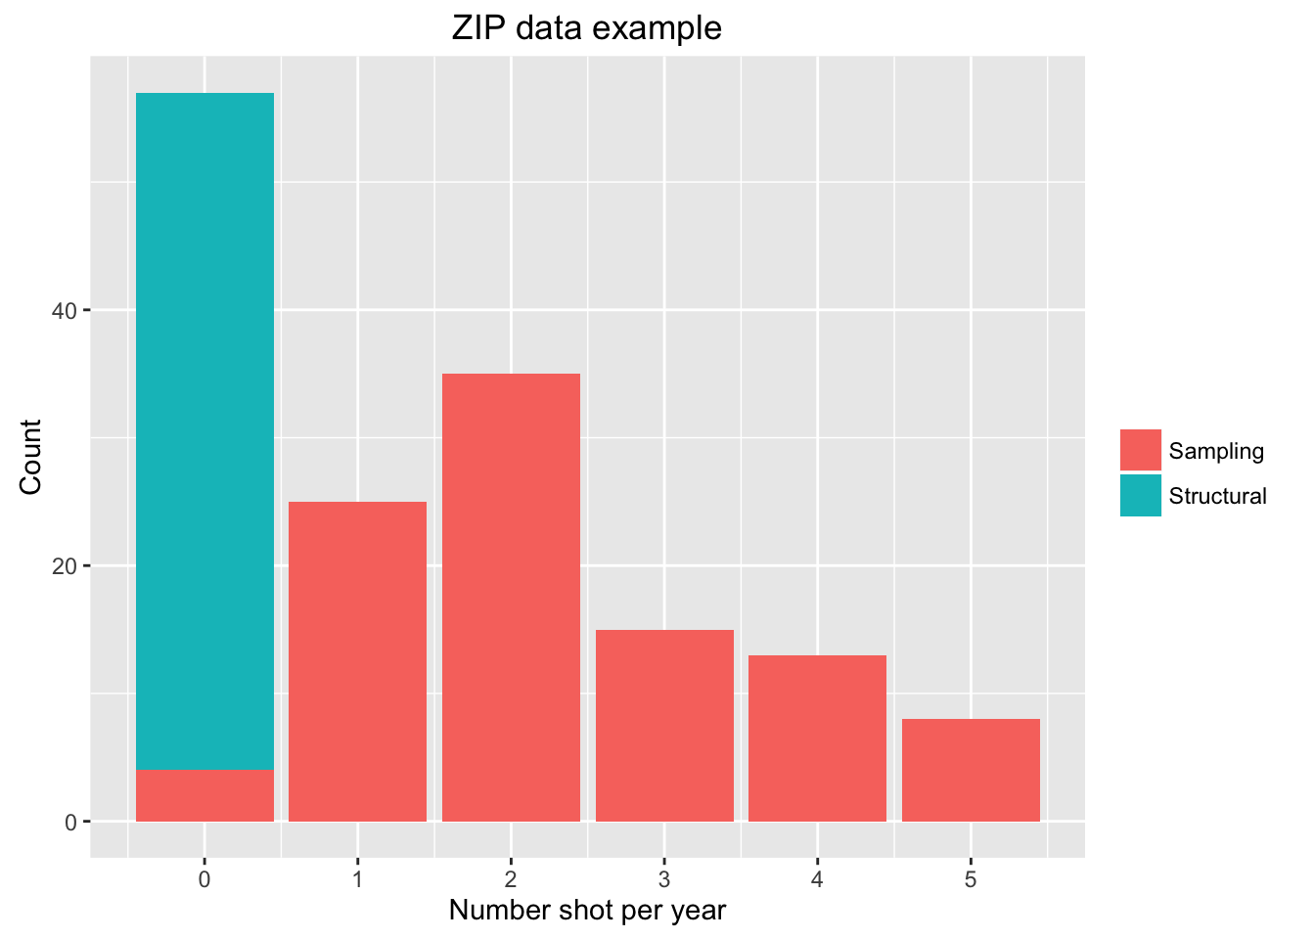
Example:
Number of officer-involved shootings in each county per year:
Notes:
Image source: https://rstudio-pubs-static.s3.amazonaws.com/236694_052d54e567174029ab3e78fdc573bf4b.html

Slide 9

Overdispersion
Given 𝑌∼𝑃𝑜𝑖𝑠𝑠𝑜𝑛(𝜃) we assume that Var(Y) = E(Y) = 𝜃
However, in most count datasets the variance is much greater than the mean
This is described as over-dispersion
Results in underestimation of standard error

Slide 10
Zero-inflated Poisson model
The zero-inflated Poisson model deals with an excess number of zeros and overdispersion
The zero-inflated Poisson model has two parts:
A process which generates data according to a Poisson probability mass function
Another underlying process which determines if the data point in the previous process is zero or non-zero

Slide 11
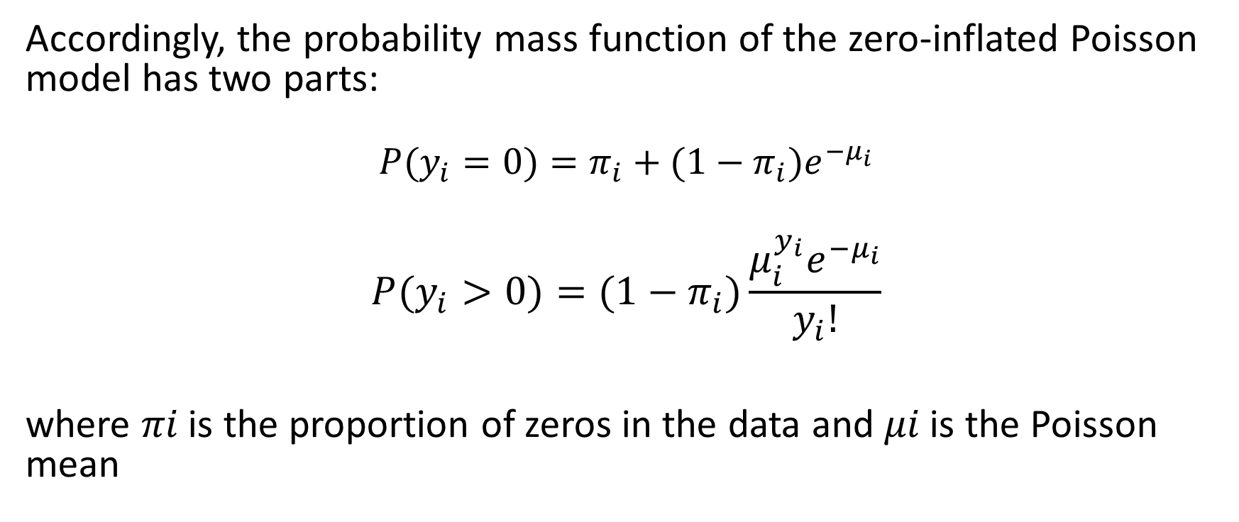
Zero-inflated Poisson model: Likelihood
Accordingly, the probability mass function of the zero-inflated Poisson model has two parts:
$$P(y_{i}=0)=π_{i}+(1−π_{i})e^{−μ_{i}}$$
$$P(y_{i}>0)=(1−π_{i})\frac{μ_{i}^{y_{i}}e^{−μ_{i}}}{y_{i}!}$$
where 𝜋𝑖 is the proportion of zeros in the data and 𝜇𝑖 is the Poisson mean

Slide 12
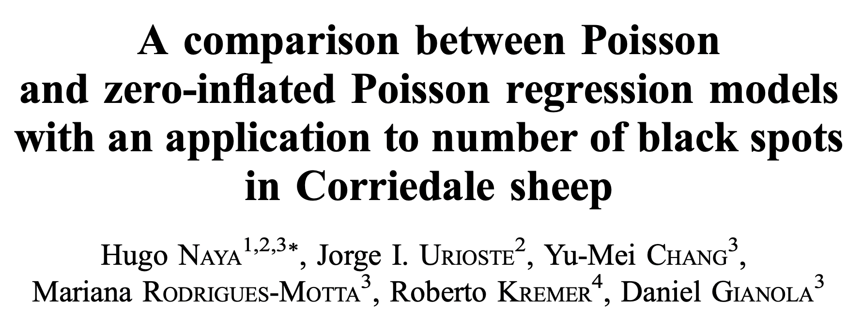
Application:
Notes:
Source: https://www.ncbi.nlm.nih.gov/pmc/articles/PMC2674908/pdf/1297-9686-40-4-379.pdf

Slide 13
Introduction
Studying the presence of black-brown fibres in wool of sheep which is a fault that reduces the competitiveness of the wool
Black-brown fibres in wool can be caused by environmental factors such as urine dyeing
Black-brown fibres can also be caused by genetic factors. For example, dark skin spots or isolated pigmented fibres
Dark skin spots are positively correlated with black-brown fibres and age appears to be the main source of variability in the number of spots
The goal of the paper was to study the effects of these variables on the presence of dark spots

Slide 14
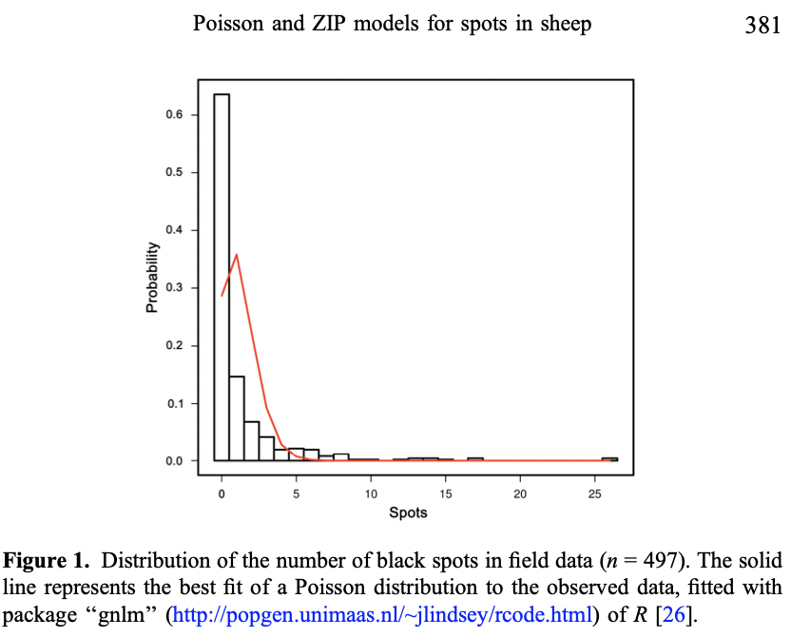
1) Excess number of zeros
2) Variance to mean ratio of 6.8 = overdispersion

Slide 15
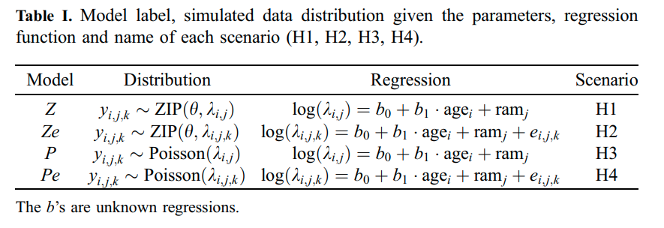
Modelling of data
In this study the authors modelled the data with both Poisson models and zero-inflated Poisson model

Slide 16
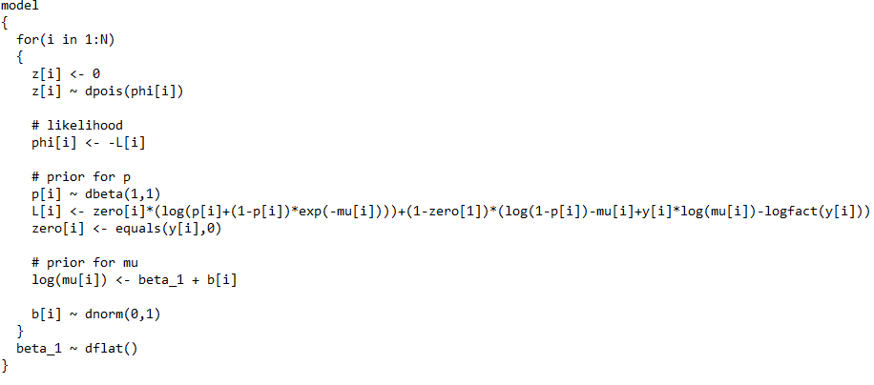
Methods
Bayesian computation (gamma prior)
Parameter inference through OpenBUGS Software (MCMC 10,000 iterations)

Slide 17
Conclusion
Pe and Ze models were the most competitive in simulation
Using deviance information criterion (DIC), the Pe model was best in most scenarios
Ze estimated true parameters well
With field data, parameters estimates were similar, Pe outperformed Ze under DIC

Slide 18
Thank you!
Question?

