Slide 1




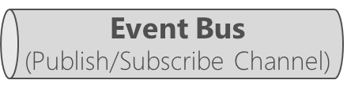



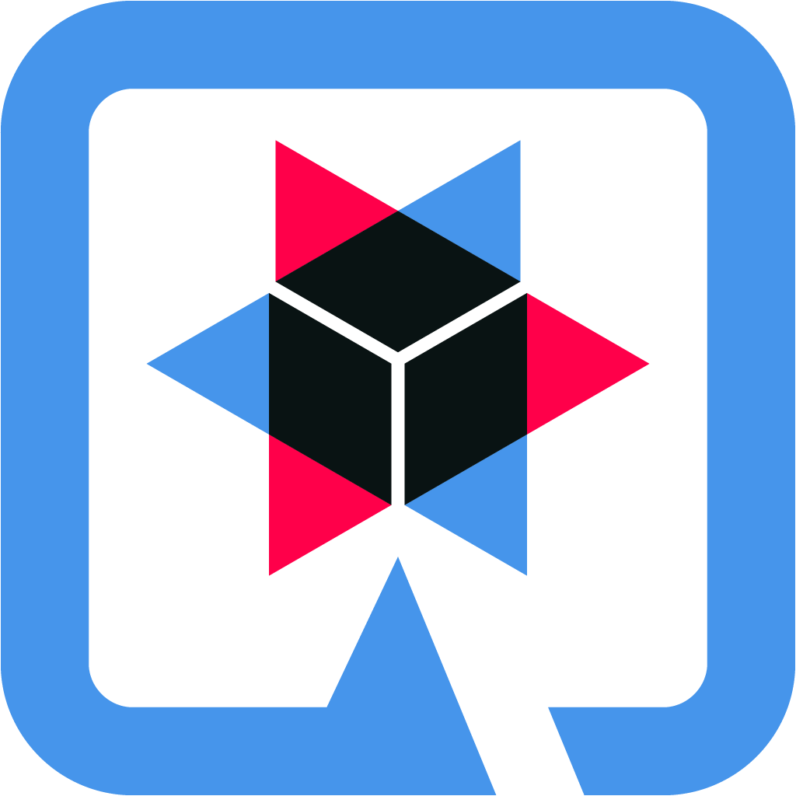

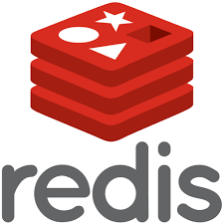



Client apps
Container orchestrator
- Autoscaler
Vitess (MySql) Database Cluster
Replica
Vitess cluster
Master
Replica
Application Containers
Ingress + API Gateway
Consume emails
Adventure.com
SPA + SSR, SSG, ISR
Next.js
Quarkus Web API
Produce emails
HAProxy Ingress
Internal Load balancing, Rate limiting,
QoS, SSL Termination, etc
Distributed Cache
Redis cluster
Distributed Tracing + Metrics
+
+
Prometheus

Slide 2


