Slide 1
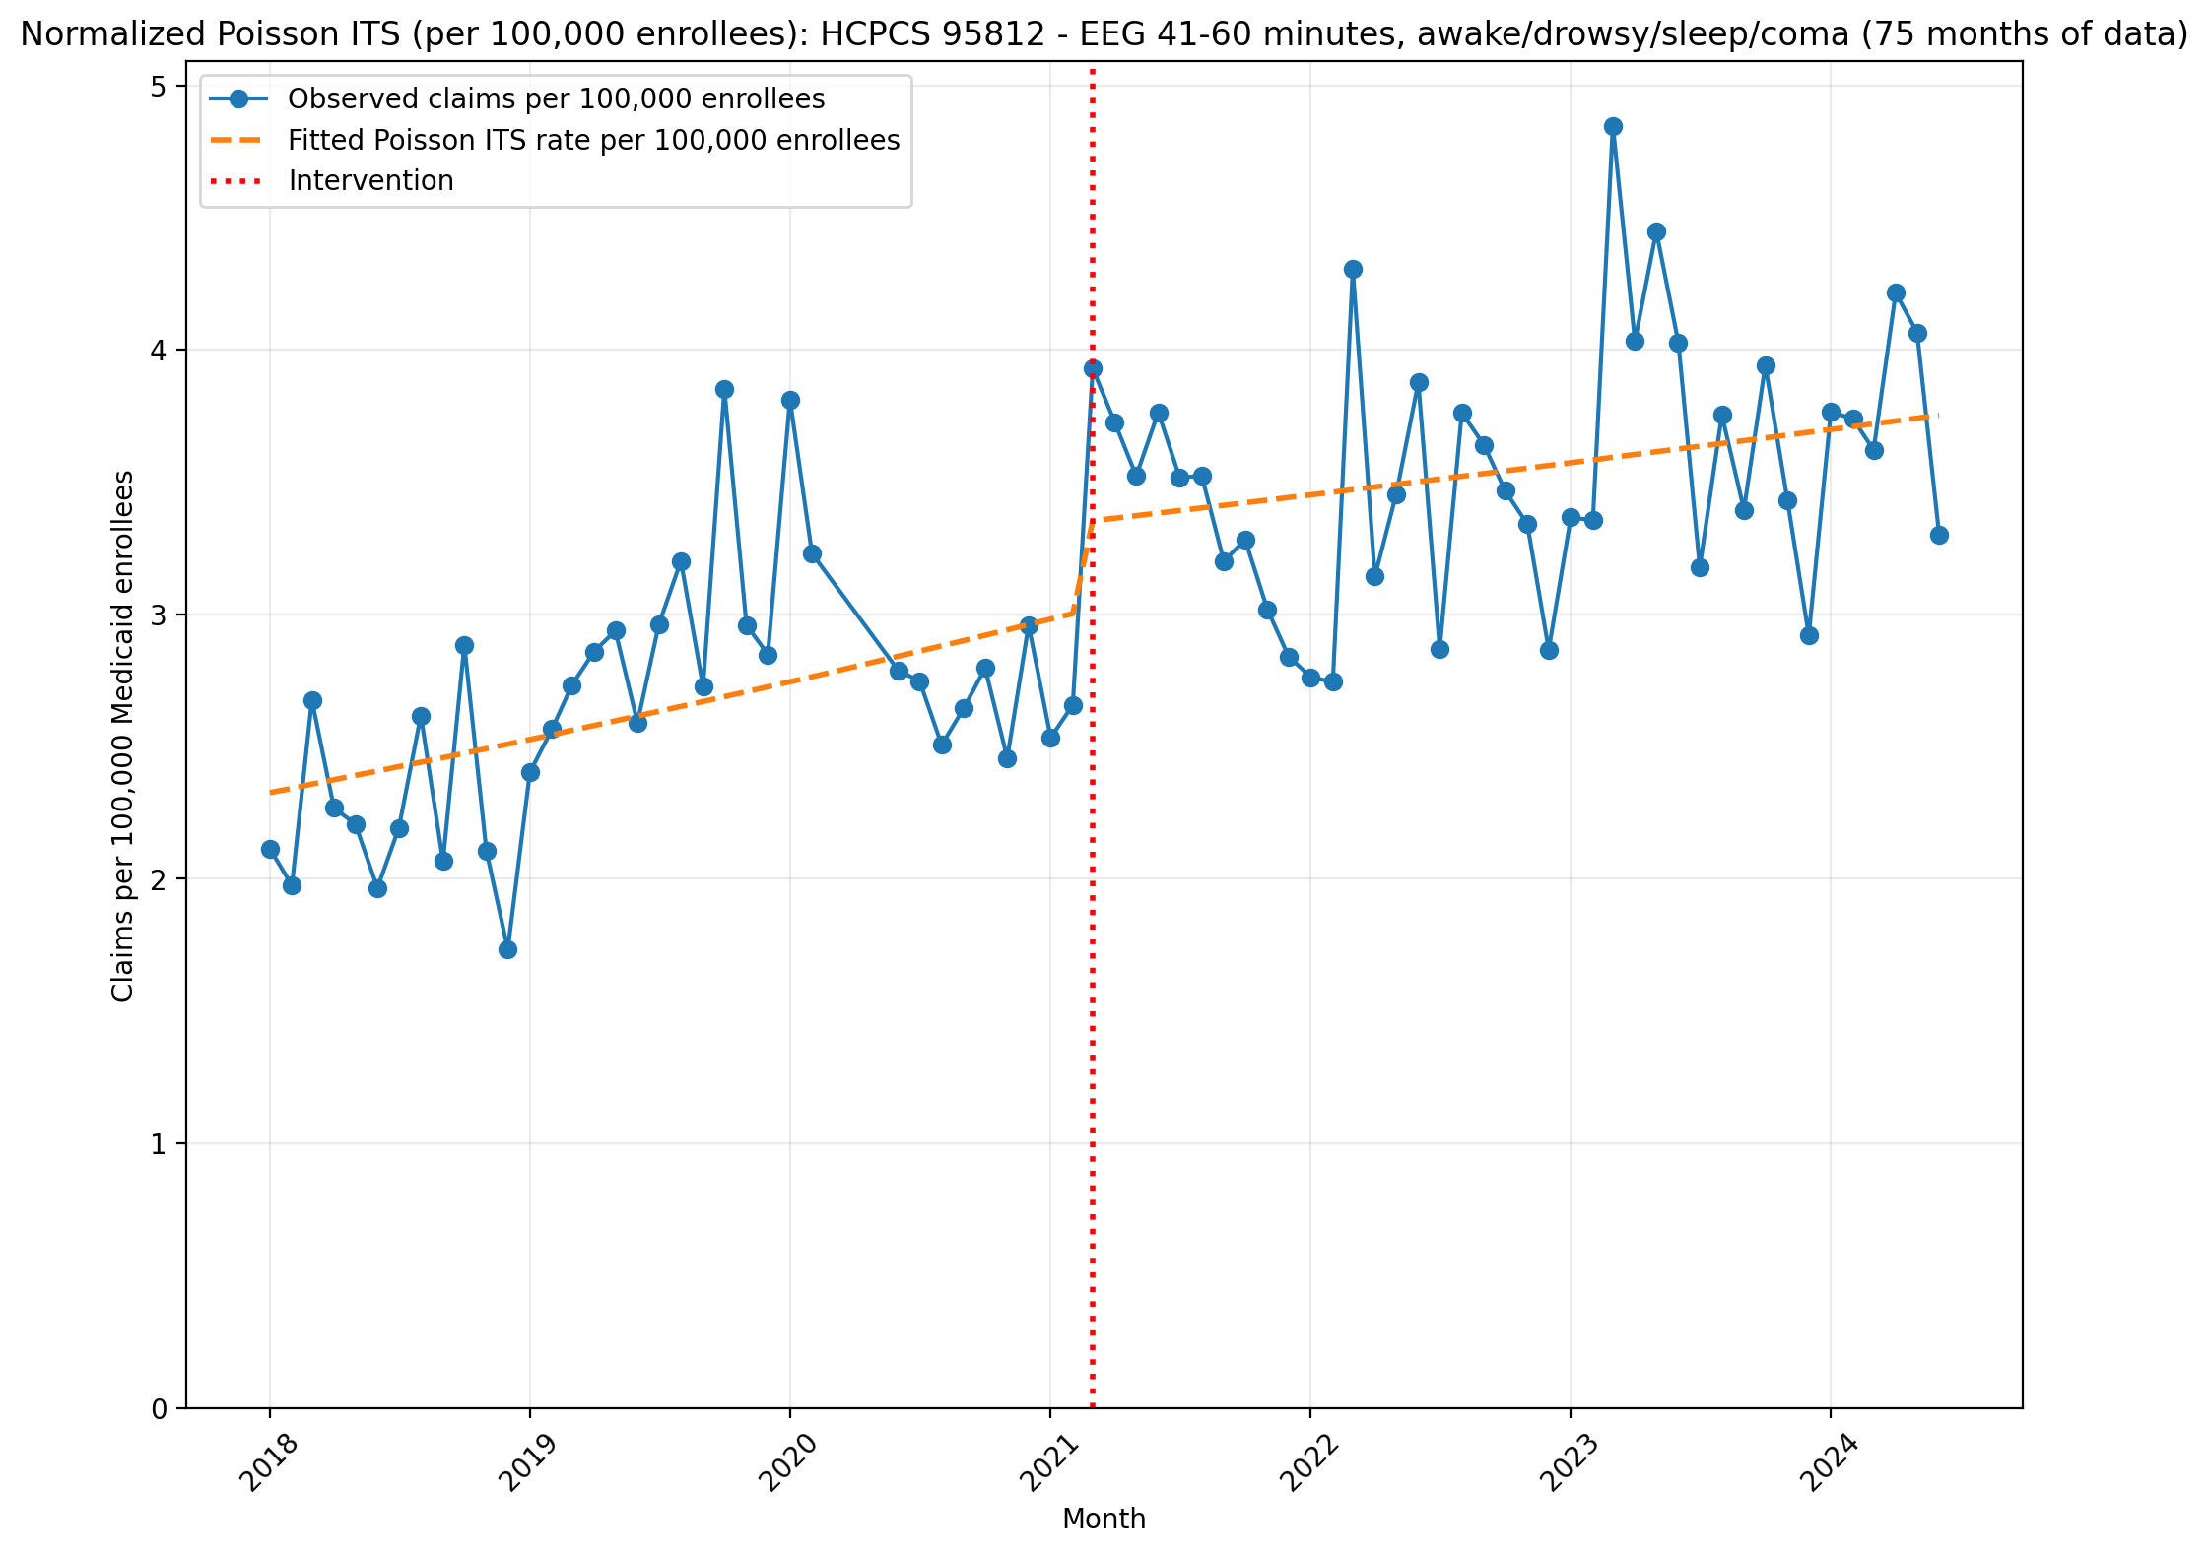
Normalized Poisson ITS (per 100,000 enrollees): HCPCS 95812 - EEG 41-60 minutes, awake/drowsy/sleep/coma (75 months of data)
Generalized Linear Model Regression Results
==============================================================================
Dep. Variable: y No. Observations: 75
Model: GLM Df Residuals: 71
Model Family: Poisson Df Model: 3
Link Function: Log Scale: 1.0000
Method: IRLS Log-Likelihood: -2308.3
Date: Thu, 07 May 2026 Deviance: 3888.8
Time: 21:22:54 Pearson chi2: 3.96e+03
No. Iterations: 4 Pseudo R-squ. (CS): 1.000
Covariance Type: nonrobust
==============================================================================
coef std err z P>|z| [0.025 0.975]
------------------------------------------------------------------------------
const -10.6689 0.007 -1461.817 0.000 -10.683 -10.655
T 0.0069 0.000 20.900 0.000 0.006 0.008
X_t 0.1076 0.009 11.816 0.000 0.090 0.126
post_time -0.0040 0.000 -9.799 0.000 -0.005 -0.003
==============================================================================

Slide 2
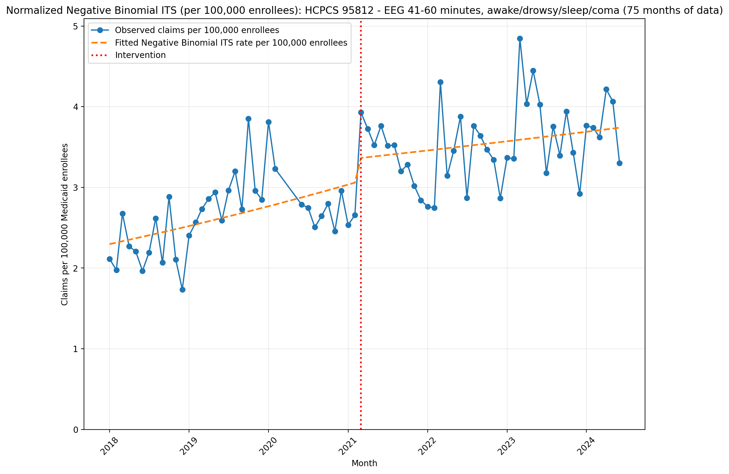
Normalized Negative Binomial ITS (per 100,000 enrollees): HCPCS 95812 - EEG 41-60 minutes, awake/drowsy/sleep/coma (75 months of data)
NegativeBinomial Regression Results
==============================================================================
Dep. Variable: y No. Observations: 75
Model: NegativeBinomial Df Residuals: 71
Method: MLE Df Model: 3
Date: Thu, 07 May 2026 Pseudo R-squ.: 0.05349
Time: 21:22:54 Log-Likelihood: -549.03
converged: False LL-Null: -580.06
Covariance Type: nonrobust LLR p-value: 2.140e-13
==============================================================================
coef std err z P>|z| [0.025 0.975]
------------------------------------------------------------------------------
const -10.6813 0.046 -233.030 0.000 -10.771 -10.591
T 0.0077 0.002 3.508 0.000 0.003 0.012
X_t 0.0930 0.066 1.409 0.159 -0.036 0.222
post_time -0.0050 0.003 -1.730 0.084 -0.011 0.001
alpha 0.0191 0.003 6.016 0.000 0.013 0.025
==============================================================================

Slide 3
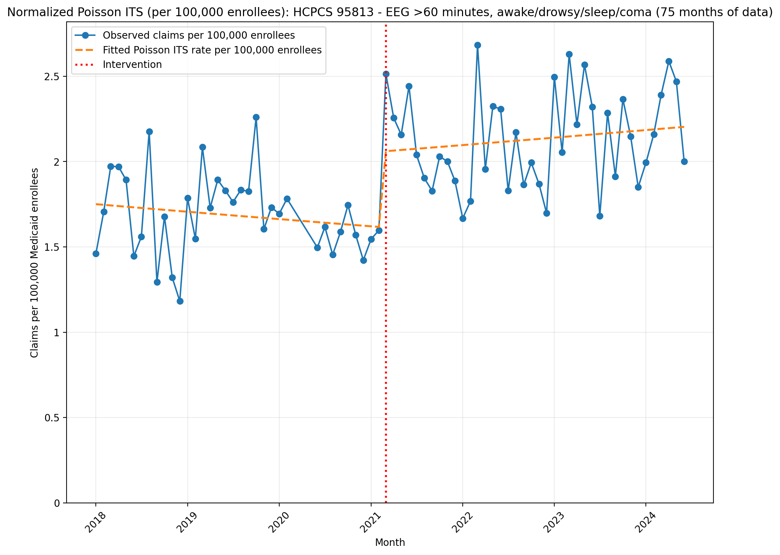
Normalized Poisson ITS (per 100,000 enrollees): HCPCS 95813 - EEG >60 minutes, awake/drowsy/sleep/coma (75 months of data)
Generalized Linear Model Regression Results
==============================================================================
Dep. Variable: y No. Observations: 75
Model: GLM Df Residuals: 71
Model Family: Poisson Df Model: 3
Link Function: Log Scale: 1.0000
Method: IRLS Log-Likelihood: -1451.4
Date: Thu, 07 May 2026 Deviance: 2210.9
Time: 21:22:56 Pearson chi2: 2.21e+03
No. Iterations: 4 Pseudo R-squ. (CS): 1.000
Covariance Type: nonrobust
==============================================================================
coef std err z P>|z| [0.025 0.975]
------------------------------------------------------------------------------
const -10.9530 0.009 -1249.781 0.000 -10.970 -10.936
T -0.0021 0.000 -5.147 0.000 -0.003 -0.001
X_t 0.2408 0.012 20.291 0.000 0.218 0.264
post_time 0.0039 0.001 7.398 0.000 0.003 0.005
==============================================================================

Slide 4
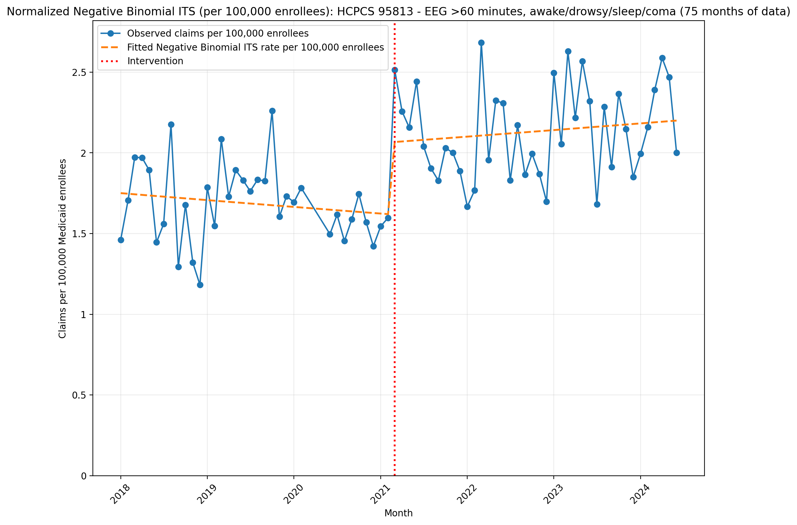
Normalized Negative Binomial ITS (per 100,000 enrollees): HCPCS 95813 - EEG >60 minutes, awake/drowsy/sleep/coma (75 months of data)
NegativeBinomial Regression Results
==============================================================================
Dep. Variable: y No. Observations: 75
Model: NegativeBinomial Df Residuals: 71
Method: MLE Df Model: 3
Date: Thu, 07 May 2026 Pseudo R-squ.: 0.04066
Time: 21:22:56 Log-Likelihood: -510.01
converged: True LL-Null: -531.63
Covariance Type: nonrobust LLR p-value: 2.191e-09
==============================================================================
coef std err z P>|z| [0.025 0.975]
------------------------------------------------------------------------------
const -10.9530 0.043 -252.899 0.000 -11.038 -10.868
T -0.0021 0.002 -1.005 0.315 -0.006 0.002
X_t 0.2419 0.063 3.858 0.000 0.119 0.365
post_time 0.0037 0.003 1.337 0.181 -0.002 0.009
alpha 0.0174 0.003 5.921 0.000 0.012 0.023
==============================================================================

Slide 5
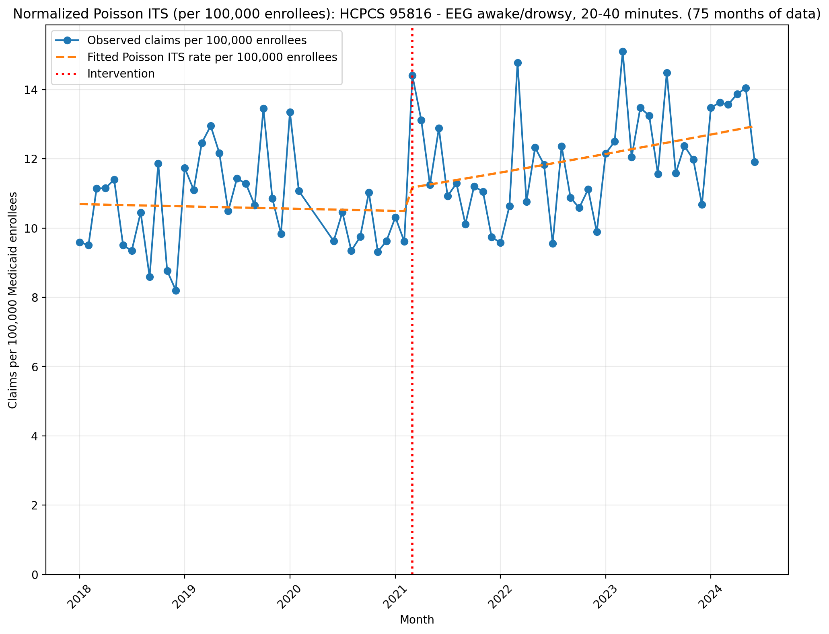
Normalized Poisson ITS (per 100,000 enrollees): HCPCS 95816 - EEG awake/drowsy, 20-40 minutes. (75 months of data)
Generalized Linear Model Regression Results
==============================================================================
Dep. Variable: y No. Observations: 75
Model: GLM Df Residuals: 71
Model Family: Poisson Df Model: 3
Link Function: Log Scale: 1.0000
Method: IRLS Log-Likelihood: -5514.7
Date: Thu, 07 May 2026 Deviance: 10204.
Time: 21:22:56 Pearson chi2: 1.03e+04
No. Iterations: 4 Pseudo R-squ. (CS): 1.000
Covariance Type: nonrobust
==============================================================================
coef std err z P>|z| [0.025 0.975]
------------------------------------------------------------------------------
const -9.1434 0.004 -2597.246 0.000 -9.150 -9.136
T -0.0005 0.000 -3.091 0.002 -0.001 -0.000
X_t 0.0593 0.005 12.285 0.000 0.050 0.069
post_time 0.0043 0.000 20.187 0.000 0.004 0.005
==============================================================================

Slide 6
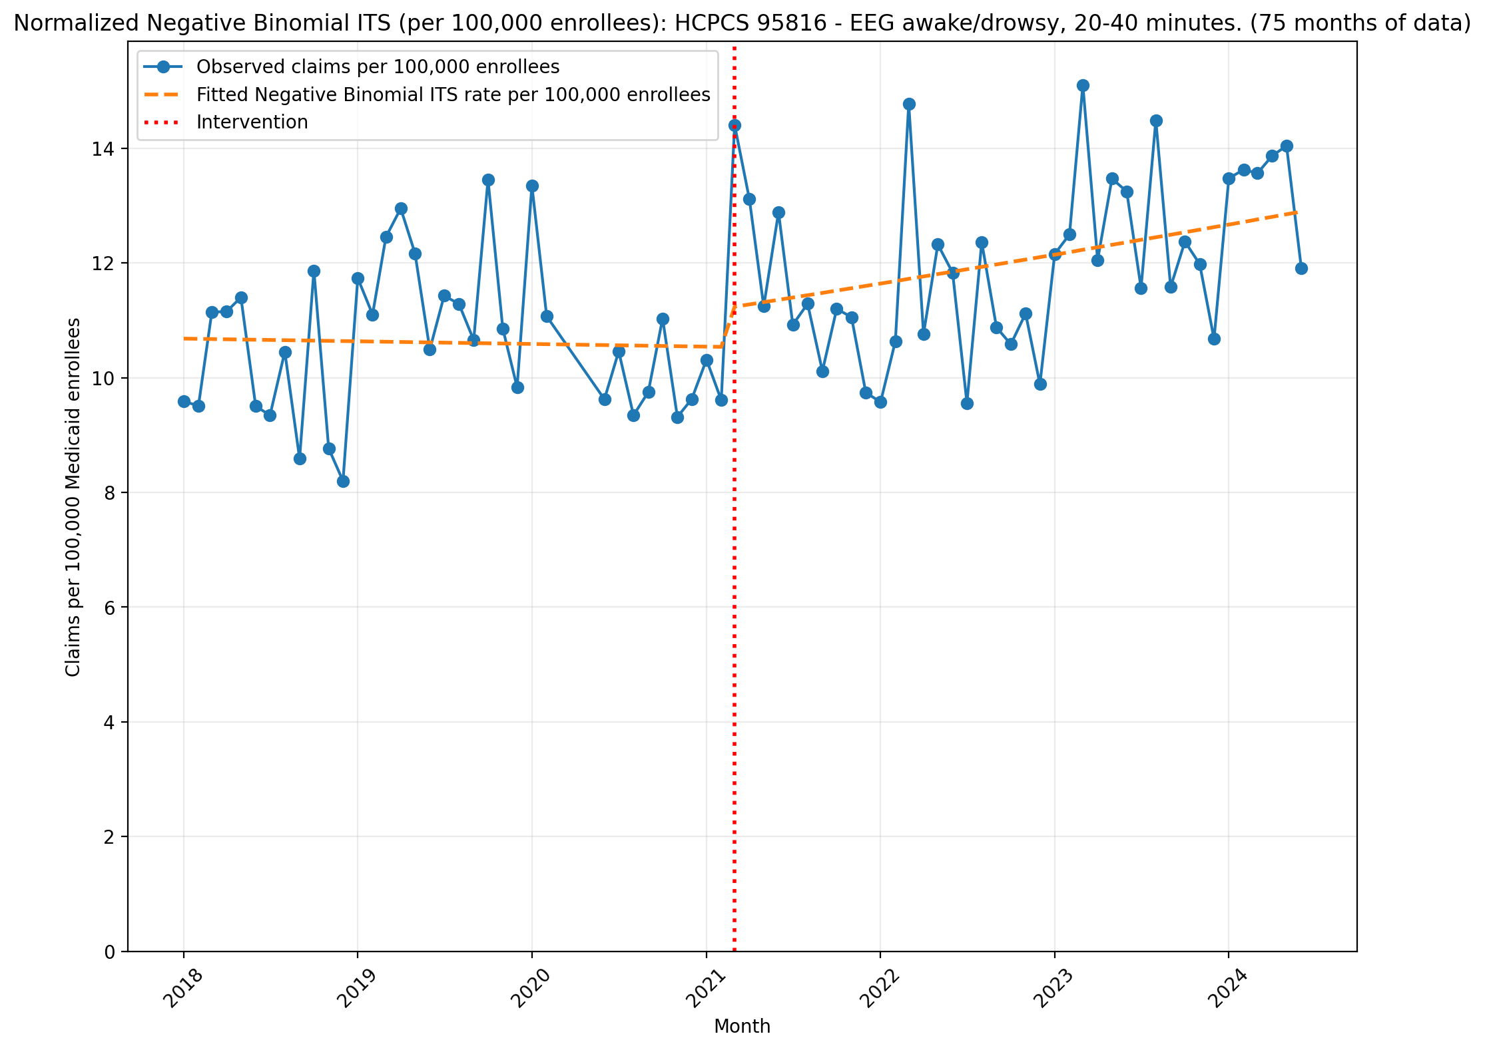
Normalized Negative Binomial ITS (per 100,000 enrollees): HCPCS 95816 - EEG awake/drowsy, 20-40 minutes. (75 months of data)
NegativeBinomial Regression Results
==============================================================================
Dep. Variable: y No. Observations: 75
Model: NegativeBinomial Df Residuals: 71
Method: MLE Df Model: 3
Date: Thu, 07 May 2026 Pseudo R-squ.: 0.01741
Time: 21:22:57 Log-Likelihood: -634.47
converged: True LL-Null: -645.71
Covariance Type: nonrobust LLR p-value: 5.164e-05
==============================================================================
coef std err z P>|z| [0.025 0.975]
------------------------------------------------------------------------------
const -9.1444 0.038 -237.637 0.000 -9.220 -9.069
T -0.0004 0.002 -0.198 0.843 -0.004 0.003
X_t 0.0608 0.056 1.094 0.274 -0.048 0.170
post_time 0.0039 0.002 1.593 0.111 -0.001 0.009
alpha 0.0140 0.002 6.091 0.000 0.009 0.018
==============================================================================

Slide 7
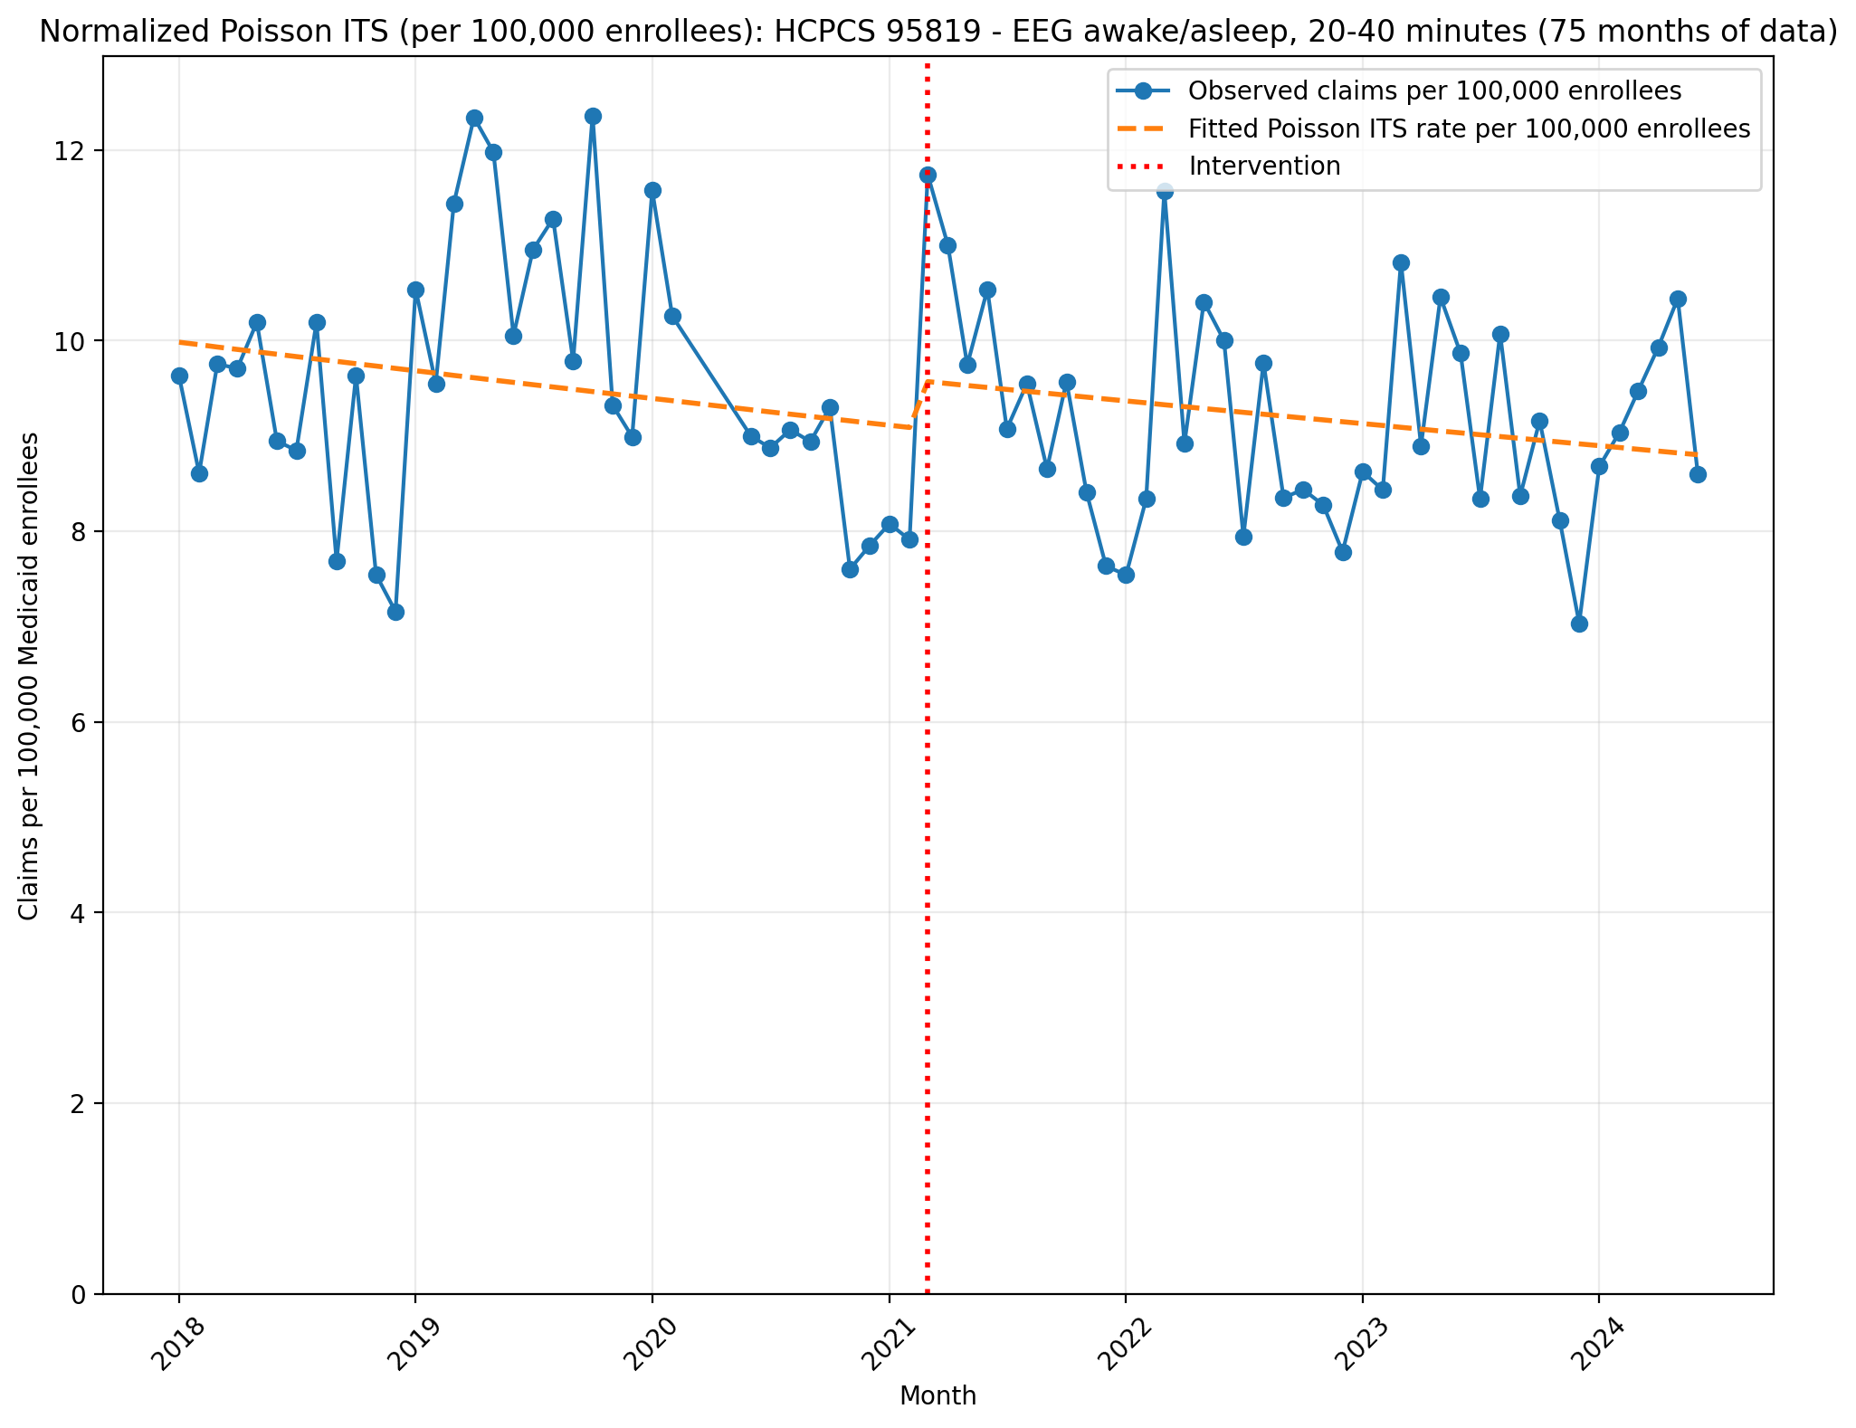
Normalized Poisson ITS (per 100,000 enrollees): HCPCS 95819 - EEG awake/asleep, 20-40 minutes (75 months of data)
Generalized Linear Model Regression Results
==============================================================================
Dep. Variable: y No. Observations: 75
Model: GLM Df Residuals: 71
Model Family: Poisson Df Model: 3
Link Function: Log Scale: 1.0000
Method: IRLS Log-Likelihood: -5251.7
Date: Thu, 07 May 2026 Deviance: 9692.4
Time: 21:22:58 Pearson chi2: 9.77e+03
No. Iterations: 4 Pseudo R-squ. (CS): 0.9998
Covariance Type: nonrobust
==============================================================================
coef std err z P>|z| [0.025 0.975]
------------------------------------------------------------------------------
const -9.2119 0.004 -2505.874 0.000 -9.219 -9.205
T -0.0025 0.000 -14.519 0.000 -0.003 -0.002
X_t 0.0537 0.005 10.236 0.000 0.043 0.064
post_time 0.0004 0.000 1.710 0.087 -5.78e-05 0.001
==============================================================================

Slide 8
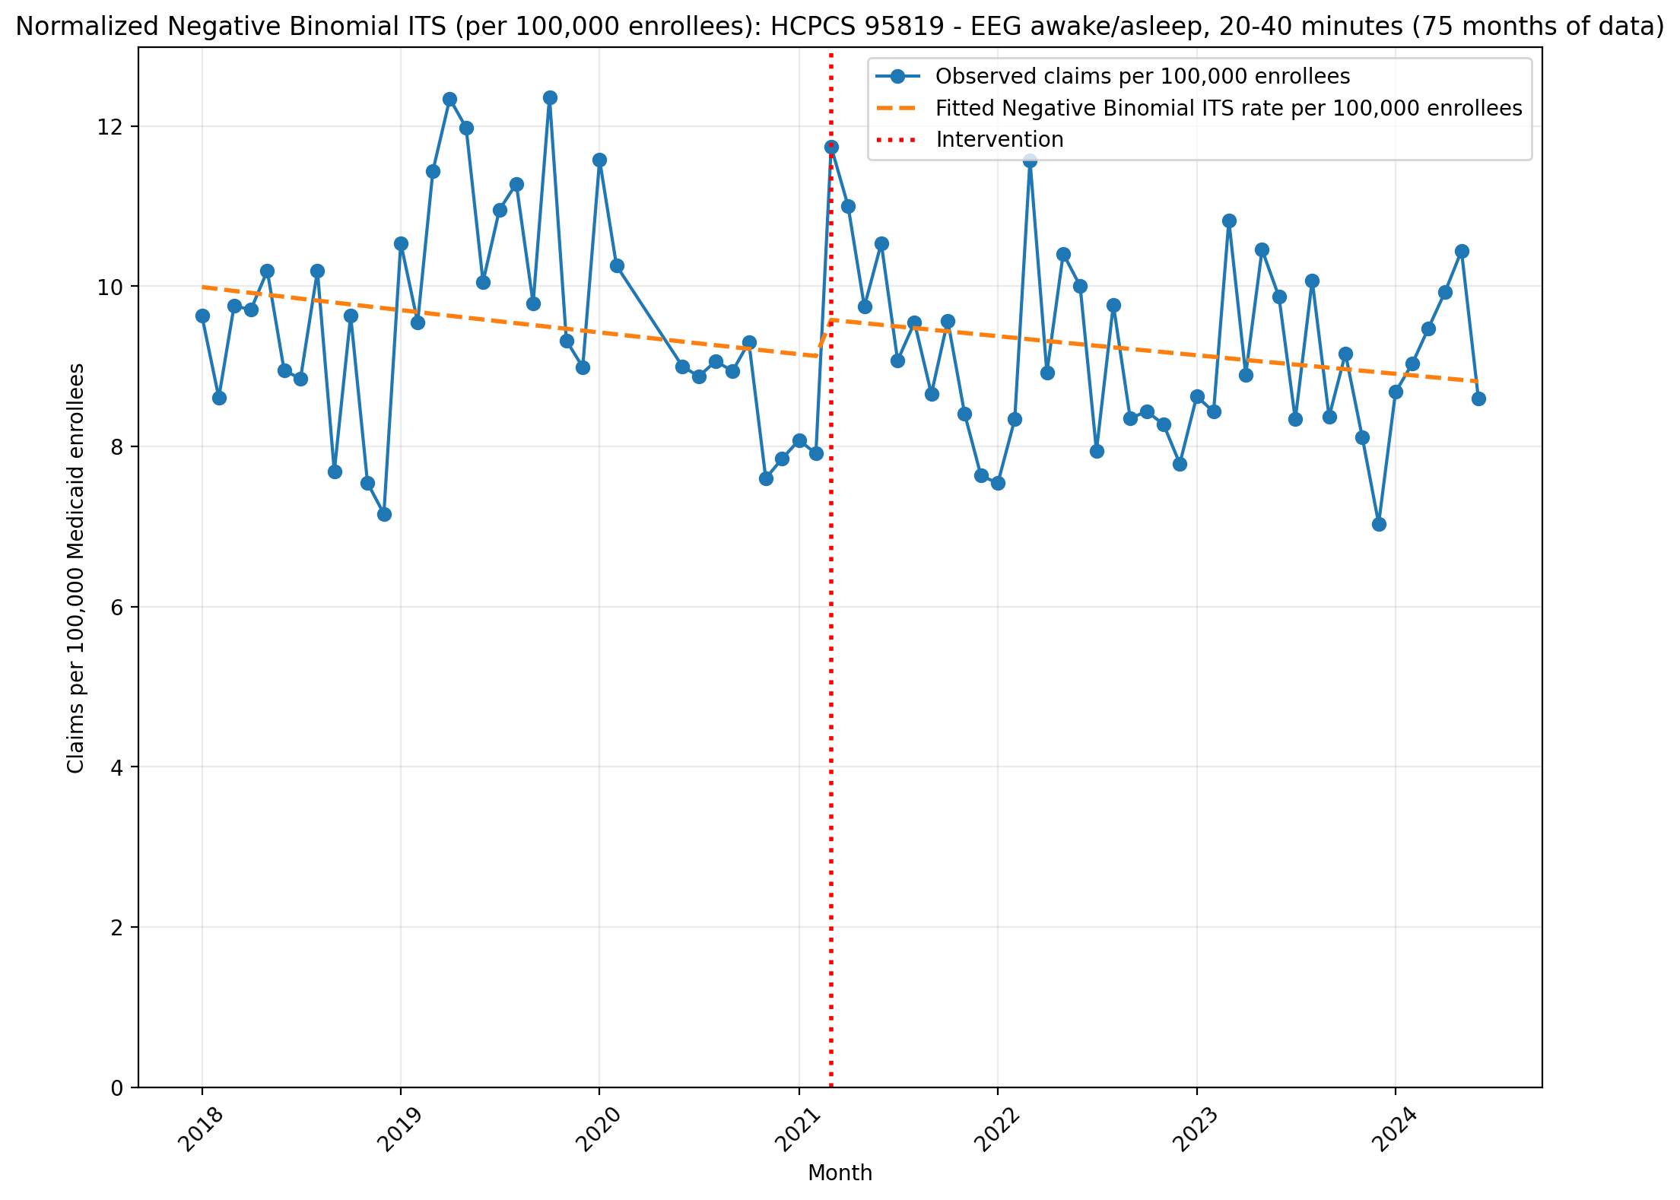
Normalized Negative Binomial ITS (per 100,000 enrollees): HCPCS 95819 - EEG awake/asleep, 20-40 minutes (75 months of data)
NegativeBinomial Regression Results
==============================================================================
Dep. Variable: y No. Observations: 75
Model: NegativeBinomial Df Residuals: 71
Method: MLE Df Model: 3
Date: Thu, 07 May 2026 Pseudo R-squ.: 0.003749
Time: 21:22:58 Log-Likelihood: -625.73
converged: False LL-Null: -628.08
Covariance Type: nonrobust LLR p-value: 0.1943
==============================================================================
coef std err z P>|z| [0.025 0.975]
------------------------------------------------------------------------------
const -9.2113 0.042 -220.036 0.000 -9.293 -9.129
T -0.0024 0.002 -1.207 0.227 -0.006 0.002
X_t 0.0503 0.060 0.834 0.404 -0.068 0.168
post_time 0.0003 0.003 0.110 0.912 -0.005 0.005
alpha 0.0163 0.003 6.092 0.000 0.011 0.022
==============================================================================

Slide 9
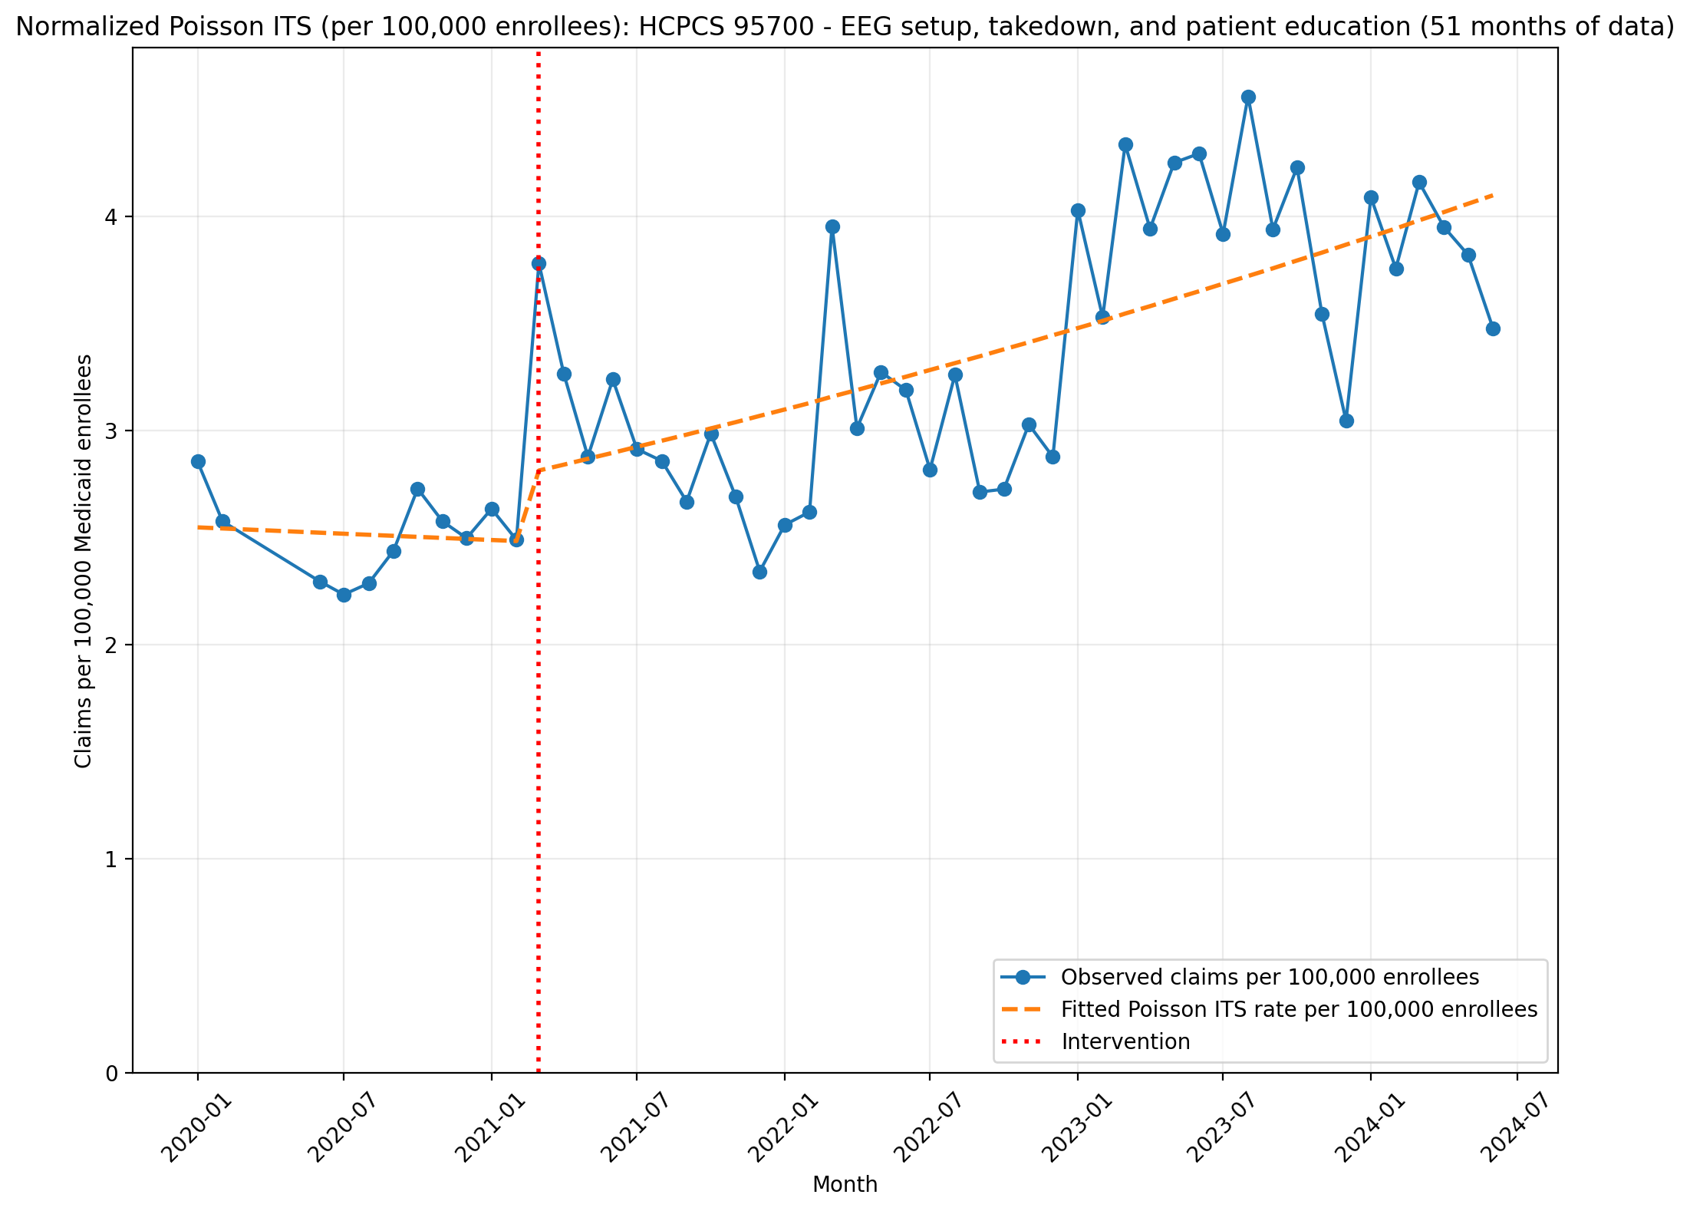
Normalized Poisson ITS (per 100,000 enrollees): HCPCS 95700 - EEG setup, takedown, and patient education (51 months of data)
Generalized Linear Model Regression Results
==============================================================================
Dep. Variable: y No. Observations: 51
Model: GLM Df Residuals: 47
Model Family: Poisson Df Model: 3
Link Function: Log Scale: 1.0000
Method: IRLS Log-Likelihood: -1531.4
Date: Thu, 07 May 2026 Deviance: 2563.4
Time: 21:22:59 Pearson chi2: 2.58e+03
No. Iterations: 4 Pseudo R-squ. (CS): 1.000
Covariance Type: nonrobust
==============================================================================
coef std err z P>|z| [0.025 0.975]
------------------------------------------------------------------------------
const -10.5782 0.014 -733.694 0.000 -10.606 -10.550
T -0.0020 0.002 -1.162 0.245 -0.005 0.001
X_t 0.1150 0.013 8.976 0.000 0.090 0.140
post_time 0.0116 0.002 6.838 0.000 0.008 0.015
==============================================================================

Slide 10
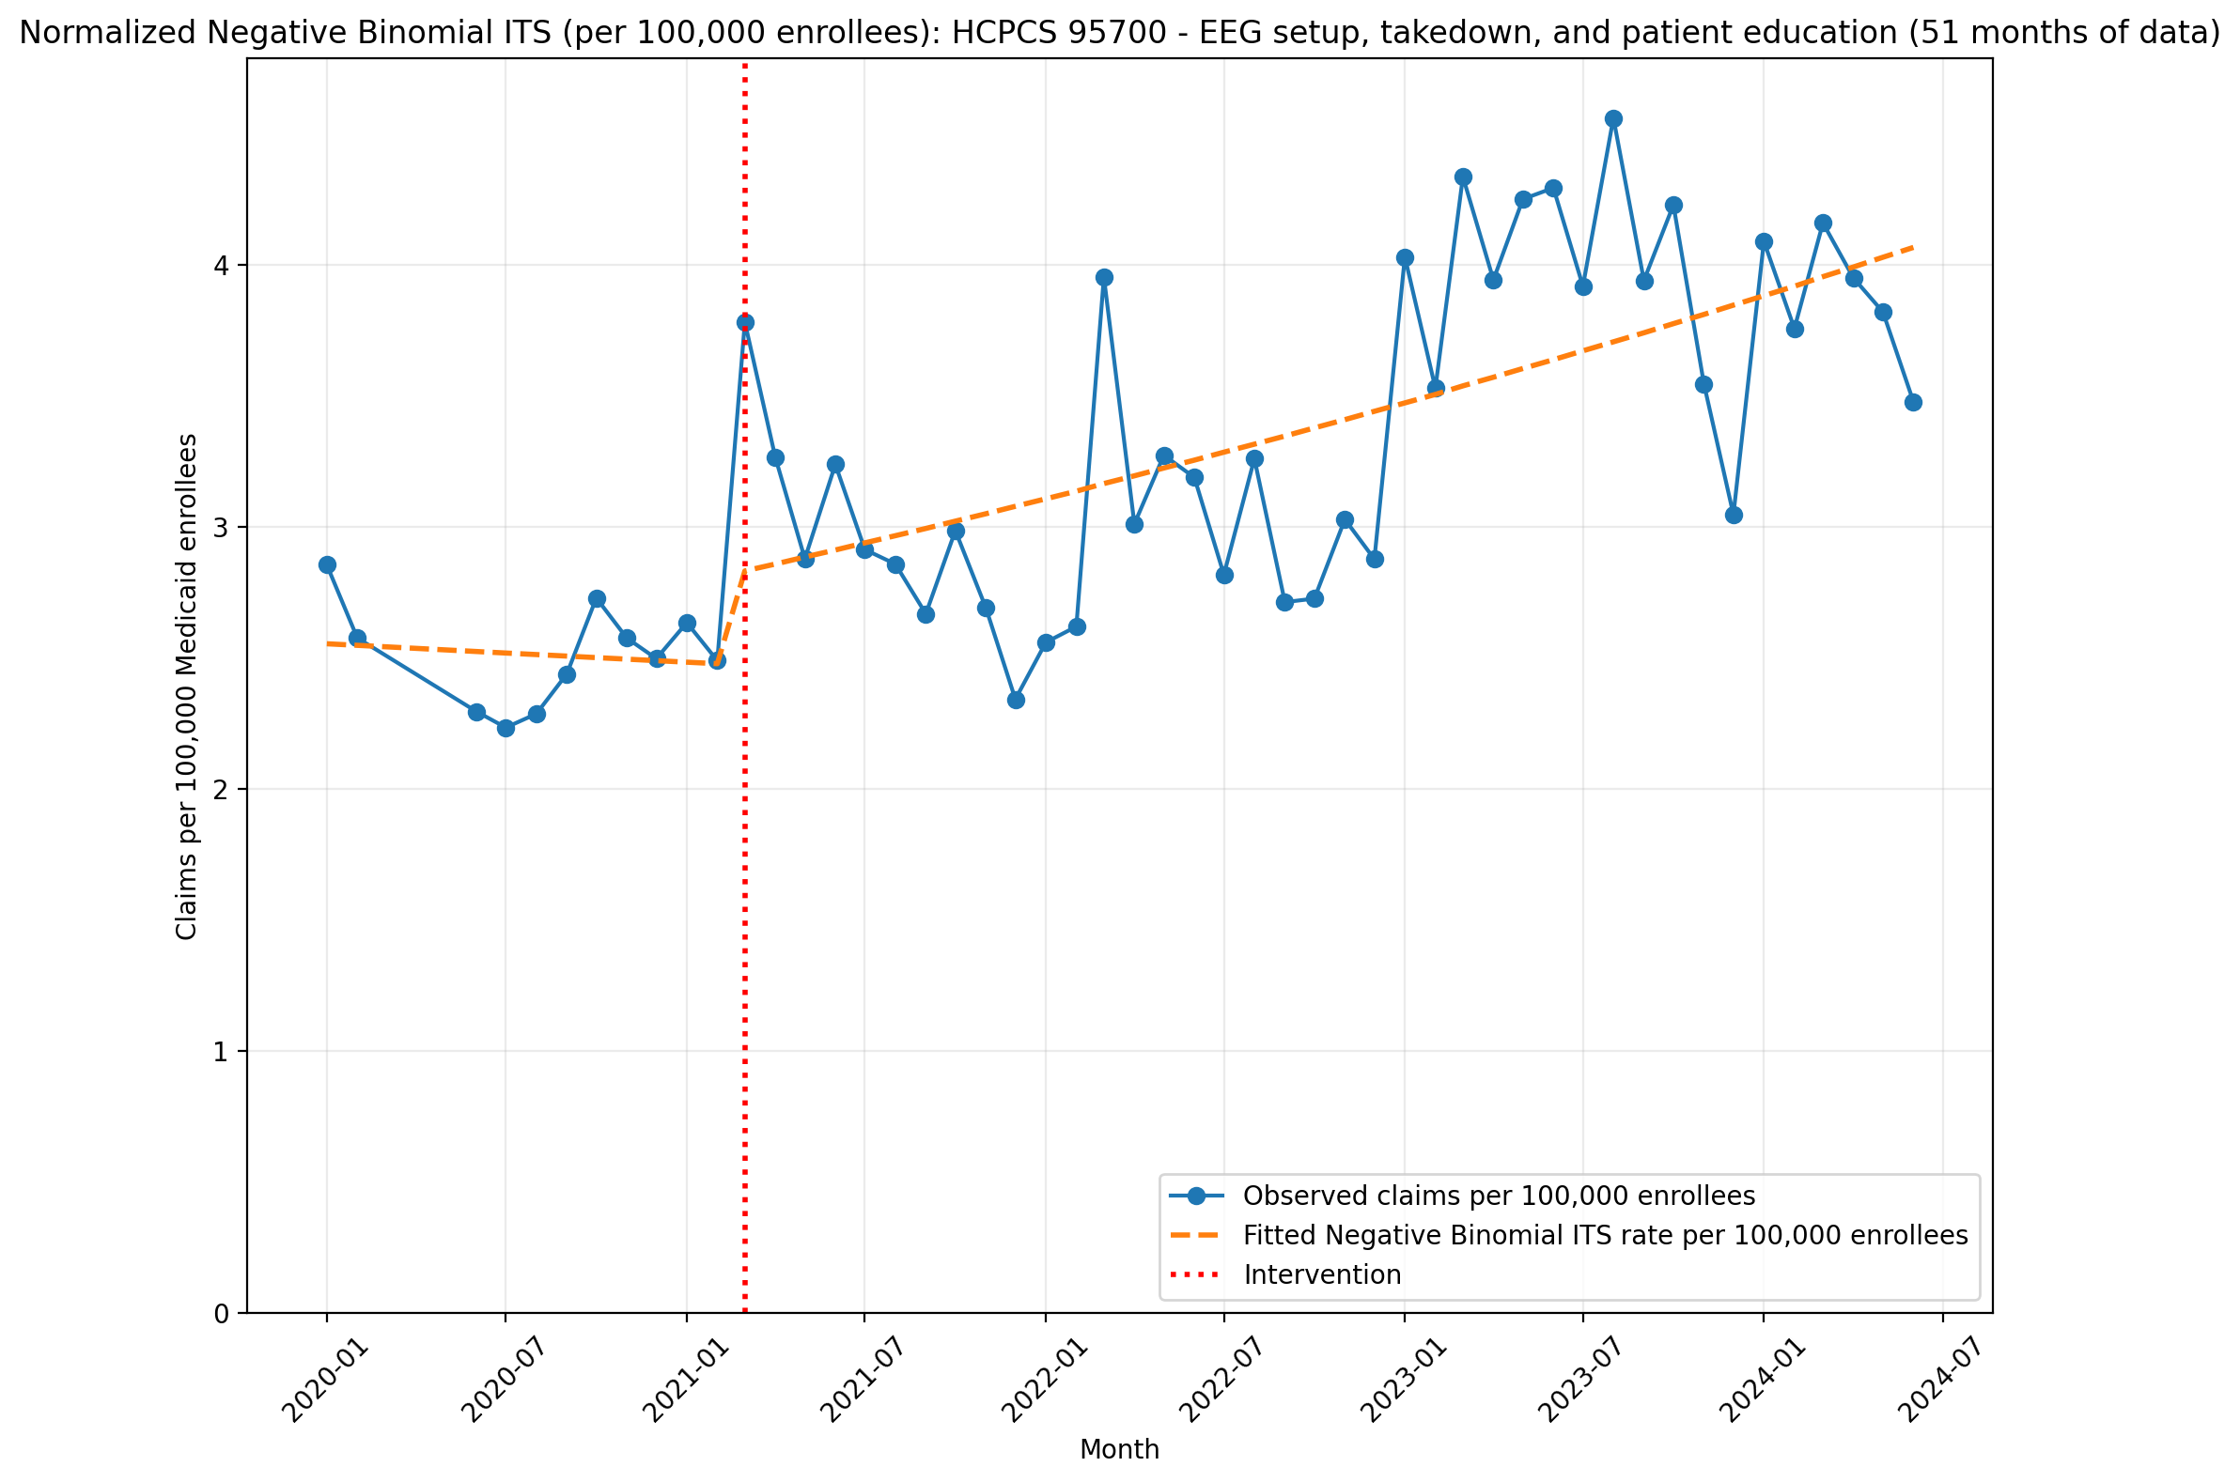
Normalized Negative Binomial ITS (per 100,000 enrollees): HCPCS 95700 - EEG setup, takedown, and patient education (51 months of data)
NegativeBinomial Regression Results
==============================================================================
Dep. Variable: y No. Observations: 51
Model: NegativeBinomial Df Residuals: 47
Method: MLE Df Model: 3
Date: Thu, 07 May 2026 Pseudo R-squ.: 0.05814
Time: 21:22:59 Log-Likelihood: -373.46
converged: False LL-Null: -396.52
Covariance Type: nonrobust LLR p-value: 5.373e-10
==============================================================================
coef std err z P>|z| [0.025 0.975]
------------------------------------------------------------------------------
const -10.5757 0.081 -131.318 0.000 -10.734 -10.418
T -0.0023 0.009 -0.246 0.806 -0.021 0.016
X_t 0.1243 0.077 1.611 0.107 -0.027 0.276
post_time 0.0116 0.010 1.208 0.227 -0.007 0.030
alpha 0.0162 0.003 4.960 0.000 0.010 0.023
==============================================================================

Slide 11
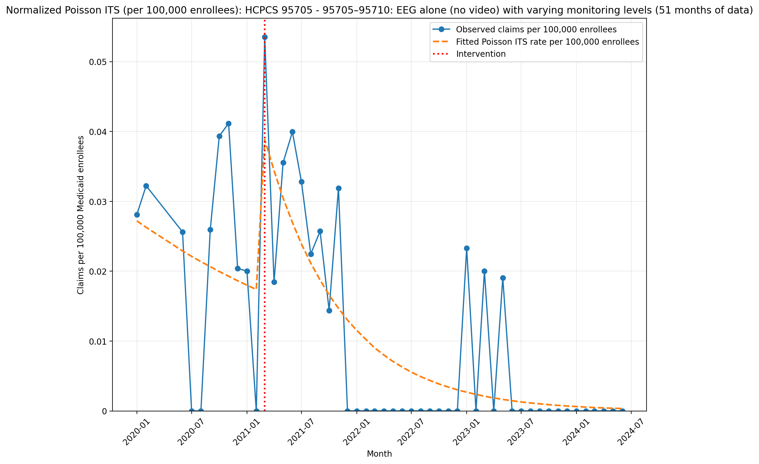
Normalized Poisson ITS (per 100,000 enrollees): HCPCS 95705 - 95705–95710: EEG alone (no video) with varying monitoring levels (51 months of data)
Generalized Linear Model Regression Results
==============================================================================
Dep. Variable: y No. Observations: 51
Model: GLM Df Residuals: 47
Model Family: Poisson Df Model: 3
Link Function: Log Scale: 1.0000
Method: IRLS Log-Likelihood: -317.81
Date: Thu, 07 May 2026 Deviance: 535.64
Time: 21:23:00 Pearson chi2: 722.
No. Iterations: 6 Pseudo R-squ. (CS): 0.9999
Covariance Type: nonrobust
==============================================================================
coef std err z P>|z| [0.025 0.975]
------------------------------------------------------------------------------
const -15.1173 0.145 -104.241 0.000 -15.401 -14.833
T -0.0344 0.018 -1.942 0.052 -0.069 0.000
X_t 0.9254 0.155 5.968 0.000 0.621 1.229
post_time -0.0871 0.019 -4.517 0.000 -0.125 -0.049
==============================================================================

Slide 12
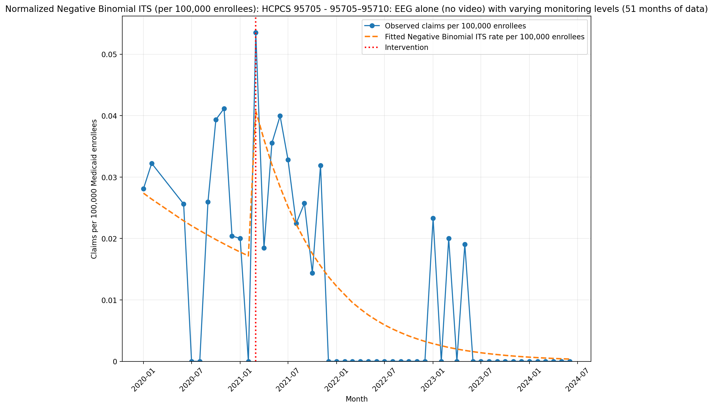
Normalized Negative Binomial ITS (per 100,000 enrollees): HCPCS 95705 - 95705–95710: EEG alone (no video) with varying monitoring levels (51 months of data)
NegativeBinomial Regression Results
==============================================================================
Dep. Variable: y No. Observations: 51
Model: NegativeBinomial Df Residuals: 47
Method: MLE Df Model: 3
Date: Thu, 07 May 2026 Pseudo R-squ.: 0.04240
Time: 21:23:00 Log-Likelihood: -124.50
converged: True LL-Null: -130.01
Covariance Type: nonrobust LLR p-value: 0.01160
==============================================================================
coef std err z P>|z| [0.025 0.975]
------------------------------------------------------------------------------
const -15.1109 1.458 -10.367 0.000 -17.968 -12.254
T -0.0359 0.173 -0.208 0.836 -0.375 0.303
X_t 0.9849 1.443 0.683 0.495 -1.843 3.813
post_time -0.0846 0.177 -0.478 0.633 -0.431 0.262
alpha 5.0573 1.471 3.437 0.001 2.173 7.941
==============================================================================

Slide 13
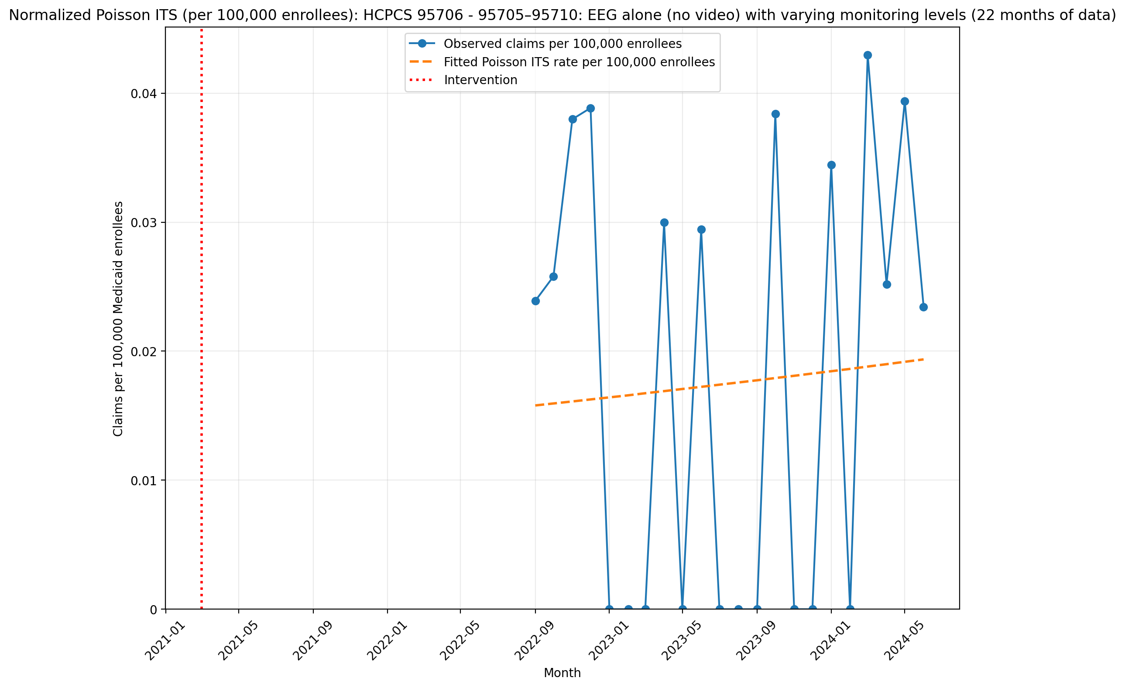
Normalized Poisson ITS (per 100,000 enrollees): HCPCS 95706 - 95705–95710: EEG alone (no video) with varying monitoring levels (22 months of data)
Generalized Linear Model Regression Results
==============================================================================
Dep. Variable: y No. Observations: 22
Model: GLM Df Residuals: 20
Model Family: Poisson Df Model: 1
Link Function: Log Scale: 1.0000
Method: IRLS Log-Likelihood: -263.13
Date: Thu, 07 May 2026 Deviance: 463.51
Time: 21:23:01 Pearson chi2: 338.
No. Iterations: 5 Pseudo R-squ. (CS): 0.05938
Covariance Type: nonrobust
==============================================================================
coef std err z P>|z| [0.025 0.975]
------------------------------------------------------------------------------
T 0.8294 0.013 62.531 0.000 0.803 0.855
X_t -0.0868 0.001 -89.471 0.000 -0.089 -0.085
post_time -0.8197 0.005 -152.564 0.000 -0.830 -0.809
==============================================================================

Slide 14
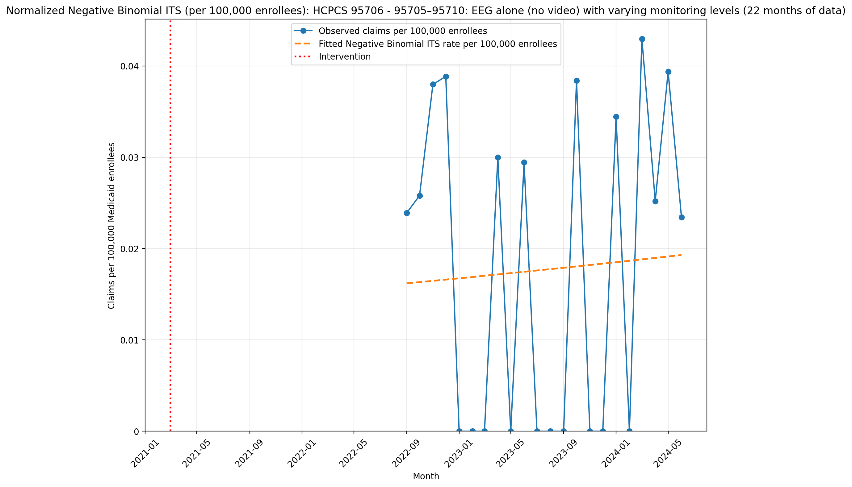
Normalized Negative Binomial ITS (per 100,000 enrollees): HCPCS 95706 - 95705–95710: EEG alone (no video) with varying monitoring levels (22 months of data)
NegativeBinomial Regression Results
==============================================================================
Dep. Variable: y No. Observations: 22
Model: NegativeBinomial Df Residuals: 20
Method: MLE Df Model: 1
Date: Thu, 07 May 2026 Pseudo R-squ.: 0.0001354
Time: 21:23:02 Log-Likelihood: -74.608
converged: True LL-Null: -74.618
Covariance Type: nonrobust LLR p-value: 0.8869
==============================================================================
coef std err z P>|z| [0.025 0.975]
------------------------------------------------------------------------------
T 0.0130 nan nan nan nan nan
X_t -15.5472 nan nan nan nan nan
post_time -0.0047 nan nan nan nan nan
alpha 4.1937 nan nan nan nan nan
==============================================================================

Slide 15
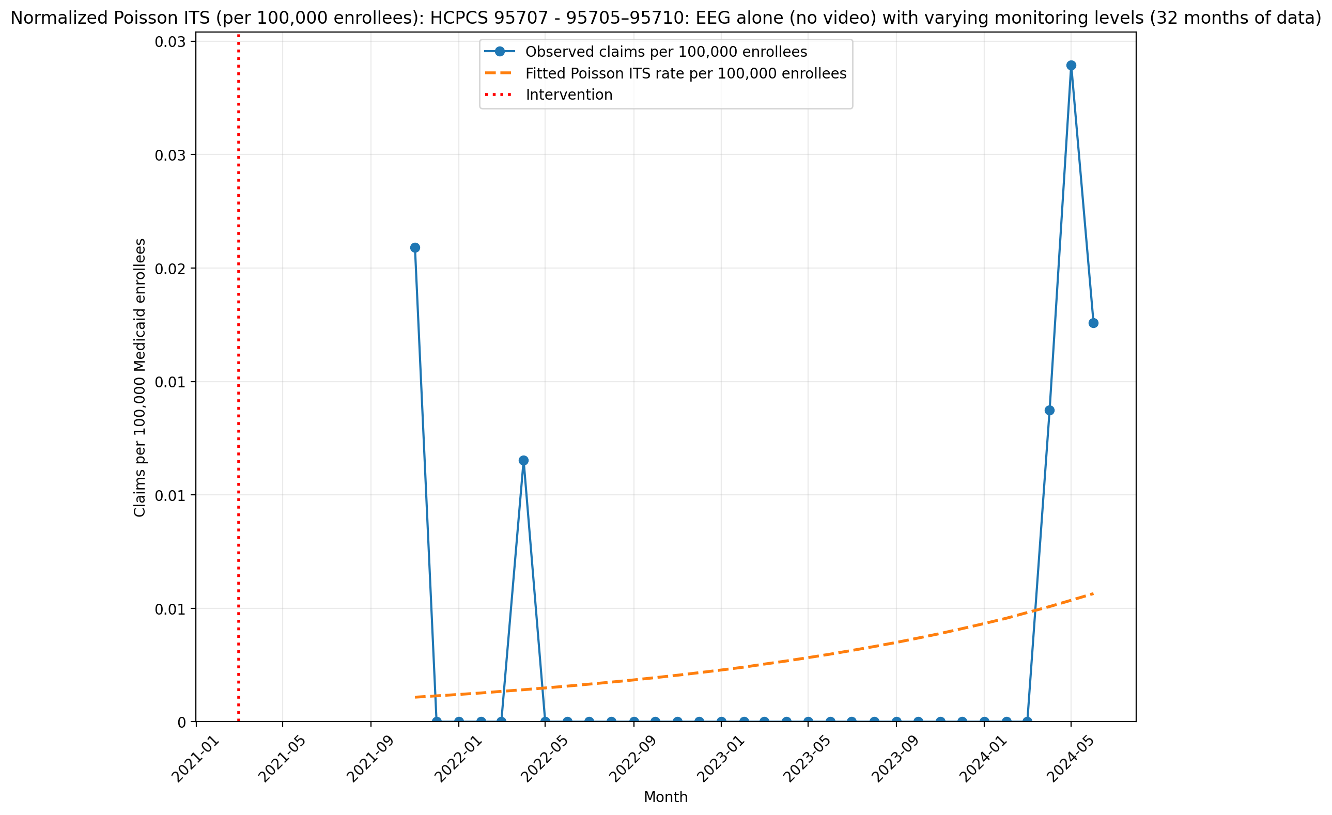
Normalized Poisson ITS (per 100,000 enrollees): HCPCS 95707 - 95705–95710: EEG alone (no video) with varying monitoring levels (32 months of data)
Generalized Linear Model Regression Results
==============================================================================
Dep. Variable: y No. Observations: 32
Model: GLM Df Residuals: 30
Model Family: Poisson Df Model: 1
Link Function: Log Scale: 1.0000
Method: IRLS Log-Likelihood: -164.17
Date: Thu, 07 May 2026 Deviance: 305.25
Time: 21:23:03 Pearson chi2: 596.
No. Iterations: 6 Pseudo R-squ. (CS): 0.4357
Covariance Type: nonrobust
==============================================================================
coef std err z P>|z| [0.025 0.975]
------------------------------------------------------------------------------
T 2.0416 0.042 48.965 0.000 1.960 2.123
X_t -0.4478 0.008 -56.628 0.000 -0.463 -0.432
post_time -1.9883 0.030 -67.166 0.000 -2.046 -1.930
==============================================================================

Slide 16
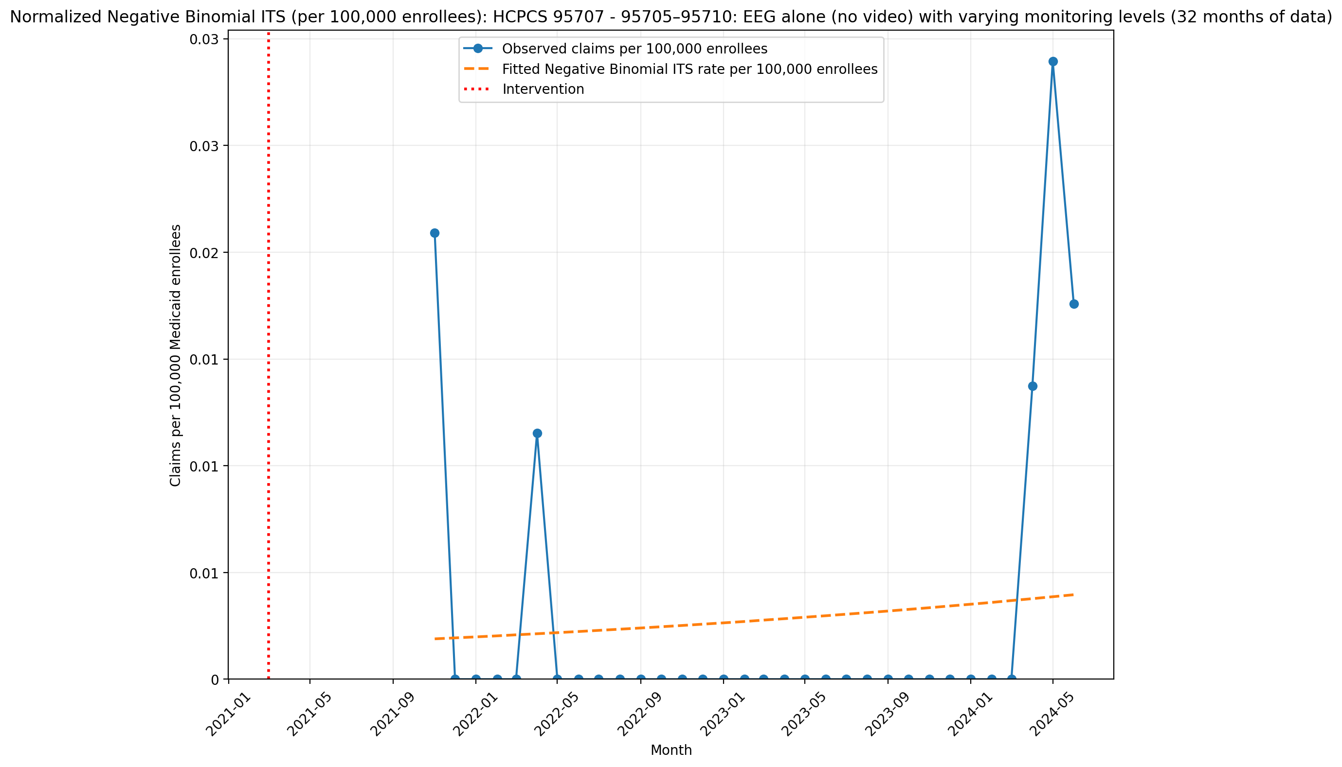
Normalized Negative Binomial ITS (per 100,000 enrollees): HCPCS 95707 - 95705–95710: EEG alone (no video) with varying monitoring levels (32 months of data)
NegativeBinomial Regression Results
==============================================================================
Dep. Variable: y No. Observations: 32
Model: NegativeBinomial Df Residuals: 30
Method: MLE Df Model: 1
Date: Thu, 07 May 2026 Pseudo R-squ.: 0.002128
Time: 21:23:03 Log-Likelihood: -35.891
converged: True LL-Null: -35.967
Covariance Type: nonrobust LLR p-value: 0.6956
==============================================================================
coef std err z P>|z| [0.025 0.975]
------------------------------------------------------------------------------
T 0.0697 1.01e+06 6.9e-08 1.000 -1.98e+06 1.98e+06
X_t -17.3699 9.09e+06 -1.91e-06 1.000 -1.78e+07 1.78e+07
post_time -0.0459 1.01e+06 -4.55e-08 1.000 -1.98e+06 1.98e+06
alpha 22.9944 12.045 1.909 0.056 -0.614 46.603
==============================================================================

Slide 17
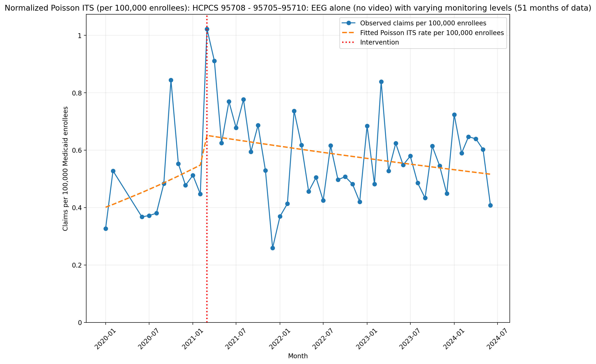
Normalized Poisson ITS (per 100,000 enrollees): HCPCS 95708 - 95705–95710: EEG alone (no video) with varying monitoring levels (51 months of data)
Generalized Linear Model Regression Results
==============================================================================
Dep. Variable: y No. Observations: 51
Model: GLM Df Residuals: 47
Model Family: Poisson Df Model: 3
Link Function: Log Scale: 1.0000
Method: IRLS Log-Likelihood: -981.28
Date: Thu, 07 May 2026 Deviance: 1553.1
Time: 21:23:04 Pearson chi2: 1.56e+03
No. Iterations: 4 Pseudo R-squ. (CS): 0.9939
Covariance Type: nonrobust
==============================================================================
coef std err z P>|z| [0.025 0.975]
------------------------------------------------------------------------------
const -12.4265 0.035 -354.255 0.000 -12.495 -12.358
T 0.0240 0.004 6.081 0.000 0.016 0.032
X_t 0.1786 0.028 6.281 0.000 0.123 0.234
post_time -0.0300 0.004 -7.504 0.000 -0.038 -0.022
==============================================================================

Slide 18
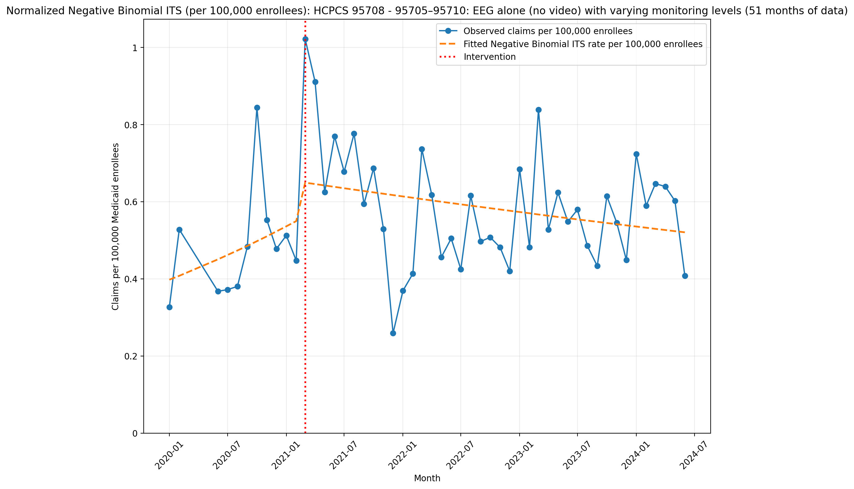
Normalized Negative Binomial ITS (per 100,000 enrollees): HCPCS 95708 - 95705–95710: EEG alone (no video) with varying monitoring levels (51 months of data)
NegativeBinomial Regression Results
==============================================================================
Dep. Variable: y No. Observations: 51
Model: NegativeBinomial Df Residuals: 47
Method: MLE Df Model: 3
Date: Thu, 07 May 2026 Pseudo R-squ.: 0.01411
Time: 21:23:04 Log-Likelihood: -316.92
converged: True LL-Null: -321.46
Covariance Type: nonrobust LLR p-value: 0.02839
==============================================================================
coef std err z P>|z| [0.025 0.975]
------------------------------------------------------------------------------
const -12.4348 0.158 -78.462 0.000 -12.745 -12.124
T 0.0249 0.019 1.329 0.184 -0.012 0.062
X_t 0.1724 0.148 1.162 0.245 -0.118 0.463
post_time -0.0305 0.019 -1.609 0.108 -0.068 0.007
alpha 0.0581 0.012 4.923 0.000 0.035 0.081
==============================================================================

Slide 19
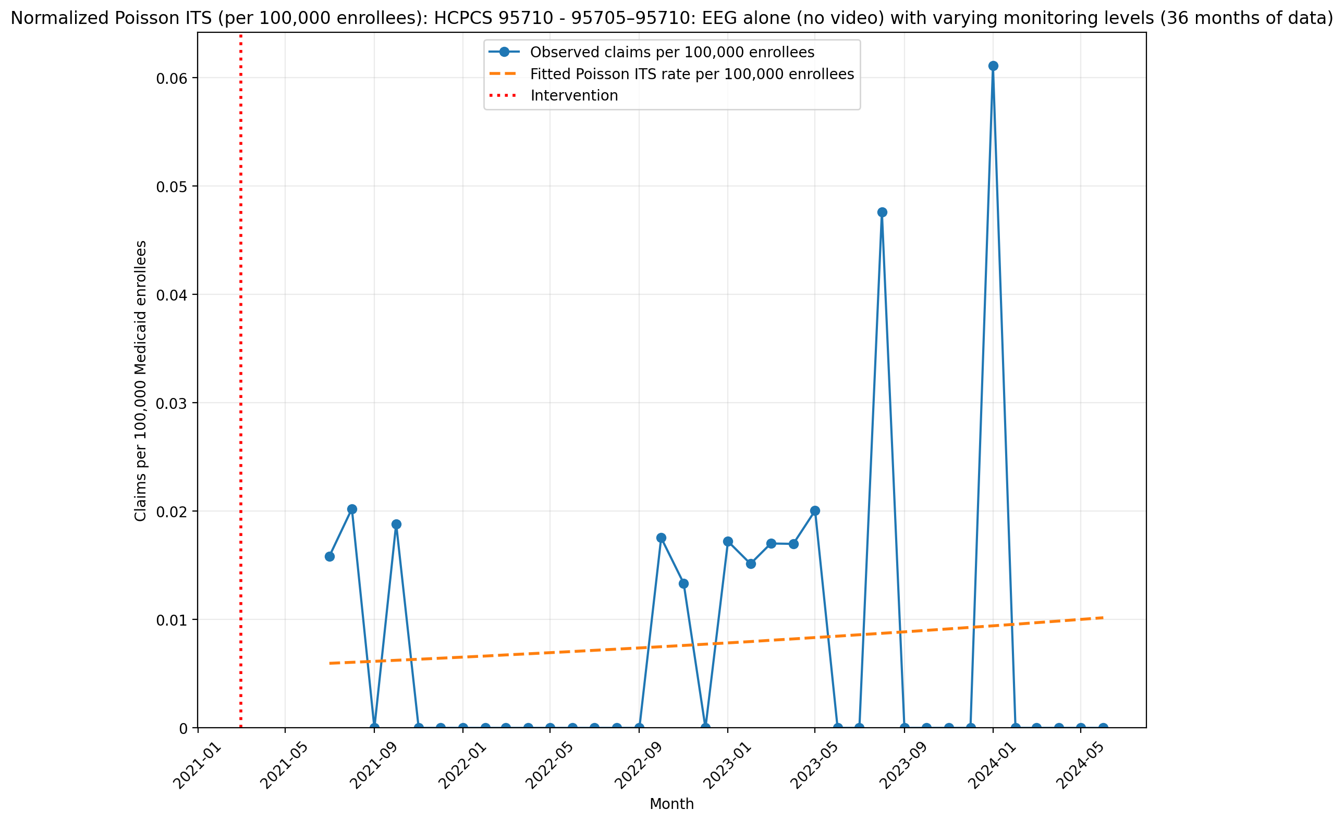
Normalized Poisson ITS (per 100,000 enrollees): HCPCS 95710 - 95705–95710: EEG alone (no video) with varying monitoring levels (36 months of data)
Generalized Linear Model Regression Results
==============================================================================
Dep. Variable: y No. Observations: 36
Model: GLM Df Residuals: 34
Model Family: Poisson Df Model: 1
Link Function: Log Scale: 1.0000
Method: IRLS Log-Likelihood: -351.24
Date: Thu, 07 May 2026 Deviance: 644.52
Time: 21:23:05 Pearson chi2: 737.
No. Iterations: 5 Pseudo R-squ. (CS): 0.1623
Covariance Type: nonrobust
==============================================================================
coef std err z P>|z| [0.025 0.975]
------------------------------------------------------------------------------
T 3.0952 0.029 105.080 0.000 3.037 3.153
X_t -1.2350 0.011 -115.702 0.000 -1.256 -1.214
post_time -3.0800 0.024 -128.445 0.000 -3.127 -3.033
==============================================================================

Slide 20
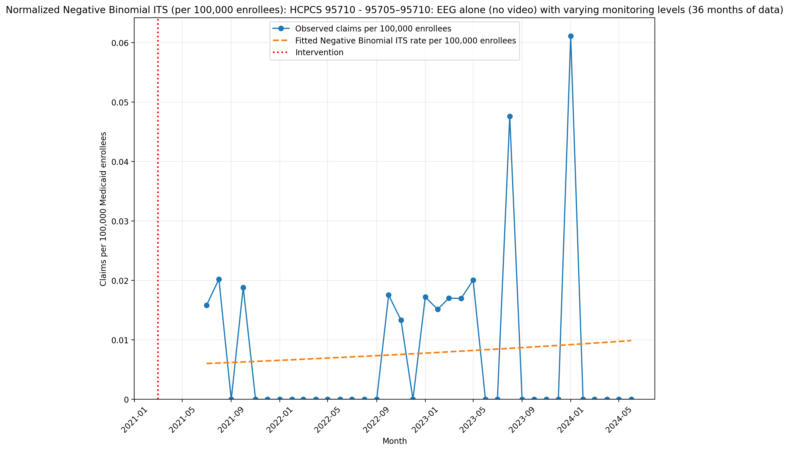
Normalized Negative Binomial ITS (per 100,000 enrollees): HCPCS 95710 - 95705–95710: EEG alone (no video) with varying monitoring levels (36 months of data)
NegativeBinomial Regression Results
==============================================================================
Dep. Variable: y No. Observations: 36
Model: NegativeBinomial Df Residuals: 34
Method: MLE Df Model: 1
Date: Thu, 07 May 2026 Pseudo R-squ.: 0.0004918
Time: 21:23:06 Log-Likelihood: -78.301
converged: True LL-Null: -78.340
Covariance Type: nonrobust LLR p-value: 0.7813
==============================================================================
coef std err z P>|z| [0.025 0.975]
------------------------------------------------------------------------------
T 0.0610 nan nan nan nan nan
X_t -16.3878 nan nan nan nan nan
post_time -0.0470 nan nan nan nan nan
alpha 9.2979 nan nan nan nan nan
==============================================================================

Slide 21
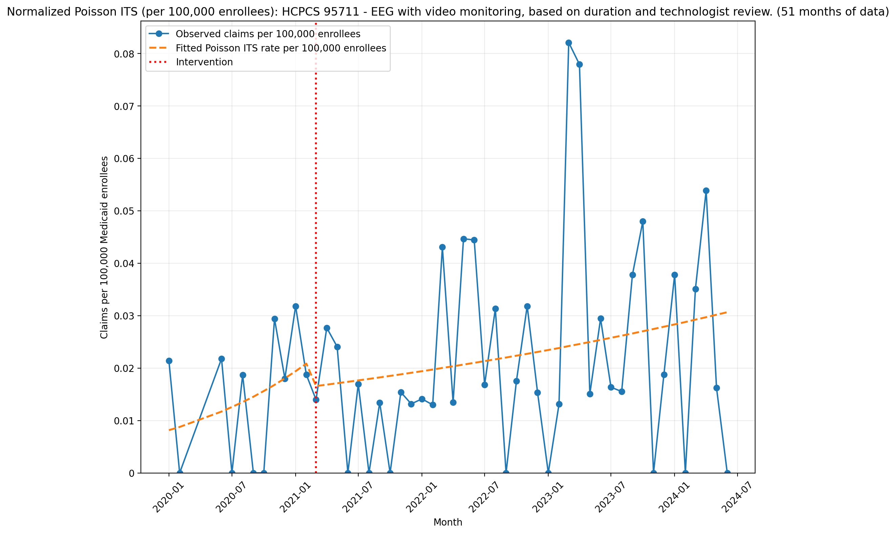
Normalized Poisson ITS (per 100,000 enrollees): HCPCS 95711 - EEG with video monitoring, based on duration and technologist review. (51 months of data)
Generalized Linear Model Regression Results
==============================================================================
Dep. Variable: y No. Observations: 51
Model: GLM Df Residuals: 47
Model Family: Poisson Df Model: 3
Link Function: Log Scale: 1.0000
Method: IRLS Log-Likelihood: -475.48
Date: Thu, 07 May 2026 Deviance: 759.05
Time: 21:23:07 Pearson chi2: 676.
No. Iterations: 5 Pseudo R-squ. (CS): 0.6989
Covariance Type: nonrobust
==============================================================================
coef std err z P>|z| [0.025 0.975]
------------------------------------------------------------------------------
const -16.3220 0.228 -71.547 0.000 -16.769 -15.875
T 0.0722 0.024 2.973 0.003 0.025 0.120
X_t -0.2453 0.157 -1.565 0.118 -0.553 0.062
post_time -0.0564 0.024 -2.306 0.021 -0.104 -0.008
==============================================================================

Slide 22
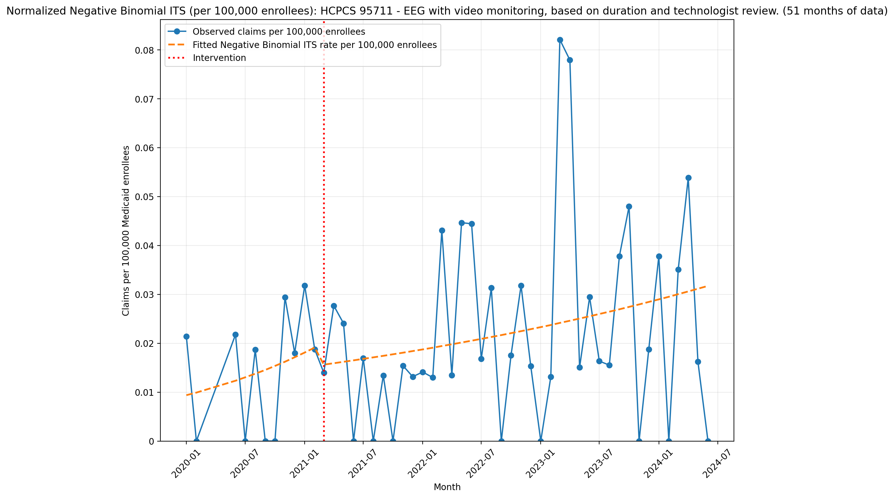
Normalized Negative Binomial ITS (per 100,000 enrollees): HCPCS 95711 - EEG with video monitoring, based on duration and technologist review. (51 months of data)
NegativeBinomial Regression Results
==============================================================================
Dep. Variable: y No. Observations: 51
Model: NegativeBinomial Df Residuals: 47
Method: MLE Df Model: 3
Date: Thu, 07 May 2026 Pseudo R-squ.: 0.005937
Time: 21:23:07 Log-Likelihood: -199.10
converged: True LL-Null: -200.29
Covariance Type: nonrobust LLR p-value: 0.4977
==============================================================================
coef std err z P>|z| [0.025 0.975]
------------------------------------------------------------------------------
const -16.1820 0.730 -22.179 0.000 -17.612 -14.752
T 0.0548 0.083 0.659 0.510 -0.108 0.218
X_t -0.2199 0.723 -0.304 0.761 -1.636 1.197
post_time -0.0366 0.085 -0.431 0.667 -0.203 0.130
alpha 1.4468 0.332 4.364 0.000 0.797 2.097
==============================================================================

Slide 23
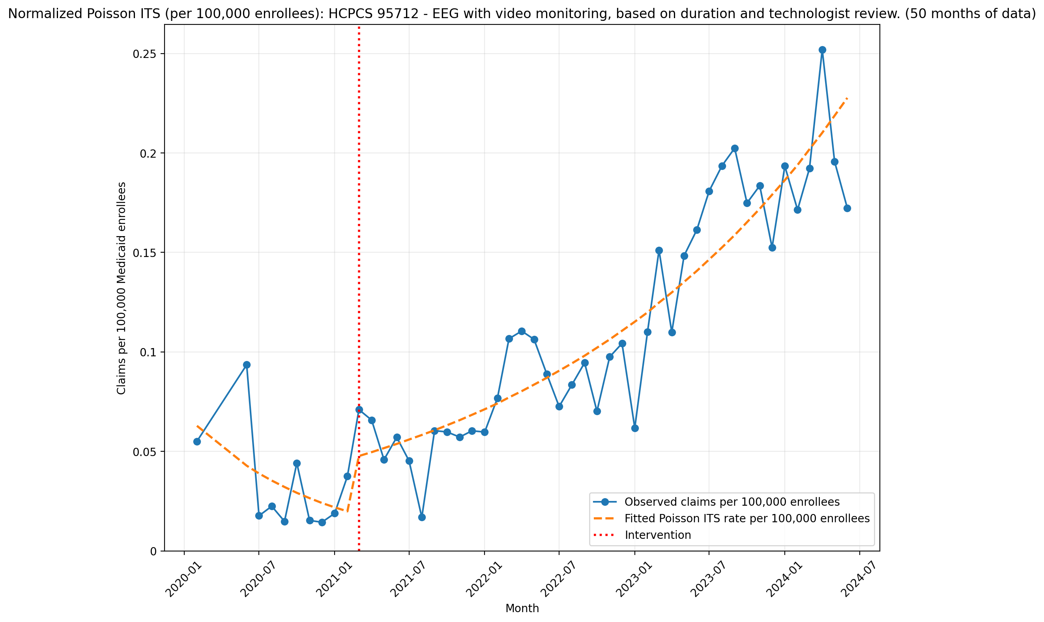
Normalized Poisson ITS (per 100,000 enrollees): HCPCS 95712 - EEG with video monitoring, based on duration and technologist review. (50 months of data)
Generalized Linear Model Regression Results
==============================================================================
Dep. Variable: y No. Observations: 50
Model: GLM Df Residuals: 46
Model Family: Poisson Df Model: 3
Link Function: Log Scale: 1.0000
Method: IRLS Log-Likelihood: -294.40
Date: Thu, 07 May 2026 Deviance: 284.31
Time: 21:23:08 Pearson chi2: 283.
No. Iterations: 5 Pseudo R-squ. (CS): 1.000
Covariance Type: nonrobust
==============================================================================
coef std err z P>|z| [0.025 0.975]
------------------------------------------------------------------------------
const -14.2799 0.120 -119.324 0.000 -14.514 -14.045
T -0.0960 0.017 -5.730 0.000 -0.129 -0.063
X_t 0.8349 0.122 6.838 0.000 0.596 1.074
post_time 0.1360 0.017 8.095 0.000 0.103 0.169
==============================================================================

Slide 24
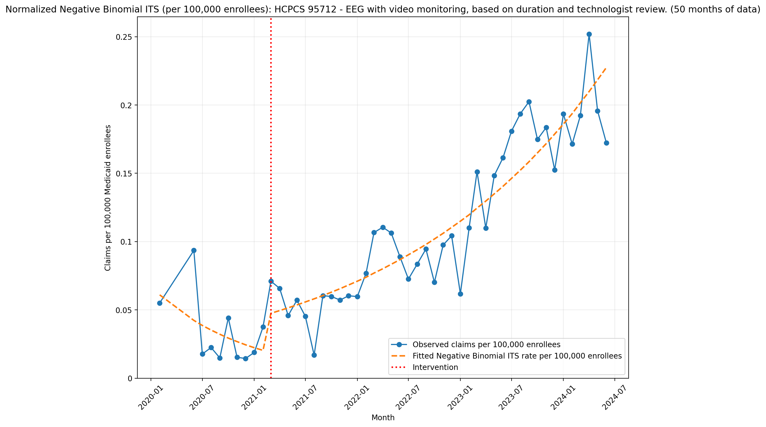
Normalized Negative Binomial ITS (per 100,000 enrollees): HCPCS 95712 - EEG with video monitoring, based on duration and technologist review. (50 months of data)
NegativeBinomial Regression Results
==============================================================================
Dep. Variable: y No. Observations: 50
Model: NegativeBinomial Df Residuals: 46
Method: MLE Df Model: 3
Date: Thu, 07 May 2026 Pseudo R-squ.: 0.1497
Time: 21:23:08 Log-Likelihood: -227.74
converged: True LL-Null: -267.82
Covariance Type: nonrobust LLR p-value: 2.836e-17
==============================================================================
coef std err z P>|z| [0.025 0.975]
------------------------------------------------------------------------------
const -14.3100 0.231 -61.920 0.000 -14.763 -13.857
T -0.0915 0.030 -3.069 0.002 -0.150 -0.033
X_t 0.8080 0.211 3.825 0.000 0.394 1.222
post_time 0.1316 0.030 4.375 0.000 0.073 0.191
alpha 0.0761 0.020 3.788 0.000 0.037 0.116
==============================================================================

Slide 25
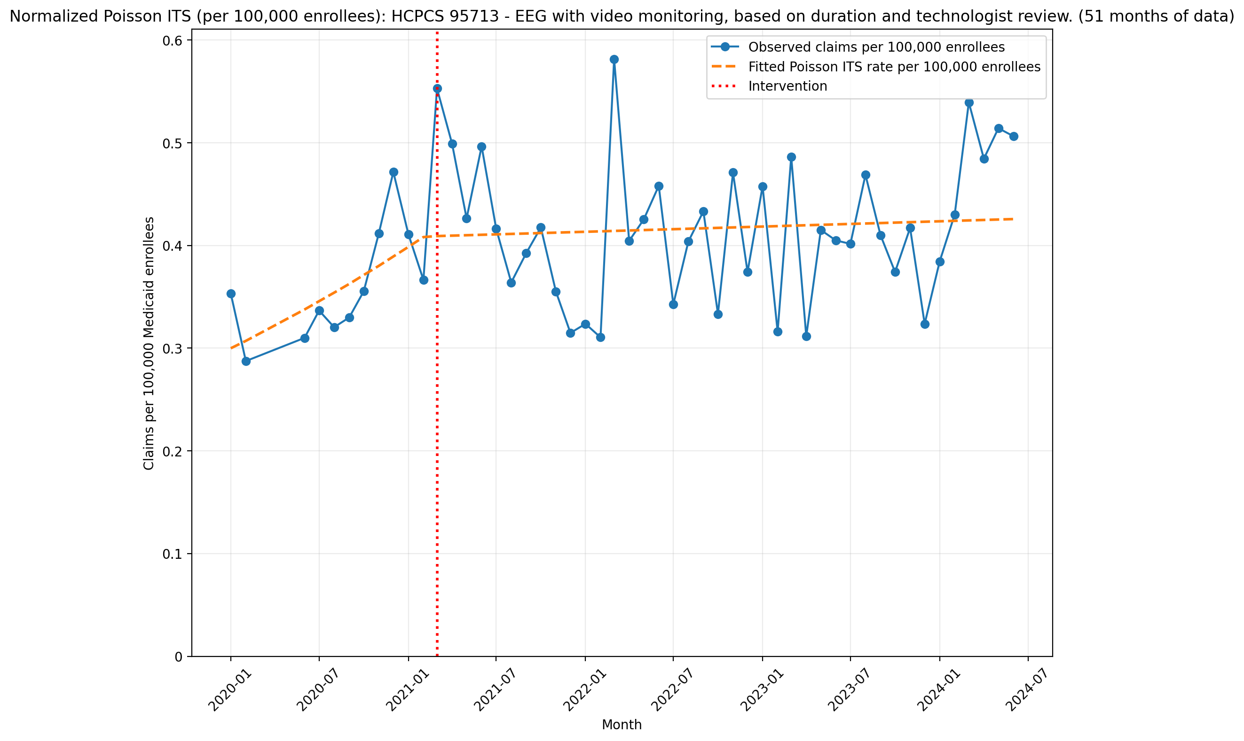
Normalized Poisson ITS (per 100,000 enrollees): HCPCS 95713 - EEG with video monitoring, based on duration and technologist review. (51 months of data)
Generalized Linear Model Regression Results
==============================================================================
Dep. Variable: y No. Observations: 51
Model: GLM Df Residuals: 47
Model Family: Poisson Df Model: 3
Link Function: Log Scale: 1.0000
Method: IRLS Log-Likelihood: -427.31
Date: Thu, 07 May 2026 Deviance: 460.57
Time: 21:23:09 Pearson chi2: 465.
No. Iterations: 4 Pseudo R-squ. (CS): 0.8201
Covariance Type: nonrobust
==============================================================================
coef std err z P>|z| [0.025 0.975]
------------------------------------------------------------------------------
const -12.7171 0.041 -313.373 0.000 -12.797 -12.638
T 0.0237 0.005 5.192 0.000 0.015 0.033
X_t 0.0014 0.033 0.042 0.967 -0.064 0.067
post_time -0.0227 0.005 -4.911 0.000 -0.032 -0.014
==============================================================================

Slide 26
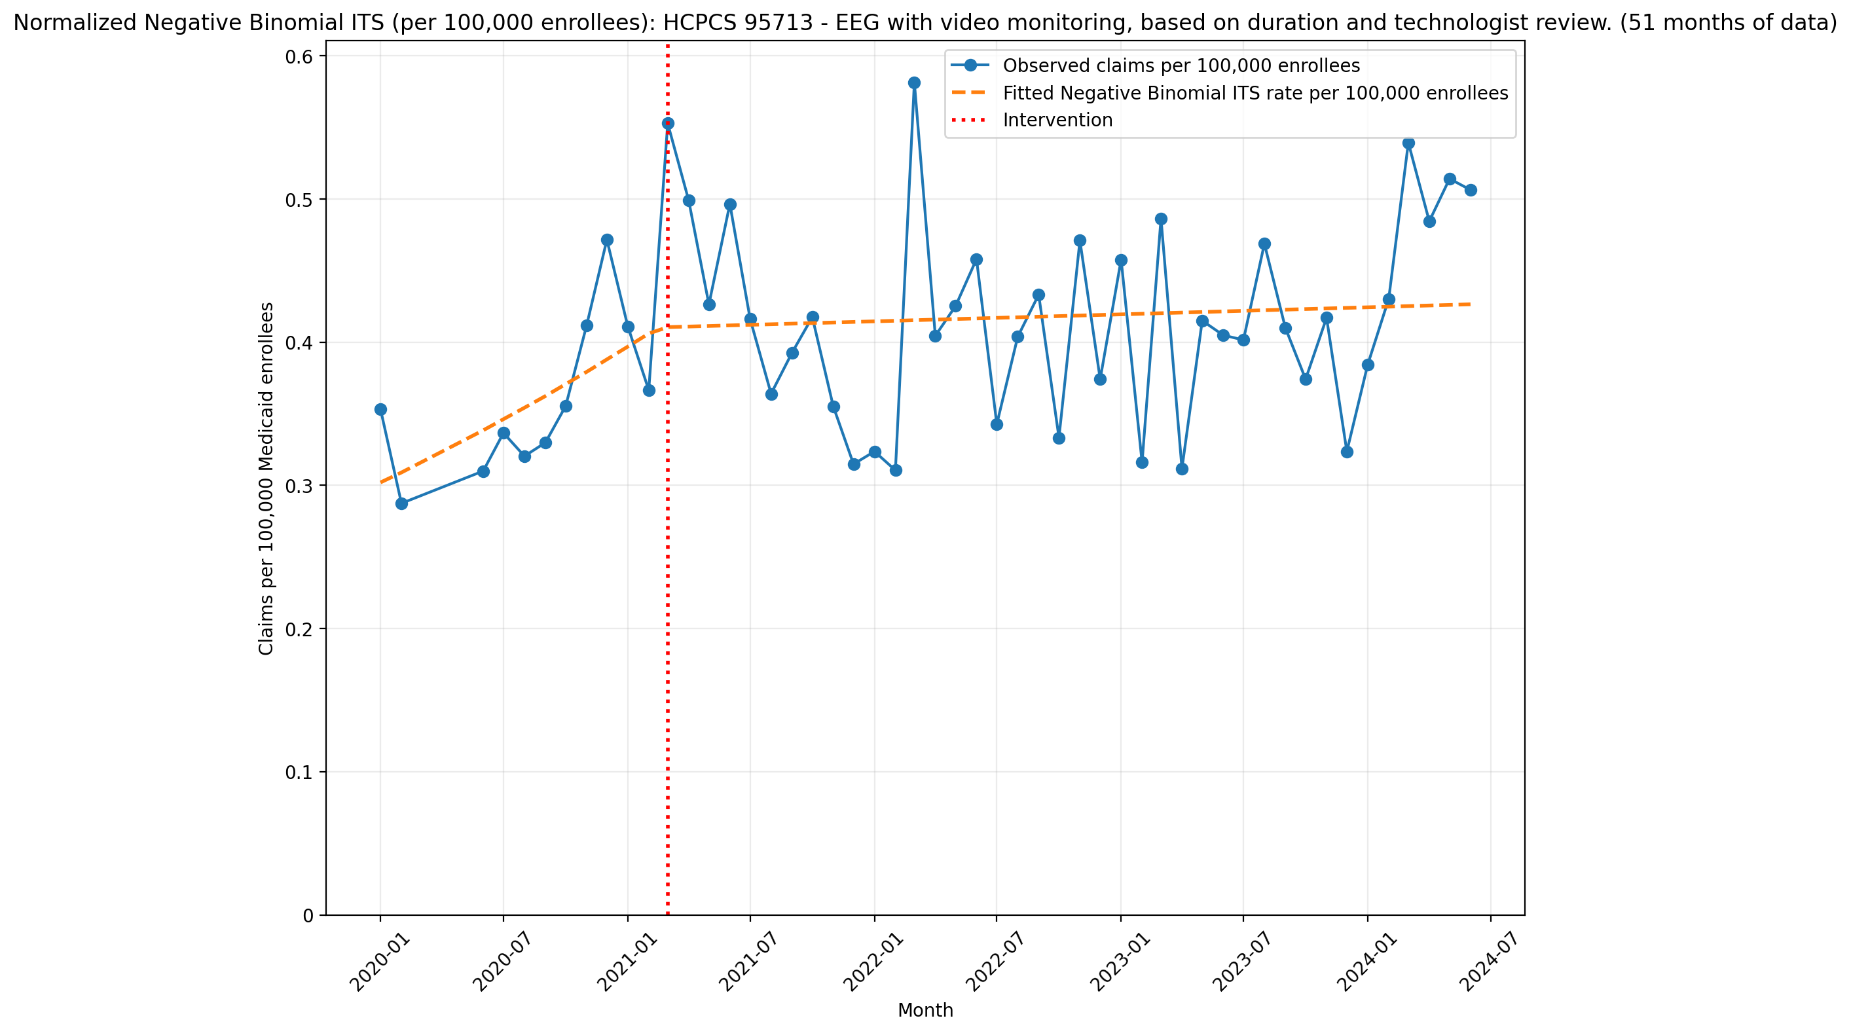
Normalized Negative Binomial ITS (per 100,000 enrollees): HCPCS 95713 - EEG with video monitoring, based on duration and technologist review. (51 months of data)
NegativeBinomial Regression Results
==============================================================================
Dep. Variable: y No. Observations: 51
Model: NegativeBinomial Df Residuals: 47
Method: MLE Df Model: 3
Date: Thu, 07 May 2026 Pseudo R-squ.: 0.01888
Time: 21:23:10 Log-Likelihood: -277.88
converged: True LL-Null: -283.22
Covariance Type: nonrobust LLR p-value: 0.01350
==============================================================================
coef std err z P>|z| [0.025 0.975]
------------------------------------------------------------------------------
const -12.7100 0.100 -126.929 0.000 -12.906 -12.514
T 0.0228 0.012 1.947 0.052 -0.000 0.046
X_t 0.0100 0.093 0.107 0.915 -0.173 0.193
post_time -0.0218 0.012 -1.835 0.067 -0.045 0.001
alpha 0.0214 0.005 4.502 0.000 0.012 0.031
==============================================================================

Slide 27
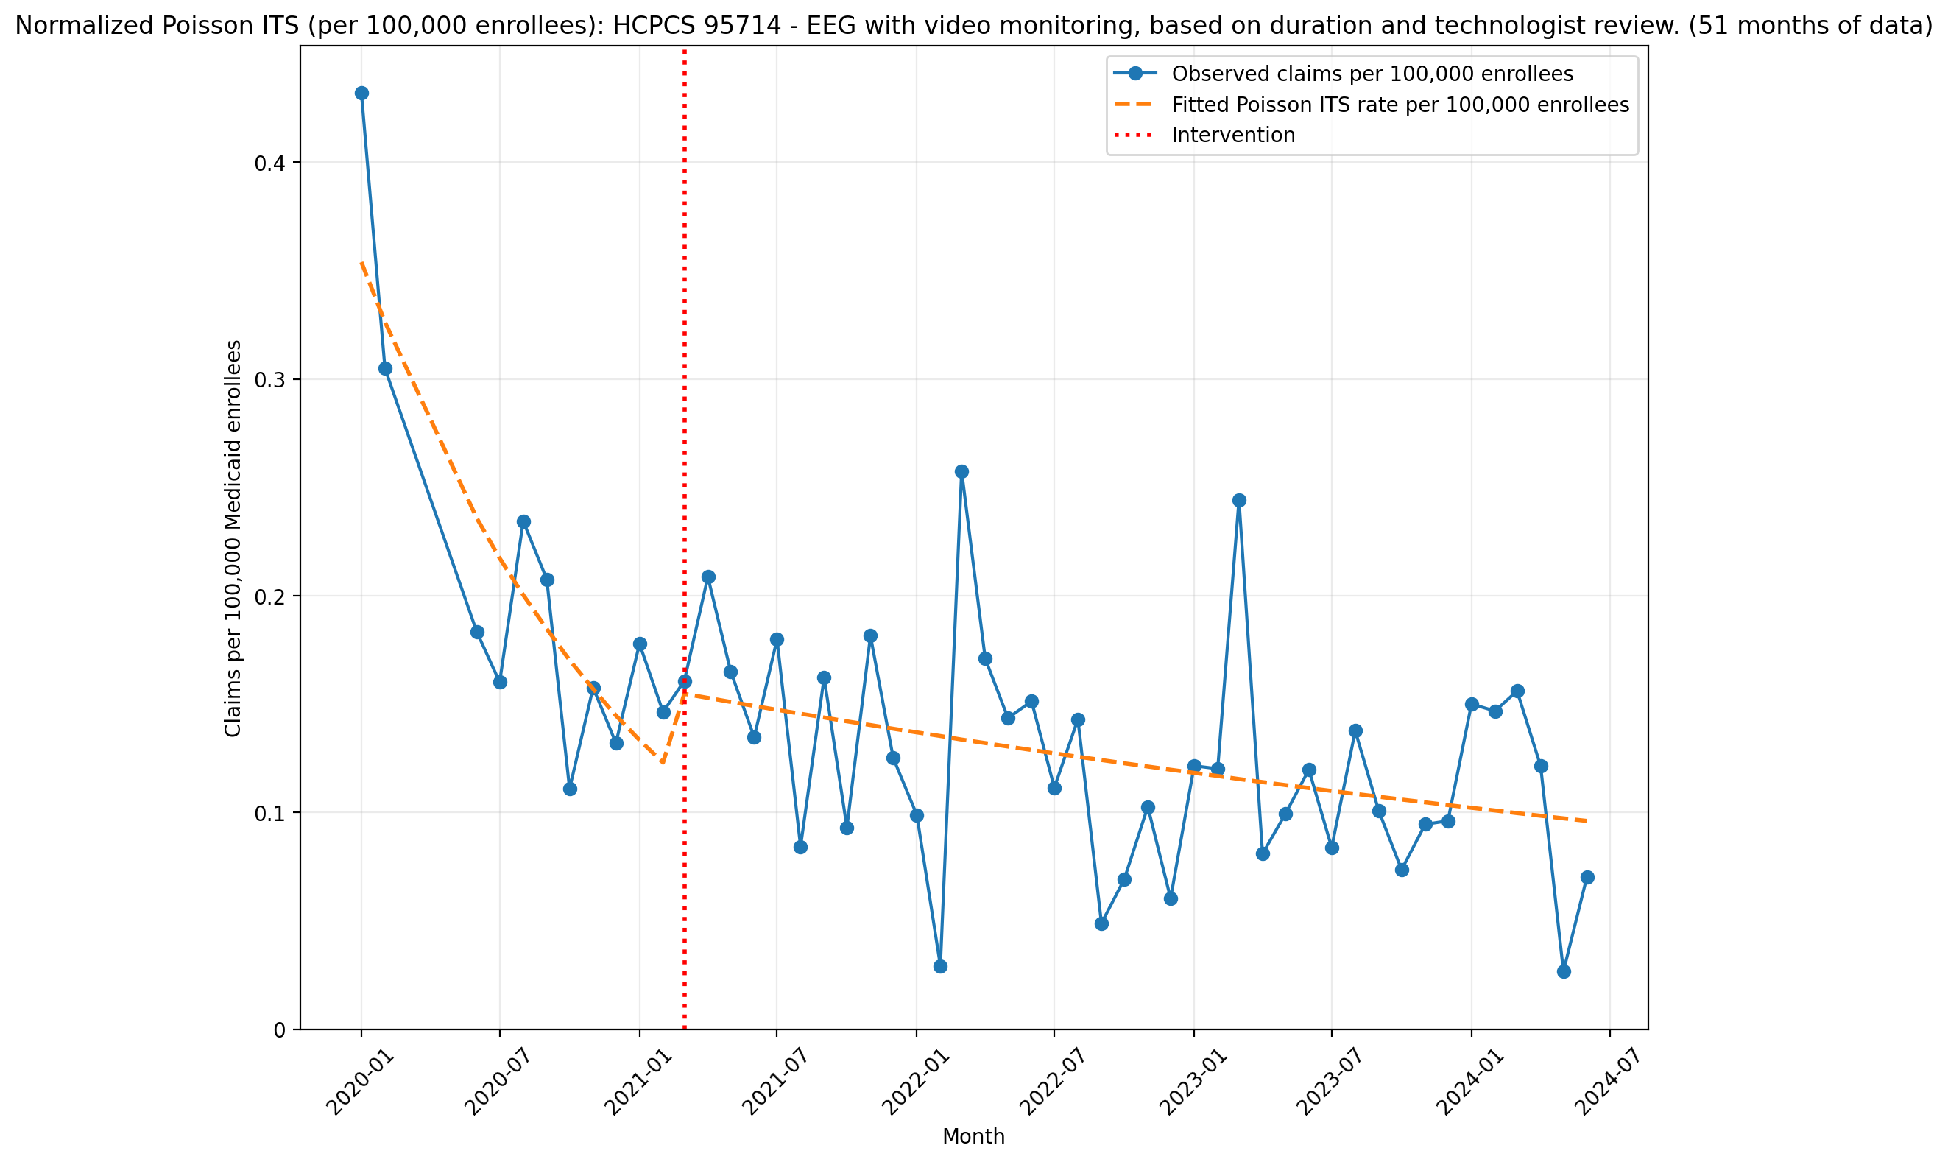
Normalized Poisson ITS (per 100,000 enrollees): HCPCS 95714 - EEG with video monitoring, based on duration and technologist review. (51 months of data)
Generalized Linear Model Regression Results
==============================================================================
Dep. Variable: y No. Observations: 51
Model: GLM Df Residuals: 47
Model Family: Poisson Df Model: 3
Link Function: Log Scale: 1.0000
Method: IRLS Log-Likelihood: -561.95
Date: Thu, 07 May 2026 Deviance: 789.13
Time: 21:23:11 Pearson chi2: 770.
No. Iterations: 4 Pseudo R-squ. (CS): 1.000
Covariance Type: nonrobust
==============================================================================
coef std err z P>|z| [0.025 0.975]
------------------------------------------------------------------------------
const -12.5516 0.042 -297.664 0.000 -12.634 -12.469
T -0.0813 0.006 -14.563 0.000 -0.092 -0.070
X_t 0.2417 0.053 4.552 0.000 0.138 0.346
post_time 0.0691 0.006 12.046 0.000 0.058 0.080
==============================================================================

Slide 28
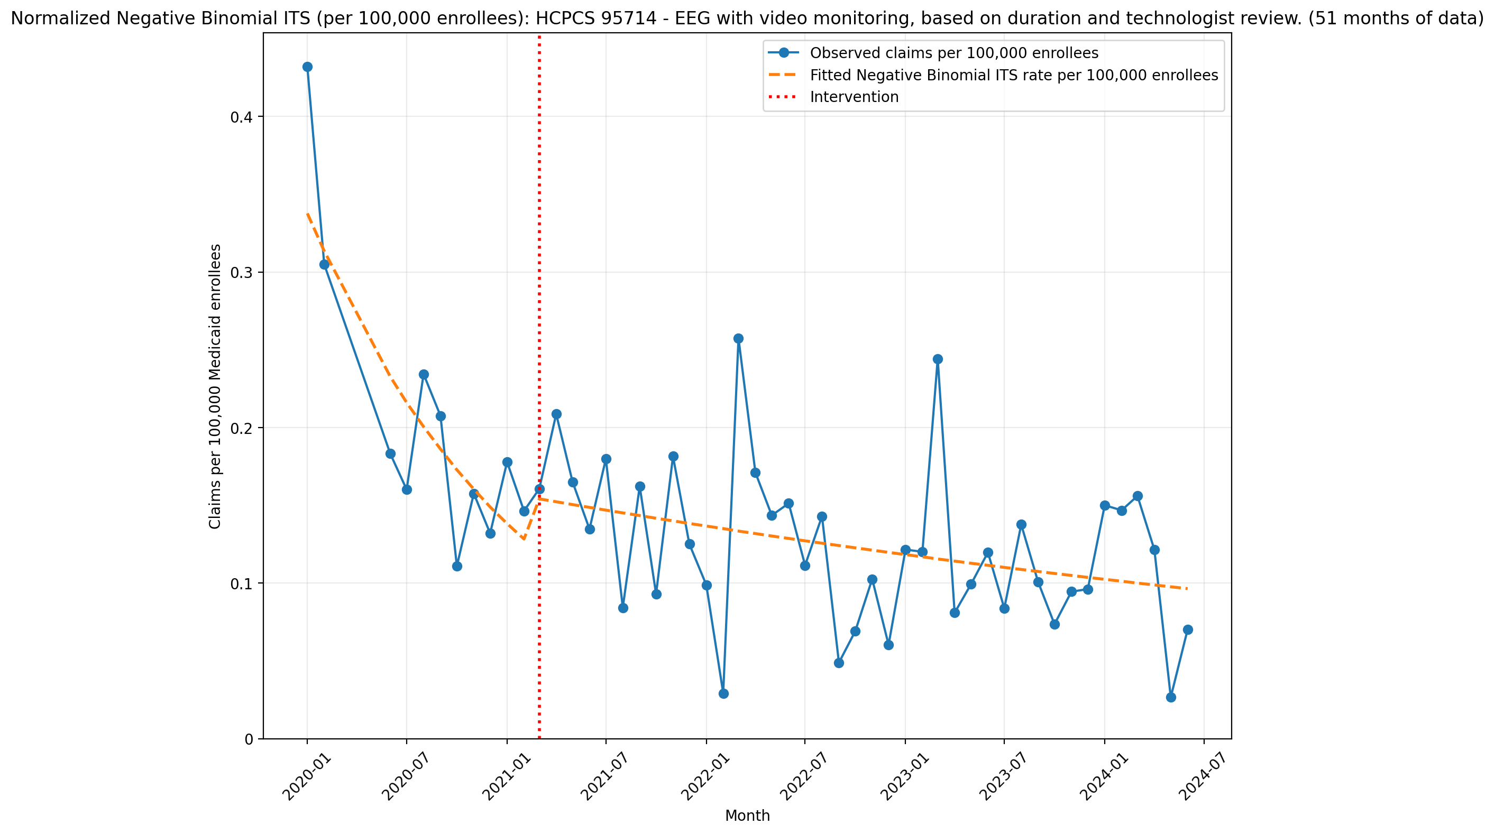
Normalized Negative Binomial ITS (per 100,000 enrollees): HCPCS 95714 - EEG with video monitoring, based on duration and technologist review. (51 months of data)
NegativeBinomial Regression Results
==============================================================================
Dep. Variable: y No. Observations: 51
Model: NegativeBinomial Df Residuals: 47
Method: MLE Df Model: 3
Date: Thu, 07 May 2026 Pseudo R-squ.: 0.04308
Time: 21:23:11 Log-Likelihood: -265.63
converged: True LL-Null: -277.59
Covariance Type: nonrobust LLR p-value: 2.599e-05
==============================================================================
coef std err z P>|z| [0.025 0.975]
------------------------------------------------------------------------------
const -12.5985 0.228 -55.247 0.000 -13.045 -12.152
T -0.0744 0.027 -2.788 0.005 -0.127 -0.022
X_t 0.1953 0.223 0.874 0.382 -0.243 0.633
post_time 0.0624 0.027 2.295 0.022 0.009 0.116
alpha 0.1355 0.028 4.772 0.000 0.080 0.191
==============================================================================

Slide 29
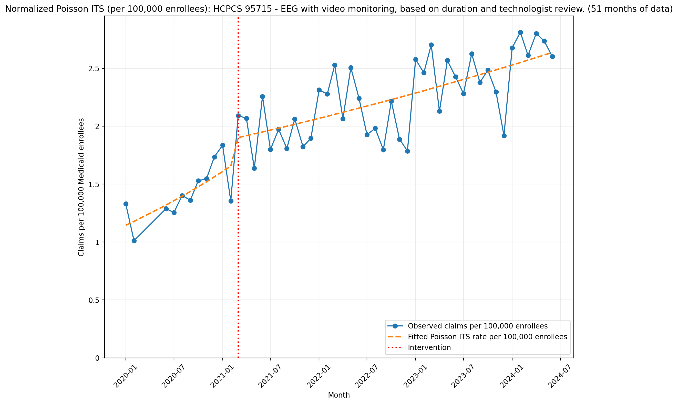
Normalized Poisson ITS (per 100,000 enrollees): HCPCS 95715 - EEG with video monitoring, based on duration and technologist review. (51 months of data)
Generalized Linear Model Regression Results
==============================================================================
Dep. Variable: y No. Observations: 51
Model: GLM Df Residuals: 47
Model Family: Poisson Df Model: 3
Link Function: Log Scale: 1.0000
Method: IRLS Log-Likelihood: -814.25
Date: Thu, 07 May 2026 Deviance: 1152.0
Time: 21:23:12 Pearson chi2: 1.14e+03
No. Iterations: 5 Pseudo R-squ. (CS): 1.000
Covariance Type: nonrobust
==============================================================================
coef std err z P>|z| [0.025 0.975]
------------------------------------------------------------------------------
const -11.3782 0.021 -551.296 0.000 -11.419 -11.338
T 0.0284 0.002 12.282 0.000 0.024 0.033
X_t 0.1308 0.016 8.053 0.000 0.099 0.163
post_time -0.0200 0.002 -8.579 0.000 -0.025 -0.015
==============================================================================

Slide 30
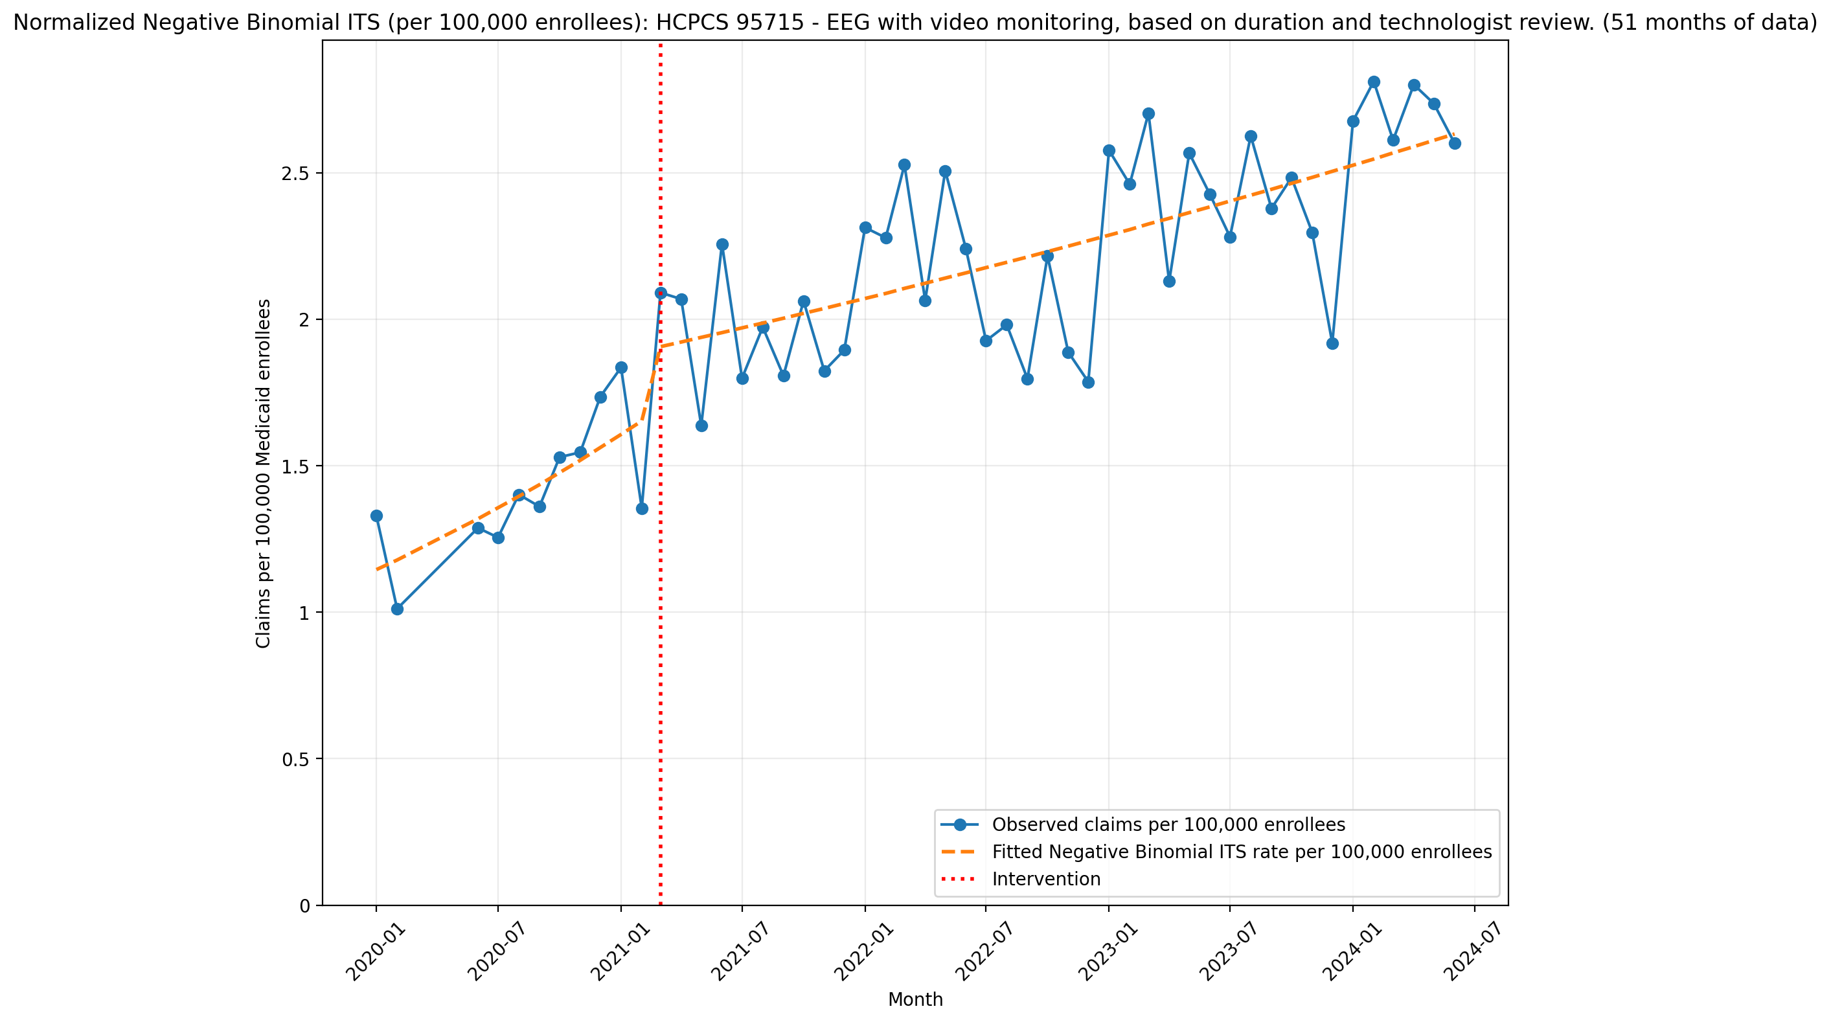
Normalized Negative Binomial ITS (per 100,000 enrollees): HCPCS 95715 - EEG with video monitoring, based on duration and technologist review. (51 months of data)
NegativeBinomial Regression Results
==============================================================================
Dep. Variable: y No. Observations: 51
Model: NegativeBinomial Df Residuals: 47
Method: MLE Df Model: 3
Date: Thu, 07 May 2026 Pseudo R-squ.: 0.1012
Time: 21:23:12 Log-Likelihood: -342.67
converged: True LL-Null: -381.23
Covariance Type: nonrobust LLR p-value: 1.266e-16
==============================================================================
coef std err z P>|z| [0.025 0.975]
------------------------------------------------------------------------------
const -11.3775 0.071 -160.447 0.000 -11.516 -11.238
T 0.0282 0.008 3.389 0.001 0.012 0.045
X_t 0.1345 0.067 2.013 0.044 0.004 0.265
post_time -0.0199 0.008 -2.358 0.018 -0.037 -0.003
alpha 0.0115 0.002 4.821 0.000 0.007 0.016
==============================================================================

Slide 31
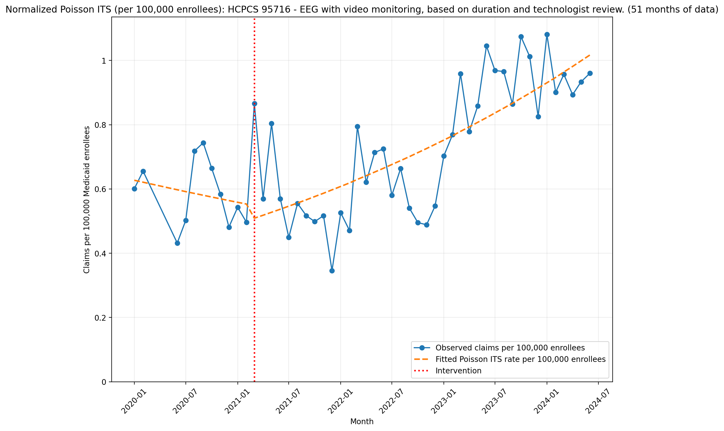
Normalized Poisson ITS (per 100,000 enrollees): HCPCS 95716 - EEG with video monitoring, based on duration and technologist review. (51 months of data)
Generalized Linear Model Regression Results
==============================================================================
Dep. Variable: y No. Observations: 51
Model: GLM Df Residuals: 47
Model Family: Poisson Df Model: 3
Link Function: Log Scale: 1.0000
Method: IRLS Log-Likelihood: -794.51
Date: Thu, 07 May 2026 Deviance: 1168.2
Time: 21:23:13 Pearson chi2: 1.19e+03
No. Iterations: 4 Pseudo R-squ. (CS): 1.000
Covariance Type: nonrobust
==============================================================================
coef std err z P>|z| [0.025 0.975]
------------------------------------------------------------------------------
const -11.9796 0.029 -408.323 0.000 -12.037 -11.922
T -0.0097 0.003 -2.796 0.005 -0.016 -0.003
X_t -0.1007 0.027 -3.688 0.000 -0.154 -0.047
post_time 0.0274 0.003 7.836 0.000 0.021 0.034
==============================================================================

Slide 32
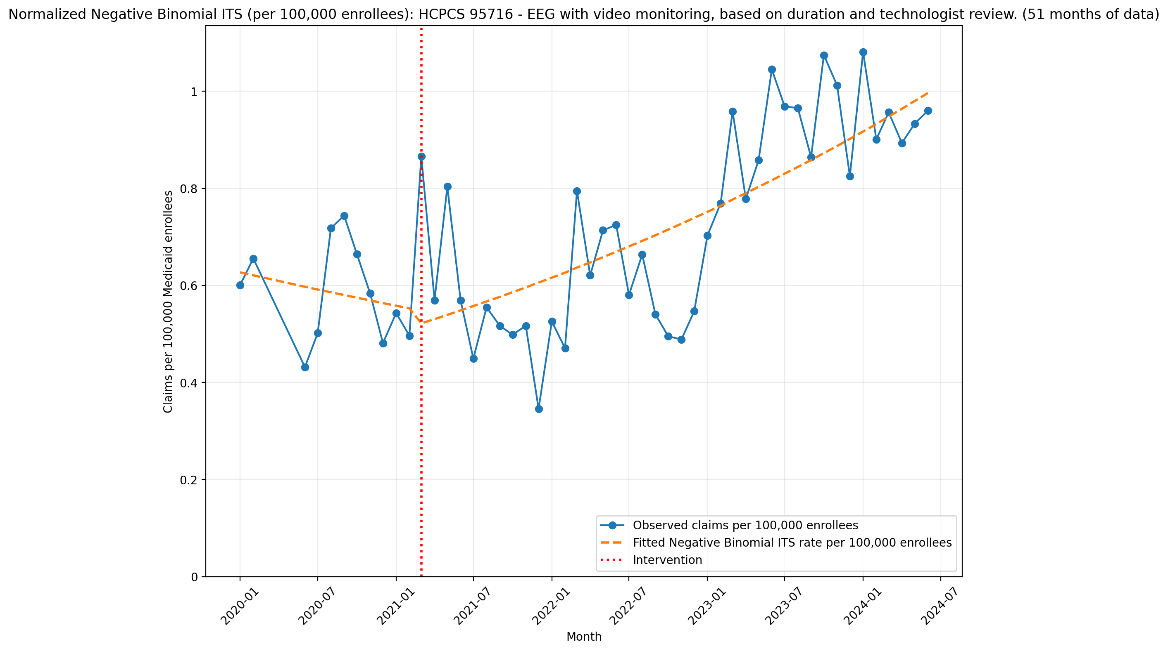
Normalized Negative Binomial ITS (per 100,000 enrollees): HCPCS 95716 - EEG with video monitoring, based on duration and technologist review. (51 months of data)
NegativeBinomial Regression Results
==============================================================================
Dep. Variable: y No. Observations: 51
Model: NegativeBinomial Df Residuals: 47
Method: MLE Df Model: 3
Date: Thu, 07 May 2026 Pseudo R-squ.: 0.05271
Time: 21:23:14 Log-Likelihood: -317.28
converged: True LL-Null: -334.93
Covariance Type: nonrobust LLR p-value: 1.049e-07
==============================================================================
coef std err z P>|z| [0.025 0.975]
------------------------------------------------------------------------------
const -11.9800 0.128 -93.434 0.000 -12.231 -11.729
T -0.0097 0.015 -0.637 0.524 -0.039 0.020
X_t -0.0742 0.121 -0.614 0.540 -0.311 0.163
post_time 0.0263 0.015 1.703 0.088 -0.004 0.056
alpha 0.0376 0.008 4.849 0.000 0.022 0.053
==============================================================================

Slide 33
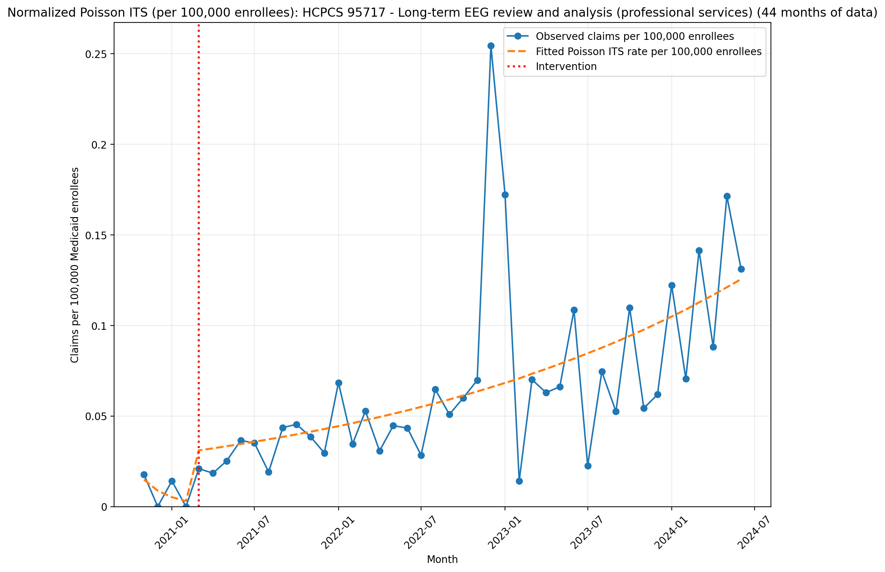
Normalized Poisson ITS (per 100,000 enrollees): HCPCS 95717 - Long-term EEG review and analysis (professional services) (44 months of data)
Generalized Linear Model Regression Results
==============================================================================
Dep. Variable: y No. Observations: 44
Model: GLM Df Residuals: 40
Model Family: Poisson Df Model: 3
Link Function: Log Scale: 1.0000
Method: IRLS Log-Likelihood: -499.30
Date: Thu, 07 May 2026 Deviance: 759.17
Time: 21:23:15 Pearson chi2: 971.
No. Iterations: 7 Pseudo R-squ. (CS): 1.000
Covariance Type: nonrobust
==============================================================================
coef std err z P>|z| [0.025 0.975]
------------------------------------------------------------------------------
const -15.7209 0.257 -61.155 0.000 -16.225 -15.217
T -0.5263 0.192 -2.745 0.006 -0.902 -0.150
X_t 2.2784 0.451 5.052 0.000 1.394 3.162
post_time 0.5621 0.192 2.932 0.003 0.186 0.938
==============================================================================

Slide 34
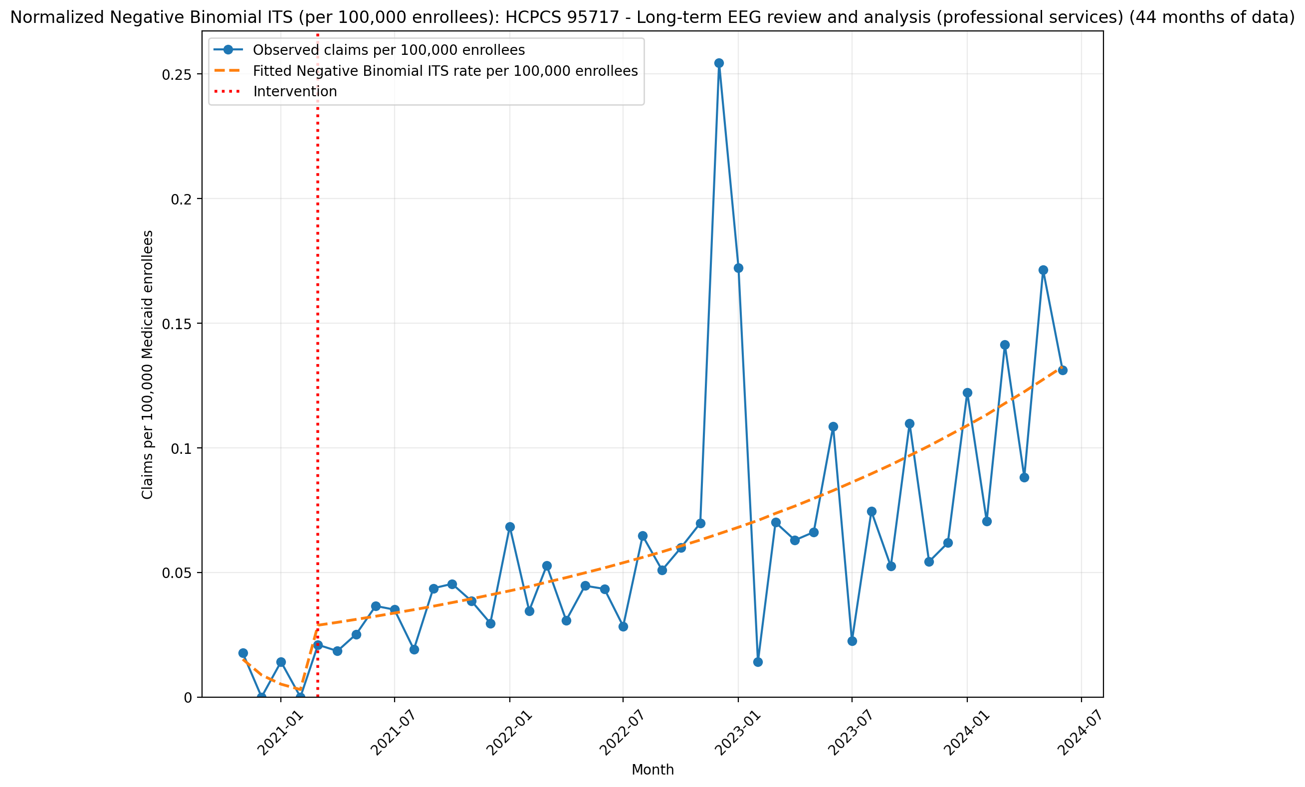
Normalized Negative Binomial ITS (per 100,000 enrollees): HCPCS 95717 - Long-term EEG review and analysis (professional services) (44 months of data)
NegativeBinomial Regression Results
==============================================================================
Dep. Variable: y No. Observations: 44
Model: NegativeBinomial Df Residuals: 40
Method: MLE Df Model: 3
Date: Thu, 07 May 2026 Pseudo R-squ.: 0.08737
Time: 21:23:15 Log-Likelihood: -201.65
converged: True LL-Null: -220.95
Covariance Type: nonrobust LLR p-value: 2.098e-08
==============================================================================
coef std err z P>|z| [0.025 0.975]
------------------------------------------------------------------------------
const -15.7036 0.521 -30.116 0.000 -16.726 -14.682
T -0.5395 0.314 -1.718 0.086 -1.155 0.076
X_t 2.2232 0.662 3.357 0.001 0.925 3.521
post_time 0.5786 0.314 1.842 0.066 -0.037 1.194
alpha 0.2664 0.064 4.179 0.000 0.141 0.391
==============================================================================

Slide 35
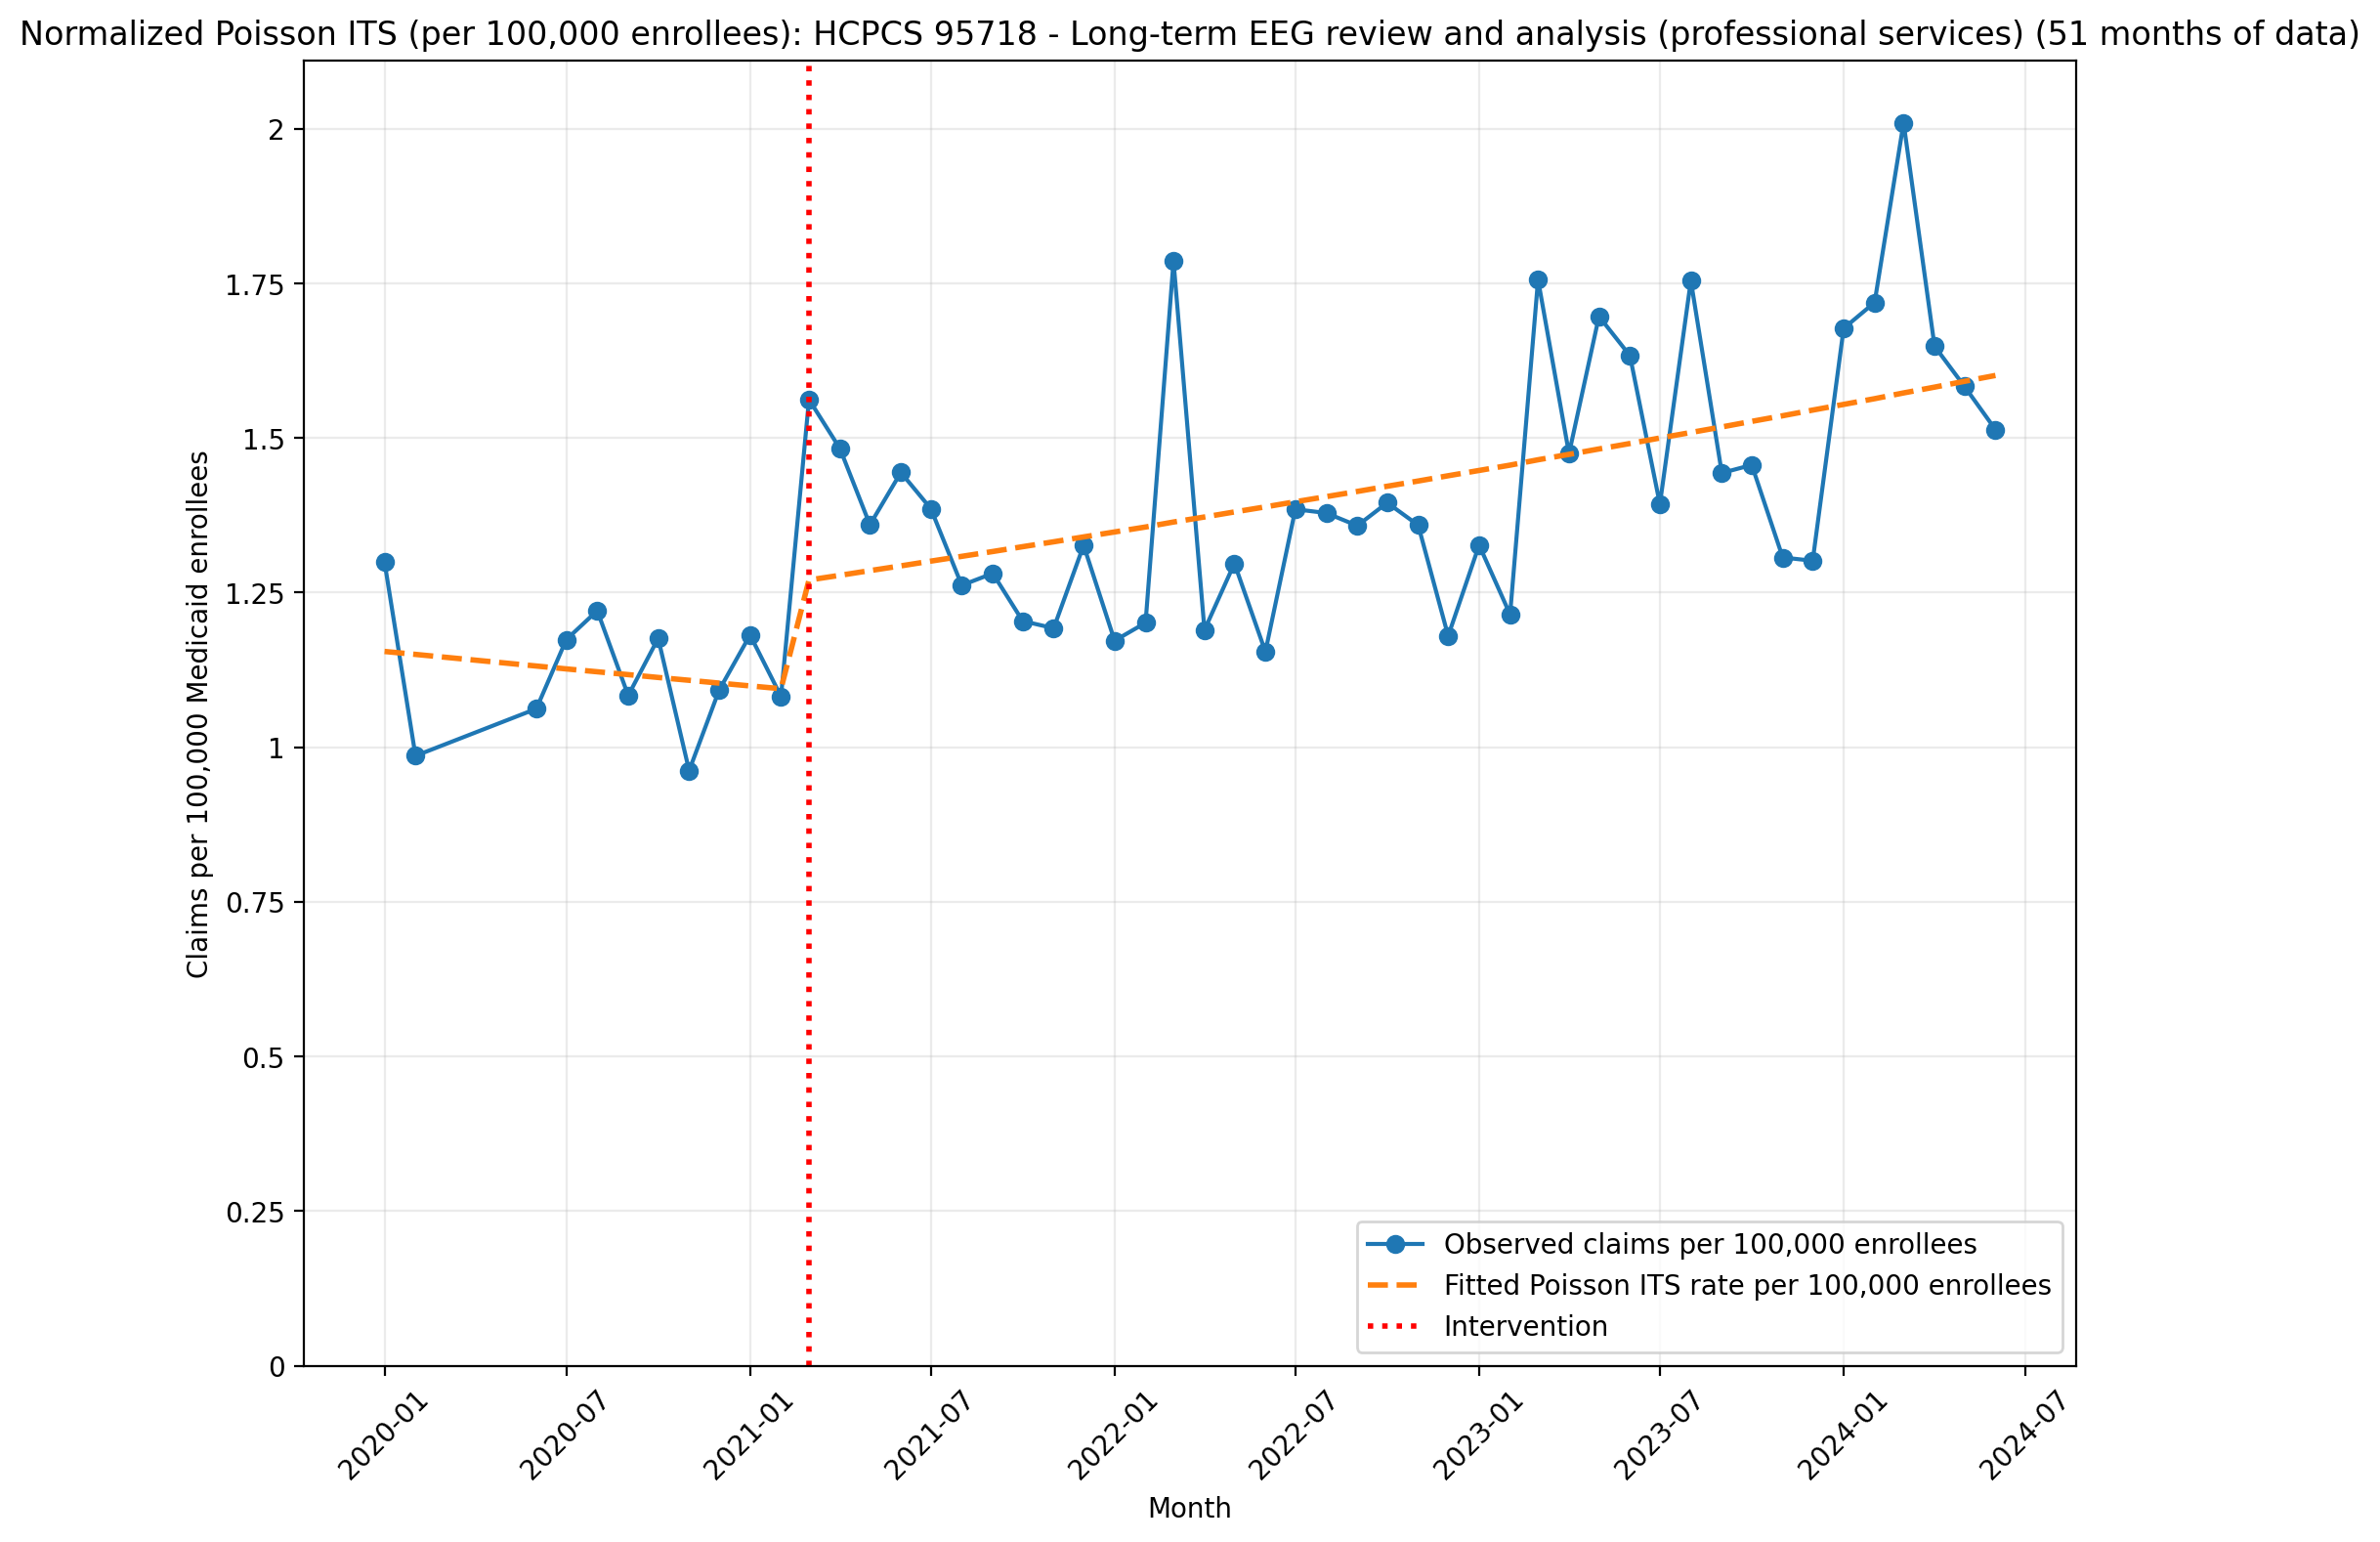
Normalized Poisson ITS (per 100,000 enrollees): HCPCS 95718 - Long-term EEG review and analysis (professional services) (51 months of data)
Generalized Linear Model Regression Results
==============================================================================
Dep. Variable: y No. Observations: 51
Model: GLM Df Residuals: 47
Model Family: Poisson Df Model: 3
Link Function: Log Scale: 1.0000
Method: IRLS Log-Likelihood: -664.15
Date: Thu, 07 May 2026 Deviance: 872.35
Time: 21:23:16 Pearson chi2: 889.
No. Iterations: 4 Pseudo R-squ. (CS): 1.000
Covariance Type: nonrobust
==============================================================================
coef std err z P>|z| [0.025 0.975]
------------------------------------------------------------------------------
const -11.3691 0.021 -529.522 0.000 -11.411 -11.327
T -0.0041 0.003 -1.643 0.100 -0.009 0.001
X_t 0.1430 0.019 7.420 0.000 0.105 0.181
post_time 0.0101 0.003 3.963 0.000 0.005 0.015
==============================================================================

Slide 36
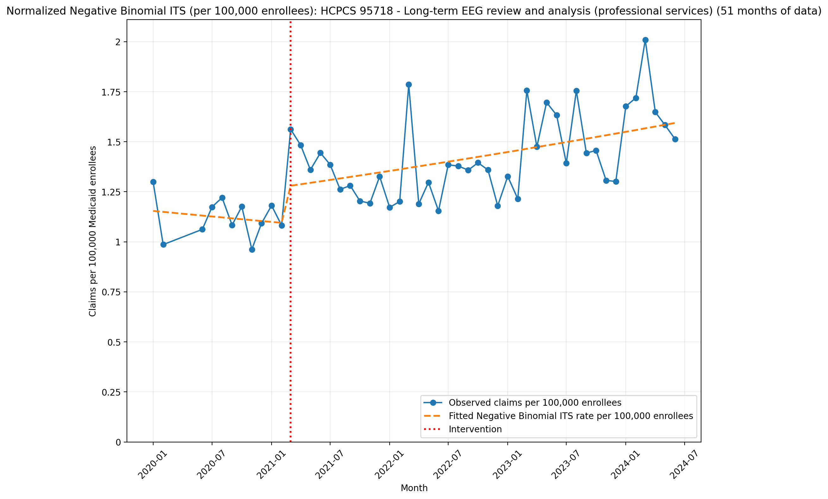
Normalized Negative Binomial ITS (per 100,000 enrollees): HCPCS 95718 - Long-term EEG review and analysis (professional services) (51 months of data)
NegativeBinomial Regression Results
==============================================================================
Dep. Variable: y No. Observations: 51
Model: NegativeBinomial Df Residuals: 47
Method: MLE Df Model: 3
Date: Thu, 07 May 2026 Pseudo R-squ.: 0.05158
Time: 21:23:16 Log-Likelihood: -324.34
converged: True LL-Null: -341.98
Covariance Type: nonrobust LLR p-value: 1.064e-07
==============================================================================
coef std err z P>|z| [0.025 0.975]
------------------------------------------------------------------------------
const -11.3696 0.074 -154.395 0.000 -11.514 -11.225
T -0.0041 0.009 -0.468 0.640 -0.021 0.013
X_t 0.1507 0.070 2.159 0.031 0.014 0.288
post_time 0.0097 0.009 1.098 0.272 -0.008 0.027
alpha 0.0124 0.003 4.758 0.000 0.007 0.018
==============================================================================

Slide 37
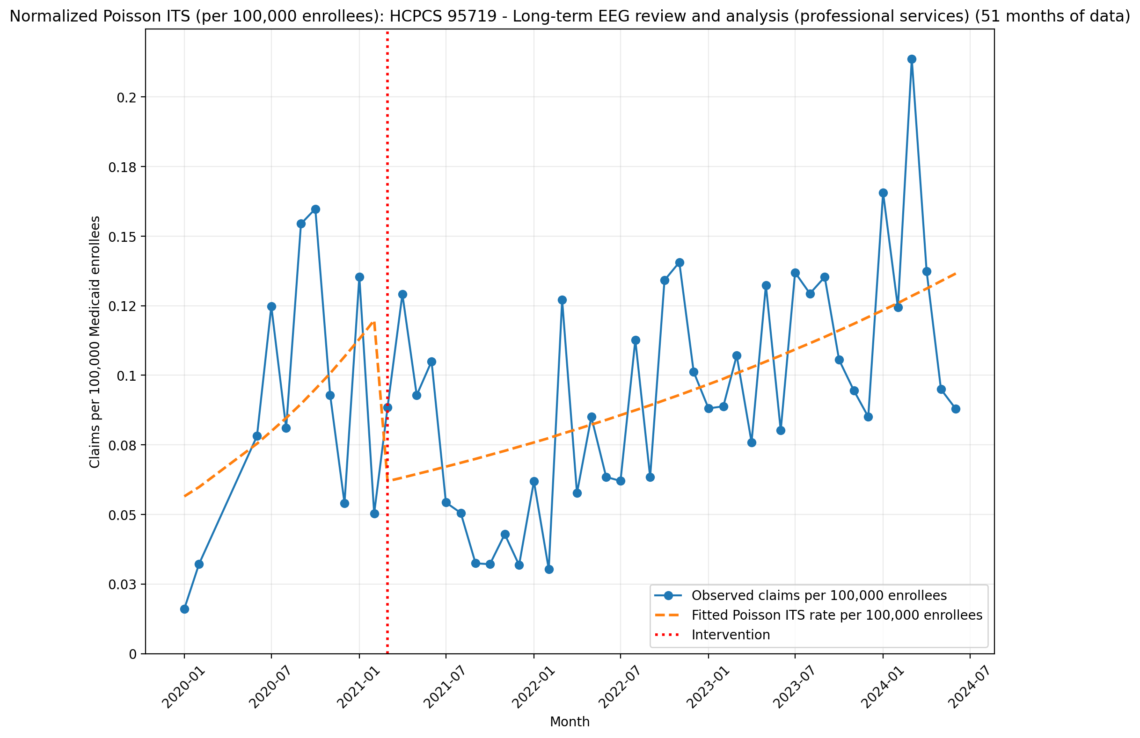
Normalized Poisson ITS (per 100,000 enrollees): HCPCS 95719 - Long-term EEG review and analysis (professional services) (51 months of data)
Generalized Linear Model Regression Results
==============================================================================
Dep. Variable: y No. Observations: 51
Model: GLM Df Residuals: 47
Model Family: Poisson Df Model: 3
Link Function: Log Scale: 1.0000
Method: IRLS Log-Likelihood: -476.18
Date: Thu, 07 May 2026 Deviance: 638.50
Time: 21:23:17 Pearson chi2: 636.
No. Iterations: 4 Pseudo R-squ. (CS): 0.9871
Covariance Type: nonrobust
==============================================================================
coef std err z P>|z| [0.025 0.975]
------------------------------------------------------------------------------
const -14.3866 0.089 -162.043 0.000 -14.561 -14.213
T 0.0578 0.010 6.024 0.000 0.039 0.077
X_t -0.6794 0.068 -9.980 0.000 -0.813 -0.546
post_time -0.0375 0.010 -3.864 0.000 -0.057 -0.018
==============================================================================

Slide 38
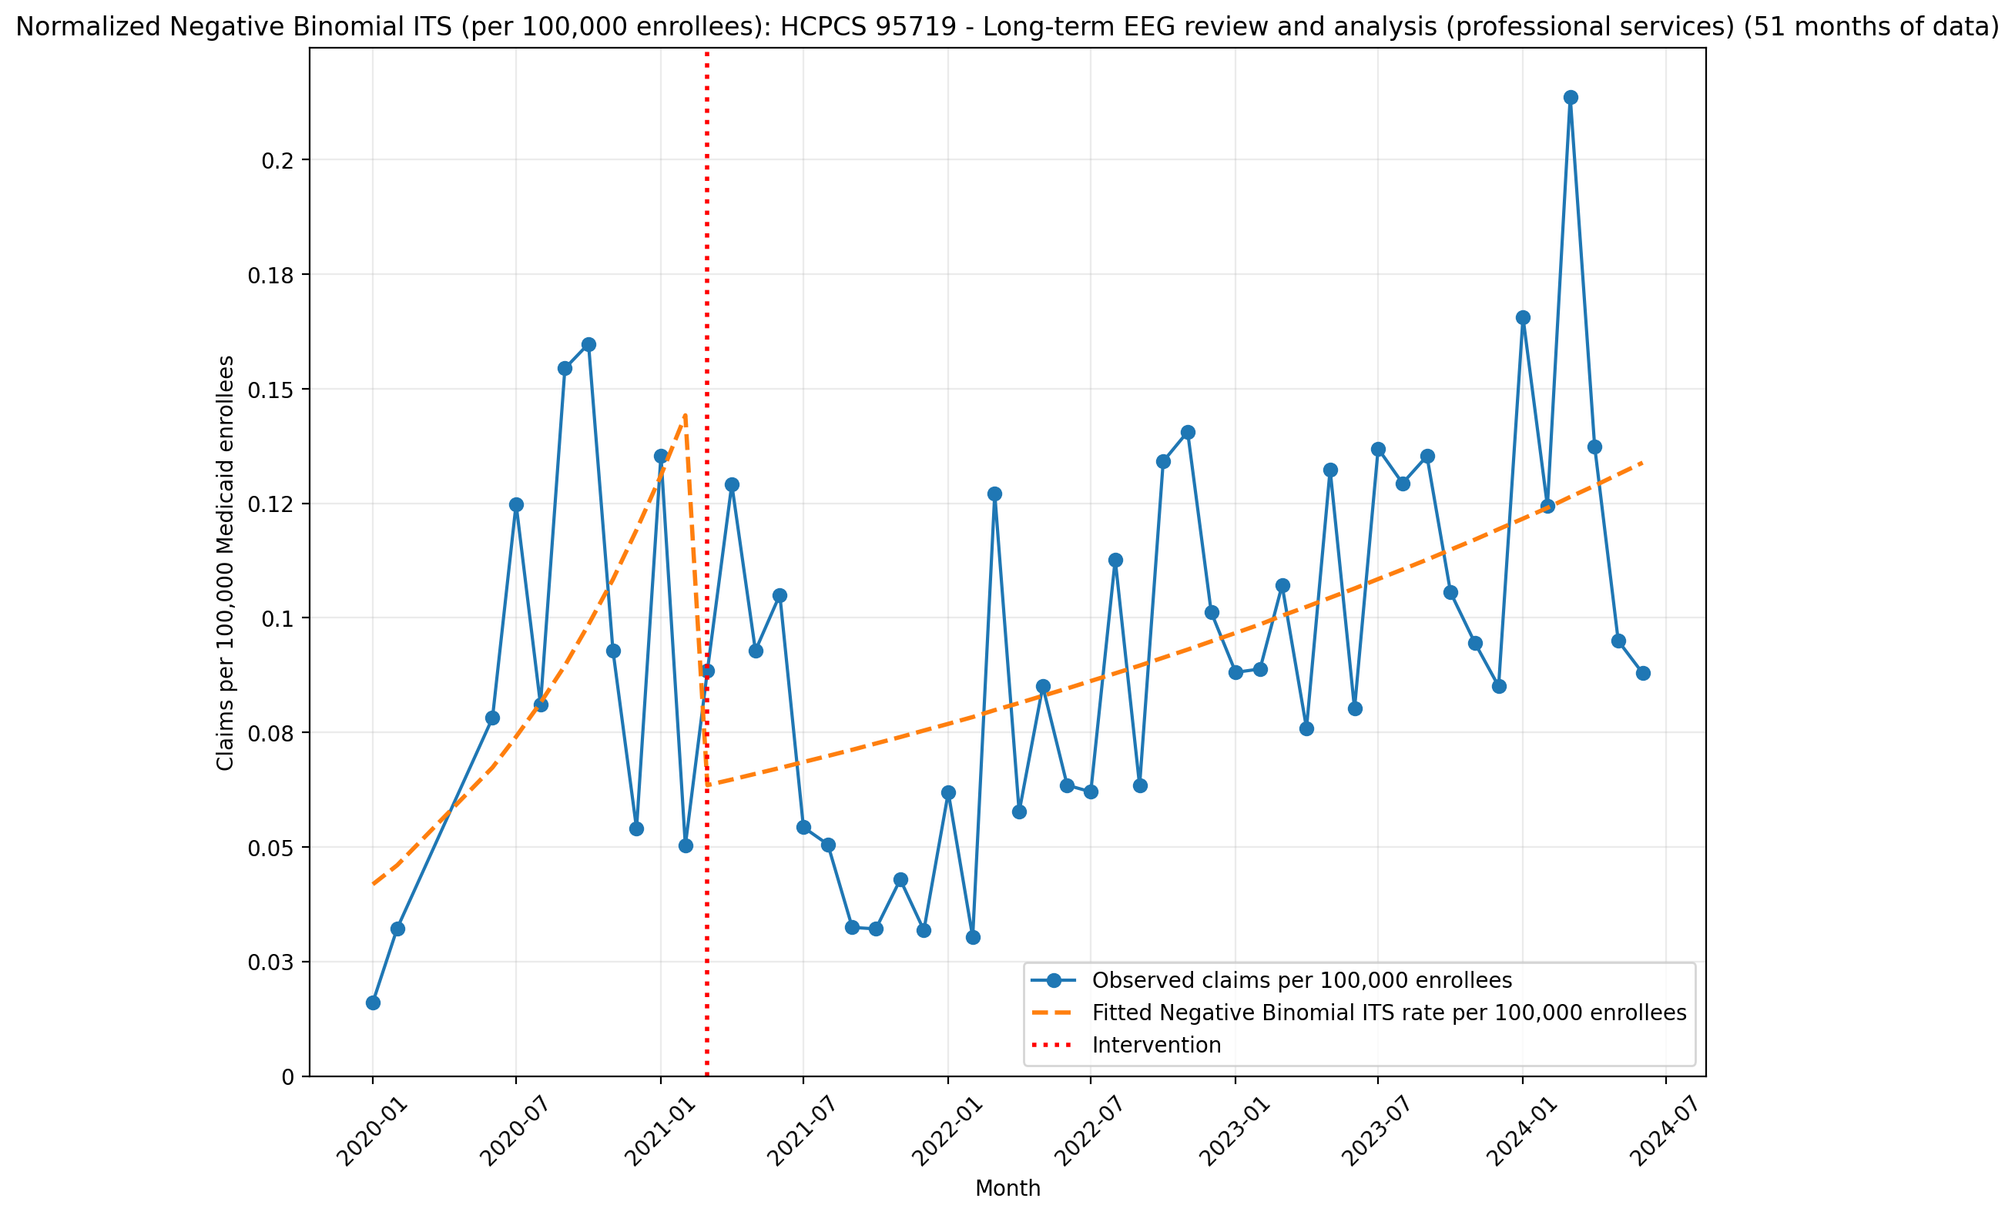
Normalized Negative Binomial ITS (per 100,000 enrollees): HCPCS 95719 - Long-term EEG review and analysis (professional services) (51 months of data)
NegativeBinomial Regression Results
==============================================================================
Dep. Variable: y No. Observations: 51
Model: NegativeBinomial Df Residuals: 47
Method: MLE Df Model: 3
Date: Thu, 07 May 2026 Pseudo R-squ.: 0.03022
Time: 21:23:18 Log-Likelihood: -249.08
converged: True LL-Null: -256.84
Covariance Type: nonrobust LLR p-value: 0.001421
==============================================================================
coef std err z P>|z| [0.025 0.975]
------------------------------------------------------------------------------
const -14.6868 0.319 -46.048 0.000 -15.312 -14.062
T 0.0952 0.039 2.454 0.014 0.019 0.171
X_t -0.8395 0.278 -3.020 0.003 -1.384 -0.295
post_time -0.0761 0.039 -1.941 0.052 -0.153 0.001
alpha 0.1568 0.033 4.705 0.000 0.091 0.222
==============================================================================

Slide 39
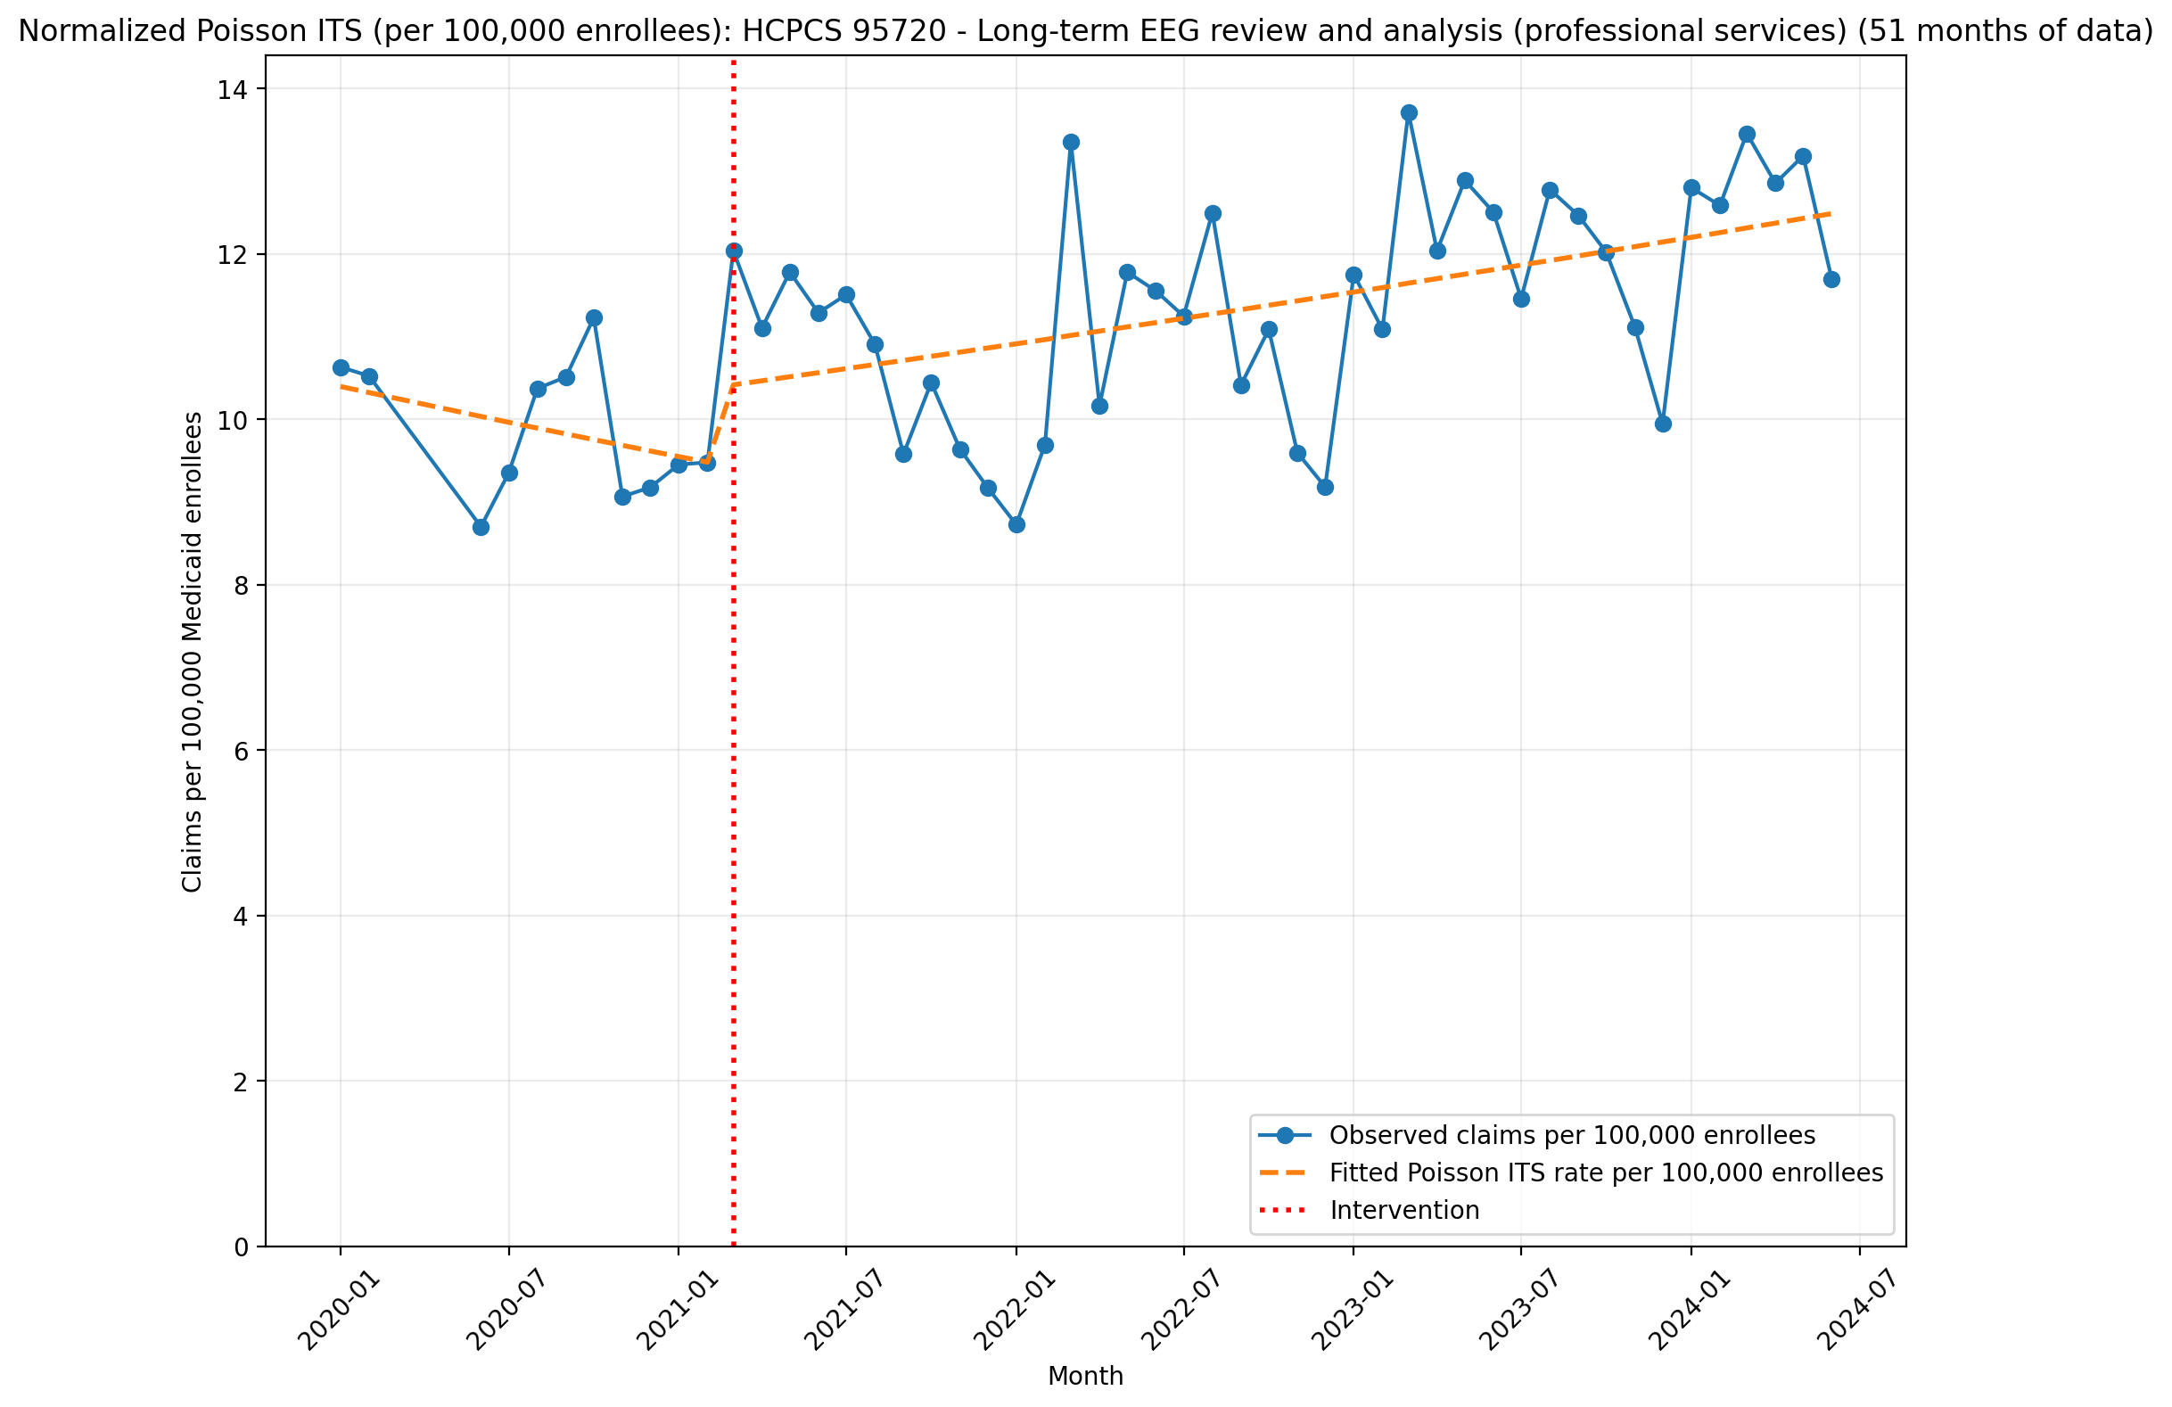
Normalized Poisson ITS (per 100,000 enrollees): HCPCS 95720 - Long-term EEG review and analysis (professional services) (51 months of data)
Generalized Linear Model Regression Results
==============================================================================
Dep. Variable: y No. Observations: 51
Model: GLM Df Residuals: 47
Model Family: Poisson Df Model: 3
Link Function: Log Scale: 1.0000
Method: IRLS Log-Likelihood: -2716.2
Date: Thu, 07 May 2026 Deviance: 4869.3
Time: 21:23:19 Pearson chi2: 4.82e+03
No. Iterations: 4 Pseudo R-squ. (CS): 1.000
Covariance Type: nonrobust
==============================================================================
coef std err z P>|z| [0.025 0.975]
------------------------------------------------------------------------------
const -9.1713 0.007 -1277.005 0.000 -9.185 -9.157
T -0.0071 0.001 -8.420 0.000 -0.009 -0.005
X_t 0.0895 0.007 13.607 0.000 0.077 0.102
post_time 0.0117 0.001 13.761 0.000 0.010 0.013
==============================================================================

Slide 40
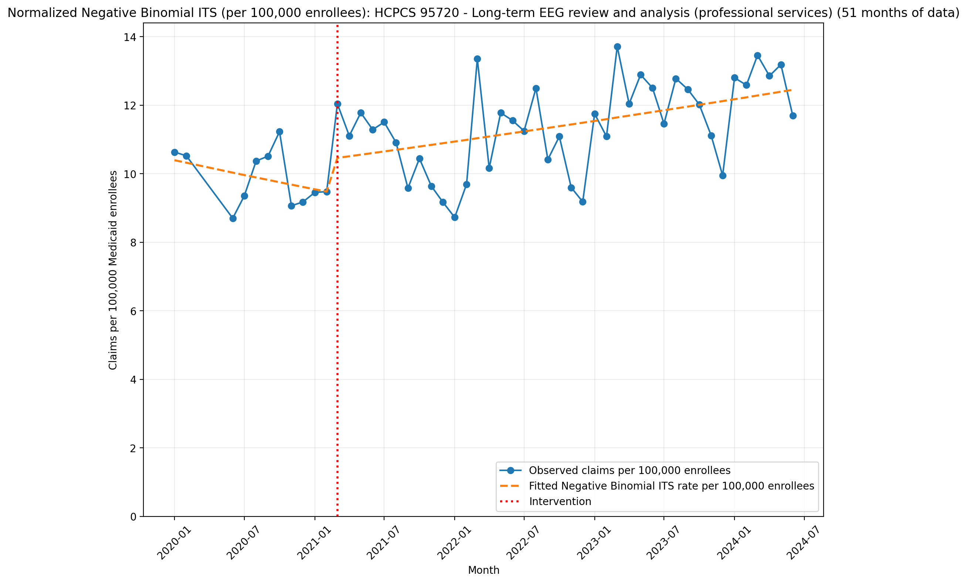
Normalized Negative Binomial ITS (per 100,000 enrollees): HCPCS 95720 - Long-term EEG review and analysis (professional services) (51 months of data)
NegativeBinomial Regression Results
==============================================================================
Dep. Variable: y No. Observations: 51
Model: NegativeBinomial Df Residuals: 47
Method: MLE Df Model: 3
Date: Thu, 07 May 2026 Pseudo R-squ.: 0.02824
Time: 21:23:19 Log-Likelihood: -423.00
converged: True LL-Null: -435.29
Covariance Type: nonrobust LLR p-value: 1.885e-05
==============================================================================
coef std err z P>|z| [0.025 0.975]
------------------------------------------------------------------------------
const -9.1715 0.062 -148.573 0.000 -9.293 -9.051
T -0.0071 0.007 -0.975 0.330 -0.021 0.007
X_t 0.0943 0.059 1.602 0.109 -0.021 0.210
post_time 0.0116 0.007 1.562 0.118 -0.003 0.026
alpha 0.0094 0.002 5.004 0.000 0.006 0.013
==============================================================================

Slide 41
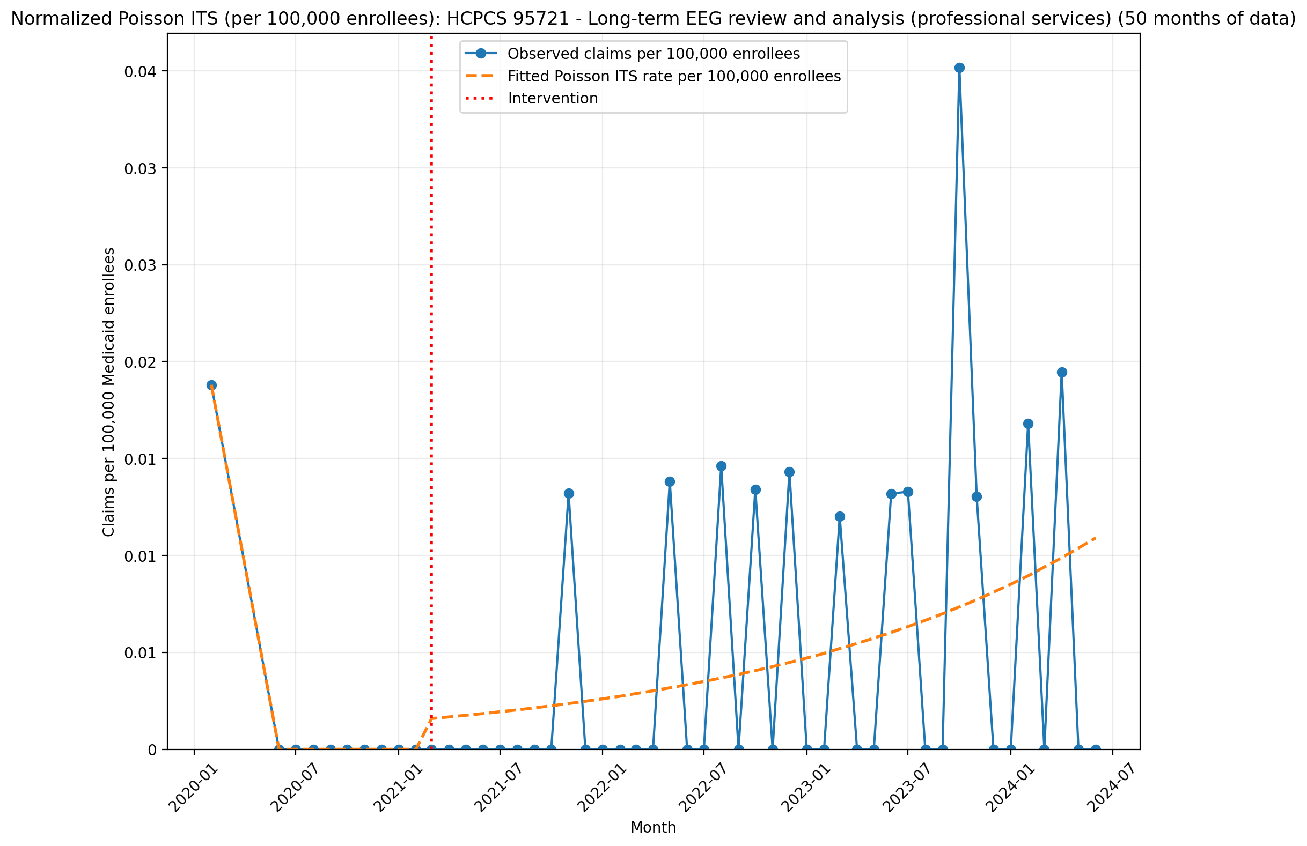
Normalized Poisson ITS (per 100,000 enrollees): HCPCS 95721 - Long-term EEG review and analysis (professional services) (50 months of data)
Generalized Linear Model Regression Results
==============================================================================
Dep. Variable: y No. Observations: 50
Model: GLM Df Residuals: 46
Model Family: Poisson Df Model: 3
Link Function: Log Scale: 1.0000
Method: IRLS Log-Likelihood: -229.18
Date: Thu, 07 May 2026 Deviance: 399.65
Time: 21:23:20 Pearson chi2: 410.
No. Iterations: 23 Pseudo R-squ. (CS): 0.9362
Covariance Type: nonrobust
==============================================================================
coef std err z P>|z| [0.025 0.975]
------------------------------------------------------------------------------
const -15.4865 0.267 -57.945 0.000 -16.010 -14.963
T -4.8811 310.312 -0.016 0.987 -613.082 603.320
X_t 56.0507 3723.748 0.015 0.988 -7242.362 7354.463
post_time 4.9305 310.312 0.016 0.987 -603.271 613.132
==============================================================================

Slide 42
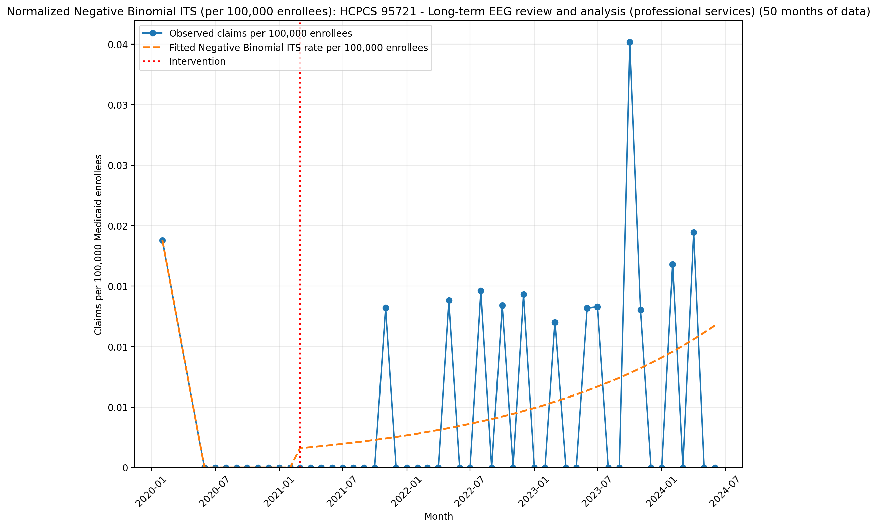
Normalized Negative Binomial ITS (per 100,000 enrollees): HCPCS 95721 - Long-term EEG review and analysis (professional services) (50 months of data)
NegativeBinomial Regression Results
==============================================================================
Dep. Variable: y No. Observations: 50
Model: NegativeBinomial Df Residuals: 46
Method: MLE Df Model: 3
Date: Thu, 07 May 2026 Pseudo R-squ.: nan
Time: 21:23:20 Log-Likelihood: nan
converged: False LL-Null: -83.717
Covariance Type: nonrobust LLR p-value: nan
==============================================================================
coef std err z P>|z| [0.025 0.975]
------------------------------------------------------------------------------
const -15.4865 1.060 -14.610 0.000 -17.564 -13.409
T -6.7023 4.41e+04 -0.000 1.000 -8.64e+04 8.64e+04
X_t 77.9133 5.29e+05 0.000 1.000 -1.04e+06 1.04e+06
post_time 6.7535 4.41e+04 0.000 1.000 -8.64e+04 8.64e+04
alpha 1.0522 0.177 5.948 0.000 0.706 1.399
==============================================================================

Slide 43
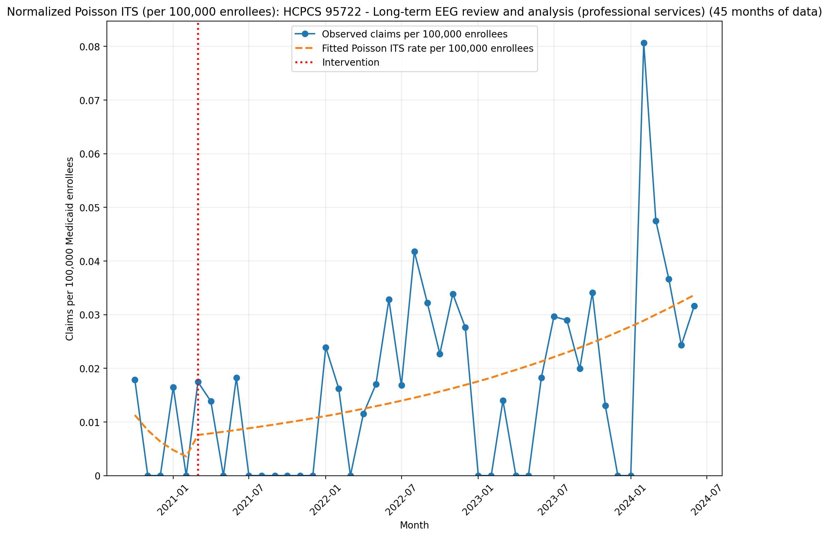
Normalized Poisson ITS (per 100,000 enrollees): HCPCS 95722 - Long-term EEG review and analysis (professional services) (45 months of data)
Generalized Linear Model Regression Results
==============================================================================
Dep. Variable: y No. Observations: 45
Model: GLM Df Residuals: 41
Model Family: Poisson Df Model: 3
Link Function: Log Scale: 1.0000
Method: IRLS Log-Likelihood: -389.85
Date: Thu, 07 May 2026 Deviance: 641.48
Time: 21:23:22 Pearson chi2: 513.
No. Iterations: 5 Pseudo R-squ. (CS): 0.9668
Covariance Type: nonrobust
==============================================================================
coef std err z P>|z| [0.025 0.975]
------------------------------------------------------------------------------
const -15.9974 0.273 -58.603 0.000 -16.532 -15.462
T -0.2885 0.138 -2.088 0.037 -0.559 -0.018
X_t 0.7170 0.411 1.745 0.081 -0.088 1.522
post_time 0.3267 0.138 2.364 0.018 0.056 0.598
==============================================================================

Slide 44
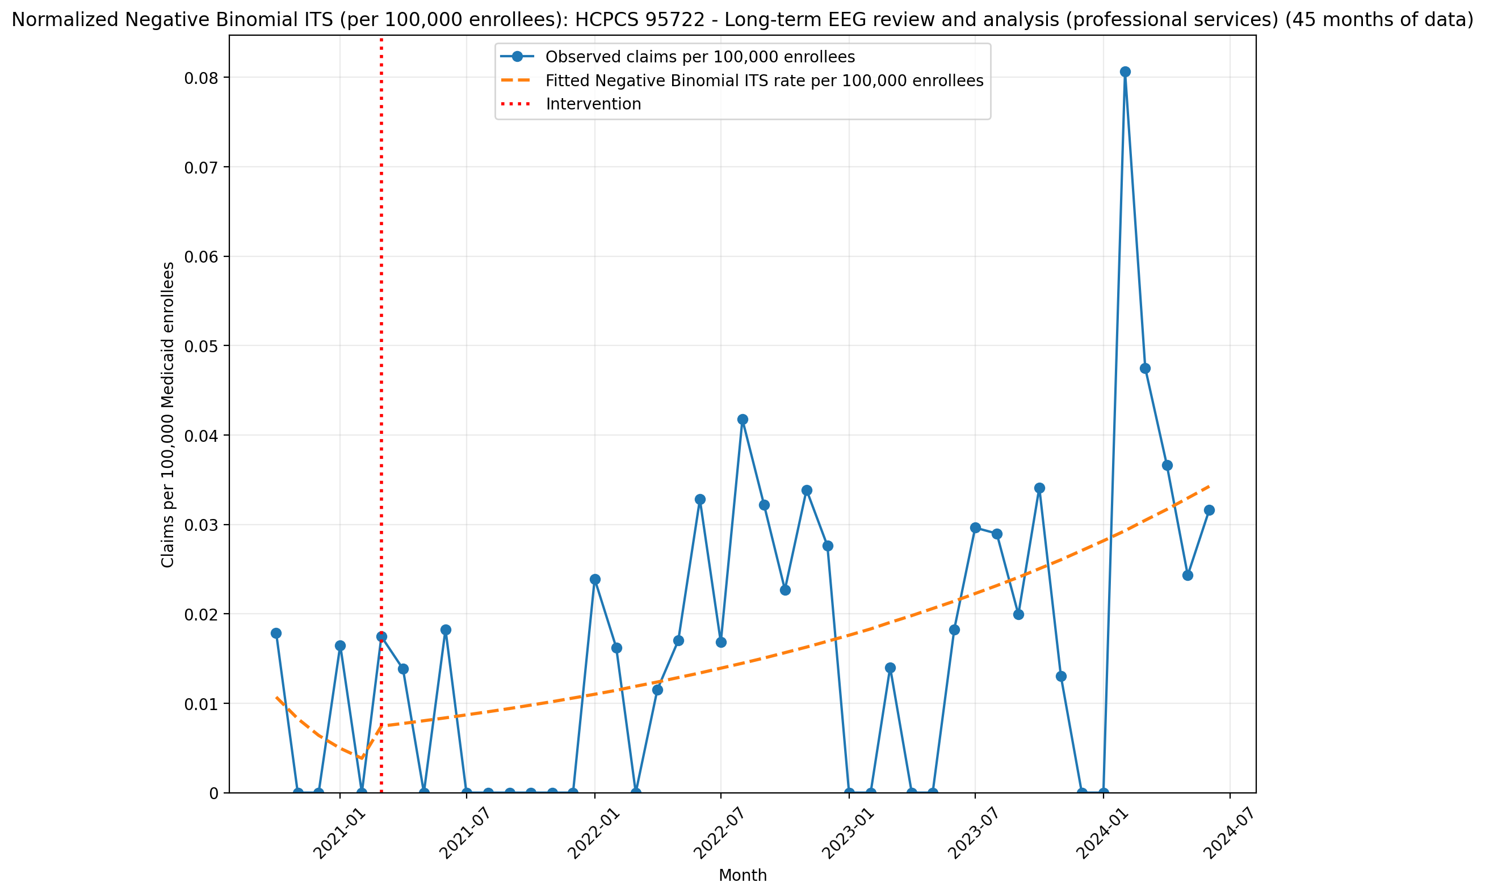
Normalized Negative Binomial ITS (per 100,000 enrollees): HCPCS 95722 - Long-term EEG review and analysis (professional services) (45 months of data)
NegativeBinomial Regression Results
==============================================================================
Dep. Variable: y No. Observations: 45
Model: NegativeBinomial Df Residuals: 41
Method: MLE Df Model: 3
Date: Thu, 07 May 2026 Pseudo R-squ.: 0.01311
Time: 21:23:22 Log-Likelihood: -155.73
converged: True LL-Null: -157.80
Covariance Type: nonrobust LLR p-value: 0.2468
==============================================================================
coef std err z P>|z| [0.025 0.975]
------------------------------------------------------------------------------
const -16.0509 1.261 -12.731 0.000 -18.522 -13.580
T -0.2563 0.517 -0.495 0.620 -1.270 0.758
X_t 0.6229 1.393 0.447 0.655 -2.107 3.353
post_time 0.2955 0.518 0.570 0.568 -0.720 1.311
alpha 2.5686 0.658 3.904 0.000 1.279 3.858
==============================================================================

Slide 45
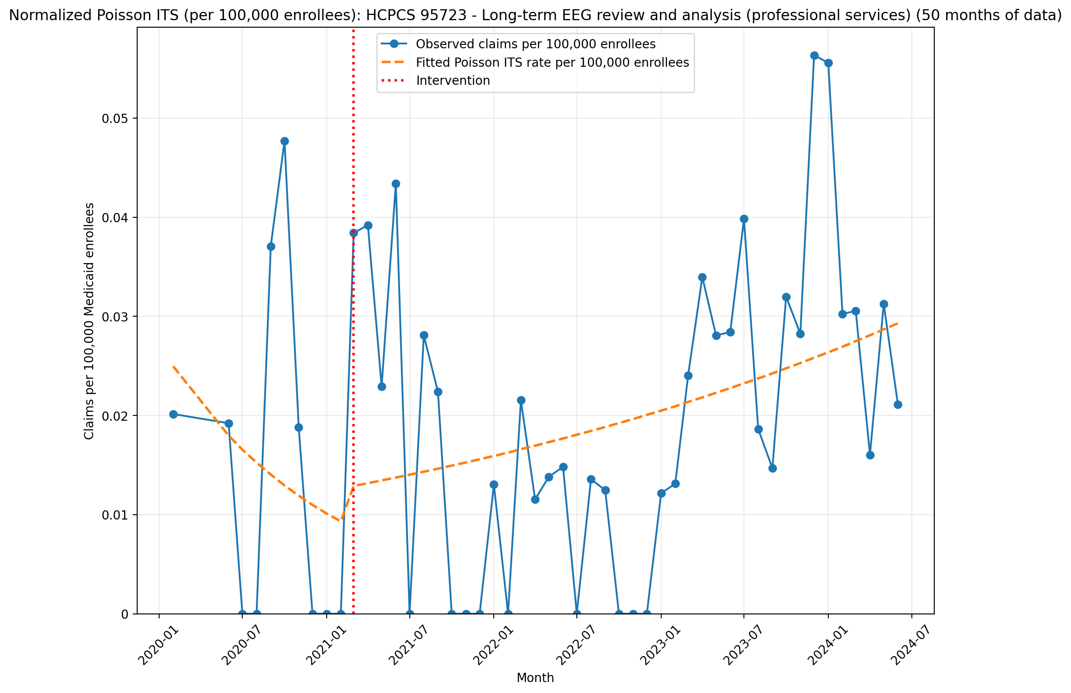
Normalized Poisson ITS (per 100,000 enrollees): HCPCS 95723 - Long-term EEG review and analysis (professional services) (50 months of data)
Generalized Linear Model Regression Results
==============================================================================
Dep. Variable: y No. Observations: 50
Model: GLM Df Residuals: 46
Model Family: Poisson Df Model: 3
Link Function: Log Scale: 1.0000
Method: IRLS Log-Likelihood: -421.74
Date: Thu, 07 May 2026 Deviance: 666.12
Time: 21:23:23 Pearson chi2: 585.
No. Iterations: 5 Pseudo R-squ. (CS): 0.7222
Covariance Type: nonrobust
==============================================================================
coef std err z P>|z| [0.025 0.975]
------------------------------------------------------------------------------
const -15.2033 0.187 -81.290 0.000 -15.570 -14.837
T -0.0822 0.026 -3.202 0.001 -0.132 -0.032
X_t 0.3045 0.192 1.583 0.114 -0.073 0.682
post_time 0.1032 0.026 3.990 0.000 0.053 0.154
==============================================================================

Slide 46
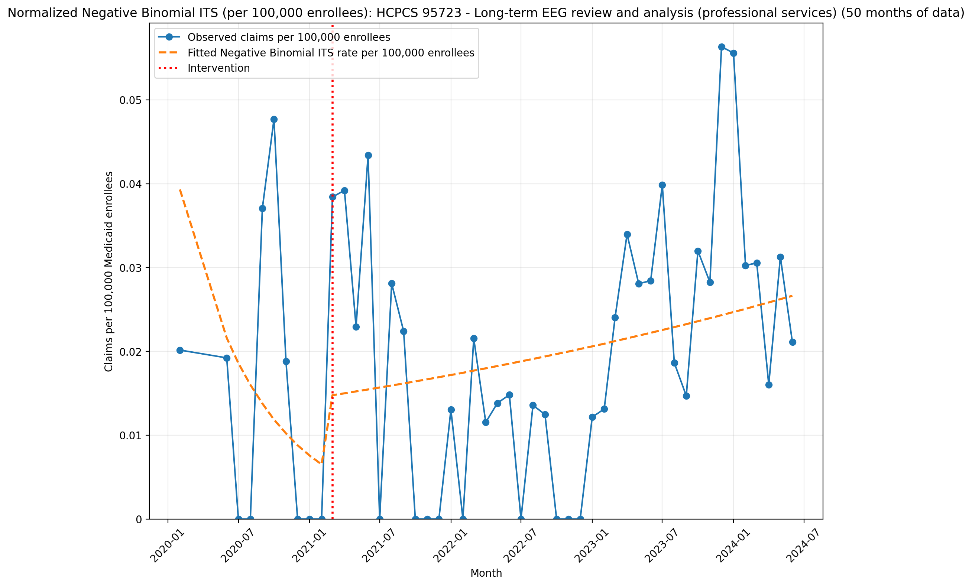
Normalized Negative Binomial ITS (per 100,000 enrollees): HCPCS 95723 - Long-term EEG review and analysis (professional services) (50 months of data)
NegativeBinomial Regression Results
==============================================================================
Dep. Variable: y No. Observations: 50
Model: NegativeBinomial Df Residuals: 46
Method: MLE Df Model: 3
Date: Thu, 07 May 2026 Pseudo R-squ.: 0.005448
Time: 21:23:23 Log-Likelihood: -189.06
converged: True LL-Null: -190.10
Covariance Type: nonrobust LLR p-value: 0.5577
==============================================================================
coef std err z P>|z| [0.025 0.975]
------------------------------------------------------------------------------
const -14.7493 1.445 -10.206 0.000 -17.582 -11.917
T -0.1498 0.192 -0.778 0.436 -0.527 0.227
X_t 0.8031 1.095 0.734 0.463 -1.343 2.949
post_time 0.1649 0.193 0.854 0.393 -0.214 0.543
alpha 1.7420 0.409 4.258 0.000 0.940 2.544
==============================================================================

Slide 47
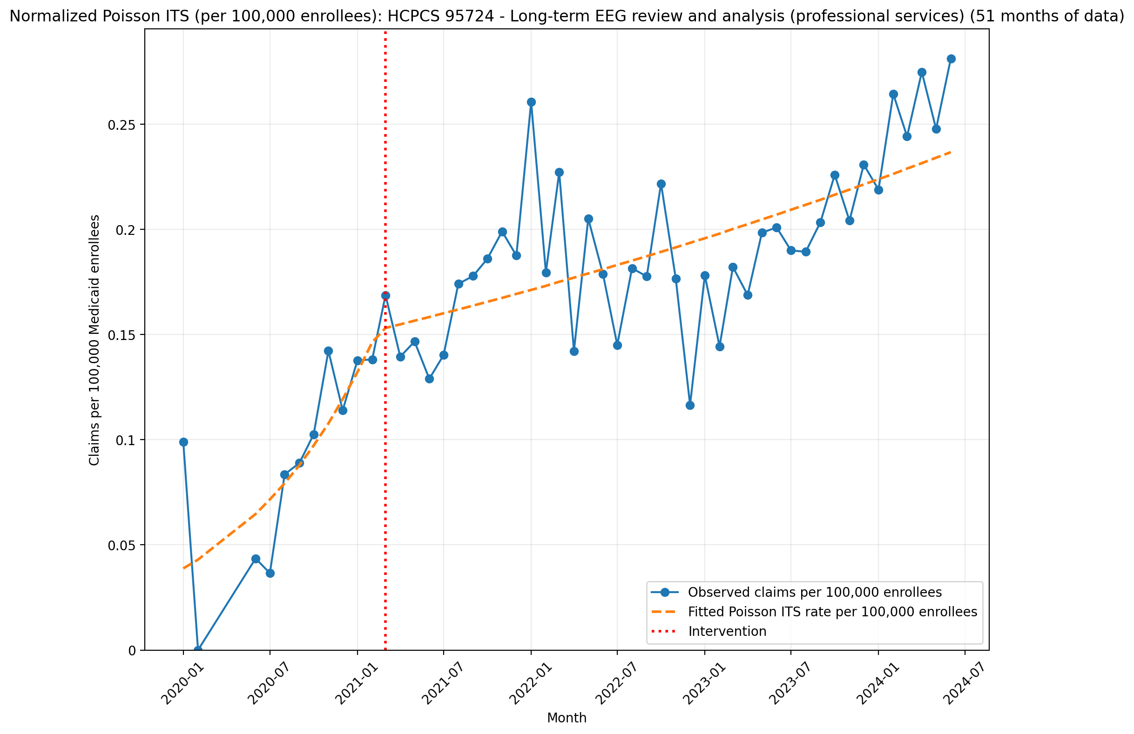
Normalized Poisson ITS (per 100,000 enrollees): HCPCS 95724 - Long-term EEG review and analysis (professional services) (51 months of data)
Generalized Linear Model Regression Results
==============================================================================
Dep. Variable: y No. Observations: 51
Model: GLM Df Residuals: 47
Model Family: Poisson Df Model: 3
Link Function: Log Scale: 1.0000
Method: IRLS Log-Likelihood: -336.09
Date: Thu, 07 May 2026 Deviance: 330.51
Time: 21:23:24 Pearson chi2: 317.
No. Iterations: 5 Pseudo R-squ. (CS): 1.000
Covariance Type: nonrobust
==============================================================================
coef std err z P>|z| [0.025 0.975]
------------------------------------------------------------------------------
const -14.7613 0.099 -149.043 0.000 -14.955 -14.567
T 0.1021 0.010 9.970 0.000 0.082 0.122
X_t 0.0342 0.060 0.575 0.565 -0.082 0.151
post_time -0.0909 0.010 -8.833 0.000 -0.111 -0.071
==============================================================================

Slide 48
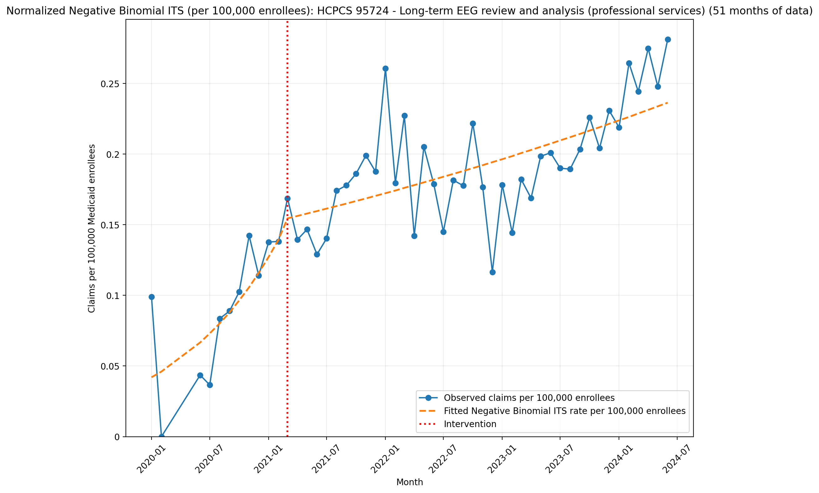
Normalized Negative Binomial ITS (per 100,000 enrollees): HCPCS 95724 - Long-term EEG review and analysis (professional services) (51 months of data)
NegativeBinomial Regression Results
==============================================================================
Dep. Variable: y No. Observations: 51
Model: NegativeBinomial Df Residuals: 47
Method: MLE Df Model: 3
Date: Thu, 07 May 2026 Pseudo R-squ.: 0.08273
Time: 21:23:24 Log-Likelihood: -265.25
converged: True LL-Null: -289.18
Covariance Type: nonrobust LLR p-value: 2.293e-10
==============================================================================
coef std err z P>|z| [0.025 0.975]
------------------------------------------------------------------------------
const -14.6831 0.177 -82.787 0.000 -15.031 -14.335
T 0.0924 0.020 4.620 0.000 0.053 0.132
X_t 0.0913 0.154 0.593 0.553 -0.210 0.393
post_time -0.0815 0.020 -4.017 0.000 -0.121 -0.042
alpha 0.0579 0.017 3.458 0.001 0.025 0.091
==============================================================================

Slide 49
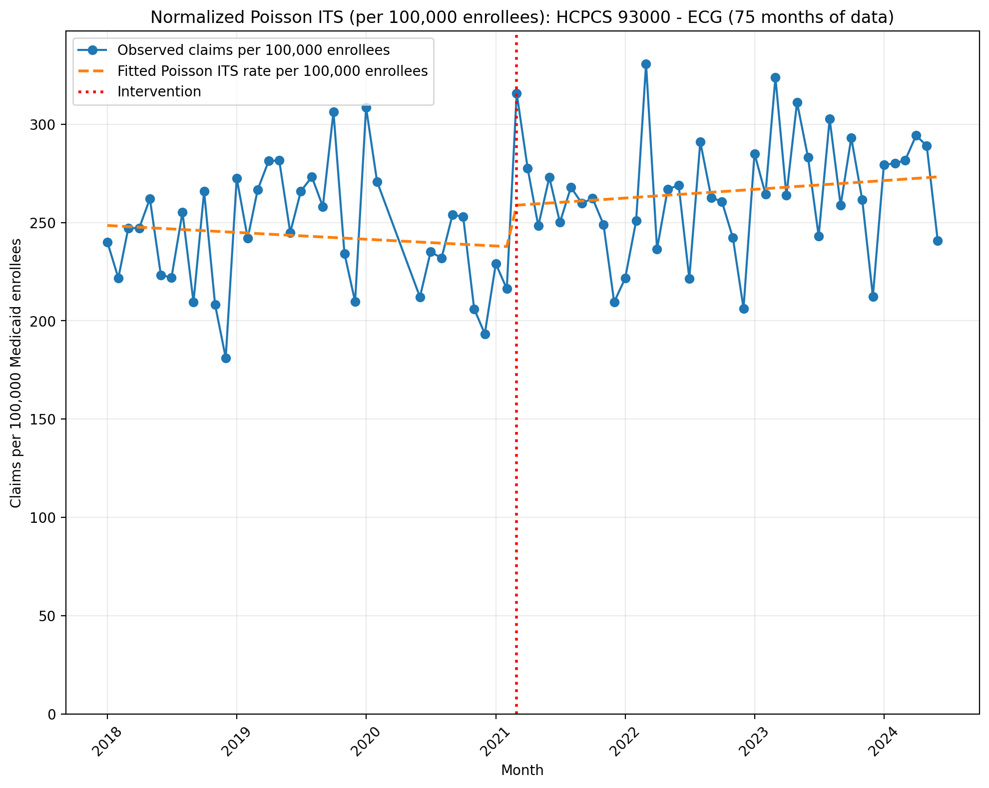
Normalized Poisson ITS (per 100,000 enrollees): HCPCS 93000 - ECG (75 months of data)
Generalized Linear Model Regression Results
==============================================================================
Dep. Variable: y No. Observations: 75
Model: GLM Df Residuals: 71
Model Family: Poisson Df Model: 3
Link Function: Log Scale: 1.0000
Method: IRLS Log-Likelihood: -1.0962e+05
Date: Thu, 07 May 2026 Deviance: 2.1819e+05
Time: 21:36:56 Pearson chi2: 2.18e+05
No. Iterations: 4 Pseudo R-squ. (CS): 1.000
Covariance Type: nonrobust
==============================================================================
coef std err z P>|z| [0.025 0.975]
------------------------------------------------------------------------------
const -5.9975 0.001 -8187.913 0.000 -5.999 -5.996
T -0.0012 3.46e-05 -34.484 0.000 -0.001 -0.001
X_t 0.0834 0.001 82.307 0.000 0.081 0.085
post_time 0.0026 4.45e-05 57.938 0.000 0.002 0.003
==============================================================================

Slide 50
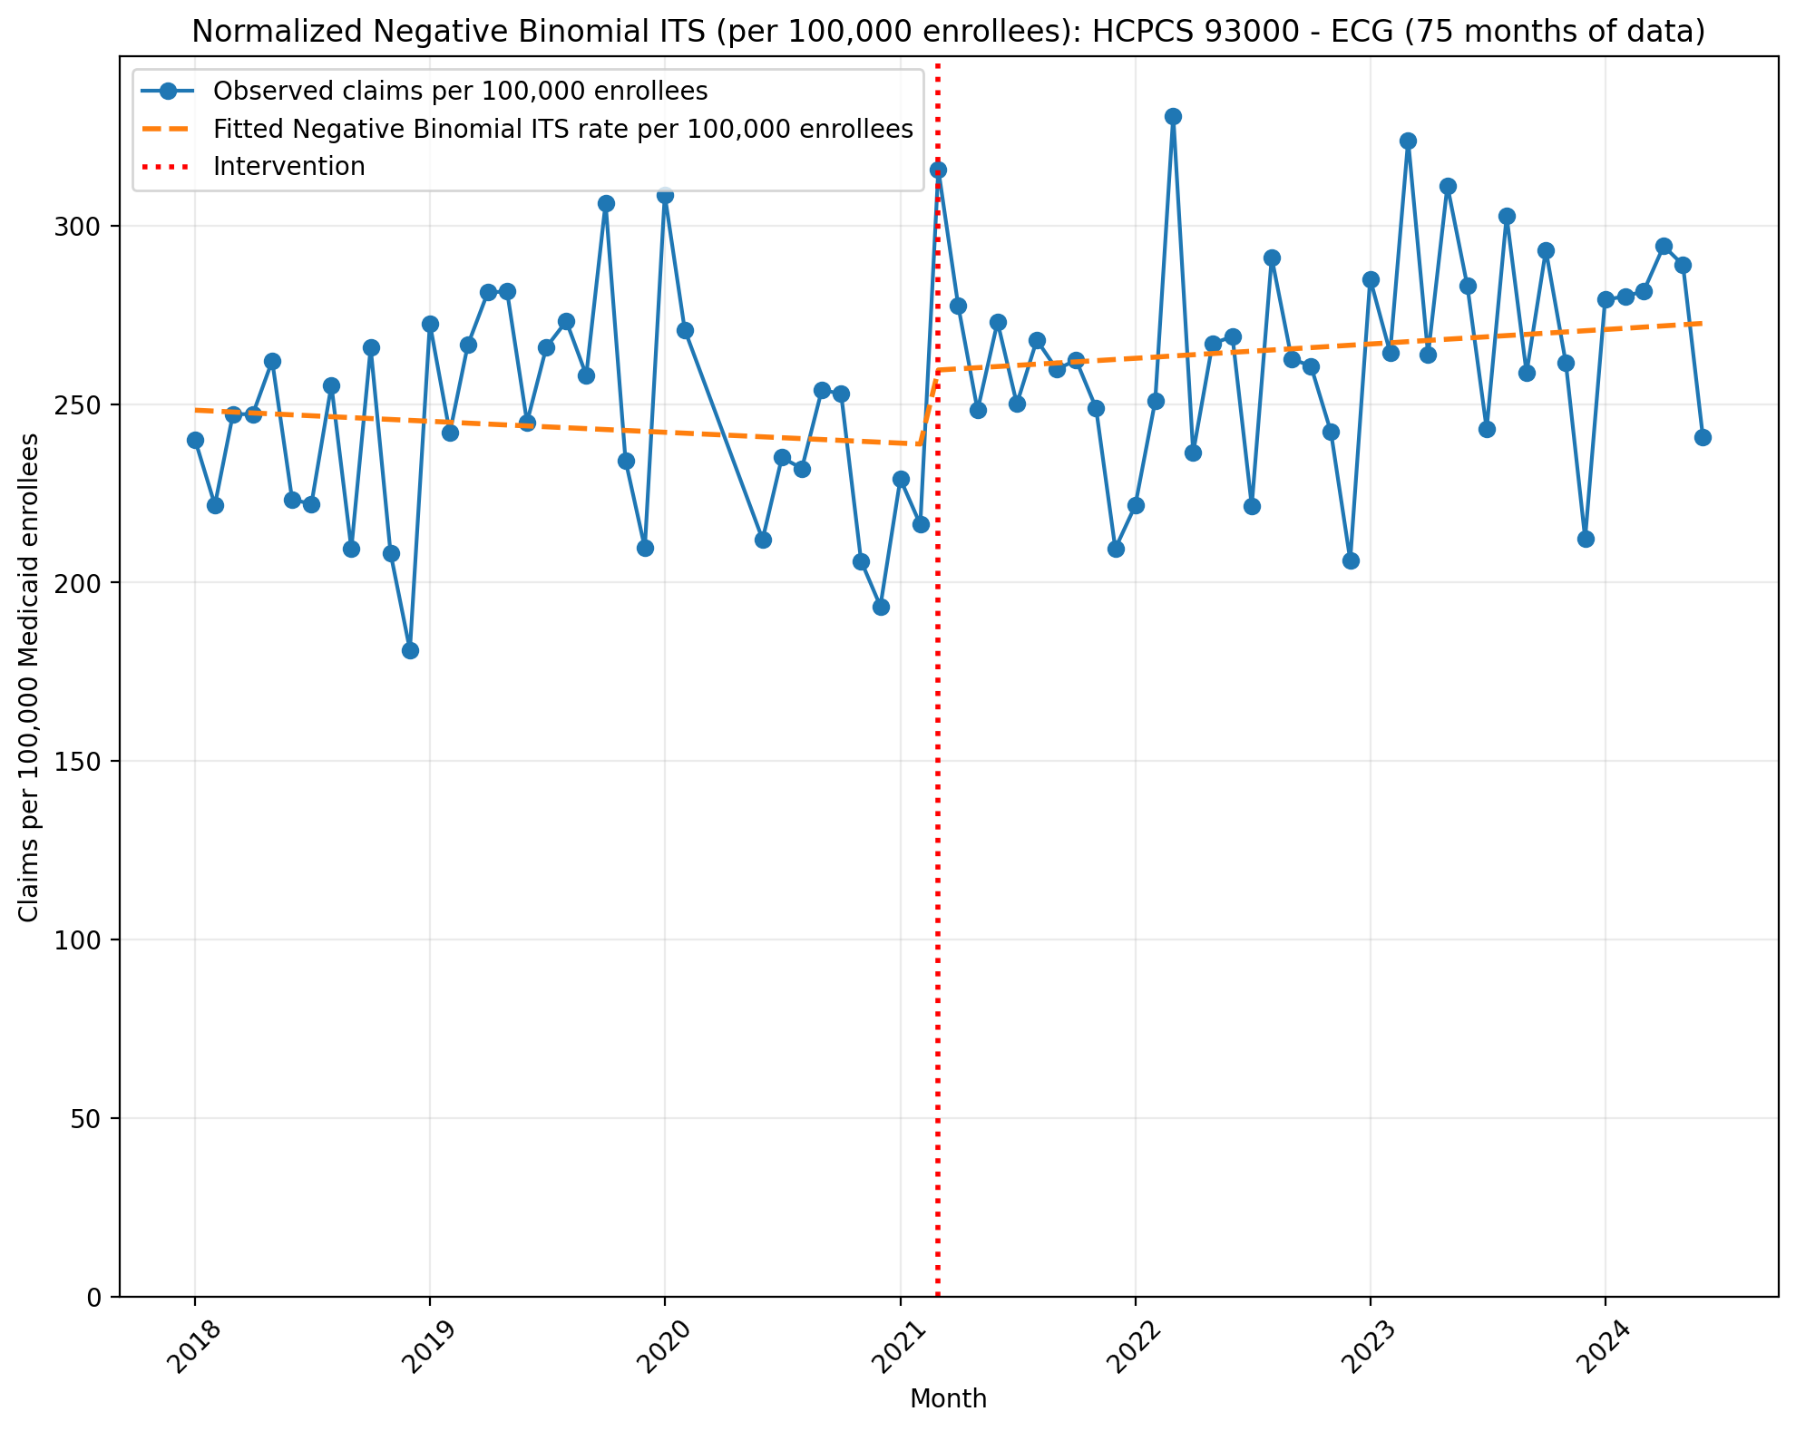
Normalized Negative Binomial ITS (per 100,000 enrollees): HCPCS 93000 - ECG (75 months of data)
NegativeBinomial Regression Results
==============================================================================
Dep. Variable: y No. Observations: 75
Model: NegativeBinomial Df Residuals: 71
Method: MLE Df Model: 3
Date: Thu, 07 May 2026 Pseudo R-squ.: 0.006158
Time: 21:36:56 Log-Likelihood: -866.47
converged: True LL-Null: -871.84
Covariance Type: nonrobust LLR p-value: 0.01323
==============================================================================
coef std err z P>|z| [0.025 0.975]
------------------------------------------------------------------------------
const -5.9984 0.038 -159.145 0.000 -6.072 -5.924
T -0.0011 0.002 -0.581 0.561 -0.005 0.002
X_t 0.0820 0.055 1.500 0.134 -0.025 0.189
post_time 0.0023 0.002 0.961 0.337 -0.002 0.007
alpha 0.0135 0.002 6.135 0.000 0.009 0.018
==============================================================================

Slide 51

Normalized Poisson ITS (per 100,000 enrollees): HCPCS 93005 - routine electrocardiogram (ECG/EKG) with at least 12 leads (75 months of data)
Generalized Linear Model Regression Results
==============================================================================
Dep. Variable: y No. Observations: 75
Model: GLM Df Residuals: 71
Model Family: Poisson Df Model: 3
Link Function: Log Scale: 1.0000
Method: IRLS Log-Likelihood: -95087.
Date: Thu, 07 May 2026 Deviance: 1.8904e+05
Time: 21:36:57 Pearson chi2: 1.89e+05
No. Iterations: 4 Pseudo R-squ. (CS): 1.000
Covariance Type: nonrobust
==============================================================================
coef std err z P>|z| [0.025 0.975]
------------------------------------------------------------------------------
const -4.9679 0.000 -1.14e+04 0.000 -4.969 -4.967
T -0.0001 2.04e-05 -6.914 0.000 -0.000 -0.000
X_t 0.0601 0.001 100.001 0.000 0.059 0.061
post_time 0.0001 2.65e-05 4.663 0.000 7.17e-05 0.000
==============================================================================

Slide 52

Normalized Negative Binomial ITS (per 100,000 enrollees): HCPCS 93005 - routine electrocardiogram (ECG/EKG) with at least 12 leads (75 months of data)
NegativeBinomial Regression Results
==============================================================================
Dep. Variable: y No. Observations: 75
Model: NegativeBinomial Df Residuals: 71
Method: MLE Df Model: 3
Date: Thu, 07 May 2026 Pseudo R-squ.: 0.006995
Time: 21:36:57 Log-Likelihood: -900.78
converged: True LL-Null: -907.13
Covariance Type: nonrobust LLR p-value: 0.005354
==============================================================================
coef std err z P>|z| [0.025 0.975]
------------------------------------------------------------------------------
const -4.9692 0.021 -235.668 0.000 -5.010 -4.928
T 1.596e-05 0.001 0.016 0.987 -0.002 0.002
X_t 0.0579 0.031 1.892 0.058 -0.002 0.118
post_time -0.0001 0.001 -0.085 0.932 -0.003 0.003
alpha 0.0043 0.001 6.126 0.000 0.003 0.006
==============================================================================

Slide 53

Normalized Poisson ITS (per 100,000 enrollees): HCPCS 93010 - interpretation and report of a routine 12-lead electrocardiogram (75 months of data)
Generalized Linear Model Regression Results
==============================================================================
Dep. Variable: y No. Observations: 75
Model: GLM Df Residuals: 71
Model Family: Poisson Df Model: 3
Link Function: Log Scale: 1.0000
Method: IRLS Log-Likelihood: -1.1622e+05
Date: Thu, 07 May 2026 Deviance: 2.3126e+05
Time: 21:36:58 Pearson chi2: 2.31e+05
No. Iterations: 4 Pseudo R-squ. (CS): 1.000
Covariance Type: nonrobust
==============================================================================
coef std err z P>|z| [0.025 0.975]
------------------------------------------------------------------------------
const -4.4277 0.000 -1.34e+04 0.000 -4.428 -4.427
T 0.0012 1.54e-05 74.954 0.000 0.001 0.001
X_t 0.0229 0.000 50.280 0.000 0.022 0.024
post_time -0.0046 2.03e-05 -225.769 0.000 -0.005 -0.005
==============================================================================

Slide 54

Normalized Negative Binomial ITS (per 100,000 enrollees): HCPCS 93010 - interpretation and report of a routine 12-lead electrocardiogram (75 months of data)
NegativeBinomial Regression Results
==============================================================================
Dep. Variable: y No. Observations: 75
Model: NegativeBinomial Df Residuals: 71
Method: MLE Df Model: 3
Date: Thu, 07 May 2026 Pseudo R-squ.: 0.01203
Time: 21:36:58 Log-Likelihood: -927.31
converged: True LL-Null: -938.60
Covariance Type: nonrobust LLR p-value: 4.946e-05
==============================================================================
coef std err z P>|z| [0.025 0.975]
------------------------------------------------------------------------------
const -4.4293 0.018 -248.660 0.000 -4.464 -4.394
T 0.0013 0.001 1.539 0.124 -0.000 0.003
X_t 0.0188 0.026 0.728 0.466 -0.032 0.070
post_time -0.0047 0.001 -4.130 0.000 -0.007 -0.002
alpha 0.0031 0.000 6.125 0.000 0.002 0.004
==============================================================================

Slide 55

Normalized Poisson ITS (per 100,000 enrollees): HCPCS 93040 - Rhythm ECG (limited, interpretation dependent) (75 months of data)
Generalized Linear Model Regression Results
==============================================================================
Dep. Variable: y No. Observations: 75
Model: GLM Df Residuals: 71
Model Family: Poisson Df Model: 3
Link Function: Log Scale: 1.0000
Method: IRLS Log-Likelihood: -2209.5
Date: Thu, 07 May 2026 Deviance: 3675.0
Time: 21:36:59 Pearson chi2: 3.70e+03
No. Iterations: 4 Pseudo R-squ. (CS): 1.000
Covariance Type: nonrobust
==============================================================================
coef std err z P>|z| [0.025 0.975]
------------------------------------------------------------------------------
const -9.9890 0.005 -1823.768 0.000 -10.000 -9.978
T -0.0048 0.000 -18.400 0.000 -0.005 -0.004
X_t -0.0881 0.008 -10.668 0.000 -0.104 -0.072
post_time 0.0050 0.000 13.865 0.000 0.004 0.006
==============================================================================

Slide 56

Normalized Negative Binomial ITS (per 100,000 enrollees): HCPCS 93040 - Rhythm ECG (limited, interpretation dependent) (75 months of data)
NegativeBinomial Regression Results
==============================================================================
Dep. Variable: y No. Observations: 75
Model: NegativeBinomial Df Residuals: 71
Method: MLE Df Model: 3
Date: Thu, 07 May 2026 Pseudo R-squ.: 0.03240
Time: 21:36:59 Log-Likelihood: -554.99
converged: True LL-Null: -573.57
Covariance Type: nonrobust LLR p-value: 4.252e-08
==============================================================================
coef std err z P>|z| [0.025 0.975]
------------------------------------------------------------------------------
const -9.9886 0.039 -256.059 0.000 -10.065 -9.912
T -0.0049 0.002 -2.607 0.009 -0.009 -0.001
X_t -0.0853 0.057 -1.495 0.135 -0.197 0.027
post_time 0.0048 0.003 1.923 0.054 -9.15e-05 0.010
alpha 0.0146 0.002 6.012 0.000 0.010 0.019
==============================================================================

Slide 57

Normalized Poisson ITS (per 100,000 enrollees): HCPCS 93041 - Rhythm ECG (limited, interpretation dependent) (75 months of data)
Generalized Linear Model Regression Results
==============================================================================
Dep. Variable: y No. Observations: 75
Model: GLM Df Residuals: 71
Model Family: Poisson Df Model: 3
Link Function: Log Scale: 1.0000
Method: IRLS Log-Likelihood: -2676.7
Date: Thu, 07 May 2026 Deviance: 4506.3
Time: 21:37:00 Pearson chi2: 4.45e+03
No. Iterations: 4 Pseudo R-squ. (CS): 1.000
Covariance Type: nonrobust
==============================================================================
coef std err z P>|z| [0.025 0.975]
------------------------------------------------------------------------------
const -8.5984 0.003 -3188.398 0.000 -8.604 -8.593
T -0.0018 0.000 -14.474 0.000 -0.002 -0.002
X_t 0.0401 0.004 10.114 0.000 0.032 0.048
post_time -0.0140 0.000 -77.833 0.000 -0.014 -0.014
==============================================================================

Slide 58

Normalized Negative Binomial ITS (per 100,000 enrollees): HCPCS 93041 - Rhythm ECG (limited, interpretation dependent) (75 months of data)
NegativeBinomial Regression Results
==============================================================================
Dep. Variable: y No. Observations: 75
Model: NegativeBinomial Df Residuals: 71
Method: MLE Df Model: 3
Date: Thu, 07 May 2026 Pseudo R-squ.: 0.1228
Time: 21:37:00 Log-Likelihood: -614.45
converged: True LL-Null: -700.43
Covariance Type: nonrobust LLR p-value: 4.812e-37
==============================================================================
coef std err z P>|z| [0.025 0.975]
------------------------------------------------------------------------------
const -8.5997 0.022 -394.220 0.000 -8.642 -8.557
T -0.0017 0.001 -1.673 0.094 -0.004 0.000
X_t 0.0373 0.032 1.170 0.242 -0.025 0.100
post_time -0.0141 0.001 -10.092 0.000 -0.017 -0.011
alpha 0.0046 0.001 6.024 0.000 0.003 0.006
==============================================================================

Slide 59

Normalized Poisson ITS (per 100,000 enrollees): HCPCS 93042 - Rhythm ECG (limited, interpretation dependent) (75 months of data)
Generalized Linear Model Regression Results
==============================================================================
Dep. Variable: y No. Observations: 75
Model: GLM Df Residuals: 71
Model Family: Poisson Df Model: 3
Link Function: Log Scale: 1.0000
Method: IRLS Log-Likelihood: -4980.7
Date: Thu, 07 May 2026 Deviance: 9132.4
Time: 21:37:00 Pearson chi2: 8.88e+03
No. Iterations: 4 Pseudo R-squ. (CS): 1.000
Covariance Type: nonrobust
==============================================================================
coef std err z P>|z| [0.025 0.975]
------------------------------------------------------------------------------
const -9.0527 0.003 -2727.437 0.000 -9.059 -9.046
T 0.0025 0.000 16.253 0.000 0.002 0.003
X_t 0.0506 0.005 11.169 0.000 0.042 0.059
post_time -0.0105 0.000 -51.193 0.000 -0.011 -0.010
==============================================================================

Slide 60

Normalized Negative Binomial ITS (per 100,000 enrollees): HCPCS 93042 - Rhythm ECG (limited, interpretation dependent) (75 months of data)
NegativeBinomial Regression Results
==============================================================================
Dep. Variable: y No. Observations: 75
Model: NegativeBinomial Df Residuals: 71
Method: MLE Df Model: 3
Date: Thu, 07 May 2026 Pseudo R-squ.: 0.02204
Time: 21:37:01 Log-Likelihood: -632.14
converged: False LL-Null: -646.38
Covariance Type: nonrobust LLR p-value: 2.862e-06
==============================================================================
coef std err z P>|z| [0.025 0.975]
------------------------------------------------------------------------------
const -9.0559 0.036 -254.831 0.000 -9.126 -8.986
T 0.0028 0.002 1.622 0.105 -0.001 0.006
X_t 0.0386 0.051 0.755 0.450 -0.062 0.139
post_time -0.0103 0.002 -4.590 0.000 -0.015 -0.006
alpha 0.0120 0.002 6.085 0.000 0.008 0.016
==============================================================================

Slide 61

Normalized Poisson ITS (per 100,000 enrollees): Custom Aggregate Aggregate EEG 1
Generalized Linear Model Regression Results
==============================================================================
Dep. Variable: y No. Observations: 75
Model: GLM Df Residuals: 71
Model Family: Poisson Df Model: 3
Link Function: Log Scale: 1.0000
Method: IRLS Log-Likelihood: -12254.
Date: Thu, 07 May 2026 Deviance: 23621.
Time: 21:30:07 Pearson chi2: 2.38e+04
No. Iterations: 4 Pseudo R-squ. (CS): 1.000
Covariance Type: nonrobust
==============================================================================
coef std err z P>|z| [0.025 0.975]
------------------------------------------------------------------------------
const -8.3048 0.002 -3586.245 0.000 -8.309 -8.300
T -0.0006 0.000 -5.578 0.000 -0.001 -0.000
X_t 0.0763 0.003 23.930 0.000 0.070 0.083
post_time 0.0021 0.000 14.805 0.000 0.002 0.002
==============================================================================
Codes in aggregation: 95812, 95813, 95816, 95819

Slide 62

Normalized Negative Binomial ITS (per 100,000 enrollees): Custom Aggregate Aggregate EEG 1
NegativeBinomial Regression Results
==============================================================================
Dep. Variable: y No. Observations: 75
Model: NegativeBinomial Df Residuals: 71
Method: MLE Df Model: 3
Date: Thu, 07 May 2026 Pseudo R-squ.: 0.007930
Time: 21:30:07 Log-Likelihood: -696.96
converged: False LL-Null: -702.53
Covariance Type: nonrobust LLR p-value: 0.01098
==============================================================================
coef std err z P>|z| [0.025 0.975]
------------------------------------------------------------------------------
const -8.3062 0.039 -212.318 0.000 -8.383 -8.230
T -0.0004 0.002 -0.221 0.825 -0.004 0.003
X_t 0.0744 0.056 1.317 0.188 -0.036 0.185
post_time 0.0017 0.002 0.700 0.484 -0.003 0.007
alpha 0.0144 0.002 6.118 0.000 0.010 0.019
==============================================================================
Codes in aggregation: 95812, 95813, 95816, 95819

Slide 63

Normalized Poisson ITS (per 100,000 enrollees): Custom Aggregate Aggregate EEG 2
Generalized Linear Model Regression Results
==============================================================================
Dep. Variable: y No. Observations: 51
Model: GLM Df Residuals: 47
Model Family: Poisson Df Model: 3
Link Function: Log Scale: 1.0000
Method: IRLS Log-Likelihood: -3925.6
Date: Thu, 07 May 2026 Deviance: 7266.9
Time: 21:35:03 Pearson chi2: 7.26e+03
No. Iterations: 4 Pseudo R-squ. (CS): 1.000
Covariance Type: nonrobust
==============================================================================
coef std err z P>|z| [0.025 0.975]
------------------------------------------------------------------------------
const -8.8383 0.006 -1463.216 0.000 -8.850 -8.826
T -0.0019 0.001 -2.682 0.007 -0.003 -0.001
X_t 0.0922 0.005 17.047 0.000 0.082 0.103
post_time 0.0077 0.001 10.795 0.000 0.006 0.009
==============================================================================
Codes in aggregation: 95705, 95706, 95707, 95708, 95710, 95711, 95712, 95713, 95714, 95715, 95716, 95717, 95718, 95719, 95720, 95721, 95722, 95723, 95724

Slide 64

Normalized Negative Binomial ITS (per 100,000 enrollees): Custom Aggregate Aggregate EEG 2
NegativeBinomial Regression Results
==============================================================================
Dep. Variable: y No. Observations: 51
Model: NegativeBinomial Df Residuals: 47
Method: MLE Df Model: 3
Date: Thu, 07 May 2026 Pseudo R-squ.: 0.04084
Time: 21:35:04 Log-Likelihood: -443.43
converged: False LL-Null: -462.31
Covariance Type: nonrobust LLR p-value: 3.168e-08
==============================================================================
coef std err z P>|z| [0.025 0.975]
------------------------------------------------------------------------------
const -8.8385 0.061 -145.388 0.000 -8.958 -8.719
T -0.0019 0.007 -0.266 0.790 -0.016 0.012
X_t 0.0987 0.058 1.705 0.088 -0.015 0.212
post_time 0.0075 0.007 1.023 0.306 -0.007 0.022
alpha 0.0091 0.002 5.021 0.000 0.006 0.013
==============================================================================
Codes in aggregation: 95705, 95706, 95707, 95708, 95710, 95711, 95712, 95713, 95714, 95715, 95716, 95717, 95718, 95719, 95720, 95721, 95722, 95723, 95724

Slide 65

Normalized Poisson ITS (per 100,000 enrollees): Custom Aggregate Aggregate ECG 1
Generalized Linear Model Regression Results
==============================================================================
Dep. Variable: y No. Observations: 75
Model: GLM Df Residuals: 71
Model Family: Poisson Df Model: 3
Link Function: Log Scale: 1.0000
Method: IRLS Log-Likelihood: -2.5244e+05
Date: Thu, 07 May 2026 Deviance: 5.0367e+05
Time: 21:38:19 Pearson chi2: 5.05e+05
No. Iterations: 4 Pseudo R-squ. (CS): 1.000
Covariance Type: nonrobust
==============================================================================
coef std err z P>|z| [0.025 0.975]
------------------------------------------------------------------------------
const -3.8451 0.000 -1.55e+04 0.000 -3.846 -3.845
T 0.0005 1.16e-05 40.861 0.000 0.000 0.000
X_t 0.0411 0.000 120.300 0.000 0.040 0.042
post_time -0.0022 1.52e-05 -143.551 0.000 -0.002 -0.002
==============================================================================
Codes in aggregation: 93000, 93005, 93010

Slide 66

Normalized Negative Binomial ITS (per 100,000 enrollees): Custom Aggregate Aggregate ECG 1
NegativeBinomial Regression Results
==============================================================================
Dep. Variable: y No. Observations: 75
Model: NegativeBinomial Df Residuals: 71
Method: MLE Df Model: 3
Date: Thu, 07 May 2026 Pseudo R-squ.: 0.002916
Time: 21:38:19 Log-Likelihood: -978.97
converged: True LL-Null: -981.84
Covariance Type: nonrobust LLR p-value: 0.1257
==============================================================================
coef std err z P>|z| [0.025 0.975]
------------------------------------------------------------------------------
const -3.8466 0.020 -195.694 0.000 -3.885 -3.808
T 0.0006 0.001 0.673 0.501 -0.001 0.002
X_t 0.0381 0.029 1.335 0.182 -0.018 0.094
post_time -0.0024 0.001 -1.879 0.060 -0.005 0.000
alpha 0.0037 0.001 6.127 0.000 0.003 0.005
==============================================================================
Codes in aggregation: 93000, 93005, 93010

Slide 67

Normalized Poisson ITS (per 100,000 enrollees): Custom Aggregate Aggregate ECG 2
Generalized Linear Model Regression Results
==============================================================================
Dep. Variable: y No. Observations: 75
Model: GLM Df Residuals: 71
Model Family: Poisson Df Model: 3
Link Function: Log Scale: 1.0000
Method: IRLS Log-Likelihood: -5402.2
Date: Thu, 07 May 2026 Deviance: 9903.5
Time: 21:39:15 Pearson chi2: 9.74e+03
No. Iterations: 4 Pseudo R-squ. (CS): 1.000
Covariance Type: nonrobust
==============================================================================
coef std err z P>|z| [0.025 0.975]
------------------------------------------------------------------------------
const -7.9658 0.002 -4074.290 0.000 -7.970 -7.962
T -0.0007 9.2e-05 -7.172 0.000 -0.001 -0.000
X_t 0.0271 0.003 9.652 0.000 0.022 0.033
post_time -0.0100 0.000 -78.958 0.000 -0.010 -0.010
==============================================================================
Codes in aggregation: 93040, 93041, 93042

Slide 68

Normalized Negative Binomial ITS (per 100,000 enrollees): Custom Aggregate Aggregate ECG 2
NegativeBinomial Regression Results
==============================================================================
Dep. Variable: y No. Observations: 75
Model: NegativeBinomial Df Residuals: 71
Method: MLE Df Model: 3
Date: Thu, 07 May 2026 Pseudo R-squ.: 0.07759
Time: 21:39:15 Log-Likelihood: -670.73
converged: True LL-Null: -727.15
Covariance Type: nonrobust LLR p-value: 2.684e-24
==============================================================================
coef std err z P>|z| [0.025 0.975]
------------------------------------------------------------------------------
const -7.9671 0.023 -351.668 0.000 -8.011 -7.923
T -0.0005 0.001 -0.500 0.617 -0.003 0.002
X_t 0.0205 0.033 0.622 0.534 -0.044 0.085
post_time -0.0098 0.001 -6.819 0.000 -0.013 -0.007
alpha 0.0050 0.001 6.082 0.000 0.003 0.007
==============================================================================
Codes in aggregation: 93040, 93041, 93042

Slide 69
'warning': 'Code 95725 was not found in claims_pivot.csv.’
'warning': 'Code 95726 was not found in claims_pivot.csv.'

