Slide 1
EEG

Slide 2
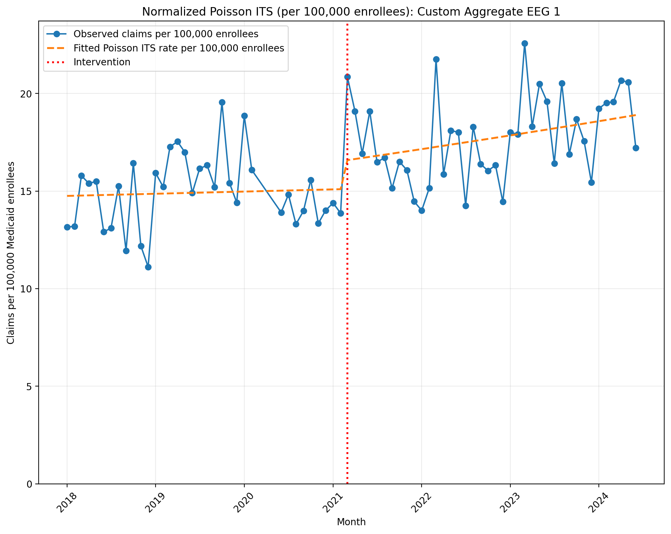
Normalized Poisson ITS (per 100,000 enrollees): Custom Aggregate EEG 1
Generalized Linear Model Regression Results
==============================================================================
Dep. Variable: y No. Observations: 75
Model: GLM Df Residuals: 71
Model Family: Poisson Df Model: 3
Link Function: Log Scale: 1.0000
Method: IRLS Log-Likelihood: -7801.7
Date: Mon, 11 May 2026 Deviance: 14750.
Time: 17:43:26 Pearson chi2: 1.49e+04
No. Iterations: 4 Pseudo R-squ. (CS): 1.000
Covariance Type: nonrobust
==============================================================================
coef std err z P>|z| [0.025 0.975]
------------------------------------------------------------------------------
const -8.8214 0.003 -2958.493 0.000 -8.827 -8.816
T 0.0006 0.000 4.468 0.000 0.000 0.001
X_t 0.0908 0.004 22.621 0.000 0.083 0.099
post_time 0.0027 0.000 15.369 0.000 0.002 0.003
==============================================================================
Codes in aggregation: 95812, 95813, 95816

Slide 3
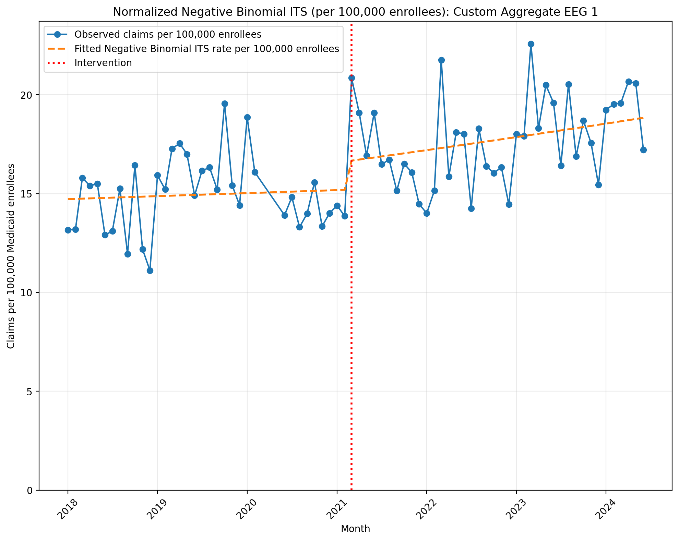
Normalized Negative Binomial ITS (per 100,000 enrollees): Custom Aggregate EEG 1
NegativeBinomial Regression Results
==============================================================================
Dep. Variable: y No. Observations: 75
Model: NegativeBinomial Df Residuals: 71
Method: MLE Df Model: 3
Date: Mon, 11 May 2026 Pseudo R-squ.: 0.02484
Time: 17:43:26 Log-Likelihood: -661.97
converged: True LL-Null: -678.83
Covariance Type: nonrobust LLR p-value: 2.262e-07
==============================================================================
coef std err z P>|z| [0.025 0.975]
------------------------------------------------------------------------------
const -8.8236 0.039 -229.010 0.000 -8.899 -8.748
T 0.0008 0.002 0.458 0.647 -0.003 0.004
X_t 0.0898 0.056 1.613 0.107 -0.019 0.199
post_time 0.0023 0.002 0.933 0.351 -0.003 0.007
alpha 0.0140 0.002 6.105 0.000 0.010 0.019
==============================================================================
Codes in aggregation: 95812, 95813, 95816

Slide 4
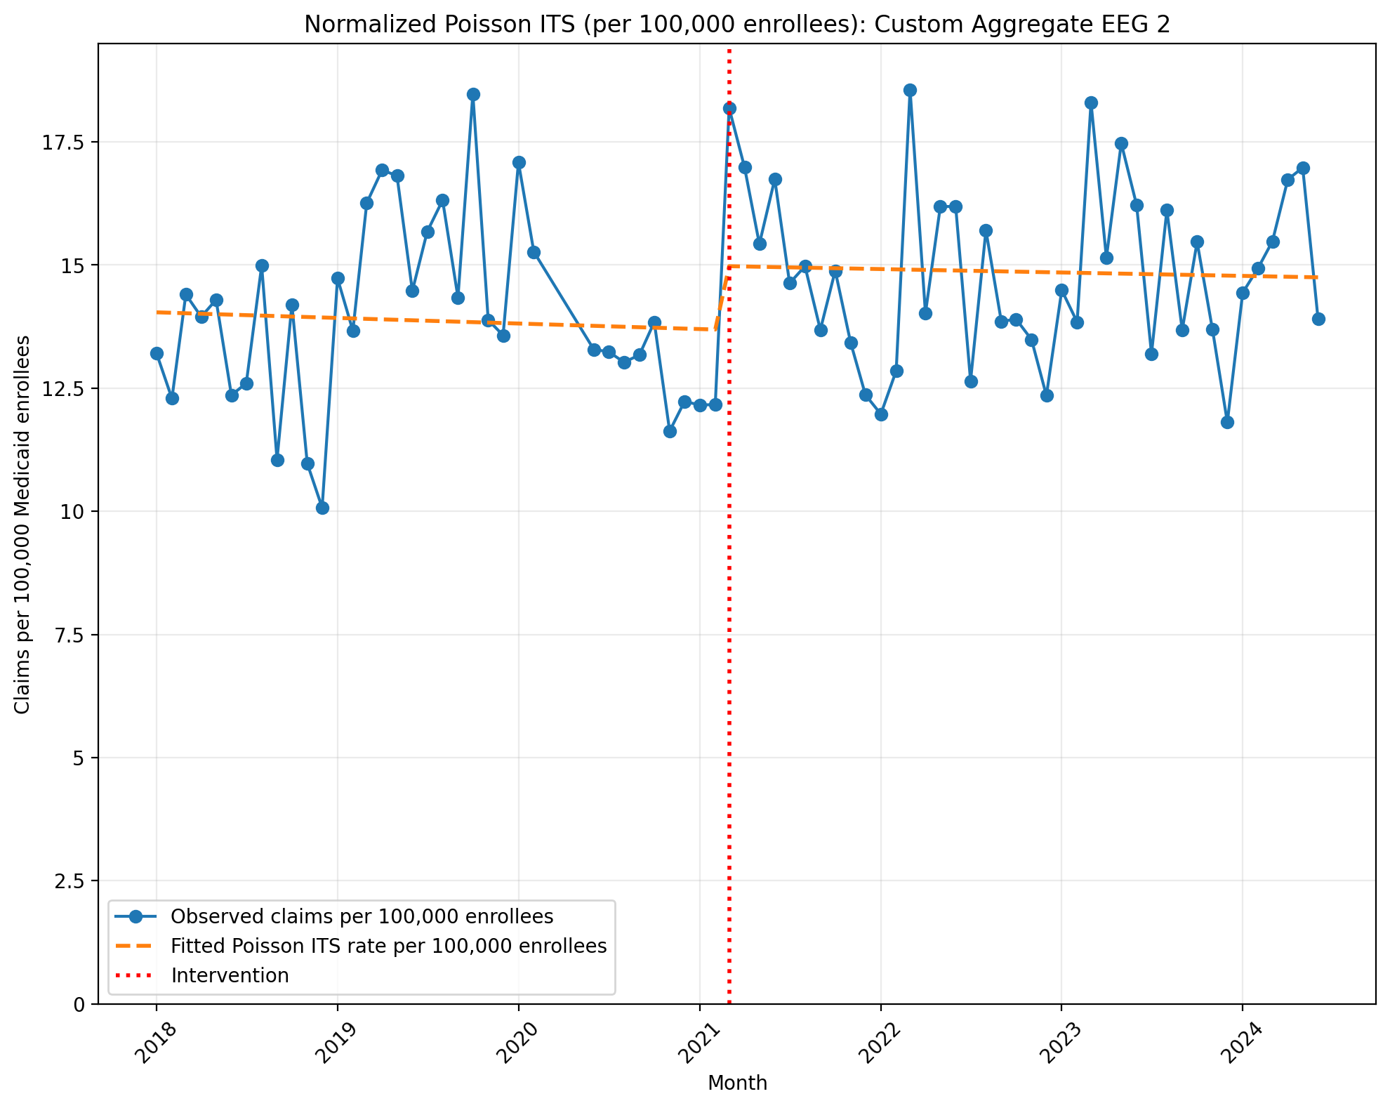
Normalized Poisson ITS (per 100,000 enrollees): Custom Aggregate EEG 2
Generalized Linear Model Regression Results
==============================================================================
Dep. Variable: y No. Observations: 75
Model: GLM Df Residuals: 71
Model Family: Poisson Df Model: 3
Link Function: Log Scale: 1.0000
Method: IRLS Log-Likelihood: -7584.5
Date: Mon, 11 May 2026 Deviance: 14326.
Time: 17:45:02 Pearson chi2: 1.44e+04
No. Iterations: 4 Pseudo R-squ. (CS): 1.000
Covariance Type: nonrobust
==============================================================================
coef std err z P>|z| [0.025 0.975]
------------------------------------------------------------------------------
const -8.8711 0.003 -2885.281 0.000 -8.877 -8.865
T -0.0007 0.000 -4.707 0.000 -0.001 -0.000
X_t 0.0901 0.004 21.255 0.000 0.082 0.098
post_time 0.0003 0.000 1.560 0.119 -7.49e-05 0.001
==============================================================================
Codes in aggregation: 95812, 95813, 95819

Slide 5
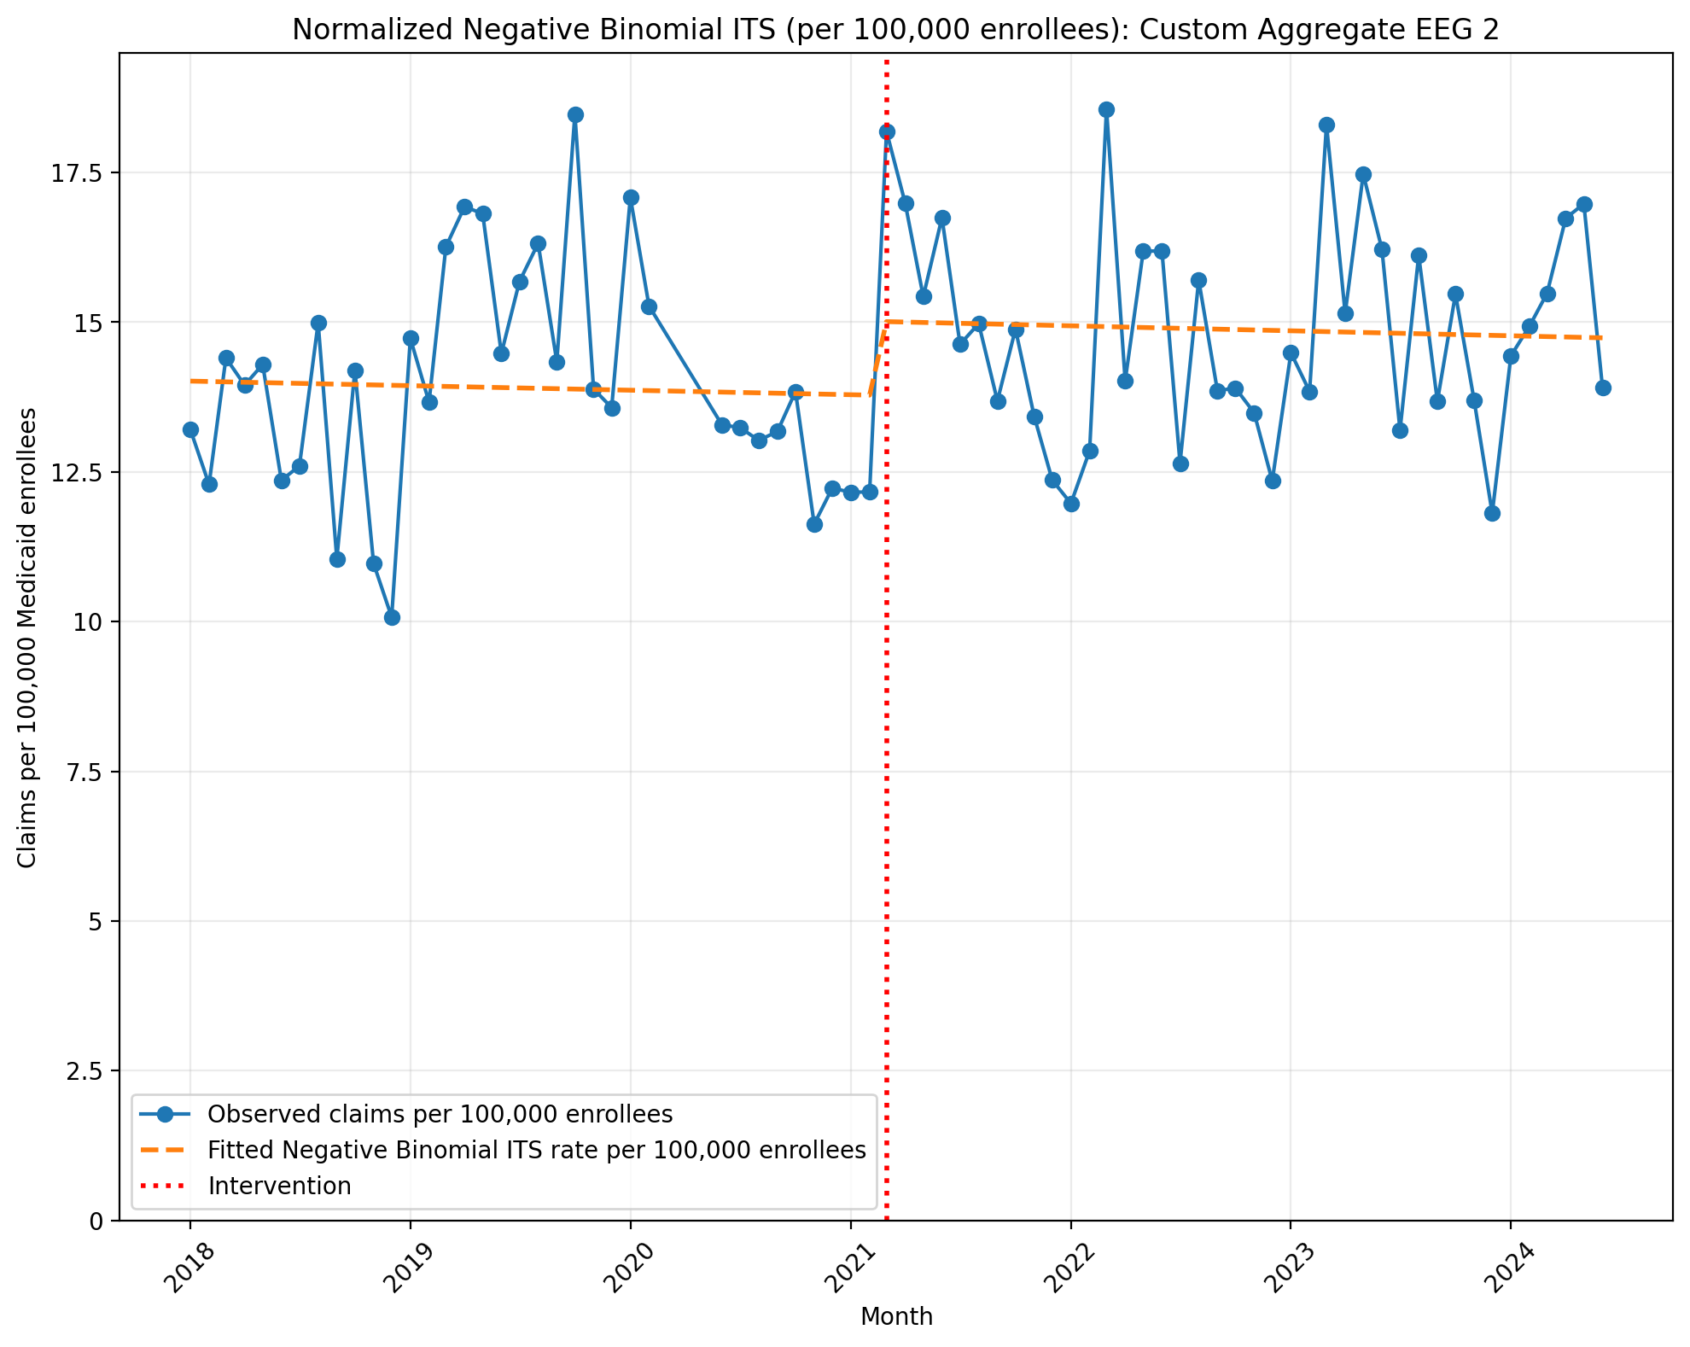
Normalized Negative Binomial ITS (per 100,000 enrollees): Custom Aggregate EEG 2
NegativeBinomial Regression Results
==============================================================================
Dep. Variable: y No. Observations: 75
Model: NegativeBinomial Df Residuals: 71
Method: MLE Df Model: 3
Date: Mon, 11 May 2026 Pseudo R-squ.: 0.004037
Time: 17:45:02 Log-Likelihood: -656.55
converged: True LL-Null: -659.21
Covariance Type: nonrobust LLR p-value: 0.1496
==============================================================================
coef std err z P>|z| [0.025 0.975]
------------------------------------------------------------------------------
const -8.8728 0.041 -216.757 0.000 -8.953 -8.793
T -0.0005 0.002 -0.231 0.818 -0.004 0.003
X_t 0.0857 0.059 1.452 0.146 -0.030 0.201
post_time -1.201e-05 0.003 -0.005 0.996 -0.005 0.005
alpha 0.0157 0.003 6.107 0.000 0.011 0.021
==============================================================================
Codes in aggregation: 95812, 95813, 95819

Slide 6
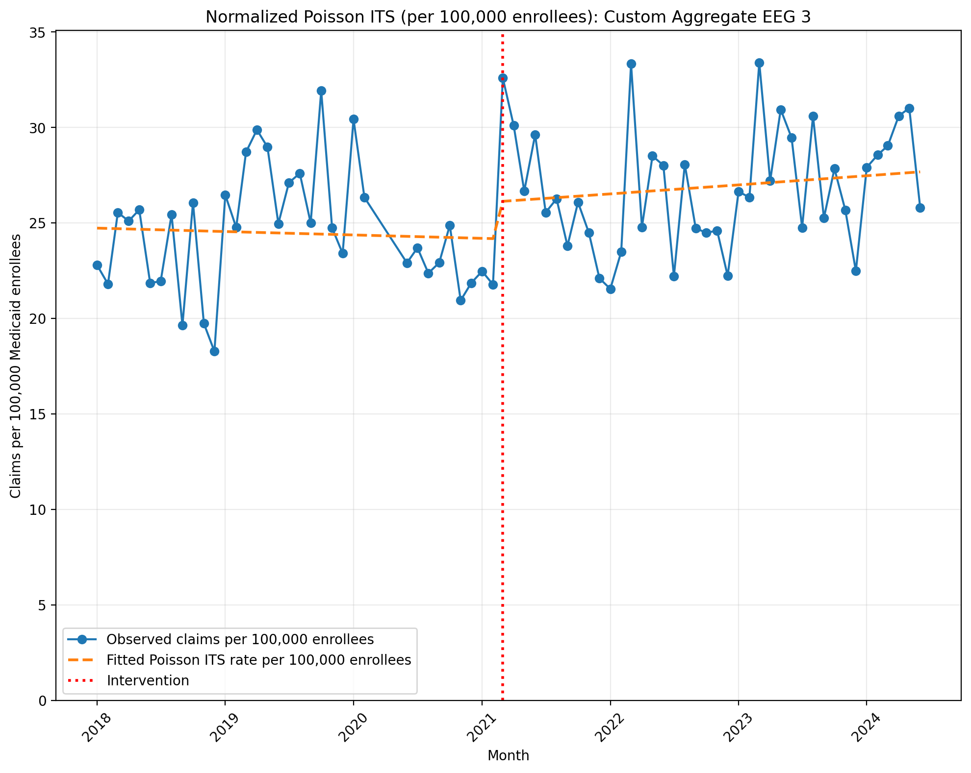
Normalized Poisson ITS (per 100,000 enrollees): Custom Aggregate EEG 3
Generalized Linear Model Regression Results
==============================================================================
Dep. Variable: y No. Observations: 75
Model: GLM Df Residuals: 71
Model Family: Poisson Df Model: 3
Link Function: Log Scale: 1.0000
Method: IRLS Log-Likelihood: -12254.
Date: Mon, 11 May 2026 Deviance: 23621.
Time: 17:45:57 Pearson chi2: 2.38e+04
No. Iterations: 4 Pseudo R-squ. (CS): 1.000
Covariance Type: nonrobust
==============================================================================
coef std err z P>|z| [0.025 0.975]
------------------------------------------------------------------------------
const -8.3048 0.002 -3586.245 0.000 -8.309 -8.300
T -0.0006 0.000 -5.578 0.000 -0.001 -0.000
X_t 0.0763 0.003 23.930 0.000 0.070 0.083
post_time 0.0021 0.000 14.805 0.000 0.002 0.002
==============================================================================
Codes in aggregation: 95812, 95813, 95816, 95819

Slide 7
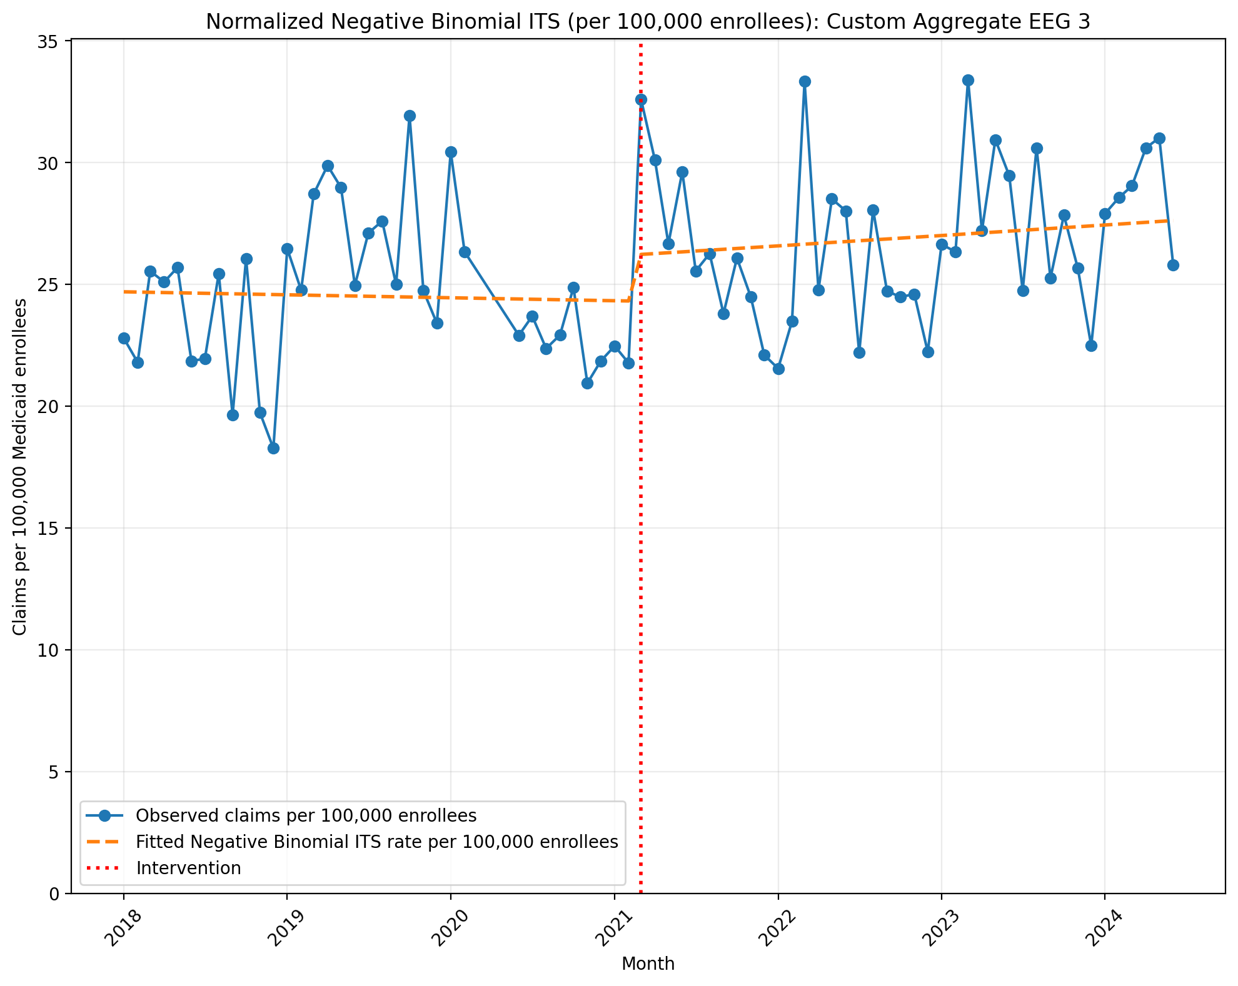
Normalized Negative Binomial ITS (per 100,000 enrollees): Custom Aggregate EEG 3
NegativeBinomial Regression Results
==============================================================================
Dep. Variable: y No. Observations: 75
Model: NegativeBinomial Df Residuals: 71
Method: MLE Df Model: 3
Date: Mon, 11 May 2026 Pseudo R-squ.: 0.007930
Time: 17:45:58 Log-Likelihood: -696.96
converged: True LL-Null: -702.53
Covariance Type: nonrobust LLR p-value: 0.01098
==============================================================================
coef std err z P>|z| [0.025 0.975]
------------------------------------------------------------------------------
const -8.3062 0.039 -212.318 0.000 -8.383 -8.230
T -0.0004 0.002 -0.221 0.825 -0.004 0.003
X_t 0.0744 0.056 1.317 0.188 -0.036 0.185
post_time 0.0017 0.002 0.700 0.484 -0.003 0.007
alpha 0.0144 0.002 6.118 0.000 0.010 0.019
==============================================================================
Codes in aggregation: 95812, 95813, 95816, 95819

Slide 8
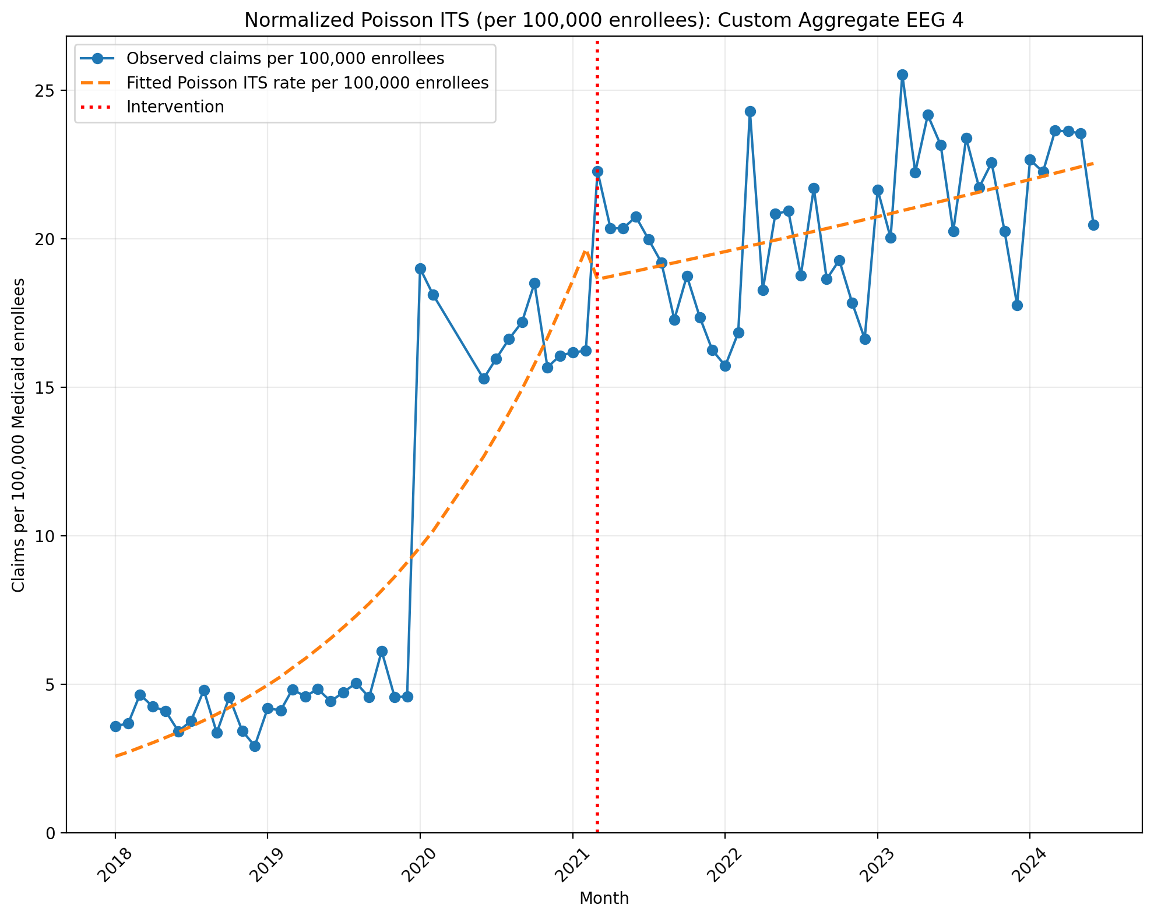
Normalized Poisson ITS (per 100,000 enrollees): Custom Aggregate EEG 4
Generalized Linear Model Regression Results
==============================================================================
Dep. Variable: y No. Observations: 75
Model: GLM Df Residuals: 71
Model Family: Poisson Df Model: 3
Link Function: Log Scale: 1.0000
Method: IRLS Log-Likelihood: -16107.
Date: Mon, 11 May 2026 Deviance: 31384.
Time: 17:46:46 Pearson chi2: 3.29e+04
No. Iterations: 6 Pseudo R-squ. (CS): 1.000
Covariance Type: nonrobust
==============================================================================
coef std err z P>|z| [0.025 0.975]
------------------------------------------------------------------------------
const -10.5704 0.005 -1949.816 0.000 -10.581 -10.560
T 0.0550 0.000 273.351 0.000 0.055 0.055
X_t -0.0581 0.004 -14.392 0.000 -0.066 -0.050
post_time -0.0501 0.000 -222.571 0.000 -0.051 -0.050
==============================================================================
Codes in aggregation: 95812, 95813, 95700, 95720

Slide 9
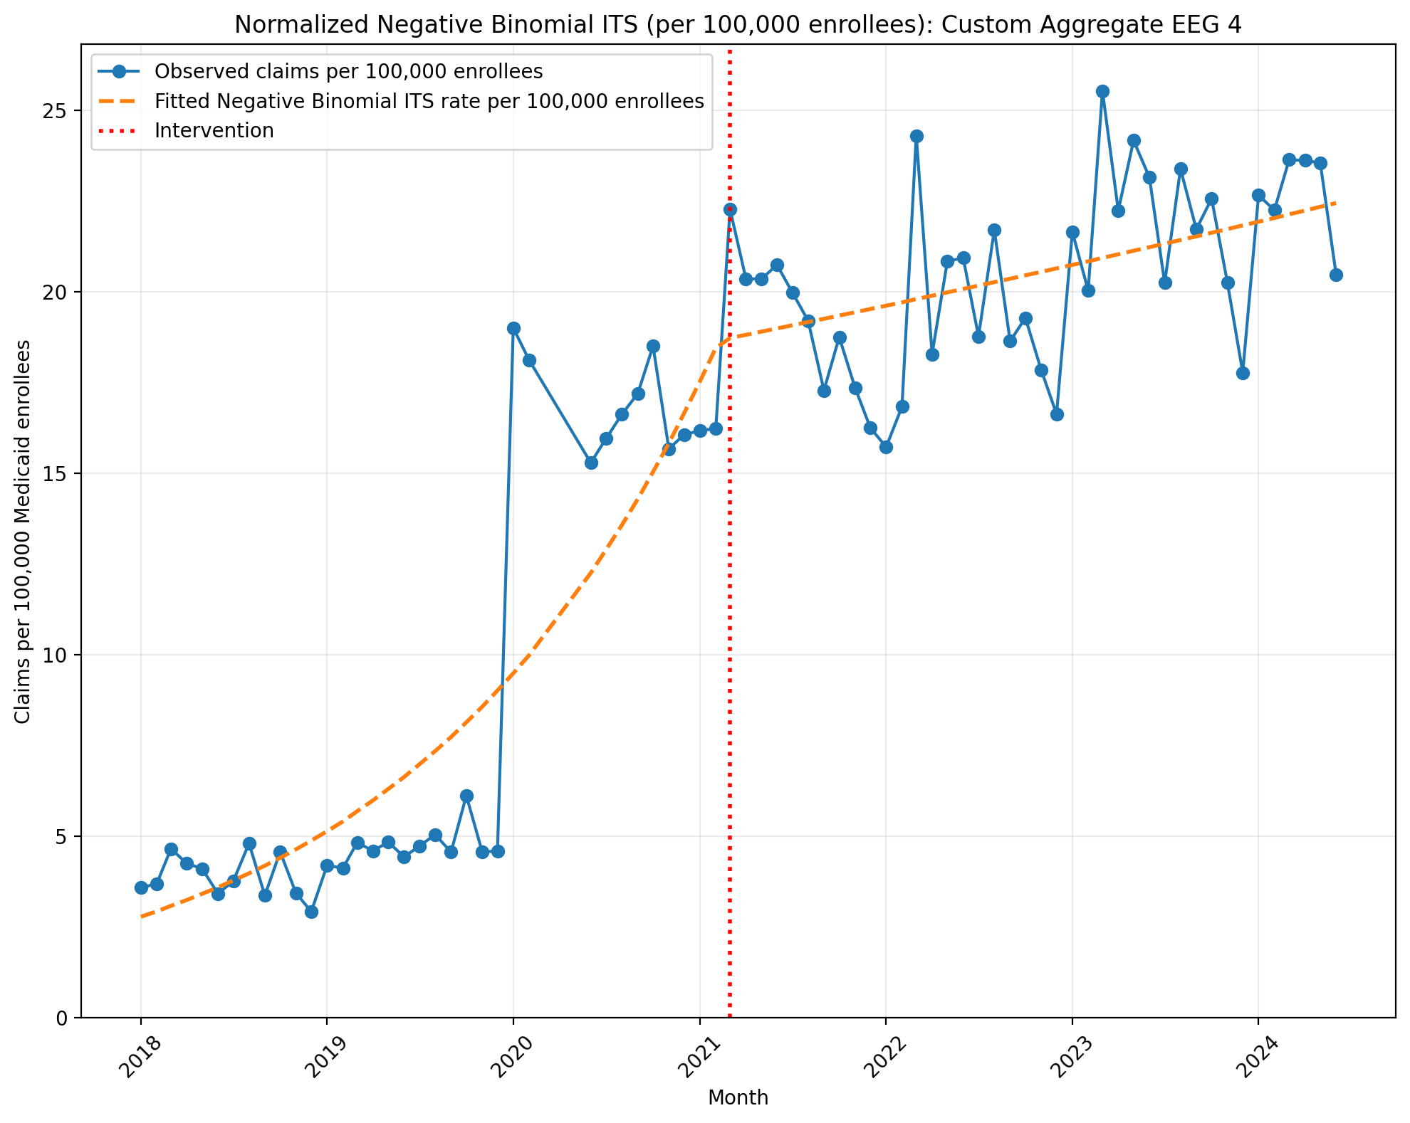
Normalized Negative Binomial ITS (per 100,000 enrollees): Custom Aggregate EEG 4
NegativeBinomial Regression Results
==============================================================================
Dep. Variable: y No. Observations: 75
Model: NegativeBinomial Df Residuals: 71
Method: MLE Df Model: 3
Date: Mon, 11 May 2026 Pseudo R-squ.: 0.1003
Time: 17:46:46 Log-Likelihood: -691.68
converged: False LL-Null: -768.81
Covariance Type: nonrobust LLR p-value: 3.181e-33
==============================================================================
coef std err z P>|z| [0.025 0.975]
------------------------------------------------------------------------------
const -10.4924 0.073 -144.005 0.000 -10.635 -10.350
T 0.0512 0.003 14.992 0.000 0.045 0.058
X_t 0.0100 0.108 0.093 0.926 -0.202 0.222
post_time -0.0466 0.005 -9.917 0.000 -0.056 -0.037
alpha 0.0563 0.009 6.160 0.000 0.038 0.074
==============================================================================
Codes in aggregation: 95812, 95813, 95700, 95720

Slide 10
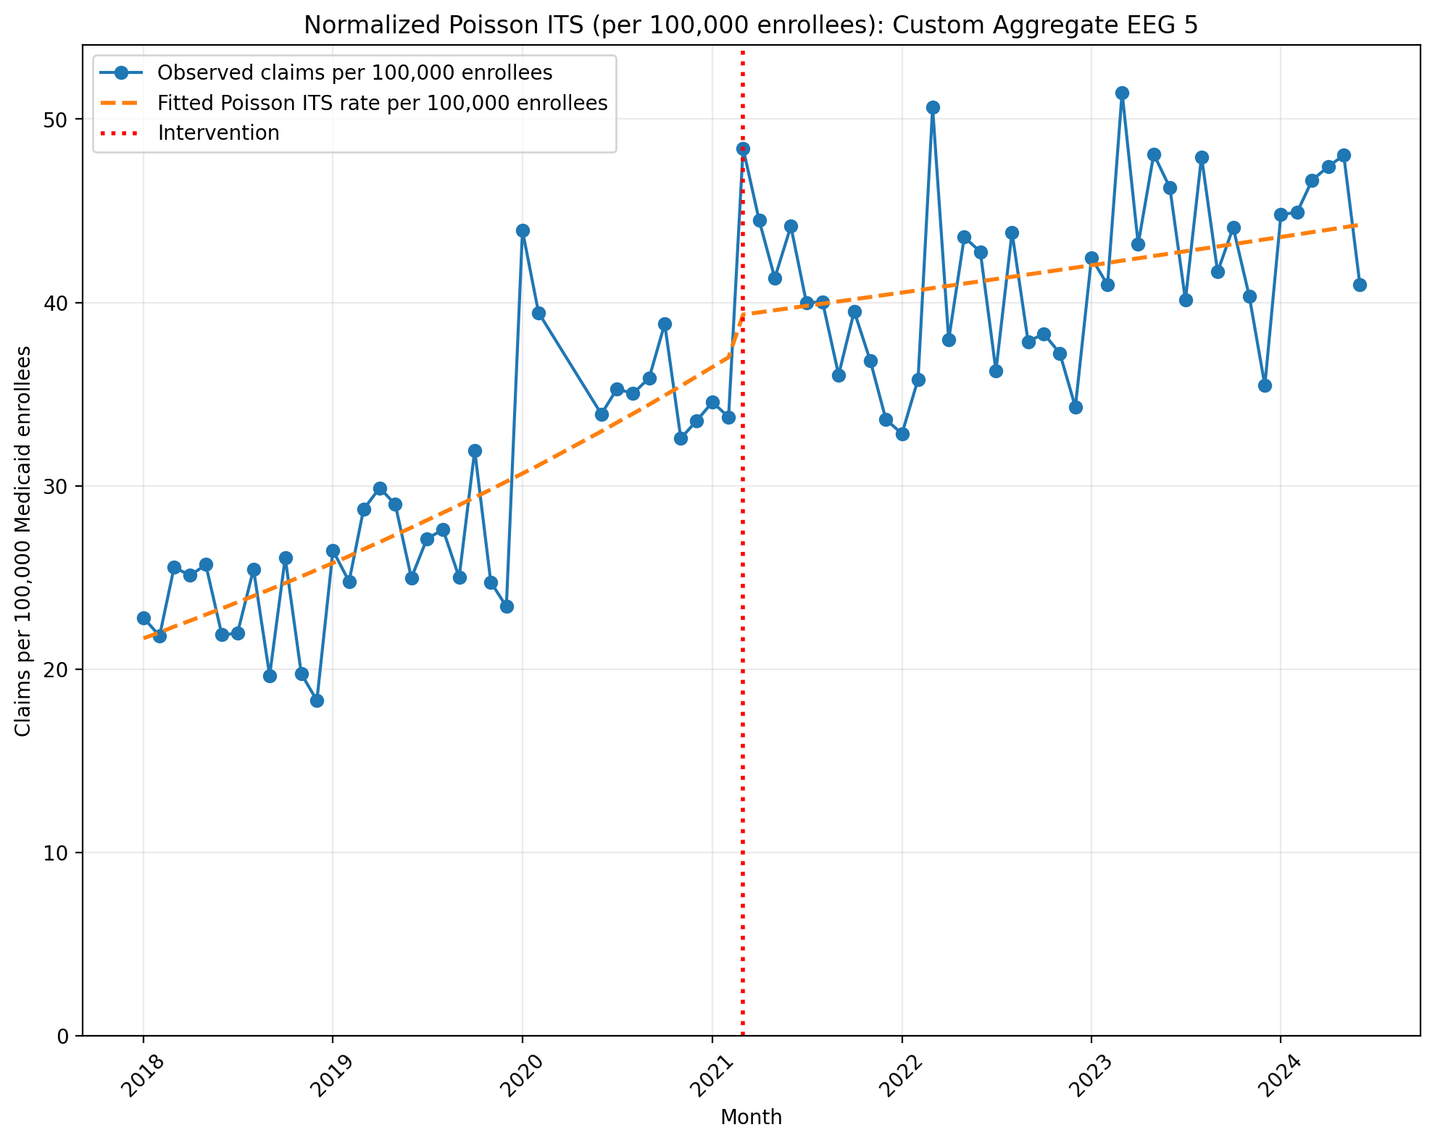
Normalized Poisson ITS (per 100,000 enrollees): Custom Aggregate EEG 5
Generalized Linear Model Regression Results
==============================================================================
Dep. Variable: y No. Observations: 75
Model: GLM Df Residuals: 71
Model Family: Poisson Df Model: 3
Link Function: Log Scale: 1.0000
Method: IRLS Log-Likelihood: -16783.
Date: Mon, 11 May 2026 Deviance: 32656.
Time: 17:47:55 Pearson chi2: 3.30e+04
No. Iterations: 5 Pseudo R-squ. (CS): 1.000
Covariance Type: nonrobust
==============================================================================
coef std err z P>|z| [0.025 0.975]
------------------------------------------------------------------------------
const -8.4367 0.002 -3656.450 0.000 -8.441 -8.432
T 0.0145 0.000 143.681 0.000 0.014 0.015
X_t 0.0581 0.003 21.791 0.000 0.053 0.063
post_time -0.0115 0.000 -93.000 0.000 -0.012 -0.011
==============================================================================
Codes in aggregation: 95812, 95813, 95816, 95819, 95700, 95720

Slide 11
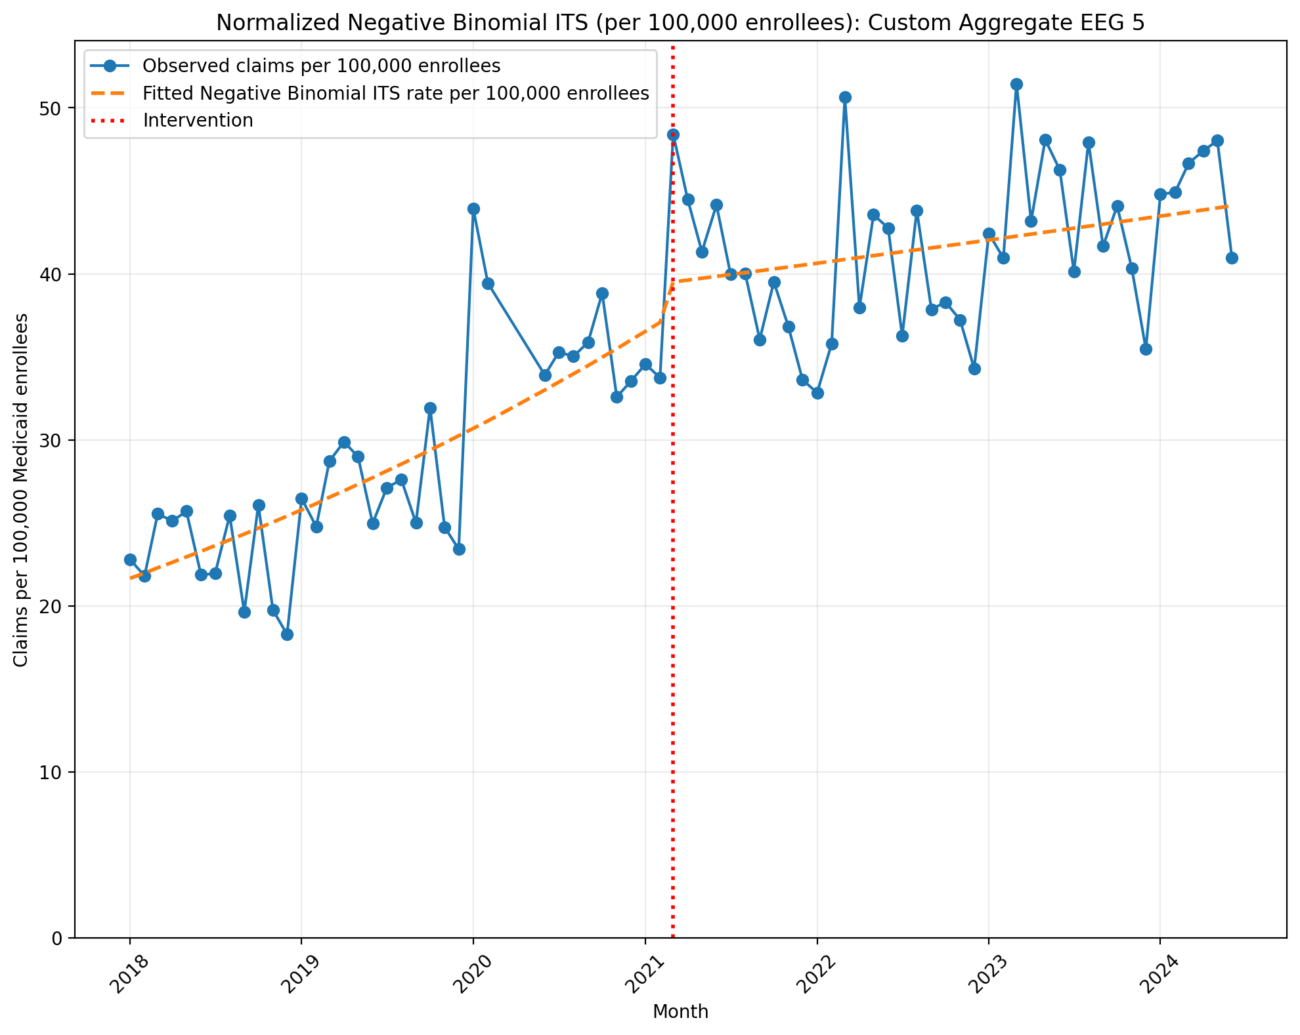
Normalized Negative Binomial ITS (per 100,000 enrollees): Custom Aggregate EEG 5
NegativeBinomial Regression Results
==============================================================================
Dep. Variable: y No. Observations: 75
Model: NegativeBinomial Df Residuals: 71
Method: MLE Df Model: 3
Date: Mon, 11 May 2026 Pseudo R-squ.: 0.07032
Time: 17:47:56 Log-Likelihood: -720.97
converged: True LL-Null: -775.51
Covariance Type: nonrobust LLR p-value: 1.743e-23
==============================================================================
coef std err z P>|z| [0.025 0.975]
------------------------------------------------------------------------------
const -8.4379 0.039 -215.476 0.000 -8.515 -8.361
T 0.0145 0.002 7.791 0.000 0.011 0.018
X_t 0.0609 0.057 1.067 0.286 -0.051 0.173
post_time -0.0117 0.003 -4.688 0.000 -0.017 -0.007
alpha 0.0151 0.002 6.123 0.000 0.010 0.020
==============================================================================
Codes in aggregation: 95812, 95813, 95816, 95819, 95700, 95720

Slide 12
ECG

Slide 13
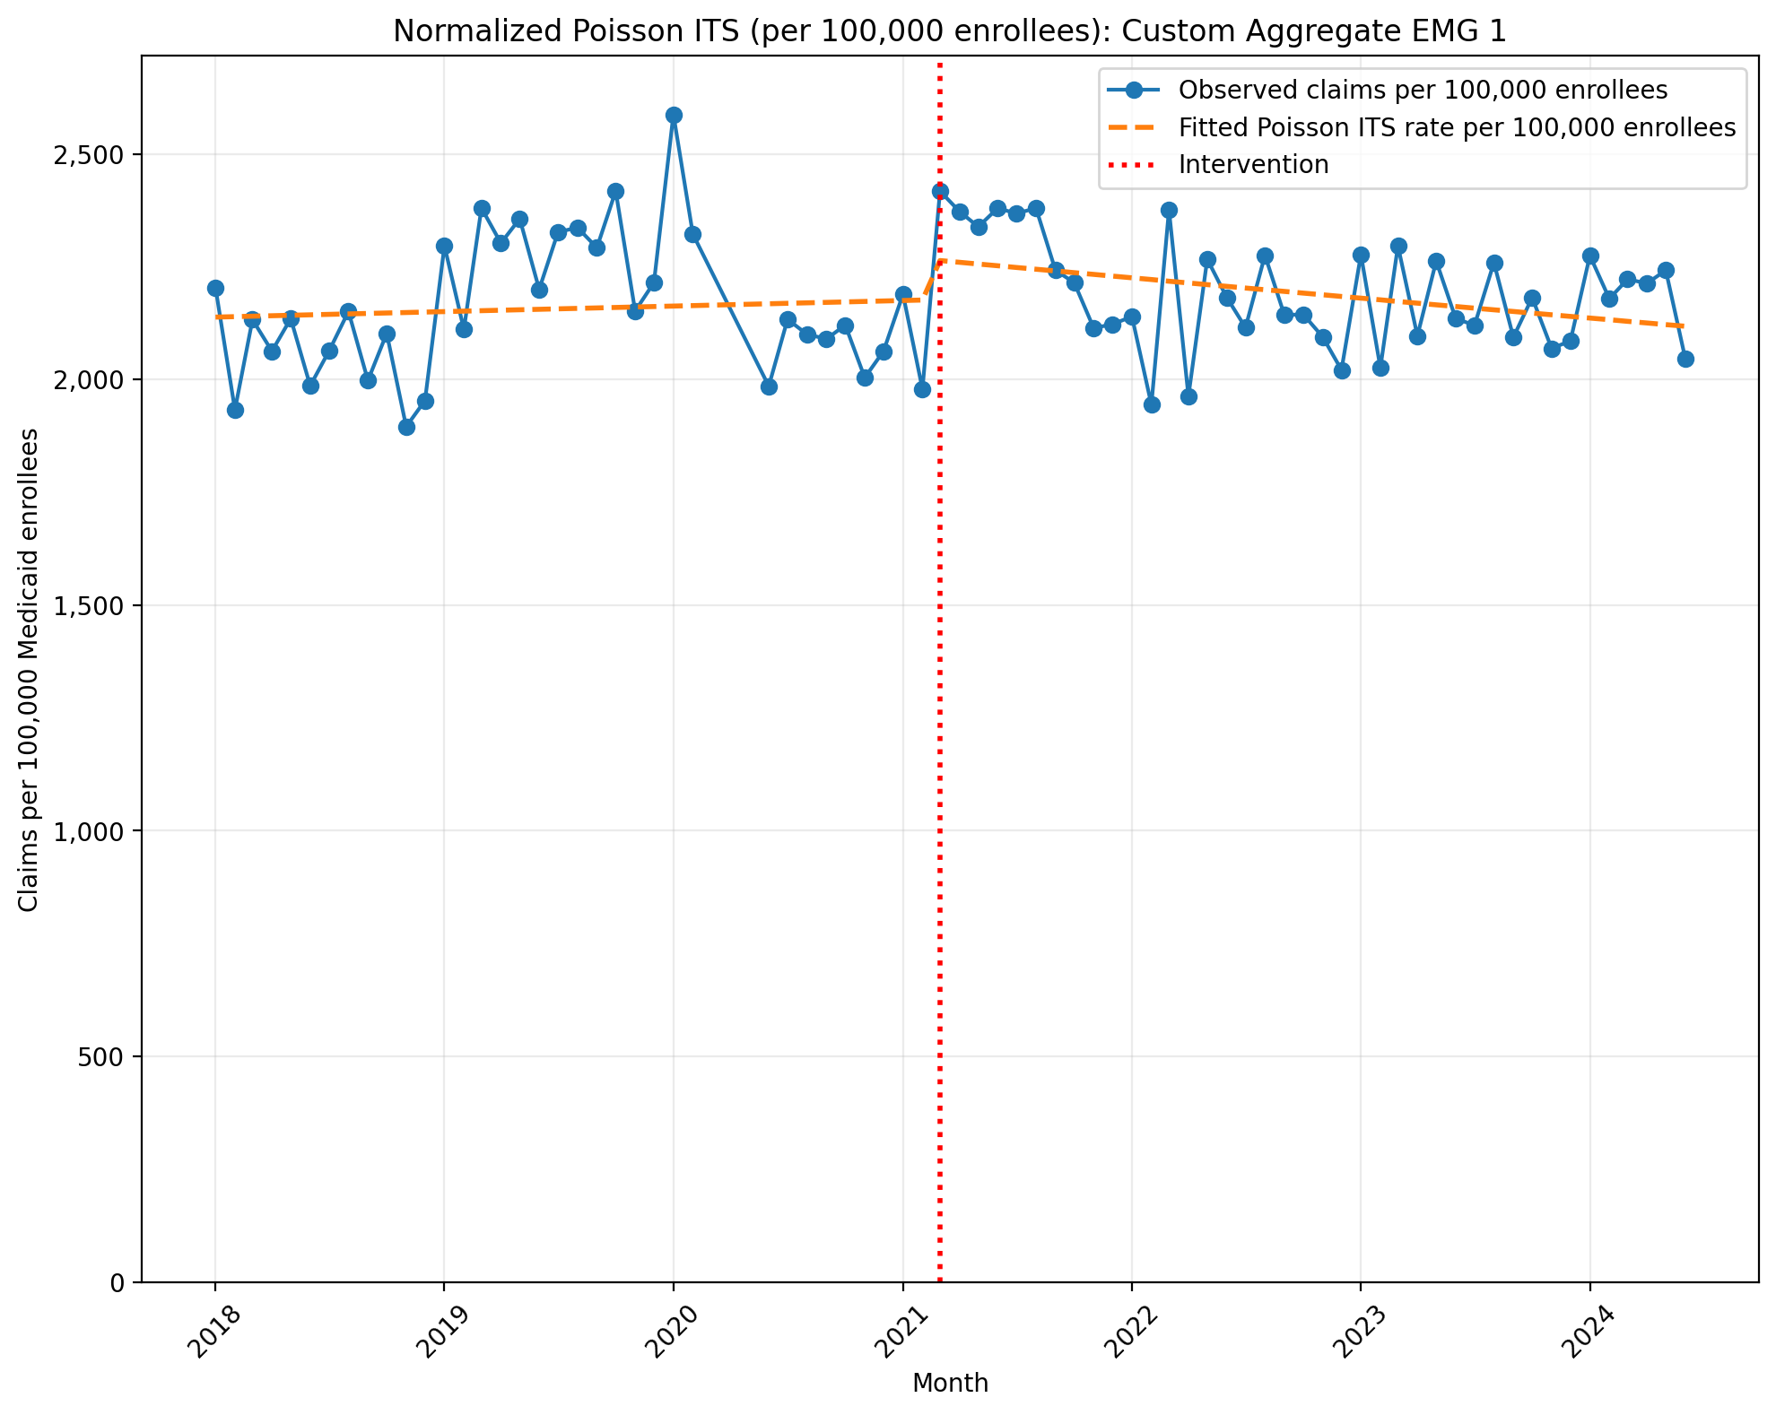
Normalized Poisson ITS (per 100,000 enrollees): Custom Aggregate ECG 1
Generalized Linear Model Regression Results
==============================================================================
Dep. Variable: y No. Observations: 75
Model: GLM Df Residuals: 71
Model Family: Poisson Df Model: 3
Link Function: Log Scale: 1.0000
Method: IRLS Log-Likelihood: -2.5244e+05
Date: Mon, 11 May 2026 Deviance: 5.0367e+05
Time: 17:48:52 Pearson chi2: 5.05e+05
No. Iterations: 4 Pseudo R-squ. (CS): 1.000
Covariance Type: nonrobust
==============================================================================
coef std err z P>|z| [0.025 0.975]
------------------------------------------------------------------------------
const -3.8451 0.000 -1.55e+04 0.000 -3.846 -3.845
T 0.0005 1.16e-05 40.861 0.000 0.000 0.000
X_t 0.0411 0.000 120.300 0.000 0.040 0.042
post_time -0.0022 1.52e-05 -143.551 0.000 -0.002 -0.002
==============================================================================
Codes in aggregation: 93000, 93005, 93010

Slide 14
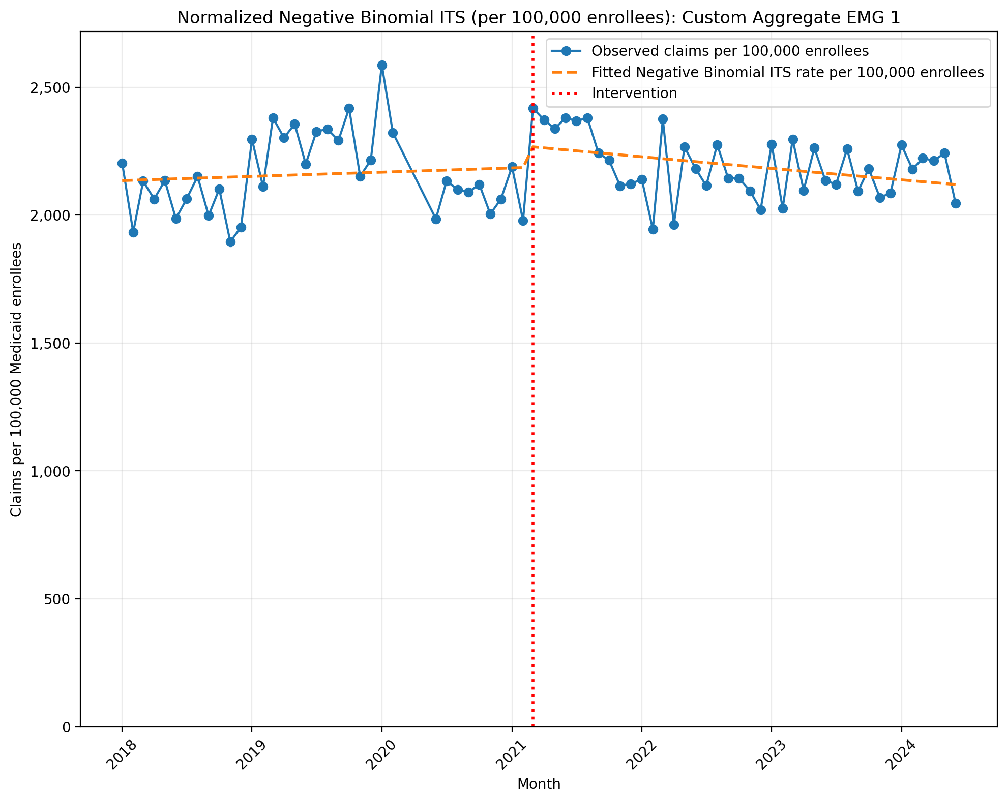
Normalized Negative Binomial ITS (per 100,000 enrollees): Custom Aggregate ECG 1
NegativeBinomial Regression Results
==============================================================================
Dep. Variable: y No. Observations: 75
Model: NegativeBinomial Df Residuals: 71
Method: MLE Df Model: 3
Date: Mon, 11 May 2026 Pseudo R-squ.: 0.002916
Time: 17:48:52 Log-Likelihood: -978.97
converged: False LL-Null: -981.84
Covariance Type: nonrobust LLR p-value: 0.1257
==============================================================================
coef std err z P>|z| [0.025 0.975]
------------------------------------------------------------------------------
const -3.8466 0.020 -195.694 0.000 -3.885 -3.808
T 0.0006 0.001 0.673 0.501 -0.001 0.002
X_t 0.0381 0.029 1.335 0.182 -0.018 0.094
post_time -0.0024 0.001 -1.879 0.060 -0.005 0.000
alpha 0.0037 0.001 6.127 0.000 0.003 0.005
==============================================================================
Codes in aggregation: 93000, 93005, 93010

Slide 15
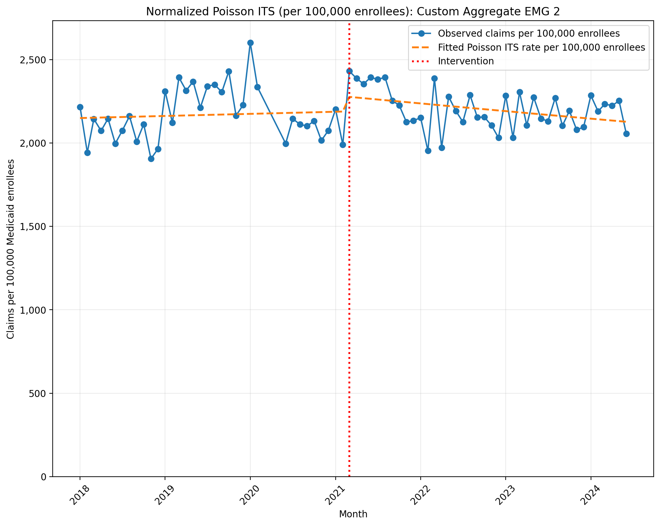
Normalized Poisson ITS (per 100,000 enrollees): Custom Aggregate ECG 2
Generalized Linear Model Regression Results
==============================================================================
Dep. Variable: y No. Observations: 75
Model: GLM Df Residuals: 71
Model Family: Poisson Df Model: 3
Link Function: Log Scale: 1.0000
Method: IRLS Log-Likelihood: -2.5455e+05
Date: Mon, 11 May 2026 Deviance: 5.0789e+05
Time: 17:50:32 Pearson chi2: 5.09e+05
No. Iterations: 4 Pseudo R-squ. (CS): 1.000
Covariance Type: nonrobust
==============================================================================
coef std err z P>|z| [0.025 0.975]
------------------------------------------------------------------------------
const -3.8397 0.000 -1.55e+04 0.000 -3.840 -3.839
T 0.0005 1.16e-05 41.968 0.000 0.000 0.001
X_t 0.0412 0.000 120.724 0.000 0.040 0.042
post_time -0.0022 1.51e-05 -146.868 0.000 -0.002 -0.002
==============================================================================
Codes in aggregation: 93042, 93000, 93005, 93010

Slide 16

Normalized Negative Binomial ITS (per 100,000 enrollees): Custom Aggregate ECG 2
NegativeBinomial Regression Results
==============================================================================
Dep. Variable: y No. Observations: 75
Model: NegativeBinomial Df Residuals: 71
Method: MLE Df Model: 3
Date: Mon, 11 May 2026 Pseudo R-squ.: 0.002963
Time: 17:50:32 Log-Likelihood: -979.48
converged: False LL-Null: -982.39
Covariance Type: nonrobust LLR p-value: 0.1206
==============================================================================
coef std err z P>|z| [0.025 0.975]
------------------------------------------------------------------------------
const -3.8412 0.020 -195.147 0.000 -3.880 -3.803
T 0.0006 0.001 0.685 0.493 -0.001 0.002
X_t 0.0381 0.029 1.334 0.182 -0.018 0.094
post_time -0.0024 0.001 -1.912 0.056 -0.005 6.08e-05
alpha 0.0037 0.001 6.126 0.000 0.003 0.005
==============================================================================
Codes in aggregation: 93042, 93000, 93005, 93010

Slide 17
EMG

Slide 18
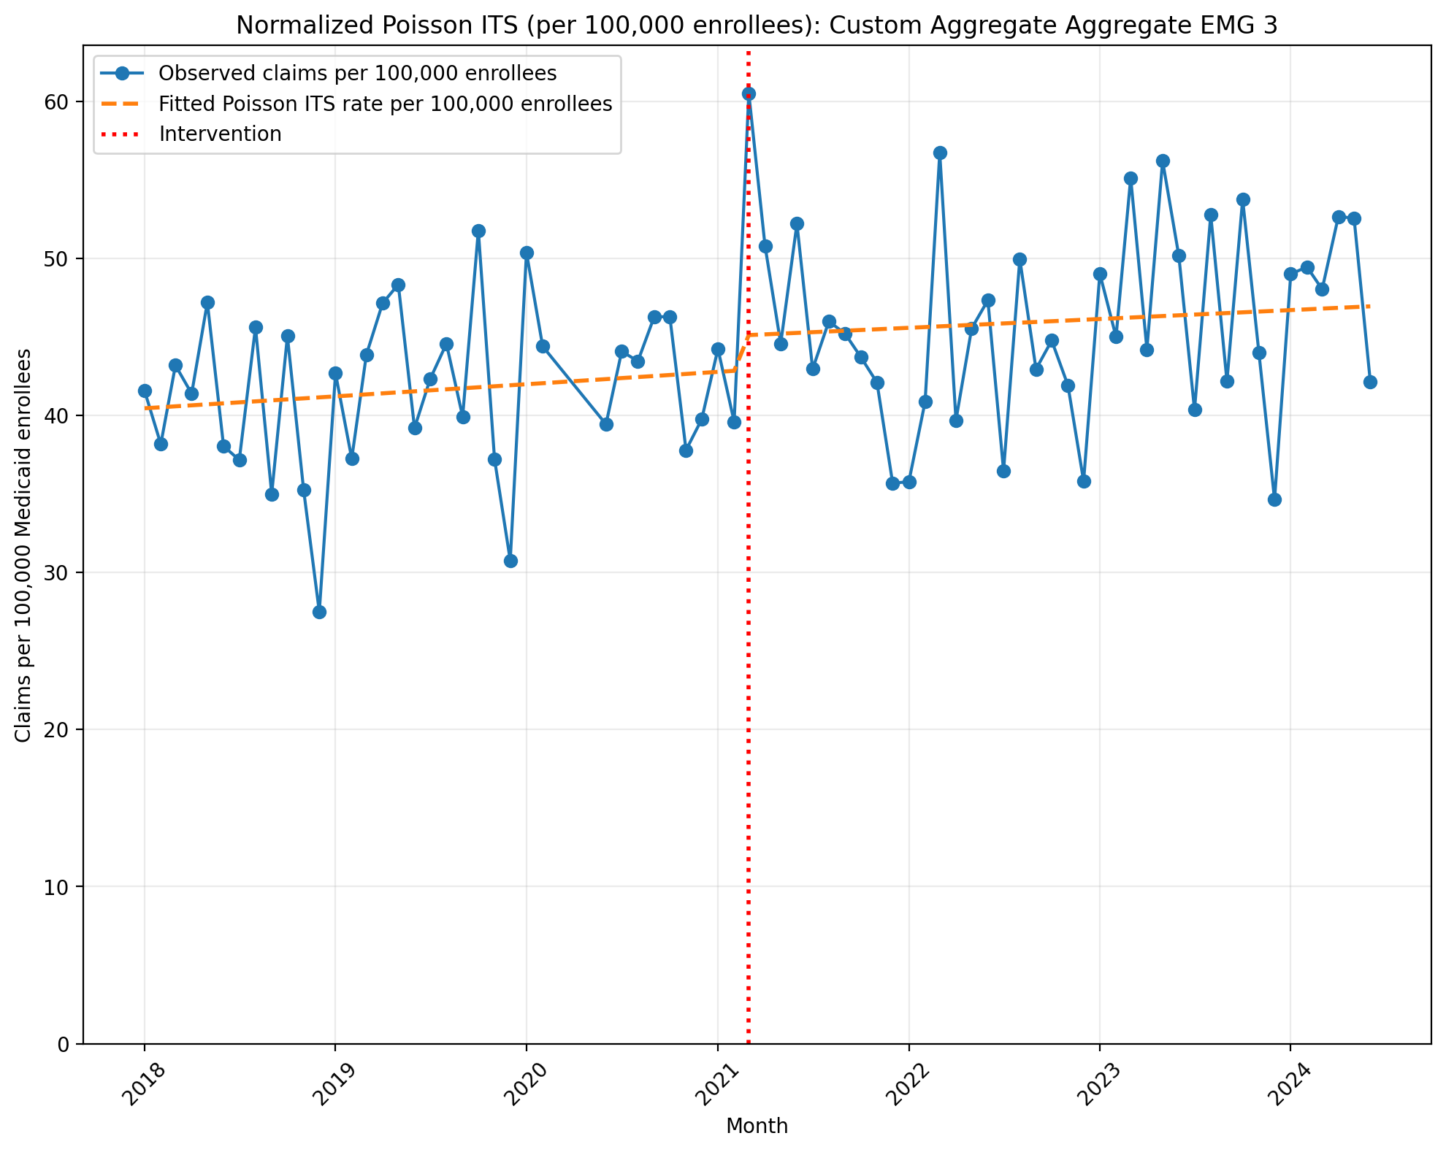
Normalized Poisson ITS (per 100,000 enrollees): Custom Aggregate EMG 3
Generalized Linear Model Regression Results
==============================================================================
Dep. Variable: y No. Observations: 75
Model: GLM Df Residuals: 71
Model Family: Poisson Df Model: 3
Link Function: Log Scale: 1.0000
Method: IRLS Log-Likelihood: -24624.
Date: Thu, 07 May 2026 Deviance: 48320.
Time: 21:48:07 Pearson chi2: 4.79e+04
No. Iterations: 4 Pseudo R-squ. (CS): 1.000
Covariance Type: nonrobust
==============================================================================
coef std err z P>|z| [0.025 0.975]
------------------------------------------------------------------------------
const -7.8128 0.002 -4356.798 0.000 -7.816 -7.809
T 0.0015 8.34e-05 18.556 0.000 0.001 0.002
X_t 0.0508 0.002 20.953 0.000 0.046 0.055
post_time -0.0005 0.000 -4.920 0.000 -0.001 -0.000
==============================================================================
Codes in aggregation: 95885, 95886, 95887, 95907, 95908, 95909, 95910, 95911, 95912, 95913

Slide 19
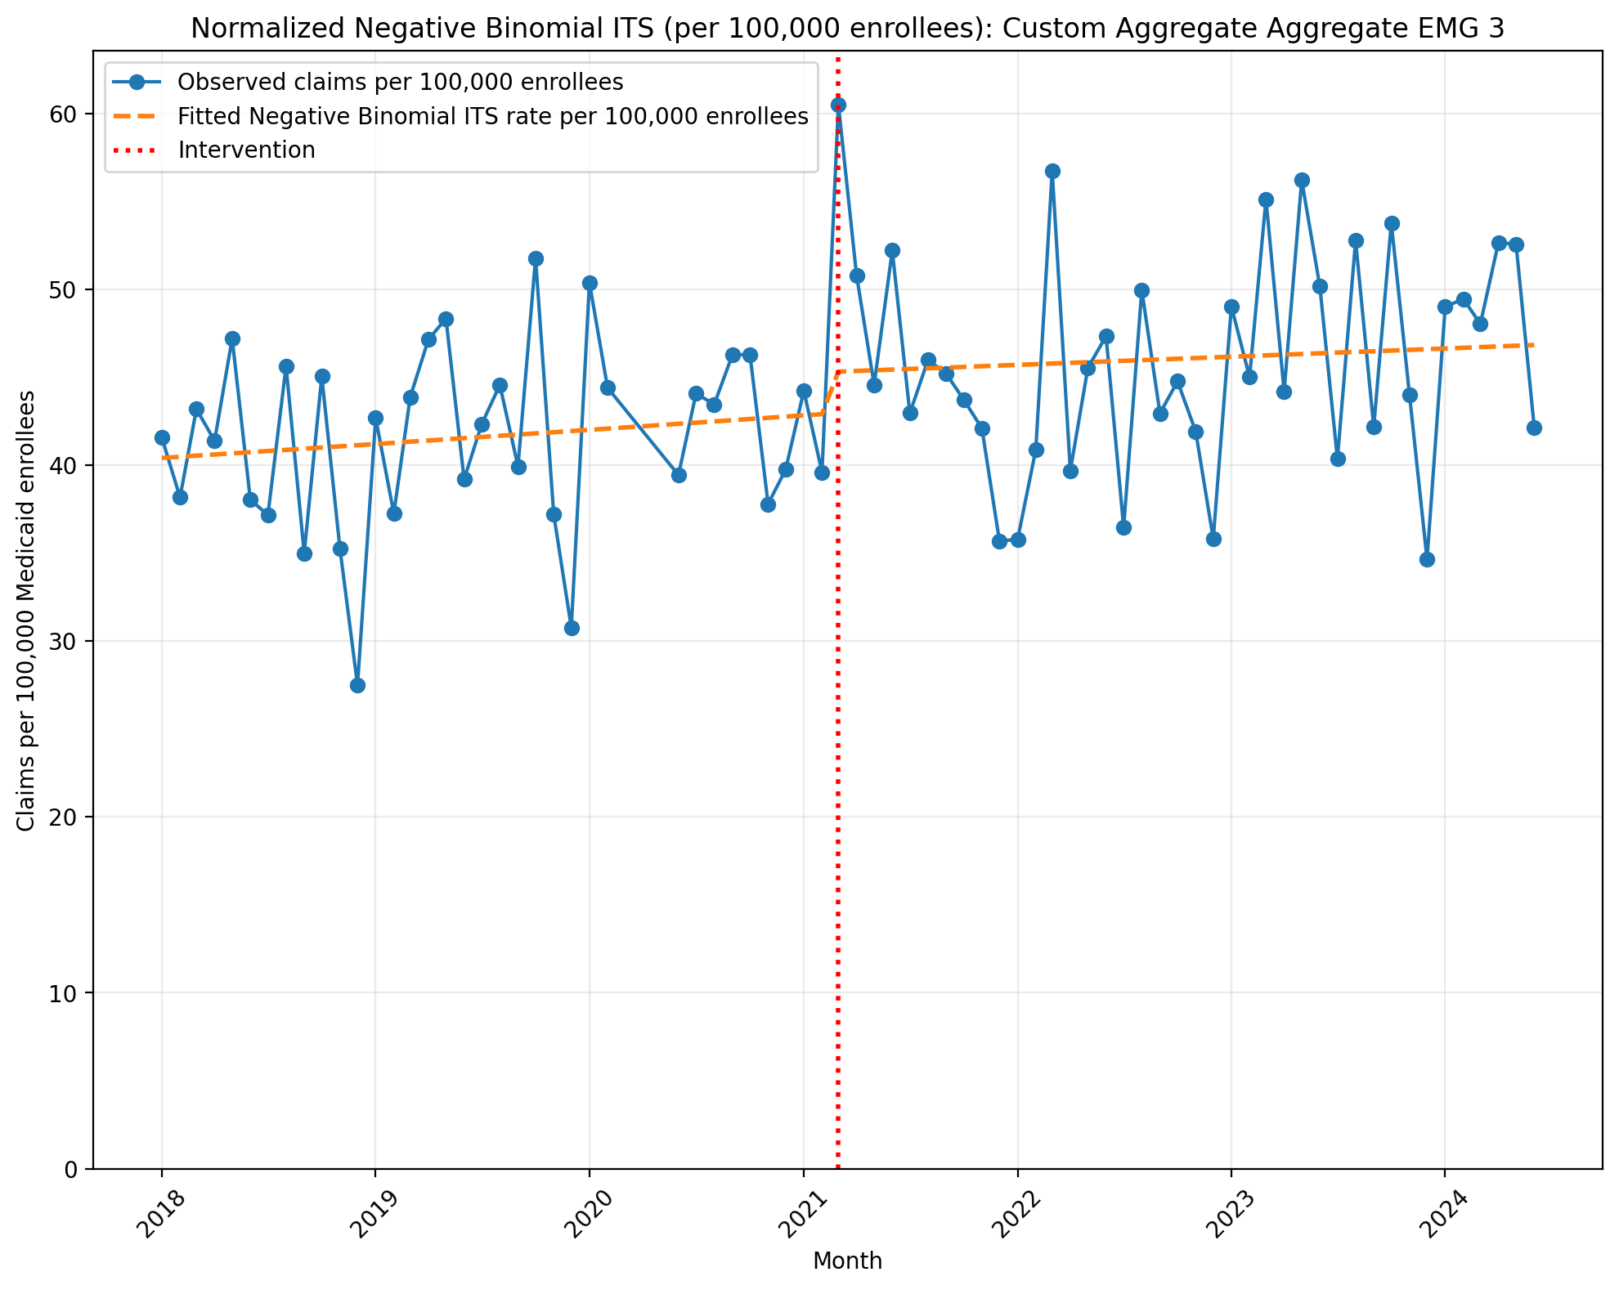
Normalized Negative Binomial ITS (per 100,000 enrollees): Custom Aggregate EMG 3
NegativeBinomial Regression Results
==============================================================================
Dep. Variable: y No. Observations: 75
Model: NegativeBinomial Df Residuals: 71
Method: MLE Df Model: 3
Date: Thu, 07 May 2026 Pseudo R-squ.: 0.007508
Time: 21:48:07 Log-Likelihood: -743.57
converged: True LL-Null: -749.20
Covariance Type: nonrobust LLR p-value: 0.01045
==============================================================================
coef std err z P>|z| [0.025 0.975]
------------------------------------------------------------------------------
const -7.8138 0.042 -186.264 0.000 -7.896 -7.732
T 0.0016 0.002 0.807 0.419 -0.002 0.006
X_t 0.0540 0.061 0.885 0.376 -0.066 0.174
post_time -0.0008 0.003 -0.290 0.772 -0.006 0.004
alpha 0.0173 0.003 6.131 0.000 0.012 0.023
==============================================================================
Codes in aggregation: 95885, 95886, 95887, 95907, 95908, 95909, 95910, 95911, 95912, 95913

