Slide 1
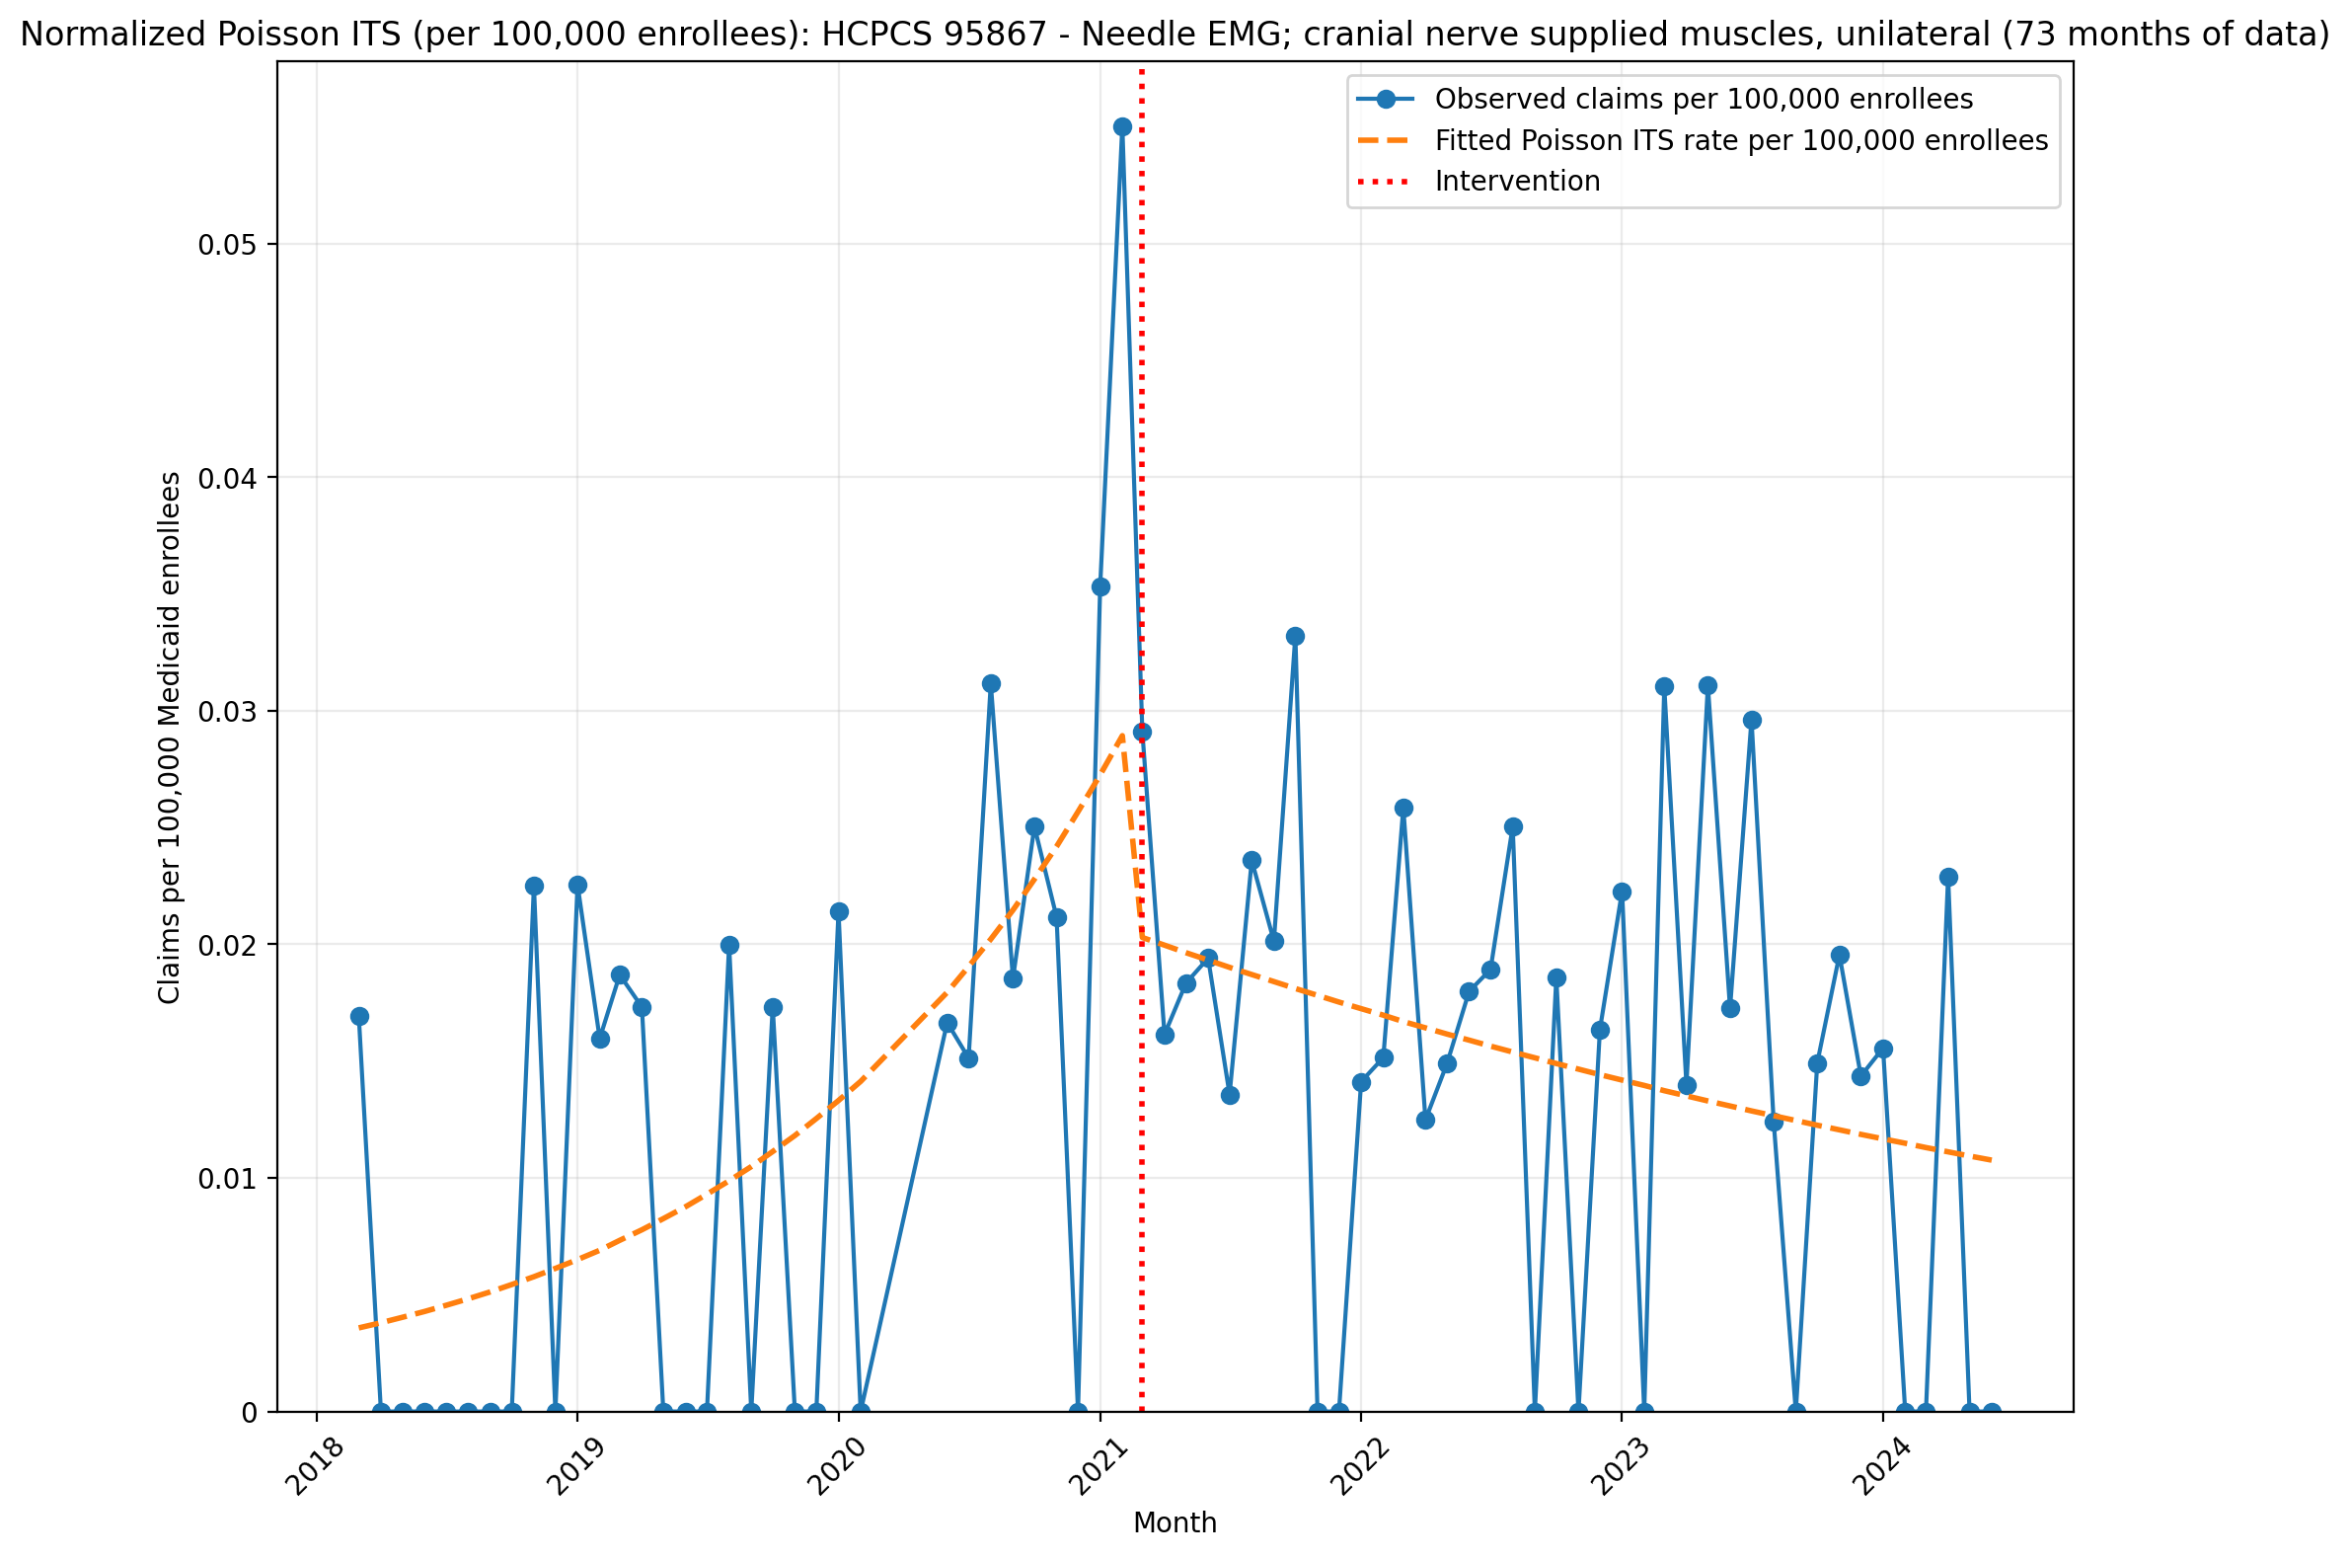
Normalized Poisson ITS (per 100,000 enrollees): HCPCS 95867 - Needle EMG; cranial nerve supplied muscles, unilateral (73 months of data)
Generalized Linear Model Regression Results
==============================================================================
Dep. Variable: y No. Observations: 73
Model: GLM Df Residuals: 69
Model Family: Poisson Df Model: 3
Link Function: Log Scale: 1.0000
Method: IRLS Log-Likelihood: -448.76
Date: Thu, 07 May 2026 Deviance: 676.09
Time: 21:44:55 Pearson chi2: 533.
No. Iterations: 5 Pseudo R-squ. (CS): 0.8650
Covariance Type: nonrobust
==============================================================================
coef std err z P>|z| [0.025 0.975]
------------------------------------------------------------------------------
const -17.1455 0.148 -115.708 0.000 -17.436 -16.855
T 0.0597 0.006 10.354 0.000 0.048 0.071
X_t -0.3385 0.119 -2.851 0.004 -0.571 -0.106
post_time -0.0760 0.007 -11.026 0.000 -0.089 -0.062
==============================================================================

Slide 2
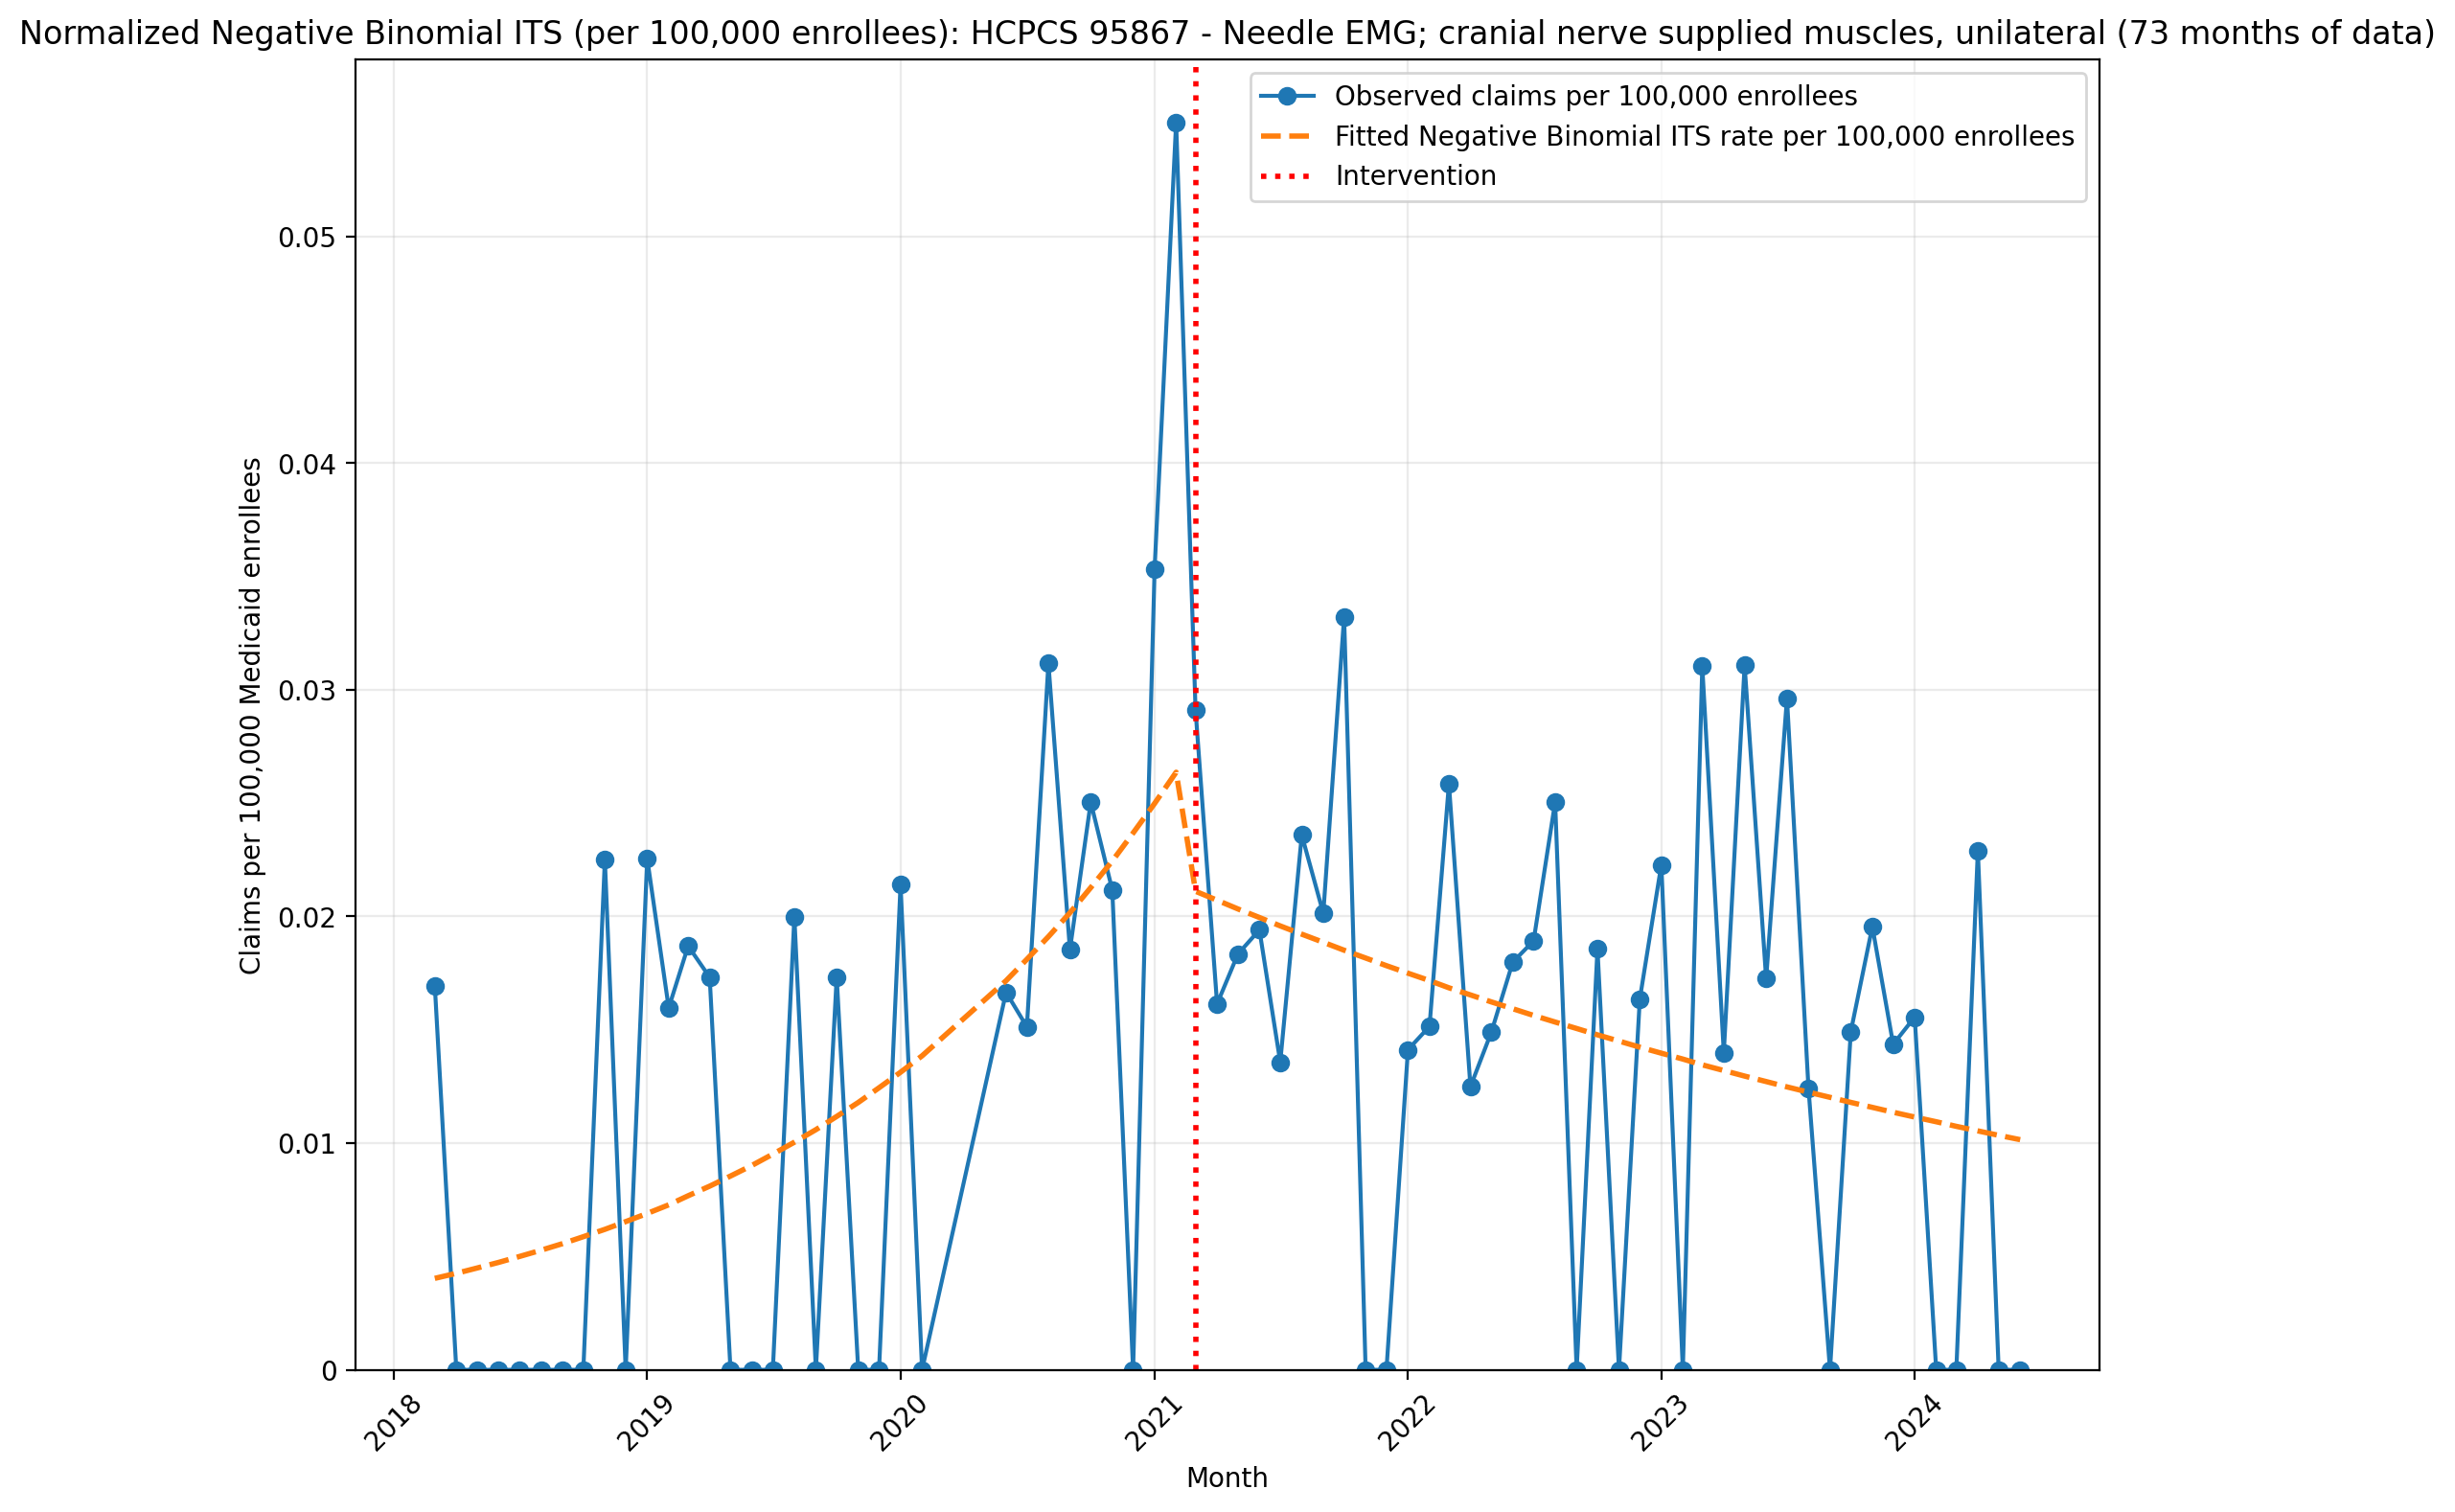
Normalized Negative Binomial ITS (per 100,000 enrollees): HCPCS 95867 - Needle EMG; cranial nerve supplied muscles, unilateral (73 months of data)
NegativeBinomial Regression Results
==============================================================================
Dep. Variable: y No. Observations: 73
Model: NegativeBinomial Df Residuals: 69
Method: MLE Df Model: 3
Date: Thu, 07 May 2026 Pseudo R-squ.: 0.01298
Time: 21:44:55 Log-Likelihood: -243.16
converged: True LL-Null: -246.36
Covariance Type: nonrobust LLR p-value: 0.09378
==============================================================================
coef std err z P>|z| [0.025 0.975]
------------------------------------------------------------------------------
const -17.0256 0.472 -36.099 0.000 -17.950 -16.101
T 0.0536 0.023 2.325 0.020 0.008 0.099
X_t -0.2035 0.680 -0.299 0.765 -1.537 1.130
post_time -0.0724 0.031 -2.333 0.020 -0.133 -0.012
alpha 1.9693 0.416 4.733 0.000 1.154 2.785
==============================================================================

Slide 3
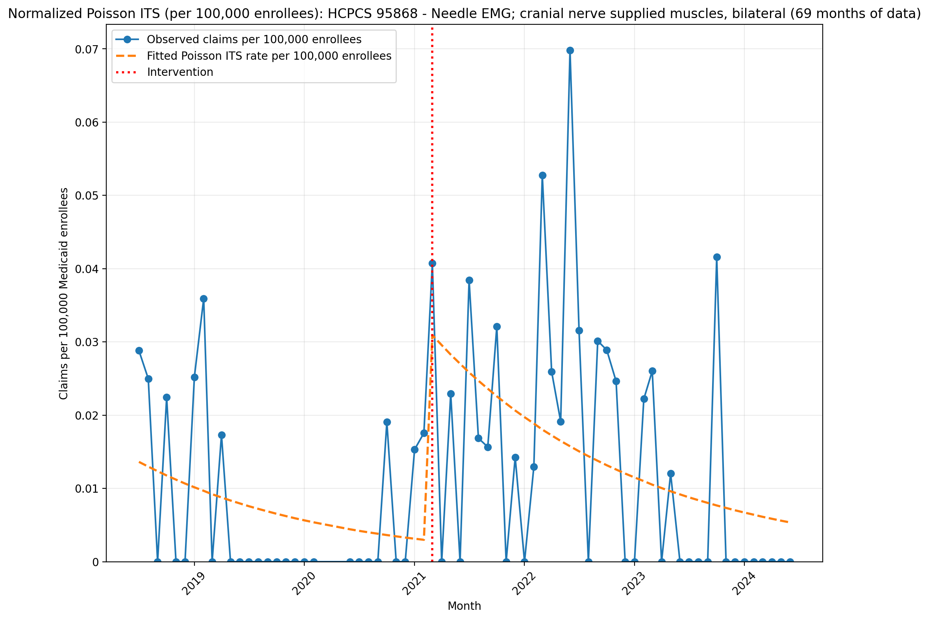
Normalized Poisson ITS (per 100,000 enrollees): HCPCS 95868 - Needle EMG; cranial nerve supplied muscles, bilateral (69 months of data)
Generalized Linear Model Regression Results
==============================================================================
Dep. Variable: y No. Observations: 69
Model: GLM Df Residuals: 65
Model Family: Poisson Df Model: 3
Link Function: Log Scale: 1.0000
Method: IRLS Log-Likelihood: -610.32
Date: Thu, 07 May 2026 Deviance: 1077.5
Time: 21:44:56 Pearson chi2: 1.08e+03
No. Iterations: 5 Pseudo R-squ. (CS): 0.9658
Covariance Type: nonrobust
==============================================================================
coef std err z P>|z| [0.025 0.975]
------------------------------------------------------------------------------
const -15.8087 0.126 -125.016 0.000 -16.057 -15.561
T -0.0489 0.009 -5.462 0.000 -0.066 -0.031
X_t 2.3816 0.209 11.379 0.000 1.971 2.792
post_time 0.0040 0.010 0.405 0.685 -0.015 0.023
==============================================================================

Slide 4
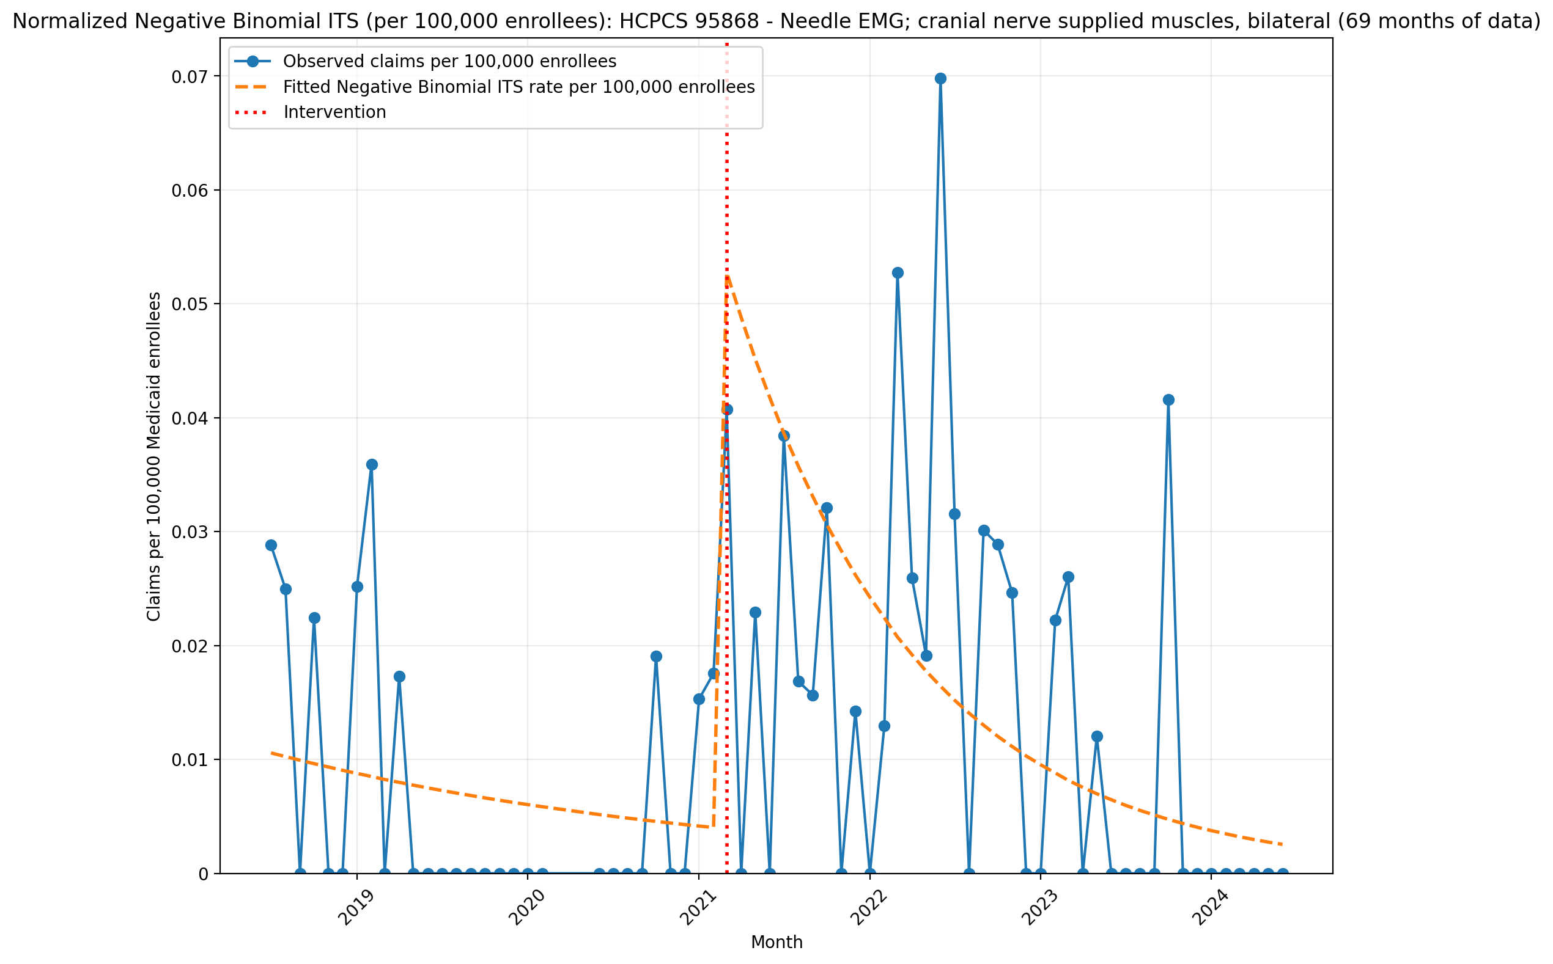
Normalized Negative Binomial ITS (per 100,000 enrollees): HCPCS 95868 - Needle EMG; cranial nerve supplied muscles, bilateral (69 months of data)
NegativeBinomial Regression Results
==============================================================================
Dep. Variable: y No. Observations: 69
Model: NegativeBinomial Df Residuals: 65
Method: MLE Df Model: 3
Date: Thu, 07 May 2026 Pseudo R-squ.: 0.01315
Time: 21:44:56 Log-Likelihood: -180.53
converged: True LL-Null: -182.94
Covariance Type: nonrobust LLR p-value: 0.1861
==============================================================================
coef std err z P>|z| [0.025 0.975]
------------------------------------------------------------------------------
const -16.0624 0.704 -22.812 0.000 -17.442 -14.682
T -0.0312 0.036 -0.854 0.393 -0.103 0.040
X_t 2.6508 1.240 2.138 0.033 0.220 5.081
post_time -0.0466 0.058 -0.806 0.420 -0.160 0.067
alpha 5.7426 1.337 4.295 0.000 3.122 8.363
==============================================================================

Slide 5
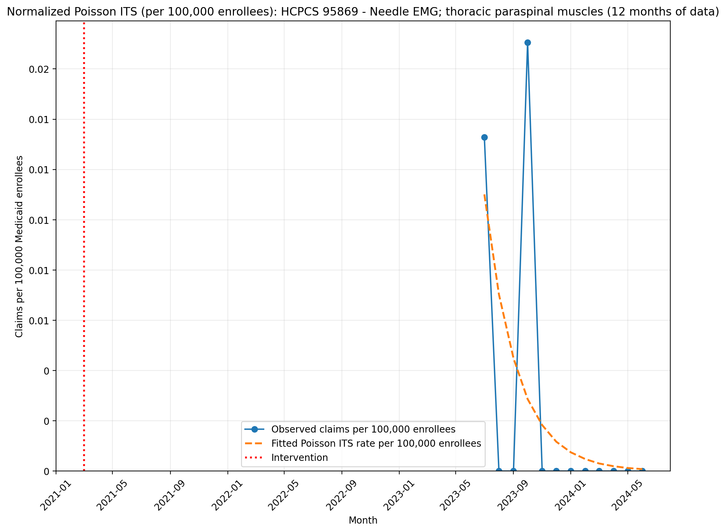
Normalized Poisson ITS (per 100,000 enrollees): HCPCS 95869 - Needle EMG; thoracic paraspinal muscles (12 months of data)
Generalized Linear Model Regression Results
==============================================================================
Dep. Variable: y No. Observations: 12
Model: GLM Df Residuals: 10
Model Family: Poisson Df Model: 1
Link Function: Log Scale: 1.0000
Method: IRLS Log-Likelihood: -35.485
Date: Thu, 07 May 2026 Deviance: 61.933
Time: 21:46:36 Pearson chi2: 81.8
No. Iterations: 6 Pseudo R-squ. (CS): 0.9628
Covariance Type: nonrobust
==============================================================================
coef std err z P>|z| [0.025 0.975]
------------------------------------------------------------------------------
T 0.1034 0.098 1.058 0.290 -0.088 0.295
X_t -0.0226 0.004 -6.333 0.000 -0.030 -0.016
post_time -0.5517 0.008 -67.239 0.000 -0.568 -0.536
==============================================================================

Slide 6
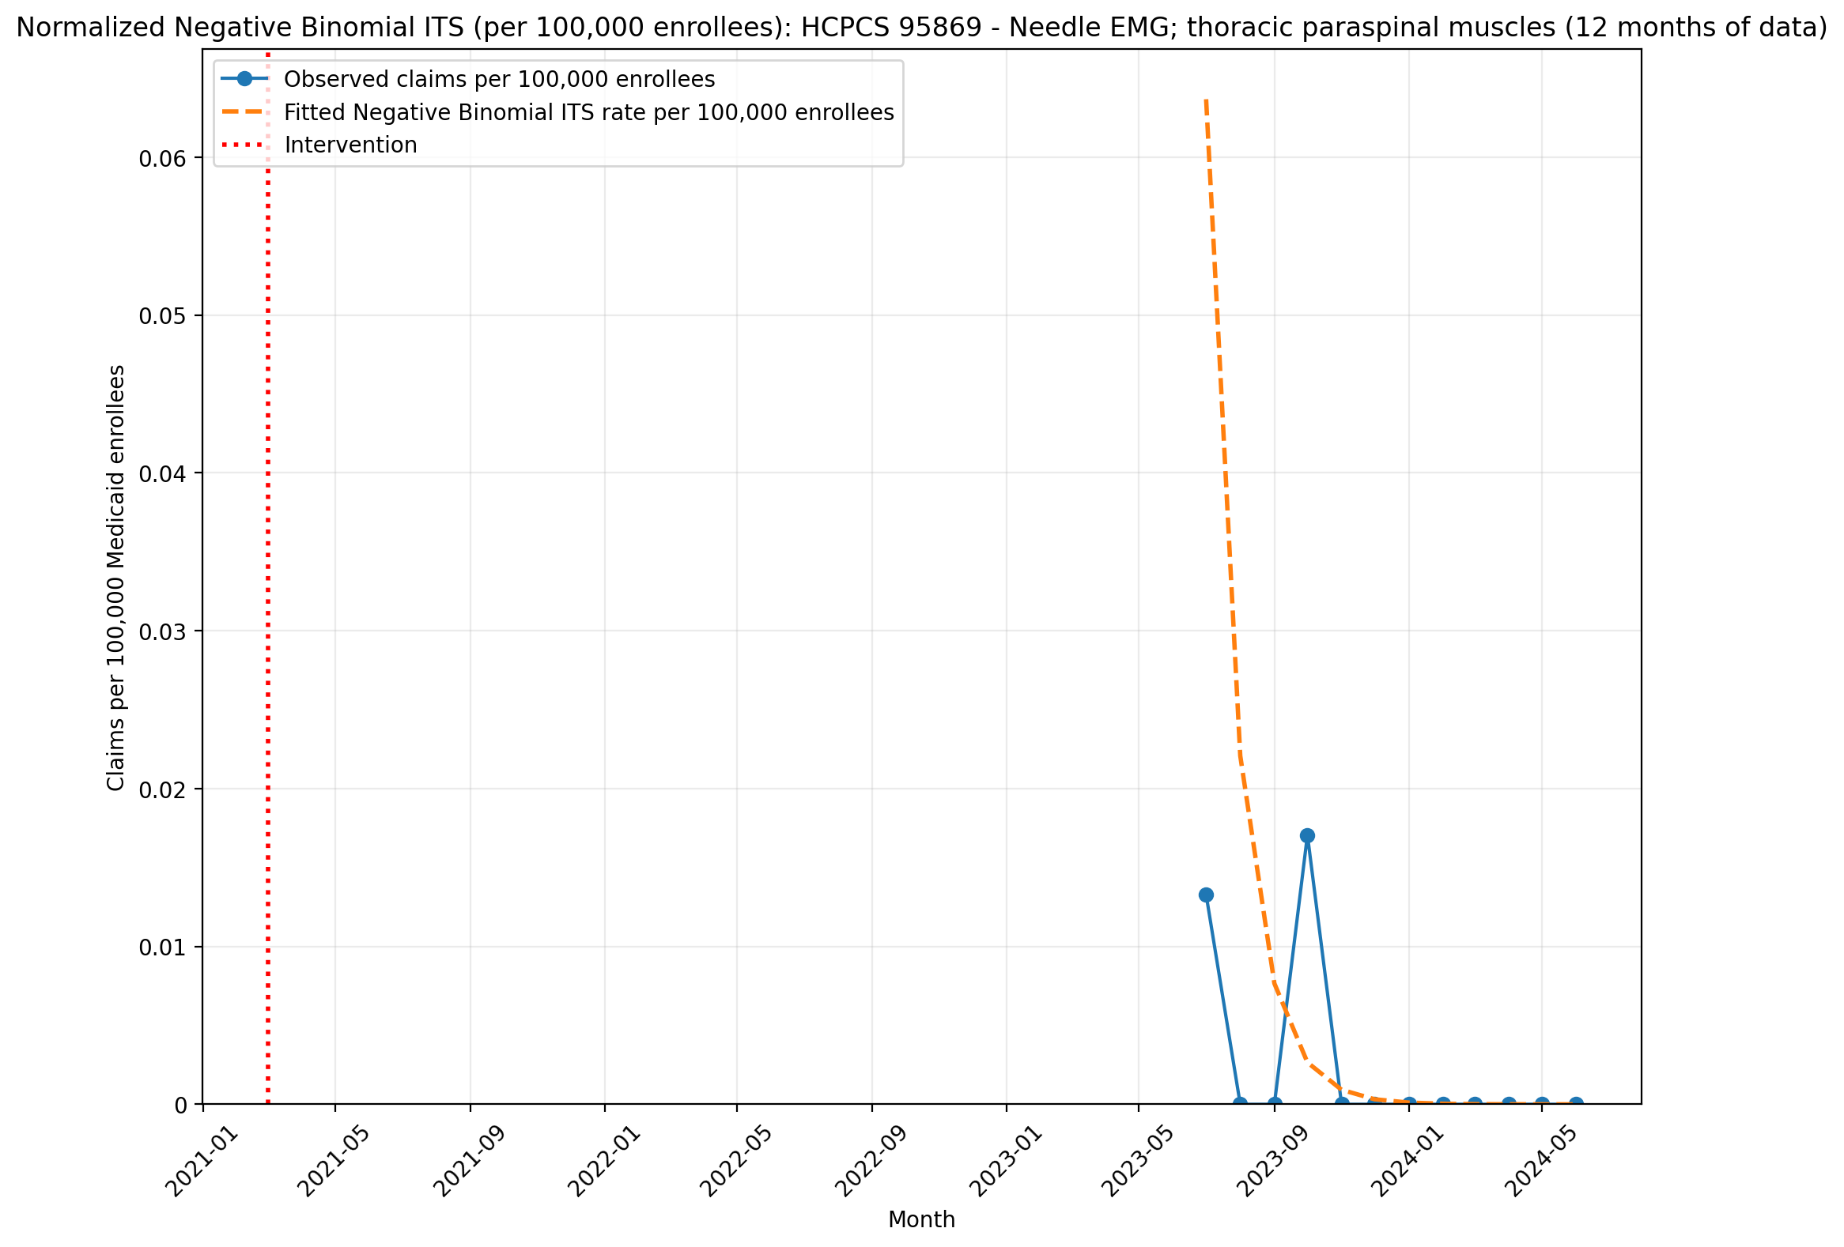
Normalized Negative Binomial ITS (per 100,000 enrollees): HCPCS 95869 - Needle EMG; thoracic paraspinal muscles (12 months of data)
NegativeBinomial Regression Results
==============================================================================
Dep. Variable: y No. Observations: 12
Model: NegativeBinomial Df Residuals: 10
Method: MLE Df Model: 1
Date: Thu, 07 May 2026 Pseudo R-squ.: 0.1117
Time: 21:46:37 Log-Likelihood: -12.361
converged: True LL-Null: -13.916
Covariance Type: nonrobust LLR p-value: 0.07785
==============================================================================
coef std err z P>|z| [0.025 0.975]
------------------------------------------------------------------------------
T -1.1689 nan nan nan nan nan
X_t -17.4489 nan nan nan nan nan
post_time 0.1097 nan nan nan nan nan
alpha 8.4992 nan nan nan nan nan
==============================================================================

Slide 8
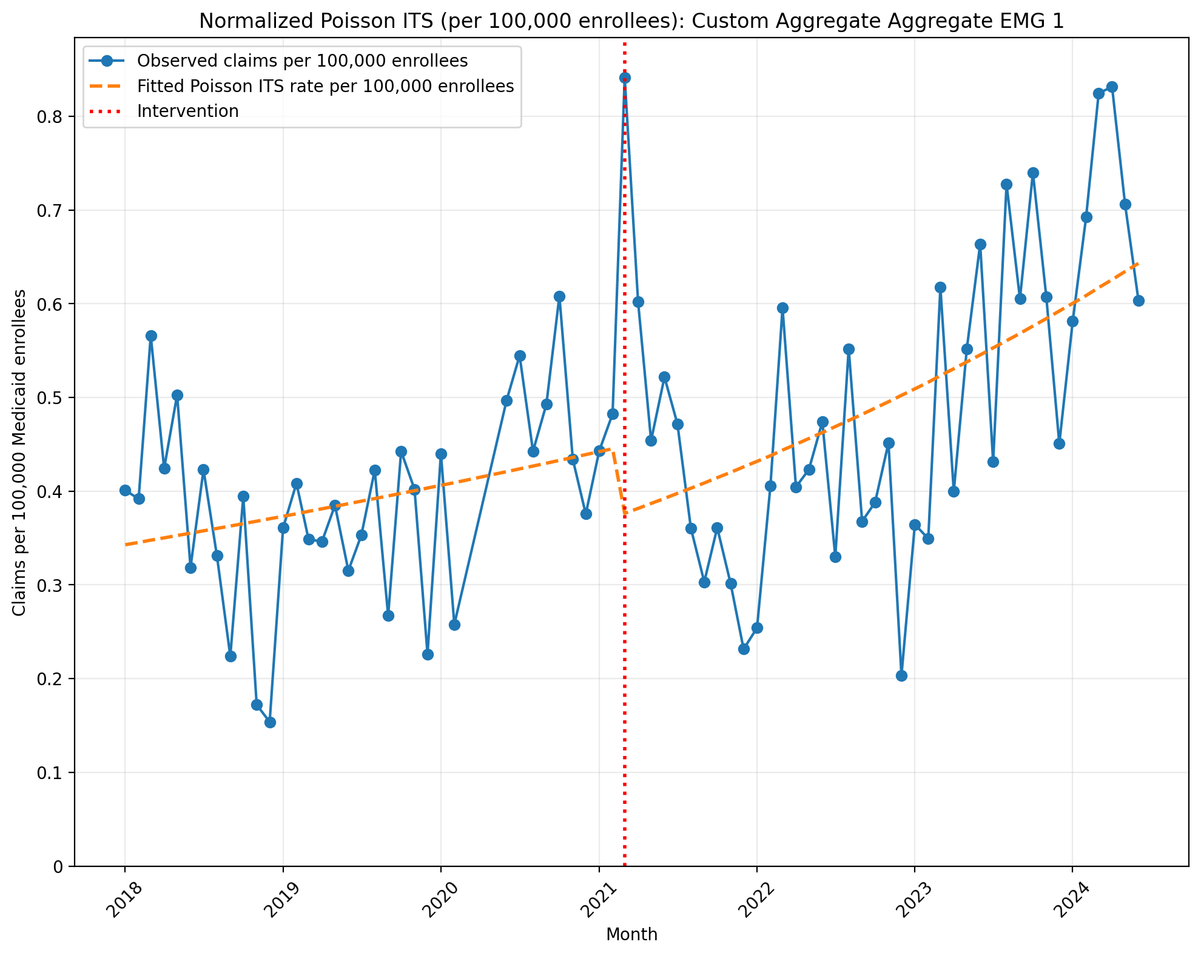
Normalized Poisson ITS (per 100,000 enrollees): Custom Aggregate Aggregate EMG 1
Generalized Linear Model Regression Results
==============================================================================
Dep. Variable: y No. Observations: 75
Model: GLM Df Residuals: 71
Model Family: Poisson Df Model: 3
Link Function: Log Scale: 1.0000
Method: IRLS Log-Likelihood: -1453.1
Date: Thu, 07 May 2026 Deviance: 2326.8
Time: 21:42:41 Pearson chi2: 2.35e+03
No. Iterations: 4 Pseudo R-squ. (CS): 1.000
Covariance Type: nonrobust
==============================================================================
coef std err z P>|z| [0.025 0.975]
------------------------------------------------------------------------------
const -12.5833 0.019 -662.499 0.000 -12.621 -12.546
T 0.0071 0.001 8.226 0.000 0.005 0.009
X_t -0.1818 0.025 -7.414 0.000 -0.230 -0.134
post_time 0.0067 0.001 6.177 0.000 0.005 0.009
==============================================================================
Codes in aggregation: 95860, 95861, 95864

Slide 9
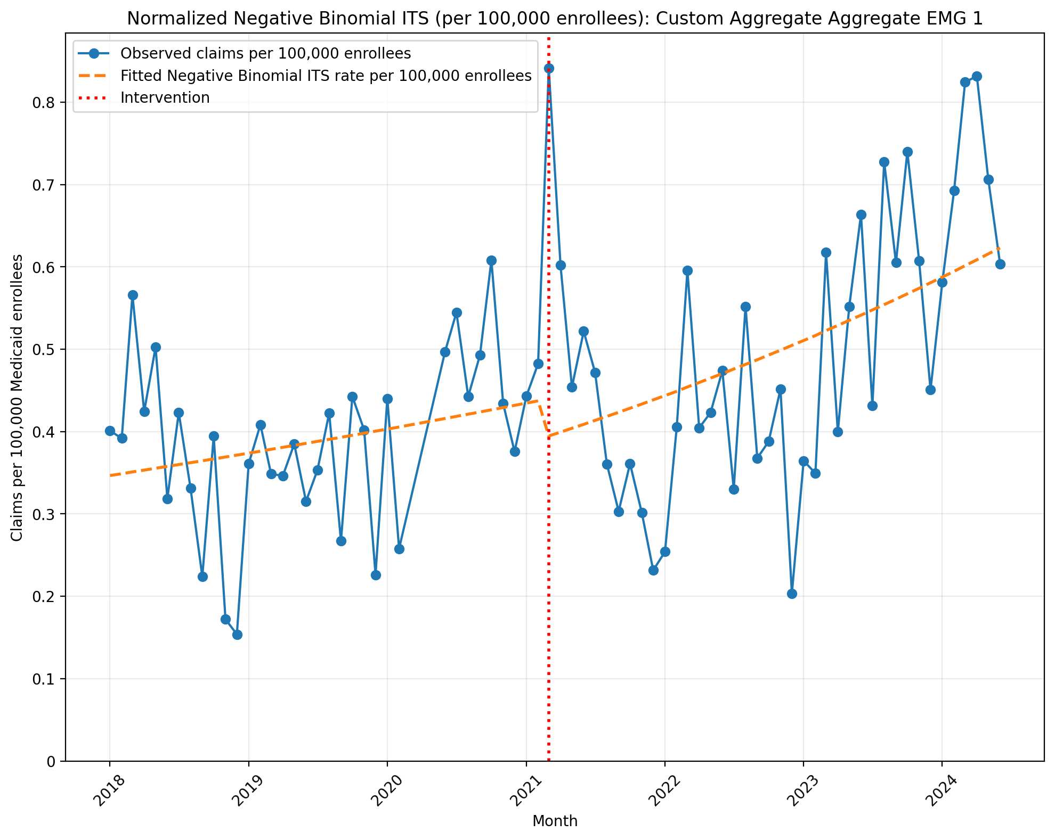
Normalized Negative Binomial ITS (per 100,000 enrollees): Custom Aggregate Aggregate EMG 1
NegativeBinomial Regression Results
==============================================================================
Dep. Variable: y No. Observations: 75
Model: NegativeBinomial Df Residuals: 71
Method: MLE Df Model: 3
Date: Thu, 07 May 2026 Pseudo R-squ.: 0.02370
Time: 21:42:41 Log-Likelihood: -457.36
converged: True LL-Null: -468.46
Covariance Type: nonrobust LLR p-value: 5.910e-05
==============================================================================
coef std err z P>|z| [0.025 0.975]
------------------------------------------------------------------------------
const -12.5724 0.091 -138.331 0.000 -12.750 -12.394
T 0.0063 0.004 1.472 0.141 -0.002 0.015
X_t -0.1143 0.131 -0.870 0.384 -0.372 0.143
post_time 0.0054 0.006 0.956 0.339 -0.006 0.017
alpha 0.0836 0.014 5.987 0.000 0.056 0.111
==============================================================================
Codes in aggregation: 95860, 95861, 95864

Slide 10
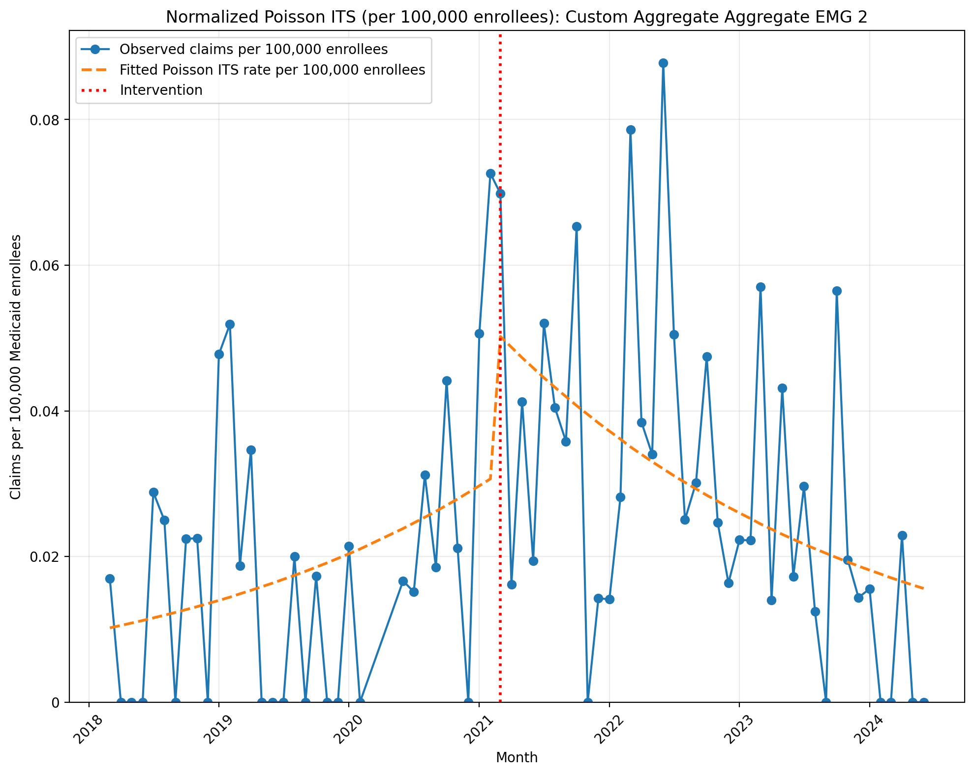
Normalized Poisson ITS (per 100,000 enrollees): Custom Aggregate Aggregate EMG 2
Generalized Linear Model Regression Results
==============================================================================
Dep. Variable: y No. Observations: 73
Model: GLM Df Residuals: 69
Model Family: Poisson Df Model: 3
Link Function: Log Scale: 1.0000
Method: IRLS Log-Likelihood: -673.91
Date: Thu, 07 May 2026 Deviance: 1074.4
Time: 21:44:13 Pearson chi2: 950.
No. Iterations: 5 Pseudo R-squ. (CS): 0.9685
Covariance Type: nonrobust
==============================================================================
coef std err z P>|z| [0.025 0.975]
------------------------------------------------------------------------------
const -16.0983 0.101 -158.741 0.000 -16.297 -15.900
T 0.0314 0.004 7.229 0.000 0.023 0.040
X_t 0.5233 0.095 5.518 0.000 0.337 0.709
post_time -0.0614 0.005 -11.937 0.000 -0.071 -0.051
==============================================================================
Codes in aggregation: 95867, 95868

Slide 11
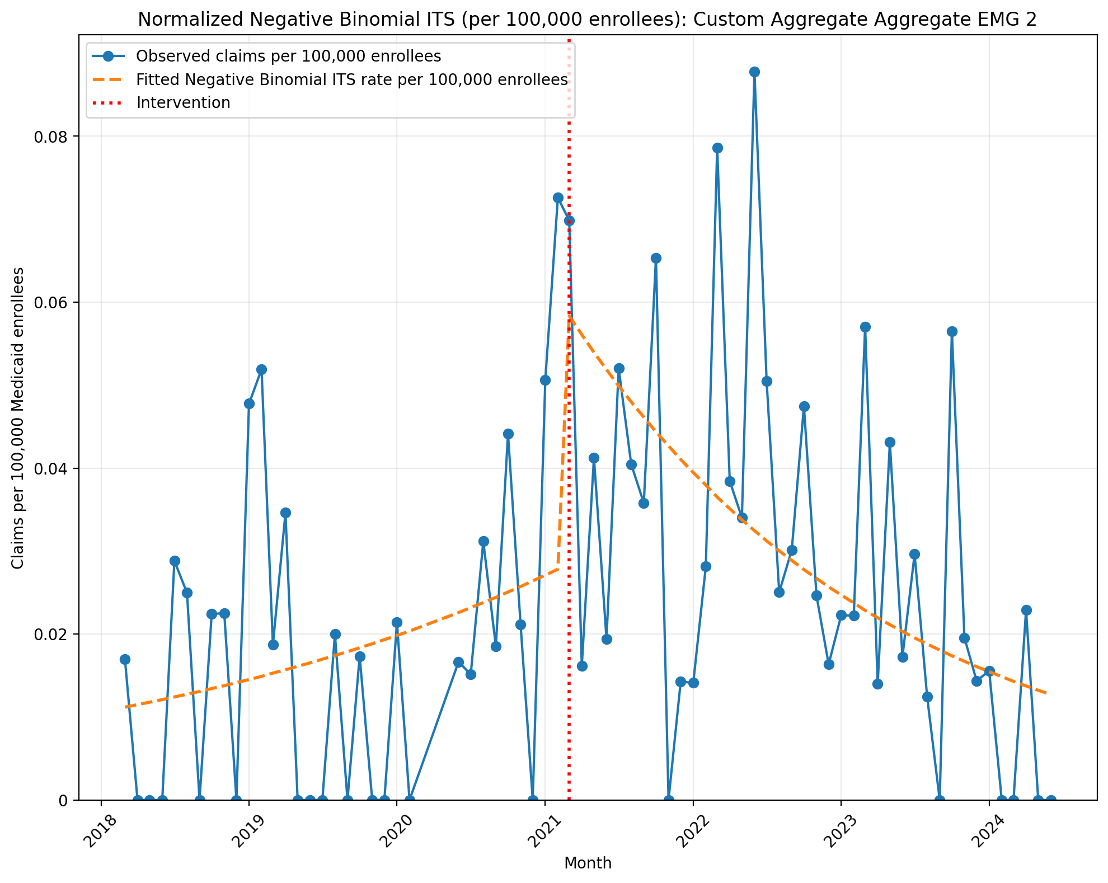
Normalized Negative Binomial ITS (per 100,000 enrollees): Custom Aggregate Aggregate EMG 2
NegativeBinomial Regression Results
==============================================================================
Dep. Variable: y No. Observations: 73
Model: NegativeBinomial Df Residuals: 69
Method: MLE Df Model: 3
Date: Thu, 07 May 2026 Pseudo R-squ.: 0.01312
Time: 21:44:13 Log-Likelihood: -287.09
converged: True LL-Null: -290.91
Covariance Type: nonrobust LLR p-value: 0.05429
==============================================================================
coef std err z P>|z| [0.025 0.975]
------------------------------------------------------------------------------
const -16.0056 0.404 -39.577 0.000 -16.798 -15.213
T 0.0260 0.020 1.311 0.190 -0.013 0.065
X_t 0.7797 0.621 1.256 0.209 -0.437 1.996
post_time -0.0651 0.028 -2.308 0.021 -0.120 -0.010
alpha 1.5736 0.306 5.149 0.000 0.975 2.173
==============================================================================
Codes in aggregation: 95867, 95868

Slide 12
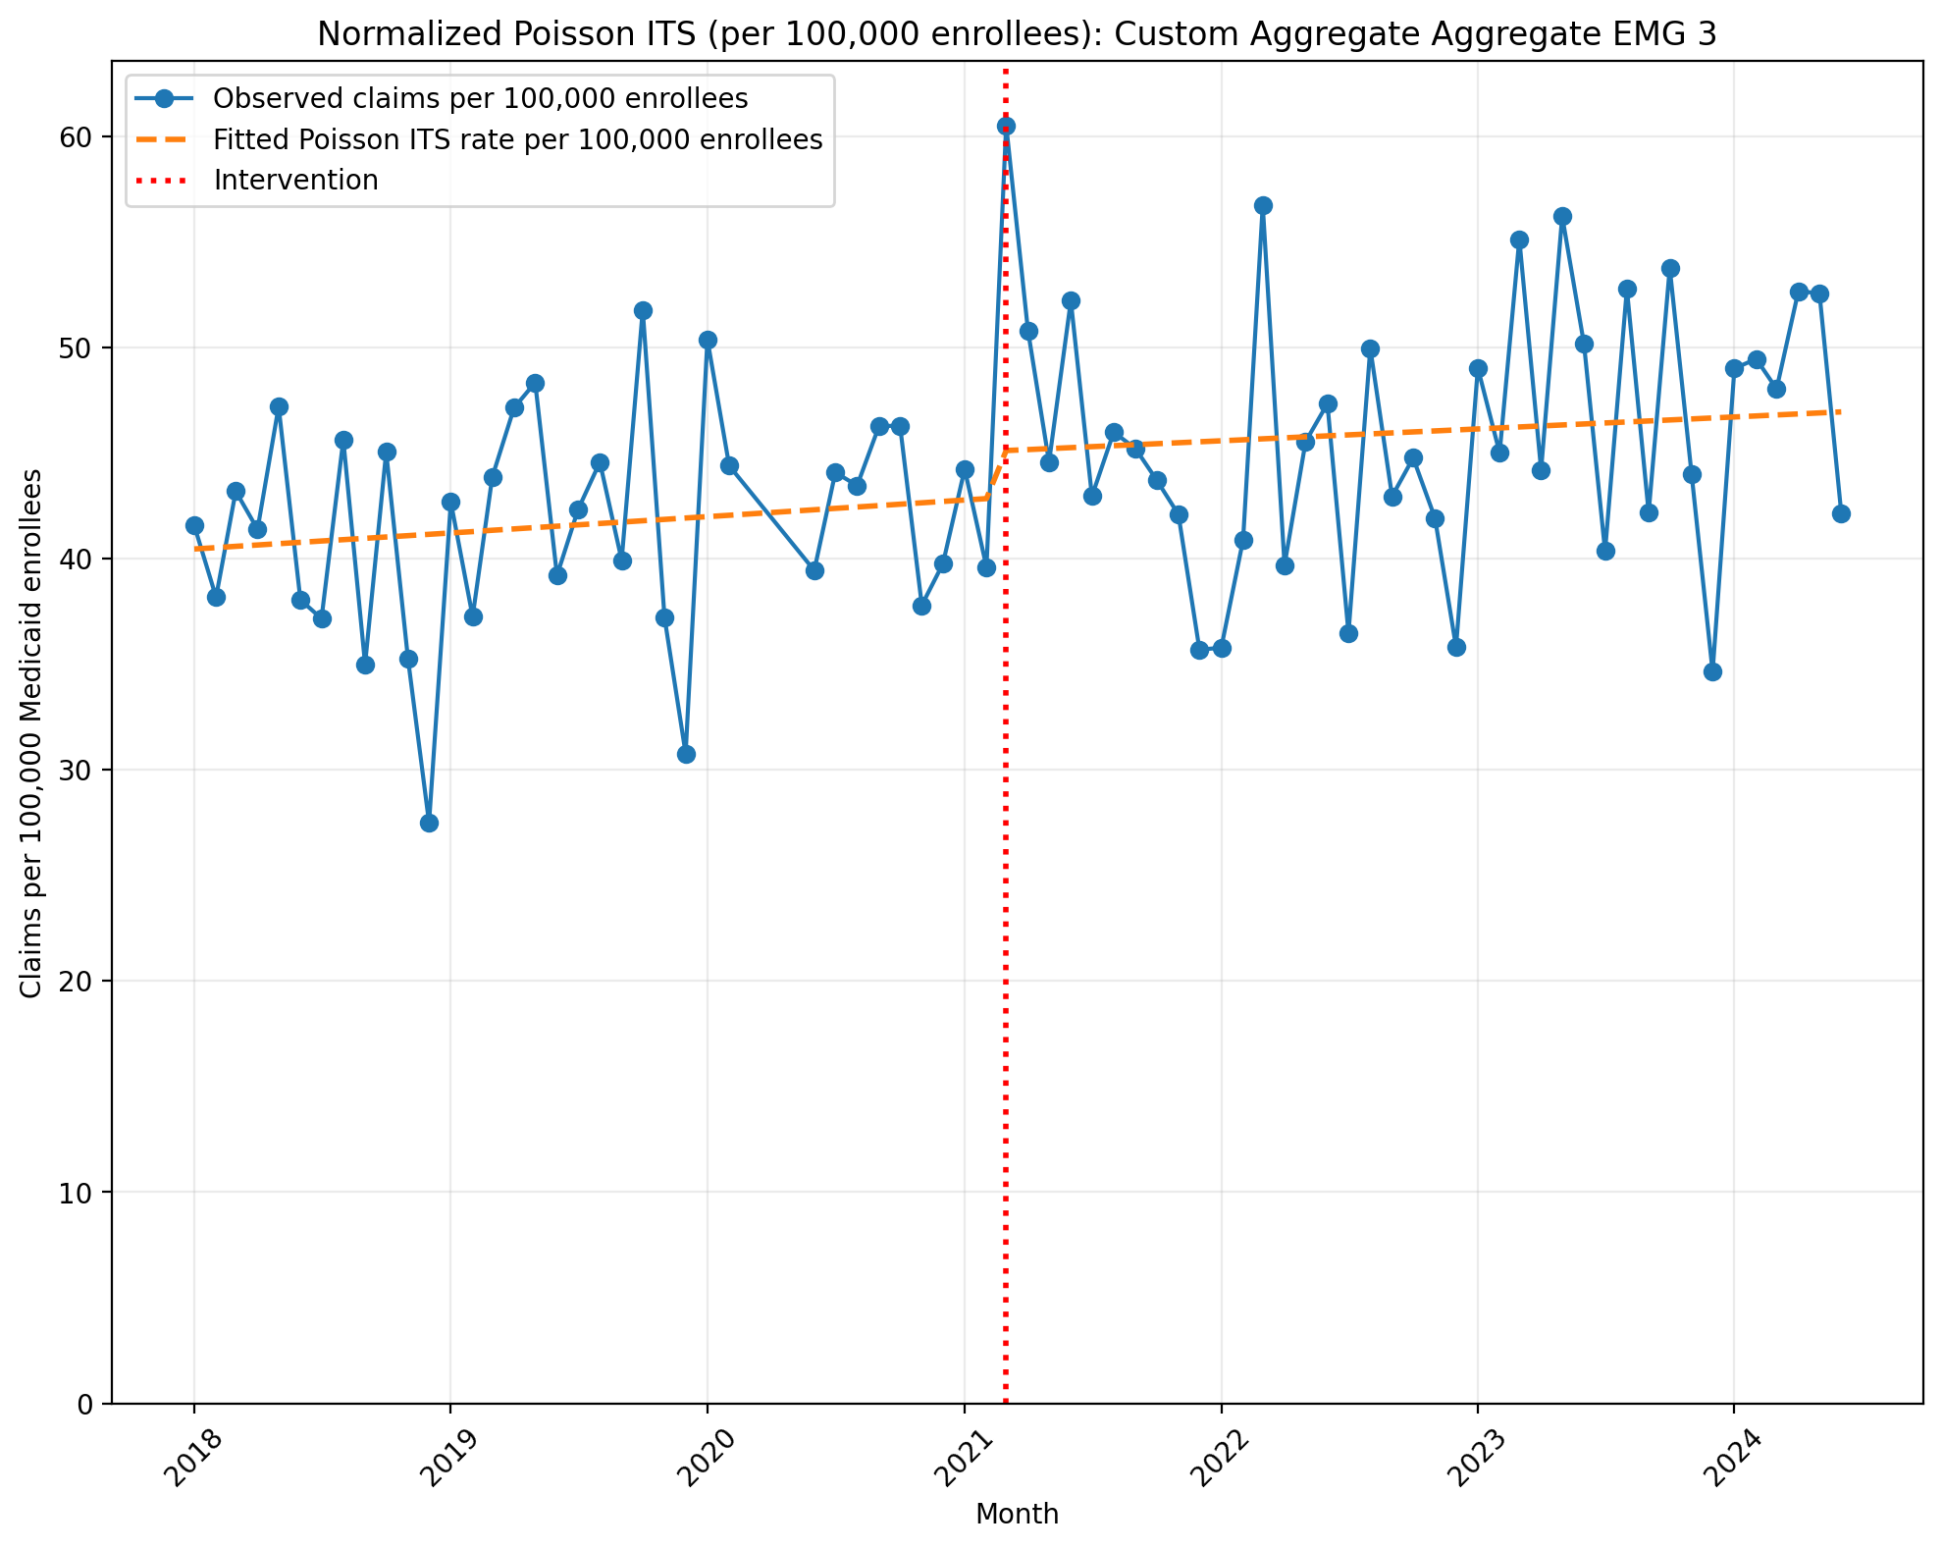
Normalized Poisson ITS (per 100,000 enrollees): Custom Aggregate Aggregate EMG 3
Generalized Linear Model Regression Results
==============================================================================
Dep. Variable: y No. Observations: 75
Model: GLM Df Residuals: 71
Model Family: Poisson Df Model: 3
Link Function: Log Scale: 1.0000
Method: IRLS Log-Likelihood: -24624.
Date: Thu, 07 May 2026 Deviance: 48320.
Time: 21:48:07 Pearson chi2: 4.79e+04
No. Iterations: 4 Pseudo R-squ. (CS): 1.000
Covariance Type: nonrobust
==============================================================================
coef std err z P>|z| [0.025 0.975]
------------------------------------------------------------------------------
const -7.8128 0.002 -4356.798 0.000 -7.816 -7.809
T 0.0015 8.34e-05 18.556 0.000 0.001 0.002
X_t 0.0508 0.002 20.953 0.000 0.046 0.055
post_time -0.0005 0.000 -4.920 0.000 -0.001 -0.000
==============================================================================
Codes in aggregation: 95885, 95886, 95887, 95907, 95908, 95909, 95910, 95911, 95912, 95913

Slide 13
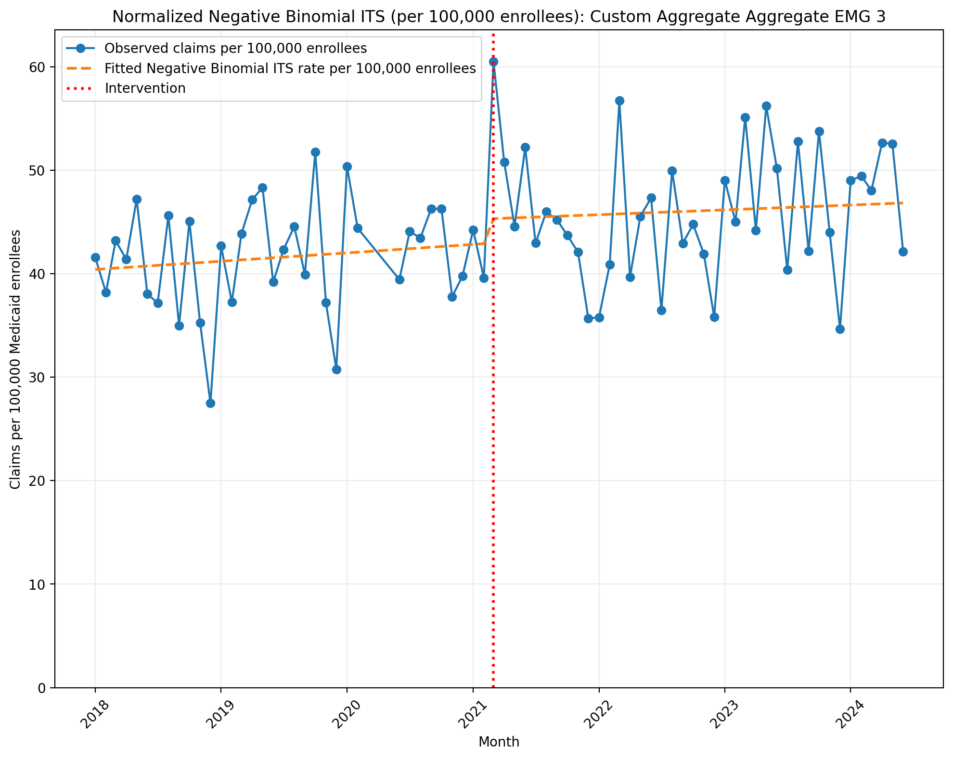
Normalized Negative Binomial ITS (per 100,000 enrollees): Custom Aggregate Aggregate EMG 3
NegativeBinomial Regression Results
==============================================================================
Dep. Variable: y No. Observations: 75
Model: NegativeBinomial Df Residuals: 71
Method: MLE Df Model: 3
Date: Thu, 07 May 2026 Pseudo R-squ.: 0.007508
Time: 21:48:07 Log-Likelihood: -743.57
converged: True LL-Null: -749.20
Covariance Type: nonrobust LLR p-value: 0.01045
==============================================================================
coef std err z P>|z| [0.025 0.975]
------------------------------------------------------------------------------
const -7.8138 0.042 -186.264 0.000 -7.896 -7.732
T 0.0016 0.002 0.807 0.419 -0.002 0.006
X_t 0.0540 0.061 0.885 0.376 -0.066 0.174
post_time -0.0008 0.003 -0.290 0.772 -0.006 0.004
alpha 0.0173 0.003 6.131 0.000 0.012 0.023
==============================================================================
Codes in aggregation: 95885, 95886, 95887, 95907, 95908, 95909, 95910, 95911, 95912, 95913

Slide 14
Codes not found:
95863

