Slide 1
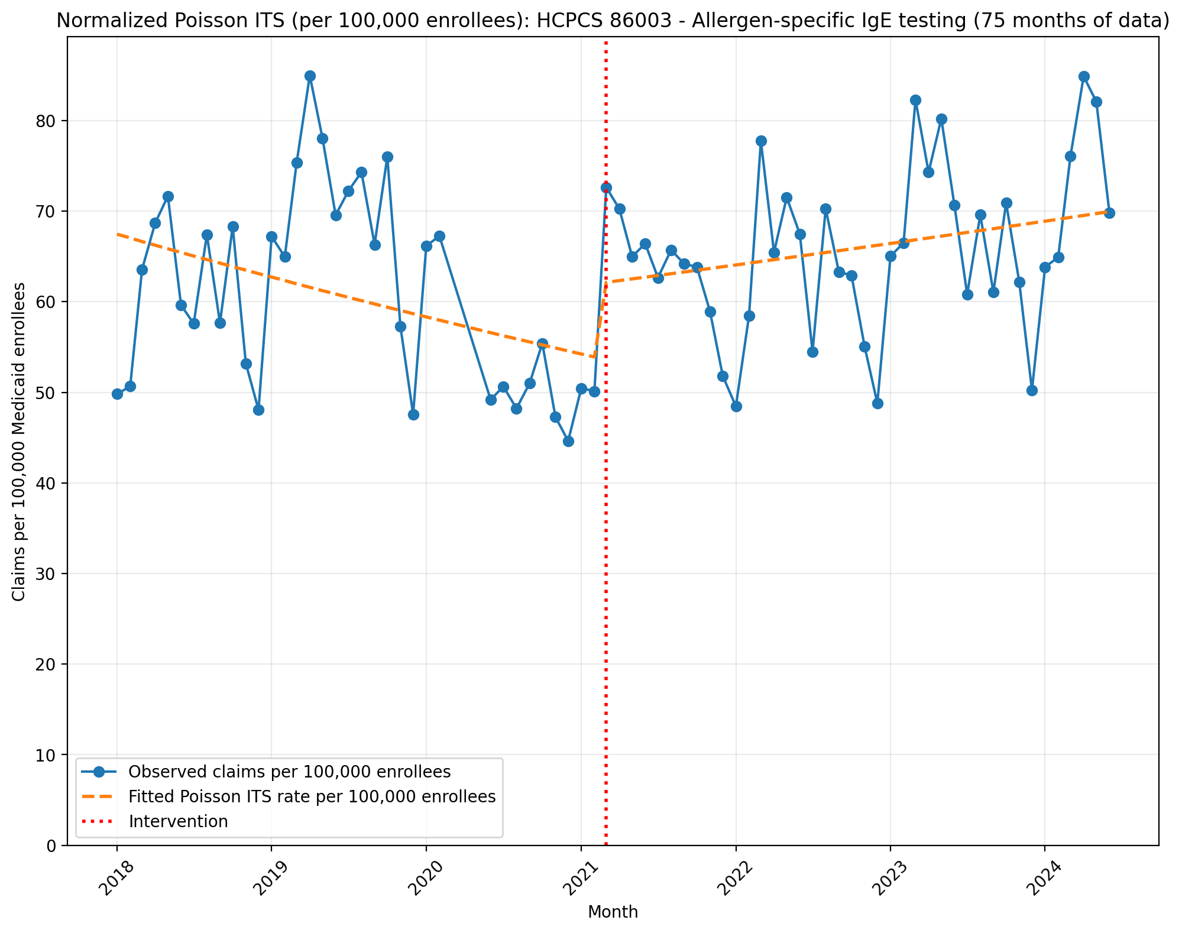
Normalized Poisson ITS (per 100,000 enrollees): HCPCS 86003 - Allergen-specific IgE testing (75 months of data)
Generalized Linear Model Regression Results
==============================================================================
Dep. Variable: y No. Observations: 75
Model: GLM Df Residuals: 71
Model Family: Poisson Df Model: 3
Link Function: Log Scale: 1.0000
Method: IRLS Log-Likelihood: -42573.
Date: Wed, 13 May 2026 Deviance: 84192.
Time: 21:51:20 Pearson chi2: 8.40e+04
No. Iterations: 4 Pseudo R-squ. (CS): 1.000
Covariance Type: nonrobust
==============================================================================
coef std err z P>|z| [0.025 0.975]
------------------------------------------------------------------------------
const -7.3015 0.001 -5083.201 0.000 -7.304 -7.299
T -0.0061 6.96e-05 -87.087 0.000 -0.006 -0.006
X_t 0.1392 0.002 67.171 0.000 0.135 0.143
post_time 0.0091 8.96e-05 101.481 0.000 0.009 0.009
==============================================================================

Slide 2
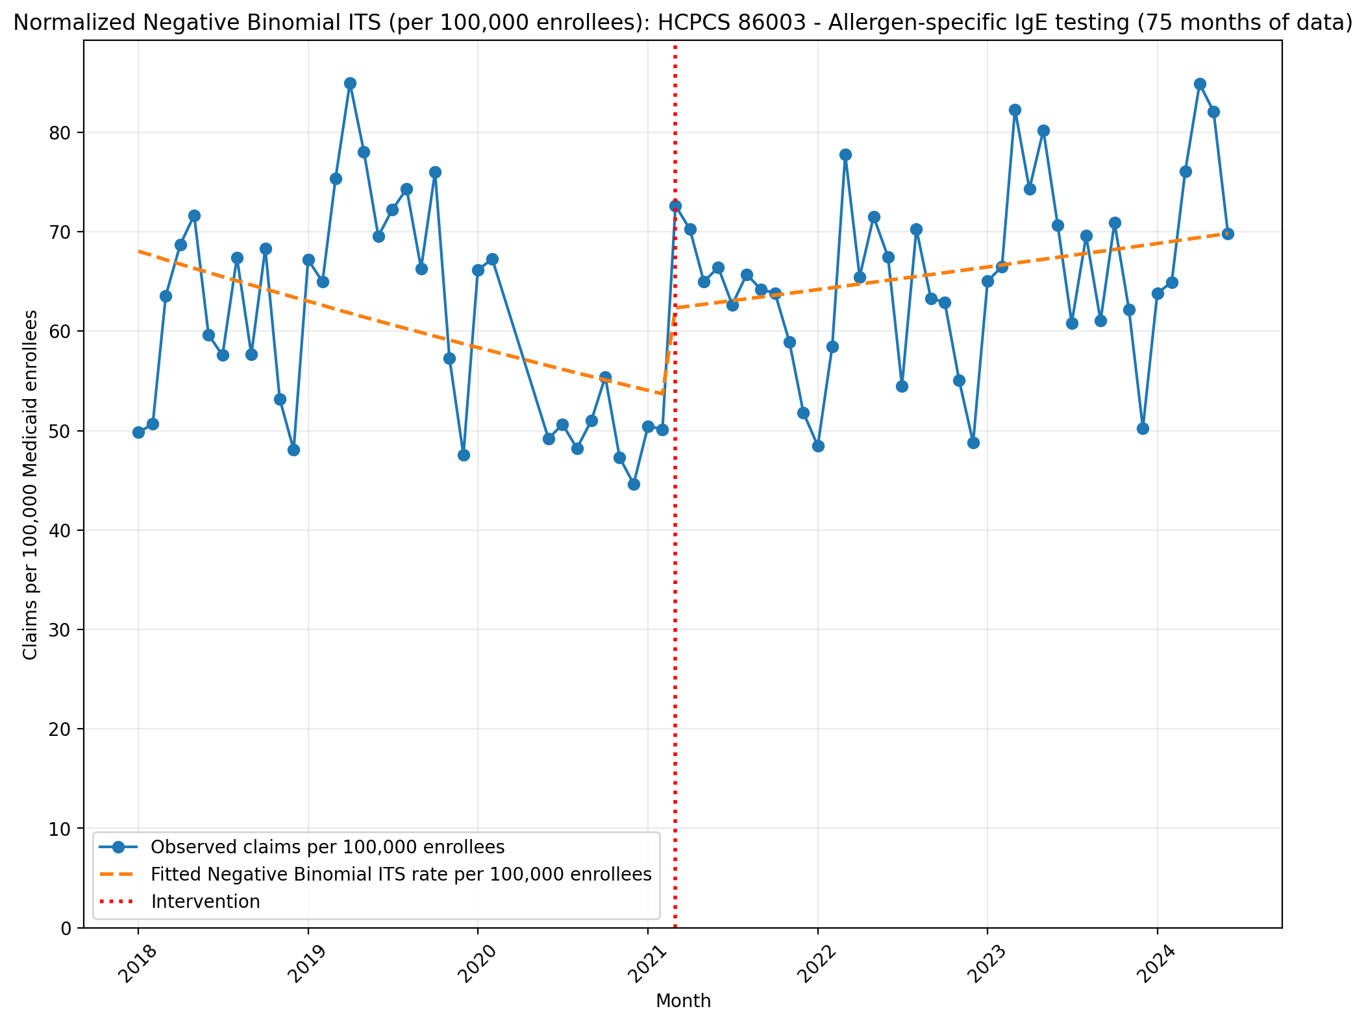
Normalized Negative Binomial ITS (per 100,000 enrollees): HCPCS 86003 - Allergen-specific IgE testing (75 months of data)
NegativeBinomial Regression Results
==============================================================================
Dep. Variable: y No. Observations: 75
Model: NegativeBinomial Df Residuals: 71
Method: MLE Df Model: 3
Date: Wed, 13 May 2026 Pseudo R-squ.: 0.008993
Time: 21:51:20 Log-Likelihood: -778.82
converged: False LL-Null: -785.89
Covariance Type: nonrobust LLR p-value: 0.002727
==============================================================================
coef std err z P>|z| [0.025 0.975]
------------------------------------------------------------------------------
const -7.2928 0.048 -151.873 0.000 -7.387 -7.199
T -0.0064 0.002 -2.758 0.006 -0.011 -0.002
X_t 0.1463 0.069 2.123 0.034 0.011 0.281
post_time 0.0093 0.003 3.060 0.002 0.003 0.015
alpha 0.0212 0.003 6.140 0.000 0.014 0.028
==============================================================================

Slide 3
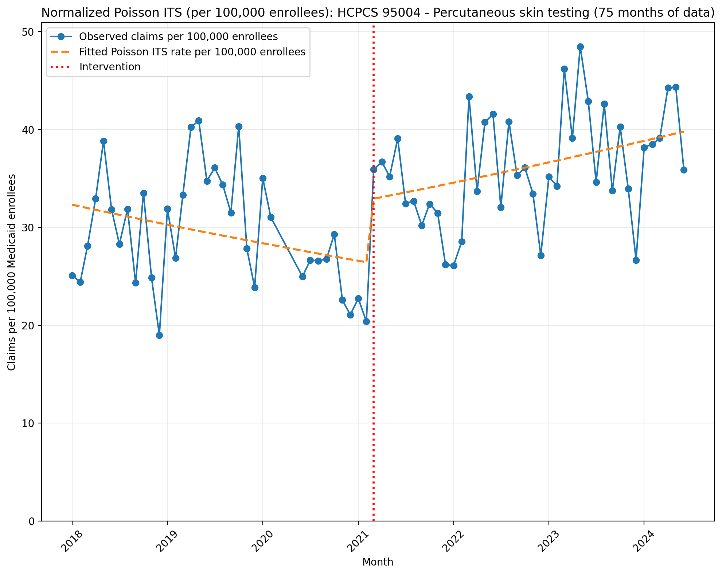
Normalized Poisson ITS (per 100,000 enrollees): HCPCS 95004 - Percutaneous skin testing (75 months of data)
Generalized Linear Model Regression Results
==============================================================================
Dep. Variable: y No. Observations: 75
Model: GLM Df Residuals: 71
Model Family: Poisson Df Model: 3
Link Function: Log Scale: 1.0000
Method: IRLS Log-Likelihood: -28382.
Date: Wed, 13 May 2026 Deviance: 55859.
Time: 21:51:20 Pearson chi2: 5.57e+04
No. Iterations: 4 Pseudo R-squ. (CS): 1.000
Covariance Type: nonrobust
==============================================================================
coef std err z P>|z| [0.025 0.975]
------------------------------------------------------------------------------
const -8.0375 0.002 -3883.766 0.000 -8.042 -8.033
T -0.0054 9.99e-05 -54.217 0.000 -0.006 -0.005
X_t 0.2144 0.003 73.766 0.000 0.209 0.220
post_time 0.0103 0.000 81.755 0.000 0.010 0.011
==============================================================================

Slide 4
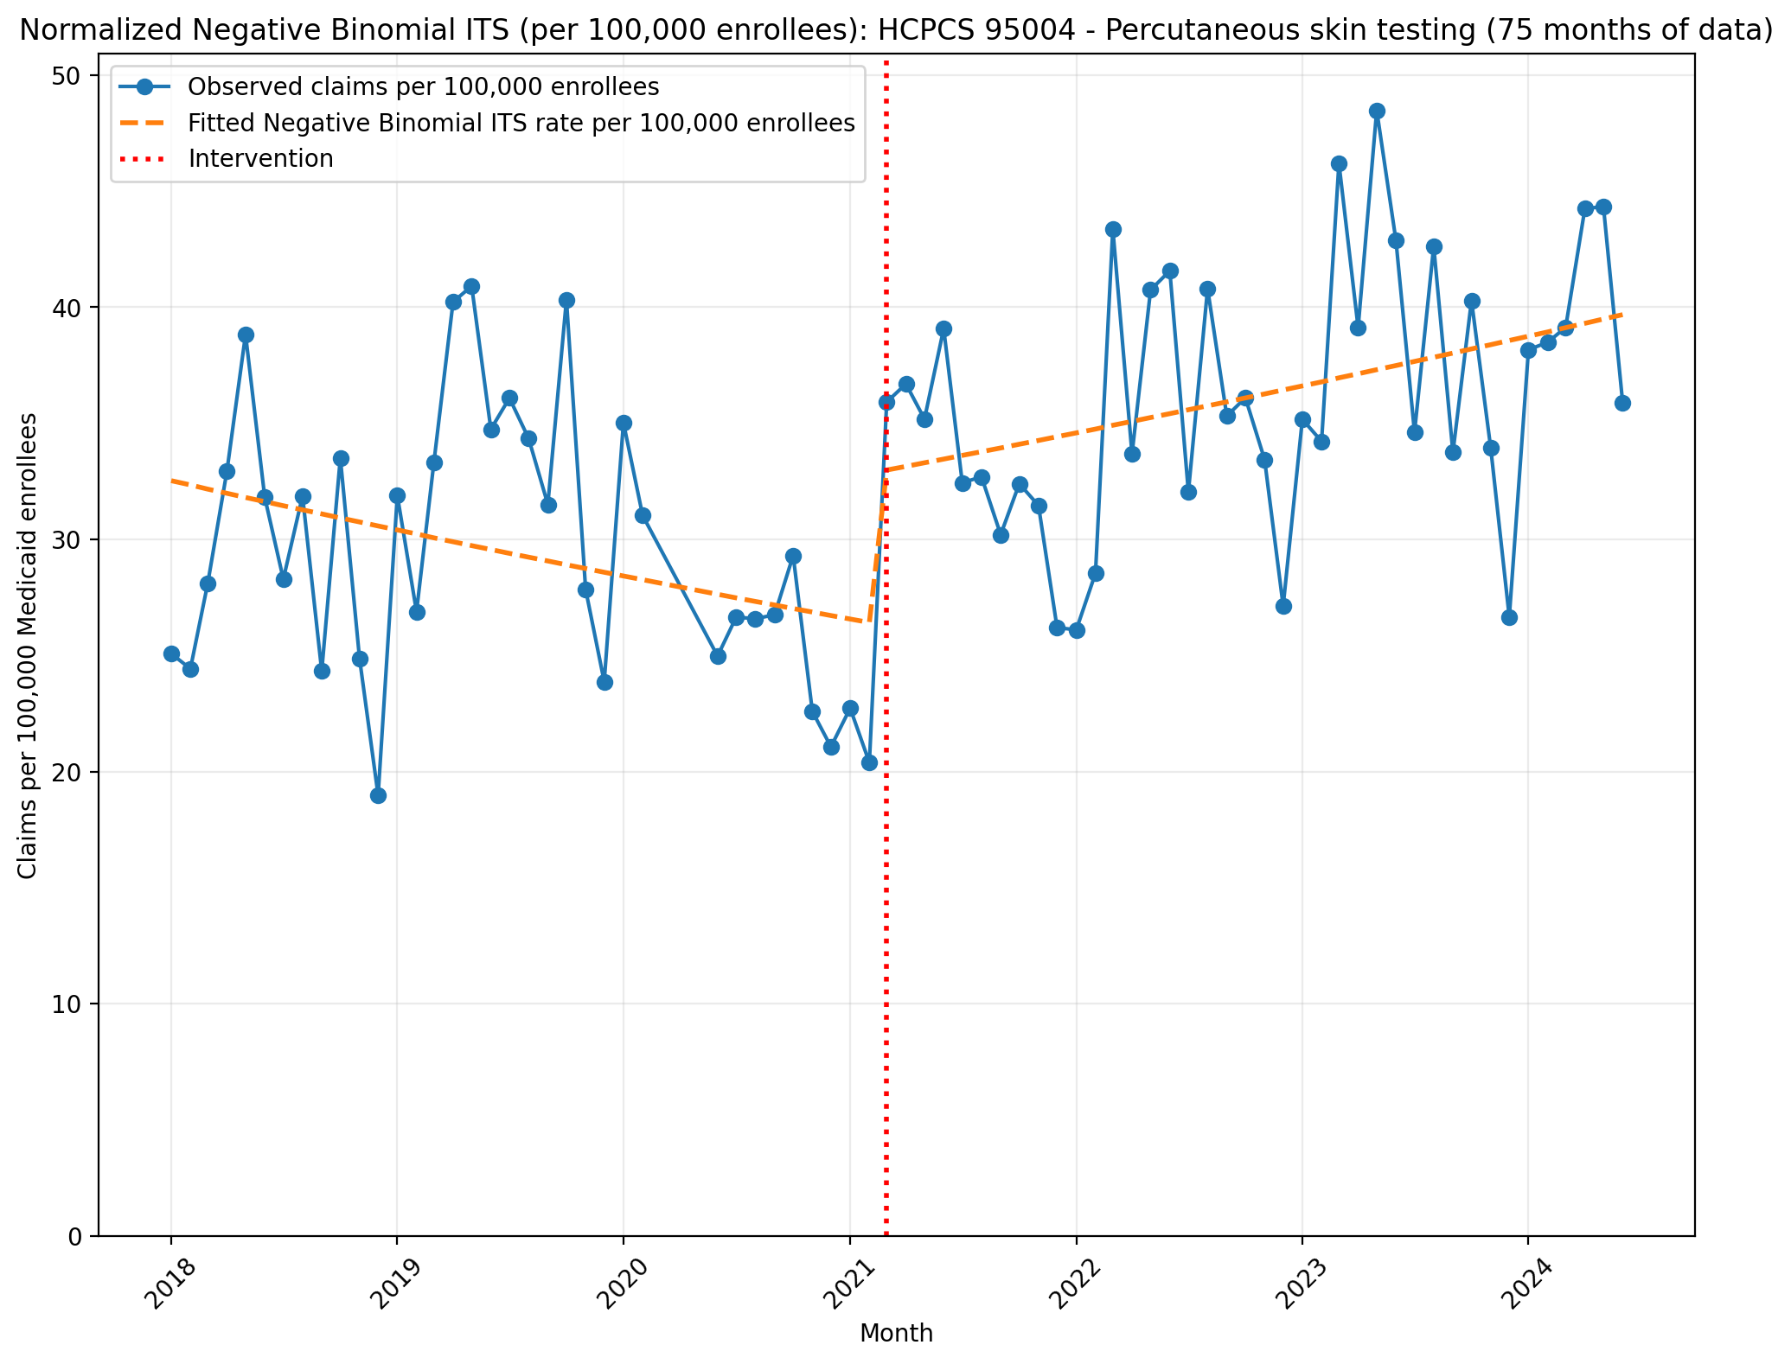
Normalized Negative Binomial ITS (per 100,000 enrollees): HCPCS 95004 - Percutaneous skin testing (75 months of data)
NegativeBinomial Regression Results
==============================================================================
Dep. Variable: y No. Observations: 75
Model: NegativeBinomial Df Residuals: 71
Method: MLE Df Model: 3
Date: Wed, 13 May 2026 Pseudo R-squ.: 0.02013
Time: 21:51:21 Log-Likelihood: -739.12
converged: True LL-Null: -754.31
Covariance Type: nonrobust LLR p-value: 1.155e-06
==============================================================================
coef std err z P>|z| [0.025 0.975]
------------------------------------------------------------------------------
const -8.0309 0.055 -146.434 0.000 -8.138 -7.923
T -0.0056 0.003 -2.121 0.034 -0.011 -0.000
X_t 0.2173 0.079 2.750 0.006 0.062 0.372
post_time 0.0104 0.003 2.969 0.003 0.004 0.017
alpha 0.0276 0.004 6.143 0.000 0.019 0.036
==============================================================================

Slide 5
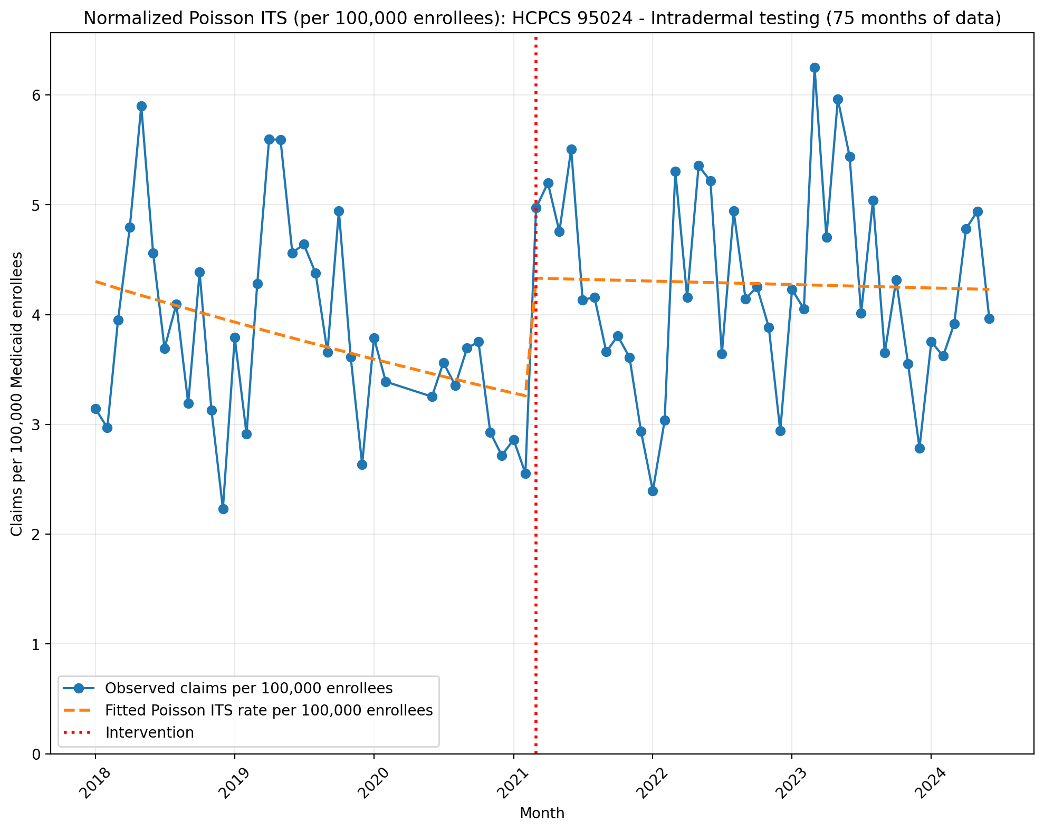
Normalized Poisson ITS (per 100,000 enrollees): HCPCS 95024 - Intradermal testing (75 months of data)
Generalized Linear Model Regression Results
==============================================================================
Dep. Variable: y No. Observations: 75
Model: GLM Df Residuals: 71
Model Family: Poisson Df Model: 3
Link Function: Log Scale: 1.0000
Method: IRLS Log-Likelihood: -6175.3
Date: Wed, 13 May 2026 Deviance: 11604.
Time: 21:51:21 Pearson chi2: 1.16e+04
No. Iterations: 4 Pseudo R-squ. (CS): 1.000
Covariance Type: nonrobust
==============================================================================
coef std err z P>|z| [0.025 0.975]
------------------------------------------------------------------------------
const -10.0540 0.006 -1756.601 0.000 -10.065 -10.043
T -0.0075 0.000 -26.787 0.000 -0.008 -0.007
X_t 0.2846 0.008 34.632 0.000 0.268 0.301
post_time 0.0069 0.000 19.283 0.000 0.006 0.008
==============================================================================

Slide 6
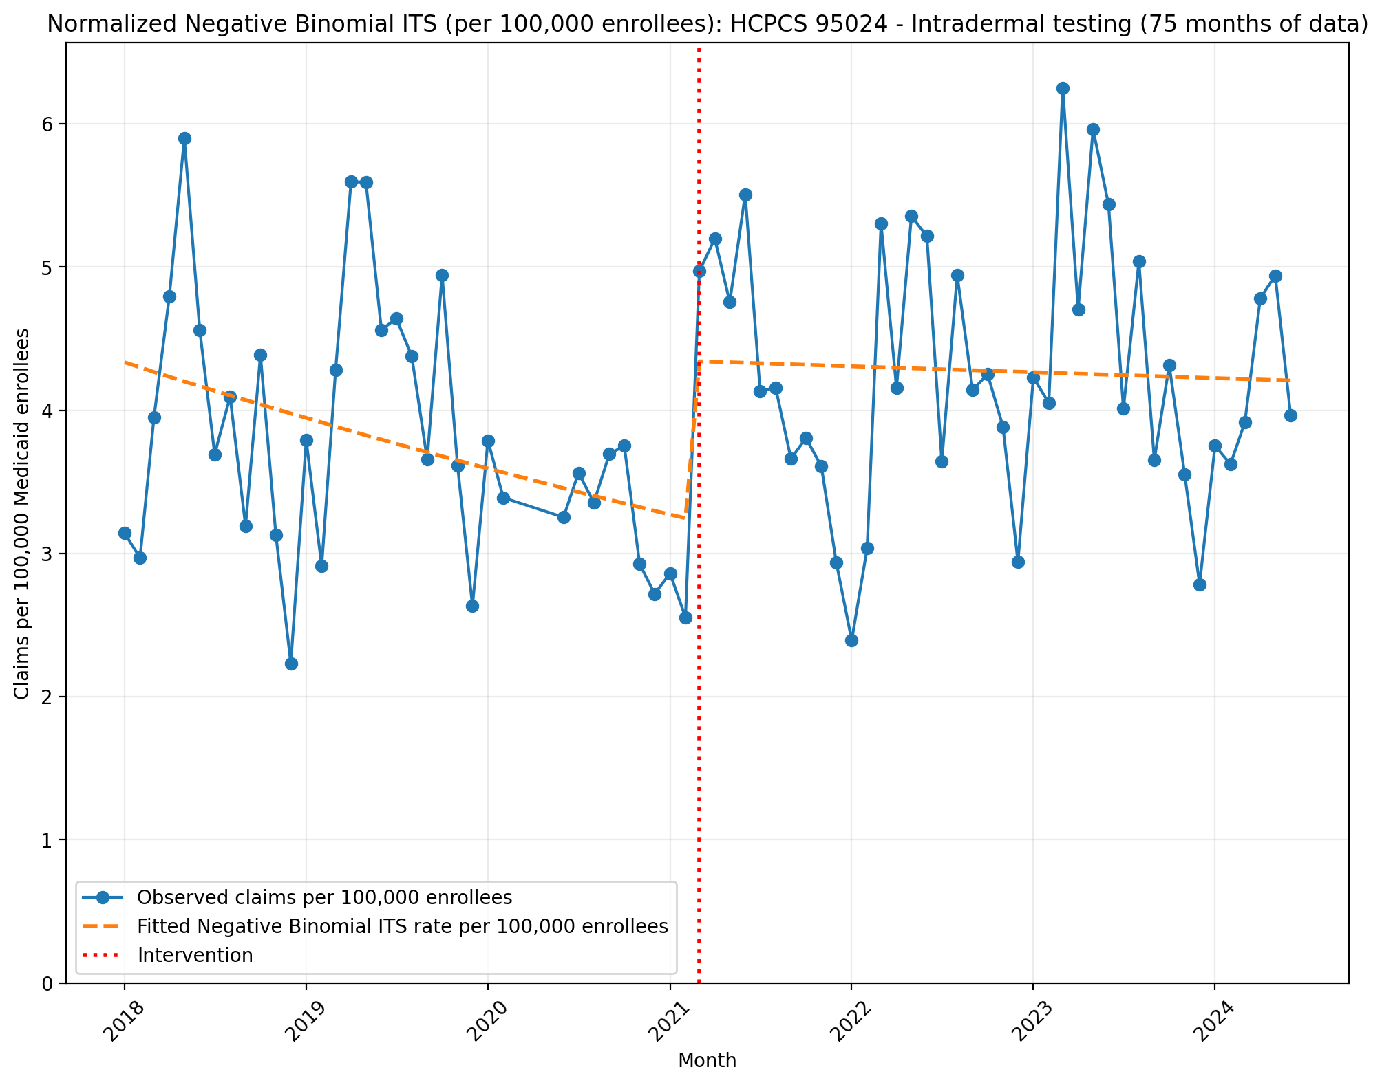
Normalized Negative Binomial ITS (per 100,000 enrollees): HCPCS 95024 - Intradermal testing (75 months of data)
NegativeBinomial Regression Results
==============================================================================
Dep. Variable: y No. Observations: 75
Model: NegativeBinomial Df Residuals: 71
Method: MLE Df Model: 3
Date: Wed, 13 May 2026 Pseudo R-squ.: 0.008940
Time: 21:51:21 Log-Likelihood: -599.63
converged: False LL-Null: -605.04
Covariance Type: nonrobust LLR p-value: 0.01275
==============================================================================
coef std err z P>|z| [0.025 0.975]
------------------------------------------------------------------------------
const -10.0464 0.069 -144.909 0.000 -10.182 -9.911
T -0.0078 0.003 -2.339 0.019 -0.014 -0.001
X_t 0.2916 0.100 2.907 0.004 0.095 0.488
post_time 0.0070 0.004 1.584 0.113 -0.002 0.016
alpha 0.0447 0.007 6.127 0.000 0.030 0.059
==============================================================================

Slide 7
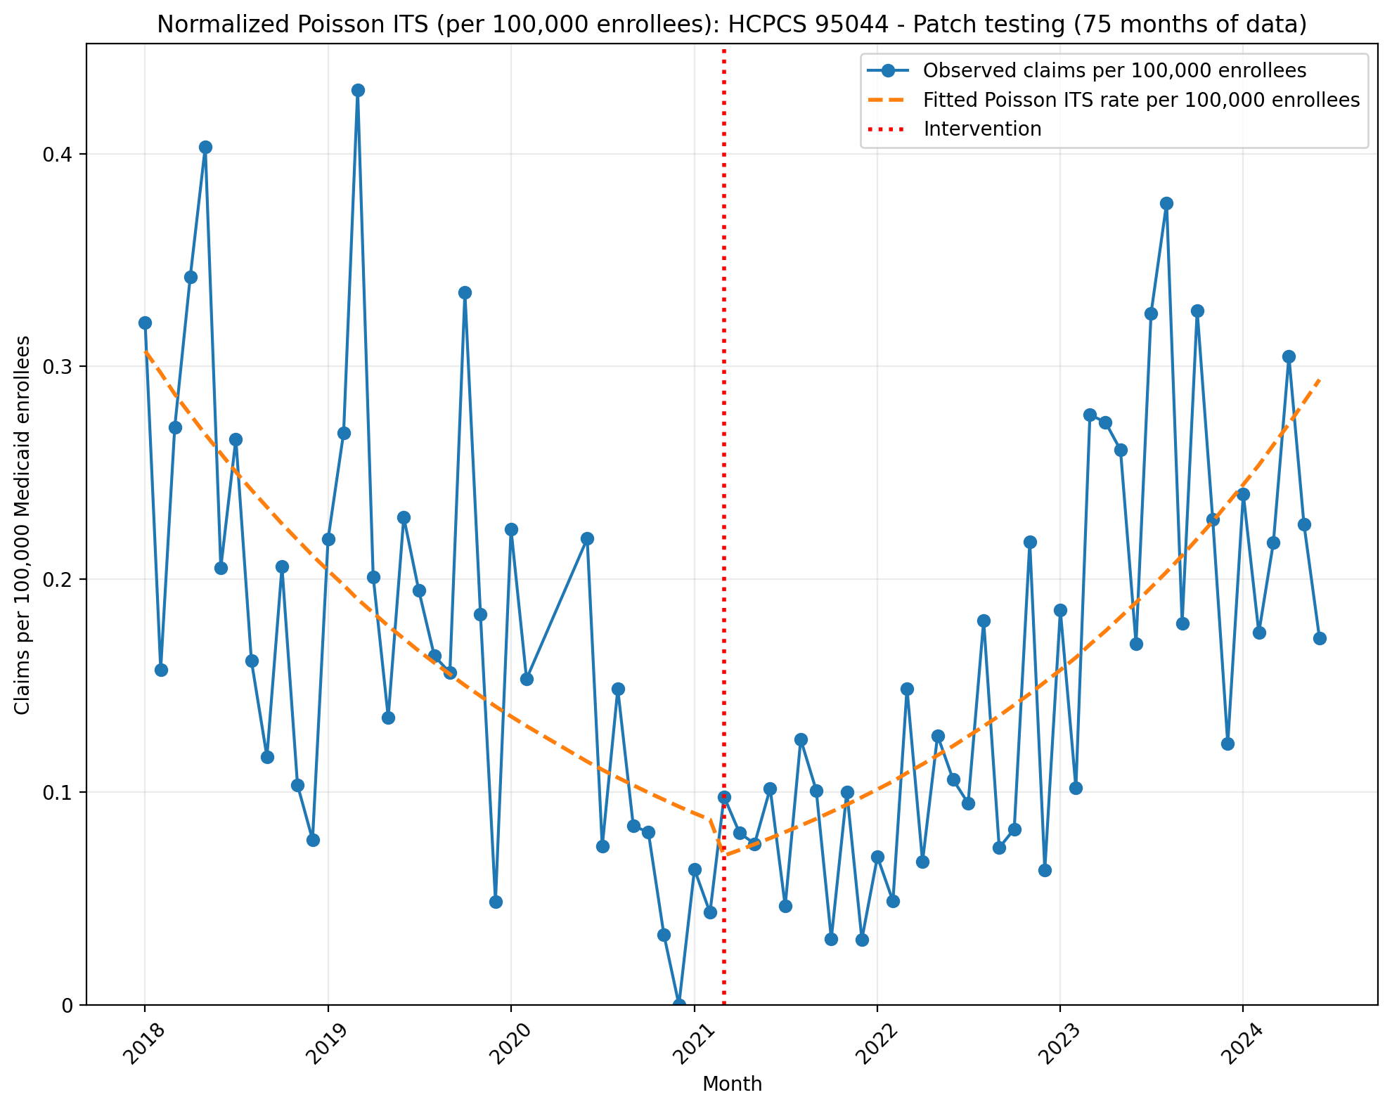
Normalized Poisson ITS (per 100,000 enrollees): HCPCS 95044 - Patch testing (75 months of data)
Generalized Linear Model Regression Results
==============================================================================
Dep. Variable: y No. Observations: 75
Model: GLM Df Residuals: 71
Model Family: Poisson Df Model: 3
Link Function: Log Scale: 1.0000
Method: IRLS Log-Likelihood: -1282.6
Date: Wed, 13 May 2026 Deviance: 2074.6
Time: 21:51:22 Pearson chi2: 2.04e+03
No. Iterations: 4 Pseudo R-squ. (CS): 1.000
Covariance Type: nonrobust
==============================================================================
coef std err z P>|z| [0.025 0.975]
------------------------------------------------------------------------------
const -12.6930 0.024 -531.351 0.000 -12.740 -12.646
T -0.0341 0.001 -24.996 0.000 -0.037 -0.031
X_t -0.2526 0.048 -5.261 0.000 -0.347 -0.158
post_time 0.0709 0.002 38.721 0.000 0.067 0.074
==============================================================================

Slide 8
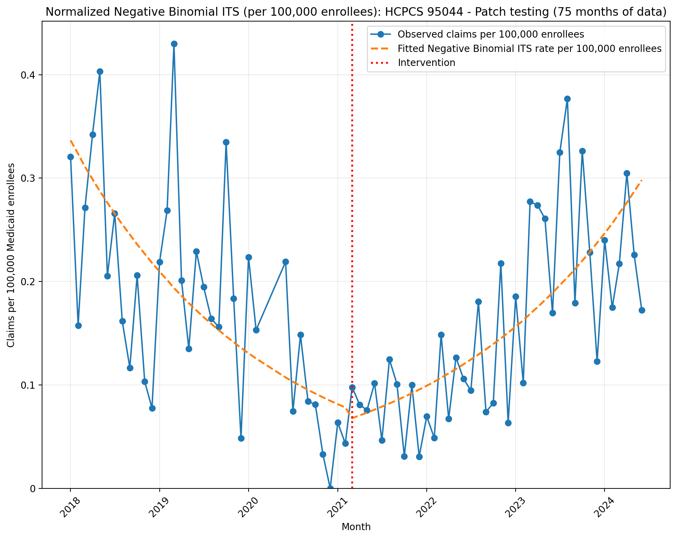
Normalized Negative Binomial ITS (per 100,000 enrollees): HCPCS 95044 - Patch testing (75 months of data)
NegativeBinomial Regression Results
==============================================================================
Dep. Variable: y No. Observations: 75
Model: NegativeBinomial Df Residuals: 71
Method: MLE Df Model: 3
Date: Wed, 13 May 2026 Pseudo R-squ.: 0.04531
Time: 21:51:22 Log-Likelihood: -415.54
converged: True LL-Null: -435.27
Covariance Type: nonrobust LLR p-value: 1.395e-08
==============================================================================
coef std err z P>|z| [0.025 0.975]
------------------------------------------------------------------------------
const -12.6023 0.171 -73.498 0.000 -12.938 -12.266
T -0.0394 0.008 -4.676 0.000 -0.056 -0.023
X_t -0.1799 0.247 -0.728 0.466 -0.664 0.304
post_time 0.0774 0.011 7.071 0.000 0.056 0.099
alpha 0.2453 0.042 5.832 0.000 0.163 0.328
==============================================================================

