Slide 1
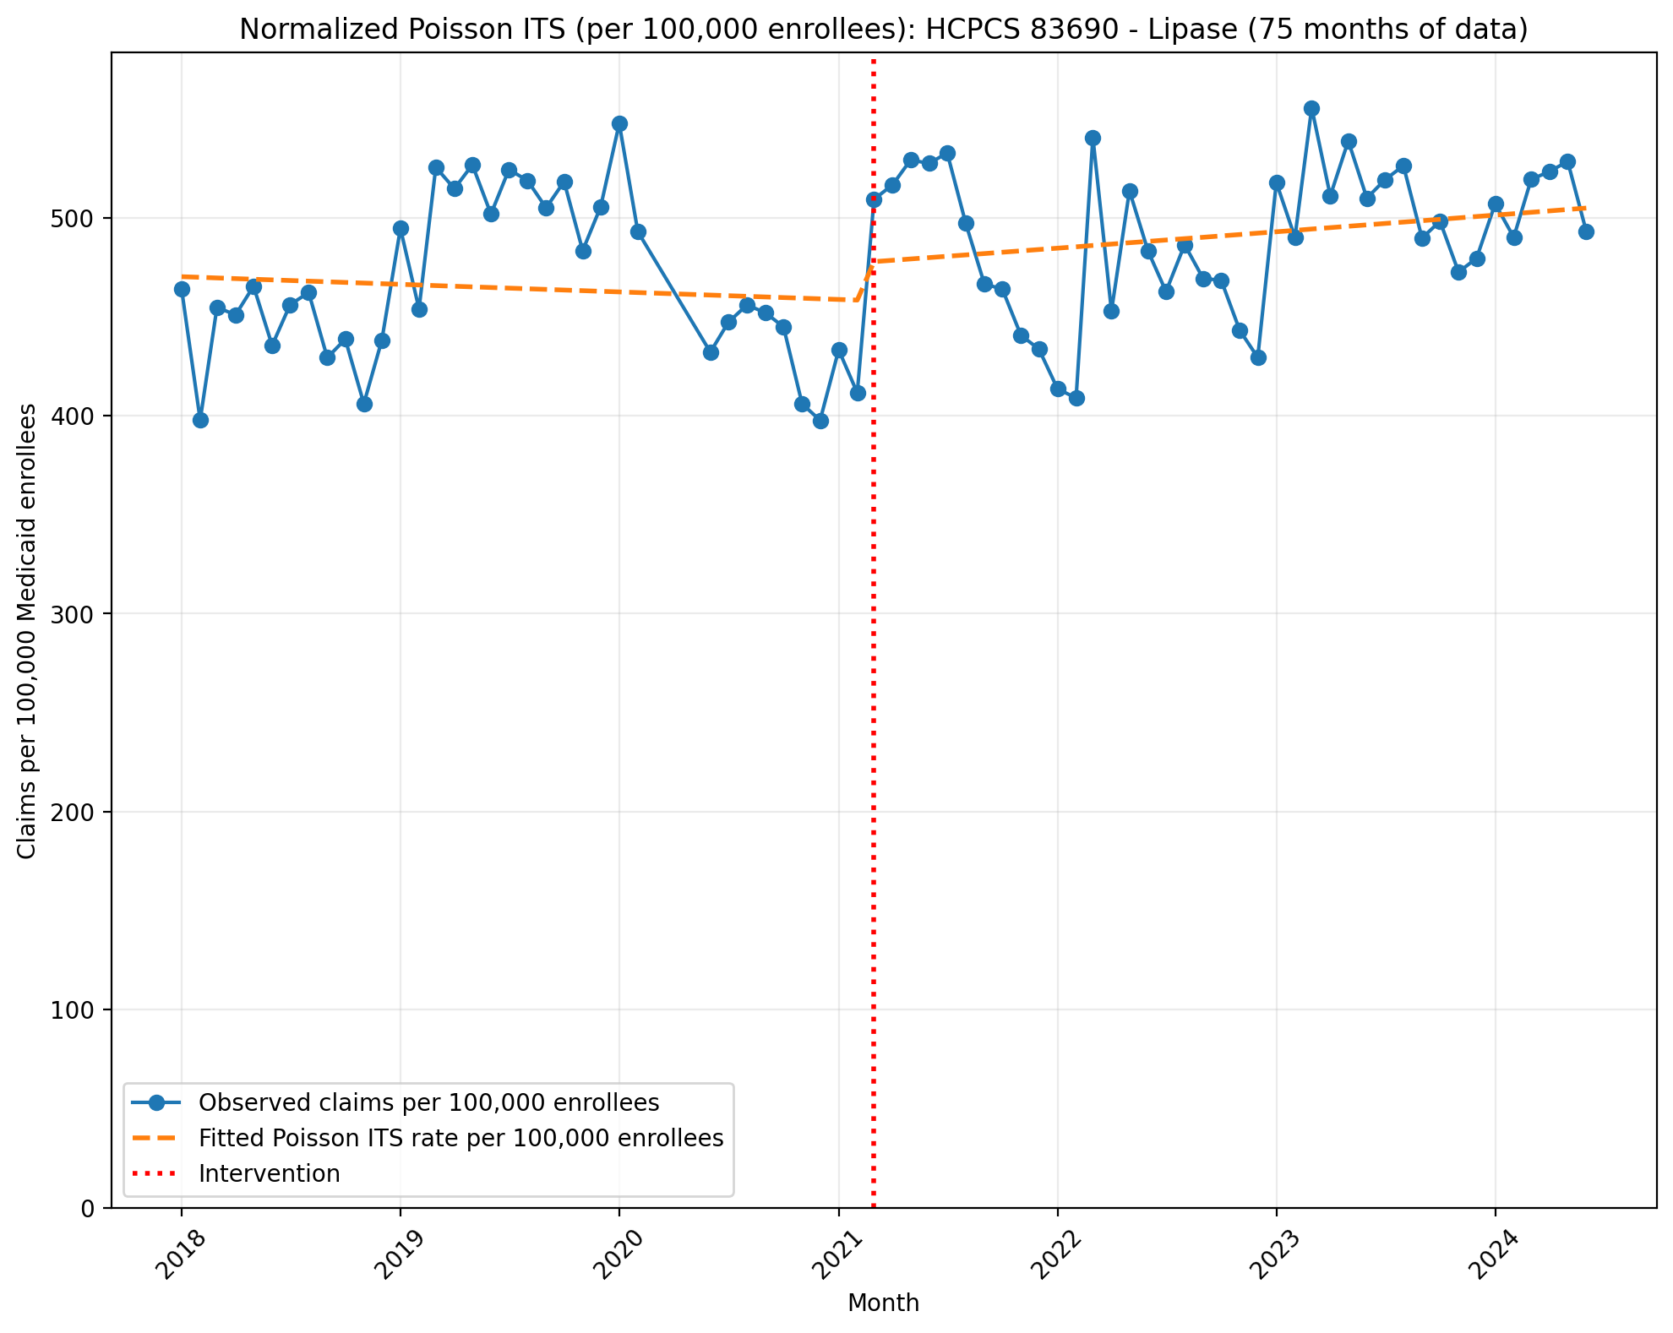
Normalized Poisson ITS (per 100,000 enrollees): HCPCS 83690 - Lipase (75 months of data)
Generalized Linear Model Regression Results
==============================================================================
Dep. Variable: y No. Observations: 75
Model: GLM Df Residuals: 71
Model Family: Poisson Df Model: 3
Link Function: Log Scale: 1.0000
Method: IRLS Log-Likelihood: -96468.
Date: Sun, 17 May 2026 Deviance: 1.9183e+05
Time: 22:46:52 Pearson chi2: 1.91e+05
No. Iterations: 4 Pseudo R-squ. (CS): 1.000
Covariance Type: nonrobust
==============================================================================
coef std err z P>|z| [0.025 0.975]
------------------------------------------------------------------------------
const -5.3598 0.001 -1.01e+04 0.000 -5.361 -5.359
T -0.0007 2.5e-05 -27.518 0.000 -0.001 -0.001
X_t 0.0401 0.001 54.334 0.000 0.039 0.042
post_time 0.0021 3.24e-05 64.717 0.000 0.002 0.002
==============================================================================

Slide 2
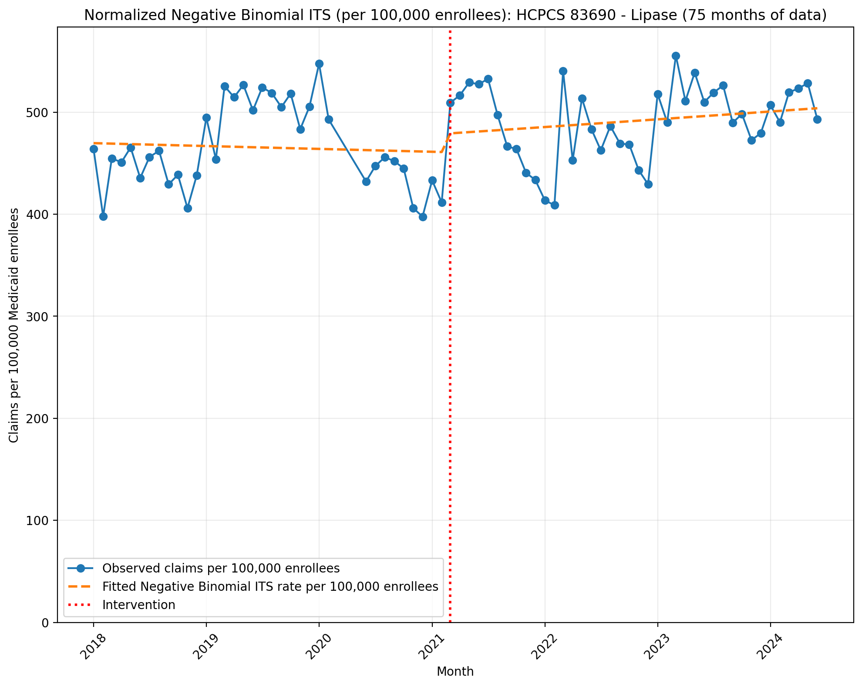
Normalized Negative Binomial ITS (per 100,000 enrollees): HCPCS 83690 - Lipase (75 months of data)
NegativeBinomial Regression Results
==============================================================================
Dep. Variable: y No. Observations: 75
Model: NegativeBinomial Df Residuals: 71
Method: MLE Df Model: 3
Date: Sun, 17 May 2026 Pseudo R-squ.: 0.005344
Time: 22:46:52 Log-Likelihood: -885.86
converged: False LL-Null: -890.62
Covariance Type: nonrobust LLR p-value: 0.02314
==============================================================================
coef std err z P>|z| [0.025 0.975]
------------------------------------------------------------------------------
const -5.3610 0.026 -205.848 0.000 -5.412 -5.310
T -0.0005 0.001 -0.402 0.687 -0.003 0.002
X_t 0.0376 0.038 0.998 0.318 -0.036 0.111
post_time 0.0018 0.002 1.079 0.280 -0.001 0.005
alpha 0.0064 0.001 6.128 0.000 0.004 0.008
==============================================================================

Slide 3
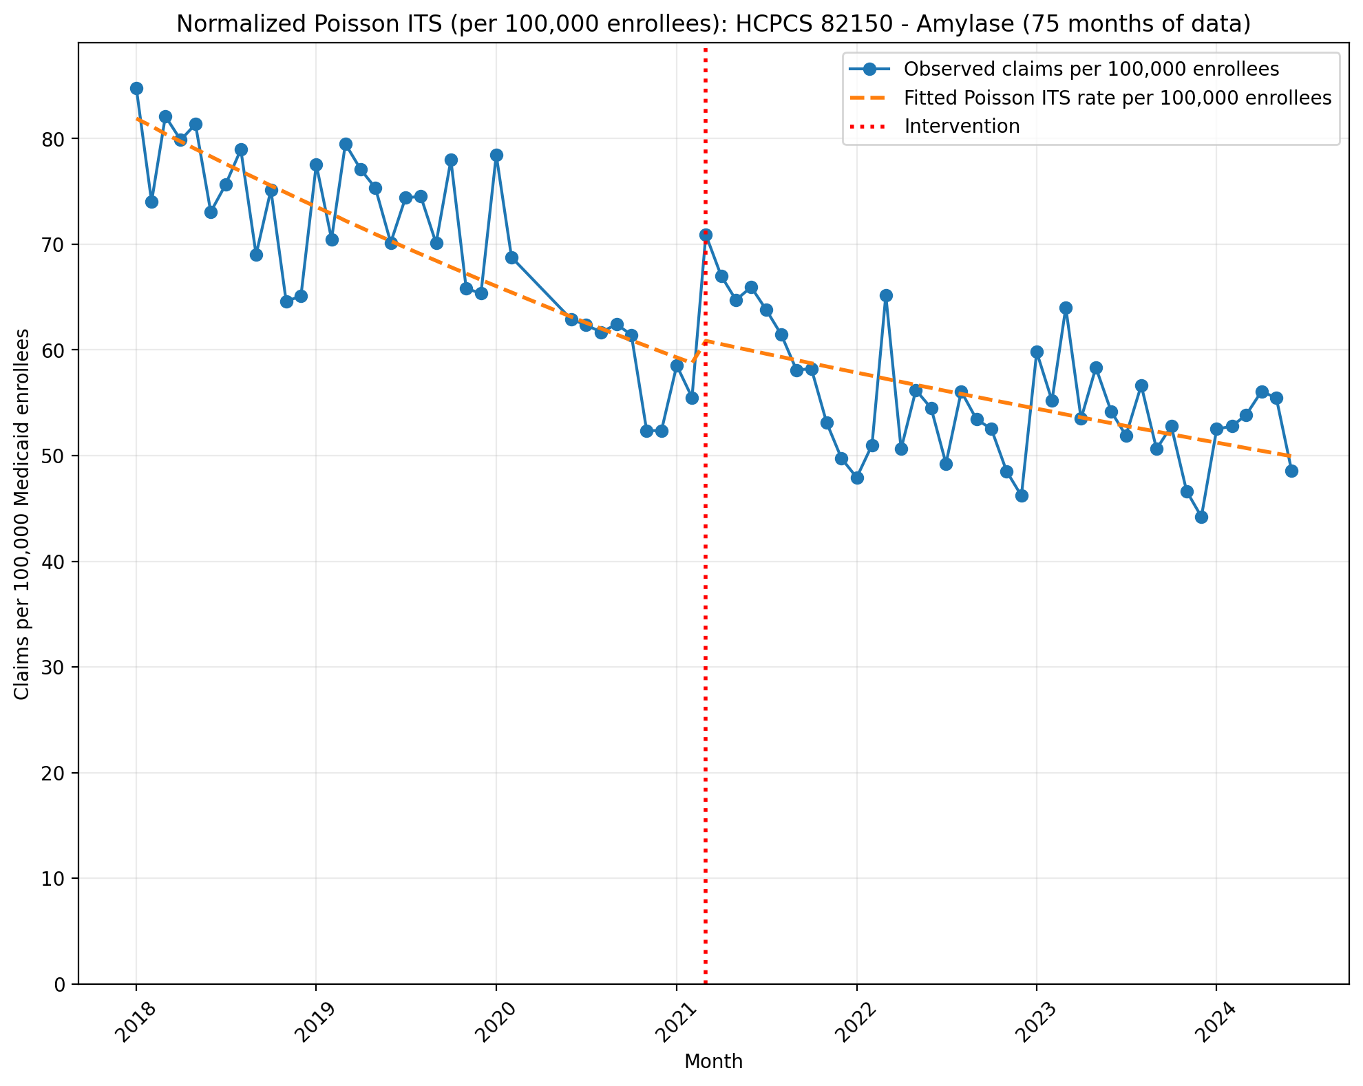
Normalized Poisson ITS (per 100,000 enrollees): HCPCS 82150 - Amylase (75 months of data)
Generalized Linear Model Regression Results
==============================================================================
Dep. Variable: y No. Observations: 75
Model: GLM Df Residuals: 71
Model Family: Poisson Df Model: 3
Link Function: Log Scale: 1.0000
Method: IRLS Log-Likelihood: -14568.
Date: Sun, 17 May 2026 Deviance: 28183.
Time: 22:46:53 Pearson chi2: 2.81e+04
No. Iterations: 4 Pseudo R-squ. (CS): 1.000
Covariance Type: nonrobust
==============================================================================
coef std err z P>|z| [0.025 0.975]
------------------------------------------------------------------------------
const -7.1074 0.001 -5383.920 0.000 -7.110 -7.105
T -0.0090 6.5e-05 -138.087 0.000 -0.009 -0.009
X_t 0.0401 0.002 19.506 0.000 0.036 0.044
post_time 0.0039 8.96e-05 43.584 0.000 0.004 0.004
==============================================================================

Slide 4
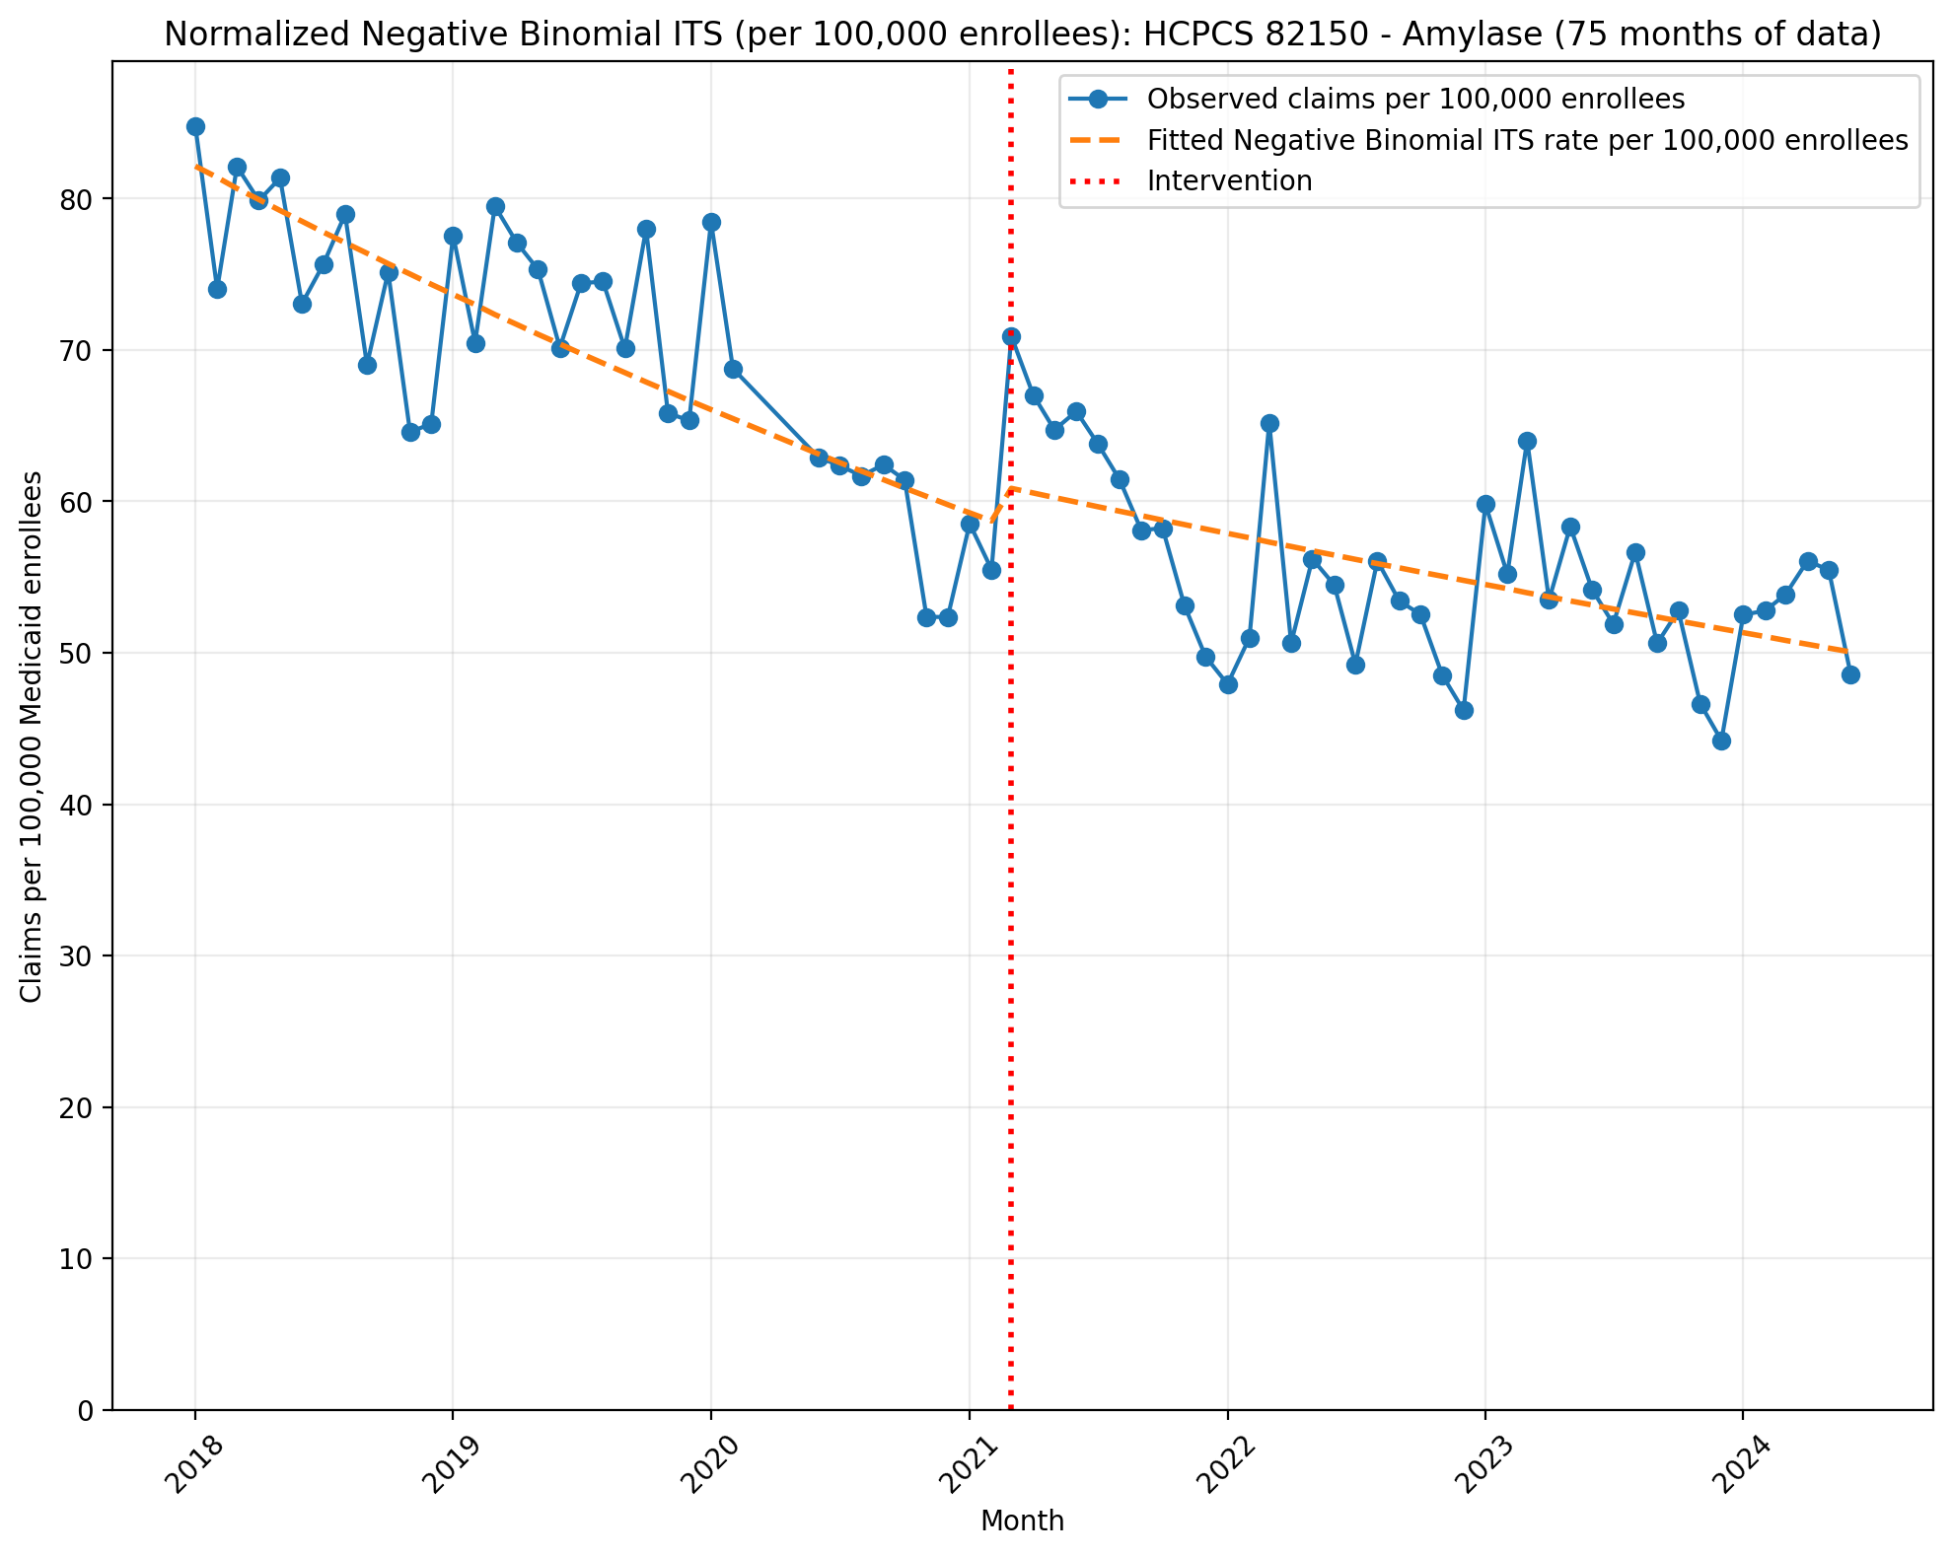
Normalized Negative Binomial ITS (per 100,000 enrollees): HCPCS 82150 - Amylase (75 months of data)
NegativeBinomial Regression Results
==============================================================================
Dep. Variable: y No. Observations: 75
Model: NegativeBinomial Df Residuals: 71
Method: MLE Df Model: 3
Date: Sun, 17 May 2026 Pseudo R-squ.: 0.06476
Time: 22:46:53 Log-Likelihood: -736.38
converged: False LL-Null: -787.38
Covariance Type: nonrobust LLR p-value: 5.805e-22
==============================================================================
coef std err z P>|z| [0.025 0.975]
------------------------------------------------------------------------------
const -7.1044 0.027 -260.295 0.000 -7.158 -7.051
T -0.0091 0.001 -6.946 0.000 -0.012 -0.007
X_t 0.0410 0.040 1.036 0.300 -0.037 0.119
post_time 0.0041 0.002 2.342 0.019 0.001 0.007
alpha 0.0072 0.001 6.115 0.000 0.005 0.009
==============================================================================

Slide 5
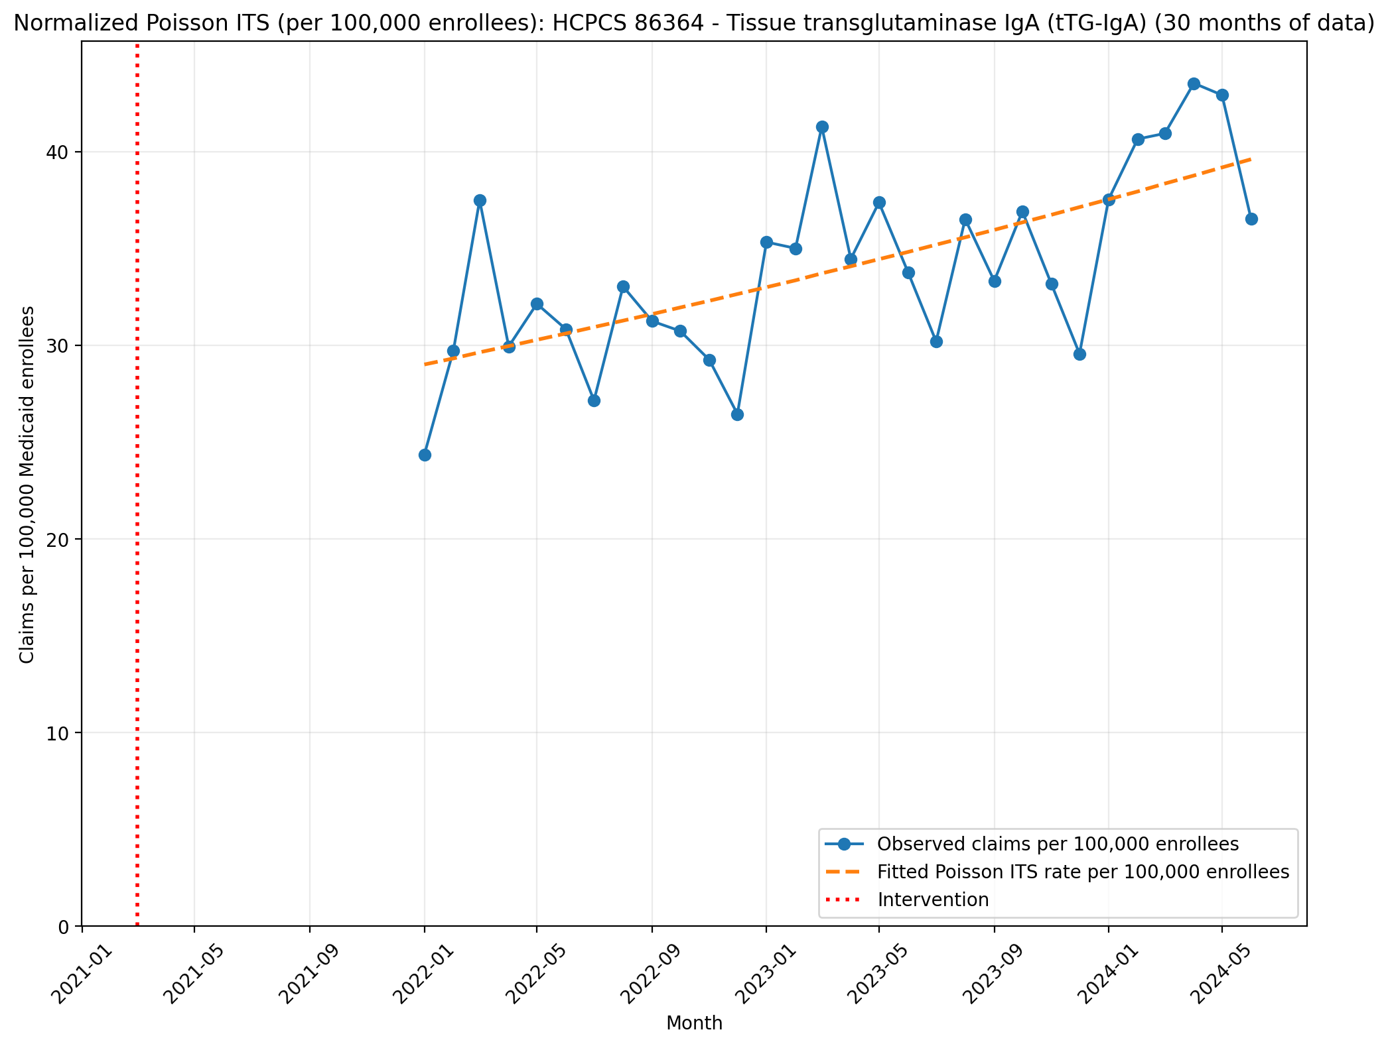
Normalized Poisson ITS (per 100,000 enrollees): HCPCS 86364 - Tissue transglutaminase IgA (tTG-IgA) (30 months of data)
Generalized Linear Model Regression Results
==============================================================================
Dep. Variable: y No. Observations: 30
Model: GLM Df Residuals: 28
Model Family: Poisson Df Model: 1
Link Function: Log Scale: 1.0000
Method: IRLS Log-Likelihood: -5655.1
Date: Sun, 17 May 2026 Deviance: 10944.
Time: 22:46:54 Pearson chi2: 1.09e+04
No. Iterations: 4 Pseudo R-squ. (CS): 1.000
Covariance Type: nonrobust
==============================================================================
coef std err z P>|z| [0.025 0.975]
------------------------------------------------------------------------------
T 0.7391 0.000 2510.708 0.000 0.739 0.740
X_t -0.1334 4.33e-05 -3080.377 0.000 -0.133 -0.133
post_time -0.7284 0.000 -3951.426 0.000 -0.729 -0.728
==============================================================================

Slide 6
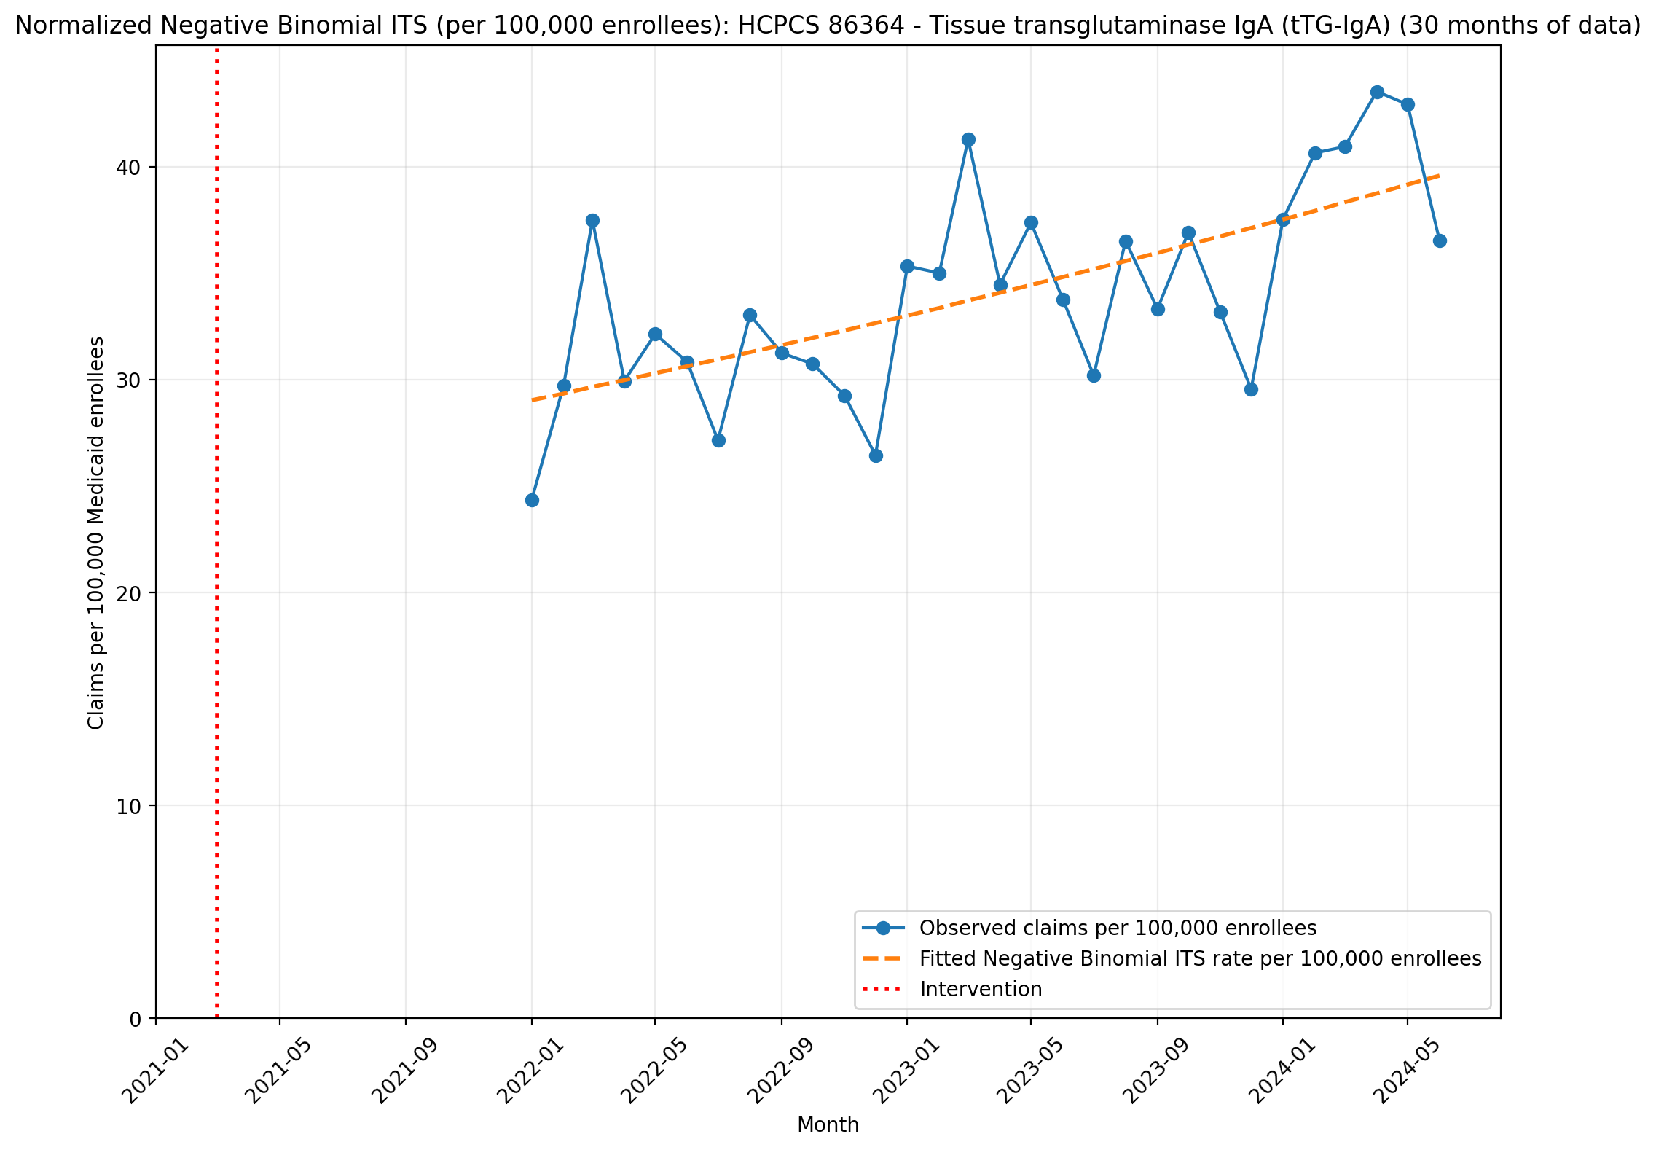
Normalized Negative Binomial ITS (per 100,000 enrollees): HCPCS 86364 - Tissue transglutaminase IgA (tTG-IgA) (30 months of data)
NegativeBinomial Regression Results
==============================================================================
Dep. Variable: y No. Observations: 30
Model: NegativeBinomial Df Residuals: 28
Method: MLE Df Model: 1
Date: Sun, 17 May 2026 Pseudo R-squ.: 0.02829
Time: 22:46:55 Log-Likelihood: -286.83
converged: True LL-Null: -295.19
Covariance Type: nonrobust LLR p-value: 4.375e-05
==============================================================================
coef std err z P>|z| [0.025 0.975]
------------------------------------------------------------------------------
T 0.0355 nan nan nan nan nan
X_t -7.8716 nan nan nan nan nan
post_time -0.0248 nan nan nan nan nan
alpha 0.0116 nan nan nan nan nan
==============================================================================

Slide 7
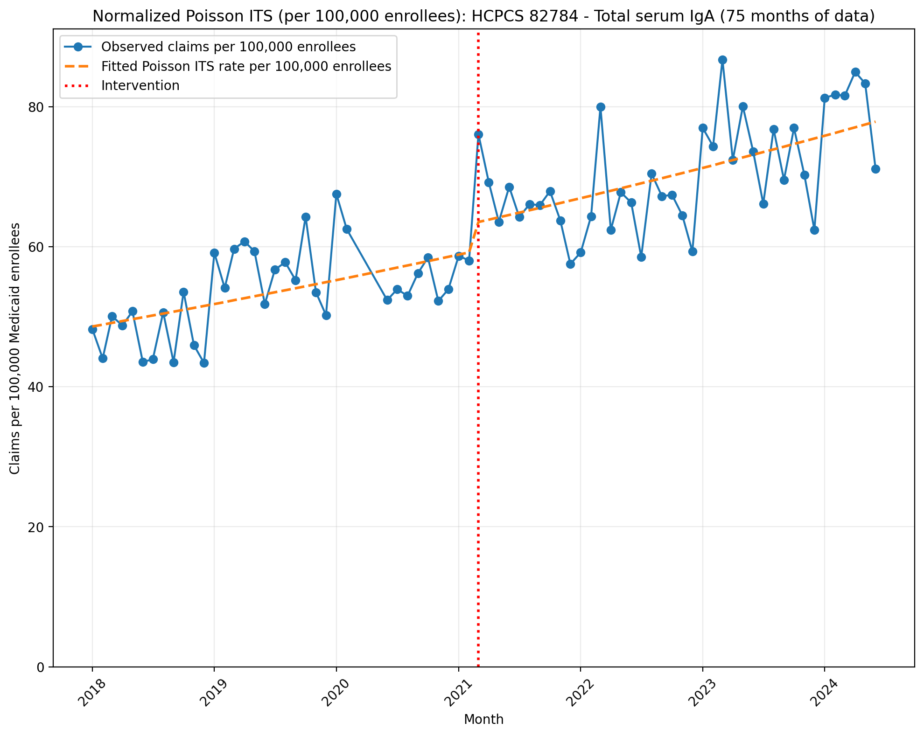
Normalized Poisson ITS (per 100,000 enrollees): HCPCS 82784 - Total serum IgA (75 months of data)
Generalized Linear Model Regression Results
==============================================================================
Dep. Variable: y No. Observations: 75
Model: GLM Df Residuals: 71
Model Family: Poisson Df Model: 3
Link Function: Log Scale: 1.0000
Method: IRLS Log-Likelihood: -18103.
Date: Sun, 17 May 2026 Deviance: 35252.
Time: 22:46:56 Pearson chi2: 3.54e+04
No. Iterations: 4 Pseudo R-squ. (CS): 1.000
Covariance Type: nonrobust
==============================================================================
coef std err z P>|z| [0.025 0.975]
------------------------------------------------------------------------------
const -7.6291 0.002 -4744.365 0.000 -7.632 -7.626
T 0.0053 7.33e-05 72.581 0.000 0.005 0.005
X_t 0.0656 0.002 31.991 0.000 0.062 0.070
post_time -0.0001 9.15e-05 -1.198 0.231 -0.000 6.97e-05
==============================================================================

Slide 8
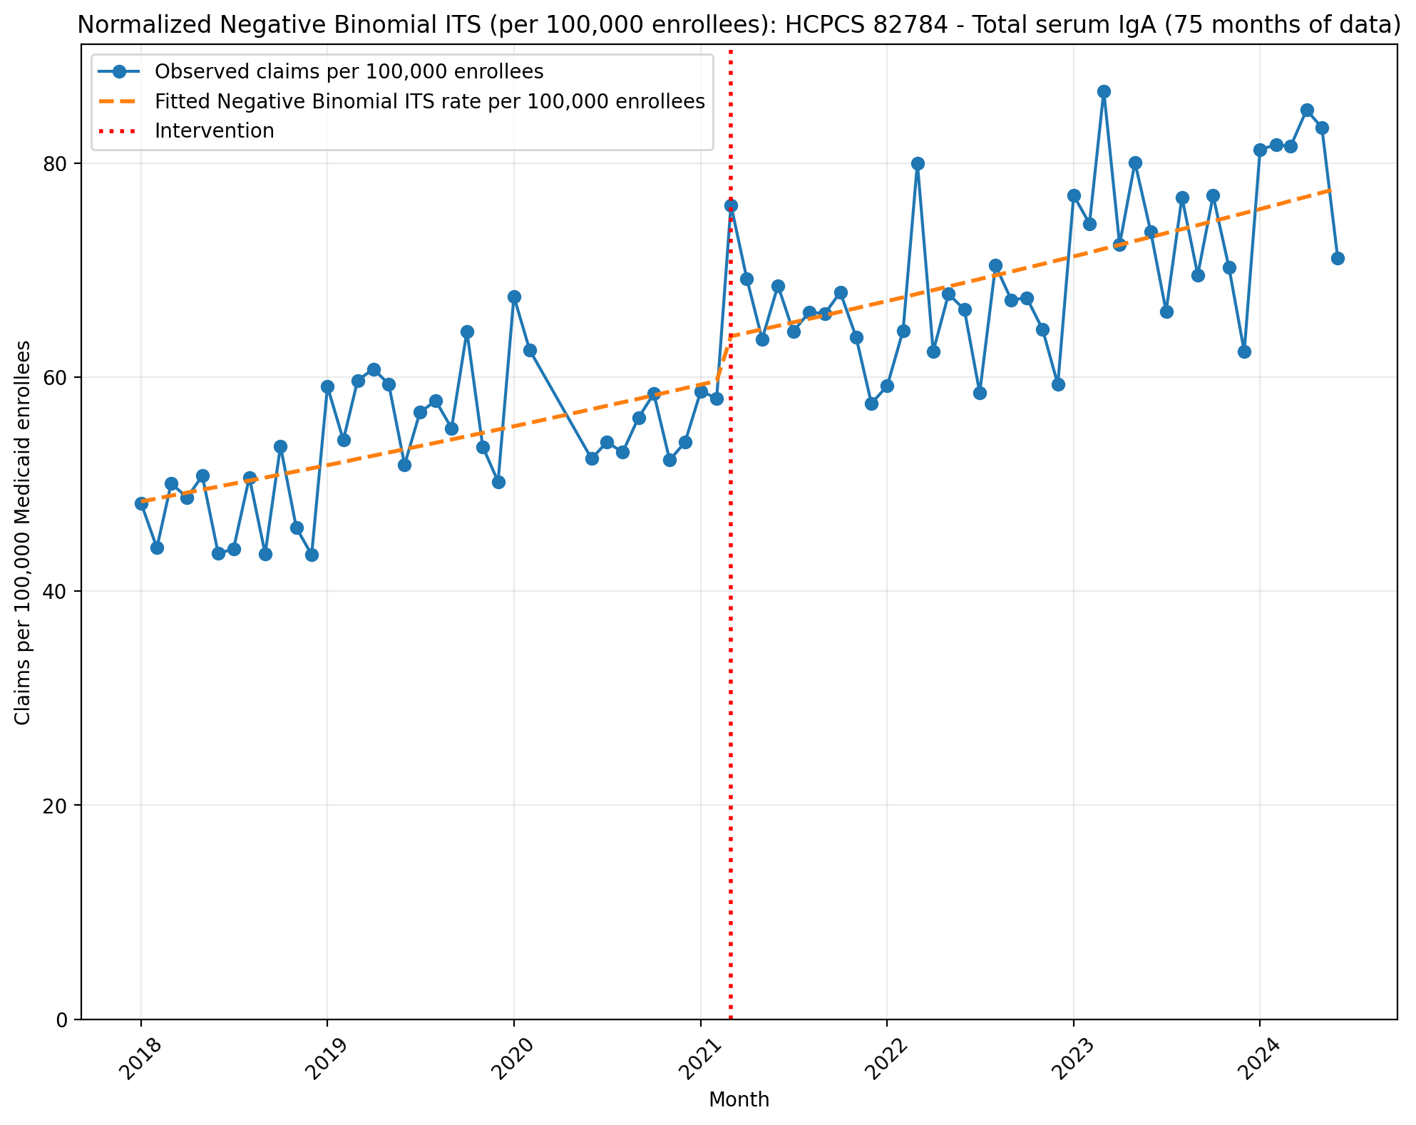
Normalized Negative Binomial ITS (per 100,000 enrollees): HCPCS 82784 - Total serum IgA (75 months of data)
NegativeBinomial Regression Results
==============================================================================
Dep. Variable: y No. Observations: 75
Model: NegativeBinomial Df Residuals: 71
Method: MLE Df Model: 3
Date: Sun, 17 May 2026 Pseudo R-squ.: 0.05982
Time: 22:46:56 Log-Likelihood: -744.17
converged: True LL-Null: -791.52
Covariance Type: nonrobust LLR p-value: 2.142e-20
==============================================================================
coef std err z P>|z| [0.025 0.975]
------------------------------------------------------------------------------
const -7.6338 0.030 -252.195 0.000 -7.693 -7.574
T 0.0057 0.001 3.898 0.000 0.003 0.009
X_t 0.0628 0.044 1.431 0.152 -0.023 0.149
post_time -0.0006 0.002 -0.329 0.742 -0.004 0.003
alpha 0.0088 0.001 6.119 0.000 0.006 0.012
==============================================================================

Slide 9
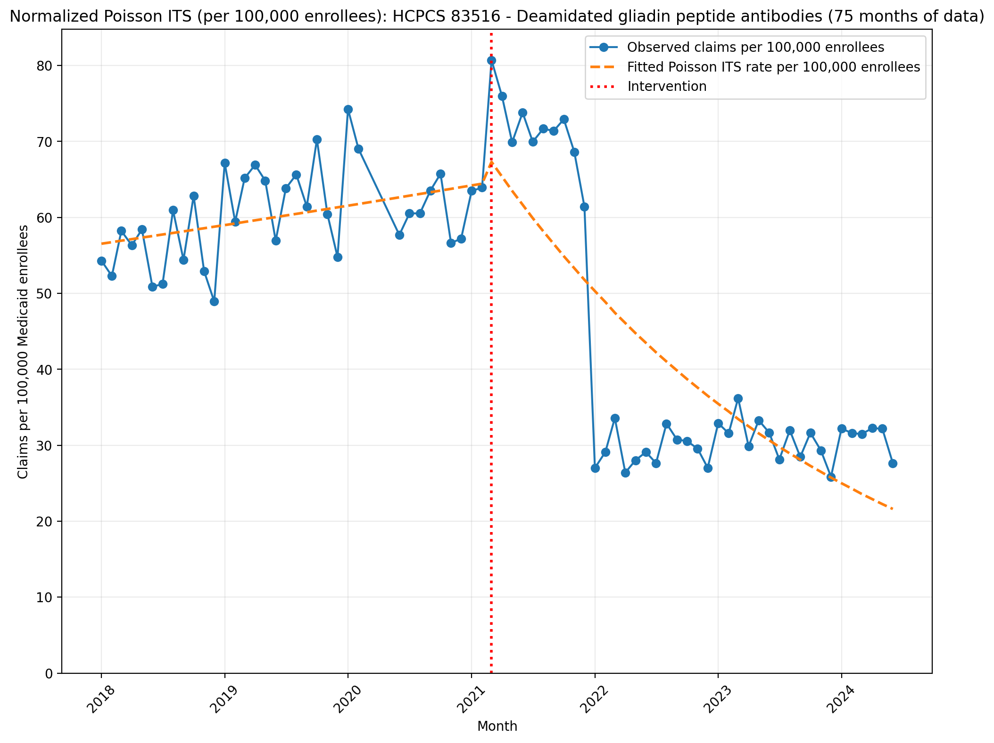
Normalized Poisson ITS (per 100,000 enrollees): HCPCS 83516 - Deamidated gliadin peptide antibodies (75 months of data)
Generalized Linear Model Regression Results
==============================================================================
Dep. Variable: y No. Observations: 75
Model: GLM Df Residuals: 71
Model Family: Poisson Df Model: 3
Link Function: Log Scale: 1.0000
Method: IRLS Log-Likelihood: -57476.
Date: Sun, 17 May 2026 Deviance: 1.1402e+05
Time: 22:46:57 Pearson chi2: 1.09e+05
No. Iterations: 5 Pseudo R-squ. (CS): 1.000
Covariance Type: nonrobust
==============================================================================
coef std err z P>|z| [0.025 0.975]
------------------------------------------------------------------------------
const -7.4780 0.002 -4974.495 0.000 -7.481 -7.475
T 0.0035 6.92e-05 51.089 0.000 0.003 0.004
X_t 0.0726 0.002 34.242 0.000 0.068 0.077
post_time -0.0327 0.000 -321.494 0.000 -0.033 -0.032
==============================================================================

Slide 10
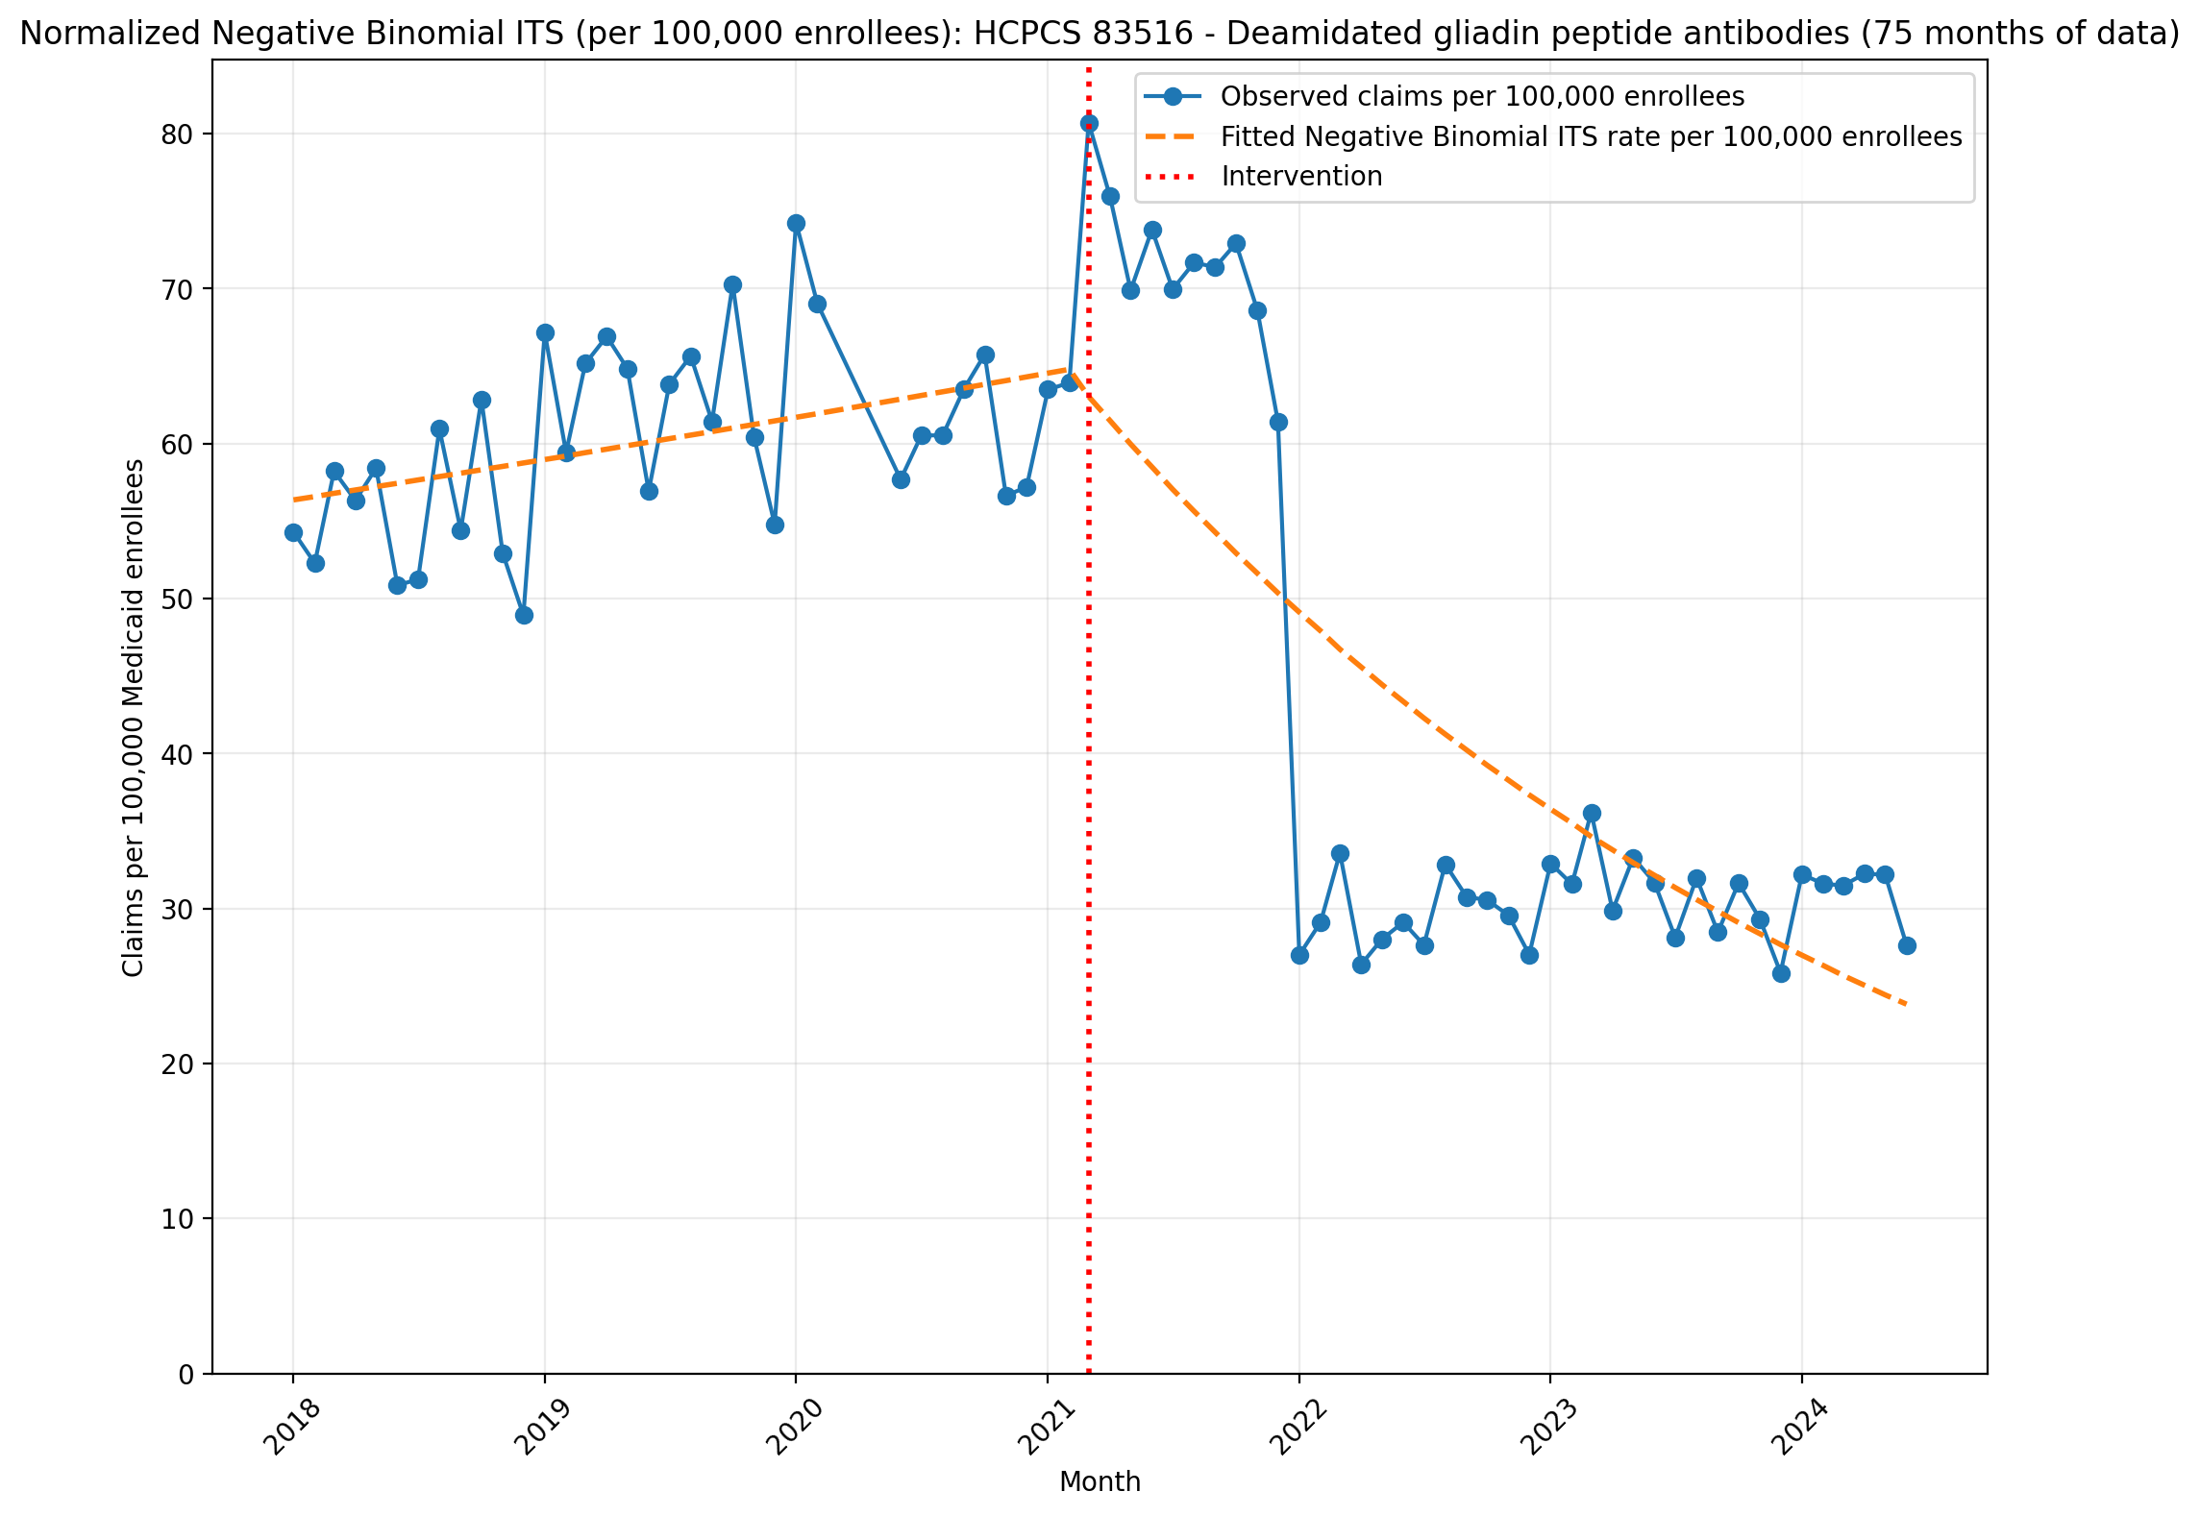
Normalized Negative Binomial ITS (per 100,000 enrollees): HCPCS 83516 - Deamidated gliadin peptide antibodies (75 months of data)
NegativeBinomial Regression Results
==============================================================================
Dep. Variable: y No. Observations: 75
Model: NegativeBinomial Df Residuals: 71
Method: MLE Df Model: 3
Date: Sun, 17 May 2026 Pseudo R-squ.: 0.05518
Time: 22:46:57 Log-Likelihood: -779.51
converged: True LL-Null: -825.03
Covariance Type: nonrobust LLR p-value: 1.302e-19
==============================================================================
coef std err z P>|z| [0.025 0.975]
------------------------------------------------------------------------------
const -7.4810 0.064 -117.721 0.000 -7.606 -7.356
T 0.0038 0.003 1.236 0.216 -0.002 0.010
X_t -0.0025 0.090 -0.028 0.978 -0.179 0.174
post_time -0.0287 0.004 -7.285 0.000 -0.036 -0.021
alpha 0.0389 0.006 6.159 0.000 0.026 0.051
==============================================================================

Slide 11
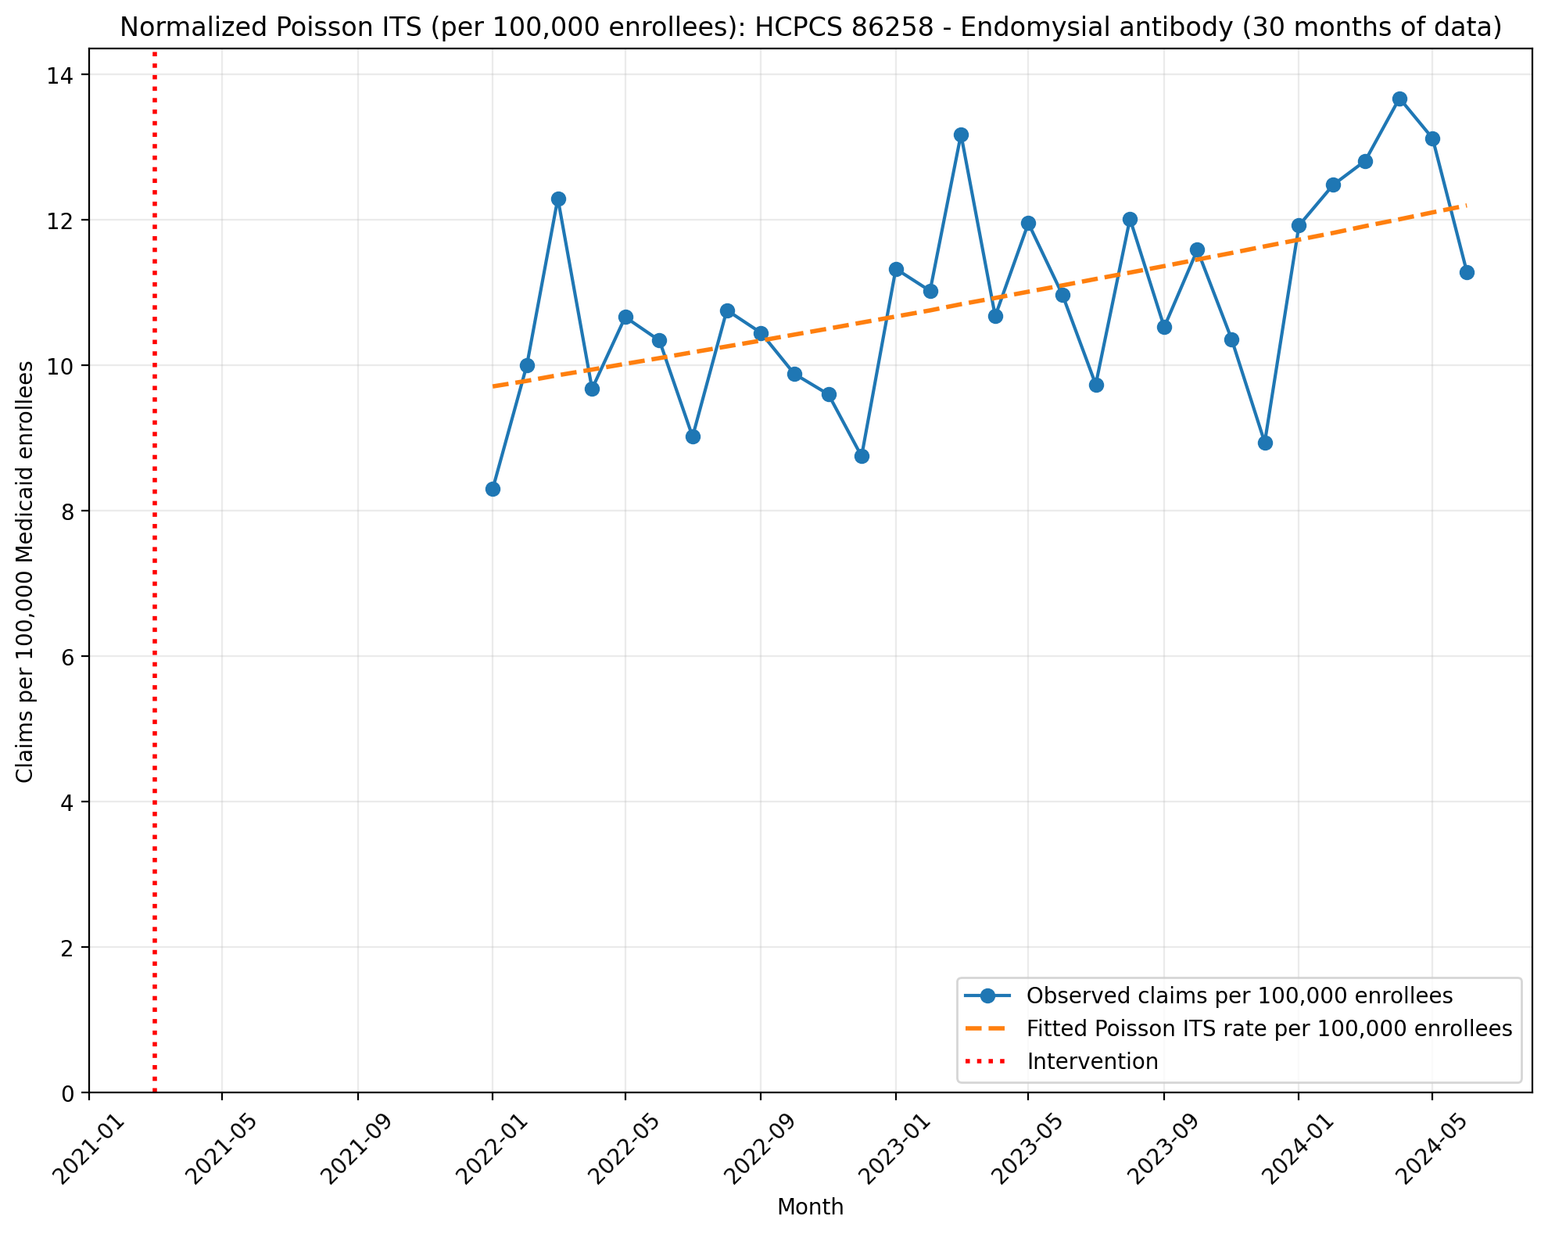
Normalized Poisson ITS (per 100,000 enrollees): HCPCS 86258 - Endomysial antibody (30 months of data)
Generalized Linear Model Regression Results
==============================================================================
Dep. Variable: y No. Observations: 30
Model: GLM Df Residuals: 28
Model Family: Poisson Df Model: 1
Link Function: Log Scale: 1.0000
Method: IRLS Log-Likelihood: -1871.5
Date: Sun, 17 May 2026 Deviance: 3410.9
Time: 22:46:58 Pearson chi2: 3.40e+03
No. Iterations: 4 Pseudo R-squ. (CS): 1.000
Covariance Type: nonrobust
==============================================================================
coef std err z P>|z| [0.025 0.975]
------------------------------------------------------------------------------
T 0.8341 0.001 1617.281 0.000 0.833 0.835
X_t -0.1509 7.58e-05 -1992.141 0.000 -0.151 -0.151
post_time -0.8263 0.000 -2566.698 0.000 -0.827 -0.826
==============================================================================

Slide 12
Normalized Negative Binomial ITS (per 100,000 enrollees): HCPCS 86258 - Endomysial antibody (30 months of data)
Negative Binomial ITS could not be fit:
Singular matrix

Slide 13
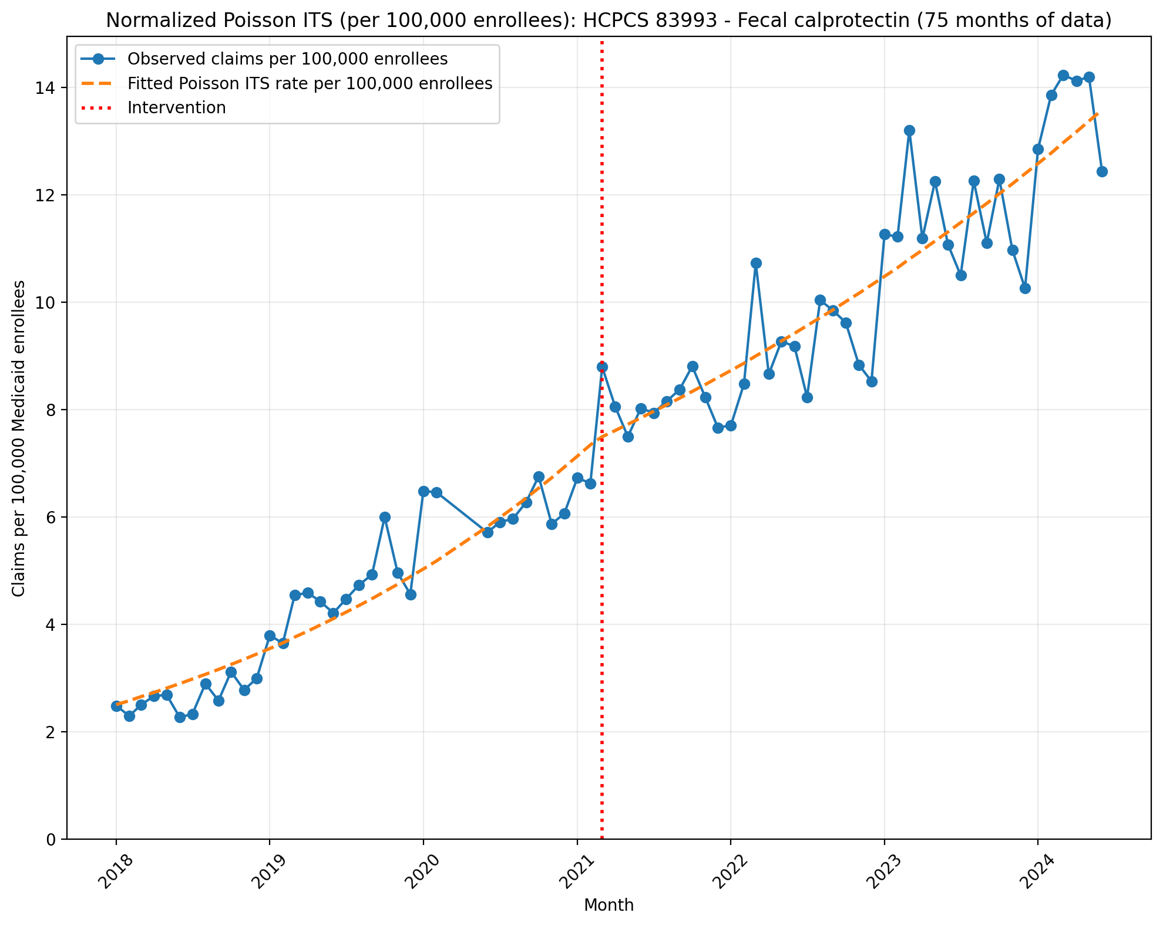
Normalized Poisson ITS (per 100,000 enrollees): HCPCS 83993 - Fecal calprotectin (75 months of data)
Generalized Linear Model Regression Results
==============================================================================
Dep. Variable: y No. Observations: 75
Model: GLM Df Residuals: 71
Model Family: Poisson Df Model: 3
Link Function: Log Scale: 1.0000
Method: IRLS Log-Likelihood: -2965.0
Date: Sun, 17 May 2026 Deviance: 5143.9
Time: 22:46:59 Pearson chi2: 5.19e+03
No. Iterations: 5 Pseudo R-squ. (CS): 1.000
Covariance Type: nonrobust
==============================================================================
coef std err z P>|z| [0.025 0.975]
------------------------------------------------------------------------------
const -10.5961 0.006 -1676.888 0.000 -10.608 -10.584
T 0.0291 0.000 112.736 0.000 0.029 0.030
X_t 0.0052 0.006 0.853 0.394 -0.007 0.017
post_time -0.0139 0.000 -46.822 0.000 -0.014 -0.013
==============================================================================

Slide 14
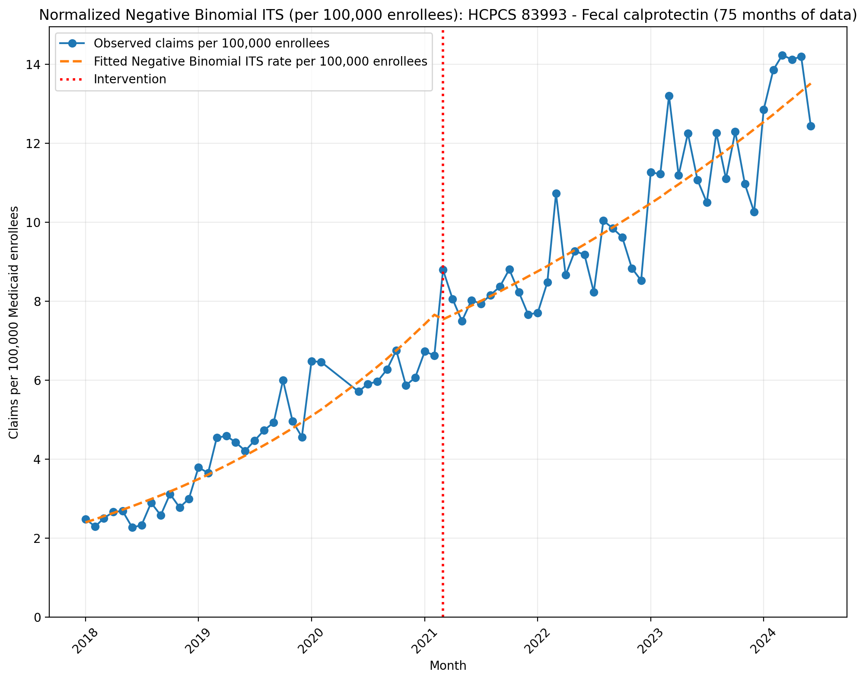
Normalized Negative Binomial ITS (per 100,000 enrollees): HCPCS 83993 - Fecal calprotectin (75 months of data)
NegativeBinomial Regression Results
==============================================================================
Dep. Variable: y No. Observations: 75
Model: NegativeBinomial Df Residuals: 71
Method: MLE Df Model: 3
Date: Sun, 17 May 2026 Pseudo R-squ.: 0.1637
Time: 22:47:00 Log-Likelihood: -588.71
converged: True LL-Null: -703.96
Covariance Type: nonrobust LLR p-value: 1.077e-49
==============================================================================
coef std err z P>|z| [0.025 0.975]
------------------------------------------------------------------------------
const -10.6385 0.036 -296.504 0.000 -10.709 -10.568
T 0.0314 0.002 18.249 0.000 0.028 0.035
X_t -0.0302 0.051 -0.588 0.557 -0.131 0.070
post_time -0.0164 0.002 -7.243 0.000 -0.021 -0.012
alpha 0.0117 0.002 6.014 0.000 0.008 0.015
==============================================================================

Slide 15
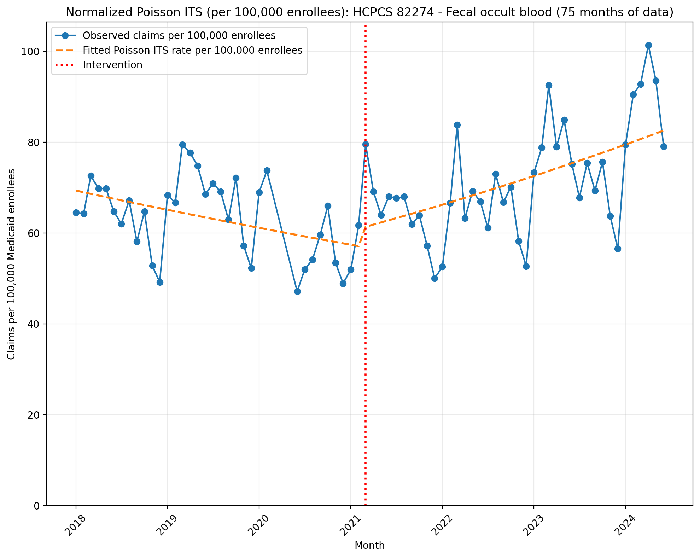
Normalized Poisson ITS (per 100,000 enrollees): HCPCS 82274 - Fecal occult blood (75 months of data)
Generalized Linear Model Regression Results
==============================================================================
Dep. Variable: y No. Observations: 75
Model: GLM Df Residuals: 71
Model Family: Poisson Df Model: 3
Link Function: Log Scale: 1.0000
Method: IRLS Log-Likelihood: -39679.
Date: Sun, 17 May 2026 Deviance: 78399.
Time: 22:47:01 Pearson chi2: 7.78e+04
No. Iterations: 4 Pseudo R-squ. (CS): 1.000
Covariance Type: nonrobust
==============================================================================
coef std err z P>|z| [0.025 0.975]
------------------------------------------------------------------------------
const -7.2738 0.001 -5152.926 0.000 -7.277 -7.271
T -0.0052 6.81e-05 -76.979 0.000 -0.005 -0.005
X_t 0.0645 0.002 31.821 0.000 0.061 0.068
post_time 0.0128 8.71e-05 147.350 0.000 0.013 0.013
==============================================================================

Slide 16
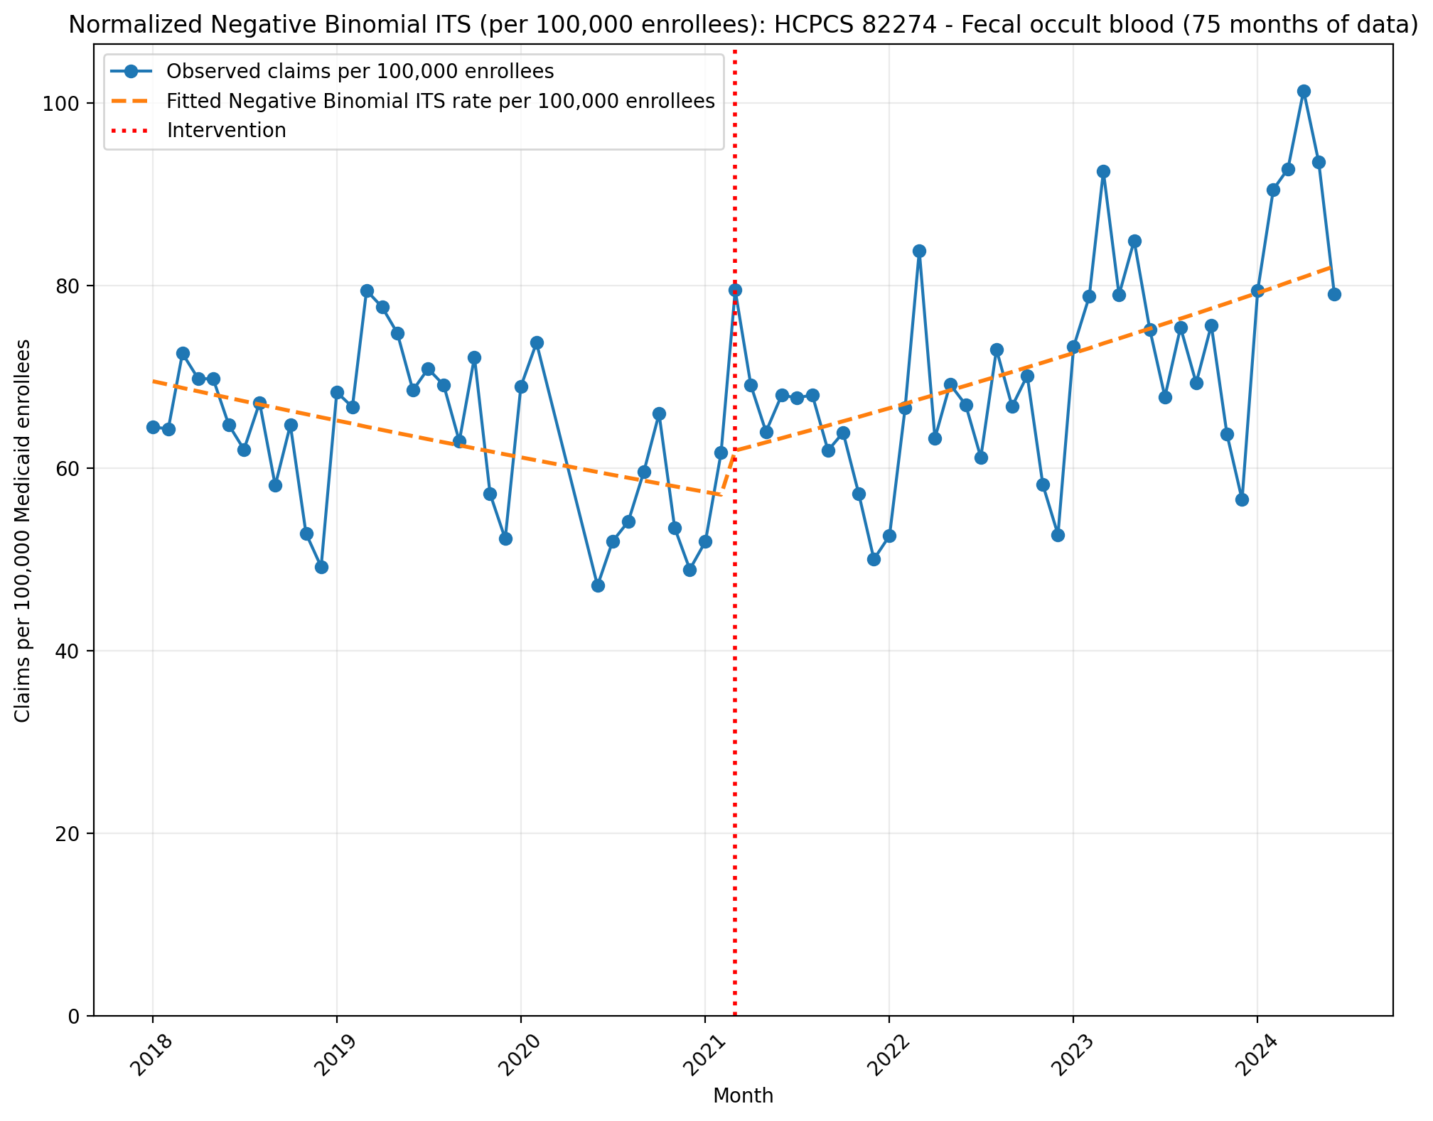
Normalized Negative Binomial ITS (per 100,000 enrollees): HCPCS 82274 - Fecal occult blood (75 months of data)
NegativeBinomial Regression Results
==============================================================================
Dep. Variable: y No. Observations: 75
Model: NegativeBinomial Df Residuals: 71
Method: MLE Df Model: 3
Date: Sun, 17 May 2026 Pseudo R-squ.: 0.01951
Time: 22:47:01 Log-Likelihood: -777.14
converged: True LL-Null: -792.60
Covariance Type: nonrobust LLR p-value: 8.801e-07
==============================================================================
coef std err z P>|z| [0.025 0.975]
------------------------------------------------------------------------------
const -7.2712 0.043 -168.248 0.000 -7.356 -7.186
T -0.0053 0.002 -2.572 0.010 -0.009 -0.001
X_t 0.0741 0.062 1.186 0.236 -0.048 0.197
post_time 0.0126 0.003 4.583 0.000 0.007 0.018
alpha 0.0179 0.003 6.136 0.000 0.012 0.024
==============================================================================

Slide 17
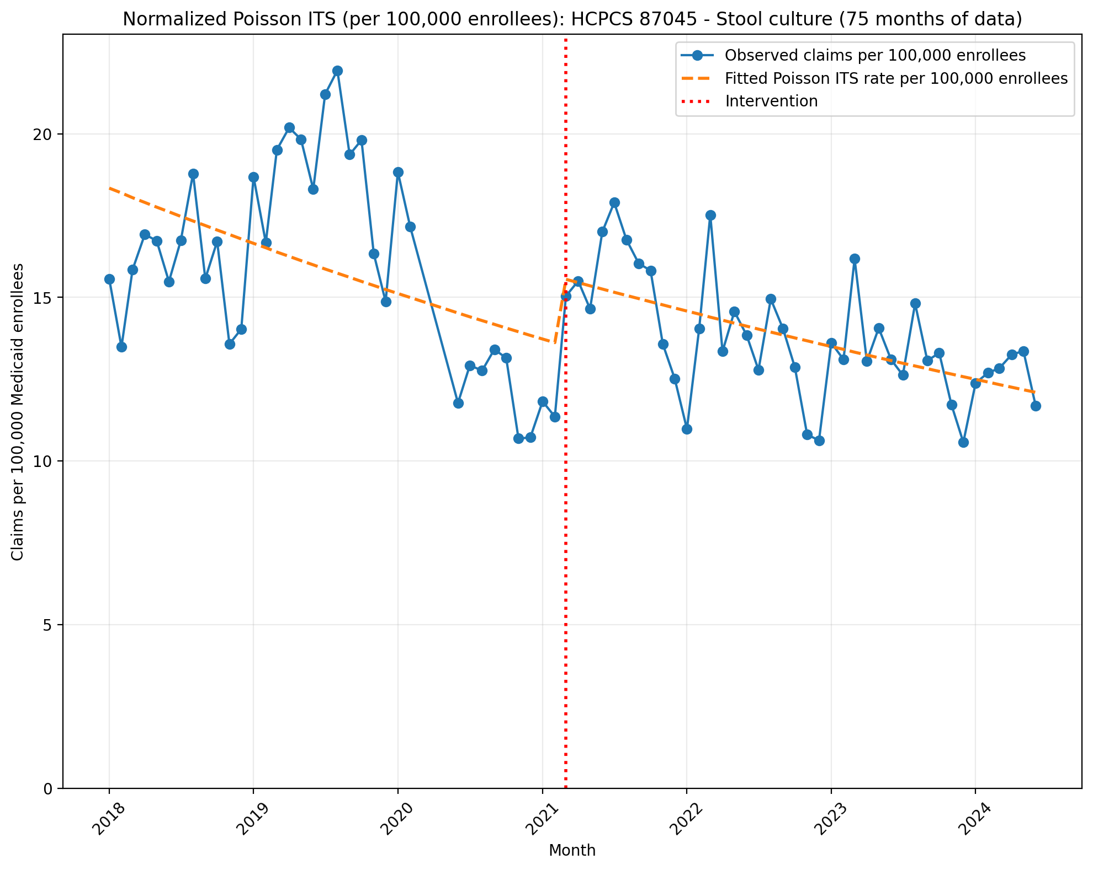
Normalized Poisson ITS (per 100,000 enrollees): HCPCS 87045 - Stool culture (75 months of data)
Generalized Linear Model Regression Results
==============================================================================
Dep. Variable: y No. Observations: 75
Model: GLM Df Residuals: 71
Model Family: Poisson Df Model: 3
Link Function: Log Scale: 1.0000
Method: IRLS Log-Likelihood: -9909.2
Date: Sun, 17 May 2026 Deviance: 18974.
Time: 22:47:02 Pearson chi2: 1.92e+04
No. Iterations: 4 Pseudo R-squ. (CS): 1.000
Covariance Type: nonrobust
==============================================================================
coef std err z P>|z| [0.025 0.975]
------------------------------------------------------------------------------
const -8.6038 0.003 -3096.461 0.000 -8.609 -8.598
T -0.0080 0.000 -59.128 0.000 -0.008 -0.008
X_t 0.1393 0.004 33.198 0.000 0.131 0.148
post_time 0.0016 0.000 8.742 0.000 0.001 0.002
==============================================================================

Slide 18
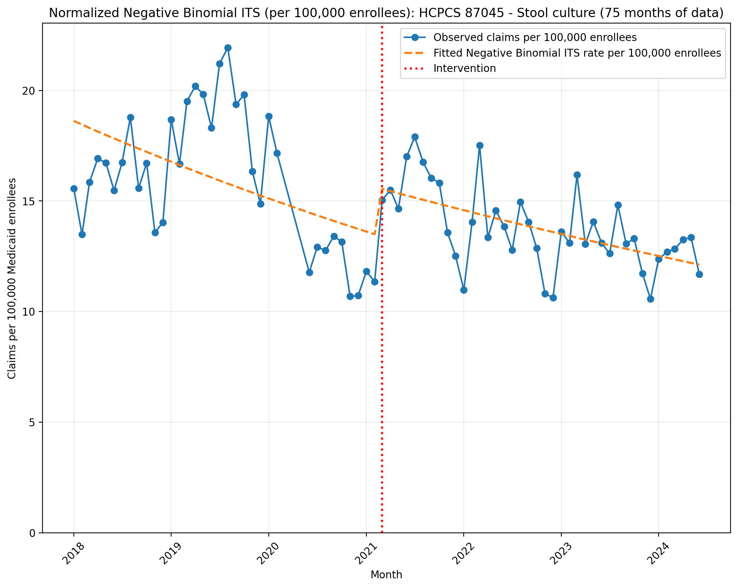
Normalized Negative Binomial ITS (per 100,000 enrollees): HCPCS 87045 - Stool culture (75 months of data)
NegativeBinomial Regression Results
==============================================================================
Dep. Variable: y No. Observations: 75
Model: NegativeBinomial Df Residuals: 71
Method: MLE Df Model: 3
Date: Sun, 17 May 2026 Pseudo R-squ.: 0.02640
Time: 22:47:02 Log-Likelihood: -667.43
converged: True LL-Null: -685.52
Covariance Type: nonrobust LLR p-value: 6.825e-08
==============================================================================
coef std err z P>|z| [0.025 0.975]
------------------------------------------------------------------------------
const -8.5886 0.047 -181.060 0.000 -8.682 -8.496
T -0.0087 0.002 -3.775 0.000 -0.013 -0.004
X_t 0.1473 0.068 2.170 0.030 0.014 0.280
post_time 0.0023 0.003 0.771 0.441 -0.004 0.008
alpha 0.0201 0.003 6.120 0.000 0.014 0.027
==============================================================================

Slide 19
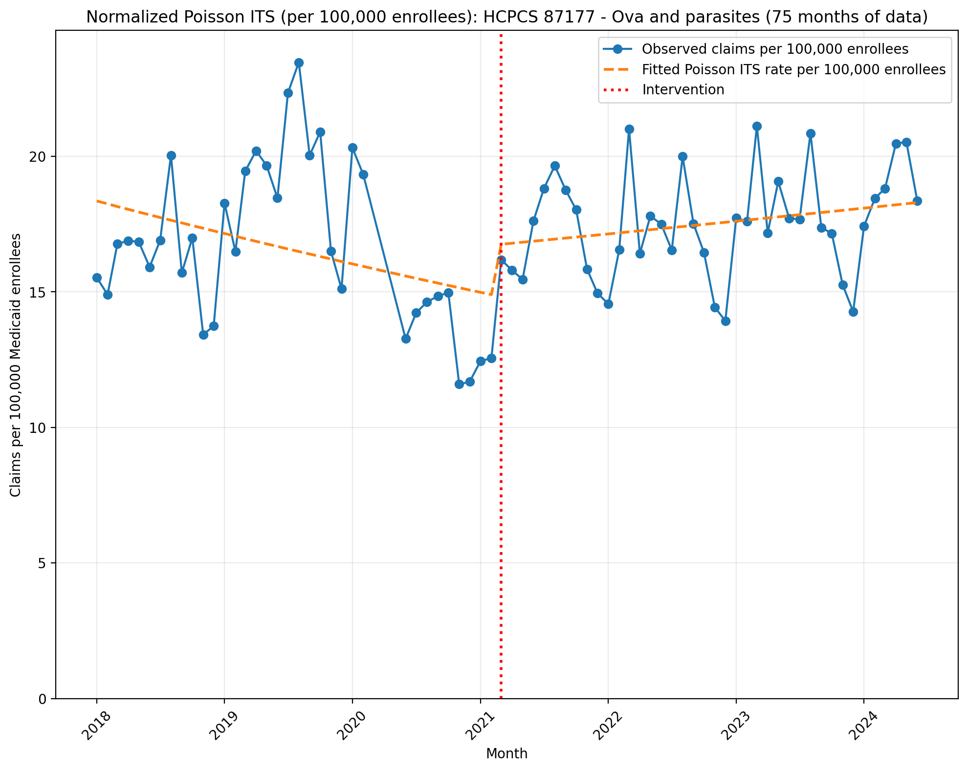
Normalized Poisson ITS (per 100,000 enrollees): HCPCS 87177 - Ova and parasites (75 months of data)
Generalized Linear Model Regression Results
==============================================================================
Dep. Variable: y No. Observations: 75
Model: GLM Df Residuals: 71
Model Family: Poisson Df Model: 3
Link Function: Log Scale: 1.0000
Method: IRLS Log-Likelihood: -10512.
Date: Sun, 17 May 2026 Deviance: 20168.
Time: 22:47:04 Pearson chi2: 2.05e+04
No. Iterations: 4 Pseudo R-squ. (CS): 1.000
Covariance Type: nonrobust
==============================================================================
coef std err z P>|z| [0.025 0.975]
------------------------------------------------------------------------------
const -8.6032 0.003 -3129.940 0.000 -8.609 -8.598
T -0.0056 0.000 -42.421 0.000 -0.006 -0.005
X_t 0.1152 0.004 29.008 0.000 0.107 0.123
post_time 0.0079 0.000 45.807 0.000 0.008 0.008
==============================================================================

Slide 20
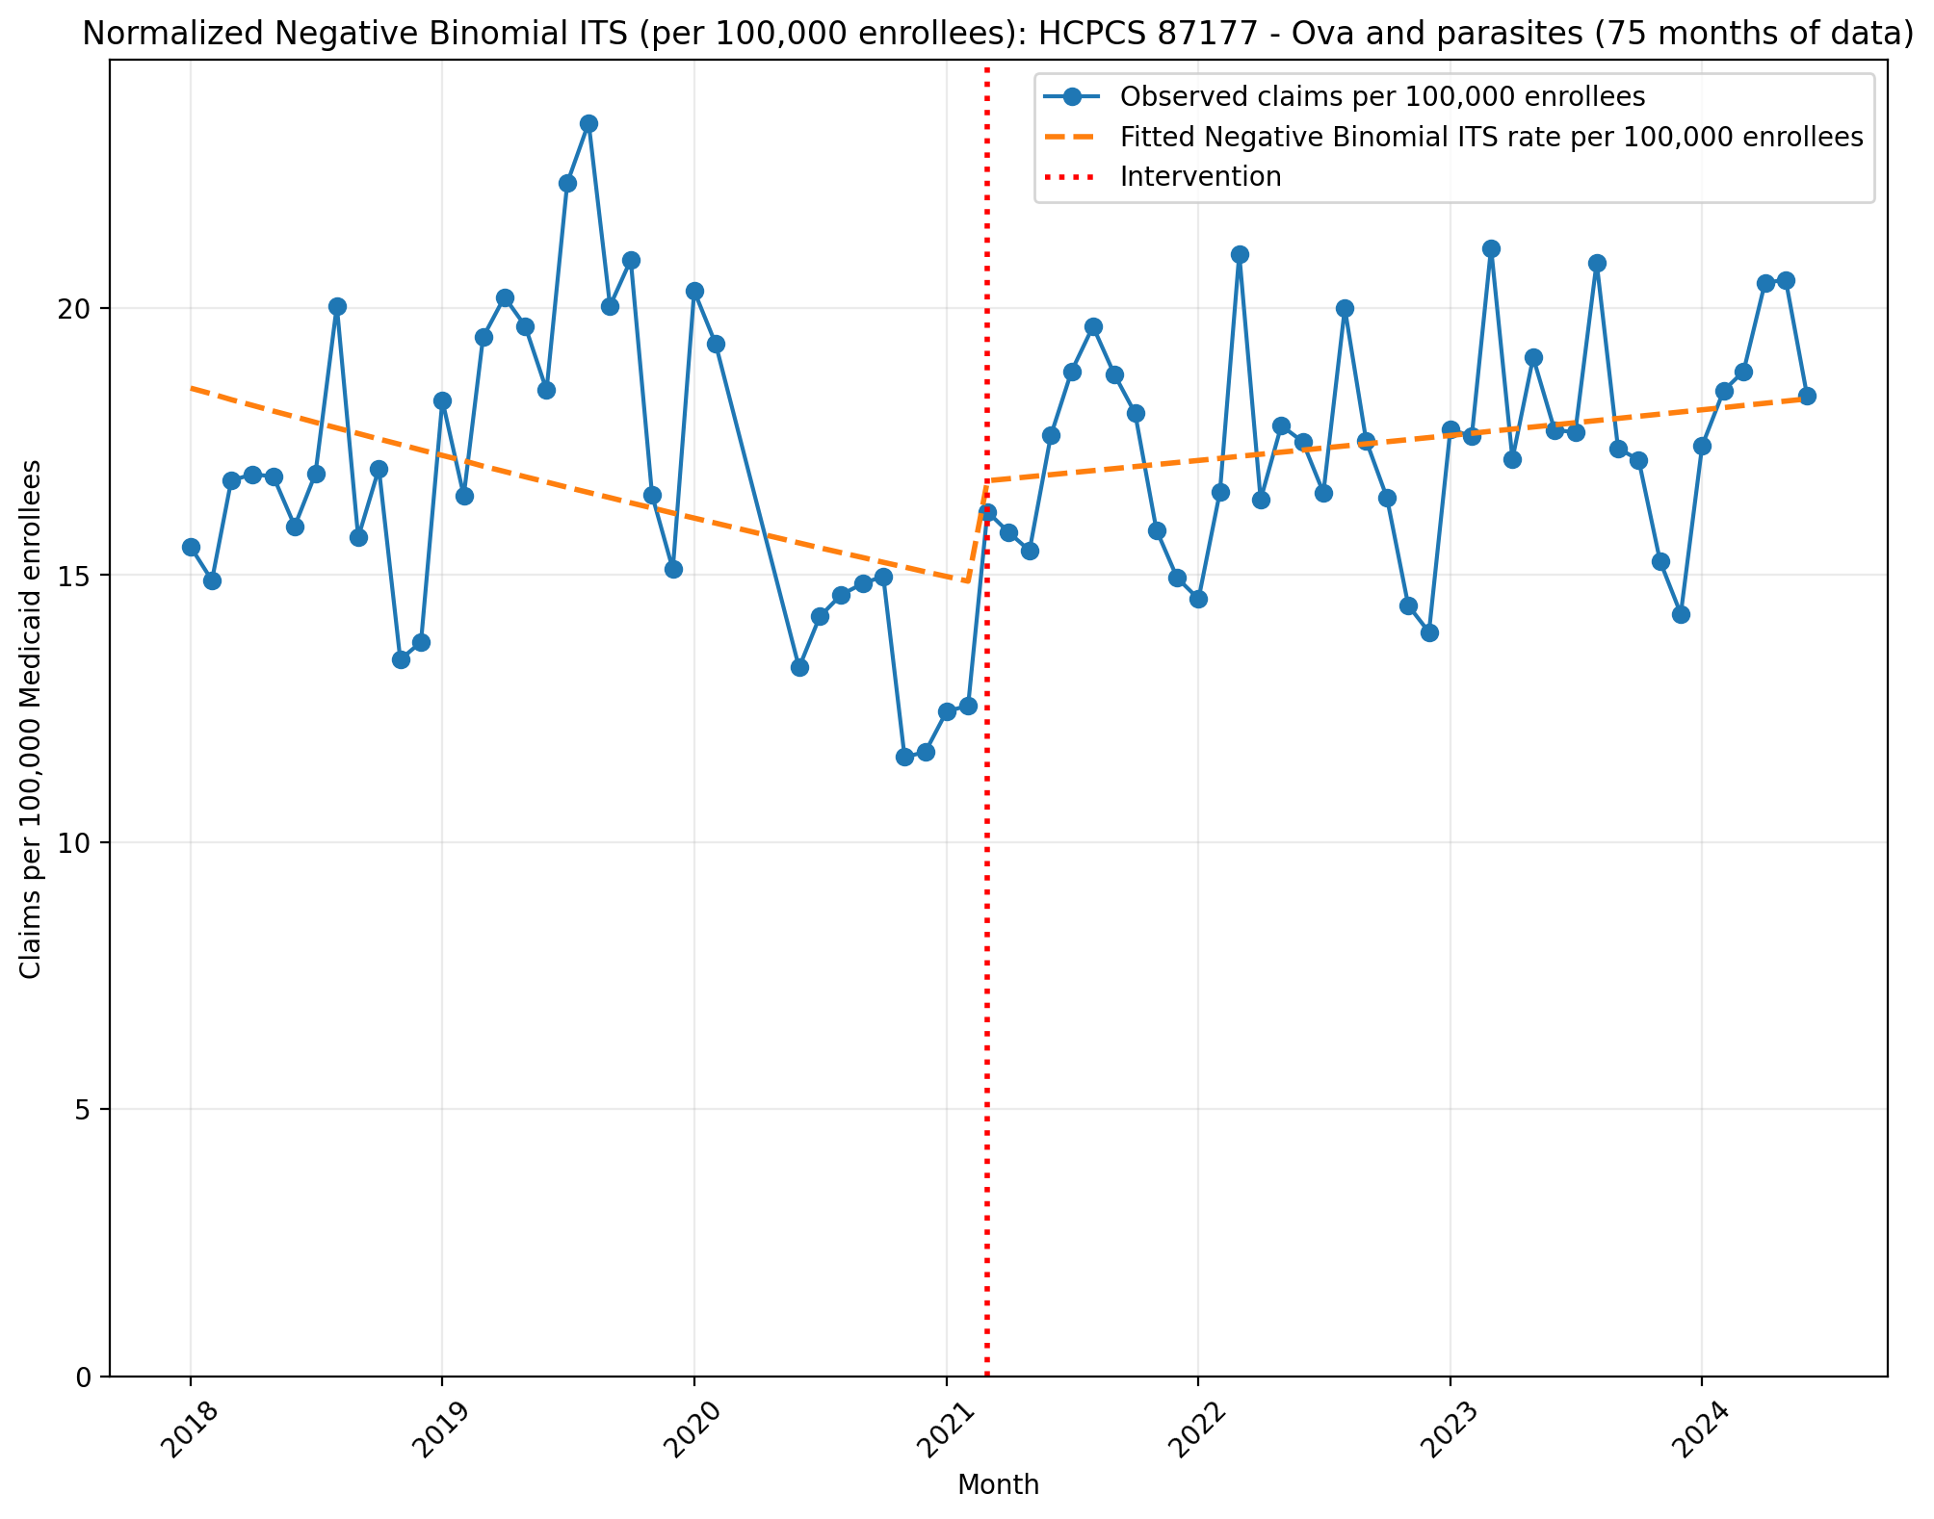
Normalized Negative Binomial ITS (per 100,000 enrollees): HCPCS 87177 - Ova and parasites (75 months of data)
NegativeBinomial Regression Results
==============================================================================
Dep. Variable: y No. Observations: 75
Model: NegativeBinomial Df Residuals: 71
Method: MLE Df Model: 3
Date: Sun, 17 May 2026 Pseudo R-squ.: 0.007258
Time: 22:47:04 Log-Likelihood: -676.88
converged: True LL-Null: -681.83
Covariance Type: nonrobust LLR p-value: 0.01946
==============================================================================
coef std err z P>|z| [0.025 0.975]
------------------------------------------------------------------------------
const -8.5952 0.046 -186.633 0.000 -8.685 -8.505
T -0.0059 0.002 -2.635 0.008 -0.010 -0.002
X_t 0.1168 0.066 1.766 0.077 -0.013 0.246
post_time 0.0081 0.003 2.776 0.005 0.002 0.014
alpha 0.0192 0.003 6.120 0.000 0.013 0.025
==============================================================================

Slide 21
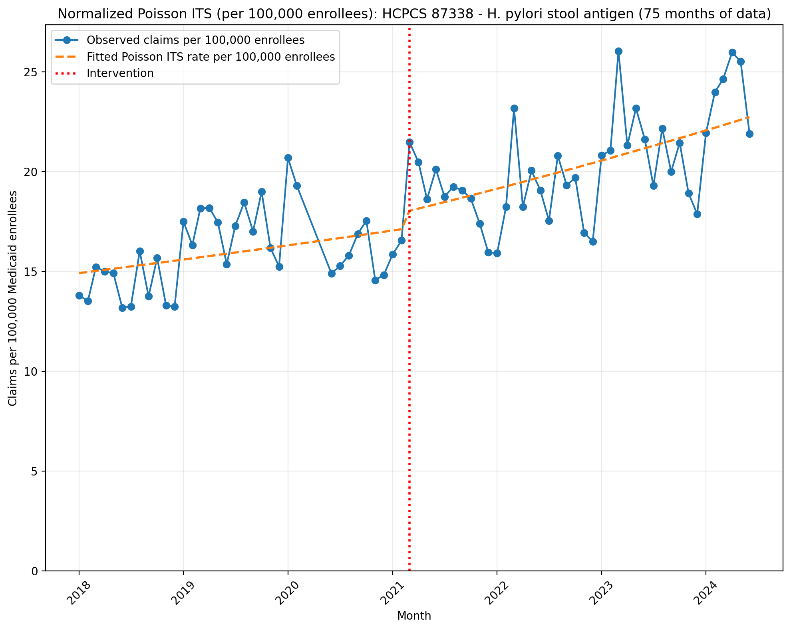
Normalized Poisson ITS (per 100,000 enrollees): HCPCS 87338 - H. pylori stool antigen (75 months of data)
Generalized Linear Model Regression Results
==============================================================================
Dep. Variable: y No. Observations: 75
Model: GLM Df Residuals: 71
Model Family: Poisson Df Model: 3
Link Function: Log Scale: 1.0000
Method: IRLS Log-Likelihood: -7263.3
Date: Sun, 17 May 2026 Deviance: 13666.
Time: 22:47:05 Pearson chi2: 1.38e+04
No. Iterations: 4 Pseudo R-squ. (CS): 1.000
Covariance Type: nonrobust
==============================================================================
coef std err z P>|z| [0.025 0.975]
------------------------------------------------------------------------------
const -8.8104 0.003 -3013.009 0.000 -8.816 -8.805
T 0.0037 0.000 27.650 0.000 0.003 0.004
X_t 0.0469 0.004 12.303 0.000 0.039 0.054
post_time 0.0022 0.000 13.088 0.000 0.002 0.003
==============================================================================

Slide 22
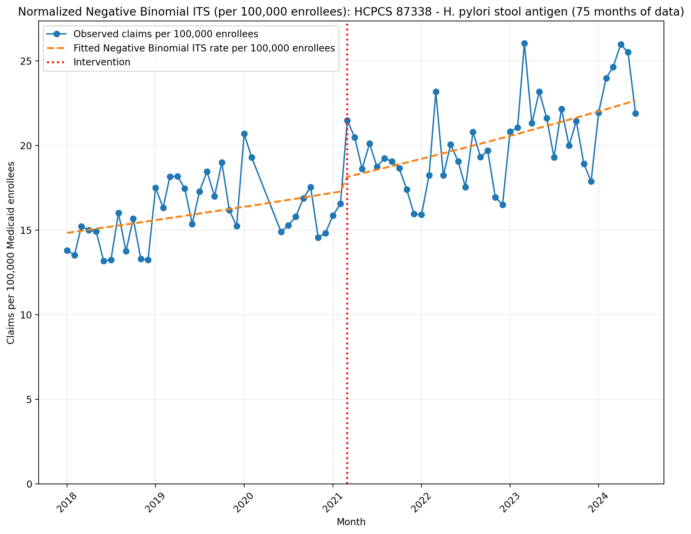
Normalized Negative Binomial ITS (per 100,000 enrollees): HCPCS 87338 - H. pylori stool antigen (75 months of data)
NegativeBinomial Regression Results
==============================================================================
Dep. Variable: y No. Observations: 75
Model: NegativeBinomial Df Residuals: 71
Method: MLE Df Model: 3
Date: Sun, 17 May 2026 Pseudo R-squ.: 0.05005
Time: 22:47:05 Log-Likelihood: -662.11
converged: False LL-Null: -696.99
Covariance Type: nonrobust LLR p-value: 4.791e-15
==============================================================================
coef std err z P>|z| [0.025 0.975]
------------------------------------------------------------------------------
const -8.8156 0.035 -253.014 0.000 -8.884 -8.747
T 0.0041 0.002 2.457 0.014 0.001 0.007
X_t 0.0438 0.050 0.871 0.384 -0.055 0.142
post_time 0.0016 0.002 0.710 0.478 -0.003 0.006
alpha 0.0114 0.002 6.100 0.000 0.008 0.015
==============================================================================

Slide 23
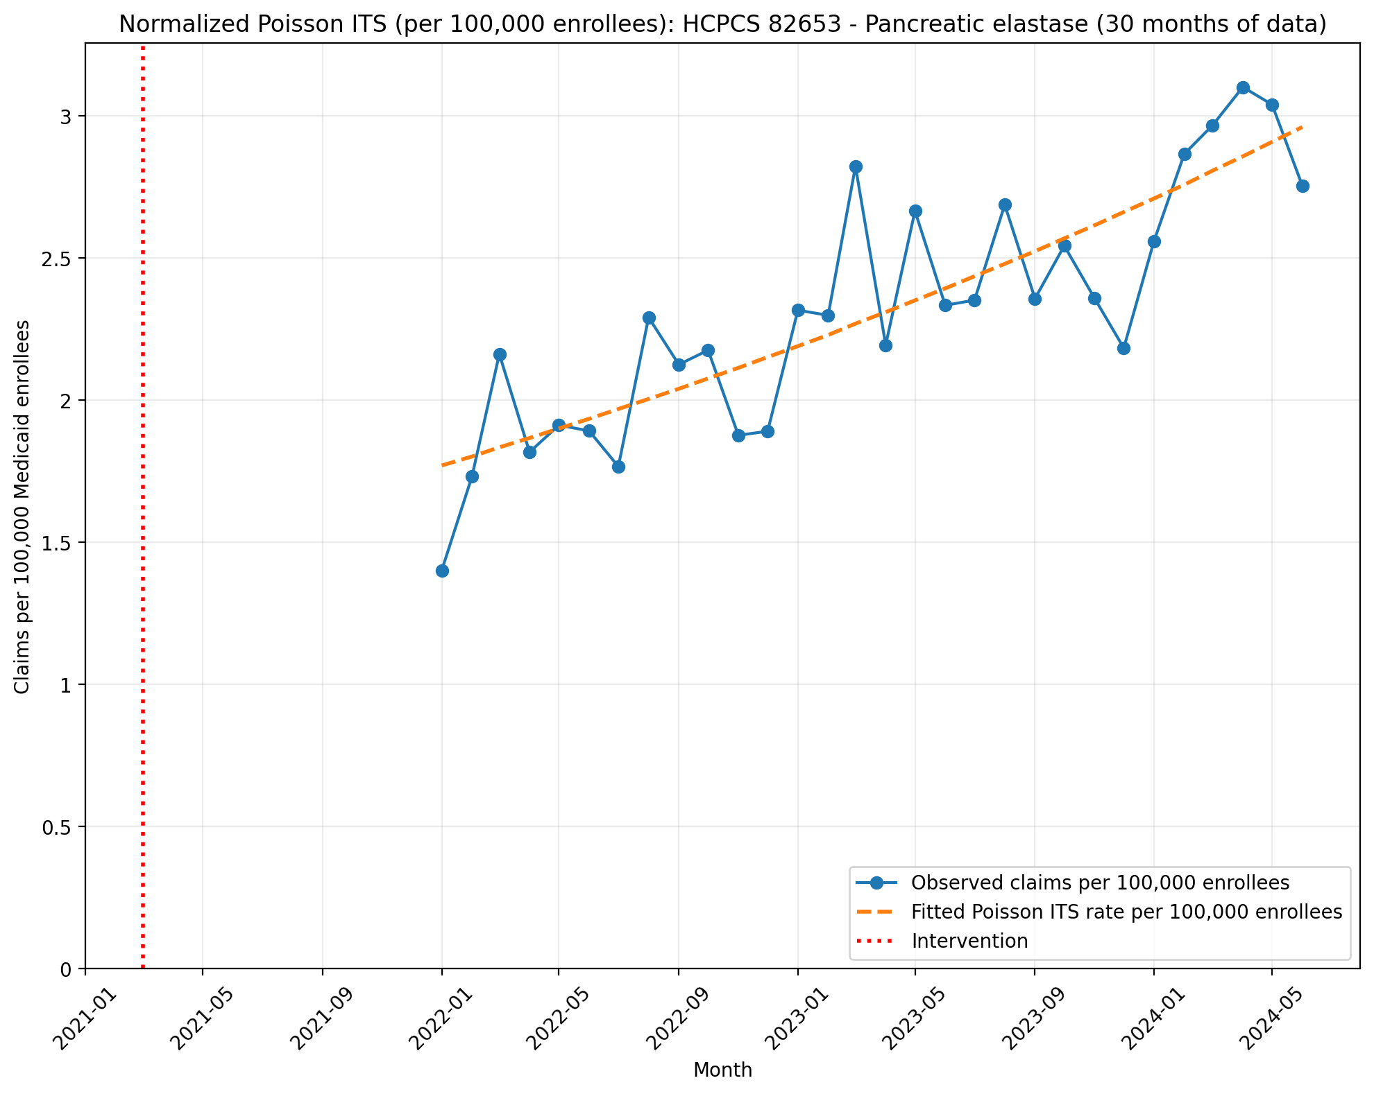
Normalized Poisson ITS (per 100,000 enrollees): HCPCS 82653 - Pancreatic elastase (30 months of data)
Generalized Linear Model Regression Results
==============================================================================
Dep. Variable: y No. Observations: 30
Model: GLM Df Residuals: 28
Model Family: Poisson Df Model: 1
Link Function: Log Scale: 1.0000
Method: IRLS Log-Likelihood: -458.10
Date: Sun, 17 May 2026 Deviance: 630.85
Time: 22:47:06 Pearson chi2: 633.
No. Iterations: 4 Pseudo R-squ. (CS): 1.000
Covariance Type: nonrobust
==============================================================================
coef std err z P>|z| [0.025 0.975]
------------------------------------------------------------------------------
T 0.9961 0.001 864.107 0.000 0.994 0.998
X_t -0.1795 0.000 -1054.930 0.000 -0.180 -0.179
post_time -0.9784 0.001 -1345.331 0.000 -0.980 -0.977
==============================================================================

Slide 24
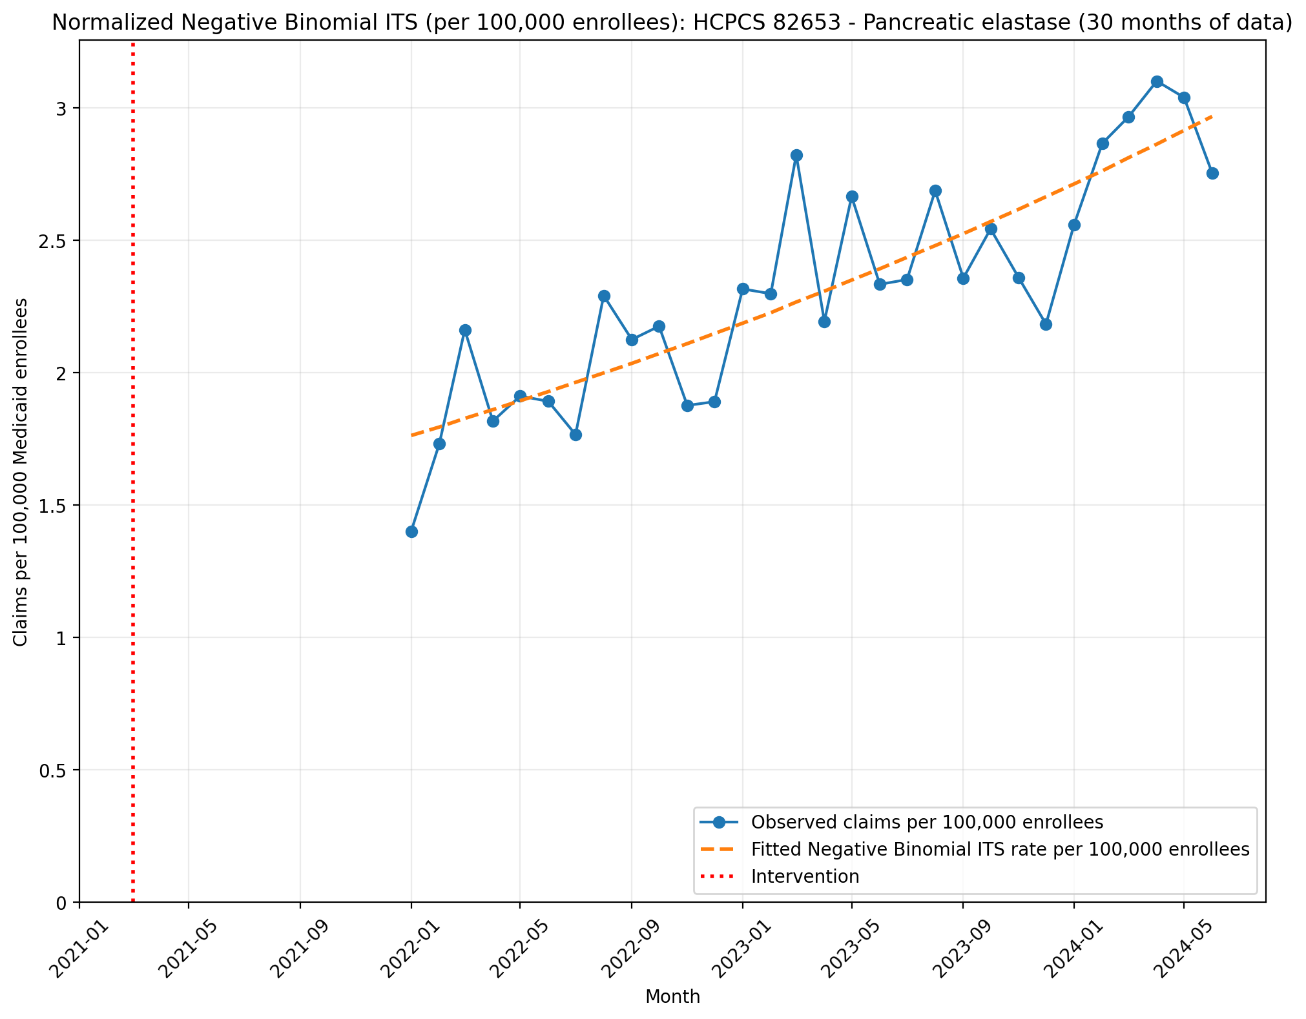
Normalized Negative Binomial ITS (per 100,000 enrollees): HCPCS 82653 - Pancreatic elastase (30 months of data)
NegativeBinomial Regression Results
==============================================================================
Dep. Variable: y No. Observations: 30
Model: NegativeBinomial Df Residuals: 28
Method: MLE Df Model: 1
Date: Sun, 17 May 2026 Pseudo R-squ.: 0.08241
Time: 22:47:06 Log-Likelihood: -203.77
converged: True LL-Null: -222.07
Covariance Type: nonrobust LLR p-value: 1.448e-09
==============================================================================
coef std err z P>|z| [0.025 0.975]
------------------------------------------------------------------------------
T 0.0423 nan nan nan nan nan
X_t -10.6788 nan nan nan nan nan
post_time -0.0243 nan nan nan nan nan
alpha 0.0095 nan nan nan nan nan
==============================================================================

Slide 25
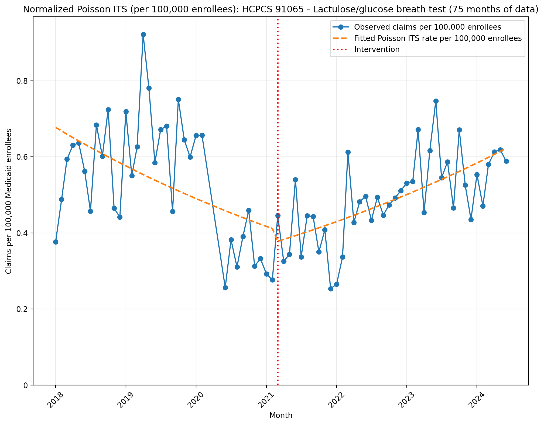
Normalized Poisson ITS (per 100,000 enrollees): HCPCS 91065 - Lactulose/glucose breath test (75 months of data)
Generalized Linear Model Regression Results
==============================================================================
Dep. Variable: y No. Observations: 75
Model: GLM Df Residuals: 71
Model Family: Poisson Df Model: 3
Link Function: Log Scale: 1.0000
Method: IRLS Log-Likelihood: -1107.6
Date: Sun, 17 May 2026 Deviance: 1624.1
Time: 22:47:07 Pearson chi2: 1.63e+03
No. Iterations: 4 Pseudo R-squ. (CS): 1.000
Covariance Type: nonrobust
==============================================================================
coef std err z P>|z| [0.025 0.975]
------------------------------------------------------------------------------
const -11.9028 0.015 -804.263 0.000 -11.932 -11.874
T -0.0135 0.001 -18.018 0.000 -0.015 -0.012
X_t -0.0978 0.024 -4.077 0.000 -0.145 -0.051
post_time 0.0262 0.001 26.343 0.000 0.024 0.028
==============================================================================

Slide 26
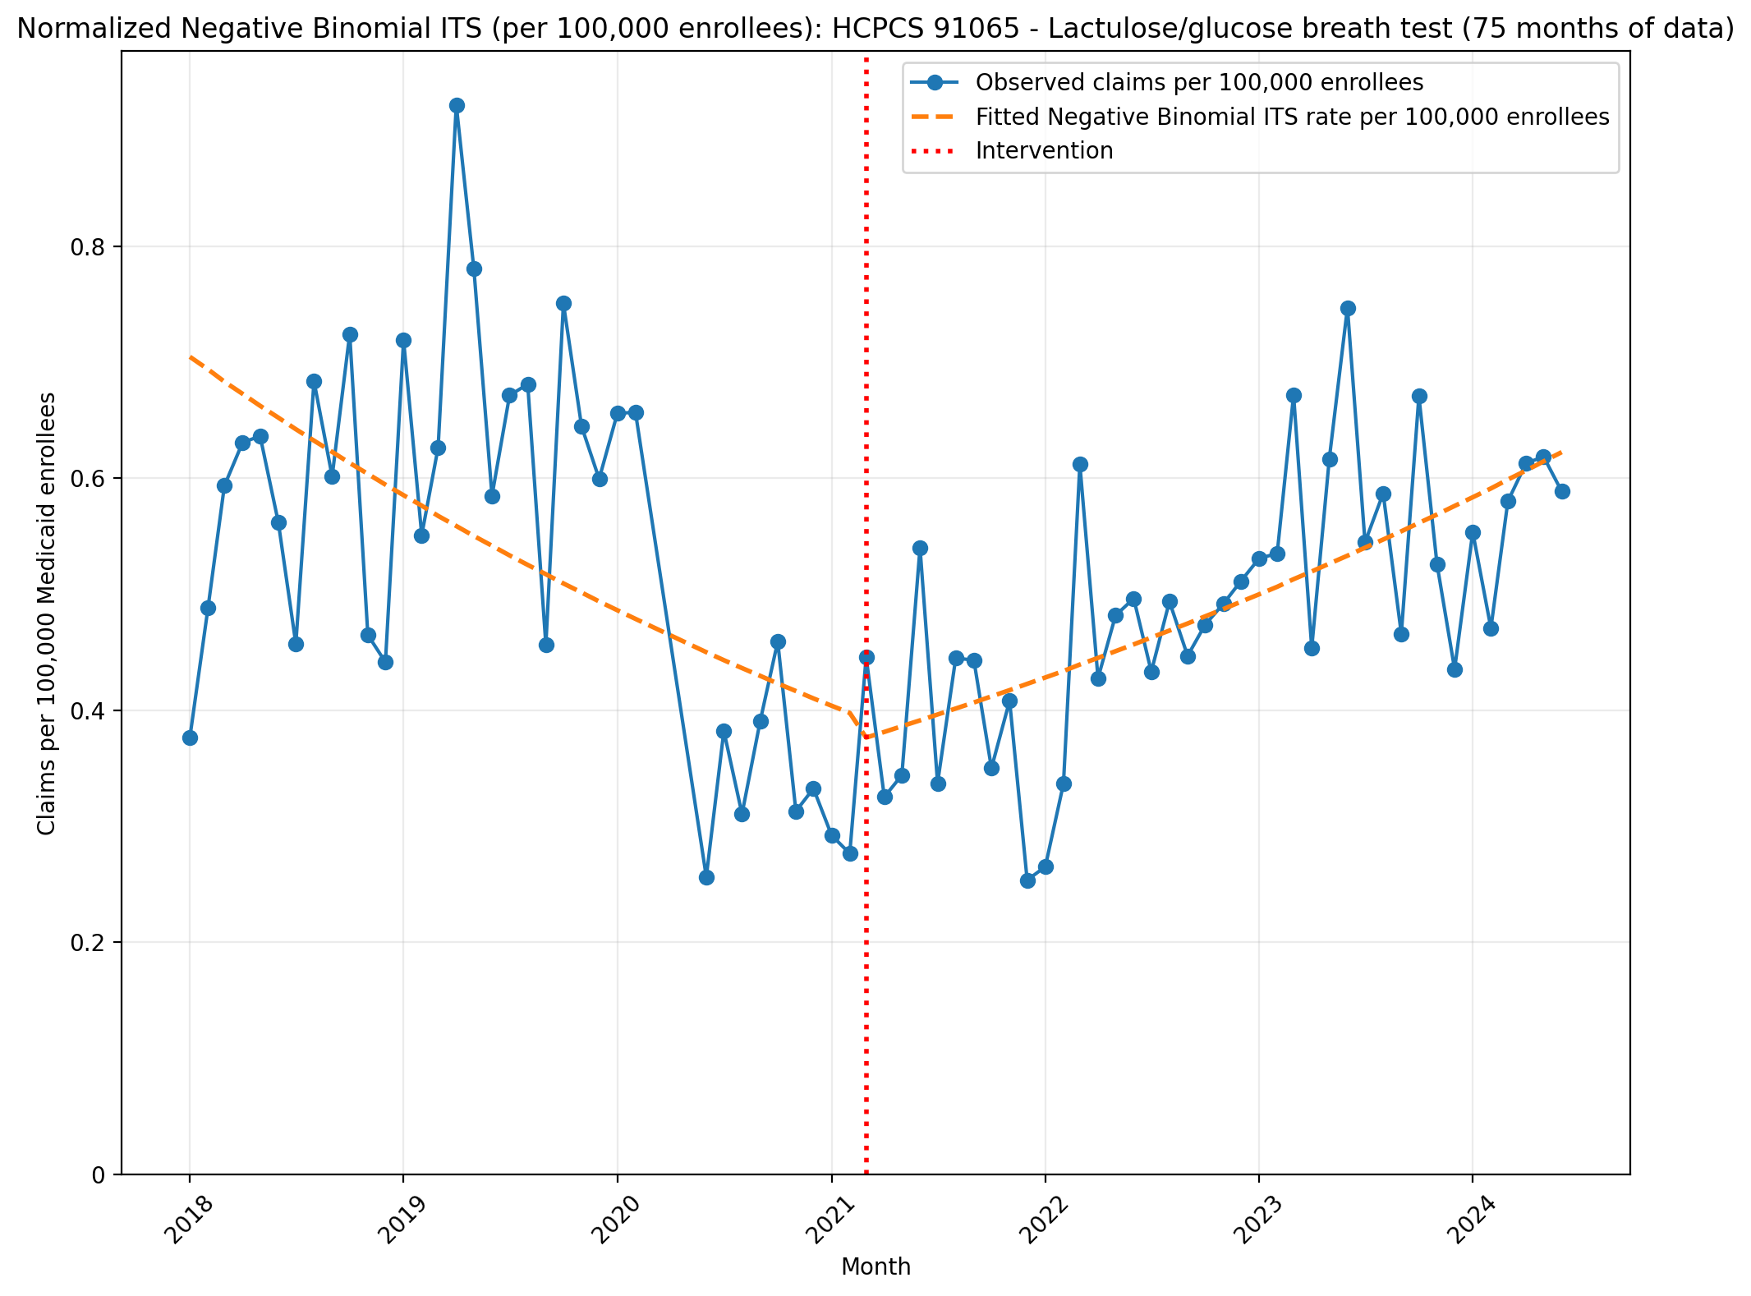
Normalized Negative Binomial ITS (per 100,000 enrollees): HCPCS 91065 - Lactulose/glucose breath test (75 months of data)
NegativeBinomial Regression Results
==============================================================================
Dep. Variable: y No. Observations: 75
Model: NegativeBinomial Df Residuals: 71
Method: MLE Df Model: 3
Date: Sun, 17 May 2026 Pseudo R-squ.: 0.03233
Time: 22:47:07 Log-Likelihood: -449.69
converged: True LL-Null: -464.71
Covariance Type: nonrobust LLR p-value: 1.350e-06
==============================================================================
coef std err z P>|z| [0.025 0.975]
------------------------------------------------------------------------------
const -11.8631 0.078 -152.919 0.000 -12.015 -11.711
T -0.0155 0.004 -4.072 0.000 -0.023 -0.008
X_t -0.0679 0.111 -0.610 0.542 -0.286 0.150
post_time 0.0284 0.005 5.743 0.000 0.019 0.038
alpha 0.0499 0.008 5.878 0.000 0.033 0.066
==============================================================================

