Slide 1
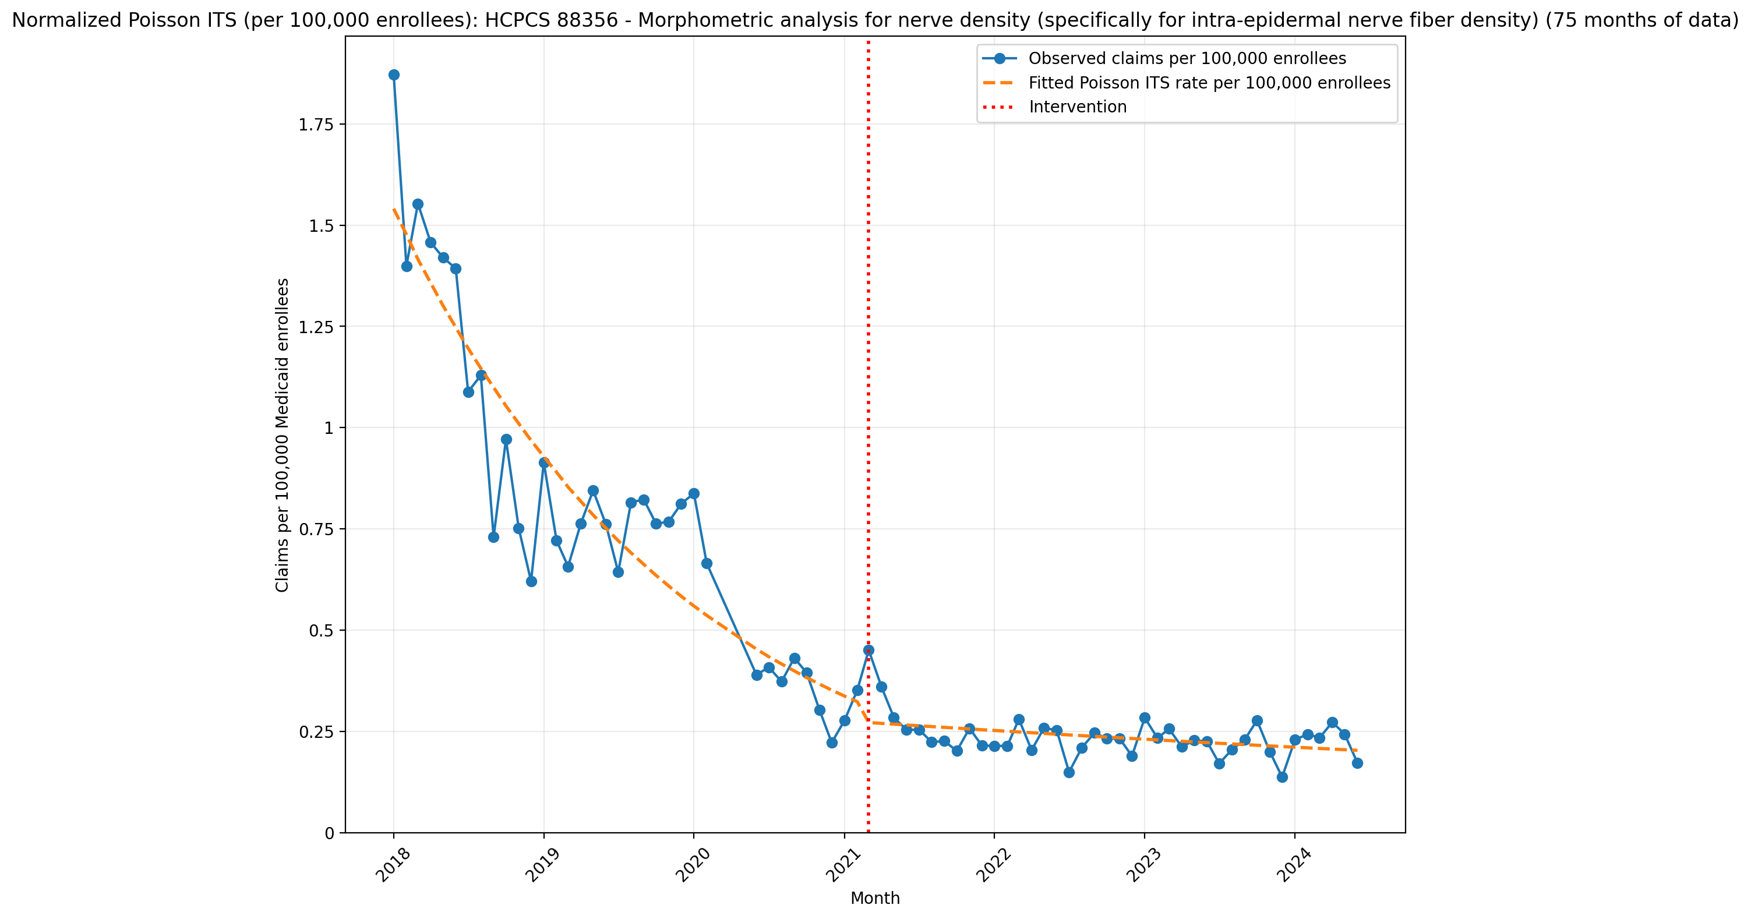
Normalized Poisson ITS (per 100,000 enrollees): HCPCS 88356 - Morphometric analysis for nerve density (specifically for intra-epidermal nerve fiber density) (75 months of data)
Generalized Linear Model Regression Results
==============================================================================
Dep. Variable: y No. Observations: 75
Model: GLM Df Residuals: 71
Model Family: Poisson Df Model: 3
Link Function: Log Scale: 1.0000
Method: IRLS Log-Likelihood: -841.44
Date: Mon, 11 May 2026 Deviance: 1109.2
Time: 18:06:50 Pearson chi2: 1.11e+03
No. Iterations: 5 Pseudo R-squ. (CS): 1.000
Covariance Type: nonrobust
==============================================================================
coef std err z P>|z| [0.025 0.975]
------------------------------------------------------------------------------
const -11.0808 0.011 -1007.076 0.000 -11.102 -11.059
T -0.0422 0.001 -63.810 0.000 -0.043 -0.041
X_t -0.1662 0.027 -6.050 0.000 -0.220 -0.112
post_time 0.0347 0.001 30.119 0.000 0.032 0.037
==============================================================================

Slide 2
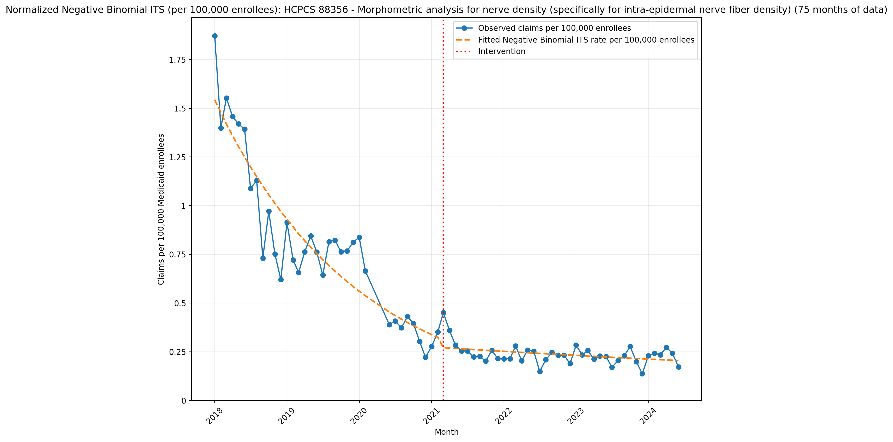
Normalized Negative Binomial ITS (per 100,000 enrollees): HCPCS 88356 - Morphometric analysis for nerve density (specifically for intra-epidermal nerve fiber density) (75 months of data)
NegativeBinomial Regression Results
==============================================================================
Dep. Variable: y No. Observations: 75
Model: NegativeBinomial Df Residuals: 71
Method: MLE Df Model: 3
Date: Mon, 11 May 2026 Pseudo R-squ.: 0.1906
Time: 18:06:50 Log-Likelihood: -420.55
converged: True LL-Null: -519.57
Covariance Type: nonrobust LLR p-value: 1.113e-42
==============================================================================
coef std err z P>|z| [0.025 0.975]
------------------------------------------------------------------------------
const -11.0789 0.061 -180.275 0.000 -11.199 -10.958
T -0.0422 0.003 -14.192 0.000 -0.048 -0.036
X_t -0.1720 0.091 -1.883 0.060 -0.351 0.007
post_time 0.0350 0.004 8.779 0.000 0.027 0.043
alpha 0.0352 0.006 5.639 0.000 0.023 0.047
==============================================================================

Slide 3
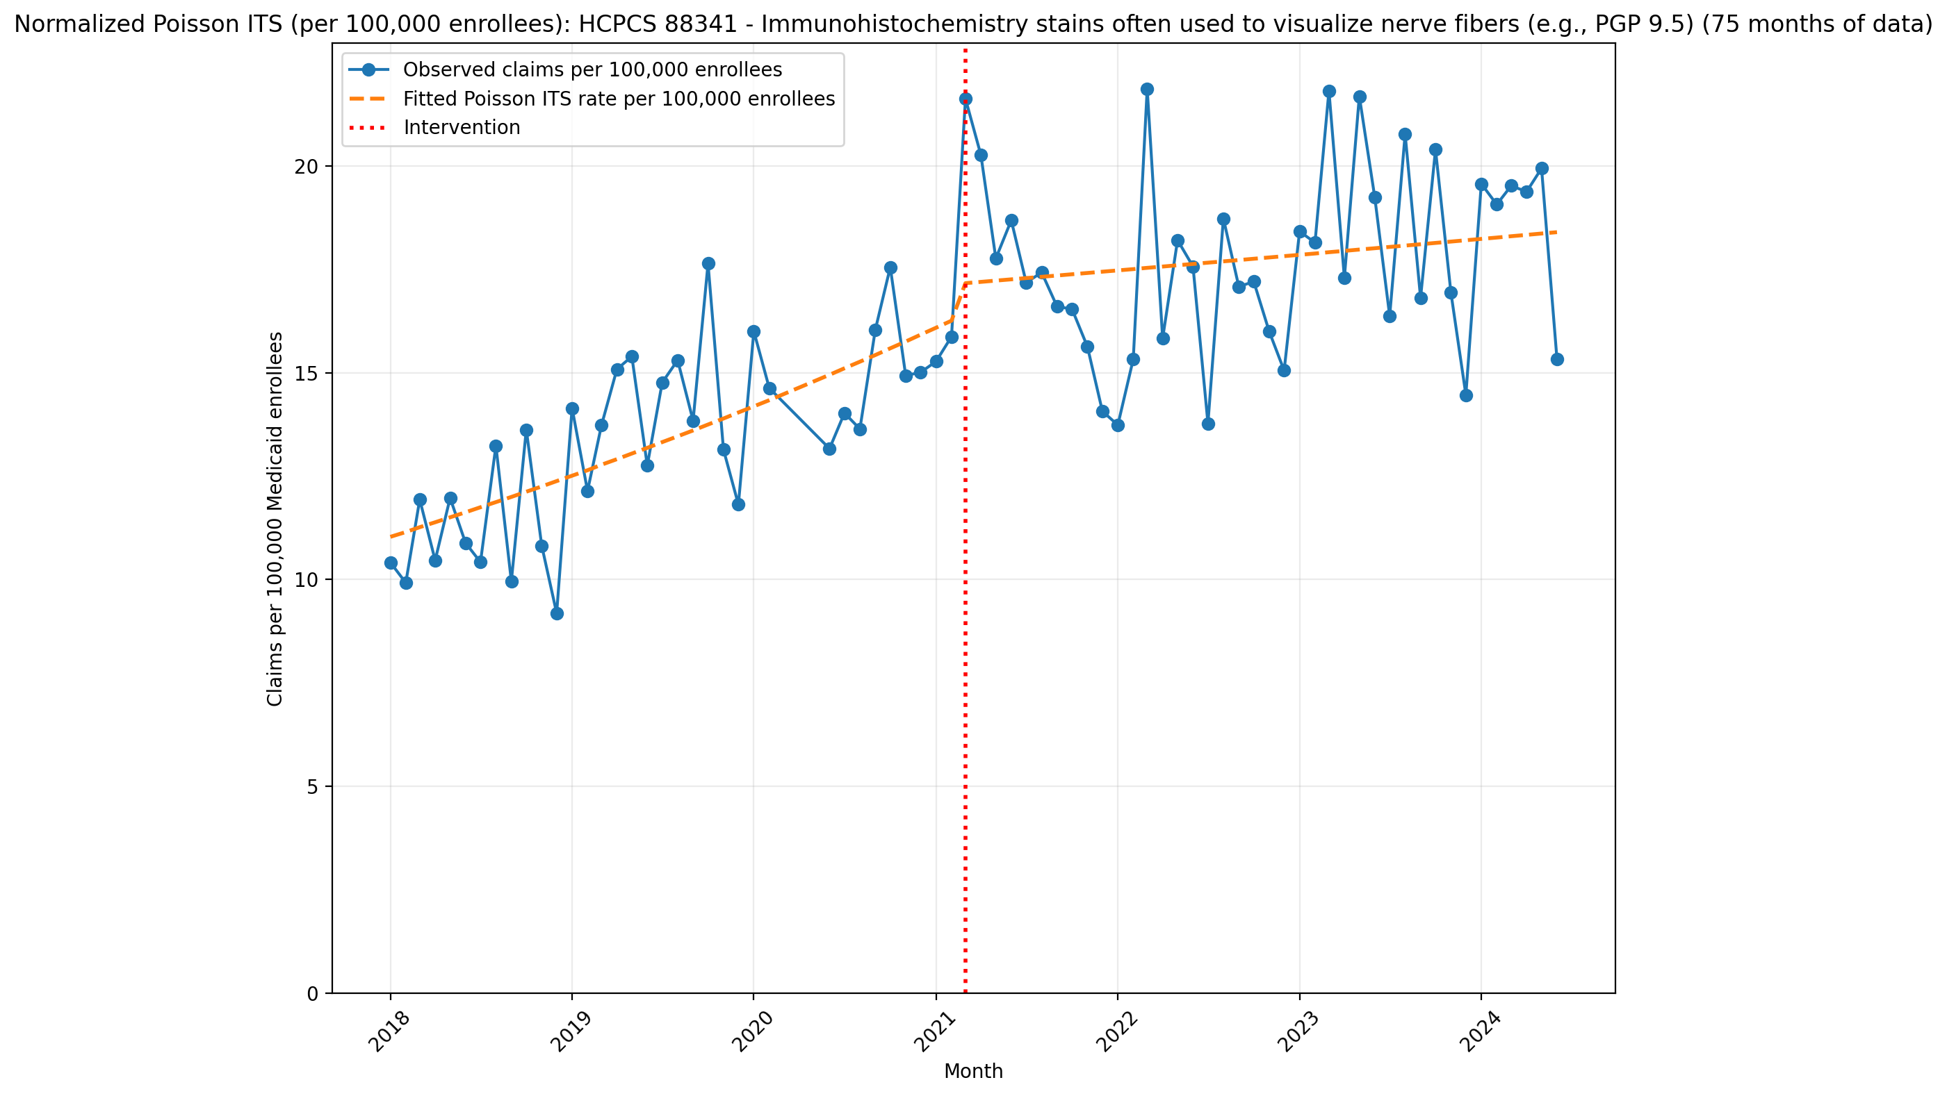
Normalized Poisson ITS (per 100,000 enrollees): HCPCS 88341 - Immunohistochemistry stains often used to visualize nerve fibers (e.g., PGP 9.5) (75 months of data)
Generalized Linear Model Regression Results
==============================================================================
Dep. Variable: y No. Observations: 75
Model: GLM Df Residuals: 71
Model Family: Poisson Df Model: 3
Link Function: Log Scale: 1.0000
Method: IRLS Log-Likelihood: -7965.8
Date: Mon, 11 May 2026 Deviance: 15083.
Time: 18:06:51 Pearson chi2: 1.51e+04
No. Iterations: 4 Pseudo R-squ. (CS): 1.000
Covariance Type: nonrobust
==============================================================================
coef std err z P>|z| [0.025 0.975]
------------------------------------------------------------------------------
const -9.1124 0.003 -2764.636 0.000 -9.119 -9.106
T 0.0105 0.000 71.550 0.000 0.010 0.011
X_t 0.0526 0.004 13.144 0.000 0.045 0.060
post_time -0.0087 0.000 -47.715 0.000 -0.009 -0.008
==============================================================================

Slide 4
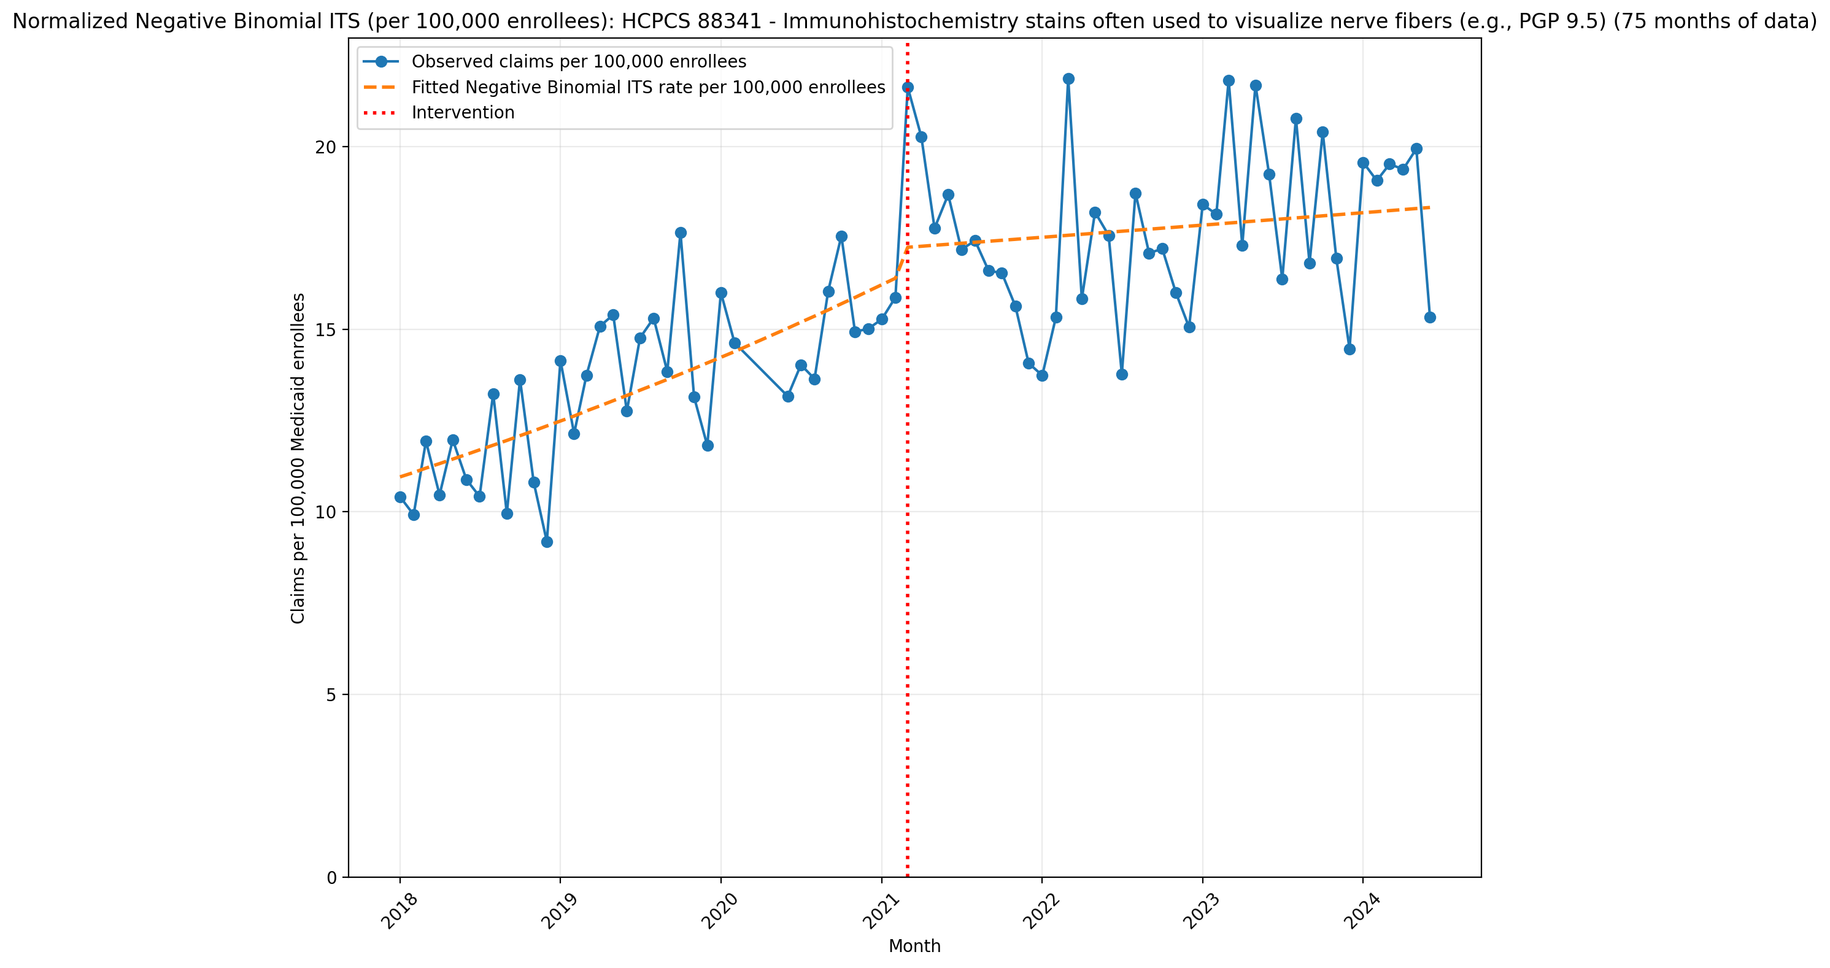
Normalized Negative Binomial ITS (per 100,000 enrollees): HCPCS 88341 - Immunohistochemistry stains often used to visualize nerve fibers (e.g., PGP 9.5) (75 months of data)
NegativeBinomial Regression Results
==============================================================================
Dep. Variable: y No. Observations: 75
Model: NegativeBinomial Df Residuals: 71
Method: MLE Df Model: 3
Date: Mon, 11 May 2026 Pseudo R-squ.: 0.05557
Time: 18:06:51 Log-Likelihood: -659.72
converged: False LL-Null: -698.54
Covariance Type: nonrobust LLR p-value: 9.876e-17
==============================================================================
coef std err z P>|z| [0.025 0.975]
------------------------------------------------------------------------------
const -9.1192 0.039 -232.634 0.000 -9.196 -9.042
T 0.0109 0.002 5.805 0.000 0.007 0.015
X_t 0.0489 0.057 0.860 0.390 -0.062 0.160
post_time -0.0093 0.002 -3.738 0.000 -0.014 -0.004
alpha 0.0147 0.002 6.106 0.000 0.010 0.019
==============================================================================

Slide 5
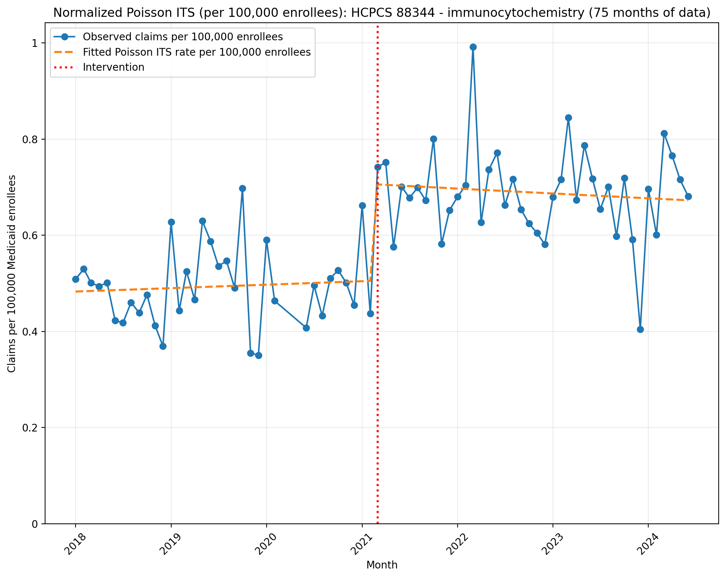
Normalized Poisson ITS (per 100,000 enrollees): HCPCS 88344 - immunocytochemistry (75 months of data)
Generalized Linear Model Regression Results
==============================================================================
Dep. Variable: y No. Observations: 75
Model: GLM Df Residuals: 71
Model Family: Poisson Df Model: 3
Link Function: Log Scale: 1.0000
Method: IRLS Log-Likelihood: -705.99
Date: Mon, 11 May 2026 Deviance: 808.48
Time: 18:06:52 Pearson chi2: 811.
No. Iterations: 4 Pseudo R-squ. (CS): 1.000
Covariance Type: nonrobust
==============================================================================
coef std err z P>|z| [0.025 0.975]
------------------------------------------------------------------------------
const -12.2411 0.016 -744.600 0.000 -12.273 -12.209
T 0.0012 0.001 1.579 0.114 -0.000 0.003
X_t 0.3359 0.021 15.879 0.000 0.294 0.377
post_time -0.0024 0.001 -2.581 0.010 -0.004 -0.001
==============================================================================

Slide 6
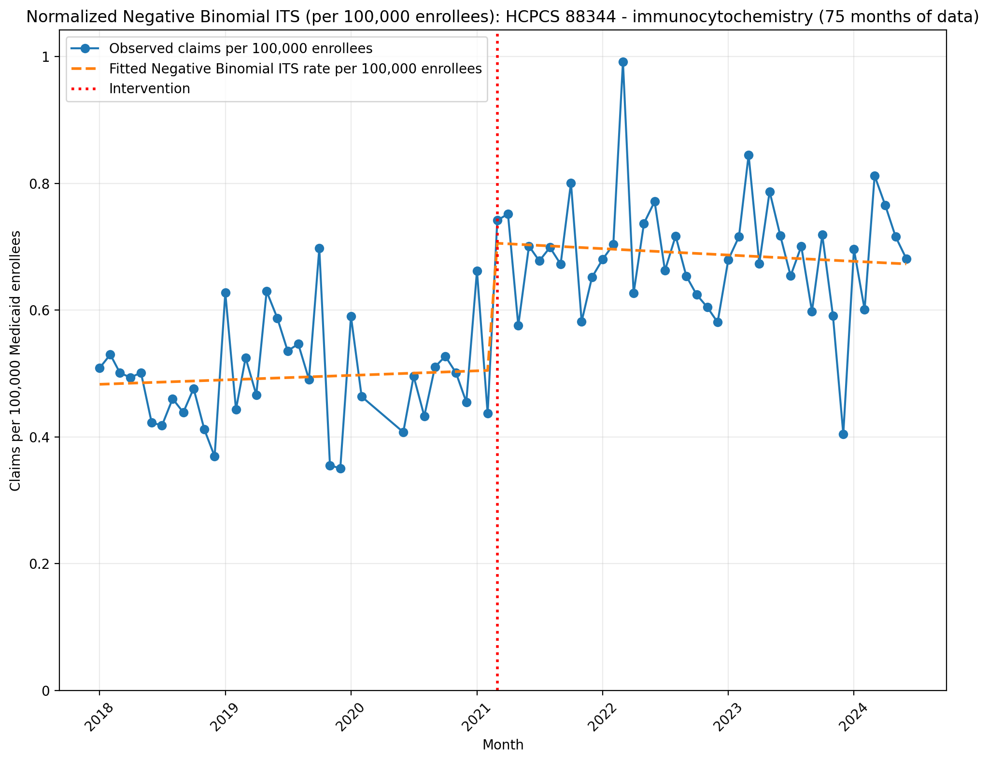
Normalized Negative Binomial ITS (per 100,000 enrollees): HCPCS 88344 - immunocytochemistry (75 months of data)
NegativeBinomial Regression Results
==============================================================================
Dep. Variable: y No. Observations: 75
Model: NegativeBinomial Df Residuals: 71
Method: MLE Df Model: 3
Date: Mon, 11 May 2026 Pseudo R-squ.: 0.06678
Time: 18:06:52 Log-Likelihood: -429.11
converged: True LL-Null: -459.81
Covariance Type: nonrobust LLR p-value: 2.930e-13
==============================================================================
coef std err z P>|z| [0.025 0.975]
------------------------------------------------------------------------------
const -12.2409 0.048 -256.217 0.000 -12.335 -12.147
T 0.0012 0.002 0.526 0.599 -0.003 0.006
X_t 0.3360 0.069 4.870 0.000 0.201 0.471
post_time -0.0024 0.003 -0.795 0.427 -0.008 0.004
alpha 0.0198 0.004 5.534 0.000 0.013 0.027
==============================================================================

Slide 7
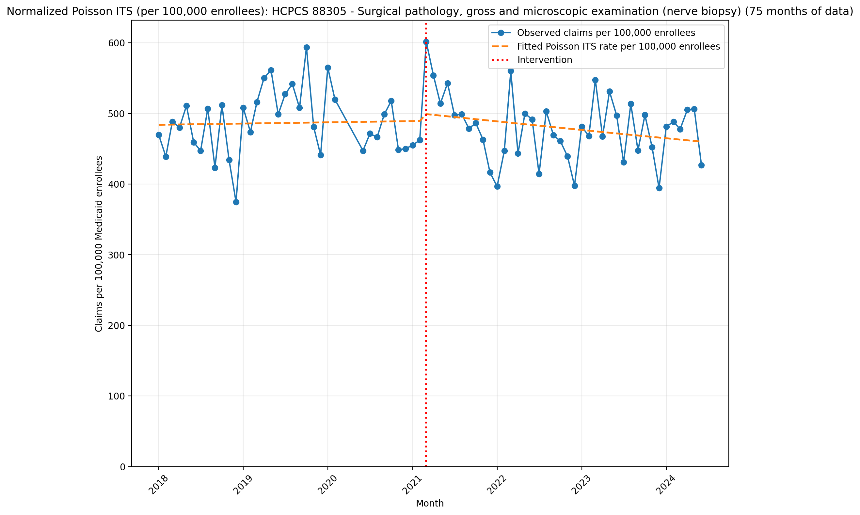
Normalized Poisson ITS (per 100,000 enrollees): HCPCS 88305 - Surgical pathology, gross and microscopic examination (nerve biopsy) (75 months of data)
Generalized Linear Model Regression Results
==============================================================================
Dep. Variable: y No. Observations: 75
Model: GLM Df Residuals: 71
Model Family: Poisson Df Model: 3
Link Function: Log Scale: 1.0000
Method: IRLS Log-Likelihood: -1.3247e+05
Date: Mon, 11 May 2026 Deviance: 2.6384e+05
Time: 18:06:52 Pearson chi2: 2.63e+05
No. Iterations: 4 Pseudo R-squ. (CS): 1.000
Covariance Type: nonrobust
==============================================================================
coef std err z P>|z| [0.025 0.975]
------------------------------------------------------------------------------
const -5.3310 0.001 -1.02e+04 0.000 -5.332 -5.330
T 0.0003 2.44e-05 12.196 0.000 0.000 0.000
X_t 0.0218 0.001 30.089 0.000 0.020 0.023
post_time -0.0024 3.22e-05 -74.187 0.000 -0.002 -0.002
==============================================================================

Slide 8
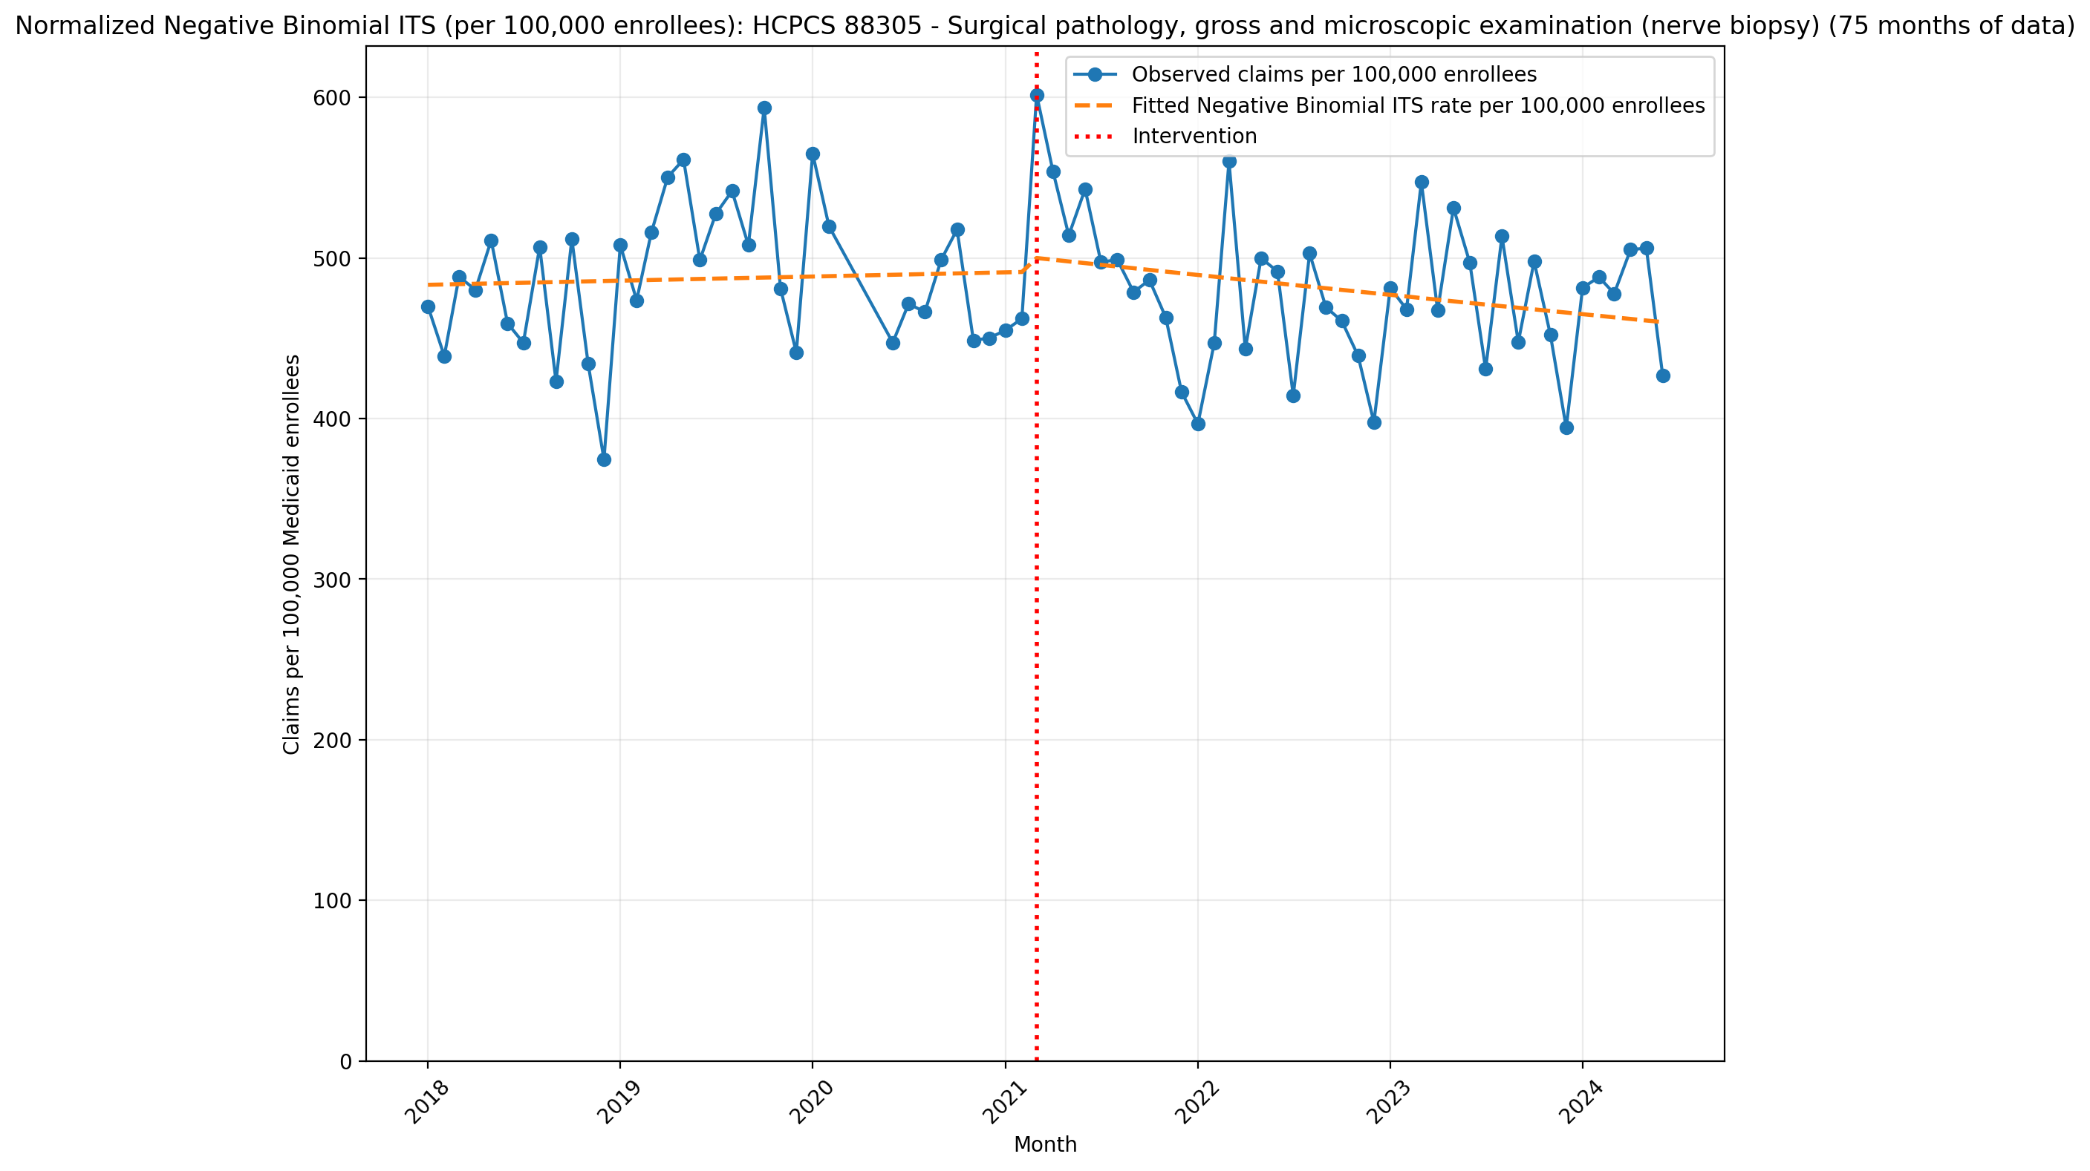
Normalized Negative Binomial ITS (per 100,000 enrollees): HCPCS 88305 - Surgical pathology, gross and microscopic examination (nerve biopsy) (75 months of data)
NegativeBinomial Regression Results
==============================================================================
Dep. Variable: y No. Observations: 75
Model: NegativeBinomial Df Residuals: 71
Method: MLE Df Model: 3
Date: Mon, 11 May 2026 Pseudo R-squ.: 0.001899
Time: 18:06:52 Log-Likelihood: -897.46
converged: False LL-Null: -899.17
Covariance Type: nonrobust LLR p-value: 0.3318
==============================================================================
coef std err z P>|z| [0.025 0.975]
------------------------------------------------------------------------------
const -5.3324 0.030 -178.199 0.000 -5.391 -5.274
T 0.0004 0.001 0.309 0.758 -0.002 0.003
X_t 0.0197 0.043 0.454 0.650 -0.065 0.105
post_time -0.0026 0.002 -1.352 0.176 -0.006 0.001
alpha 0.0086 0.001 6.131 0.000 0.006 0.011
==============================================================================

Slide 9
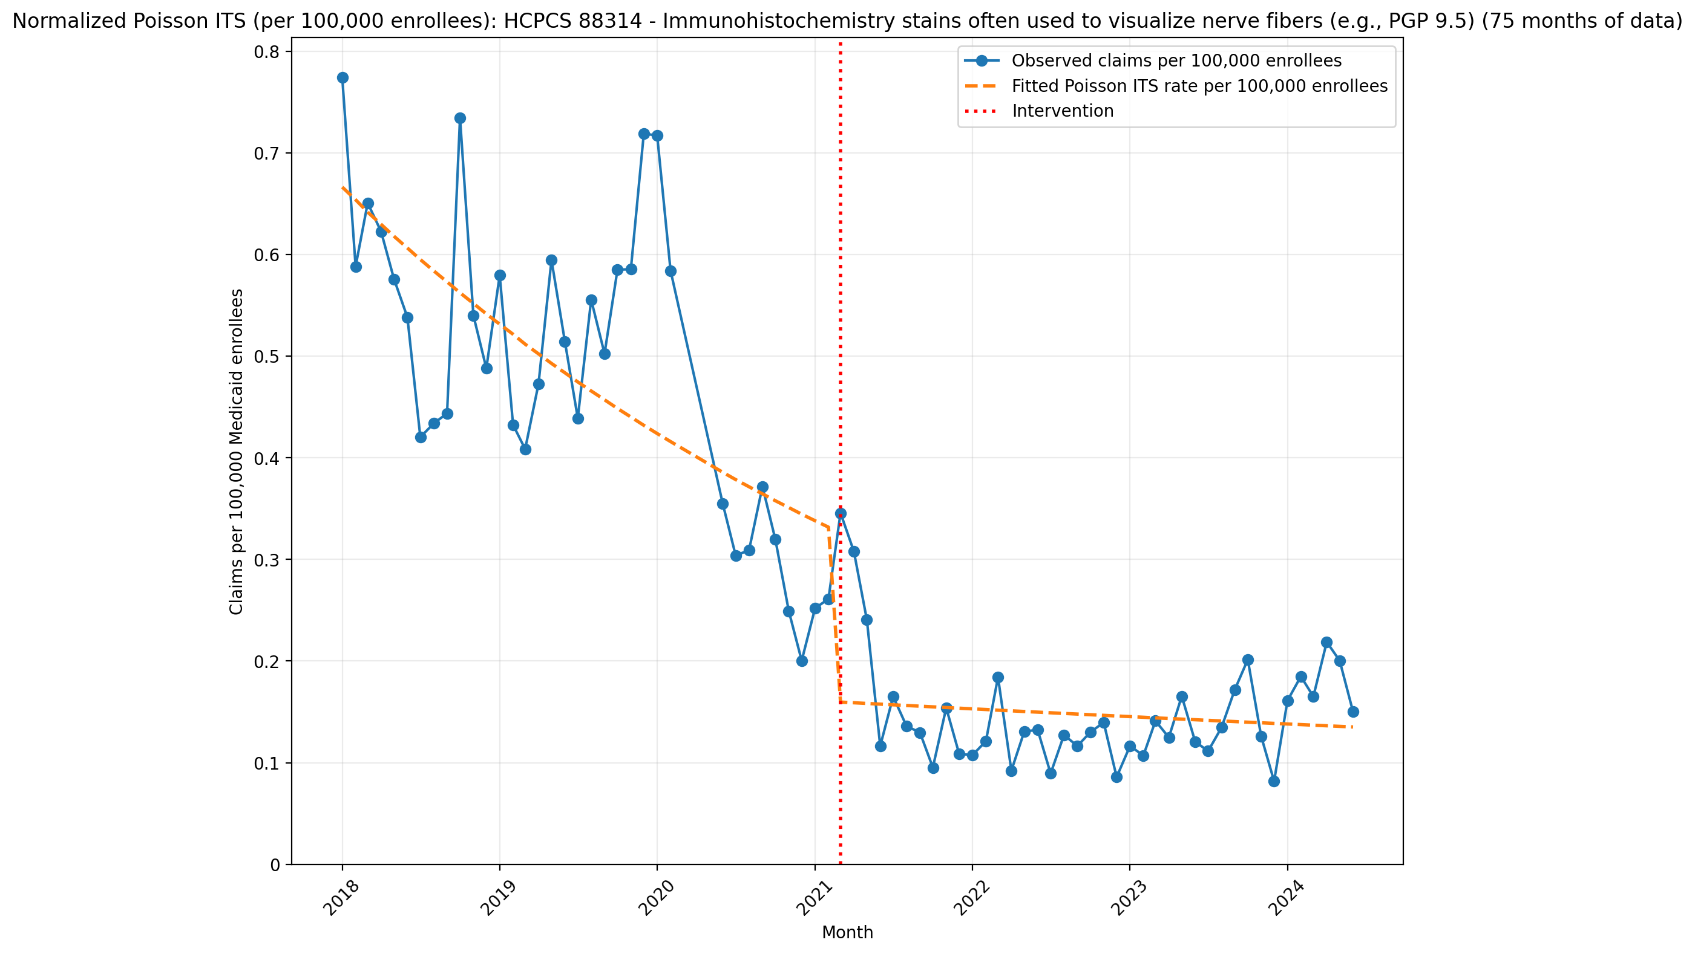
Normalized Poisson ITS (per 100,000 enrollees): HCPCS 88314 - Immunohistochemistry stains often used to visualize nerve fibers (e.g., PGP 9.5) (75 months of data)
Generalized Linear Model Regression Results
==============================================================================
Dep. Variable: y No. Observations: 75
Model: GLM Df Residuals: 71
Model Family: Poisson Df Model: 3
Link Function: Log Scale: 1.0000
Method: IRLS Log-Likelihood: -944.01
Date: Mon, 11 May 2026 Deviance: 1349.3
Time: 18:06:53 Pearson chi2: 1.46e+03
No. Iterations: 5 Pseudo R-squ. (CS): 1.000
Covariance Type: nonrobust
==============================================================================
coef std err z P>|z| [0.025 0.975]
------------------------------------------------------------------------------
const -11.9186 0.015 -781.178 0.000 -11.949 -11.889
T -0.0189 0.001 -23.719 0.000 -0.020 -0.017
X_t -0.7273 0.033 -21.749 0.000 -0.793 -0.662
post_time 0.0146 0.001 10.158 0.000 0.012 0.017
==============================================================================

Slide 10
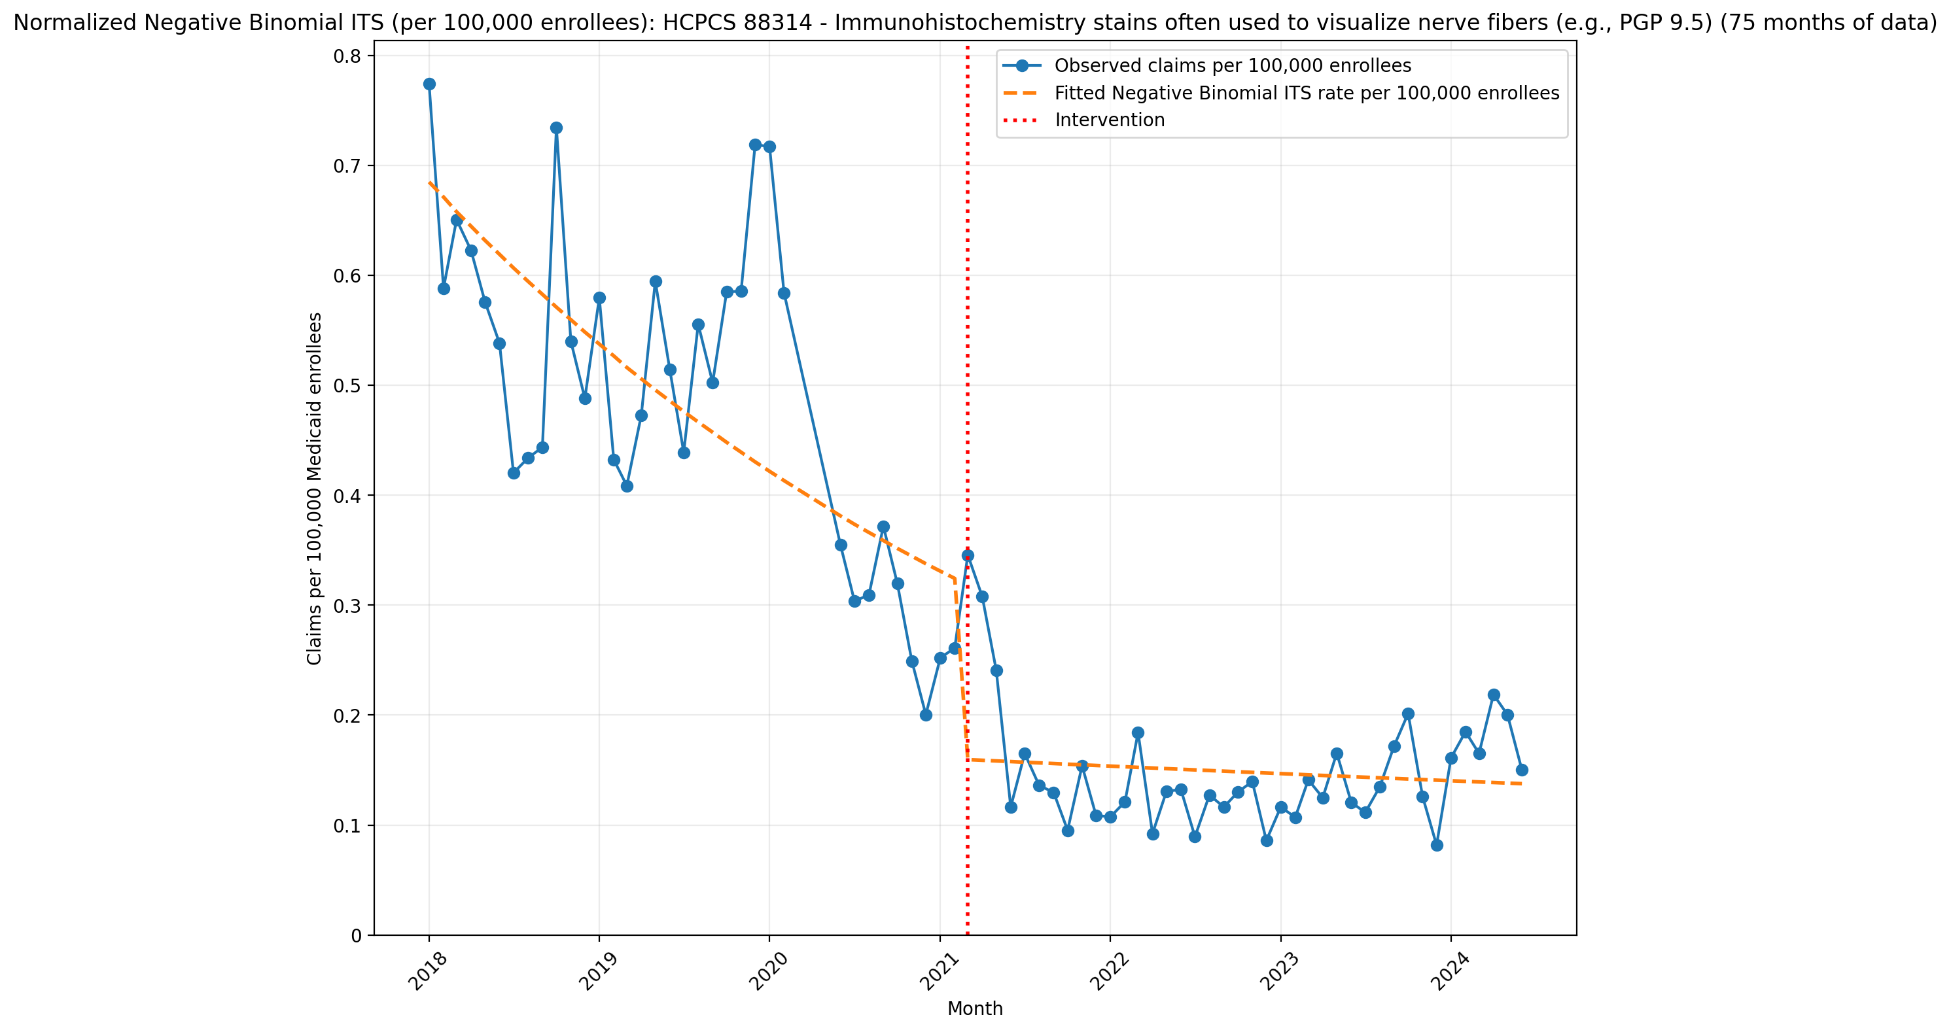
Normalized Negative Binomial ITS (per 100,000 enrollees): HCPCS 88314 - Immunohistochemistry stains often used to visualize nerve fibers (e.g., PGP 9.5) (75 months of data)
NegativeBinomial Regression Results
==============================================================================
Dep. Variable: y No. Observations: 75
Model: NegativeBinomial Df Residuals: 71
Method: MLE Df Model: 3
Date: Mon, 11 May 2026 Pseudo R-squ.: 0.1354
Time: 18:06:54 Log-Likelihood: -415.05
converged: True LL-Null: -480.04
Covariance Type: nonrobust LLR p-value: 5.431e-28
==============================================================================
coef std err z P>|z| [0.025 0.975]
------------------------------------------------------------------------------
const -11.8911 0.094 -126.770 0.000 -12.075 -11.707
T -0.0202 0.005 -4.437 0.000 -0.029 -0.011
X_t -0.7058 0.133 -5.296 0.000 -0.967 -0.445
post_time 0.0164 0.006 2.810 0.005 0.005 0.028
alpha 0.0777 0.013 5.785 0.000 0.051 0.104
==============================================================================

Slide 11
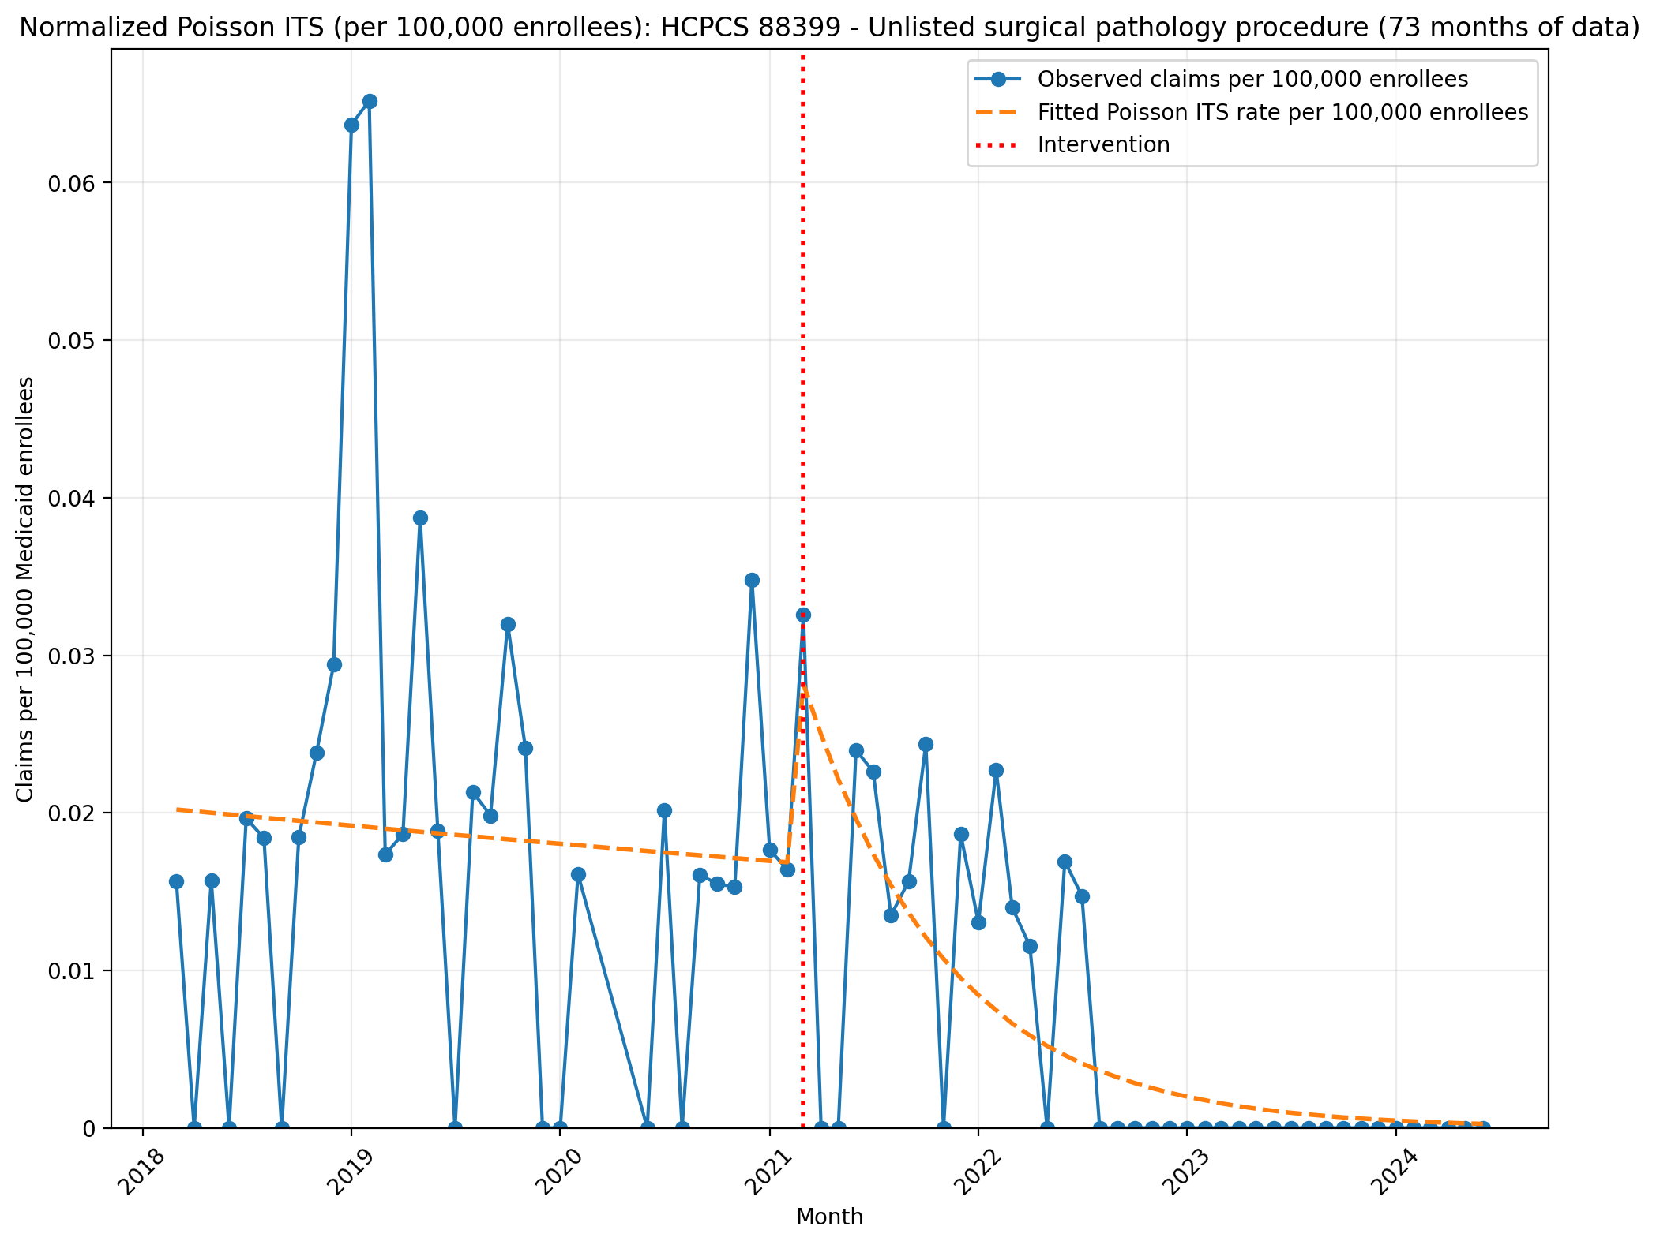
Normalized Poisson ITS (per 100,000 enrollees): HCPCS 88399 - Unlisted surgical pathology procedure (73 months of data)
Generalized Linear Model Regression Results
==============================================================================
Dep. Variable: y No. Observations: 73
Model: GLM Df Residuals: 69
Model Family: Poisson Df Model: 3
Link Function: Log Scale: 1.0000
Method: IRLS Log-Likelihood: -397.40
Date: Mon, 11 May 2026 Deviance: 617.02
Time: 18:06:54 Pearson chi2: 532.
No. Iterations: 6 Pseudo R-squ. (CS): 0.9987
Covariance Type: nonrobust
==============================================================================
coef std err z P>|z| [0.025 0.975]
------------------------------------------------------------------------------
const -15.4146 0.085 -181.761 0.000 -15.581 -15.248
T -0.0052 0.004 -1.202 0.229 -0.014 0.003
X_t 0.6336 0.138 4.600 0.000 0.364 0.904
post_time -0.1154 0.010 -11.690 0.000 -0.135 -0.096
==============================================================================

Slide 12
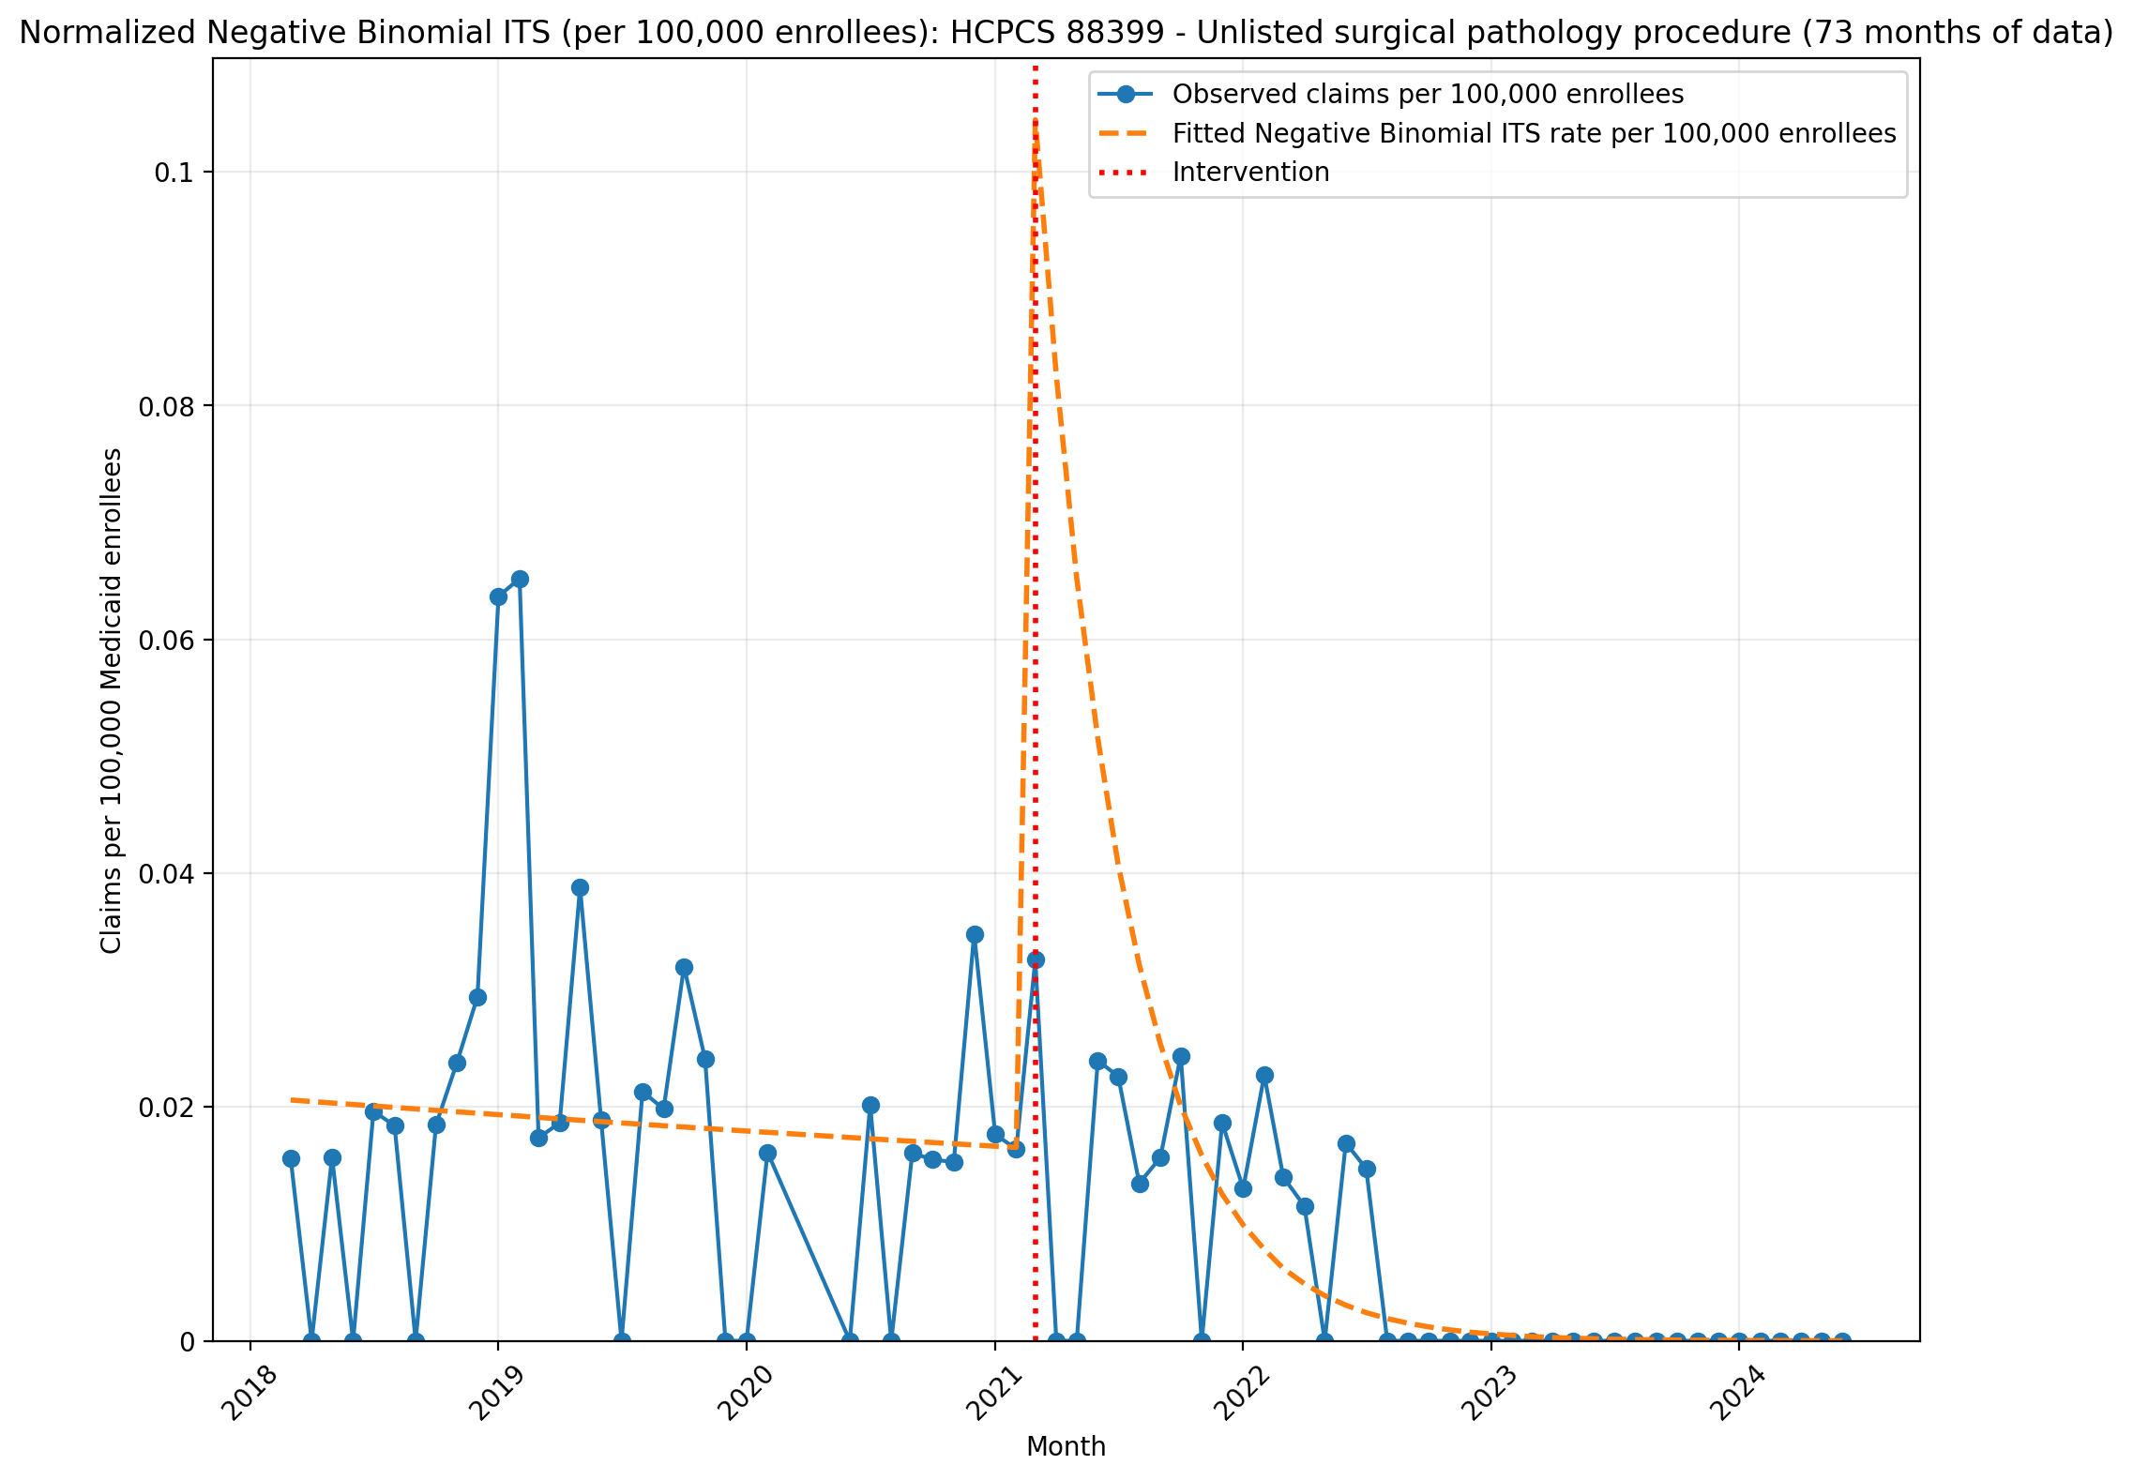
Normalized Negative Binomial ITS (per 100,000 enrollees): HCPCS 88399 - Unlisted surgical pathology procedure (73 months of data)
NegativeBinomial Regression Results
==============================================================================
Dep. Variable: y No. Observations: 73
Model: NegativeBinomial Df Residuals: 69
Method: MLE Df Model: 3
Date: Mon, 11 May 2026 Pseudo R-squ.: 0.09949
Time: 18:06:54 Log-Likelihood: -194.20
converged: True LL-Null: -215.66
Covariance Type: nonrobust LLR p-value: 2.570e-09
==============================================================================
coef std err z P>|z| [0.025 0.975]
------------------------------------------------------------------------------
const -15.3955 0.481 -32.011 0.000 -16.338 -14.453
T -0.0063 0.025 -0.254 0.799 -0.055 0.042
X_t 2.0783 0.905 2.296 0.022 0.304 3.852
post_time -0.2293 0.054 -4.259 0.000 -0.335 -0.124
alpha 1.8966 0.442 4.288 0.000 1.030 2.764
==============================================================================

