Slide 1
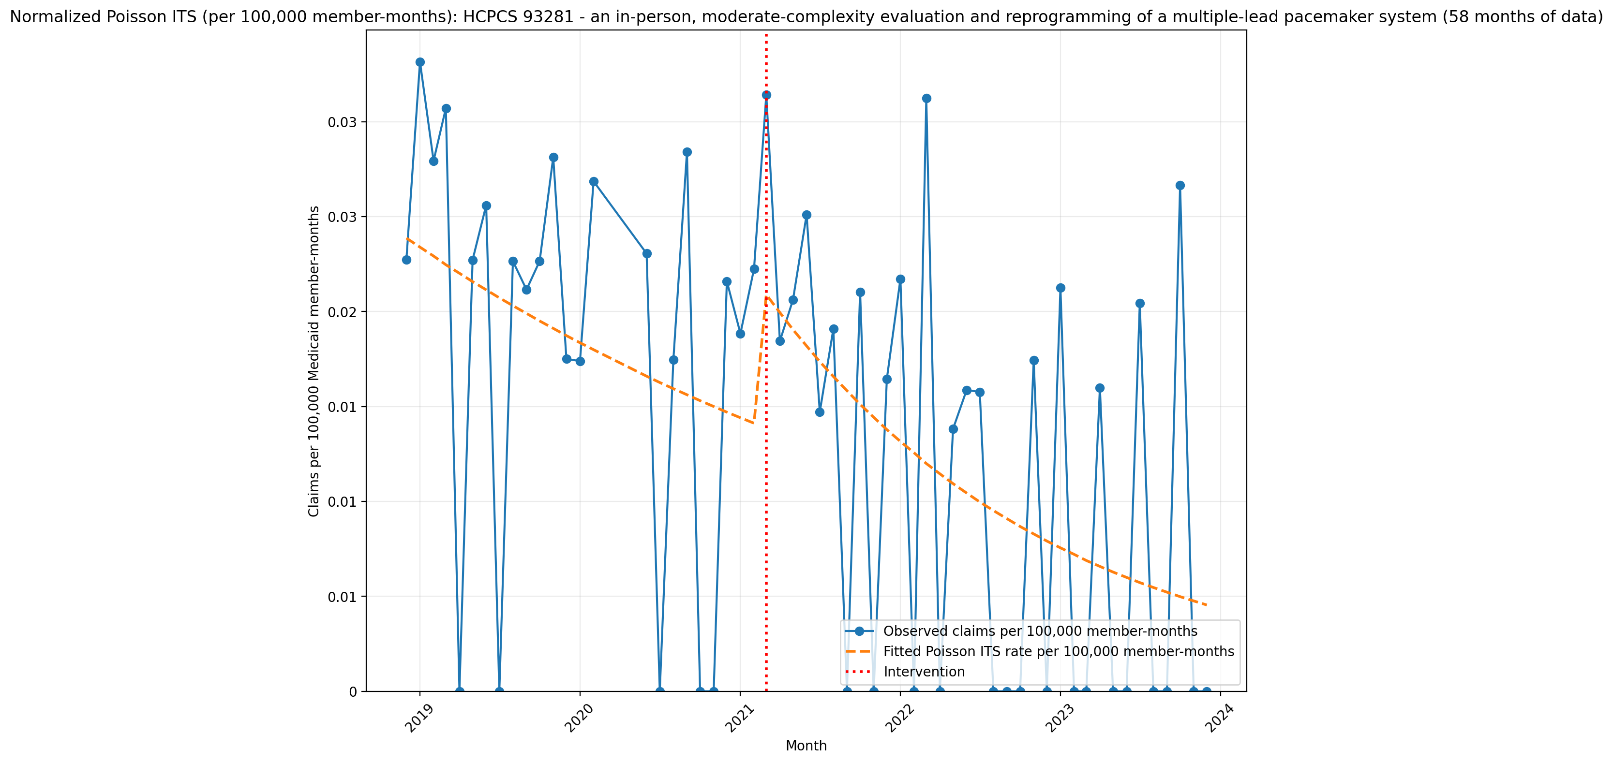
Normalized Poisson ITS (per 100,000 member-months): HCPCS 93281 - an in-person, moderate-complexity evaluation and reprogramming of a multiple-lead pacemaker system (58 months of data)
Generalized Linear Model Regression Results
==============================================================================
Dep. Variable: y No. Observations: 58
Model: GLM Df Residuals: 54
Model Family: Poisson Df Model: 3
Link Function: Log Scale: 1.0000
Method: IRLS Log-Likelihood: -369.67
Date: Tue, 14 Jul 2026 Deviance: 563.79
Time: 15:35:44 Pearson chi2: 456.
No. Iterations: 5 Pseudo R-squ. (CS): 0.8905
Covariance Type: nonrobust
==============================================================================
coef std err z P>|z| [0.025 0.975]
------------------------------------------------------------------------------
const -15.2479 0.094 -162.993 0.000 -15.431 -15.065
T -0.0202 0.007 -3.064 0.002 -0.033 -0.007
X_t 0.4380 0.146 3.009 0.003 0.153 0.723
post_time -0.0260 0.009 -2.949 0.003 -0.043 -0.009
==============================================================================

Slide 2
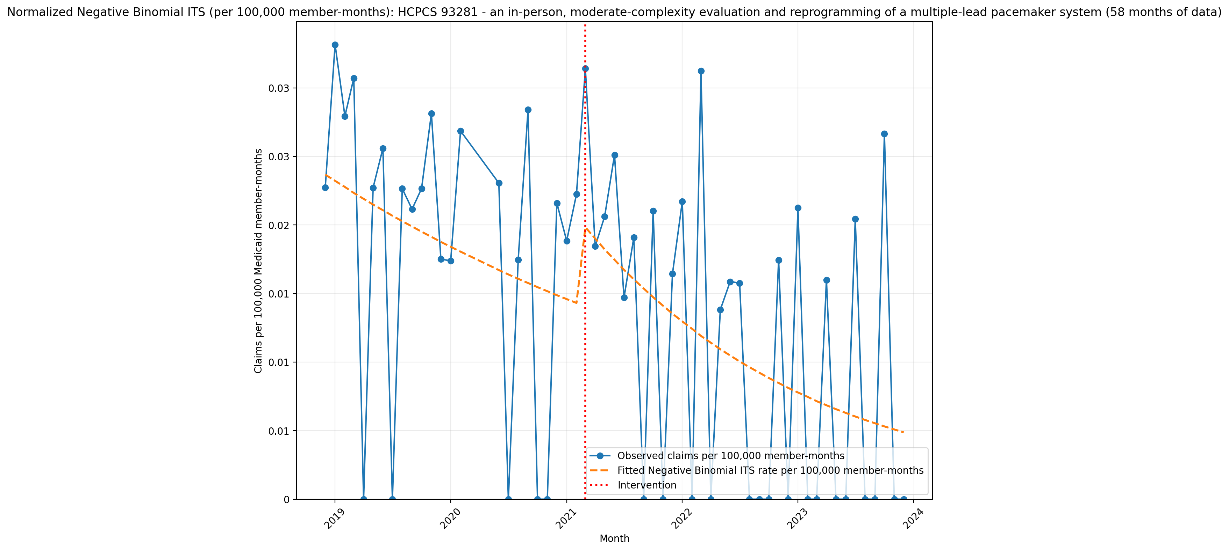
Normalized Negative Binomial ITS (per 100,000 member-months): HCPCS 93281 - an in-person, moderate-complexity evaluation and reprogramming of a multiple-lead pacemaker system (58 months of data)
NegativeBinomial Regression Results
==============================================================================
Dep. Variable: y No. Observations: 58
Model: NegativeBinomial Df Residuals: 54
Method: MLE Df Model: 3
Date: Tue, 14 Jul 2026 Pseudo R-squ.: 0.01214
Time: 15:35:44 Log-Likelihood: -194.53
converged: True LL-Null: -196.92
Covariance Type: nonrobust LLR p-value: 0.1886
==============================================================================
coef std err z P>|z| [0.025 0.975]
------------------------------------------------------------------------------
const -15.2562 0.550 -27.715 0.000 -16.335 -14.177
T -0.0193 0.036 -0.531 0.596 -0.091 0.052
X_t 0.3687 0.767 0.481 0.631 -1.134 1.872
post_time -0.0232 0.044 -0.523 0.601 -0.110 0.064
alpha 2.1439 0.500 4.291 0.000 1.165 3.123
==============================================================================

