Slide 1
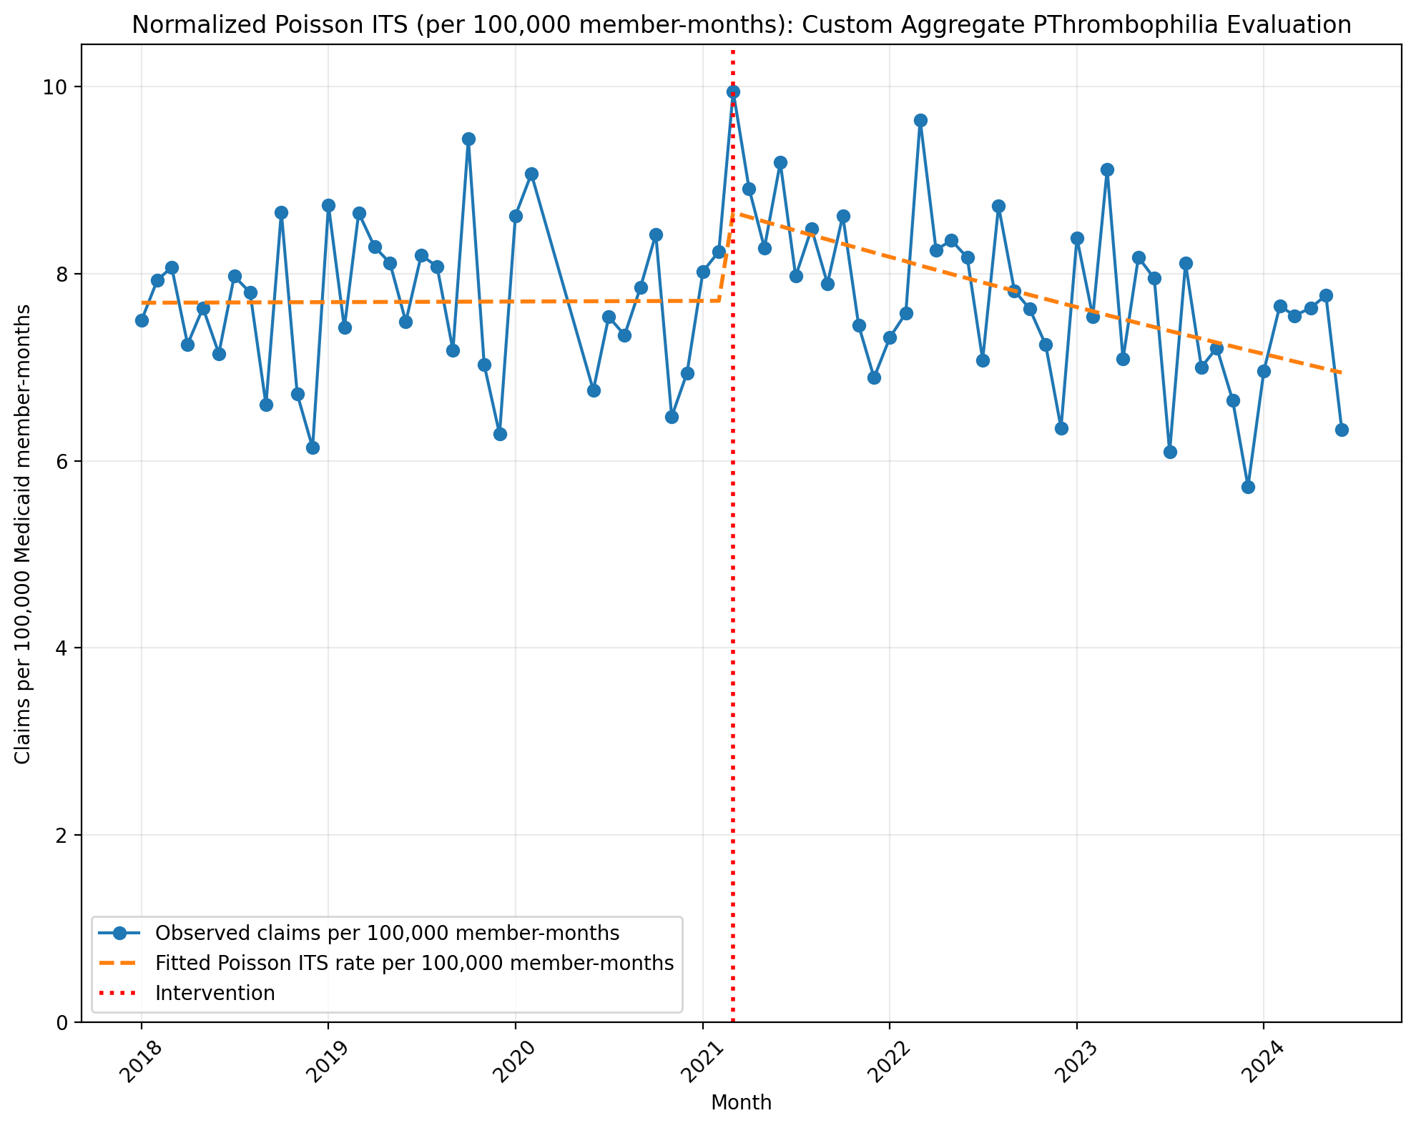
Normalized Poisson ITS (per 100,000 member-months): Custom Aggregate PThrombophilia Evaluation
Generalized Linear Model Regression Results
==============================================================================
Dep. Variable: y No. Observations: 75
Model: GLM Df Residuals: 71
Model Family: Poisson Df Model: 3
Link Function: Log Scale: 1.0000
Method: IRLS Log-Likelihood: -2899.0
Date: Tue, 09 Jun 2026 Deviance: 5001.2
Time: 15:53:15 Pearson chi2: 4.98e+03
No. Iterations: 4 Pseudo R-squ. (CS): 1.000
Covariance Type: nonrobust
==============================================================================
coef std err z P>|z| [0.025 0.975]
------------------------------------------------------------------------------
const -9.4731 0.004 -2287.893 0.000 -9.481 -9.465
T 7.352e-05 0.000 0.379 0.705 -0.000 0.000
X_t 0.1212 0.006 21.281 0.000 0.110 0.132
post_time -0.0057 0.000 -22.501 0.000 -0.006 -0.005
==============================================================================
Codes in aggregation: 85300, 85303, 85305, 85306, 81241, 81240

Slide 2
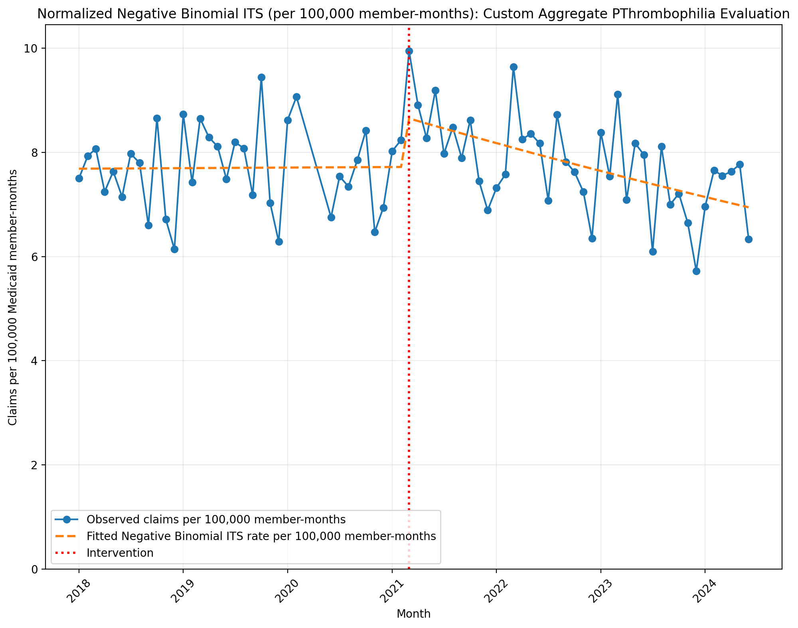
Normalized Negative Binomial ITS (per 100,000 member-months): Custom Aggregate PThrombophilia Evaluation
NegativeBinomial Regression Results
==============================================================================
Dep. Variable: y No. Observations: 75
Model: NegativeBinomial Df Residuals: 71
Method: MLE Df Model: 3
Date: Tue, 09 Jun 2026 Pseudo R-squ.: 0.01262
Time: 15:53:15 Log-Likelihood: -593.70
converged: True LL-Null: -601.28
Covariance Type: nonrobust LLR p-value: 0.001674
==============================================================================
coef std err z P>|z| [0.025 0.975]
------------------------------------------------------------------------------
const -9.4735 0.032 -292.618 0.000 -9.537 -9.410
T 0.0001 0.002 0.076 0.940 -0.003 0.003
X_t 0.1196 0.047 2.532 0.011 0.027 0.212
post_time -0.0057 0.002 -2.775 0.006 -0.010 -0.002
alpha 0.0101 0.002 6.040 0.000 0.007 0.013
==============================================================================
Codes in aggregation: 85300, 85303, 85305, 85306, 81241, 81240

Slide 3
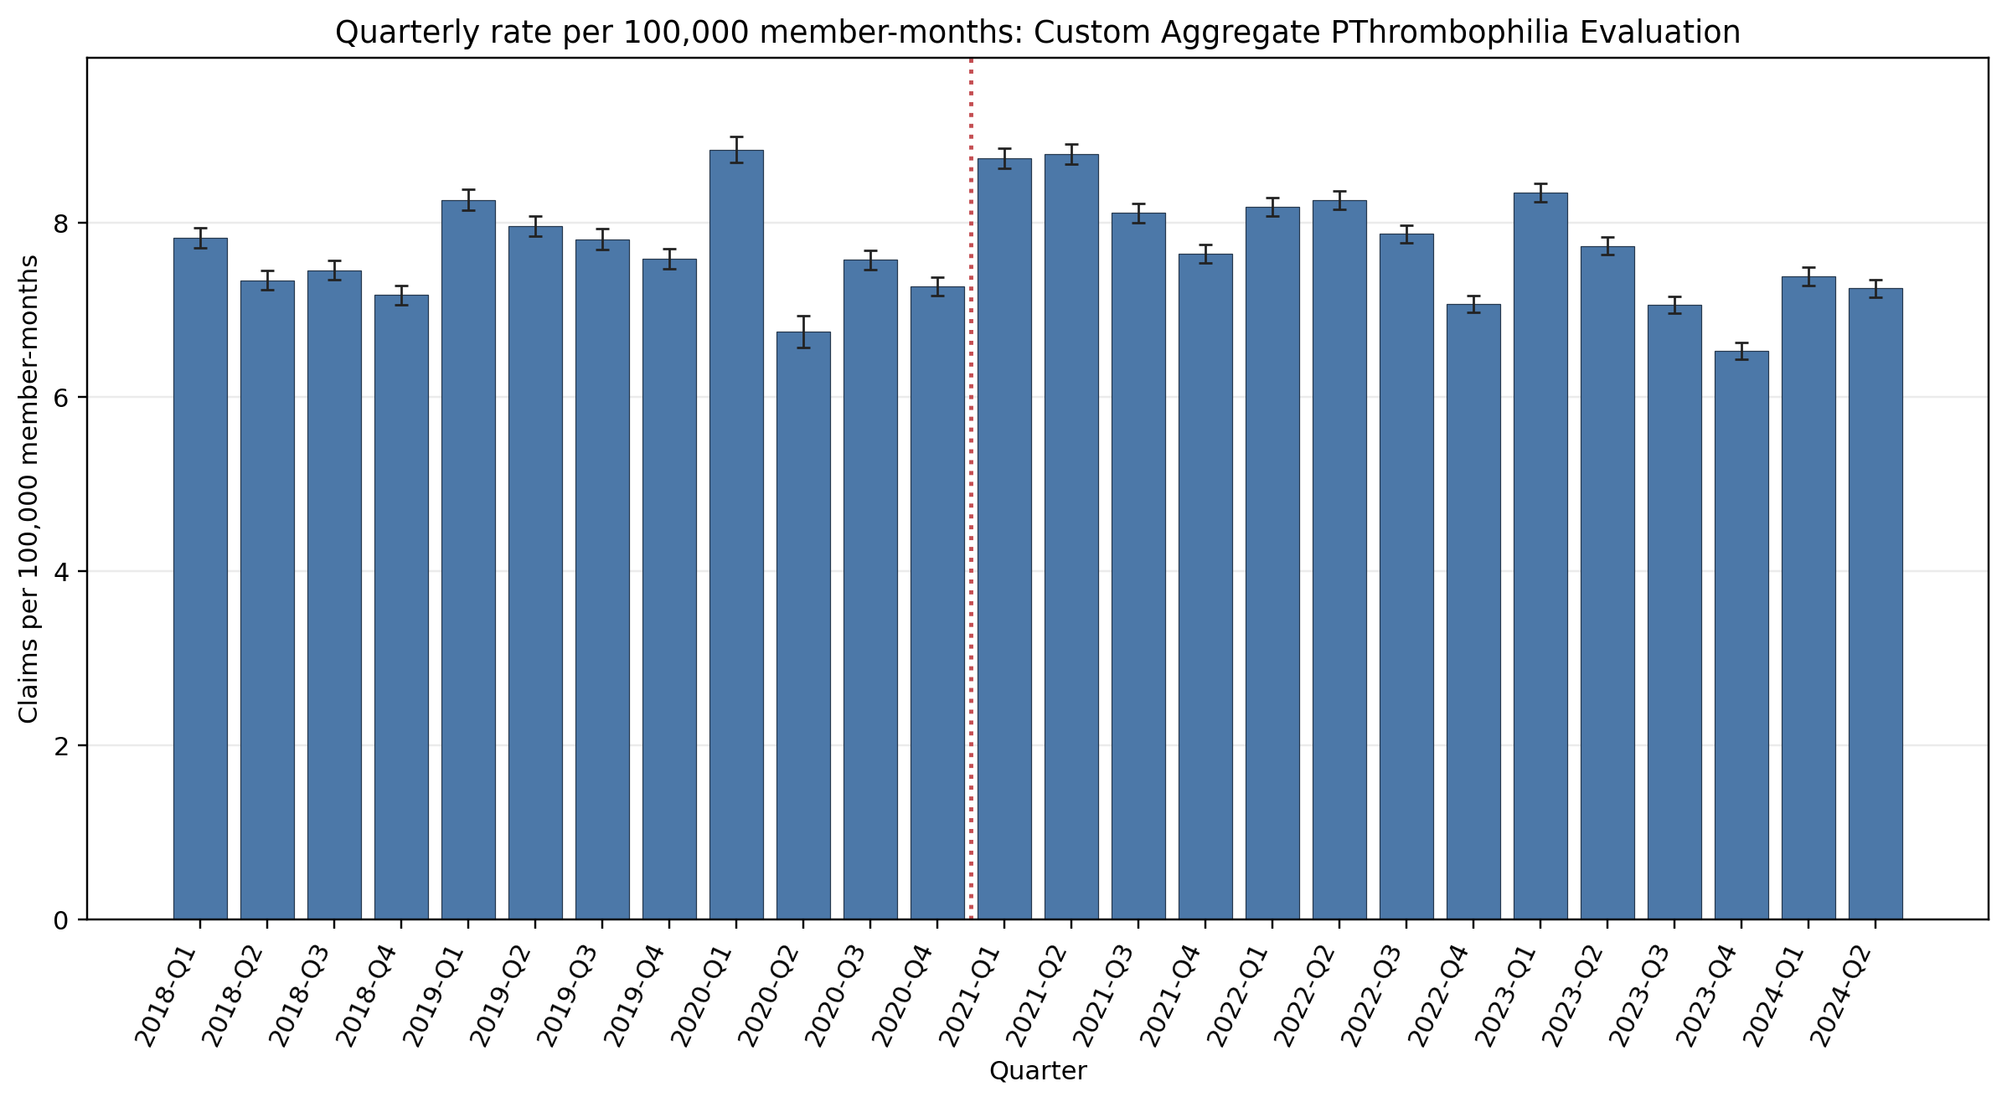
Quarterly rate per 100,000 member-months: Custom Aggregate PThrombophilia Evaluation
Error bars show exact 95% Poisson confidence intervals. Codes in aggregation: 85300, 85303, 85305, 85306, 81241, 81240

