Slide 1
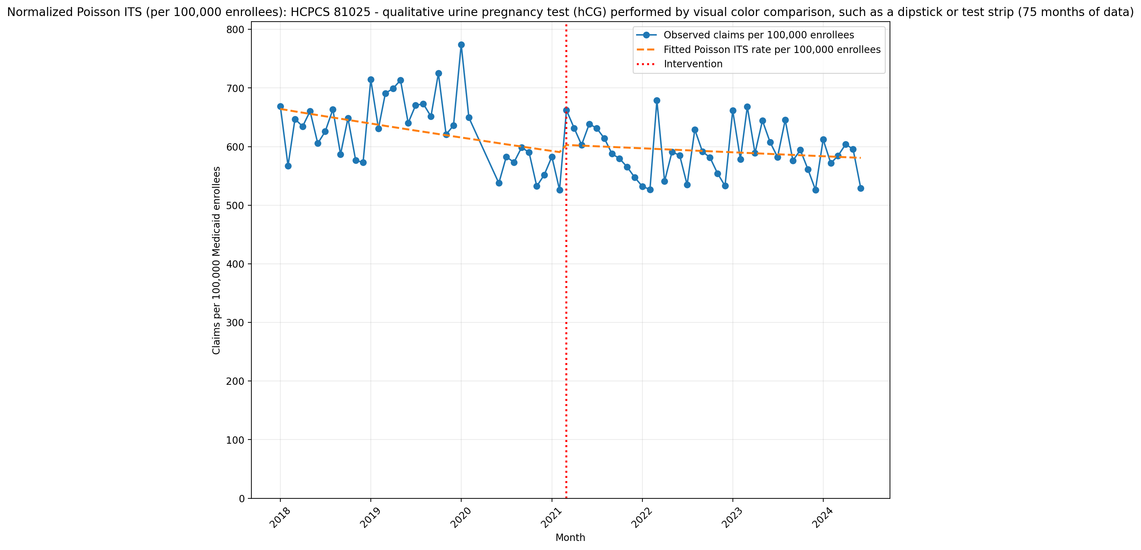
Normalized Poisson ITS (per 100,000 enrollees): HCPCS 81025 - qualitative urine pregnancy test (hCG) performed by visual color comparison, such as a dipstick or test strip (75 months of data)
Generalized Linear Model Regression Results
==============================================================================
Dep. Variable: y No. Observations: 75
Model: GLM Df Residuals: 71
Model Family: Poisson Df Model: 3
Link Function: Log Scale: 1.0000
Method: IRLS Log-Likelihood: -1.1596e+05
Date: Thu, 21 May 2026 Deviance: 2.3079e+05
Time: 14:11:39 Pearson chi2: 2.33e+05
No. Iterations: 4 Pseudo R-squ. (CS): 1.000
Covariance Type: nonrobust
==============================================================================
coef std err z P>|z| [0.025 0.975]
------------------------------------------------------------------------------
const -5.0144 0.000 -1.11e+04 0.000 -5.015 -5.014
T -0.0032 2.16e-05 -147.129 0.000 -0.003 -0.003
X_t 0.0213 0.001 32.688 0.000 0.020 0.023
post_time 0.0022 2.86e-05 77.480 0.000 0.002 0.002
==============================================================================

Slide 2
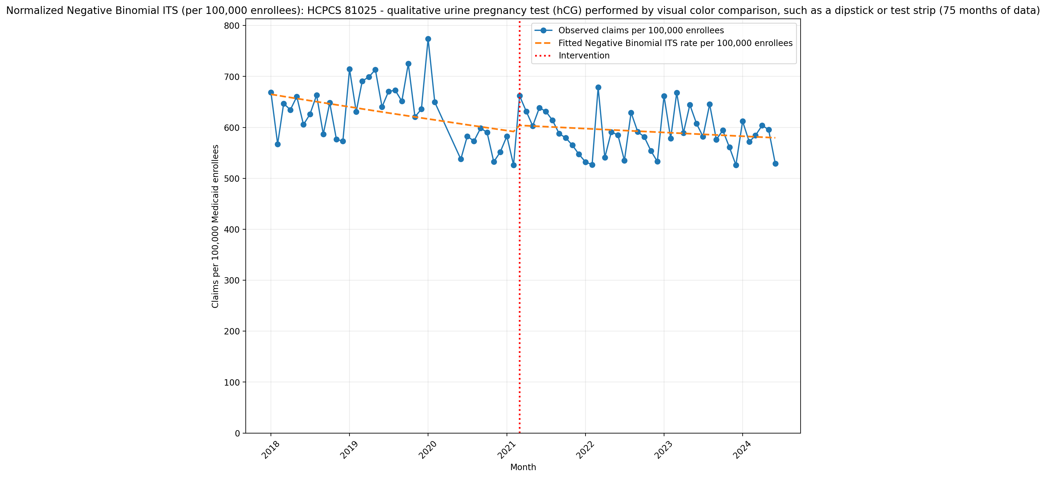
Normalized Negative Binomial ITS (per 100,000 enrollees): HCPCS 81025 - qualitative urine pregnancy test (hCG) performed by visual color comparison, such as a dipstick or test strip (75 months of data)
NegativeBinomial Regression Results
==============================================================================
Dep. Variable: y No. Observations: 75
Model: NegativeBinomial Df Residuals: 71
Method: MLE Df Model: 3
Date: Thu, 21 May 2026 Pseudo R-squ.: 0.009606
Time: 14:11:39 Log-Likelihood: -901.09
converged: True LL-Null: -909.83
Covariance Type: nonrobust LLR p-value: 0.0005632
==============================================================================
coef std err z P>|z| [0.025 0.975]
------------------------------------------------------------------------------
const -5.0133 0.025 -200.539 0.000 -5.062 -4.964
T -0.0031 0.001 -2.619 0.009 -0.005 -0.001
X_t 0.0212 0.036 0.583 0.560 -0.050 0.092
post_time 0.0021 0.002 1.308 0.191 -0.001 0.005
alpha 0.0060 0.001 6.128 0.000 0.004 0.008
==============================================================================

