Slide 1
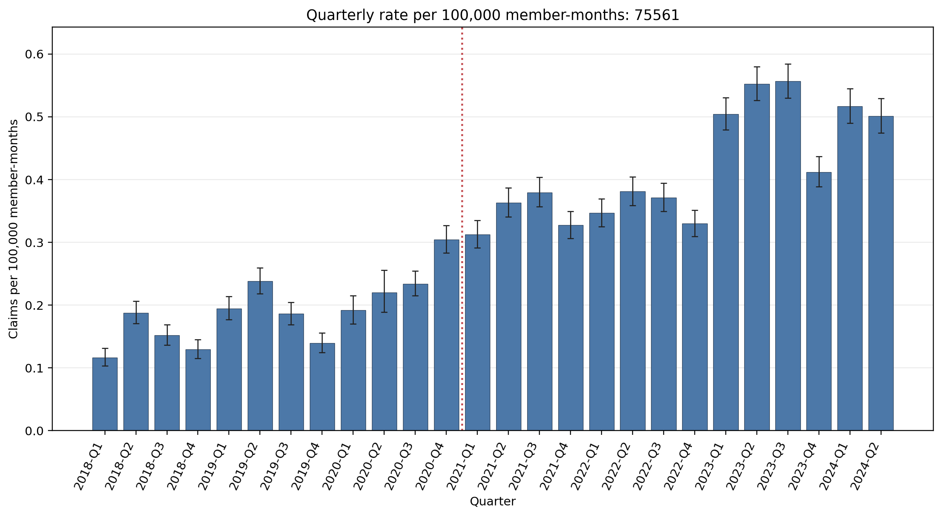
Quarterly rate per 100,000 member-months: 75561
Error bars show exact 95% Poisson confidence intervals.

