Slide 1
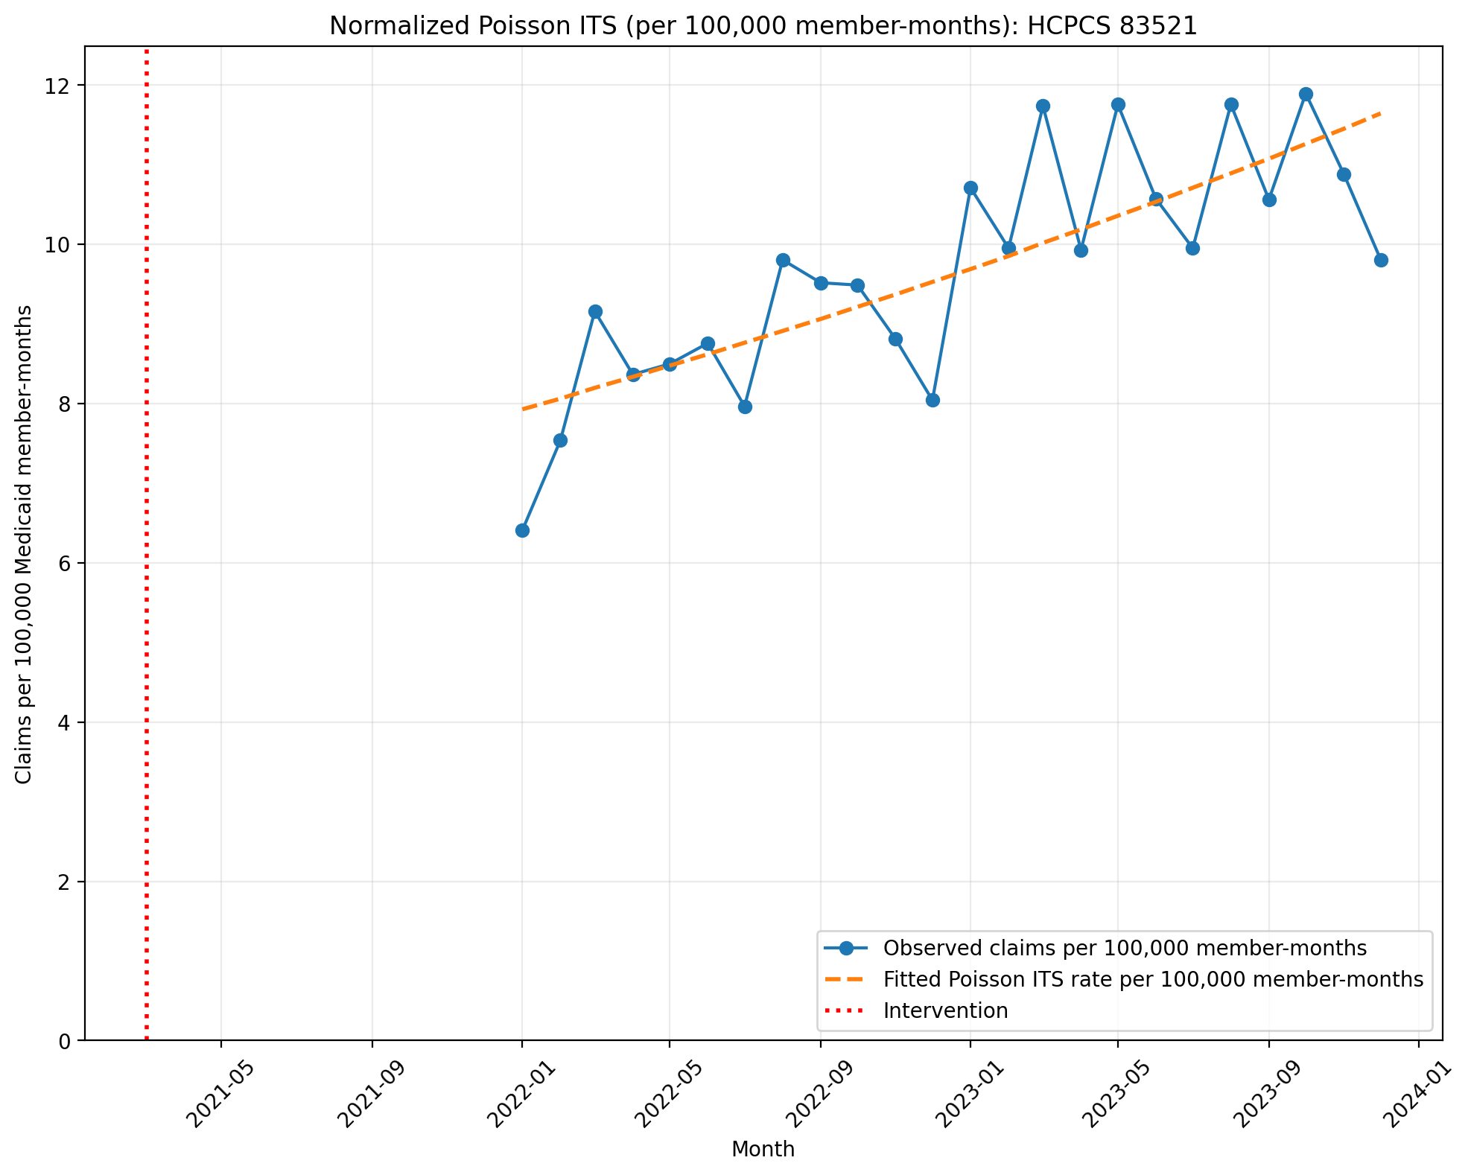
Normalized Poisson ITS (per 100,000 member-months): HCPCS 83521
Generalized Linear Model Regression Results
==============================================================================
Dep. Variable: y No. Observations: 24
Model: GLM Df Residuals: 22
Model Family: Poisson Df Model: 1
Link Function: Log Scale: 1.0000
Method: IRLS Log-Likelihood: -1094.6
Date: Tue, 08 Sep 2026 Deviance: 1926.2
Time: 12:03:10 Pearson chi2: 1.91e+03
No. Iterations: 4 Pseudo R-squ. (CS): 1.000
Covariance Type: nonrobust
==============================================================================
coef std err z P>|z| [0.025 0.975]
------------------------------------------------------------------------------
T 0.8611 0.001 1268.717 0.000 0.860 0.862
X_t -0.1550 9.66e-05 -1605.653 0.000 -0.155 -0.155
post_time -0.8443 0.000 -2166.694 0.000 -0.845 -0.844
==============================================================================

Slide 2
Normalized Negative Binomial ITS (per 100,000 member-months): HCPCS 83521
Model could not be fit:
Singular matrix

Slide 3
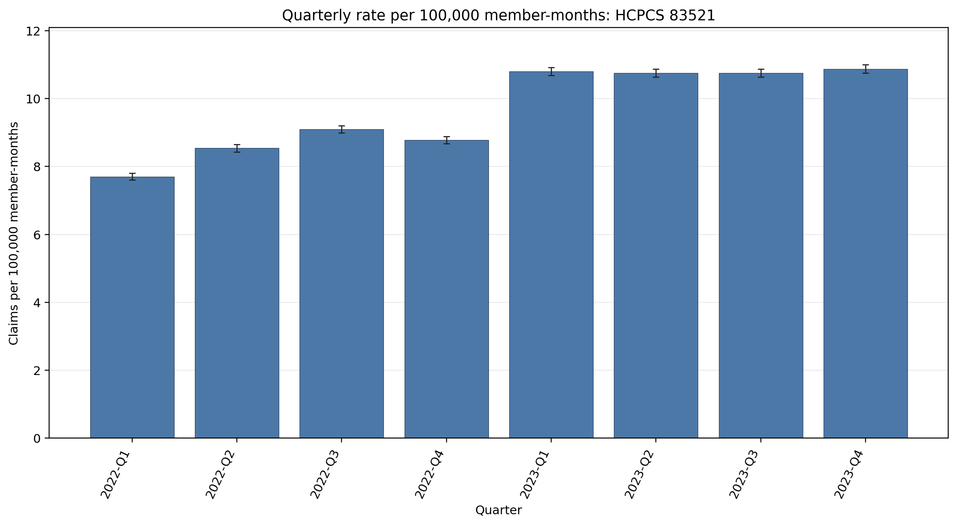
Quarterly rate per 100,000 member-months: HCPCS 83521
Error bars show exact 95% Poisson confidence intervals.
Yearly rate per 100,000 member-months (exact 95% Poisson CIs):
Year | 2022 | 2023
Rate | 8.54 | 10.79
95% CI | 8.48–8.59 | 10.73–10.85

Slide 4
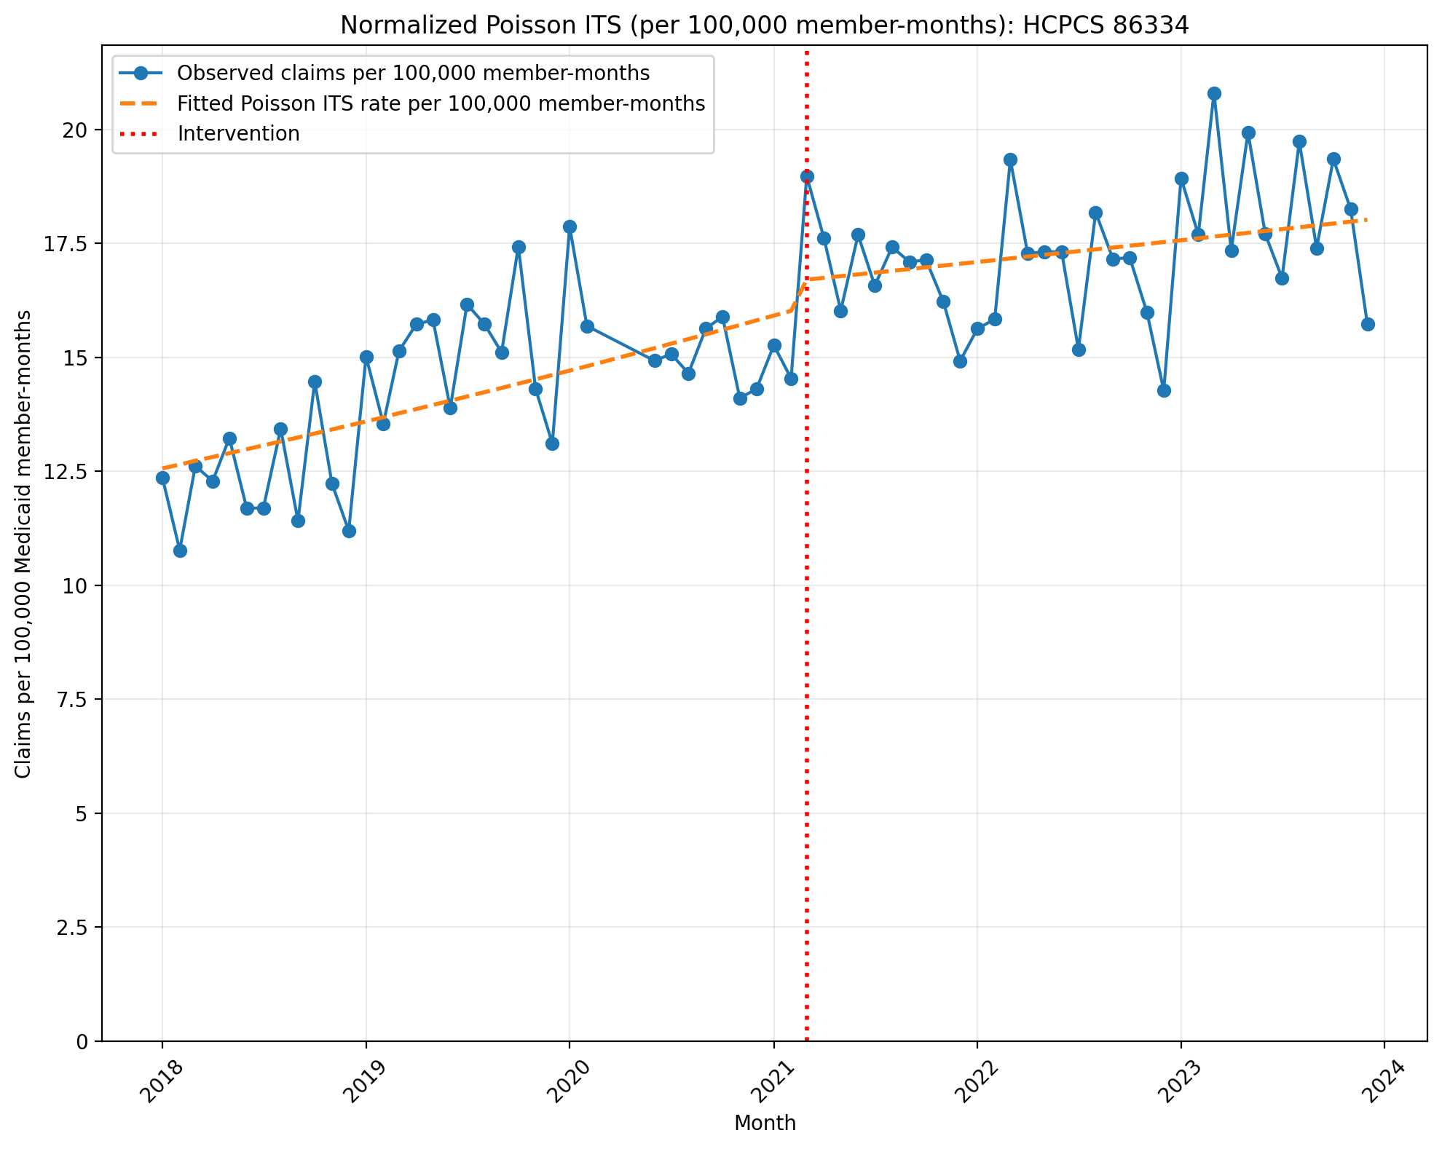
Normalized Poisson ITS (per 100,000 member-months): HCPCS 86334
Generalized Linear Model Regression Results
==============================================================================
Dep. Variable: y No. Observations: 69
Model: GLM Df Residuals: 65
Model Family: Poisson Df Model: 3
Link Function: Log Scale: 1.0000
Method: IRLS Log-Likelihood: -4055.5
Date: Tue, 08 Sep 2026 Deviance: 7329.4
Time: 12:03:10 Pearson chi2: 7.35e+03
No. Iterations: 4 Pseudo R-squ. (CS): 1.000
Covariance Type: nonrobust
==============================================================================
coef std err z P>|z| [0.025 0.975]
------------------------------------------------------------------------------
const -8.9823 0.003 -2855.866 0.000 -8.988 -8.976
T 0.0066 0.000 46.081 0.000 0.006 0.007
X_t 0.0395 0.004 9.506 0.000 0.031 0.048
post_time -0.0043 0.000 -21.499 0.000 -0.005 -0.004
==============================================================================

Slide 5
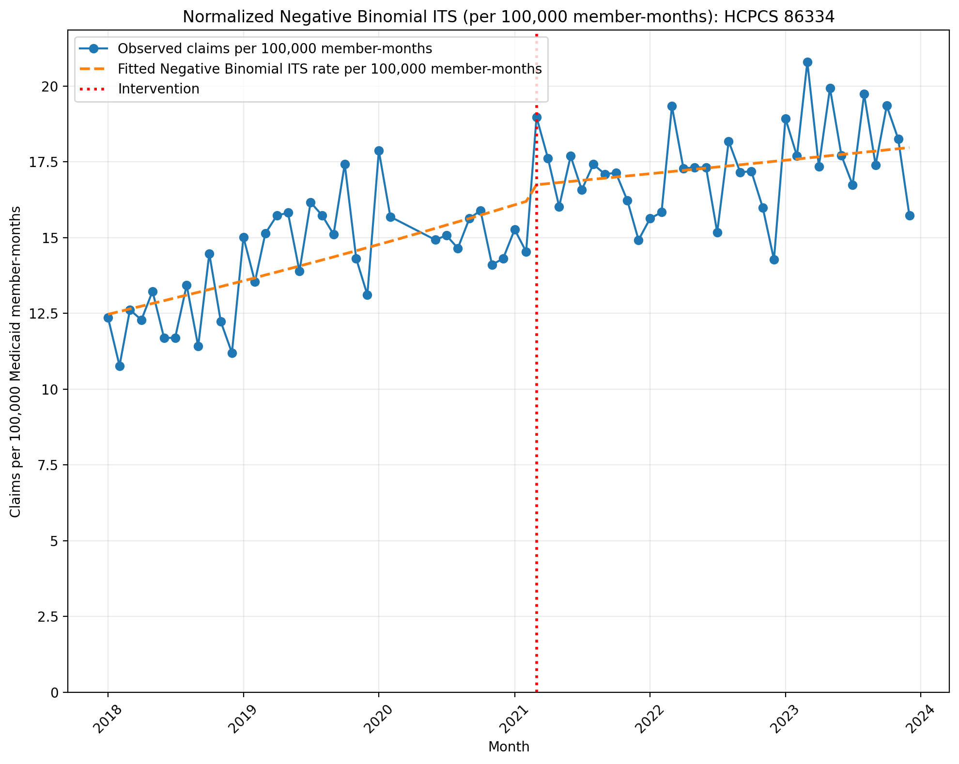
Normalized Negative Binomial ITS (per 100,000 member-months): HCPCS 86334
NegativeBinomial Regression Results
==============================================================================
Dep. Variable: y No. Observations: 69
Model: NegativeBinomial Df Residuals: 65
Method: MLE Df Model: 3
Date: Tue, 08 Sep 2026 Pseudo R-squ.: 0.05435
Time: 12:03:11 Log-Likelihood: -586.60
converged: True LL-Null: -620.32
Covariance Type: nonrobust LLR p-value: 1.511e-14
==============================================================================
coef std err z P>|z| [0.025 0.975]
------------------------------------------------------------------------------
const -8.9897 0.029 -307.925 0.000 -9.047 -8.932
T 0.0071 0.001 5.040 0.000 0.004 0.010
X_t 0.0314 0.044 0.712 0.476 -0.055 0.118
post_time -0.0049 0.002 -2.345 0.019 -0.009 -0.001
alpha 0.0080 0.001 5.823 0.000 0.005 0.011
==============================================================================

Slide 6
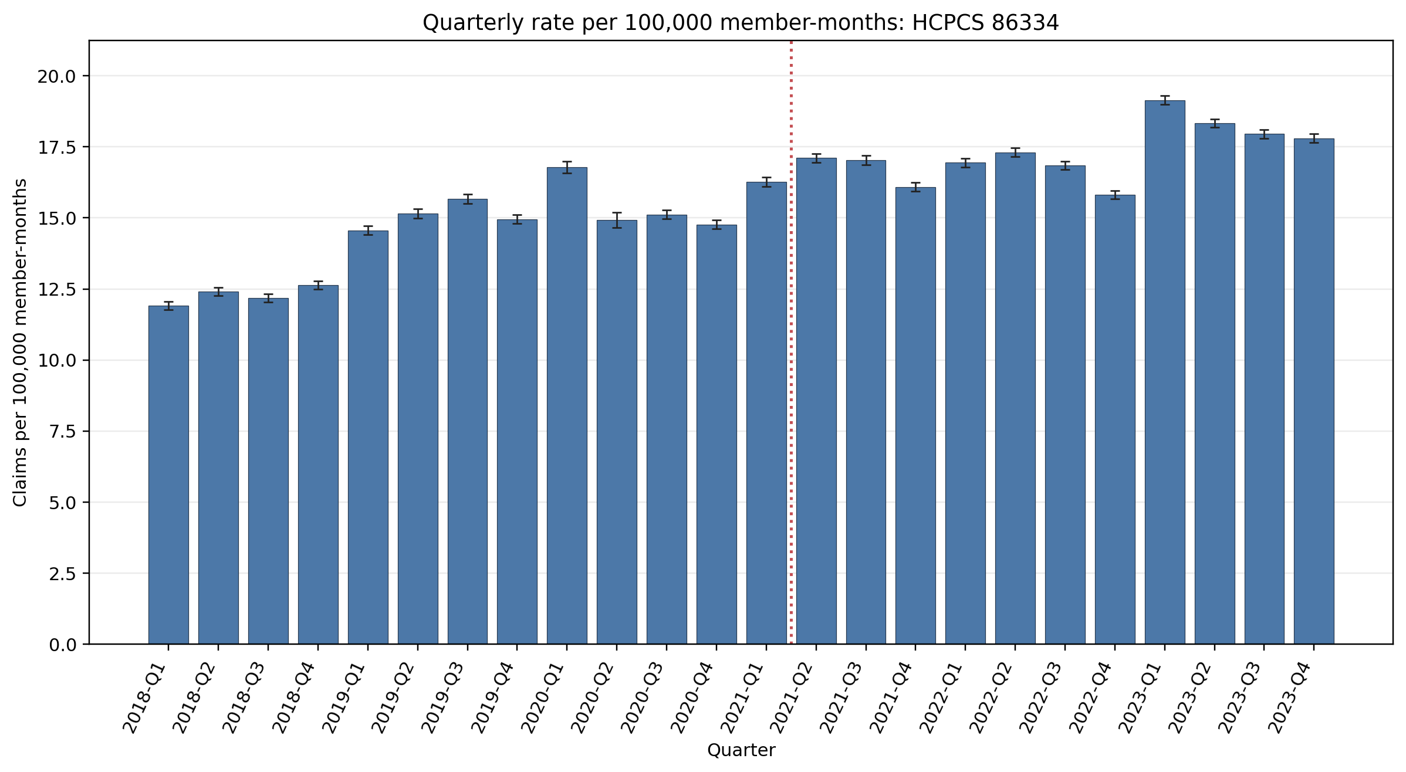
Quarterly rate per 100,000 member-months: HCPCS 86334
Error bars show exact 95% Poisson confidence intervals.
Yearly rate per 100,000 member-months (exact 95% Poisson CIs):
Year | 2018 | 2019 | 2020 | 2021 | 2022 | 2023
Rate | 12.28 | 15.08 | 15.32 | 16.62 | 16.71 | 18.32
95% CI | 12.21–12.35 | 15.00–15.16 | 15.23–15.41 | 16.54–16.70 | 16.64–16.79 | 18.24–18.39

Slide 7
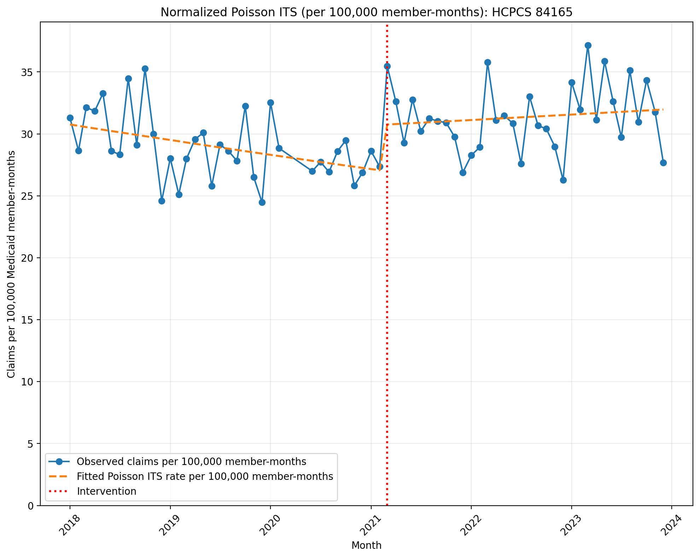
Normalized Poisson ITS (per 100,000 member-months): HCPCS 84165
Generalized Linear Model Regression Results
==============================================================================
Dep. Variable: y No. Observations: 69
Model: GLM Df Residuals: 65
Model Family: Poisson Df Model: 3
Link Function: Log Scale: 1.0000
Method: IRLS Log-Likelihood: -6450.8
Date: Tue, 08 Sep 2026 Deviance: 12075.
Time: 12:03:11 Pearson chi2: 1.21e+04
No. Iterations: 4 Pseudo R-squ. (CS): 1.000
Covariance Type: nonrobust
==============================================================================
coef std err z P>|z| [0.025 0.975]
------------------------------------------------------------------------------
const -8.0869 0.002 -3845.280 0.000 -8.091 -8.083
T -0.0035 0.000 -34.399 0.000 -0.004 -0.003
X_t 0.1267 0.003 41.140 0.000 0.121 0.133
post_time 0.0046 0.000 32.107 0.000 0.004 0.005
==============================================================================

Slide 8
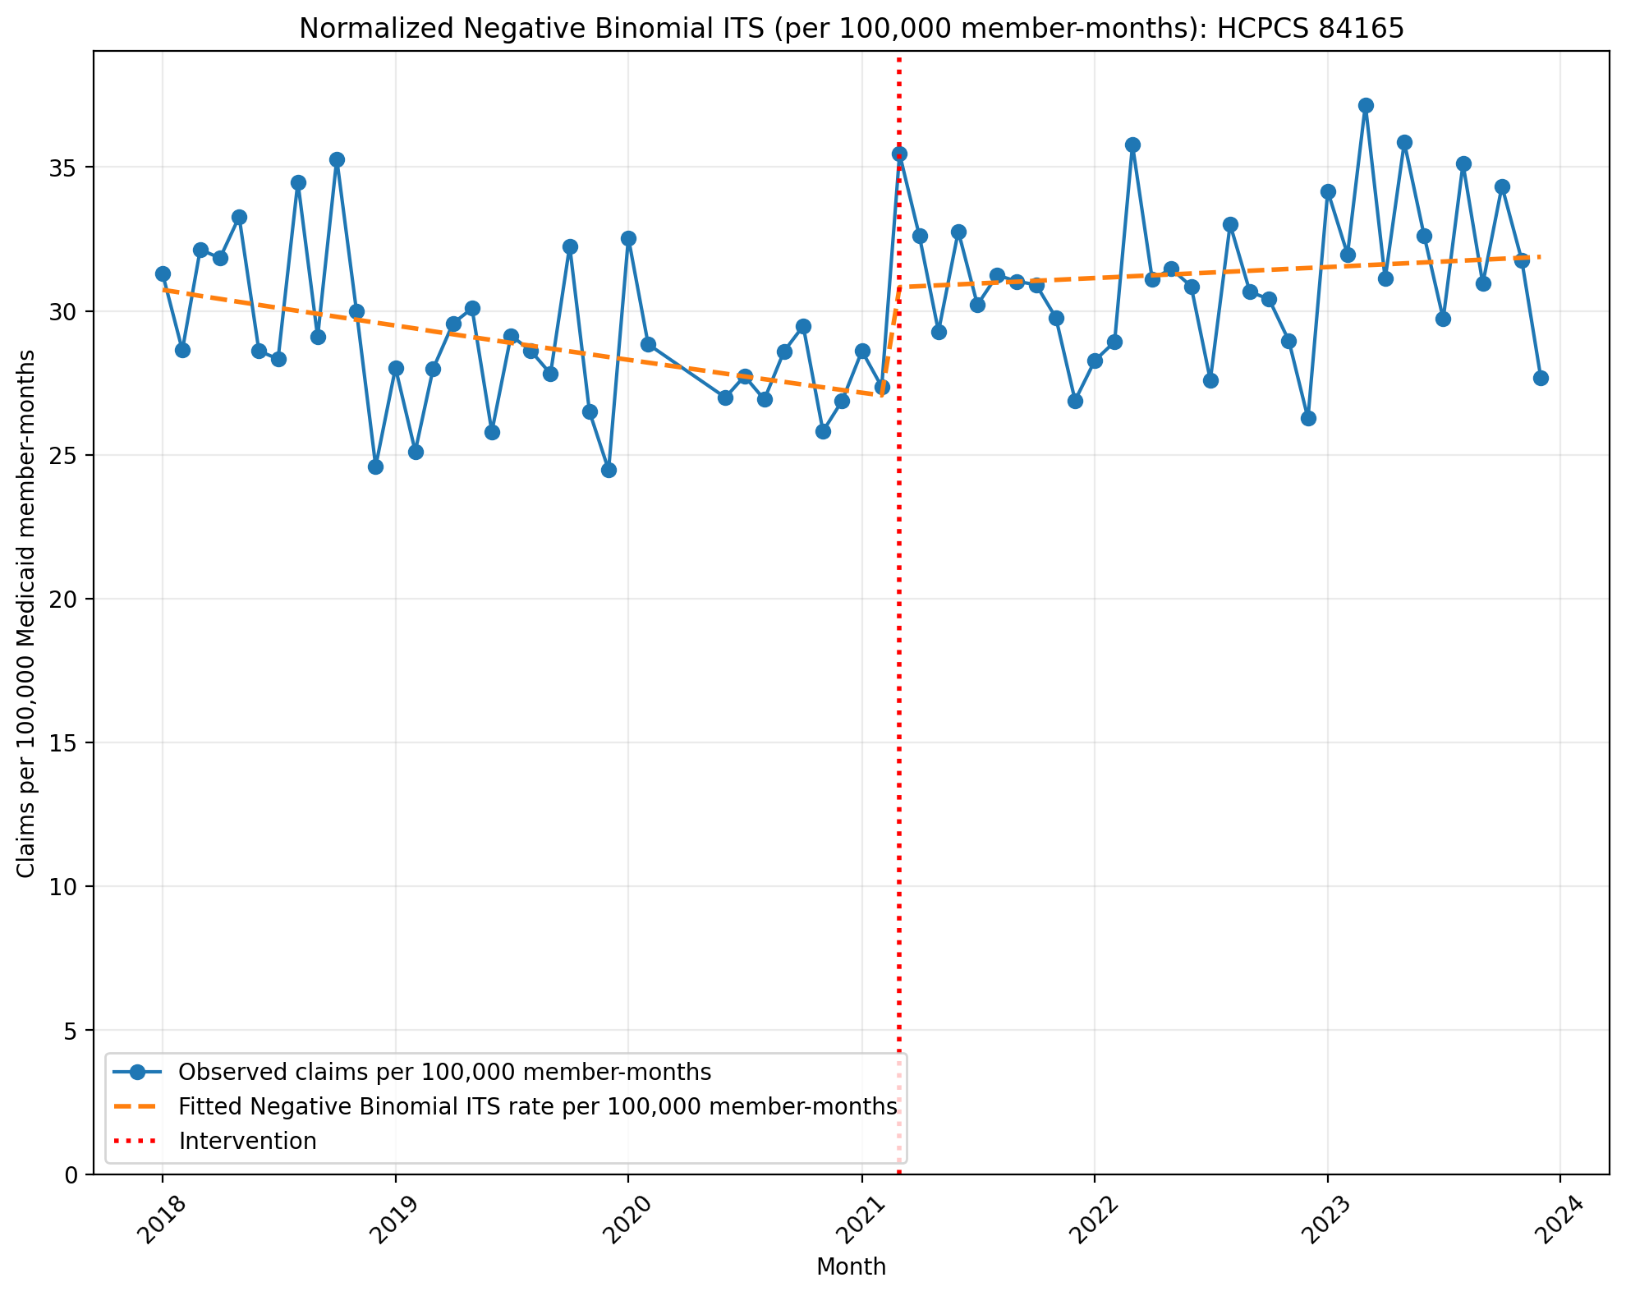
Normalized Negative Binomial ITS (per 100,000 member-months): HCPCS 84165
NegativeBinomial Regression Results
==============================================================================
Dep. Variable: y No. Observations: 69
Model: NegativeBinomial Df Residuals: 65
Method: MLE Df Model: 3
Date: Tue, 08 Sep 2026 Pseudo R-squ.: 0.01656
Time: 12:03:11 Log-Likelihood: -625.47
converged: True LL-Null: -636.00
Covariance Type: nonrobust LLR p-value: 0.0001022
==============================================================================
coef std err z P>|z| [0.025 0.975]
------------------------------------------------------------------------------
const -8.0877 0.026 -310.436 0.000 -8.139 -8.037
T -0.0034 0.001 -2.769 0.006 -0.006 -0.001
X_t 0.1292 0.040 3.247 0.001 0.051 0.207
post_time 0.0045 0.002 2.355 0.019 0.001 0.008
alpha 0.0067 0.001 5.846 0.000 0.004 0.009
==============================================================================

Slide 9
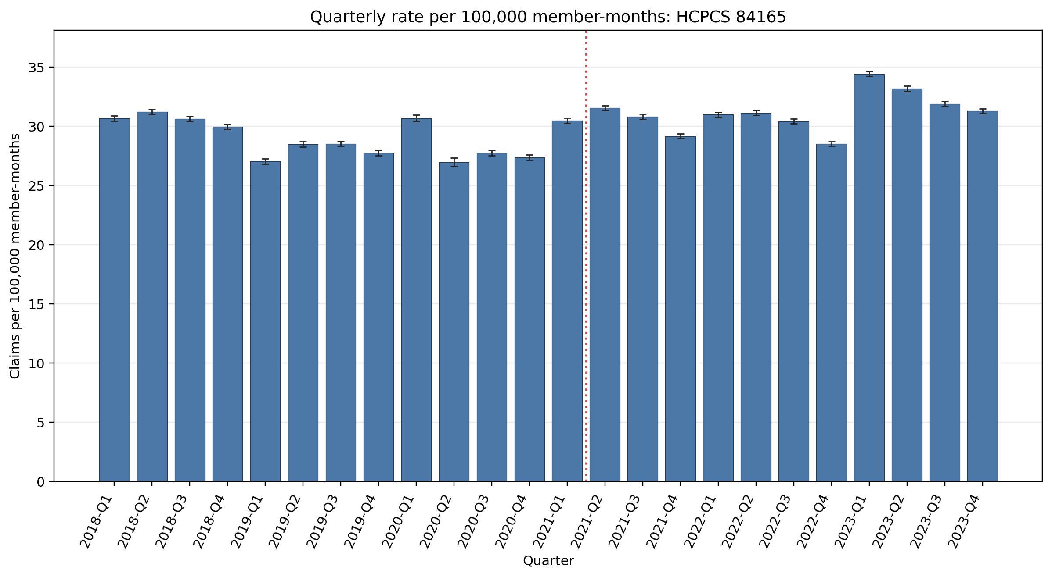
Quarterly rate per 100,000 member-months: HCPCS 84165
Error bars show exact 95% Poisson confidence intervals.
Yearly rate per 100,000 member-months (exact 95% Poisson CIs):
Year | 2018 | 2019 | 2020 | 2021 | 2022 | 2023
Rate | 30.64 | 27.95 | 28.15 | 30.50 | 30.26 | 32.74
95% CI | 30.52–30.75 | 27.84–28.06 | 28.03–28.27 | 30.40–30.61 | 30.16–30.36 | 32.64–32.85

Slide 10
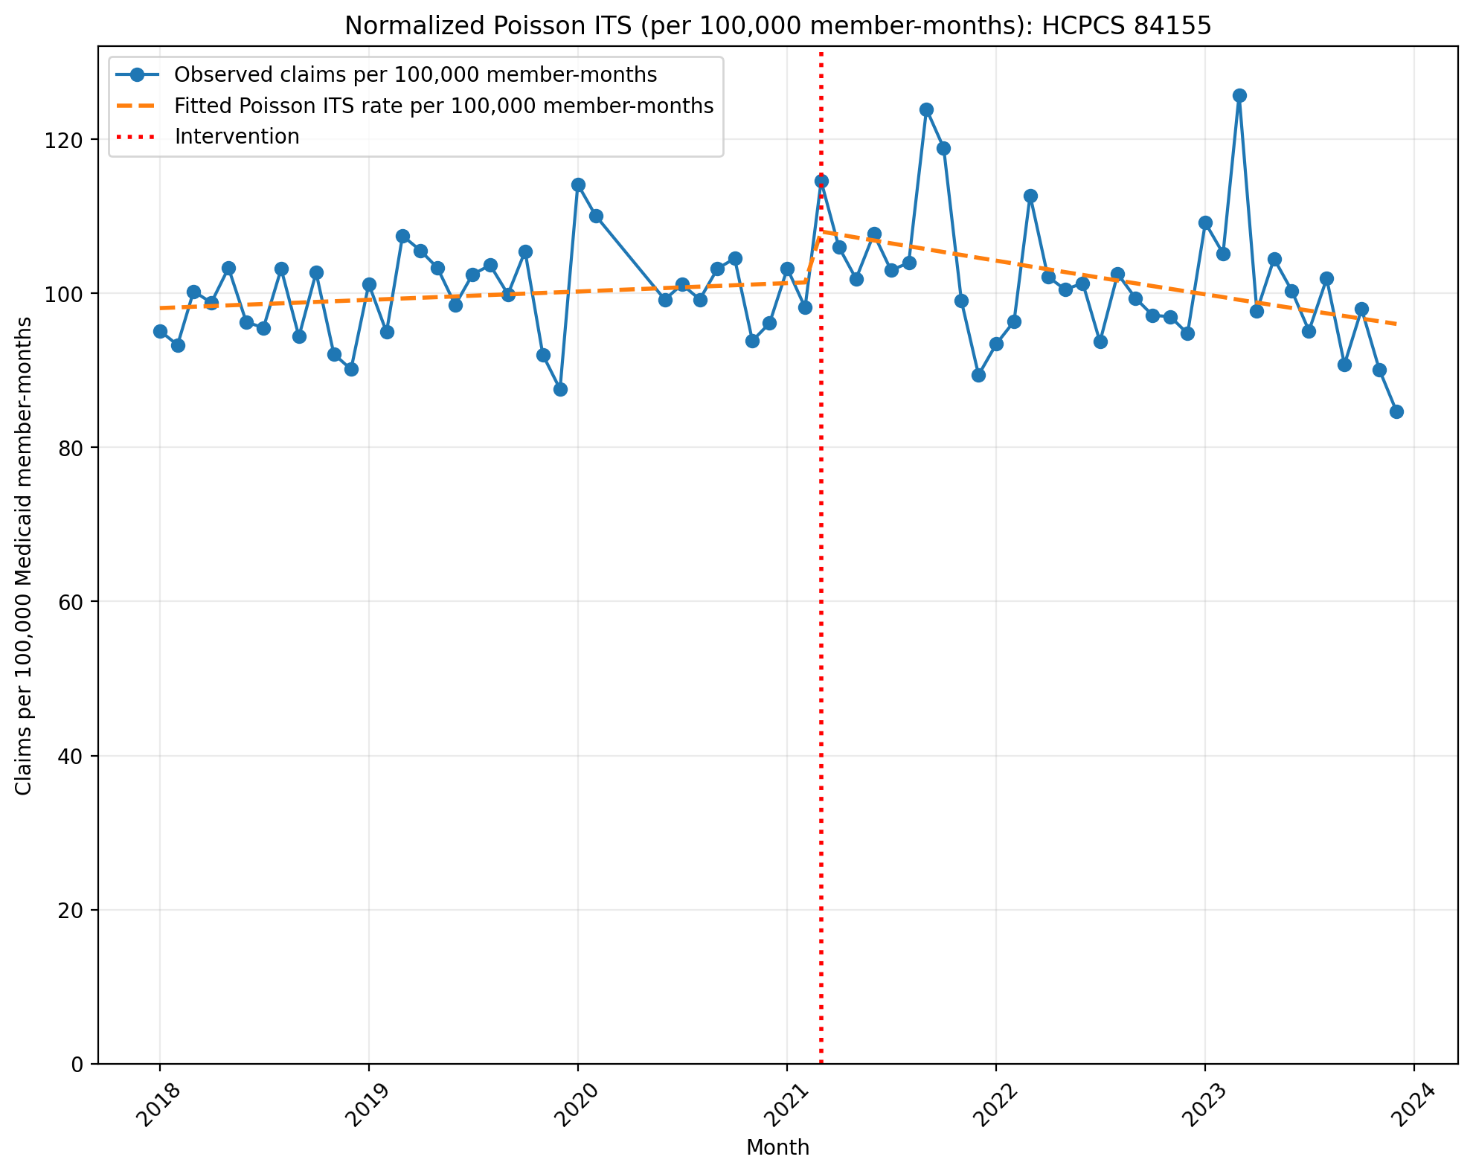
Normalized Poisson ITS (per 100,000 member-months): HCPCS 84155
Generalized Linear Model Regression Results
==============================================================================
Dep. Variable: y No. Observations: 69
Model: GLM Df Residuals: 65
Model Family: Poisson Df Model: 3
Link Function: Log Scale: 1.0000
Method: IRLS Log-Likelihood: -15283.
Date: Tue, 08 Sep 2026 Deviance: 29656.
Time: 12:03:12 Pearson chi2: 3.02e+04
No. Iterations: 4 Pseudo R-squ. (CS): 1.000
Covariance Type: nonrobust
==============================================================================
coef std err z P>|z| [0.025 0.975]
------------------------------------------------------------------------------
const -6.9270 0.001 -5997.801 0.000 -6.929 -6.925
T 0.0009 5.39e-05 16.761 0.000 0.001 0.001
X_t 0.0667 0.002 40.526 0.000 0.063 0.070
post_time -0.0045 7.86e-05 -56.891 0.000 -0.005 -0.004
==============================================================================

Slide 11
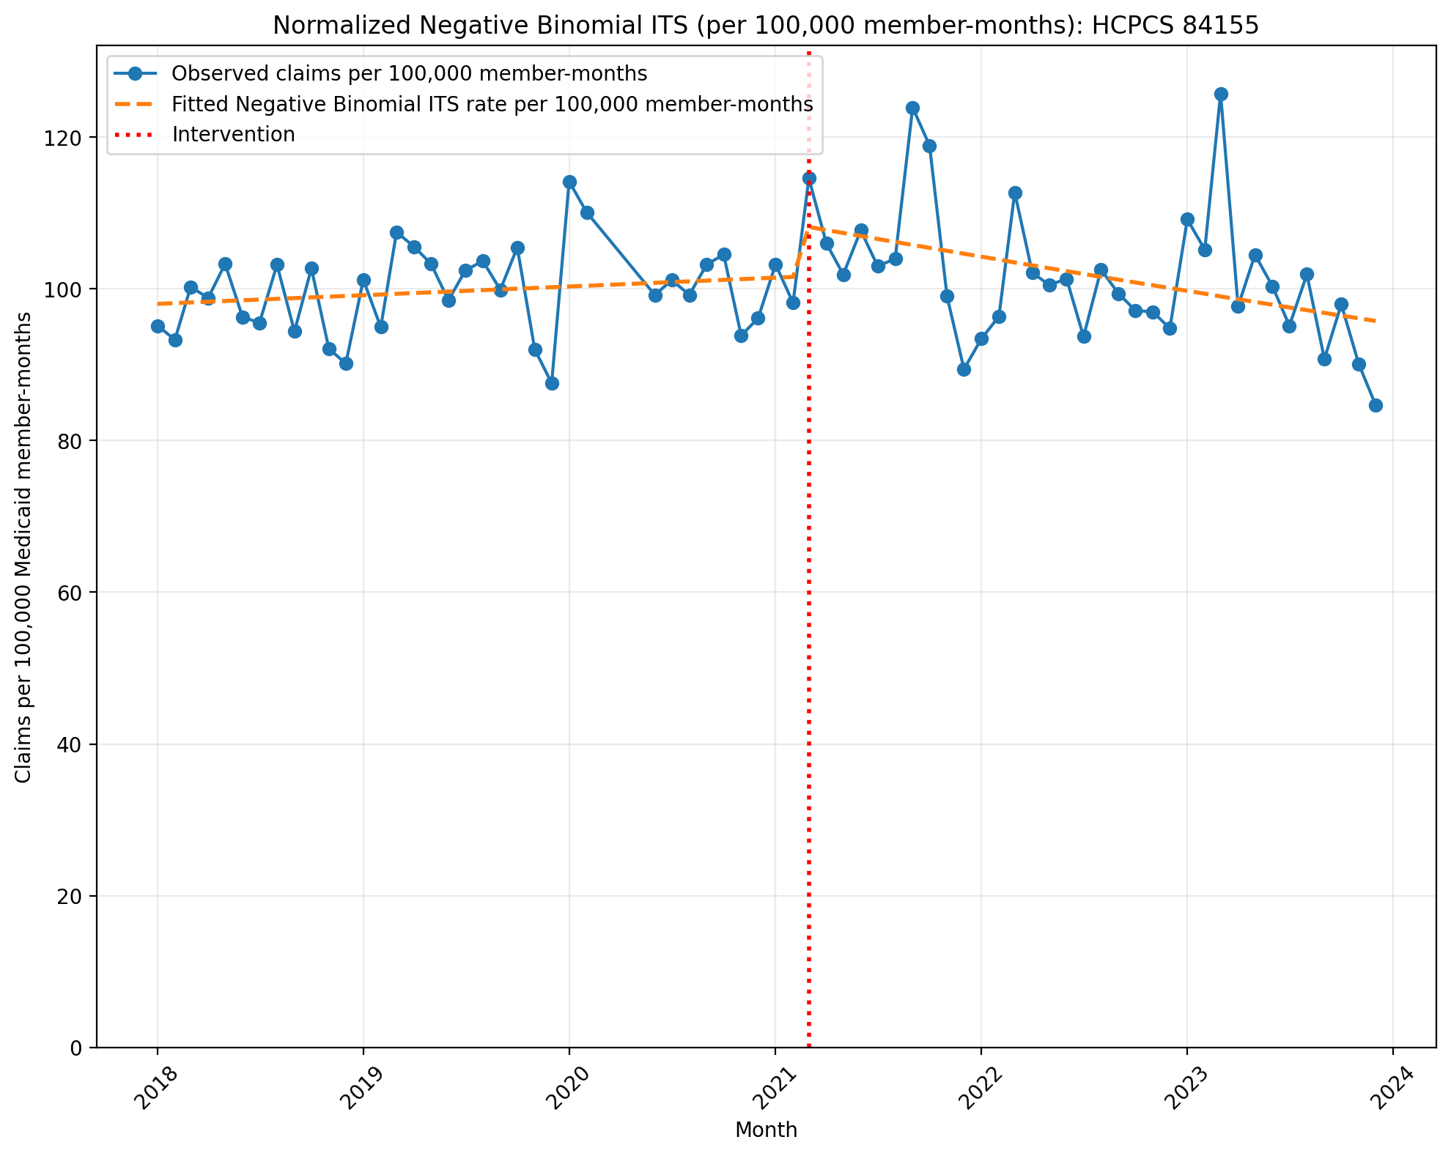
Normalized Negative Binomial ITS (per 100,000 member-months): HCPCS 84155
NegativeBinomial Regression Results
==============================================================================
Dep. Variable: y No. Observations: 69
Model: NegativeBinomial Df Residuals: 65
Method: MLE Df Model: 3
Date: Tue, 08 Sep 2026 Pseudo R-squ.: 0.007761
Time: 12:03:12 Log-Likelihood: -696.73
converged: False LL-Null: -702.17
Covariance Type: nonrobust LLR p-value: 0.01228
==============================================================================
coef std err z P>|z| [0.025 0.975]
------------------------------------------------------------------------------
const -6.9276 0.022 -314.697 0.000 -6.971 -6.884
T 0.0010 0.001 0.915 0.360 -0.001 0.003
X_t 0.0665 0.034 1.980 0.048 0.001 0.132
post_time -0.0046 0.002 -2.906 0.004 -0.008 -0.002
alpha 0.0047 0.001 5.864 0.000 0.003 0.006
==============================================================================

Slide 12
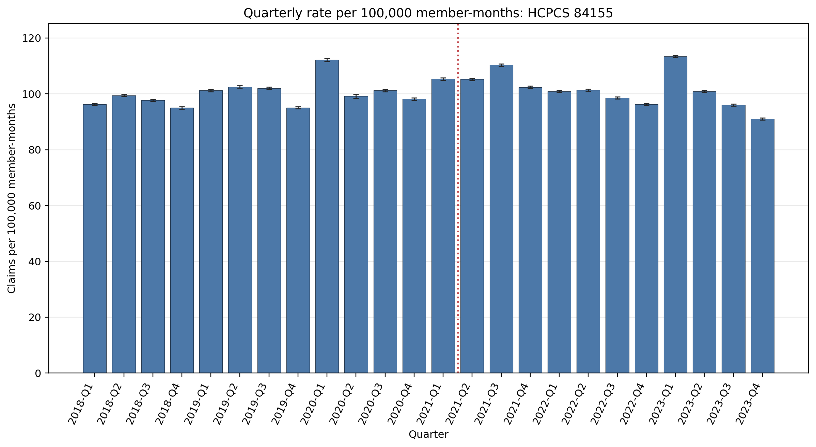
Quarterly rate per 100,000 member-months: HCPCS 84155
Error bars show exact 95% Poisson confidence intervals.
Yearly rate per 100,000 member-months (exact 95% Poisson CIs):
Year | 2018 | 2019 | 2020 | 2021 | 2022 | 2023
Rate | 97.12 | 100.19 | 102.19 | 105.82 | 99.24 | 100.51
95% CI | 96.92–97.32 | 99.99–100.40 | 101.96–102.42 | 105.62–106.01 | 99.05–99.42 | 100.32–100.69

Slide 13
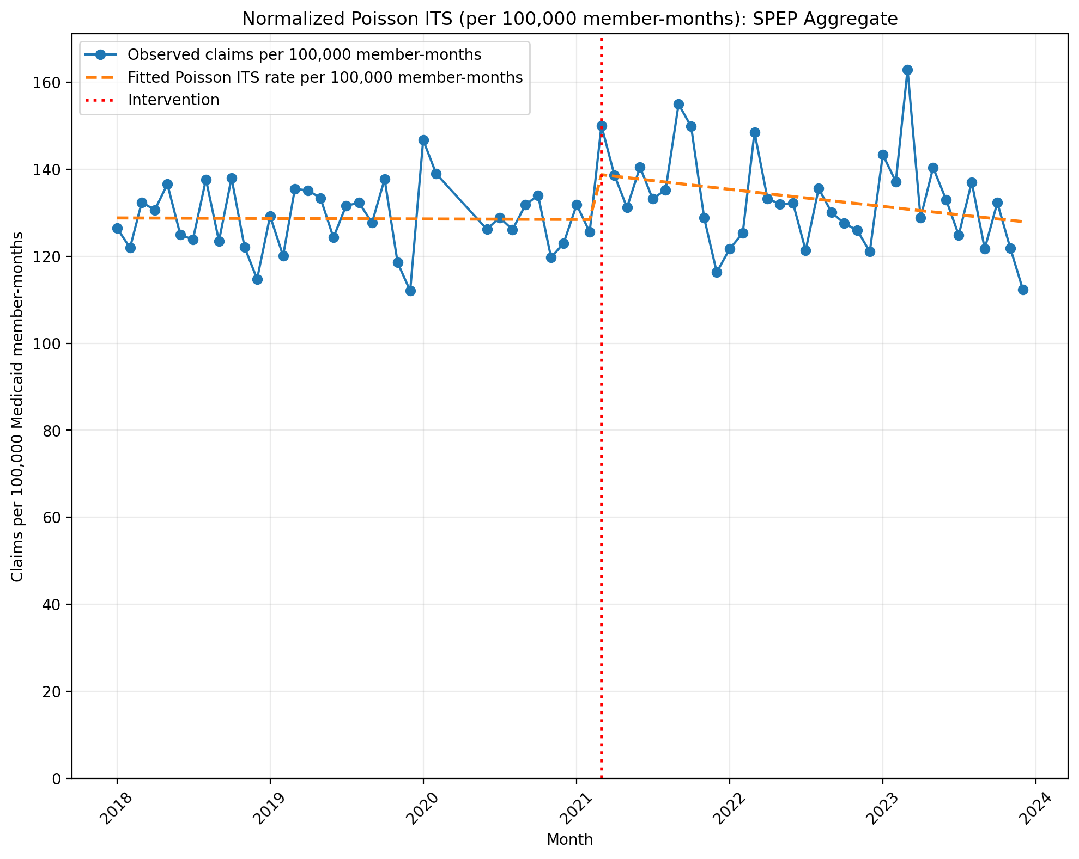
Normalized Poisson ITS (per 100,000 member-months): SPEP Aggregate
Generalized Linear Model Regression Results
==============================================================================
Dep. Variable: y No. Observations: 69
Model: GLM Df Residuals: 65
Model Family: Poisson Df Model: 3
Link Function: Log Scale: 1.0000
Method: IRLS Log-Likelihood: -19086.
Date: Tue, 08 Sep 2026 Deviance: 37243.
Time: 12:03:12 Pearson chi2: 3.77e+04
No. Iterations: 4 Pseudo R-squ. (CS): 1.000
Covariance Type: nonrobust
==============================================================================
coef std err z P>|z| [0.025 0.975]
------------------------------------------------------------------------------
const -6.6546 0.001 -6573.632 0.000 -6.657 -6.653
T -7.377e-05 4.75e-05 -1.553 0.120 -0.000 1.93e-05
X_t 0.0795 0.001 54.810 0.000 0.077 0.082
post_time -0.0024 6.9e-05 -34.500 0.000 -0.003 -0.002
==============================================================================
Codes in aggregation: 84165, 84155

Slide 14
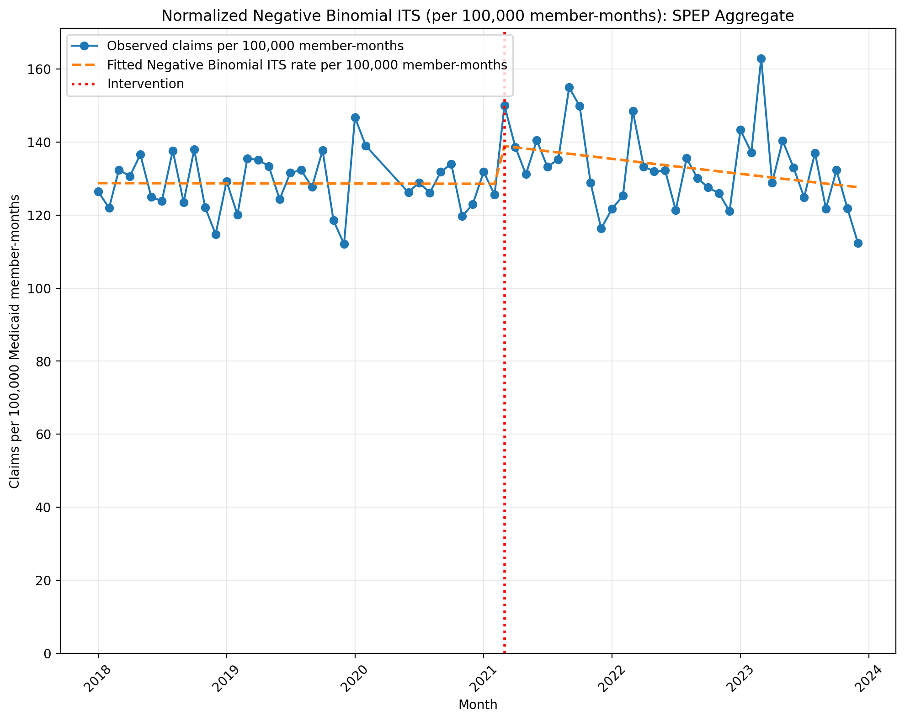
Normalized Negative Binomial ITS (per 100,000 member-months): SPEP Aggregate
NegativeBinomial Regression Results
==============================================================================
Dep. Variable: y No. Observations: 69
Model: NegativeBinomial Df Residuals: 65
Method: MLE Df Model: 3
Date: Tue, 08 Sep 2026 Pseudo R-squ.: 0.005971
Time: 12:03:12 Log-Likelihood: -713.99
converged: False LL-Null: -718.27
Covariance Type: nonrobust LLR p-value: 0.03548
==============================================================================
coef std err z P>|z| [0.025 0.975]
------------------------------------------------------------------------------
const -6.6550 0.022 -306.413 0.000 -6.698 -6.612
T -4.107e-05 0.001 -0.040 0.968 -0.002 0.002
X_t 0.0800 0.033 2.414 0.016 0.015 0.145
post_time -0.0025 0.002 -1.600 0.110 -0.006 0.001
alpha 0.0046 0.001 5.867 0.000 0.003 0.006
==============================================================================
Codes in aggregation: 84165, 84155

Slide 15
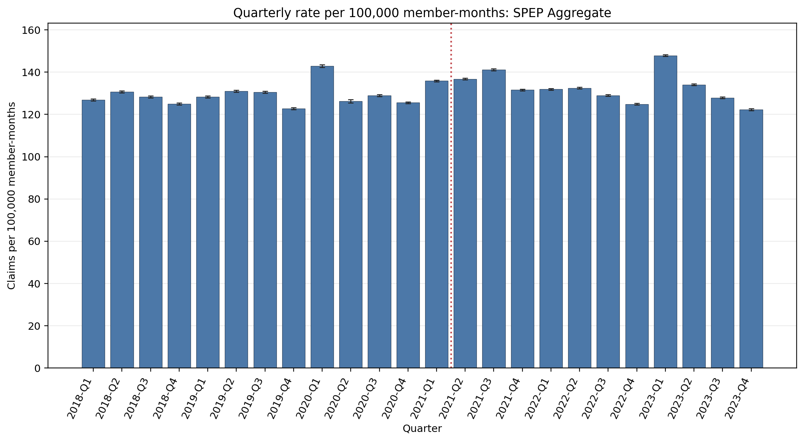
Quarterly rate per 100,000 member-months: SPEP Aggregate
Error bars show exact 95% Poisson confidence intervals. Codes in aggregation: 84165, 84155
Yearly rate per 100,000 member-months (exact 95% Poisson CIs):
Year | 2018 | 2019 | 2020 | 2021 | 2022 | 2023
Rate | 127.75 | 128.14 | 130.34 | 136.32 | 129.49 | 133.25
95% CI | 127.52–127.99 | 127.91–128.38 | 130.08–130.60 | 136.09–136.54 | 129.29–129.70 | 133.04–133.46

