Slide 1
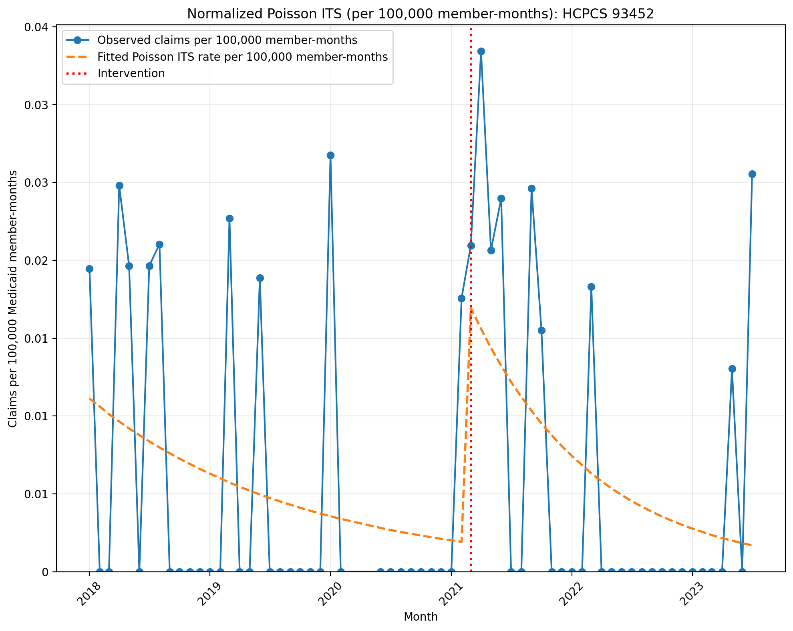
Normalized Poisson ITS (per 100,000 member-months): HCPCS 93452
Generalized Linear Model Regression Results
==============================================================================
Dep. Variable: y No. Observations: 64
Model: GLM Df Residuals: 60
Model Family: Poisson Df Model: 3
Link Function: Log Scale: 1.0000
Method: IRLS Log-Likelihood: -405.50
Date: Thu, 03 Sep 2026 Deviance: 726.18
Time: 14:01:55 Pearson chi2: 1.01e+03
No. Iterations: 6 Pseudo R-squ. (CS): 0.8337
Covariance Type: nonrobust
==============================================================================
coef std err z P>|z| [0.025 0.975]
------------------------------------------------------------------------------
const -16.0117 0.132 -121.246 0.000 -16.271 -15.753
T -0.0475 0.008 -5.783 0.000 -0.064 -0.031
X_t 2.2597 0.251 8.994 0.000 1.767 2.752
post_time -0.0349 0.013 -2.680 0.007 -0.060 -0.009
==============================================================================

Slide 2
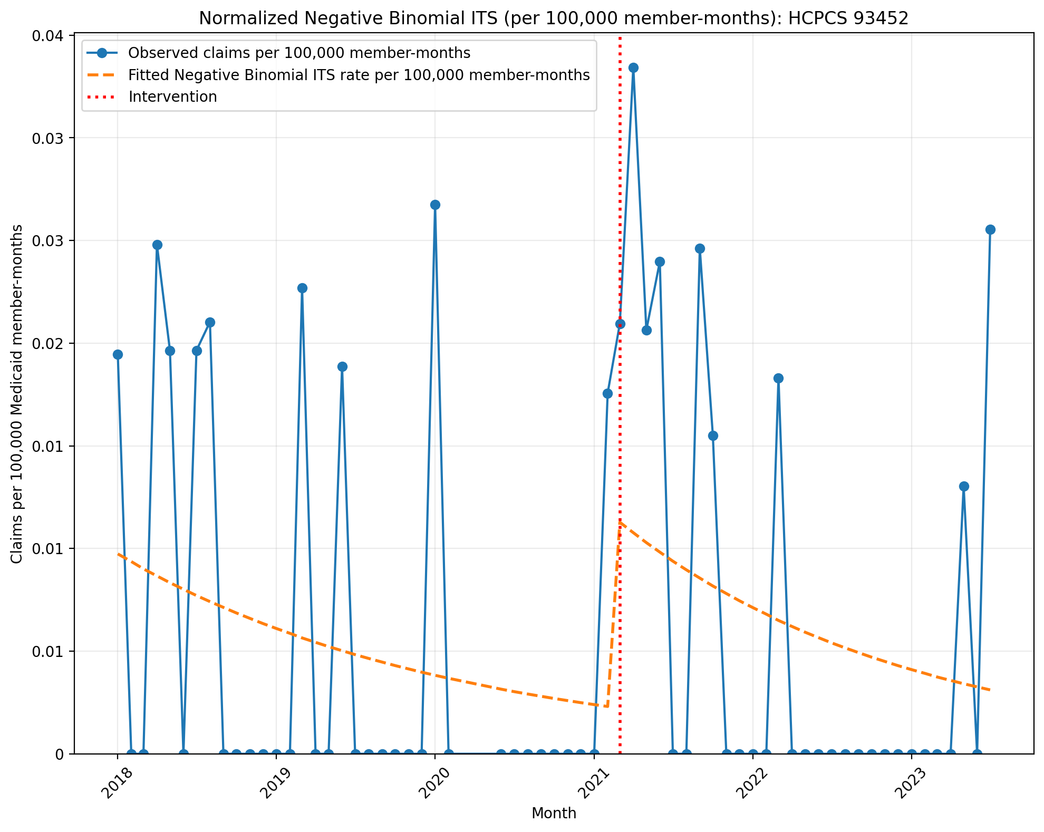
Normalized Negative Binomial ITS (per 100,000 member-months): HCPCS 93452
NegativeBinomial Regression Results
==============================================================================
Dep. Variable: y No. Observations: 64
Model: NegativeBinomial Df Residuals: 60
Method: MLE Df Model: 3
Date: Thu, 03 Sep 2026 Pseudo R-squ.: 0.006169
Time: 14:01:56 Log-Likelihood: -117.80
converged: True LL-Null: -118.53
Covariance Type: nonrobust LLR p-value: 0.6910
==============================================================================
coef std err z P>|z| [0.025 0.975]
------------------------------------------------------------------------------
const -16.1450 0.960 -16.811 0.000 -18.027 -14.263
T -0.0390 0.044 -0.876 0.381 -0.126 0.048
X_t 1.6341 1.427 1.146 0.252 -1.162 4.430
post_time -0.0070 0.069 -0.102 0.919 -0.142 0.128
alpha 10.5080 3.000 3.503 0.000 4.628 16.388
==============================================================================

Slide 3
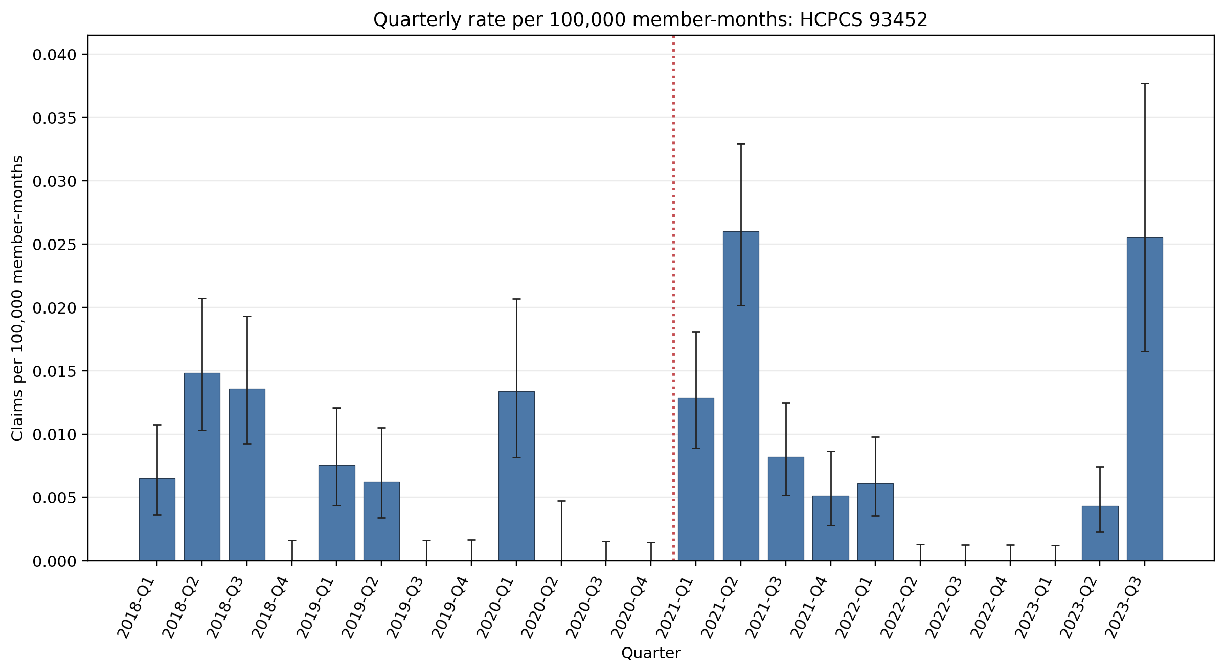
Quarterly rate per 100,000 member-months: HCPCS 93452
Error bars show exact 95% Poisson confidence intervals.
Yearly rate per 100,000 member-months (exact 95% Poisson CIs):
Year | 2018 | 2019 | 2020 | 2021 | 2022 | 2023
Rate | 0.0088 | 0.0035 | 0.0028 | 0.013 | 0.0015 | 0.0055
95% CI | 0.0069–0.011 | 0.0023–0.0049 | 0.0017–0.0043 | 0.011–0.015 | 0.0009–0.0024 | 0.0039–0.0075

Slide 4
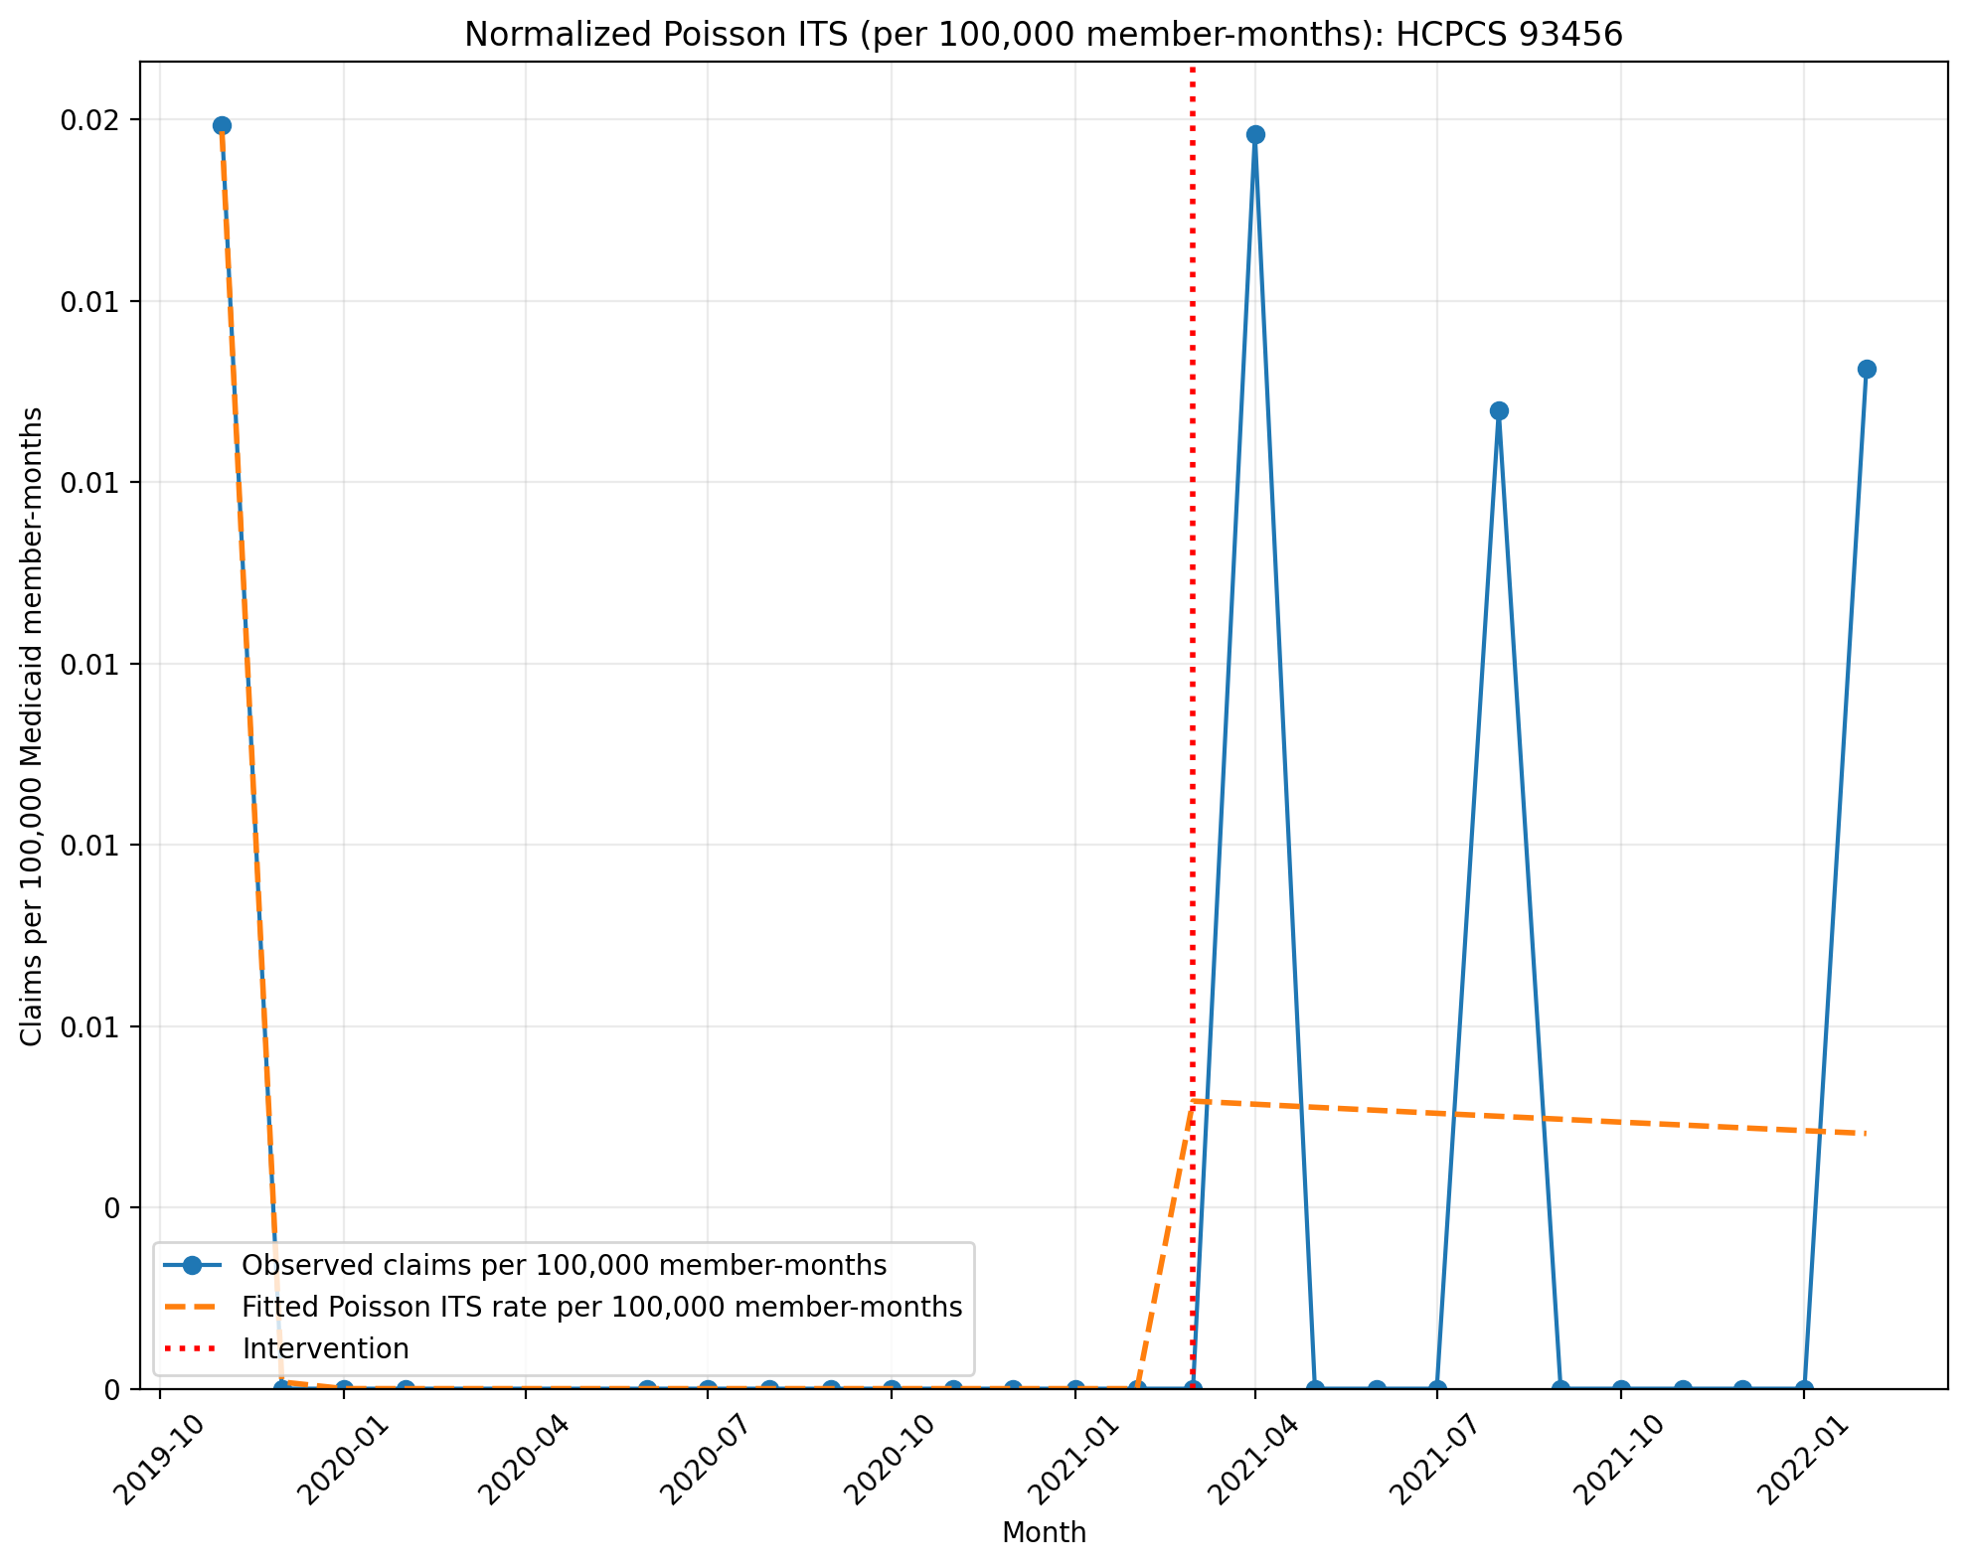
Normalized Poisson ITS (per 100,000 member-months): HCPCS 93456
Generalized Linear Model Regression Results
==============================================================================
Dep. Variable: y No. Observations: 25
Model: GLM Df Residuals: 21
Model Family: Poisson Df Model: 3
Link Function: Log Scale: 1.0000
Method: IRLS Log-Likelihood: -64.541
Date: Thu, 03 Sep 2026 Deviance: 111.36
Time: 14:01:56 Pearson chi2: 121.
No. Iterations: 100 Pseudo R-squ. (CS): 0.9624
Covariance Type: nonrobust
==============================================================================
coef std err z P>|z| [0.025 0.975]
------------------------------------------------------------------------------
const -15.5679 0.277 -56.124 0.000 -16.112 -15.024
T -5.2374 0.021 -248.746 0.000 -5.279 -5.196
X_t 77.0968 0.367 209.787 0.000 76.377 77.817
post_time 5.2266 0.050 103.661 0.000 5.128 5.325
==============================================================================

Slide 5
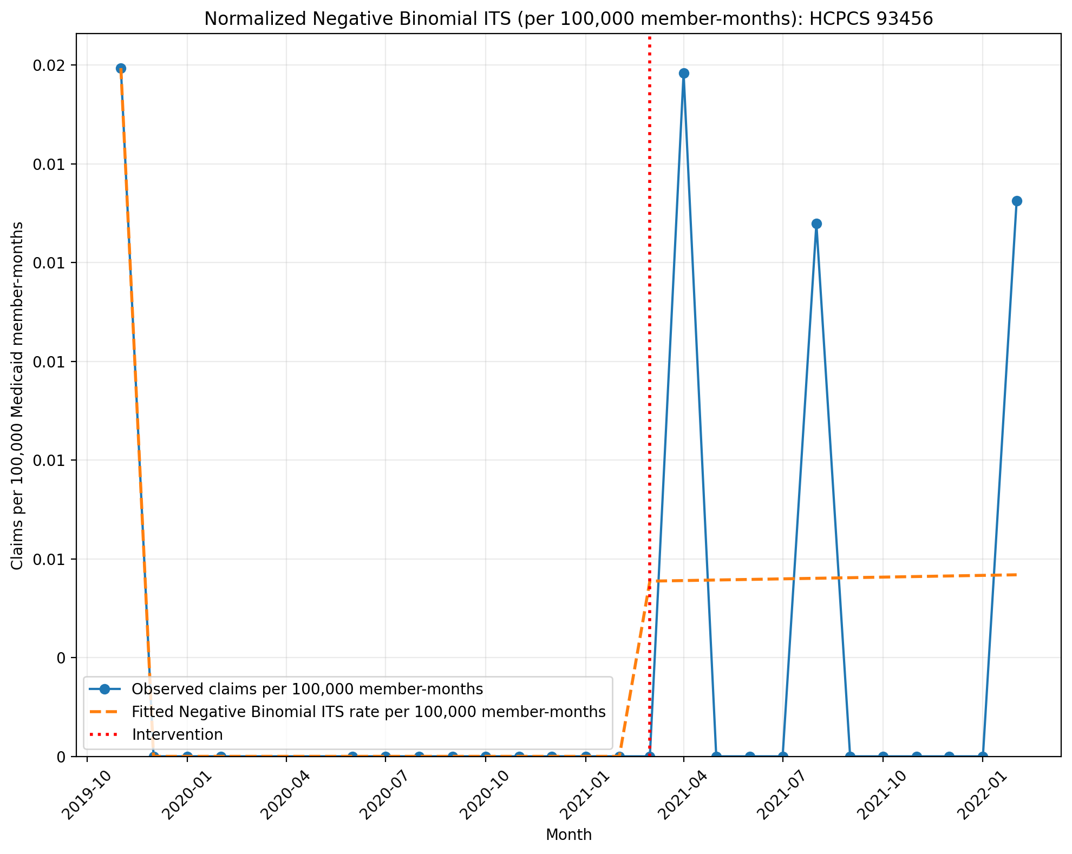
Normalized Negative Binomial ITS (per 100,000 member-months): HCPCS 93456
NegativeBinomial Regression Results
==============================================================================
Dep. Variable: y No. Observations: 25
Model: NegativeBinomial Df Residuals: 21
Method: MLE Df Model: 3
Date: Thu, 03 Sep 2026 Pseudo R-squ.: nan
Time: 14:01:56 Log-Likelihood: nan
converged: False LL-Null: -27.623
Covariance Type: nonrobust LLR p-value: nan
==============================================================================
coef std err z P>|z| [0.025 0.975]
------------------------------------------------------------------------------
const -15.5631 1.218 -12.780 0.000 -17.950 -13.176
T -14.2538 346.170 -0.041 0.967 -692.735 664.227
X_t 212.4353 5192.550 0.041 0.967 -9964.776 1.04e+04
post_time 14.2570 346.170 0.041 0.967 -664.224 692.738
alpha 1.4061 0.443 3.171 0.002 0.537 2.275
==============================================================================

Slide 6
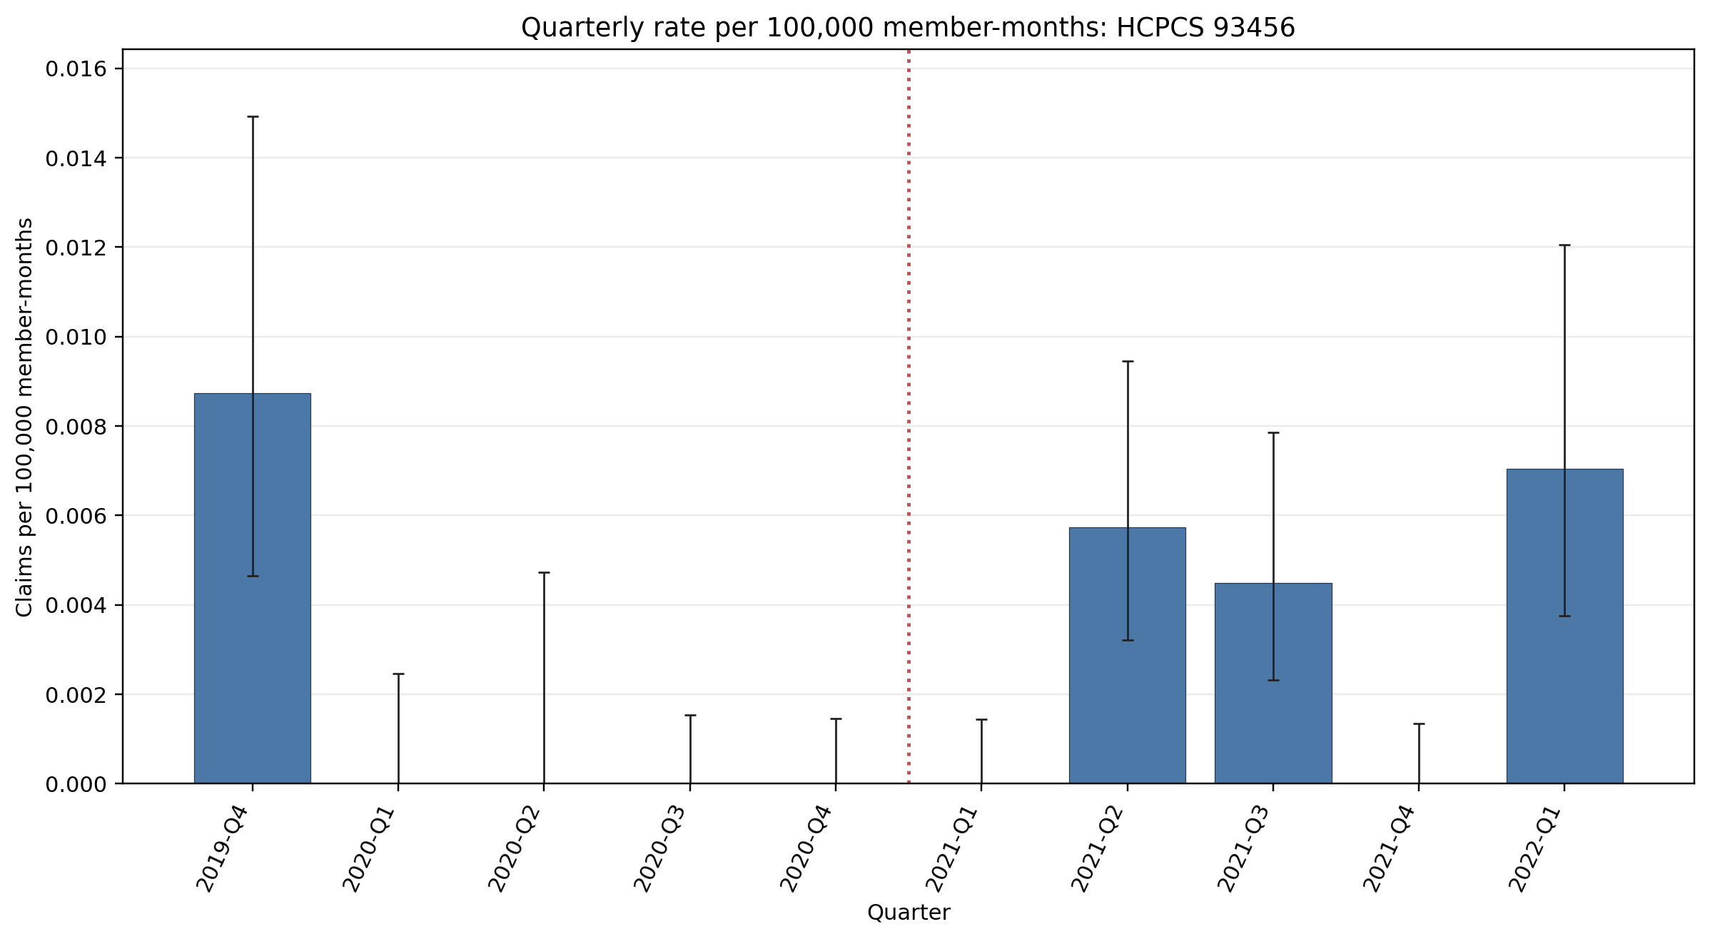
Quarterly rate per 100,000 member-months: HCPCS 93456
Error bars show exact 95% Poisson confidence intervals.
Yearly rate per 100,000 member-months (exact 95% Poisson CIs):
Year | 2019 | 2020 | 2021 | 2022
Rate | 0.0087 | 0 | 0.0026 | 0.0070
95% CI | 0.0046–0.015 | 0–0.0005 | 0.0017–0.0037 | 0.0038–0.012

Slide 7
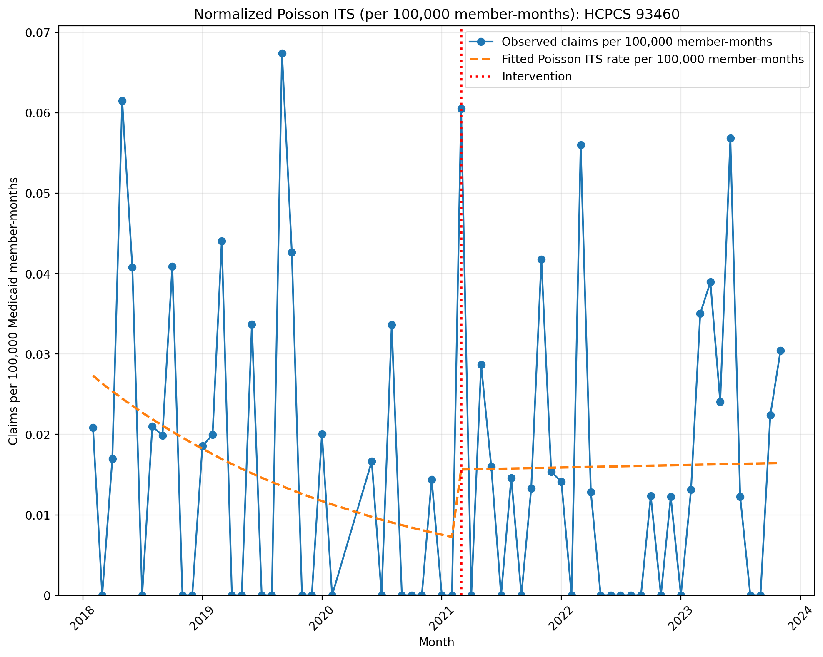
Normalized Poisson ITS (per 100,000 member-months): HCPCS 93460
Generalized Linear Model Regression Results
==============================================================================
Dep. Variable: y No. Observations: 67
Model: GLM Df Residuals: 63
Model Family: Poisson Df Model: 3
Link Function: Log Scale: 1.0000
Method: IRLS Log-Likelihood: -724.18
Date: Thu, 03 Sep 2026 Deviance: 1267.0
Time: 14:01:57 Pearson chi2: 1.20e+03
No. Iterations: 5 Pseudo R-squ. (CS): 0.6037
Covariance Type: nonrobust
==============================================================================
coef std err z P>|z| [0.025 0.975]
------------------------------------------------------------------------------
const -15.1130 0.082 -184.986 0.000 -15.273 -14.953
T -0.0368 0.005 -7.599 0.000 -0.046 -0.027
X_t 0.7657 0.153 5.007 0.000 0.466 1.065
post_time 0.0384 0.007 5.653 0.000 0.025 0.052
==============================================================================

Slide 8
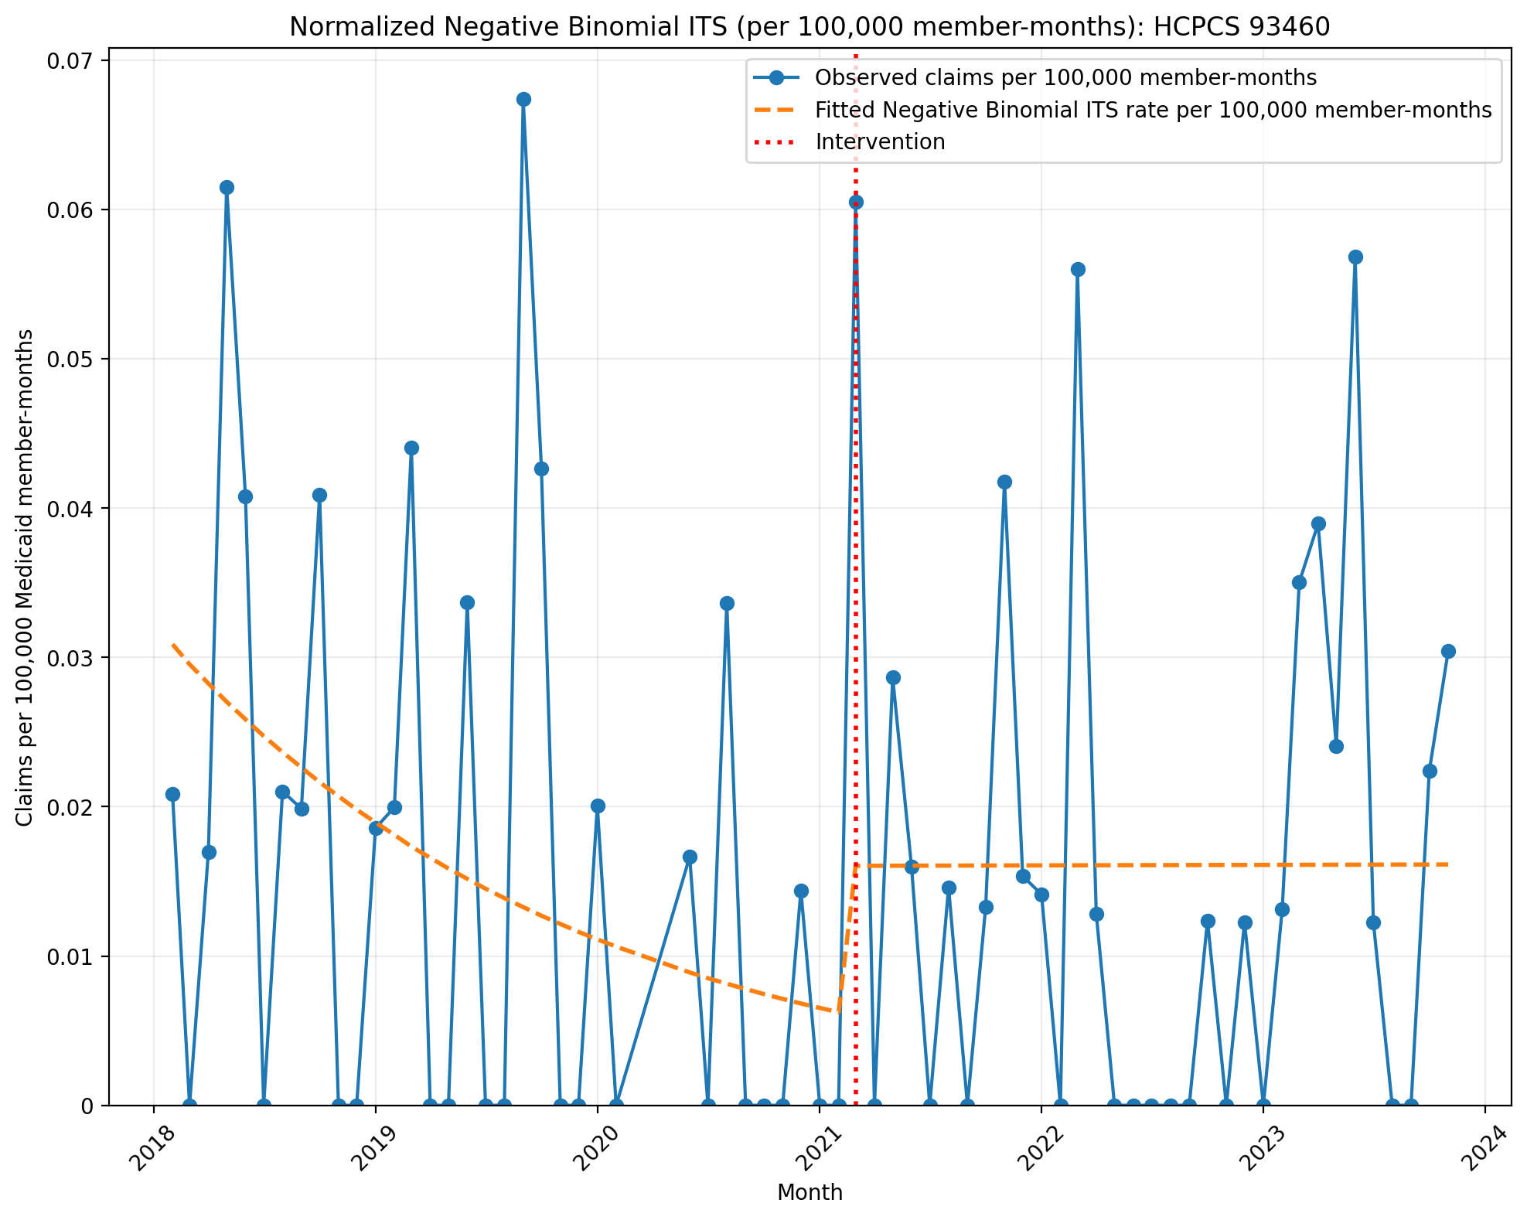
Normalized Negative Binomial ITS (per 100,000 member-months): HCPCS 93460
NegativeBinomial Regression Results
==============================================================================
Dep. Variable: y No. Observations: 67
Model: NegativeBinomial Df Residuals: 63
Method: MLE Df Model: 3
Date: Thu, 03 Sep 2026 Pseudo R-squ.: 0.003553
Time: 14:01:57 Log-Likelihood: -215.53
converged: True LL-Null: -216.30
Covariance Type: nonrobust LLR p-value: 0.6737
==============================================================================
coef std err z P>|z| [0.025 0.975]
------------------------------------------------------------------------------
const -14.9904 0.696 -21.531 0.000 -16.355 -13.626
T -0.0444 0.035 -1.259 0.208 -0.114 0.025
X_t 0.9444 0.985 0.958 0.338 -0.987 2.876
post_time 0.0446 0.048 0.937 0.349 -0.049 0.138
alpha 3.8506 0.807 4.774 0.000 2.270 5.431
==============================================================================

Slide 9
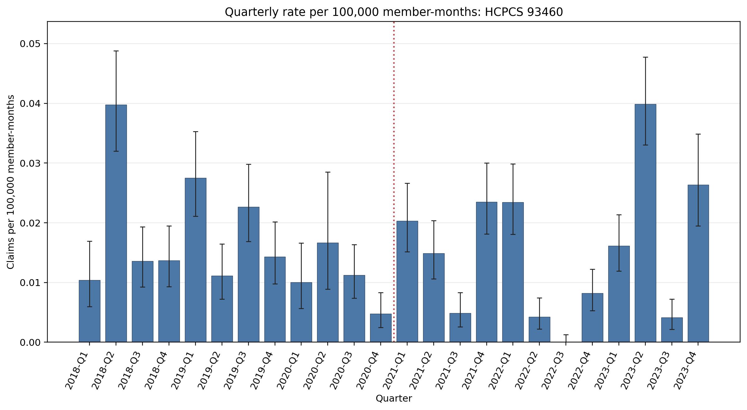
Quarterly rate per 100,000 member-months: HCPCS 93460
Error bars show exact 95% Poisson confidence intervals.
Yearly rate per 100,000 member-months (exact 95% Poisson CIs):
Year | 2018 | 2019 | 2020 | 2021 | 2022 | 2023
Rate | 0.020 | 0.019 | 0.0093 | 0.016 | 0.0089 | 0.021
95% CI | 0.017–0.023 | 0.016–0.022 | 0.0072–0.012 | 0.014–0.018 | 0.0072–0.011 | 0.019–0.024

Slide 10
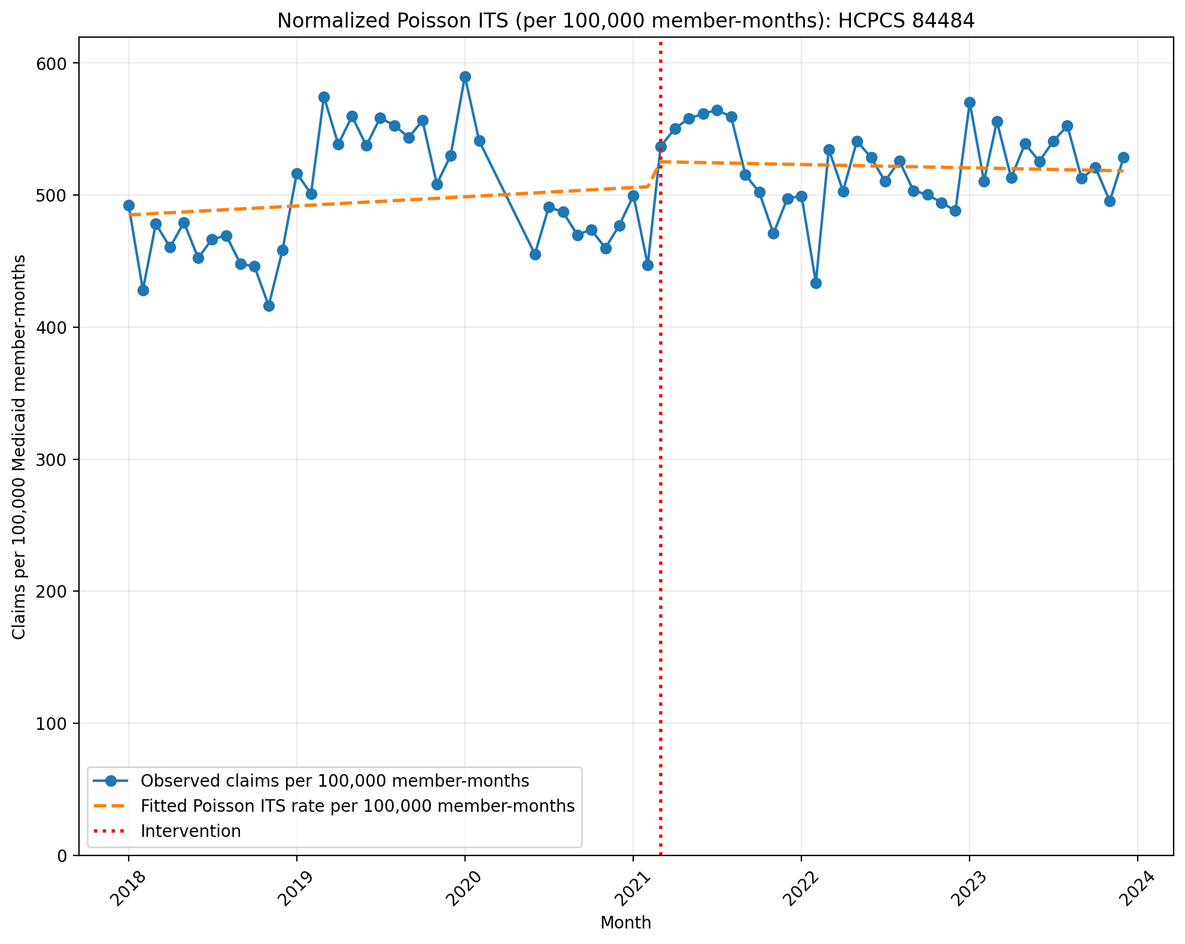
Normalized Poisson ITS (per 100,000 member-months): HCPCS 84484
Generalized Linear Model Regression Results
==============================================================================
Dep. Variable: y No. Observations: 69
Model: GLM Df Residuals: 65
Model Family: Poisson Df Model: 3
Link Function: Log Scale: 1.0000
Method: IRLS Log-Likelihood: -77793.
Date: Thu, 03 Sep 2026 Deviance: 1.5456e+05
Time: 14:01:57 Pearson chi2: 1.55e+05
No. Iterations: 4 Pseudo R-squ. (CS): 1.000
Covariance Type: nonrobust
==============================================================================
coef std err z P>|z| [0.025 0.975]
------------------------------------------------------------------------------
const -5.3289 0.001 -1.03e+04 0.000 -5.330 -5.328
T 0.0012 2.42e-05 48.238 0.000 0.001 0.001
X_t 0.0370 0.001 50.238 0.000 0.036 0.038
post_time -0.0016 3.5e-05 -44.715 0.000 -0.002 -0.001
==============================================================================

Slide 11
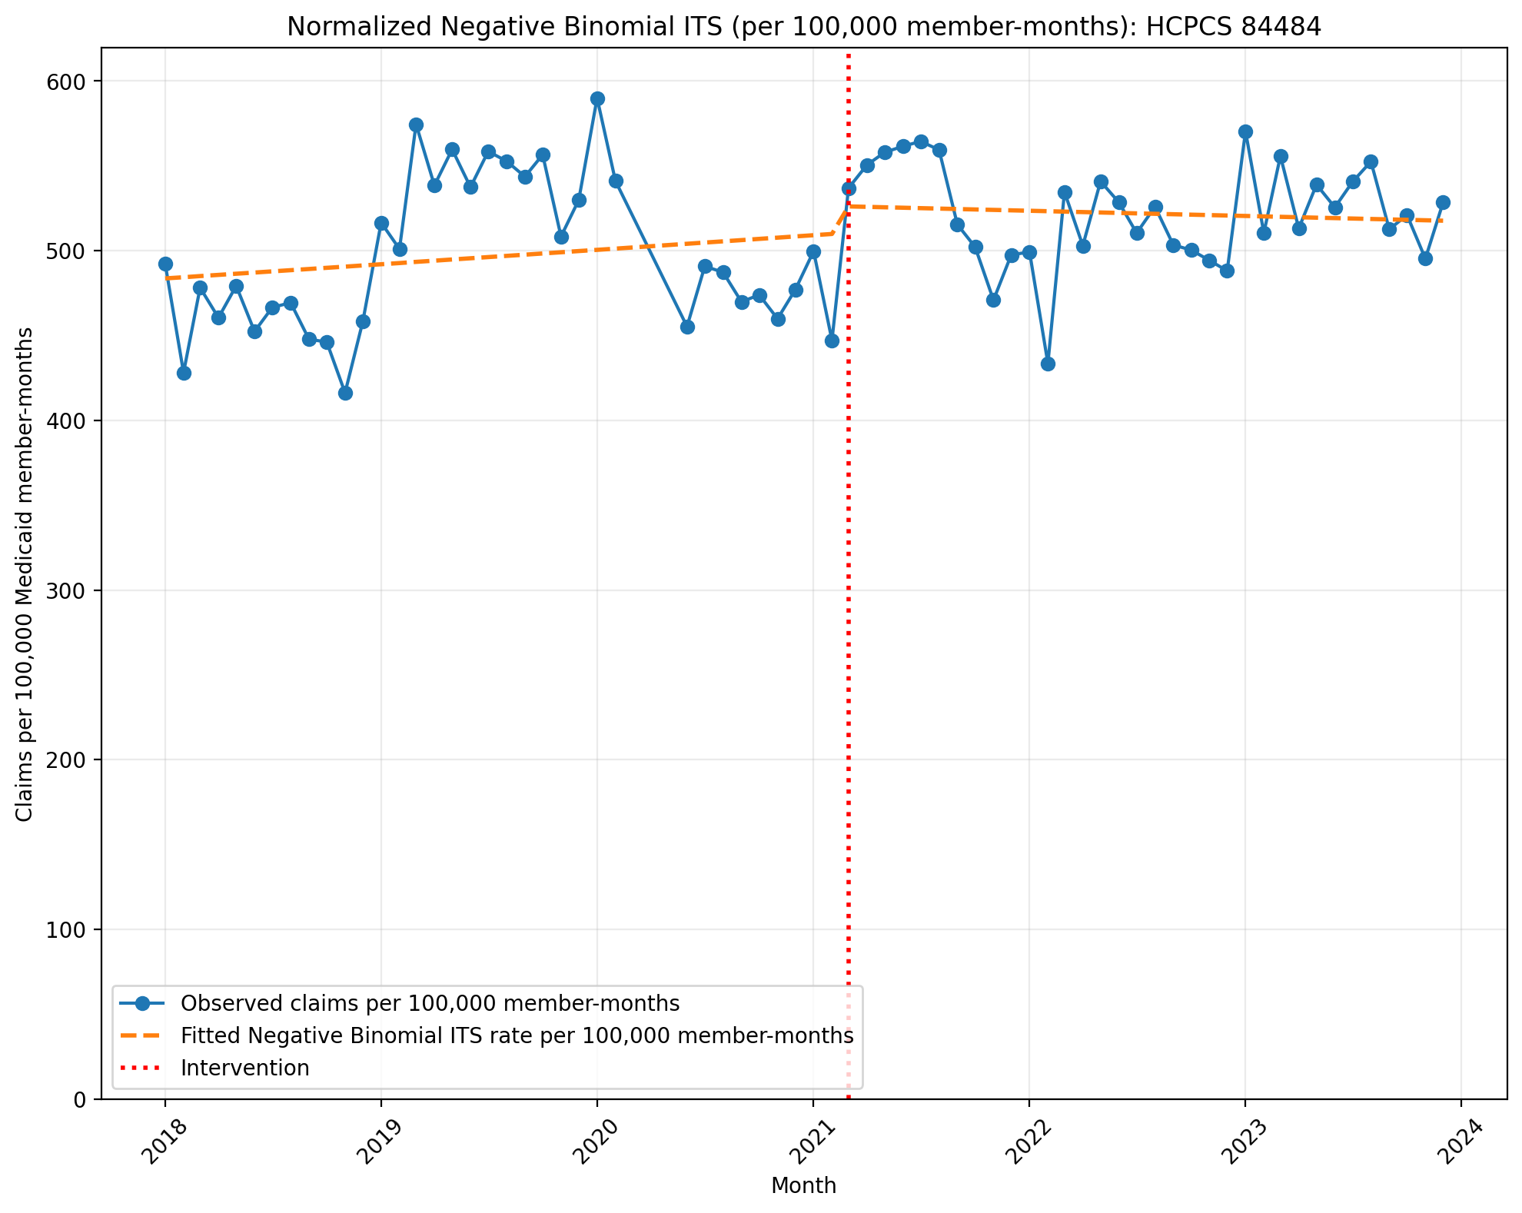
Normalized Negative Binomial ITS (per 100,000 member-months): HCPCS 84484
NegativeBinomial Regression Results
==============================================================================
Dep. Variable: y No. Observations: 69
Model: NegativeBinomial Df Residuals: 65
Method: MLE Df Model: 3
Date: Thu, 03 Sep 2026 Pseudo R-squ.: 0.005583
Time: 14:01:58 Log-Likelihood: -813.34
converged: False LL-Null: -817.91
Covariance Type: nonrobust LLR p-value: 0.02757
==============================================================================
coef std err z P>|z| [0.025 0.975]
------------------------------------------------------------------------------
const -5.3315 0.024 -222.237 0.000 -5.379 -5.285
T 0.0014 0.001 1.237 0.216 -0.001 0.004
X_t 0.0318 0.036 0.880 0.379 -0.039 0.103
post_time -0.0019 0.002 -1.111 0.266 -0.005 0.001
alpha 0.0055 0.001 5.876 0.000 0.004 0.007
==============================================================================

Slide 12
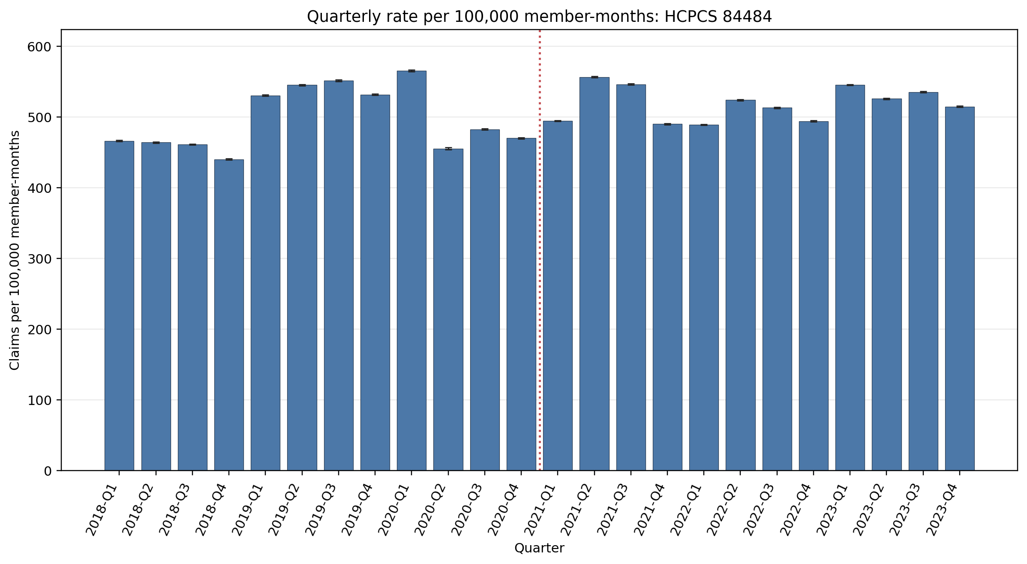
Quarterly rate per 100,000 member-months: HCPCS 84484
Error bars show exact 95% Poisson confidence intervals.
Yearly rate per 100,000 member-months (exact 95% Poisson CIs):
Year | 2018 | 2019 | 2020 | 2021 | 2022 | 2023
Rate | 457.99 | 539.78 | 492.49 | 521.90 | 505.21 | 530.67
95% CI | 457.55–458.43 | 539.30–540.26 | 491.98–493.00 | 521.47–522.34 | 504.80–505.63 | 530.25–531.09

Slide 13
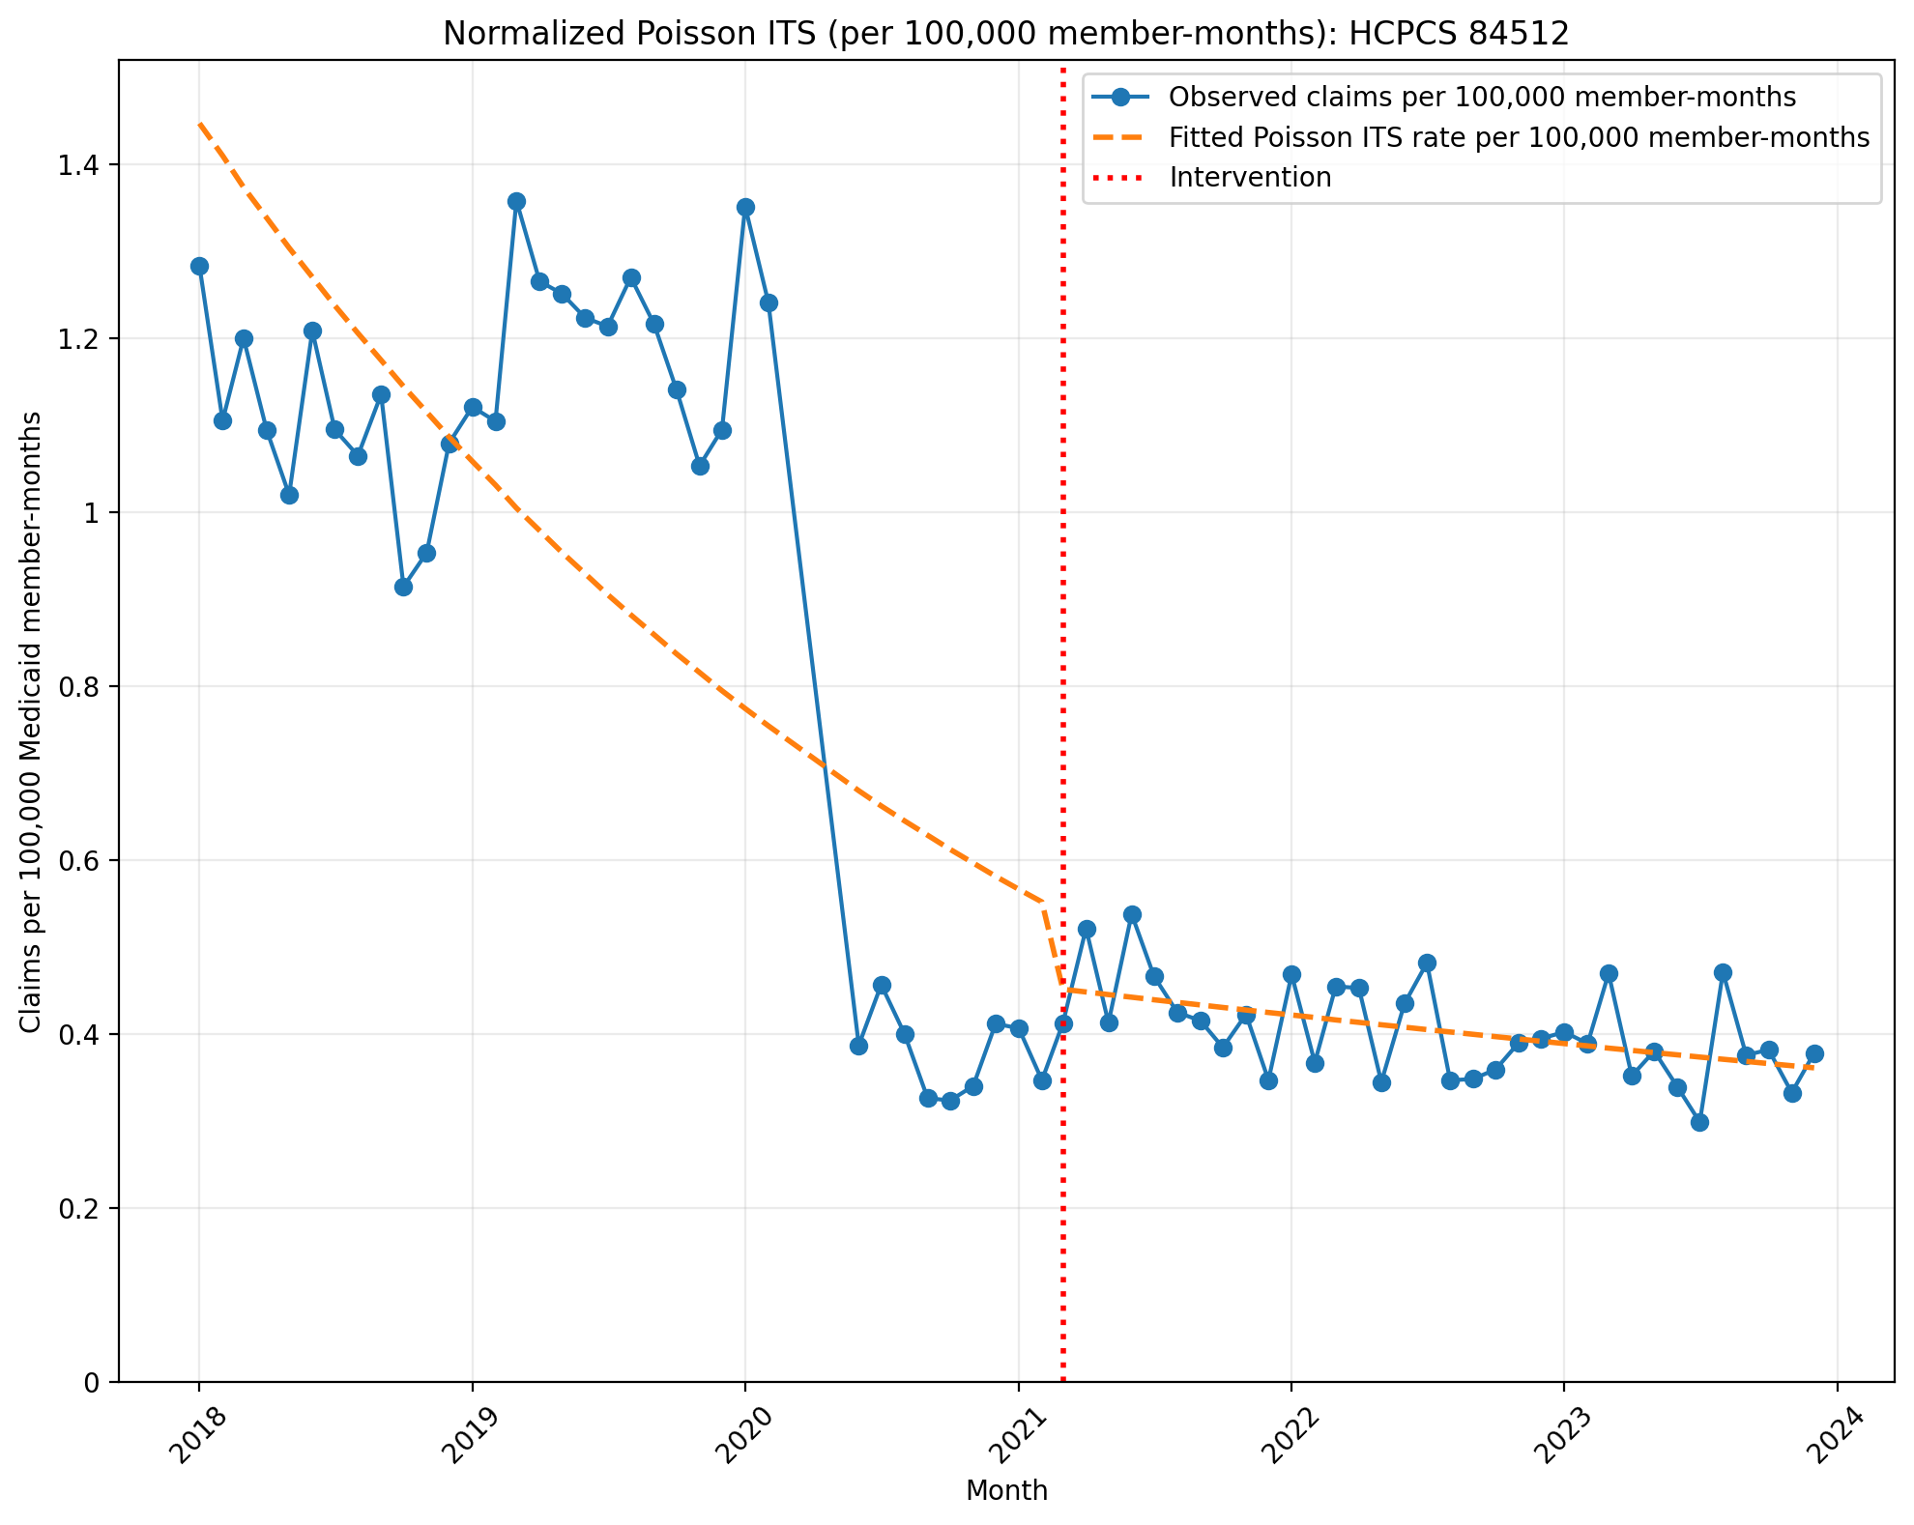
Normalized Poisson ITS (per 100,000 member-months): HCPCS 84512
Generalized Linear Model Regression Results
==============================================================================
Dep. Variable: y No. Observations: 69
Model: GLM Df Residuals: 65
Model Family: Poisson Df Model: 3
Link Function: Log Scale: 1.0000
Method: IRLS Log-Likelihood: -1513.0
Date: Thu, 03 Sep 2026 Deviance: 2470.2
Time: 14:01:58 Pearson chi2: 2.52e+03
No. Iterations: 4 Pseudo R-squ. (CS): 1.000
Covariance Type: nonrobust
==============================================================================
coef std err z P>|z| [0.025 0.975]
------------------------------------------------------------------------------
const -11.1433 0.011 -1045.024 0.000 -11.164 -11.122
T -0.0261 0.001 -44.958 0.000 -0.027 -0.025
X_t -0.1943 0.023 -8.475 0.000 -0.239 -0.149
post_time 0.0193 0.001 17.900 0.000 0.017 0.021
==============================================================================

Slide 14
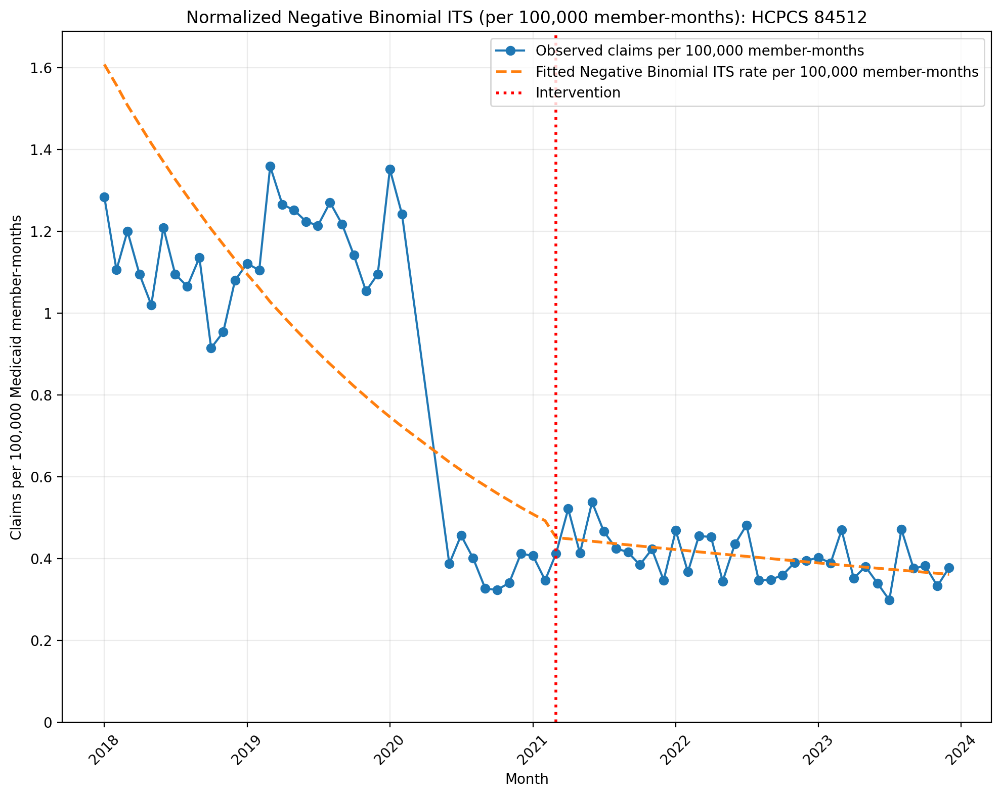
Normalized Negative Binomial ITS (per 100,000 member-months): HCPCS 84512
NegativeBinomial Regression Results
==============================================================================
Dep. Variable: y No. Observations: 69
Model: NegativeBinomial Df Residuals: 65
Method: MLE Df Model: 3
Date: Thu, 03 Sep 2026 Pseudo R-squ.: 0.1128
Time: 14:01:58 Log-Likelihood: -431.31
converged: True LL-Null: -486.17
Covariance Type: nonrobust LLR p-value: 1.257e-23
==============================================================================
coef std err z P>|z| [0.025 0.975]
------------------------------------------------------------------------------
const -11.0383 0.086 -128.474 0.000 -11.207 -10.870
T -0.0320 0.004 -7.539 0.000 -0.040 -0.024
X_t -0.0805 0.127 -0.636 0.524 -0.328 0.167
post_time 0.0253 0.006 4.166 0.000 0.013 0.037
alpha 0.0594 0.010 5.753 0.000 0.039 0.080
==============================================================================

Slide 15
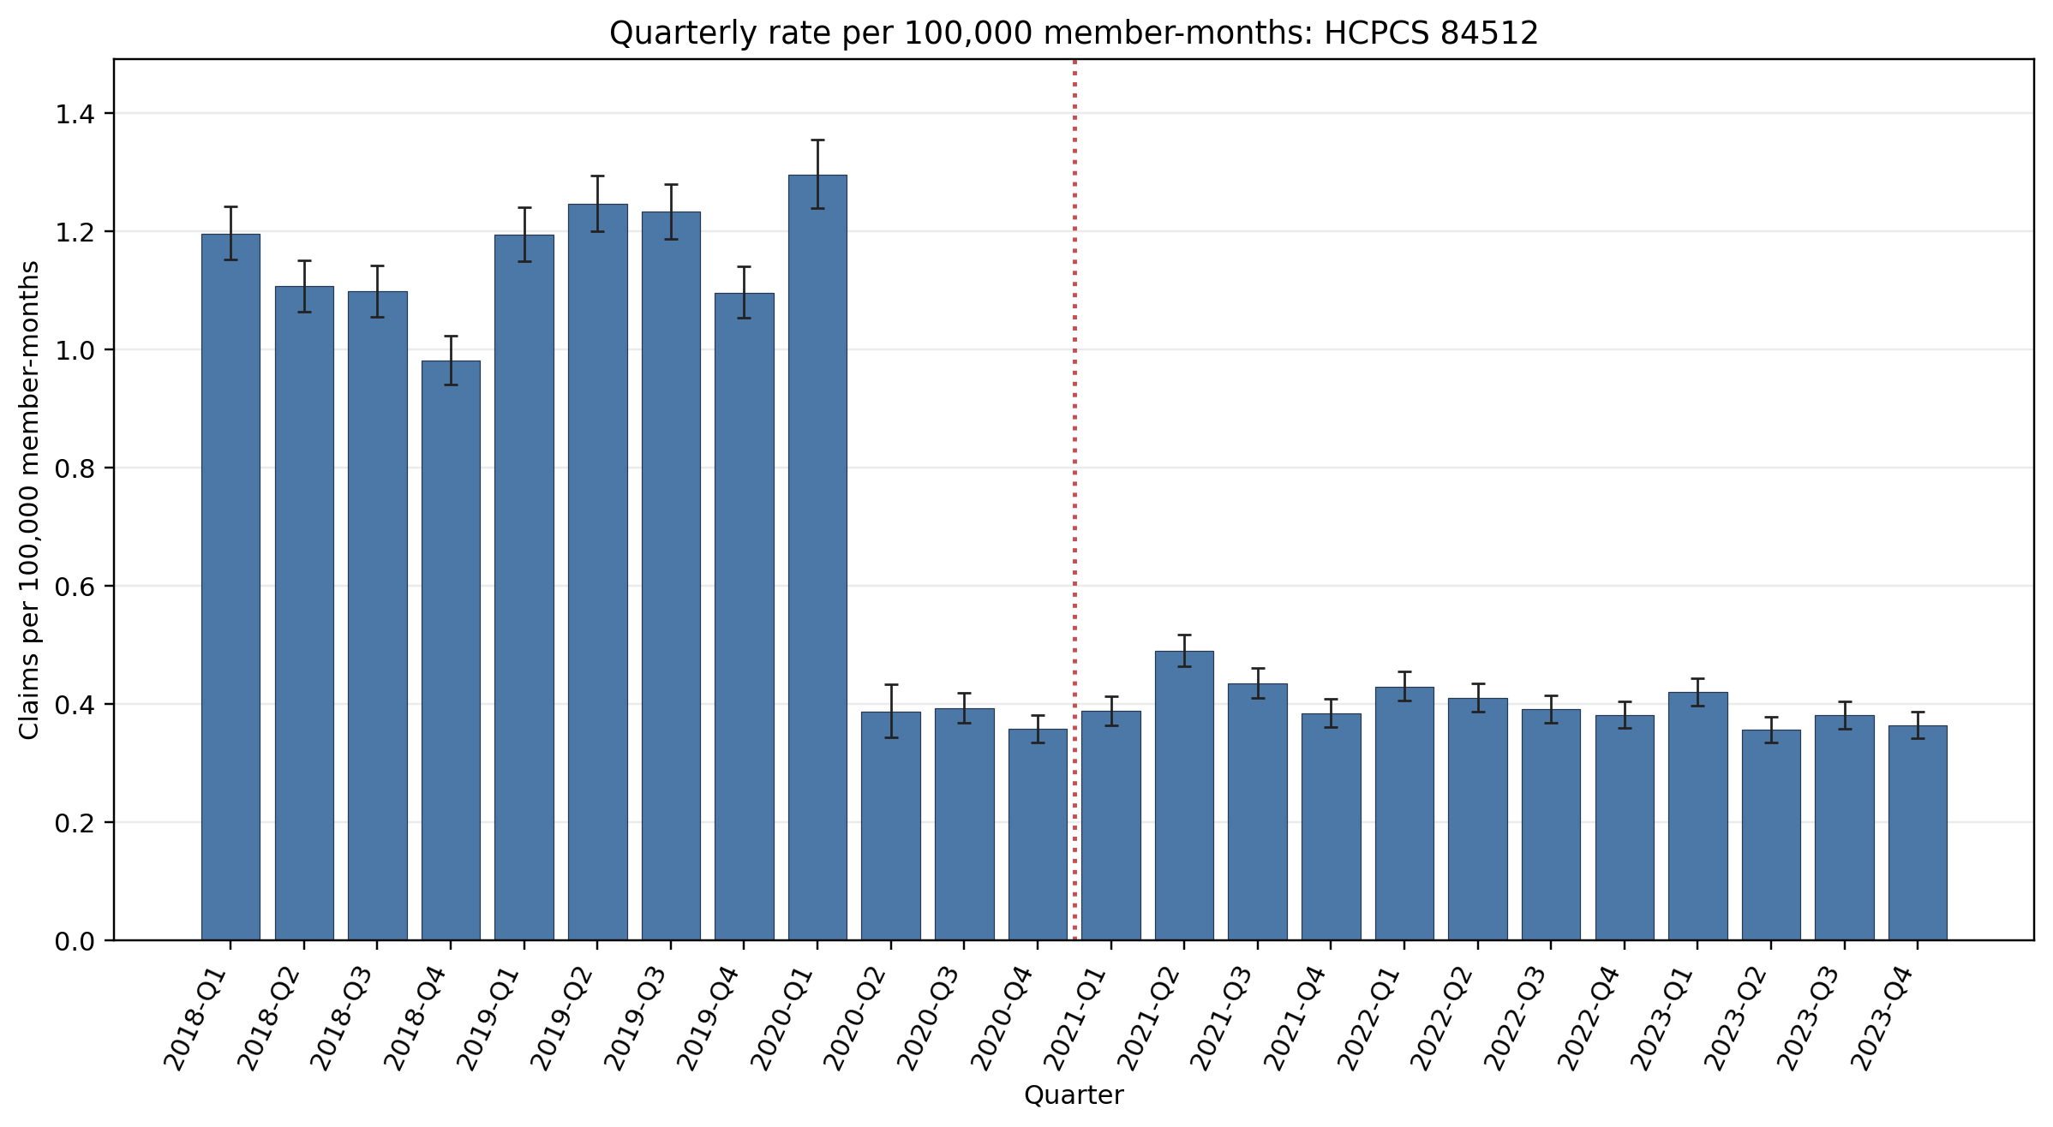
Quarterly rate per 100,000 member-months: HCPCS 84512
Error bars show exact 95% Poisson confidence intervals.
Yearly rate per 100,000 member-months (exact 95% Poisson CIs):
Year | 2018 | 2019 | 2020 | 2021 | 2022 | 2023
Rate | 1.10 | 1.19 | 0.568 | 0.424 | 0.403 | 0.381
95% CI | 1.08–1.12 | 1.17–1.22 | 0.550–0.585 | 0.412–0.437 | 0.391–0.415 | 0.370–0.392

Slide 16
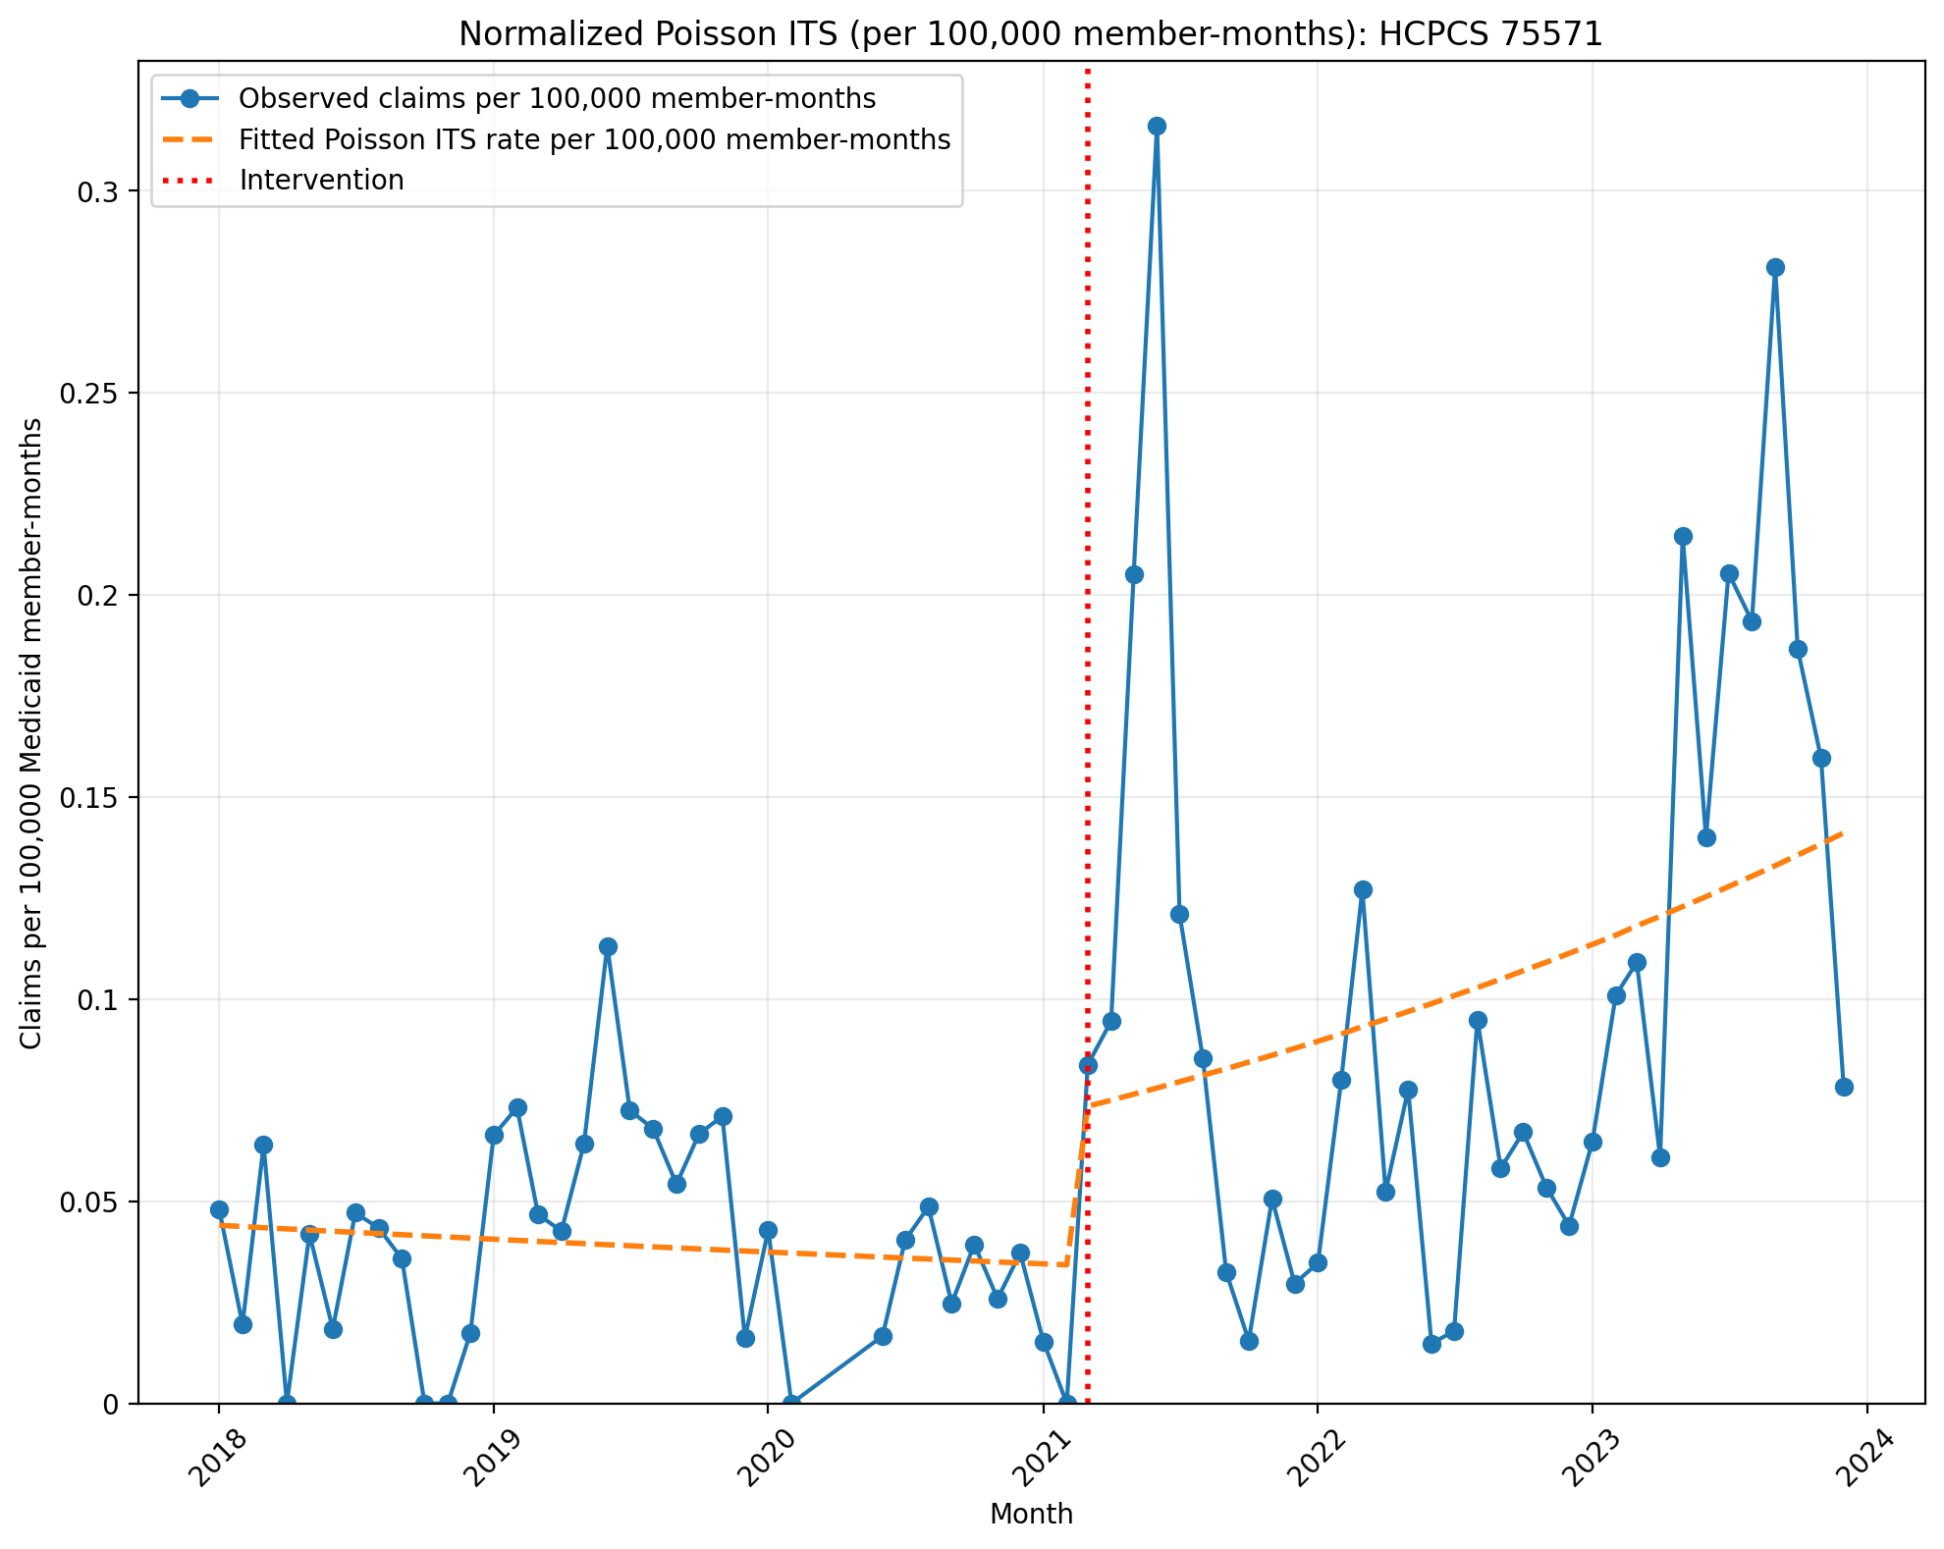
Normalized Poisson ITS (per 100,000 member-months): HCPCS 75571
Generalized Linear Model Regression Results
==============================================================================
Dep. Variable: y No. Observations: 69
Model: GLM Df Residuals: 65
Model Family: Poisson Df Model: 3
Link Function: Log Scale: 1.0000
Method: IRLS Log-Likelihood: -1190.0
Date: Thu, 03 Sep 2026 Deviance: 2012.2
Time: 14:01:59 Pearson chi2: 2.14e+03
No. Iterations: 5 Pseudo R-squ. (CS): 1.000
Covariance Type: nonrobust
==============================================================================
coef std err z P>|z| [0.025 0.975]
------------------------------------------------------------------------------
const -14.6354 0.056 -259.556 0.000 -14.746 -14.525
T -0.0068 0.003 -2.471 0.013 -0.012 -0.001
X_t 0.7434 0.074 10.061 0.000 0.599 0.888
post_time 0.0265 0.003 8.069 0.000 0.020 0.033
==============================================================================

Slide 17
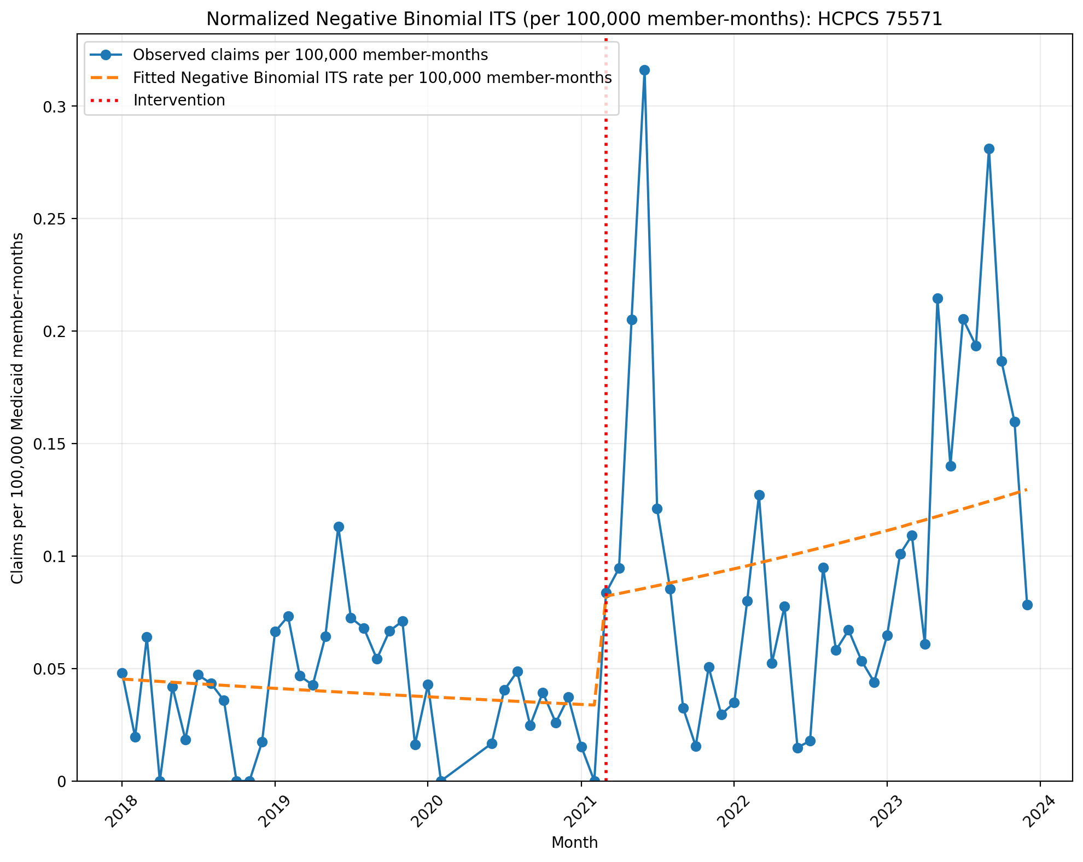
Normalized Negative Binomial ITS (per 100,000 member-months): HCPCS 75571
NegativeBinomial Regression Results
==============================================================================
Dep. Variable: y No. Observations: 69
Model: NegativeBinomial Df Residuals: 65
Method: MLE Df Model: 3
Date: Thu, 03 Sep 2026 Pseudo R-squ.: 0.02988
Time: 14:01:59 Log-Likelihood: -342.18
converged: True LL-Null: -352.72
Covariance Type: nonrobust LLR p-value: 0.0001015
==============================================================================
coef std err z P>|z| [0.025 0.975]
------------------------------------------------------------------------------
const -14.6073 0.294 -49.609 0.000 -15.184 -14.030
T -0.0080 0.015 -0.546 0.585 -0.037 0.021
X_t 0.8761 0.407 2.153 0.031 0.079 1.674
post_time 0.0218 0.019 1.137 0.255 -0.016 0.059
alpha 0.6614 0.120 5.523 0.000 0.427 0.896
==============================================================================

Slide 18
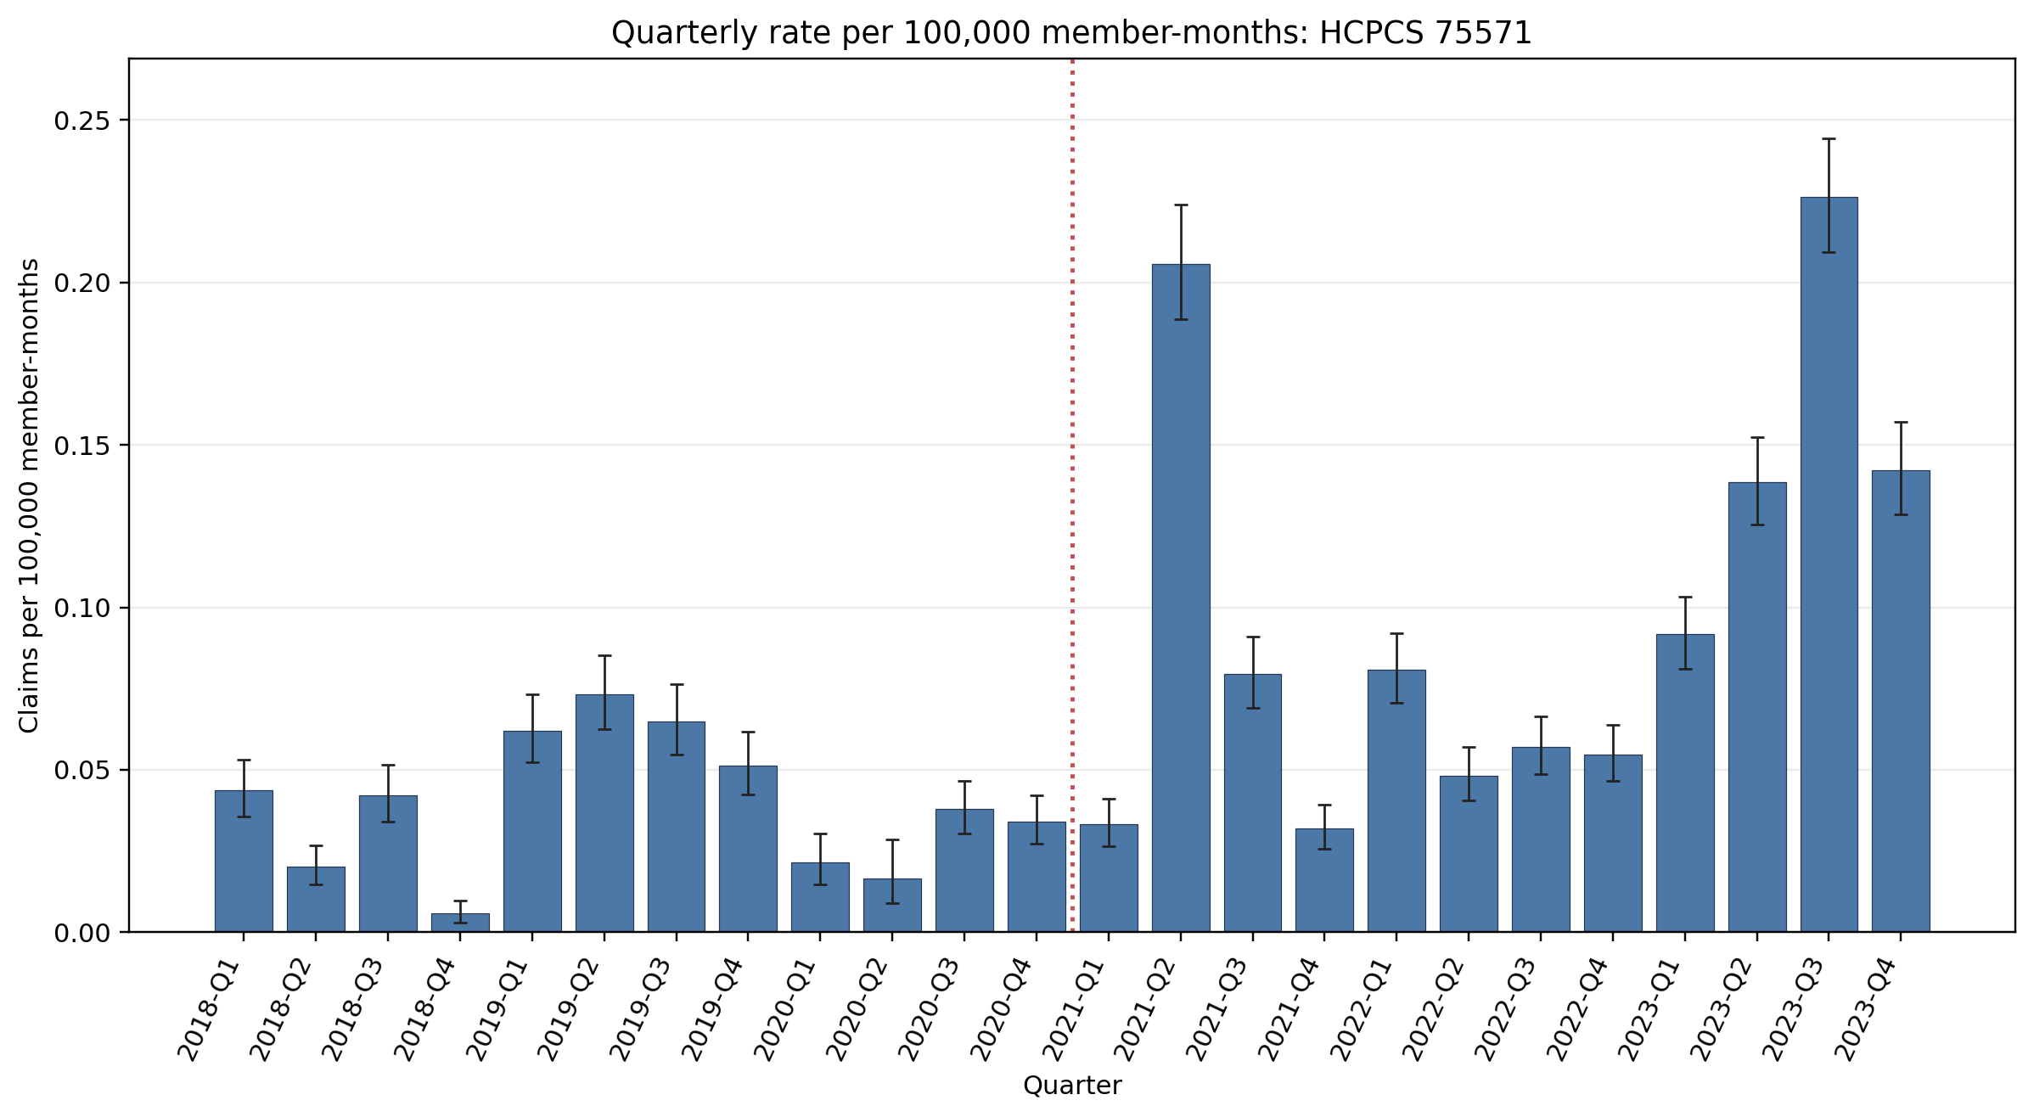
Quarterly rate per 100,000 member-months: HCPCS 75571
Error bars show exact 95% Poisson confidence intervals.
Yearly rate per 100,000 member-months (exact 95% Poisson CIs):
Year | 2018 | 2019 | 2020 | 2021 | 2022 | 2023
Rate | 0.028 | 0.063 | 0.031 | 0.087 | 0.060 | 0.149
95% CI | 0.025–0.032 | 0.058–0.068 | 0.027–0.035 | 0.082–0.093 | 0.056–0.065 | 0.142–0.156

Slide 19
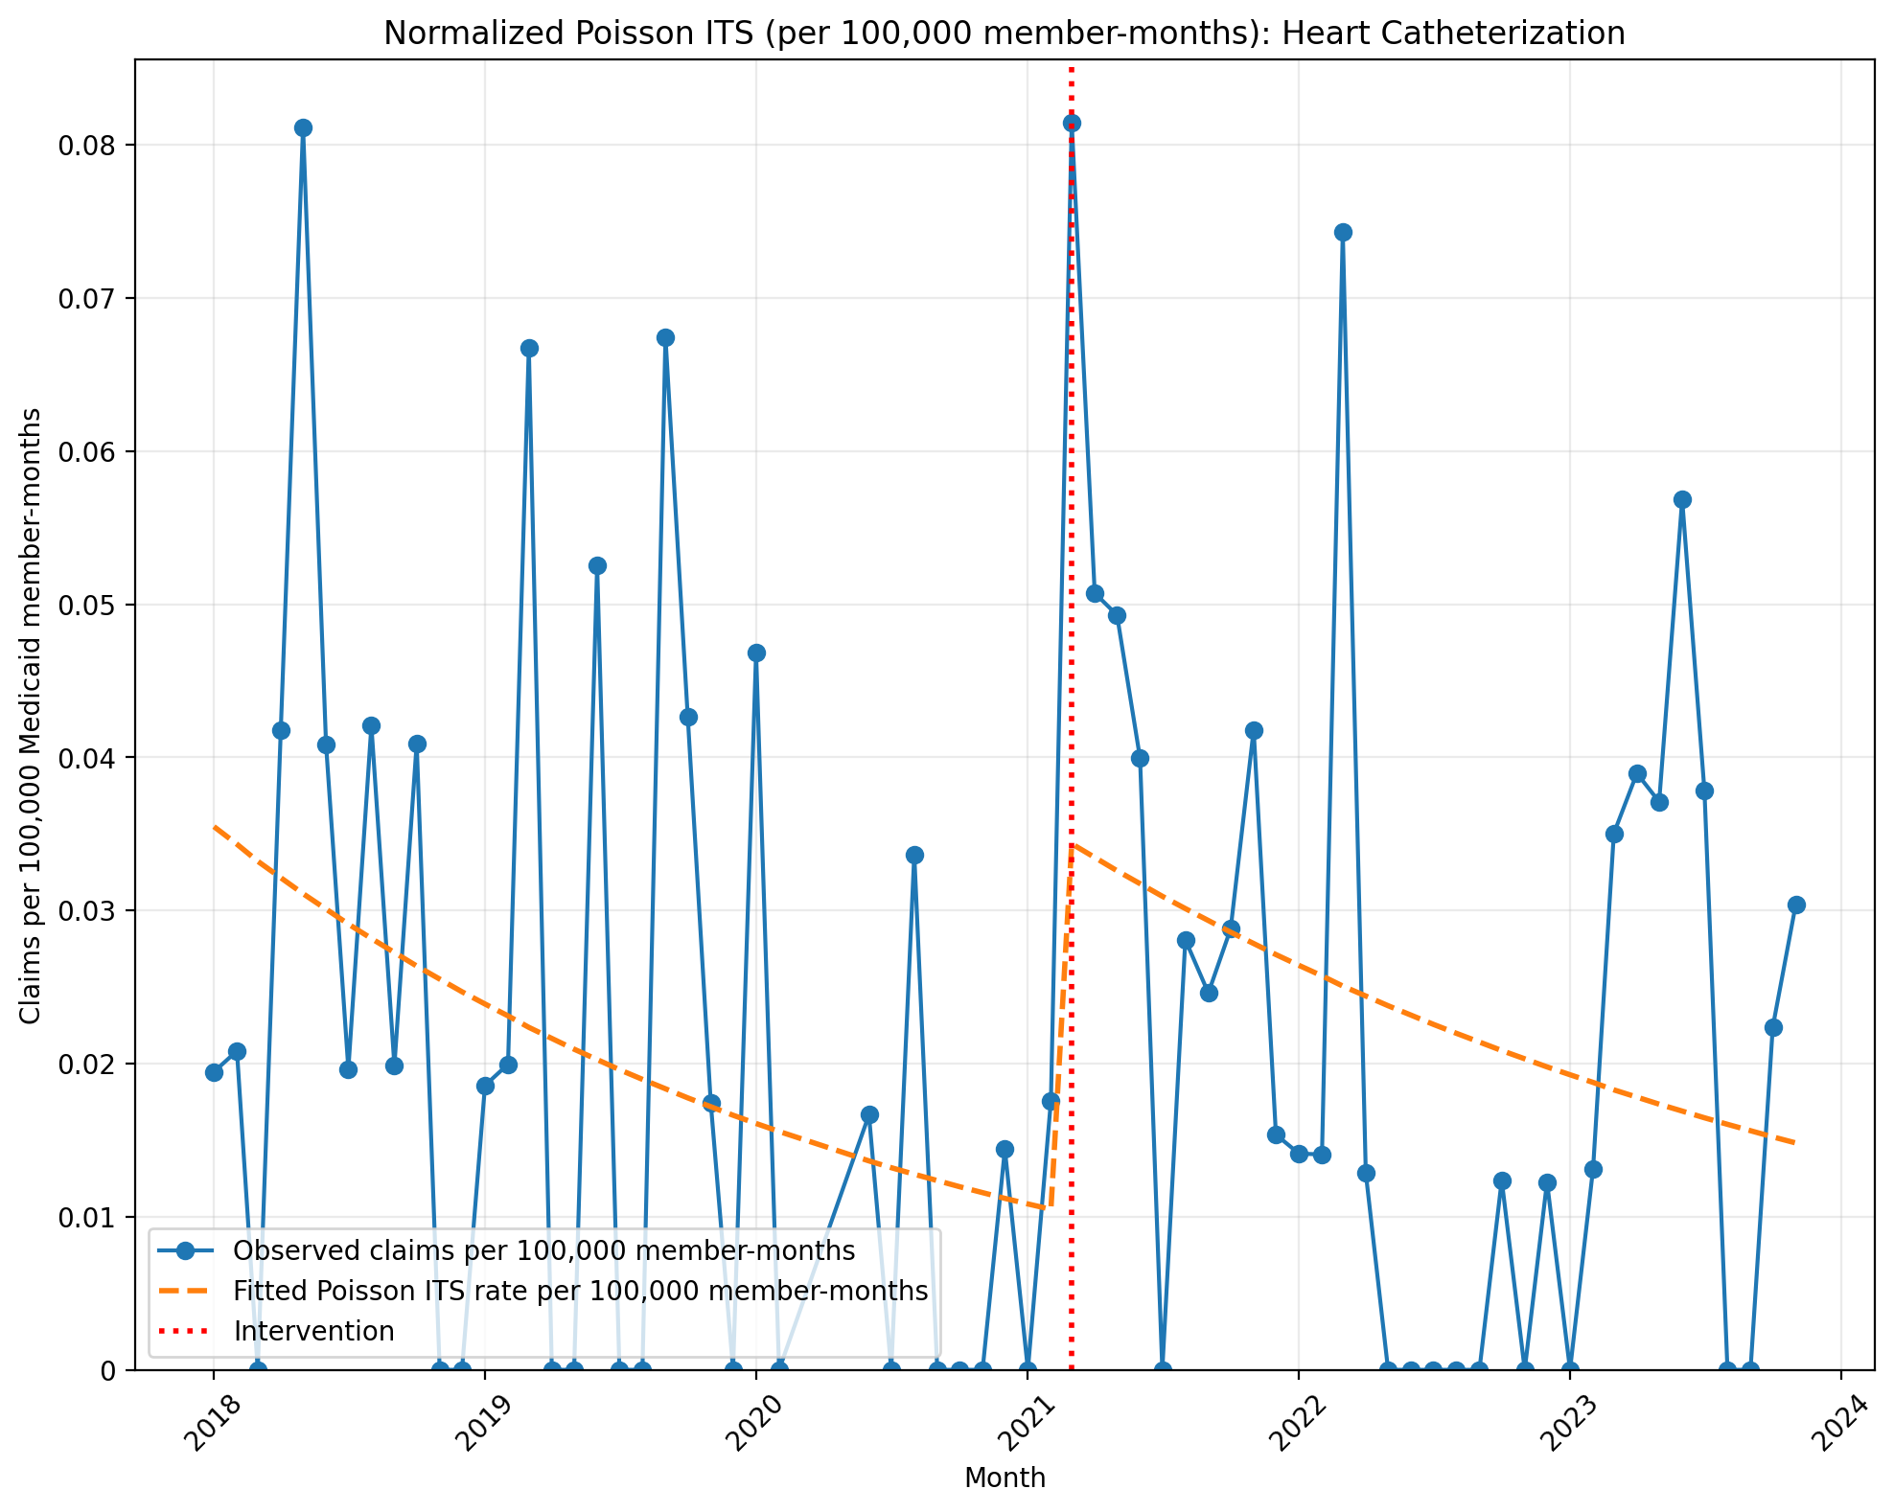
Normalized Poisson ITS (per 100,000 member-months): Heart Catheterization
Generalized Linear Model Regression Results
==============================================================================
Dep. Variable: y No. Observations: 68
Model: GLM Df Residuals: 64
Model Family: Poisson Df Model: 3
Link Function: Log Scale: 1.0000
Method: IRLS Log-Likelihood: -794.85
Date: Thu, 03 Sep 2026 Deviance: 1366.7
Time: 14:01:59 Pearson chi2: 1.20e+03
No. Iterations: 5 Pseudo R-squ. (CS): 0.8271
Covariance Type: nonrobust
==============================================================================
coef std err z P>|z| [0.025 0.975]
------------------------------------------------------------------------------
const -14.8517 0.070 -212.224 0.000 -14.989 -14.715
T -0.0330 0.004 -8.302 0.000 -0.041 -0.025
X_t 1.2133 0.123 9.882 0.000 0.973 1.454
post_time 0.0067 0.006 1.182 0.237 -0.004 0.018
==============================================================================
Codes in aggregation: 93541, 93452, 93453, 93456, 93457, 93460

Slide 20
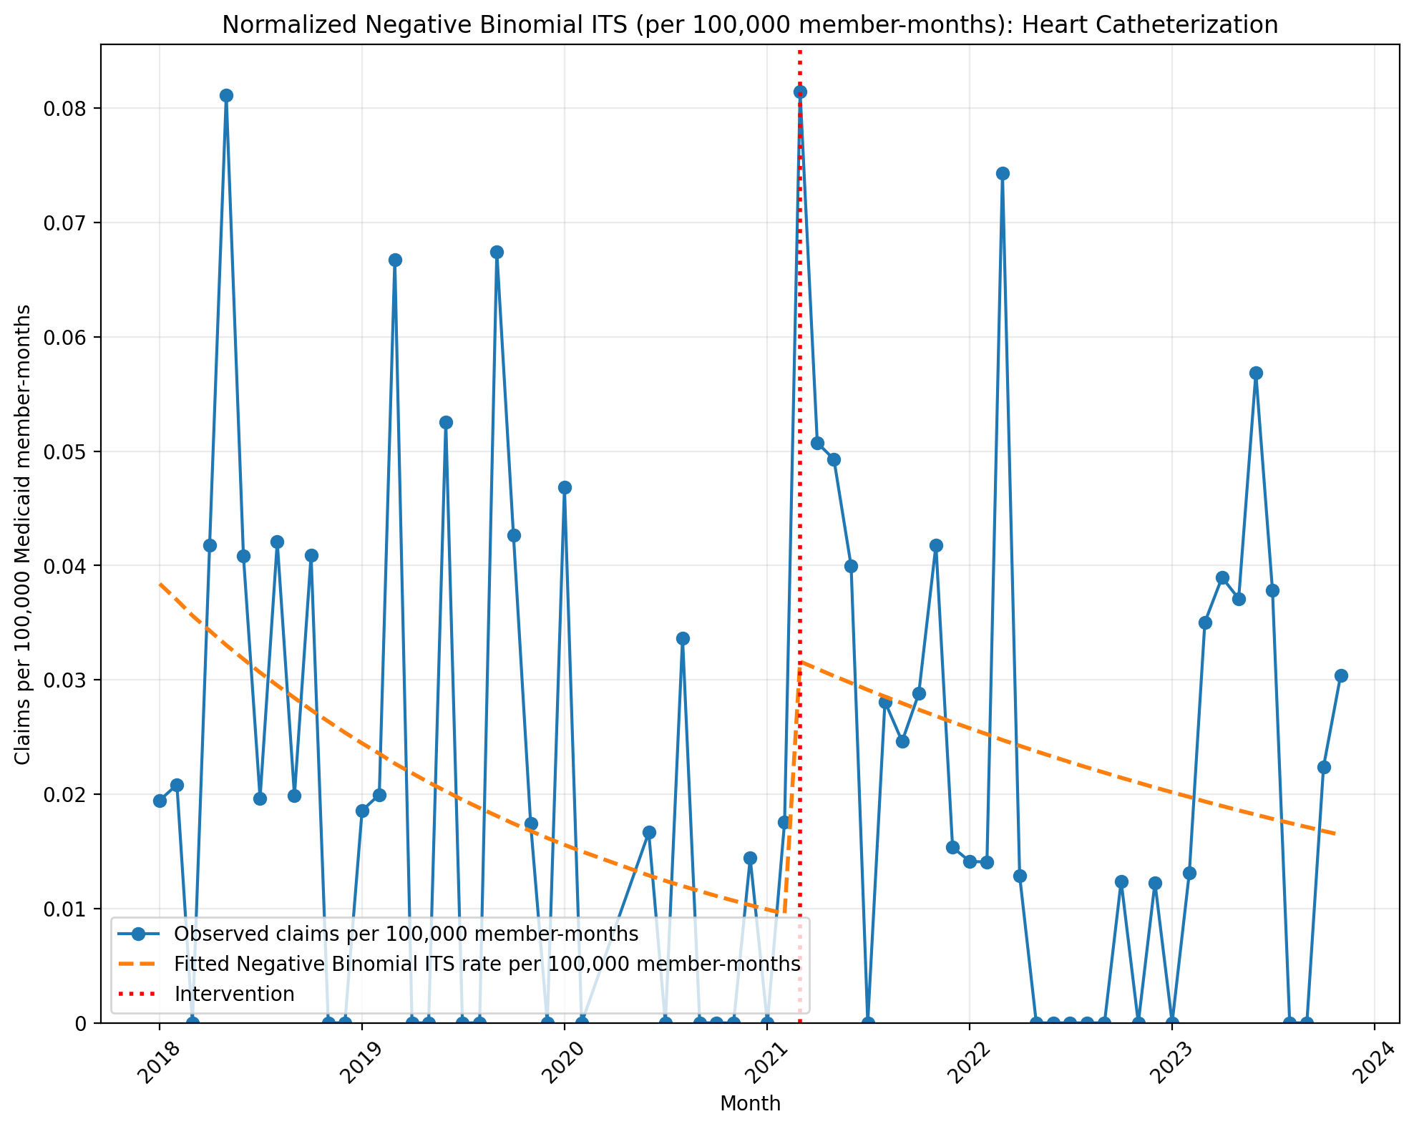
Normalized Negative Binomial ITS (per 100,000 member-months): Heart Catheterization
NegativeBinomial Regression Results
==============================================================================
Dep. Variable: y No. Observations: 68
Model: NegativeBinomial Df Residuals: 64
Method: MLE Df Model: 3
Date: Thu, 03 Sep 2026 Pseudo R-squ.: 0.004823
Time: 14:01:59 Log-Likelihood: -251.18
converged: True LL-Null: -252.39
Covariance Type: nonrobust LLR p-value: 0.4872
==============================================================================
coef std err z P>|z| [0.025 0.975]
------------------------------------------------------------------------------
const -14.7726 0.562 -26.282 0.000 -15.874 -13.671
T -0.0376 0.027 -1.370 0.171 -0.091 0.016
X_t 1.2174 0.802 1.517 0.129 -0.355 2.790
post_time 0.0172 0.038 0.453 0.651 -0.057 0.092
alpha 2.7365 0.540 5.063 0.000 1.677 3.796
==============================================================================
Codes in aggregation: 93541, 93452, 93453, 93456, 93457, 93460

Slide 21
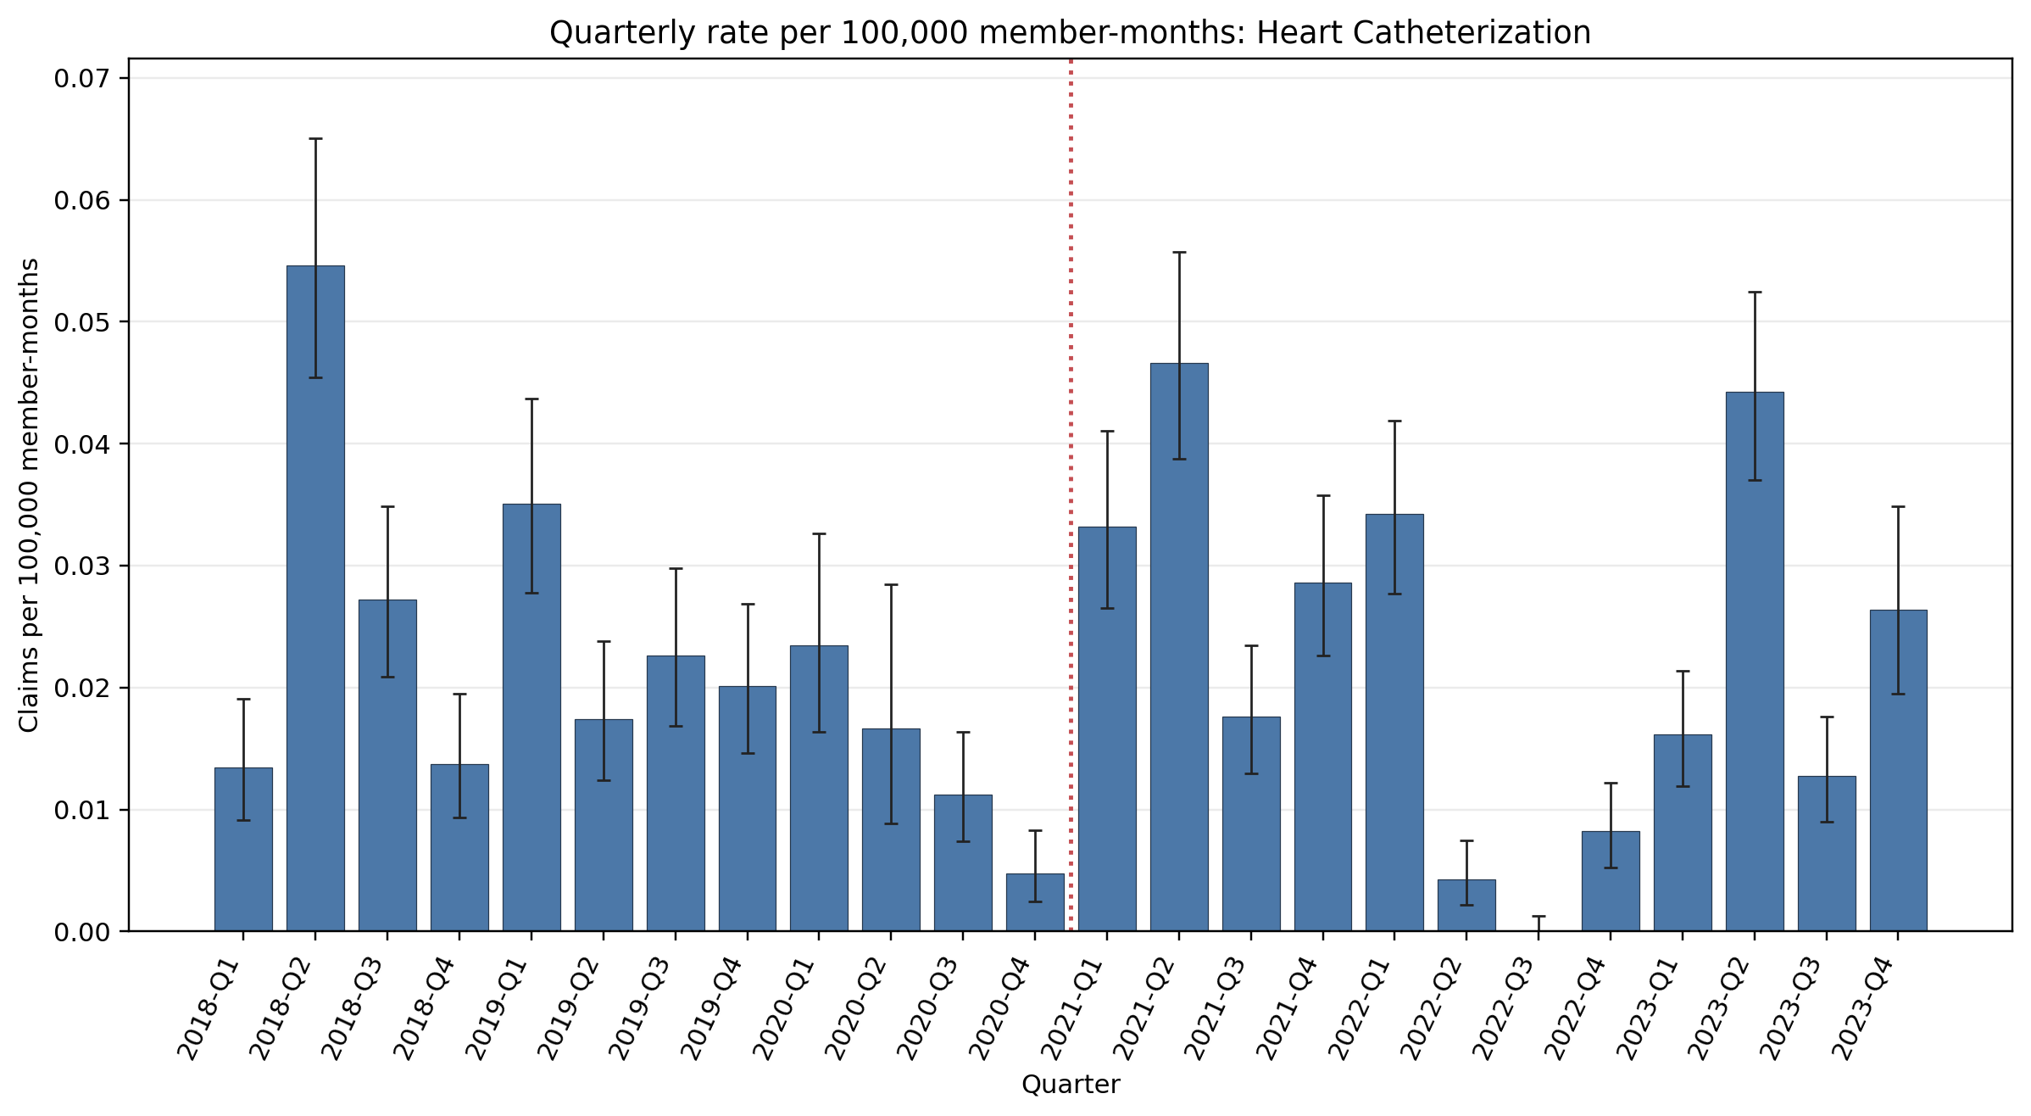
Quarterly rate per 100,000 member-months: Heart Catheterization
Error bars show exact 95% Poisson confidence intervals. Codes in aggregation: 93541, 93452, 93453, 93456, 93457, 93460
Yearly rate per 100,000 member-months (exact 95% Poisson CIs):
Year | 2018 | 2019 | 2020 | 2021 | 2022 | 2023
Rate | 0.027 | 0.024 | 0.012 | 0.031 | 0.012 | 0.025
95% CI | 0.024–0.031 | 0.021–0.027 | 0.0097–0.015 | 0.028–0.035 | 0.0096–0.014 | 0.022–0.028

