Slide 1
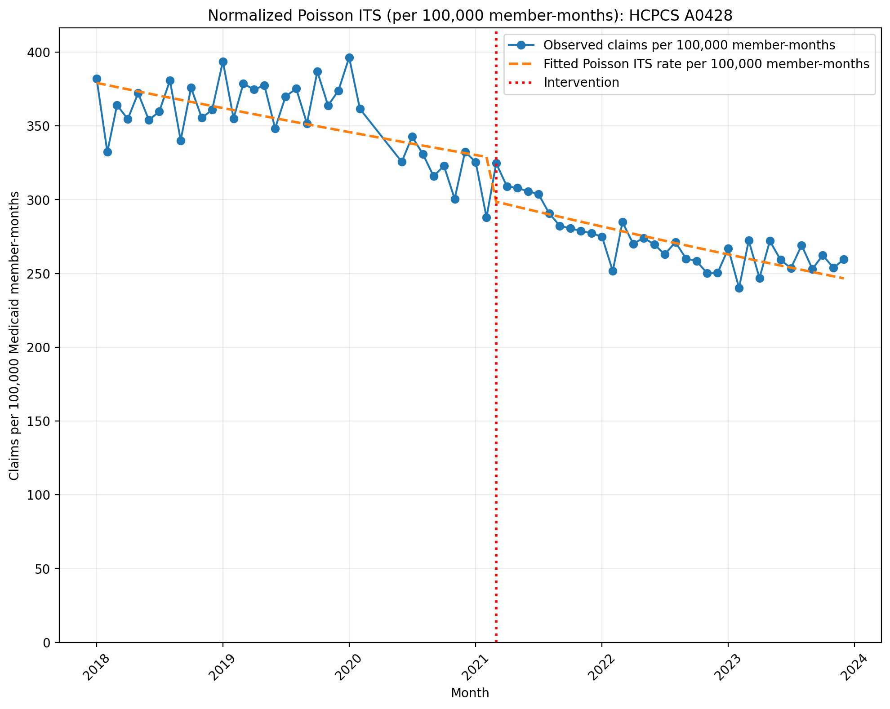
Normalized Poisson ITS (per 100,000 member-months): HCPCS A0428
Generalized Linear Model Regression Results
==============================================================================
Dep. Variable: y No. Observations: 69
Model: GLM Df Residuals: 65
Model Family: Poisson Df Model: 3
Link Function: Log Scale: 1.0000
Method: IRLS Log-Likelihood: -25985.
Date: Mon, 10 Aug 2026 Deviance: 50982.
Time: 10:08:34 Pearson chi2: 5.09e+04
No. Iterations: 4 Pseudo R-squ. (CS): 1.000
Covariance Type: nonrobust
==============================================================================
coef std err z P>|z| [0.025 0.975]
------------------------------------------------------------------------------
const -5.5751 0.001 -9291.778 0.000 -5.576 -5.574
T -0.0038 2.87e-05 -133.531 0.000 -0.004 -0.004
X_t -0.0912 0.001 -96.290 0.000 -0.093 -0.089
post_time -0.0020 4.53e-05 -43.107 0.000 -0.002 -0.002
==============================================================================

Slide 2
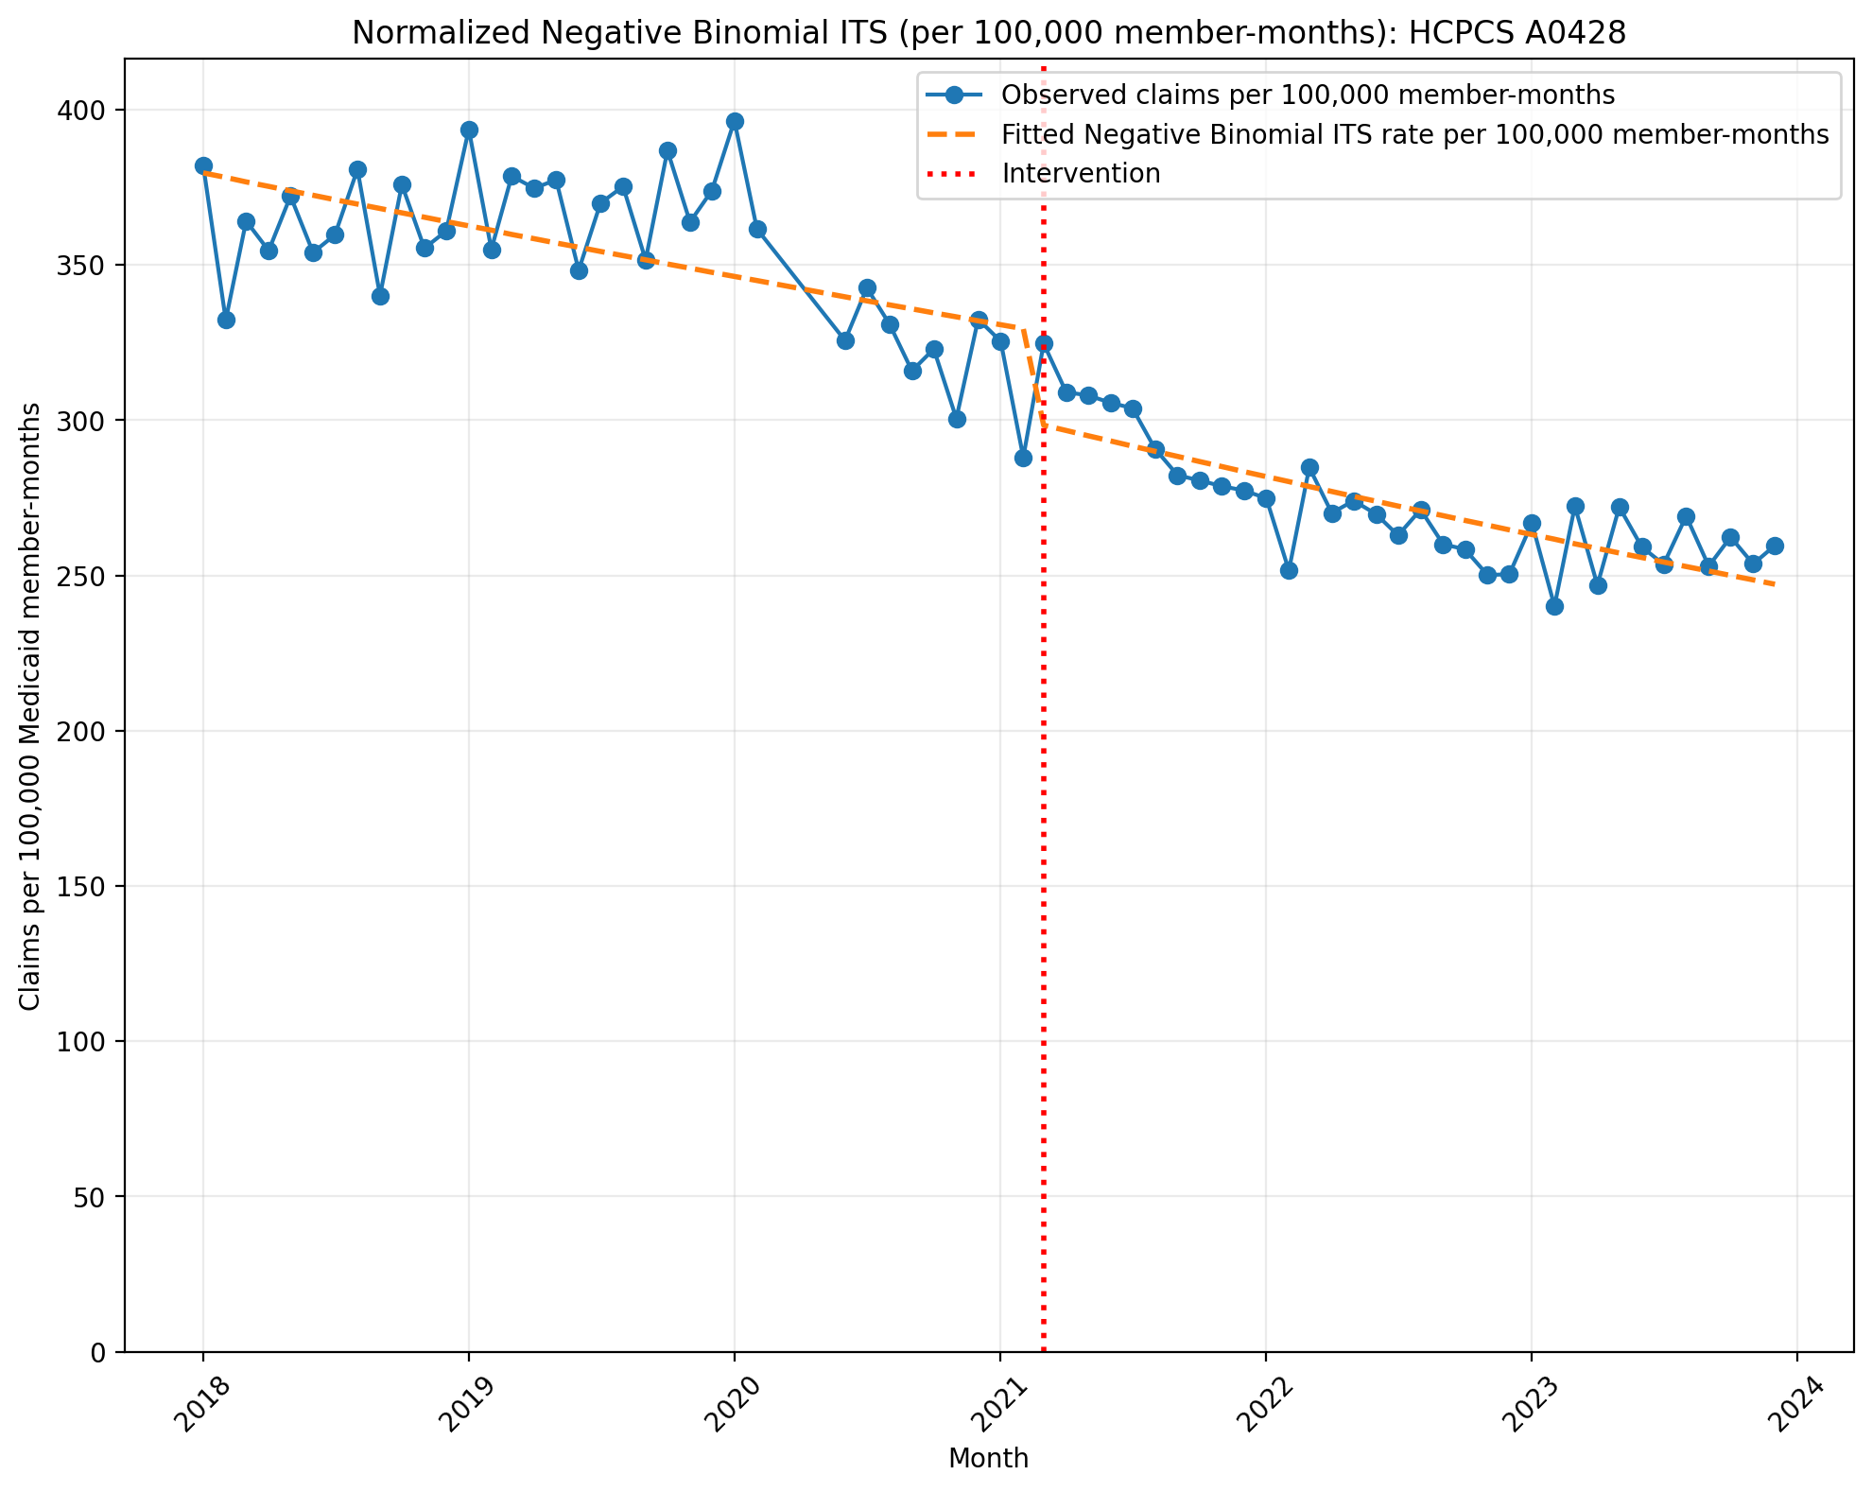
Normalized Negative Binomial ITS (per 100,000 member-months): HCPCS A0428
NegativeBinomial Regression Results
==============================================================================
Dep. Variable: y No. Observations: 69
Model: NegativeBinomial Df Residuals: 65
Method: MLE Df Model: 3
Date: Mon, 10 Aug 2026 Pseudo R-squ.: 0.08792
Time: 10:08:34 Log-Likelihood: -756.09
converged: True LL-Null: -828.98
Covariance Type: nonrobust LLR p-value: 2.155e-31
==============================================================================
coef std err z P>|z| [0.025 0.975]
------------------------------------------------------------------------------
const -5.5738 0.017 -327.726 0.000 -5.607 -5.540
T -0.0038 0.001 -4.697 0.000 -0.005 -0.002
X_t -0.0934 0.026 -3.637 0.000 -0.144 -0.043
post_time -0.0019 0.001 -1.537 0.124 -0.004 0.001
alpha 0.0028 0.000 5.868 0.000 0.002 0.004
==============================================================================

Slide 3
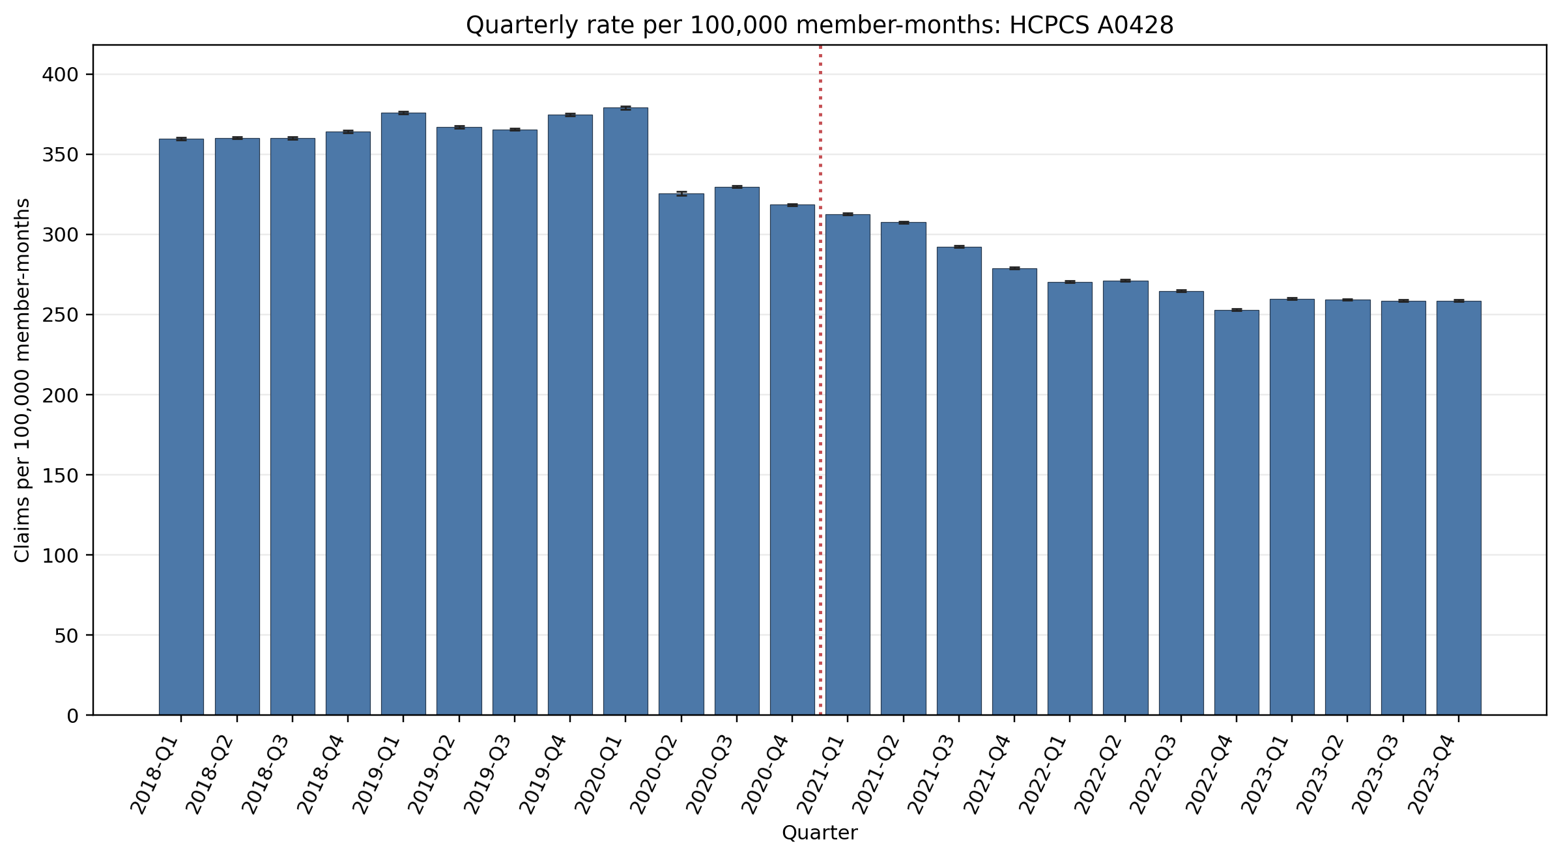
Quarterly rate per 100,000 member-months: HCPCS A0428
Error bars show exact 95% Poisson confidence intervals.
Yearly rate per 100,000 member-months (exact 95% Poisson CIs):
Year | 2018 | 2019 | 2020 | 2021 | 2022 | 2023
Rate | 361.00 | 370.74 | 335.57 | 297.53 | 264.70 | 259.07
95% CI | 360.61–361.39 | 370.34–371.14 | 335.15–335.99 | 297.21–297.86 | 264.40–265.00 | 258.78–259.36

Slide 4
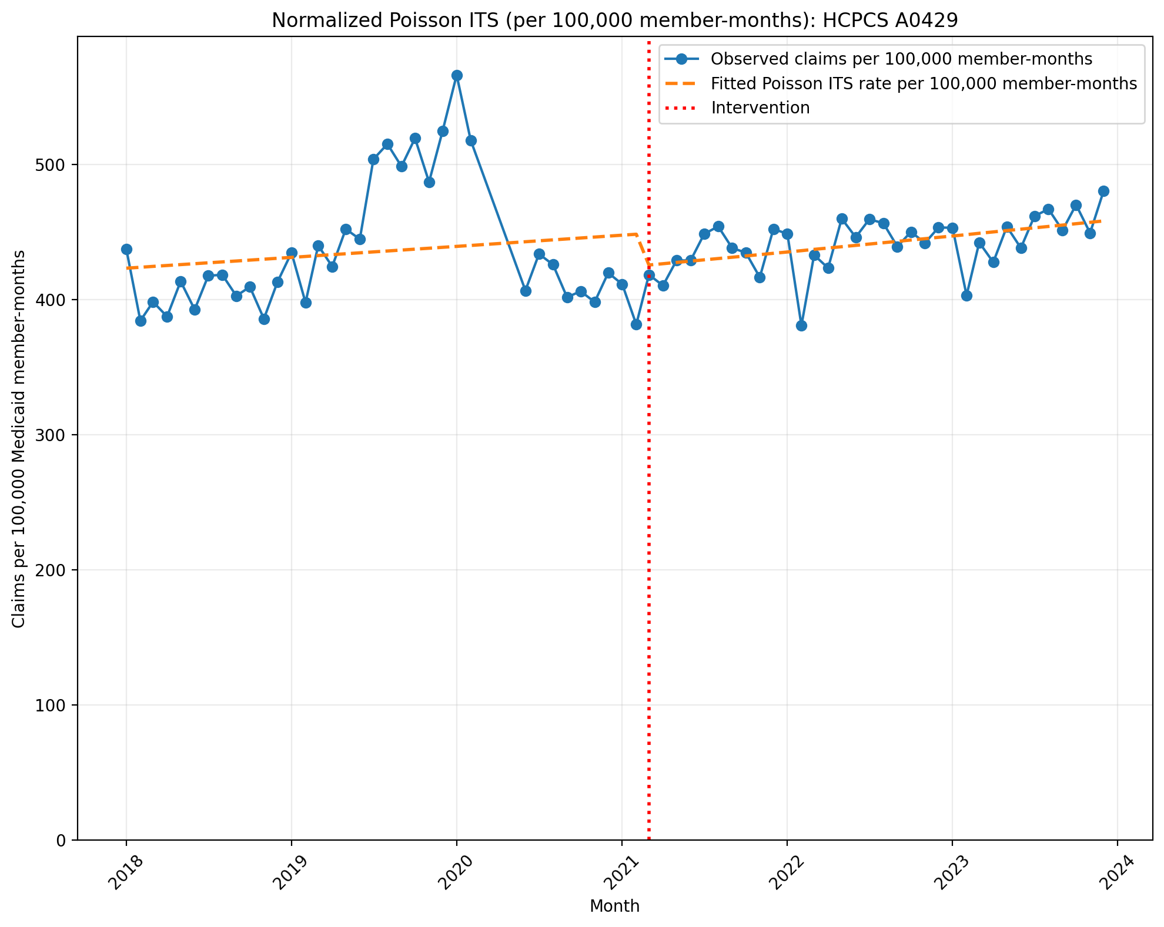
Normalized Poisson ITS (per 100,000 member-months): HCPCS A0429
Generalized Linear Model Regression Results
==============================================================================
Dep. Variable: y No. Observations: 69
Model: GLM Df Residuals: 65
Model Family: Poisson Df Model: 3
Link Function: Log Scale: 1.0000
Method: IRLS Log-Likelihood: -77669.
Date: Mon, 10 Aug 2026 Deviance: 1.5433e+05
Time: 10:08:35 Pearson chi2: 1.58e+05
No. Iterations: 4 Pseudo R-squ. (CS): 1.000
Covariance Type: nonrobust
==============================================================================
coef std err z P>|z| [0.025 0.975]
------------------------------------------------------------------------------
const -5.4650 0.001 -9858.036 0.000 -5.466 -5.464
T 0.0016 2.58e-05 60.456 0.000 0.002 0.002
X_t -0.0544 0.001 -68.300 0.000 -0.056 -0.053
post_time 0.0007 3.77e-05 18.052 0.000 0.001 0.001
==============================================================================

Slide 5
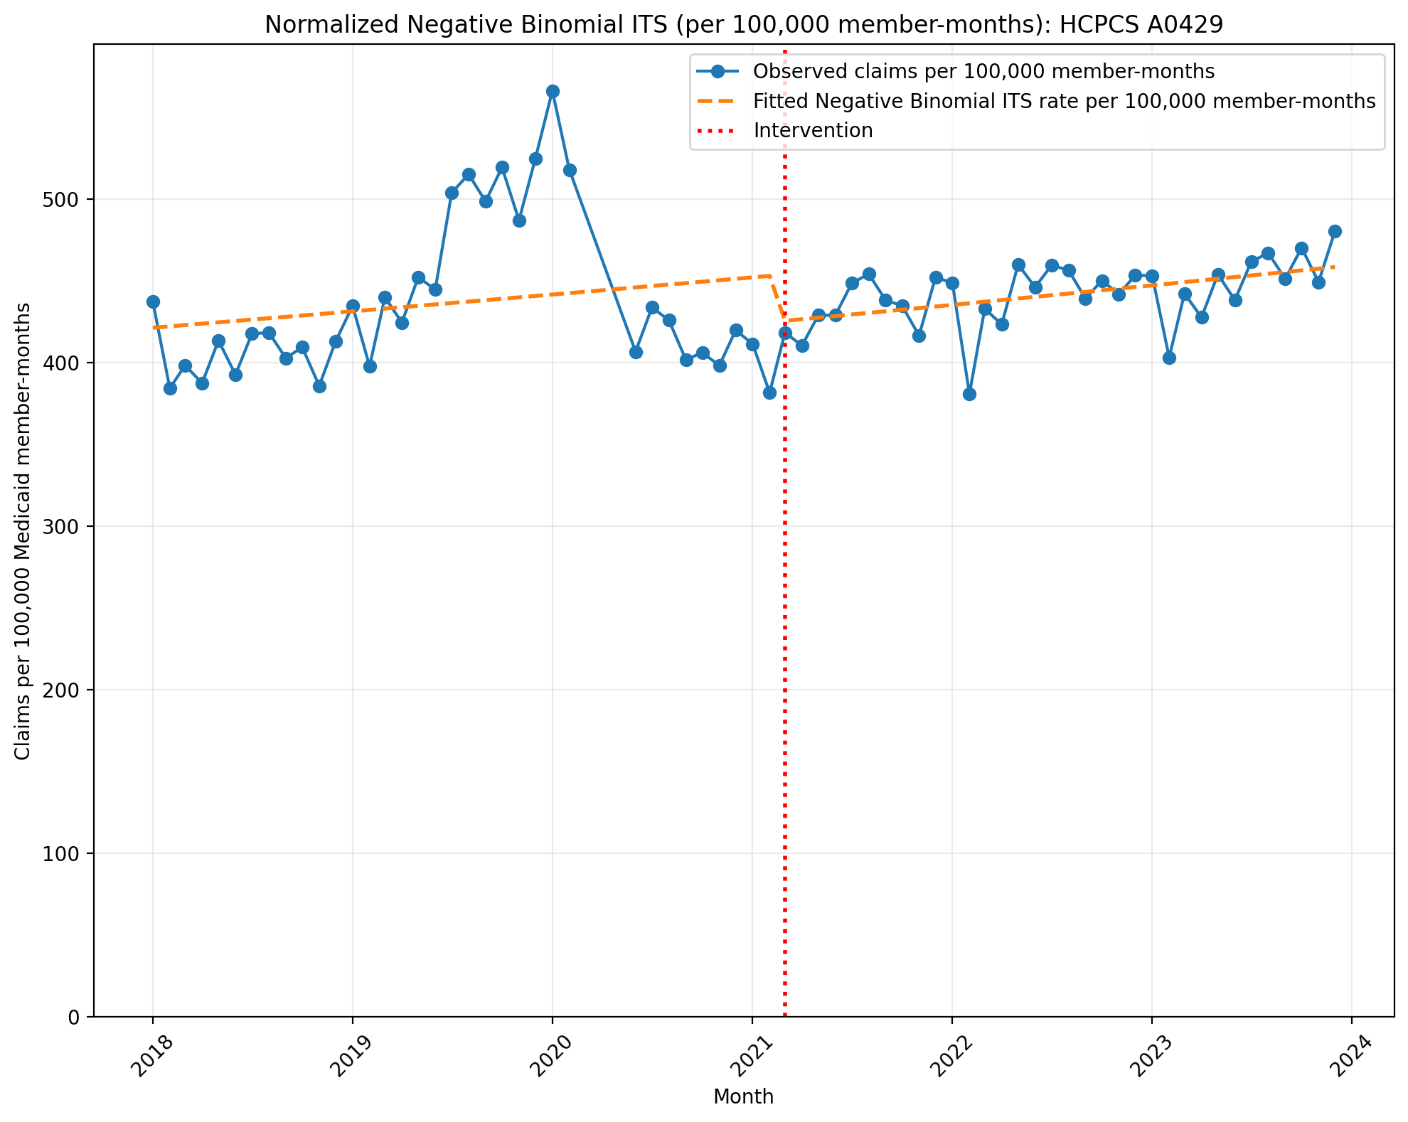
Normalized Negative Binomial ITS (per 100,000 member-months): HCPCS A0429
NegativeBinomial Regression Results
==============================================================================
Dep. Variable: y No. Observations: 69
Model: NegativeBinomial Df Residuals: 65
Method: MLE Df Model: 3
Date: Mon, 10 Aug 2026 Pseudo R-squ.: 0.003295
Time: 10:08:35 Log-Likelihood: -808.15
converged: False LL-Null: -810.82
Covariance Type: nonrobust LLR p-value: 0.1483
==============================================================================
coef std err z P>|z| [0.025 0.975]
------------------------------------------------------------------------------
const -5.4695 0.026 -211.242 0.000 -5.520 -5.419
T 0.0020 0.001 1.575 0.115 -0.000 0.004
X_t -0.0648 0.039 -1.657 0.097 -0.141 0.012
post_time 0.0003 0.002 0.158 0.874 -0.003 0.004
alpha 0.0063 0.001 5.877 0.000 0.004 0.008
==============================================================================

Slide 6
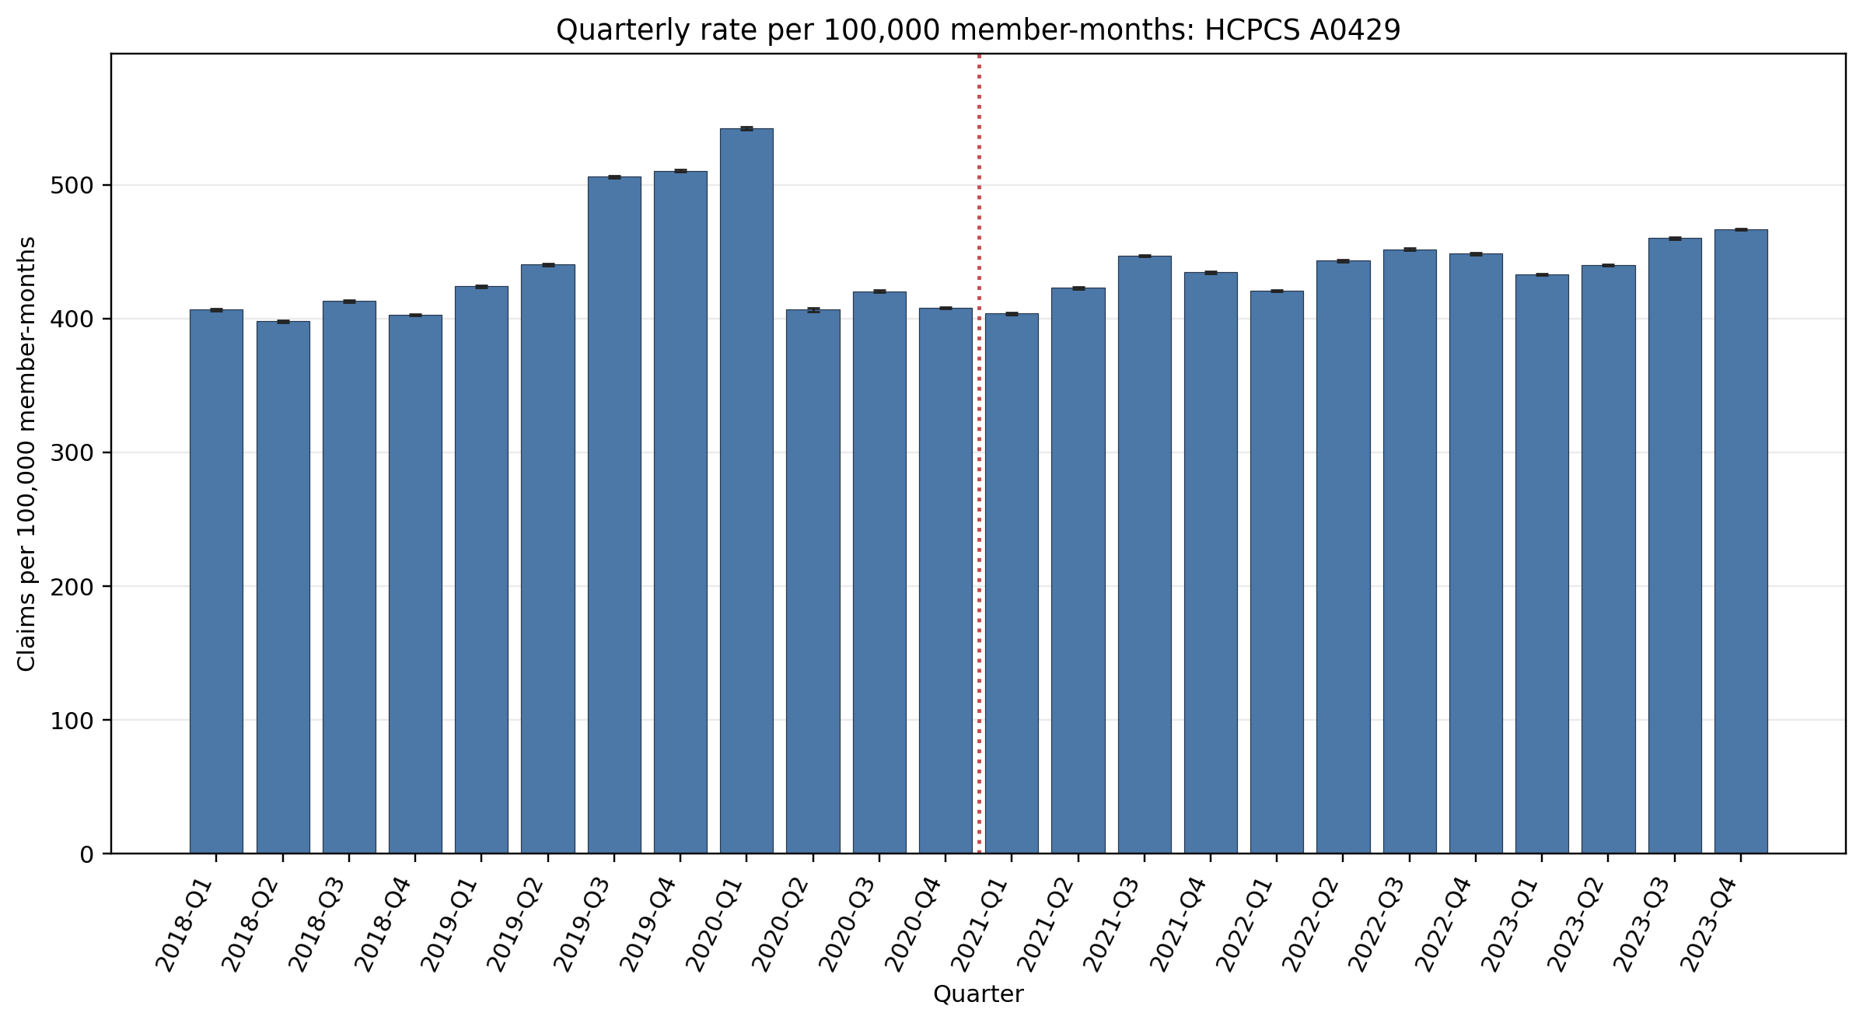
Quarterly rate per 100,000 member-months: HCPCS A0429
Error bars show exact 95% Poisson confidence intervals.
Yearly rate per 100,000 member-months (exact 95% Poisson CIs):
Year | 2018 | 2019 | 2020 | 2021 | 2022 | 2023
Rate | 405.04 | 470.20 | 439.78 | 427.30 | 441.25 | 449.50
95% CI | 404.63–405.46 | 469.75–470.64 | 439.30–440.27 | 426.91–427.69 | 440.86–441.64 | 449.11–449.88

Slide 7
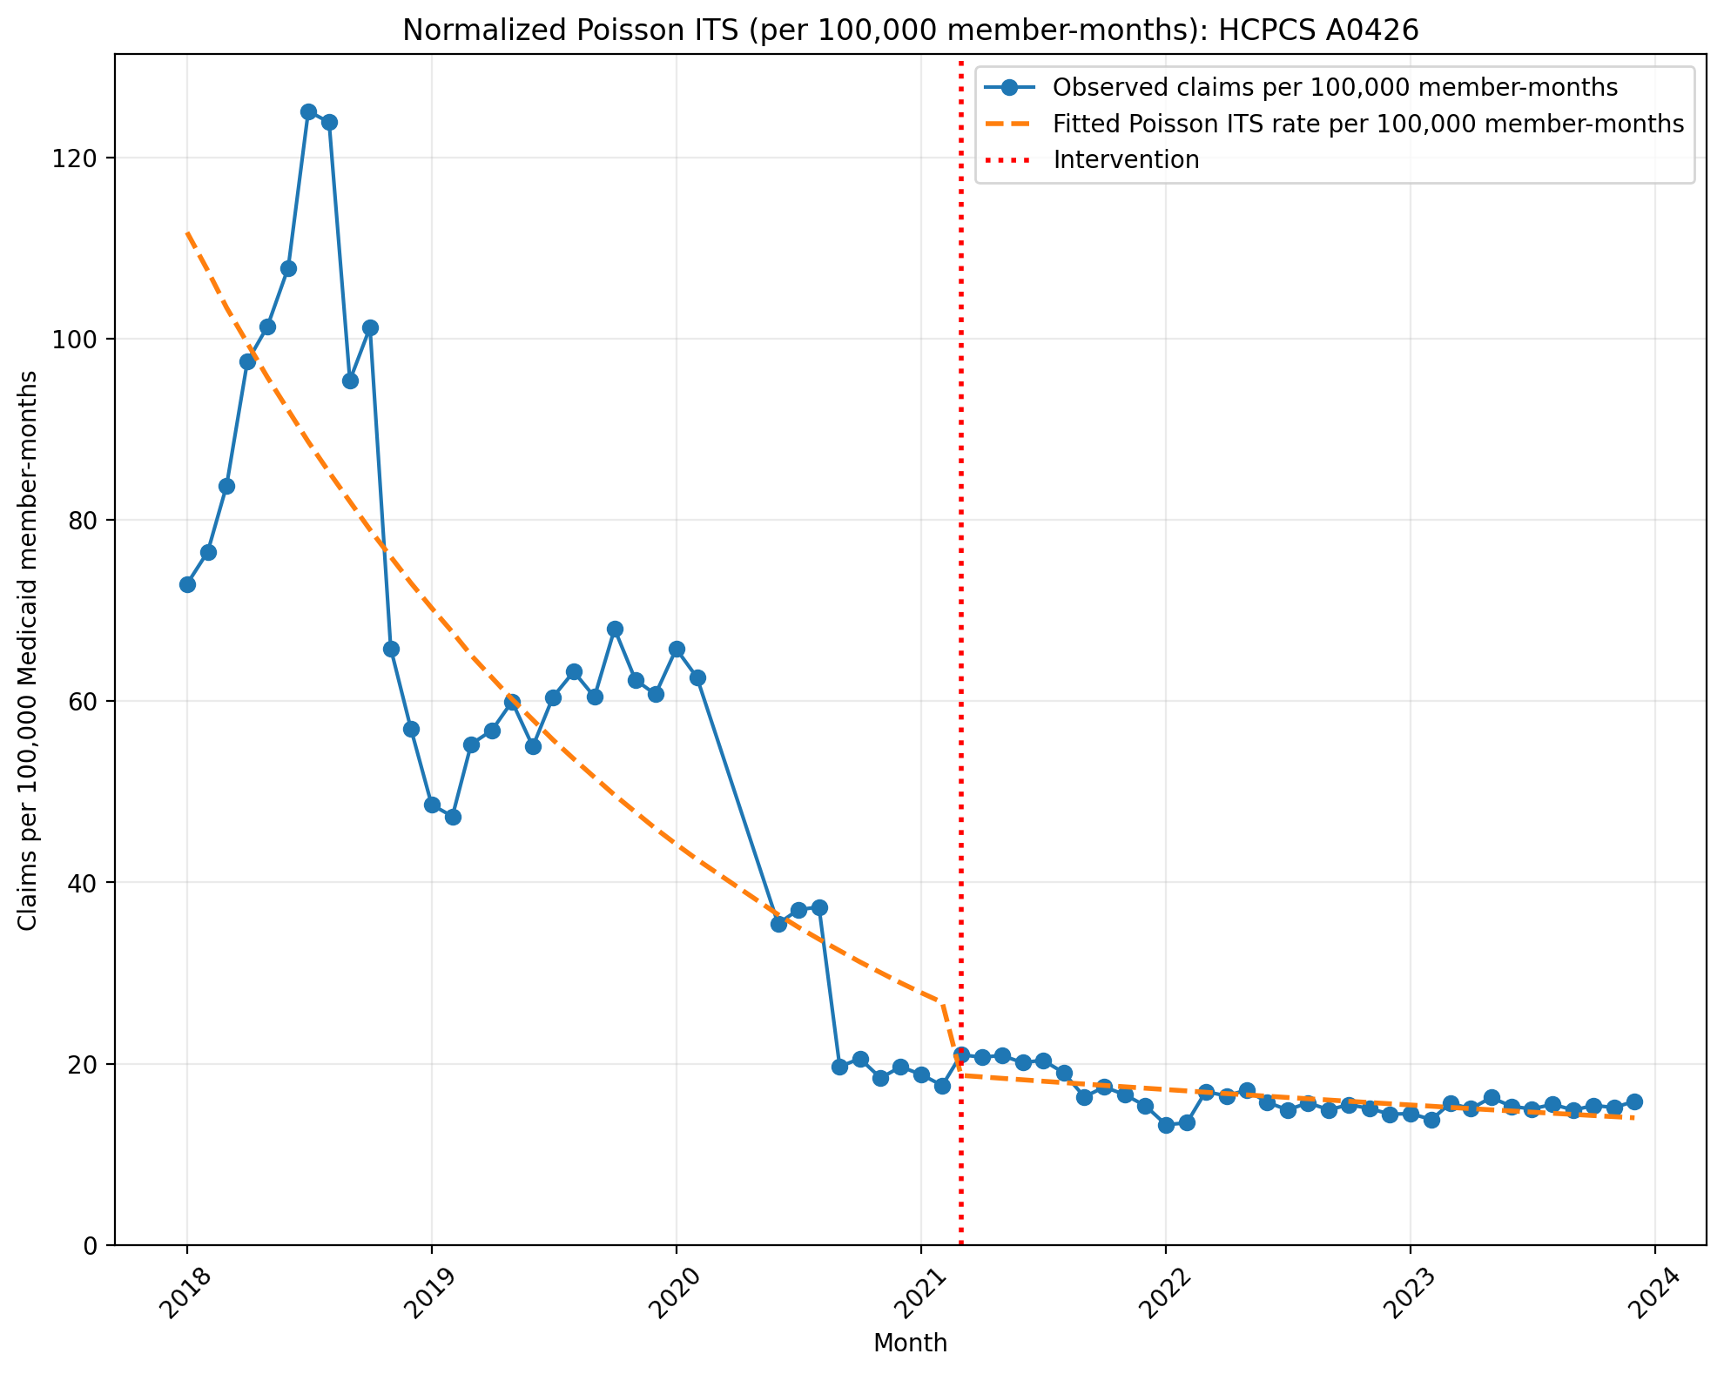
Normalized Poisson ITS (per 100,000 member-months): HCPCS A0426
Generalized Linear Model Regression Results
==============================================================================
Dep. Variable: y No. Observations: 69
Model: GLM Df Residuals: 65
Model Family: Poisson Df Model: 3
Link Function: Log Scale: 1.0000
Method: IRLS Log-Likelihood: -61132.
Date: Mon, 10 Aug 2026 Deviance: 1.2144e+05
Time: 10:08:35 Pearson chi2: 1.21e+05
No. Iterations: 5 Pseudo R-squ. (CS): 1.000
Covariance Type: nonrobust
==============================================================================
coef std err z P>|z| [0.025 0.975]
------------------------------------------------------------------------------
const -6.7967 0.001 -5332.454 0.000 -6.799 -6.794
T -0.0386 7.49e-05 -515.816 0.000 -0.039 -0.038
X_t -0.3496 0.003 -102.648 0.000 -0.356 -0.343
post_time 0.0299 0.000 184.765 0.000 0.030 0.030
==============================================================================

Slide 8
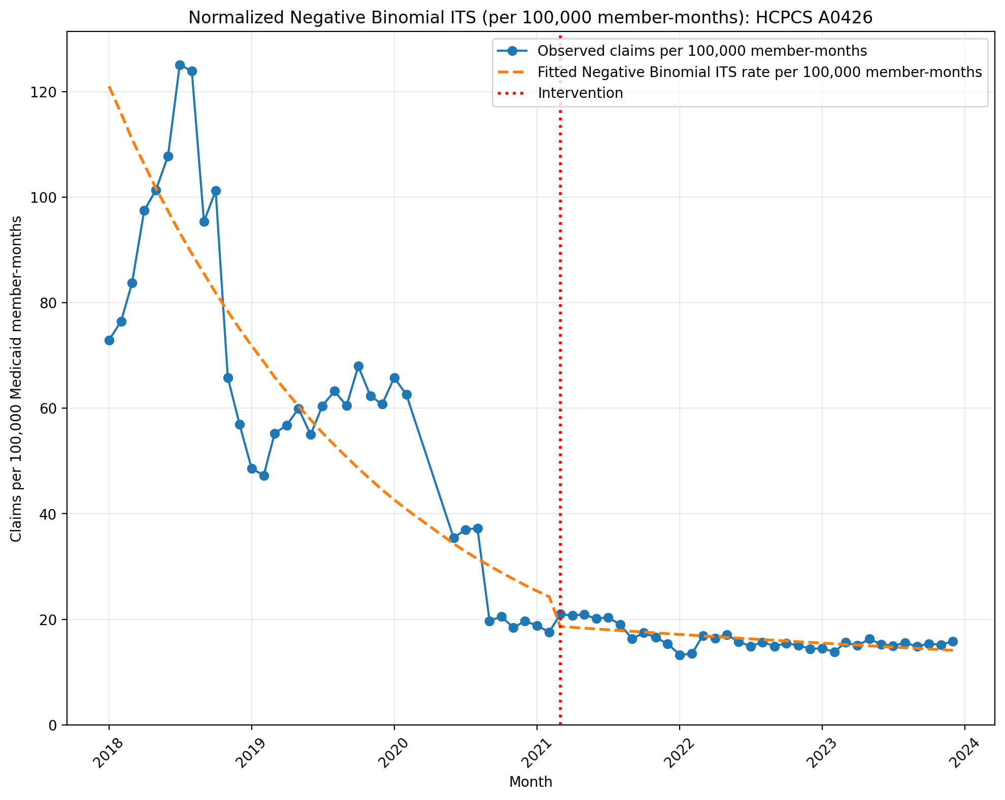
Normalized Negative Binomial ITS (per 100,000 member-months): HCPCS A0426
NegativeBinomial Regression Results
==============================================================================
Dep. Variable: y No. Observations: 69
Model: NegativeBinomial Df Residuals: 65
Method: MLE Df Model: 3
Date: Mon, 10 Aug 2026 Pseudo R-squ.: 0.1170
Time: 10:08:36 Log-Likelihood: -688.92
converged: False LL-Null: -780.24
Covariance Type: nonrobust LLR p-value: 2.373e-39
==============================================================================
coef std err z P>|z| [0.025 0.975]
------------------------------------------------------------------------------
const -6.7168 0.069 -97.055 0.000 -6.852 -6.581
T -0.0434 0.003 -12.916 0.000 -0.050 -0.037
X_t -0.2558 0.102 -2.505 0.012 -0.456 -0.056
post_time 0.0350 0.005 7.210 0.000 0.026 0.045
alpha 0.0426 0.007 5.911 0.000 0.028 0.057
==============================================================================

Slide 9
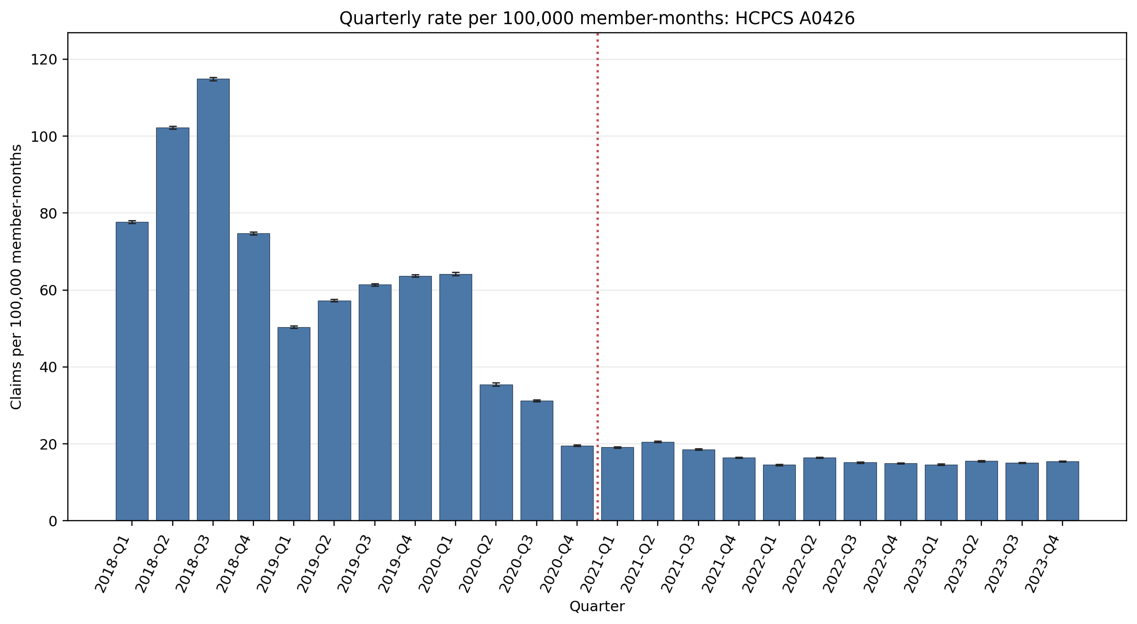
Quarterly rate per 100,000 member-months: HCPCS A0426
Error bars show exact 95% Poisson confidence intervals.
Yearly rate per 100,000 member-months (exact 95% Poisson CIs):
Year | 2018 | 2019 | 2020 | 2021 | 2022 | 2023
Rate | 92.40 | 58.17 | 34.43 | 18.64 | 15.27 | 15.18
95% CI | 92.20–92.60 | 58.01–58.33 | 34.29–34.56 | 18.56–18.73 | 15.20–15.34 | 15.11–15.25

Slide 10
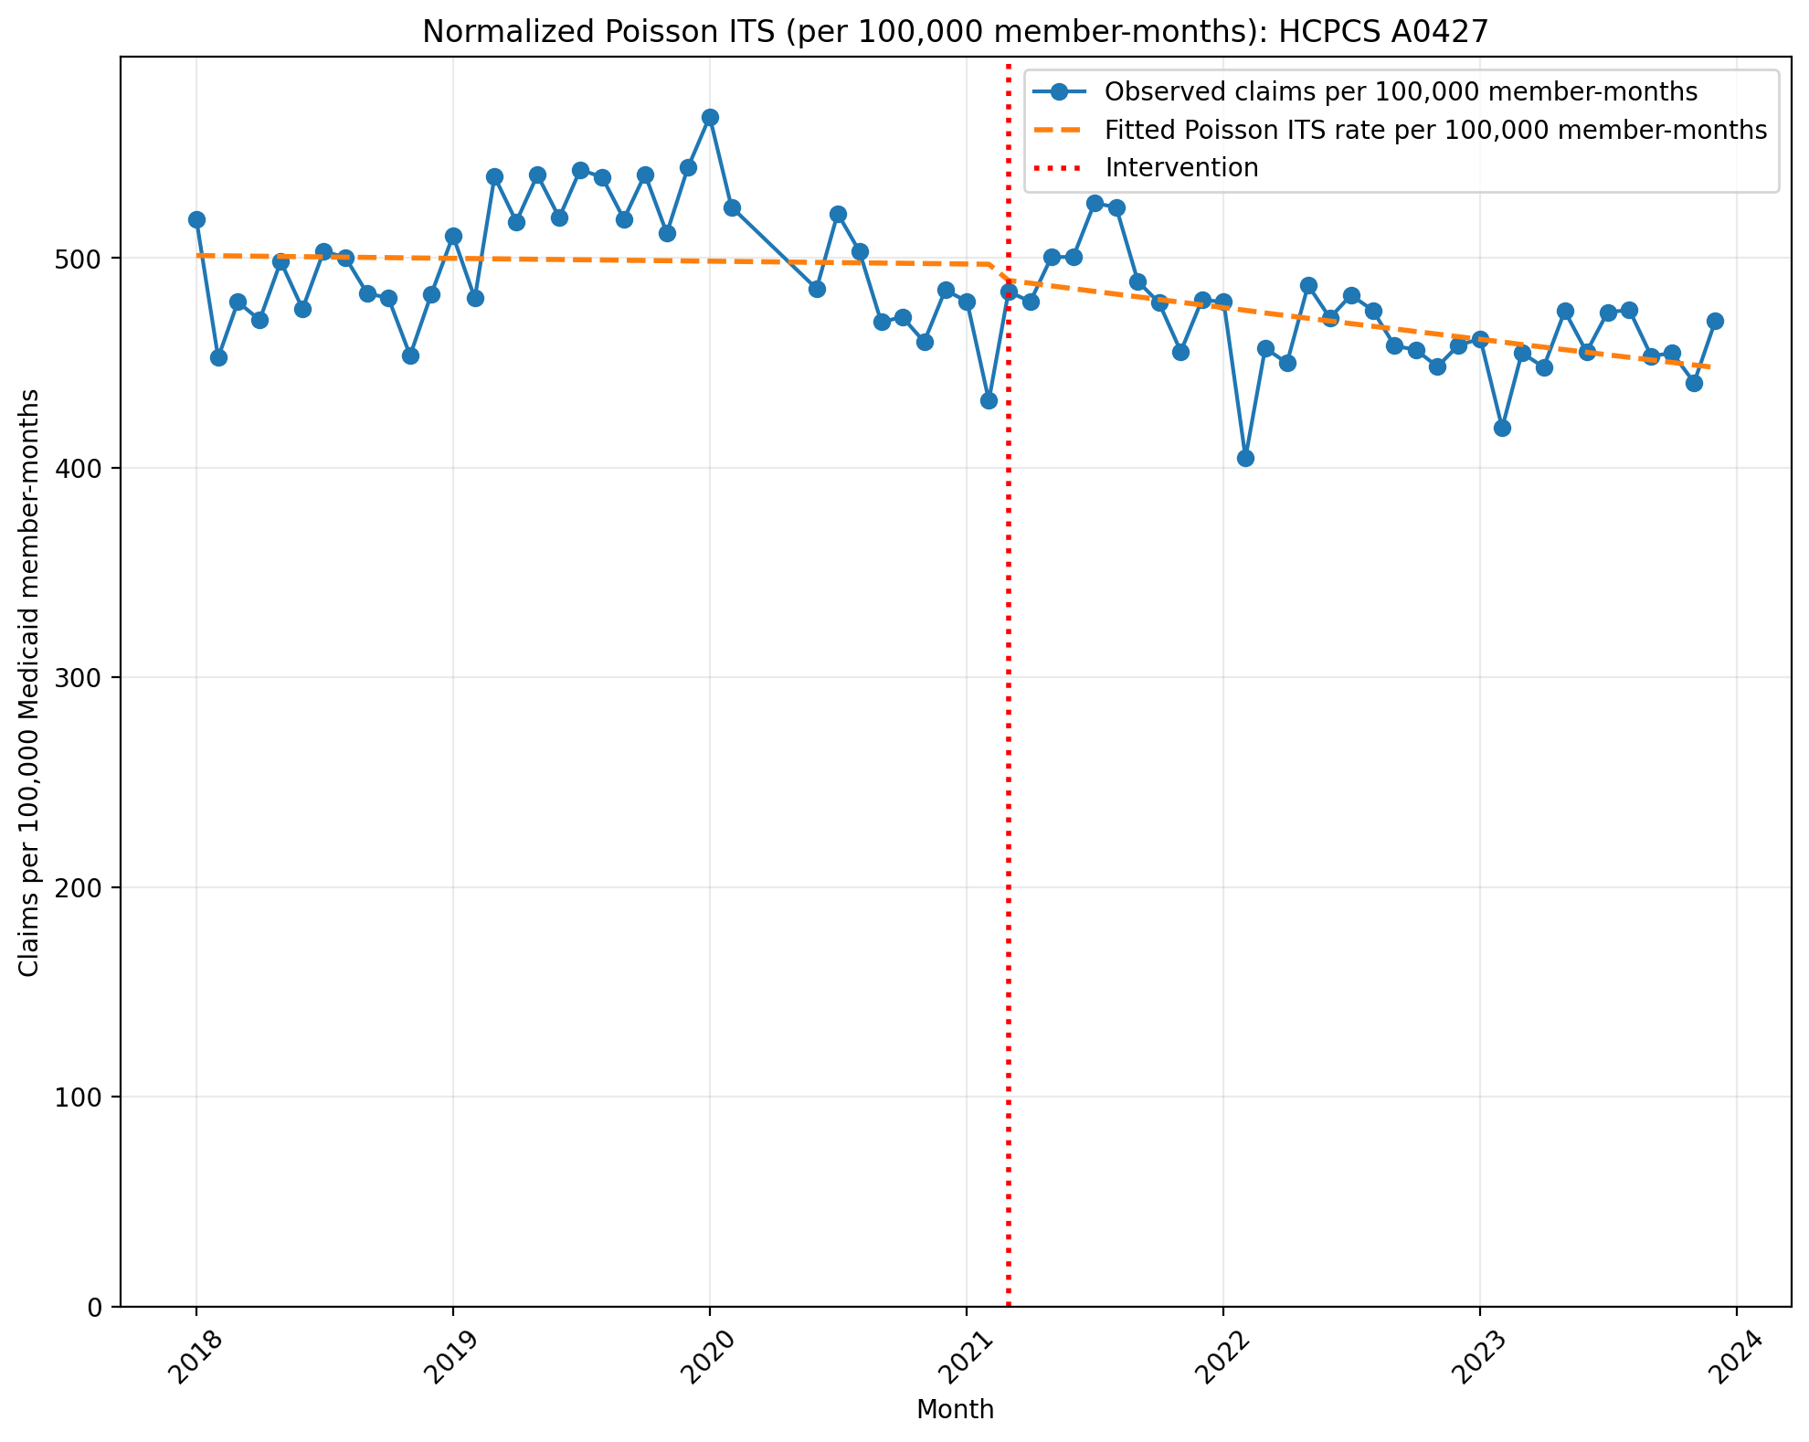
Normalized Poisson ITS (per 100,000 member-months): HCPCS A0427
Generalized Linear Model Regression Results
==============================================================================
Dep. Variable: y No. Observations: 69
Model: GLM Df Residuals: 65
Model Family: Poisson Df Model: 3
Link Function: Log Scale: 1.0000
Method: IRLS Log-Likelihood: -41367.
Date: Mon, 10 Aug 2026 Deviance: 81716.
Time: 10:08:36 Pearson chi2: 8.13e+04
No. Iterations: 4 Pseudo R-squ. (CS): 1.000
Covariance Type: nonrobust
==============================================================================
coef std err z P>|z| [0.025 0.975]
------------------------------------------------------------------------------
const -5.2959 0.001 -1.03e+04 0.000 -5.297 -5.295
T -0.0002 2.41e-05 -9.329 0.000 -0.000 -0.000
X_t -0.0130 0.001 -17.177 0.000 -0.014 -0.011
post_time -0.0025 3.6e-05 -68.518 0.000 -0.003 -0.002
==============================================================================

Slide 11
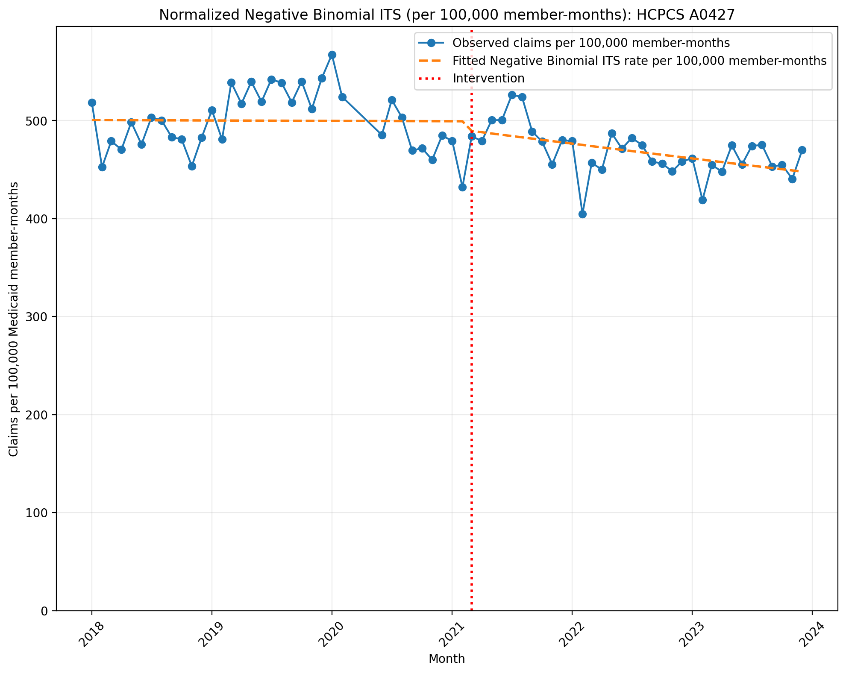
Normalized Negative Binomial ITS (per 100,000 member-months): HCPCS A0427
NegativeBinomial Regression Results
==============================================================================
Dep. Variable: y No. Observations: 69
Model: NegativeBinomial Df Residuals: 65
Method: MLE Df Model: 3
Date: Mon, 10 Aug 2026 Pseudo R-squ.: 0.01680
Time: 10:08:36 Log-Likelihood: -788.67
converged: False LL-Null: -802.14
Covariance Type: nonrobust LLR p-value: 6.035e-06
==============================================================================
coef std err z P>|z| [0.025 0.975]
------------------------------------------------------------------------------
const -5.2972 0.018 -302.336 0.000 -5.332 -5.263
T -6.529e-05 0.001 -0.078 0.938 -0.002 0.002
X_t -0.0172 0.027 -0.650 0.516 -0.069 0.035
post_time -0.0026 0.001 -2.075 0.038 -0.005 -0.000
alpha 0.0029 0.001 5.872 0.000 0.002 0.004
==============================================================================

Slide 12
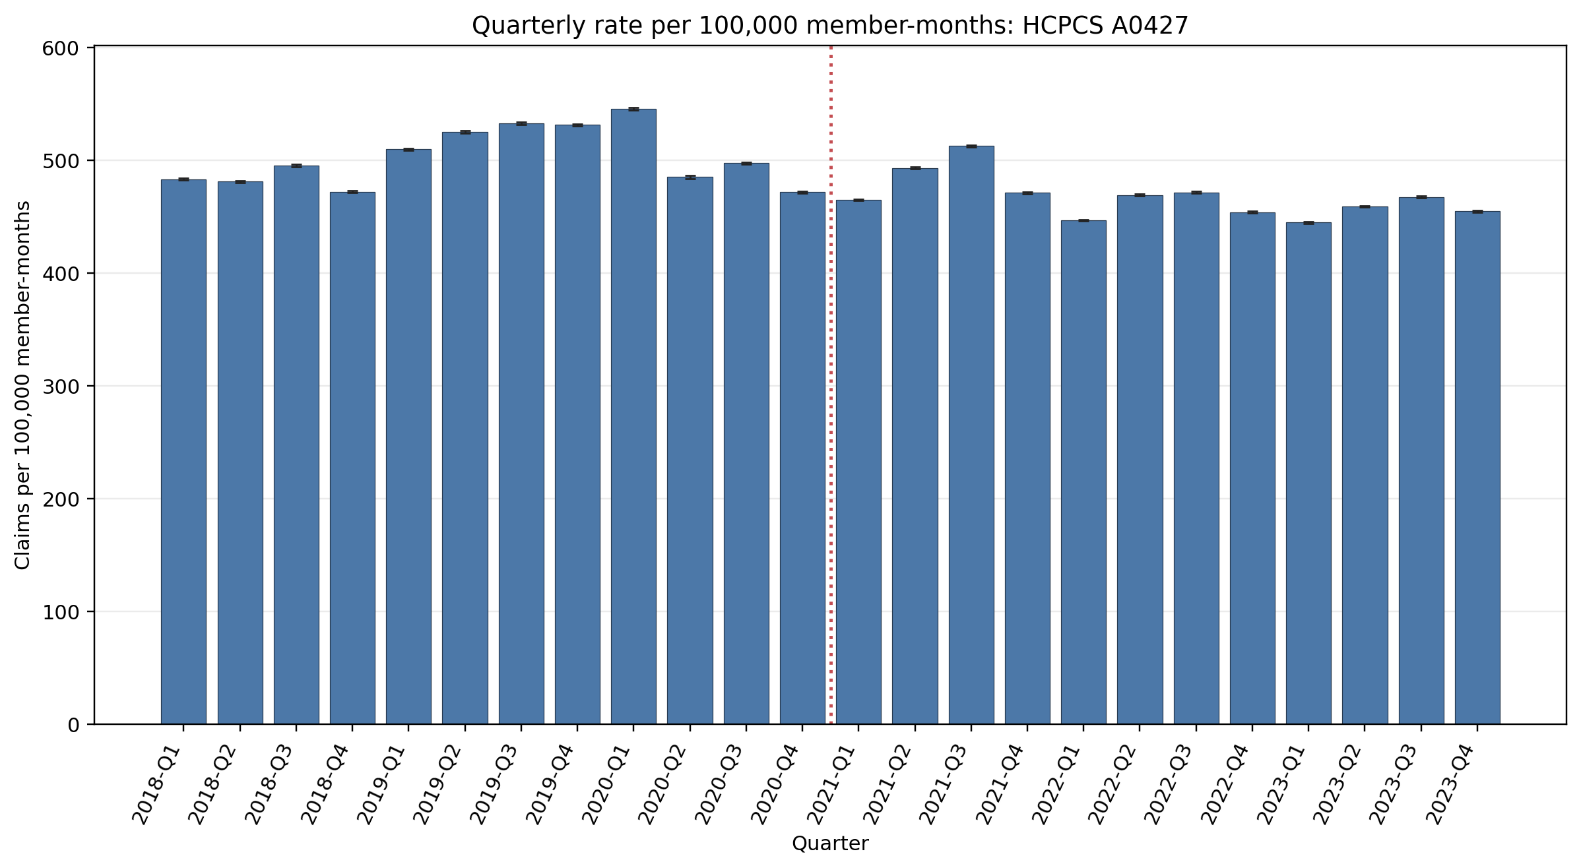
Quarterly rate per 100,000 member-months: HCPCS A0427
Error bars show exact 95% Poisson confidence intervals.
Yearly rate per 100,000 member-months (exact 95% Poisson CIs):
Year | 2018 | 2019 | 2020 | 2021 | 2022 | 2023
Rate | 483.25 | 525.04 | 497.44 | 485.84 | 460.71 | 456.72
95% CI | 482.80–483.70 | 524.56–525.51 | 496.92–497.95 | 485.42–486.27 | 460.31–461.10 | 456.33–457.11

Slide 13
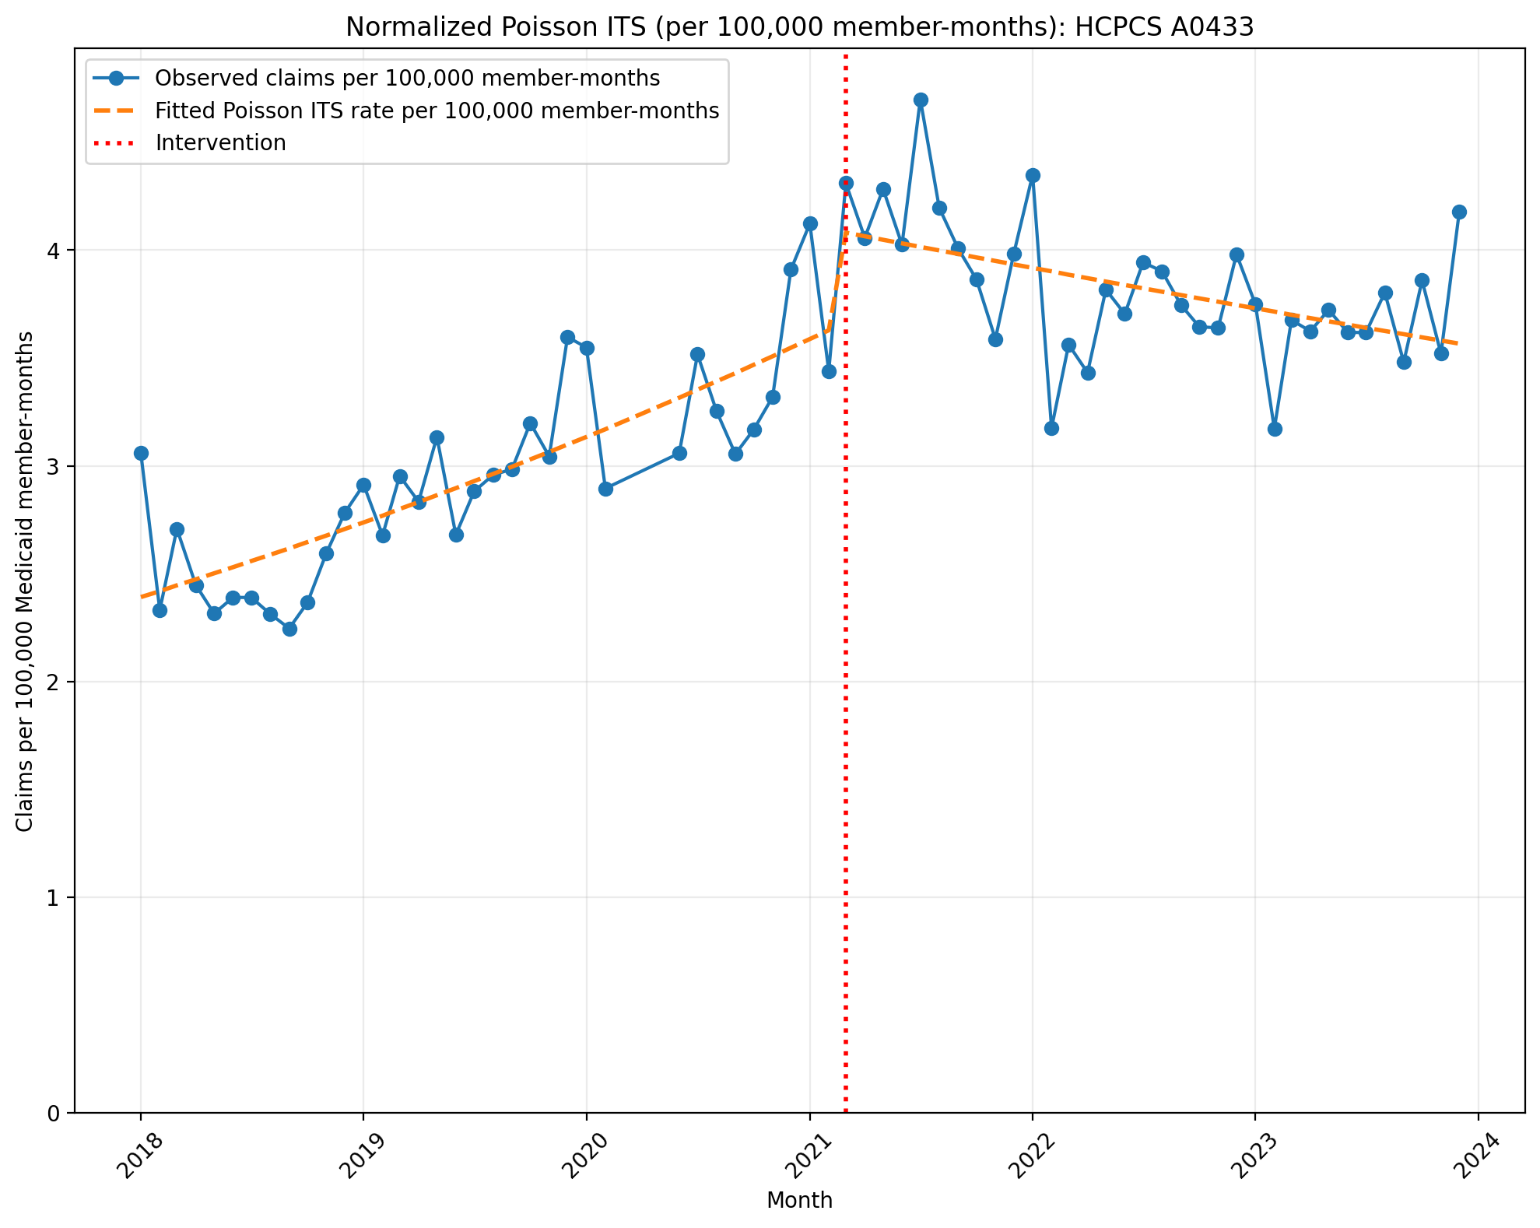
Normalized Poisson ITS (per 100,000 member-months): HCPCS A0433
Generalized Linear Model Regression Results
==============================================================================
Dep. Variable: y No. Observations: 69
Model: GLM Df Residuals: 65
Model Family: Poisson Df Model: 3
Link Function: Log Scale: 1.0000
Method: IRLS Log-Likelihood: -983.25
Date: Mon, 10 Aug 2026 Deviance: 1291.5
Time: 10:08:37 Pearson chi2: 1.30e+03
No. Iterations: 4 Pseudo R-squ. (CS): 1.000
Covariance Type: nonrobust
==============================================================================
coef std err z P>|z| [0.025 0.975]
------------------------------------------------------------------------------
const -10.6413 0.007 -1508.760 0.000 -10.655 -10.627
T 0.0113 0.000 36.097 0.000 0.011 0.012
X_t 0.1217 0.009 13.865 0.000 0.105 0.139
post_time -0.0154 0.000 -35.723 0.000 -0.016 -0.015
==============================================================================

Slide 14
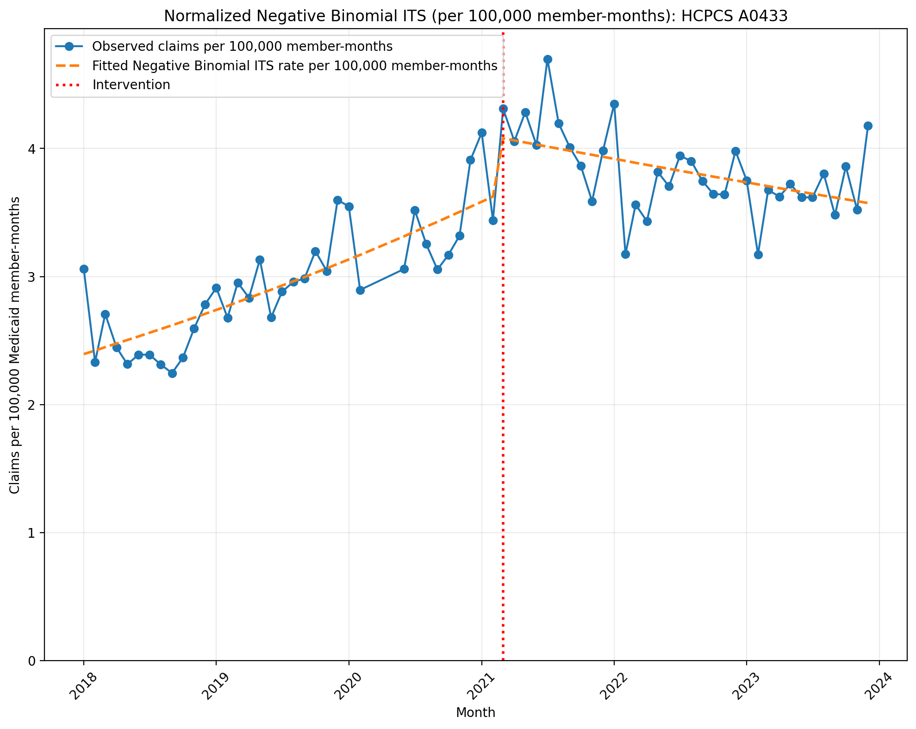
Normalized Negative Binomial ITS (per 100,000 member-months): HCPCS A0433
NegativeBinomial Regression Results
==============================================================================
Dep. Variable: y No. Observations: 69
Model: NegativeBinomial Df Residuals: 65
Method: MLE Df Model: 3
Date: Mon, 10 Aug 2026 Pseudo R-squ.: 0.1030
Time: 10:08:37 Log-Likelihood: -473.61
converged: False LL-Null: -527.99
Covariance Type: nonrobust LLR p-value: 2.022e-23
==============================================================================
coef std err z P>|z| [0.025 0.975]
------------------------------------------------------------------------------
const -10.6400 0.026 -404.970 0.000 -10.691 -10.588
T 0.0112 0.001 8.999 0.000 0.009 0.014
X_t 0.1222 0.039 3.095 0.002 0.045 0.200
post_time -0.0152 0.002 -8.109 0.000 -0.019 -0.012
alpha 0.0063 0.001 5.546 0.000 0.004 0.009
==============================================================================

Slide 15
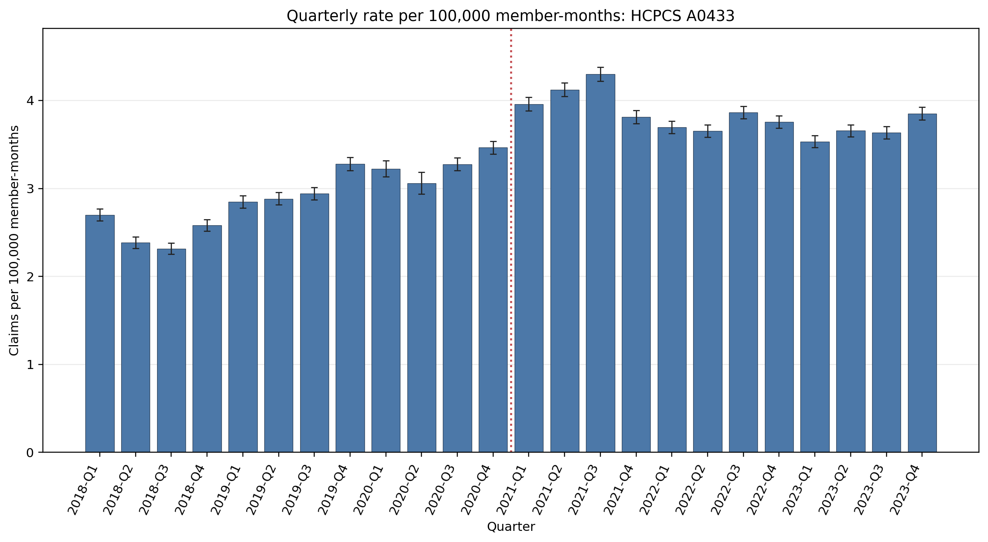
Quarterly rate per 100,000 member-months: HCPCS A0433
Error bars show exact 95% Poisson confidence intervals.
Yearly rate per 100,000 member-months (exact 95% Poisson CIs):
Year | 2018 | 2019 | 2020 | 2021 | 2022 | 2023
Rate | 2.49 | 2.99 | 3.31 | 4.05 | 3.74 | 3.67
95% CI | 2.46–2.53 | 2.95–3.02 | 3.26–3.35 | 4.01–4.09 | 3.71–3.78 | 3.63–3.70

Slide 16
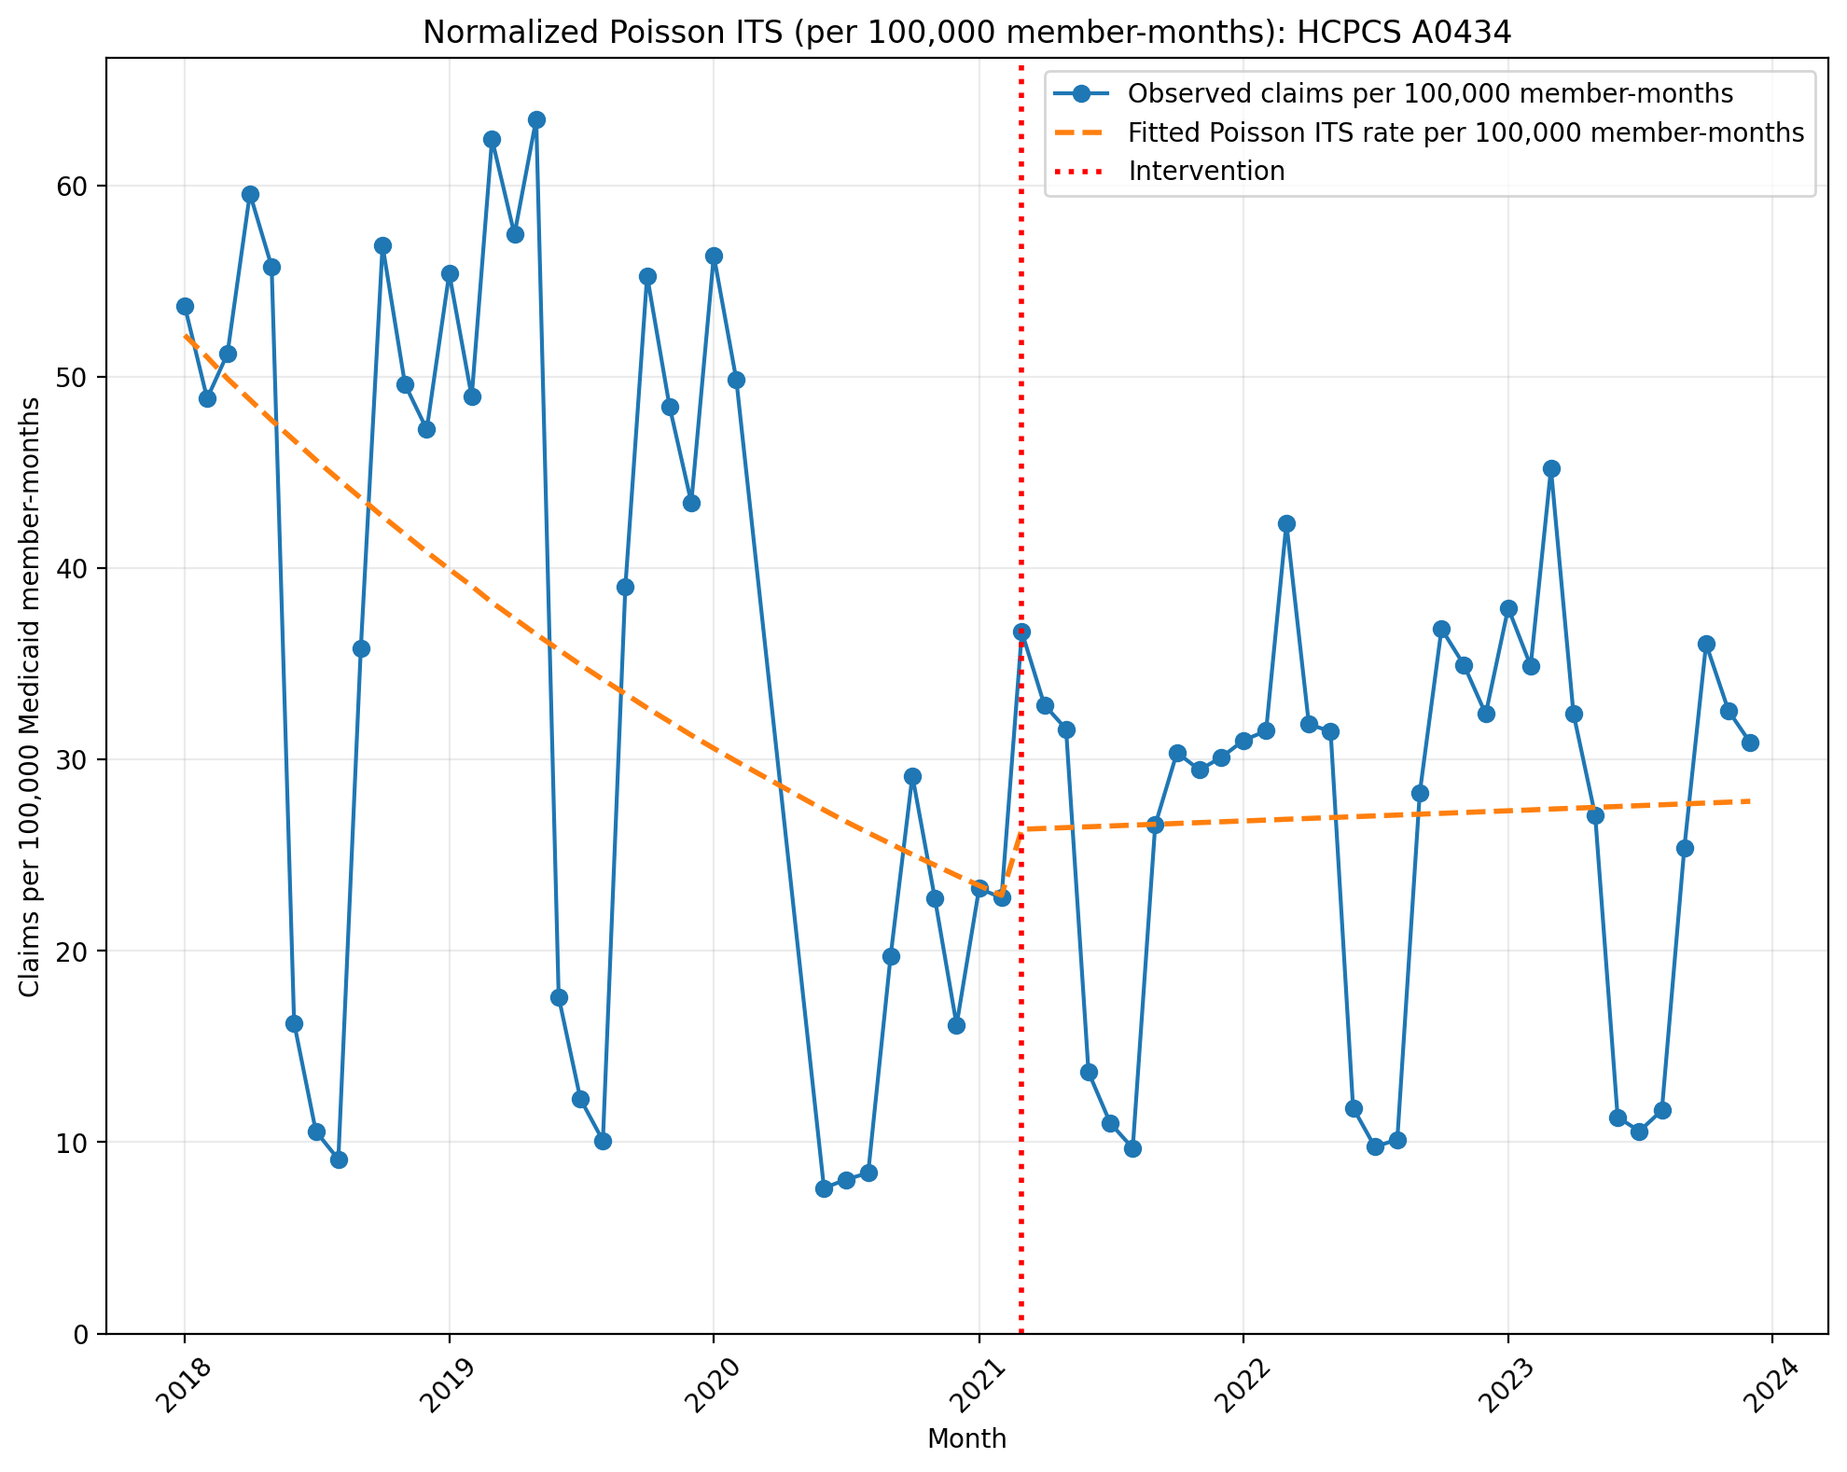
Normalized Poisson ITS (per 100,000 member-months): HCPCS A0434
Generalized Linear Model Regression Results
==============================================================================
Dep. Variable: y No. Observations: 69
Model: GLM Df Residuals: 65
Model Family: Poisson Df Model: 3
Link Function: Log Scale: 1.0000
Method: IRLS Log-Likelihood: -2.0012e+05
Date: Mon, 10 Aug 2026 Deviance: 3.9943e+05
Time: 10:08:37 Pearson chi2: 3.48e+05
No. Iterations: 5 Pseudo R-squ. (CS): 1.000
Covariance Type: nonrobust
==============================================================================
coef std err z P>|z| [0.025 0.975]
------------------------------------------------------------------------------
const -7.5583 0.002 -4322.336 0.000 -7.562 -7.555
T -0.0223 9.29e-05 -239.480 0.000 -0.022 -0.022
X_t 0.1389 0.003 43.447 0.000 0.133 0.145
post_time 0.0239 0.000 165.029 0.000 0.024 0.024
==============================================================================

Slide 17
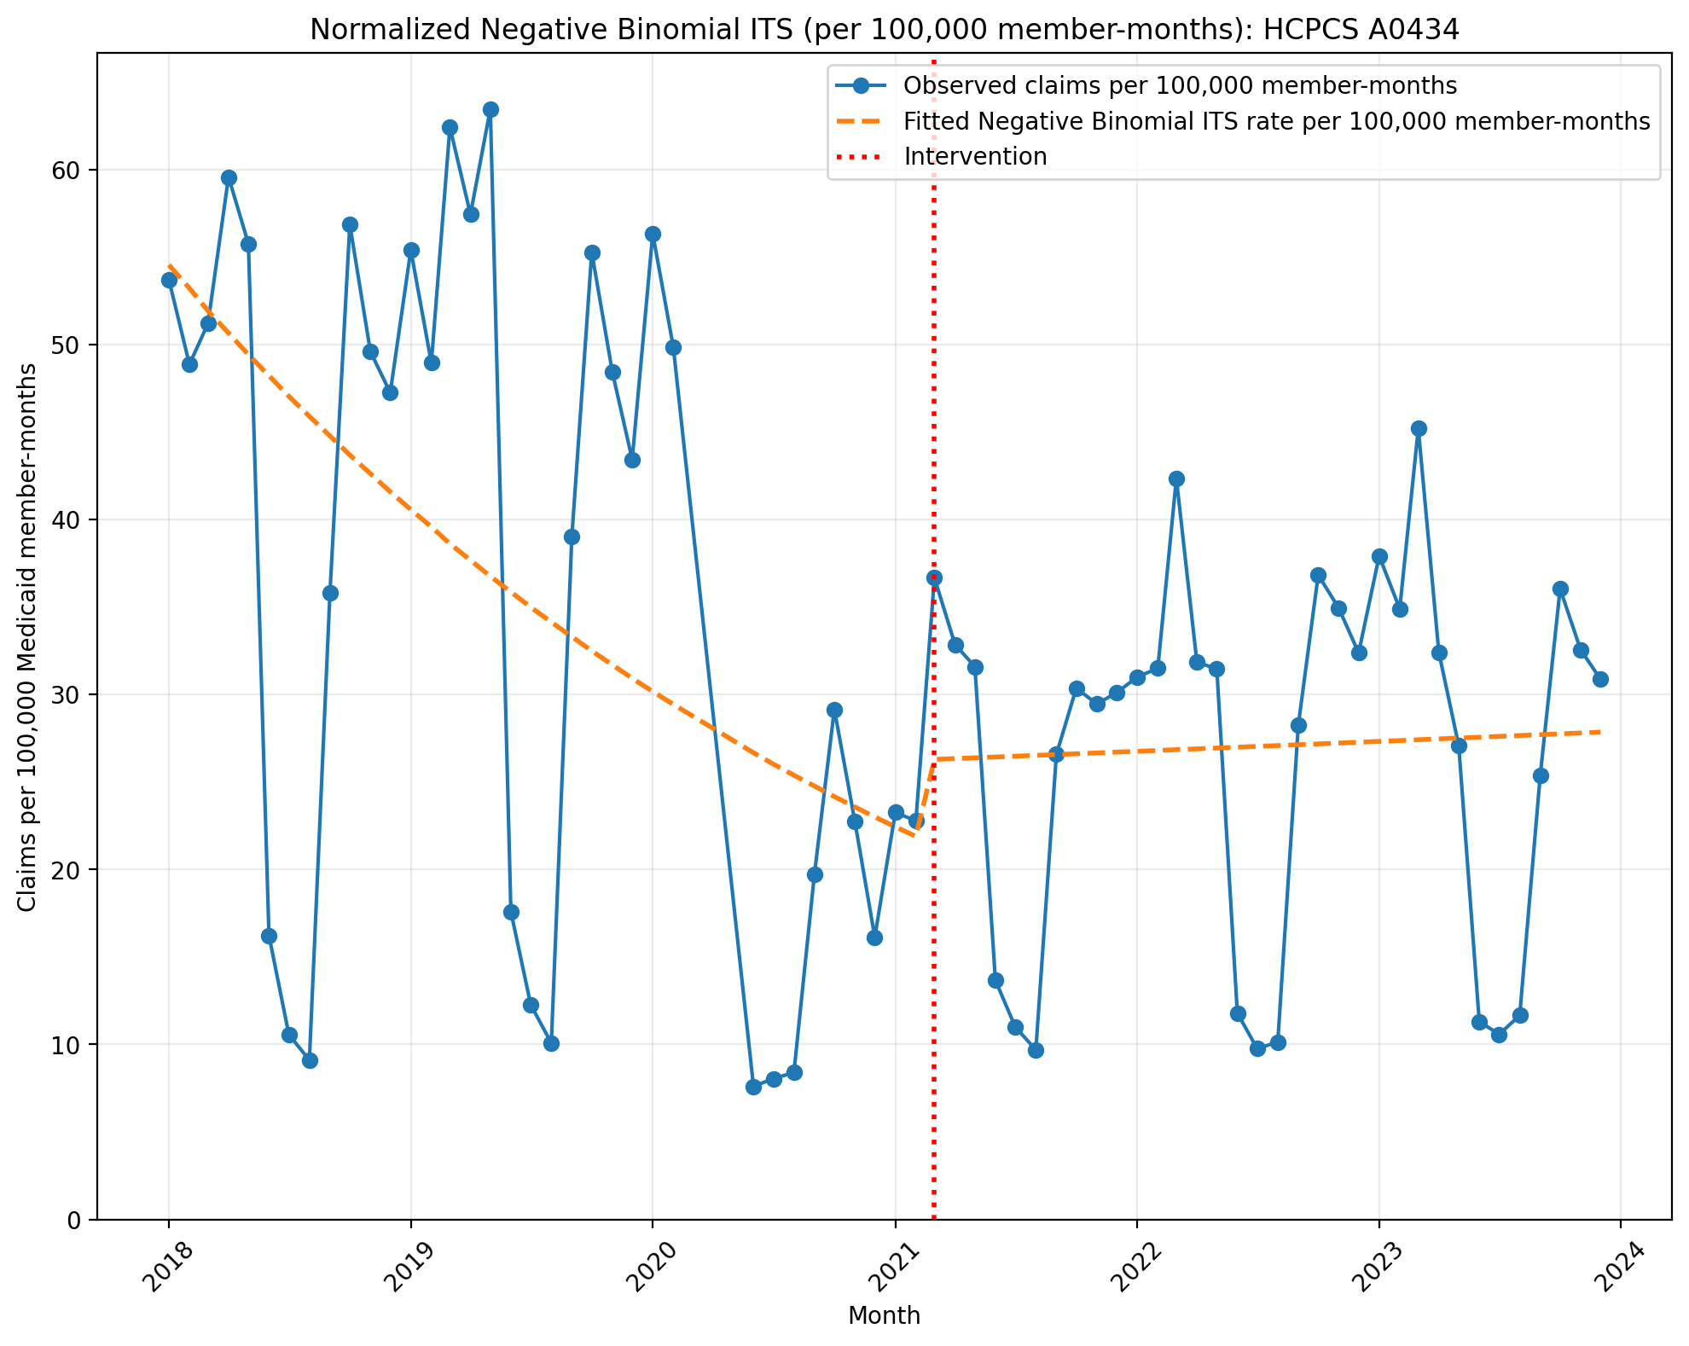
Normalized Negative Binomial ITS (per 100,000 member-months): HCPCS A0434
NegativeBinomial Regression Results
==============================================================================
Dep. Variable: y No. Observations: 69
Model: NegativeBinomial Df Residuals: 65
Method: MLE Df Model: 3
Date: Mon, 10 Aug 2026 Pseudo R-squ.: 0.008732
Time: 10:08:37 Log-Likelihood: -747.52
converged: False LL-Null: -754.11
Covariance Type: nonrobust LLR p-value: 0.004284
==============================================================================
coef std err z P>|z| [0.025 0.975]
------------------------------------------------------------------------------
const -7.5137 0.171 -43.916 0.000 -7.849 -7.178
T -0.0247 0.008 -2.974 0.003 -0.041 -0.008
X_t 0.1813 0.256 0.707 0.479 -0.321 0.684
post_time 0.0264 0.012 2.154 0.031 0.002 0.050
alpha 0.2636 0.043 6.122 0.000 0.179 0.348
==============================================================================

Slide 18
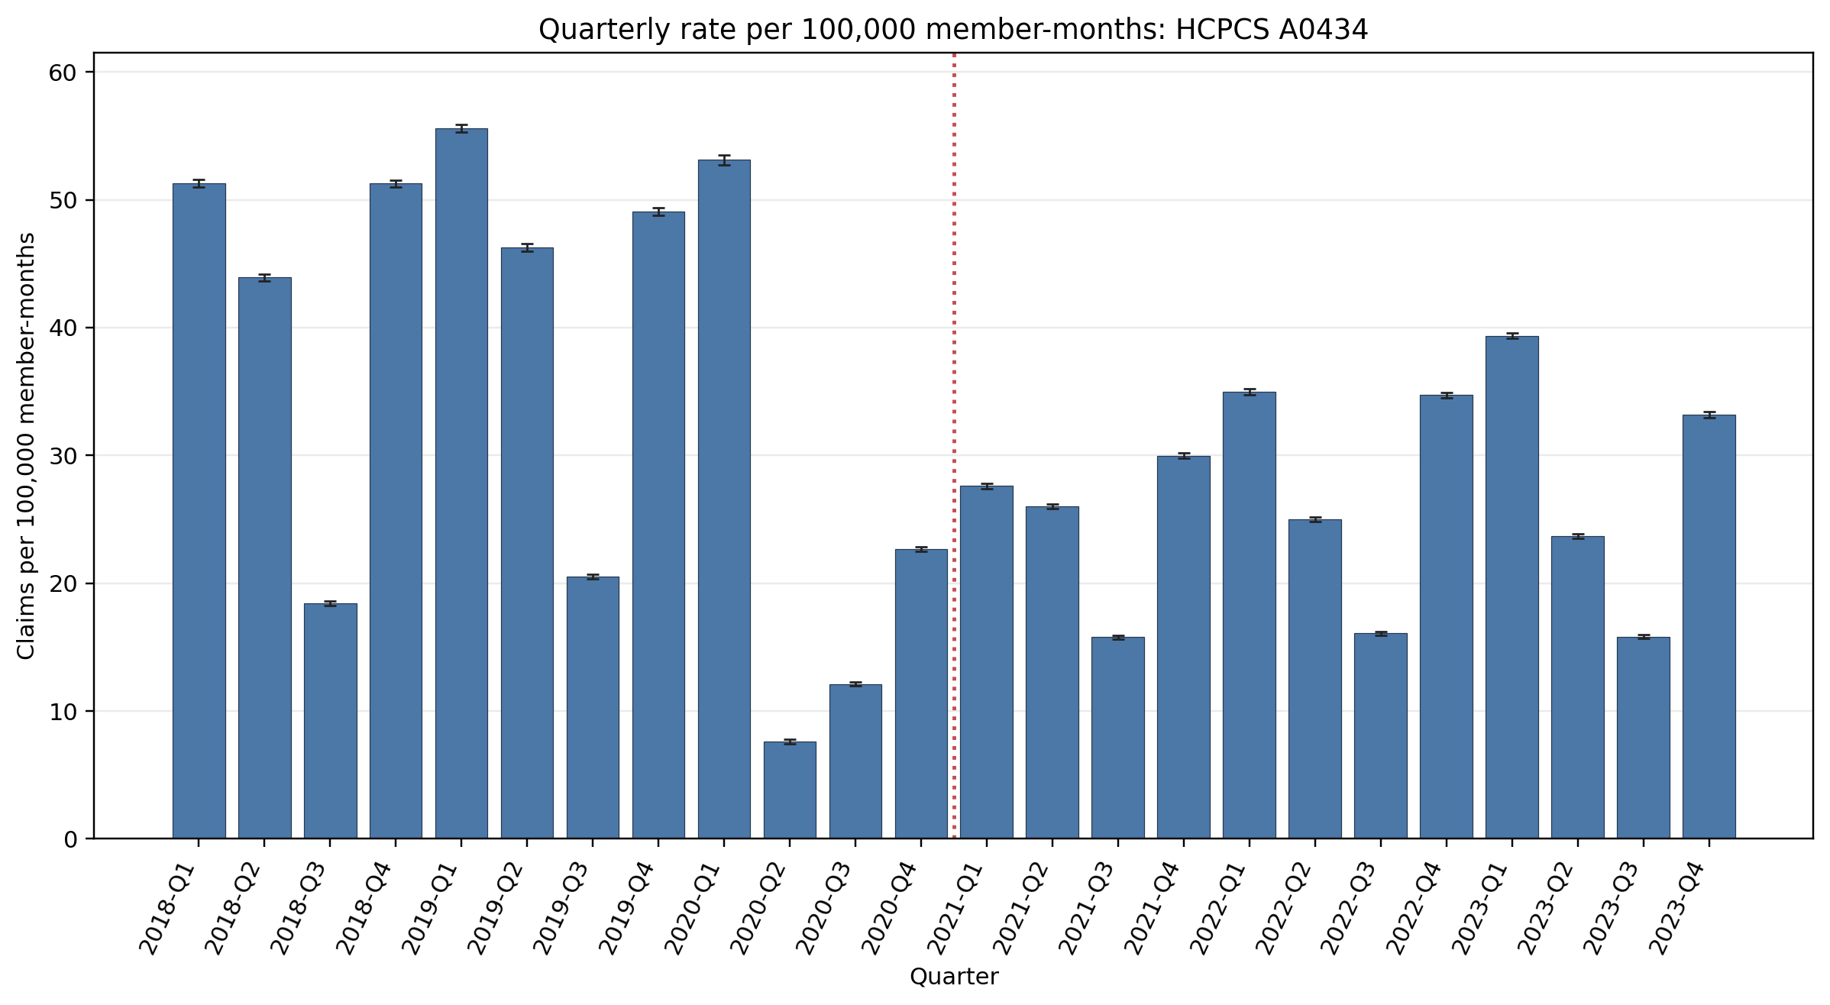
Quarterly rate per 100,000 member-months: HCPCS A0434
Error bars show exact 95% Poisson confidence intervals.
Yearly rate per 100,000 member-months (exact 95% Poisson CIs):
Year | 2018 | 2019 | 2020 | 2021 | 2022 | 2023
Rate | 41.23 | 42.85 | 23.82 | 24.83 | 27.67 | 27.99
95% CI | 41.10–41.37 | 42.72–42.99 | 23.71–23.94 | 24.74–24.93 | 27.57–27.77 | 27.89–28.09

Slide 19
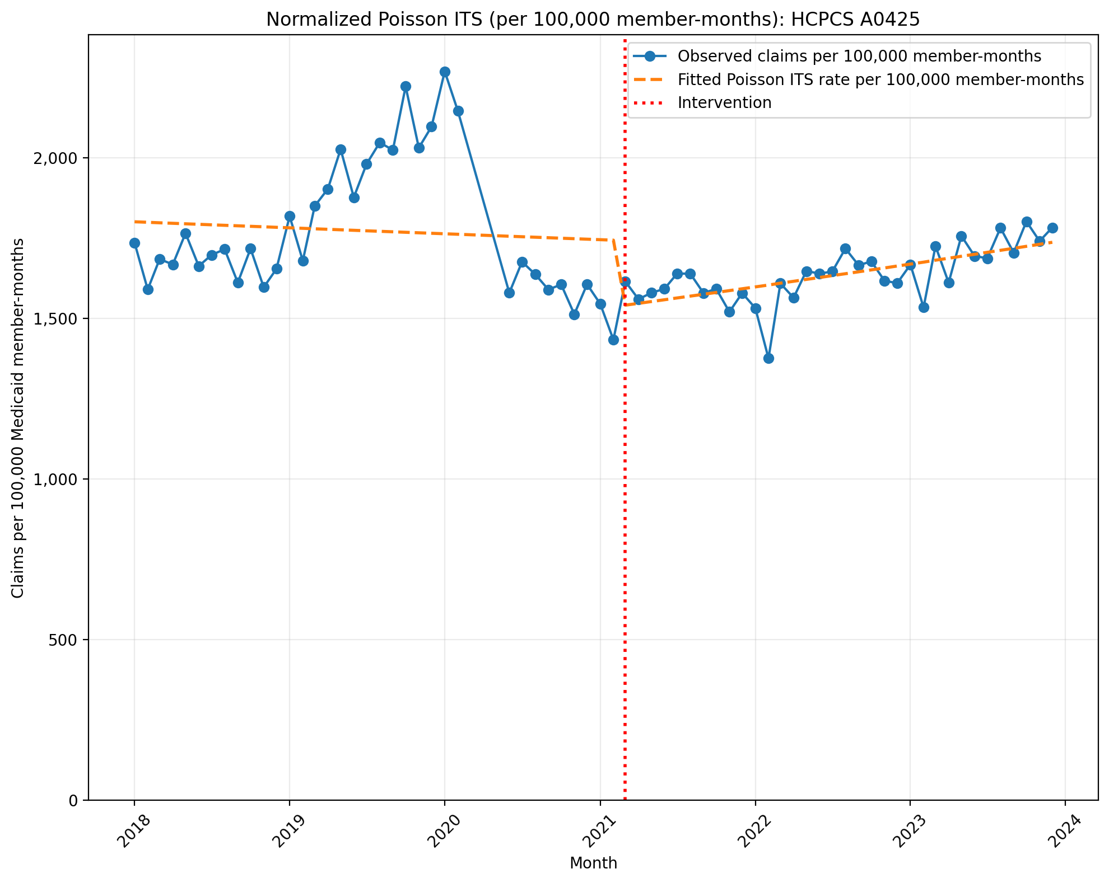
Normalized Poisson ITS (per 100,000 member-months): HCPCS A0425
Generalized Linear Model Regression Results
==============================================================================
Dep. Variable: y No. Observations: 69
Model: GLM Df Residuals: 65
Model Family: Poisson Df Model: 3
Link Function: Log Scale: 1.0000
Method: IRLS Log-Likelihood: -3.7639e+05
Date: Mon, 10 Aug 2026 Deviance: 7.5168e+05
Time: 10:08:38 Pearson chi2: 7.69e+05
No. Iterations: 4 Pseudo R-squ. (CS): 1.000
Covariance Type: nonrobust
==============================================================================
coef std err z P>|z| [0.025 0.975]
------------------------------------------------------------------------------
const -4.0169 0.000 -1.48e+04 0.000 -4.017 -4.016
T -0.0009 1.28e-05 -68.240 0.000 -0.001 -0.001
X_t -0.1271 0.000 -311.311 0.000 -0.128 -0.126
post_time 0.0045 1.92e-05 234.571 0.000 0.004 0.005
==============================================================================

Slide 20
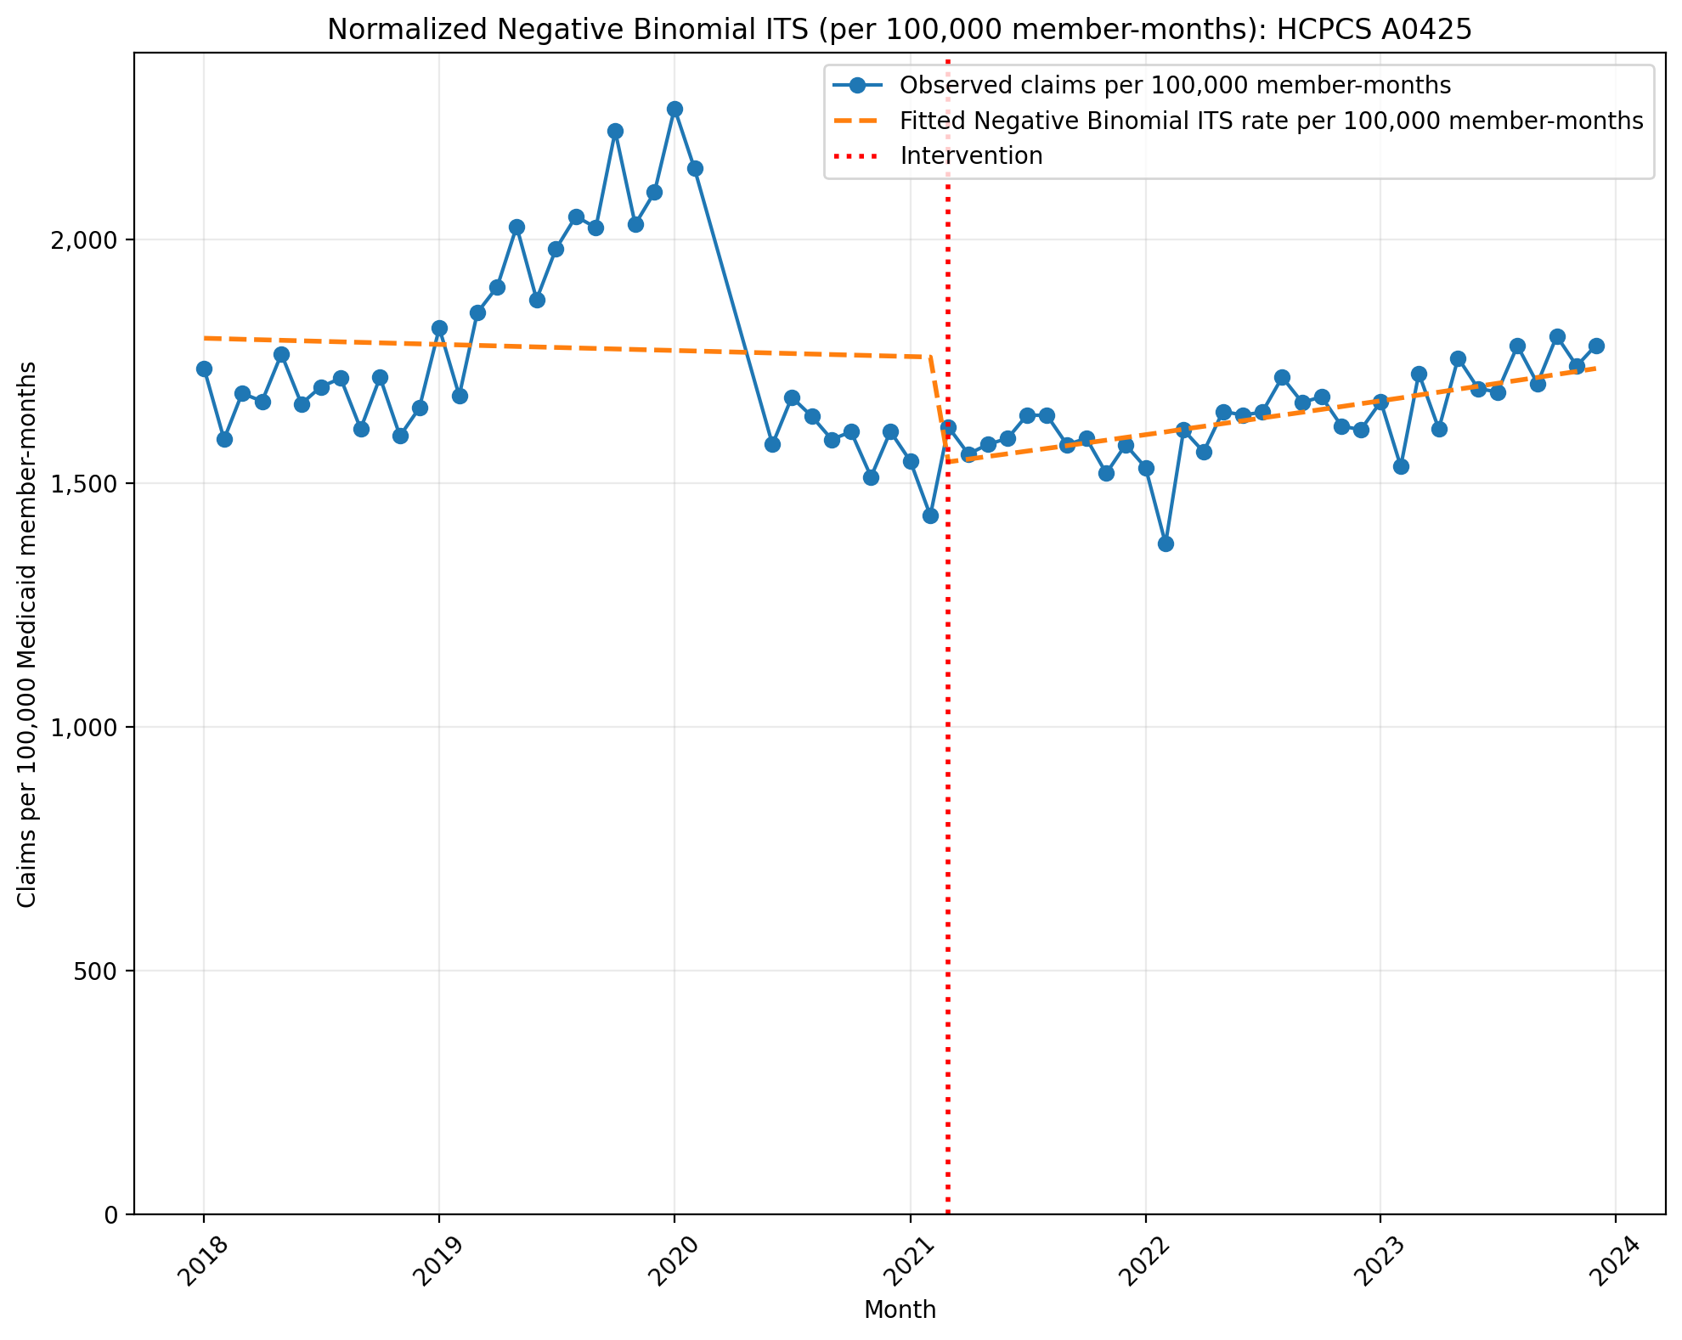
Normalized Negative Binomial ITS (per 100,000 member-months): HCPCS A0425
NegativeBinomial Regression Results
==============================================================================
Dep. Variable: y No. Observations: 69
Model: NegativeBinomial Df Residuals: 65
Method: MLE Df Model: 3
Date: Mon, 10 Aug 2026 Pseudo R-squ.: 0.009879
Time: 10:08:38 Log-Likelihood: -908.91
converged: False LL-Null: -917.98
Covariance Type: nonrobust LLR p-value: 0.0004119
==============================================================================
coef std err z P>|z| [0.025 0.975]
------------------------------------------------------------------------------
const -4.0188 0.029 -139.192 0.000 -4.075 -3.962
T -0.0006 0.001 -0.421 0.674 -0.003 0.002
X_t -0.1340 0.043 -3.089 0.002 -0.219 -0.049
post_time 0.0041 0.002 1.999 0.046 8e-05 0.008
alpha 0.0077 0.001 5.881 0.000 0.005 0.010
==============================================================================

Slide 21
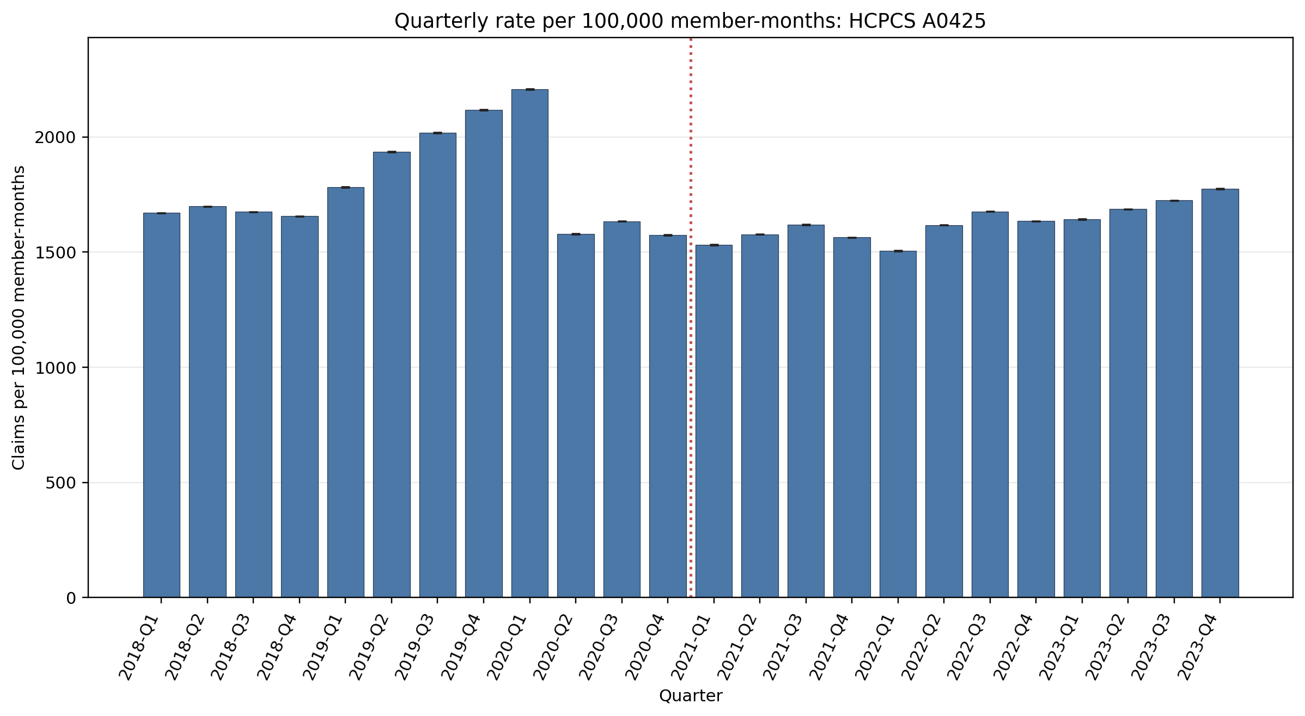
Quarterly rate per 100,000 member-months: HCPCS A0425
Error bars show exact 95% Poisson confidence intervals.
Yearly rate per 100,000 member-months (exact 95% Poisson CIs):
Year | 2018 | 2019 | 2020 | 2021 | 2022 | 2023
Rate | 1675.06 | 1963.12 | 1726.19 | 1573.19 | 1609.47 | 1706.05
95% CI | 1674.22–1675.90 | 1962.20–1964.03 | 1725.23–1727.15 | 1572.44–1573.95 | 1608.73–1610.20 | 1705.30–1706.80

Slide 22
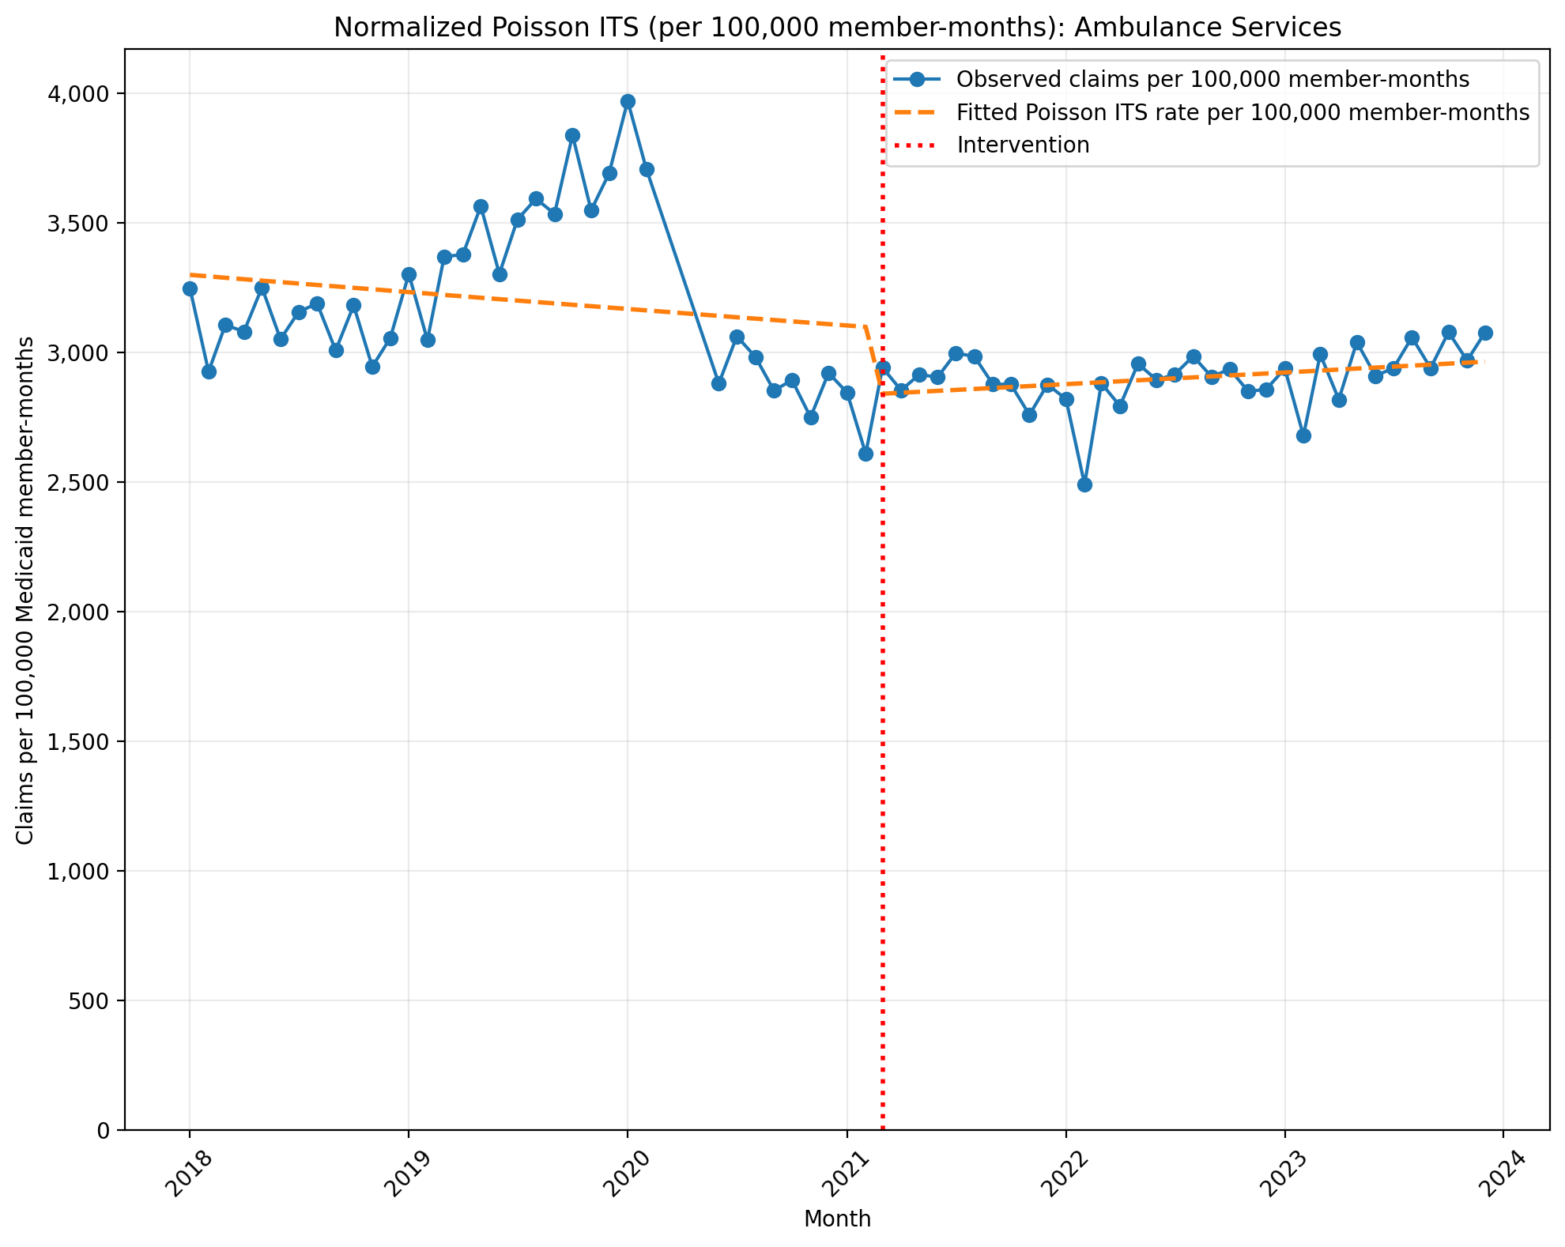
Normalized Poisson ITS (per 100,000 member-months): Ambulance Services
Generalized Linear Model Regression Results
==============================================================================
Dep. Variable: y No. Observations: 69
Model: GLM Df Residuals: 65
Model Family: Poisson Df Model: 3
Link Function: Log Scale: 1.0000
Method: IRLS Log-Likelihood: -4.8039e+05
Date: Mon, 10 Aug 2026 Deviance: 9.5963e+05
Time: 10:08:38 Pearson chi2: 9.76e+05
No. Iterations: 4 Pseudo R-squ. (CS): 1.000
Covariance Type: nonrobust
==============================================================================
coef std err z P>|z| [0.025 0.975]
------------------------------------------------------------------------------
const -3.4119 0.000 -1.69e+04 0.000 -3.412 -3.412
T -0.0017 9.53e-06 -177.794 0.000 -0.002 -0.002
X_t -0.0883 0.000 -289.941 0.000 -0.089 -0.088
post_time 0.0030 1.43e-05 208.191 0.000 0.003 0.003
==============================================================================
Codes in aggregation: A0428, A0429, A0426, A0427, A0433, A0434, A0425, A0430, A0431, A0422

Slide 23
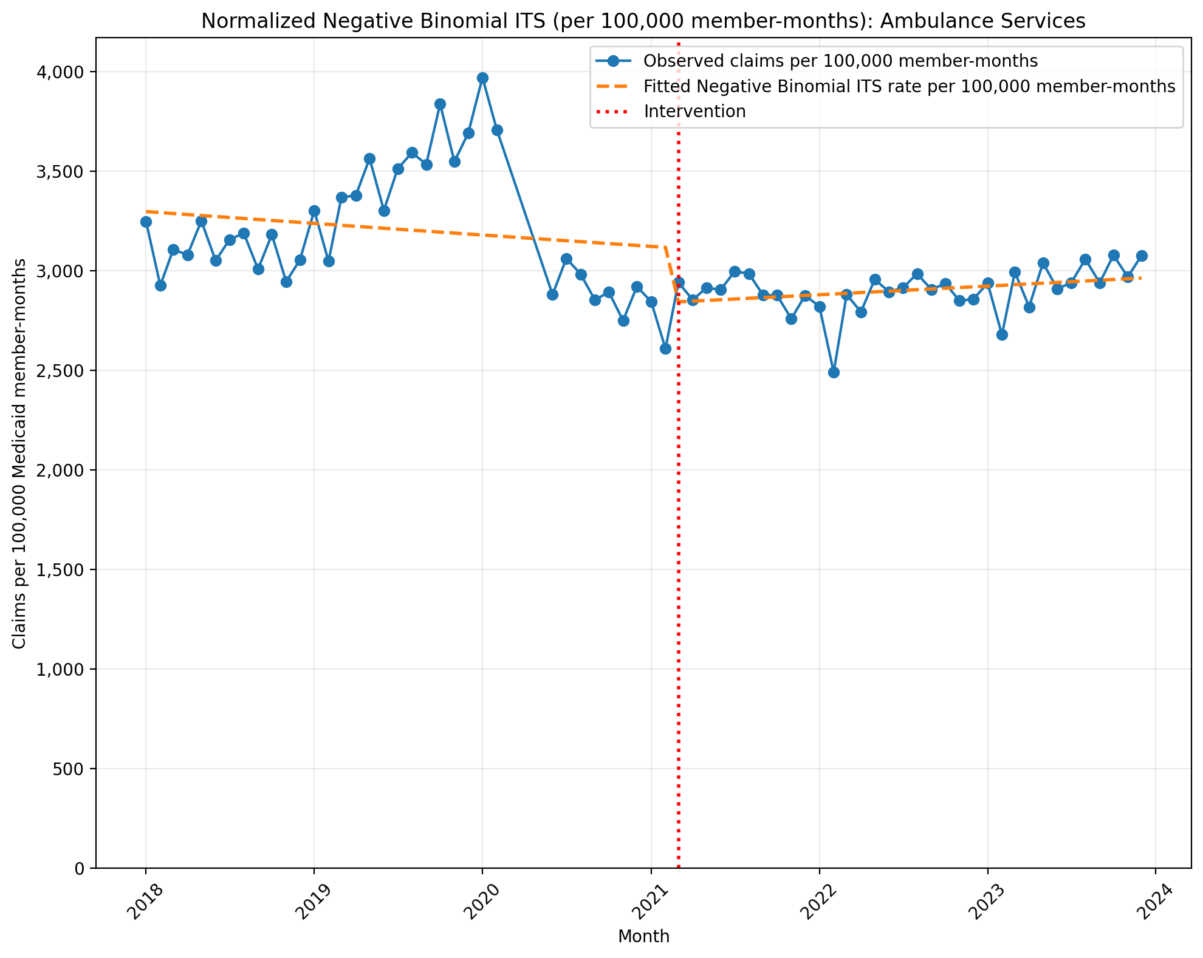
Normalized Negative Binomial ITS (per 100,000 member-months): Ambulance Services
NegativeBinomial Regression Results
==============================================================================
Dep. Variable: y No. Observations: 69
Model: NegativeBinomial Df Residuals: 65
Method: MLE Df Model: 3
Date: Mon, 10 Aug 2026 Pseudo R-squ.: 0.01458
Time: 10:08:39 Log-Likelihood: -937.41
converged: False LL-Null: -951.28
Covariance Type: nonrobust LLR p-value: 4.113e-06
==============================================================================
coef std err z P>|z| [0.025 0.975]
------------------------------------------------------------------------------
const -3.4125 0.024 -140.743 0.000 -3.460 -3.365
T -0.0015 0.001 -1.299 0.194 -0.004 0.001
X_t -0.0932 0.037 -2.551 0.011 -0.165 -0.022
post_time 0.0028 0.002 1.588 0.112 -0.001 0.006
alpha 0.0055 0.001 5.879 0.000 0.004 0.007
==============================================================================
Codes in aggregation: A0428, A0429, A0426, A0427, A0433, A0434, A0425, A0430, A0431, A0422

Slide 24
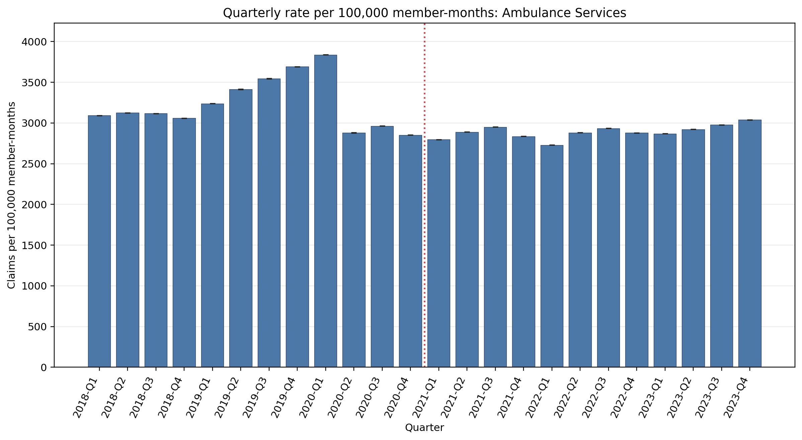
Quarterly rate per 100,000 member-months: Ambulance Services
Error bars show exact 95% Poisson confidence intervals. Codes in aggregation: A0428, A0429, A0426, A0427, A0433, A0434, A0425, A0430, A0431, A0422
Yearly rate per 100,000 member-months (exact 95% Poisson CIs):
Year | 2018 | 2019 | 2020 | 2021 | 2022 | 2023
Rate | 3098.64 | 3471.96 | 3097.03 | 2869.12 | 2856.85 | 2950.19
95% CI | 3097.50–3099.78 | 3470.74–3473.18 | 3095.75–3098.32 | 2868.09–2870.14 | 2855.87–2857.83 | 2949.20–2951.18

