Slide 1
Furniture Mart Presentation

Slide 2
Project 1: Basic Sales Reporting

Slide 3
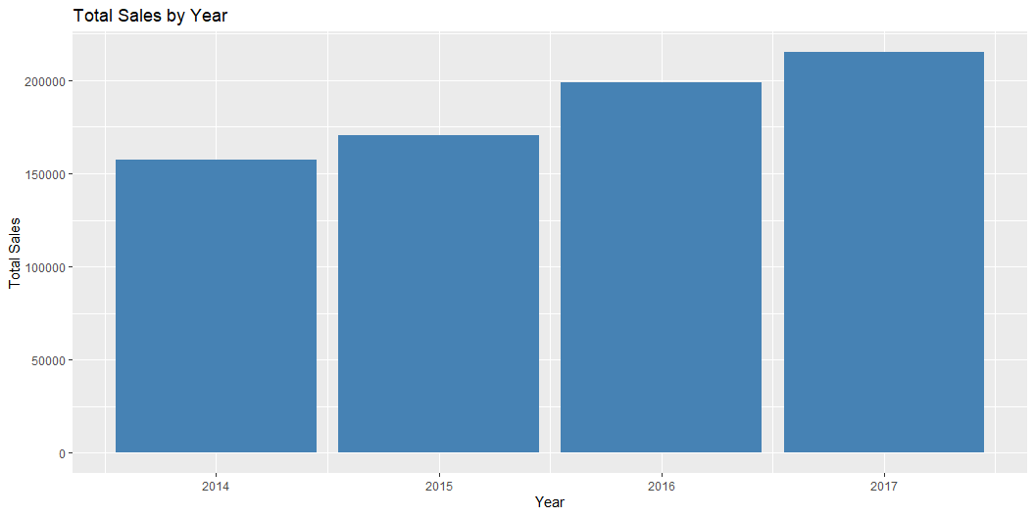
Generate a report that shows total sales, total quantity, and total profit for the entire year.

Slide 4
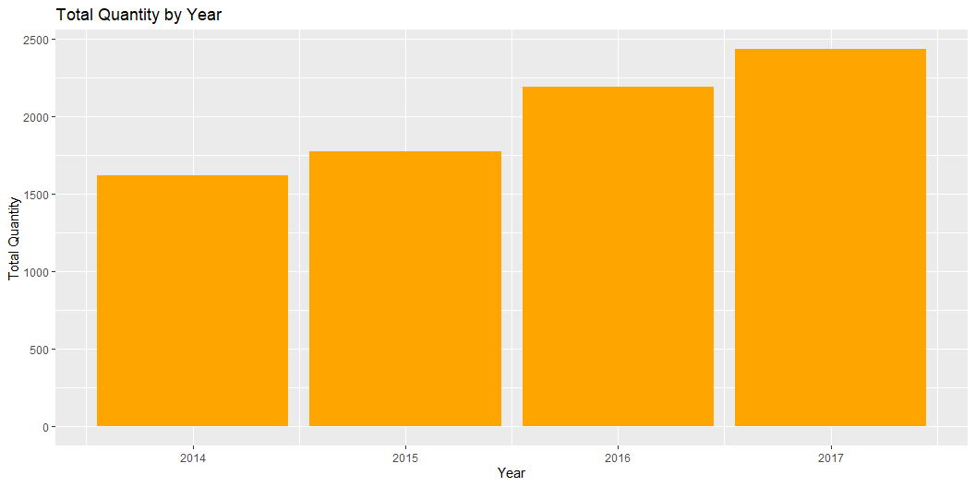

Slide 5
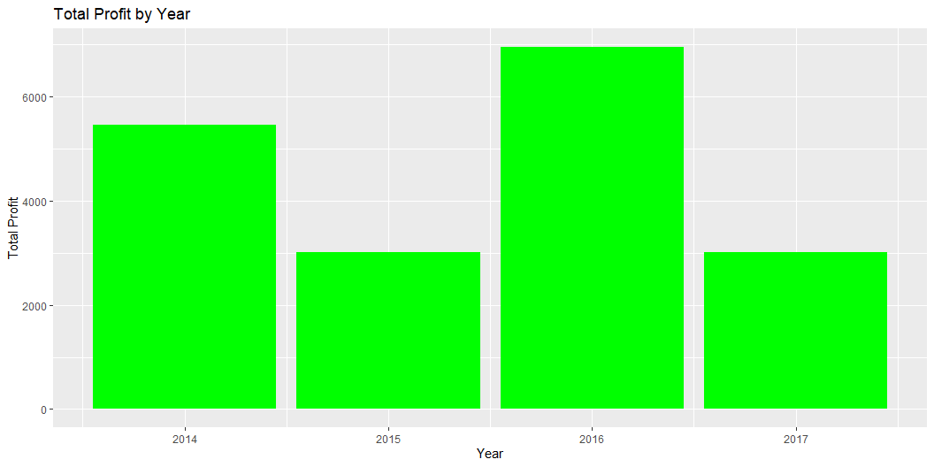

Slide 6
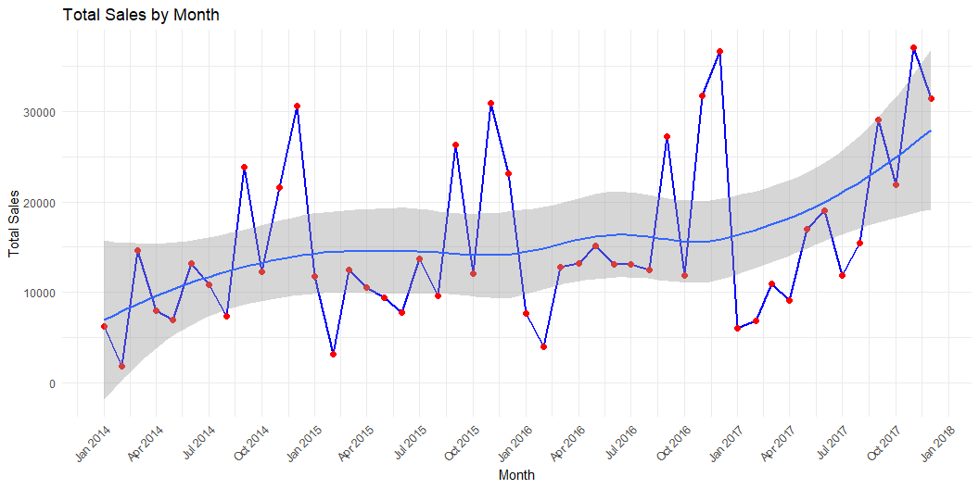
Create a summary table showing total sales by month.

Slide 7
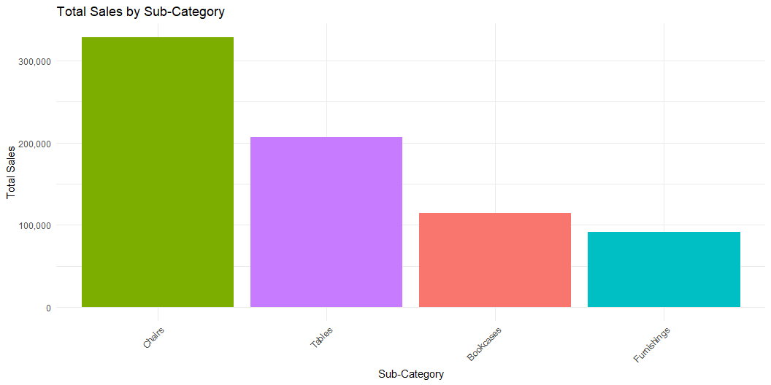
Provide a breakdown of sales by product and sub-category.

Slide 8
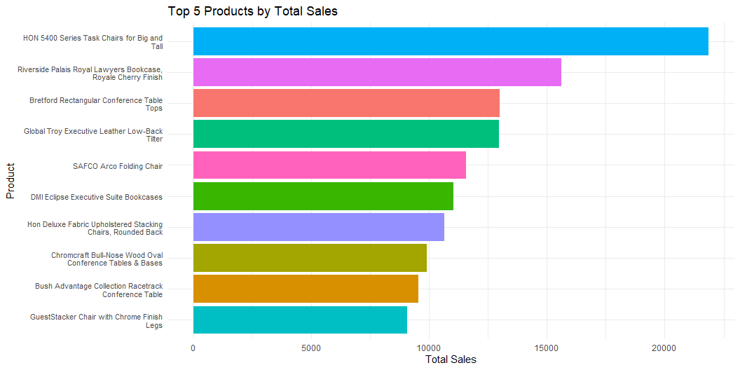

Slide 9
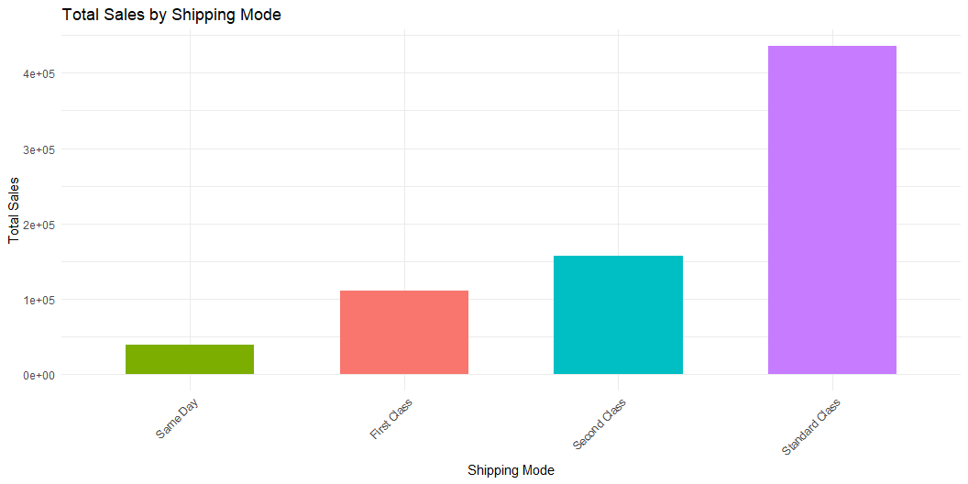
Write queries that summarize total sales, total profit, and total discount by shipping mode.

Slide 10
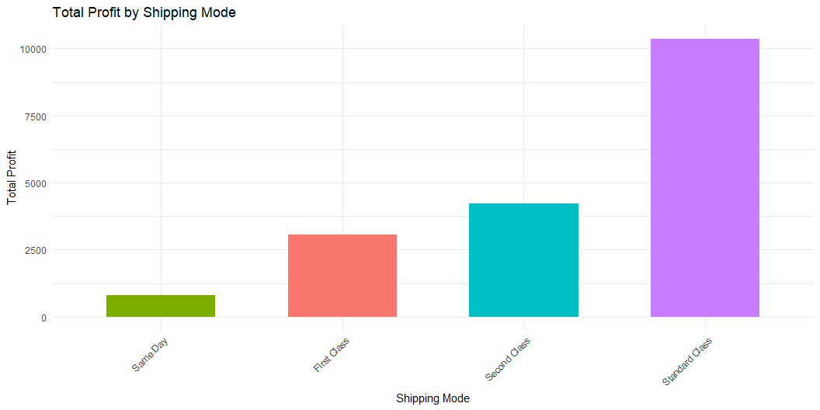

Slide 11
