Slide 1
Project 2: Customer Segmentation

Slide 2
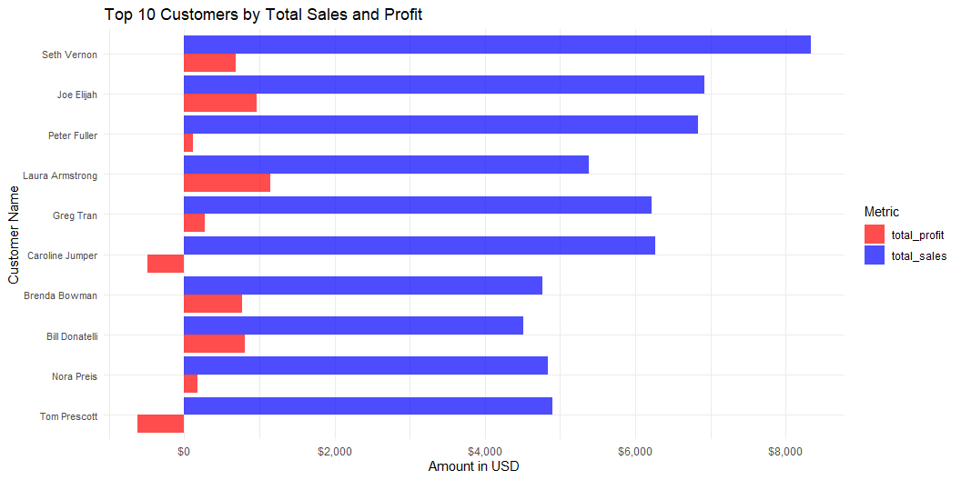
Customer Sales and Profit Profiles

Slide 3
Group customers by market segment and provide the total number of customers, average sales

Slide 4
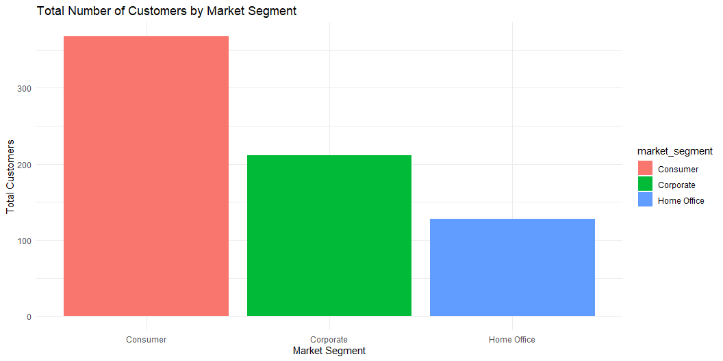
per customer, and total profit per segment.

Slide 5
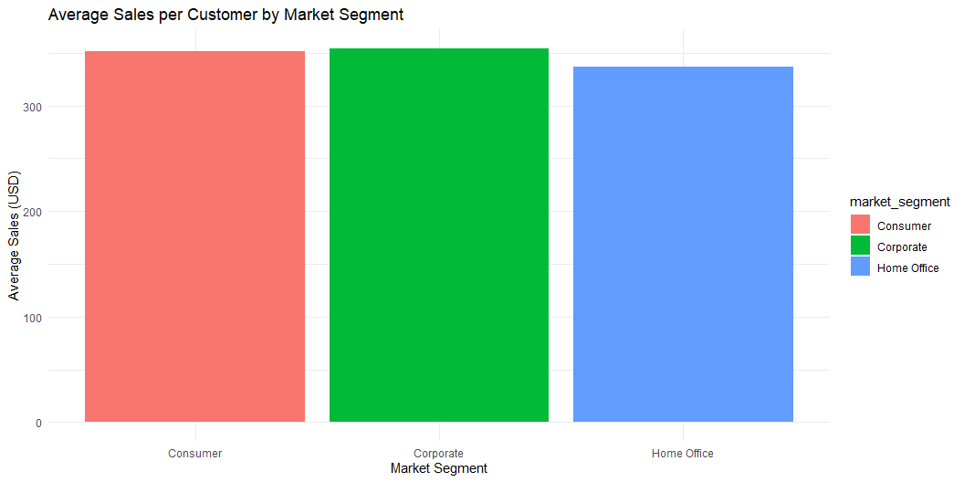

Slide 6
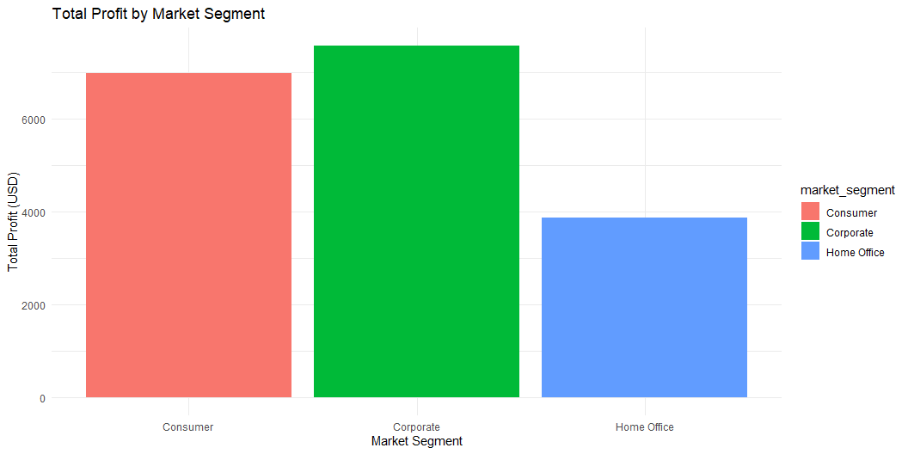

Slide 7
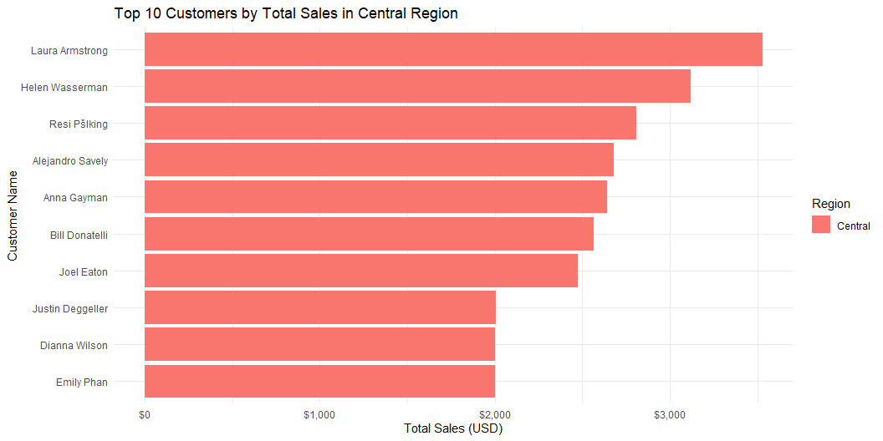
Identify the top 10 customers by total sales and their respective regions.

Slide 8
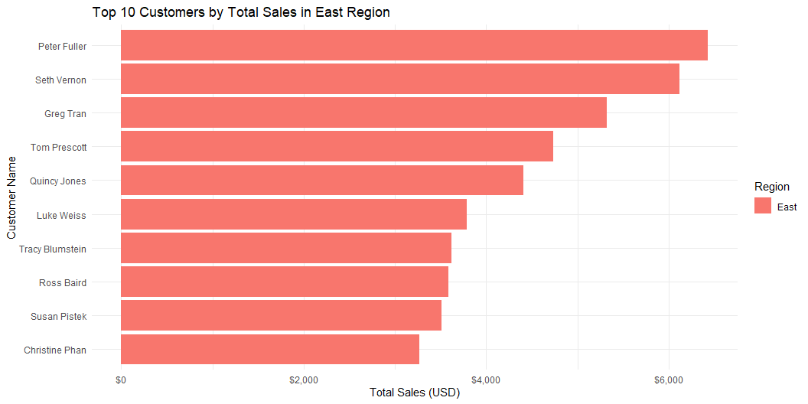

Slide 9
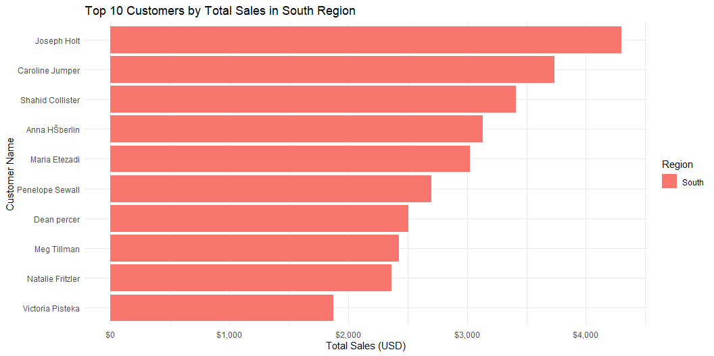

Slide 10
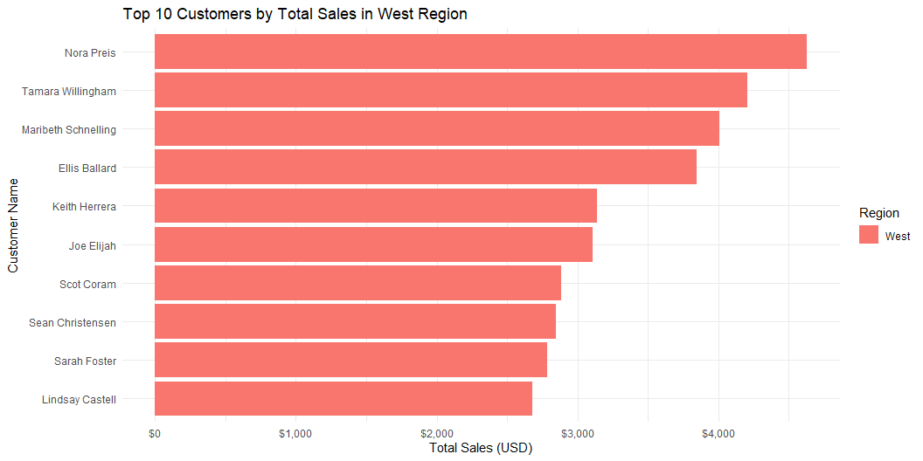

Slide 11
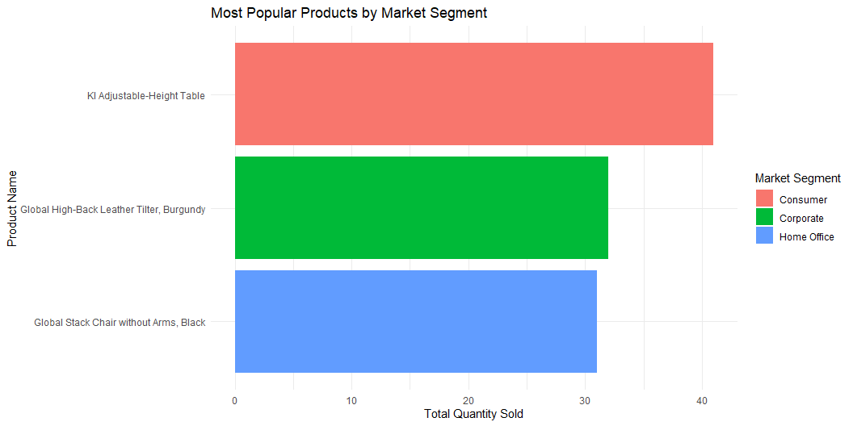
Identify which products are most popular in each market segment.

Slide 12
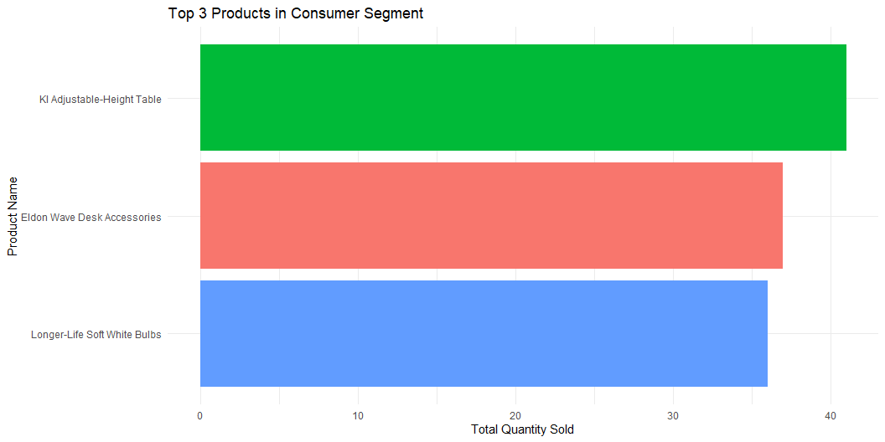

Slide 13
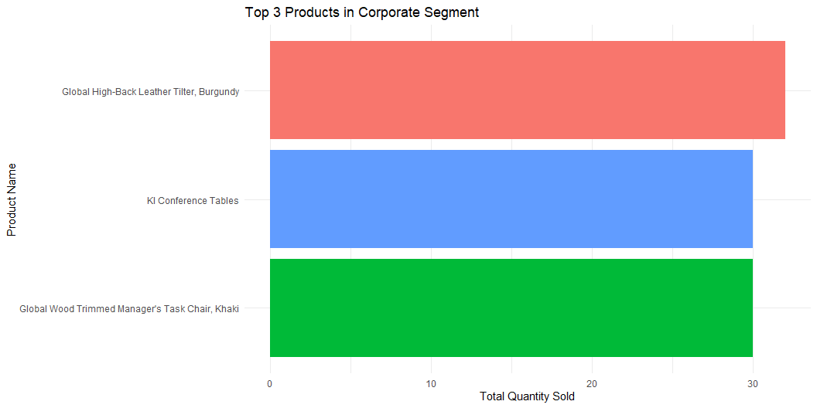

Slide 14
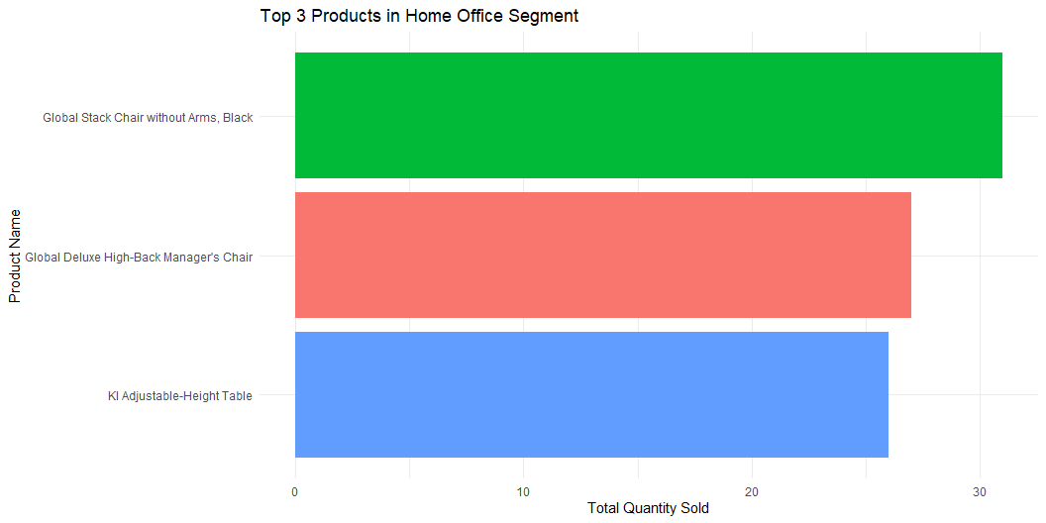

Slide 15
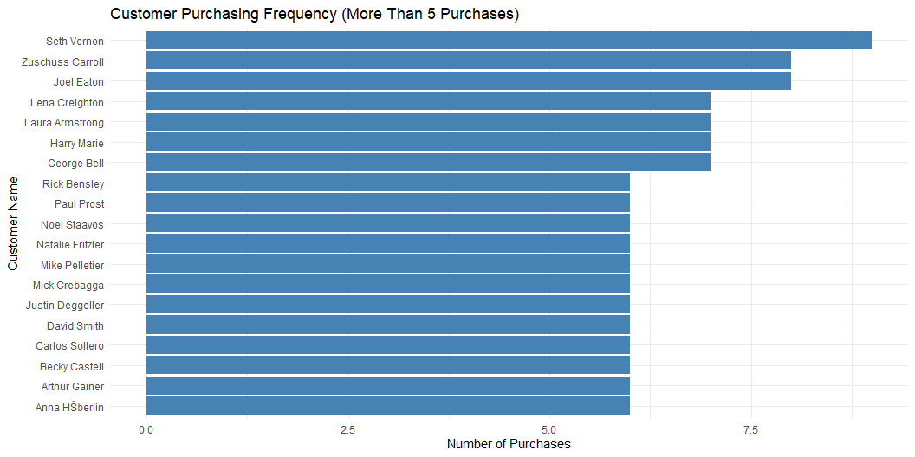
Analyze customer purchasing frequency (e.g., customers who have made more than 3
purchases).

