Slide 1
Project 4: Inventory and Product Analytics
Objective: Analyze product performance and inventory turnover to inform stock management

Slide 2
rm(list=ls()) sales_data <- read_xlsx("./sales.xlsx") sales_data$order_date <- as.Date(sales_data$order_date) sales_data$ship_date <- as.Date(sales_data$ship_date)

Slide 3
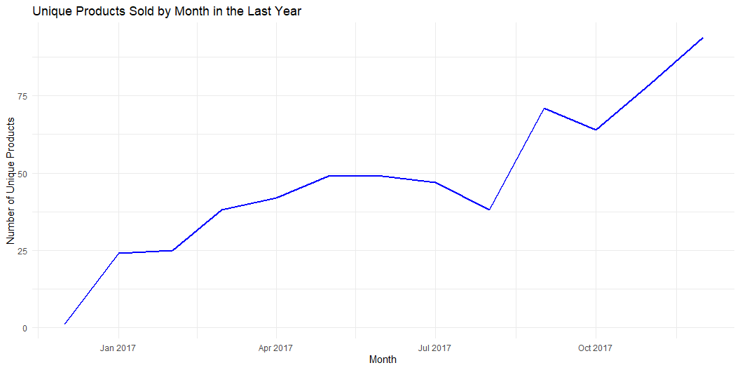
1: Calculate the total number of unique products sold within the last year.
# Get the latest date in the data latest_date <- max(sales_data$order_date, na.rm = TRUE) # Calculate the date exactly one year ago one_year_ago <- latest_date - years(1) # Filter the sales data to include only the last year last_year_sales <- sales_data %>% filter(order_date >= one_year_ago) # Calculate the number of unique products sold in the last year unique_products_sold <- last_year_sales %>% summarise(total_unique_products = n_distinct(product_id)) # Print the result print(unique_products_sold)
# A tibble: 1 × 1 total_unique_products <int> 1 315
# Plot 1: Total Unique Products Sold Over Time (by month) sales_by_month <- last_year_sales %>% group_by(month = floor_date(order_date, "month")) %>% summarise(unique_products = n_distinct(product_id)) ggplot(sales_by_month, aes(x = month, y = unique_products)) + geom_line(color = "blue", size = 1) + labs(title = "Unique Products Sold by Month in the Last Year", x = "Month", y = "Number of Unique Products") + theme_minimal()

Slide 4
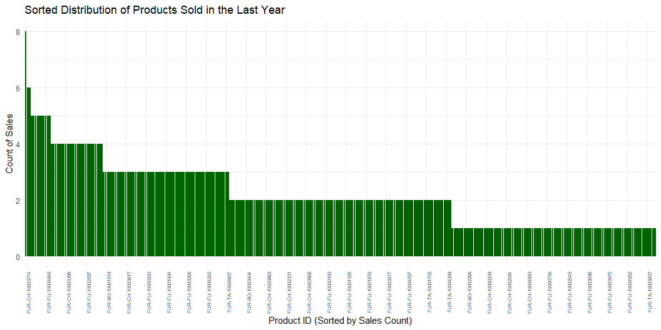
# Plot 2: Sorted Bar Chart for Product Sales Frequency with Limited X-axis Labels product_sales <- last_year_sales %>% group_by(product_id) %>% summarise(sales_count = n()) %>% arrange(desc(sales_count)) ggplot(product_sales, aes(x = reorder(product_id, -sales_count), y = sales_count)) + geom_bar(stat = "identity", fill = "darkgreen") + labs(title = "Sorted Distribution of Products Sold in the Last Year", x = "Product ID (Sorted by Sales Count)", y = "Count of Sales") + theme_minimal() + theme(axis.text.x = element_text(angle = 90, hjust = 1, size = 6)) + # Decrease label size for readability scale_x_discrete(breaks = product_sales$product_id[seq(1, nrow(product_sales), by = 10)]) # Show every 10th label

Slide 5
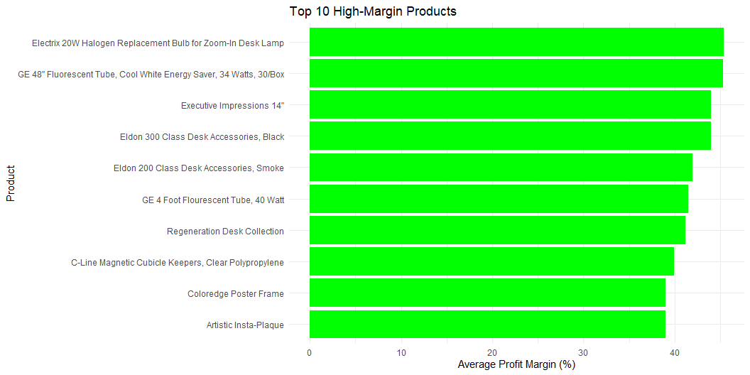
2: Rank products by profit margin and identify the top 10 high-margin products.
# # Step 2: Calculate the profit margin for each product sales_data <- sales_data %>% mutate(profit_margin = (profit / total_sales) * 100) # Profit margin as a percentage # Step 3: Rank products by profit margin product_profit_margin <- sales_data %>% group_by(product_name) %>% summarise( total_sales = sum(total_sales, na.rm = TRUE), total_profit = sum(profit, na.rm = TRUE), average_profit_margin = mean(profit_margin, na.rm = TRUE) ) %>% arrange(desc(average_profit_margin)) # Rank by profit margin # Step 4: Select the top 10 high-margin products top_10_high_margin_products <- product_profit_margin %>% top_n(10, average_profit_margin) # Step 5: Display the top 10 products in a table print(top_10_high_margin_products)
# A tibble: 10 × 4 product_name total_sales total_profit average_profit_margin <chr> <dbl> <dbl> <dbl> 1 "Electrix 20W Halogen Replace… 169. 78.3 45.4 2 "GE 48\" Fluorescent Tube, Co… 2699. 1260. 45.3 3 "Eldon 300 Class Desk Accesso… 29.7 13.1 44 4 "Executive Impressions 14\"" 378. 166. 44 5 "Eldon 200 Class Desk Accesso… 138. 58.0 42 6 "GE 4 Foot Flourescent Tube, … 98.9 42.2 41.5 7 "Regeneration Desk Collection" 35.9 15.2 41.2 8 "C-Line Magnetic Cubicle Keep… 136. 56.1 39.9 9 "Artistic Insta-Plaque" 157. 61.2 39 10 "Coloredge Poster Frame" 298. 116. 39
# Optional: Plot the top 10 high-margin products ggplot(top_10_high_margin_products, aes(x = reorder(product_name, average_profit_margin), y = average_profit_margin)) + geom_bar(stat = "identity", fill = "green") + coord_flip() + labs(title = "Top 10 High-Margin Products", x = "Product", y = "Average Profit Margin (%)") + theme_minimal()

Slide 6
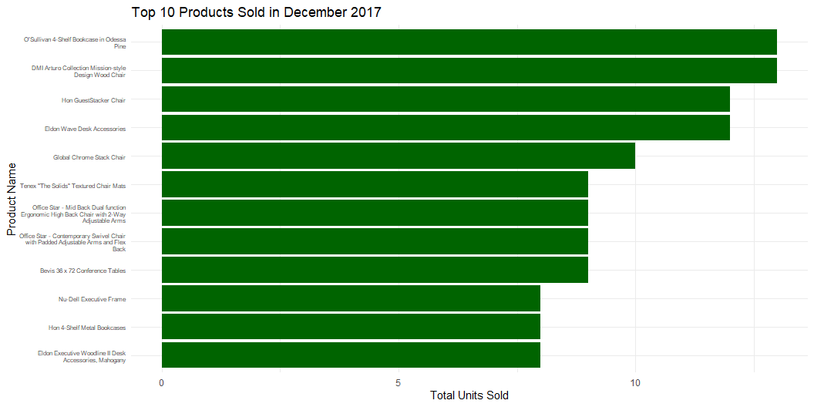
3: Calculate product sales velocity by determining how many units of each product are sold/ month
# Extract year and month from the order date sales_data <- sales_data %>% mutate(year_month = floor_date(order_date, unit = "month")) # Group by product and month, then calculate total units sold per month for each product sales_per_month <- sales_data %>% group_by(product_id, product_name, year_month) %>% summarise(total_units_sold = sum(quantity, na.rm = TRUE)) %>% ungroup() # Print the total units sold per month for each product print(sales_per_month)
# A tibble: 1,968 × 4 product_id product_name year_month total_units_sold <chr> <chr> <date> <dbl> 1 FUR-BO-10000112 Bush Birmingham Collection Bookc… 2017-09-01 9 2 FUR-BO-10000330 Sauder Camden County Barrister B… 2014-11-01 4 3 FUR-BO-10000330 Sauder Camden County Barrister B… 2015-09-01 4 4 FUR-BO-10000330 Sauder Camden County Barrister B… 2017-05-01 2 5 FUR-BO-10000362 Sauder Inglewood Library Bookcas… 2014-05-01 2 6 FUR-BO-10000362 Sauder Inglewood Library Bookcas… 2014-11-01 6 7 FUR-BO-10000362 Sauder Inglewood Library Bookcas… 2014-12-01 2 8 FUR-BO-10000362 Sauder Inglewood Library Bookcas… 2015-03-01 3 9 FUR-BO-10000362 Sauder Inglewood Library Bookcas… 2016-06-01 1 10 FUR-BO-10000468 O'Sullivan 2-Shelf Heavy-Duty Bo… 2014-08-01 4 # ℹ 1,958 more rows
# Optionally, plot total units sold for the top 10 products for a specific month # (Let's assume we are looking at the most recent month) most_recent_month <- max(sales_per_month$year_month) top_10_sales_per_month <- sales_per_month %>% filter(year_month == most_recent_month) %>% slice_max(total_units_sold, n = 10) ggplot(top_10_sales_per_month, aes(x = reorder(str_wrap(product_name, 40), total_units_sold), y = total_units_sold)) + geom_col(fill = "darkgreen") + coord_flip() + labs(title = paste("Top 10 Products Sold in", format(most_recent_month, "%B %Y")), x = "Product Name", y = "Total Units Sold") + theme_minimal() + theme(axis.text.y = element_text(size = 6))

Slide 7
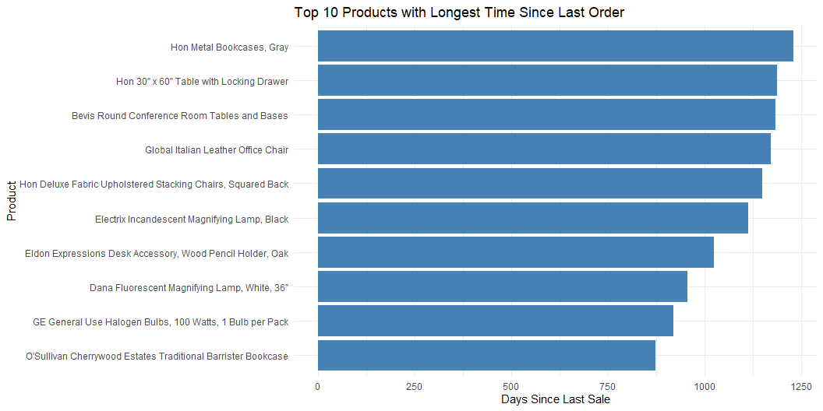
4: Identify which products have declining sales or have not been sold in the last 6 months.
# Set the reference date as December 30, 2017 reference_date <- as.Date("2017-12-30") # Step 2: Identify the last sale date for each product unsold_products <- sales_data %>% group_by(product_name) %>% summarise(last_sale_date = max(order_date)) %>% mutate(days_since_last_sale = as.numeric(reference_date - last_sale_date)) %>% arrange(desc(days_since_last_sale)) # Sort by longest duration since last order # Step 3: Filter the top 10 products with the longest duration since last order top_10_unsold_products <- unsold_products %>% top_n(10, days_since_last_sale) # Step 4: Plot the top 10 unsold products top_10_unsold_products %>% ggplot(aes(x = reorder(product_name, days_since_last_sale), y = days_since_last_sale)) + geom_bar(stat = "identity", fill = "steelblue") + coord_flip() + labs(title = "Top 10 Products with Longest Time Since Last Order", x = "Product", y = "Days Since Last Sale") + theme_minimal()

Slide 8
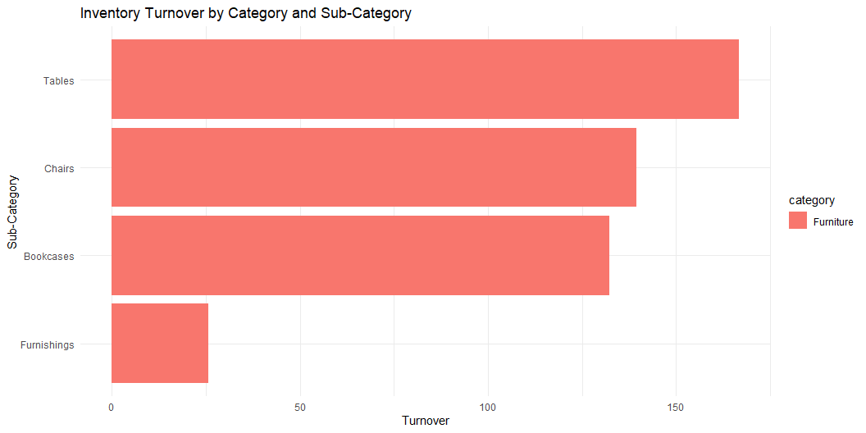
5: Create a report to identify inventory turnover for each product category and sub-category.
# Load necessary libraries library(tidyverse) library(lubridate) # Step 2: Group by category and sub_category to calculate total sales and quantity category_turnover <- sales_data %>% group_by(category, sub_category) %>% summarise( total_sales = sum(total_sales, na.rm = TRUE), total_quantity = sum(quantity, na.rm = TRUE), turnover = total_sales / total_quantity # Approximate turnover metric ) %>% arrange(desc(turnover)) # Step 3: Create a report in tabular form category_turnover_report <- category_turnover %>% mutate(turnover = round(turnover, 2)) # Round turnover values # Step 4: Plot inventory turnover for each category and sub-category ggplot(category_turnover_report, aes(x = reorder(sub_category, turnover), y = turnover, fill = category)) + geom_bar(stat = "identity") + coord_flip() + labs(title = "Inventory Turnover by Category and Sub-Category", x = "Sub-Category", y = "Turnover") + theme_minimal()

Slide 9
# Display the report as a table print(category_turnover_report)
# A tibble: 4 × 5 # Groups: category [1] category sub_category total_sales total_quantity turnover <chr> <chr> <dbl> <dbl> <dbl> 1 Furniture Tables 206966. 1241 167. 2 Furniture Chairs 328449. 2356 139. 3 Furniture Bookcases 114880. 868 132. 4 Furniture Furnishings 91705. 3563 25.7

