Slide 1
Project 5: Shipping and Logistics Optimization
Objective: Optimize shipping processes by analyzing delivery times and costs.

Slide 2
Table of Contents
Calculate the average shipping time for each shipping mode by comparing order date and ship date
Identify the regions with the longest average shipping times
Provide insights into which shipping mode yields the highest profit margin.
Analyze any correlations between shipping times and total sales
Recommend the best shipping modes for high-value customers based on historical data

Slide 3
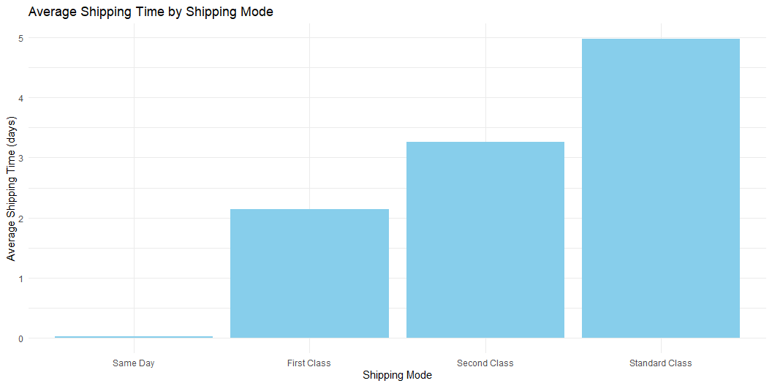
1. Calculate the average shipping time for each shipping mode by comparing order date and ship date.

Slide 4
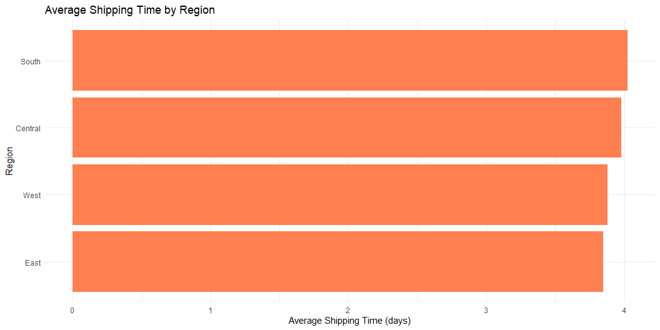
2. Identify the regions with the longest average shipping times.

Slide 5
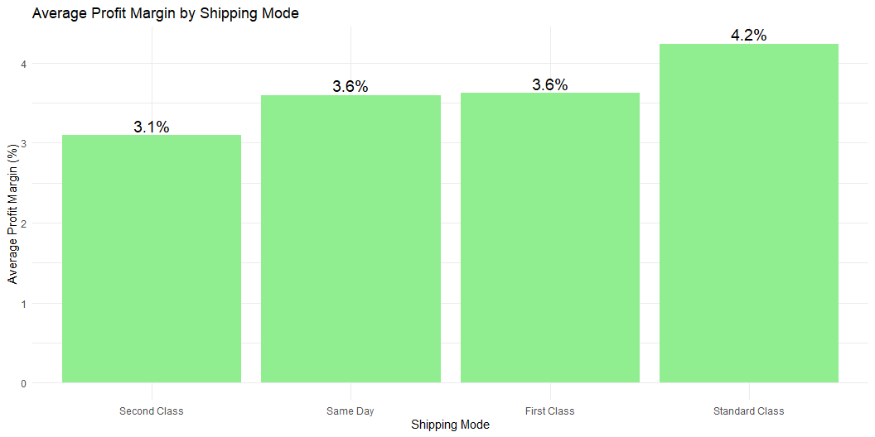
3. Provide insights into which shipping mode yields the highest profit margin.

Slide 6
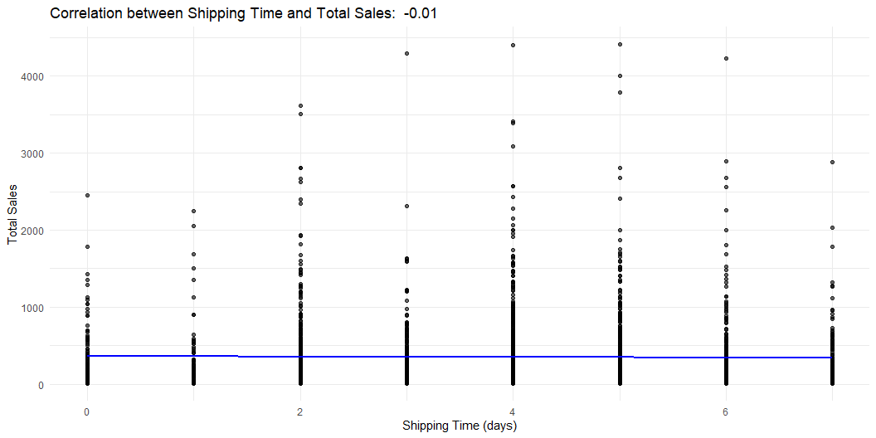
4. Analyze any correlations between shipping times and total sales

Slide 7
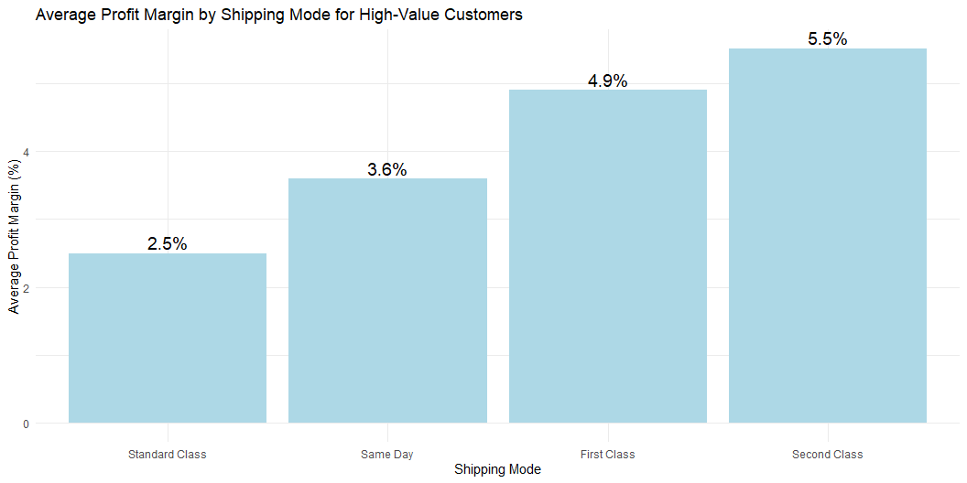
5. Recommend the best shipping modes for high-value customers based on historical data

Slide 8
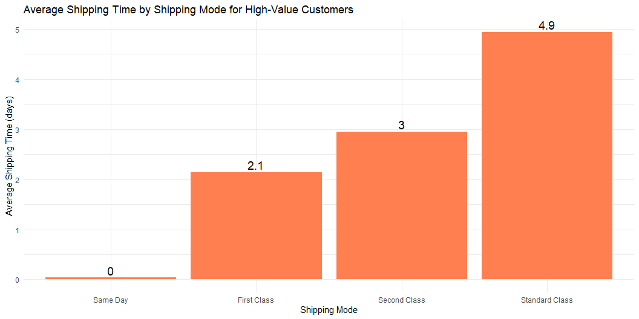
Average Shipping Time by Shipping Mode for High-Value Customers

