Slide 1
Furniture Mart: Customer Retention and Loyalty Analysis
Objective: Analyze customer retention and create strategies for improving customer loyalty.

Slide 2
rm(list=ls())
# Connect to DuckDB and explicitly create table with VARCHAR for mprime column # con <- dbConnect(duckdb(), "./furniture_mart.duckdb") # # dbWriteTable(con,"sales",sales_data) # sales <- dbGetQuery(con,"SELECT * FROM sales;")
# Check if 'con' exists and is valid if (exists("con") && dbIsValid(con)) { # Connection exists and is valid; go straight to querying sales <- dbGetQuery(con, "SELECT * FROM sales;") dbDisconnect(con) } else { # Connection does not exist or is invalid; establish connection first con <- dbConnect(duckdb(), "./furniture_mart.duckdb") sales <- dbGetQuery(con, "SELECT * FROM sales;") dbDisconnect(con) }
# Question 1: # Step 1: Extract relevant columns and add 'year' from 'order_date' sales_data <- sales %>% select(customer_id, order_date) %>% mutate(year = year(ymd(order_date))) # Step 2: Identify repeat customers in consecutive years # Group by customer_id and year, and count unique years for each customer customer_years <- sales_data %>% group_by(customer_id, year) %>% summarize(purchases = n_distinct(order_date), .groups = 'drop') # Calculate retention by checking if customer appears in consecutive years customer_retention <- customer_years %>% arrange(customer_id, year) %>% group_by(customer_id) %>% mutate(repeat_purchase = year - lag(year) == 1) %>% ungroup() # Step 3: Calculate retention rate by year retention_rate <- customer_retention %>% filter(repeat_purchase == TRUE) %>% count(year) %>% rename(retained_customers = n) %>% right_join(customer_years %>% count(year), by = "year") %>% mutate(retention_rate = retained_customers / n * 100) %>% replace_na(list(retention_rate = 0))
# A1: Top 5 customer with the longest retention # Step 1: Extract relevant columns and add 'year' from 'order_date' sales_data <- sales_data %>% select(customer_id, order_date) %>% mutate(year = year(ymd(order_date))) # Step 2: Identify consecutive purchase years and calculate retention # First, group by customer and year, then calculate retention and consecutive years customer_years <- sales_data %>% group_by(customer_id, year) %>% summarize(purchases = n_distinct(order_date), .groups = 'drop') %>% arrange(customer_id, year) %>% group_by(customer_id) %>% mutate(consecutive_year = cumsum(c(1, diff(year) != 1))) %>% ungroup() # Retention Rate Calculation (for the first plot) retention_rate <- customer_years %>% group_by(customer_id) %>% mutate(repeat_purchase = year - lag(year) == 1) %>% ungroup() %>% filter(repeat_purchase == TRUE) %>% count(year) %>% rename(retained_customers = n) %>% right_join(customer_years %>% count(year), by = "year") %>% mutate(retention_rate = retained_customers / n * 100) %>% replace_na(list(retention_rate = 0)) # Longest Retention Streak Calculation for Top 5 Customers longest_retention <- customer_years %>% group_by(customer_id, consecutive_year) %>% summarize(streak = n(), .groups = 'drop') %>% arrange(desc(streak)) %>% group_by(customer_id) %>% slice_max(streak, n = 1) %>% ungroup() %>% arrange(desc(streak)) %>% slice_head(n = 5) # Filter for top 5 customers with longest retention top_customers <- customer_years %>% filter(customer_id %in% longest_retention$customer_id)
# Question 3: # Step 1: Extract relevant columns and add 'year' from 'order_date' sales_data <- sales_data %>% select(customer_id, order_date) %>% mutate(order_date = ymd(order_date)) # Step 2: Determine the latest date in the order_date column latest_order_date <- max(sales_data$order_date) # Step 3: Identify the last purchase date for each customer last_purchase <- sales_data %>% group_by(customer_id) %>% summarize(last_purchase_date = max(order_date), .groups = 'drop') # Step 4: Calculate inactivity by comparing last purchase to the latest date in data reengagement_list <- last_purchase %>% mutate(months_since_last_purchase = interval(last_purchase_date, latest_order_date) / months(1)) %>% filter(months_since_last_purchase > 40) %>% select(customer_id, last_purchase_date, months_since_last_purchase)

Slide 3
0 Table of Contents
Calculate the retention rate by analyzing customers who made repeat purchases in consecutive years.
Identify customers who have not made a purchase in over 12 months and create a list for a re-engagement marketing campaign.
Create a customer lifetime value (CLV) metric that calculates the total profit from each customer over time.
Determine which customer segments (market segments, regions) have the highest and lowest retention rates.
Track customer purchasing patterns and identify potential churn risks based on inactivity or reduced purchasing frequency

Slide 4
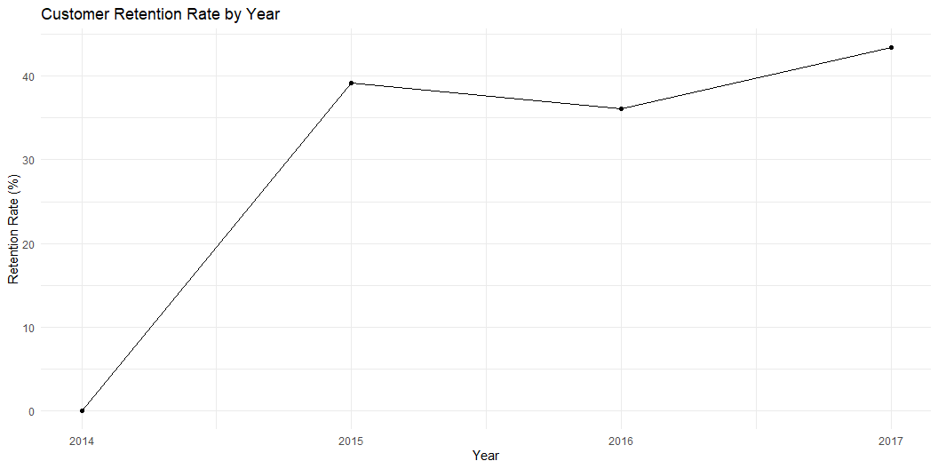
1. Calculate the retention rate by analyzing customers who made repeat purchases in consecutive years.
# Step 4: Plotting Retention Rate Over Time ggplot(retention_rate, aes(x = year, y = retention_rate)) + geom_line() + geom_point() + labs(title = "Customer Retention Rate by Year", x = "Year", y = "Retention Rate (%)") + theme_minimal()

Slide 5
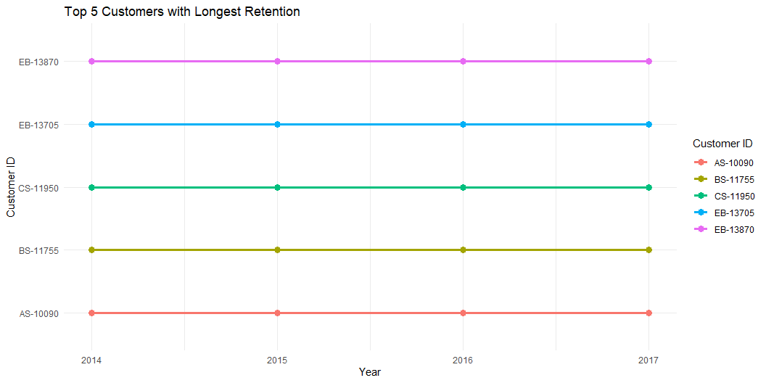
# Plot 2: Top 5 Customers with Longest Retention ggplot(top_customers, aes(x = year, y = customer_id, group = customer_id, color = as.factor(customer_id))) + geom_line(size = 1.2) + geom_point(size = 3) + labs(title = "Top 5 Customers with Longest Retention", x = "Year", y = "Customer ID", color = "Customer ID") + theme_minimal()

Slide 6
2. Identify customers who have not made a purchase in over 12 months and create a list for a re-engagement marketing campaign.
Re-Engagement Campaign List
Customers who haven't made a purchase in over 12 months
Customer ID | Last Purchase Date | Months Since Last Purchase
AA-10315 | Mon, Sep 15, 2014 | 39.5
AA-10375 | Tue, Feb 3, 2015 | 34.9
AA-10480 | Fri, Aug 26, 2016 | 16.1
AA-10645 | Sun, Sep 4, 2016 | 15.8
AB-10015 | Thu, Nov 10, 2016 | 13.6
AB-10255 | Tue, Dec 20, 2016 | 12.3
AC-10420 | Sat, Jul 12, 2014 | 41.6
AC-10660 | Wed, Oct 15, 2014 | 38.5
AF-10885 | Tue, Oct 13, 2015 | 26.5
AG-10300 | Mon, Dec 5, 2016 | 12.8
AG-10495 | Sat, Oct 24, 2015 | 26.2
AG-10525 | Mon, Sep 7, 2015 | 27.7
AG-10675 | Thu, Sep 8, 2016 | 15.7
AH-10030 | Sun, Mar 20, 2016 | 21.3
AH-10120 | Sun, Dec 18, 2016 | 12.4
AH-10195 | Thu, Mar 5, 2015 | 33.8
AH-10465 | Thu, May 5, 2016 | 19.8
AH-10690 | Tue, Oct 4, 2016 | 14.8
AJ-10945 | Fri, Nov 18, 2016 | 13.4
AO-10810 | Tue, Aug 16, 2016 | 16.5
AR-10345 | Thu, Sep 10, 2015 | 27.6
AR-10570 | Thu, Jul 14, 2016 | 17.5
AS-10135 | Sun, Nov 13, 2016 | 13.5
AS-10285 | Fri, Nov 11, 2016 | 13.6
AS-10630 | Thu, Sep 22, 2016 | 15.3
AW-10930 | Sun, Jun 12, 2016 | 18.6
AZ-10750 | Fri, Feb 5, 2016 | 22.8
BD-11635 | Sat, Dec 5, 2015 | 24.8
BE-11455 | Fri, May 6, 2016 | 19.8
BF-10975 | Sun, Jul 5, 2015 | 29.8
BF-11005 | Thu, Jul 28, 2016 | 17.1
BF-11215 | Thu, Jun 9, 2016 | 18.7
BF-11275 | Sat, Mar 22, 2014 | 45.3
BG-11035 | Wed, Nov 5, 2014 | 37.8
BH-11710 | Tue, Nov 11, 2014 | 37.6
BK-11260 | Fri, Nov 11, 2016 | 13.6
BM-11140 | Sun, Dec 4, 2016 | 12.8
BM-11785 | Sat, Oct 3, 2015 | 26.9
BS-11365 | Mon, Jun 20, 2016 | 18.3
BS-11665 | Fri, May 27, 2016 | 19.1
BT-11440 | Sat, Mar 19, 2016 | 21.4
BT-11485 | Fri, Mar 11, 2016 | 21.6
BW-11065 | Tue, Aug 11, 2015 | 28.6
BW-11200 | Thu, Oct 27, 2016 | 14.1
CA-11965 | Sat, Nov 21, 2015 | 25.3
CA-12055 | Mon, Aug 8, 2016 | 16.7
CA-12310 | Sat, Jul 19, 2014 | 41.4
CB-12415 | Sat, Jan 23, 2016 | 23.2
CB-12535 | Mon, Nov 7, 2016 | 13.7
CC-12100 | Tue, Dec 16, 2014 | 36.5
CC-12145 | Mon, Sep 7, 2015 | 27.7
CC-12610 | Mon, Oct 10, 2016 | 14.6
CD-12790 | Mon, Sep 21, 2015 | 27.3
CG-12520 | Tue, Nov 8, 2016 | 13.7
CK-12205 | Mon, Nov 21, 2016 | 13.3
CK-12595 | Fri, Apr 8, 2016 | 20.7
CL-12700 | Sat, Sep 24, 2016 | 15.2
CM-11935 | Fri, Jan 22, 2016 | 23.3
CM-12160 | Sat, Dec 17, 2016 | 12.4
CM-12235 | Thu, May 26, 2016 | 19.1
CM-12445 | Thu, Oct 20, 2016 | 14.3
CM-12715 | Sun, Mar 1, 2015 | 33.9
CP-12340 | Fri, Jun 3, 2016 | 18.9
CR-12625 | Fri, Sep 16, 2016 | 15.5
CR-12730 | Wed, Aug 20, 2014 | 40.3
CS-12130 | Tue, Aug 5, 2014 | 40.8
CS-12250 | Thu, Sep 22, 2016 | 15.3
CS-12490 | Fri, Aug 12, 2016 | 16.6
CV-12295 | Sun, Sep 4, 2016 | 15.8
CY-12745 | Sun, Jun 28, 2015 | 30.1
Co-12640 | Sat, Dec 27, 2014 | 36.1
DB-12970 | Sun, Dec 25, 2016 | 12.2
DB-13120 | Sun, Dec 27, 2015 | 24.1
DB-13210 | Mon, Sep 5, 2016 | 15.8
DB-13360 | Tue, Apr 26, 2016 | 20.1
DE-13255 | Thu, Sep 24, 2015 | 27.2
DF-13135 | Sat, Jan 30, 2016 | 23.0
DG-13300 | Sun, Oct 25, 2015 | 26.2
DH-13675 | Sun, Nov 15, 2015 | 25.5
DJ-13420 | Sat, Apr 2, 2016 | 20.9
DK-13090 | Sun, Feb 14, 2016 | 22.5
DK-13225 | Sat, Nov 26, 2016 | 13.1
DL-12865 | Sun, Sep 25, 2016 | 15.2
DL-12925 | Tue, Sep 22, 2015 | 27.3
DM-12955 | Mon, Mar 21, 2016 | 21.3
DM-13015 | Thu, May 5, 2016 | 19.8
DM-13525 | Fri, Sep 11, 2015 | 27.6
DO-13435 | Fri, Nov 27, 2015 | 25.1
DP-13105 | Fri, Sep 23, 2016 | 15.2
DP-13165 | Tue, Dec 2, 2014 | 36.9
DP-13390 | Tue, Mar 24, 2015 | 33.2
DR-12940 | Tue, Nov 29, 2016 | 13.0
DW-13480 | Sat, Nov 12, 2016 | 13.6
DW-13540 | Sat, Feb 27, 2016 | 22.1
EA-14035 | Sat, Jul 2, 2016 | 17.9
EB-14110 | Mon, Nov 14, 2016 | 13.5
EB-14170 | Fri, Oct 17, 2014 | 38.4
EH-13945 | Sat, Nov 19, 2016 | 13.4
EH-13990 | Thu, Mar 31, 2016 | 21.0
EJ-14155 | Thu, Dec 1, 2016 | 12.9
EK-13795 | Tue, Mar 18, 2014 | 45.4
EL-13735 | Fri, Apr 22, 2016 | 20.3
EM-13810 | Mon, Aug 24, 2015 | 28.2
EN-13780 | Sat, Jun 4, 2016 | 18.8
ER-13855 | Fri, Nov 4, 2016 | 13.8
ES-14080 | Mon, Dec 19, 2016 | 12.4
FA-14230 | Sun, Nov 20, 2016 | 13.3
FC-14245 | Sat, Sep 19, 2015 | 27.4
FC-14335 | Tue, Mar 15, 2016 | 21.5
FH-14365 | Tue, Nov 3, 2015 | 25.9
FM-14380 | Fri, Oct 9, 2015 | 26.7
FO-14305 | Mon, Jun 9, 2014 | 42.7
FP-14320 | Fri, Apr 1, 2016 | 20.9
GB-14575 | Tue, Mar 8, 2016 | 21.7
GH-14425 | Sun, Dec 6, 2015 | 24.8
GH-14485 | Thu, Dec 8, 2016 | 12.7
GK-14620 | Sun, Jul 13, 2014 | 41.5
GM-14680 | Sat, Oct 1, 2016 | 14.9
GR-14560 | Wed, Nov 19, 2014 | 37.4
GT-14635 | Fri, Jun 6, 2014 | 42.8
GT-14755 | Wed, Feb 18, 2015 | 34.4
GW-14605 | Tue, Feb 16, 2016 | 22.5
GZ-14470 | Thu, Mar 17, 2016 | 21.4
HA-14920 | Thu, Oct 13, 2016 | 14.5
HF-14995 | Sun, Nov 27, 2016 | 13.1
HG-14965 | Sun, Dec 18, 2016 | 12.4
HJ-14875 | Tue, Sep 20, 2016 | 15.3
HL-15040 | Mon, May 12, 2014 | 43.6
IM-15055 | Sun, Sep 4, 2016 | 15.8
IM-15070 | Fri, Dec 11, 2015 | 24.6
JB-15925 | Thu, Dec 24, 2015 | 24.2
JD-15790 | Tue, Feb 16, 2016 | 22.5
JD-15895 | Fri, Oct 28, 2016 | 14.1
JD-16060 | Mon, Mar 23, 2015 | 33.2
JE-15475 | Sun, Dec 18, 2016 | 12.4
JF-15490 | Sun, Nov 1, 2015 | 25.9
JG-15115 | Thu, Dec 3, 2015 | 24.9
JH-15820 | Sat, Nov 21, 2015 | 25.3
JH-15985 | Wed, Jan 28, 2015 | 35.1
JH-16180 | Mon, Nov 21, 2016 | 13.3
JK-15370 | Sun, Aug 21, 2016 | 16.3
JL-15850 | Fri, Mar 6, 2015 | 33.8
JM-15865 | Thu, Dec 1, 2016 | 12.9
JO-15280 | Mon, Nov 2, 2015 | 25.9
JP-16135 | Thu, Nov 3, 2016 | 13.9
JR-15670 | Thu, Dec 24, 2015 | 24.2
JS-15595 | Mon, Mar 3, 2014 | 45.9
JS-15685 | Tue, Jun 14, 2016 | 18.5
JS-15880 | Mon, Mar 14, 2016 | 21.5
JS-15940 | Fri, Sep 23, 2016 | 15.2
KB-16315 | Sat, Jan 31, 2015 | 35.0
KB-16585 | Sun, Jan 10, 2016 | 23.6
KD-16270 | Fri, Sep 2, 2016 | 15.9
KD-16345 | Sun, Dec 20, 2015 | 24.3
KD-16495 | Fri, Dec 2, 2016 | 12.9
KD-16615 | Sat, Apr 30, 2016 | 20.0
KL-16645 | Sun, Jul 31, 2016 | 17.0
KM-16225 | Thu, Nov 10, 2016 | 13.6
KM-16660 | Mon, Aug 1, 2016 | 16.9
KM-16720 | Tue, Nov 24, 2015 | 25.2
KT-16465 | Thu, Apr 14, 2016 | 20.5
KW-16570 | Fri, Nov 20, 2015 | 25.3
LA-16780 | Fri, Dec 23, 2016 | 12.2
LC-16960 | Thu, Oct 20, 2016 | 14.3
LD-17005 | Mon, May 23, 2016 | 19.2
LH-16900 | Fri, Dec 25, 2015 | 24.2
LH-17155 | Sat, Dec 10, 2016 | 12.6
LL-16840 | Thu, Apr 16, 2015 | 32.5
LM-17065 | Fri, Jun 27, 2014 | 42.1
LR-16915 | Fri, Sep 2, 2016 | 15.9
LR-17035 | Mon, Sep 26, 2016 | 15.1
LS-17200 | Wed, Nov 23, 2016 | 13.2
LS-17230 | Sat, Nov 14, 2015 | 25.5
LT-17110 | Sun, Mar 13, 2016 | 21.5
LW-16825 | Sun, Dec 25, 2016 | 12.2
LW-17125 | Sat, Nov 5, 2016 | 13.8
LW-17215 | Tue, May 17, 2016 | 19.4
MA-17560 | Thu, Aug 18, 2016 | 16.4
MC-17275 | Tue, Mar 22, 2016 | 21.3
MC-17425 | Sat, Jul 16, 2016 | 17.5
MC-17590 | Mon, Sep 12, 2016 | 15.6
MC-18130 | Mon, Dec 26, 2016 | 12.1
ME-18010 | Mon, Jul 21, 2014 | 41.3
MF-17665 | Fri, Nov 4, 2016 | 13.8
MF-18250 | Sun, Aug 9, 2015 | 28.7
MG-17875 | Tue, Sep 22, 2015 | 27.3
MH-17440 | Mon, Feb 8, 2016 | 22.7
MH-17620 | Sat, Dec 5, 2015 | 24.8
MH-17785 | Tue, Nov 18, 2014 | 37.4
MK-17905 | Fri, Oct 21, 2016 | 14.3
MM-17920 | Sat, Dec 3, 2016 | 12.9
MP-17470 | Mon, Jan 11, 2016 | 23.6
MR-17545 | Tue, Oct 7, 2014 | 38.7
MS-17365 | Sat, Nov 26, 2016 | 13.1
MS-17530 | Sat, Oct 22, 2016 | 14.3
MS-17710 | Thu, May 26, 2016 | 19.1
MS-17770 | Tue, Aug 23, 2016 | 16.2
MS-17830 | Tue, Oct 4, 2016 | 14.8
MT-17815 | Mon, Jul 25, 2016 | 17.2
MV-18190 | Fri, Jun 17, 2016 | 18.4
MW-18220 | Sat, Sep 20, 2014 | 39.3
MY-18295 | Fri, Dec 2, 2016 | 12.9
MZ-17515 | Sat, Jun 11, 2016 | 18.6
NB-18580 | Wed, Oct 22, 2014 | 38.3
NC-18625 | Thu, Oct 13, 2016 | 14.5
ND-18370 | Mon, Jul 13, 2015 | 29.5
ND-18460 | Fri, Sep 19, 2014 | 39.4
NF-18595 | Sat, Apr 4, 2015 | 32.8
NM-18445 | Sat, May 23, 2015 | 31.2
NM-18520 | Sat, Dec 3, 2016 | 12.9
NP-18325 | Sun, Aug 9, 2015 | 28.7
NP-18685 | Mon, May 25, 2015 | 31.2
NP-18700 | Fri, Aug 12, 2016 | 16.6
NS-18640 | Mon, Dec 12, 2016 | 12.6
NW-18400 | Sat, Nov 21, 2015 | 25.3
ON-18715 | Tue, Nov 15, 2016 | 13.5
PC-18745 | Sun, Nov 27, 2016 | 13.1
PC-19000 | Sat, Aug 1, 2015 | 28.9
PF-19120 | Thu, Sep 17, 2015 | 27.4
PG-18895 | Fri, Apr 22, 2016 | 20.3
PM-18940 | Fri, Dec 9, 2016 | 12.7
PM-19135 | Sat, Oct 22, 2016 | 14.3
PO-19180 | Sun, Nov 13, 2016 | 13.5
PO-19195 | Fri, Nov 20, 2015 | 25.3
PP-18955 | Thu, Nov 10, 2016 | 13.6
PS-19045 | Sat, Dec 20, 2014 | 36.3
PW-19240 | Thu, Dec 3, 2015 | 24.9
QJ-19255 | Sun, Nov 8, 2015 | 25.7
RB-19330 | Mon, Nov 17, 2014 | 37.4
RB-19360 | Thu, Jul 14, 2016 | 17.5
RB-19435 | Sun, Mar 29, 2015 | 33.0
RB-19570 | Sat, Sep 3, 2016 | 15.9
RB-19645 | Fri, Dec 18, 2015 | 24.4
RC-19825 | Mon, Jun 20, 2016 | 18.3
RD-19585 | Wed, Oct 28, 2015 | 26.1
RD-19660 | Sun, Mar 20, 2016 | 21.3
RD-19720 | Sat, Dec 3, 2016 | 12.9
RD-19900 | Sat, Sep 24, 2016 | 15.2
RE-19450 | Sat, Aug 15, 2015 | 28.5
RF-19345 | Mon, Nov 28, 2016 | 13.1
RF-19840 | Mon, Dec 12, 2016 | 12.6
RH-19495 | Fri, Jul 31, 2015 | 29.0
RH-19510 | Mon, Sep 19, 2016 | 15.4
RH-19600 | Sun, Nov 8, 2015 | 25.7
RK-19300 | Mon, Oct 12, 2015 | 26.6
RM-19375 | Thu, Jul 7, 2016 | 17.7
RM-19675 | Fri, Nov 14, 2014 | 37.5
RP-19270 | Thu, Aug 6, 2015 | 28.8
RP-19390 | Wed, Dec 24, 2014 | 36.2
RR-19525 | Sat, Dec 5, 2015 | 24.8
RW-19630 | Tue, Dec 13, 2016 | 12.5
SB-20290 | Sun, Sep 7, 2014 | 39.7
SC-20020 | Mon, Nov 10, 2014 | 37.6
SC-20095 | Mon, Jul 25, 2016 | 17.2
SC-20230 | Sun, Aug 21, 2016 | 16.3
SC-20260 | Mon, Aug 31, 2015 | 28.0
SC-20440 | Thu, Sep 24, 2015 | 27.2
SC-20575 | Mon, Jun 16, 2014 | 42.5
SC-20680 | Thu, Nov 24, 2016 | 13.2
SC-20695 | Sun, Sep 25, 2016 | 15.2
SE-20110 | Thu, Sep 8, 2016 | 15.7
SF-20965 | Mon, Oct 31, 2016 | 14.0
SG-20080 | Sat, Oct 31, 2015 | 26.0
SG-20605 | Sun, Dec 6, 2015 | 24.8
SH-20395 | Mon, Nov 3, 2014 | 37.9
SH-20635 | Thu, Nov 26, 2015 | 25.1
SJ-20500 | Thu, Dec 1, 2016 | 12.9
SM-20005 | Fri, Nov 4, 2016 | 13.8
SM-20905 | Tue, May 3, 2016 | 19.9
SN-20560 | Fri, Sep 11, 2015 | 27.6
SP-20545 | Sun, Oct 9, 2016 | 14.7
SP-20650 | Sat, Nov 12, 2016 | 13.6
SP-20860 | Thu, Nov 24, 2016 | 13.2
SR-20740 | Mon, Jan 5, 2015 | 35.8
SS-20410 | Sat, Nov 21, 2015 | 25.3
SS-20515 | Fri, Jul 24, 2015 | 29.2
SS-20875 | Fri, Nov 20, 2015 | 25.3
ST-20530 | Mon, Jul 14, 2014 | 41.5
SV-20785 | Thu, May 26, 2016 | 19.1
SV-20815 | Mon, Sep 21, 2015 | 27.3
SW-20755 | Thu, Jul 14, 2016 | 17.5
TA-21385 | Fri, Sep 2, 2016 | 15.9
TB-21055 | Sat, Aug 27, 2016 | 16.1
TB-21250 | Sat, Jan 30, 2016 | 23.0
TB-21280 | Thu, May 26, 2016 | 19.1
TB-21520 | Thu, Feb 4, 2016 | 22.8
TC-21535 | Sat, Sep 19, 2015 | 27.4
TG-21310 | Tue, Jul 14, 2015 | 29.5
TH-21100 | Mon, Nov 24, 2014 | 37.2
TN-21040 | Fri, Apr 22, 2016 | 20.3
TP-21565 | Fri, Nov 4, 2016 | 13.8
TR-21325 | Thu, Sep 8, 2016 | 15.7
TS-21160 | Sat, Aug 13, 2016 | 16.5
TS-21430 | Sun, Nov 13, 2016 | 13.5
TT-21220 | Sat, Aug 8, 2015 | 28.7
TZ-21580 | Fri, Dec 4, 2015 | 24.8
VB-21745 | Fri, Oct 28, 2016 | 14.1
VD-21670 | Sun, Nov 1, 2015 | 25.9
VT-21700 | Sun, Apr 5, 2015 | 32.8
VW-21775 | Fri, Oct 21, 2016 | 14.3
XP-21865 | Fri, Aug 26, 2016 | 16.1
YC-21895 | Mon, Nov 17, 2014 | 37.4
ZD-21925 | Thu, May 5, 2016 | 19.8
# Step 1: Extract relevant columns and add 'year' from 'order_date' sales_data <- sales_data %>% select(customer_id, order_date) %>% mutate(order_date = ymd(order_date)) # Step 2: Determine the latest date in the order_date column latest_order_date <- max(sales_data$order_date) # Step 3: Identify the last purchase date for each customer last_purchase <- sales_data %>% group_by(customer_id) %>% summarize(last_purchase_date = max(order_date), .groups = 'drop') # Step 4: Calculate inactivity by comparing last purchase to the latest date in data reengagement_list <- last_purchase %>% mutate(months_since_last_purchase = interval(last_purchase_date, latest_order_date) / months(1)) %>% filter(months_since_last_purchase > 12) %>% select(customer_id, last_purchase_date, months_since_last_purchase) # Step 5: Use gt to make a pretty table reengagement_table <- reengagement_list %>% gt() %>% tab_header( title = "Re-Engagement Campaign List", subtitle = "Customers who haven't made a purchase in over 12 months" ) %>% fmt_date( columns = vars(last_purchase_date), date_style = 3 # Format dates to "Mar 15, 2023" style ) %>% fmt_number( columns = vars(months_since_last_purchase), decimals = 1 ) %>% cols_label( customer_id = "Customer ID", last_purchase_date = "Last Purchase Date", months_since_last_purchase = "Months Since Last Purchase" ) %>% tab_options( table.font.size = 12, heading.title.font.size = 16, heading.subtitle.font.size = 14 ) reengagement_table

Slide 7
3. Create a customer lifetime value (CLV) metric that calculates the total profit from each customer over time.

Slide 8
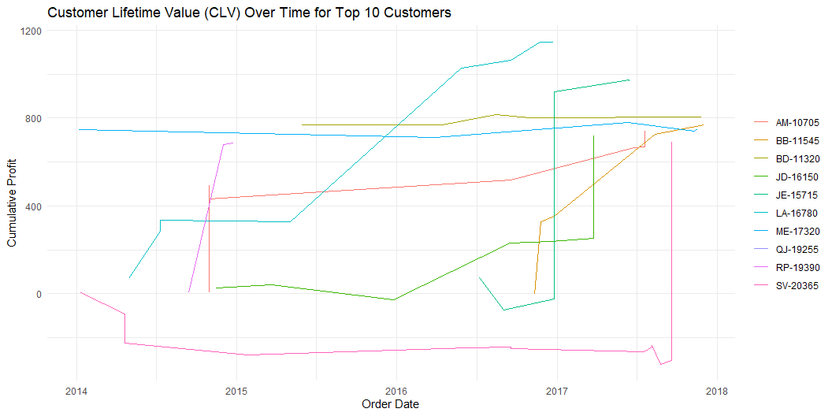
4. Determine which customer segments (market segments, regions) have the highest and lowest retention rates.
# Calculate cumulative profit for each customer over time sales_data <- sales %>% arrange(customer_id, order_date) %>% group_by(customer_id) %>% mutate(cumulative_profit = cumsum(profit)) %>% ungroup() # Summarize total CLV and identify top 10 customers by total profit top_customers <- sales_data %>% group_by(customer_id) %>% summarise(customer_name = first(customer_name), # Assuming each customer has a consistent name total_profit = sum(profit)) %>% arrange(desc(total_profit)) %>% slice_head(n = 10) %>% # Select the top 10 customers pull(customer_id) # Filter data to include only top 10 customers top_sales_data <- sales_data %>% filter(customer_id %in% top_customers) # Plot cumulative profit for the top 10 customers over time ggplot(top_sales_data, aes(x = order_date, y = cumulative_profit, color = customer_id)) + geom_line() + labs(title = "Customer Lifetime Value (CLV) Over Time for Top 10 Customers", x = "Order Date", y = "Cumulative Profit") + theme_minimal() + theme(legend.title = element_blank()) #

Slide 9
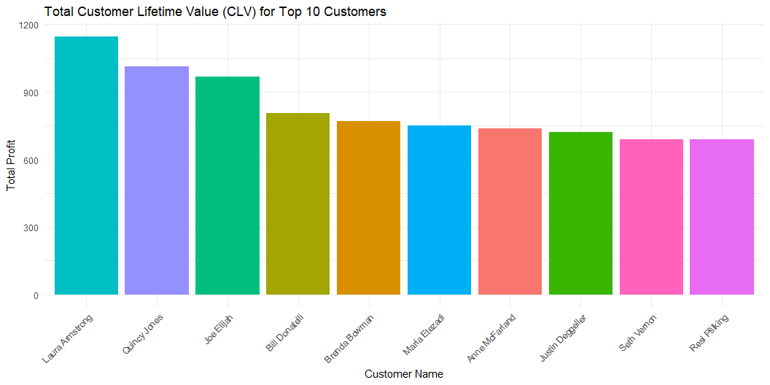
# 1. Bar Plot of Total Profit for the Top 10 Customers # Bar Plot of Total Profit for Top 10 Customers ggplot(top_sales_data %>% group_by(customer_id, customer_name) %>% summarise(total_profit = sum(profit)), aes(x = reorder(customer_name, -total_profit), y = total_profit, fill = customer_id)) + geom_bar(stat = "identity") + labs(title = "Total Customer Lifetime Value (CLV) for Top 10 Customers", x = "Customer Name", y = "Total Profit") + theme_minimal() + theme(axis.text.x = element_text(angle = 45, hjust = 1), legend.position = "none")

Slide 10
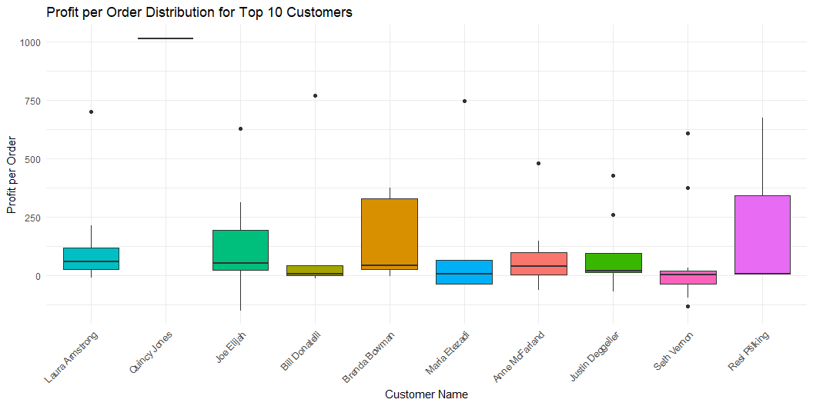
# 2. Box Plot of Order Profit Distribution for Top 10 Customers # Box Plot of Profit Distribution per Order for Top 10 Customers # Calculate total profit per customer and add it to the dataset for sorting purposes in the plot top_sales_data <- top_sales_data %>% group_by(customer_id) %>% mutate(total_profit = sum(profit)) %>% ungroup() # Create the box plot with the corrected data ggplot(top_sales_data, aes(x = reorder(customer_name, -total_profit), y = profit, fill = customer_id)) + geom_boxplot() + labs(title = "Profit per Order Distribution for Top 10 Customers", x = "Customer Name", y = "Profit per Order") + theme_minimal() + theme(axis.text.x = element_text(angle = 45, hjust = 1), legend.position = "none")

Slide 11
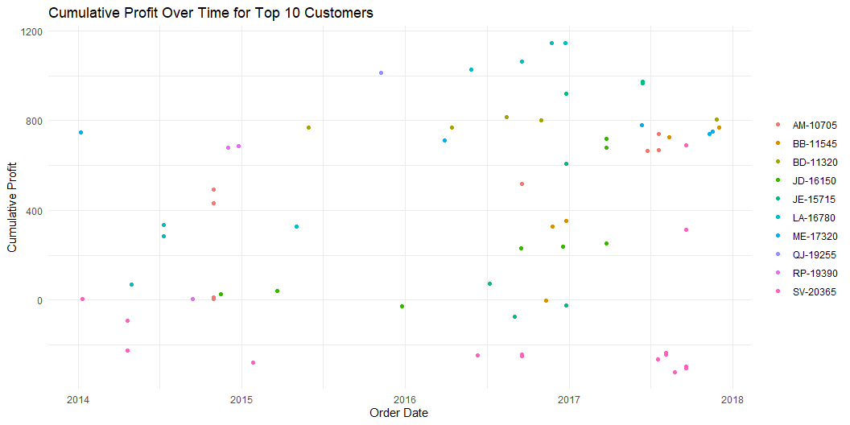
# 3. Scatter Plot of Cumulative Profit by Order Date for Top 10 Customers # Scatter Plot of Cumulative Profit by Order Date for Top 10 Customers ggplot(top_sales_data, aes(x = order_date, y = cumulative_profit, color = customer_id)) + geom_point() + labs(title = "Cumulative Profit Over Time for Top 10 Customers", x = "Order Date", y = "Cumulative Profit") + theme_minimal() + theme(legend.title = element_blank())

Slide 12
5. Track customer purchasing patterns and identify potential churn risks based on inactivity or reduced purchasing frequency
Top 10 Customers at Risk of Churning
Customer ID | Customer Name | Total Purchases | Avg Days Between Purchases | Max Days Between Purchases | Days Since Last Purchase
DL-13315 | Delfina Latchford | 2 | 1,422.0 | 1,422.0 | 0.0
BS-11590 | Brendan Sweed | 2 | 1,411.0 | 1,411.0 | 0.0
AY-10555 | Andy Yotov | 5 | 337.5 | 1,350.0 | 0.0
KN-16450 | Kean Nguyen | 2 | 1,306.0 | 1,306.0 | 0.0
TT-21070 | Ted Trevino | 4 | 430.3 | 1,275.0 | 0.0
RA-19885 | Ruben Ausman | 2 | 1,267.0 | 1,267.0 | 0.0
HG-14845 | Harry Greene | 2 | 1,259.0 | 1,259.0 | 0.0
KE-16420 | Katrina Edelman | 3 | 637.5 | 1,254.0 | 0.0
SR-20425 | Sharelle Roach | 3 | 643.5 | 1,237.0 | 0.0
VF-21715 | Vicky Freymann | 2 | 1,225.0 | 1,225.0 | 0.0
# Assuming `sales_data` is your dataset with columns 'customer_id', 'order_date', and 'total_sales' # Step 1: Calculate time intervals and recency sales_data <- sales %>% arrange(customer_id, order_date) %>% group_by(customer_id) %>% mutate( days_since_last_purchase = as.numeric(difftime(order_date, lag(order_date), units = "days")), recency = as.numeric(difftime(max(order_date), order_date, units = "days")) ) %>% ungroup() # Step 2: Summarize churn risk metrics churn_risk <- sales_data %>% group_by(customer_id) %>% summarise( customer_name = first(customer_name), total_purchases = n(), avg_days_between_purchases = mean(days_since_last_purchase, na.rm = TRUE), max_days_between_purchases = max(days_since_last_purchase, na.rm = TRUE), latest_recency = min(recency) ) %>% ungroup() # Step 3: Rank and select top 10 customers at risk top_churn_risk <- churn_risk %>% arrange(desc(latest_recency), desc(max_days_between_purchases)) %>% slice_head(n = 10) # Step 4: Format the data with gt top_churn_risk %>% gt() %>% tab_header( title = "Top 10 Customers at Risk of Churning" ) %>% cols_label( customer_id = "Customer ID", customer_name = "Customer Name", total_purchases = "Total Purchases", avg_days_between_purchases = "Avg Days Between Purchases", max_days_between_purchases = "Max Days Between Purchases", latest_recency = "Days Since Last Purchase" ) %>% fmt_number( columns = vars(avg_days_between_purchases, max_days_between_purchases, latest_recency), decimals = 1 ) %>% tab_style( style = cell_text(weight = "bold"), locations = cells_column_labels(everything()) ) %>% tab_options( table.font.size = "small", column_labels.font.size = "medium" )

