Slide 1
PSE Take-Home Task
Author: David Li
Contact: davidjli@umich.edu / (248)918-8782

Slide 2
Contents
Objective Overview
Exploratory Data Analysis
Uni-Variate Statistics
Bi-Variate Correlations/Statistics
Modeling
Modelling Process
Obtaining Customers with High Gas Usage / Likely Furnace Users

Slide 3
Objective Overview
The task at hand is to analyze the Gas/Temp Usage Dataset (linked in the Assessment instructions) and determine a method to analyze/formulate a Machine Learning model to detect Gas Furnace customers.
Business/Task Requirements:
Use a decided Machine Learning Technique to determine Gas Furnace customers
Incorporate Visualization/Presentation Elements
Document thoroughly
Things to look out for / Anticipated Challenges:
This is data we are not fully familiar with the collection and engineering process. So we should especially be on lookout for missing or low-quality data.
We immediately notice that there are no existing labels with the data we are given. This will orient our thinking more directed on finding the distinction of the categories ourselves, than having existing data to denote that. That is an immediate clue that we might be looking at an unsupervised machine learning situation.
A very large clue we are told is we can expect Low Temperatures + High Gas Usage are likely to be Gas Furnace Users. We will need to lookout for edge cases or "halfway" scenarios and make a determination for then.

Slide 4
Exploratory Data Analysis (EDA)
It's important to be well-informed on the data we are working with, before modelling!
Exploratory Data Analysis (EDA) is the process of reviewing and understanding the data we have provided before beginning more complex tasks with the data, such as modeling.
Primary in two forms: Uni-Variate (single variables) or Bi-Variate (multiple variables)
There are Several Reasons why EDA is a critical pre-cursor to modelling.
Determining how to address missing/low-quality data upfront segments much of the Data Manipulation code away from the AI/ML Modelling Code, making corrections/revisions easy to add in the corresponding section (as vs. all of the code entangled together)
Addressing all Data Quality Issues upfront eliminates confusion between a Data process issue vs. a Modelling process issue, which is extremely relevant when we need to identify the root cause of poor model performance or make model enhancements/improvements. It saves significant time.
It gives direction on how to initially approach the modelling steps. Learning what variables are poorly maintained, insignificant, or irrelevant can save significant time in deciding how to be constructing and setting up the model. It becomes easier to quickly start with a fairly reasonable model - especially great if deadlines or resources happen to be constrained.

Slide 5
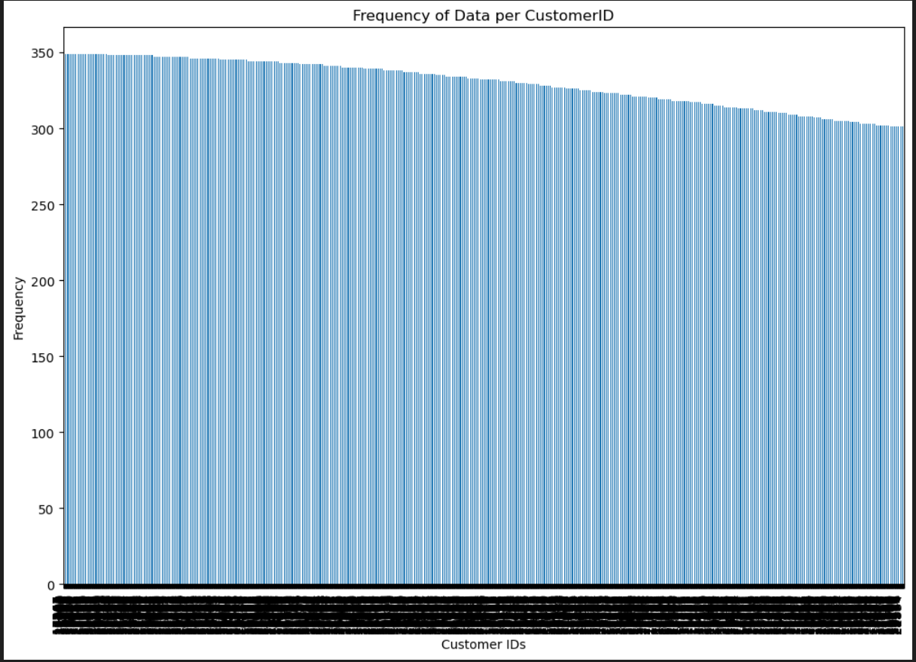
EDA(Uni-Variate)
Goal of this Visual
Technical: Obtain a quick visual breakdown of how many data points occur for each unique CustomerID
Business: Determine if the amount of data we have on each customer is fairly consistent, or extremely variable
Takeaways
The distribution of Customer IDs shows that generally there are consistently about 300-350 data points per customer.
This is good to be aware of, as a much dirtier dataset could have a wide variety of frequencies when considering groupings (i.e. some select customers we only have < 5 very little data points, while others we have much much more).
This is relevant and carries over to later analysis in that we looked for behaviors and patterns within groups that were relatively equally sized (i.e. avoiding a grouping imbalance problem).
-

Slide 6
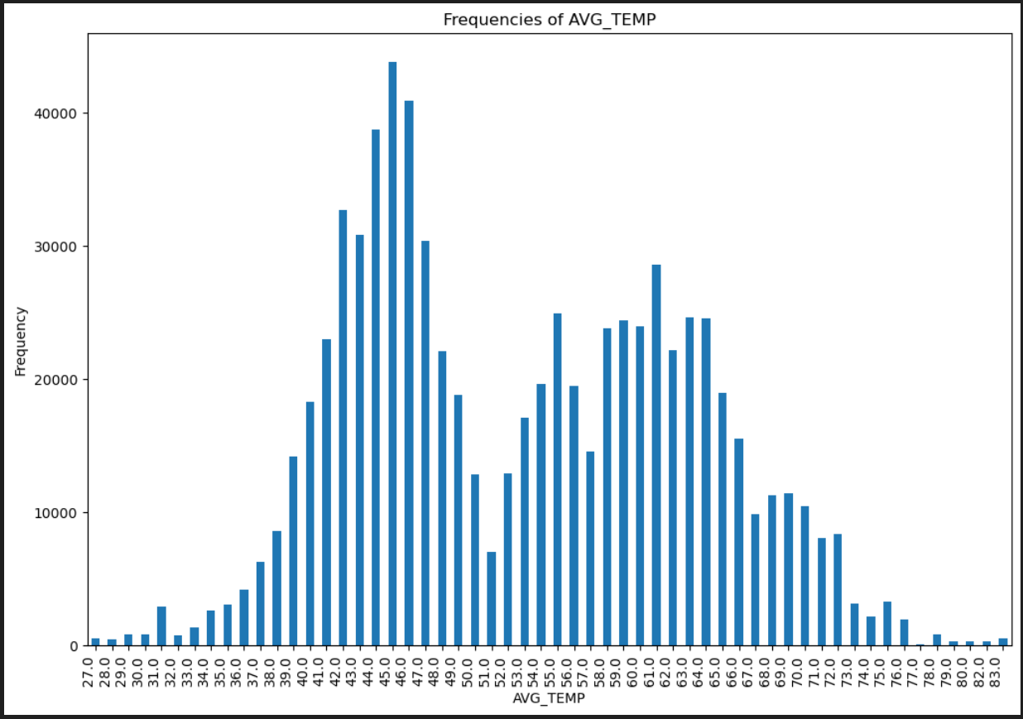
EDA(Uni-Variate)
Goal of this Visual
Technical: Obtain a quick visual breakdown of frequencies of various Temperatures we see in the data
Business: Determine the spread of Temperatures seen in our data is fairly consistent, or extremely variable
Takeaways
We aren’t given an explicit unit of Temperature. Based on the range of values here, we might be safe to assume Farenheit.
The AVG_TEMP attribute shows an interesting bimodel distribution nature. An educated guess is that this is purely coincidental (i.e. theres not a particular reason why the ~50 average temperature is so low), but good to be aware of.
The distribution of this is important to realize when analyzing our ML model later on, as it could contribute in some form

Slide 7
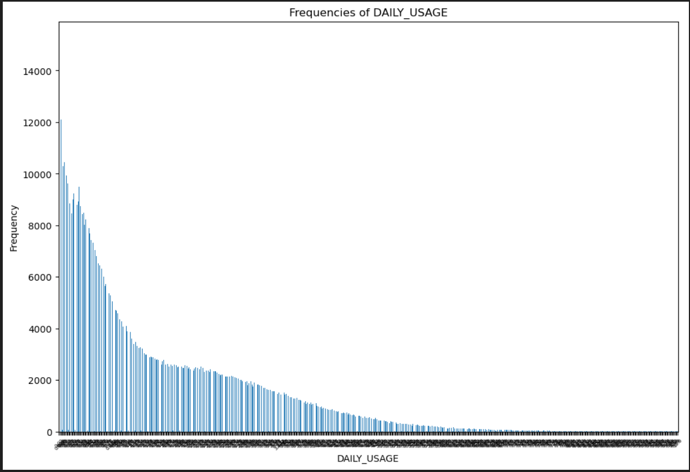
EDA(Uni-Variate)
Goal of this Visual
Technical: Obtain a quick visual breakdown of frequencies of various Usage counts we see in the data
Business: Determine the spread of Gas Usage seen in our data is fairly consistent, or extremely variable
Takeaways
We aren’t given an explicit unit of Usage. Additionally, it isn’t immediately clear what unit this should be in.
Although this visual was created quickly and the Usage labels on the X axis are not visible – these are sorted in descending counts. From left to right, it start from low usage ascending to higher usage.
DAILY_USAGE is very right-skewed, and it would be good to ask questions and consider reasons why it is distributed this way to this degree.
This also presents multiple additional considerations to remember for later - most of the usage metrics are centered in the lower region so it may be harder to distinguish here. But with the higher usage values, they’re less frequented in the data so it is easy to pick out the stand-outs.

Slide 8
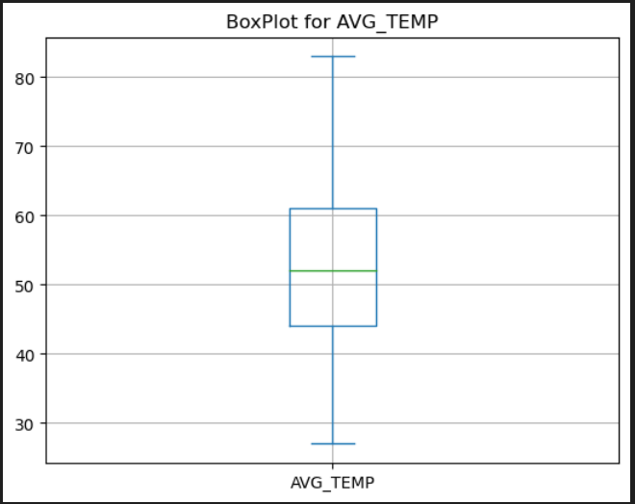
EDA(Uni-Variate)
Goal of this Visual
Technical: Create a box & whisker plot for AVG_TEMP, determining spread and outliers.
Business: Obtain a quick visual breakdown of the spread and potential outliers in AVG_TEMP. Important because some models can be extremely inaccurate with the presence of outliers
Takeaways
Fairly reasonable distribution, with a large spread such that no outliers are easily found.
Requires no additional steps to clean up outliers here

Slide 9
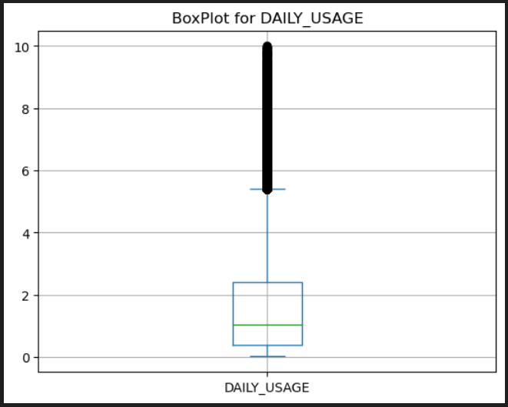
EDA(Uni-Variate)
Goal of this Visual
Technical: Create a box & whisker plot for DAILY_USAGE, determining spread and outliers.
Business: Obtain a quick visual breakdown of the spread and potential outliers in DAILY_USAGE. Important because some models can be extremely inaccurate with the presence of outliers
Takeaways
This distribution is extremely right skewed. Not only is it important to note the nature of the distribution, but to the degree of the skewness.
Normally outliers are presented as individual dots such as in this graph here. However given existing knowledge of the extreme right-skewness – these points are likely legitimate and more attributed to how skewed the distribution is in the first place. Further evidence is that these points are fairly clustered together, instead of extremely isolated points.

Slide 10
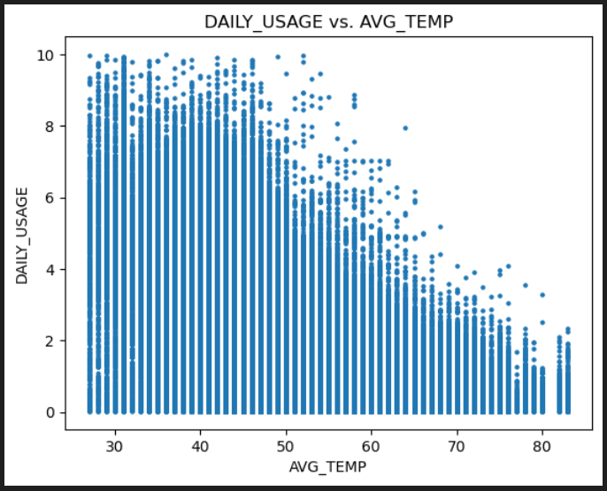
EDA(Bi-Variate)
Goal of this Visual
Technical: Create a standard scatter for DAILY_USAGE, determining rough layout of the data visually.
Business: Obtain a quick plot of USAGE vs TEMP. Even if a very standard visual, gives a strong idea of how the data is laid out.
Takeaways
There is a seeable negative correlation between the two, which is consistent with the Problem Statement clues regarding these two data attributes.
It’s important to know the ranges of the data elements, and how they impose upon each other. Daily_Usage ranges between 0 to 10, and Avg_Temp ranges from 20 – 100
This is an overall plot without groupings by Customer ID.

Slide 11
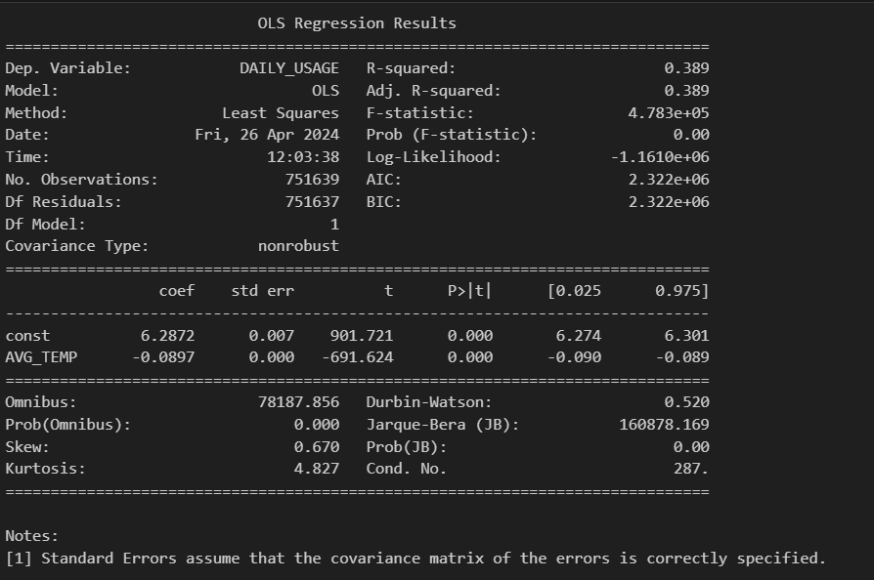
EDA(Bi-Variate)
Goal of this Visual
Technical: Create a Least Squares Regression, determining the strength of a correlation and how statistically significant it is.
Business: There are various Statistical Tests to prove hypotheses, including this Ordinary Least Squares Regression test to determine the strength of the relationship between AVG_TEMP and DAILY_USAGE.
Takeaways
The p-value (commonly referenced in these Statistical Tests) indicate the significance of the relationship.
Because the value here of 0.000 is less than the typical threshold of 0.05, its strong evidence to support there is a relationship between AVG_TEMP and DAILY_USAGE

Slide 12
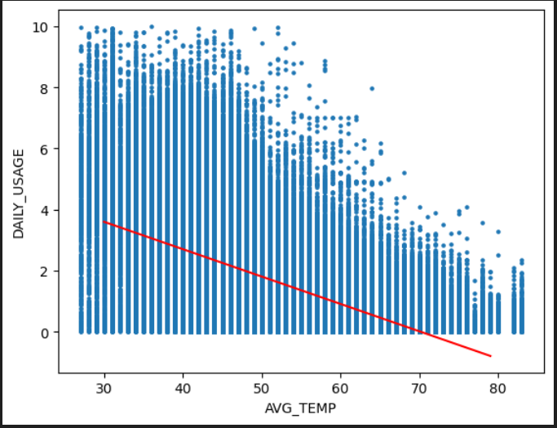
EDA(Bi-Variate)
Goal of this Visual
Technical: Overlay a Least Squares Regression line on our data, visually looking at the relationship
Business: As an extension from the previous slide, using what “best fit” line the OLS model has determined as the linear relationship and seeing how it looks with our data
Takeaways
The OLS / Best Fit line is clearly negative sloping, confirming our idea of a strong negative correlation between AVG_TEMP and DAILY_USAGE
The line is not the most accurate for prediction, likely due to the over simplistic nature of OLS. But it gives a good generic conceptual sense.

Slide 13
Modelling Process
From the Problem Statement Definition as well as the nature of the data, we determine that this scenario is an Unsupervised Modelling need. By far the most common algorithm of choice here is Clustering, namely we can start with simpler Clustering models such as k-means.
Conceptully, K-means is an algorithm that looks for multiple groupings in “clusters” such that each cluster is distinctly apart enough from the other based on the center/mean locations of the clusters, and the spread of data within each cluster.
From a High Level Overview Perspective, we determine our modeling process to answer the Problem Statement as follows:
1. Train the Clustering Model to learn 2 clusters - data points that belong in 1 cluster of likely gas furnace users, 1 clusters of likely not gas furnace users.
2. Review the Predicted labels per data point and analyze cluster differing characteristics.
3. For Each Customer Grouping, analyze the proportion of their data points that are likely gas furnace users.'
4. If a majority of the points above some threshold follow the gas furnace user cluster, then we make a judgment call this customer is likely a gas furnace user.

Slide 14
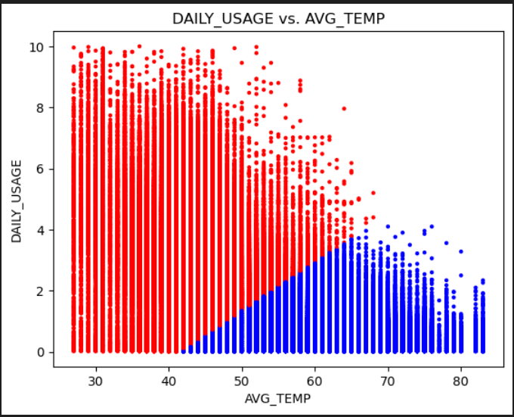
Cluster Model Outcome

Slide 15
Obtaining Customers with High Gas Usage / Likely Furnace Users
Based from the modelling outcome and visual depiction, we now have every data point falling into a High Usage Cluster (shown as blue) or Normal/Low Usage Cluster (shown as red).
The final step is to review within each customer and determine their percentage of High Usage data points.
Our Classification Criteria: If Customer's proportion of High Gas Usage Data Points is > 0.5, Determine Customer is High Usage Customer and Likely Gas Furnace User
We can then extract a list of customers meeting this criteria.

Slide 16
Obtaining Customers with High Gas Usage / Likely Furnace Users
Based from the modelling outcome and visual depiction, we now have every data point falling into a High Usage Cluster (shown as blue) or Normal/Low Usage Cluster (shown as red).
The final step is to review within each customer and determine their percentage of High Usage data points.
Our Classification Criteria: If Customer's proportion of High Gas Usage Data Points is > 0.5, Determine Customer is High Usage Customer and Likely Gas Furnace User
We can then extract a list of customers meeting this criteria.

