Slide 1
*NIX Cheatsheet
To do | Zsh | Finder
Set timestamp to “now” recursively inclusive of current location | Touch **/** | Not supported
Return to root from anywhere | cd
User Root | Cd ~
Current folder path | pwd
Fuzzy search | fzf
fzf --style full \ --preview 'fzf-preview.sh {}' --bind 'focus:transform-header:file --brief {}'
tldr is man on a diet
Alias: aliases aren't persistent by default, and you'll need to add them to your shell's configuration file | alias
update = "sudo apt update && sudo apt upgrade -y"
Systemd: startup information | systemd-analyze plot > bootanalysis.png

Slide 3
Mudbox Cheatsheet
To: | Win/Lin | MAC
Rotate Camera | Alt + drag | Opt or Cmd + drag
Track Camera | Alt + Middle drag | Opt or Cmd + middle drag
Dolly | Alt + R Drag | Opt or Cmd + Right drag
Focus | f | f
Frame All | a | a
Wireframe display on | w | w
Subdivide mesh | D | D

Slide 4
Maya Cheatsheet
To: | Win/Lin | MAC
Rotate Camera | Alt + drag | Opt or Cmd + drag
Track Camera | Alt + Middle drag | Opt or Cmd + middle drag
Dolly | Alt + R Drag | Opt or Cmd + Right drag
Move | w
Rotate | e
Scale | r
Focus | f | f
Layer Left V toggle visible | P toggle playback | T= not selectable
 |  | R= Reference View

Slide 5
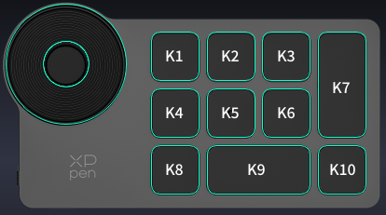
Drawing Tablet Cheatsheet
Phase: | K1 | K2 | K3 | K4 | K5 | K6 | K7 | K8 | K9 | K10 | K11
Sketch | DEL | Paste Here | Ctrl-Y | P Pen | B Brush | T Text | Undo | C Char | HAND | Next Phase | Dial+
Outline | DEL | Finder | Space | P | S Simplify | J Reshape | Undo | Space | HAND | Next | Dial+
Fill | DEL | Space | Space | I Eye Dropper | G Fill | A AirBrush | Undo | Space | HAND | Next | Dial+
Shade | DEL | Space | Space | Space | Space | Space | Undo | Space | HAND | Next | Dial+

