Slide 1
SALES & FINANCIAL DATA REVIEW
Red30 Tech
Key Insights from the Finance Spreadsheets
Executive summary of findings across 11 spreadsheets: five years of financial statements and two years of order-level sales data.
Prepared August 8, 2026 · finance/ directory, 11 source files

Slide 2
EXECUTIVE SUMMARY
Three takeaways for leadership
Growth is real but slow, and margin is quietly eroding. Revenue grew 2.6%/yr from 2014–2018 while gross margin slipped from 63.6% to 62.2% — well under real-world U.S. retail (4.0–4.3%/yr) and e-commerce (14–16%/yr) growth over the same period.
Working capital is stretching. Accounts Receivable grew +81% against a –5% decline in Accounts Payable — the balance sheet is expanding faster than the business generating it.
The reporting can’t be trusted end-to-end. Three files report three different “total revenue” figures for the same company (a 147× spread), and several workbook labels are stale or inconsistent.
None of this is disqualifying — it’s a normal state for a growing operation — but each point below is worth a controller’s attention.
Red30 Tech · Key Insights · Slide 2 of 12

Slide 3
FINDING 01
Revenue is climbing. Margin is not.
Gross Revenue grew from $914.8M (2014) to $1,013.1M (2018) — a 2.6%/yr compound rate.
Gross margin declined from 63.6% to 62.2% (–1.4 pts) as COGS grew slightly faster than revenue in 4 of the 5 years.
Operating margin ended flat at 12.6% (2018 vs. 2014), after dipping to 10.9% in 2015.
Red30 Tech · Key Insights · Slide 3 of 12

Slide 4
FINDING 02
Receivables are outrunning payables
Accounts Receivable grew +81% (2014–18) while Accounts Payable shrank –5%.
Total Assets grew 39% against revenue’s 11% growth over the same period — the balance sheet is expanding much faster than the business.
Executive read: if this were a real ledger, it’s the first place a controller would look — cash conversion is stretching even as the top line barely moves.
Red30 Tech · Key Insights · Slide 4 of 12

Slide 5
FINDING 03
Revenue concentrates. Inventory doesn’t follow it.
Software (28%) and Hardware (17%) make up 45% of the $121.3M product-line revenue total.
Robots holds 41% of all inventory value ($481K of $1.19M) but generates only 7.5% of revenue ($9.1M) — a likely overstock.
Blueprints sits at the other extreme: just 2.3% of revenue.
Red30 Tech · Key Insights · Slide 5 of 12

Slide 6
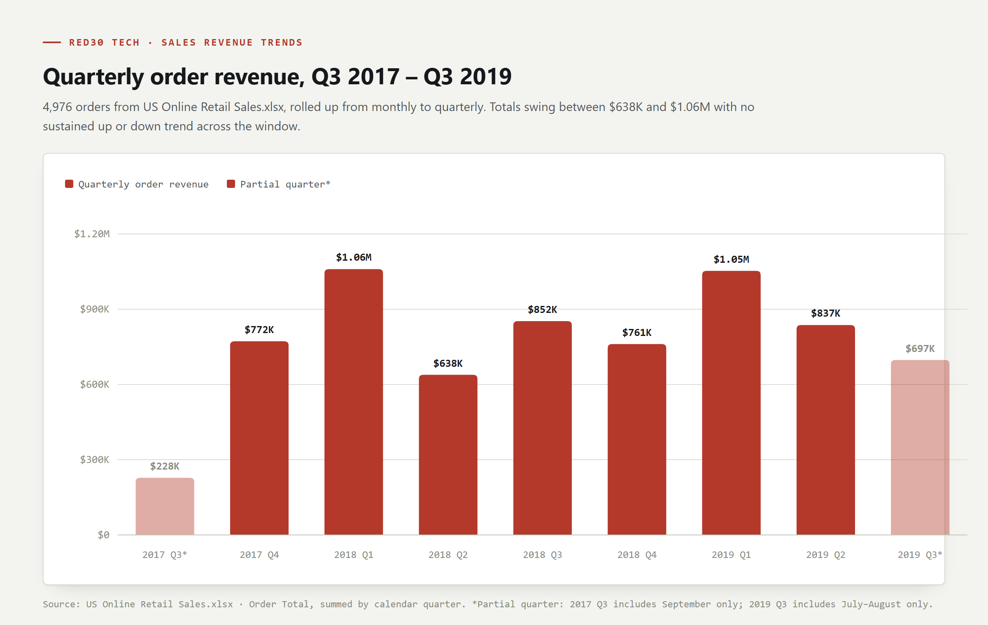
SALES DATA
Quarterly order revenue, Q3 2017–Q3 2019
4,976 orders swing between $638K and $1.06M per quarter with no sustained trend up or down — growth here is essentially flat across the two-year window.
Red30 Tech · Key Insights · Slide 6 of 12

Slide 7
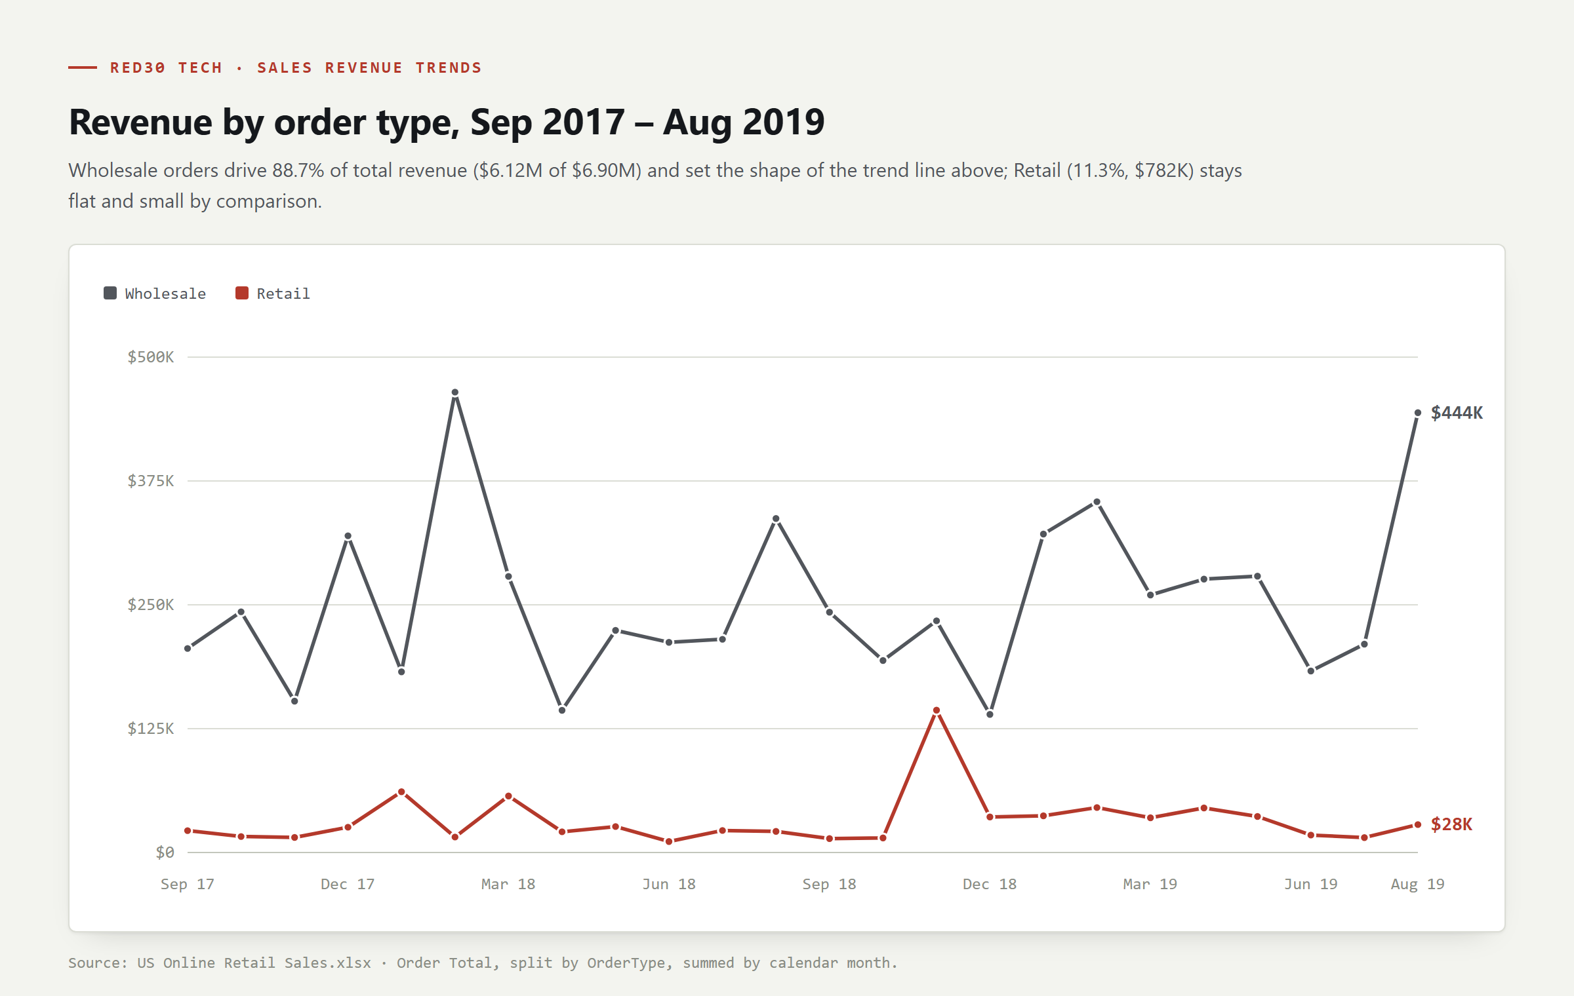
SALES DATA
Revenue by order type
Wholesale drives 88.7% of order revenue ($6.12M of $6.90M) and sets the shape of the overall trend; Retail (11.3%, $782K) stays flat and small throughout — despite the file’s name, this is a wholesale book.
Red30 Tech · Key Insights · Slide 7 of 12

Slide 8
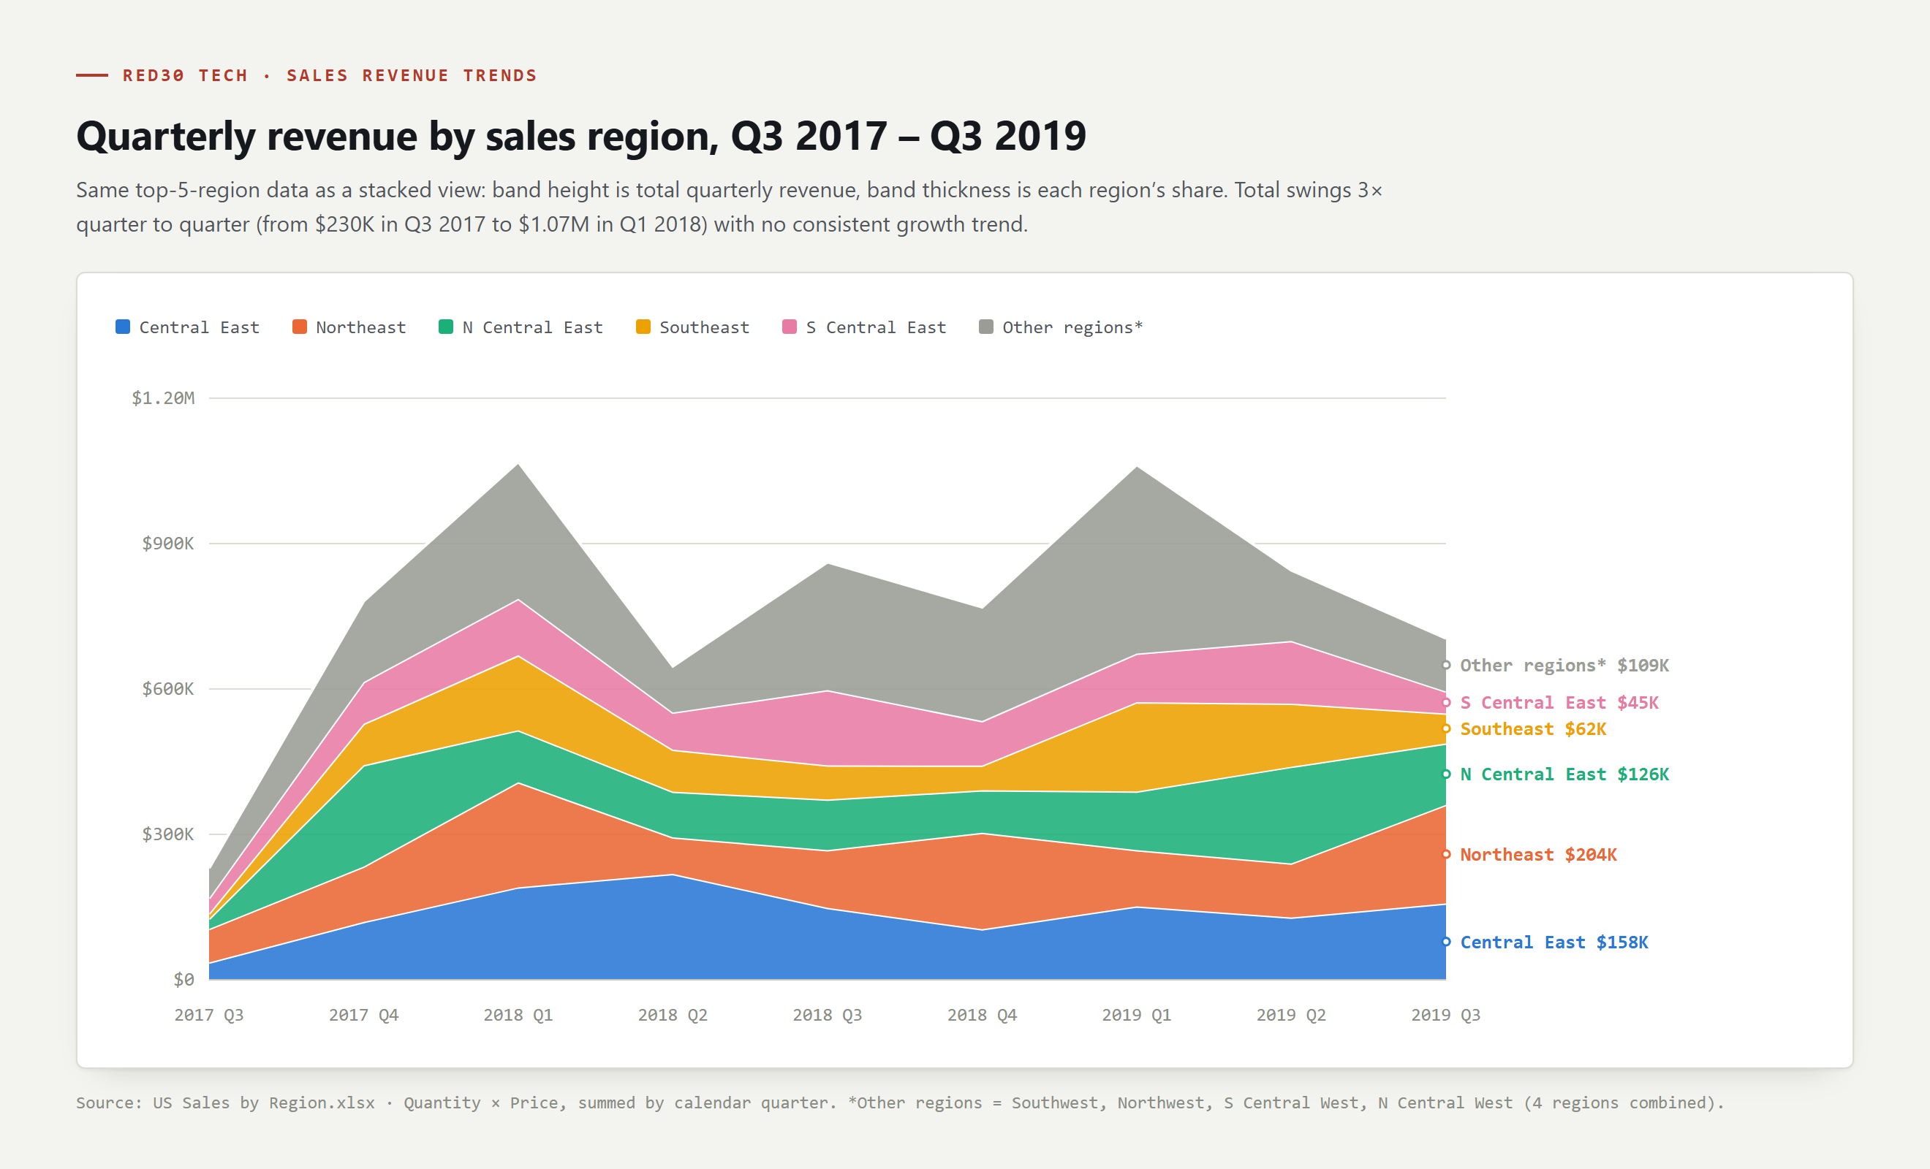
SALES DATA
Quarterly revenue by sales region
Central East and Northeast lead most quarters; total revenue (band height) swings 3× quarter to quarter with no region showing a sustained upward trend.
Red30 Tech · Key Insights · Slide 8 of 12

Slide 9
DATA QUALITY
Three revenue figures, one company, no match
Financial Statement (2018 income statement): $1,013,072,000
Product Line workbook (single snapshot): $121,258,930 — 8.4× smaller
Order-level transactions (4,976 orders, Sep 2017–Aug 2019): $6,899,236 — 147× smaller than the Financial Statement
These aren’t tiers of one model — they’re independent datasets that happen to share a company name.
Product Line’s own two tabs agree with each other to the penny ($121,258,930.23, both times); the mismatch is only across files, never within one.
Red30 Tech · Key Insights · Slide 9 of 12

Slide 10
MARKET CONTEXT
Red30 Tech vs. the real market, 2017–2019
U.S. retail sales grew 4.0% (2017) and 4.3% (2018); e-commerce specifically grew 15.5% (2017), 14.2% (2018), 14.9% (2019).
Red30 Tech’s five-year revenue CAGR (2.6%/yr) and its order-level data (flat, no growth trend) both sit well below these benchmarks.
Executive read: don’t use this dataset as a growth-rate reference for real retail or e-commerce planning.
Source: U.S. Census Bureau, Annual Retail Trade Survey · Digital Commerce 360, retrieved August 2, 2026.
Red30 Tech · Key Insights · Slide 10 of 12

Slide 11
DATA QUALITY
Three things to fix before this gets reused
Overhead Costs.xlsx — the 2018 tab’s title still reads “2017 Overhead Costs.”
Marketing Expenses.xlsx — the labor section header changes from “LABOR” (2017) to “MARKETING LABOR” (2018) for the same line items.
US Online Retail Sales.xlsx / US Sales by Region.xlsx — same 4,976 orders, split across two files with no overlapping columns (Discount/Order Total live in one, Employee/Region in the other).
Red30 Tech · Key Insights · Slide 11 of 12

Slide 12
CONCLUSION
What to trust, what to ignore
TRUST
TREAT SEPARATELY
The statement series (Balance Sheet → Overhead Costs) as one internally consistent five-year model
Product Line’s own revenue math — its two tabs agree to the penny
Reconciling order-level or Product Line revenue against the income statement — they’re unrelated datasets
The order data as a seasonality example — no real holiday pattern
Red30 Tech’s growth rate as a market benchmark — well under actual 2017–2019 retail/e-commerce growth
Method: local .xlsx files parsed directly from OOXML (zipfile + stdlib XML); charts rendered via headless-browser SVG export; benchmark figures via web search, August 2026 (U.S. Census Bureau ARTS; Digital Commerce 360).
Red30 Tech · Key Insights · Slide 12 of 12

