Slide 1
An introduction to Stack Buffer Overflows (BOF), how to discover one, and how they can be
exploited for fun and profit
[H4F ATTIC]

Slide 2
What is a BOF?
A buffer overflow occurs when memory is overwritten outside of the range it was meant to be limited to.
Failure to do proper bounds checking is the common culprit.
  strcpy(), memcpy(), etc.
Modern compilers and operating systems implement protections such as Structured Exception Handling (SEH) and Data Execution Prevention (DEP), etc.
These protections help, but can be bypassed.
Notes:
Alongside SEP and DEP there is also Structured Exception Handling Overwrite Protection (SEHOP) and Address Space Layout Randomization (ASLR), as well as compiler replacement of unsafe functions

Slide 3
How does this happen?
When a function is called it is allocated memory, called a stack frame, inside which it is intended to stay.
Sometimes calling functions such as strcpy() or memcpy() can cause overwrites of memory outside of its caller’s stack frame.
Overwriting memory with junk often just causes a crash.
But overwriting it with specially crafted data can sometimes allow execution control to be hijacked.

Slide 4
What is a stack frame?
A stack frame is a portion of memory set aside for a function to use, and includes:
  Arguments passed to the function
  Addresses needed to return properly to the caller (EBP, EIP)
  Working space for local variables
????
????
????
????
EBP
EIP
Arg1
Arg2
????
????
????
????
Lower memory (0x19EC00)
ESP
Base pointer of caller
Return address in caller
First argument passed in
Second argument passed in
Higher memory (0x19EC2C)
Notes:
The memory view here starts with lower memory at the top and moves down to higher memory. Conventionally you will see this represented the other way around, but I used this view here because this is how it will be presented in most debuggers

Slide 5
How does an overflow occur?
Assume a function defined as such:
void myFunc(char* str, int len)
{
char Buffer[8];
strcpy(Buffer, str);
}
  ESP will be decremented by 8 bytes to make room for ‘Buffer’.
  The call to strcpy() will write data into memory at the address of Buffer.
  Since no bounds checking is done this could overwrite data at higher memory locations than were allocated to Buffer.
????
????
????
????
EBP
EIP
str
len
????
????
????
????
0x19EC00
{
ESP
Buffer
0x19EC2C
Notes:
This assume the cdecl calling convention. There are other such as stdcall, syscall, and fastcall that pass parameters in different ways and/or have other requirements placed on the caller/callee, but that is outside the scope of this presentation

Slide 6
So what then?
Assume the function is called as such:
  myFunc(“DEADBEEFDEADBEEF”, 16);
  The simplified view is that this will overwrite EBP and EIP!
  The function, when it returns, will now return execution to the address 0xFEEB
  If the user controls what is passed to strcpy() then they can control where execution will continue
????
????
DEAD
BEEF
DEAD
BEEF
str
len
????
????
????
????
0x19EC00
{
ESP
Buffer
EBP
EIP
0x19EC2C
Notes:
I ignore the null terminator that would also overwrite part of the “str” argument on the stack.
Also note that addresses are read in little-endian so the value “0xBEEF” in memory will be treated as address “0xFEEB”.

Slide 7

How to find these vulnerabilities?
Sometimes discovered by accident and later analyzed
If intentionally searching, there are 3 primary approaches:
  Static analysis
  Dynamic analysis
  Fuzzing (also dynamic)

Slide 8
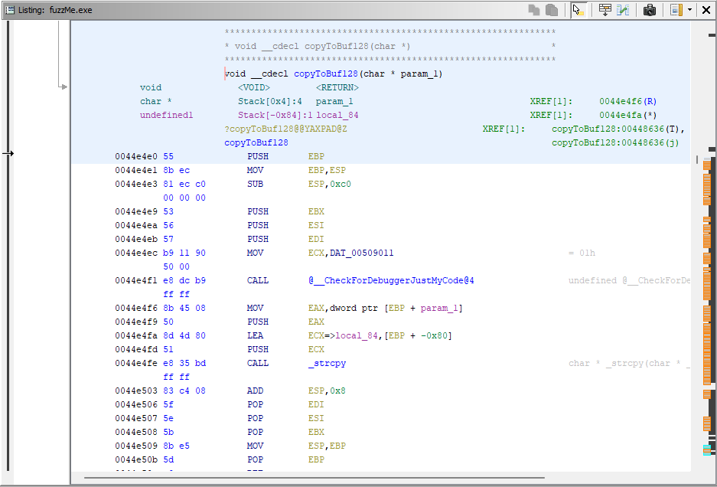
Static Analysis
IDA Pro, Ghidra
Powerful tools
make this easier
but it is still very
manual
Useful, but tough
Notes:
Obviously this is not a complete list of tools, but they are a couple of the most well known and popular.

Slide 9
Static Analysis
Example of a vulnerable function:
__declspec(noinline) void copyToBuf100(char* c)
{
char buf[100];
strcpy(buf, c);
}
Notes:
This is copied from some training materials. The “__declspec(noinline)” is used to prevent the compiler from inlining the function.

Slide 10
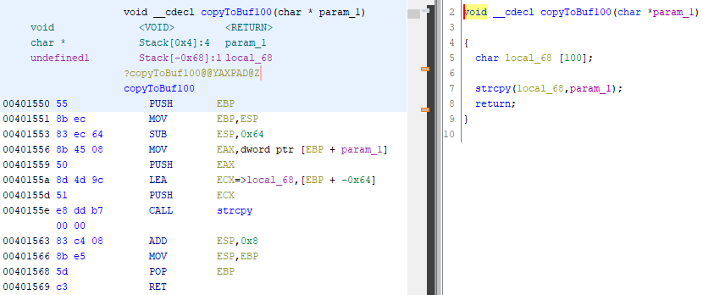
Static Analysis
Make room on the stack for 100 bytes

Slide 11
Static Analysis
Potentially vulnerable call to strcpy()
Notes:
This is potentially vulnerable. Need to establish whether there is a path from user input into this function, and whether that data is validated in any way

Slide 12
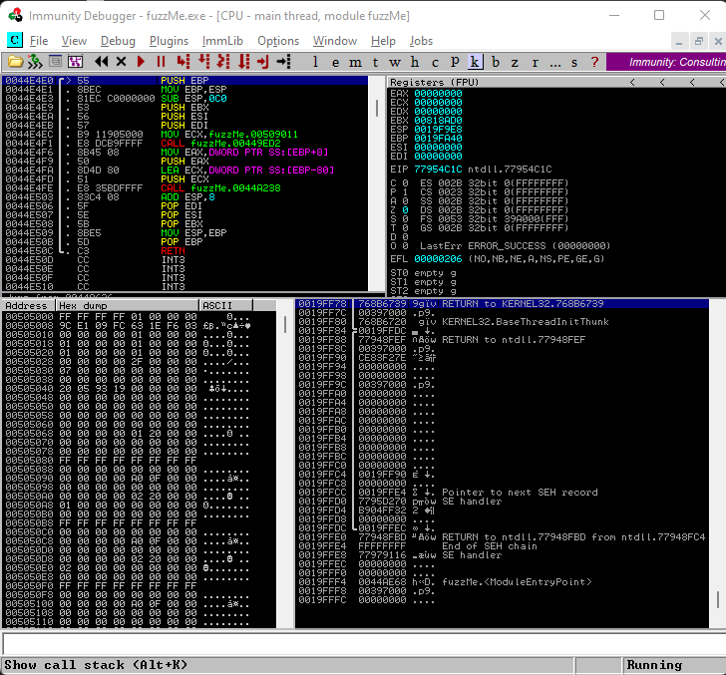
Dynamic Analysis
OllyDbg, Immunity
Watch/break code
execution
Examine memory
and registers
See the state on
exceptions
Notes:
Again, not a complete list of debuggers but some favorites.

Slide 13
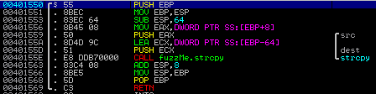
Dynamic Analysis
The same example function from before, but now viewed in Immunity debugger:
Make room on the stack for 100 bytes
Potentially vulnerable call to strcpy()

Slide 14
Dynamic Analysis
Let’s send this function more data than it can handle safely:
This is just a preamble required to get our payload into the vulnerable function
Since the function only handles up to 100 bytes let’s fill that up
This should overwrite the old EBP value
This should overwrite EIP

Slide 15
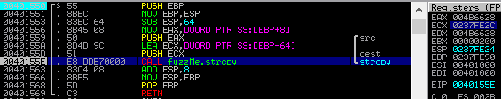
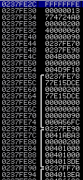
Dynamic Analysis
View of assembly, registers, stack prior to calling strcpy():
Destination memory in stack
Destination address, from register ECX, pushed onto stack as argument to strcpy()
Return address for copyToBuf100() stack frame (old EBP is above it)
Notes:
Paused on breakpoint just prior to calling strcp() you can see the setup in registers and on the stack

Slide 16
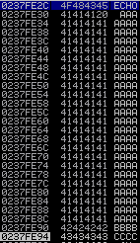
Dynamic Analysis
View of assembly, registers, stack after calling strcpy():
Destination memory in stack after call to strcpy() is filled with the passed in buffer
Return address for copyToBuf100() stack frame overwritten
Notes:
Paused on breakpoint just after calling strcp() you can see the overwrite on the stack

Slide 17

Dynamic Analysis
Error state after attempt to return from copyToBuf100():
Old EBP has been overwritten with 0x42424242
Debugger displays an error after retn is called. The error indicates an attempt to execute code at invalid address 0x43434343
EIP has been overwritten with 0x43434343
Notes:
Huzzah, we now have control of execution!

Slide 18
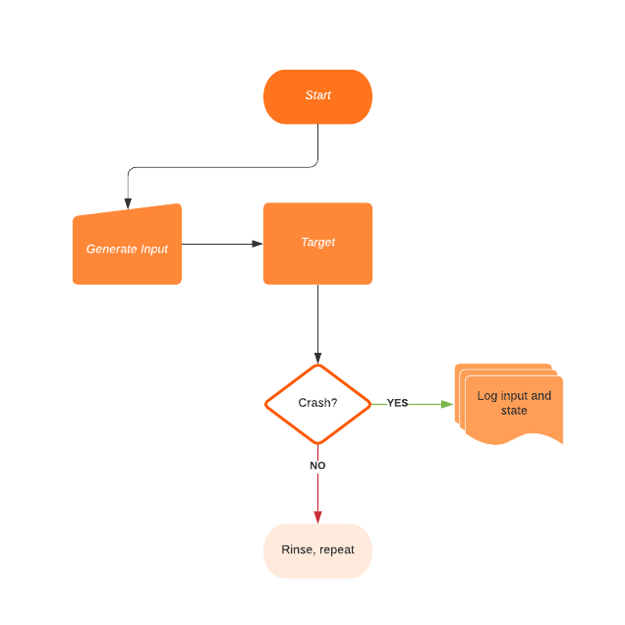
Fuzzing
Providing varied inputs and monitoring state
Can be random input or semi-intelligent
Process can range from simple to complex
Notes:
A whole presentation could be made just on fuzzing techniques, but this is just an intro

Slide 19

Fuzzing

Slide 20
Exploiting for fun and profit
Overwriting EIP is just the beginning.
Need to hijack execution and redirect to instructions of our own desire
  Payloads
  Stealth
  Persistence
Notes:
Many other techniques, some quite advanced, can be employed during exploitation. This is just the simplest example to introduce people to.

Slide 21
EIP Overwrite
Notes:
Many other techniques, some quite advanced, can be employed during exploitation. This is just the simplest example to introduce people to.

