Slide 1
Linear Circuits 1
ECET 250E
Week 1 | Chapter 1: Basic Concepts
Camosun College
Electronics & Computer Engineering Technology
Mozhgan Bacon, PhD, P.Eng.
Fall 2026
Based on Fundamentals of Electric Circuits, 2026 Release — C.K. Alexander, M.N.O. Sadiku & S.J. Fredette (McGraw Hill)

Slide 2
Introduction
This chapter introduces the concept of voltage and current.
The concept of a circuit will be introduced.
Sources will be introduced.
These can provide either a specified voltage or current.
Dependent and independent sources will be discussed.

Slide 3
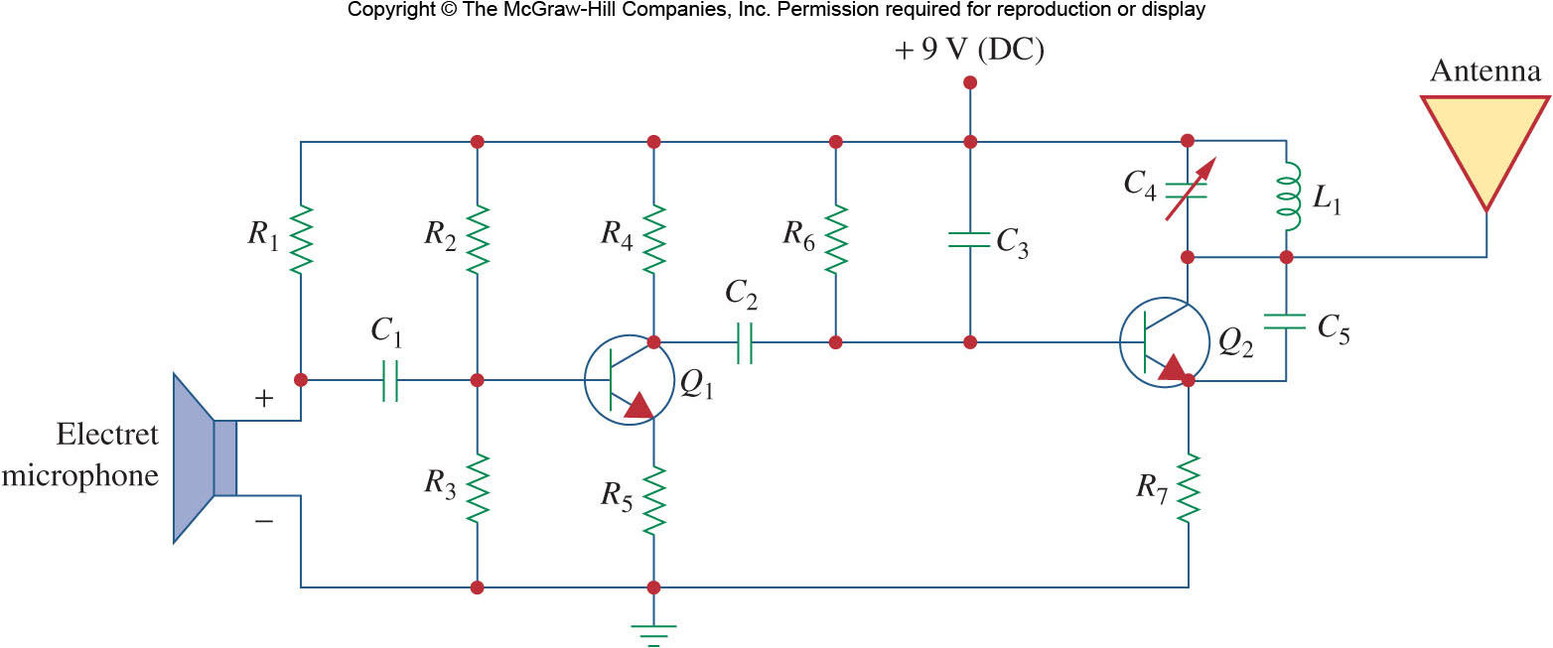
What is a circuit?
An electric circuit is an interconnection of electrical elements.
It may consist of only two elements or many more:

Slide 4
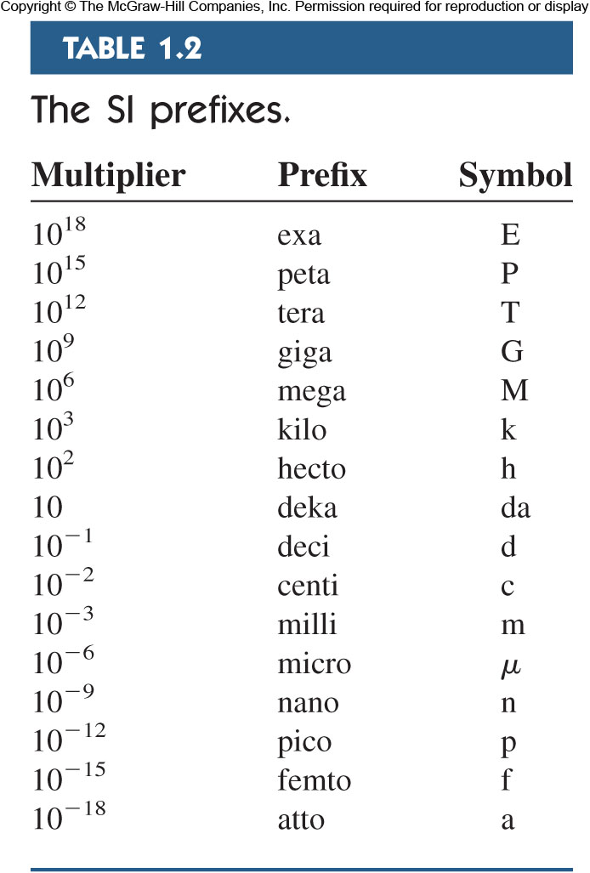
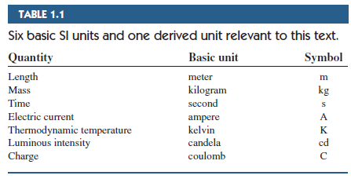

Units
When taking measurements, we must use units to quantify values.
We use the International Systems of Units (SI for short).
Prefixes on SI units allow for easy relationships between large and small values.
In the lab, one typically sees (pC, nC, or

Slide 5
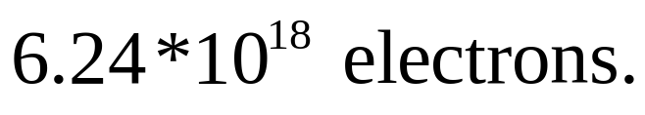

Charge
Charge is a basic SI unit, measured in Coulombs (C).
Counts the number of electrons (or positive charges) present.
Charge of single electron is
$$−1.602∗10^{−19}C.$$
One Coulomb is quite large,

Slide 6
Charge II
Charge is always multiple of electron charge.
Charge cannot be created or destroyed, only transferred.

Slide 7
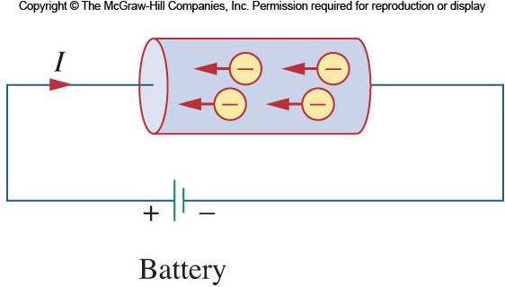
Current
The movement of charge is called a current.
Historically the moving charges were thought to be positive.
Thus, we always note the direction of the equivalent positive charges, even if the moving charges are negative.

Slide 8
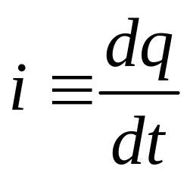

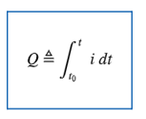
Current II
Current, i, is measured as charge moved per unit time through an element.
Unit is Ampere (A), is one Coulomb/second.

Slide 9
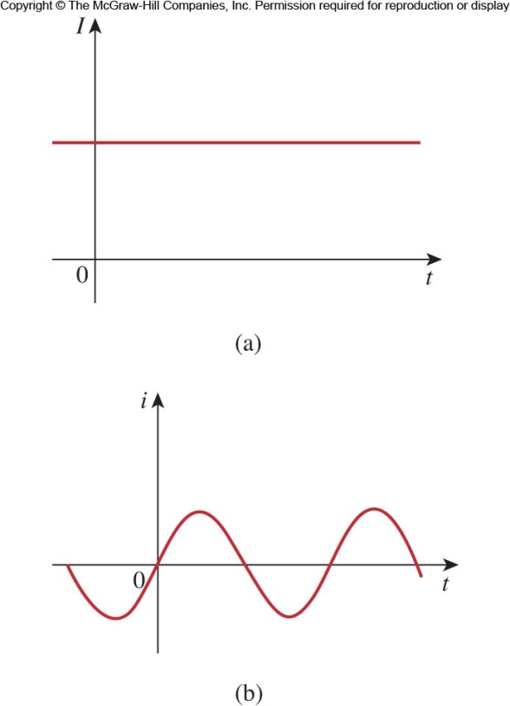
D C versus A C
A current that remains constant with time is called Direct Current (D C).
Such current is represented by the capital I, time varying current uses the lowercase, i.
A common source of D C is a battery.
A current that varies sinusoidally with time is called Alternating Current (A C).
Mains power is an example of A C.

Slide 10
Direction of Current
The sign of the current indicates the direction in which the charge is moving with reference to the direction of interest we define.
We need not use the direction that the charge moves in as our reference and often have no choice in the matter.

Slide 11
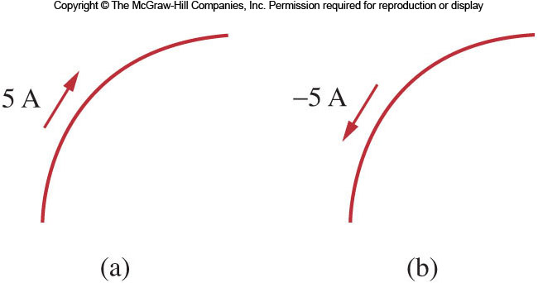
Direction of Current II
A positive current through a component is the same as a negative current flowing in the opposite direction.

Slide 12


Examples
How much charge is represented by 4,600 electrons?
Calculate the amount of charge represented by 10 billion protons.

Slide 13
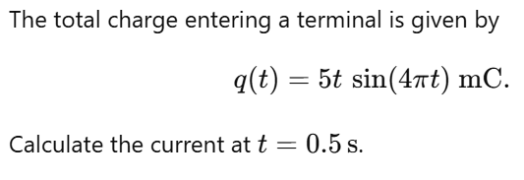
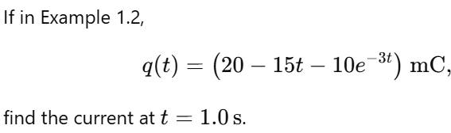
Examples

Slide 14
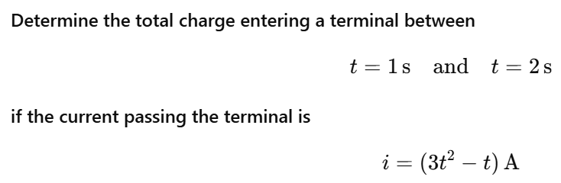
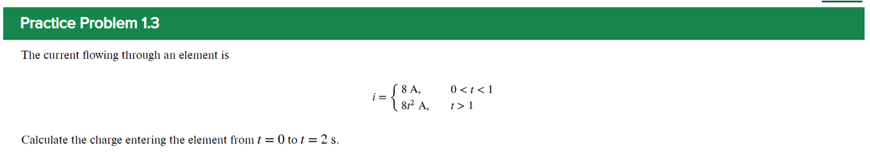
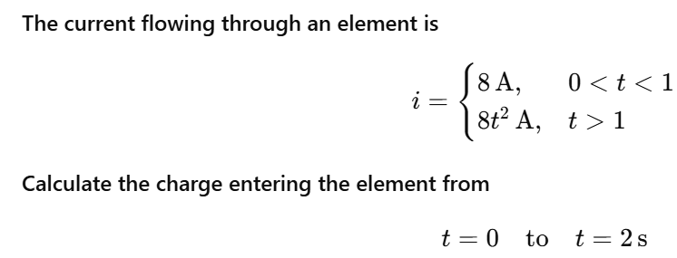
Examples

Slide 15


Voltage
Electrons move when there is a difference in charge between two locations.
This difference is expressed at the potential difference, or voltage (V).
It is always expressed with reference to two locations.

Slide 16
Voltage II
It is equal to the energy needed to move a unit charge between the locations.
Positive charge moving from a higher potential to a lower yields energy.
Moving from negative to positive requires energy.

Slide 17
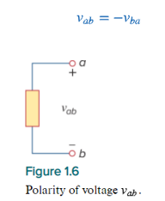
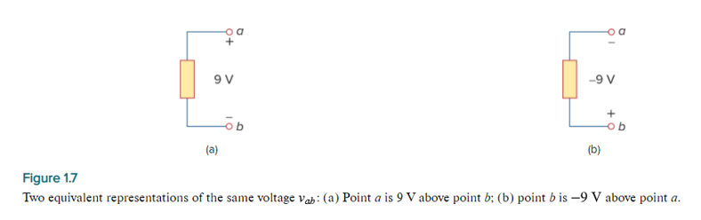
Voltage III
For example, in Fig. 1.7, we have two representations of the same voltage. In Fig. 1.7(a), point a is +9 V above point b; in Fig. 1.7(b), point b is −9 V above point a. We may say that in Fig. 1.7(a), there is a 9-V voltage drop from a to b or equivalently a 9-V voltage rise from b to a. In other words, a voltage drop from a to b is equivalent to a voltage rise from b to a.

Slide 18
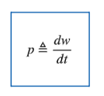
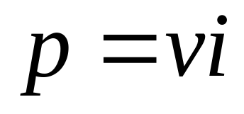

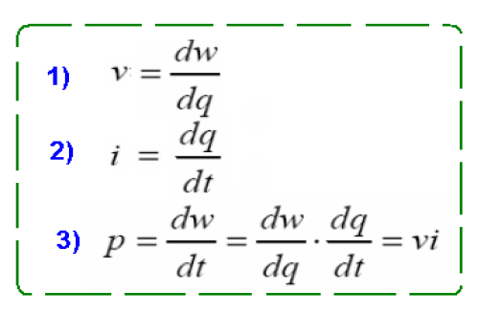
Power and Energy
Voltage alone does not equal power.
It requires the movement of charge, that is, a current.
Power is the product of voltage and current.
It is equal to the rate of energy provided or consumed per unit time.
It is measured in Watts (W).

Slide 19
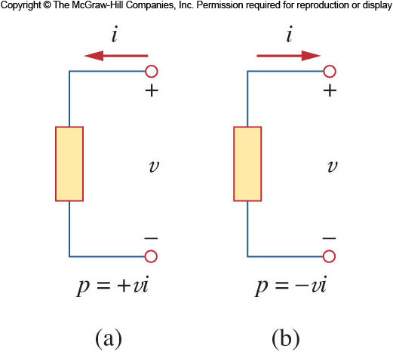
Passive Sign Convention
By convention, we say that an element being supplied power has positive power.
A power source, such as a battery has negative power.
Passive sign convention is satisfied if the direction of current is selected such that current enters through the terminal that is more positively biased.

Slide 20
Conservation of Energy
In a circuit, energy cannot be created or destroyed.
Thus power also must be conserved.
The sum of all power supplied must be absorbed by the other elements.
Energy can be described as watts x time.
Power companies usually measure energy in watt-hours.

Slide 21
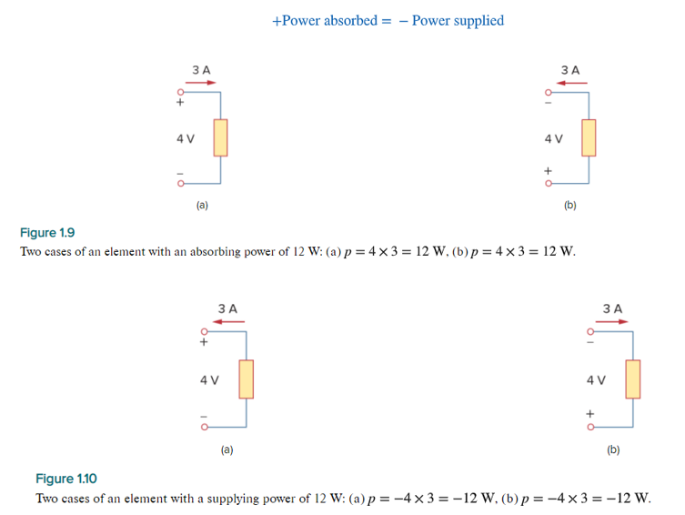
Power and Energy
In fact, the law of conservation of energy must be obeyed in any electric circuit. For this reason, the algebraic sum of power in a circuit, at any instant of time, must be zero:
∑p=0

Slide 22

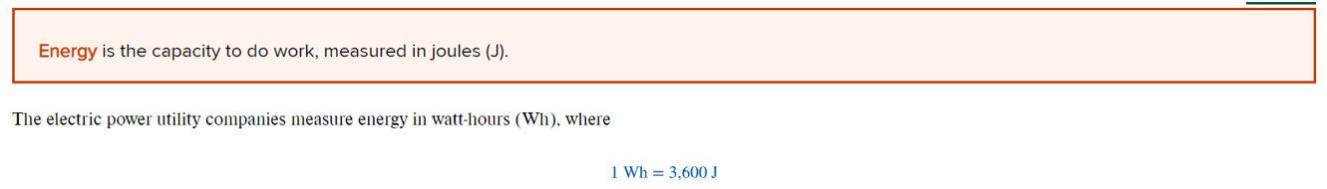
Power and Energy

Slide 23
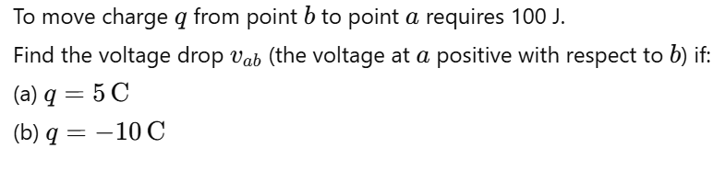
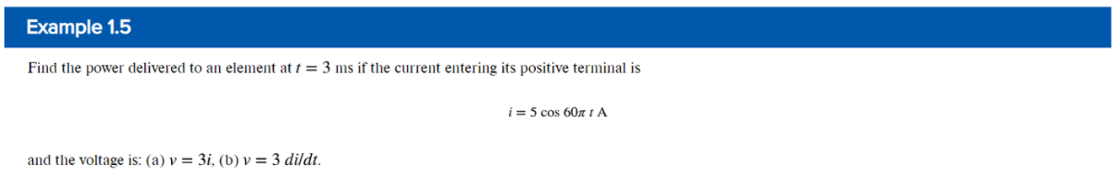
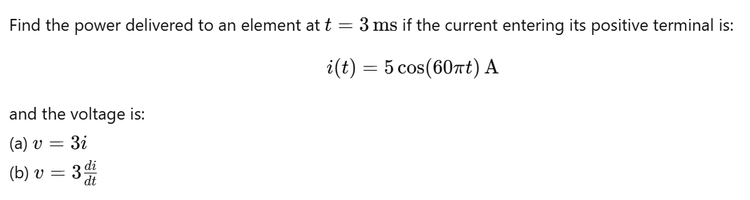
Power and Energy Examples

Slide 24
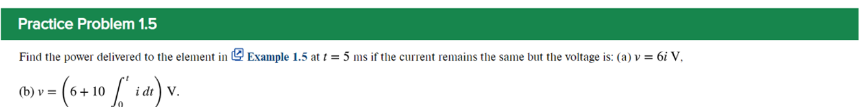
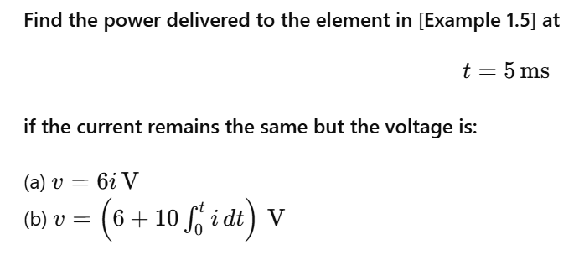
Power and Energy Examples

Slide 25
Power and Energy Examples

Slide 26
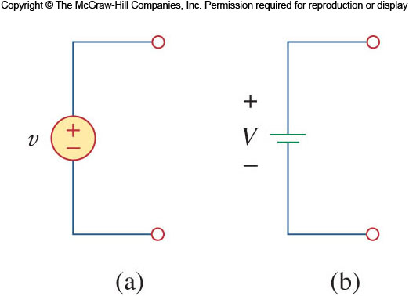
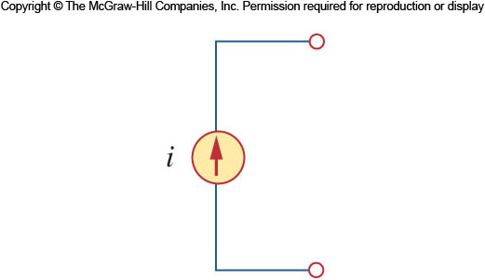
Circuit Elements
Two types:
  Active: Active elements can generate energy.
  Passive.
The most important active elements are voltage and current sources.
Active elements examples:
  Generators.
  Batteries.
  Operational Amplifiers.

Slide 27
Circuit Elements II
Passives absorb energy.
  Resistors.
  Capacitors.
  Inductors.
But it should be noted that only the resistor dissipates energy ideally.
The inductor and capacitor do not.

Slide 28
Ideal Voltage Source
An ideal voltage source has no internal resistance.
It also is capable of producing any amount of current needed to establish the desired voltage at its terminals.
Thus, we can know the voltage at its terminals, but we don’t know in advance the current.

Slide 29
Ideal Current Source
Current sources are the opposite of the voltage source:
They have infinite resistance.
They will generate any voltage to establish the desired current through them.
We can know the current through them in advance, but not the voltage.

Slide 30
Ideal sources
Both the voltage and current source ideally can generate infinite power.
They are also capable of absorbing power from the circuit.
It is important to remember that these sources do have limits in reality:
Voltage sources have an upper current limit.
Current sources have an upper voltage limit.

Slide 31
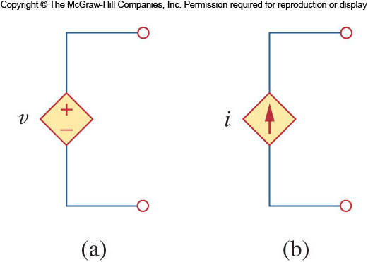
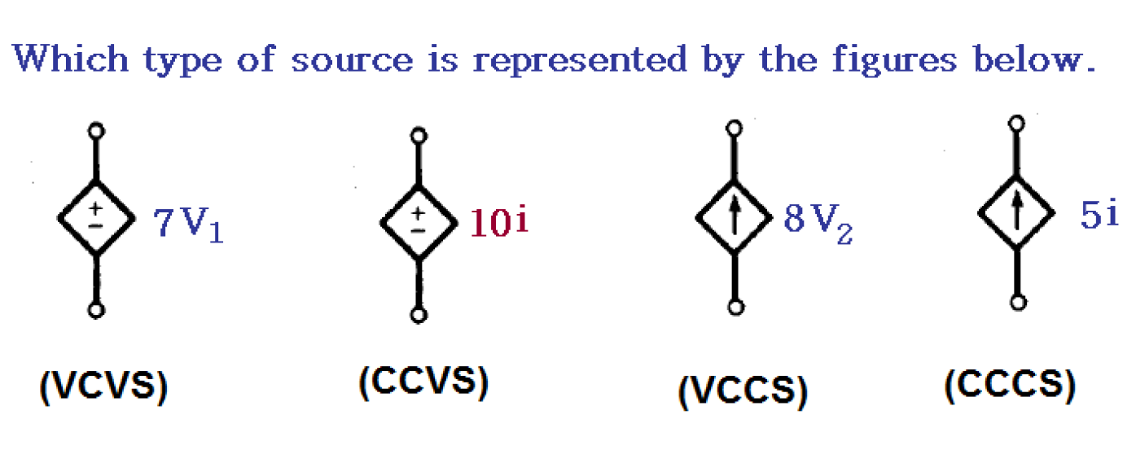
Dependent Sources
A dependent source has its output controlled by an input value.
Symbolically represented as a diamond.
Four types:
  A voltage-controlled voltage source (V C V S).
  A current-controlled voltage source (C C V S).
  A voltage-controlled current source (V C C S).
  A current-controlled current source (C C C S).

Slide 32
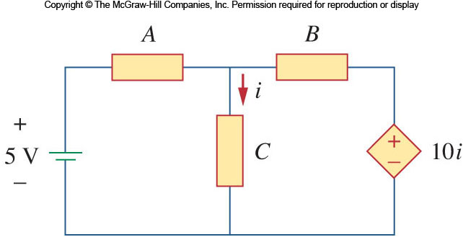
Dependent Source example
The circuit shown below is an example of using a dependent source.
The source on the right is controlled by the current passing through element C.

Slide 33
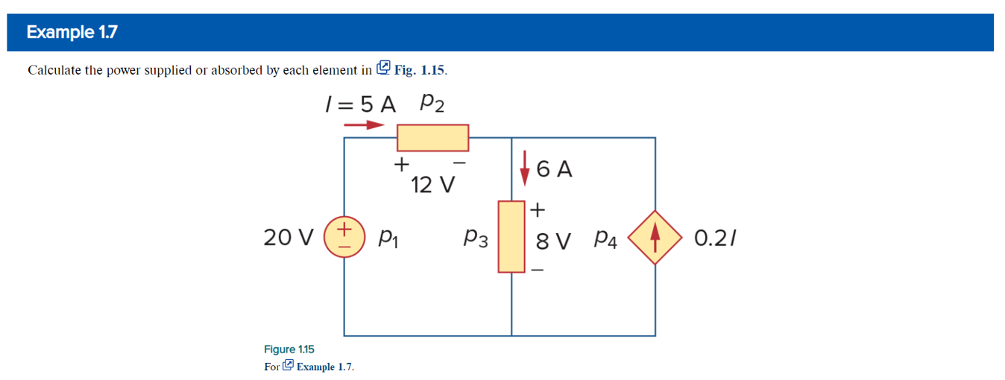
Circuit Elements Example

Slide 34
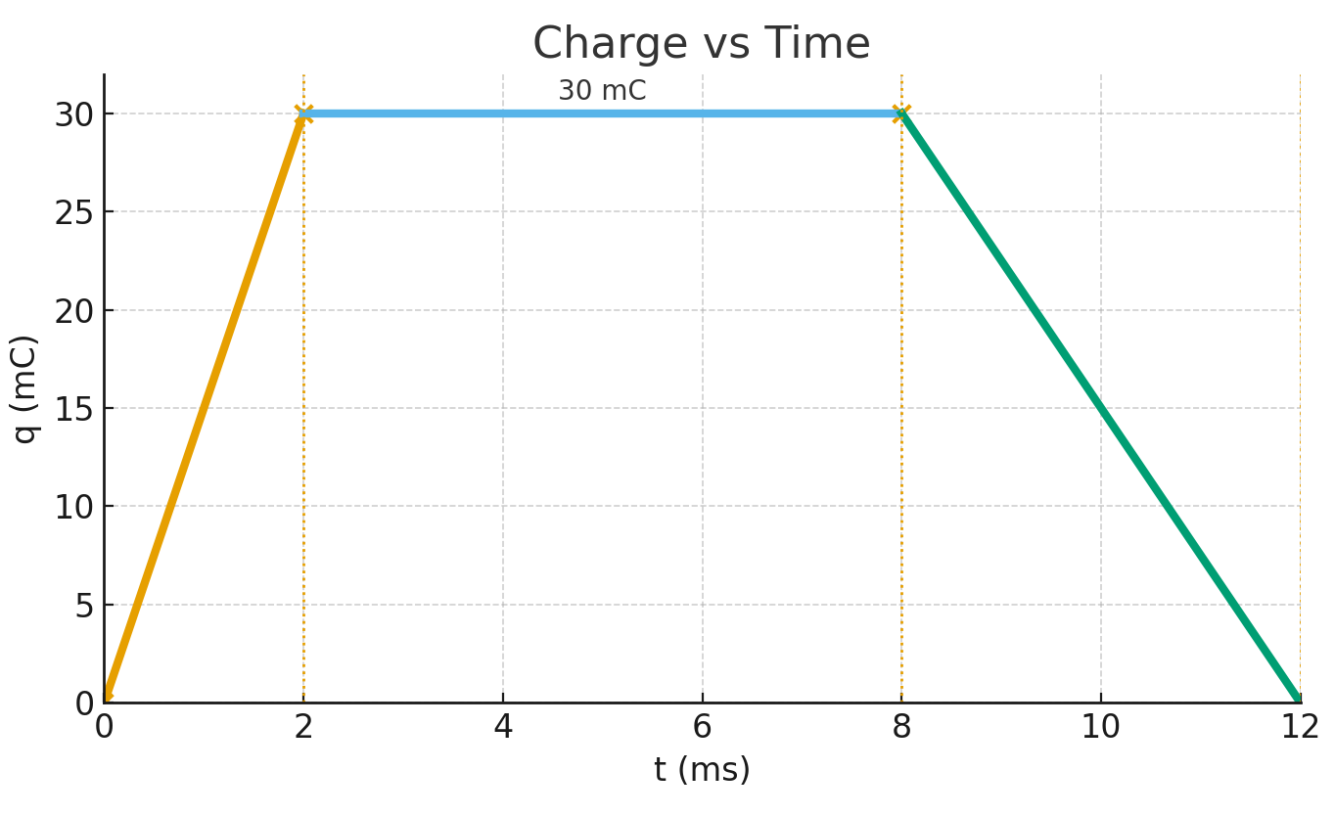
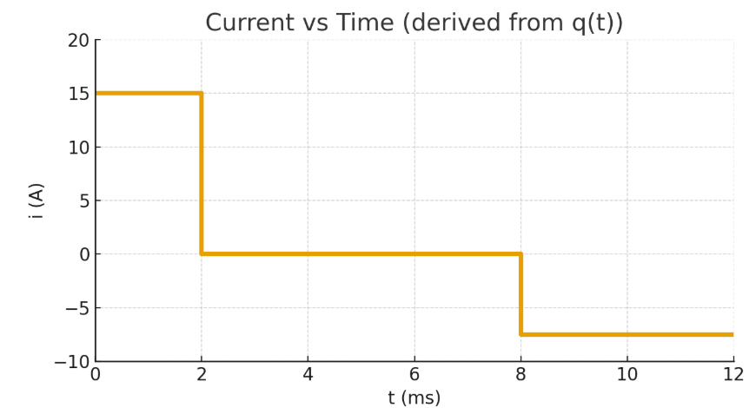


Extra Examples for charge and current
The charge entering a certain element is shown in the figure below.
Find the current at:
(a) t = 2 ms (b) t = 6 ms (c) t = 8 ms
(Assume q(t) is in mC and t is in ms.) and Sketch the corresponding current.

Slide 35
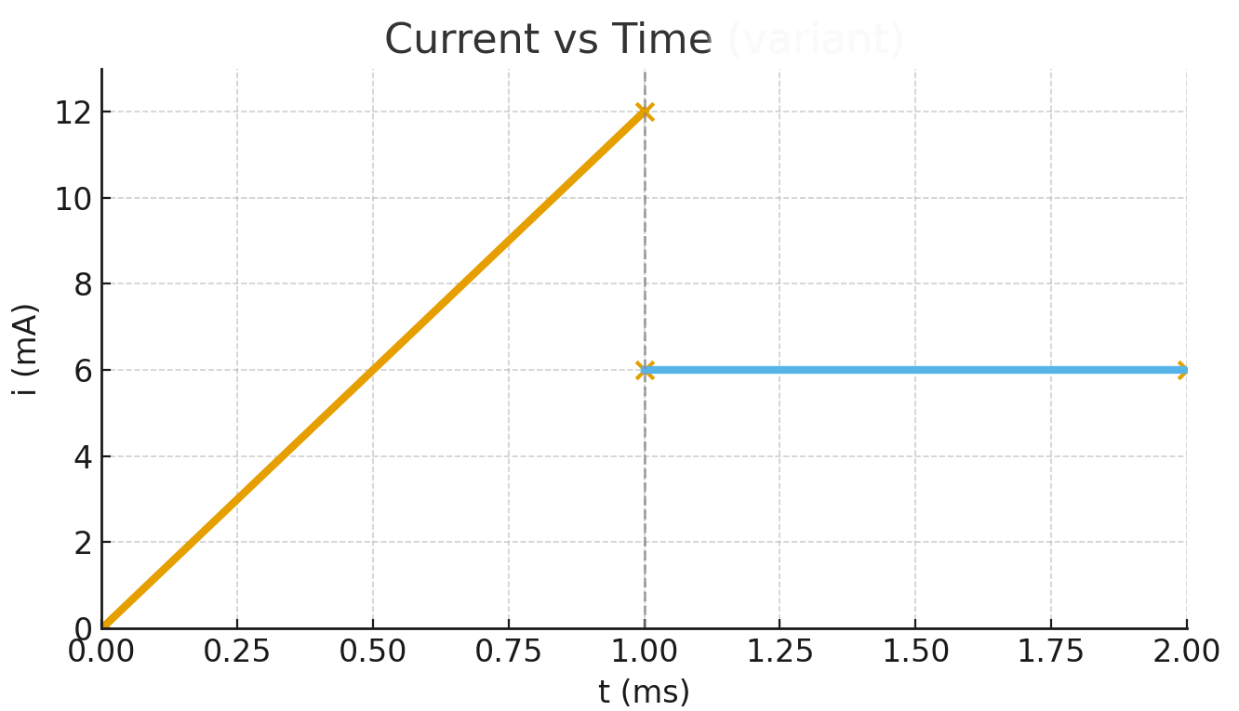
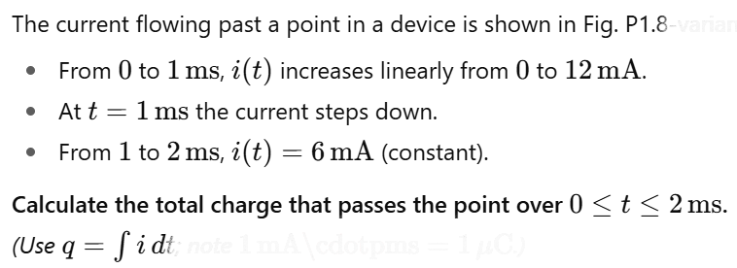
Example

Slide 36



Because learning changes everything.®
www.mheducation.com
© McGraw Hill LLC.

