Slide 1
Linear Circuits 1
ECET 250E
Week 3 | Chapter 3: Methods of Analysis
Camosun College
Electronics & Computer Engineering Technology
Mozhgan Bacon, PhD, P.Eng.
Fall 2026
Based on Fundamentals of Electric Circuits, 2026 Release — C.K. Alexander, M.N.O. Sadiku & S.J. Fredette (McGraw Hill)

Slide 2
Overview
With Ohm’s and Kirchhoff’s law established, they may now be applied to circuit analysis.
Two techniques will be presented in this chapter:
  Nodal analysis, which is based on Kichhoff current law (K C L).
  Mesh analysis, which is based on Kichhoff voltage law (K V L).

Slide 3
Nodal Analysis
If instead of focusing on the voltages of the circuit elements, one looks at the voltages at the nodes of the circuit, the number of simultaneous equations to solve for can be reduced.
Given a circuit with n nodes, without voltage sources, the nodal analysis is accomplished via three steps:
  Select a node as the reference node. Assign voltages v₁,v₂,…v_{n} to the remaining n-1 nodes, voltages are relative to the reference node.
  Apply K C L to each of the n − 1 non-reference nodes. Use Ohm’s law to express the branch currents in terms of node voltages.
  Solve the resulting n − 1 simultaneous equations to obtain the unknown node voltages.
The reference, or datum, node is commonly referred to as the ground since its voltage is by default zero.

Slide 4
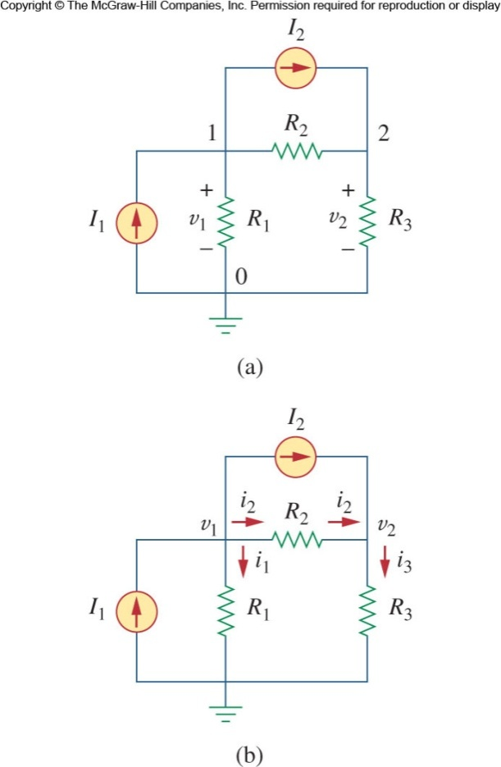




Applying Nodal Analysis
Let’s apply nodal analysis to this circuit to see how it works.
This circuit has a node that is designed as ground. We will use that as the reference node (node 0).
The remaining two nodes are designed 1 and 2 and assigned voltages v₁ and v₂.
Now apply K C L to each node:
At node 1.
At node 2.
We can express this principle as

Slide 5
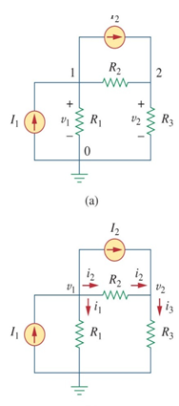
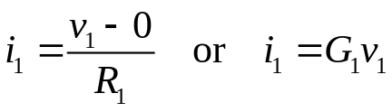
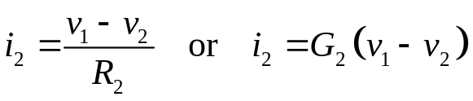
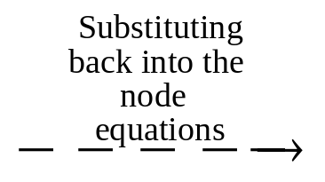
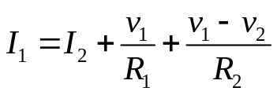
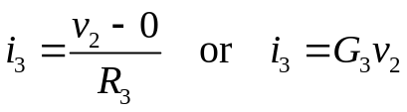
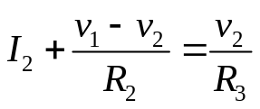



Apply Nodal Analysis II
We can now use O H M’s law to express the unknown currents i₁, i₂, and i₃ in terms of node voltages.
In doing so, keep in mind that current flows from high potential to low.
From this we get:
The last step is to solve the system of equations.

Slide 6
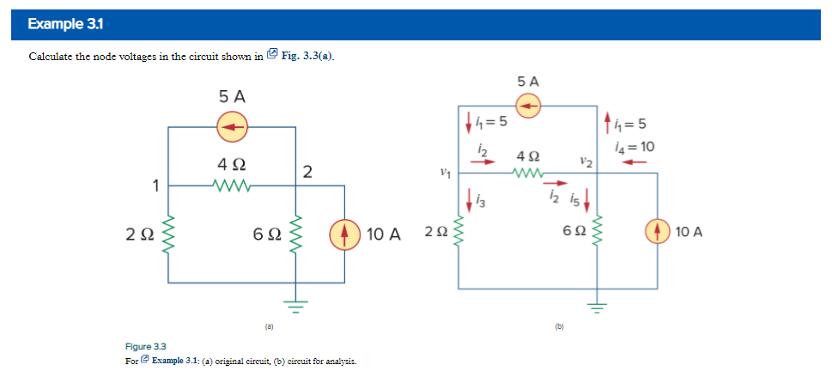
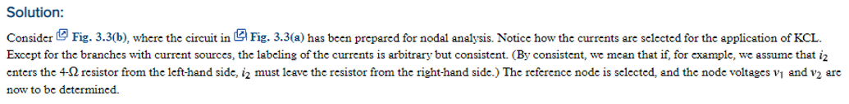
Apply Nodal Analysis

Slide 7
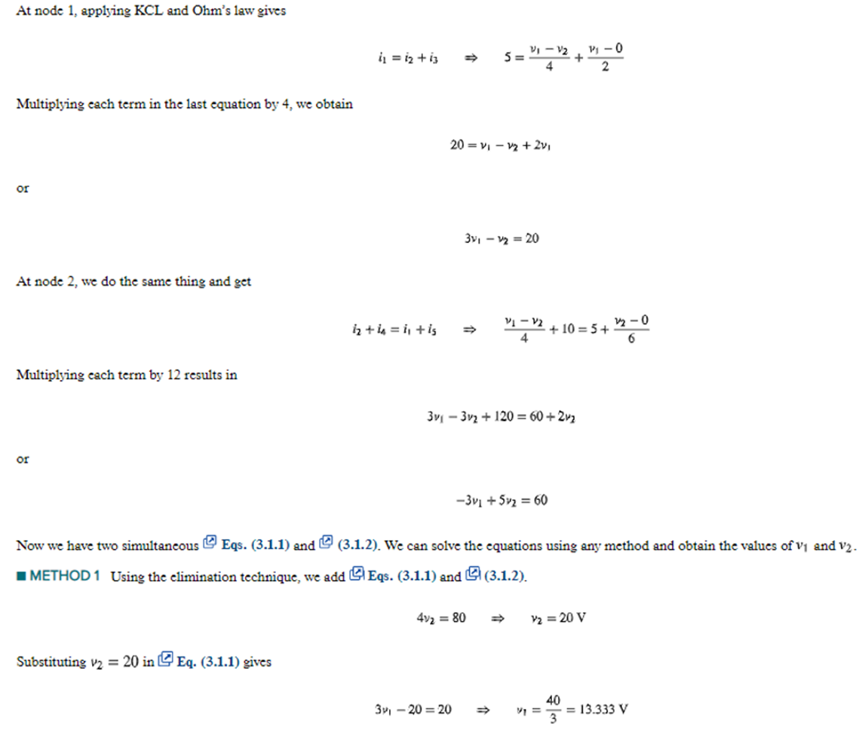


Slide 8
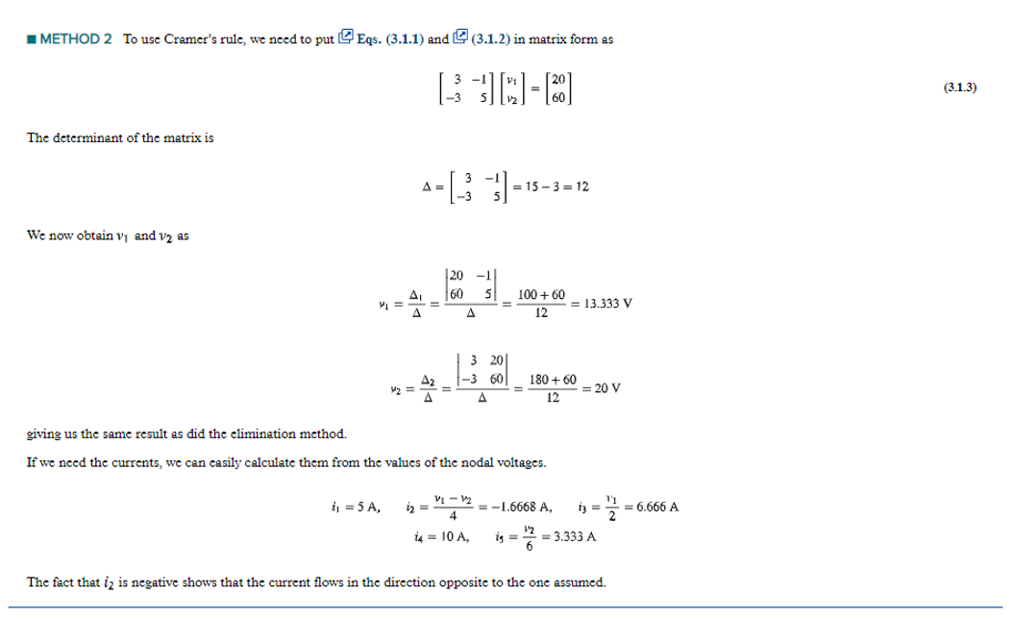

Slide 9
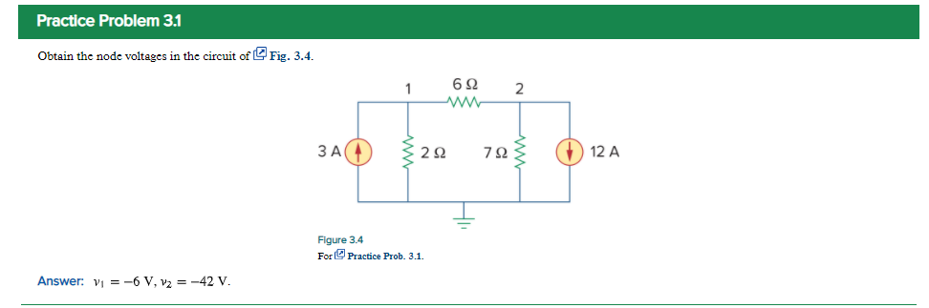

Slide 10
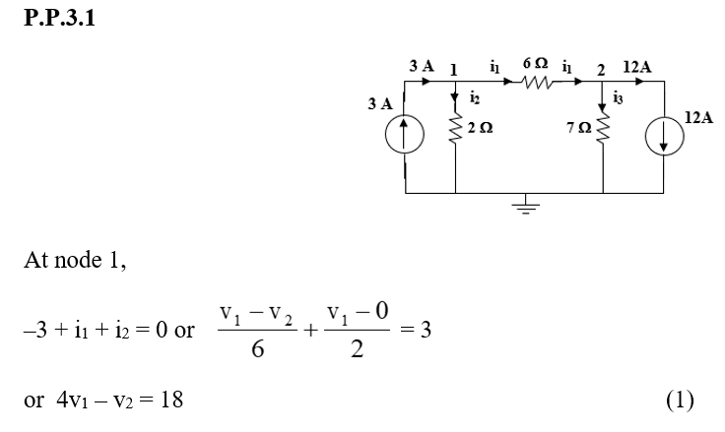
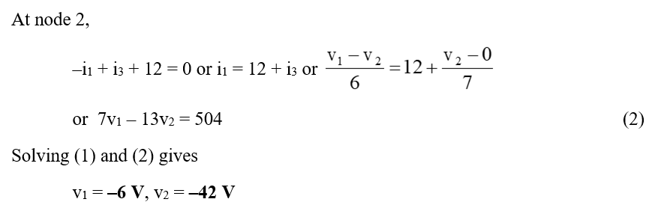

Slide 11
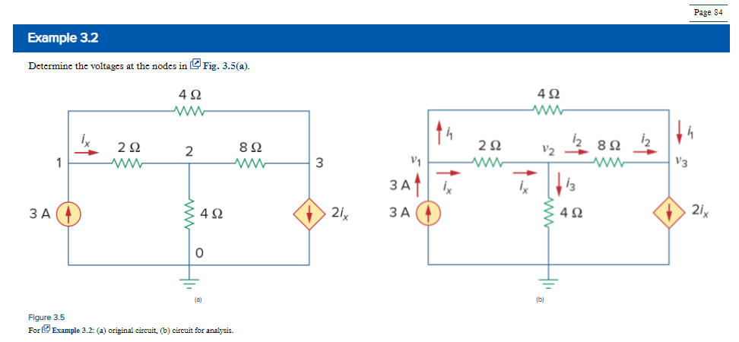

Slide 12
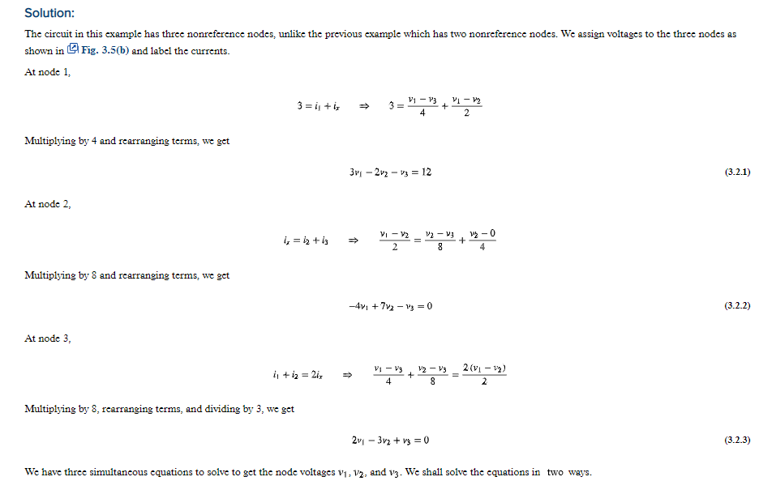

Slide 13
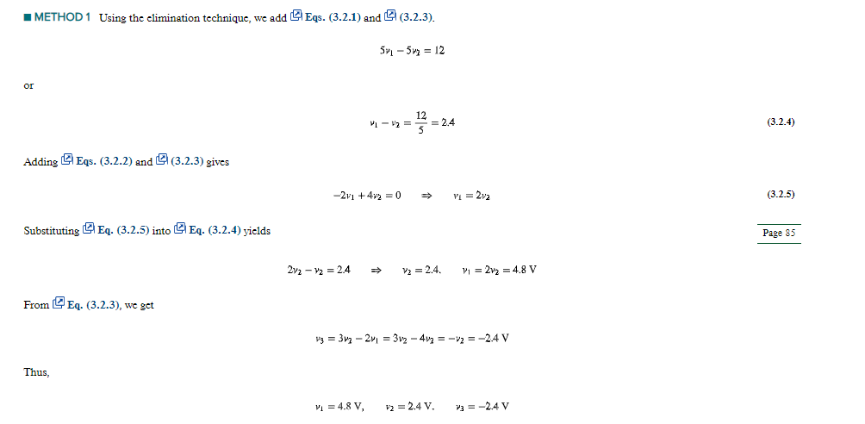

Slide 14
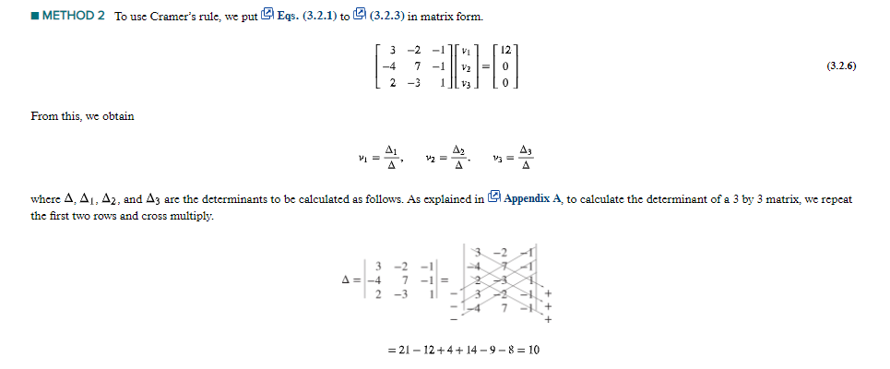
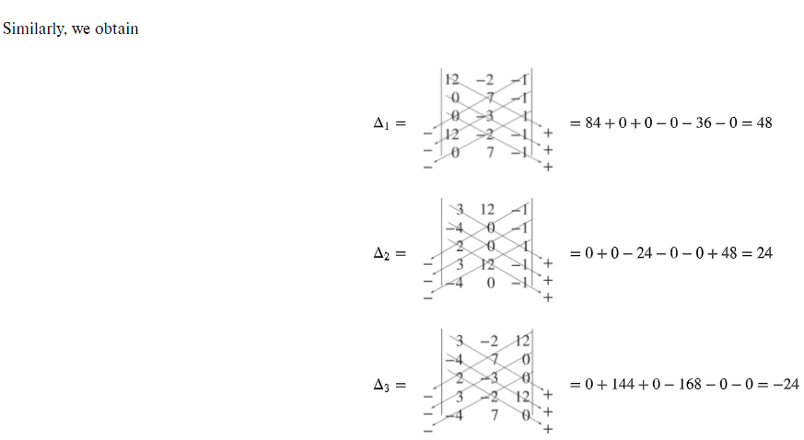

Slide 15
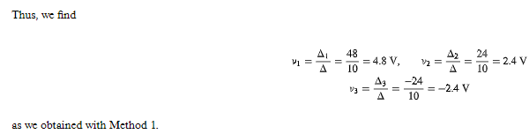
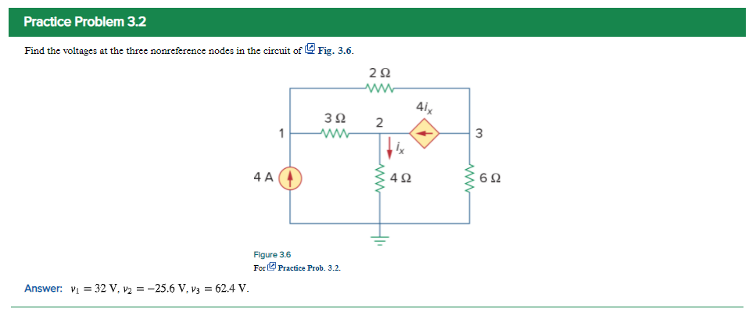

Slide 16
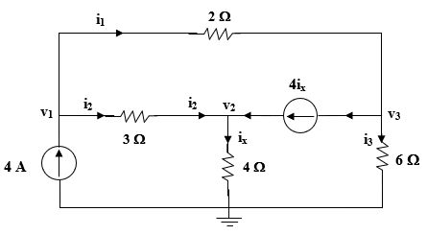
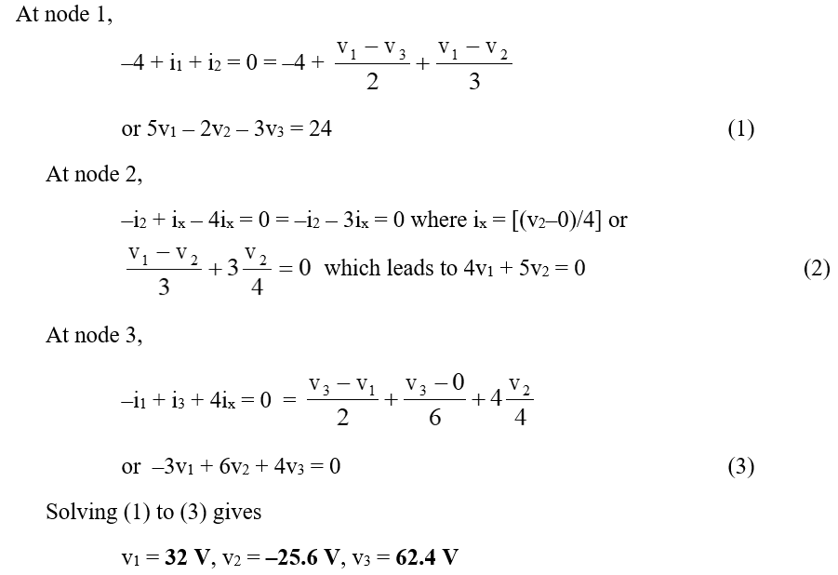

Slide 17
Mesh Analysis
Another general procedure for analyzing circuits is to use the mesh currents as the circuit variables.
Recall:
  A loop is a closed path with no node passed more than once.
  A mesh is a loop that does not contain any other loop within it.
Mesh analysis uses K V L to find unknown currents.

Slide 18
Mesh Analysis Steps
Mesh analysis follows these steps:
Assign mesh currents i₁,i₂,…i_{n} to the n meshes.
Apply K V L to each of the n mesh currents.
Solve the resulting n simultaneous equations to get the mesh currents.

Slide 19
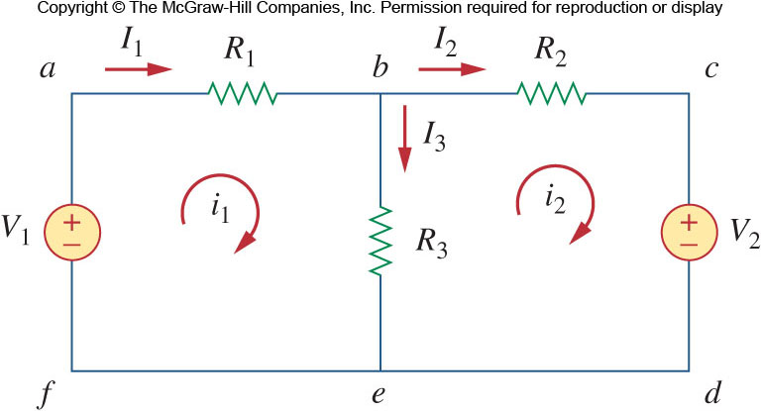
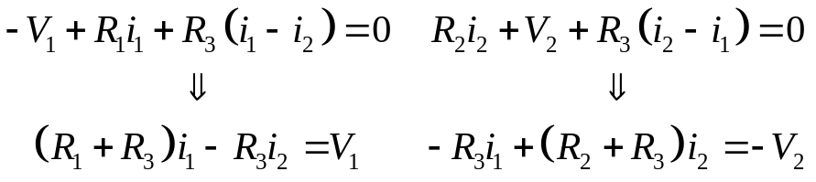
Mesh Analysis Example
The above circuit has two paths that are meshes (abefa and bcdeb).
The outer loop (abcdefa) is a loop, but not a mesh.
First, mesh currents i₁ and i₂ are assigned to the two meshes.
Applying K V L to the meshes:

Slide 20
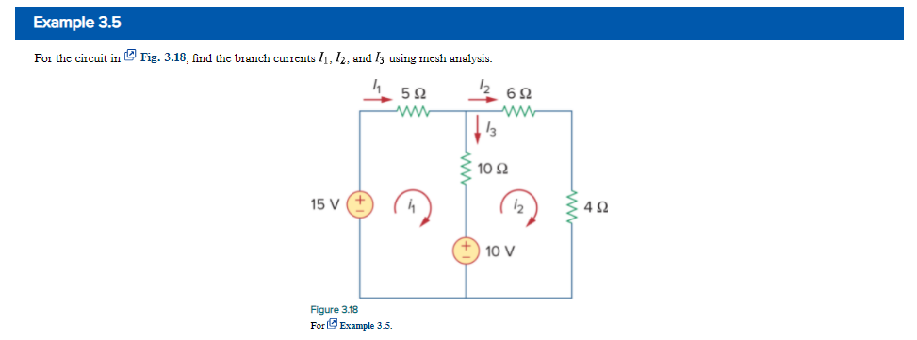
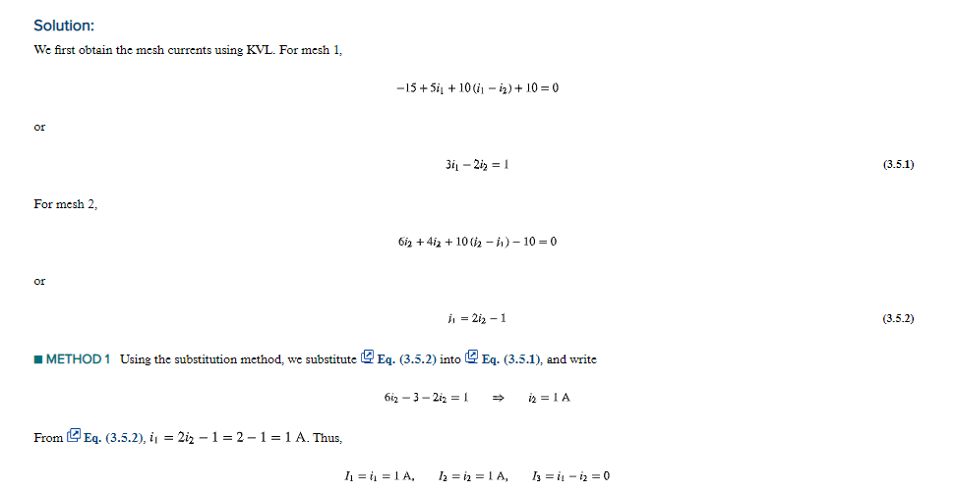

Slide 21
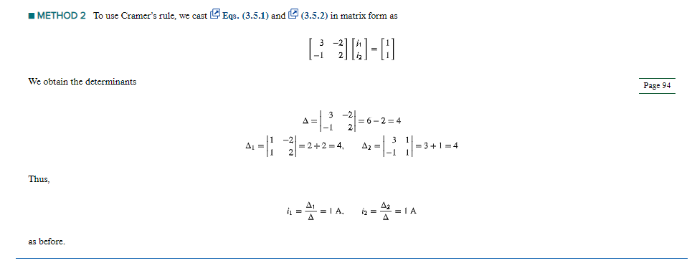

Slide 22
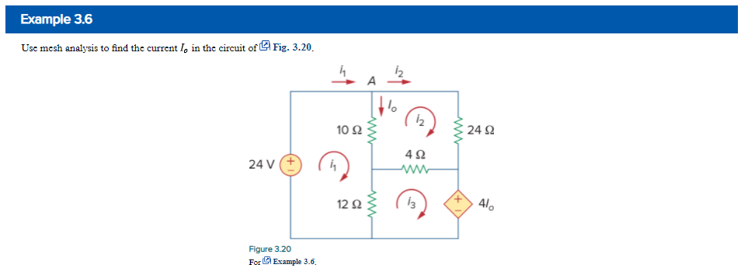

Slide 23
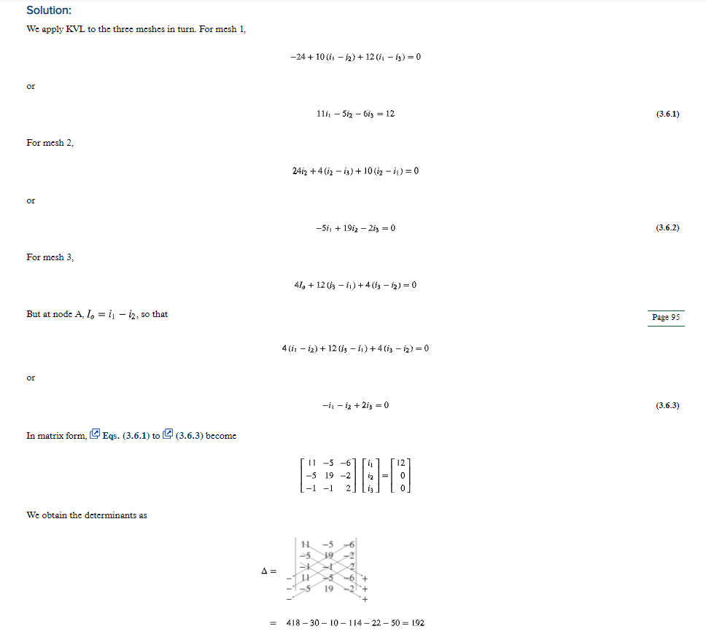
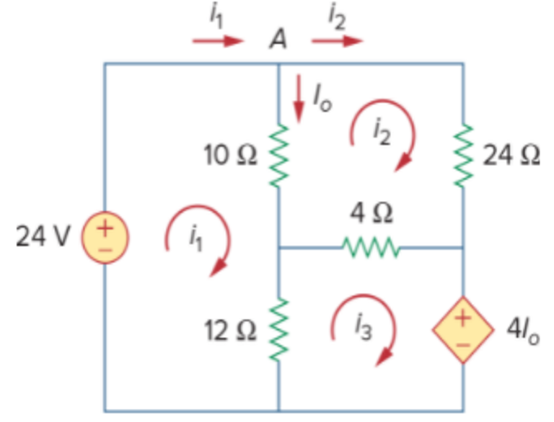






Slide 24
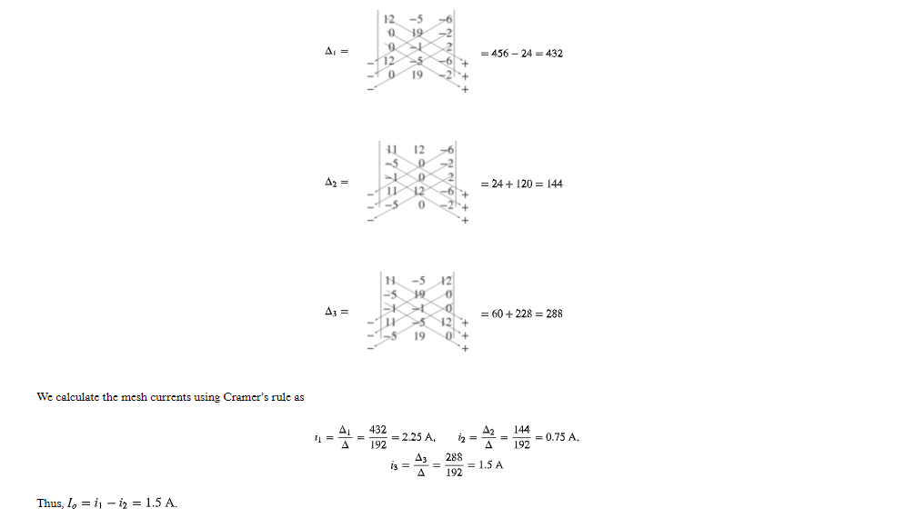

Slide 25
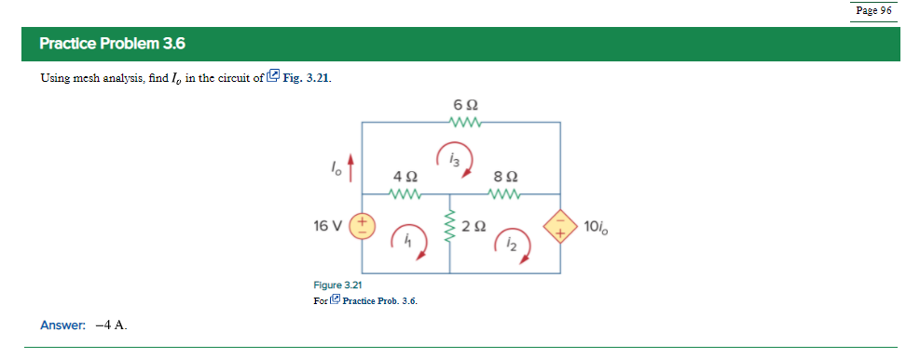
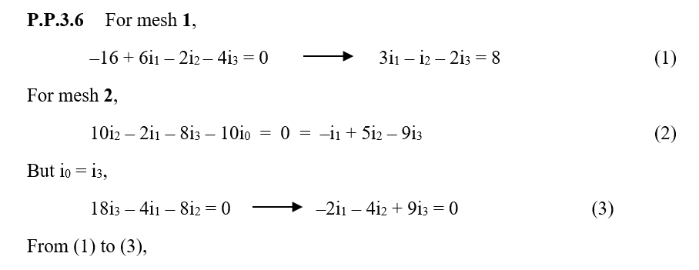




Slide 26
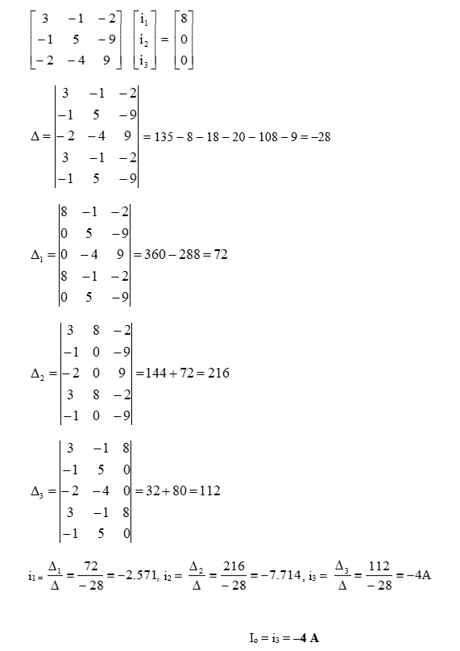


Slide 27
Mesh analysis when…
If the network contains:
  Many series connected elements.
  Voltage sources.
  A circuit with fewer meshes than nodes.

Slide 28
Nodal analysis if…
If the network contains:
  Many parallel connected elements.
  Current sources.
  Circuits with fewer nodes than meshes.

Slide 29



Because learning changes everything.®
www.mheducation.com
© McGraw Hill LLC.

