Slide 1
Linear Circuits 1
ECET 250E
Week 7 | Chapter 8: Second-Order Circuits
Camosun College
Electronics & Computer Engineering Technology
Mozhgan Bacon, PhD, P.Eng.
Fall 2026
Based on Fundamentals of Electric Circuits, 2026 Release — C.K. Alexander, M.N.O. Sadiku & S.J. Fredette (McGraw Hill)

Slide 2
Overview
The previous chapter introduced the concept of first order circuits.
This chapter will expand on that with second order circuits: those that need a second order differential equation.
R L C series and parallel circuits will be discussed in this context.
The step response of these circuits will be covered as well.

Slide 3
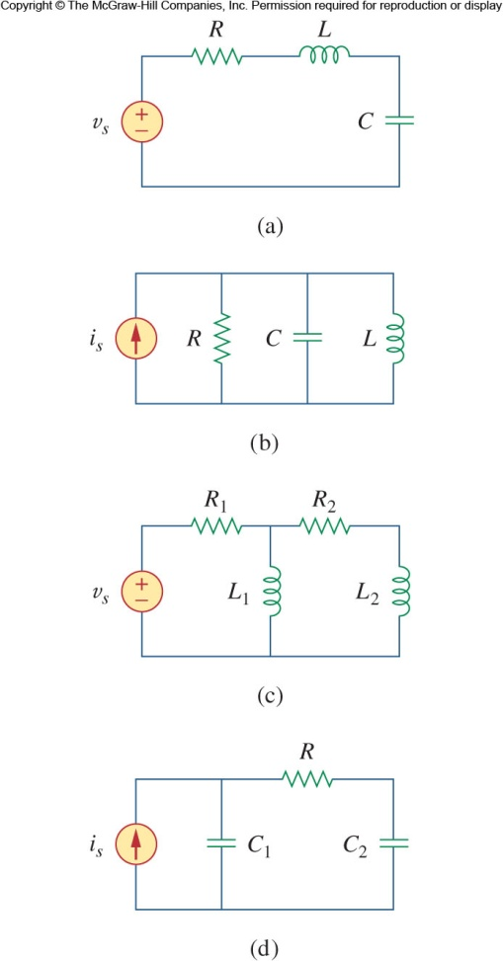
Second Order Circuits
The previous chapter considered circuits which only required first order differential equations to solve.
However, when more than one “storage element”, that is, capacitor or inductor is present, the equations require second order differential equations.
The analysis is similar to what was done with first order circuits.
This time, though we will only consider D C independent sources.

Slide 4
Finding Initial and Final Values
Working on second order system is harder than first order in terms of finding initial and final conditions.
You need to know the derivatives, d v/d t and d i/d t as well.
Getting the polarity across a capacitor and the direction of current through an inductor is critical.
Capacitor voltage and inductor current are always continuous.

Slide 5
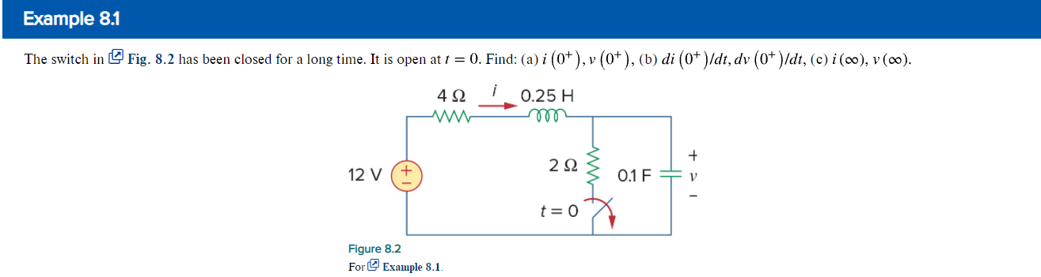

Slide 6
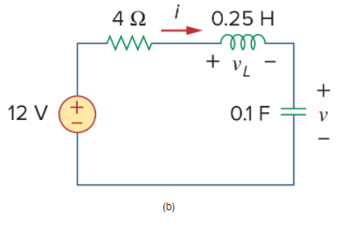
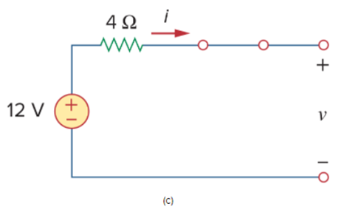

Slide 7
Source Free R L C Circuits
Source Free Series R L C
2. Source Free Parallel R L C

Slide 8
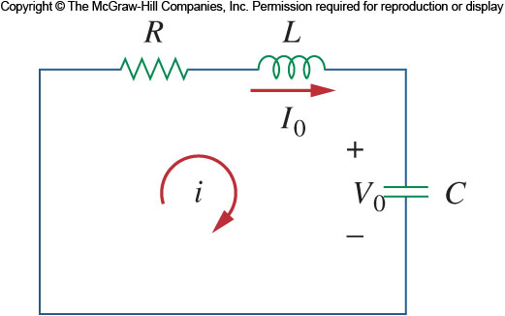
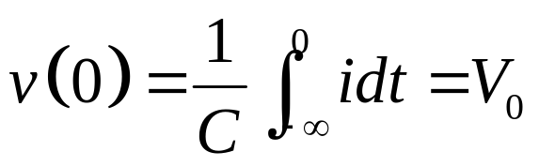
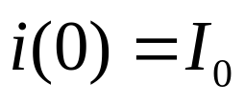
Source Free Series R L C 1
Consider the circuit shown.
The energy at t = 0 is stored in the capacitor, represented by V₀ and in the inductor, represented by I₀.

Slide 9
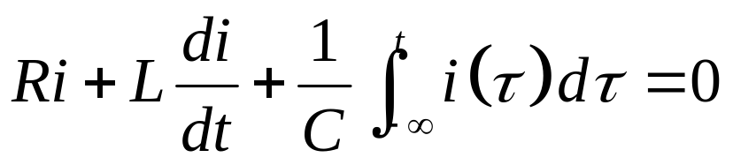
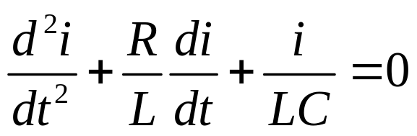
Source Free Series R L C 2
Applying K V L around the loop:
The integral can be eliminated by differentiation:
Here you can see the second order equation that results.

Slide 10
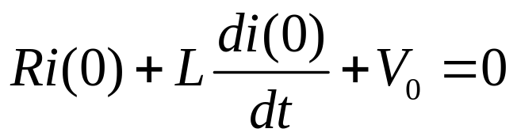
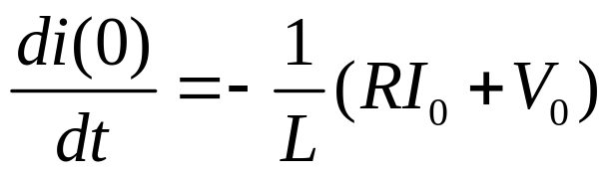
Source Free Series R L C 3
Two initial conditions are needed for solving this problem.
The initial current is given.
The first derivative of the current can also be:
Or

Slide 11

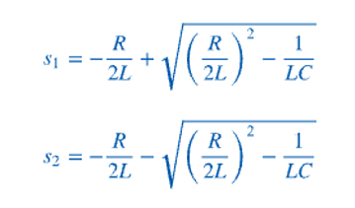
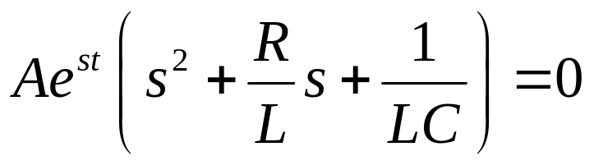

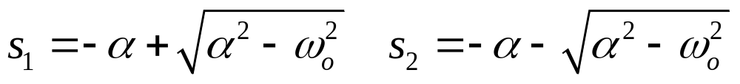
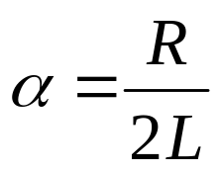
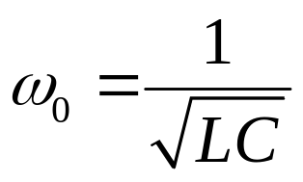
Source Free Series R L C 4
Based on the first order solutions, we can expect that the solution will be in exponential form.
The equation will then be:
For which the solutions are:

Slide 12
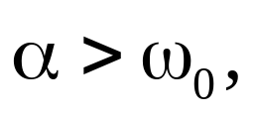

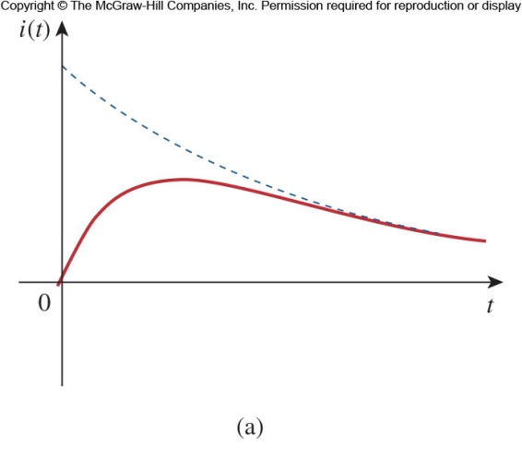

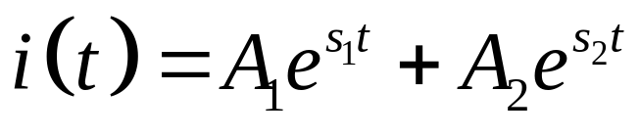
Overdamped (Alpha > Omega₀)
When
the system is overdamped.
In this case, both s₁ and s₂ are real and negative.
The response of the system is:
From this, we should not expect to see an oscillation.

Slide 13
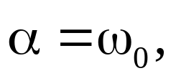

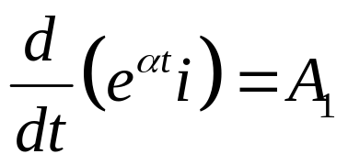

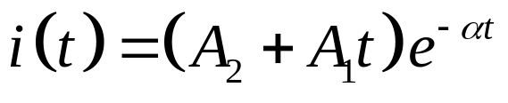

Critically Damped (Alpha = Omega₀)
When
the system is critically damped.
The differential equation becomes:
For which the solution is:
There are two components to the response, an exponential decay and an exponential decay multiplied by a linear term.

Slide 14
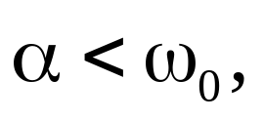

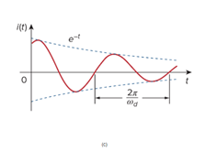
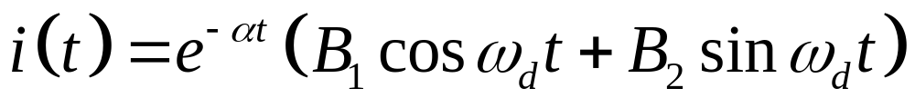
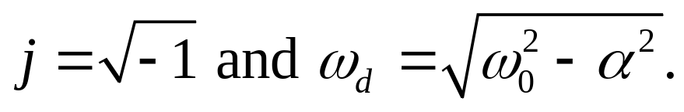


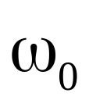
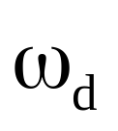
Underdamped (Alpha < Omega₀)
When
the system is considered to be
underdamped.
In this case, the solution will be:
Where
is often called the undamped natural frequency.
is called the damped natural frequency.

Slide 15
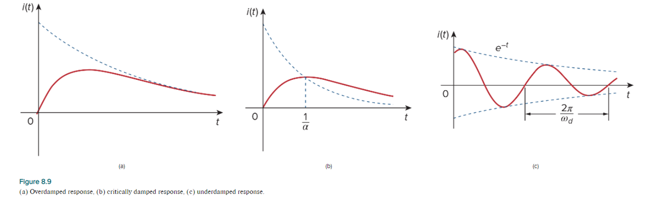

Slide 16
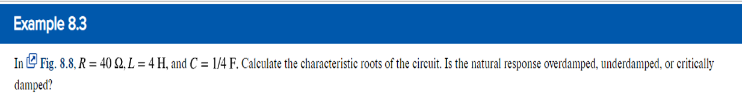

Slide 17
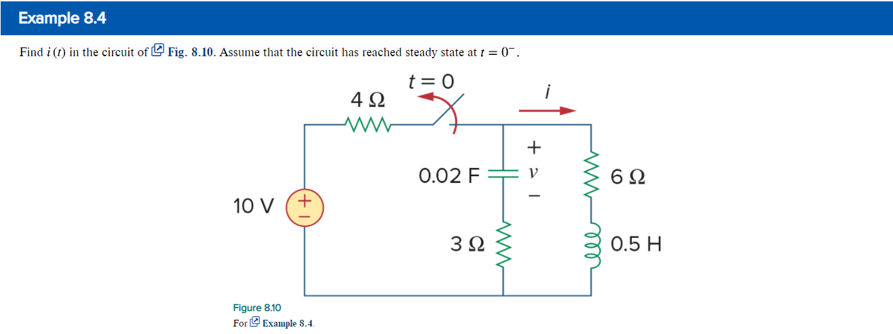

Slide 21
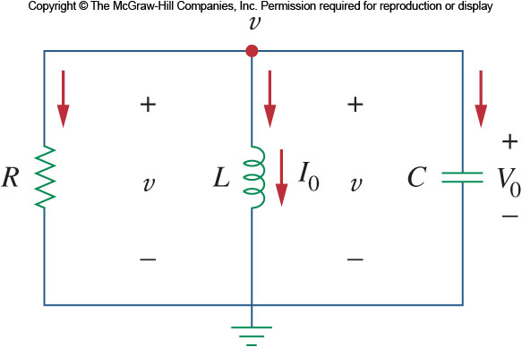
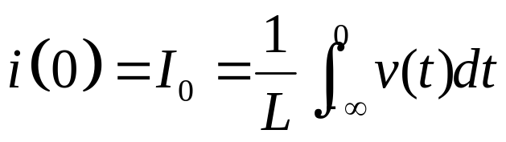
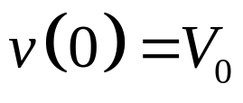
Source Free Parallel R L C Network 1
Now let us look at parallel forms of R L C networks.
Consider the circuit shown.
Assume the initial current and voltage to be:

Slide 22
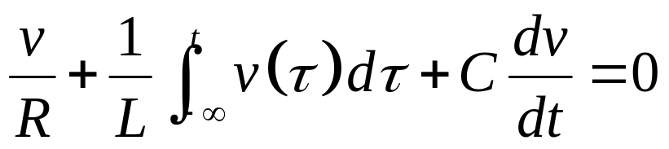
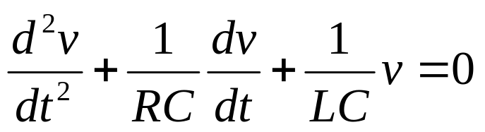
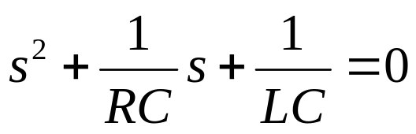
Source Free Parallel R L C Network 2
Applying K C L to the top node we get:
Taking the derivative with respect to t gives:
The characteristic equation for this is:

Slide 23
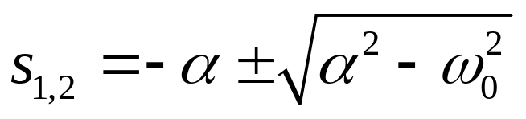
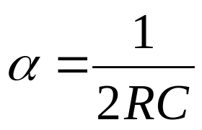

Source Free Parallel R L C Network 3
From this, we can find the roots of the characteristic equation to be:
As in last time, there are three scenarios to consider.

Slide 24
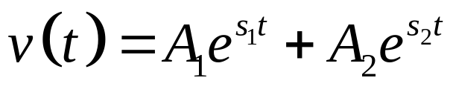
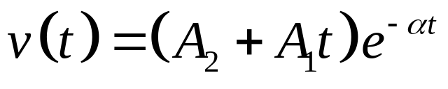
Damping
For the overdamped case, the roots are real and negative, so the response is:
For critically damped, the roots are real and equal, so the response is:

Slide 25
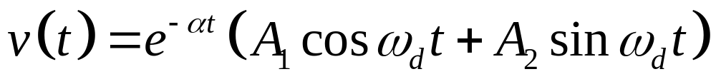
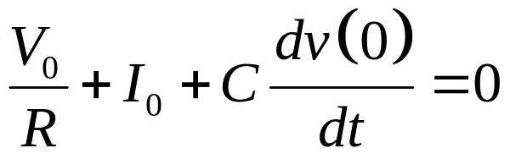
Underdamped
In the underdamped case, the roots are complex and so the response will be:
To get the values for the constants, we need to know v(0) and d v(0)/d t.
To find the second term, we use:

Slide 26
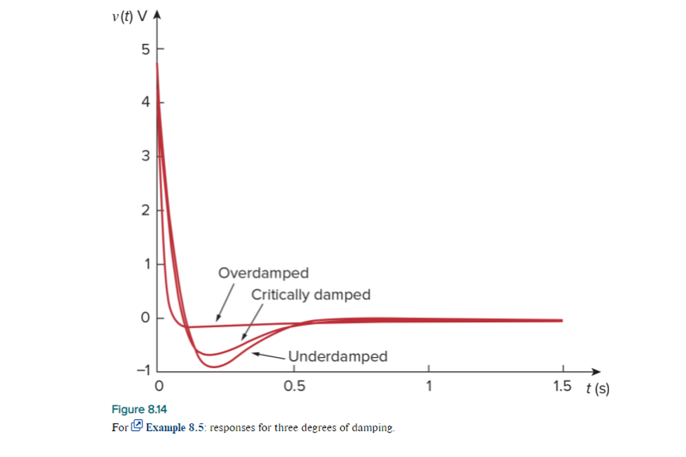
The voltage waveforms will be similar to those shown for the series network.
Note that in the series network, we first found the inductor current and then solved for the rest from that.
Here we start with the capacitor voltage and similarly, solve for the other variables from that.

Slide 27
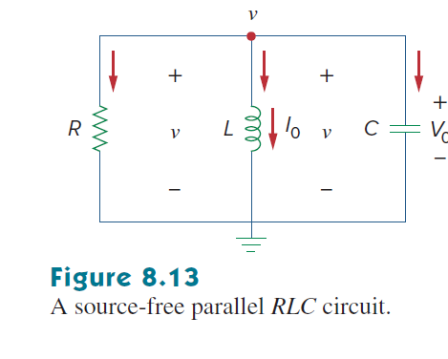

Slide 31
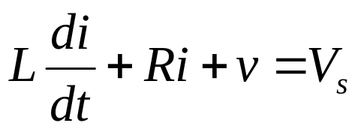
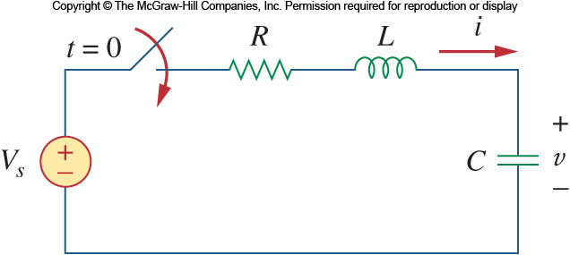
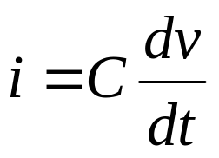
Step Response of a Series R L C Circuit
Now let us consider what happens when a D C voltage is suddenly applied to a second order circuit.
Consider the circuit shown. The switch closes at t = 0.
Applying K V L around the loop for t > 0:
but

Slide 32
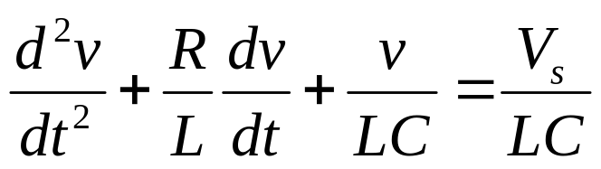
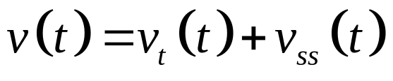
Step Response of a Series R L C Circuit 2
Substituting for i gives:
This is similar to the response for the source free version of the series circuit, except the variable is different.
The solution to this equation is a combination of transient response and steady state.

Slide 33
Step Response of a Series R L C Circuit
The transient response is in the same form as the solutions for the source free version.
The steady state response is the final value of v(t). In this case, the capacitor voltage will equal the source voltage.

Slide 34

Step Response of a Series R L C Circuit 4
The complete solutions for the three conditions of damping are:
The variables A₁ and A₂ are obtained from the initial conditions, v(0) and d v(0)/d t.

Slide 35


Slide 36





Step Response of a Parallel R L C Circuit
The same treatment given to the parallel R L C circuit yields the same result.

Slide 37

Step Response of a Parallel R L C Circuit
The response is a combination of transient and steady state responses:
$$\begin{matrix}i\left(t\right)=I_{s}+A_{1}e^{s_{1}t}+A_{2}e^{s_{2}t} & (\text{Overdamped})\end{matrix}$$
$$\begin{matrix}i\left(t\right)=I_{s}+\left(A_{1}+A_{2}t\right)e^{−αt} & (\text{Crit}\text{ic}\text{ally} \text{Damped})\end{matrix}$$
Here the variables A₁ and A₂ are obtained from the initial conditions, i(0) and d i(0)/d t.

Slide 38


Slide 41
Damping and R L C networks
R L C networks can be characterized by the following:
The behavior of these networks is captured by the idea of damping.
Oscillatory response is possible due to the presence of two types of energy storage elements.
It is typically difficult to tell the difference between damped and critically damped responses.

Slide 42










Summery

Slide 43



Because learning changes everything.®
www.mheducation.com
© McGraw Hill LLC.

