Slide 1
Linear Circuits 1
ECET 250E
Week 8 | Chapter 9: Sinusoids and Phasors
Camosun College
Electronics & Computer Engineering Technology
Mozhgan Bacon, PhD, P.Eng.
Fall 2026
Based on Fundamentals of Electric Circuits, 2026 Release — C.K. Alexander, M.N.O. Sadiku & S.J. Fredette (McGraw Hill)

Slide 2
Overview
We now begin the analysis of circuits in which the source voltage or current is time-varying. In this chapter, we are particularly interested in sinusoidally time-varying excitation, or simply, excitation by a sinusoid.
This chapter will cover alternating current.
A discussion of complex numbers is included prior to introducing phasors.
Applications of phasors and frequency domain analysis for circuits including resistors, capacitors, and inductors will be covered.
The concept of impedance and admittance is also introduced.

Slide 3
Alternating Current
Alternating Current, or A C, is the dominant form of electrical power that is delivered to homes and industry.
In the late 1800’s there was a battle between proponents of D C and A C.
A C won out due to its efficiency for long distance transmission.
A C is a sinusoidal current, meaning the current reverses at regular times and has alternating positive and negative values.

Slide 4
Sinusoids
Sinusoids are interesting to us because there are a number of natural phenomenon that are sinusoidal in nature.
It is also a very easy signal to generate and transmit.
Also, through Fourier analysis, any practical periodic function can be made by adding sinusoids.
Lastly, they are very easy to handle mathematically.

Slide 5
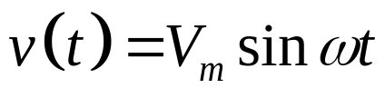
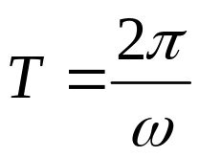
Sinusoids
A sinusoidal forcing function produces both a transient and a steady state response.
When the transient has died out, we say the circuit is in sinusoidal steady state.
A sinusoidal voltage may be represented as:
From the waveform shown below, one characteristic is clear: The function repeats itself every T seconds.
This is called the period.

Slide 6
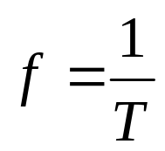

Sinusoids
The period is inversely related to another important characteristic, the frequency.
The units of this is cycles per second, or Hertz (Hz).
It is often useful to refer to frequency in angular terms:
Here the angular frequency is in radians per second (rad/s).

Slide 7
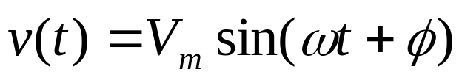
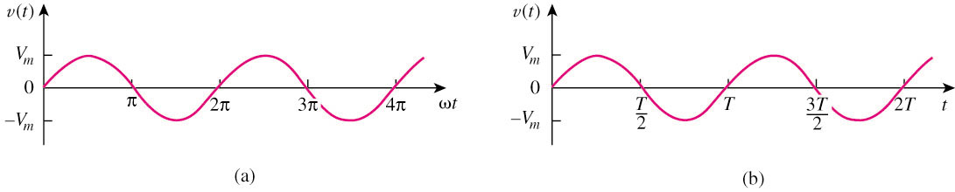

Sinusoids
A sinusoid is a signal that has the form of the sine or cosine function.
A general expression for the sinusoid,
where
Vm = the amplitude of the sinusoid
ω = the angular frequency in radians/s
Ф = the phase

Slide 8

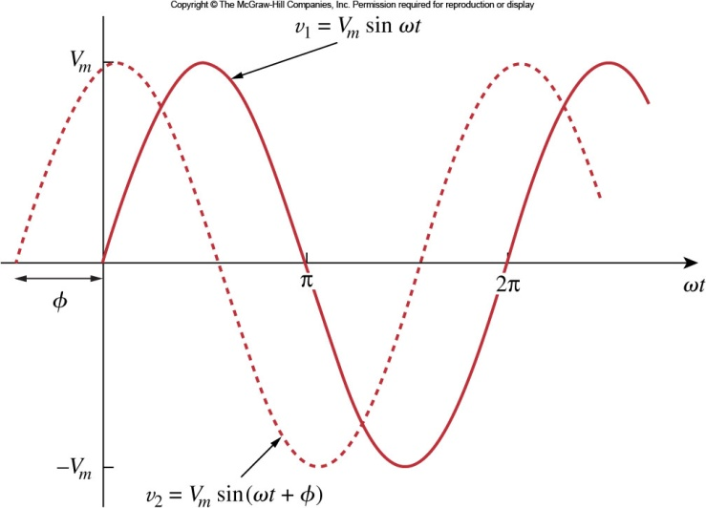
Sinusoids
More generally, we need to account for relative timing of one wave versus another.
This can be done by including a phase shift,
Consider the two sinusoids:
Only two sinusoidal values with the same frequency can be compared by their amplitude and phase difference.
If phase difference is zero( ) , they are in phase;
If phase difference is not zero( ) , they are out of phase.

Slide 9
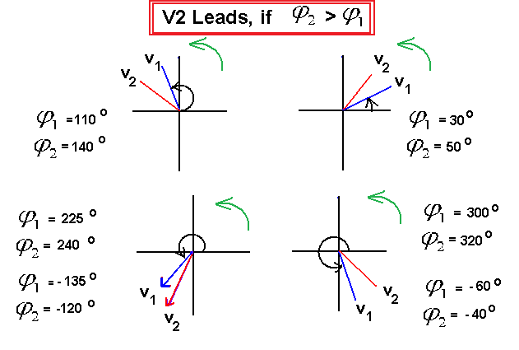
Sinusoids

Slide 10
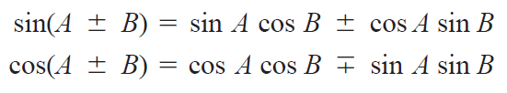
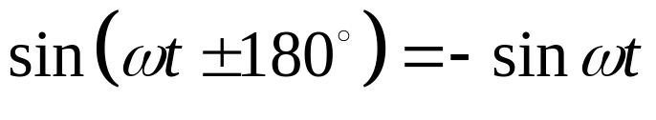
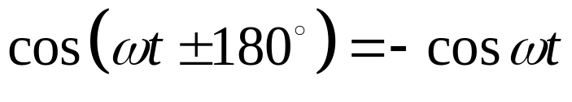
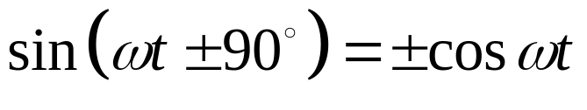
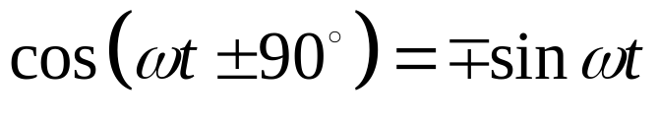
Sinusoids
If two sinusoids are in phase, then this means that the reach their maximum and minimum at the same time.
Sinusoids may be expressed as sine or cosine.
The conversion between them is:
(9.9)
(9.10)

Slide 11
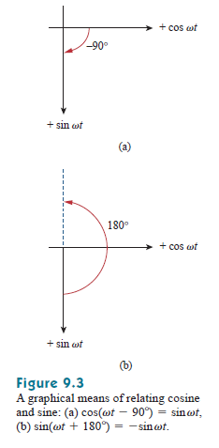
A graphical approach may be used to relate or compare sinusoids as an alternative to using the trigonometric identities in Eqs. (9.9) and (9.10). Consider the set of axes shown in
Fig. 9.3(a).
The horizontal axis represents the magnitude of cosine, while the vertical axis (pointing down) denotes the magnitude of sine.
Angles are measured positively counterclockwise from the horizontal, as usual in polar coordinates. This graphical technique can be used to relate two sinusoids.

Slide 12



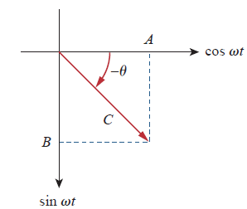
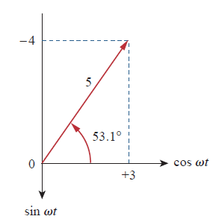

We obtain

Slide 13
Given v(t) = Vm sin (ωt +10º). Transform to Cosine
Solution
v(t) = V_{m} sin (ωt +10º)
v(t) = V_{m} cos (ωt + 10º - 90º)
v(t) = V_{m} cos (ωt – 80º)

Slide 14
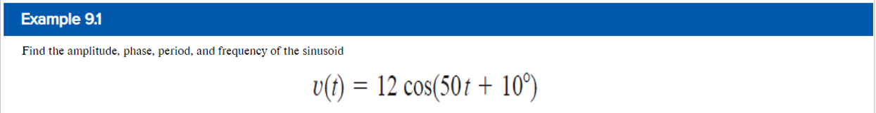

Slide 15
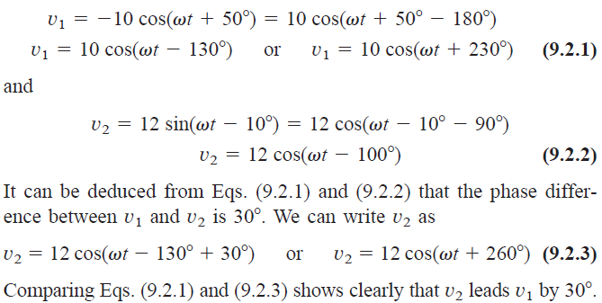


Solution:
Let us calculate the phase in three ways. The first two methods use trigonometric identities, while the third method uses the graphical approach.
■ METHOD 1 In order to compare v1 and v2 we must express them in the same form. If we express them in cosine form with positive amplitudes,

Slide 16
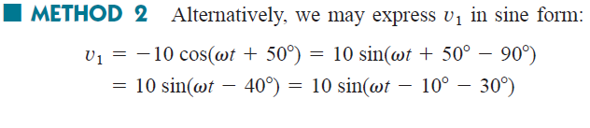

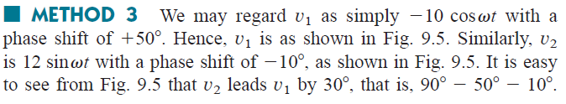
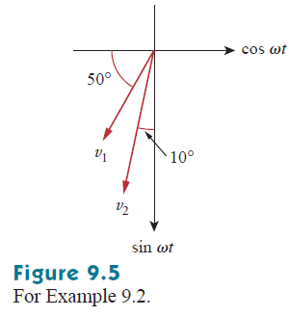

Slide 17
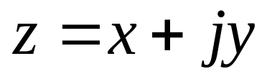
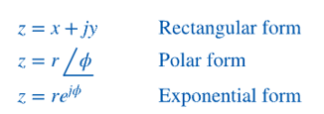
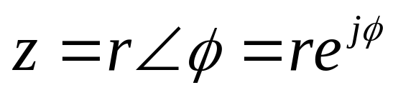
Complex Numbers
A powerful method for representing sinusoids is the phasor.
But in order to understand how they work, we need to cover some complex numbers first.
A complex number z can be represented in rectangular form as:
It can also be written in polar or exponential form as:

Slide 18
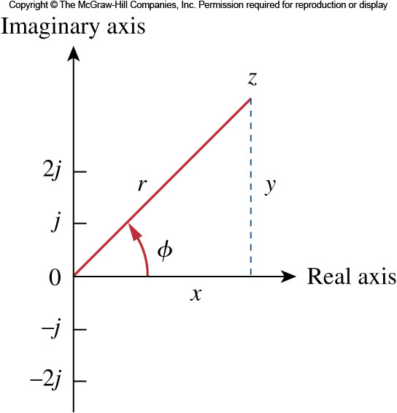
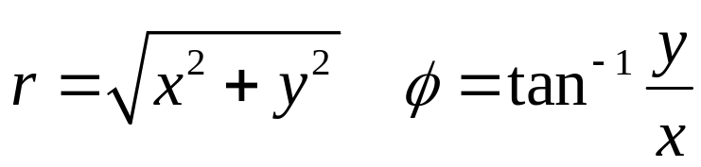
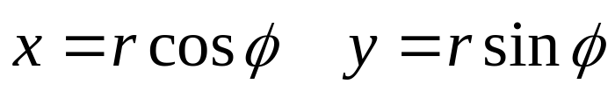
Complex Numbers
The different forms can be interconverted.
Starting with rectangular form, one can go to polar:
Likewise, from polar to rectangular form goes as follows:

Slide 19



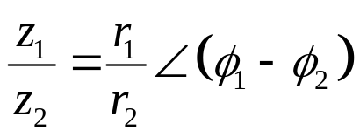
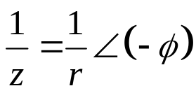




Complex Numbers
The following mathematical operations are important.
Addition
Subtraction
Multiplication
Division
Reciprocal
Square Root
Complex Conjugate
Euler’s identity

Slide 20
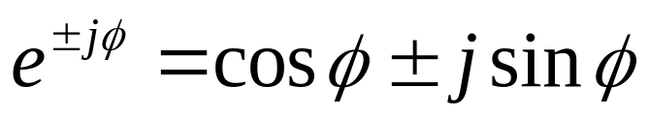
Phasors
The idea of a phasor representation is based on Euler’s identity:
From this we can represent a sinusoid as the real component of a vector in the complex plane.
The length of the vector is the amplitude of the sinusoid.
The vector, V, in polar form, is at an angle ϕ with respect to the positive real axis.

Slide 21
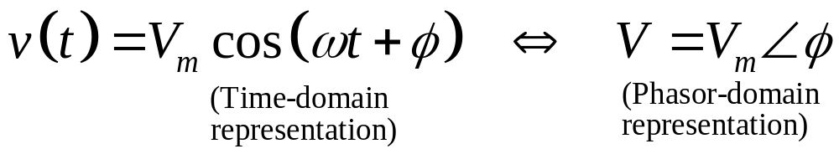
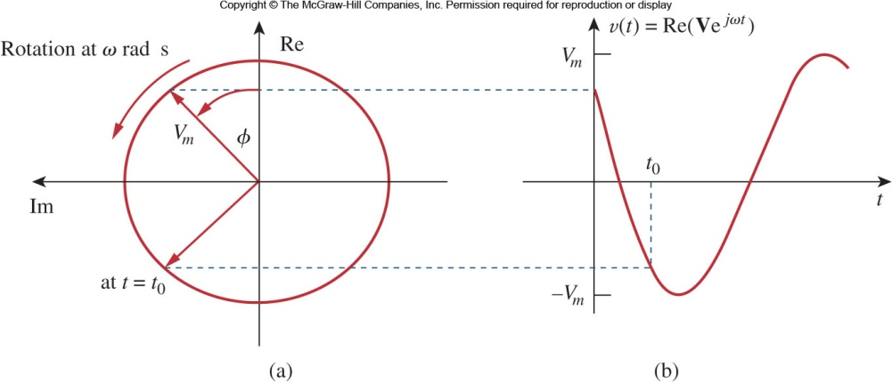
Phasors
Phasors are typically represented at t = 0.
As such, the transformation between time domain to phasor domain is:
They can be graphically represented as shown here.

Slide 22
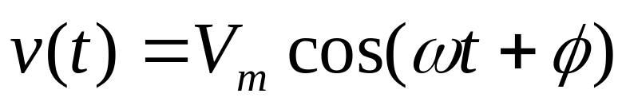
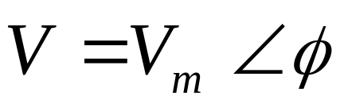
Transform a sinusoid to and from the time domain to the phasor domain:
(time domain) (phasor domain)
Amplitude and phase difference are two principal concerns in the study of voltage and current sinusoids.
Phasor will be defined from the cosine function in all our proceeding study. If a voltage or current expression is in the form of a sine, it will be changed to a cosine by subtracting from the phase.

Slide 23
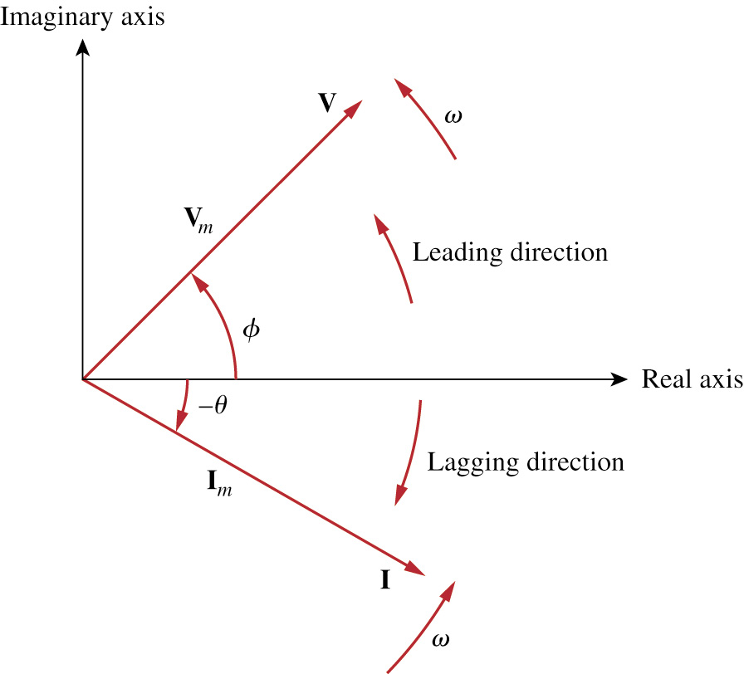

Lead or Lag seen Via Phasors
Such a graphical representation of phasors is known as a phasor diagram.

Slide 24
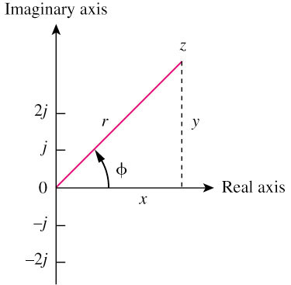




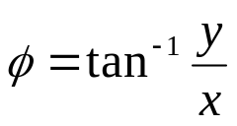
Summery: Phasors
A phasor is a complex number that represents the amplitude and phase of a sinusoid.
It can be represented in one of the following three forms:
Rectangular
Polar
Exponential
where

Slide 25
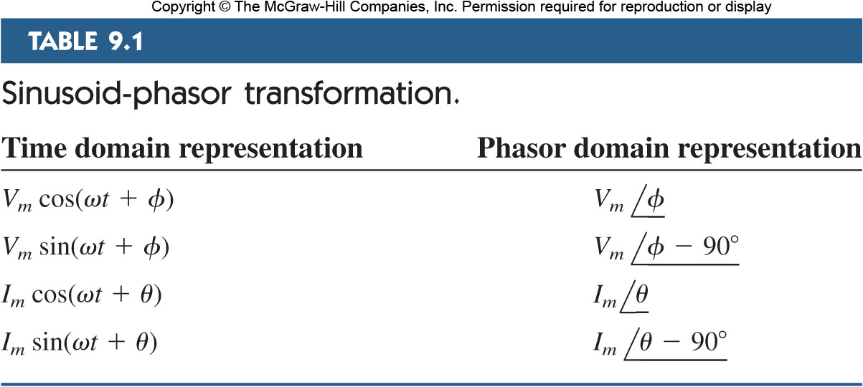
Sinusoid-Phasor Transformation 1
Here is a handy table for transforming various time domain sinusoids into phasor domain:

Slide 26
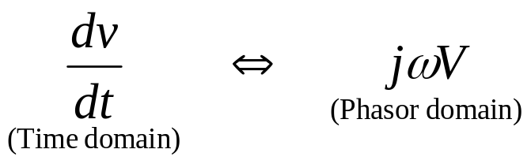
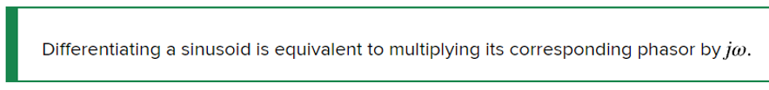
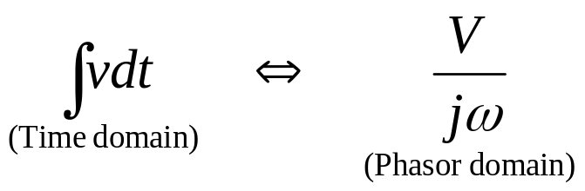

Sinusoid-Phasor Transformation 2
Note that the frequency of the phasor is not explicitly shown in the phasor diagram.
For this reason phasor domain is also known as frequency domain.
Applying a derivative to a phasor yields:
Applying an integral to a phasor yields:

Slide 27
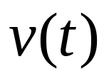
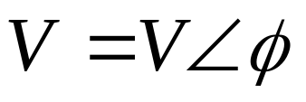
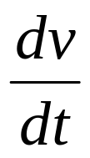
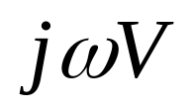
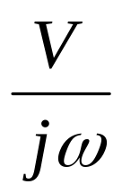
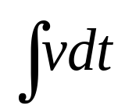

Slide 28
The differences between v(t) and V:
v(t) is instantaneous or time-domain representation
V is the frequency or phasor-domain representation.
v(t) is time dependent, V is not.
v(t) is always real with no complex term, V is generally complex.
Note: Phasor analysis applies only when frequency is constant; when it is applied to two or more sinusoid signals only if they have the same frequency.

Slide 29
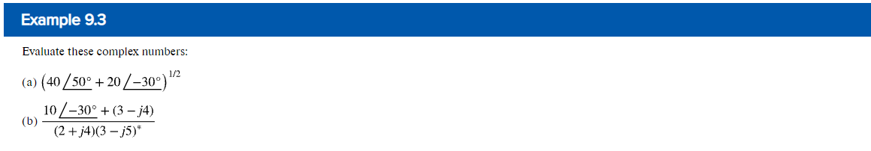
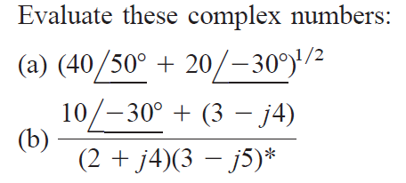
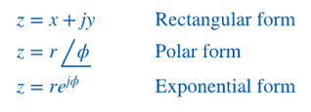



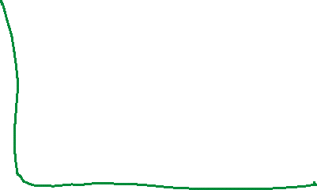

Slide 31

Transform the following sinusoids to phasors:
  i = 6cos(50t – 40º) A
  v = –4sin(30t + 50º) V

Slide 32



Slide 33



Slide 34


Phasor relationships for circuit elements
Transform the voltage-current relationship from the time domain to the frequency domain for each element.
we will assume the passive sign convention.
Voltage and Current are in phase in resistance

Slide 35




Phasor Relationships for Resistors
Each circuit element has a relationship between its current and voltage.
These can be mapped into phasor relationships very simply for resistors capacitors and inductor.
For the resistor, the voltage and current are related via Ohm’s law.
As such, the voltage and current are in phase with each other.

Slide 36




Phasor Relationships for Inductors
Inductors on the other hand have a phase shift between the voltage and current.
In this case, the voltage leads the current by 90°.
Or one says the current lags the voltage, which is the standard convention.
This is represented on the phasor diagram by a positive phase angle between the voltage and current.

Slide 37





Phasor Relationships for Inductors

Slide 38




Phasor Relationships for Capacitors
Capacitors have the opposite phase relationship as compared to inductors.
In their case, the current leads the voltage.
In a phasor diagram, this corresponds to a negative phase angle between the voltage and current.

Slide 39




The V-I Relationships for Capacitor
Phasor Relationships for Capacitors

Slide 40






Summary of voltage-current relationship
Resistor:
Inductor:
Capacitor:

Slide 41

Voltage current relationships

Slide 43

Impedance and Admittance 1
It is possible to expand Ohm’s law to capacitors and inductors.
In time domain, this would be tricky as the ratios of voltage and current and always changing.
But in frequency domain it is straightforward.
The impedance of a circuit element is the ratio of the phasor voltage to the phasor current.
Admittance is simply the inverse of impedance.

Slide 44


The impedance Z of a circuit is the ratio of the phasor voltage V to the phasor current I, measured in ohms Ω.
V = I Z ,
Positive X is for L and negative X is for C.
The admittance Y is the reciprocal of impedance, measured in siemens (S).

Slide 45






Slide 46





Impedance and Admittance 2
It is important to realize that in frequency domain, the values obtained for impedance are only valid at that frequency.
Changing to a new frequency will require recalculating the values.
The impedance of capacitors and inductors are shown here:

Slide 47


Slide 48
Impedance and Admittance 3
As a complex quantity, the impedance may be expressed in rectangular form.
The separation of the real and imaginary components is useful.
The real part is the resistance.
The imaginary component is called the reactance, X.
When it is positive, we say the impedance is inductive, and capacitive when it is negative.

Slide 49

Impedance and Admittance 4
Admittance, being the reciprocal of the impedance, is also a complex number.
It is measured in units of Siemens.
The real part of the admittance is called the conductance, G.
The imaginary part is called the susceptance, B.
These are all expressed in Siemens or (mhos).
The impedance and admittance components can be related to each other:

Slide 50

Impedance and Admittance

Slide 51
After we know how to convert RLC components from time to phasor domain, we can transform a time domain circuit into a phasor/frequency domain circuit.
Hence, we can apply the KCL laws and other theorems to directly set up phasor equations involving our target variable(s) for solving.

Slide 52


Slide 53


Slide 54
Kirchhoff's Laws in Frequency Domain
A powerful aspect of phasors is that Kirchhoff's laws apply to them as well.
This means that a circuit transformed to frequency domain can be evaluated by the same methodology developed for K V L and K C L.
One consequence is that there will likely be complex values.

Slide 55

Both KVL and KCL are hold in the phasor domain or more commonly called frequency domain.
Moreover, the variables to be handled are phasors, which are complex numbers.
All the mathematical operations involved are now in complex domain.

Slide 56


Impedance Combinations 1
Once in frequency domain, the impedance elements are generalized.
Combinations will follow the rules for resistors:

Slide 57




Impedance Combinations
Series combinations will result in a sum of the impedance elements:
2 impedances in series
Here then two elements in series can act like a voltage divider.

Slide 58



Parallel Combination
Likewise, elements combined in parallel will combine in the same fashion as resistors in parallel:

Slide 59

2 Impedances in parallel

Slide 60


Slide 62


Slide 66


Admittance
Expressed as admittance, though, they are again a sum:
Once again, these elements can act as a current divider:

Slide 67







Impedance Combinations 3
The Delta-Wye transformation is:

Slide 68



Because learning changes everything.®
www.mheducation.com
© McGraw Hill LLC.

