Slide 1
Linear Circuits 1
ECET 250E
Week 2 | Chapter 2: Basic Laws (With Solutions)
Camosun College
Electronics & Computer Engineering Technology
Mozhgan Bacon, PhD, P.Eng.
Fall 2026
Based on Fundamentals of Electric Circuits, 2026 Release — C.K. Alexander, M.N.O. Sadiku & S.J. Fredette (McGraw Hill)

Slide 2
Overview
This chapter will introduce Ohm’s law: a central concept in electric circuits.
Resistors will be discussed in more detail.
Circuit topology and the voltage and current laws will be introduced.
Finally, meters for measuring voltage, current, and resistivity will be presented.

Slide 3
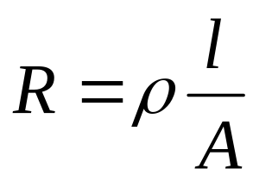
Resistivity
Materials tend to resist the flow of electricity through them.
This property is called “resistance”.
The resistance of an object is a function of its length, L, and cross sectional area, A, and the material’s resistivity:

Slide 4
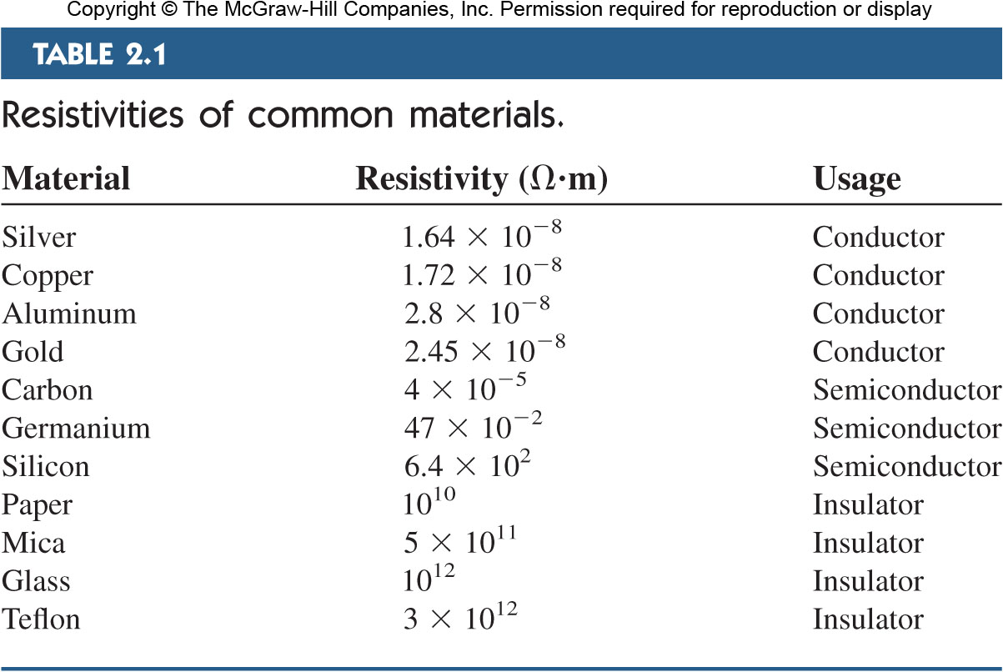
Resistivity of Common Materials

Slide 5
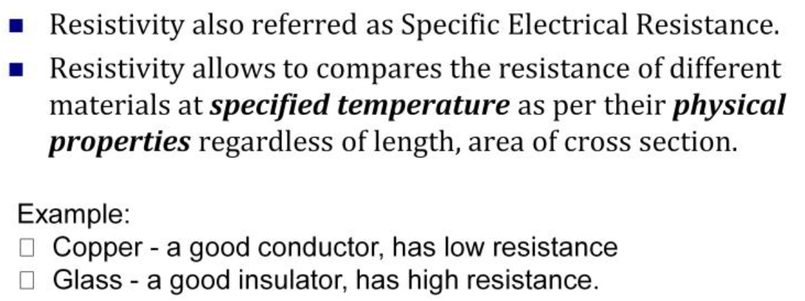
Resistivity of Common Materials

Slide 6
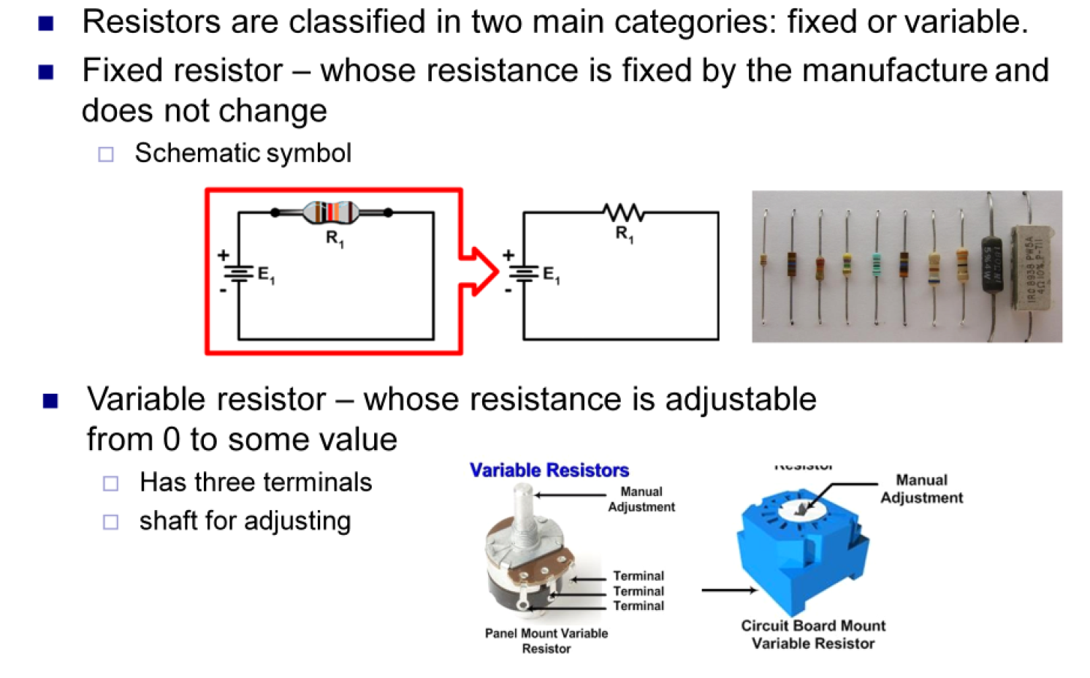
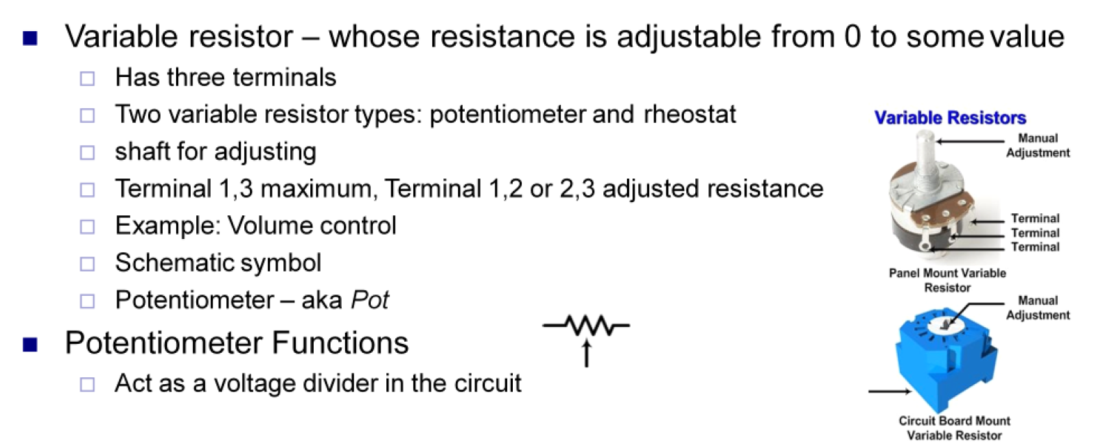
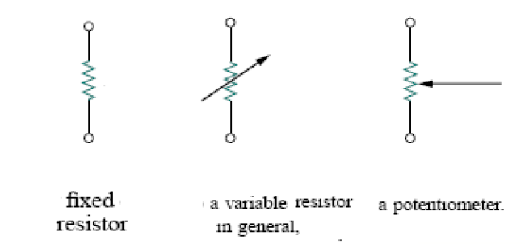
Resistor

Slide 7
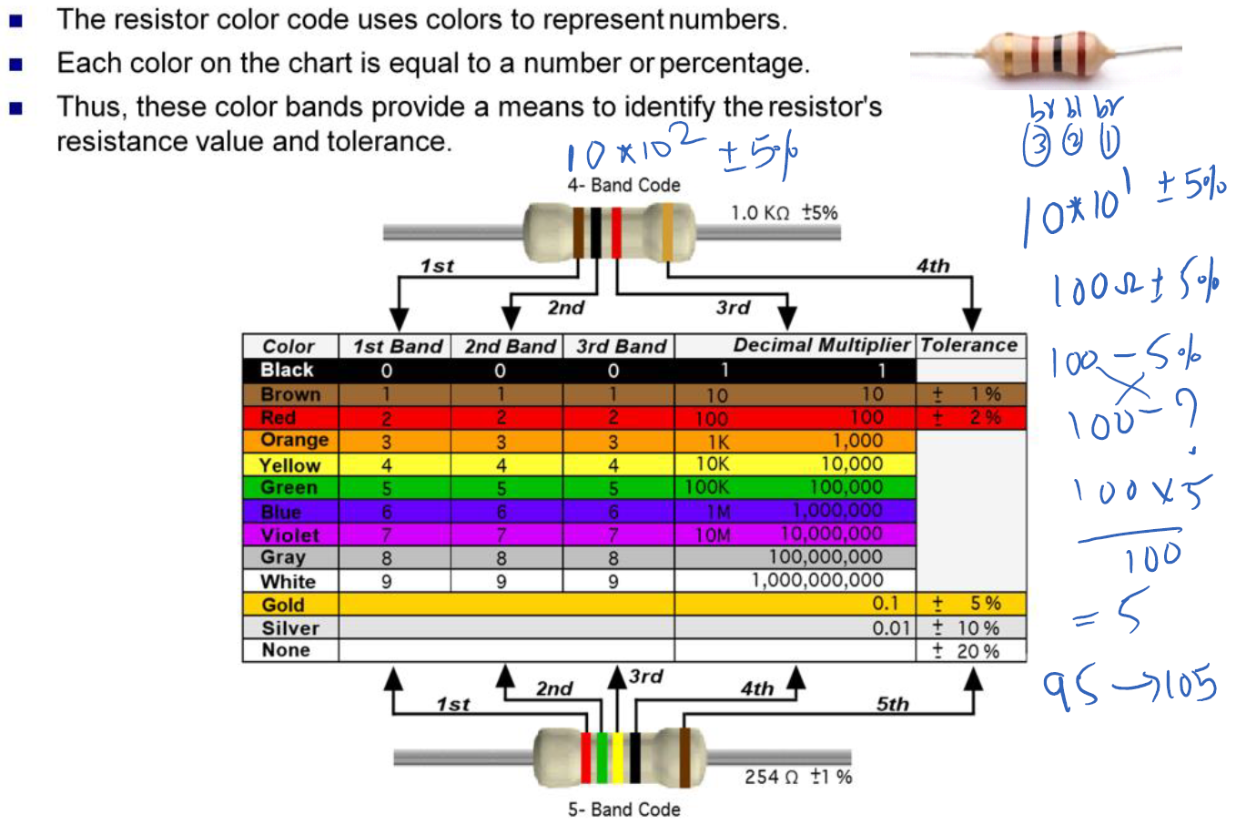
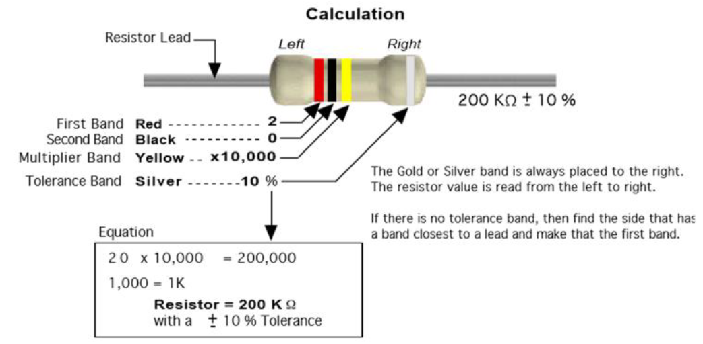
Resistor Colour Code

Slide 8
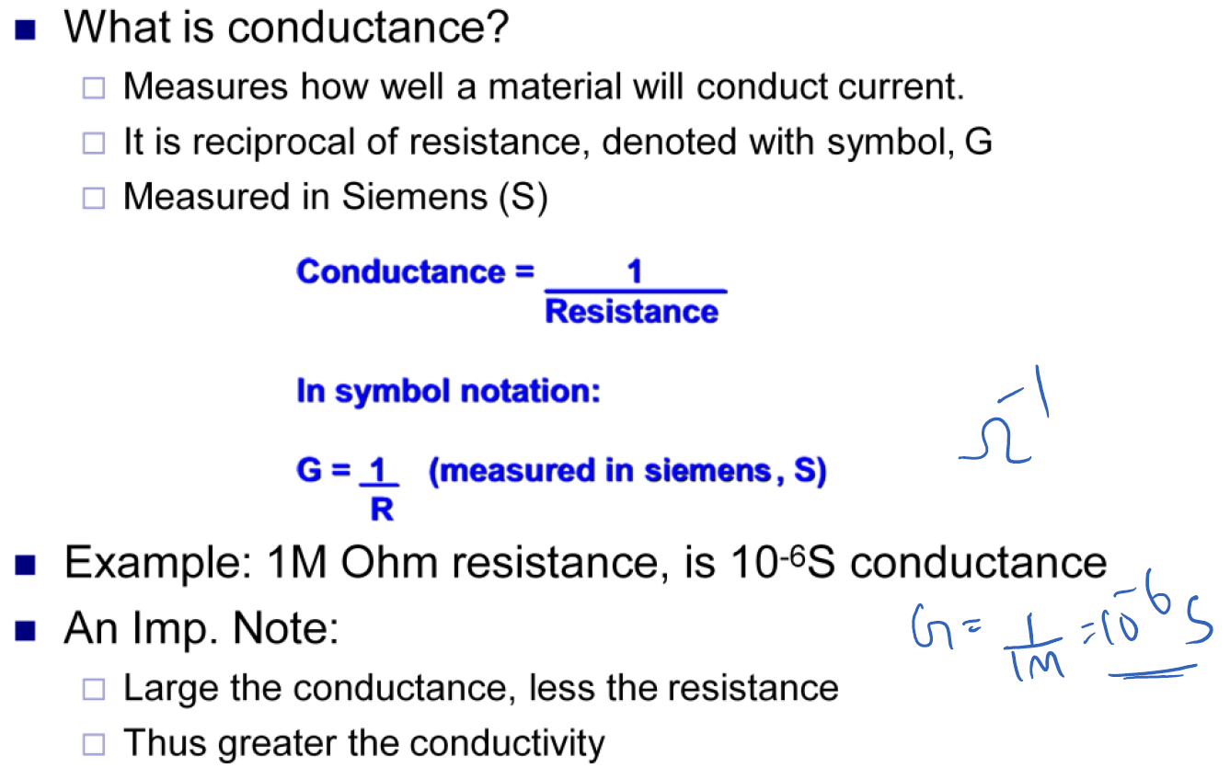
Conductance

Slide 9
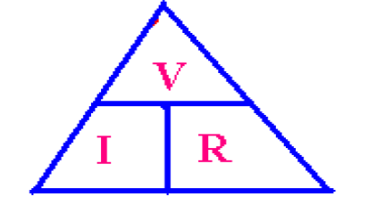
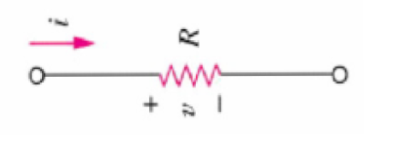

Ohm’s Law
In a resistor, the voltage across a resistor is directly proportional to the current flowing through it.
V = IR
The resistance of an element is measured in units of Ohms,
The higher the resistance, the less current will flow through for a given voltage.
Ohm’s law requires conforming to the passive sign convention.

Slide 10
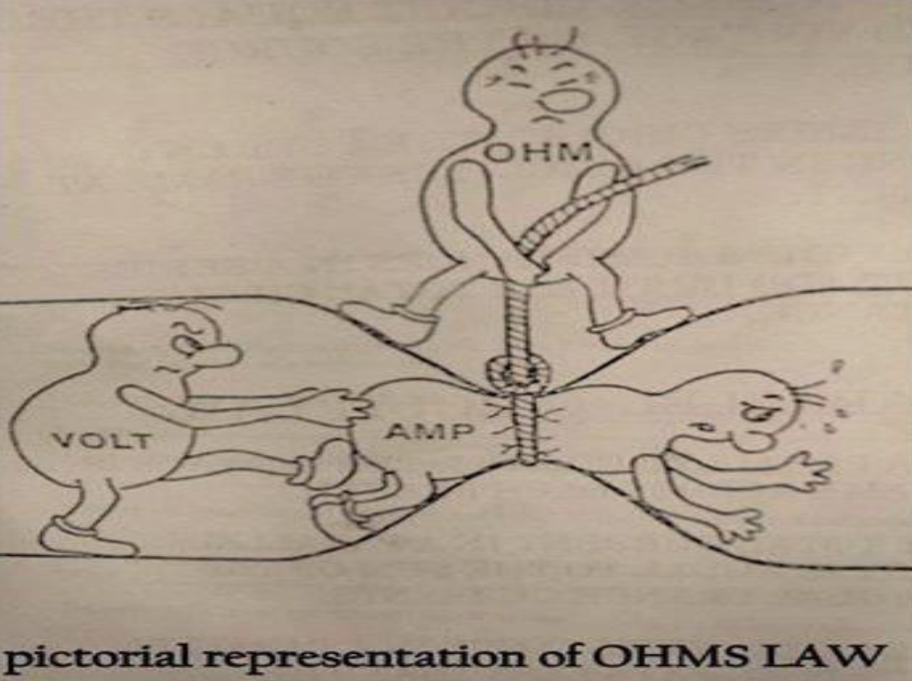

Slide 11
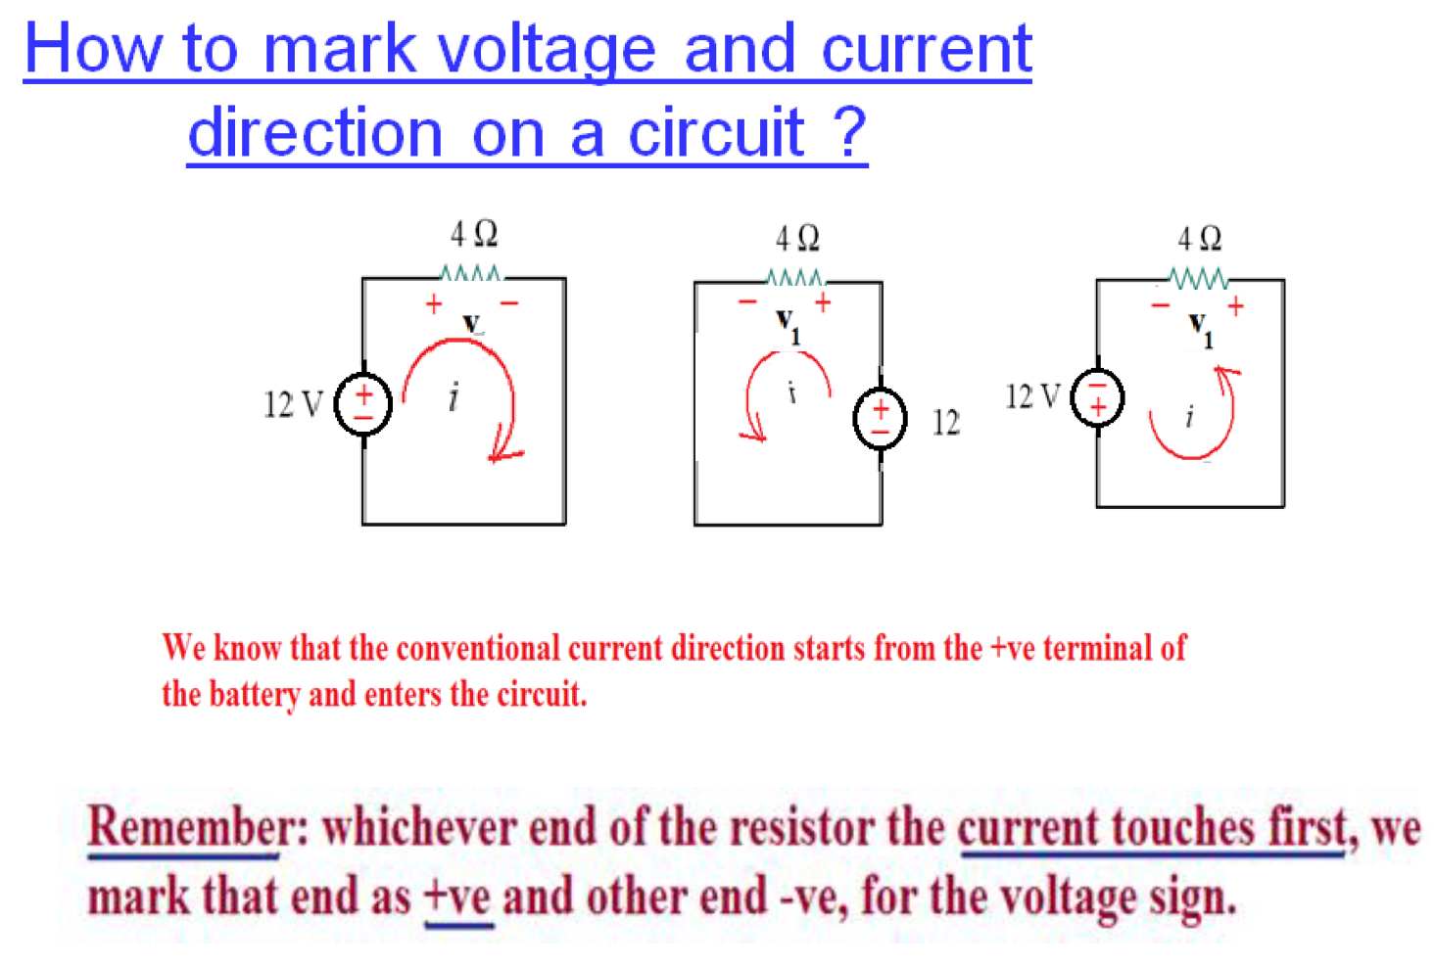

Slide 12
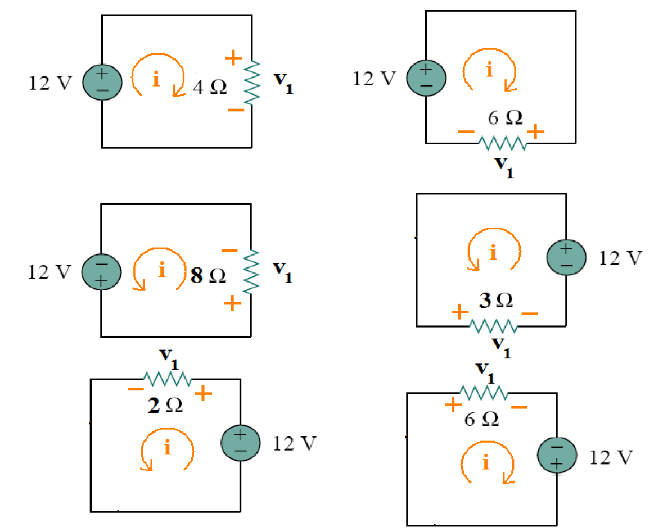

Slide 13
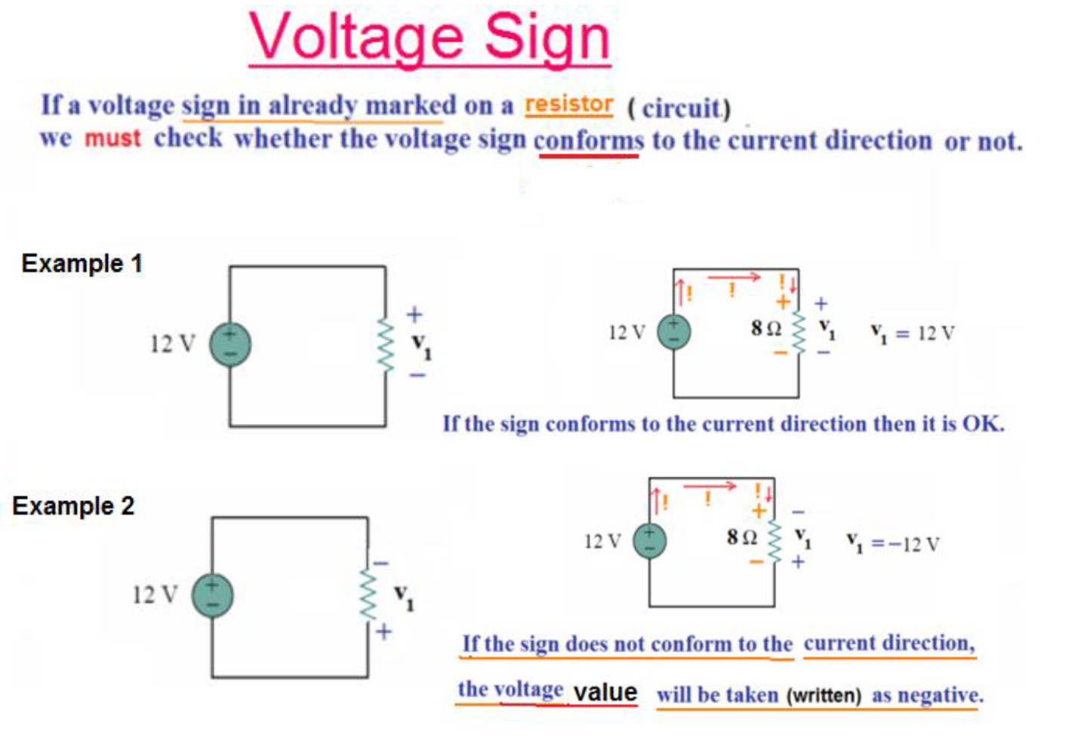

Slide 14
Short and Open Circuits
A connection with almost zero resistance is called a short circuit.
Ideally, any current may flow through the short.
In practice this is a connecting wire.
A connection with infinite resistance is called an open circuit.
Here no matter the voltage, no current flows.

Slide 15
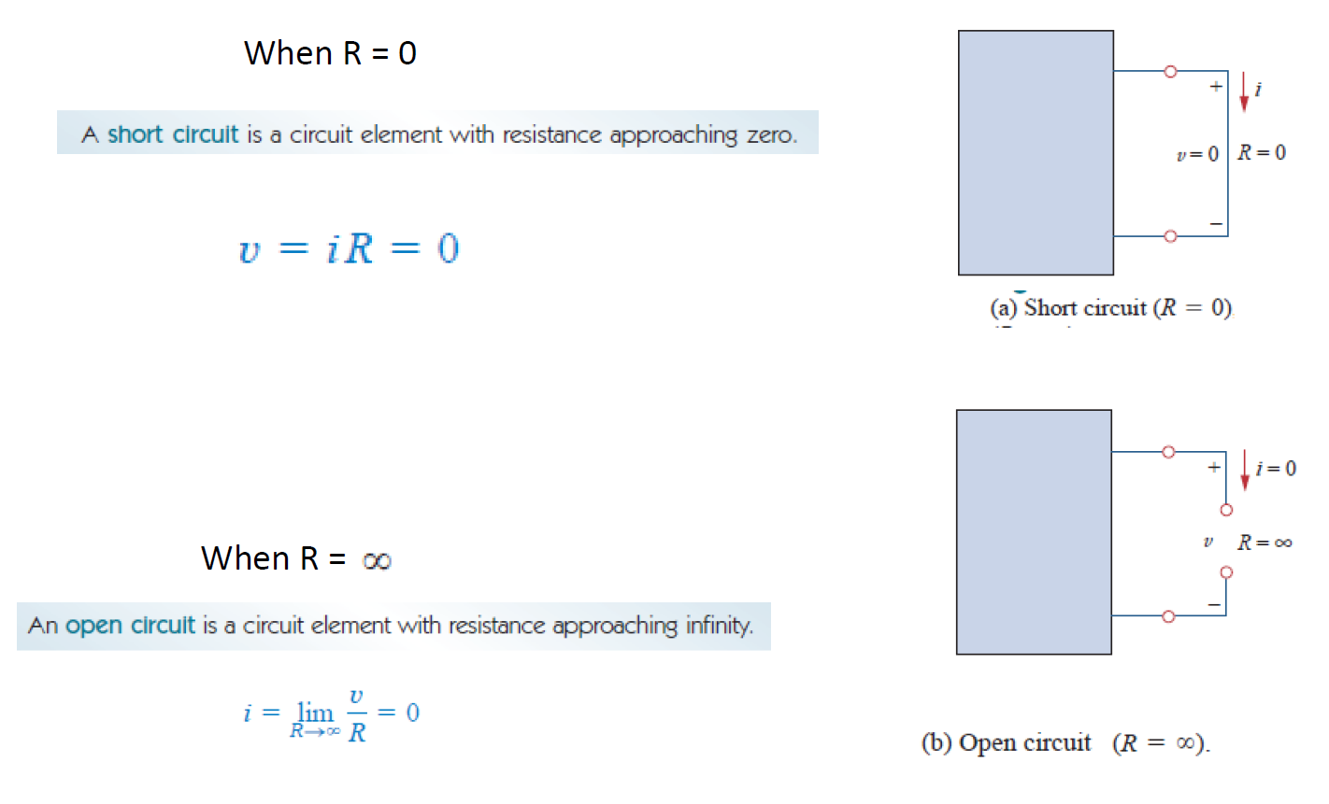



Slide 16
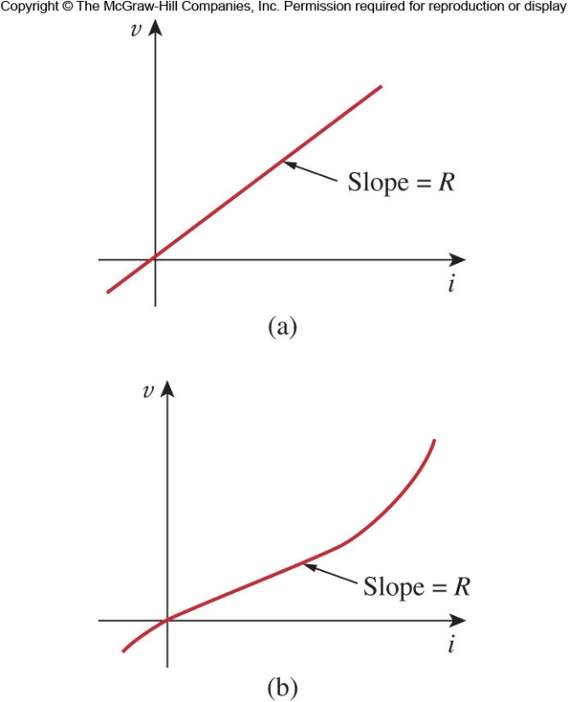
Linearity
Not all materials obey Ohm’s Law.
Resistors that do are called linear resistors because their current voltage relationship is always linearly proportional.
Diodes and light bulbs are examples of non-linear elements.

Slide 17
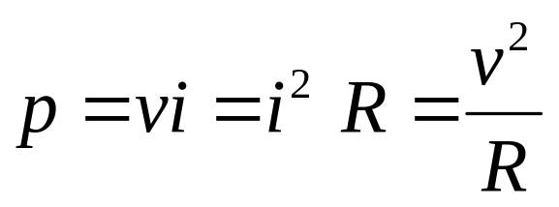
Power Dissipation
Running current through a resistor dissipates power.
The power dissipated is a non-linear function of current or voltage.
Power dissipated is always positive.
A resistor can never generate power.

Slide 18
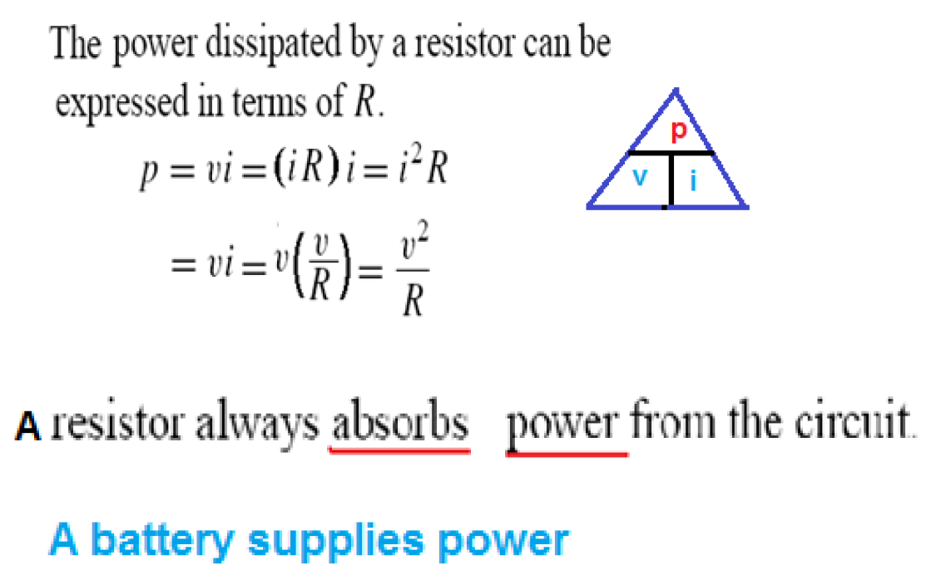

Slide 19
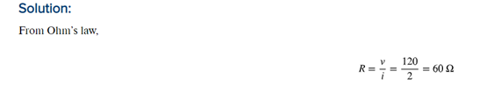
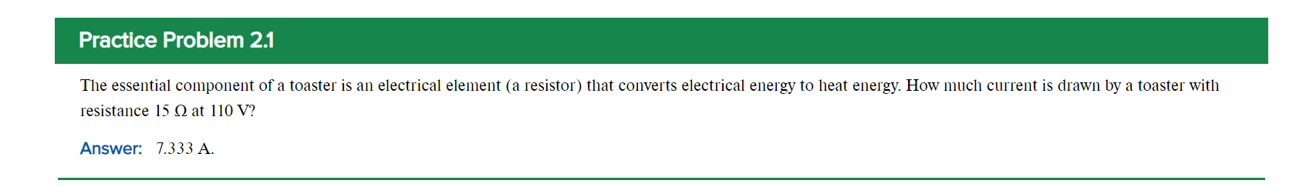
P.P.2.1 i = V/R = 110/15 = 7.333 A

Slide 20
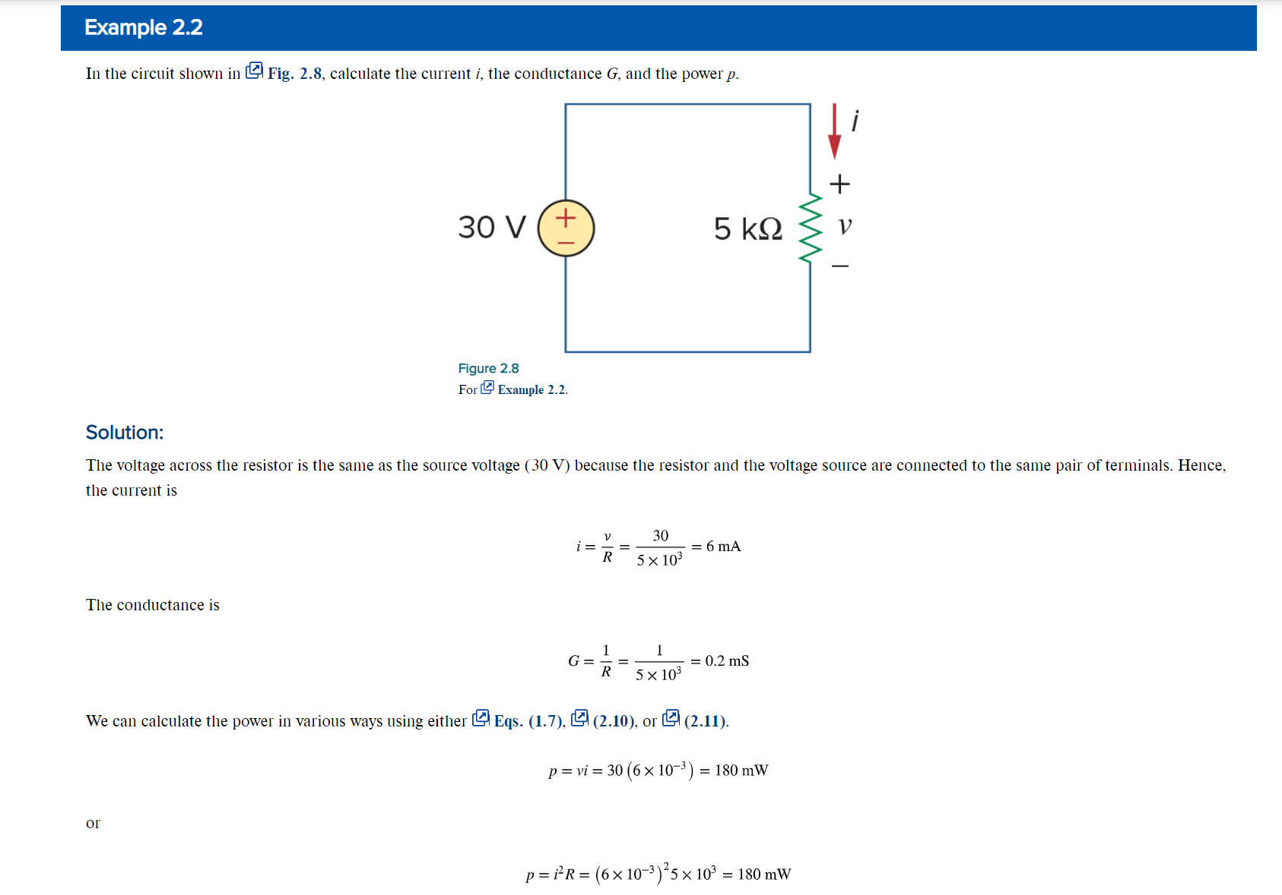


Slide 21
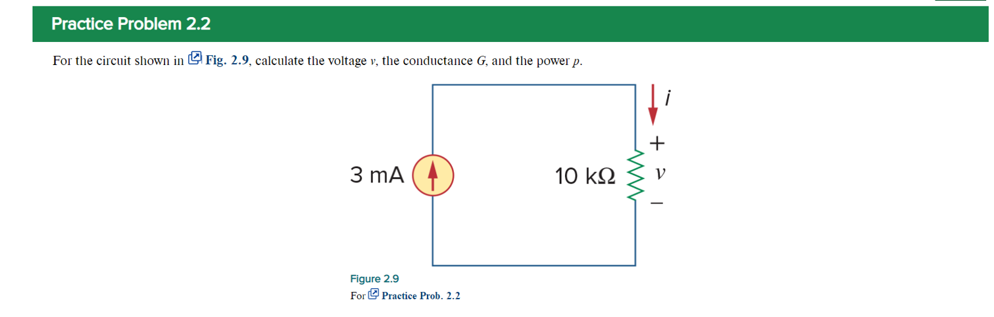
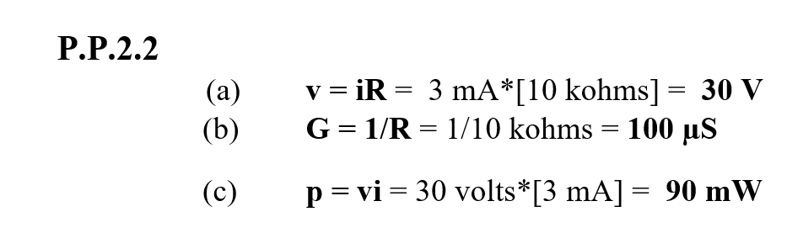

Slide 22
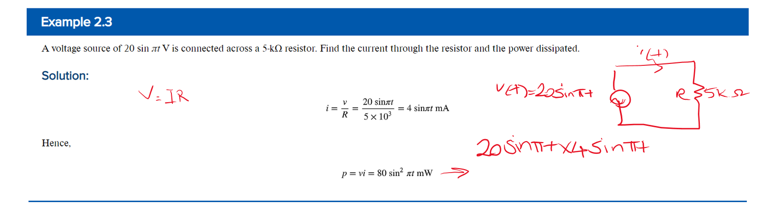
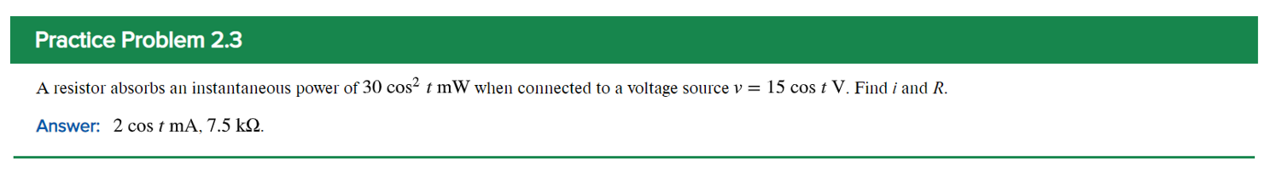
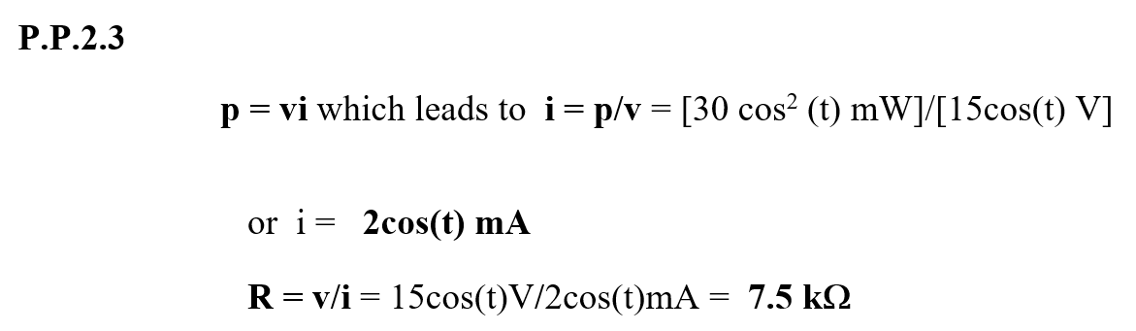

Slide 23
Nodes Branches and Loops
Circuit elements can be interconnected in multiple ways.
To understand this, we need to be familiar with some network topology concepts.
A branch represents a single element such as a voltage source or a resistor.
A node is the point of connection between two or more branches.
A loop is any closed path in a circuit.

Slide 24
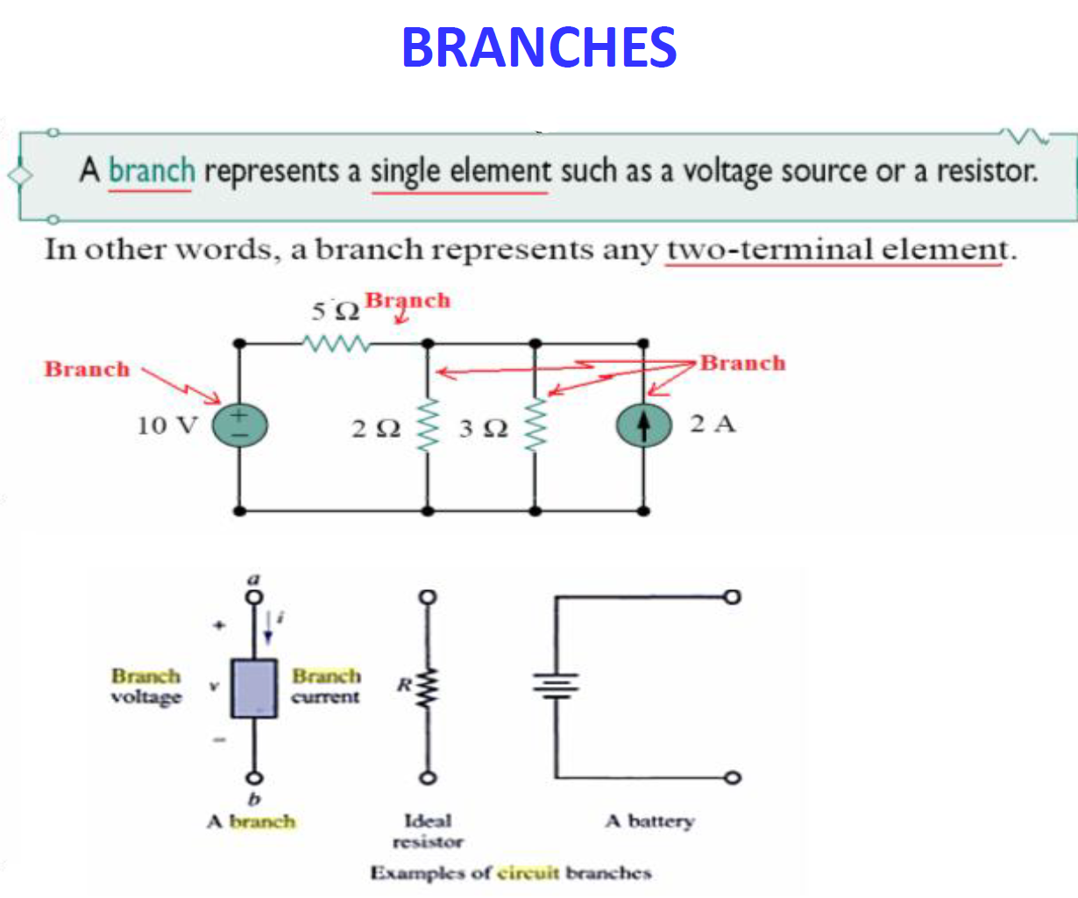


Slide 25
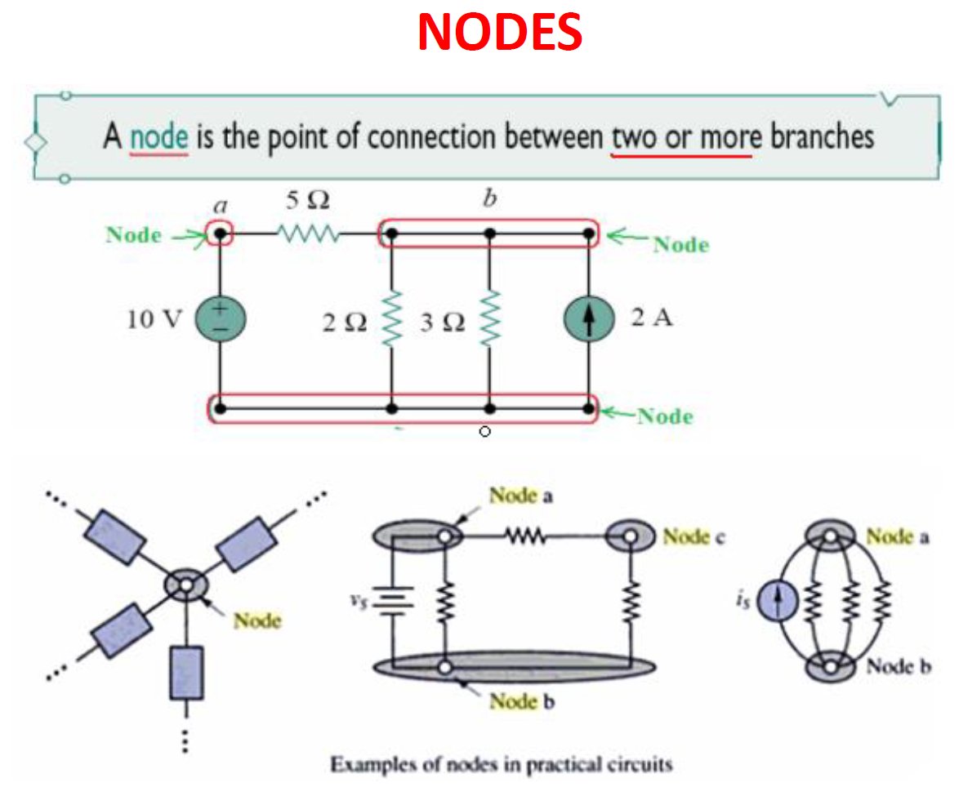

Slide 26
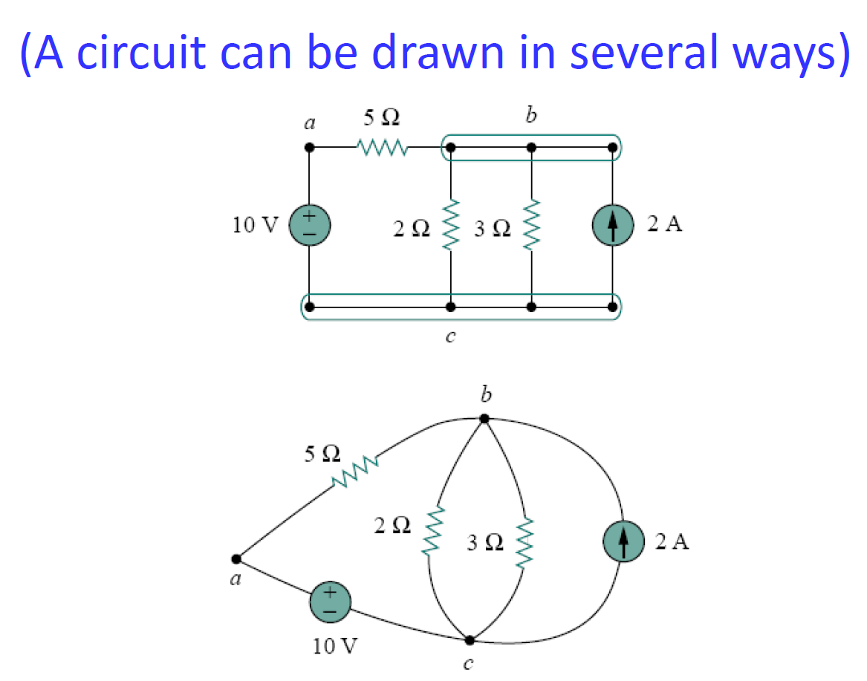

Slide 27
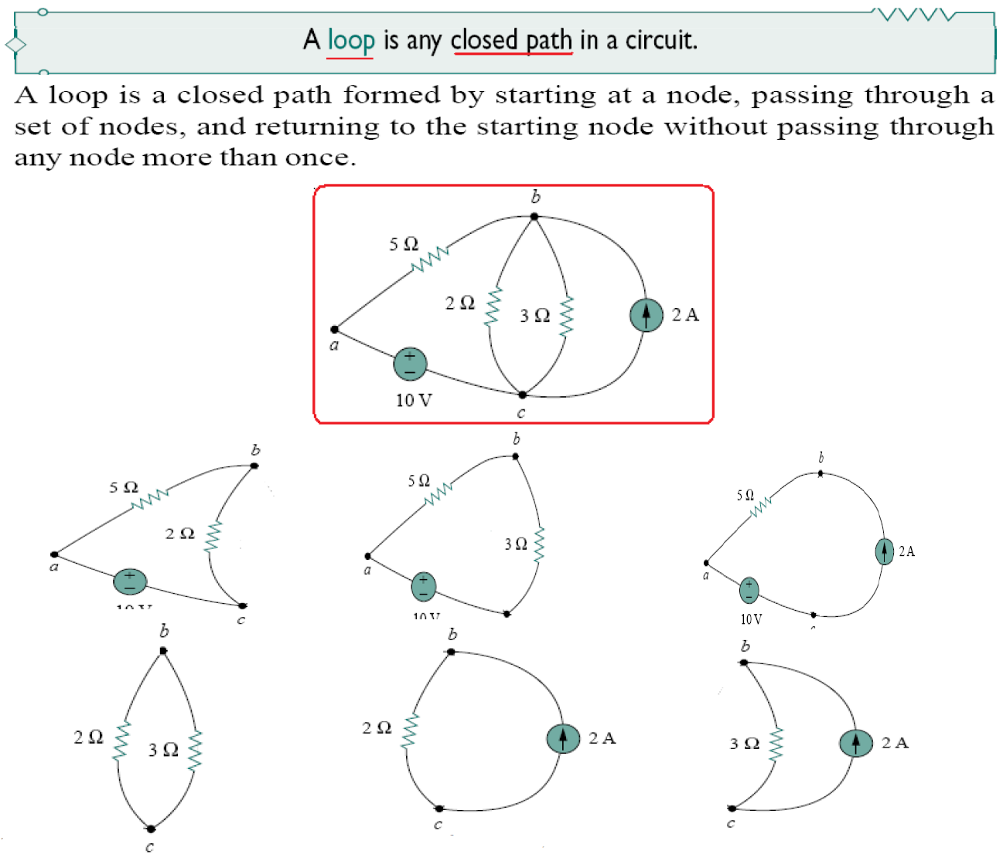

Slide 28
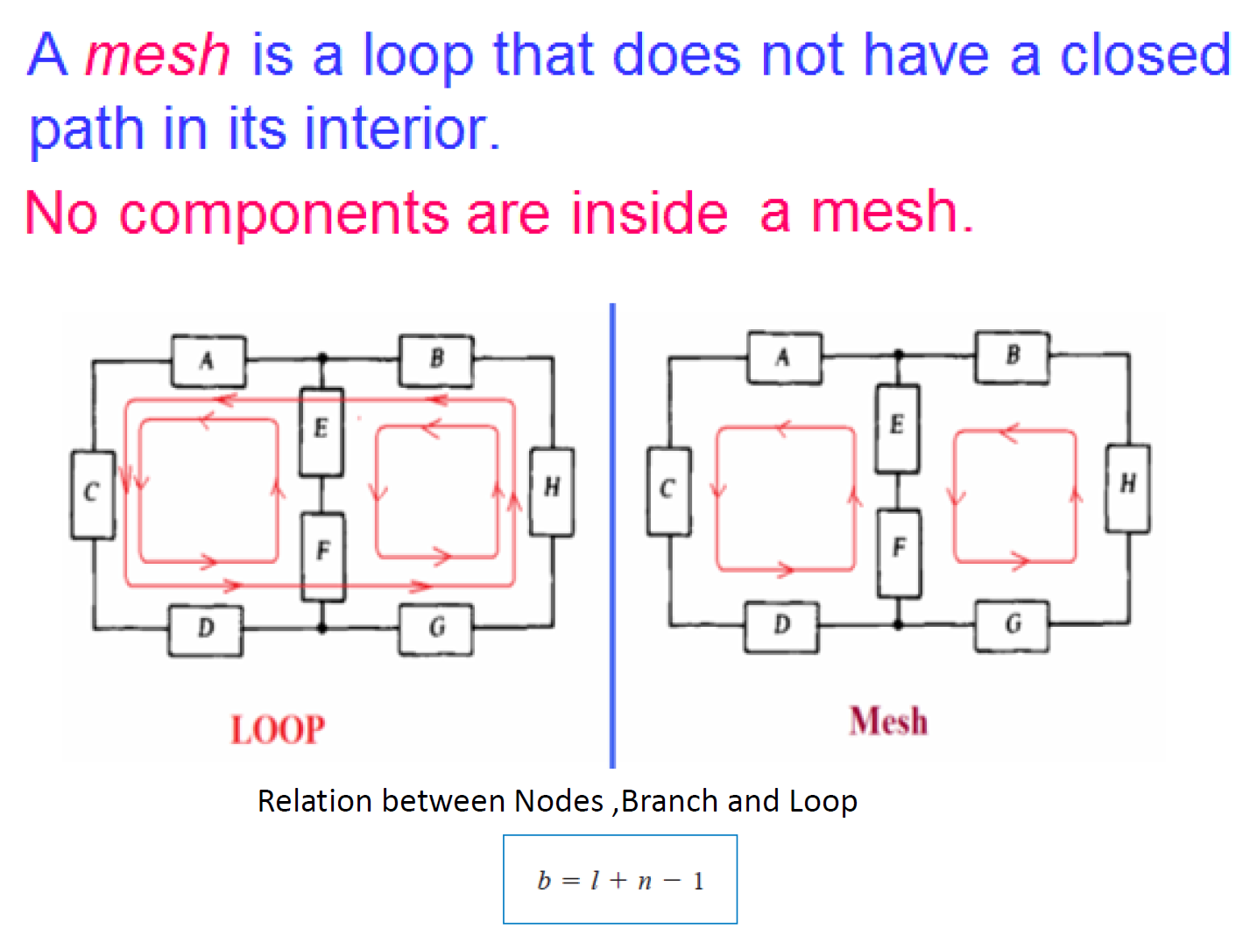

Slide 29
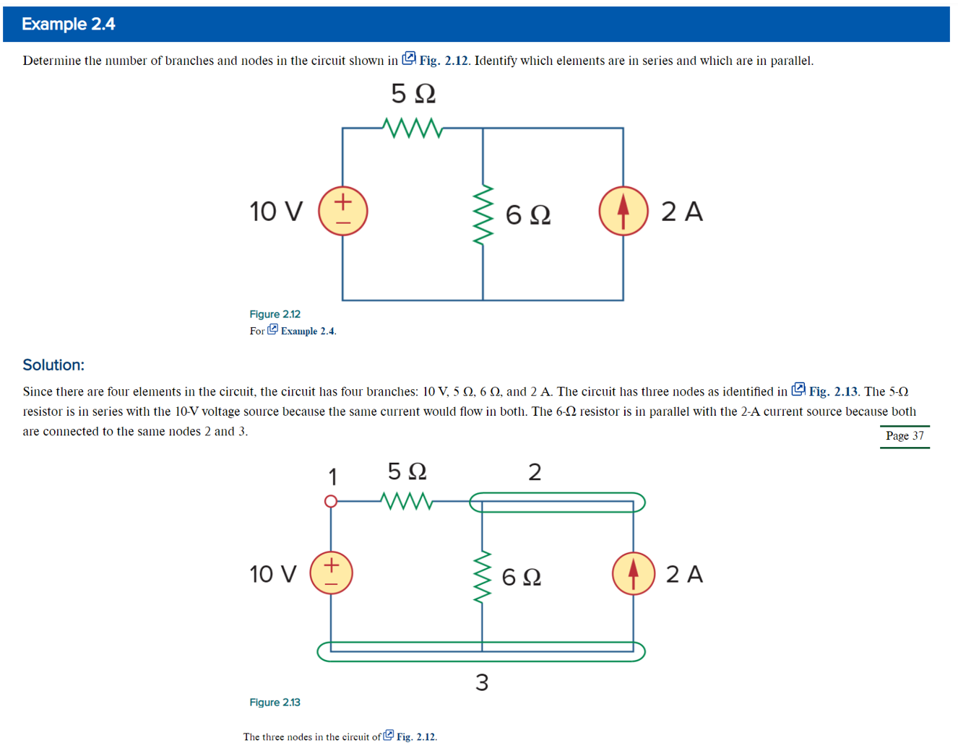

Slide 30
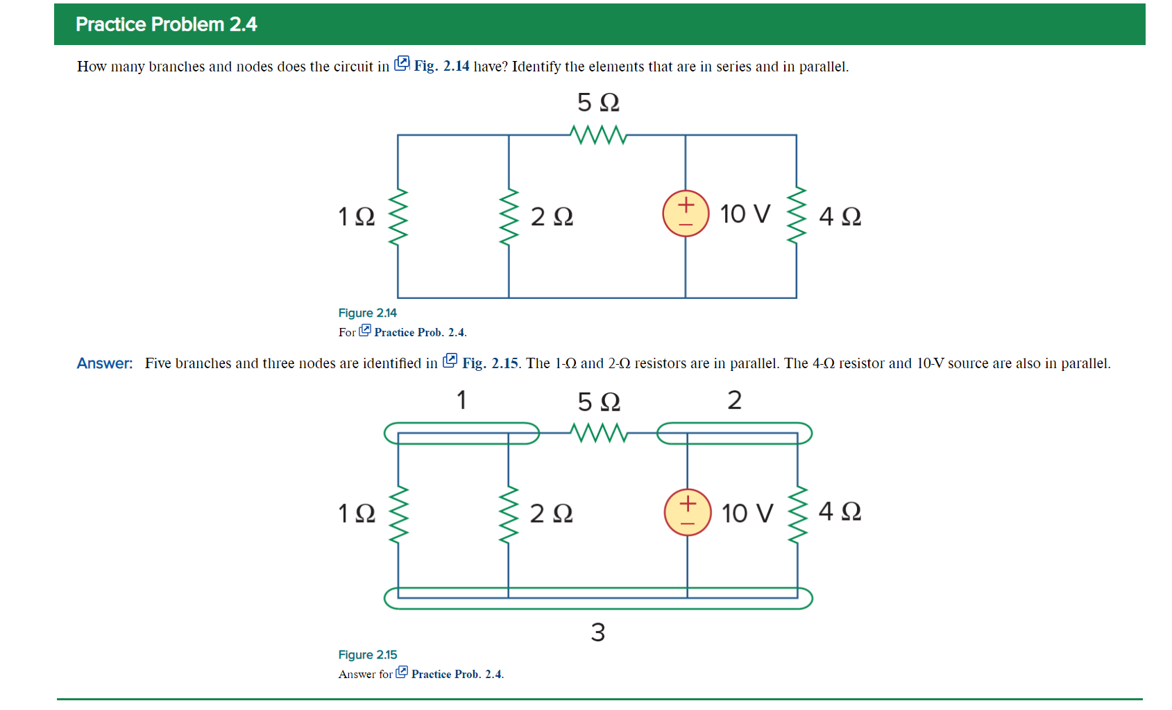
5 branches and 3 nodes. The 1 ohm and 2 ohm resistors are in parallel. The 4 ohm resistor and the 10 volt source are also in parallel.

Slide 31
Network Topology
A loop is independent if it contains at least one branch not shared by any other independent loops.
Two or more elements are in series if they share a single node and thus carry the same current.
Two or more elements are in parallel if they are connected to the same two nodes and thus have the same voltage.

Slide 32
Kirchhoff's Laws
Ohm’s law is not sufficient for circuit analysis.
Kirchhoff's laws complete the needed tools.
There are two laws:
  Kirchhoff's Current law (KCL).
  Kirchhoff's Voltage law (KVL).

Slide 33
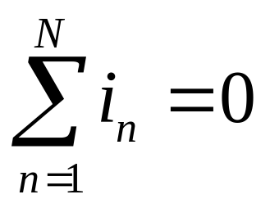
K C L
Kirchhoff's current law is based on conservation of charge.
It states that the algebraic sum of currents entering a node (or a closed boundary) is zero.
It can be expressed as:

Slide 34
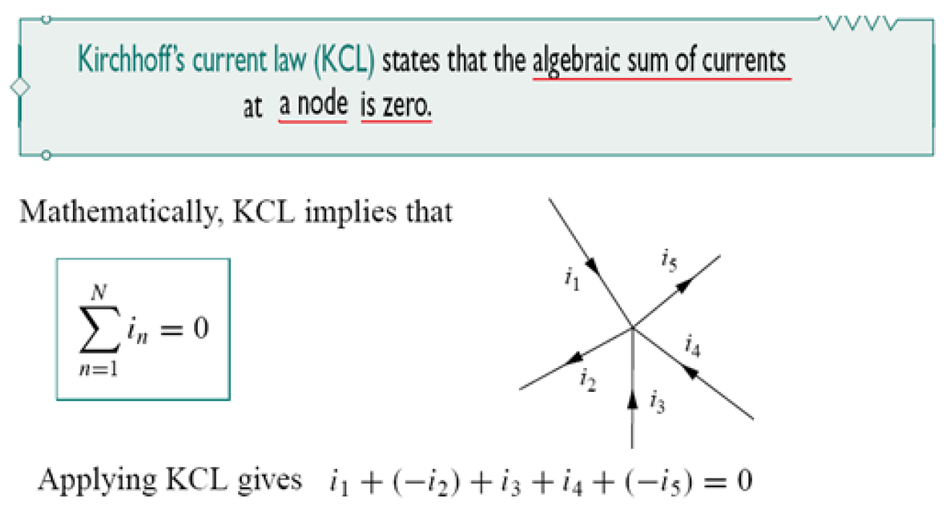
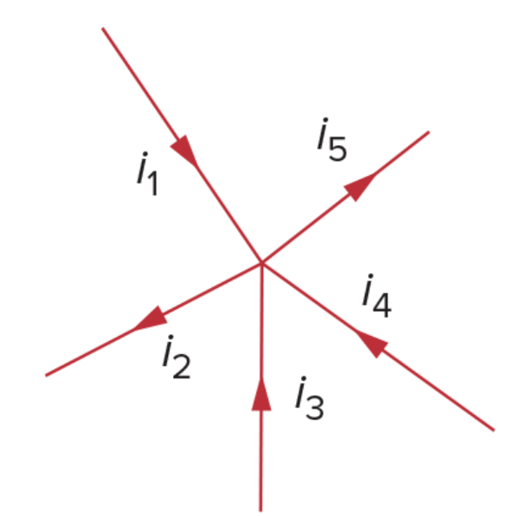
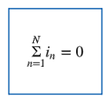
K C L

Slide 35
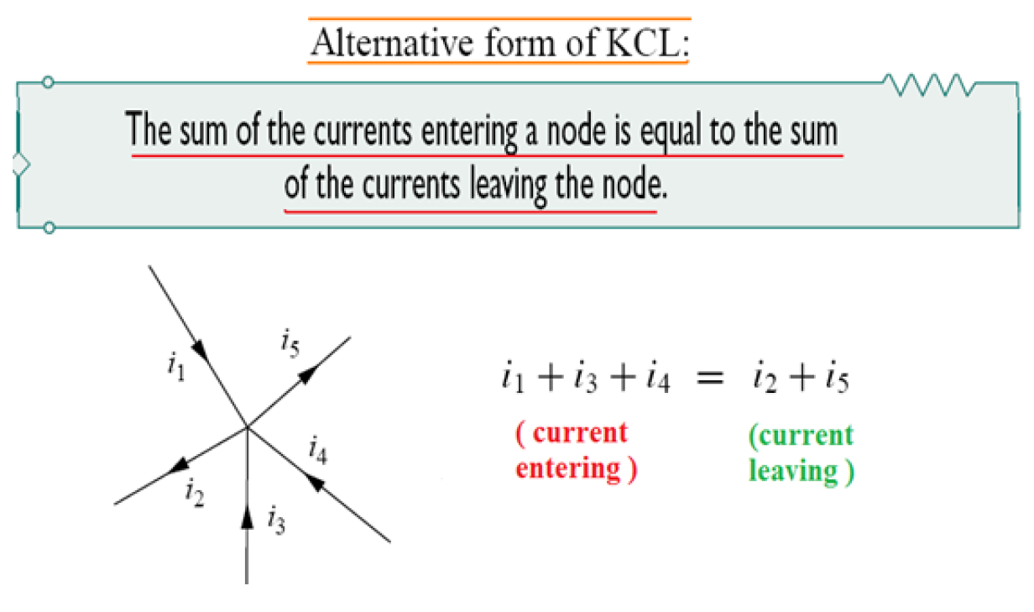

K C L

Slide 36
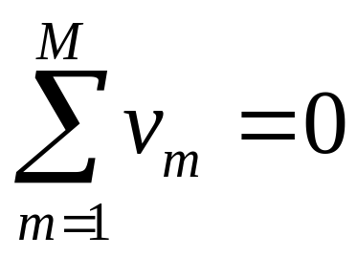
K V L
Kirchhoff's voltage law is based on conservation of energy.
It states that the algebraic sum of voltages around a closed path (or loop) is zero.
It can be expressed as:

Slide 37
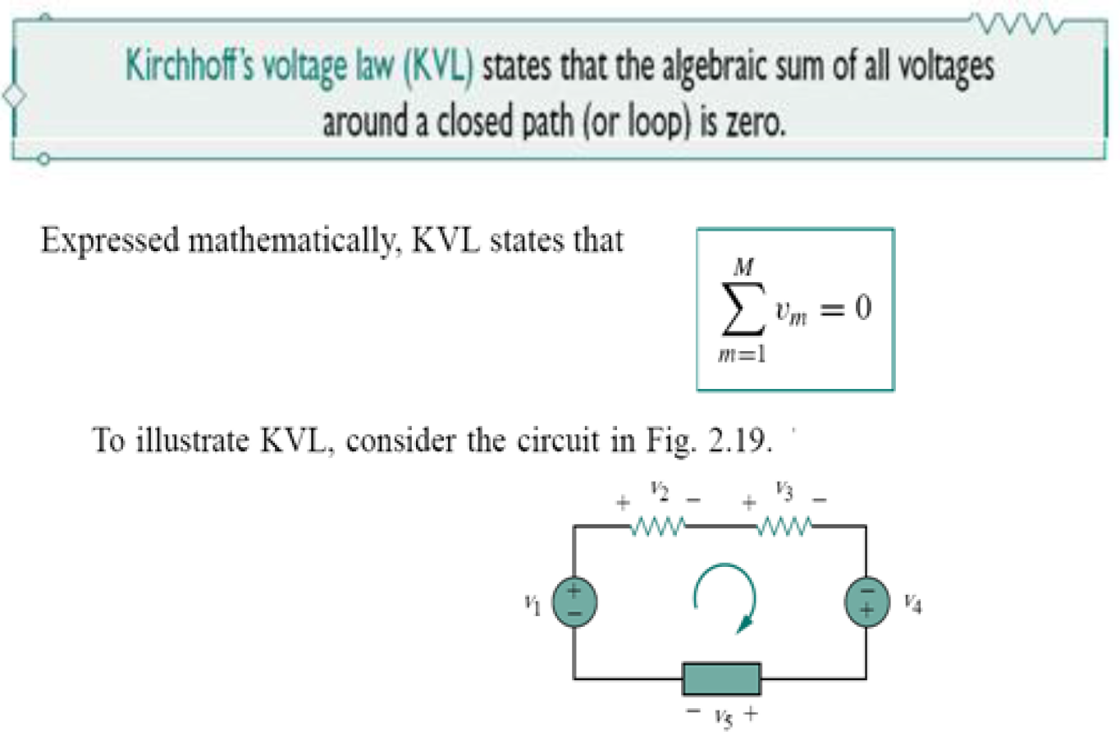
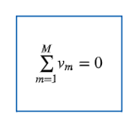
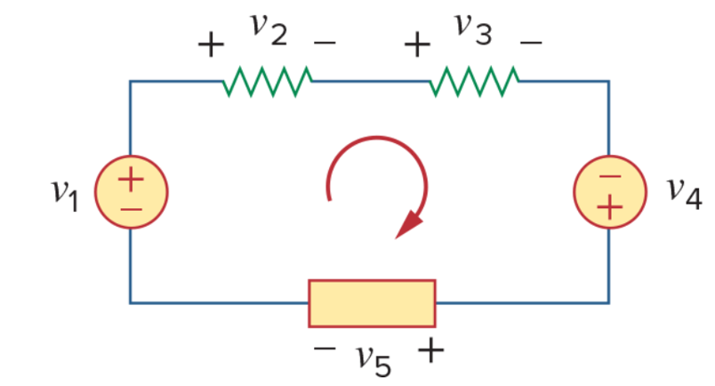

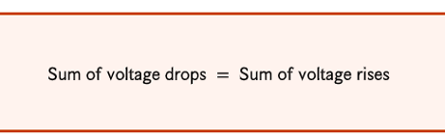


Slide 38
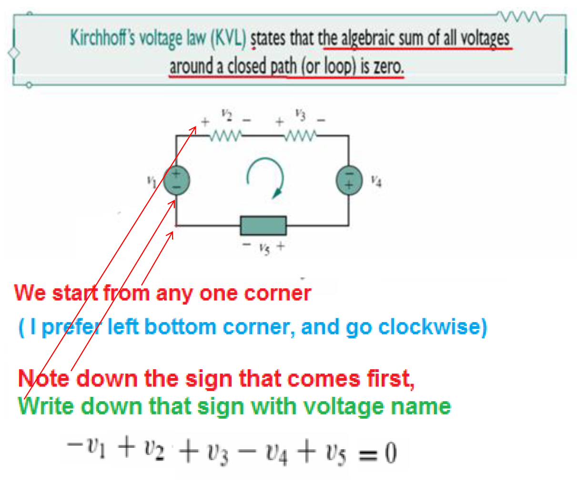

Slide 39
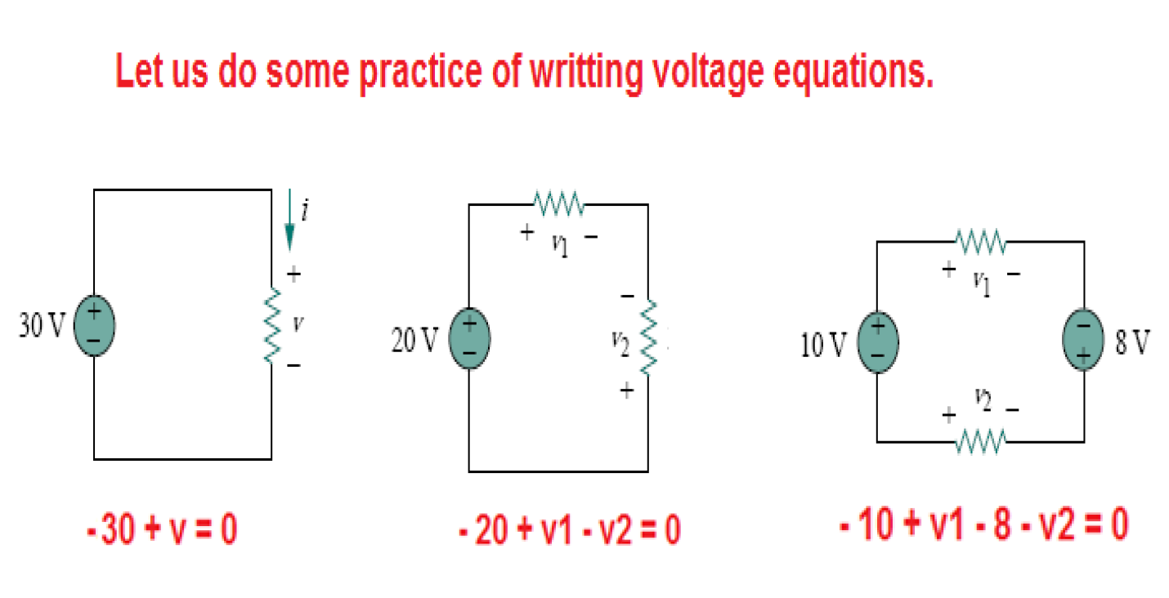

Slide 40
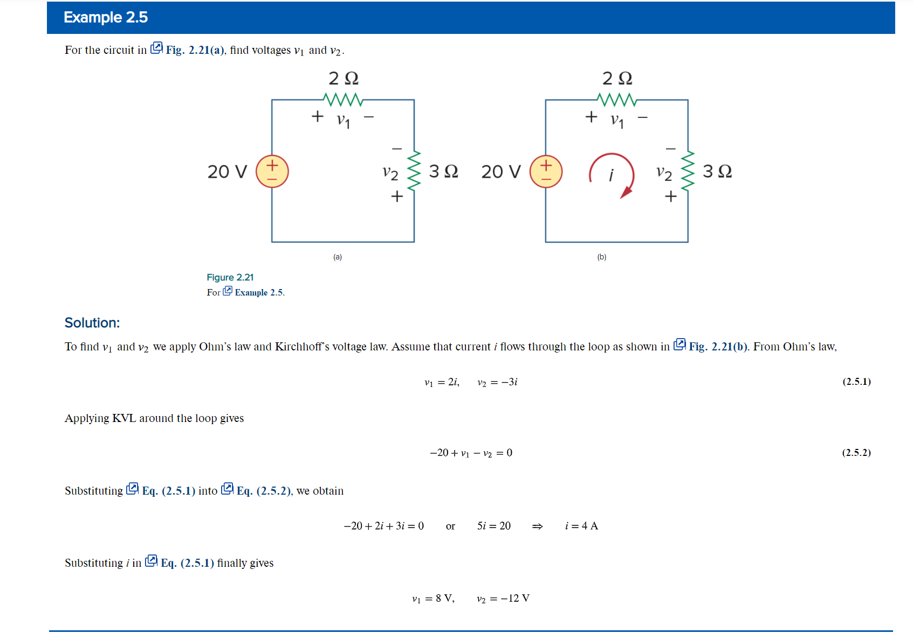

Slide 41
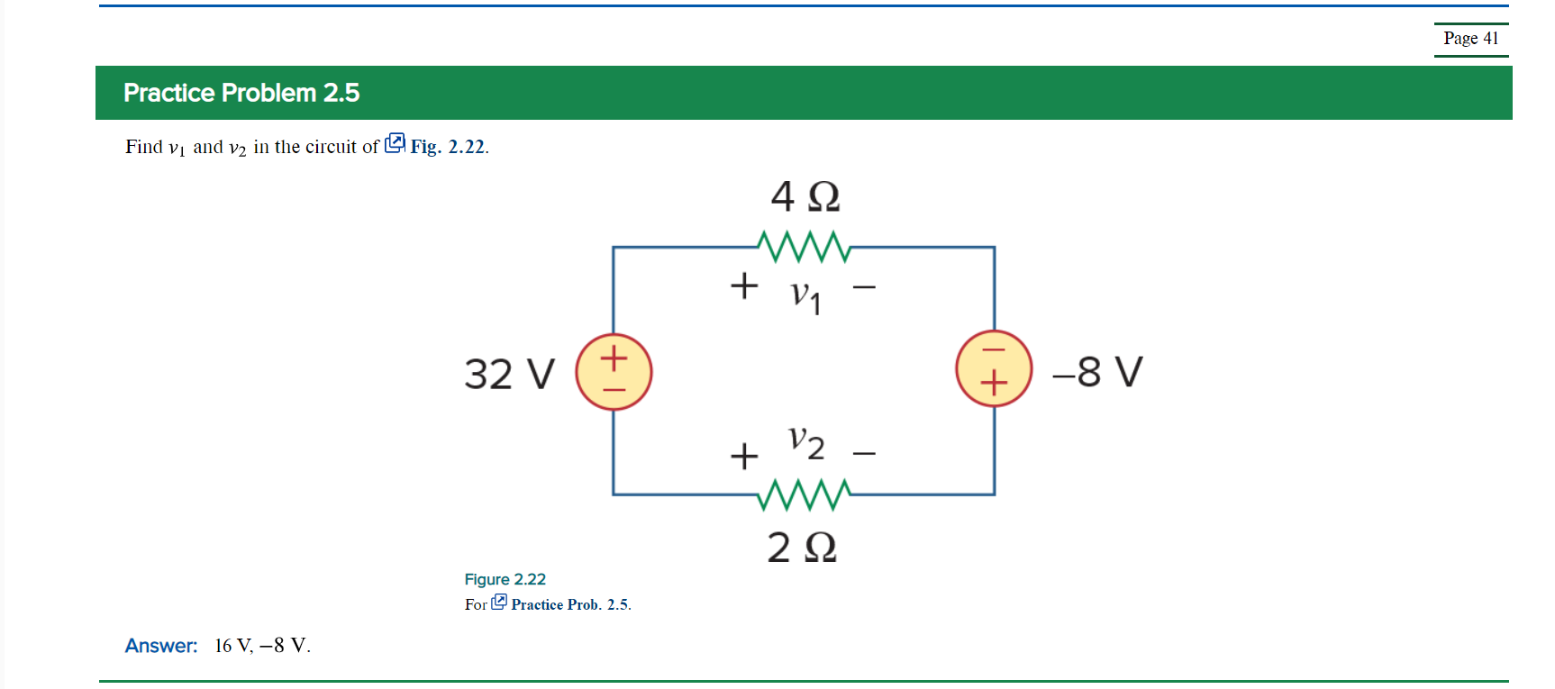
Applying KVL to the loop we get:
–32 + 4i – (–8) + 2i = 0 which leads to i = 24/6 = 4A
v₁ = 4i = 16 V and v₂ = –2i = –8 V

Slide 42
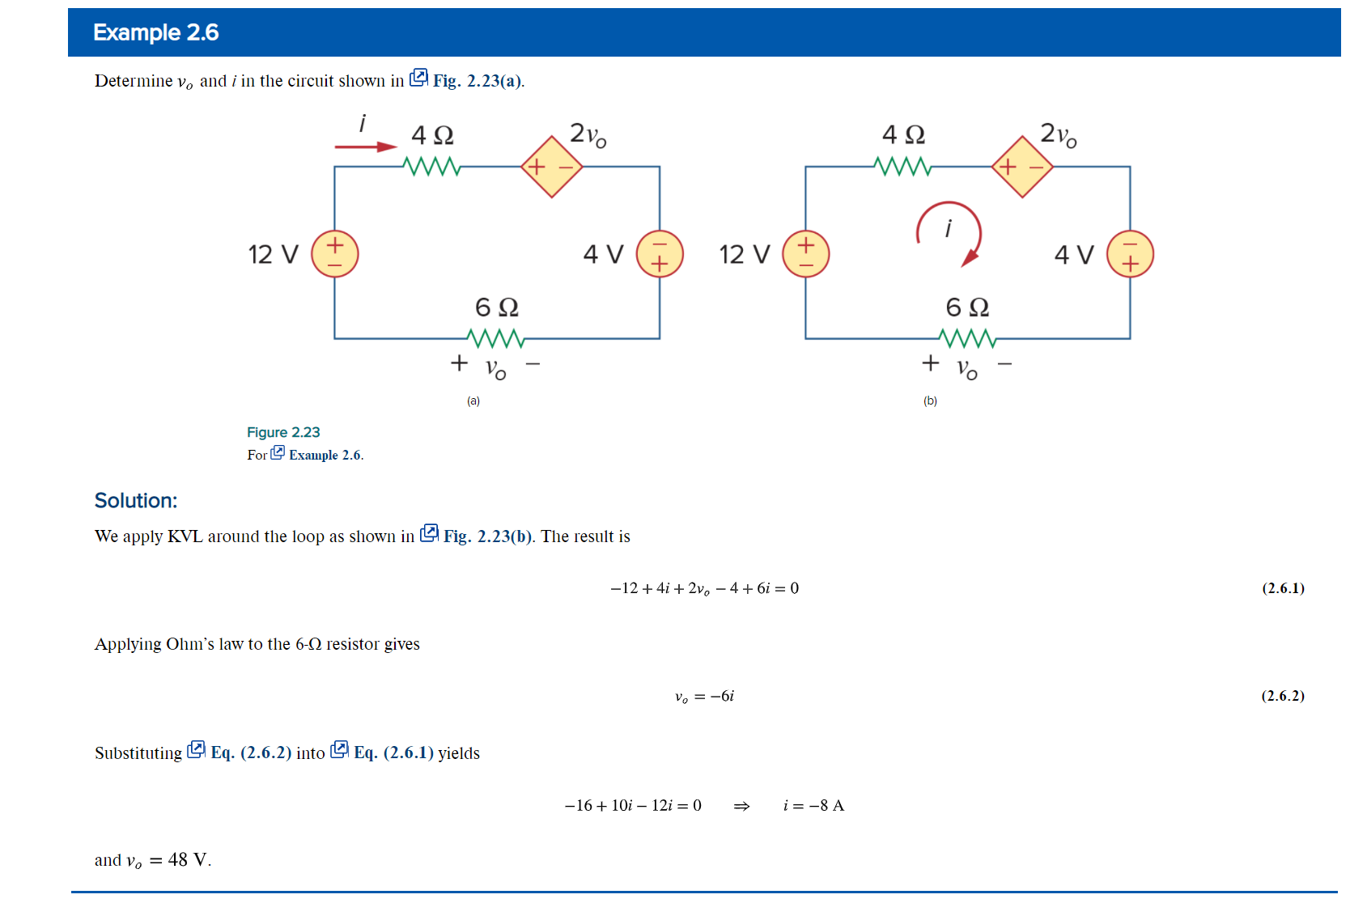

Slide 43
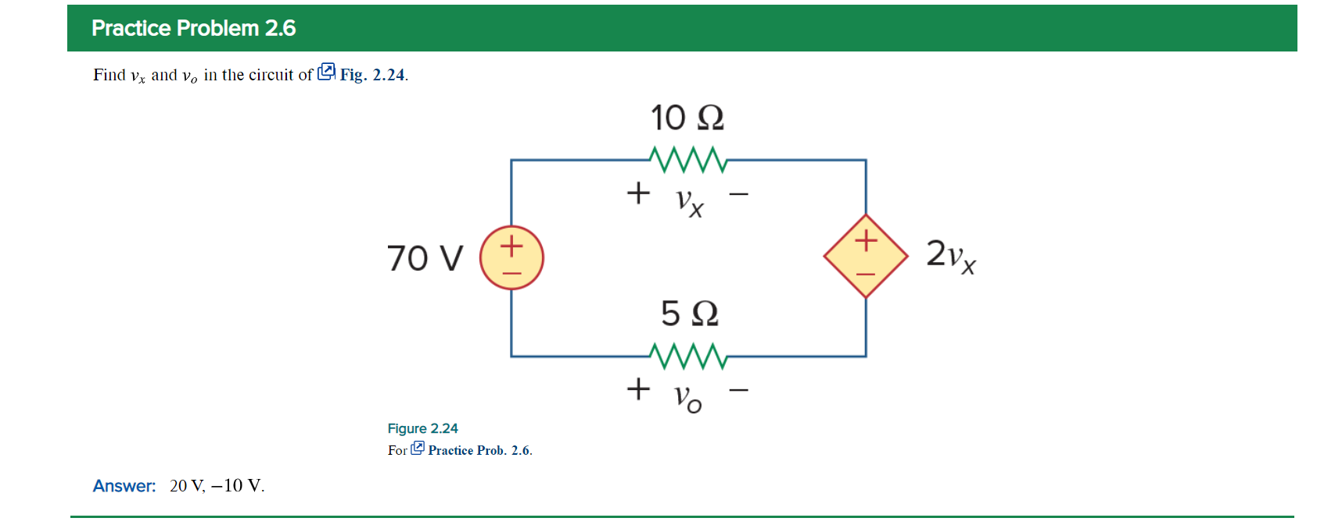
Applying KVL to the loop we get:
–70 + 10i + 2v_{x} + 5i = 0
But, v_{x} = 10i and v₀ = –5i. Hence,
–70 + 10i + 20i + 5i = 0 which leads to i = 2 A.
Thus, v_{x} = 20V and v₀ = –10 V

Slide 44


Slide 45

Applying KCL, –9 + i₀ + [i₀ /4] + [v₀ /8]=0, but i₀ = v₀/2
Which leads to: 9 = (v₀/2) + (v₀/8) + (v₀/8) thus, v₀ = 12 V and i₀ = 6 A

Slide 46



Slide 47


Slide 48


Slide 49


Slide 50



Series Resistors
Two resistors are considered in series if the same current pass through them.
Take the circuit shown:
Applying Ohm’s law to both resistors.
If we apply K V L to the loop we have:

Slide 51



Series Resistors 2
Combining the two equations:
From this we can see there is an equivalent resistance of the two resistors:
For N resistors in series:

Slide 52


Slide 53





Slide 54



Voltage Division
The voltage drop across any one resistor can be known.
The current through all the resistors is the same, so using Ohm’s law:
This is the principle of voltage division.

Slide 55






Parallel Resistors
When resistors are in parallel, the voltage drop across them is the same.
By K C L, the current at node a is
The equivalent resistance is:

Slide 56


Slide 57




Current Division
Given the current entering the node, the voltage drop across the equivalent resistance will be the same as that for the individual resistors.
This can be used in combination with Ohm’s law to get the current through each resistor:

Slide 58











Slide 59





Slide 60









Slide 61



Slide 62






Slide 63



Slide 64

Measurement Devices:
Ammeter

Slide 65

Voltmeter

Slide 66

Voltmeter II

Slide 67

Ohmmeter

Slide 68

Ohmmeter II

Slide 69


Slide 70



Because learning changes everything.®
www.mheducation.com
© McGraw Hill LLC.

