Slide 1
Linear Circuits 1
ECET 250E
Week 4 | Chapter 4: Circuit Theorems
Camosun College
Electronics & Computer Engineering Technology
Mozhgan Bacon, PhD, P.Eng.
Fall 2026
Based on Fundamentals of Electric Circuits, 2026 Release — C.K. Alexander, M.N.O. Sadiku & S.J. Fredette (McGraw Hill)

Slide 2
Overview
In this chapter, the concept of superposition will be introduced.
Source transformation will also be covered.
Thevenin and Norton’s theorems will be covered.
And Maximum Power Transfer.

Slide 3
Linearity
Linearity in a circuit means that as current is changed, the voltage changes proportionally.
It also requires that the response of a circuit to a sum of sources will be the sum of the individual responses from each source separately.
A resistor satisfies both of these criteria.

Slide 4
Superposition
If there are two or more independent sources there are two ways to solve for the circuit parameters:
  Nodal or mesh analysis.
  Use superposition.
The superposition principle states that the voltage across (or current through) an element in a linear circuit is the algebraic sum of the voltages across (or currents through) that element due to each independent source acting alone.

Slide 5
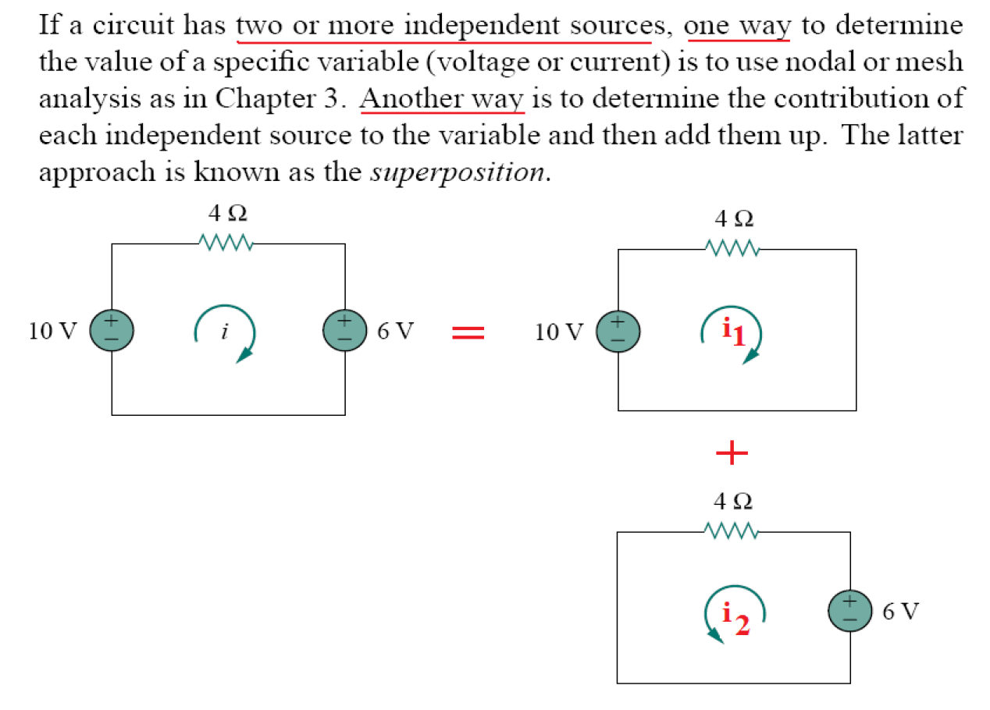

Slide 6
Applying Superposition
Using superposition means applying one independent source at a time.
Dependent sources are left alone.
The steps are:
Turn off all independent sources except one source. Find the output (voltage or current) due to that active source using the techniques covered in Chapters 2 and 3.
Repeat step 1 for each of the other independent sources.
Find the total contribution by adding algebraically all the contributions due to the independent sources.

Slide 7
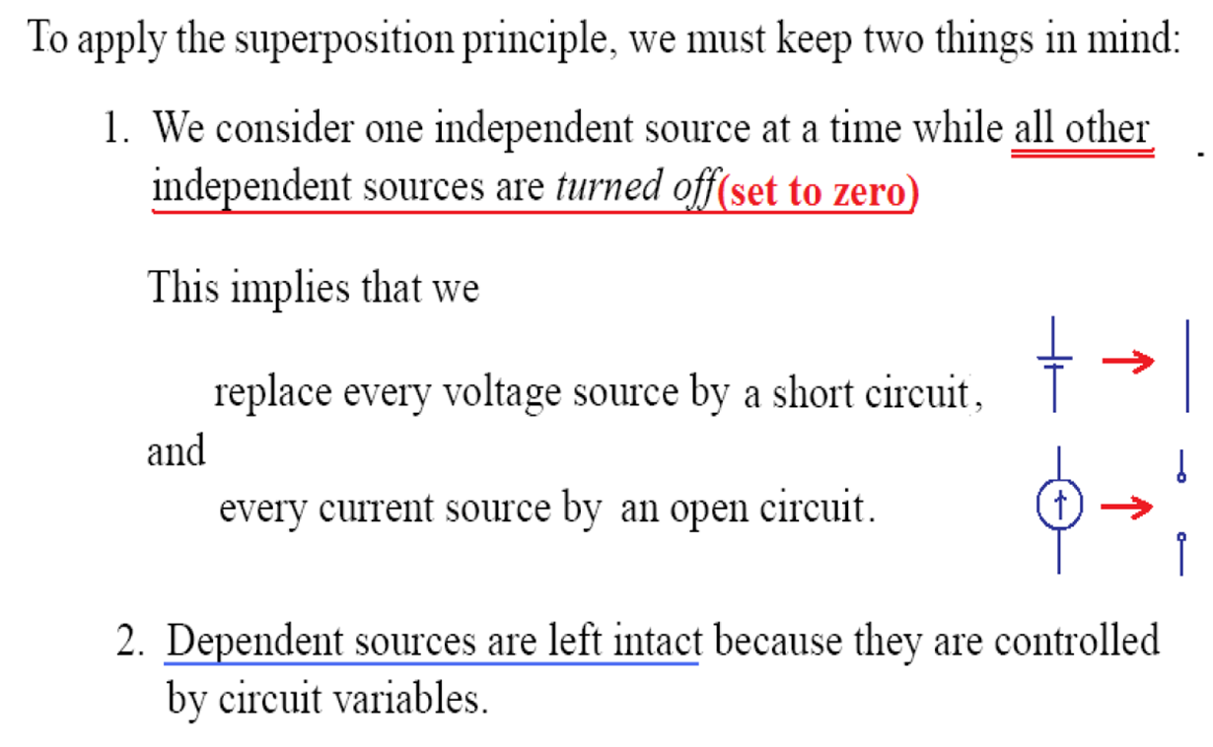

Slide 8

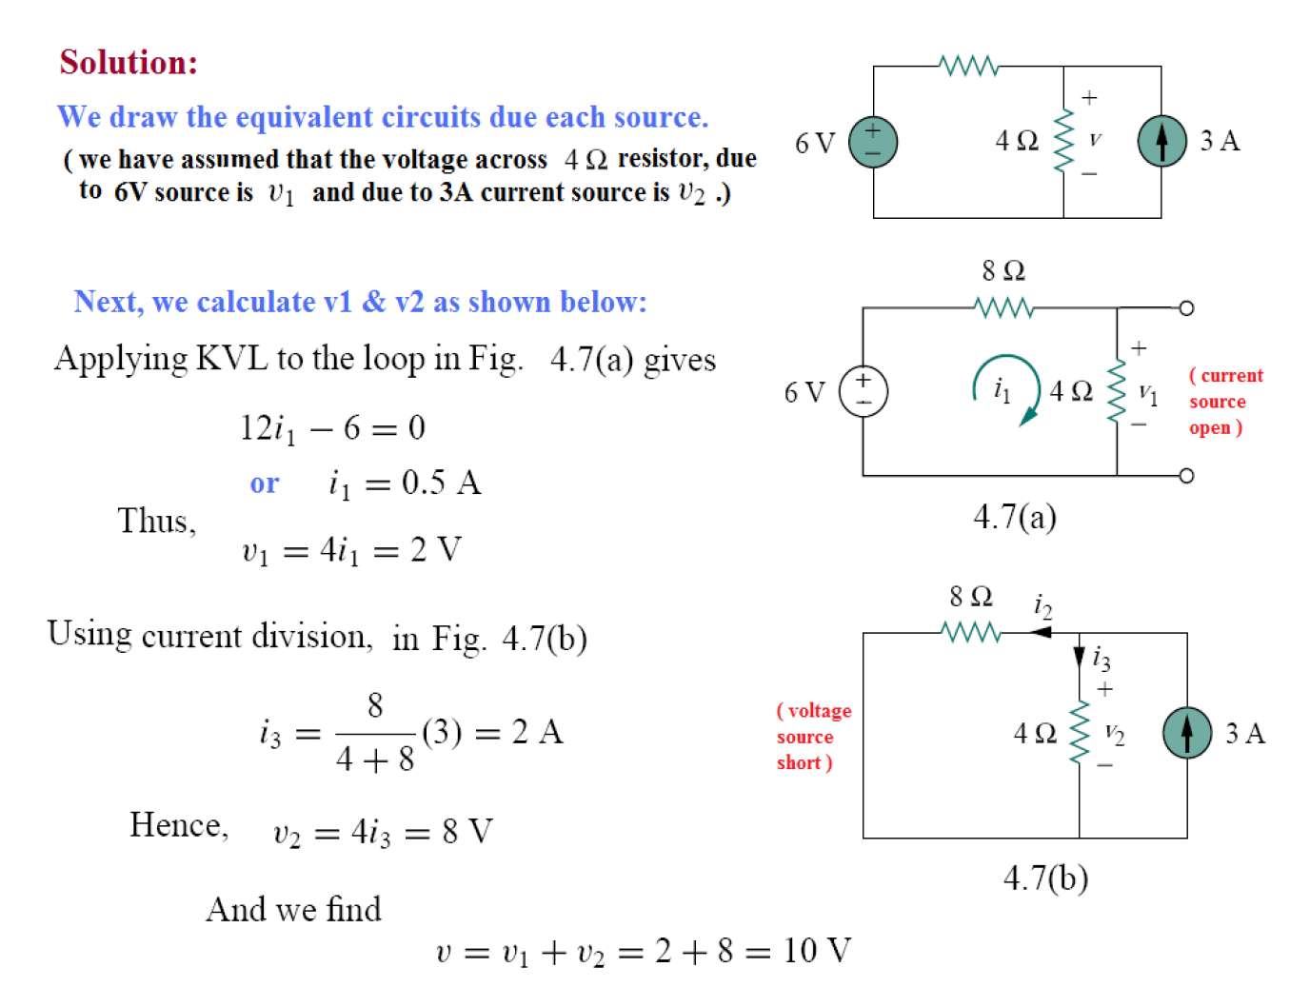



Slide 9

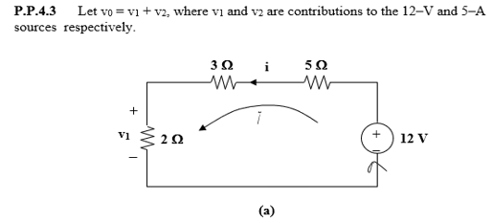
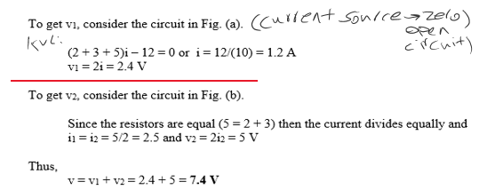
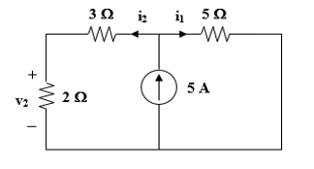
Two Different ways:
Solution (v₂ contribution)
To find v₂: turn off the voltage source (replace it with a short circuit).
Using current division to find i₂:
i₂ = 5 × [5 / (3 + 2 + 5)] = 25/10 = 2.5 A
v₂ = 2 · i₂ = 2(2.5) = 5 V
v₀ = v₁ + v₂ = 2.4 + 5 = 7.4 V ✓

Slide 10
Source Transformation
it is possible to transform a source from one form to another.
This can be useful for simplifying circuits.
The principle behind all of these transformations is equivalence.

Slide 11
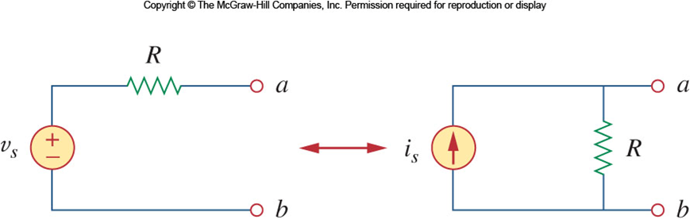
Source Transformation II
A source transformation is the process of replacing a voltage source v_{s} in series with a resistor R by a current source i_{s} in parallel with a resistor R, or vice versa.

Slide 12
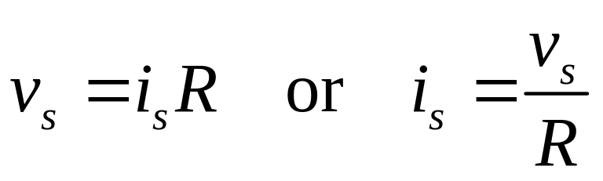
Terminal Equivalency
These transformations work because the two sources have equivalent behavior at their terminals.
If the sources are turned off the resistance at the terminals are both R.
If the terminals are short circuited, the currents need to be the same.
From this we get the following requirement:

Slide 13
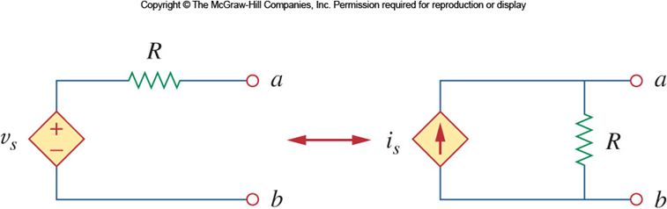
Dependent Sources
Source transformation also applies to dependent sources.
But, the dependent variable must be handled carefully.
The same relationship between the voltage and current holds here:

Slide 14
Source transformation rules
Note that the arrow of the current source is directed towards the positive terminal of the voltage source.
Source transformation is not possible when R = 0 for an ideal voltage source.
For a realistic source, R ≠ 0.
For an ideal current source, R = ∞ also prevents the use of source transformation.

Slide 15
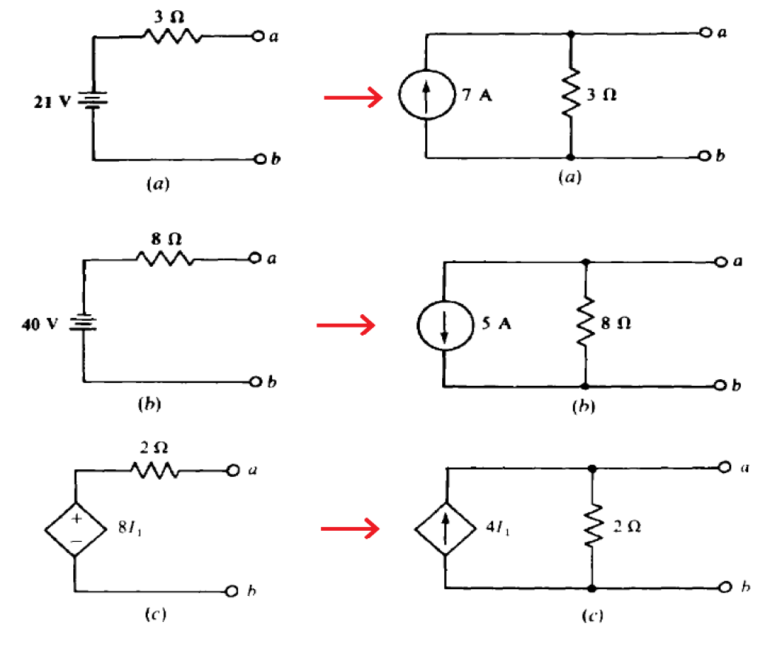

Slide 16
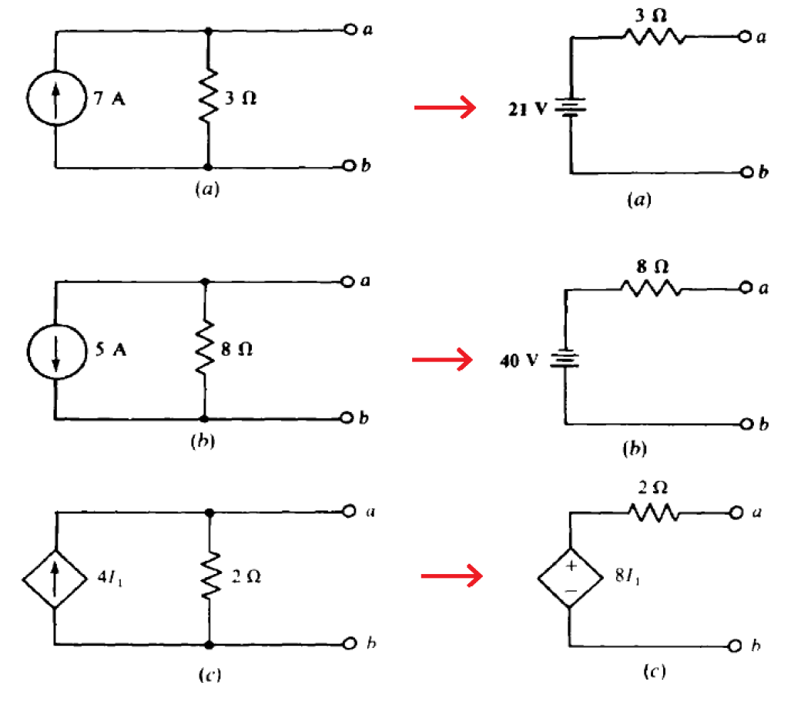

Slide 17
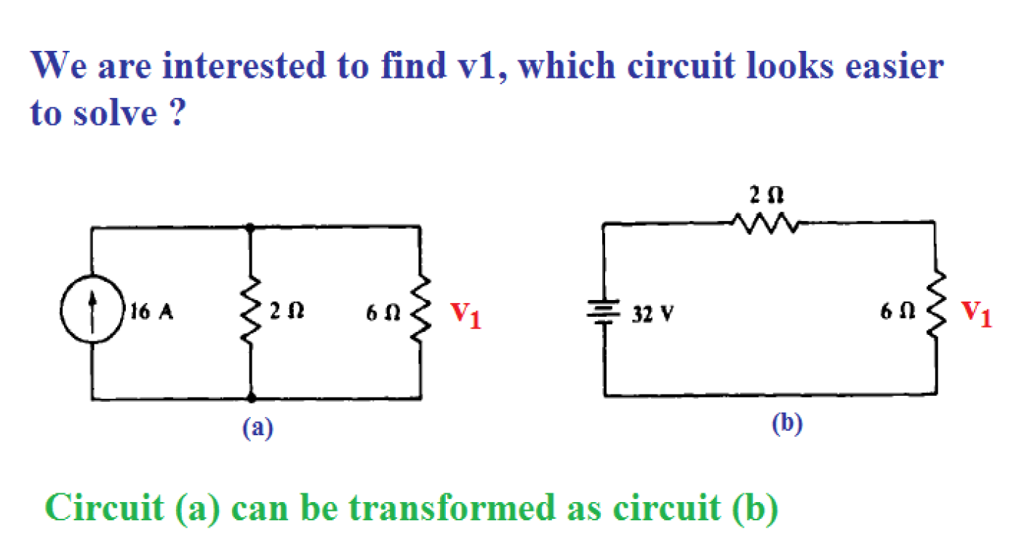

Slide 18
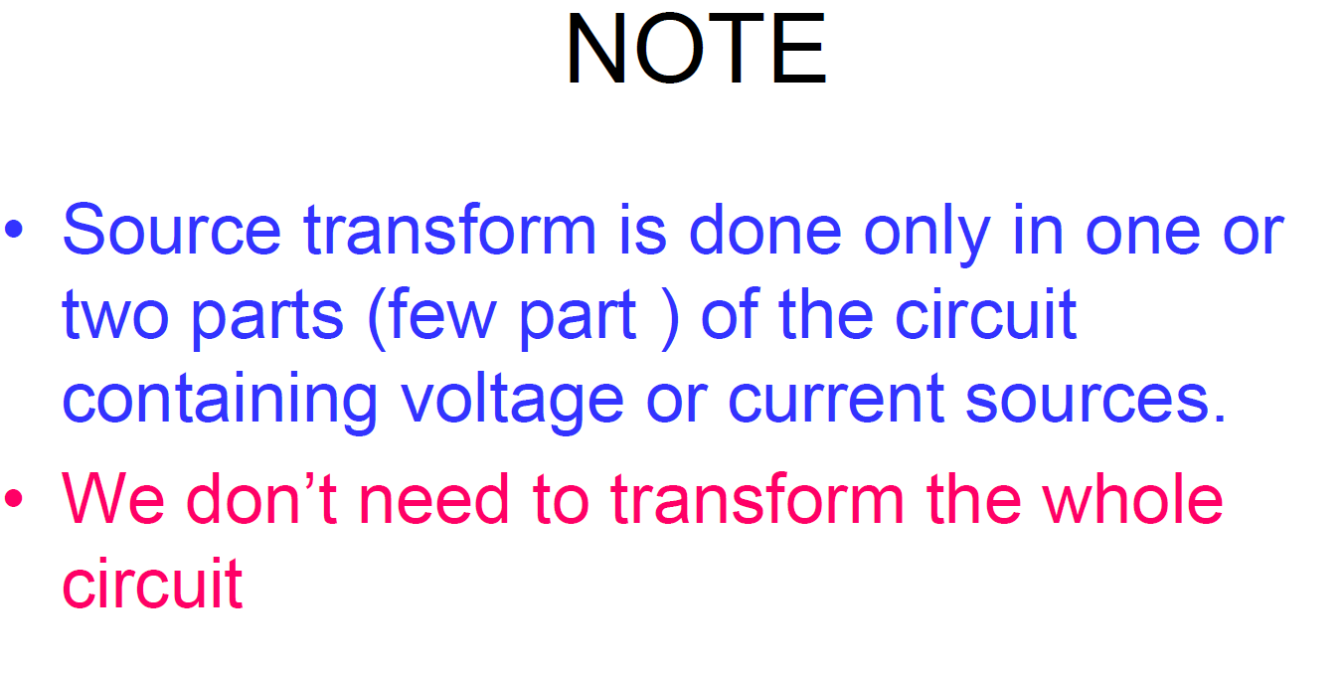

Slide 19
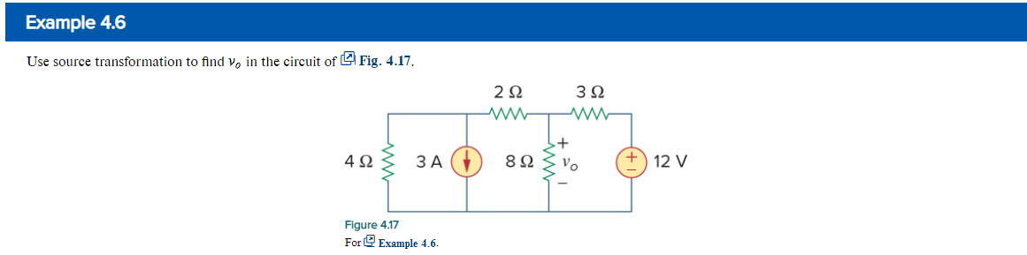
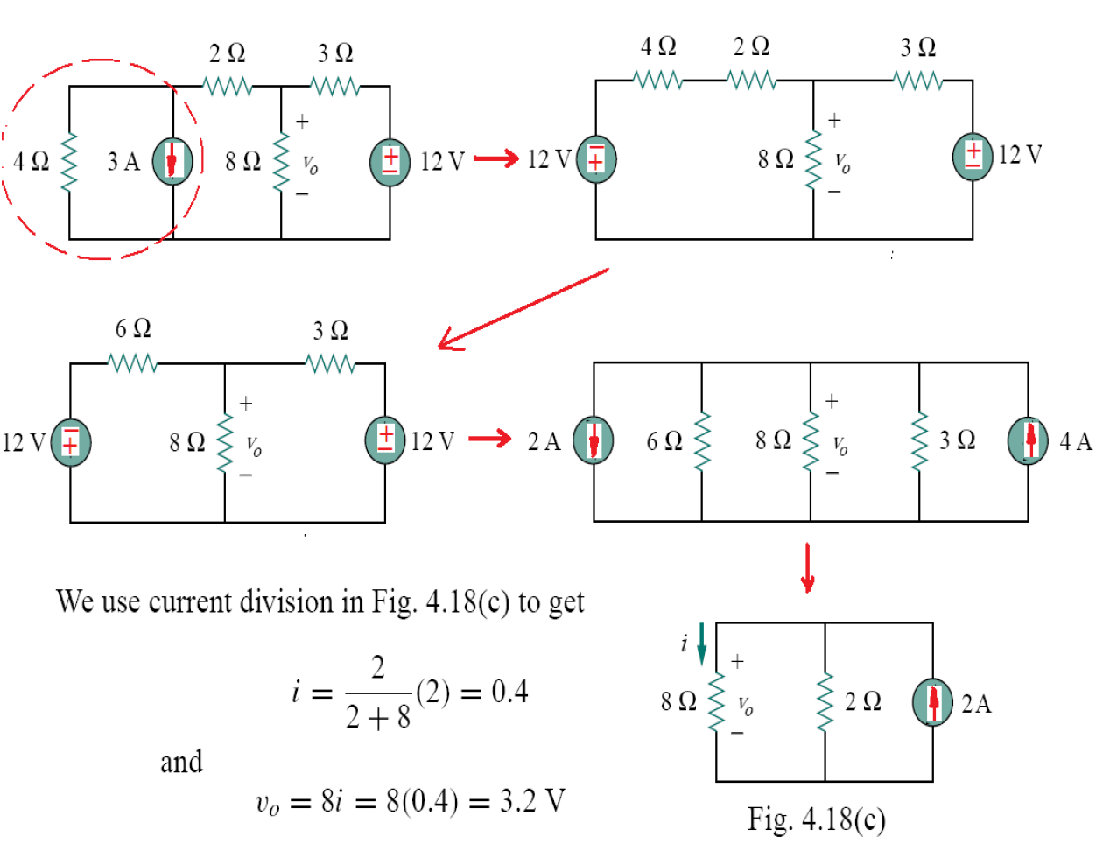
We now combine the 3Ω and 6Ω resistors in parallel to get 2Ω.
We also combine the 2A and 4A current sources to get a 2A

Slide 20

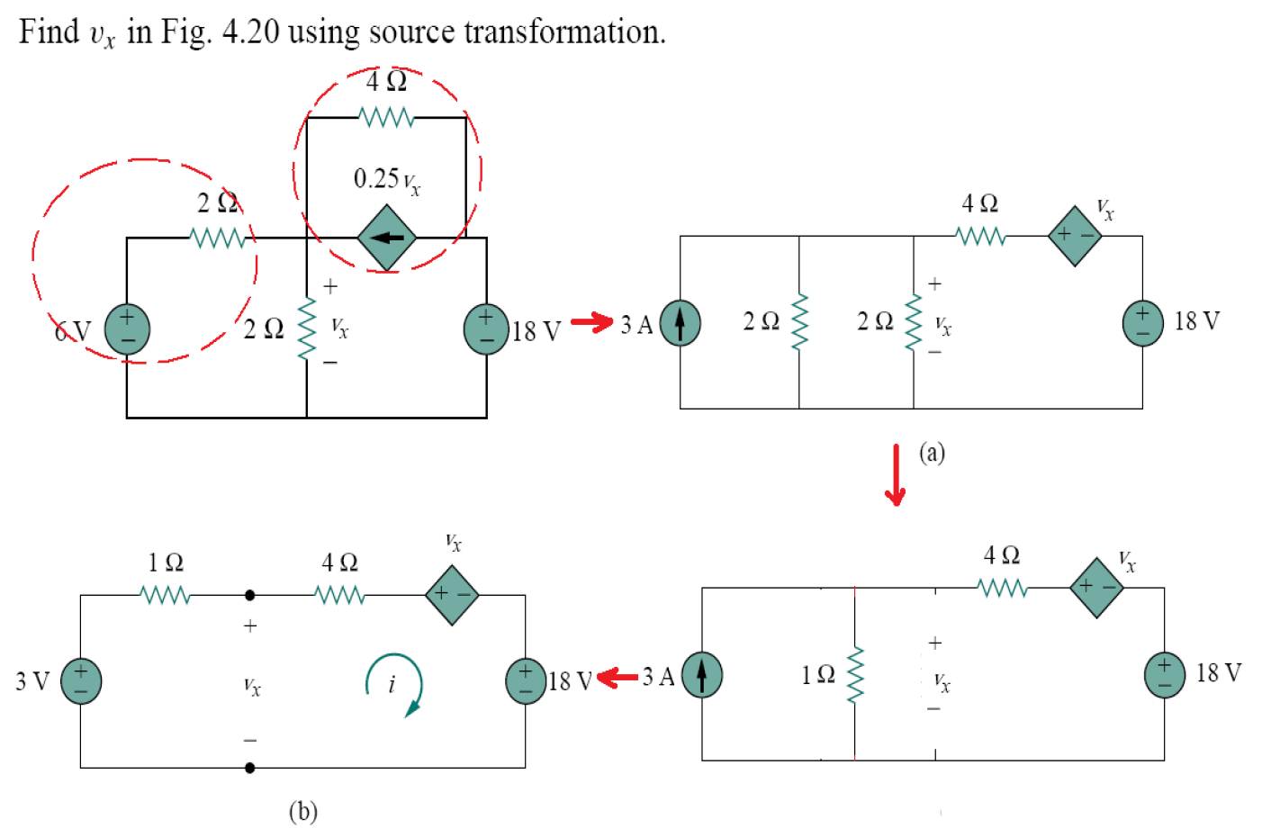
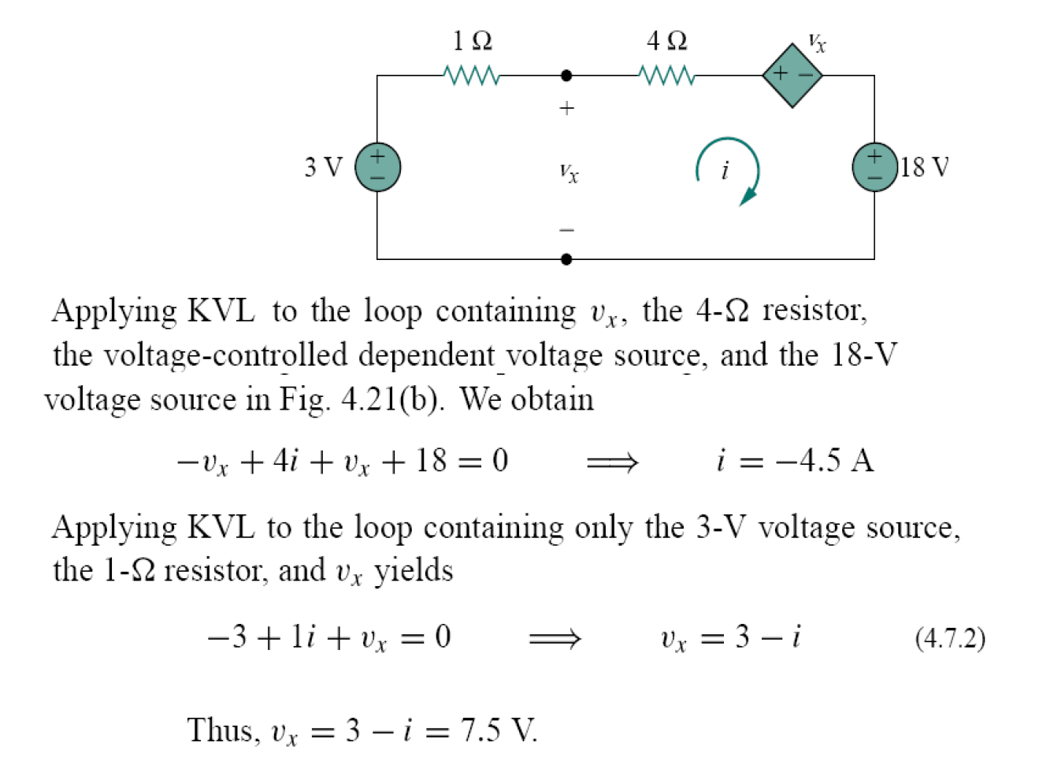

Slide 21
Thevenin’s Theorem
In many circuits, one element will be variable.
An example of this is mains power; many different appliances may be plugged into the outlet, each presenting a different resistance.
This variable element is called the load.
Ordinarily one would have to reanalyze the circuit for each change in the load.

Slide 22
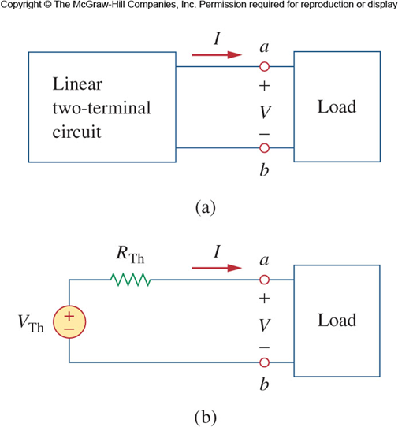
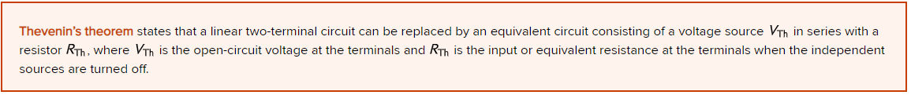
Thevenin’s Theorem II
Thevenin’s theorem states that a linear two terminal circuit may be replaced with a voltage source and resistor.
The voltage source’s value is equal to the open circuit voltage at the terminals.
The resistance is equal to the resistance measured at the terminals when the independent sources are turned off.

Slide 23
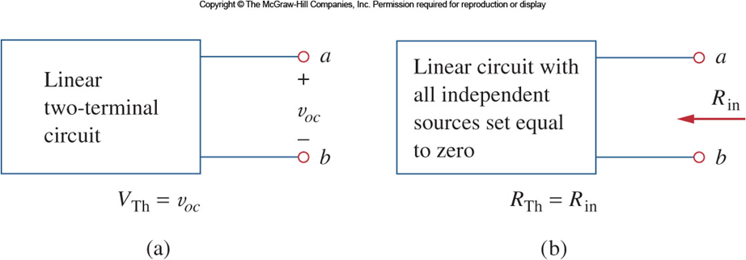
Thevenin’s Theorem III
There are two cases to consider when finding the equivalent resistance.
Case 1: If there are no dependent sources, then the resistance may be found by simply turning off all the sources.

Slide 24
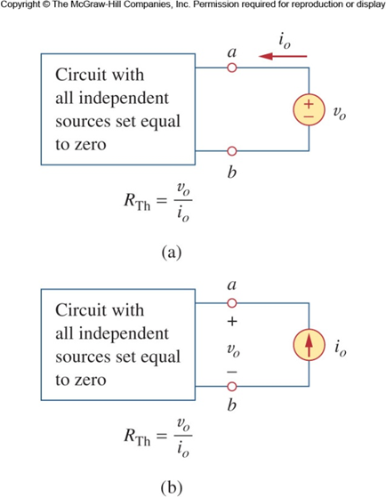
Thevenin’s Theorem IV
Case 2: If there are dependent sources, we still turn off all the independent sources.
Now apply a voltage v₀ (or current i₀) to the terminals and determine the current i₀ (voltage v₀).

Slide 25
Thevenin’s Theorem V
Thevenin’s theorem is very powerful in circuit analysis.
It allows one to simplify a circuit.
A large circuit may be replaced by a single independent voltage source and a single resistor.
The equivalent circuit behaves externally exactly the same as the original circuit.

Slide 26
Negative Resistance?
It is possible for the result of this analysis to end up with a negative resistance.
This implies the circuit is supplying power.
This is reasonable with dependent sources.
Note that in the end, the Thevenin equivalent makes working with variable loads much easier.
Load current can be calculated with a voltage source and two series resistors.
Load voltages use the voltage divider rule.

Slide 27
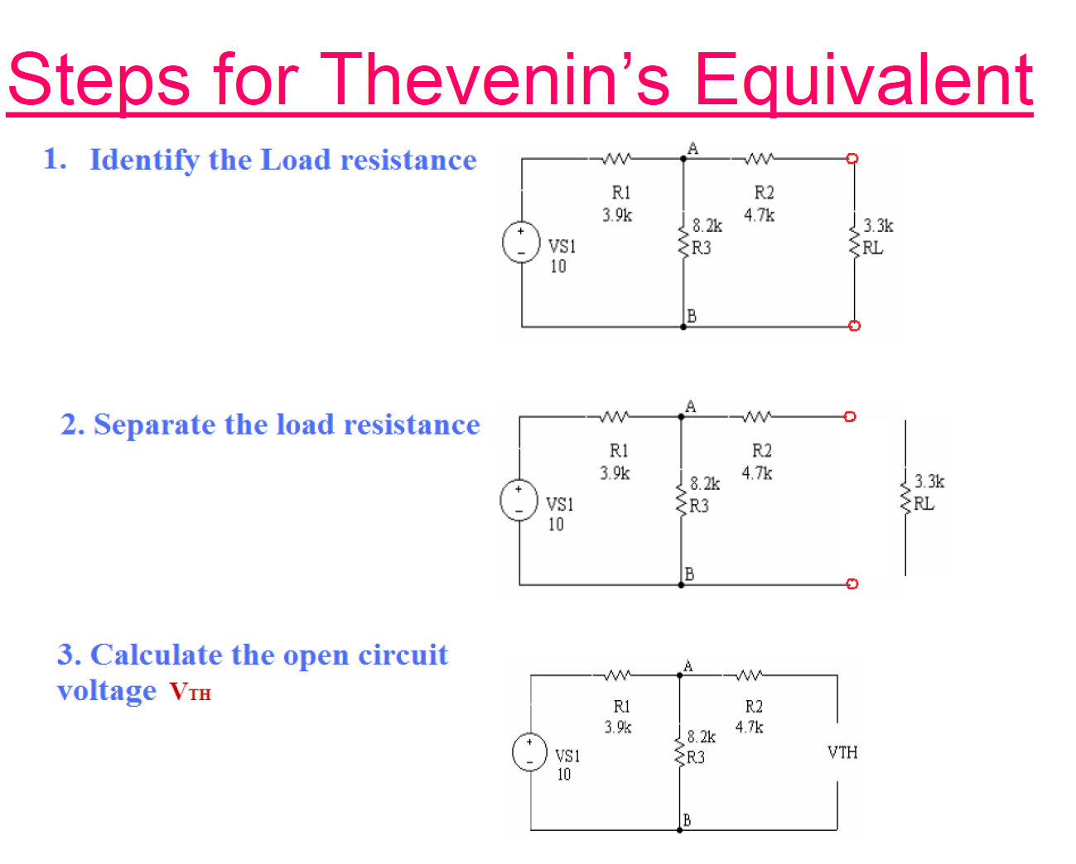

Slide 28
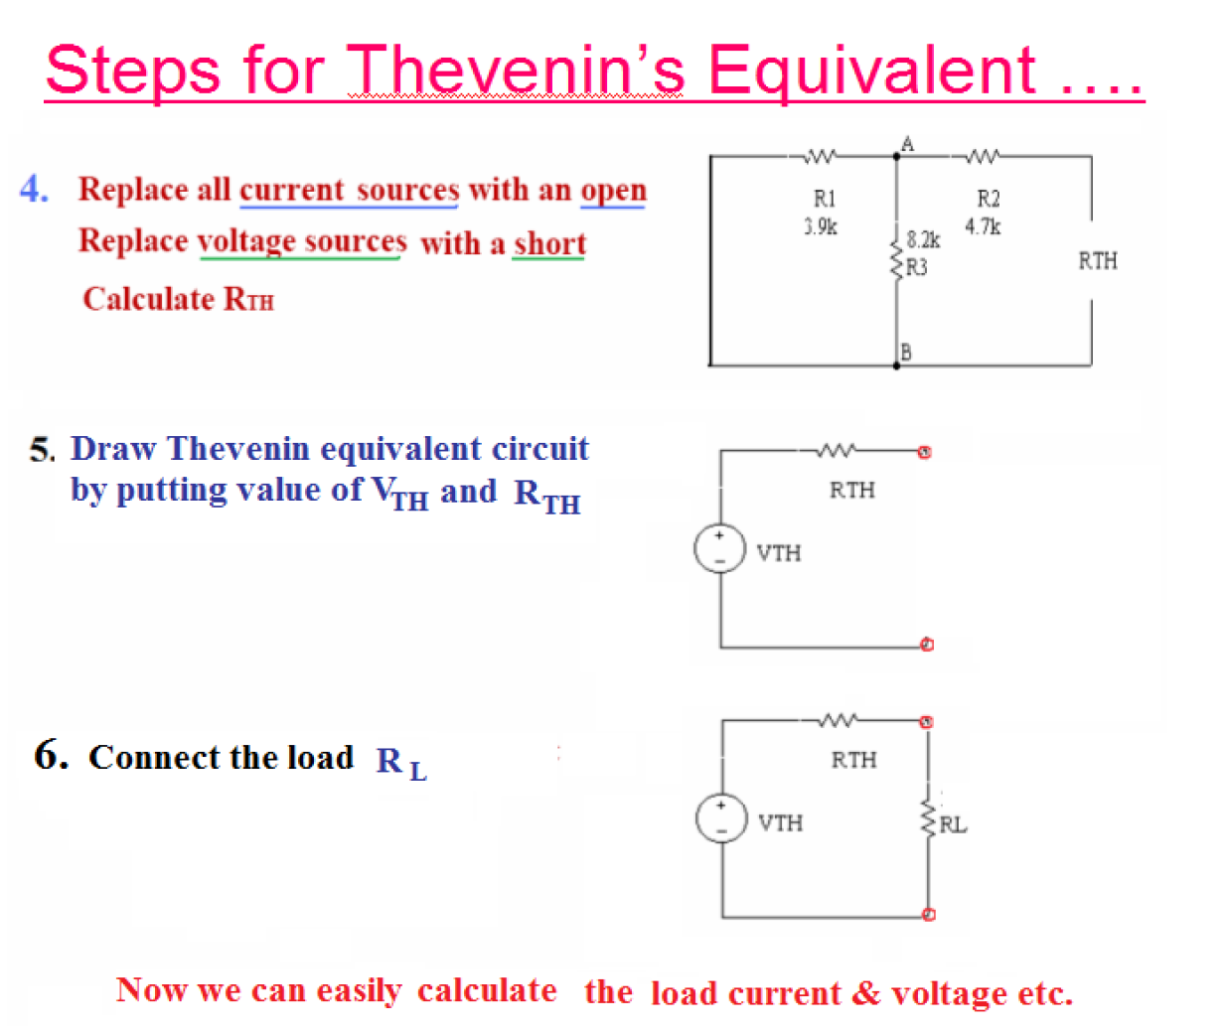

Slide 29
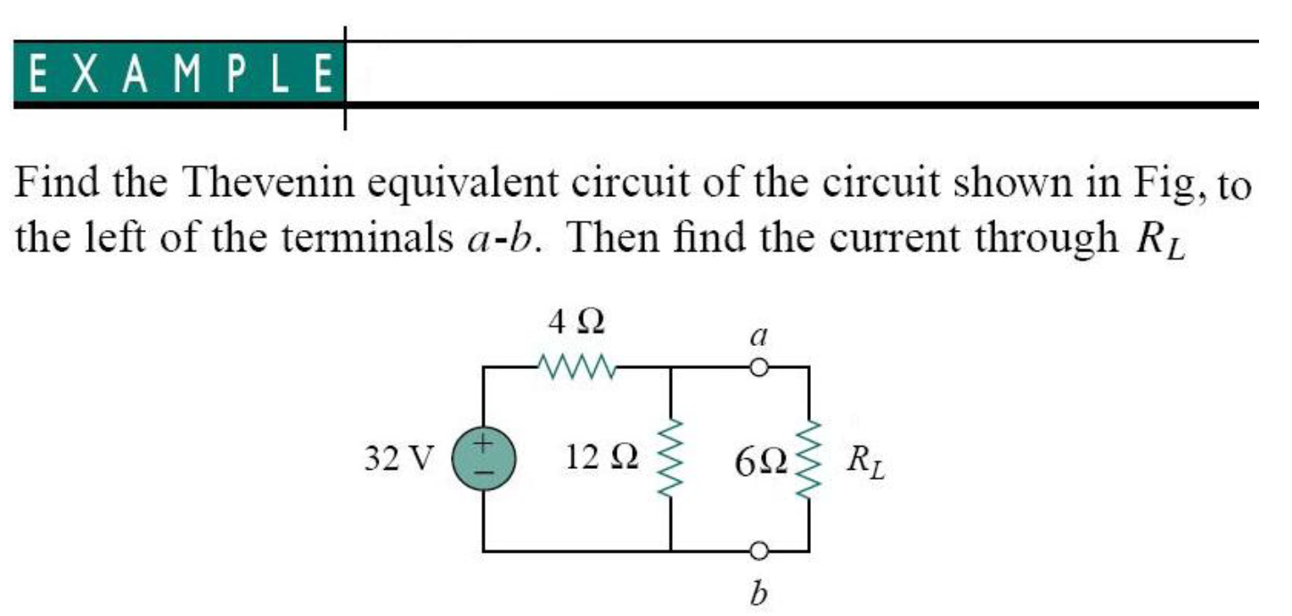

Slide 30
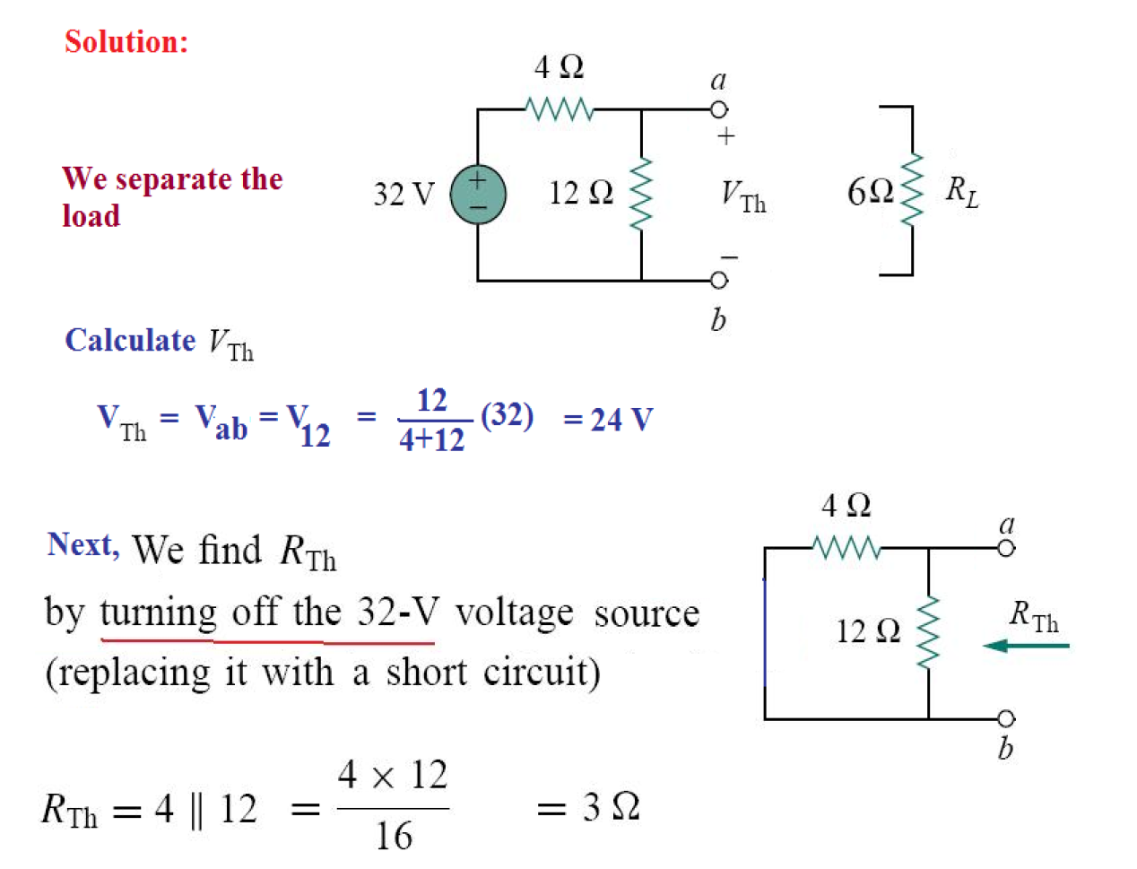

Slide 31
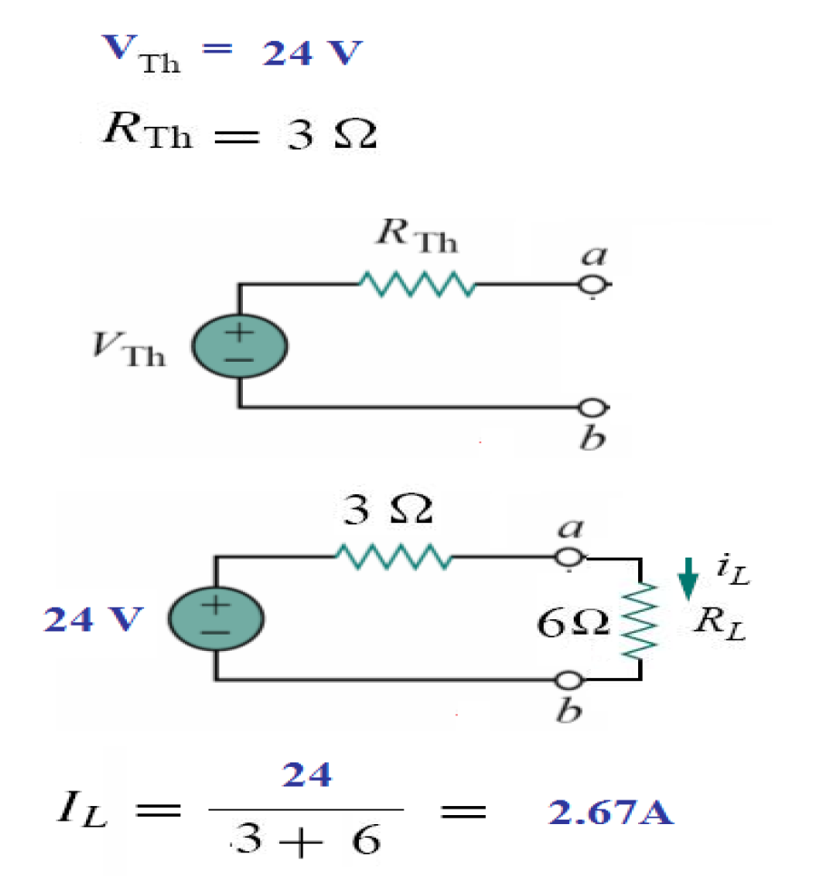

Slide 32
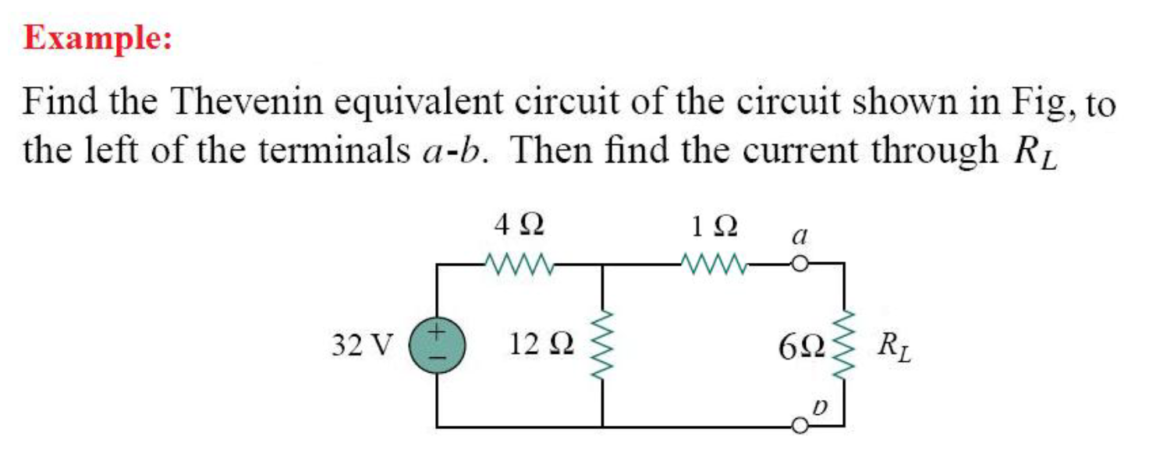

Slide 33
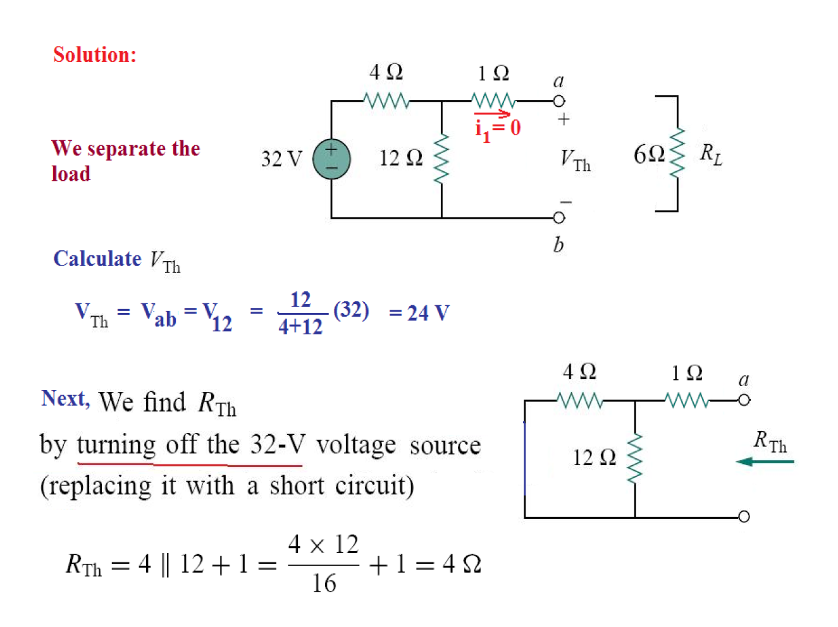

Slide 34
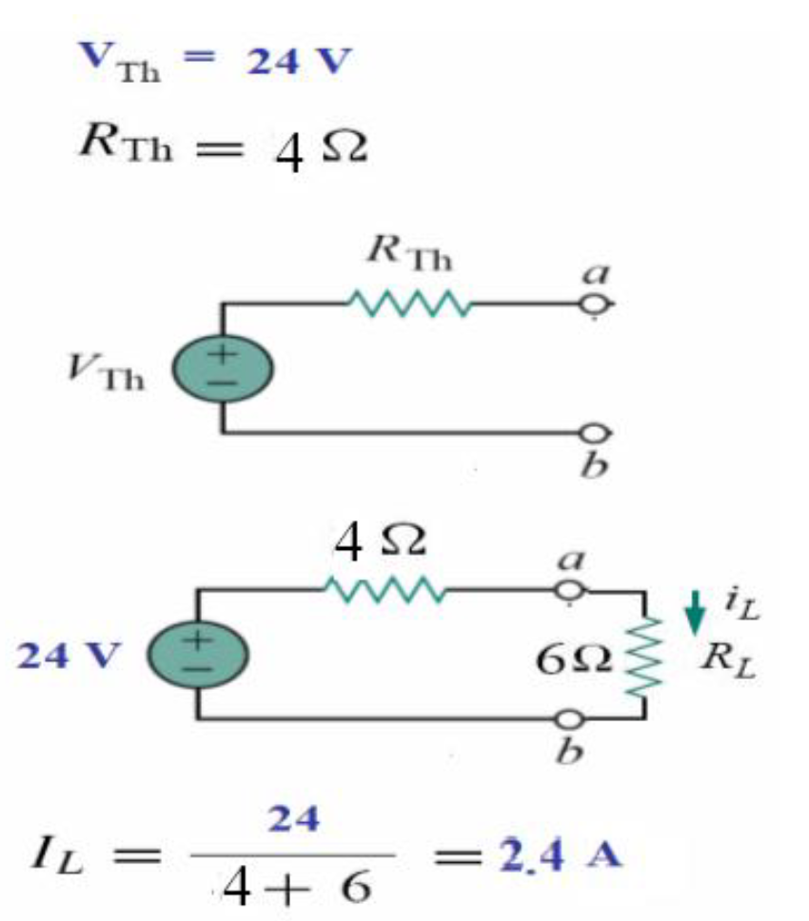

Slide 35
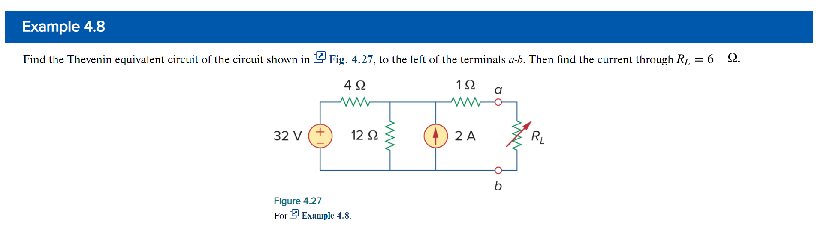
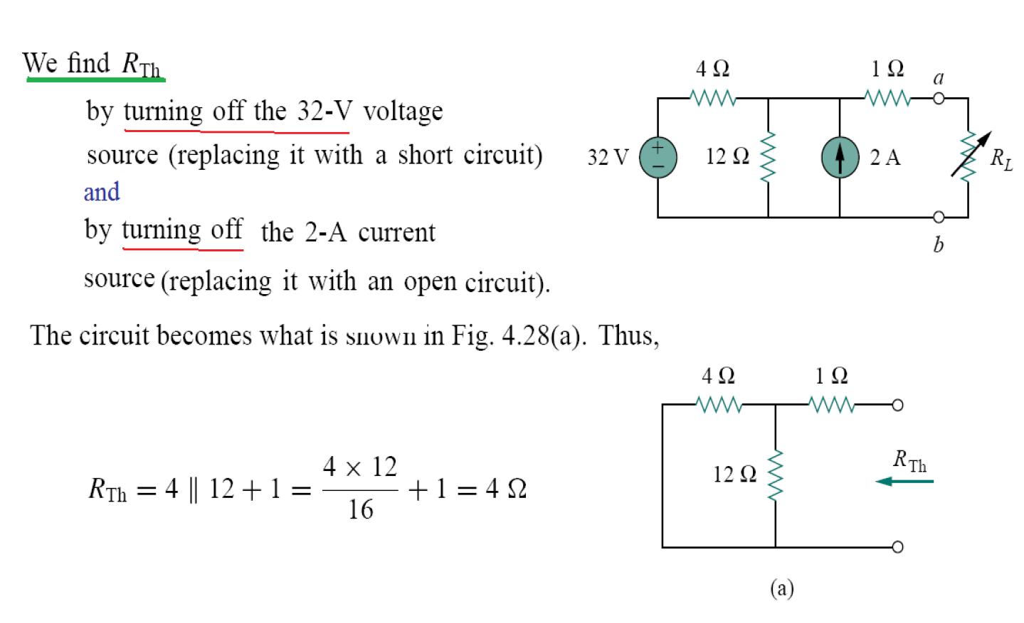

Slide 36
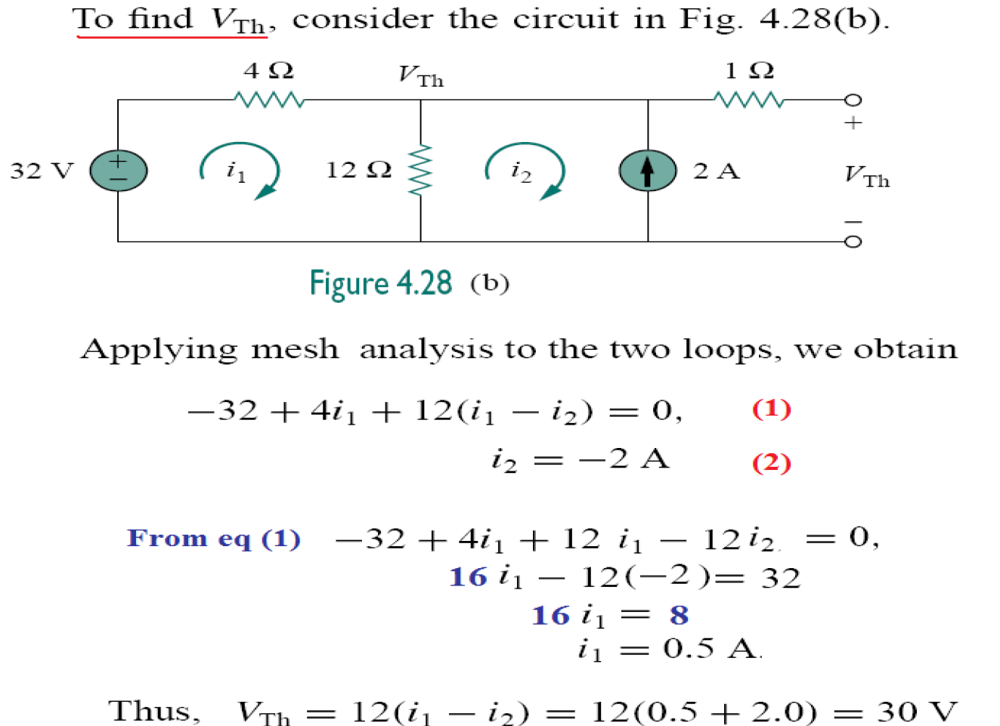

Slide 37
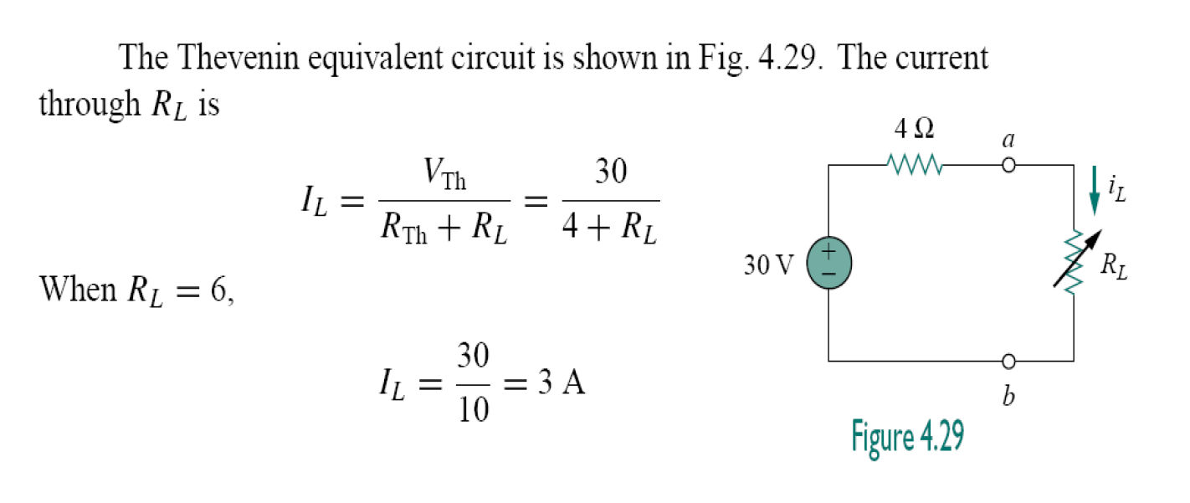

Slide 38
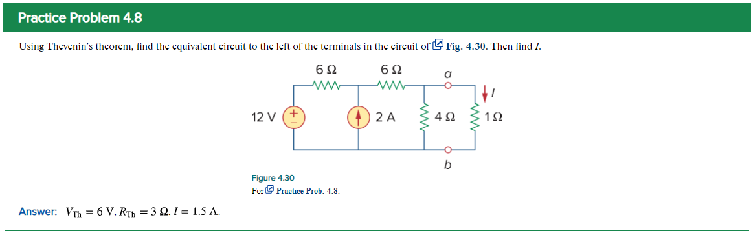
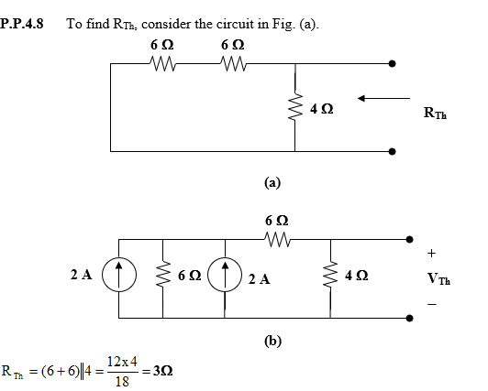
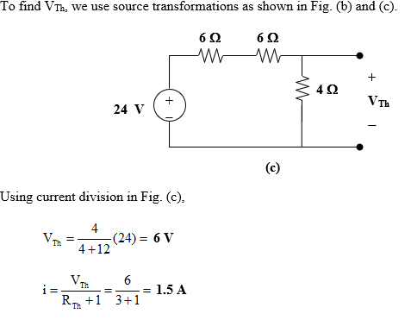


Slide 39
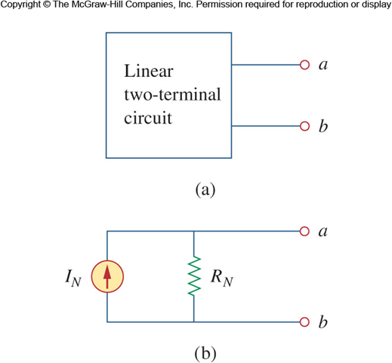
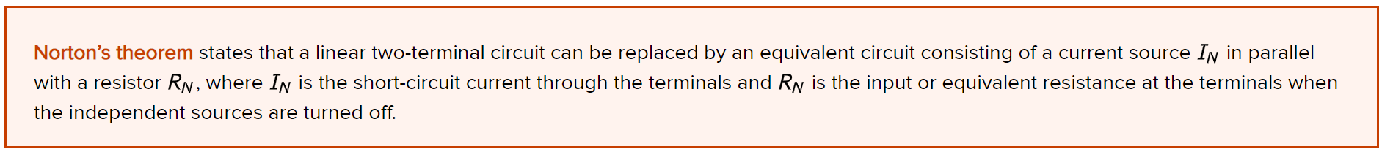
Norton’s Theorem
Similar to Thevenin’s theorem, Norton’s theorem states that a linear two terminal circuit may be replaced with an equivalent circuit containing a resistor and a current source.
The Norton resistance will be exactly the same as the Thevenin.

Slide 40
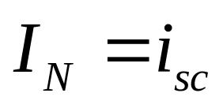
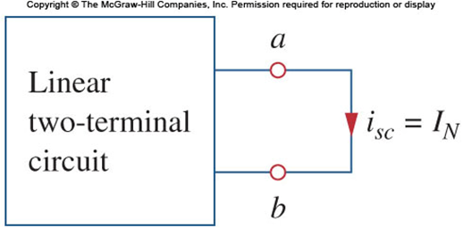
Norton’s Theorem II
The Norton current I_{N} is found by short circuiting the circuit’s terminals and measuring the resulting current.

Slide 41
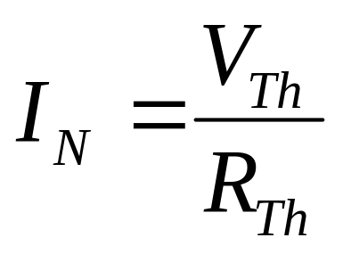
Norton versus Thevenin
These two equivalent circuits can be related to each other.
One need only look at source transformation to understand this.
The Norton current and Thevein voltage are related to each other as follows:

Slide 42
Norton versus Thevenin II
With V_{TH}, I_{N}, and (R_{TH}=R_{N}) related, finding the Thevenin or Norton equivalent circuit requires that we find:
The open-circuit voltage across terminals a and b.
The short-circuit current at terminals a and b.
The equivalent or input resistance at terminals a and b when all independent sources are turned off.

Slide 43
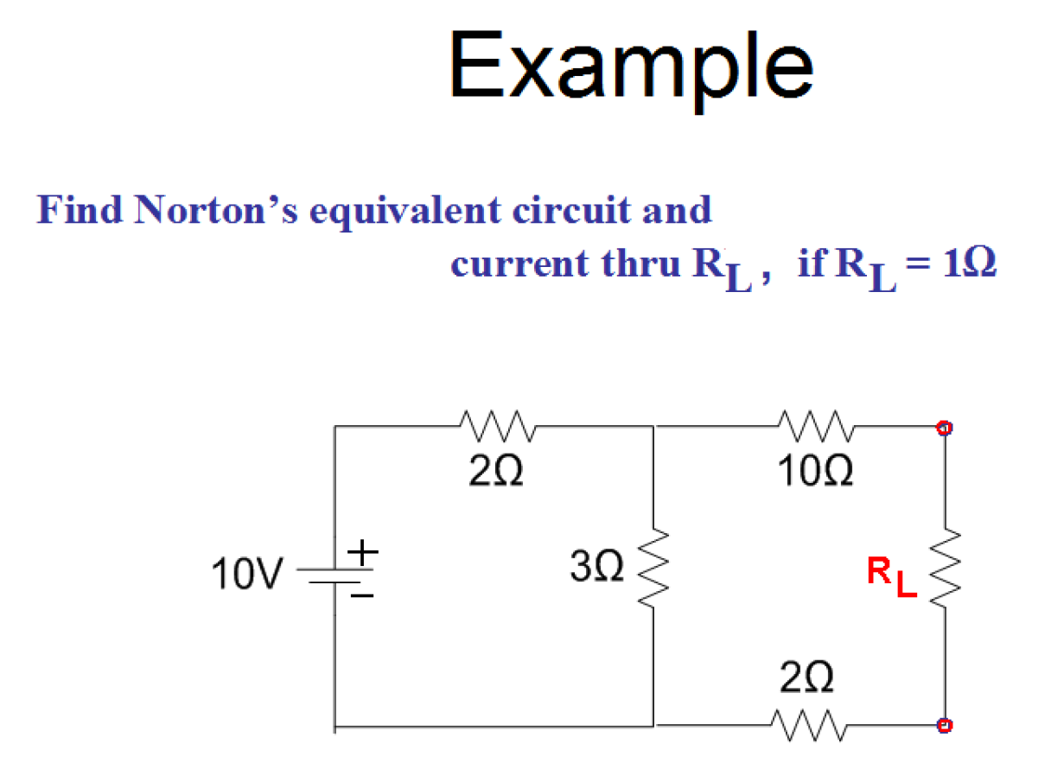

Slide 44
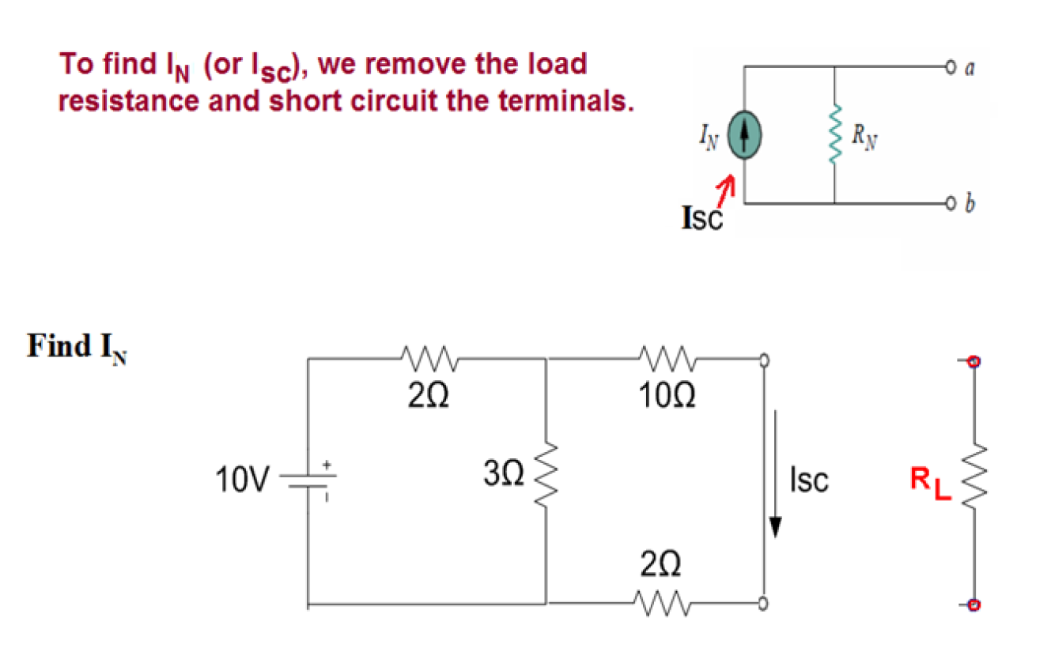

Slide 45
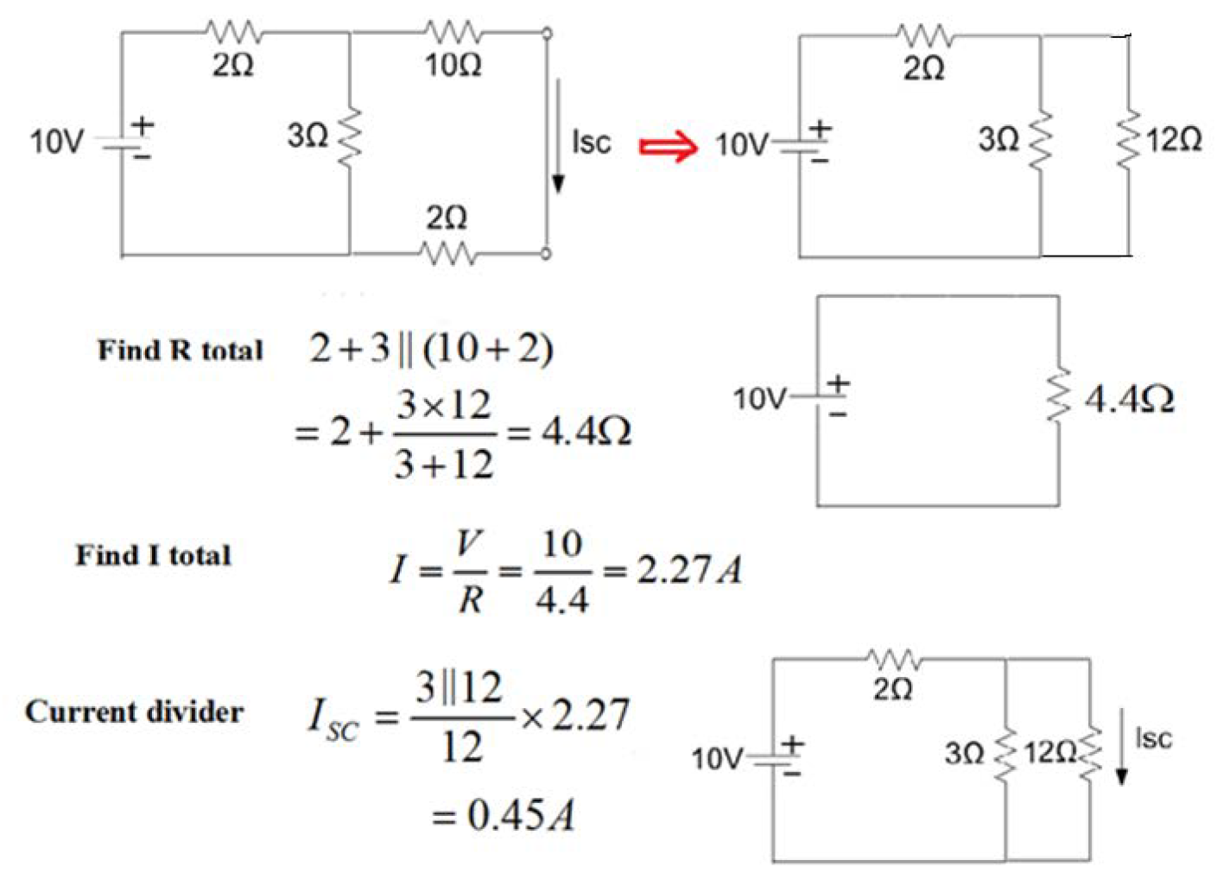

Slide 46
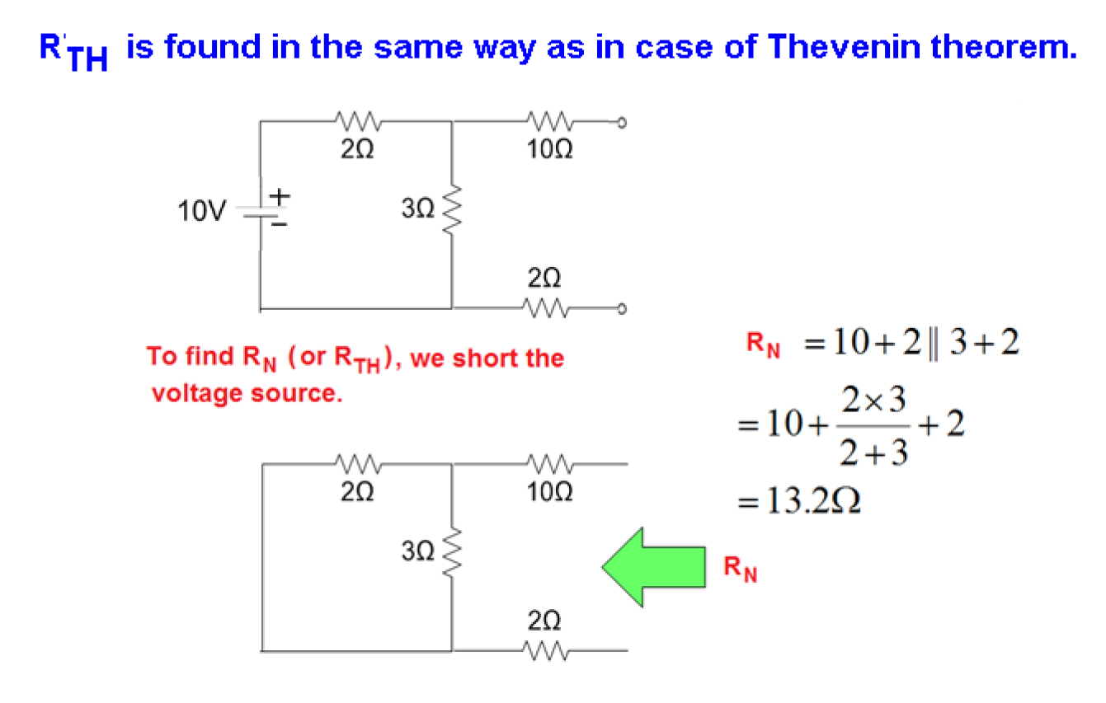

Slide 47
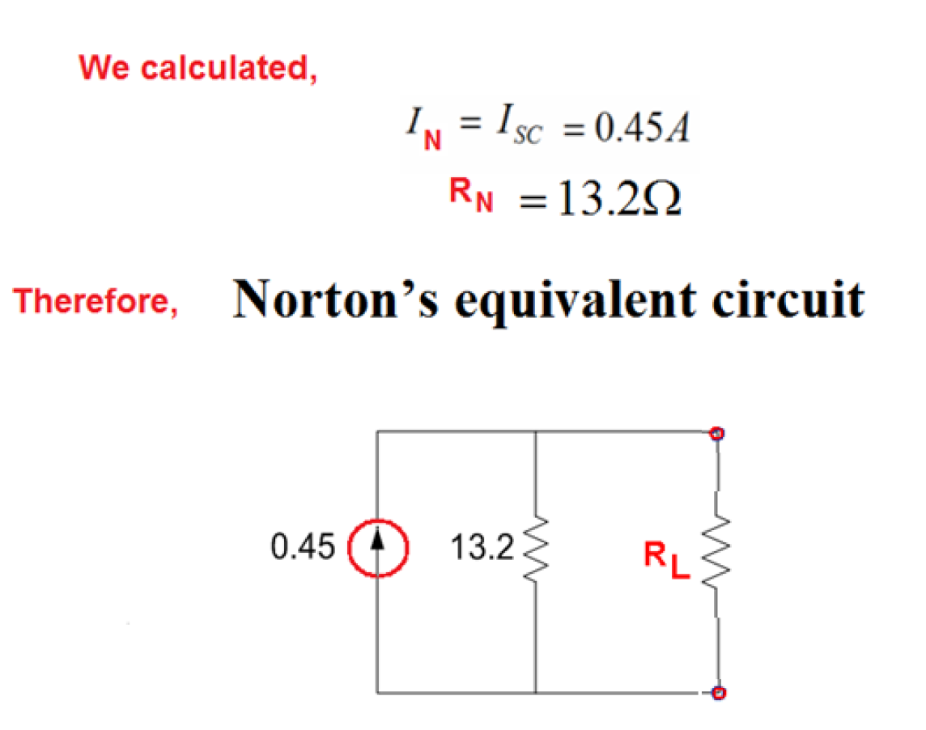

Slide 48
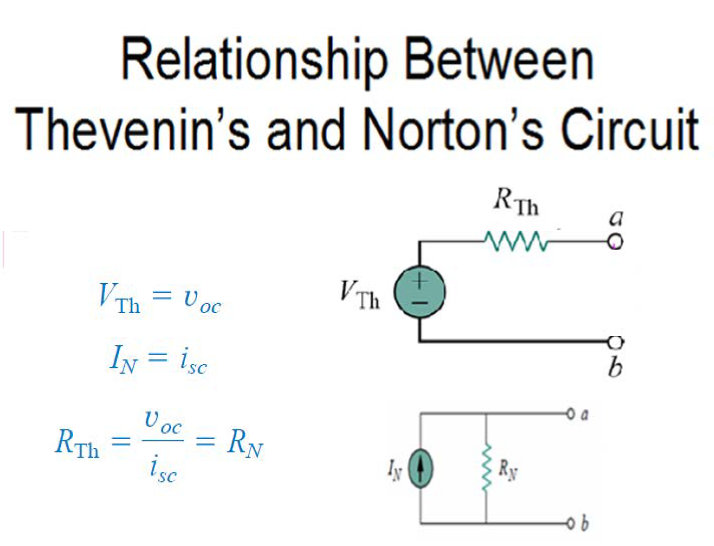

Slide 49

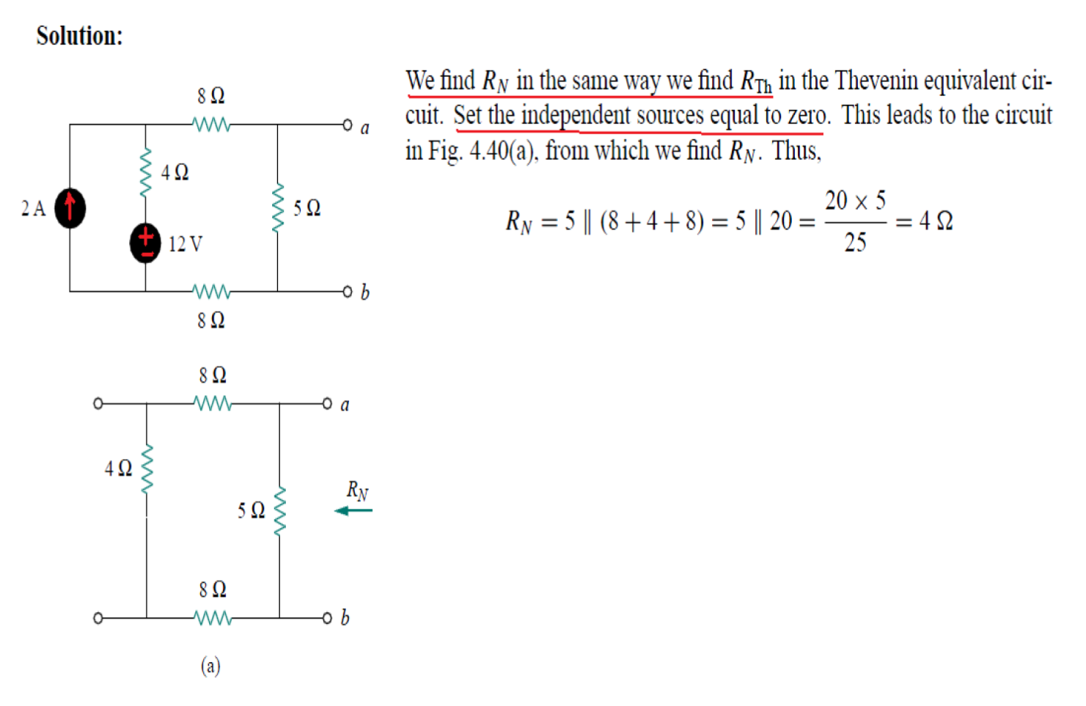

Slide 50
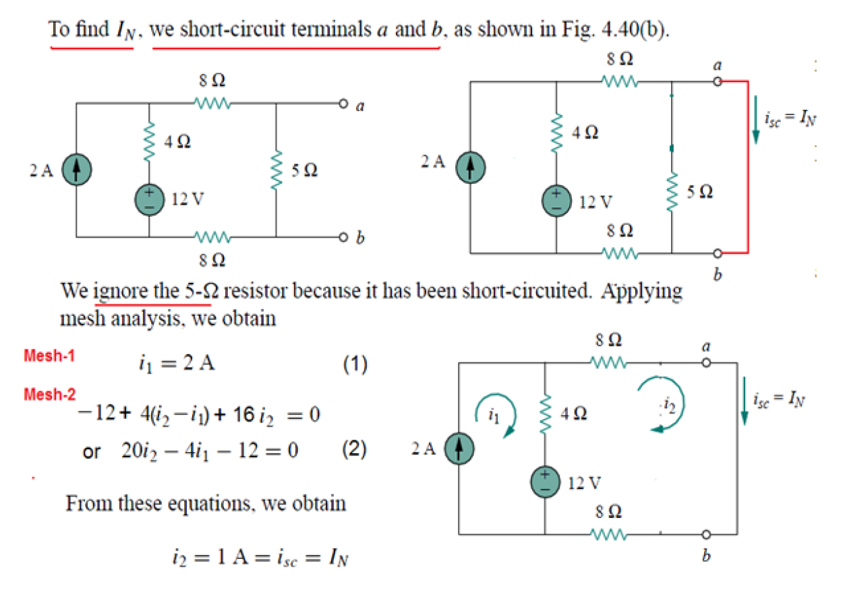

Slide 51
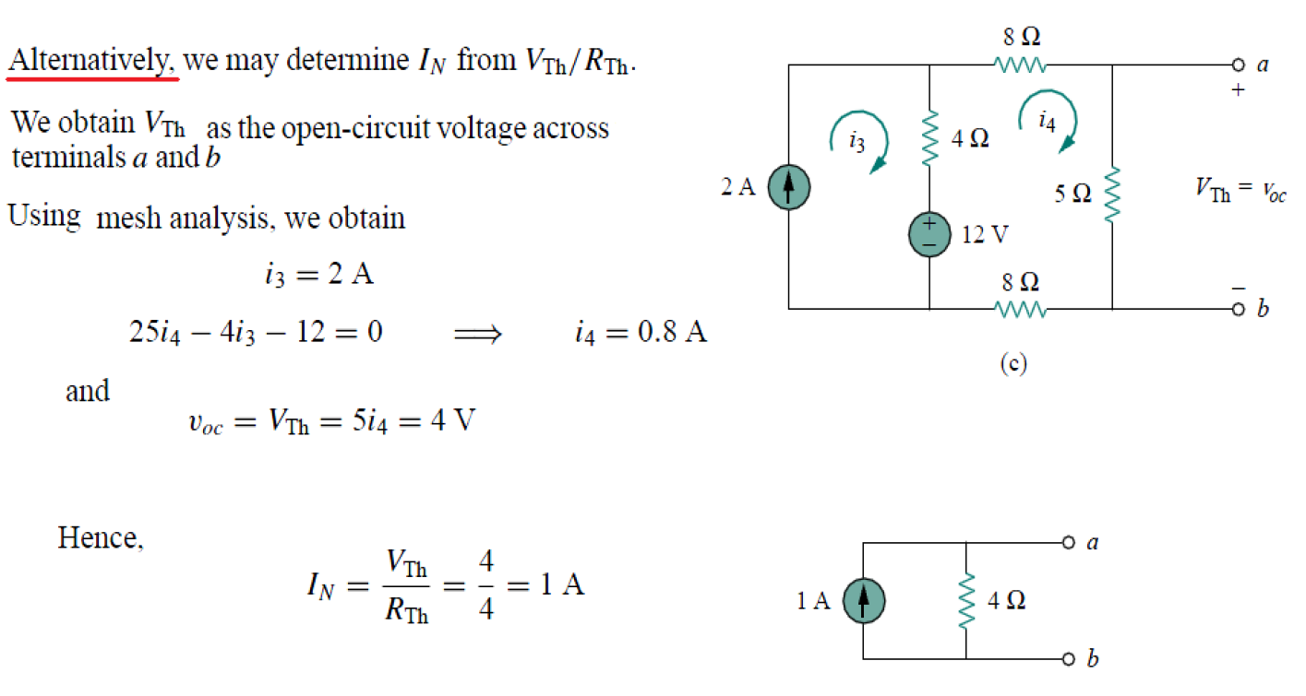

Slide 52


Slide 53


Slide 54





Verification by Nodal Analysis
Let Vᴀ = node between the 15 V source and the 4 A source, Vʙ = node a (terminal), with terminal b as reference (0 V).
KCL at A: i1+4=i2 ⟶ (15 − Vᴀ)/3 + 4 = (Vᴀ − Vʙ)/3 ⟶ 2Vᴀ − Vʙ = 27
KCL at B: i2=i2 ⟶ (Vᴀ − Vʙ)/3 = (Vʙ-0)/6 ⟶ Vᴀ = 1.5 Vʙ
Solving the two equations: Vʙ = 13.5 V
Vᴛh = Vʙ = 13.5 V
IN = Vᴛh / Rᴛh = 13.5 / 3 = 4.5 A ✓ (confirms Rₙ = 3 Ω, Iₙ = 4.5 A)
Vᴛh = Vʙ=V6 Ω=Vab
RN=RTH=(3+3)II 6=6II6= 3 Ω

Slide 55
Maximum Power Transfer
In many applications, a circuit is designed to power a load.
Among those applications there are many cases where we wish to maximize the power transferred to the load.
Unlike an ideal source, internal resistance will restrict the conditions where maximum power is transferred.

Slide 56


Maximum Power Transfer II
We can use the Thevenin equivalent circuit for finding the maximum power in a linear circuit.
We will assume that the load resistance can be varied
Looking at the equivalent circuit with load included, the power transferred is:

Slide 57

Maximum Power Transfer III
For a given circuit, V_{TH} and R_{TH} are fixed. By varying the load resistance R_{L}, the power delivered to the load varies as shown.
You can see that as R_{L} approaches 0 and ∞ the power transferred goes to zero.
In fact the maximum power transferred is when R_{L}= R_{TH}.

Slide 58


Slide 59


Slide 60


Slide 61


Slide 62





Slide 63


Slide 64

The equation above only comes when RL=RTH. When they are not equal we compute the power
delivered to the load by:

Slide 65



Because learning changes everything.®
www.mheducation.com
© McGraw Hill LLC.

