Slide 1
Linear Circuits 1
ECET 250E
Week 5 | Chapter 6: Capacitors and Inductors
Camosun College
Electronics & Computer Engineering Technology
Mozhgan Bacon, PhD, P.Eng.
Fall 2026
Based on Fundamentals of Electric Circuits, 2026 Release — C.K. Alexander, M.N.O. Sadiku & S.J. Fredette (McGraw Hill)

Slide 2
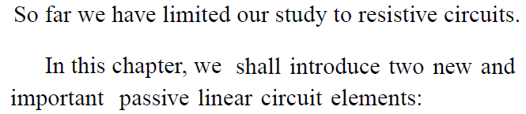
Overview
The capacitor.
The inductor.
Unlike resistors, these elements do not dissipate energy.
They instead store energy.
We will also look at how to analyze them in a circuit.

Slide 3
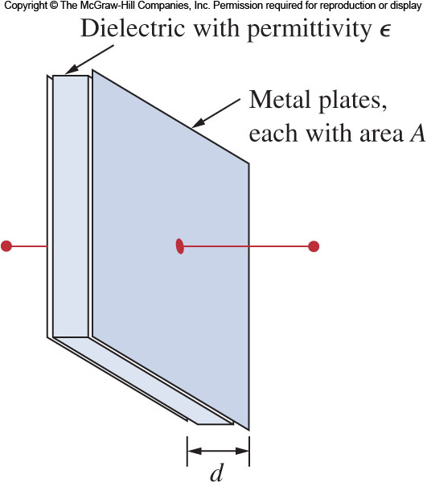
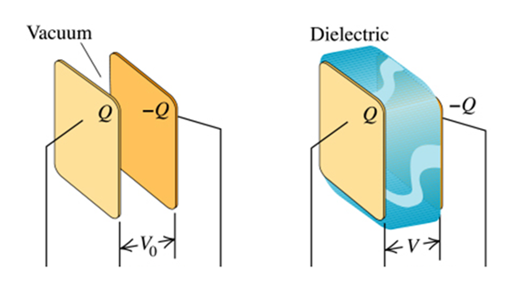
Capacitors 1
A capacitor is a passive element that stores energy in its electric field.
It consists of two conducting plates separated by an insulator (or dielectric).
The plates are typically aluminum foil.
The dielectric is often air, ceramic, paper, plastic, or mica.

Slide 4
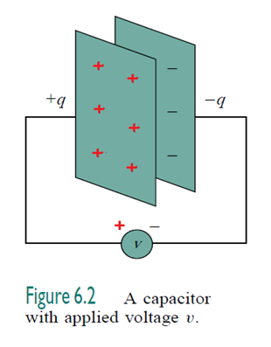
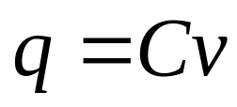
Capacitors 2
When a voltage source v is connected to the capacitor, the source deposits a positive charge q on one plate and a negative charge –q on the other.
The charges will be equal in magnitude.
The amount of charge is proportional to the voltage:
Where C is the capacitance.

Slide 5
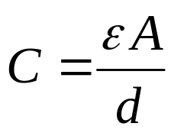
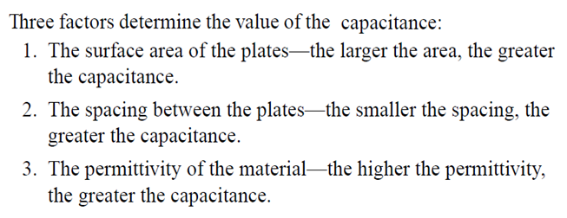
Capacitors 3
The unit of capacitance is the Farad (F)
One Farad is 1 Coulomb/Volt
Most capacitors are rated in picofarad (pF) and microfarad (μF)
Capacitance is determined by the geometery of the capacitor:
  Proportional to the area of the plates (A).
  Inversely proportional to the space between them (d).
ԑ is the permittivity of the dielectric.

Slide 6
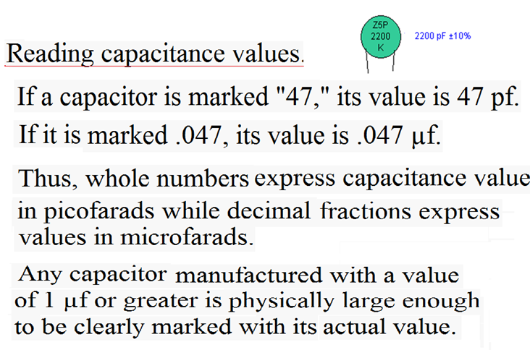

Slide 7
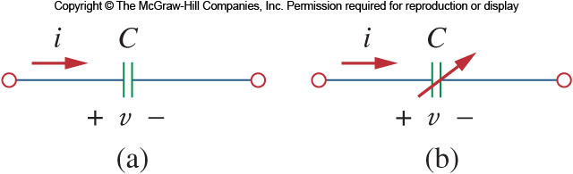
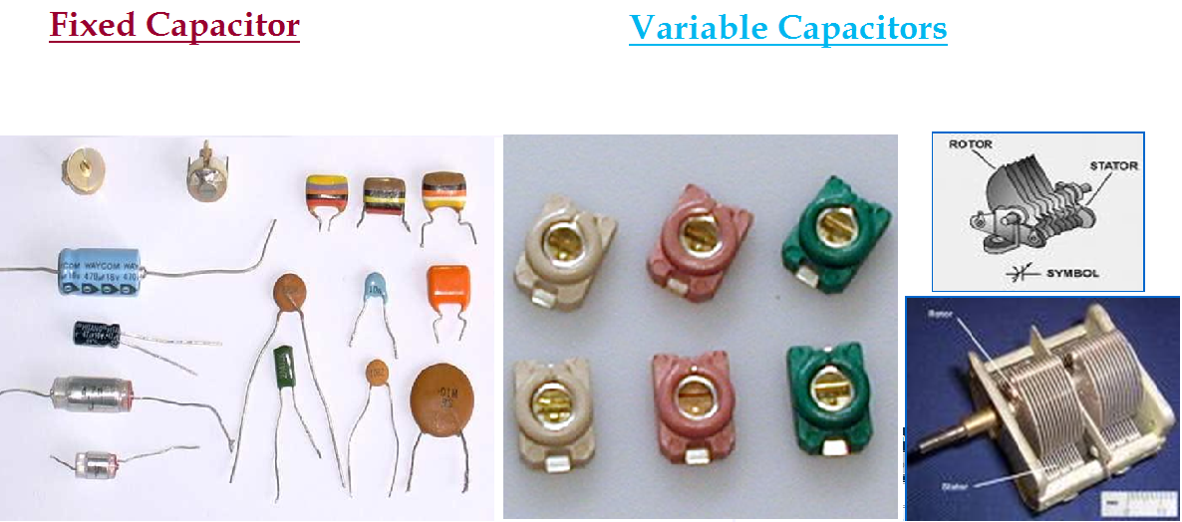
Types of Capacitors
The most common types of capacitors are film capacitors with polyester, polystyrene, or mica.
To save space, these are often rolled up before being housed in metal or plastic films.
Electrolytic caps produce a very high capacitance.
Trimmer caps have a range of values that they can be set to.
Variable air caps can be adjusted by turning a shaft attached to a set of moveable plates.

Slide 8
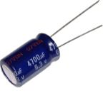

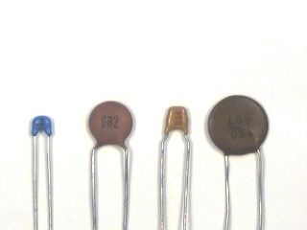
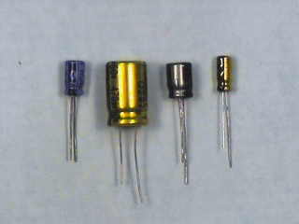
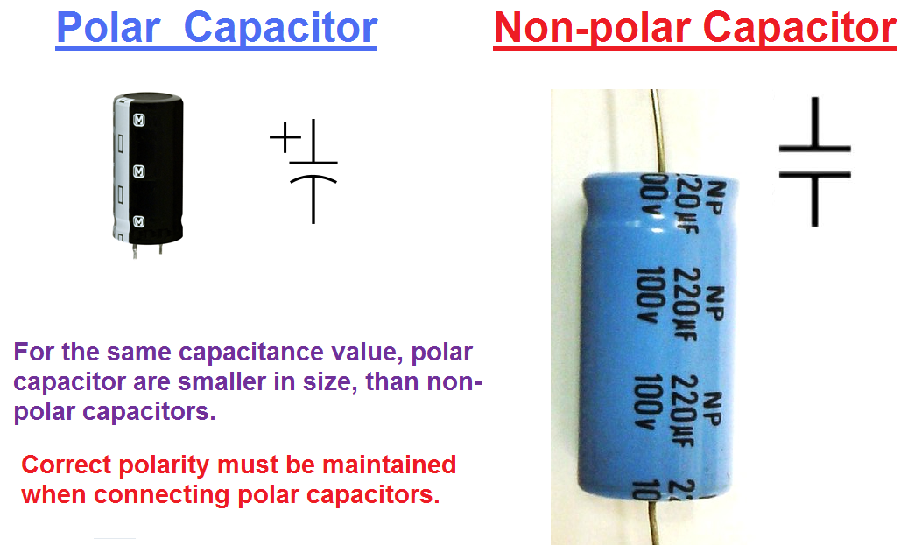
Electrolytic Capacitors
Ceramic Capacitors
Polarity must be observed

Slide 9
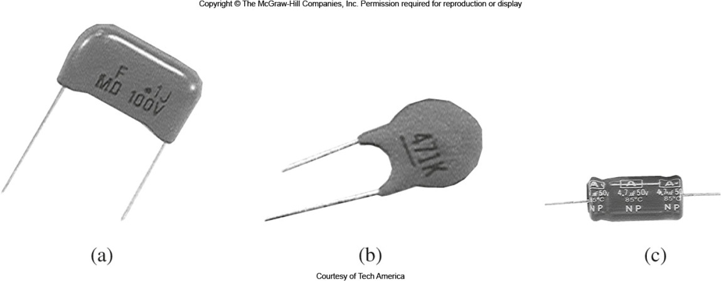
Applications for Capacitors
Capacitors have a wide range of applications, some of which are:
  Blocking DC.
  Passing AC.
  Shift phase.
  Store energy.
  Suppress noise.
  Start motors.

Slide 10
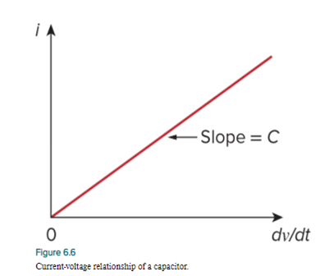
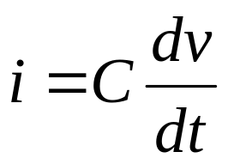
Current Voltage Relationship
Using the formula for the charge stored in a capacitor, we can find the current voltage relationship.
Take the first derivative with respect to time gives:
This assumes the passive sign convention.

Slide 11
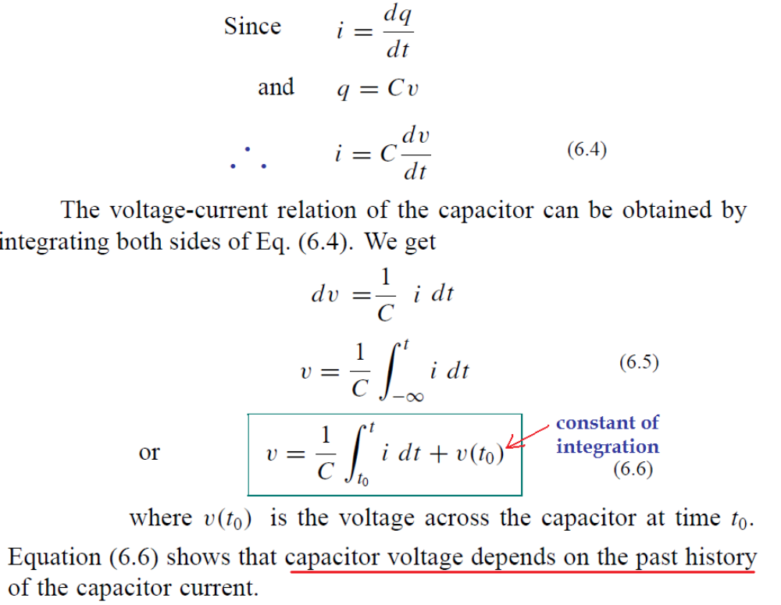

Slide 12
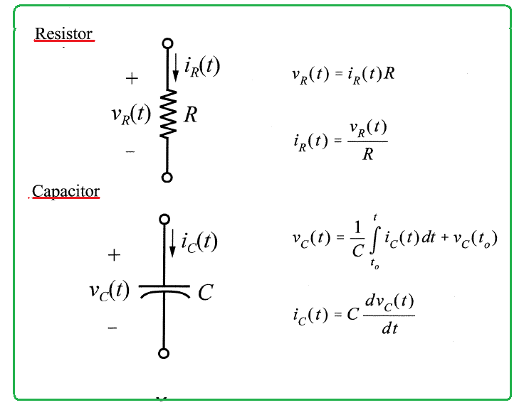

Slide 13
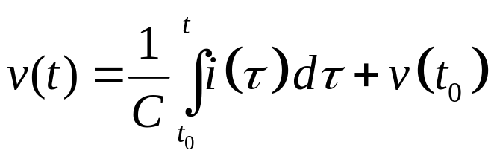
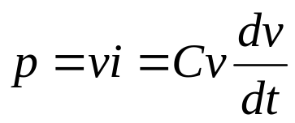
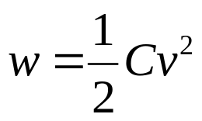
Stored Charge
Similarly, the voltage current relationship is:
This shows the capacitor has a memory, which is often exploited in circuits.
The instantaneous power delivered to the capacitor is.
The energy stored in a capacitor is:

Slide 14
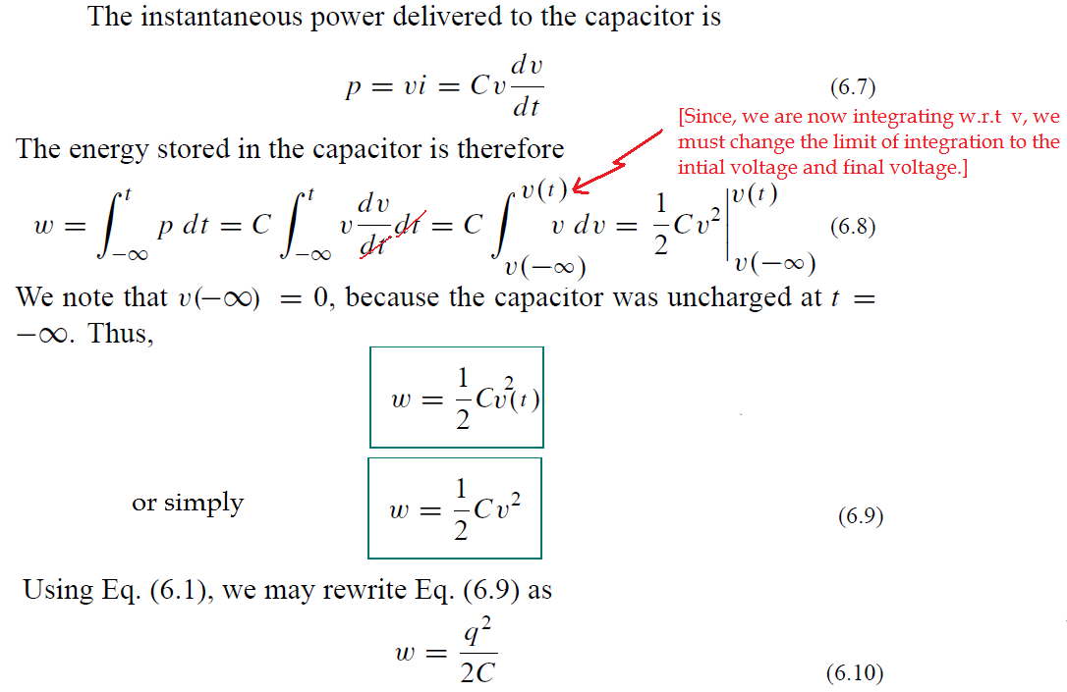

Slide 15
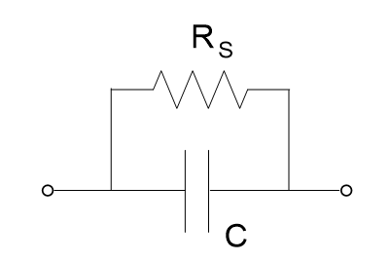
Capacitor Properties
The capacitor has the following important properties:
3. The ideal capacitor does not dissipate energy. It takes power from the circuit when storing energy and returns previously stored energy when delivering power to the circuit.
4. A real, non-ideal, capacitor has a “leakage resistance” which is modeled as shown below. The leakage resistance may be as high as 100MΩ, and can be neglected for most practical applications.
Note: In this course we will always assume that the capacitors are ideal.

Slide 16
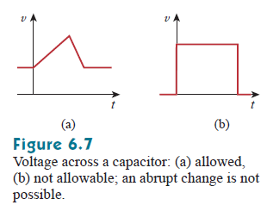
Capacitor Properties
The capacitor has the following important properties:
When the voltage across a capacitor is constant
(not changing with time) the current through the capacitor:
i = C dv/dt = 0
Thus, a capacitor is an open circuit to dc.
If, however, a dc voltage is suddenly connected across a capacitor,
the capacitor begins to charge (store energy).
The voltage across a capacitor must be continuous, since a jump
(a discontinuity) change in the voltage would require an infinite current,
which is physically impossible. Thus, a capacitor resists an abrupt
change in the voltage across it, Conversely
The voltage across a capacitor cannot change instantaneously

Slide 17
Properties of Capacitors 1
Ideal capacitors all have these characteristics:
When the voltage is not changing, the current through the cap is zero.
This means that with DC applied to the terminals no current will flow.
Except, the voltage on the capacitor’s plates can’t change instantaneously.
An abrupt change in voltage would require an infinite current!
This means if the voltage on the cap does not equal the applied voltage, charge will flow and the voltage will finally reach the applied voltage.

Slide 18
Properties of Capacitors 2
An ideal capacitor does not dissipate energy, meaning stored energy may be retrieved later.
A real capacitor has a parallel-model leakage resistance, leading to a slow loss of the stored energy internally.
This resistance is typically very high, on the order of 100 MΩ and thus can be ignored for many circuit applications.

Slide 19
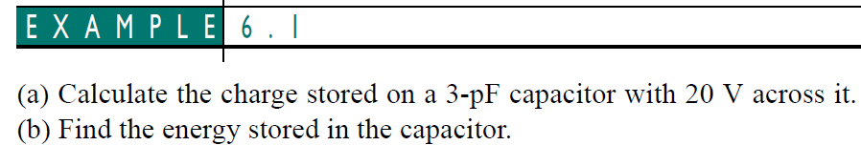

Slide 20
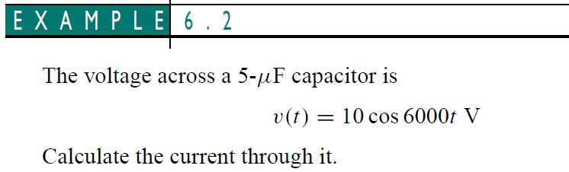

Slide 21
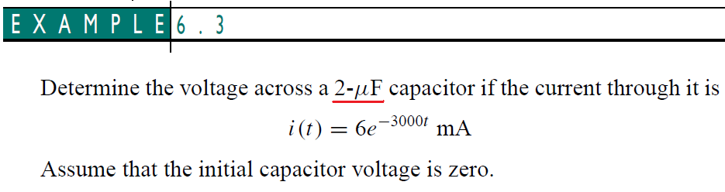

Slide 22
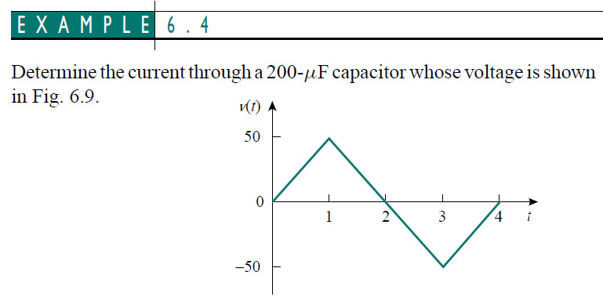

Slide 24
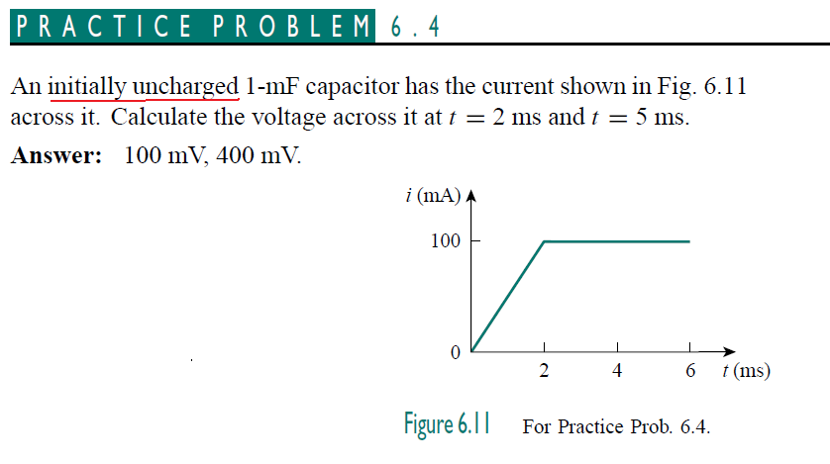

Slide 27
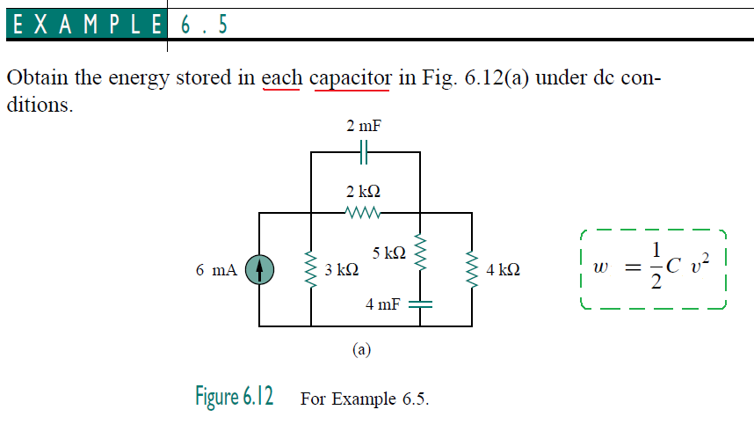

Slide 30
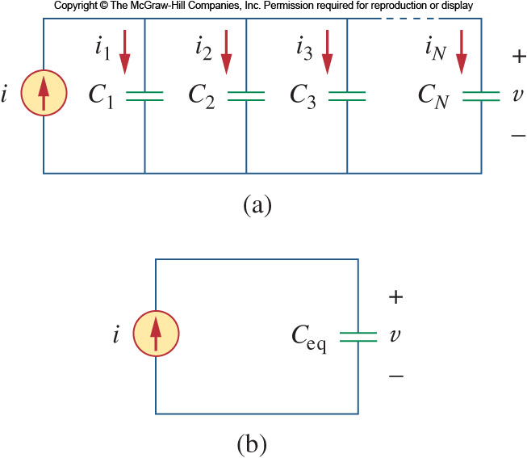
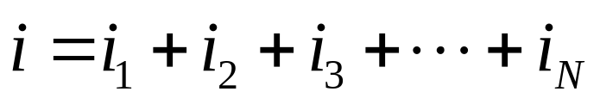
Parallel Capacitors 1
We learned with resistors that applying the equivalent series and parallel combinations can simply many circuits.
Starting with N parallel capacitors, one can note that the voltages on all the caps are the same.
Applying K C L:

Slide 31
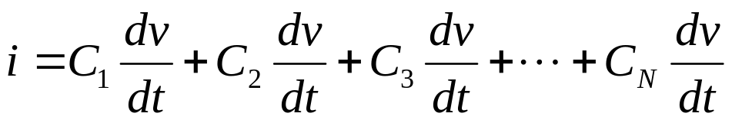
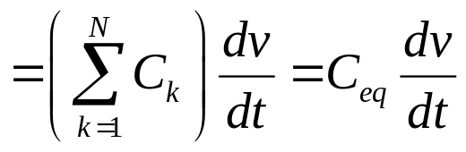

Parallel Capacitors 2
Taking into consideration the current voltage relationship of each capacitor:
Where
From this we find that parallel capacitors combine as the sum of all capacitance.

Slide 32
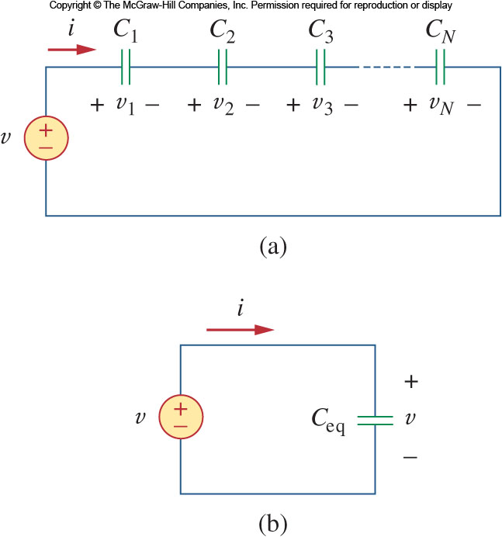
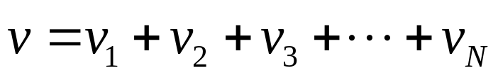
Series Capacitors 1
Turning our attention to a series arrangement of capacitors:
Here each capacitor shares the same current.
Applying K V L to the loop:
Now apply the voltage current relationship.

Slide 33
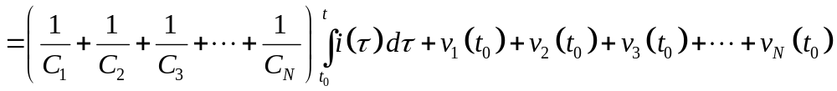
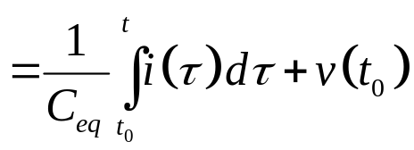
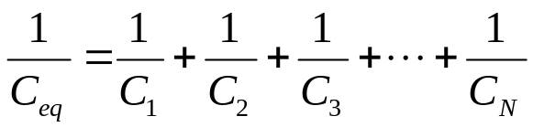
Series Capacitors 2
Where
From this we see that the series combination of capacitors resembles the parallel combination of resistors.

Slide 34
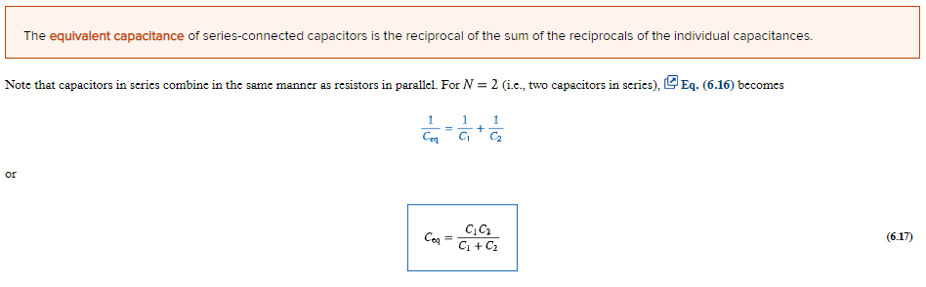

Slide 35
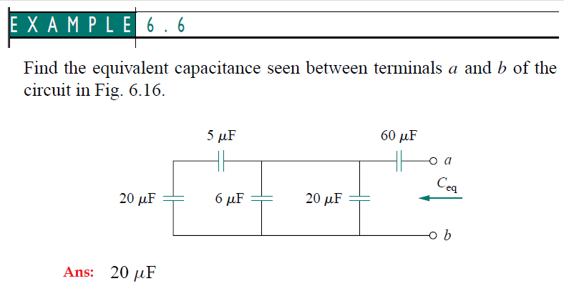

Slide 37
Series and Parallel Caps
Another way to think about the combinations of capacitors is this:
Combining capacitors in parallel is equivalent to increasing the surface area of the capacitors:
This would lead to an increased overall capacitance (as is observed).
A series combination can be seen as increasing the total plate separation.
This would result in a decrease in capacitance (as is observed).

Slide 38
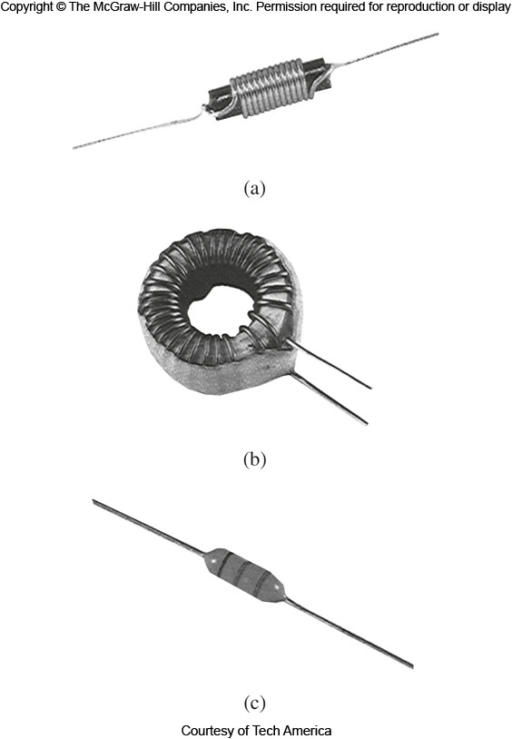
Inductors 1
An inductor is a passive element that stores energy in its magnetic field.
They have applications in power supplies, transformers, radios, TVs, radars, and electric motors.
Any conductor has inductance, but the effect is typically enhanced by coiling the wire up.

Slide 39
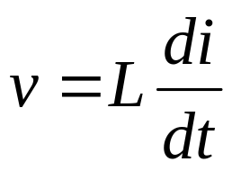
Inductors 2
If a current is passed through an inductor, the voltage across it is directly proportional to the time rate of change in current.
Where, L, is the unit of inductance, measured in Henries, H.
On Henry is 1 volt-second per ampere.
The voltage developed tends to oppose a changing flow of current.

Slide 40
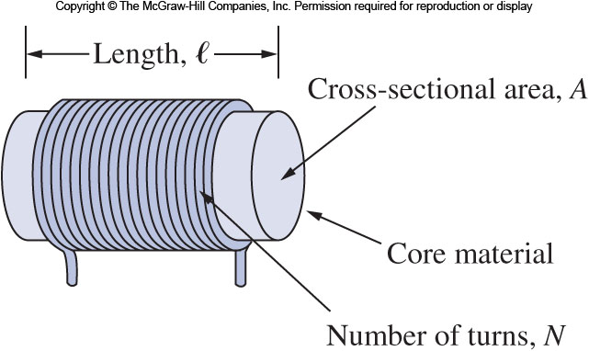
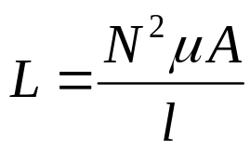
Inductors 3
Calculating the inductance depends on the geometry:
For example, for a solenoid the inductance is:
Where N is the number of turns of the wire around the core of cross sectional area A and length l.
The material used for the core has a magnetic property called the permeability, μ.

Slide 41
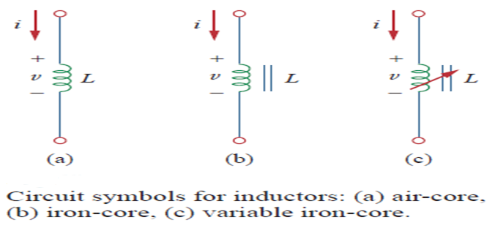

Slide 42
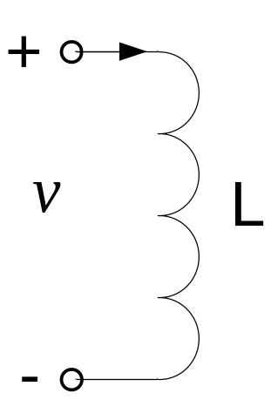
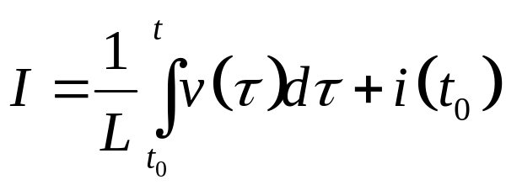
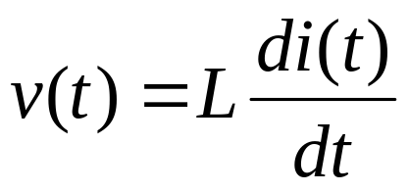


Current in an Inductor
The current voltage relationship for an inductor is:
The power delivered to the inductor is:
The energy stored is:

Slide 43





Relationship Between Current and Voltage
Integrating gives
Or
where i(t₀) = the total current evaluated at t₀ and i(−∞) ≡ 0 (which is reasonable since at some time there was no current in the inductor).

Slide 44
Properties of Inductors 1
If the current through an inductor is constant, the voltage across it is zero.
Thus an inductor acts like a short for DC.
The current through an inductor cannot change instantaneously.
If this did happen, the voltage across the inductor would be infinity!
This is an important consideration if an inductor is to be turned off abruptly; it will produce a high voltage.

Slide 45
Properties of Inductors 2
Like the ideal capacitor, the ideal inductor does not dissipate energy stored in it.
Energy stored will be returned to the circuit later.
In reality, inductors do have internal resistance due to the wiring used to make them.
A real inductor thus has a winding resistance in series with it.
There is also a small winding capacitance due to the closeness of the windings.
These two characteristics are typically small, though at high frequencies, the capacitance may matter.

Slide 46



Energy Storage in an Inductor
The instantaneous power delivered to an inductor is
The energy stored in the magnetic field is thus

Slide 47

An Inductor Properties
An inductor has the following important properties:
  An inductor acts like a short circuit to dc, since from
  v = 0 when i = a constant.
The current through an inductor cannot change instantaneously, since an instantaneous
change in current would require an infinite voltage, which is not physically possible.

Slide 48

An Inductor Properties
An inductor has the following important properties:
3. Like the ideal capacitor, the ideal inductor does not dissipate energy.
4. A real inductor has a significant resistance due to the resistance of the coil, as well as a “winding capacitance”. Thus, the model for a real inductor is shown below.
In this course, however, we will use ideal inductors and assume that an ideal inductor is a good model.

Slide 50



Slide 51



Slide 52


Series Inductors 1
We now need to extend the series parallel combinations to inductors.
First, let’s consider a series combination of inductors.
Applying K V L to the loop:

Slide 53



Series Inductors 2
Factoring in the voltage current relationship.
Where
Here we can see that the inductors have the same behavior as resistors.

Slide 54


Parallel Inductors 1
Now consider a parallel combination of inductors:
Applying K C L to the circuit:
When the current voltage relationship is considered, we have:

Slide 55


Parallel Inductors 2
The equivalent inductance is thus:
Once again, the parallel combination resembles that of resistors.

Slide 56

Summary of Capacitors and Inductors

Slide 57



Slide 58



Slide 60



Because learning changes everything.®
www.mheducation.com
© McGraw Hill LLC.

